Slide 1
Control survey for KEK e⁻/e⁺ injector linac
Y. Okayasu, K. Kakihara, T. Suwada, and M. Tanaka
High Energy Accelerator Research Organization (KEK)
K. Hisazumi, K. Kimura, Y. Mizukawa, K. Suzuki, and S. Ushimoto
Mitsubishi Electric System & Service Co. Ltd.

Slide 2
Contents :
Introduction
Control survey in KEK e⁻/e⁺ injector linac
Survey results
Results VS. Calculation
Summary

Slide 3
Contents :
Introduction
Control survey in KEK e⁻/e⁺ injector linac
Survey results
Results VS. Calculation
Summary

Slide 4
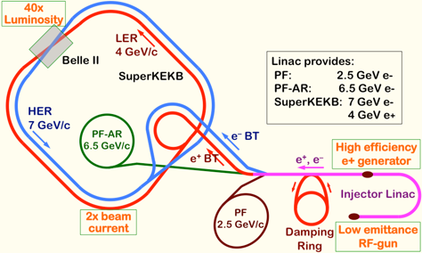
e⁻/e⁺ injector linac (645 m in total) :
120 m straight section
+ 33 m arc section
+ 492 m straight section
Further goal of SuperKEKB
→ 6 x 10³⁵ cm⁻²s⁻¹ luminosity
→ achieve lower emittance
Phase 3 (final requirement) :
e⁻ : 40 (H) / 20 (V) [μm] (norm.)
e⁺ : 100 (H) / 15 (V) [μm] (norm.)
Required alignment tolerances (sigma) :
magnets on a girders : 50 μm
neighboring girders : 100 μm
Our activities :
・Reduction of misalignment
・Understanding trends of displacement
・Realignment as request from optics Gr.

Slide 5
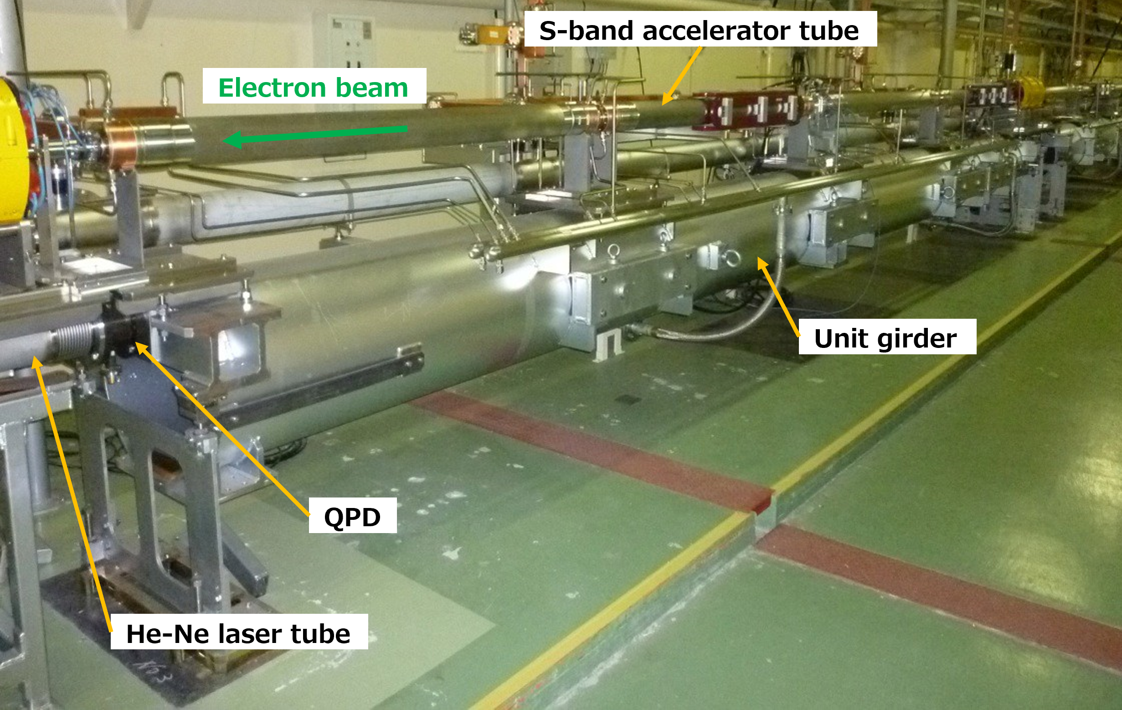
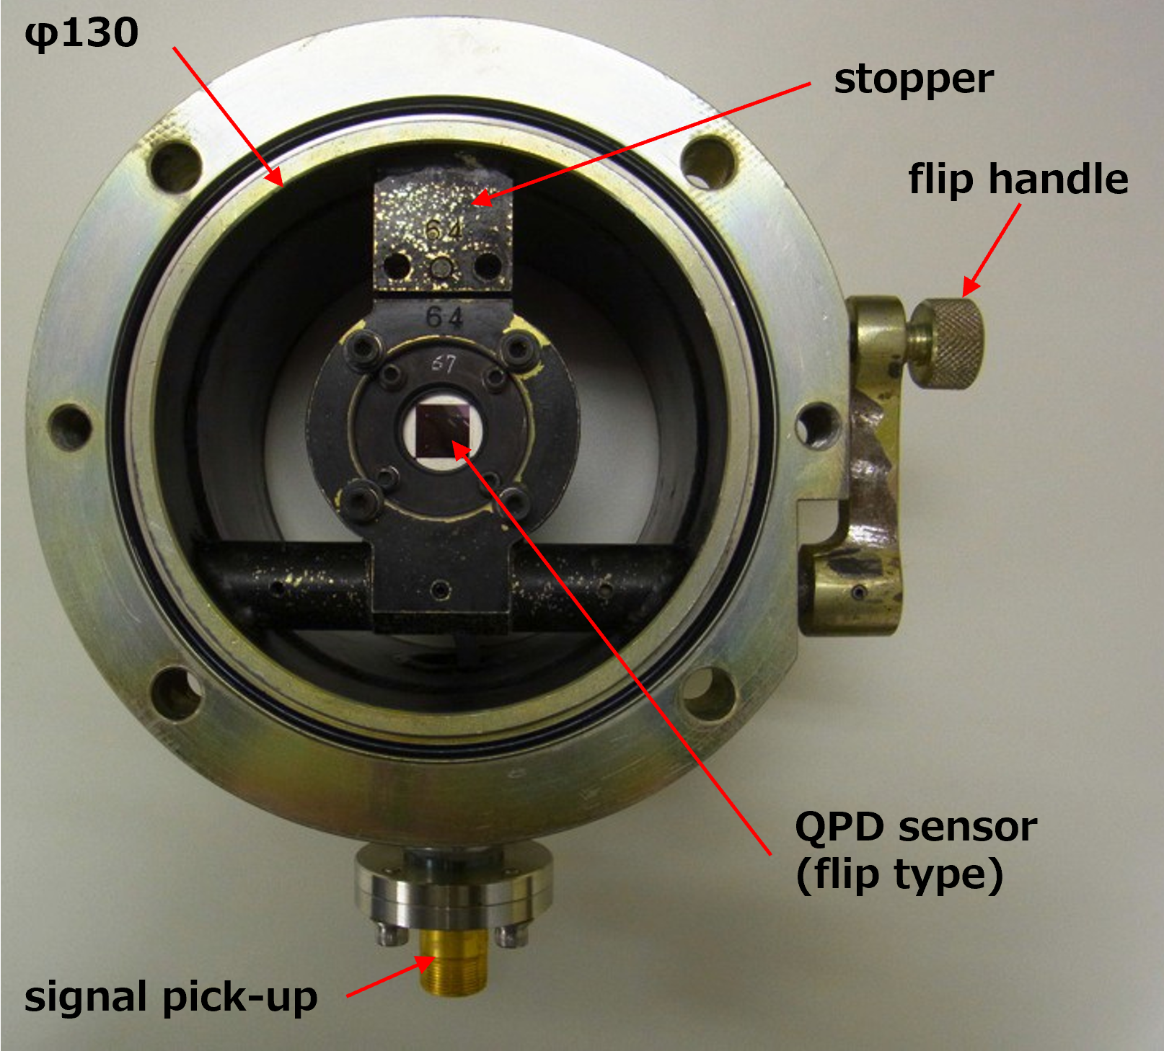
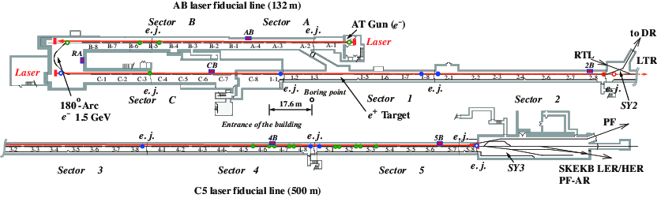
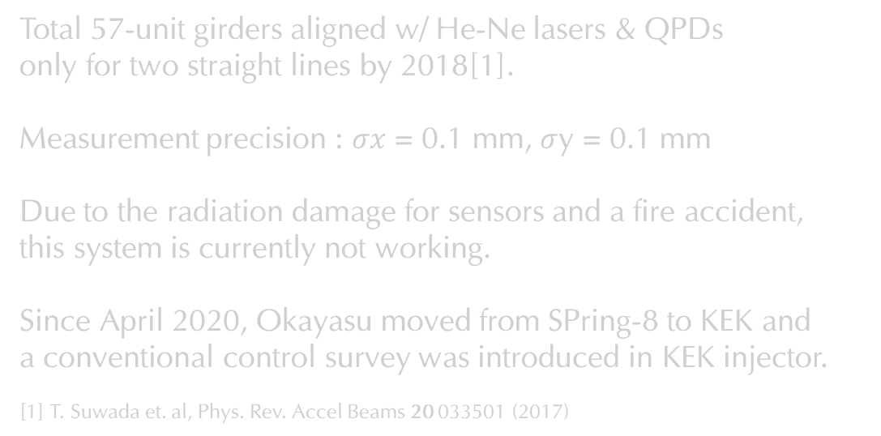
Initial girder alignment w/ Laser baseline & quadrant photo-diodes (QPD)
Total 57-unit girders aligned w/ He-Ne lasers & QPDs
only for two straight lines by 2018[1].
Measurement precision : $σx$ = 0.1 mm, $σ$y = 0.1 mm
Due to the radiation damage for sensors and a fire accident,
this system is currently not working.
Since April 2020, Okayasu moved from SPring-8 to KEK and
a conventional control survey was introduced in KEK injector.
[1] T. Suwada et. al, Phys. Rev. Accel Beams 20 033501 (2017)

Slide 6
Contents :
Introduction
Control survey in KEK e⁻/e⁺ injector linac
Survey results
Results VS. Calculation
Summary

Slide 7
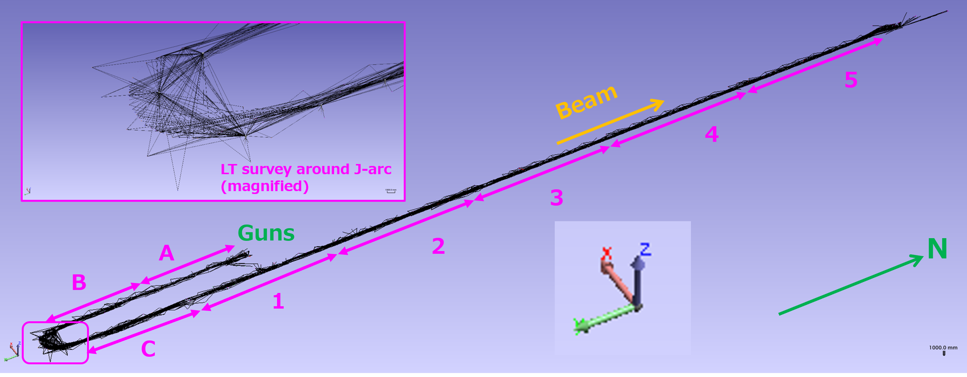
Control survey w/ Leica AT-401 & Trimble DiNi0.3
Leica AT-401
Abs. angular accuracy :
+/- 15 μm + 6 μm/m
Abs. distance accuracy :
+/- 10 μm
61 st. points w/ ~10 m distance,
total 3040 survey points.
Net. 2 weeks.
Trimble DiNi0.3
Accuracy :
0.3 mm/km of double leveling
21 st. points w/ ~16 m distance,
total 43 survey points (round-trip).
Net 2 days.
: origin
Note : beam direction from C sector is –y direction.
Evaluated errors by USMN
# of magnets, monuments and sector length of 2021 (2020) survey.
AT-401
Horizontal angle | 2.7 μrad
Vertical angle | 2.5 μrad
Distance | 17 μm
DiNi0.3
leveling | 5 μm

Slide 8
Contents :
Introduction
Control survey in KEK e⁻/e⁺ injector linac
Survey results
Results VS. Calculation
Summary

Slide 9
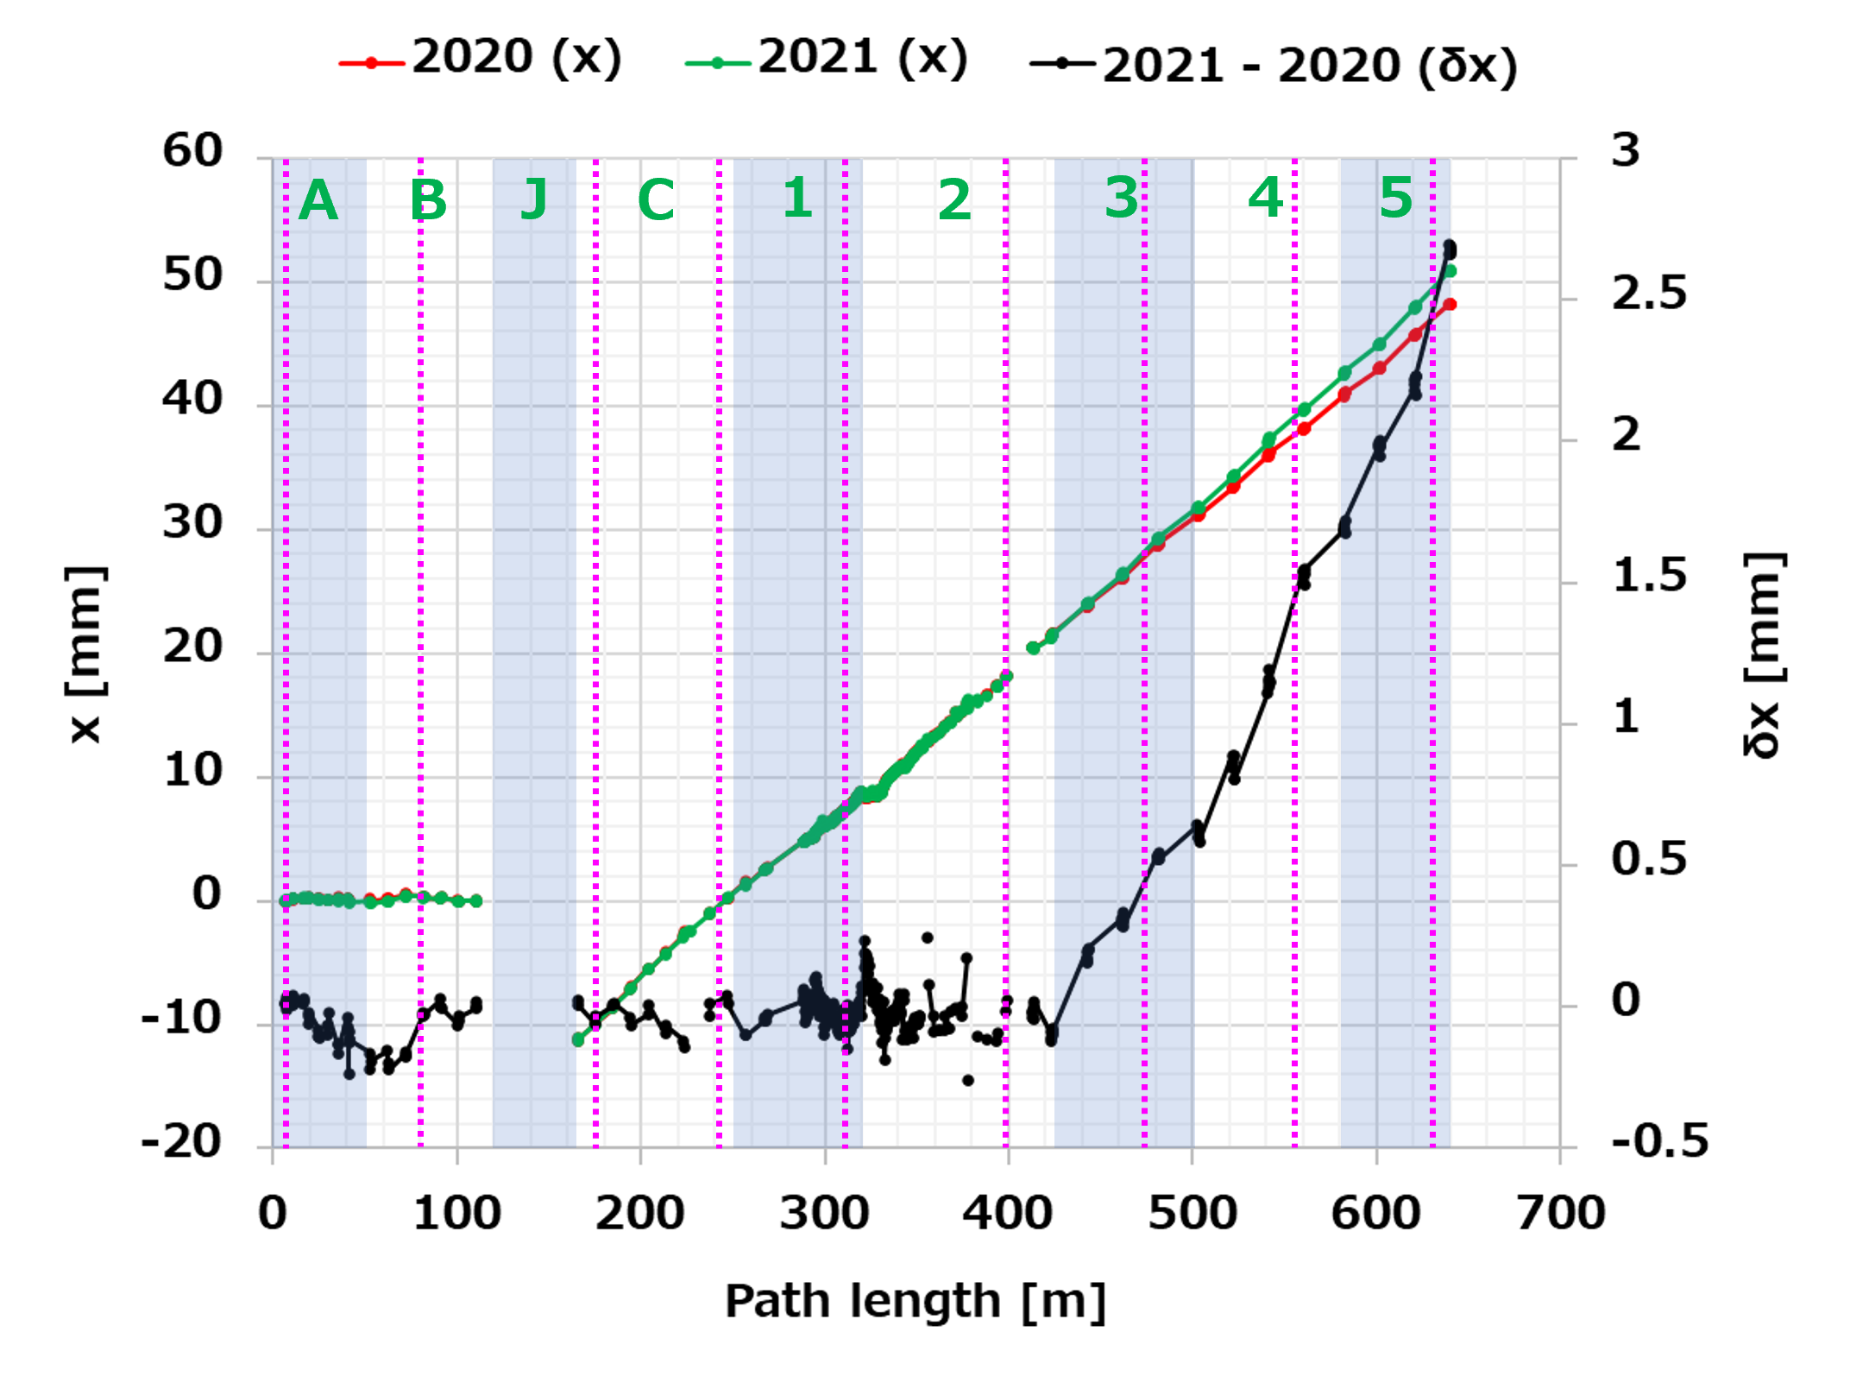
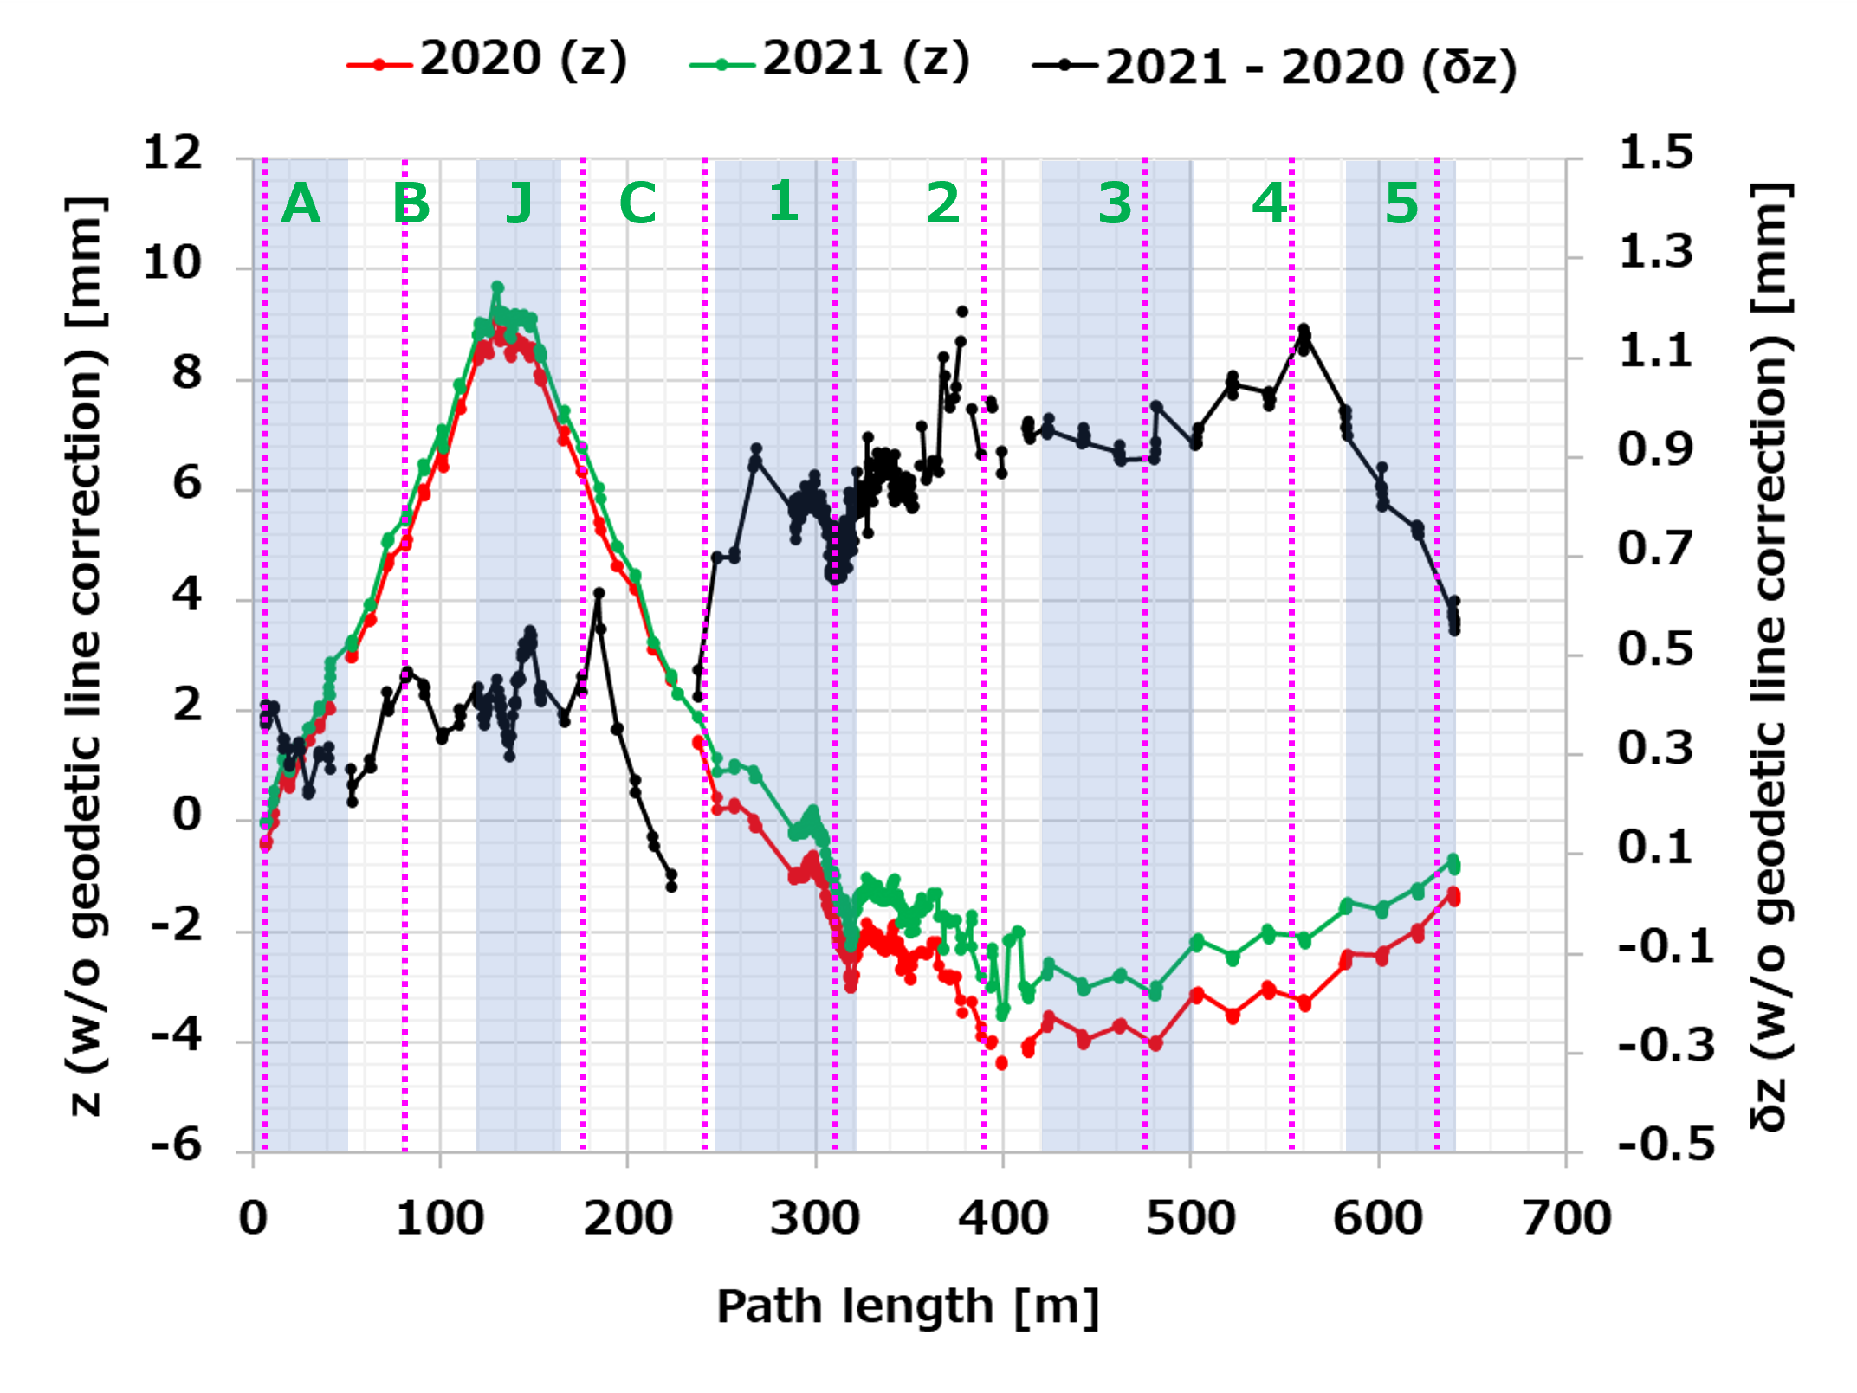
2020 VS. 2021 : x & z (w/o geodetic line correction)
・From C sector, designed offset of -15 m is subtracted
to fit in one scale.
・J-arc data is left out.
・Sudden increase started from 3 sector. ← # of control pt. diff.
・STD : 150 μm (A - B), 370 (2020) or 520 (2021) μm (C - 5).
・w/o geodetic line correction, J-arc has ~9 mm elevation.

Slide 10
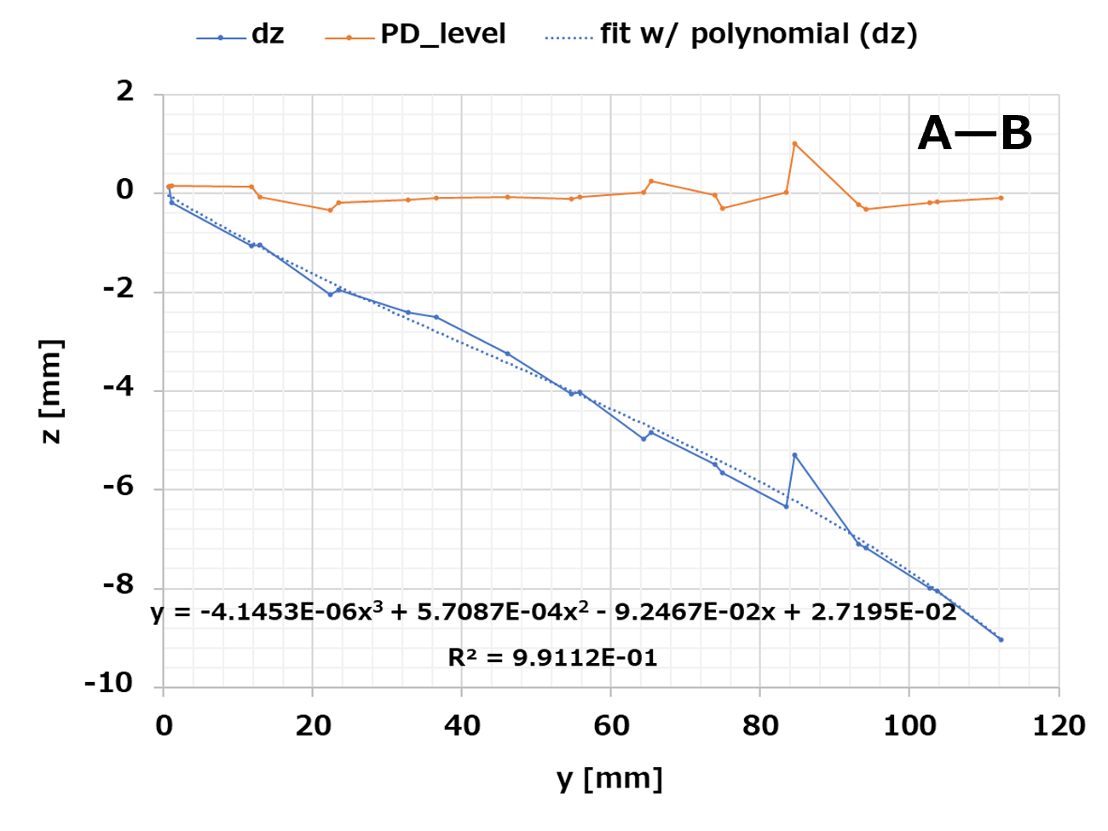
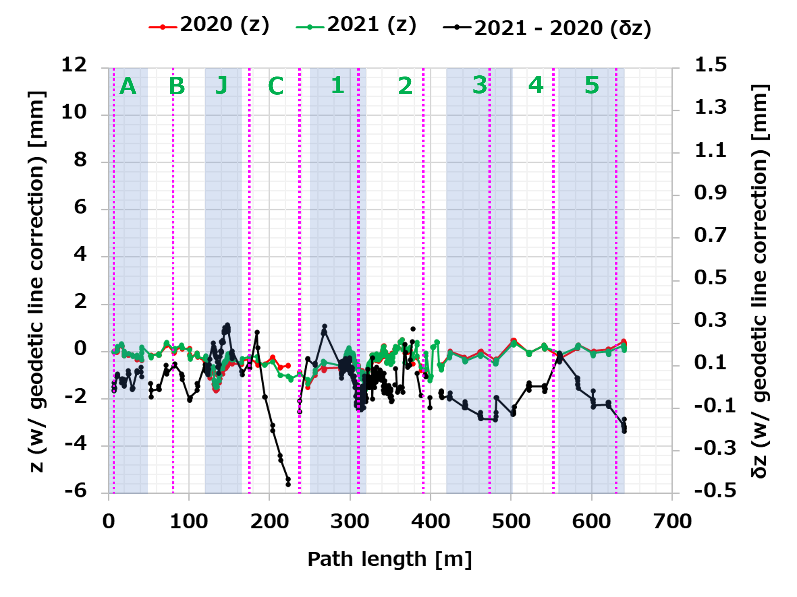
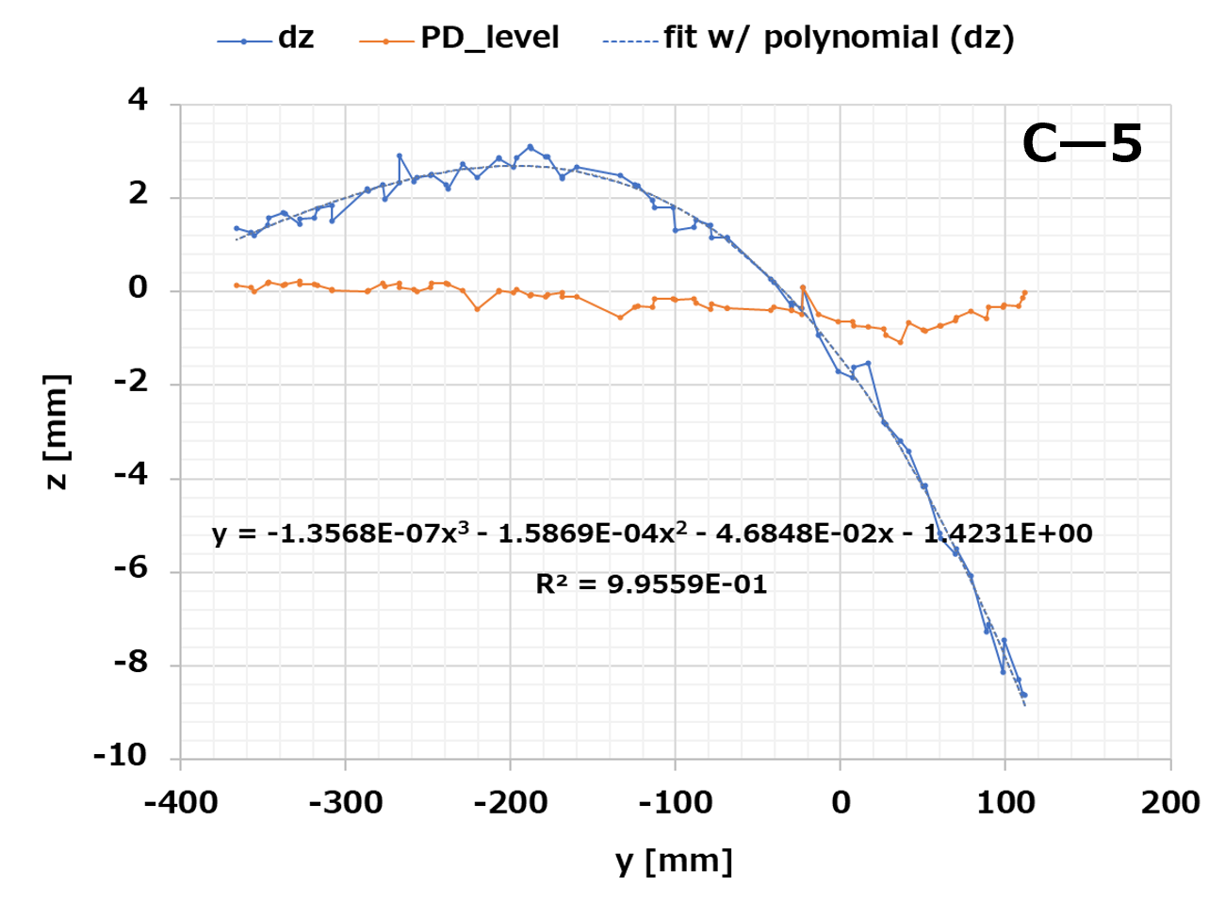
Geodetic line correction w/ QPD data
Procedure :
Analyze tracker data w/ weighted level data (DiNi) by USMN (Unified Spatial Metrology Network analysis).
Subtract QPD level data (PD_level) by USMN level (dz).
Fit dz curve w/ a polynomial.
Subtract the polynomial by all magnet level data (USMN).
STD : 425 μm

Slide 11
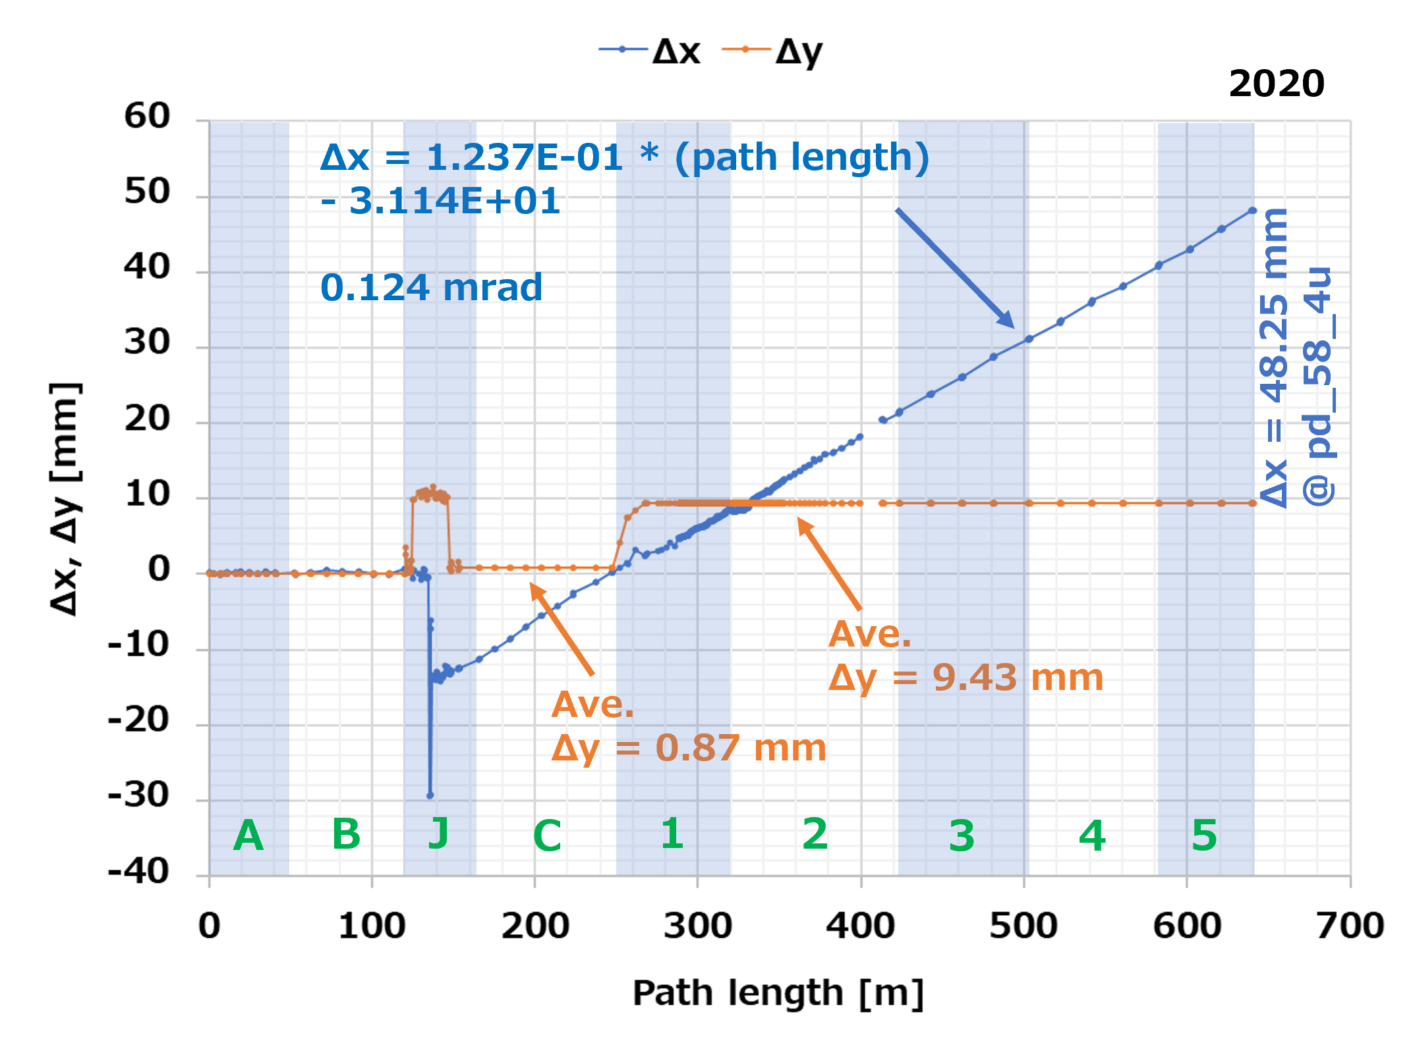
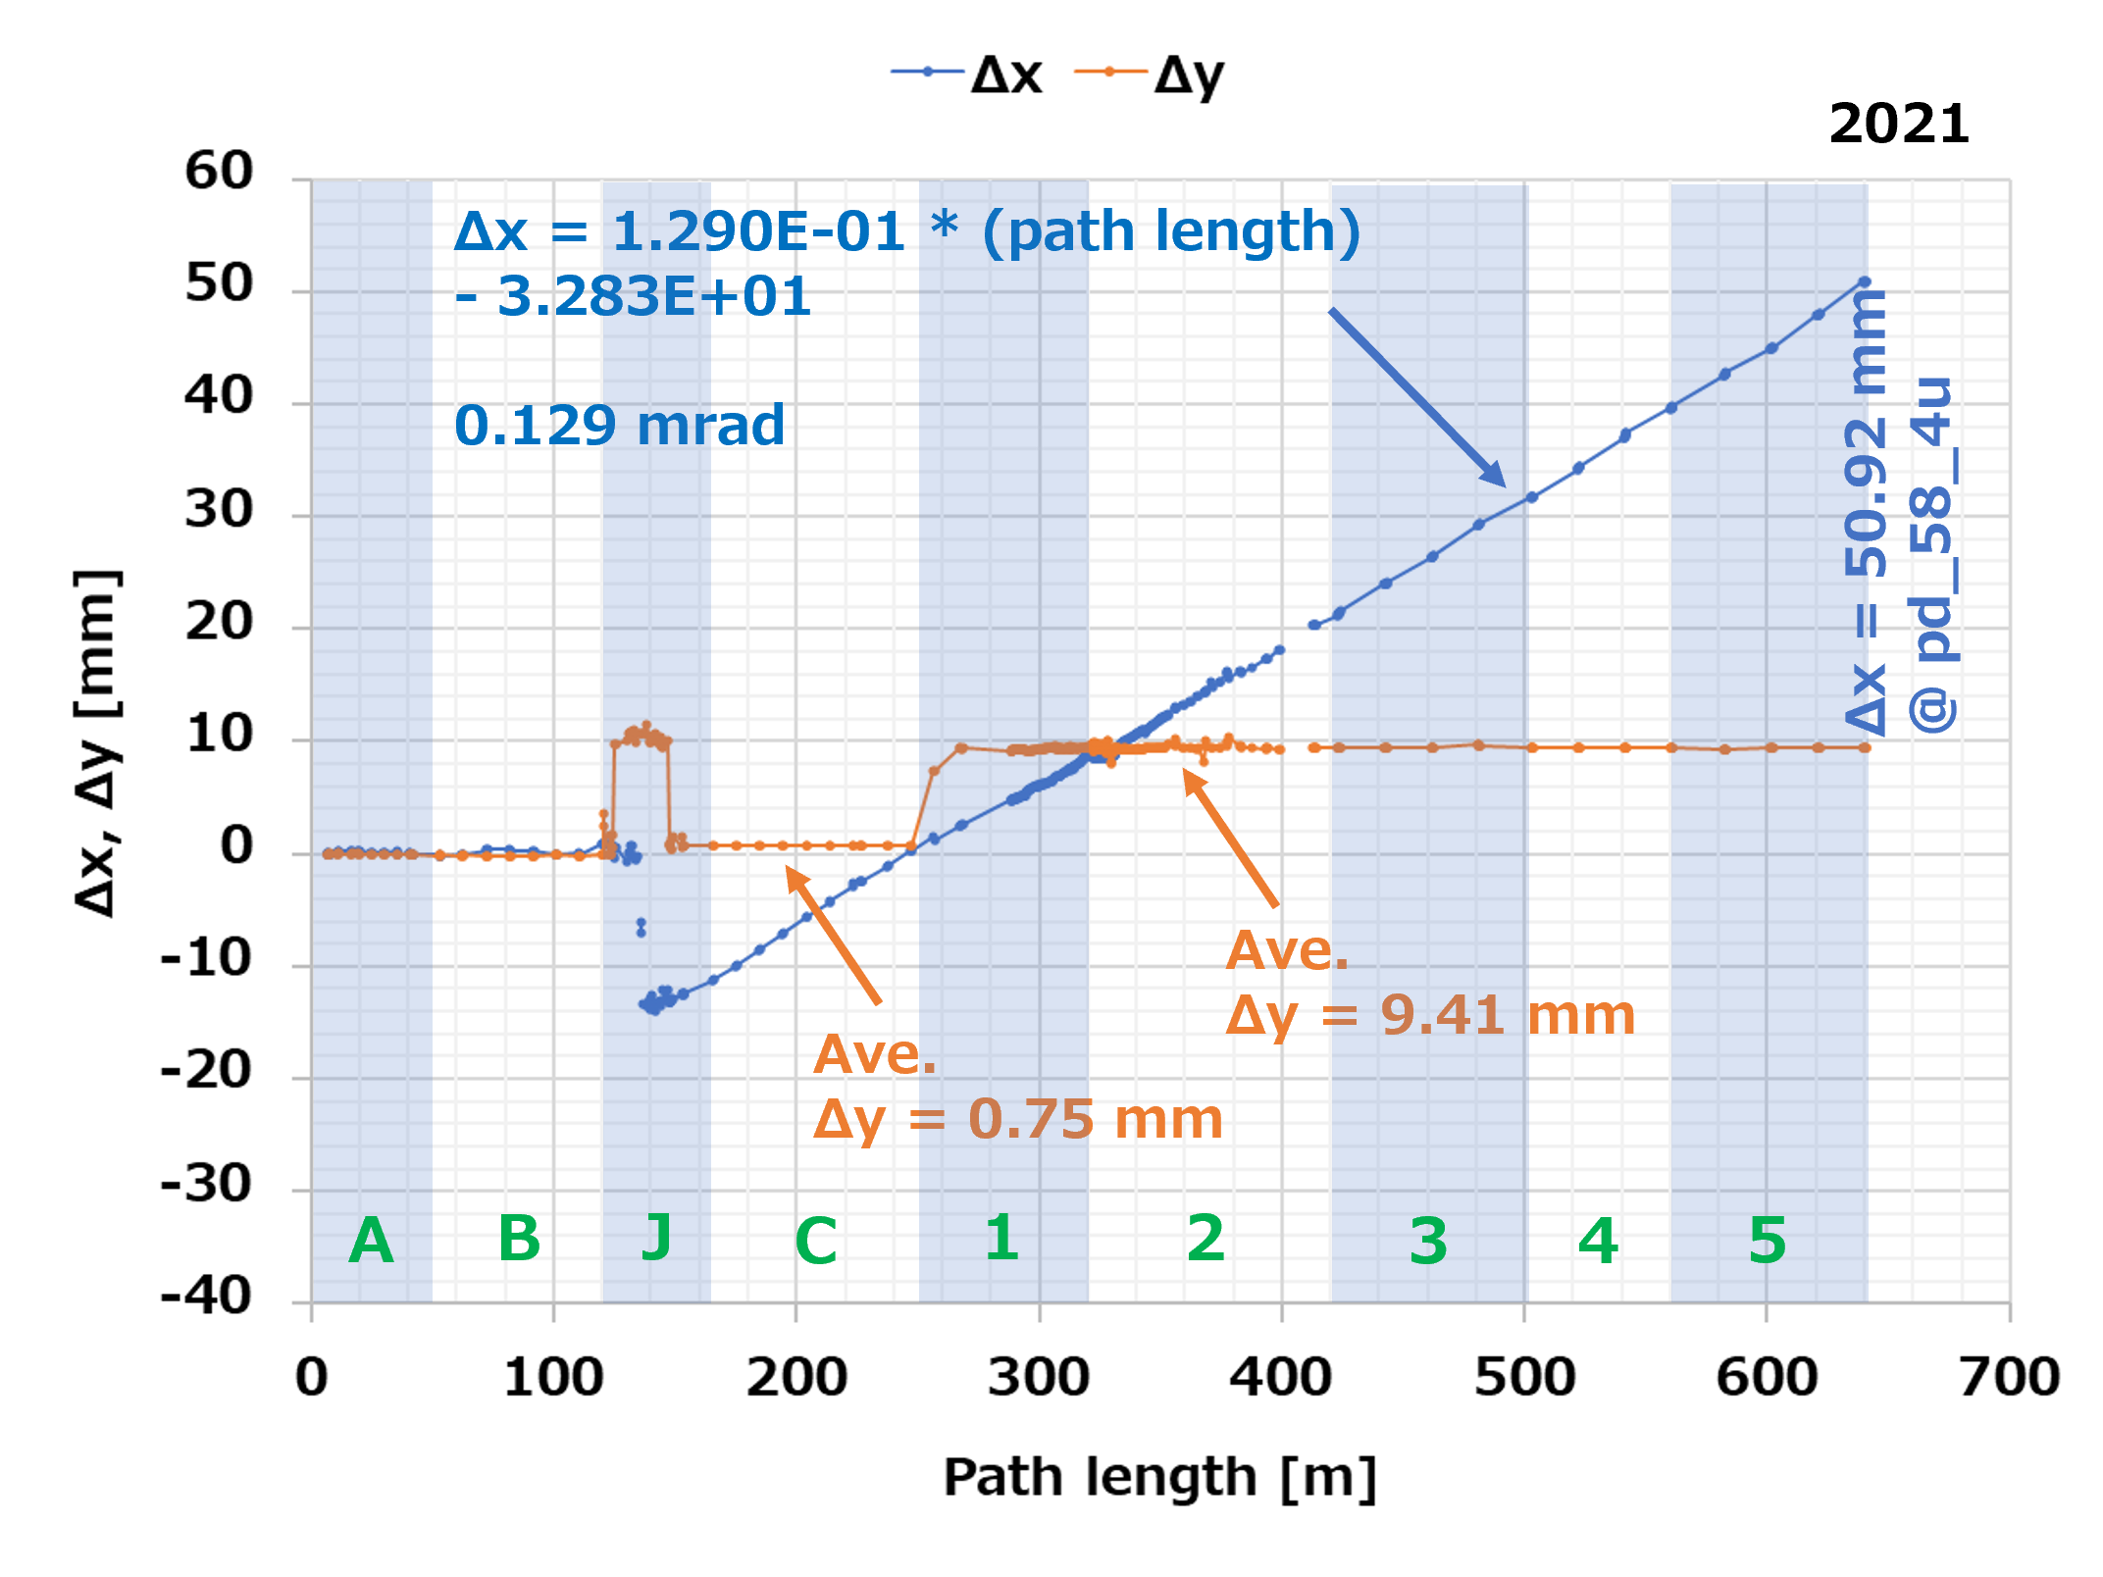
Horizontal coordinates VS. designed
Δx has slope of 0.124 mrad or 0.129 mrad from J-arc exit.
Δx = -30 mm and Δy = 10 mm @ J-arc, Δy = 9.4 mm offset from 1 sector represent that designed coordinates need to be modified.

Slide 12
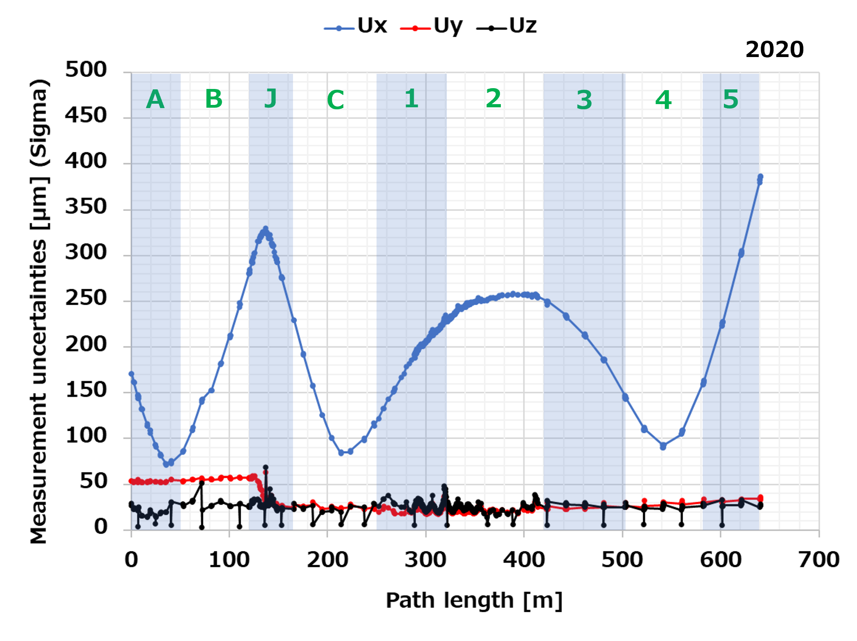
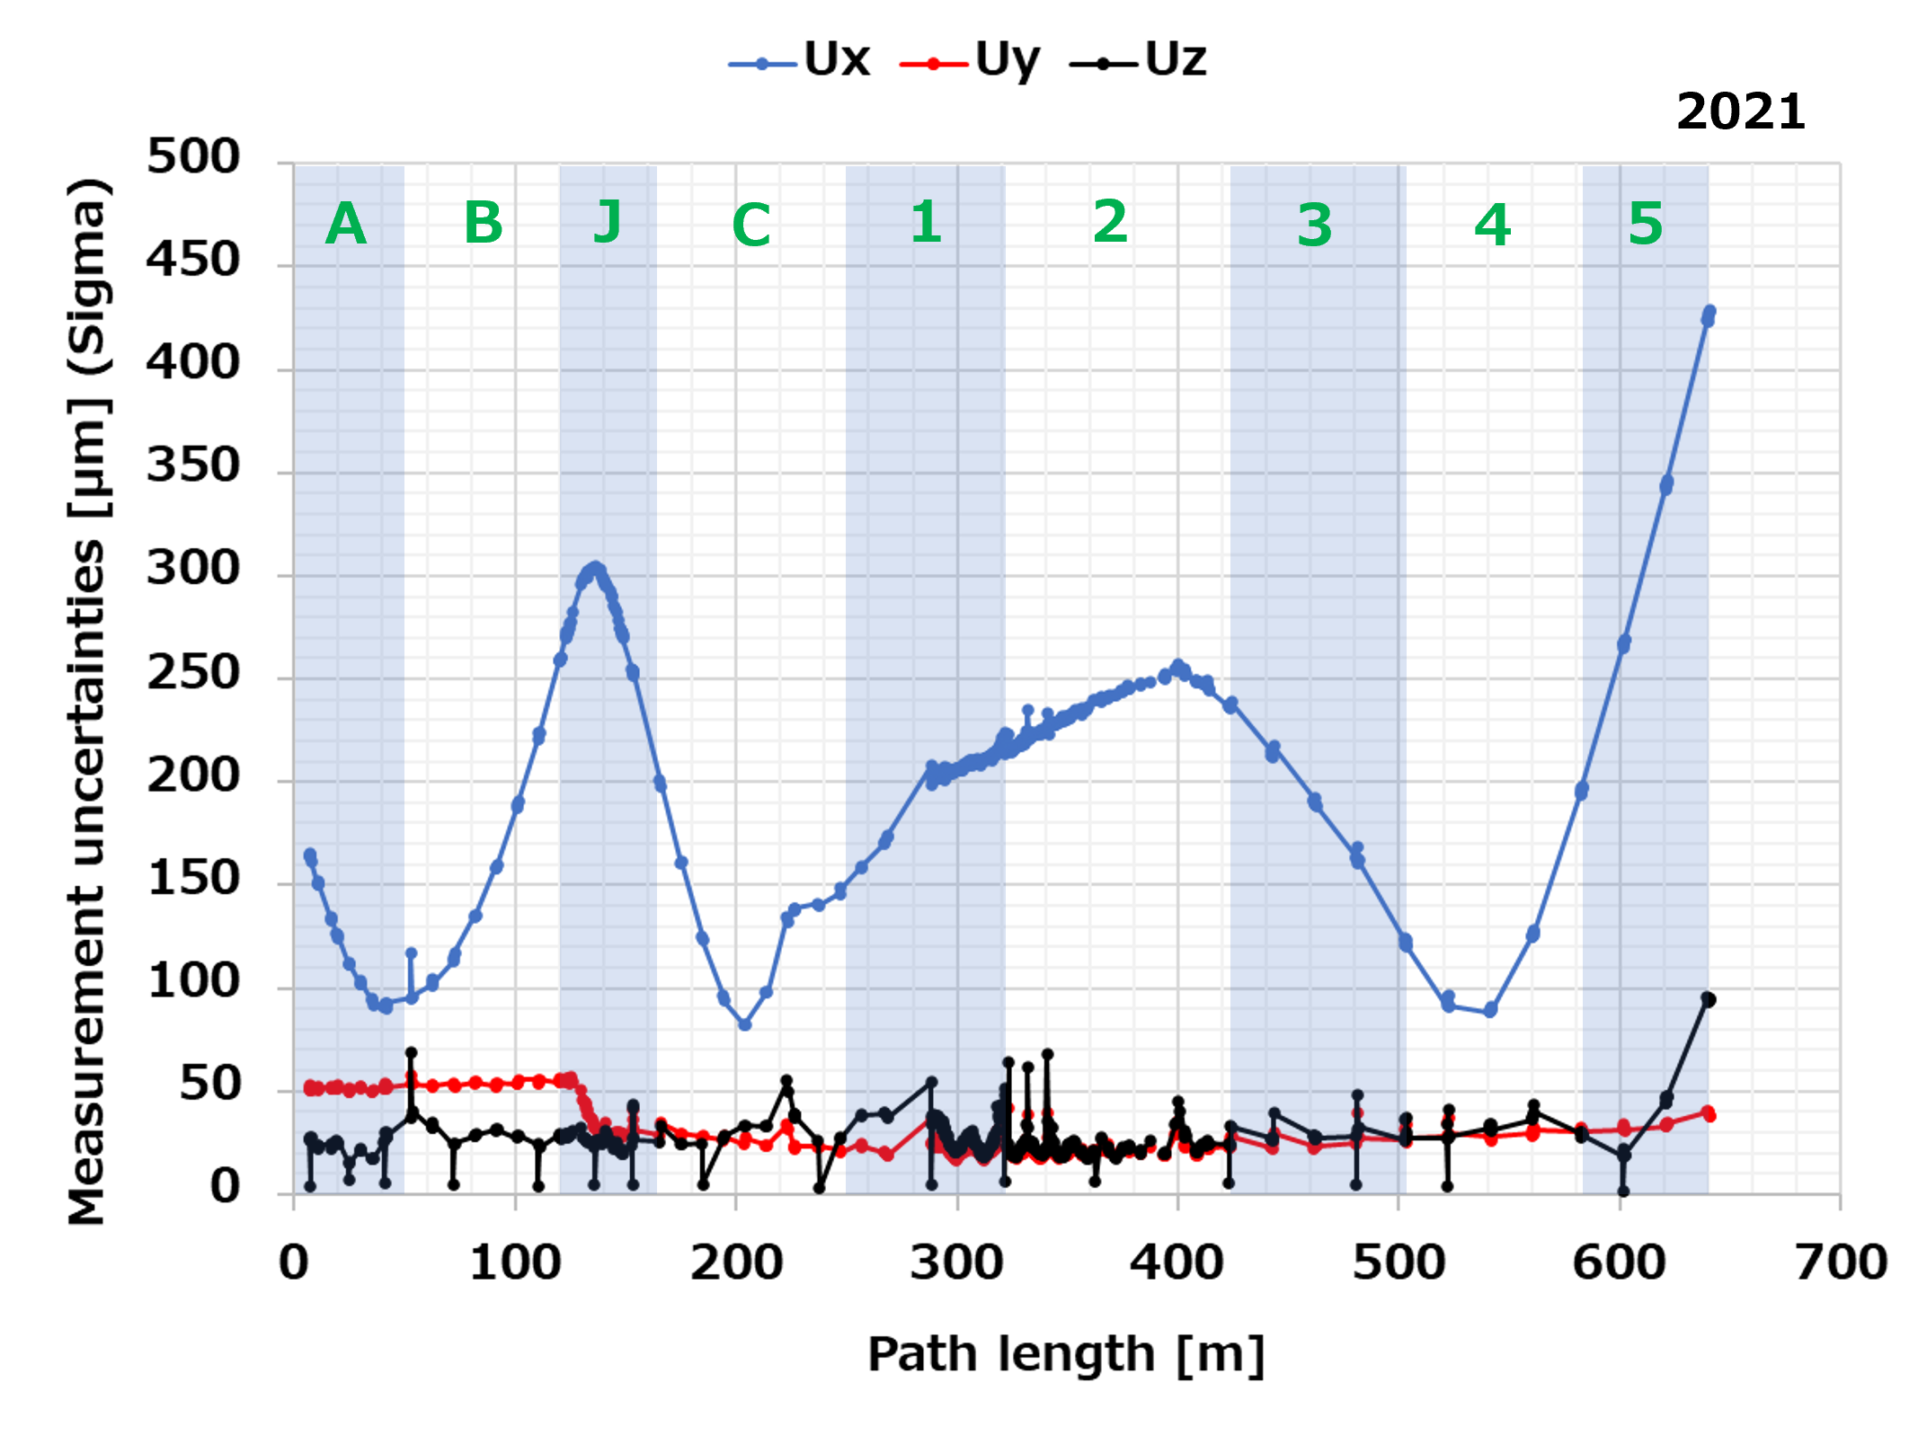
Measurement uncertainties comparison 2020 VS. 2021
Additional LT st. points added in bypass tunnel which connects A and 1.
Only Ux is much larger than Uy and Uz, has a characteristical distribution.
Uy has a step structure.

Slide 13
Contents :
Introduction
Control survey in KEK e⁻/e⁺ injector linac
Survey results
Results VS. Calculation
Summary

Slide 14
Control survey simulation
Goals :
Optimize #s and coordinates of station points & monuments to reduce uncertainty as low as possible.
Understand the difference between real coordinates and designed ones of survey points.
Procedures :
Prepare 2 coordinate files of 1) station points, 2) magnets, QPD arms, and monuments as ASCII texts.
Connect station point and survey points within 30 m from the station point as real survey. (← takes long long time…)
Scripting survey works w/ SA measurement plan (a.k.a. mp) & virtually construct survey data sets.
Manually execute USMN (scanning weight value for level data).

Slide 15
Data preparation
Station points
Survey points
・LT sensor level fixed as 1800 form floor level.
・Survey errors randomly added as gaussian depending on distances which are based on the catalogue values of LT & DiNi

Slide 16
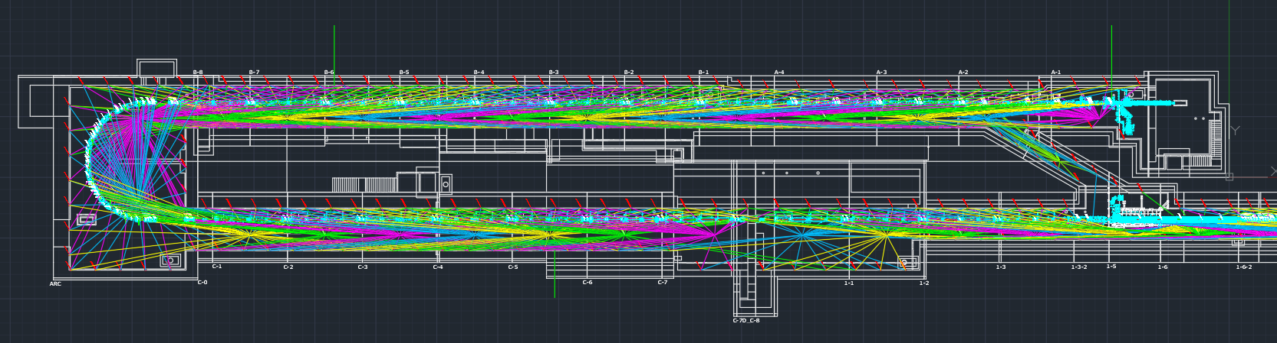
Connect station point and survey points one by one avoiding interference between LOS and structures….

Slide 17
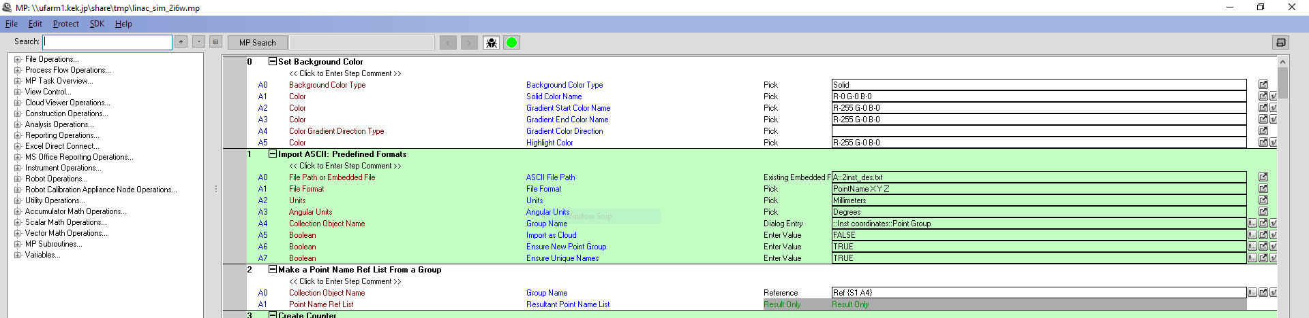
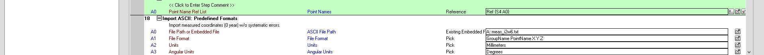
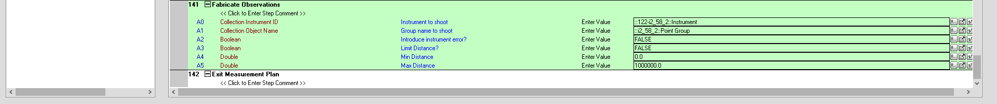
Scripting survey works w/ SA mp & virtually construct survey data sets.

Slide 18
Data preparation
Station (LT) points summary
 | Real control survey | Calc. case 1 | Calc. case 2
# of st. points | 61 | 63 | 103
Distance for y (min/max/ave) [m] | 5.9/16.0/10.3 | 5.1/14.3/10.0 | 2.0/8.1/5.1
Level (min/max/ave) [m] | 1.2/2.1/1.5 | 1.8 fix | 1.8 fix
Remark | 1 st. point/unit | 1 st. point/unit | 2 st. points/unit
Monument points summary
 | Real control survey | Calc. case 1 | Calc. case 2 | Calc. case 3
# of points | 192 | 138 | 260 | 383
Distance for y (min/max/ave) [m] | 0.0/21.6/4.1 | 0.0/7.2/4.6 | 0.1/5.2/2.5 | 0.1/3.2/1.7
Level (min/max/ave) [m] | 1.2/1.5/1.2 | 1.4 fix | 1.4 fix | 1.4 fix
Remark | 2 - 3 points/unit | 2 points/unit | 4 points/unit | 6 points/unit

Slide 19
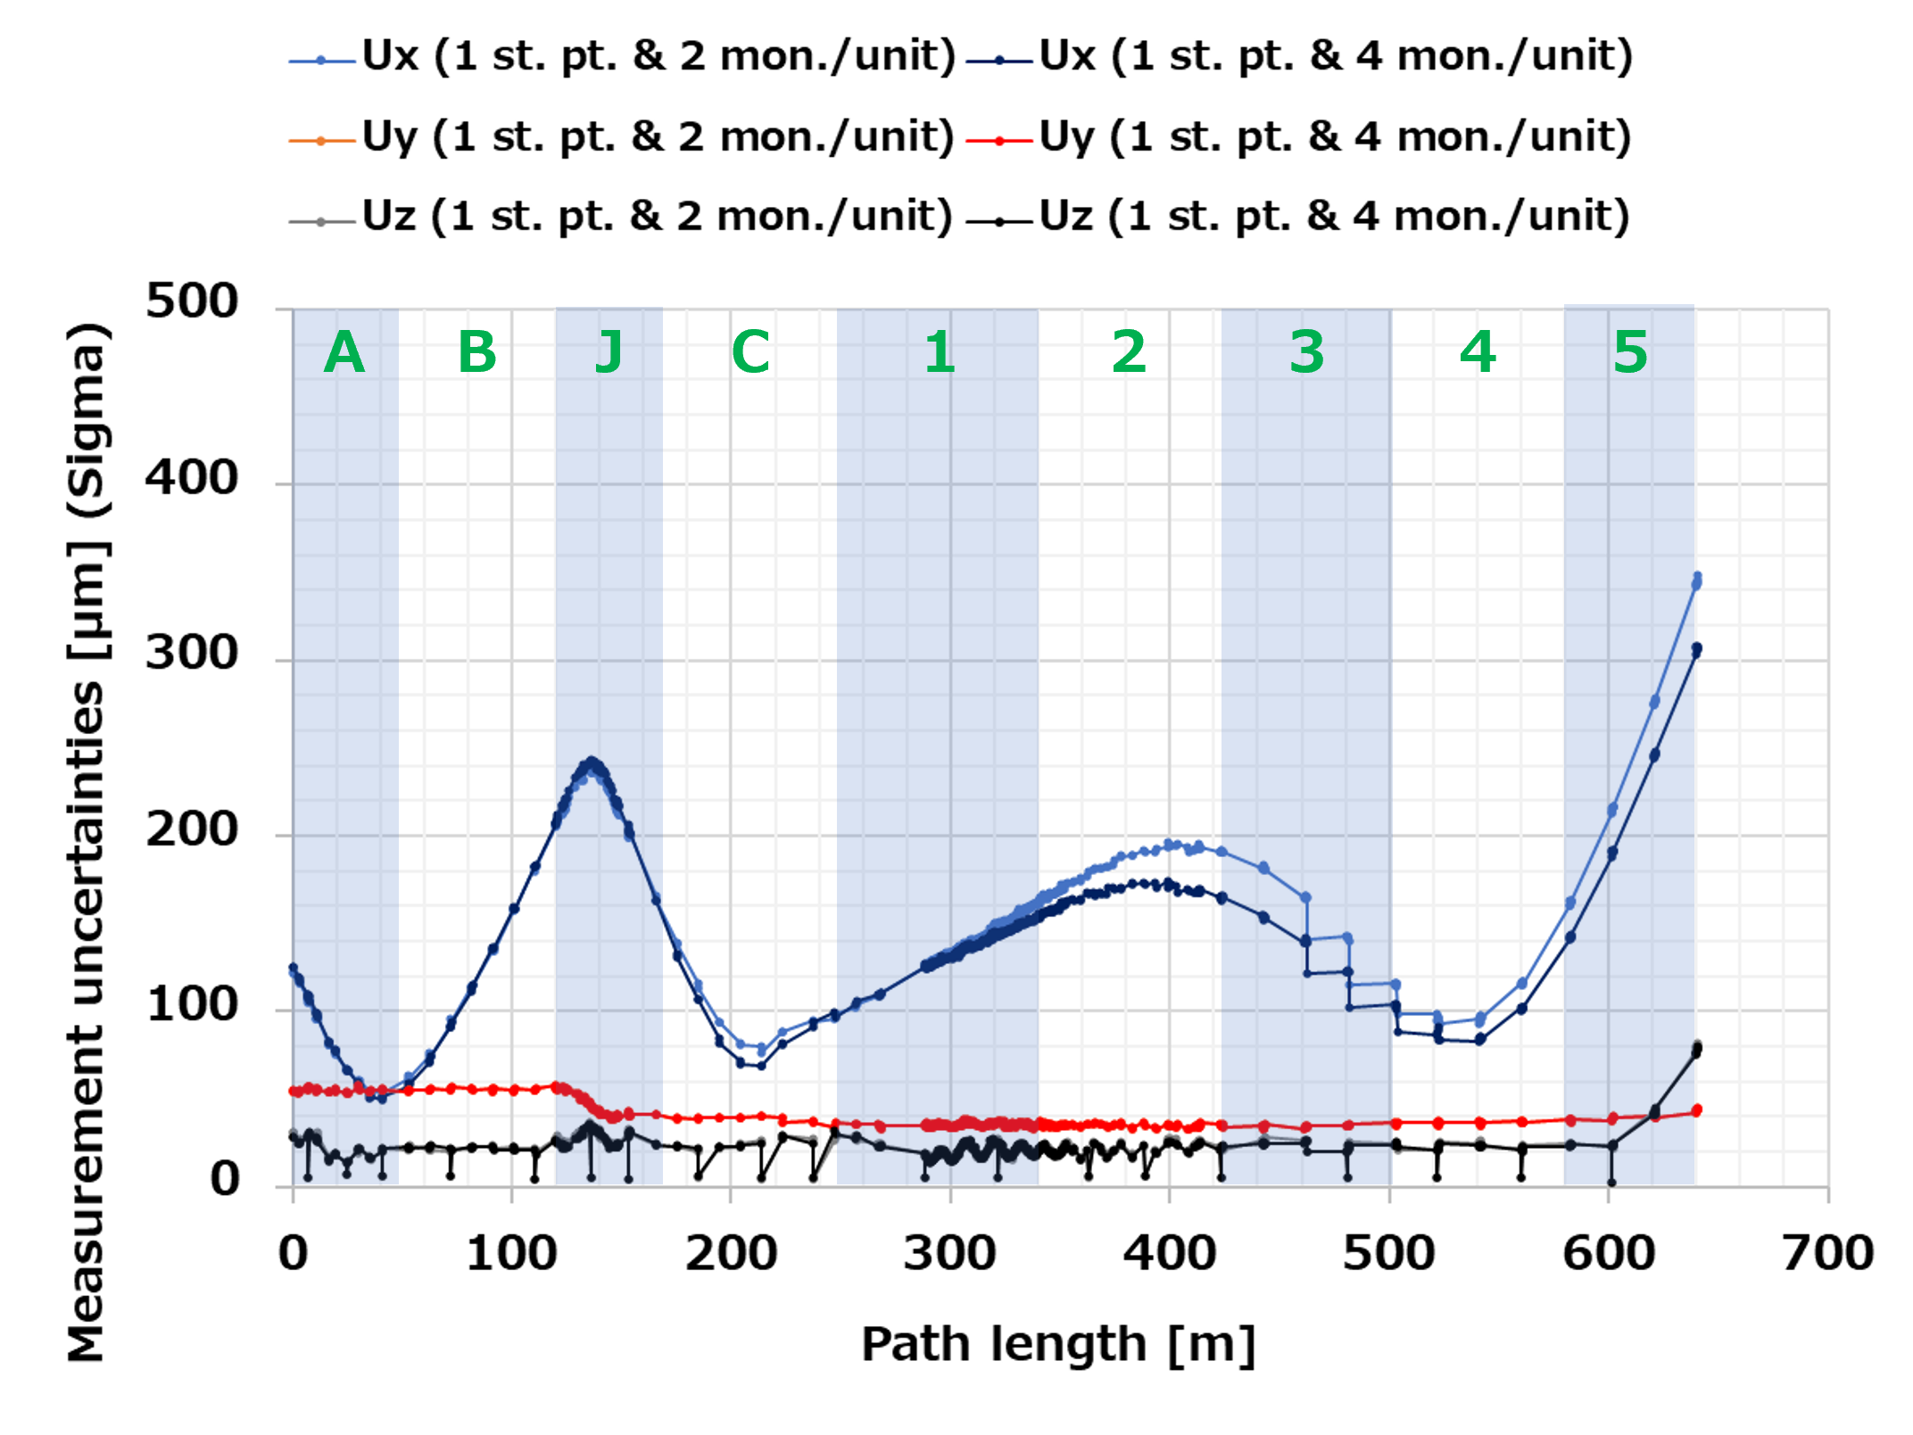
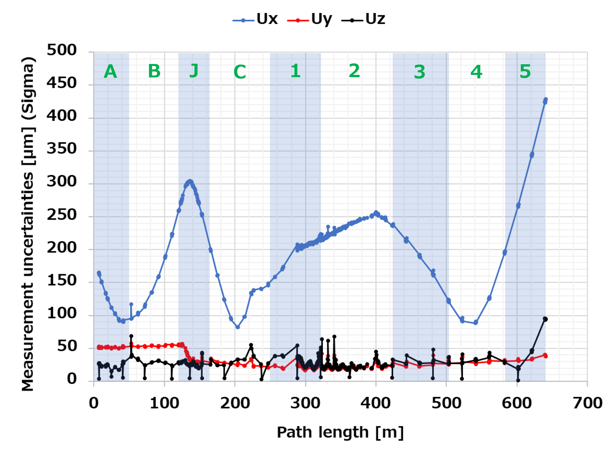
Uncertainties comparison : Calc. VS. Real survey (2021)
2021 real survey
Calculation
Distributions are well reproduced especially for Ux and Uy.
Ux of real survey are relatively x1.2 higher. Air conditions, cooling water vibrations…?
Dense of monuments or # of common pt. should probably be constant, i.e., no need to be periodic mon. configuration.

Slide 20
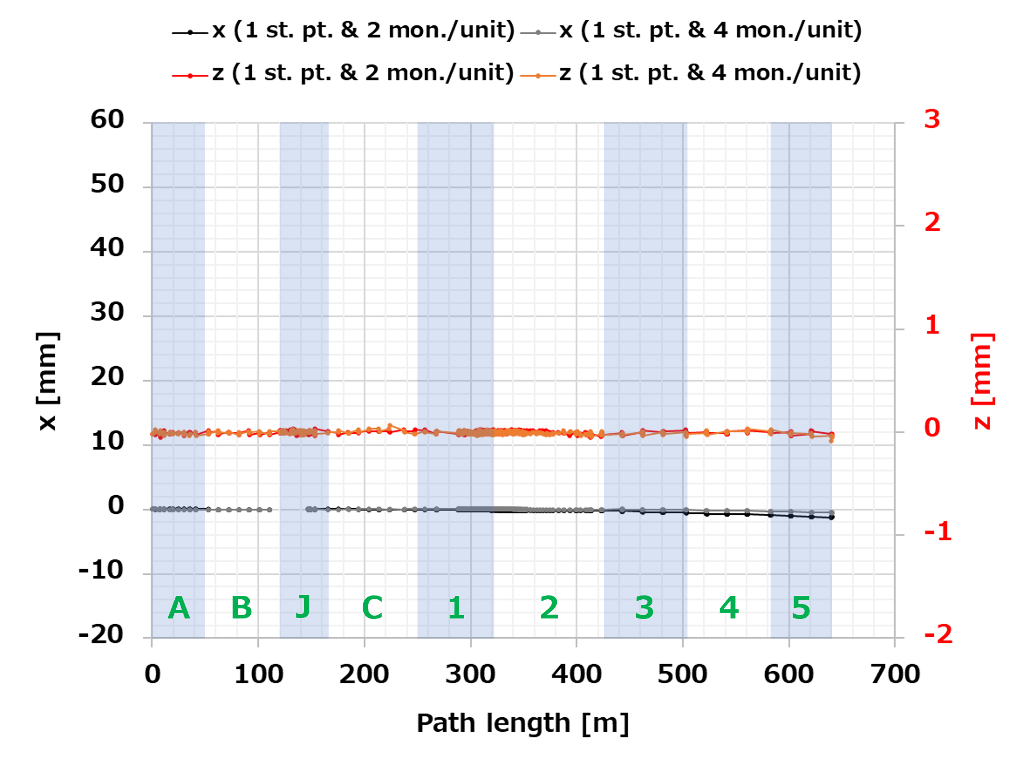
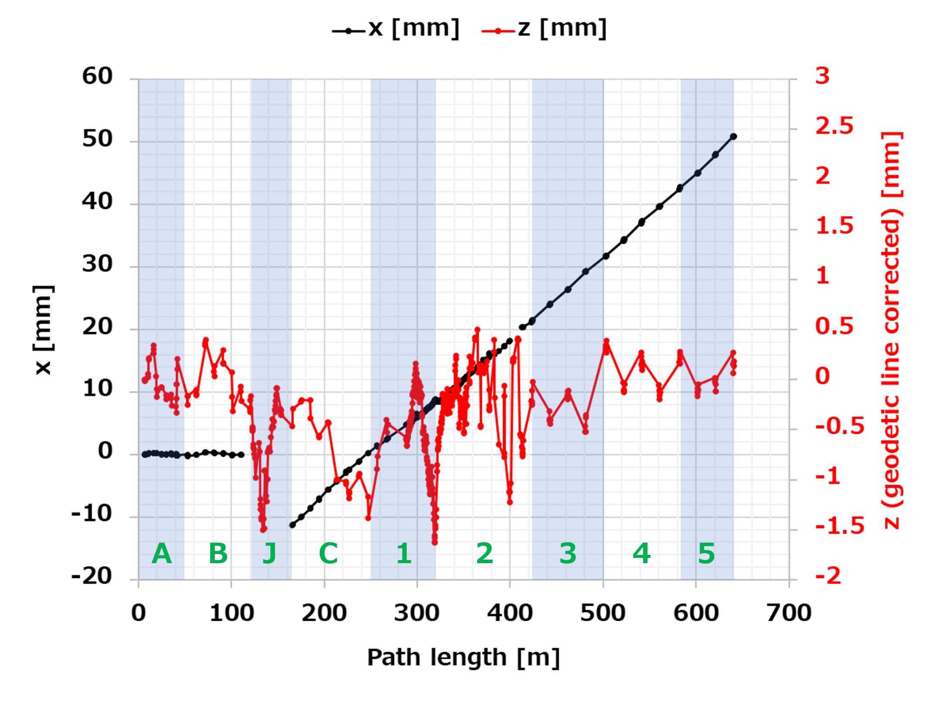
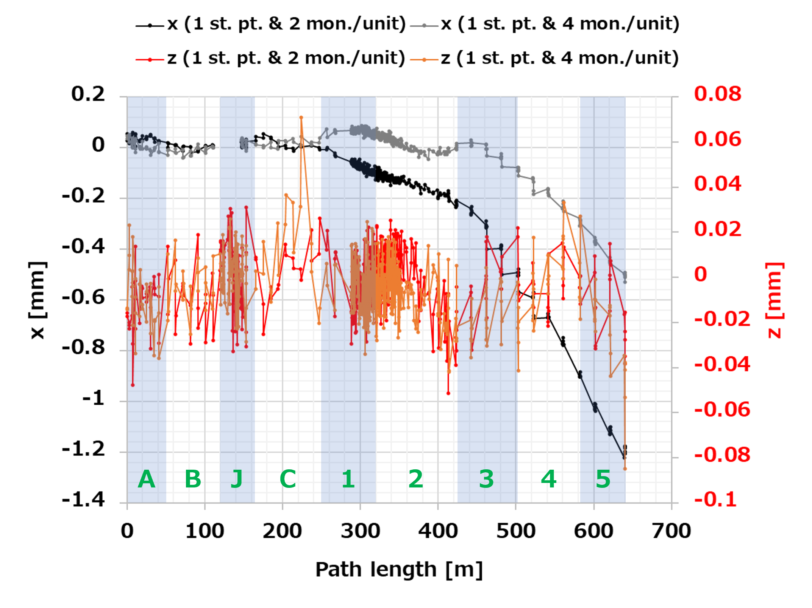
x, z comparison : Calc. VS. Real survey (2021)
2021 real survey
Magnified
At least, we can conclude, the slope of 0.12 or 0.13 mrad from J-arc exit is real slope, not artificial.
Further monument optimization is required from 1 sector.
Calculation

Slide 21
Summary
The conventional control survey has been finally introduced in KEK e⁻/e⁺ injector linac since 2020.
Horizontal coordinate x, which is orthogonal to beam direction, has counterclockwise slope of 0.12 or 0.13 mrad from J-arc exit.
Level survey data by LT & DiNi needs the geodetic line correction for both 120-m & 492-m straight section.
Virtual control survey simulation is now running to optimize #s & coordinates for both station points & monuments and to reduce measurement uncertainties.
Calculated measurement uncertainties well reproduce real ones. However, Ux of real survey is relatively x1.2 higher than calculation. Effects of air condition or cooling water vibration are suspected and further investigation is undergoing.
Dense of monuments or # of common points might be important comparing to the periodic monument configuration.

Slide 22
Backups

Slide 23
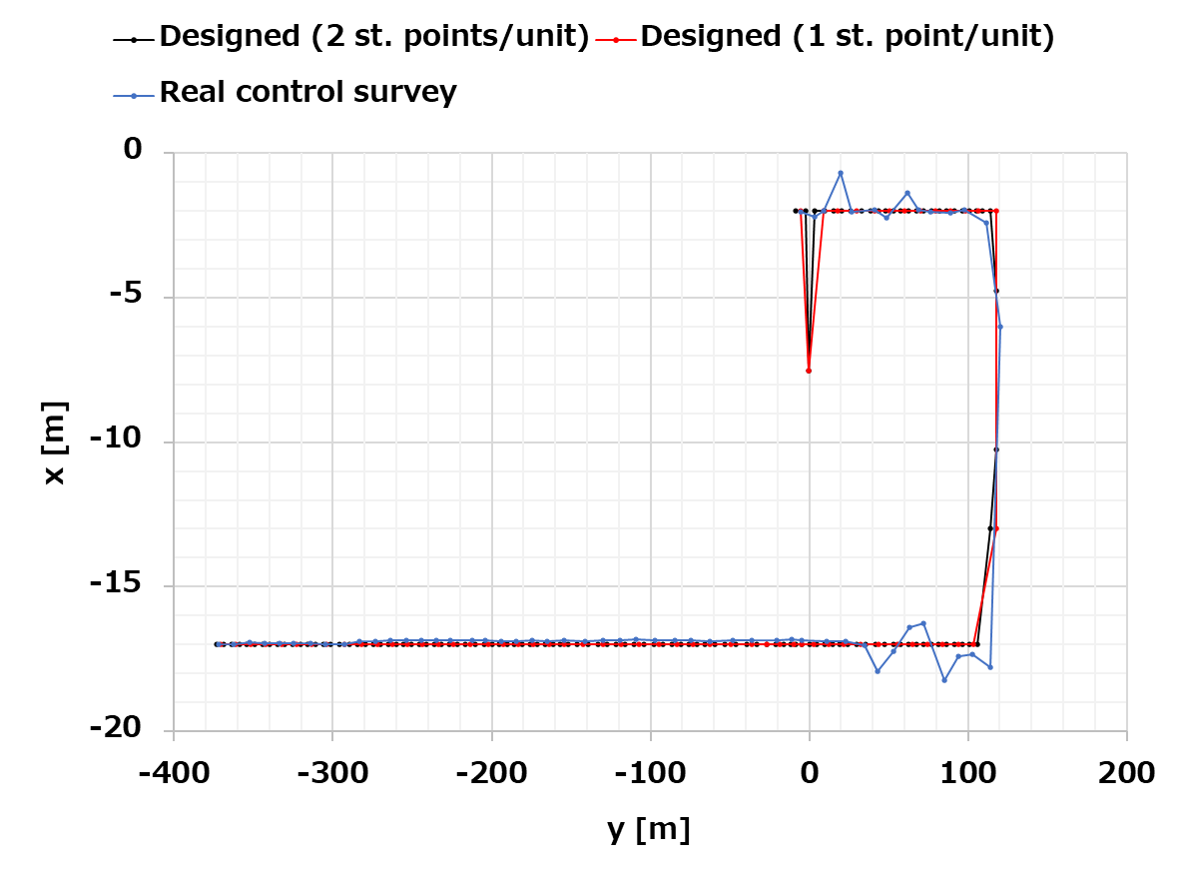
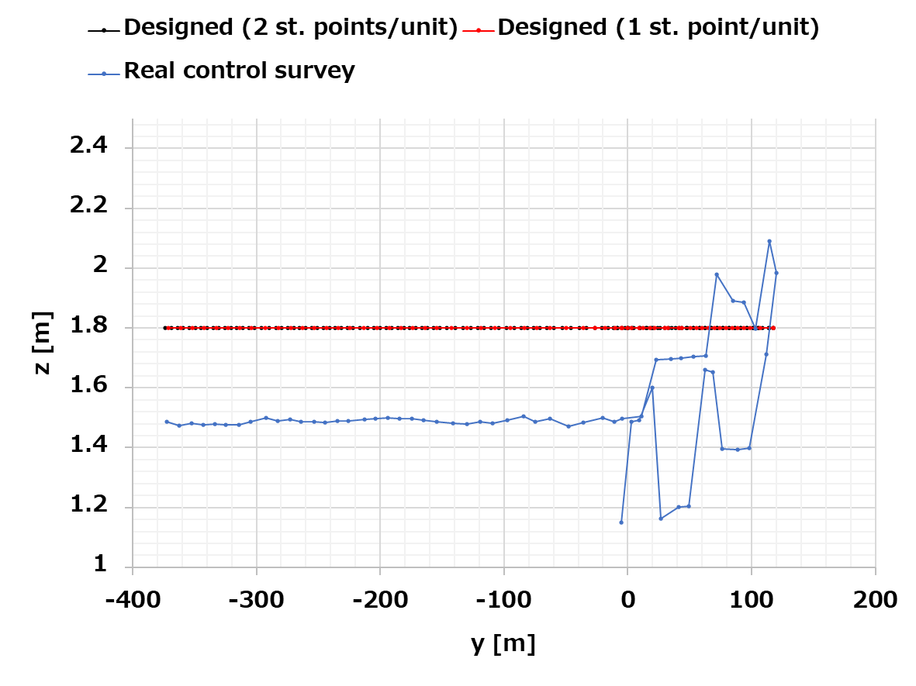
Station (LT) points summary
 | Real control survey | Calc. case 1 | Calc. case 2
# of st. points | 61 | 63 | 103
Distance for y (min/max/ave) [m] | 5.9/16.0/10.3 | 5.1/14.3/10.0 | 2.0/8.1/5.1
Level (min/max/ave) [m] | 1.2/2.1/1.5 | 1.8 fix | 1.8 fix
Remark | 1 st. point/unit | 1 st. point/unit | 2 st. points/unit

Slide 24
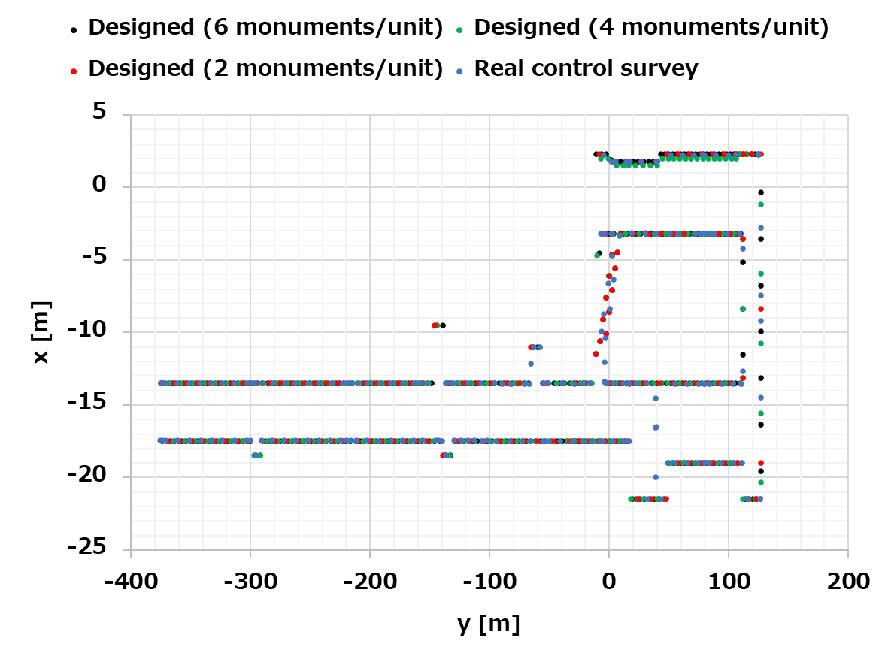
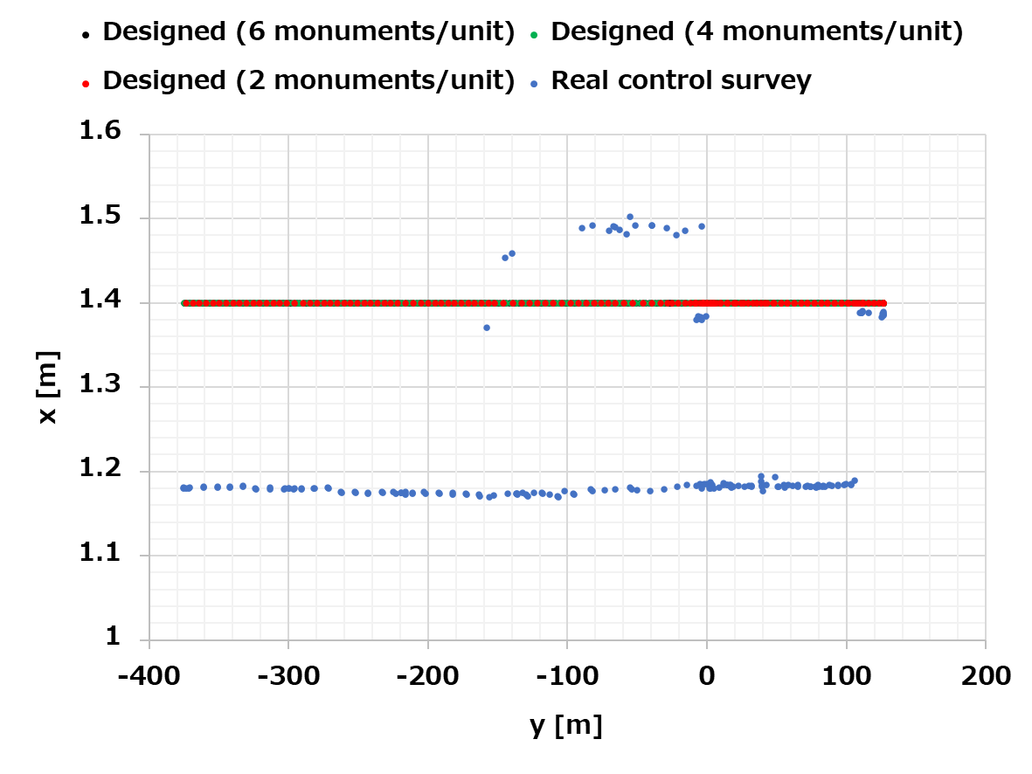
Monument points summary
 | Real control survey | Calc. case 1 | Calc. case 2 | Calc. case 3
# of points | 192 | 138 | 260 | 383
Distance for y (min/max/ave) [m] | 0.0/21.6/4.1 | 0.0/7.2/4.6 | 0.1/5.2/2.5 | 0.1/3.2/1.7
Level (min/max/ave) [m] | 1.2/1.5/1.2 | 1.4 fix | 1.4 fix | 1.4 fix
Remark | 2 - 3 points/unit | 2 points/unit | 4 points/unit | 6 points/unit

Slide 25
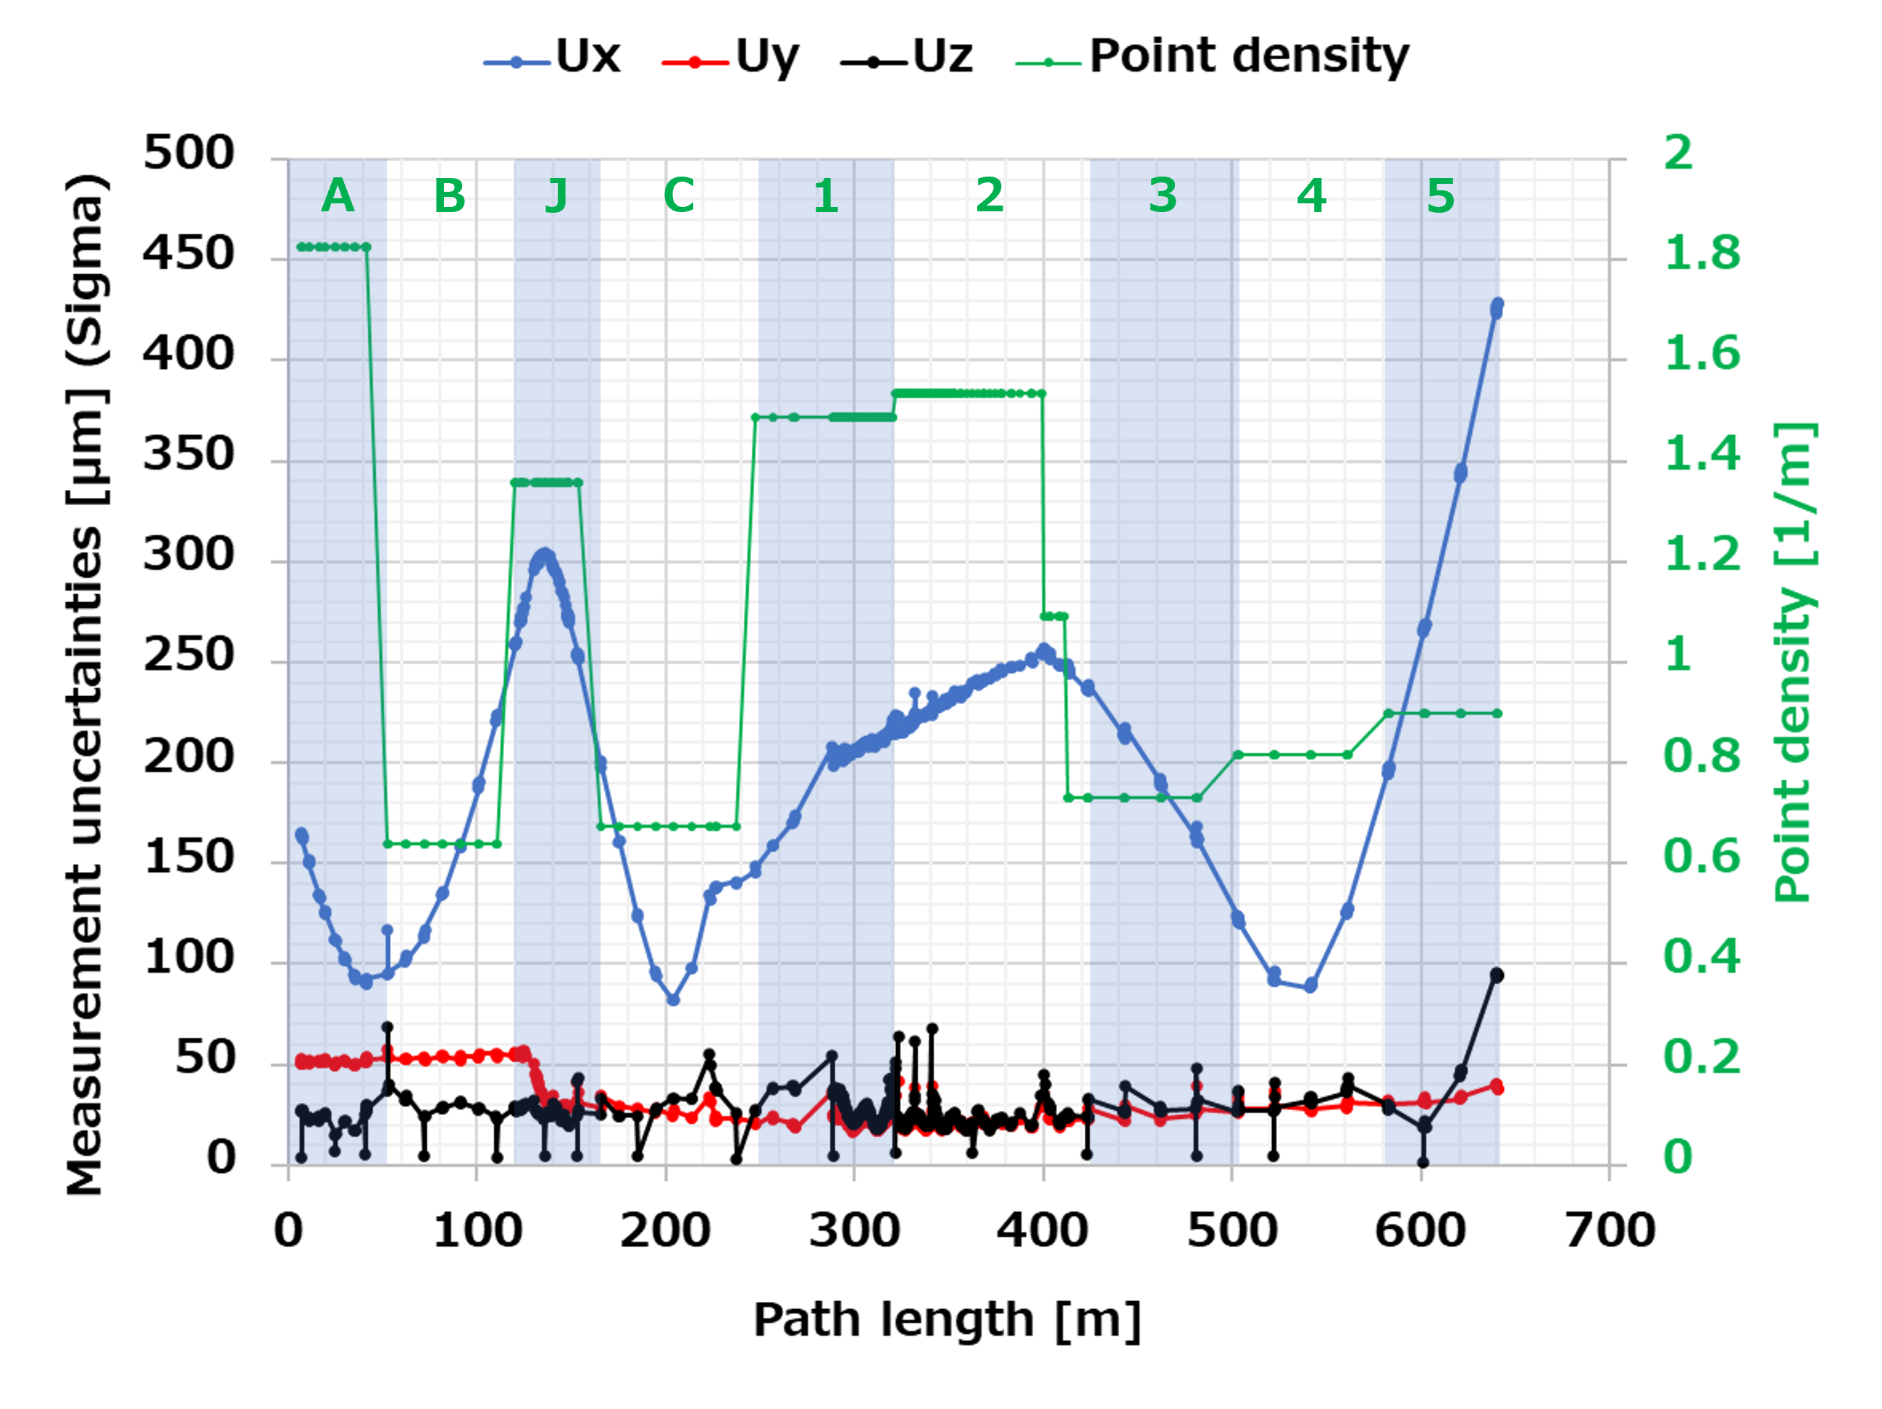
Measurement uncertainties VS. point density of each sector

Slide 26
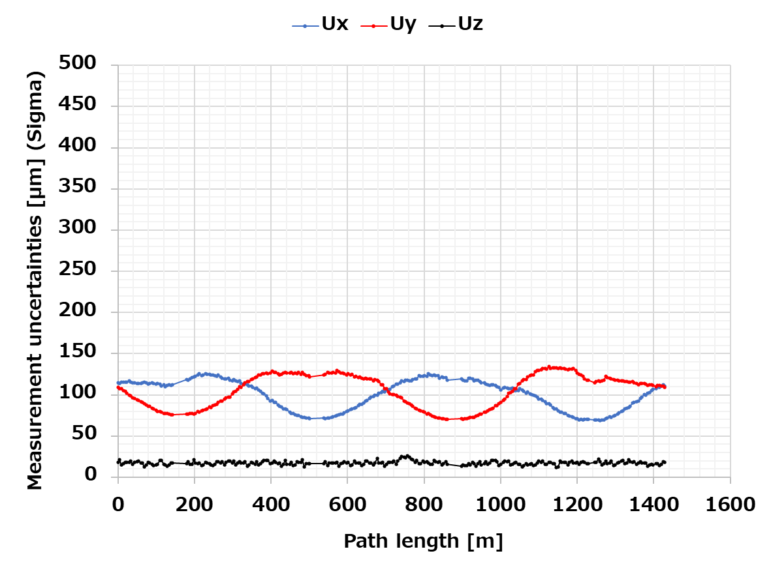

Measurement uncertainties comparison : SPring-8 SR VS. KEK injector linac
SPring-8 SR 2018
All magnets and monuments are configured as almost periodic except four long straight sections (ID sections).
That means # of common points are also equal for all instruments.

Slide 27
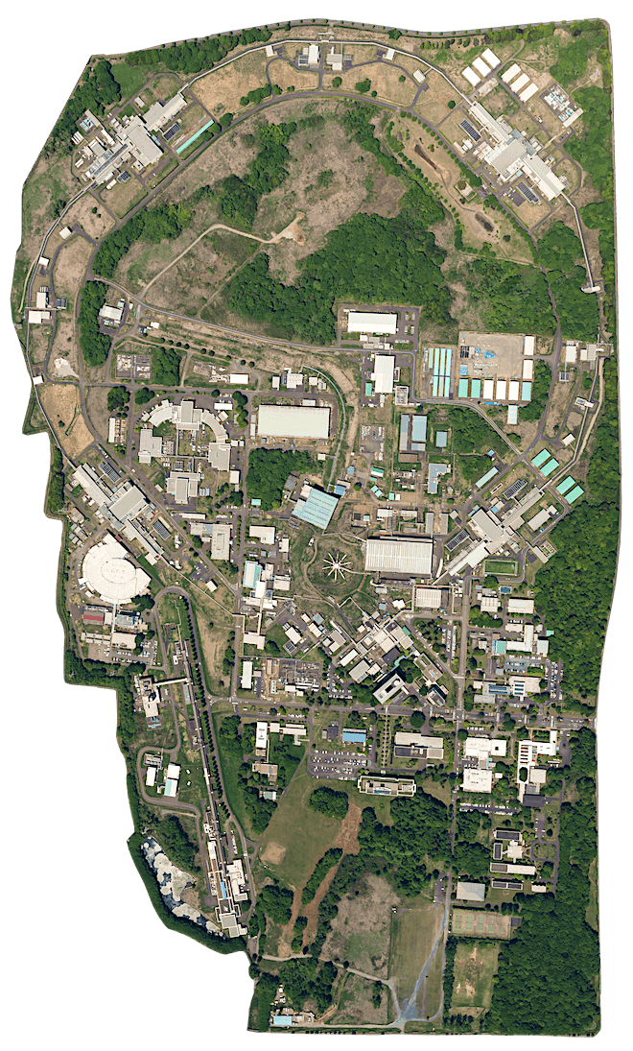

KEK Site
1 km
1.7 km
KEK
60 km
Tokyo
◀︎ Entrance

Slide 28

Photon Factory
and
Injector Linac
PF-AR (6.5 GeV)
AR : Advanced Ring
The word “ring” means synchrotron.
PF-Ring (2.5 GeV)
e– Injection
Injector
Linac
The word “linac” means linear accelerator.
The body of the linac is constructed underground.

Slide 29

Colliding
Point
SuperKEKB
and
Injector Linac
SuperKEKB
The two rings, HER and LER, are in the same tunnel and collide electrons and positrons at a colliding point for studying high energy physics.
High Energy Ring (7 GeV)
Low Energy Ring (4 GeV)
HER : High Energy Ring
LER : Low energy Ring
e–
e⁺
e– & e⁺ Injection
Injector
Linac

