Slide 1

Concluding remarks
Dominique Missiaen
4 November 2022

Slide 2
Outlook
29 years of IWAA
  My personal view and remembers
IWAA2022
Information from the international Committee
  Composition
  Next venue

Slide 3
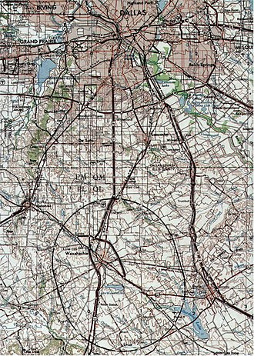
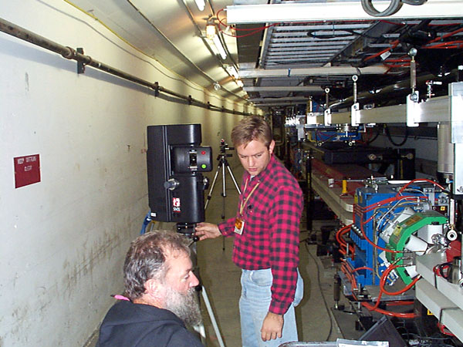
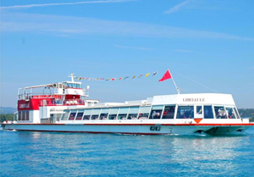
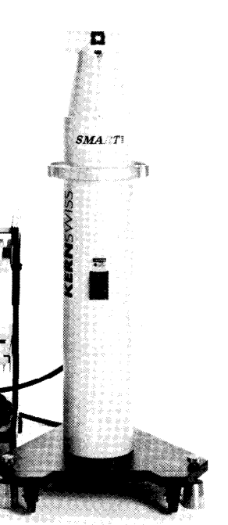
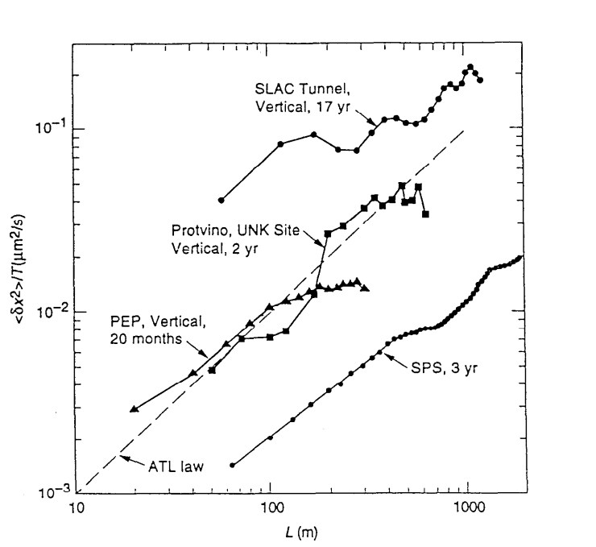
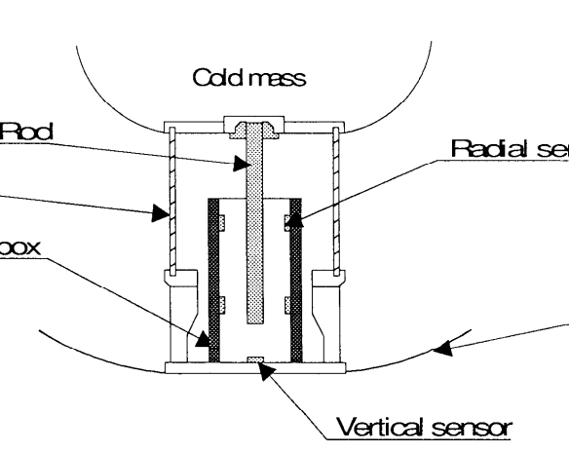
The 90’s
93 : CERN
  My first IWAA
  In a hôtel in Annecy, 50 kms away from CERN
  Chesapeake laser tracker (Ruland) > SMX
  End of the SSC (87.1 km, 20 TeV) !!!
  Banquet on the Libellule
95 : KEK, Tsukuba
  LEICA, laser tracker SMART 310, IFM, no ADM
  Beam Based Alignment (7 talks)
  Monitoring LHC cold mass
    Vibration
    Ground motion : ATL law (Schiltsev)
  Detectors positioning (Price)

Slide 4
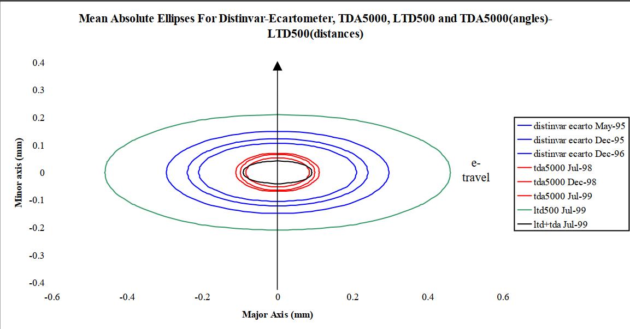
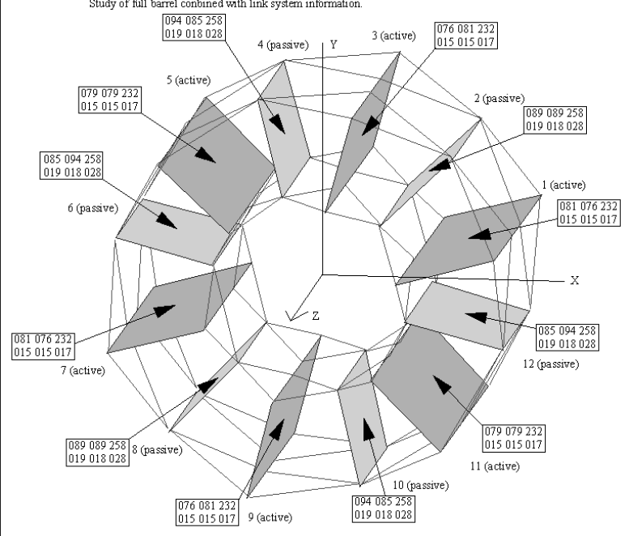
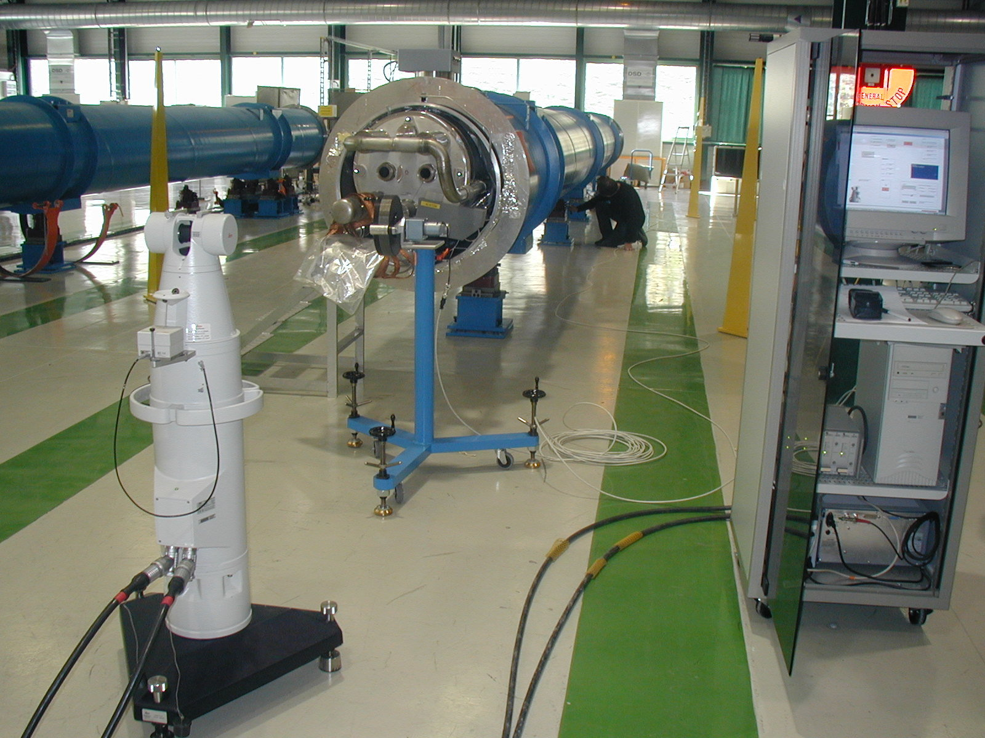
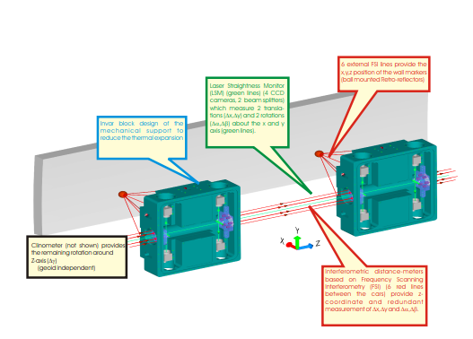
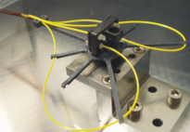
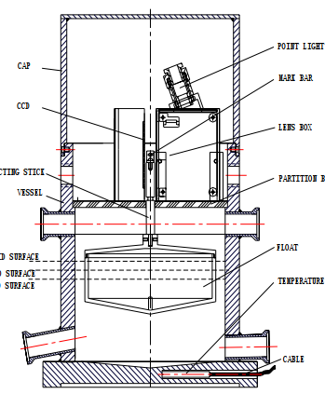
The 90’and 2000’s
99 : ESRF
  3D Metrology
    Network using polar measurement (TDA5000)
    Fiducialisation of LHC cryo-magnets(LTD500)
  Many talks on alignment of LHC big detectors (CMS)
    Instrumentation and software, methodology
2004 : CERN
  FSI for ATLAS
  Laser scanner
  HLS (11 talks)
  RTRS and LiCAS for linear colliders (Sclhoesser)
    HLS, laser and FSI

Slide 5
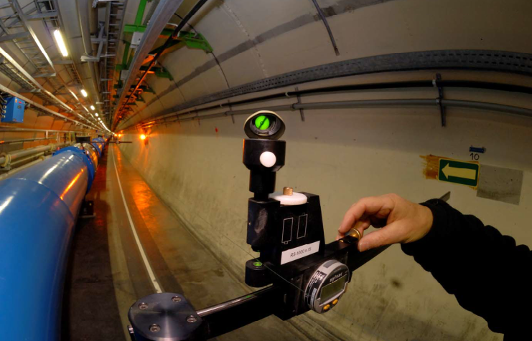
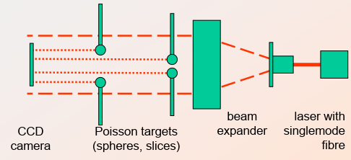
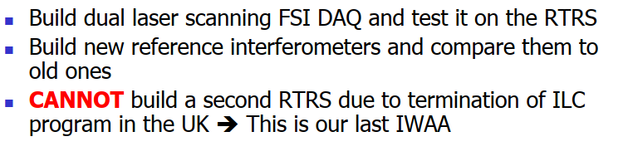
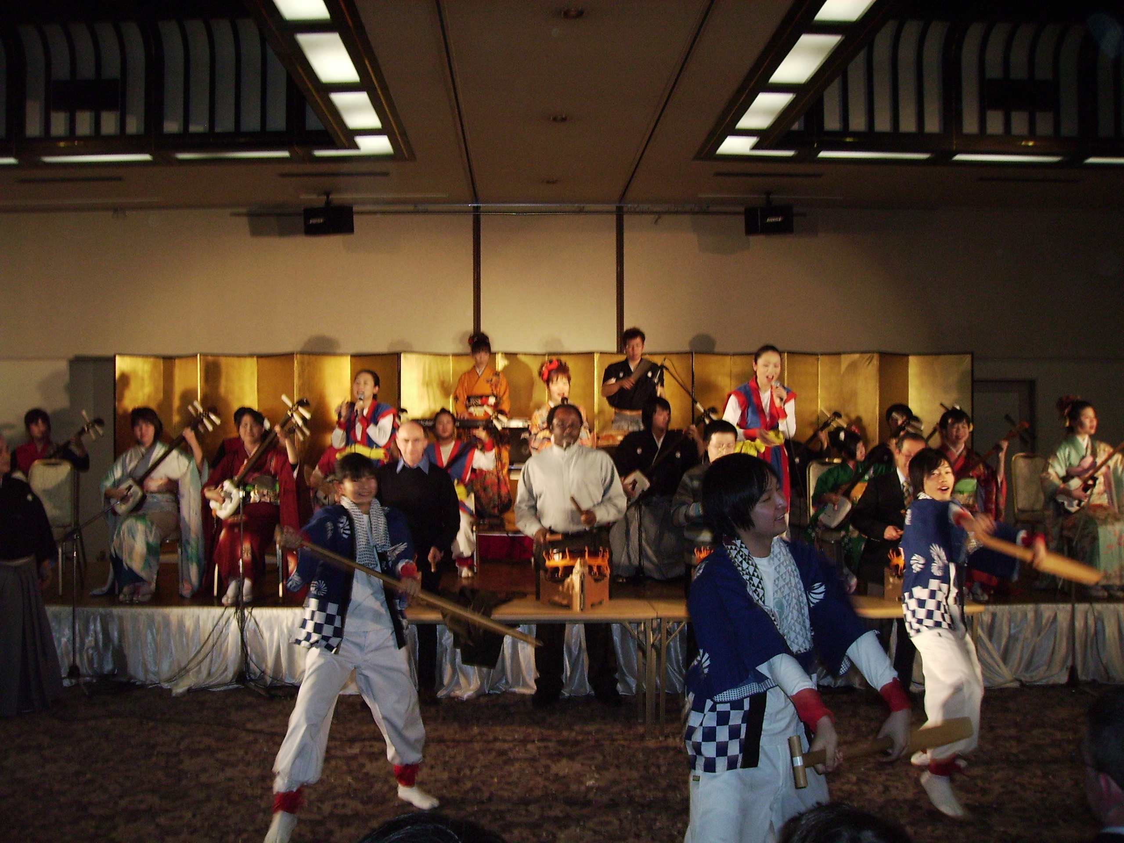
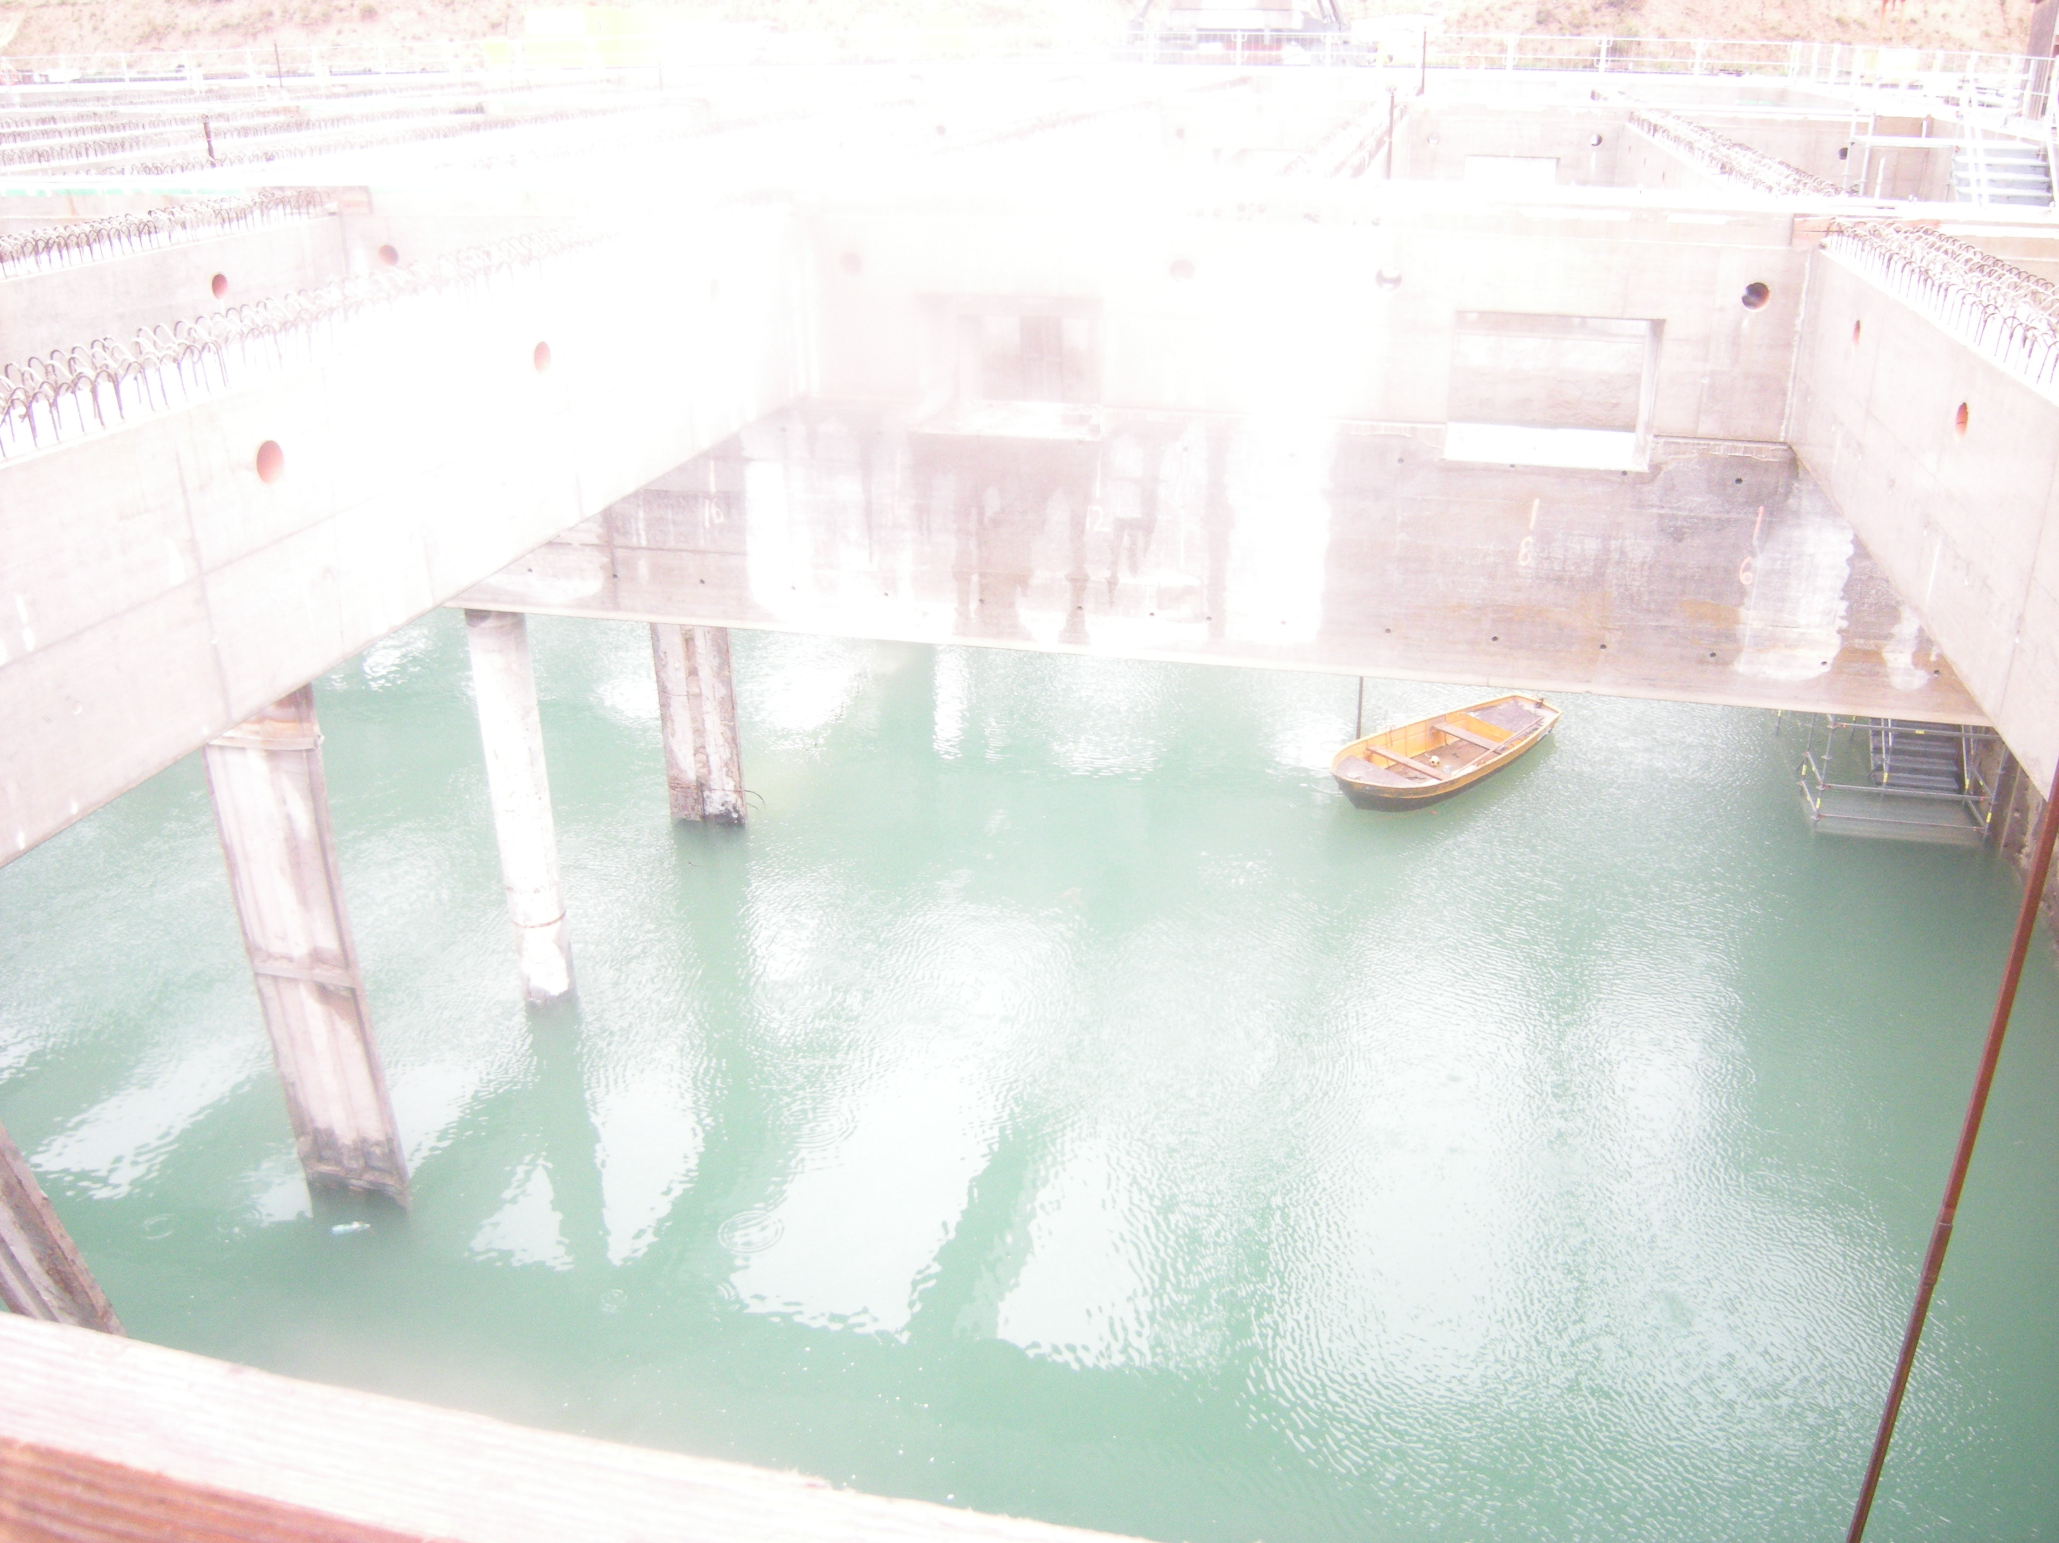
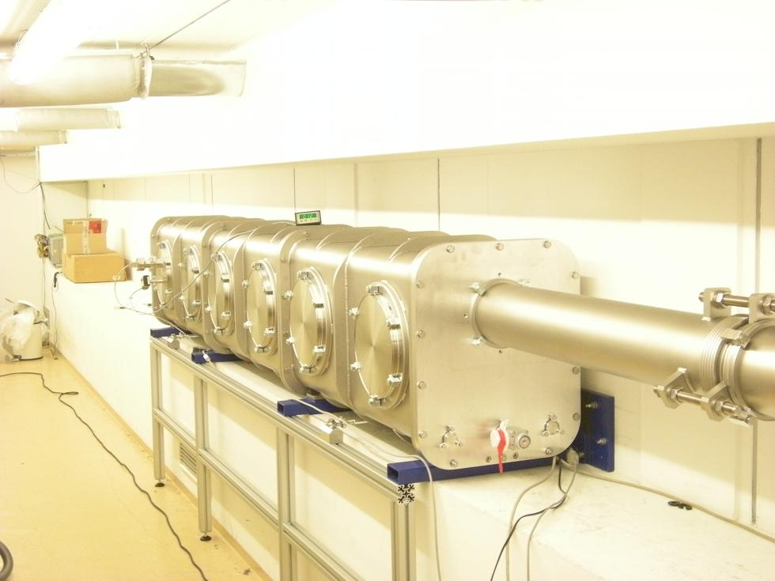
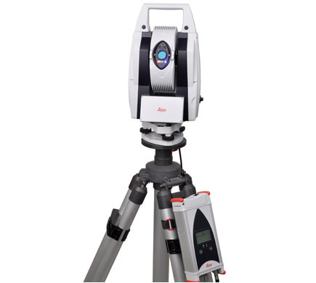
The 2000’s
2008 : KEK
  40 years of stretched wire (Quesnel)
  Poisson system for the DESY Xfel (Prenting)
  RTRS-LiCAS train (Oxford, DESY)
  Banquet
2010 : DESY
  Visit of XFEL civil engineering works : water , water !!!
  The tutorial on LS adjustment (Niemaier, Schloesser)
  A new tracker : the Absolute tracker AT401
  LHC collimator survey CERN
  Banquet on the ELBE

Slide 6
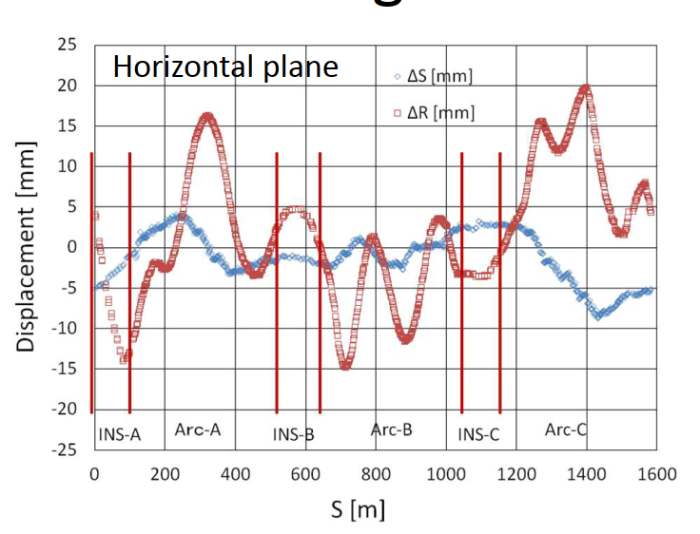
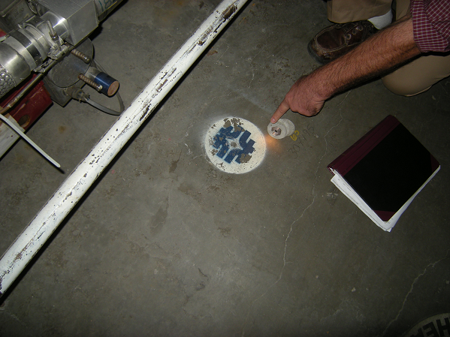
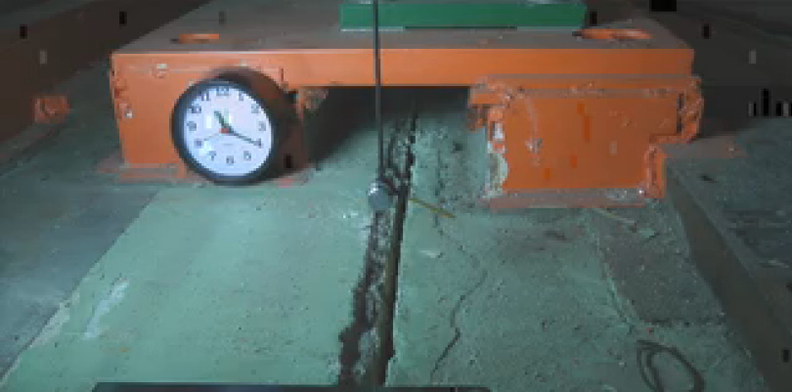
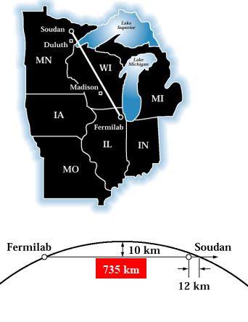
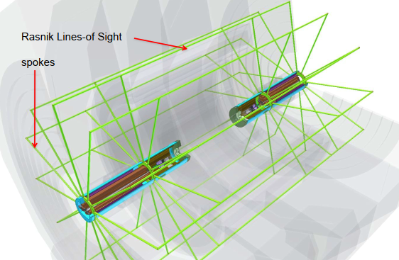
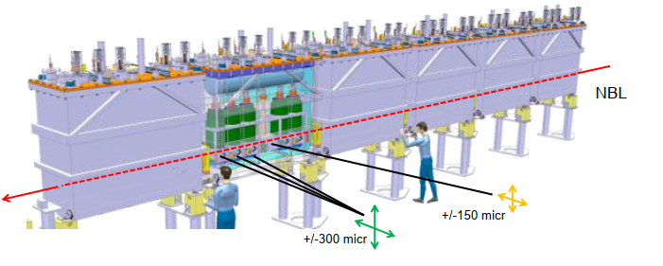
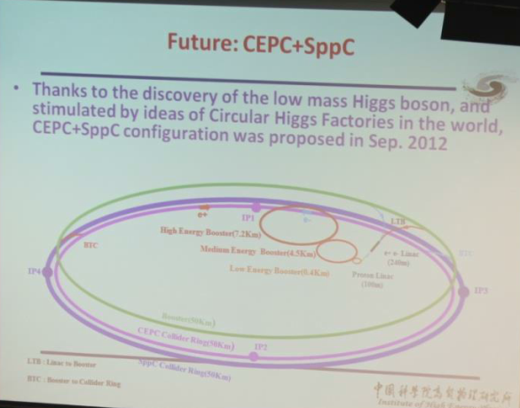
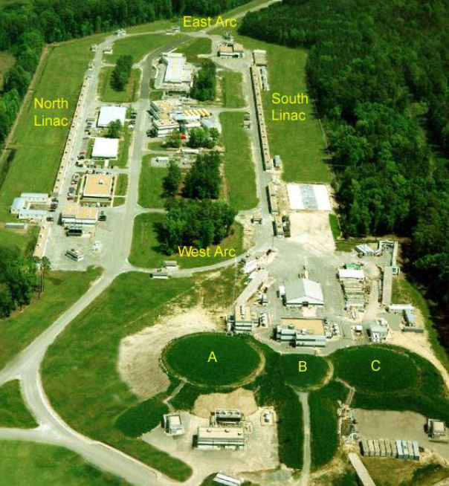
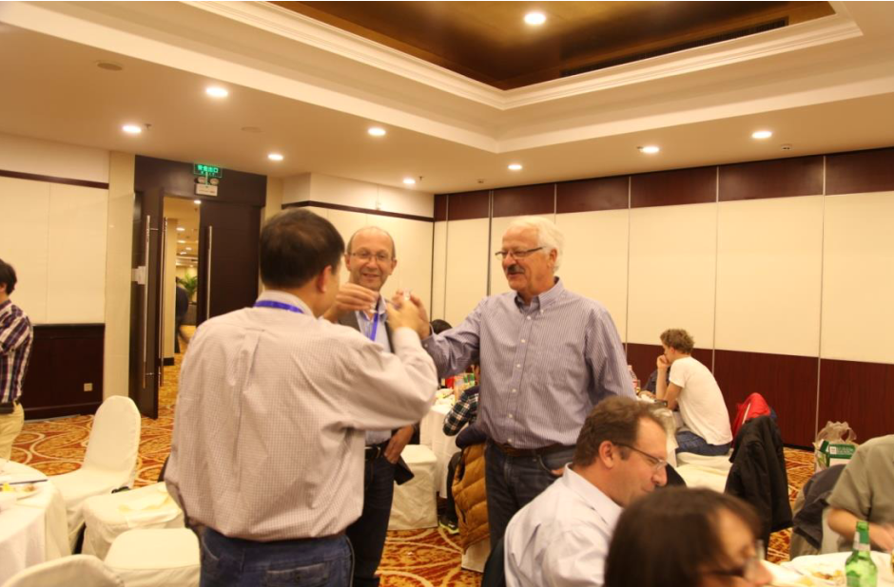
The 2010’s
2012 : FNAL, Chicago
  Reports after the 2001 earth quake in Japan
  Geodesy : distances determination(CERN>GranSasso, Minos) using GNSS
  Monitoring with Bcam (HIE-isolde)
  Several papers on CLIC
2014 : IHEP, Beijing
  CEPC : 100km circumference collider
  CEBAF alignment, Duke
  The great wall !!!

Slide 7
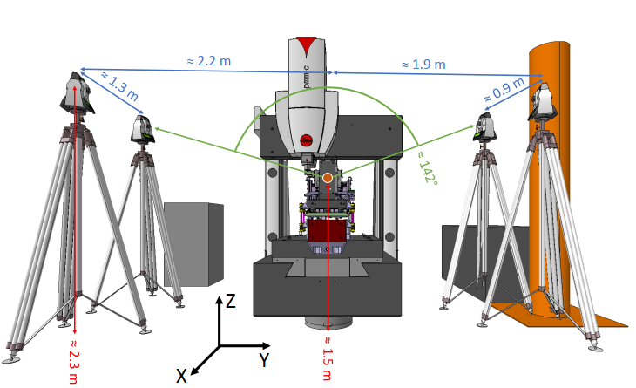
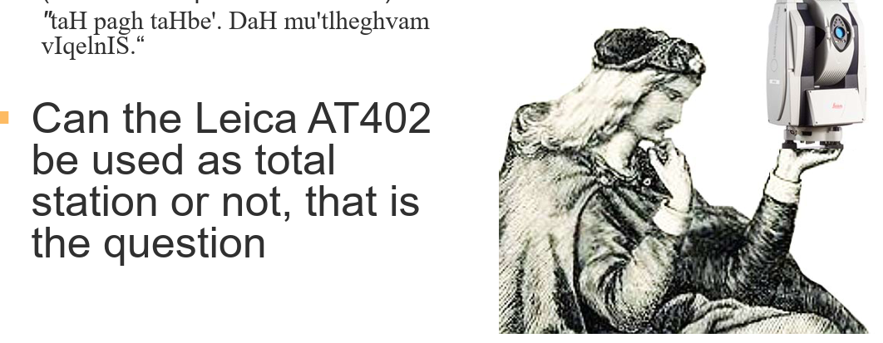
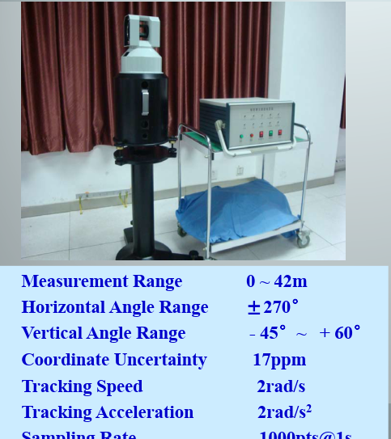
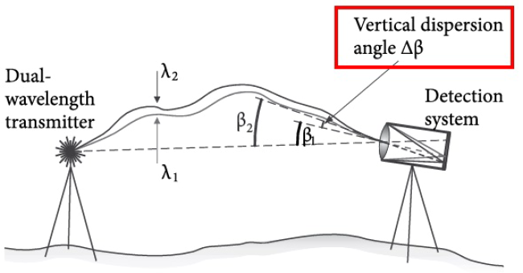
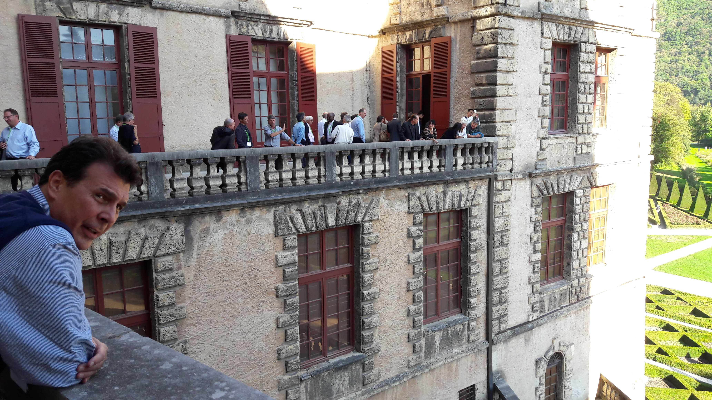
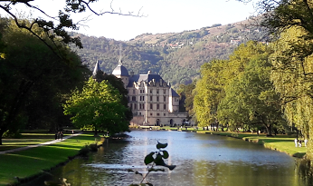
The 2010’s
2016 : ESRF, Grenoble
  The AT402 used as a total station (Miertsch)
  The Refractometer (Kyle)
  Pacman Projet (micro-triangulation, fsi, wire detection on a CMM, etc)
  Detection of stretched wire by photogrammetry (Behrens)
  laser tracker development in China (optical frequency comb, …
  Visit of the Castle
    Smell discovery and «Folies Bergères» - banquet

Slide 8
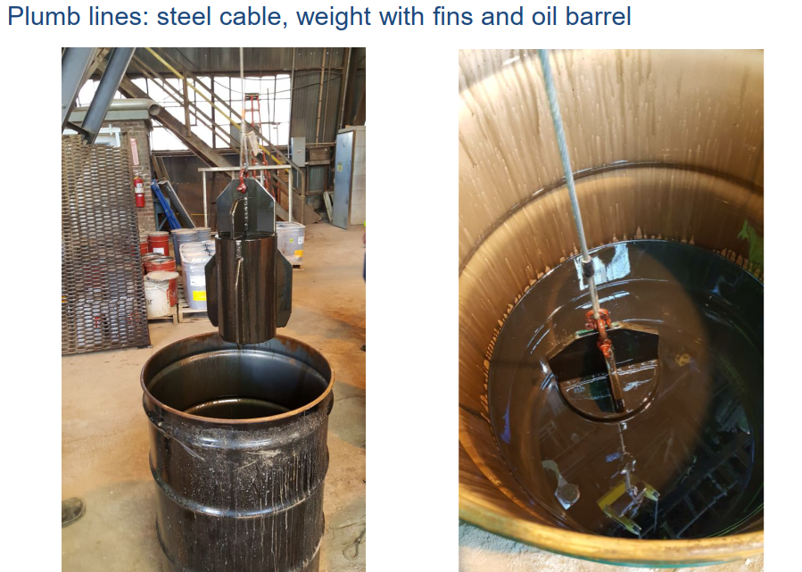
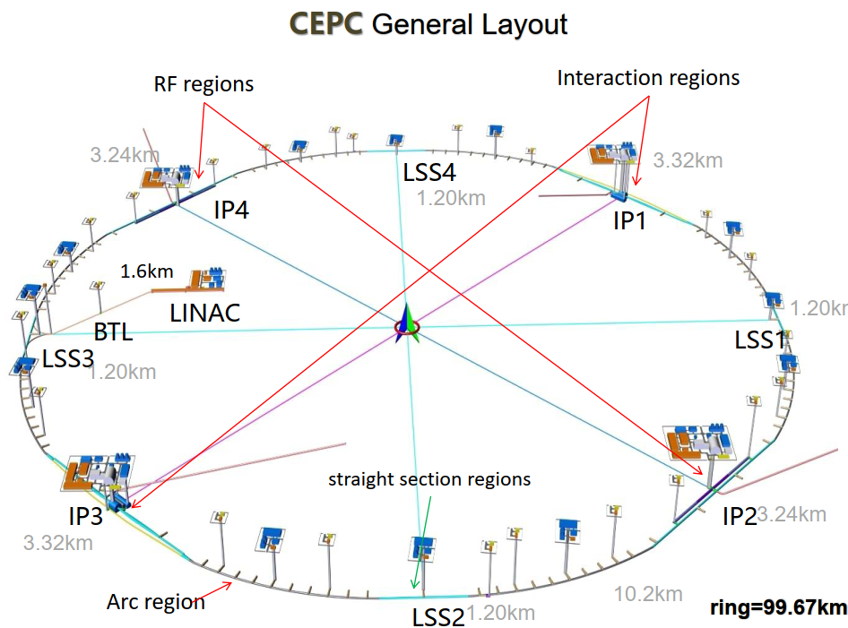
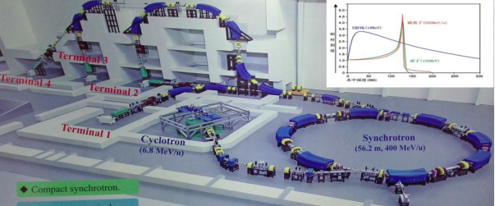
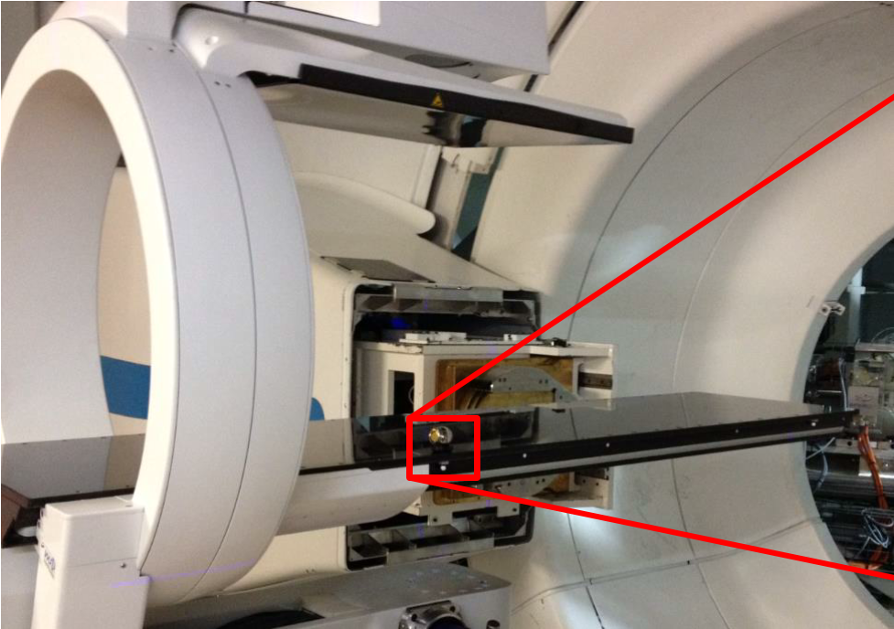
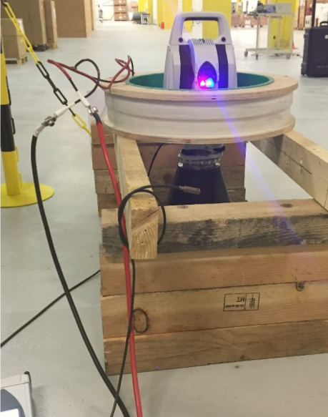
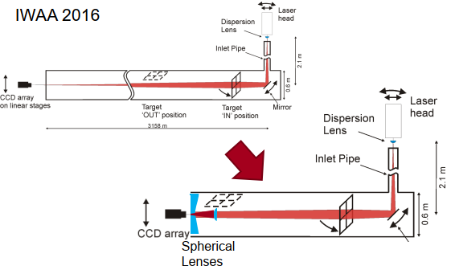
The 2010’s
2018 : FNAL, Chicago
  Transfer of co-ordinates to -1500 m level with steel cable in oil
  CEPC :
    development of a survey train using photogrammetry…
    New geoid determination : calling for experts
    construction starts in 2022 !!
  Medical machines (IMP, Pronova, etc)
  SLAC LCLS : reconditioning of the Fresnel lens system with a laser
  AT403/AT930 in magnetic field and standards
    Above 300G : adm doesnt work
    No long term exposure

Slide 9
IWAA 2022
What have we heard about
What to remember

Slide 10
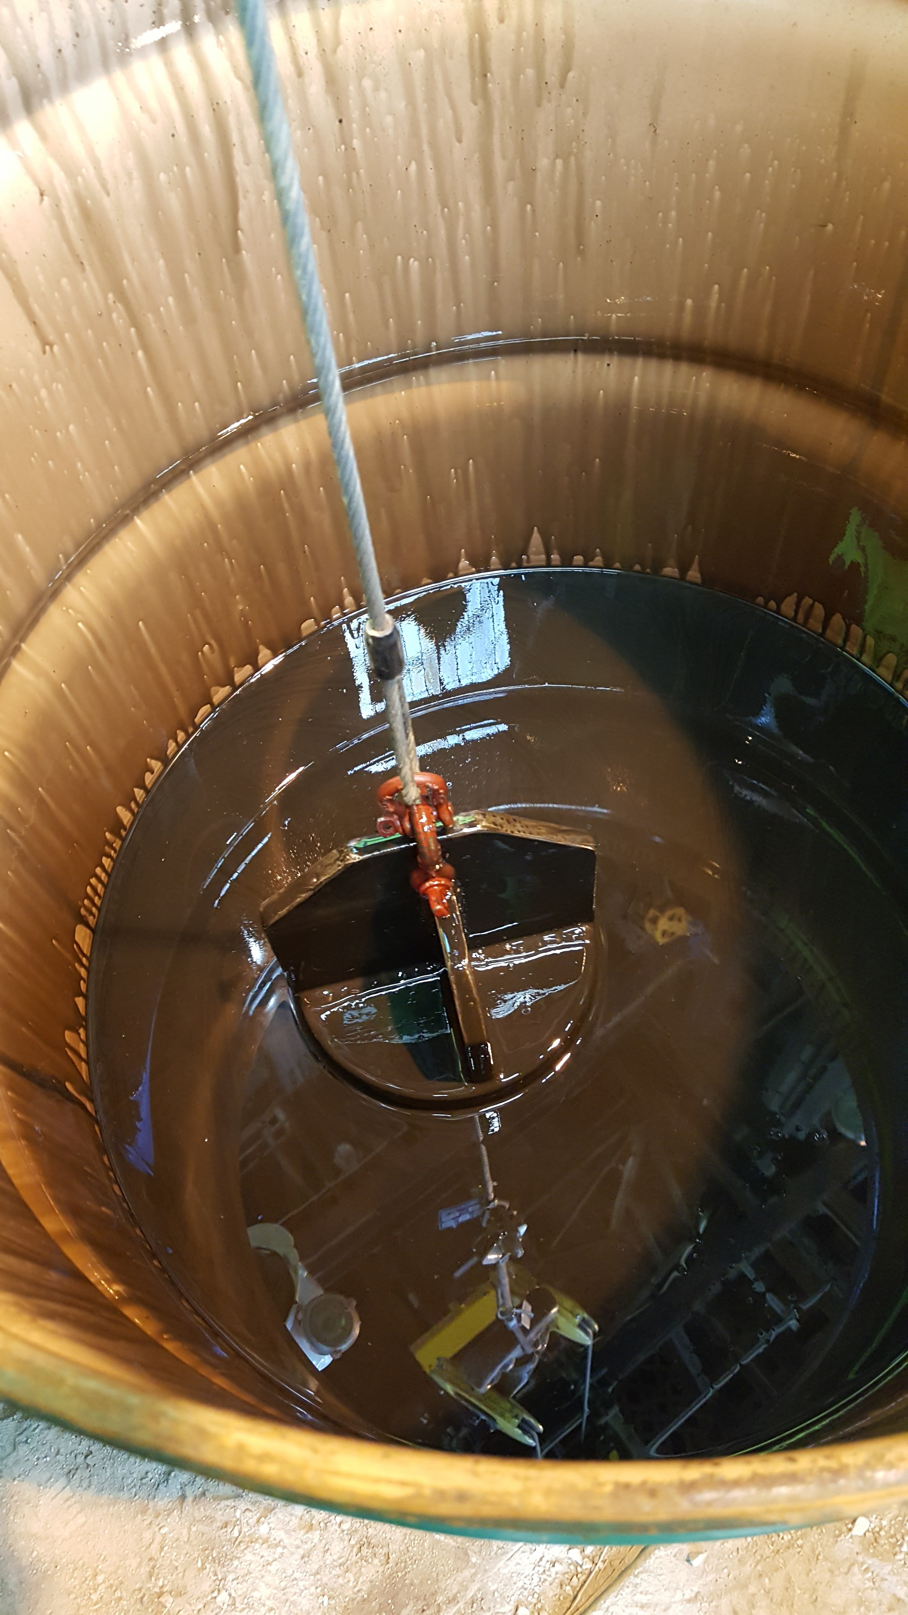
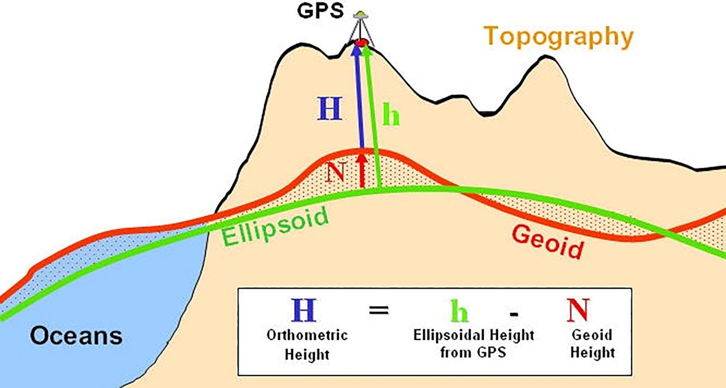
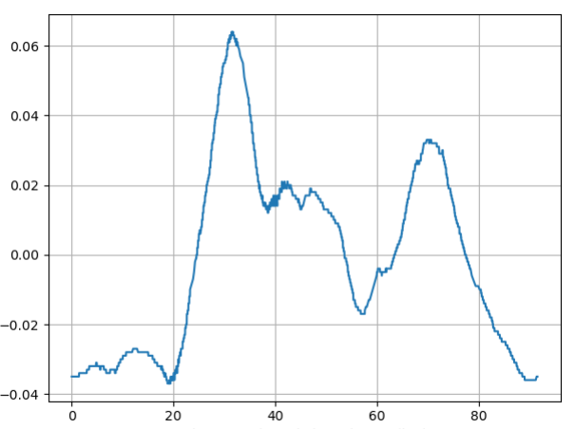
Geodesy
LBNF geodetic activities
    GNSS network over 1500km : global accuracy 10 mm
    Transfert to bottom of shafts : plumb line of 1 mile long with 10 cm accuracy
    Gyroscope to link the two shafts
    Astronomic azimut
A cm geoid for FCC
  Stokes Helmert method (constant density)
  Gravimetric geoid : 1,8 cm accuracy obtained

Slide 11
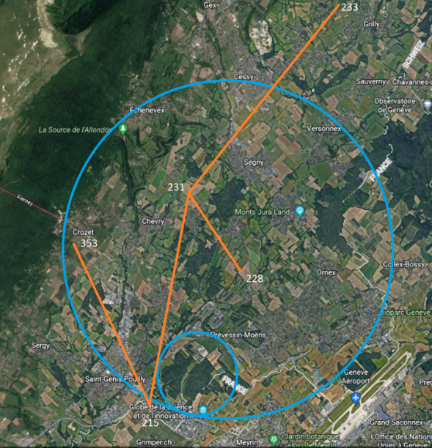
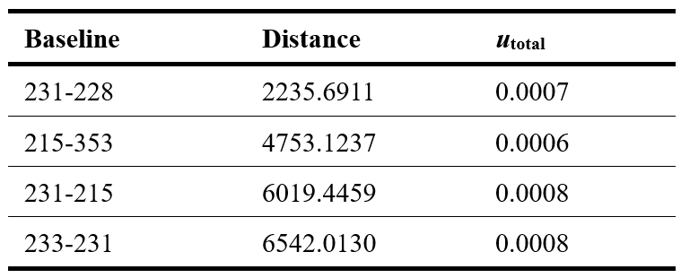
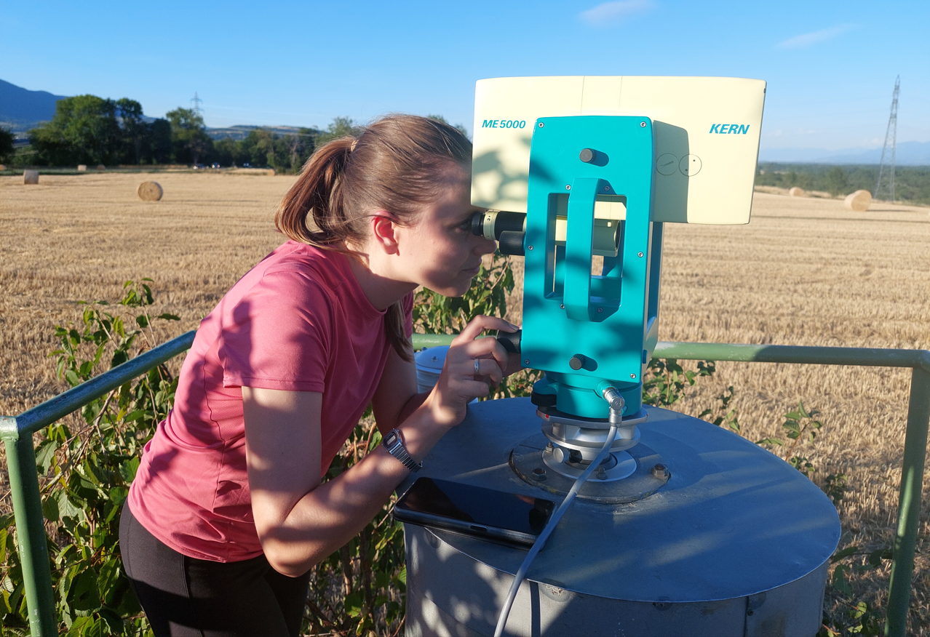
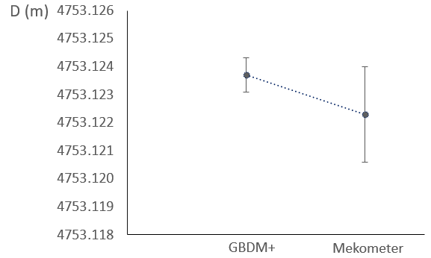
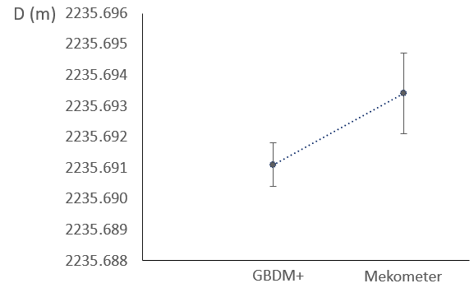
Geodesy
A new method of processing GNSS measurement to get distances
  Gnss observations needed (rinex)
  Heights of instruments/antennas with TS
  Comparison with ME5000
    Diff of 2 mm due to environment parameters not well measured

Slide 12
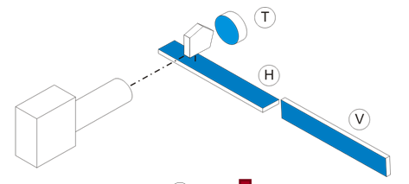
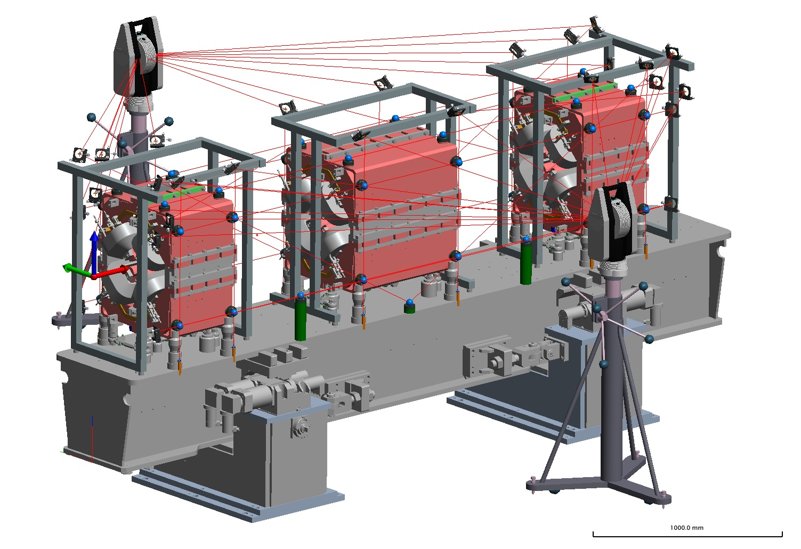


New machines or Update (1)
Mainly 3rd generation machines
  Alignment on Girders, Laser tracker, monuments
  LCLS II (SLAC)
    Interesting to hear that Autocollimation is still in use
  Advanced Photo Source (ANL)
    shimming
  Deformation measurements of girders for Petra IV
    Mirrors for interferometry
    New analysis Software
    8 microns accuracy

Slide 13




New machines or Update (3)
Updating the CLS Storage Ring Reference Network
  New network using the AT960, good results, Z not as good as XY ! some doubts about numbers?
  Smoothing for future works??
Alignment for the ESRF Extremely Brilliant
  GUM
$$U=\sqrt{{Type A}^{2}+{Type B}^{2}}$$

Slide 14





New machines or Update (3)
SIAM Photon source II
  GNSS, LT
  2030
Control survey for KEK e+/e− Injector Linac
  Digital level DiNi03 and AT401
  Geodetic corrections applied
  Simulations generated for SA
: origin

Slide 15


Monitoring movements
Stability Studies of High-Quality Concrete Slab Floors at the ESRF
Short-Term Continuous monitoring of Experimental floor above tunnels of NSLS-II (BNL, USA)
  Monitoring with LT (5-7 at the same time)
  Unstable area
  WPS will be used if needed in the future

Slide 16



Monitoring movements
Belle solenoid
QCS
QCS
BELLE II/QCS
  Analysis of mvt of a detector (8*8*10), 1400T
  RSA/FEM software used
  Gap QCS/BELLE II measured and consistent with the calculation
  Belle II shaking due to earthquake not QCS
Atlas cavern deformation
  5 mm in V in 20 years(slab) 12 mm in H (walls)
  Stable reference !!
Displacement
Nov. 1st, 2021
~1.0mm

Slide 17




Monitoring
3D calculation for the alignment of LHC Low-Beta quadrupoles (software)
  New sensors, nice equations, new way of calculating in 3D
Full Remote Alignment System
  2 X 150 m of components measured and realigned permanently
  4 different types of components for the alignment point of view
  sensors : wire, fsi, hls, wps, inclinated pendulum
    Automatic replacement of broken wire
  Alignment : motorized jacks, UAP

Slide 18





Instruments
AT500
  New features : B-Probe+, no cables, power, Wifi,
  ADM, more points in continuous mode
  Tests with magnetic field : change of the angles by 20cc in dvt from 200G
  No influence on the Bprobe
ATS600
  Frightening noise : avoid to use it in magnetic field
Mobile HLS
  Influence of t°, air current, pressure
  Close range photogrammetry
  Still a lot of questions
Vessel
Vessel
Pump
Valve

Slide 19





Instruments
Longitudinal profile of SLB
Structured laser beam
Detection of the center
  All of the algorithms are suitable for the detection of a SLB or BB
    BFA algorithm, etc
In non homogeneous environment
  The simulations demonstrated the deviation of the optical beam trajectory from the beam path.
    With linear change of temperature : parabola
    Questions stll open : use of pipe, vacuum, determination of gradient

Slide 20



Robots
B.O.R.I.S. from MAX IV
  60 microns accuracy
  Laser tracker driven
Development of a device to perform staking out procedures at large-scale accelerator facilities
  LT driven
  Trolley has to be moved manually to a rough position

Slide 21






Metrology
AGATA
    Honeycomb structure (30 flanges)
    At930 replaced romer Arm
    New survey tool developed
    30 detectors aligned to within 0.1 mm
    Fiducialisation or scanning of each detector
11T short dipole coil deformation by photogrammetry
  The 11T model coil contracts but also bends (4.85 mm), twists (0.26 mm) and the pole opens during the cold test (±0.4 mm)

Slide 22




Methodology
Smoothing of the LHC
  LHC globally more and more stable
  Some known areas well defined
Upgrade of the Fermilab Booster Accelerator Tunnel Control Network
  Booster : 1984 epoch surface network, Main injector linked to 200 epoch
  Link with LT measurement through site risers
Measurement and Alignment of the TIDVG5 SPS Beam Dump
  Hidden points of beam dump to be measured
  Using carbon bars
8GeV
Transfer Line

Slide 23


Methodology
Hidden Magnets Measurement and Alignment System for a High Radiation Area at FAIR – Part II: Design and Benchmarking
  Vertical bar : fibs
  deformation

Slide 24


Software
Geoprofiler
  Positioning a new accelerator wrt geology and radiation
Surveypad
  One simple single interface
  Facilitation of editing survey project files
  Interoperability between any survey software
Calculation of the low beta quads in 3 D (Matlab)
Analysis of the girder deformation for Petra iV

Slide 25



Quality control
Engineering to installation
  Implementationm of ISO GPS langage
  Datum sytem should be mentionned on he drawing
GUM for EBS alignment
We have a communication problem
We must change our way of working !

Slide 26
What I have not heard
Almost no development on laser scanning
Very few presentations on Detectors … as usual !!

Slide 27

What I have never seen before

Slide 28
thanks
The local Organising Committee from CERN:
A. Behrens
P. Bestmann
J.-C. Gayde
A. Herty
G. Kautzmann
J. Kotzian
H. Mainaud Durand
D. Mergelkuhl
D. Missiaen
P. Sainvitu
Great thanks to the local organisation committee
And especially to Jeanette who did a tremendous work during the last 5 months

Slide 29
IWAA international committee news
Hélène MAINAUD replaces me as a european representative
Mr KIMURA (spring8) is leaving , internal discussion for a new represntative
Next venu

