Slide 1
SurveyPad, a common interface to GEODE & data processing tools
Przemyslaw LEWANDOWSKI BE-GM-APC
4.11.2022
Notes:
1

Slide 2
Agenda
Introduction
Objectives
Architecture
Parsers and grammars
Features
Future prospects
Conclusions
4 November 2022
Przemyslaw LEWANDOWSKI | SurveyPad, a common interface to GEODE & data processing tools
2
Notes:
2

Slide 3
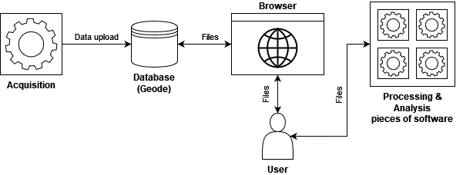

1. Introduction
Software X format
Software Y format
4 November 2022
Przemyslaw LEWANDOWSKI | SurveyPad, a common interface to GEODE & data processing tools
3
Notes:
3

Slide 4
2. Objectives
One simple single interface
Facilitation of editing survey project files
Interoperability between any survey software
4 November 2022
Przemyslaw LEWANDOWSKI | SurveyPad, a common interface to GEODE & data processing tools
4
Notes:
4

Slide 5
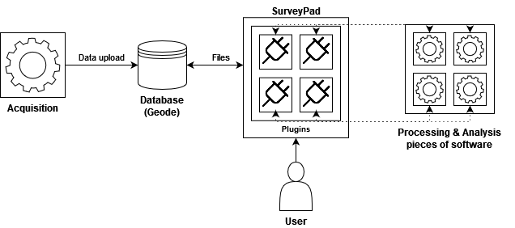
3. Architecture
4 November 2022
Przemyslaw LEWANDOWSKI | SurveyPad, a common interface to GEODE & data processing tools
5
Notes:
5

Slide 6
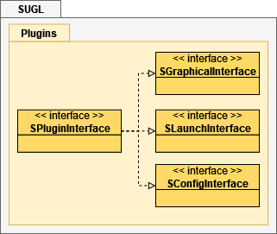

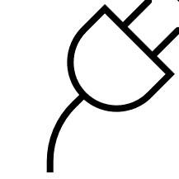
3. Architecture
Plugin
==
4 November 2022
Przemyslaw LEWANDOWSKI | SurveyPad, a common interface to GEODE & data processing tools
6
Notes:
6

Slide 7
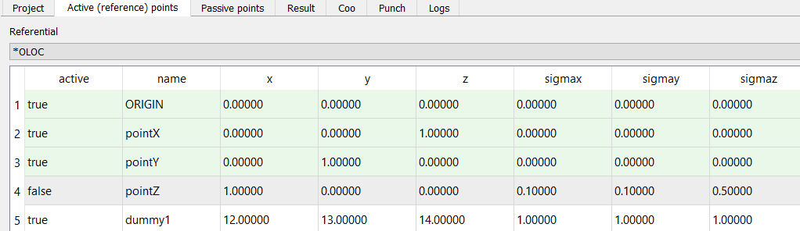
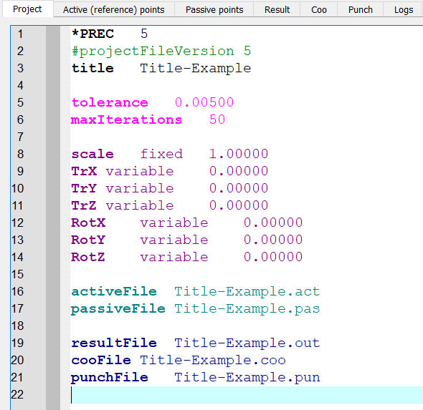
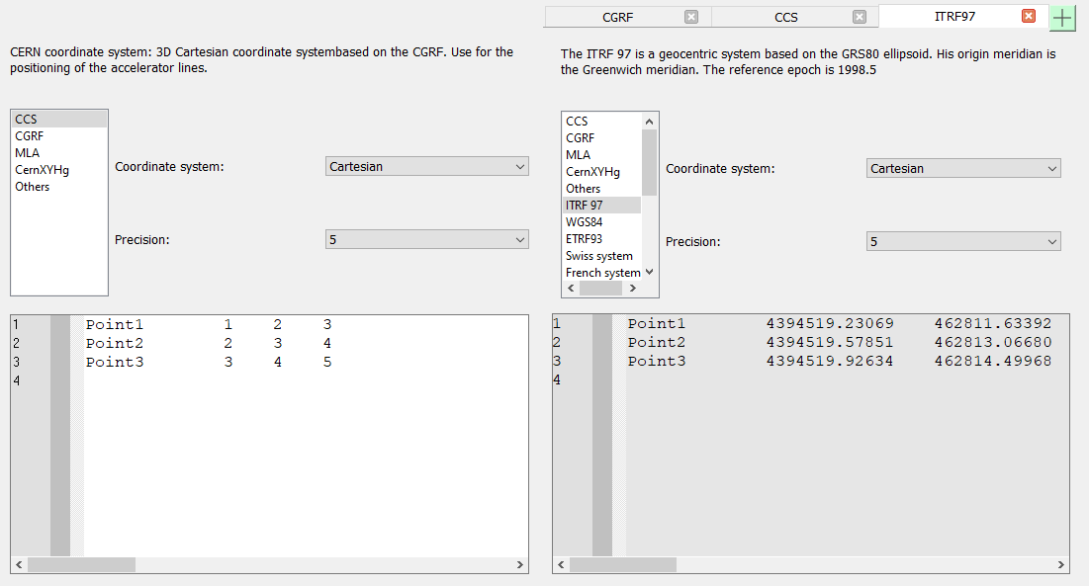
3. Architecture
4 November 2022
Przemyslaw LEWANDOWSKI | SurveyPad, a common interface to GEODE & data processing tools
7
Notes:
7

Slide 8
3. Architecture
SurveyPad
  Plugin loading and project management.
  Handling general settings and the ones specific to plugins.
  Displaying the graphical interface provided by a plugin.
  Logs handling and display.
4 November 2022
Przemyslaw LEWANDOWSKI | SurveyPad, a common interface to GEODE & data processing tools
8
Notes:
8

Slide 9



3. Architecture
Implementation
4 November 2022
Przemyslaw LEWANDOWSKI | SurveyPad, a common interface to GEODE & data processing tools
9
Notes:
9

Slide 10
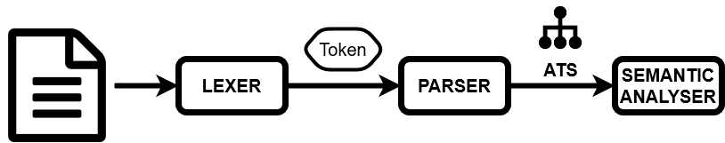
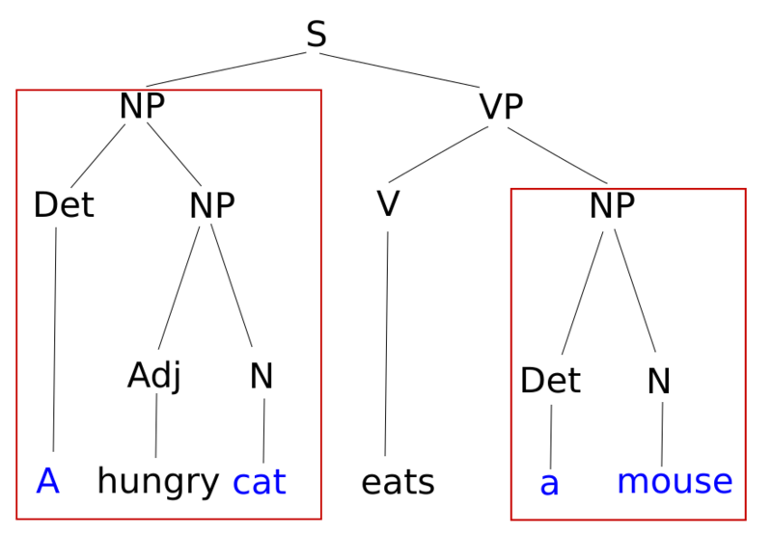
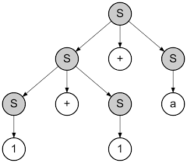
4. Parsers and grammars
S → S + S
S → 1
S → a
4 November 2022
Przemyslaw LEWANDOWSKI | SurveyPad, a common interface to GEODE & data processing tools
10
Notes:
10

Slide 11
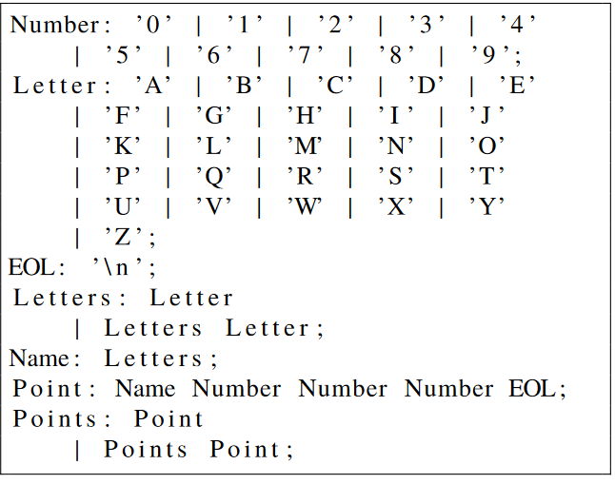
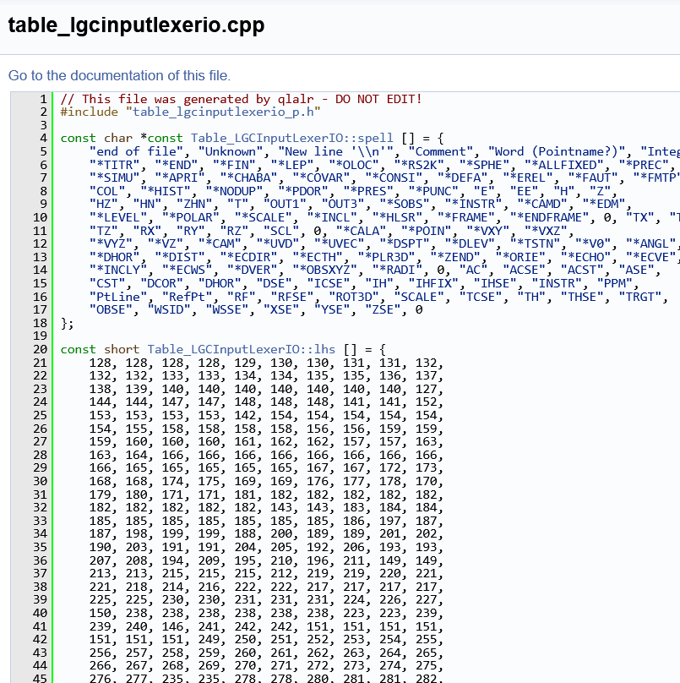
4. Parsers and grammars
FIRSTPOINT 1 2 3
SECONDPOINT 2 3 4
4 November 2022
Przemyslaw LEWANDOWSKI | SurveyPad, a common interface to GEODE & data processing tools
11
Notes:
11

Slide 12
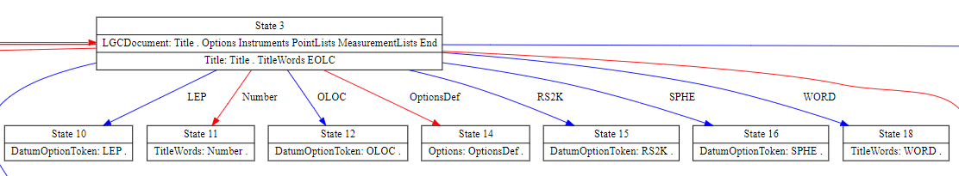
4. Parsers and grammars
4 November 2022
Przemyslaw LEWANDOWSKI | SurveyPad, a common interface to GEODE & data processing tools
12
Notes:
12

Slide 13
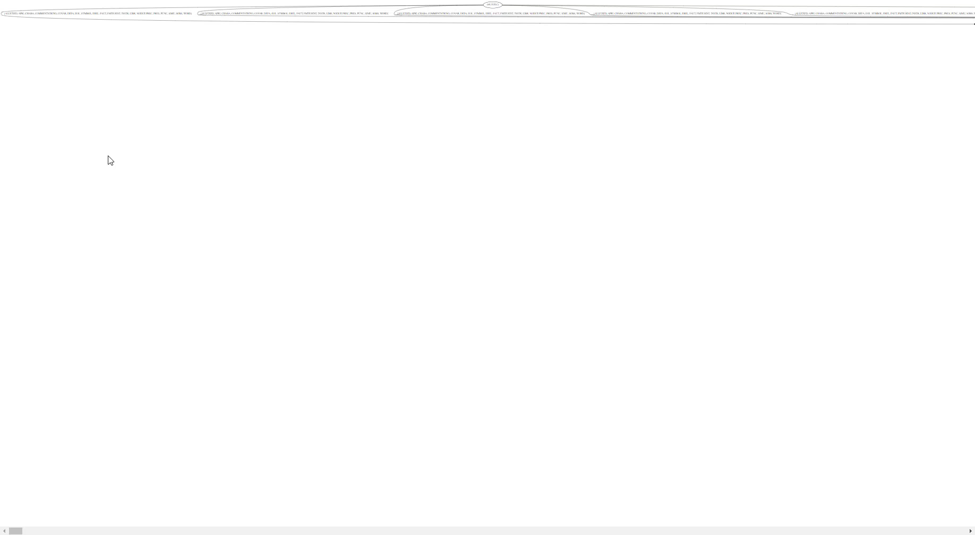
4. Parsers and grammars
4 November 2022
Przemyslaw LEWANDOWSKI | SurveyPad, a common interface to GEODE & data processing tools
13
Notes:
13

Slide 14
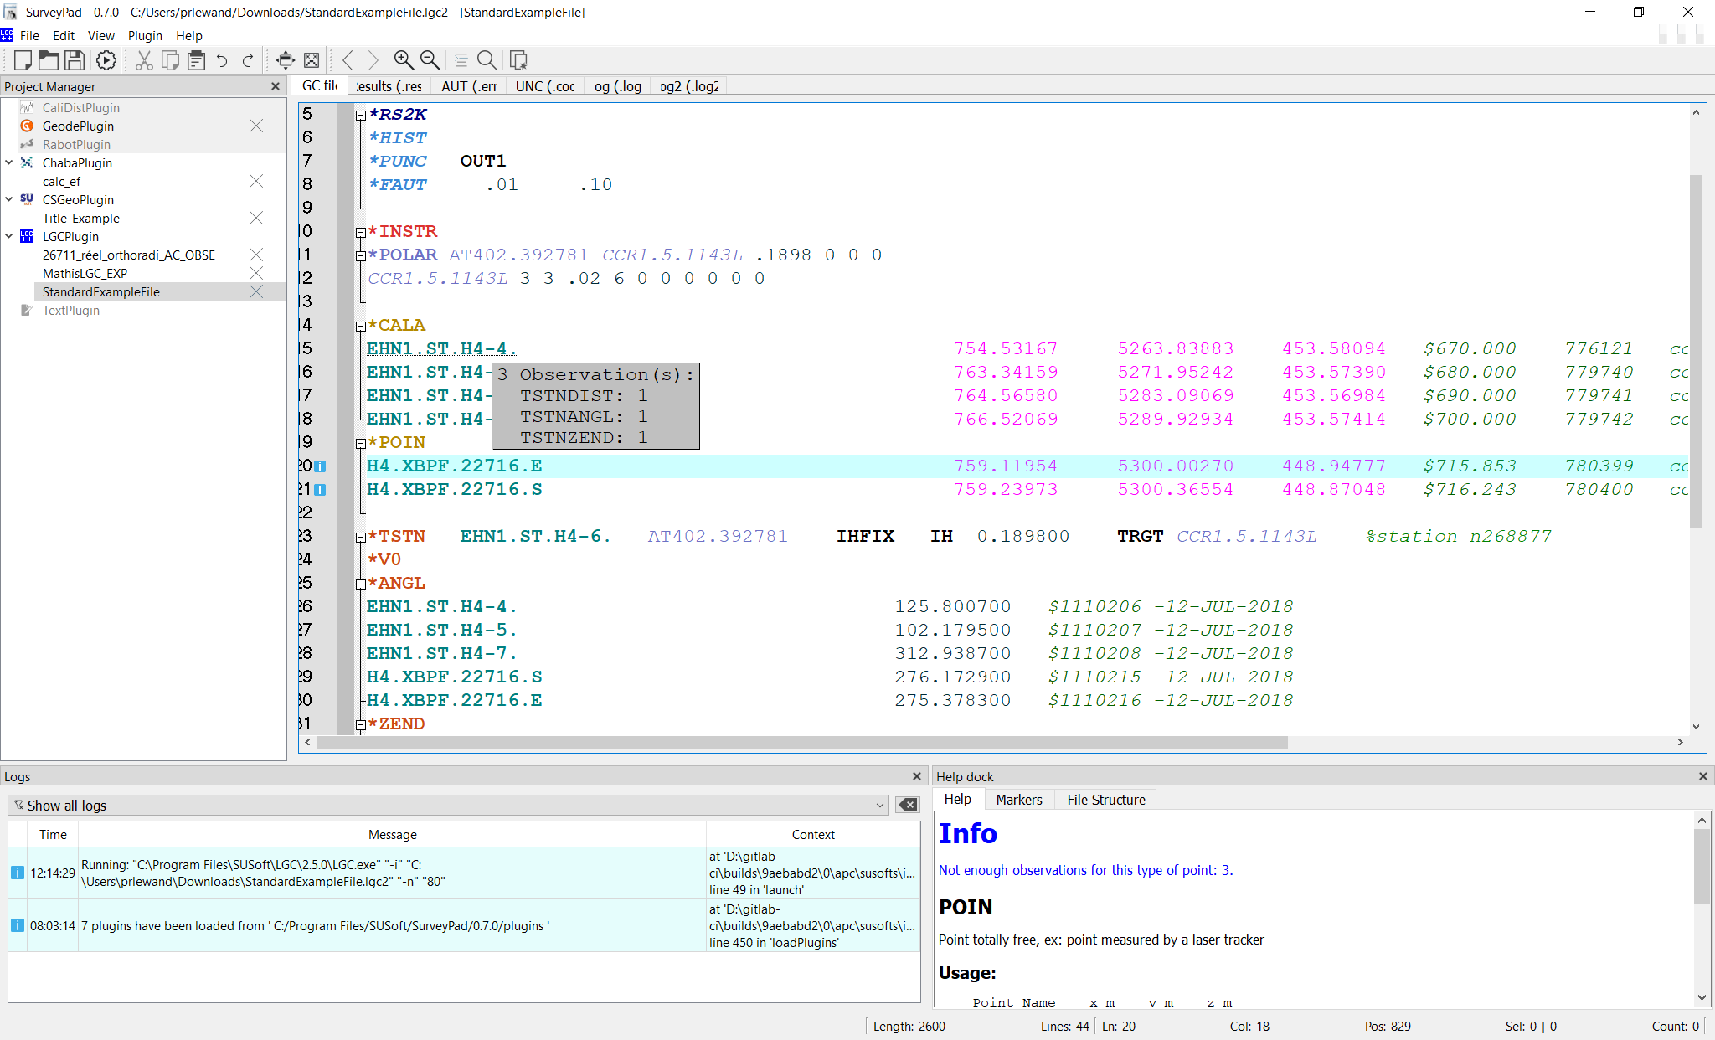
5. Features
4 November 2022
Przemyslaw LEWANDOWSKI | SurveyPad, a common interface to GEODE & data processing tools
14
Notes:
14

Slide 15
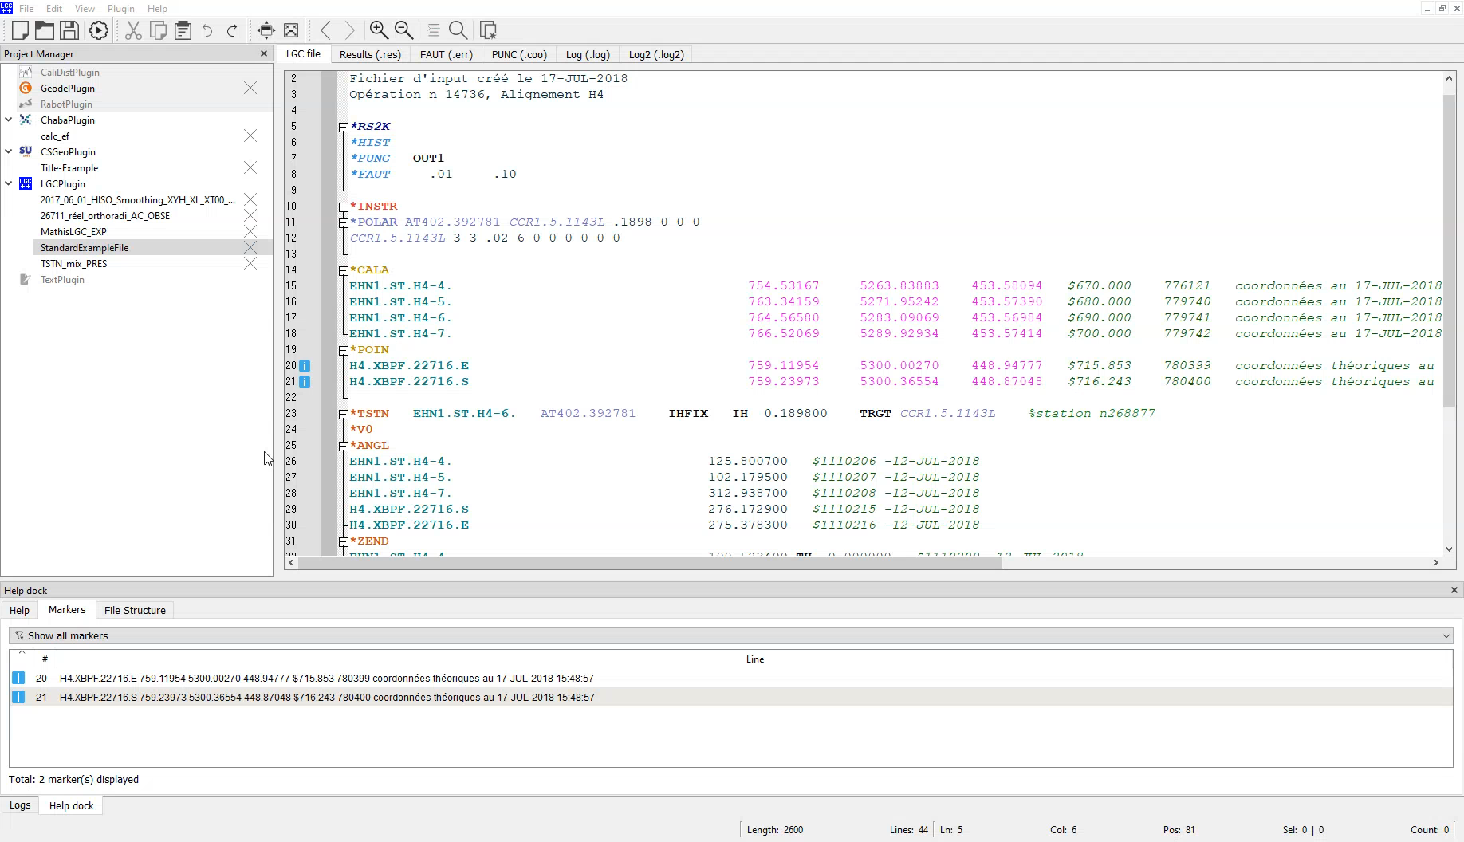
5. Features
4 November 2022
Przemyslaw LEWANDOWSKI | SurveyPad, a common interface to GEODE & data processing tools
15
Notes:
15

Slide 16
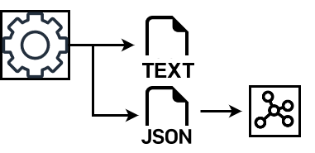
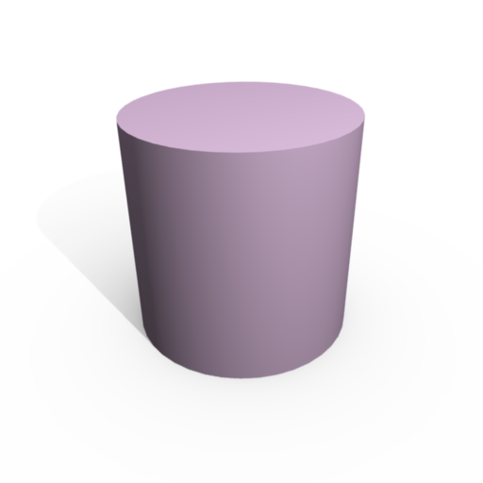
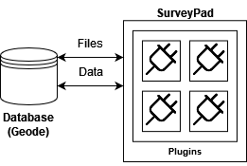
6. Future prospects
Processing software data serialization
2D/3D data visualization
Direct web communication with GEODE
4 November 2022
Przemyslaw LEWANDOWSKI | SurveyPad, a common interface to GEODE & data processing tools
16
Notes:
16

Slide 17
7. Conclusions
Well-designed, easy to maintain software
Simplified surveyor data analysis workflow with advanced editing features
Positive feedback for 7 developed plugins
More things to come
4 November 2022
Przemyslaw LEWANDOWSKI | SurveyPad, a common interface to GEODE & data processing tools
17
Notes:
17

Slide 18
Thank you
Notes:
18

Slide 19
Notes:
19

