Slide 1
Alignment activities for the LCLS-II project at SLAC
IWAA2022 – CERN, November 2022
Georg Gassner
Michael Gaydosh

Slide 2
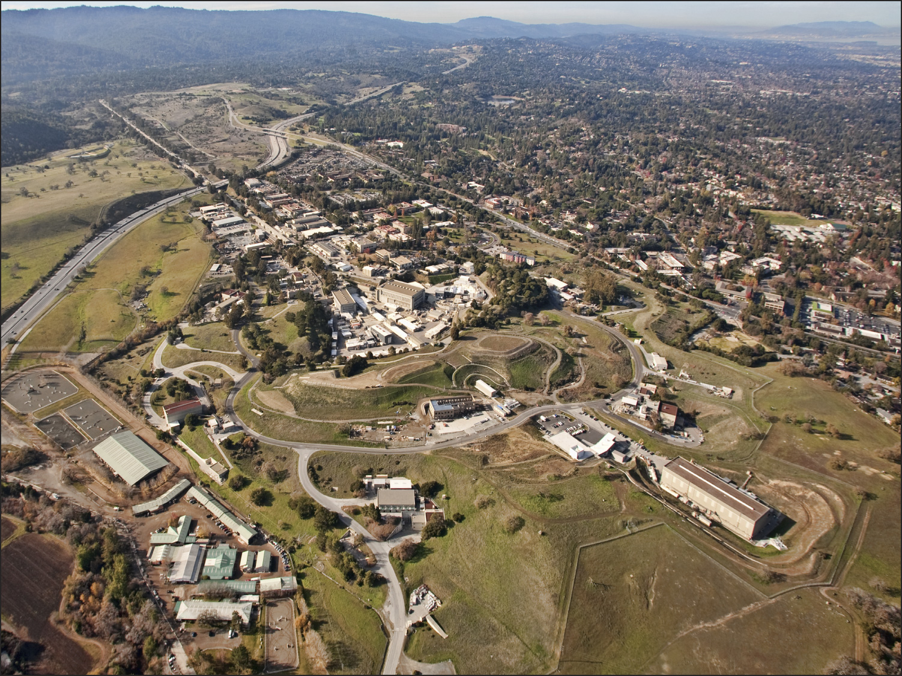

Remove SLAC
Linac from
Sectors 0-10
New Injector and
New Superconducting Linac
LCLS-II
New Cryoplant
Existing Bypass Line
New Transport Line
Two New Undulators
And X-Ray Transport
Exploit Existing Experimental Stations

Slide 3
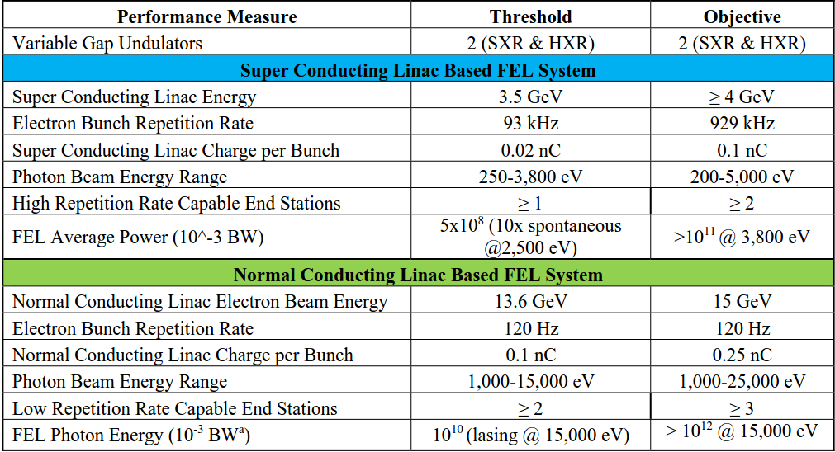
LCLSII
LCLS-II adds a 4 GeV SC linac to the first kilometer of the SLAC linac tunnel.
The copper linac in that region will be removed
The new beam will run CW at up to 1 MHz
The LCLS-I linac is not altered, retains performance
The new beam can be directed at either of two new undulators
The LCLS-I beam can be directed to the new Hard X-ray Undulator
Key Performance
Parameters for
LCLS-II:

Slide 4
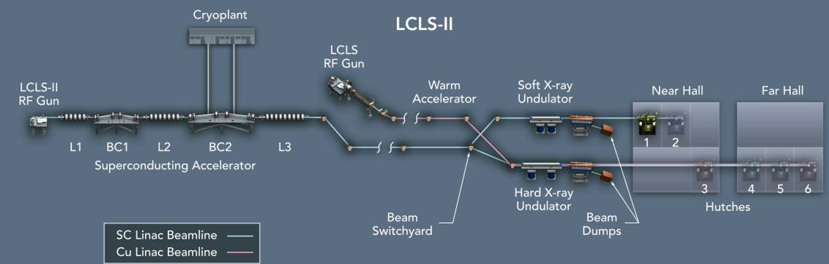
Alignment Activities
Aligned 2km bypass
Aligned x-ray
Distribution and
Experimental stations
Aligned cold beamline
Aligned 50 undulators

Slide 5
Alignment Network S0-S30 – Layout
S0-S10 no longer has a light pipe and bypass lines are not tied to girders -> Monument based network
Opposing wall monuments to mitigate effect of refraction.
Transferred light pipe information to monument network
3km
3.3m
Cryomodule
Wall Monument
Floor Monument
12m

Slide 6
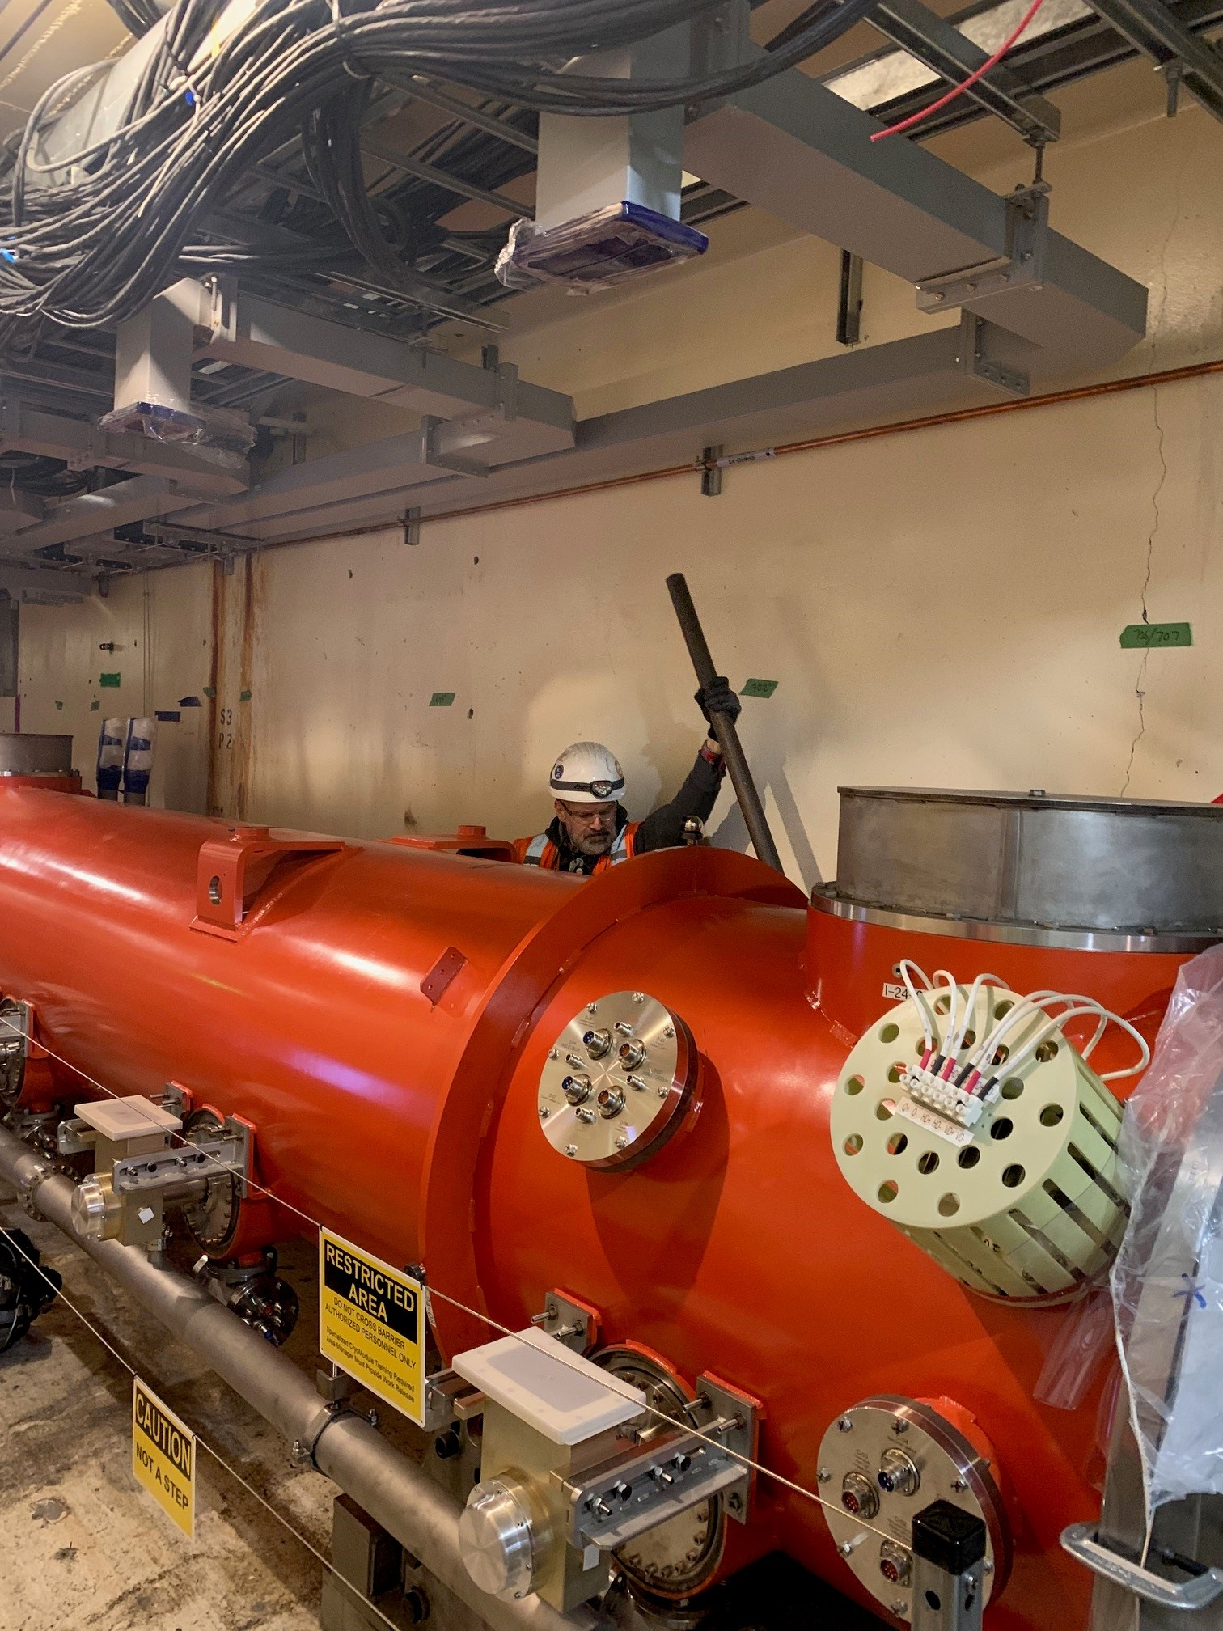
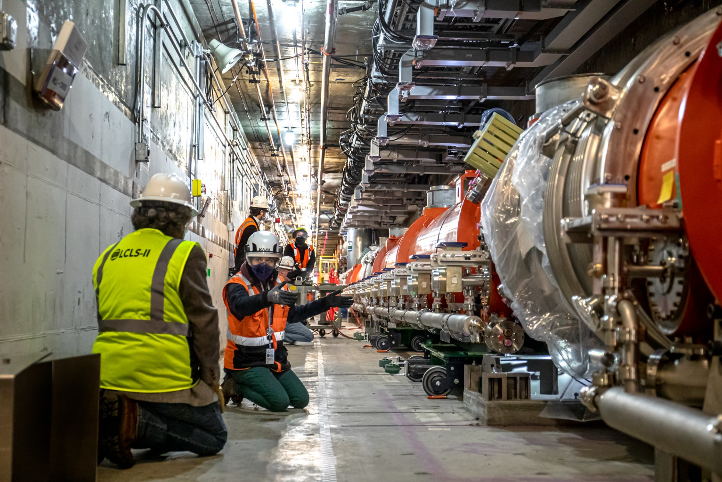
Cryomodule Alignment
After receiving inspection by mapping all fiducials on the inside and outside, the Cryomodules were transported into the tunnel and aligned relative to monument network.

Slide 7
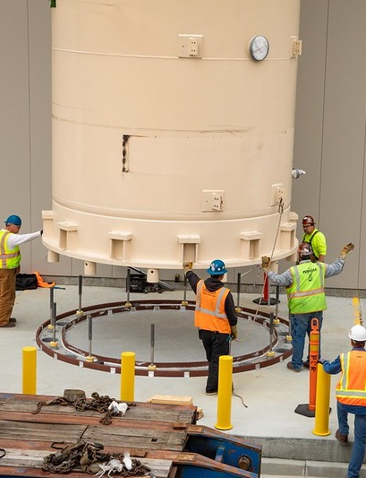
Cryoplant
Mapped anchor locations on devices at vendors and marked location at SLAC.
Delivery straight to installation site.
High consequence work, no issues.

Slide 8
Alignment Activities – Linac Middle
Re-alignment of existing bypass
Alignment of spreader area

Slide 9
Linac Middle - BTH
Re-alignment of the old bypass line.
New spreader area with up to 5 beamlines in a 3.3m x 3m tunnel.
Newly designed dump area with “coffin” design that allows swap of dump without alignment personal at the dump.
New SXR beamline through the LTU (Linac to Undulator)

Slide 10
Alignment Activities – Undulator Hall
Support production of undulators
Alignment of 50 new undulator on two beamlines

Slide 11
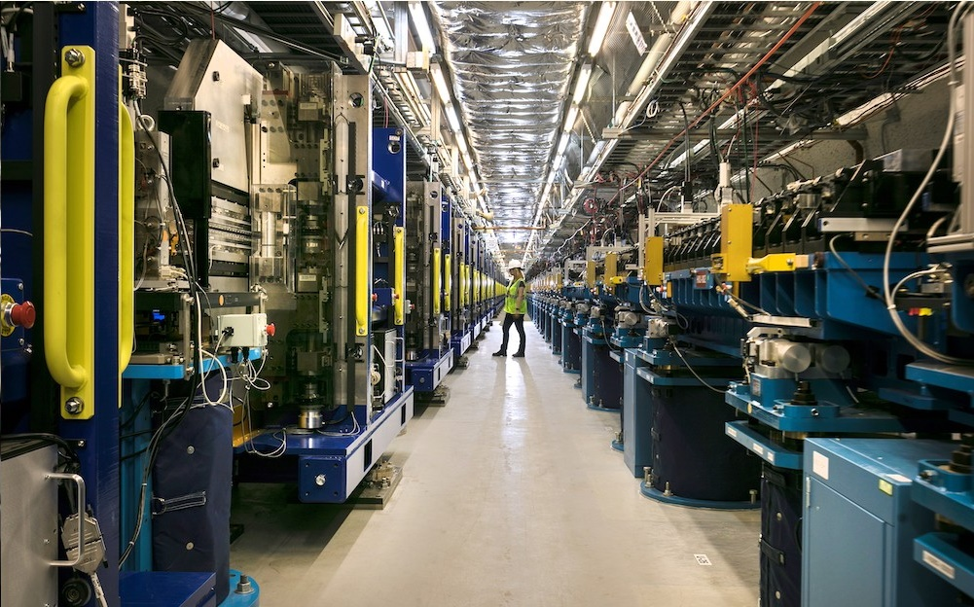
Undulator alignment

Slide 12
Alignment Network Undulator Hall
Before removal of the LCLS undulators we re-measured the alignment network in the undulator hall.
The walls move by about 100µm/year.
The quadrupoles were aligned with beam-based alignment to micrometer accuracy.
Mapping all the quadrupoles allowed us to correct our alignment network.

Slide 13
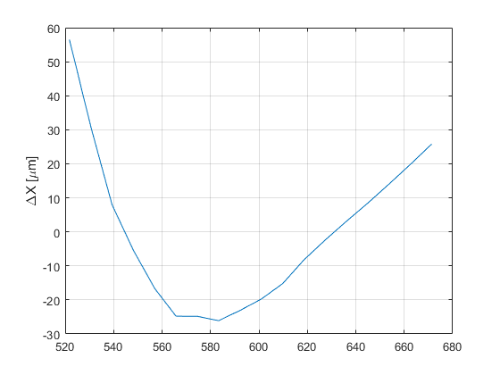
Alignment Network
Comparing the free net adjustment to the adjustment with the quadrupole locations fixed (weighted +/- 50µm).

Slide 14
Alignment Activities – Experimental Hutches
Floor stability
measurements

Slide 15
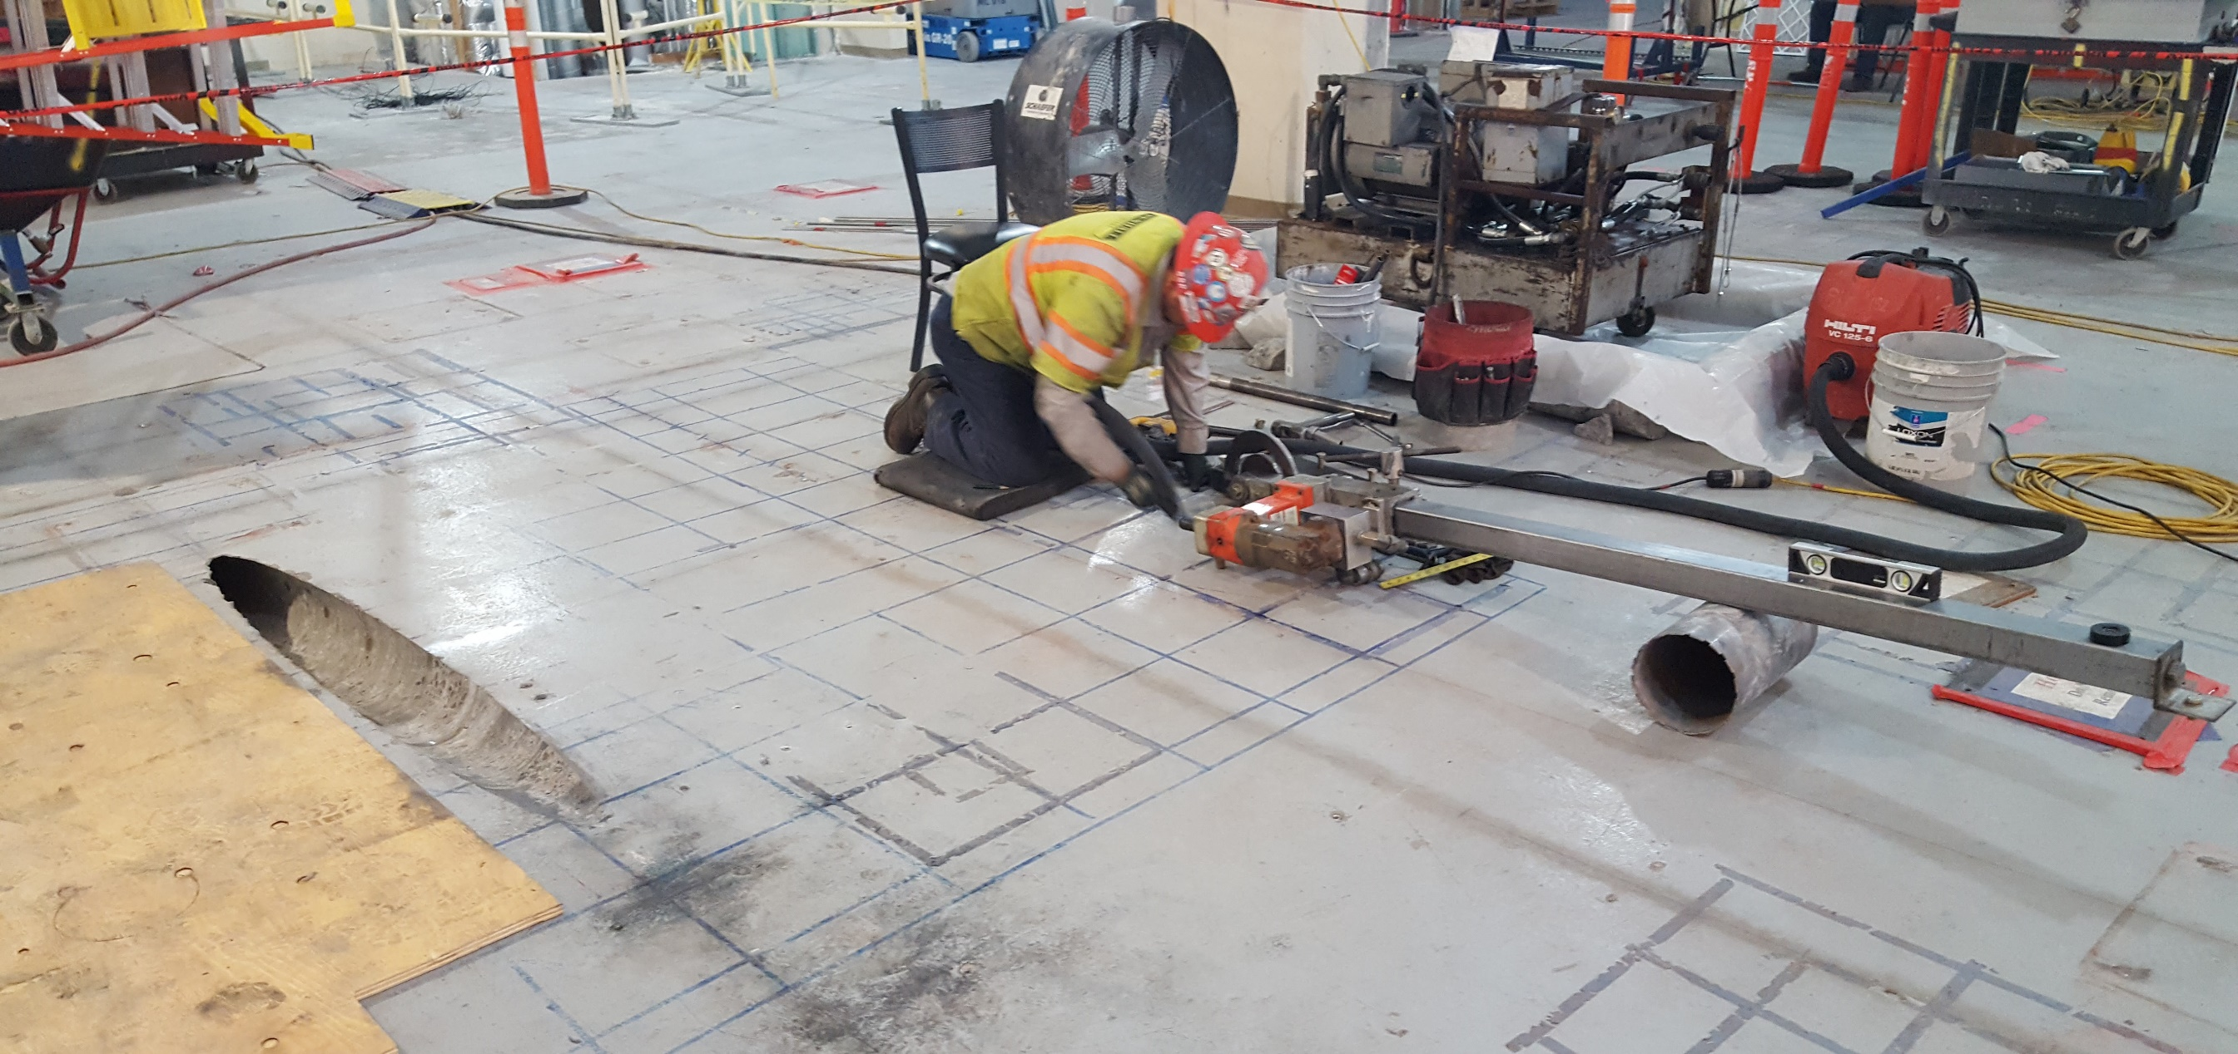
Concrete drilling
Scope to align core drill on 1st floor to point at mirror on 2nd floor. Drilling through 90cm concrete at a 7 deg angle.

Slide 16
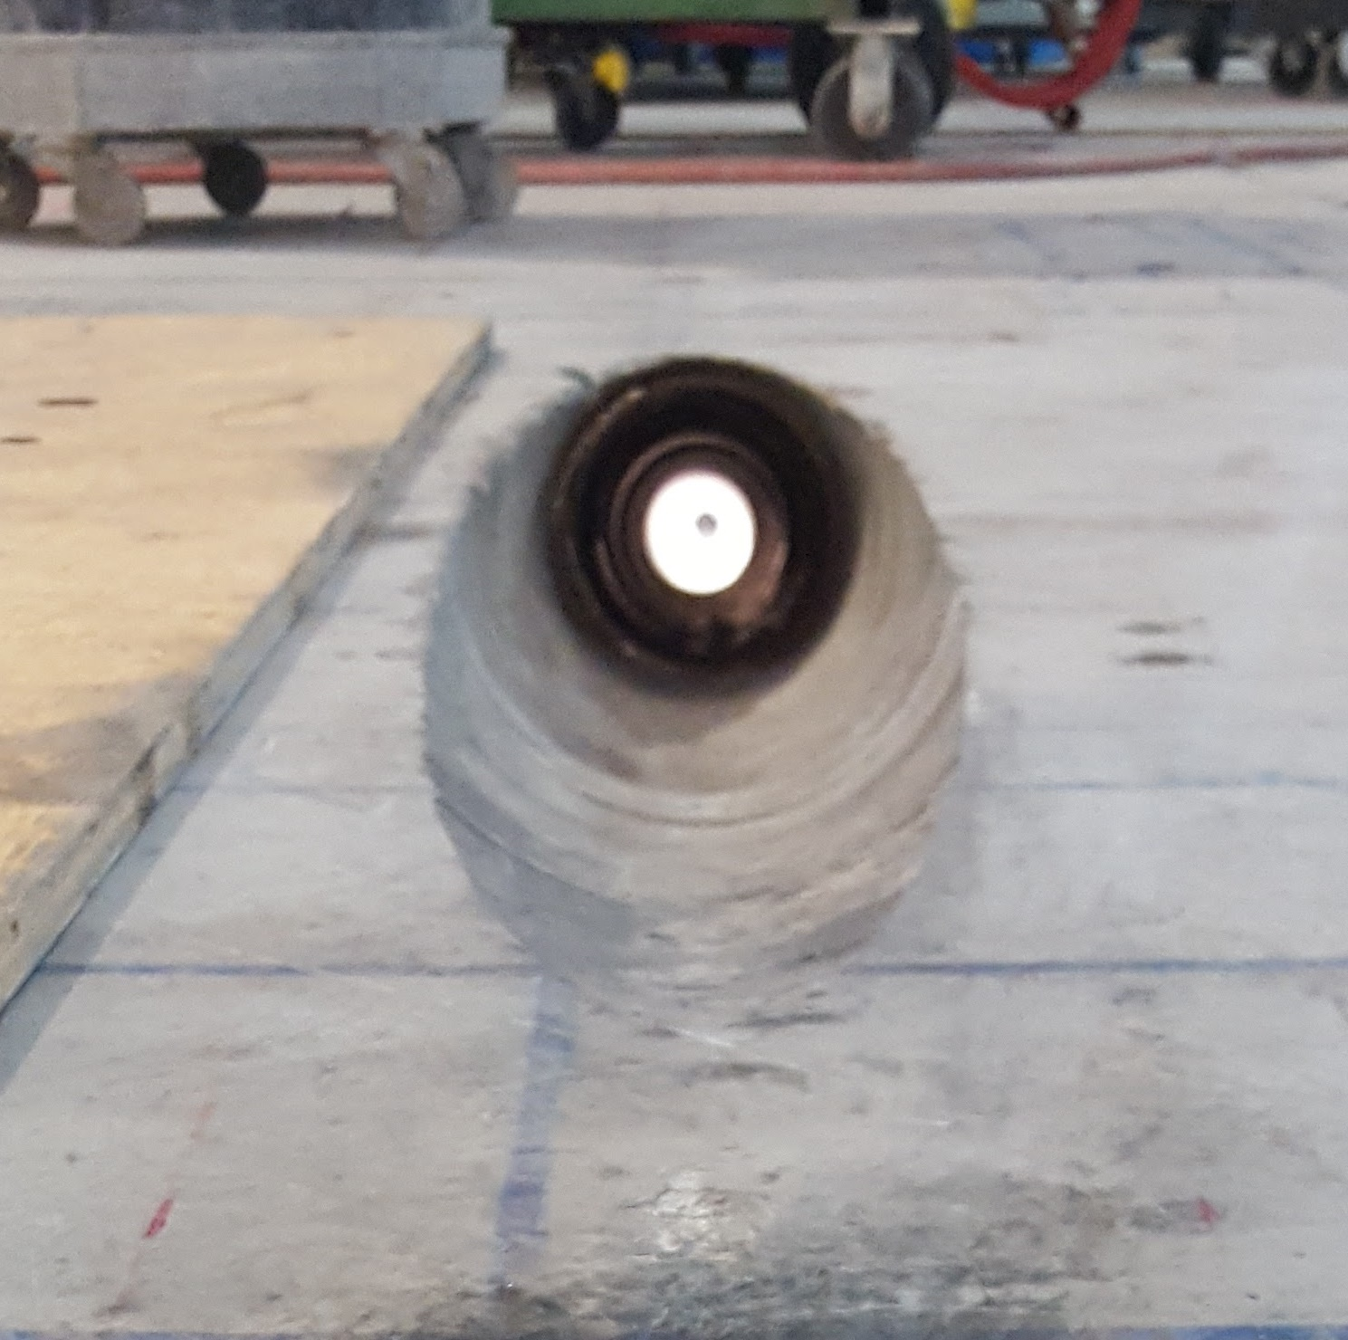
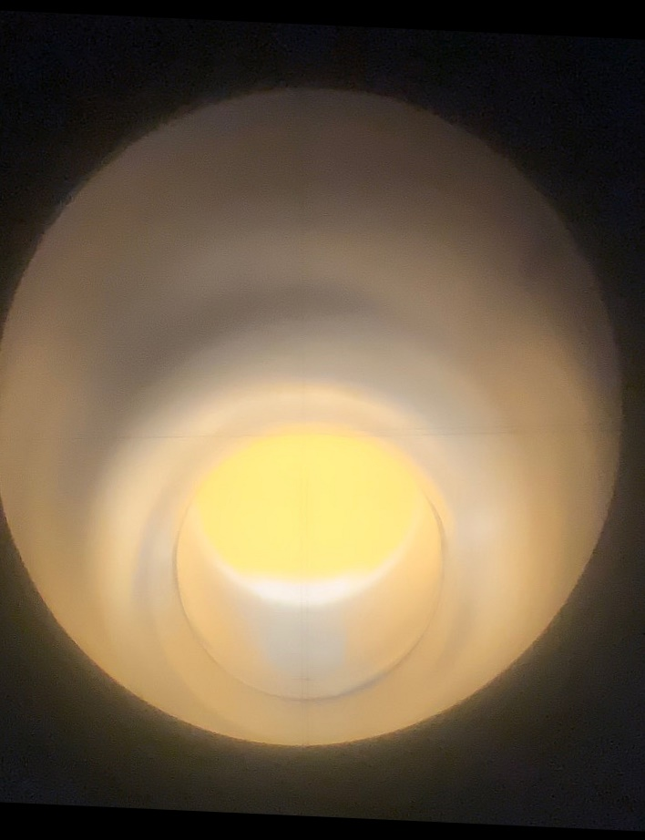
Concrete Drilling

Slide 17
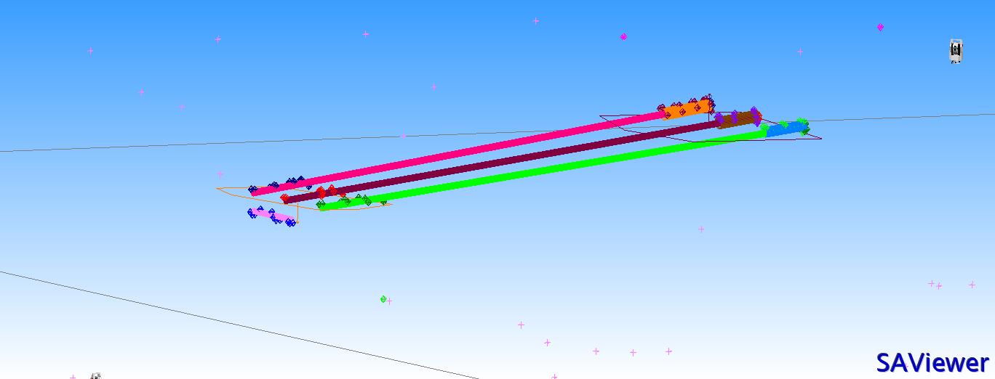
Concrete Drilling
Max. ΔVertical: 27mm
Max. ΔHorizontal: 6mm

Slide 18
Mirror Alignment
Laser Tracker (Leica AT403) is used to align the roll on vertically reflecting mirror by direct measurement through window (optical grade window)
For vertically reflecting mirror we use an Autocollimator (Moeller Wedel Elcomat 3000) with a calibrated Pentaprism.
Estimated accuracy is below 10µrad.

Slide 19
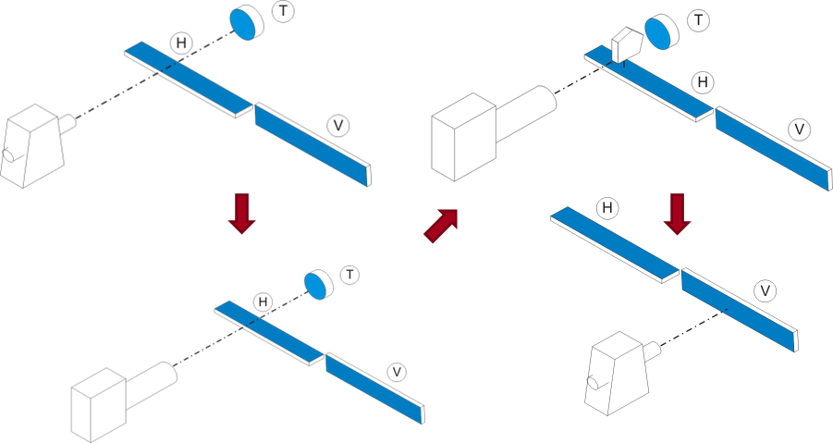
Mirror Alignment
Autocollimator
Laser Tracker
Autocollimator
Laser Tracker

Slide 20
Experimental Halls
Aligned Front End Enclosure, mirrors to steer the x-ray beam to the different experimental hutches.
3 new Experimental Hutches for Soft X-Ray Experiments.
This included the alignment of 20 mirrors.

Slide 21
Summary
Alignment of LCLSII project has been mostly completed.
We aligned over 5km of beam line
Marked around 6000 anchors
Checked and aligned 37 Cryomodules
Fiducialized and aligned 50 undulators
Aligned 20 mirrors
So far everything was aligned correctly.

