Slide 1
Status CTF3 committee 9/2010
DL only beam sent through – no combination
out of 12A in CR (x4), 10A get to TBL/TBTS PETS
up to 70MW with recirculation in TBTS PETS
3 MeV acceleration of probe beam
since then
focus on x8 combination (DL+CR)
maximize power production
maximize probe beam acceleration
1 week stop during International Linear Collider Workshop

Slide 2
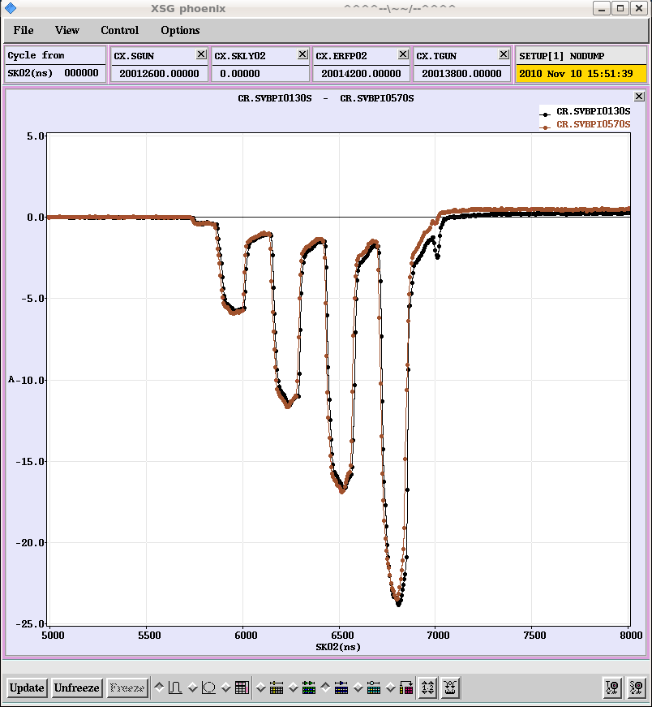
Factor 8 combination (DL+CR)
Combination well optimized in operation
transmission
closure
path length
=> record current this year (MKS13 off)

Slide 3
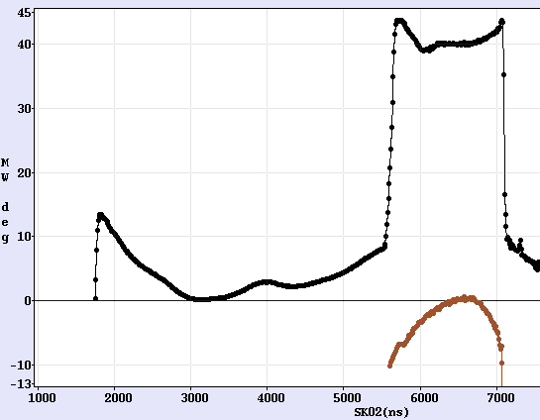
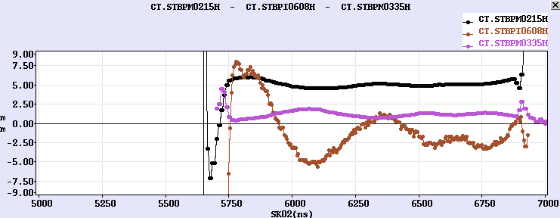
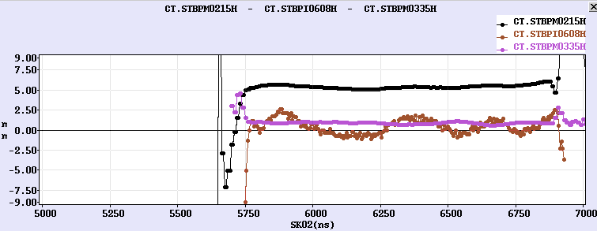
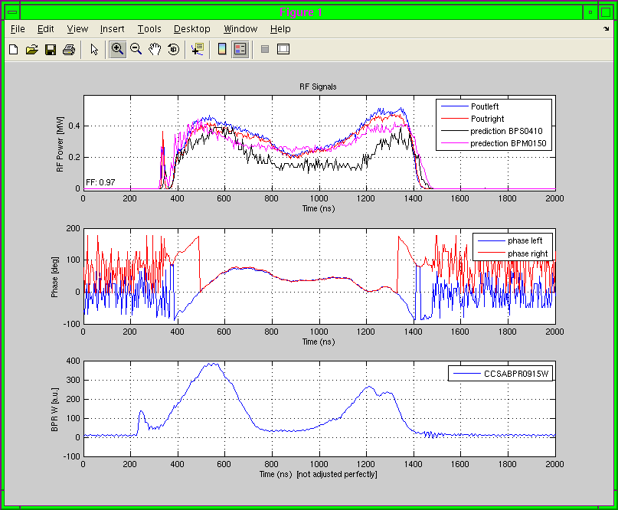
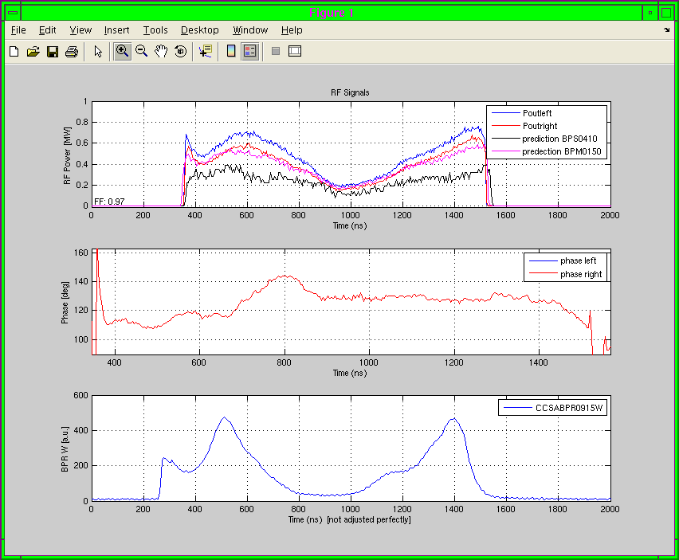
12 GHz bunch phase studies
For 12 GHz power production, bunch phase along the pulse crucial
=> need stable beam energy, klystron phases, beam current
DL, CR ring length, orbit, closure carefully optimized
used RF pulse compression to minimize ∆E/E after the linac =>
D₀₆₀₈=0.61m => 13mm = ~2% to ~3mm = ~0.5% ∆E/E
detailed studies of bunch phase, variation understood and minimized
=>
12 GHz RF phase
=>
20 deg
100 deg
Erik Adli, Reidar Lillestøl

Slide 4
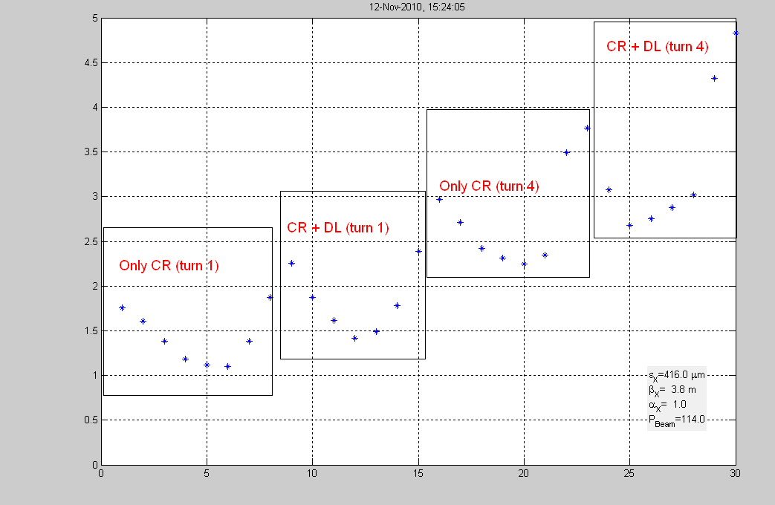
Emittance
measured in H and V for various stages of combination
emittance increase more from CR than from DL
horizontal | CR 1st | DL+CR 1st | CR 4th combined | DL+CR 4th combined
emittance [mm mrad] | 148 | 262 | 532 | 682
beta [m] | 4.8 | 5.0 | 3.7 | 3.6
alpha | 0.9 | 0.9 | 1.0 | 1.2
vertical | CR 1st | DL+CR 1st | CR 4th combined | DL+CR 4th combined
emittance [mm mrad] | 88 | 129 | 152 | 170
beta [m] | 17.2 | 11.0 | 7.3 | 9.9
alpha | -8.1 | -5.1 | -3.1 | -4.3
Simona Bettoni

Slide 5
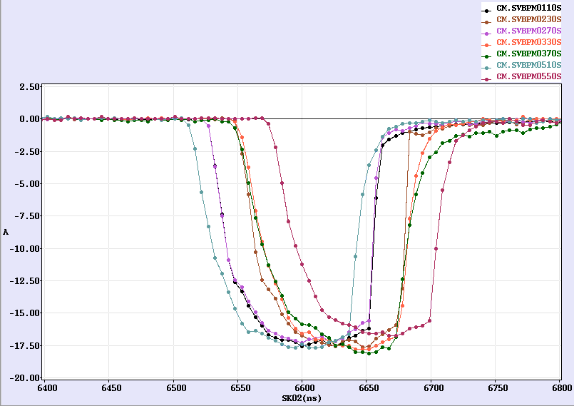
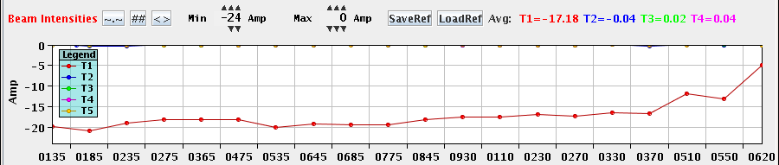
TL2 - TBTS
good transmission also for x8 combined beam from CR
>17A get to TBTS PETS
x8 recombination in CR

Slide 6
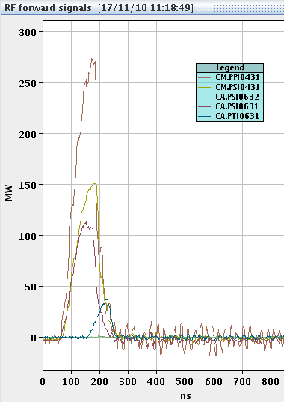
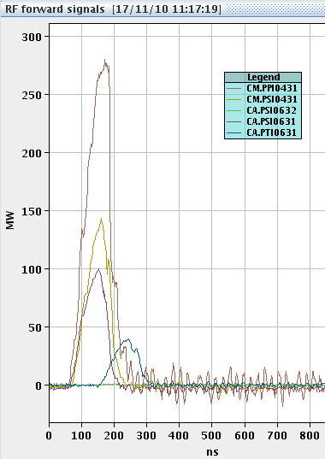
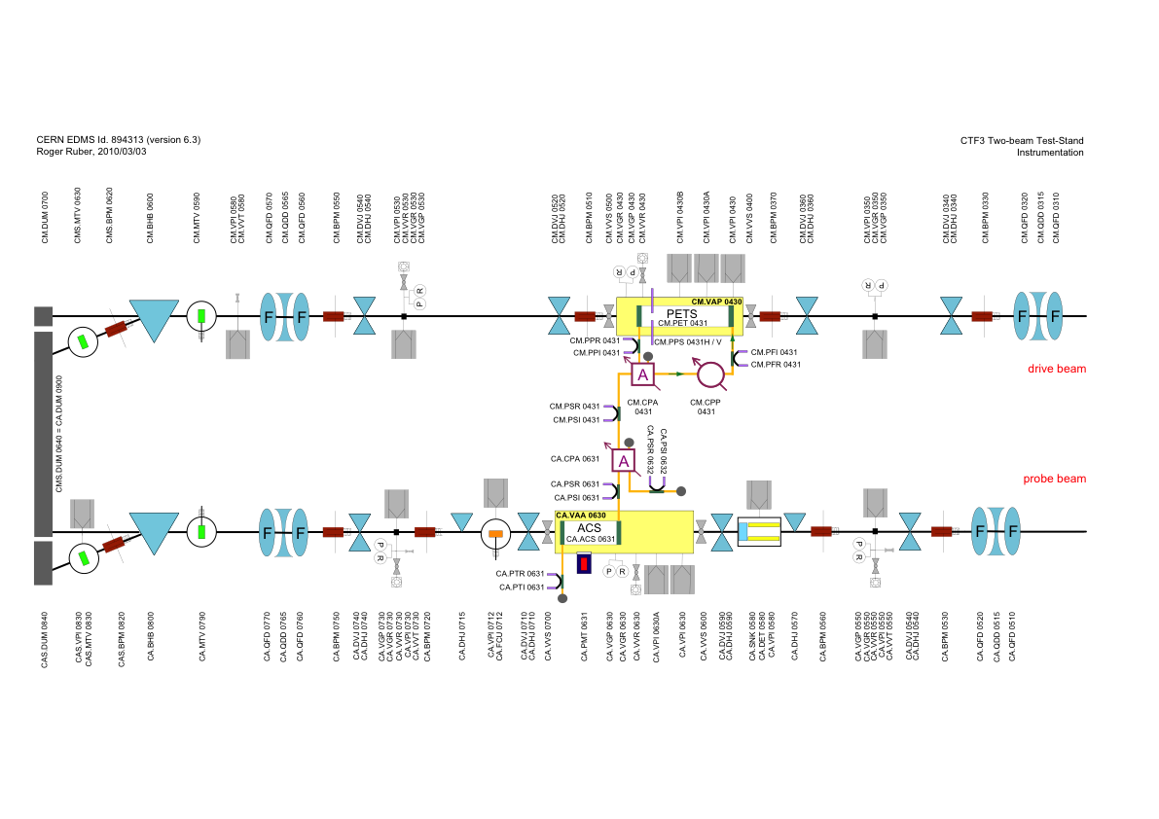
TBTS - PETS
up to >250MW in PETS structure (?)
>100MW to structure (?)
RF calibration verified/corrected
signals internally consistent
deceleration studies suggest overestimation of power measurement

Slide 7
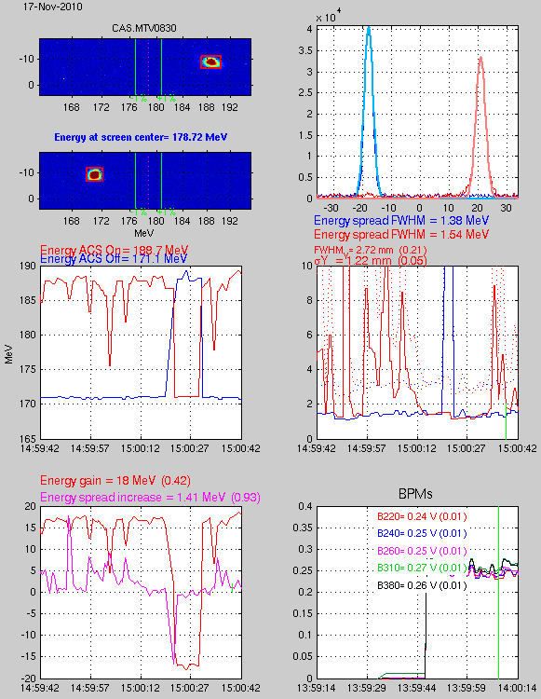
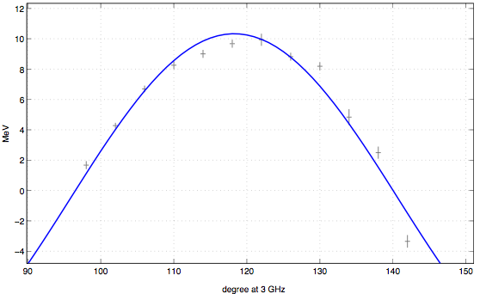
Probe beam acceleration
probe beam acceleration optimized
in time
in phase
up to 18 MeV => gradient ~90 MV/m
Andrea Palaia

Slide 8
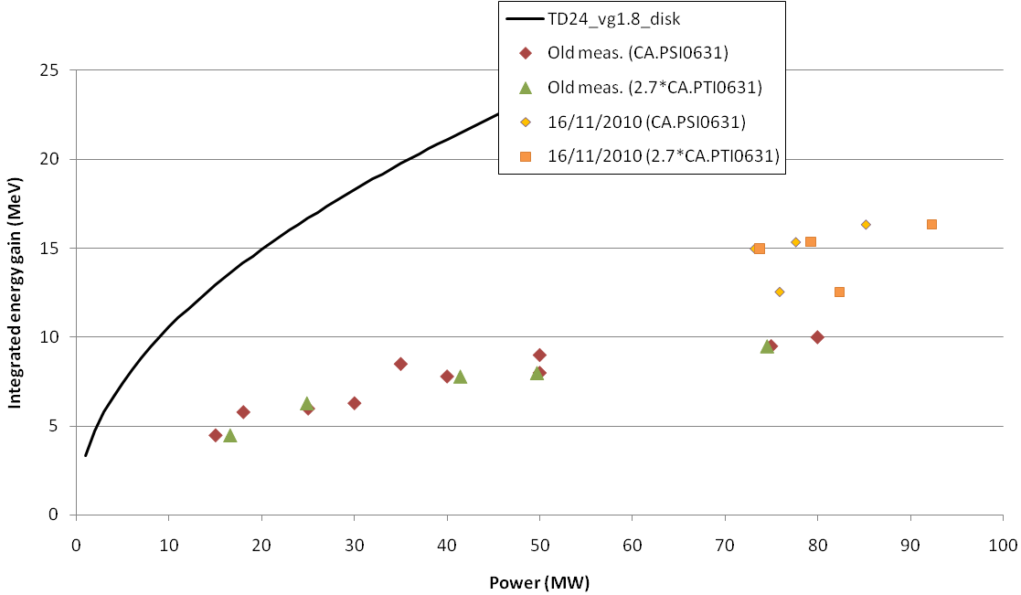
Probe beam acceleration
acceleration less than expected
power calibration, structure frequency, other modes?
connection to 30˚C water
Simona Bettoni

Slide 9
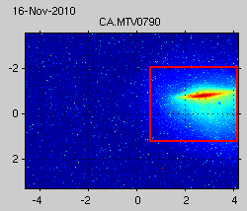
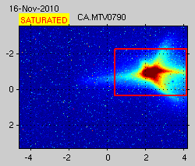
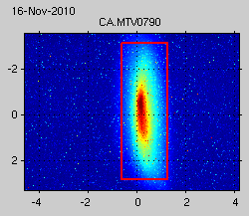
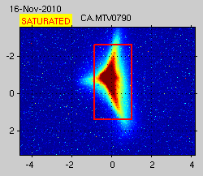
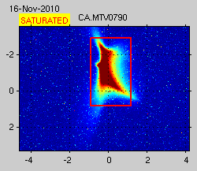
Probe beam acceleration
probe beam changes shape when accelerated (measured on straight screen for different focusing)
without with acceleration

Slide 10
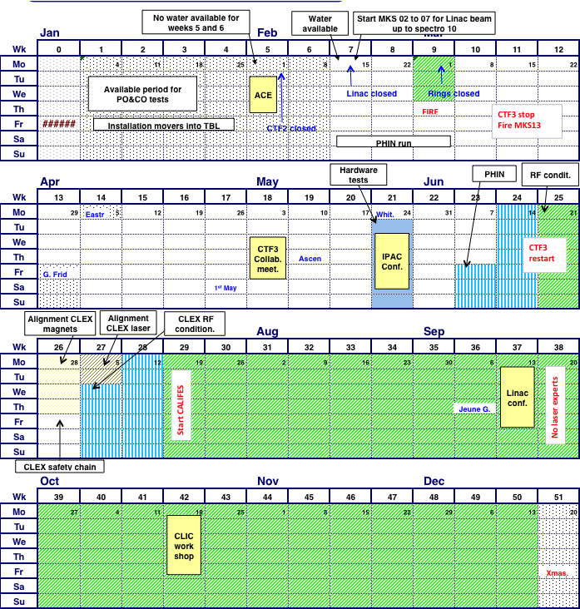
Schedule – restart 31/1/2011
Optics improvements (DL dispersion)
Full transport to CLEX
Bunch length control (first tests)
TBTS initial PETS tests
CALIFES setup
new setup when MKS13 available?
1
2
PETS conditioned to nominal power/pulse length TBL PETS tests
Accelerating structure conditioned to nominal power/pulse length
Two-Beam test
power & energy gain, 100MV/m
3
Beam
1
3
4
TBL studies (limited)
PETS breakdown rate measurements???
2
Measurement of breakdown kicks
Beam Loading compensation experiment
5
1
2
3
Measurement of effect of beam loading on breakdown rate
6
4
5
6
7
Test of new PETS on-off scheme
TBL studies 30% deceleration ?
8
Stability studies & improvements
PETS no recirculation
Phase stability
Operation at 5 Hz (or more)
Control of beam losses
Coherent Diffraction Radiation …
4
installTBL PETS ??
<---->
5
6
2nd TBL PETS installation
6 weeks PHIN
phase-coding
Laser preparation
7
7
8
8

