Slide 1



Optical fiber beam loss monitor by Cerenkov Effect
Angela Intermite
CTF3 Committee Meeting 18/11/2010

Slide 2
Overview
Optical fiber sensor: design and working principle
Photon detector:
- models
- characterization of noise sources
ALICE: first test of the sensor
- results
Future plans
Angela.Intermite@quasar-group.org CTF3 Committee meeting
2/11

Slide 3
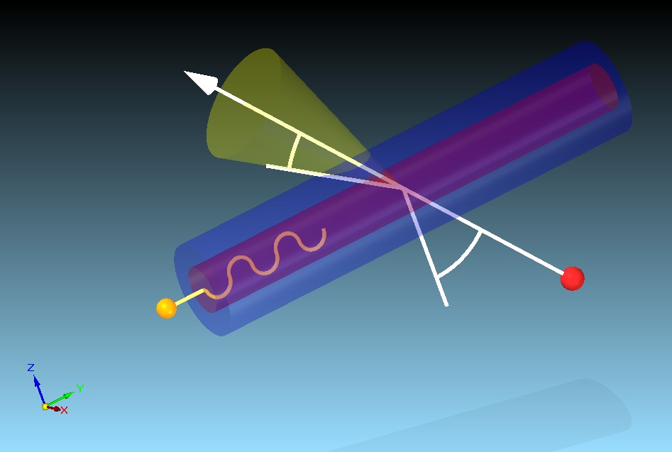
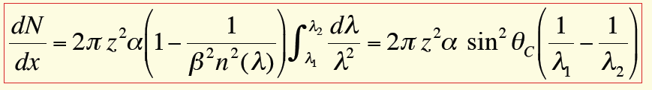
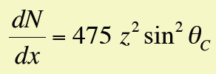
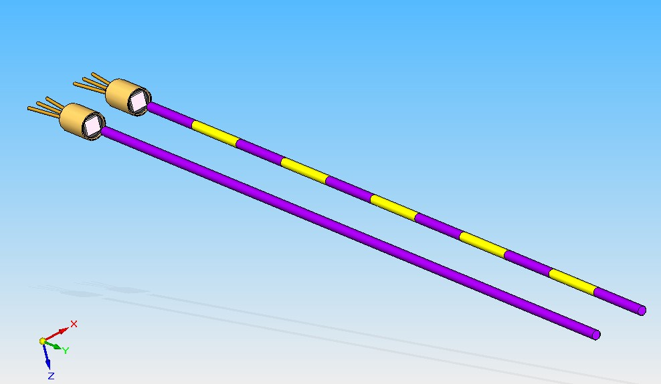
Optical fiber sensor
Cerenkov cone
θ_{C}
α
Fiber core
electron
Cerenkov photon
photons/cm for 350<λ<550 nm
Parameters:
incident angle
geometry of the fibre
kind of particles
threshold energy
SiPMs
Angela.Intermite@quasar-group.org CTF3 Committee meeting
3/11

Slide 4
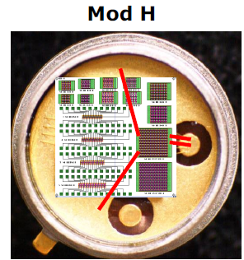
Photon detection: SiPMs
STMicroelectronics (Catania)
Photonique SA-Switzerland
Blue range
Visible range
Active surface 1mm²
Number of cells ~500
Fill factor > 70%
Angela.Intermite@quasar-group.org CTF3 Committee meeting
4/11

Slide 5
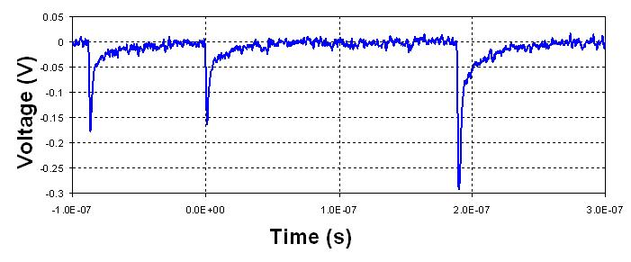
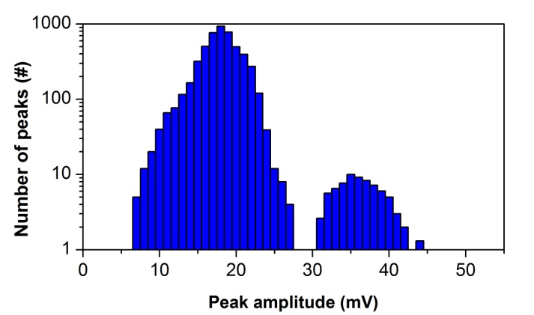
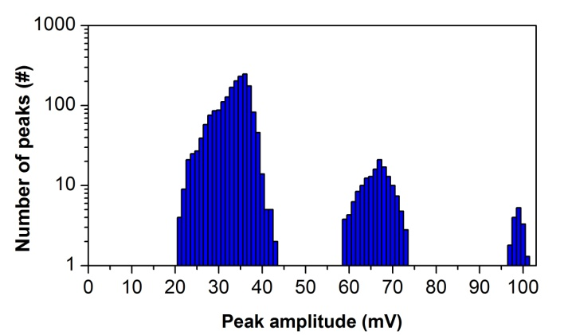
SiPM characterization: noise sources
Typical dark count signal
Optical crosstalk
Dark count rate at room temperature
Angela.Intermite@quasar-group.org CTF3 Committee meeting
5/11

Slide 6
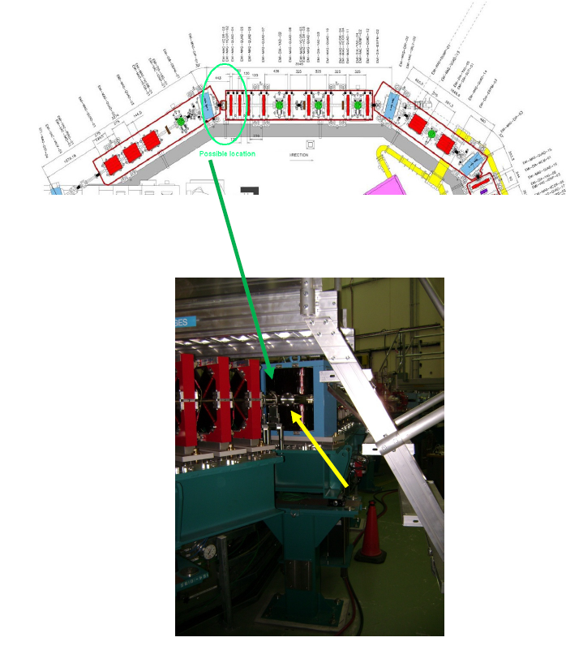
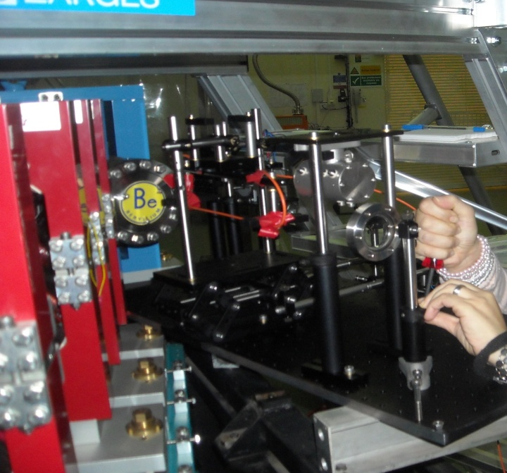
ALICE experiment: first test of the optical fiber sensor
Goals:
Observation of Cerenkov signal
Detector response
Optimization Cerenkov effect as a
function of the fiber angle
Calibration
Sensitivity
Angela.Intermite@quasar-group.org CTF3 Committee meeting
6/11

Slide 7
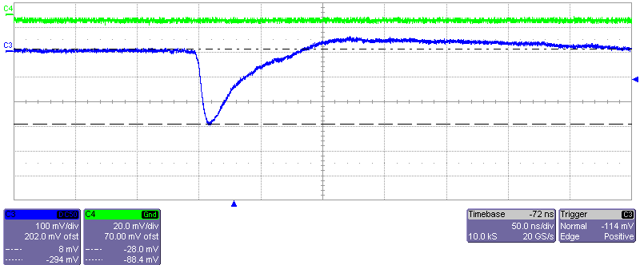
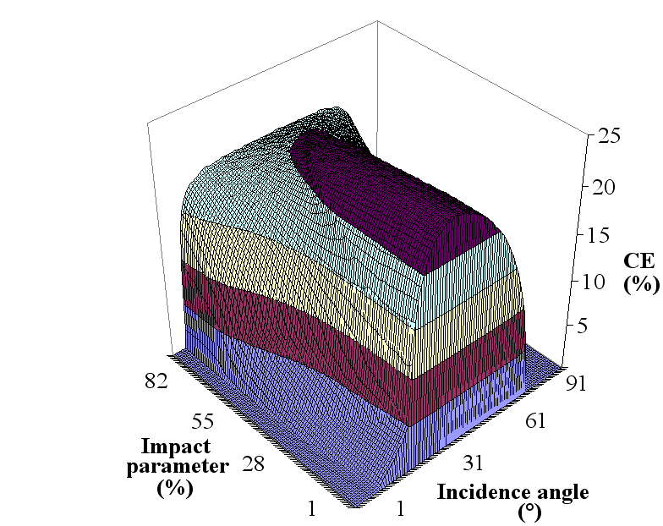
ALICE experiment: results
Cerenkov signal
Optimization of the signal as a function of the fiber properties
Angela.Intermite@quasar-group.org CTF3 Committee meeting
7/11

Slide 8
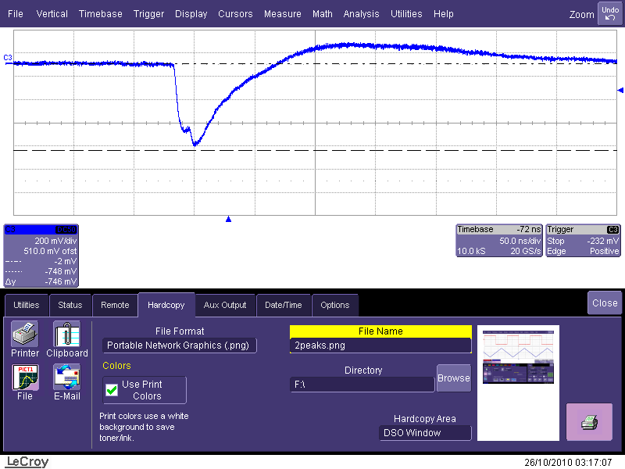
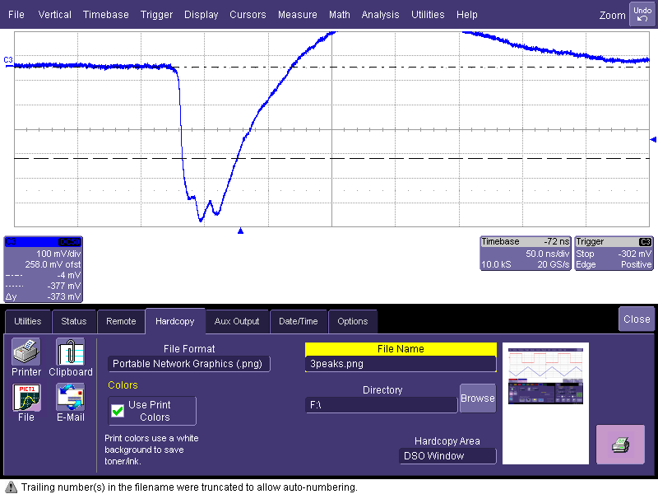
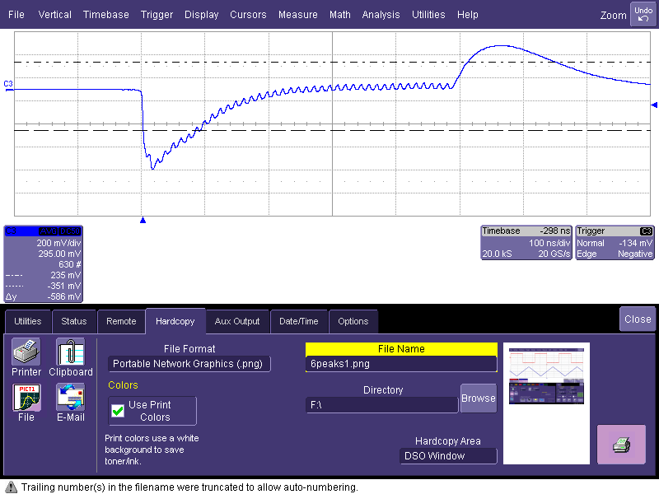
ALICE experiment: detector response
Accelerator parameters:
Energy: 27.5 MeV
# bunches: 1-3-50
Charge for bunch: 63 pC
Bunch separation: 12 ns
Angela.Intermite@quasar-group.org CTF3 Committee meeting
8/11

Slide 9
ALICE experiment: calibration
Accelerator
Sensor
Sensitvity: 100 fC
Angela.Intermite@quasar-group.org CTF3 Committee meeting
9/11

Slide 10
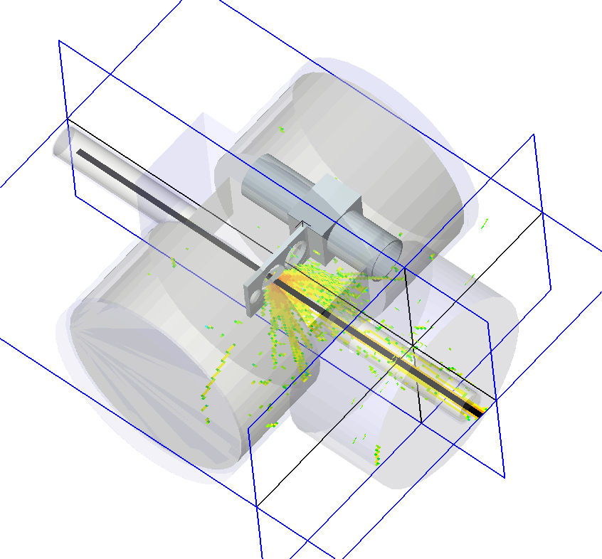
Installation Plans @ CTF3
As soon as possible (depending on fiber availability)
2 fibers placed horizontally around OTR screen
Study detector response
Achievable longitudinal resolution
Attenuation of signal in composite fiber and as
function of dose
Study background signal level
Benchmarking of simulation studies
Identification of different shower particles
First half 2011
2 x 2 fibers horizontally at TBTS
(+ possibility of vertical system at later stage)
Study of 3D losses, cross-talk, etc.
Measurement of losses from two beams
Detect losses at 10⁻⁴ level and benchmark
results from simulations
Provide feedback for machine tuning
Angela.Intermite@quasar-group.org CTF3 Committee meeting
10/11

Slide 11
Thank you for your attention
Angela.Intermite@quasar-group.org CTF3 Committee meeting
11/11

