Slide 1
Update on TBL activities 18.11.2010
Made a lot of progress with beam matching and transport
(managed to transport 17A with 95% transmission)
New power record for TBL, 50 MW produced
Quad-movers routinely used for steering, not automated yet
Intensive campaign to understand BPM calibration and performance with participation from Juanjo and Gabriel
PETS bar production for series going well
Tank production for the series started, first tank being assembled in CERN clean room, material for second tank received and being cleaned to be send to CIEMAT for assembly
Plan to install up to 3 more tanks in winter shutdown
(original plan to install one more tank in November postponed due to delays)

Slide 2
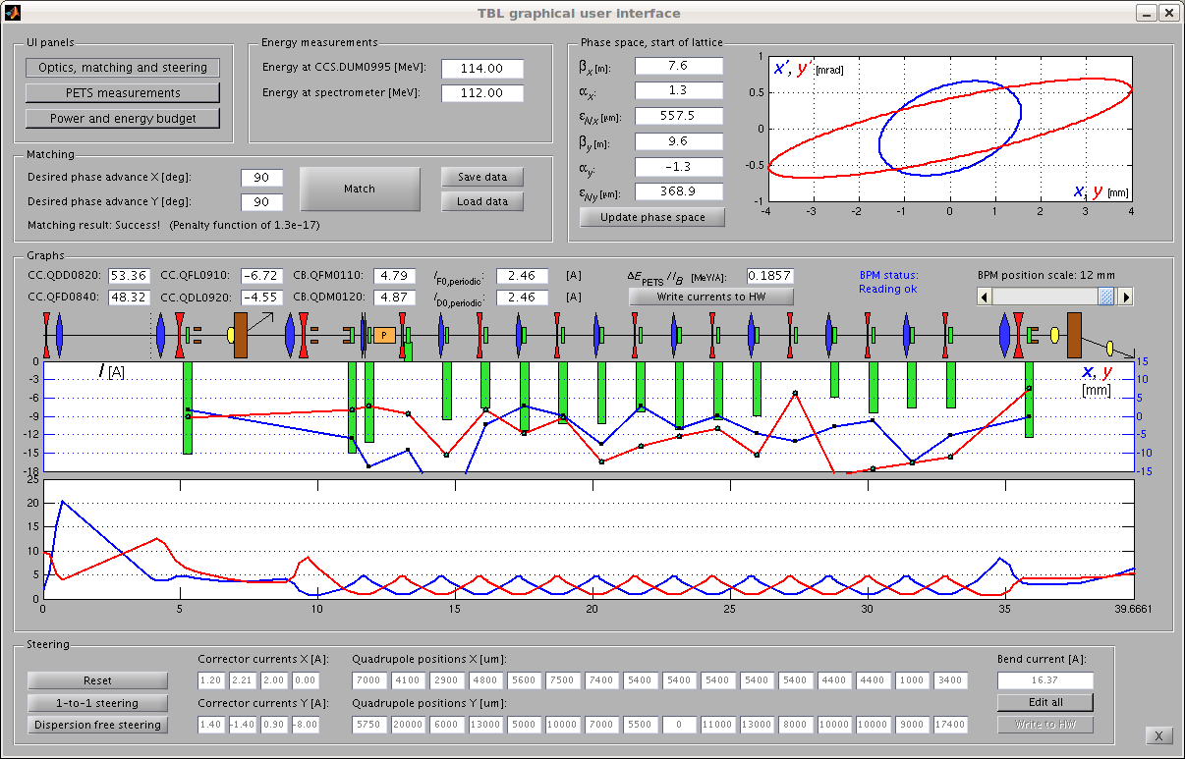
TBL operation experience
Nice tools to ease operation and perform beam matching

Slide 3
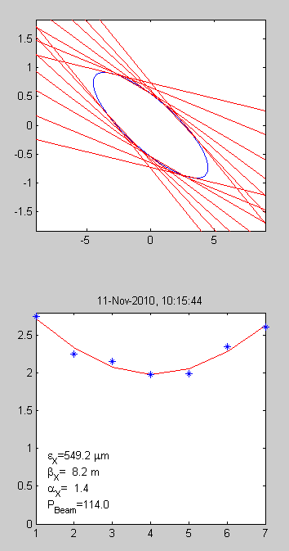
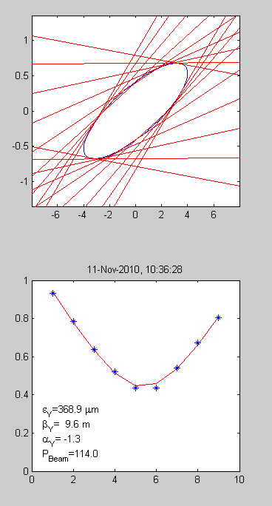
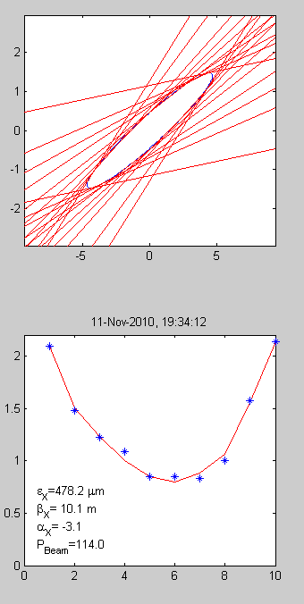
Beam parameter measurements, matching and optics check
Before TBL
After TBL
F0D0 optics seems fine, able to predict beam parameters
Prediction: β=8.4; α= -3.4

Slide 4
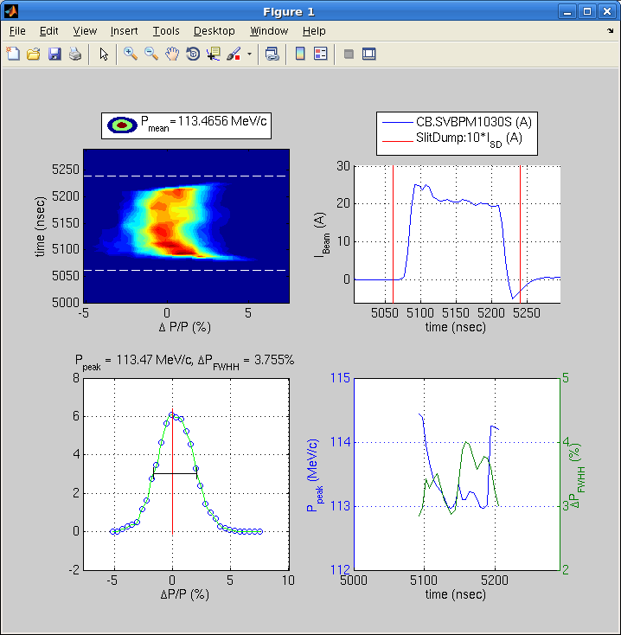
Energy and Energy spread
We try to improve the precision of the energy measurements to improve consistency, relative measurements and energy spread work well.
Can we see already a PETS effect ?

Slide 5
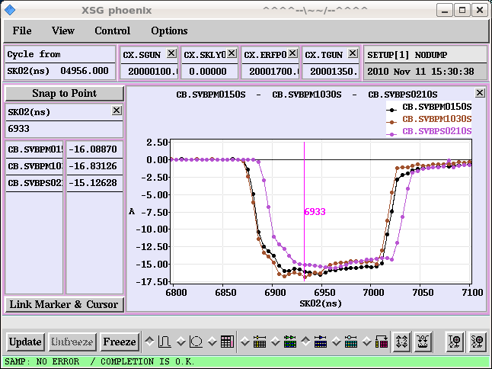
Beam transport
Obtained ‘full’ transmission even for factor 8 combined beam after matching and steering

Slide 6
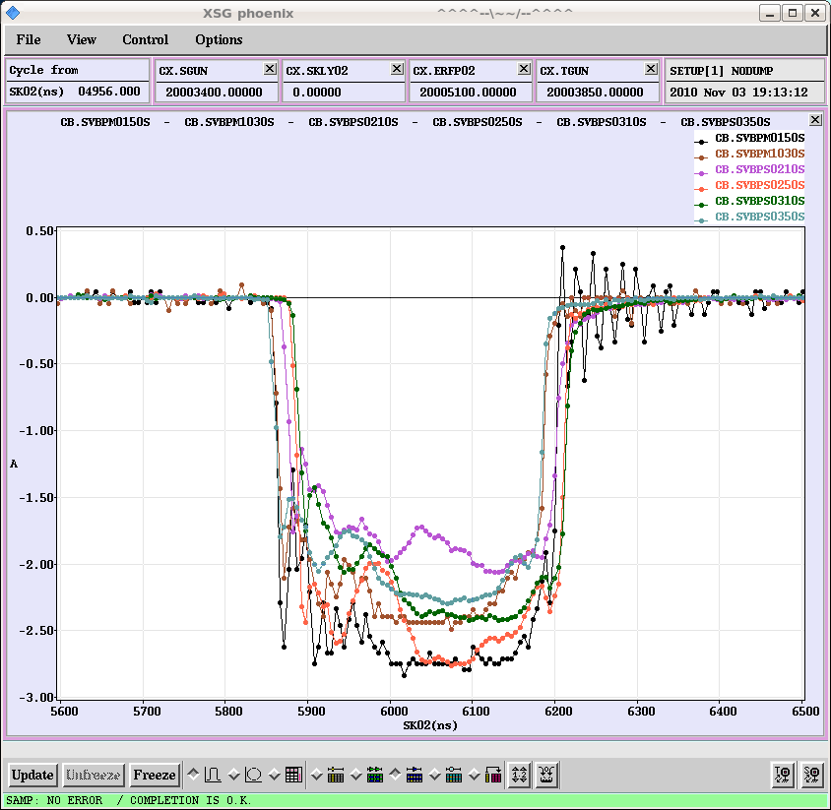
BPM status
Still noise problems, both in calibration and beam measurement, problem narrowed down to analog electronics

Slide 7
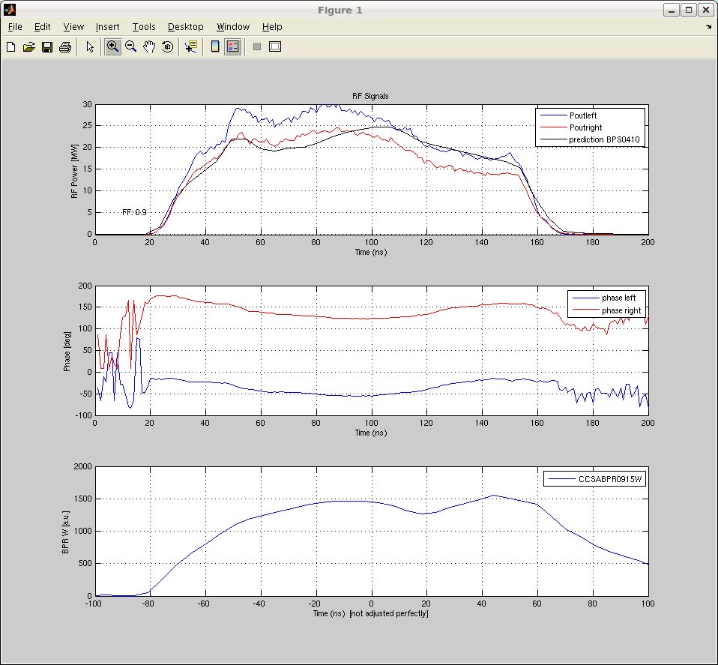
Power production
> 50 MW produced in agreement with theoretical prediction

Slide 8
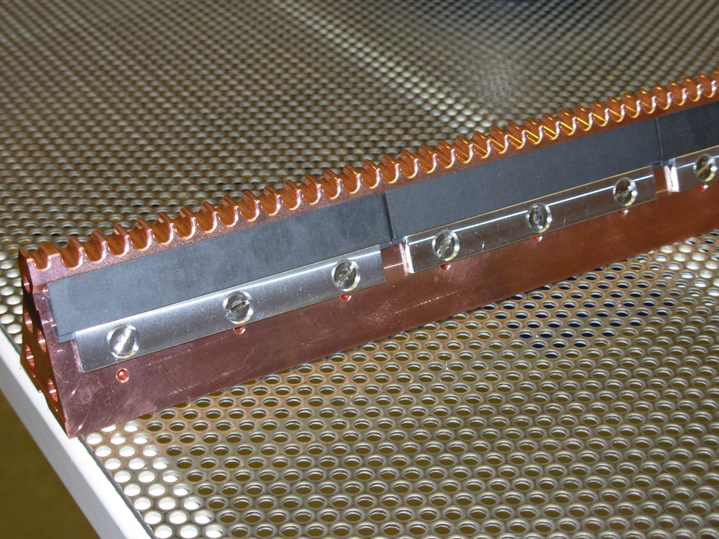
PETS series production

Slide 9
PETS series production
Receiving good quality PETS bars in the planned production rate
Some unfortunate problem with cleaning the bars
(New ultrasound bath at CERN had different frequency which caused slight surface erosion, did a study of the cleaning process and fluids involved)
First CERN made tank in last stage of assembly
Getting ready to send all necessary parts to CIEMAT for second tank
Hopefully one more tank made at CERN in January
→ Plan to have a total of 4 for the next run in 2011

