Slide 1
HEPTech Review
Survey Responses
5th April 2022

Slide 2
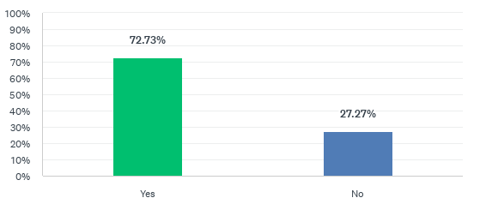
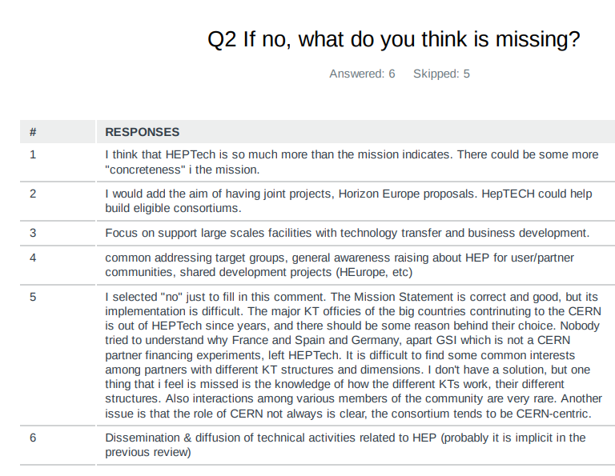
Q1. Do you think the Mission Statement reflects your understanding of HEPTech?

Slide 3
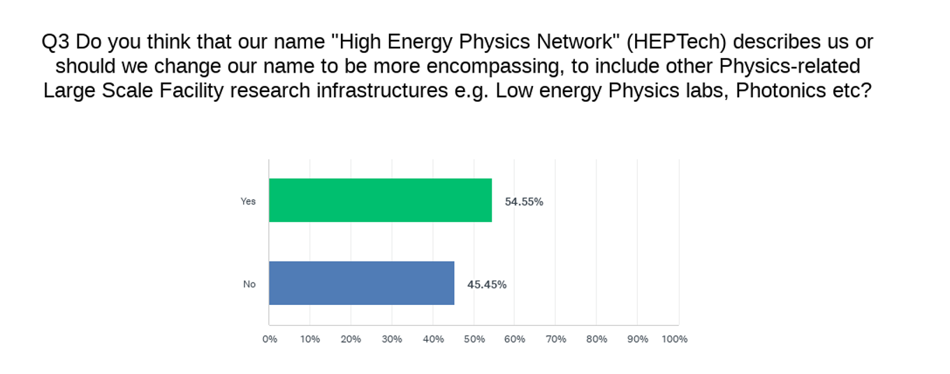
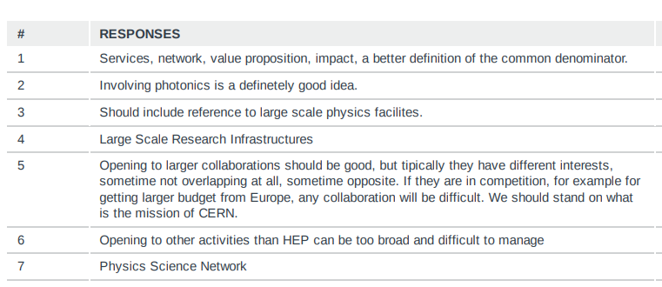

Slide 4
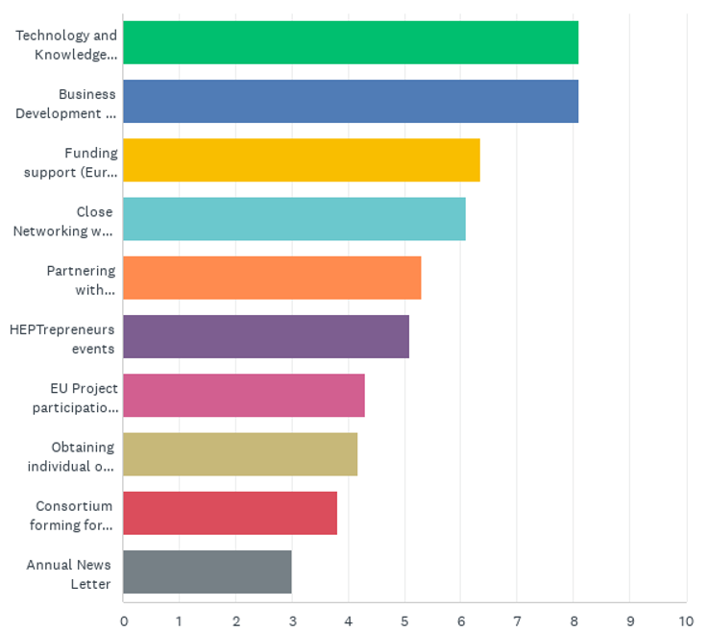

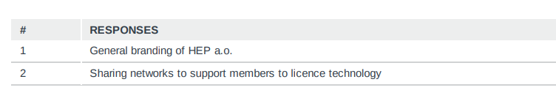
Q5: Rank the following HEPTech offerings in order of importance to you and your organisation
Data shown is the weighted average ranking of HEPTech offerings.
Offerings shown here with the largest (i.e. most important) ranking is the most preferred choice
Notes:
Larger the number here , the more important it was (on average) to respondents. Ranking questions calculate the average ranking for each answer choice so you can determine which answer choice was most preferred overall. The answer choice with the largest average ranking is the most preferred choice.
Weights are applied in reverse. In other words, the respondent's most preferred choice (which they rank as #1) has the largest weight, and their least preferred choice (which they rank in the last position) has a weight of 1
These are the descriptions of offerings in full:
Technology and Knowledge Transfer best practise exchange sessions
Business Development and Industry Contact Officer best practise and idea exchange.
Funding support (Euros 6 to 8K) for Academia Industry Matching Events (AIME)’s
Close Networking with other Physics laboratories community
Partnering with like-minded communities (e.g., EEN, ASTP, ENRIITC, TTO Circle, CERN KT Forum).
EU Project participation (European Commission's scoping study for supporting the development of a code of practice for researchers on).
Consortium forming for HORIZON Europe – Letter informing of EU Horizon Calls
Obtaining individual or group discounts to ASTP Technology Transfer training network
Annual News Letter

