Slide 1


RF separated beams in CERN’s secondary M2 beam line
Fabian Metzger^{1,2}, Dipanwita Banerjee¹, Johannes Bernhard¹, Markus Brugger¹, Lau Gatignon³, Alexander Gerbershagen⁴, Frank Gerigk¹, Laurie Nevay¹, Silvia Schuh¹ on behalf of the PBC Conventional Beams Working Group
08.11.2022
¹CERN, Geneva, Switzerland
²HISKP, University of Bonn, Germany
³University of Lancaster, UK
⁴PARTREC, University of Groningen, Netherlands

Slide 2
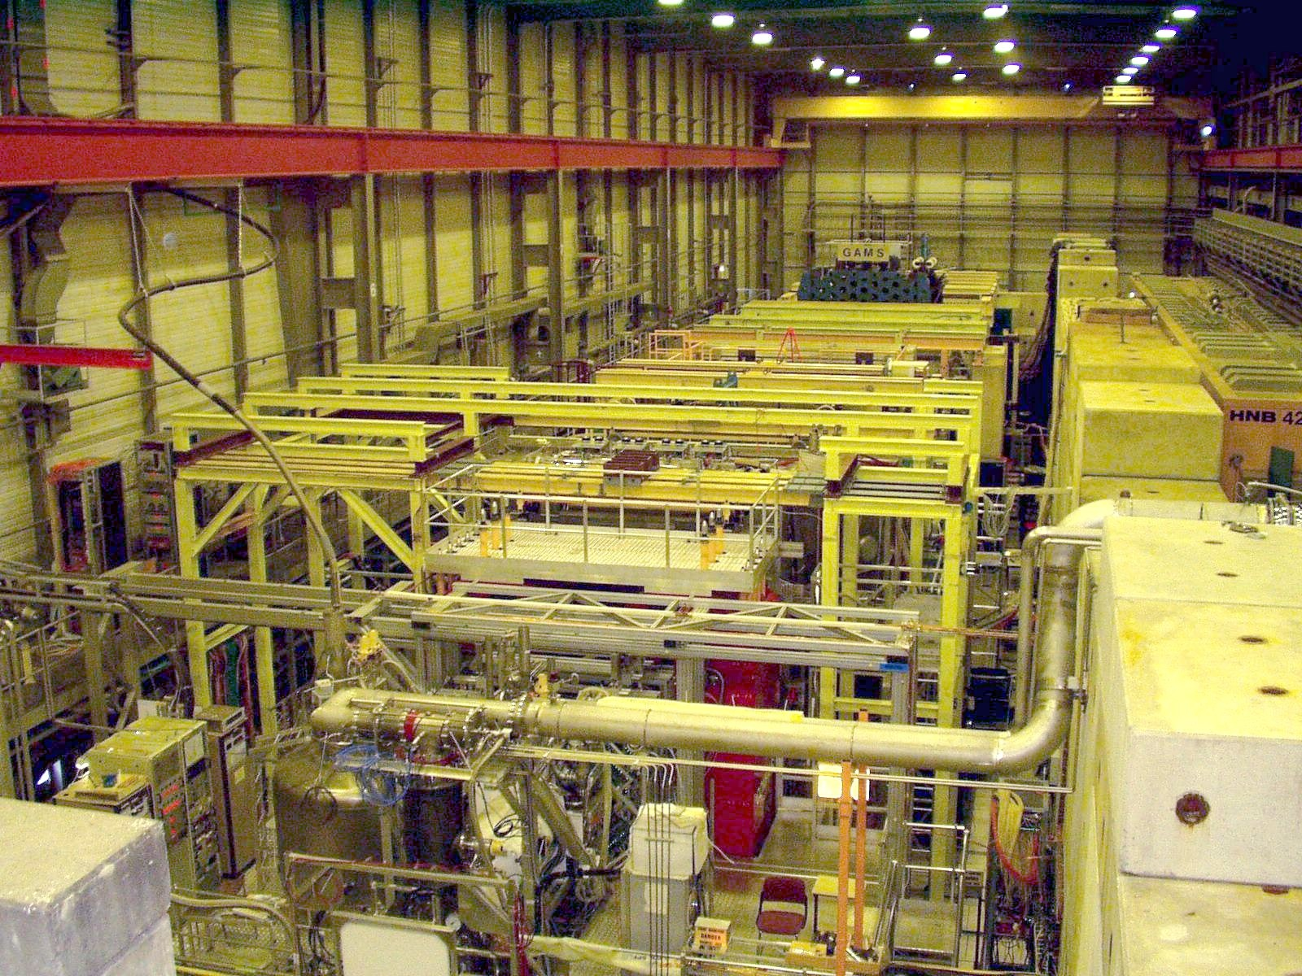
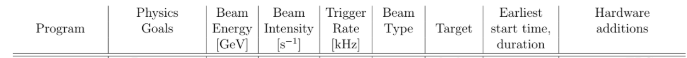
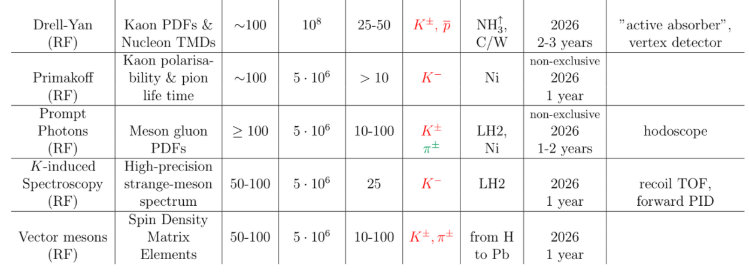
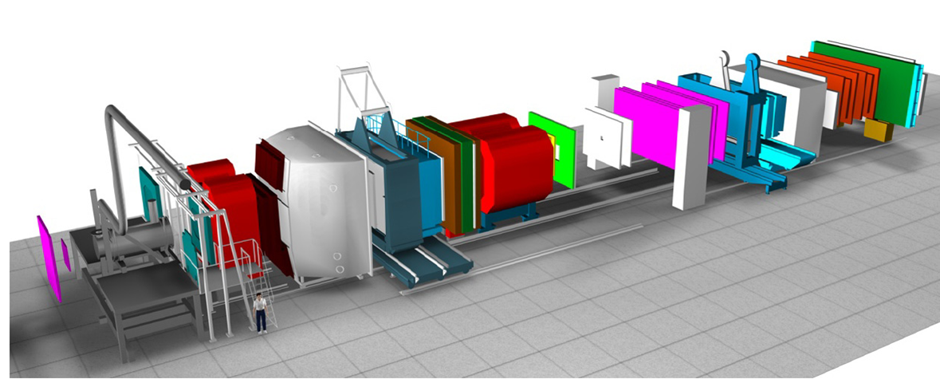
AMBER at CERN’s M$2$ beam line
AMBER’s phase 2 measurements
Very optimistic.
Current estimates: LHC Run 4

Slide 3
AMBER at CERN’s M$2$ beam line - ctd
2 workshops jointly organized by BE Experimental Area Group together with the AMBER collaboration, the EP-SME, SY-RF groups and the CERN TH department:
Workshop on RF separated beams, 30 Sep. 2021: https://indico.cern.ch/event/1069879/
  Define the physics case(s) for the phase-2 physics measurement goals of the AMBER collaboration
  Present the status of the currently available RF separated beam line studies
  Review the present technical limitations, with the goal to define the next steps towards a potential feasibility study
Follow-up Workshop, 23-24 March 2022: https://indico.cern.ch/event/1133376/
  Outcome of the RF separated beams workshop of September 2021
  Review of kaon induced DY with improvements in the conventional beam line setup

Slide 4
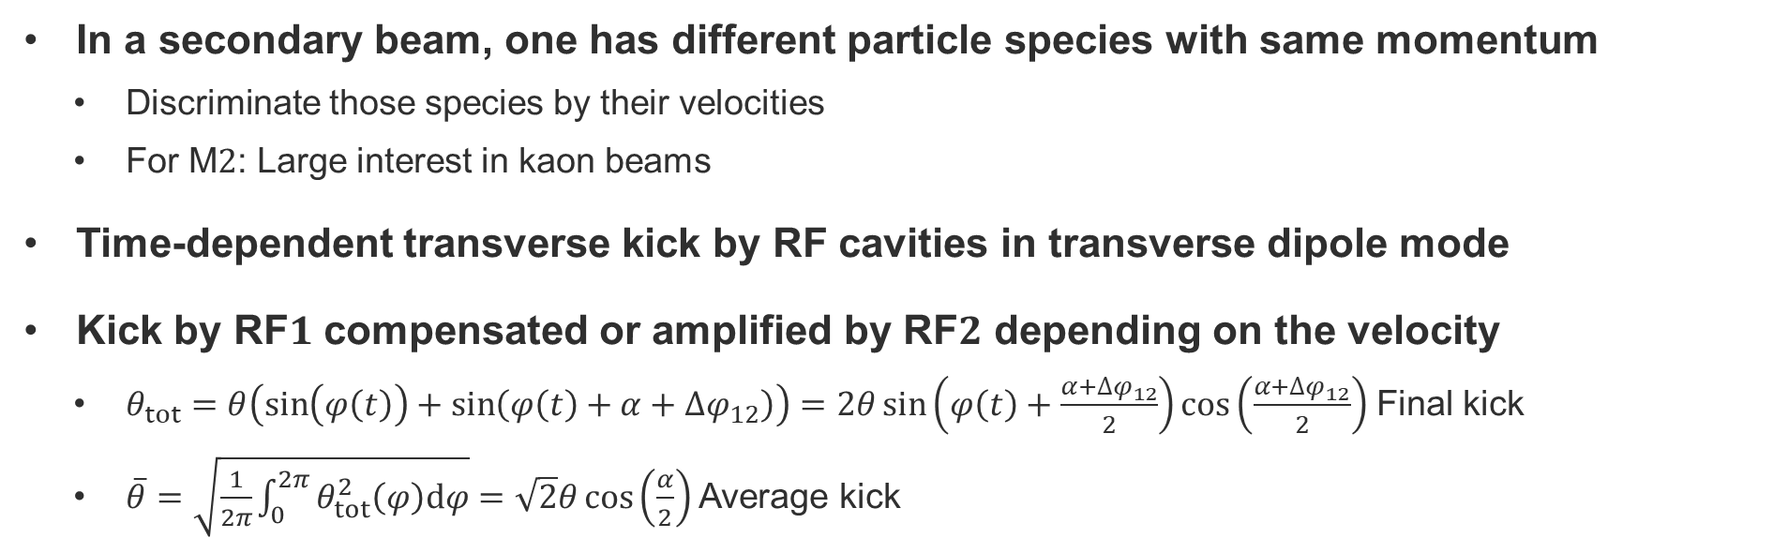
Principle of RF separation
In a secondary beam, one has different particle species with same momentum
  Discriminate those species by their velocities
  For M$2$: Large interest in kaon beams
Time-dependent transverse kick by RF cavities in transverse dipole mode
Kick by RF$1$ compensated or amplified by RF$2$ depending on the velocity
  $θ_{tot}=θ\left(\sin\left(φ\left(t\right)\right)+\sin\left(φ\left(t\right)+α+∆φ_{12}\right)\right)=2θ\sin\left(φ\left(t\right)+\frac{α+∆φ_{12}}{2}\right)\cos\left(\frac{α+∆φ_{12}}{2}\right)$ Final kick
  $\overline{θ}=\sqrt{\frac{1}{2π}\int_{0}^{2π}{θ_{tot}^{2}\left(φ\right)dφ}}=\sqrt{2}θ\cos\left(\frac{α}{2}\right)$ Average kick
C1
Wanted + unwanted particles
Experiment
Wanted
particles
RF1
RF2
DUMP
Momentum
selection
Quadrupole
L_{RF}

Slide 5
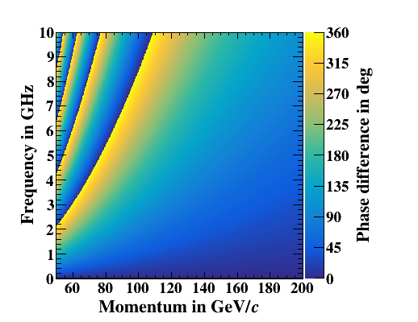
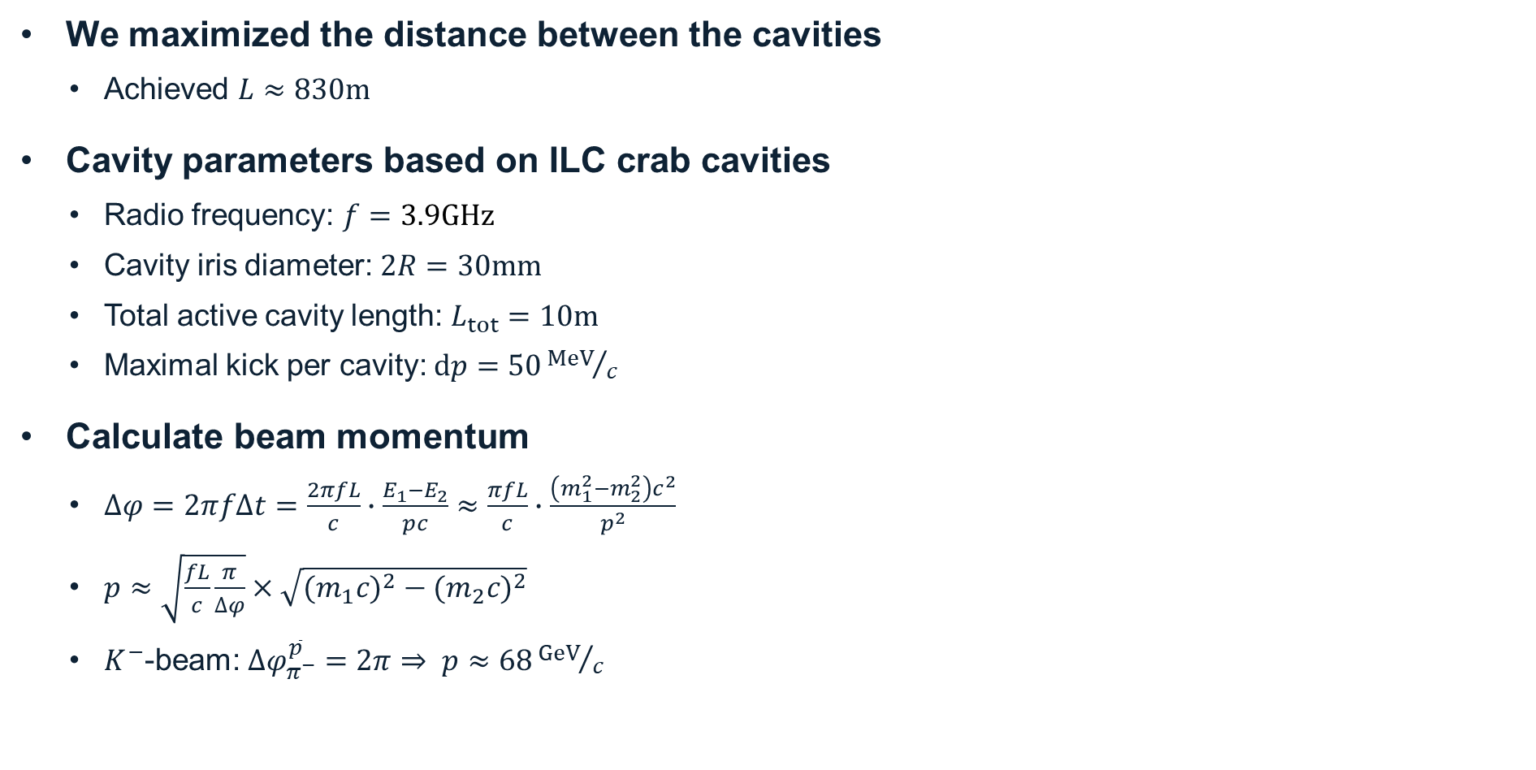

Cavity parameters
$${∆φ}_{pion}^{antiproton}$$
We maximized the distance between the cavities
  Achieved $L≈830m$
Cavity parameters based on ILC crab cavities
  Radio frequency: $f=3.9GHz$
  Cavity iris diameter: $2R=30mm$
  Total active cavity length: $L_{tot}=10m$
  Maximal kick per cavity: $dp=50{MeV}/c$
Calculate beam momentum
  $∆φ=2πf∆t=\frac{2πfL}{c}∙\frac{E_{1}−E_{2}}{pc}≈\frac{πfL}{c}∙\frac{\left(m_{1}^{2}−m_{2}^{2}\right)c^{2}}{p^{2}}$
  $p≈\sqrt{\frac{fL}{c}\frac{π}{∆φ}}×\sqrt{{{(m}_{1}c)}^{2}−{{(m}_{2}c)}^{2}}$
  $K^{−}$-beam: $∆φ_{π^{−}}^{\overline{p}}=2π⇒ p≈68{GeV}/c$
is fixed and close to achievable maximum

Slide 6

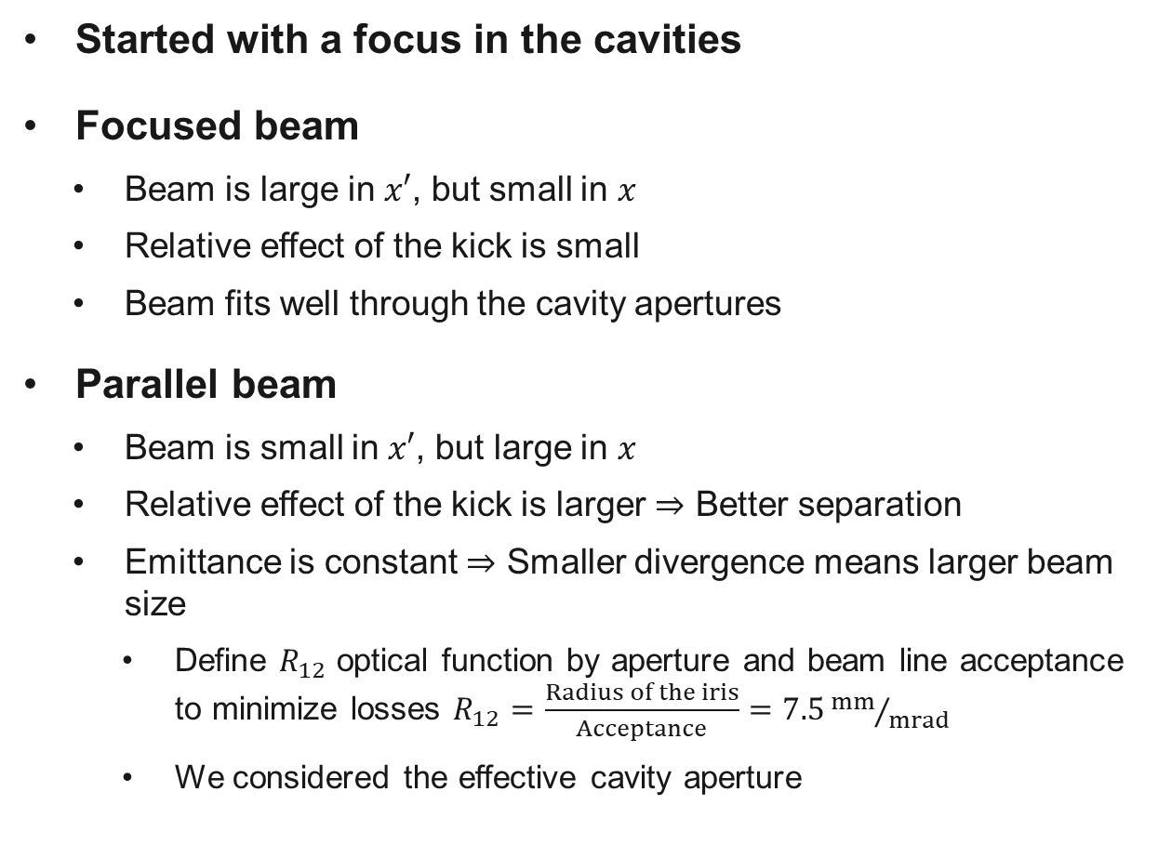
Focused vs. parallel beam in the cavities
X’
Started with a focus in the cavities
Focused beam
  Beam is large in $x′$, but small in $x$
  Relative effect of the kick is small
  Beam fits well through the cavity apertures
Parallel beam
  Beam is small in $x′$, but large in $x$
  Relative effect of the kick is larger $⇒$ Better separation
  Emittance is constant $⇒$ Smaller divergence means larger beam size
    Define $R_{12}$ optical function by aperture and beam line acceptance to minimize losses $R_{12}=\frac{Radius of the iris}{Acceptance}=7.5{mm}/{mrad}$
    We considered the effective cavity aperture
Effect of a kick
X
X’
Effect of a kick
X

Slide 7
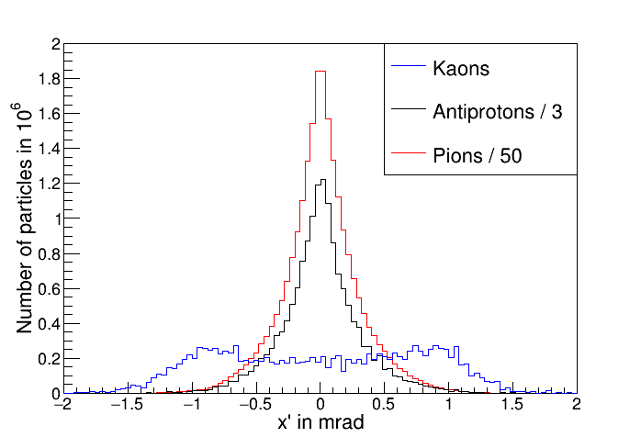
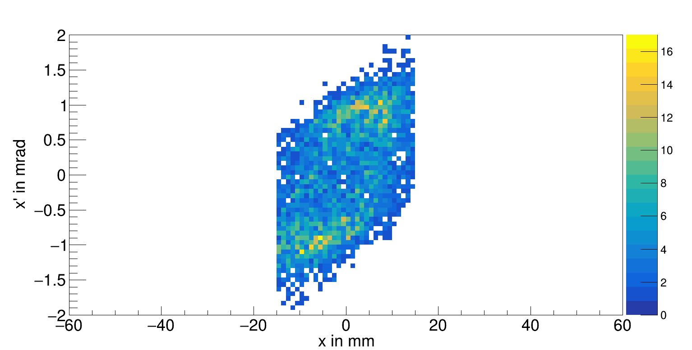
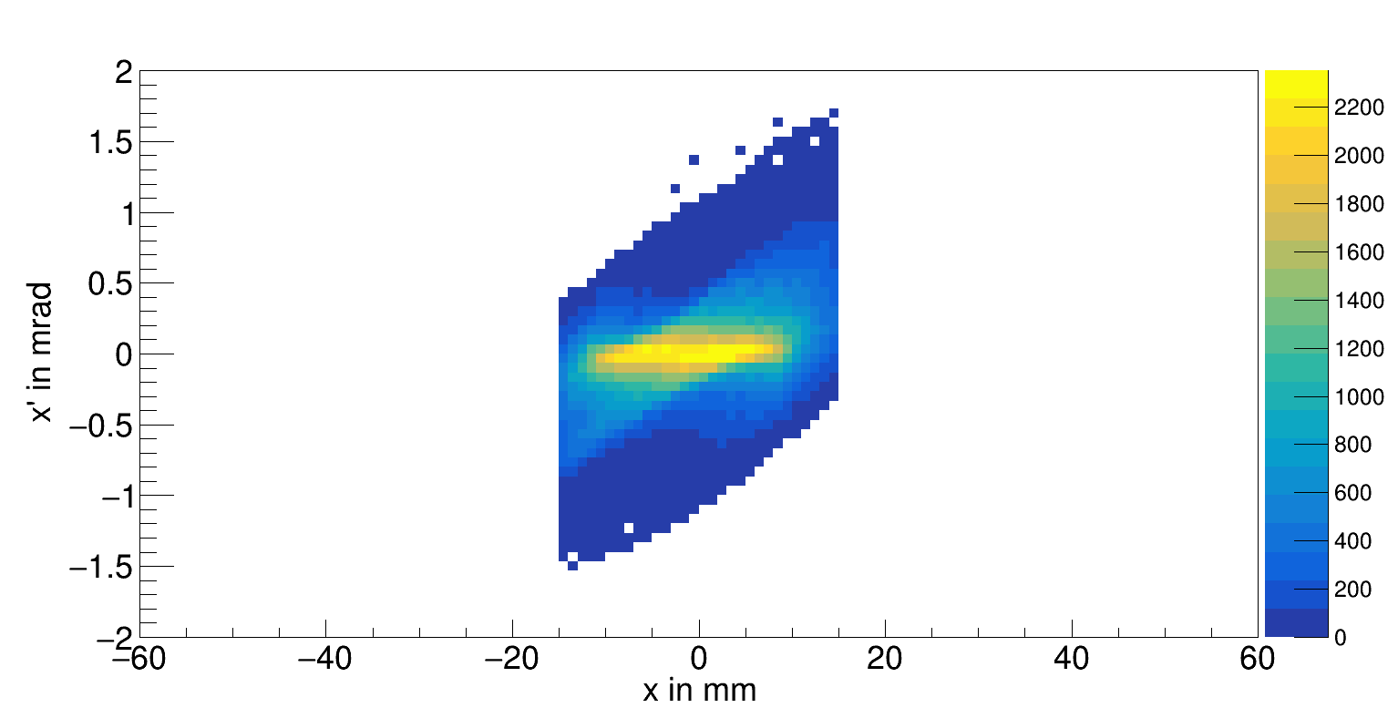
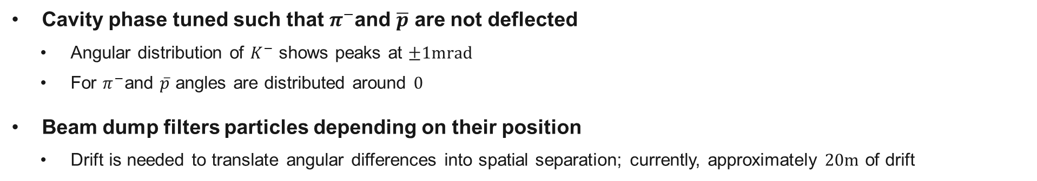


Phase space distribution after RF$2$
$K^{−}$ phase space
$π^{−}$ phase space
Cavity phase tuned such that $π^{−}$and $\overline{p}$ are not deflected
  Angular distribution of $K^{−}$ shows peaks at $±1mrad$
  For $π^{−}$and $\overline{p}$ angles are distributed around $0$
Beam dump filters particles depending on their position
  Drift is needed to translate angular differences into spatial separation; currently, approximately $20m$ of drift

Slide 8
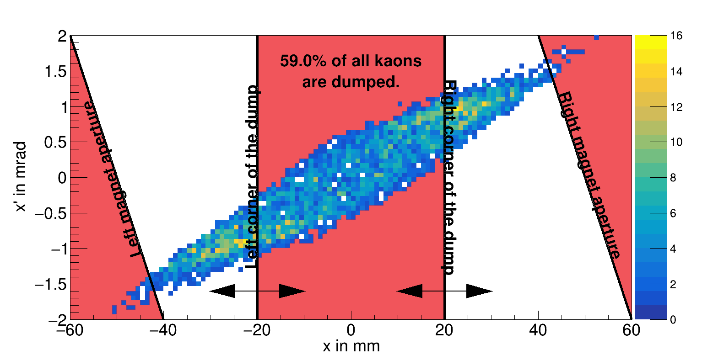
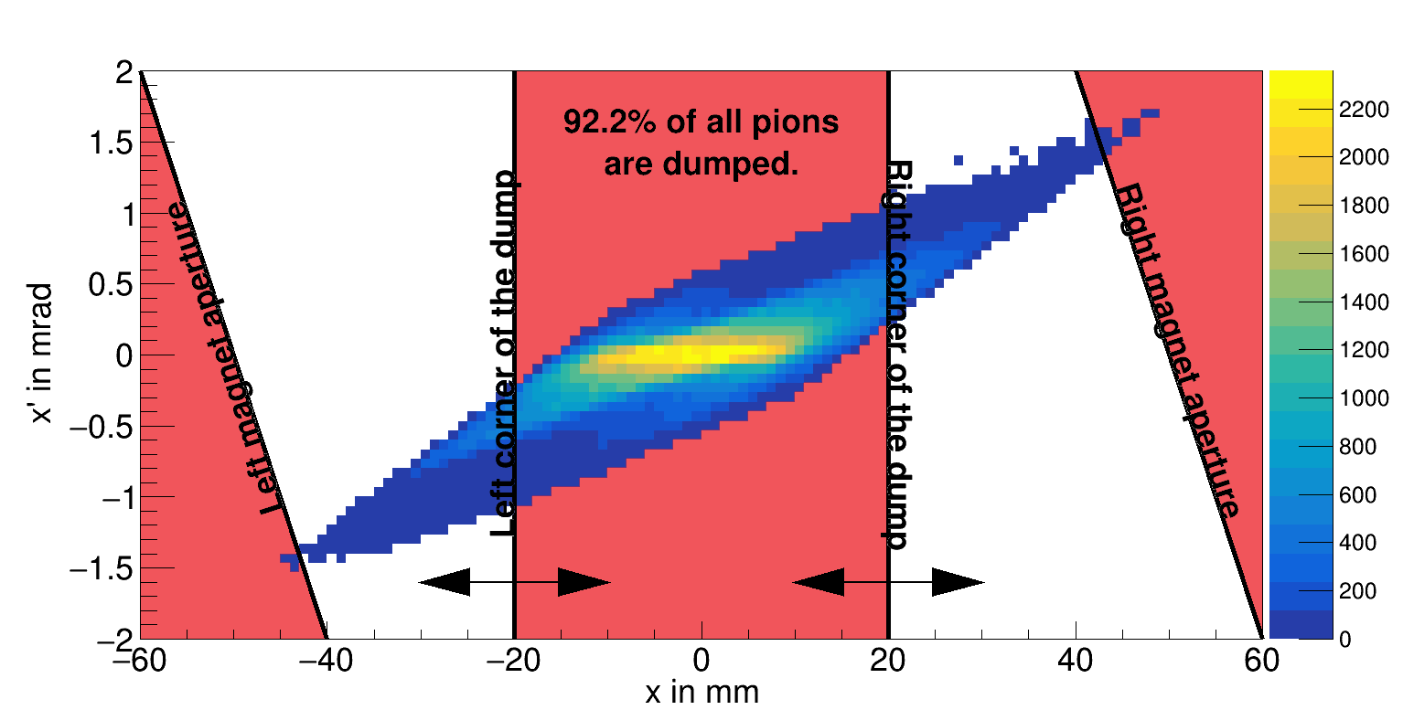
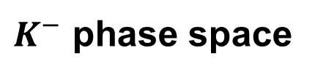
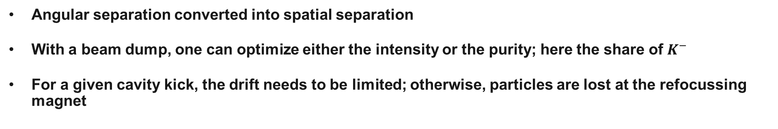
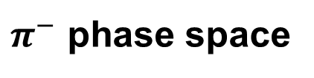
Phase space distribution $20m$ after RF$2$ (dump)
$K^{−}$ phase space
$π^{−}$ phase space
Angular separation converted into spatial separation
With a beam dump, one can optimize either the intensity or the purity; here the share of $K^{−}$
For a given cavity kick, the drift needs to be limited; otherwise, particles are lost at the refocussing magnet

Slide 9
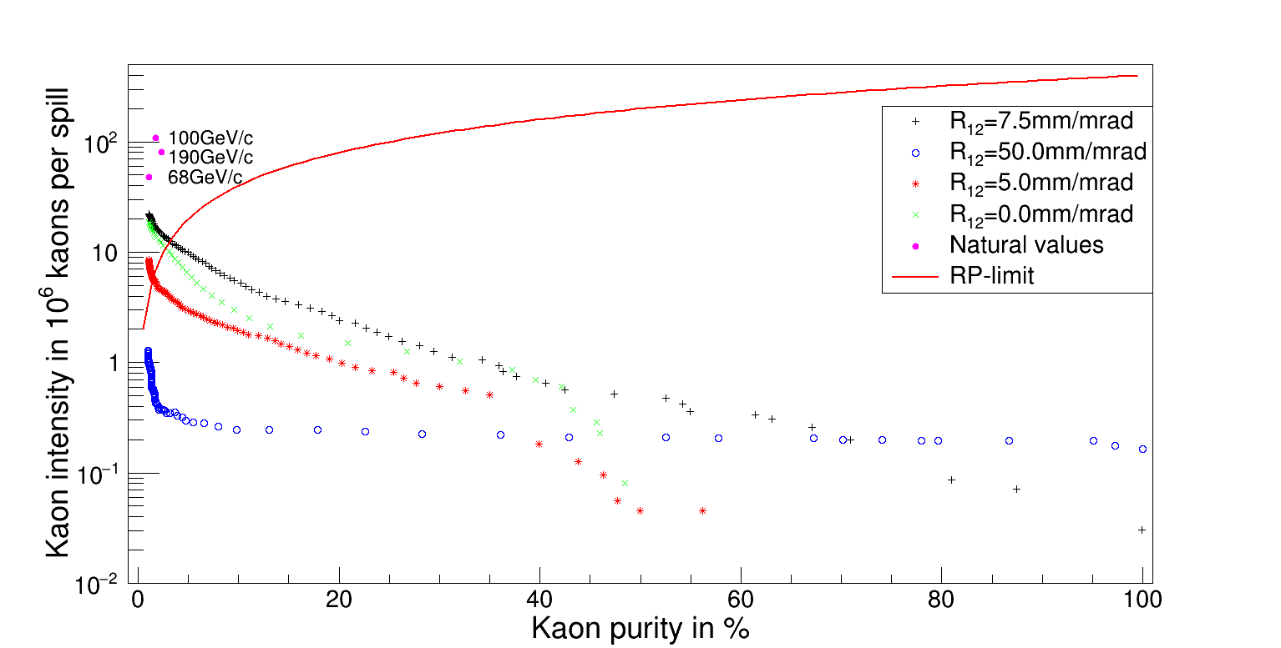
Separation power
Everything above the solid red curve is currently limited due to radiation protection in the EHN$2$ hall
Simulated with $150$ units on T$6$ ($1$ unit $\hat{=}$ ${10}^{11}$ protons on target)
SPS spill length is $4.8s$ (beam constantly extracted over this period)

Slide 10
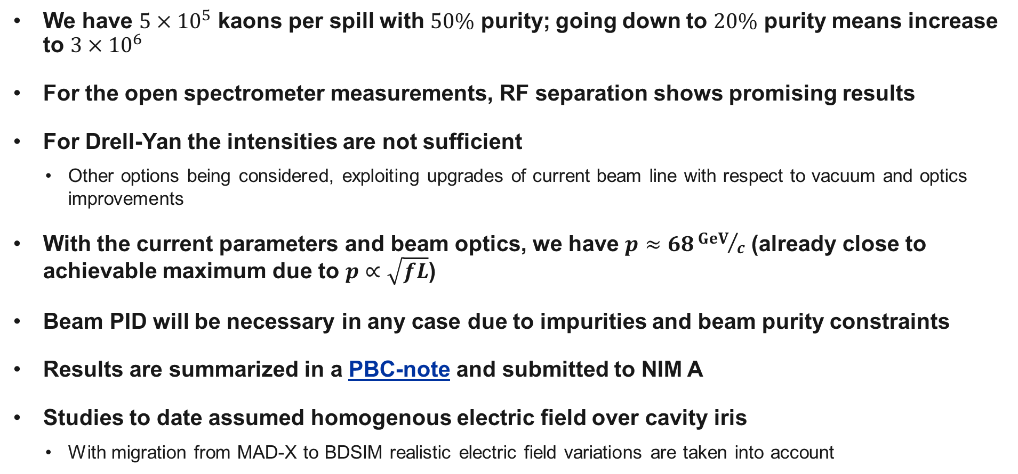
Summary and conclusions of current status
We have $5×{10}^{5}$ kaons per spill with $50\%$ purity; going down to $20\%$ purity means increase to $3×{10}^{6}$
For the open spectrometer measurements, RF separation shows promising results
For Drell-Yan the intensities are not sufficient
  Other options being considered, exploiting upgrades of current beam line with respect to vacuum and optics improvements
With the current parameters and beam optics, we have $p≈68{GeV}/c$ (already close to achievable maximum due to $p∝\sqrt{fL}$)
Beam PID will be necessary in any case due to impurities and beam purity constraints
Results are summarized in a PBC-note and submitted to NIM A
Studies to date assumed homogenous electric field over cavity iris
  With migration from MAD-X to BDSIM realistic electric field variations are taken into account

Slide 11
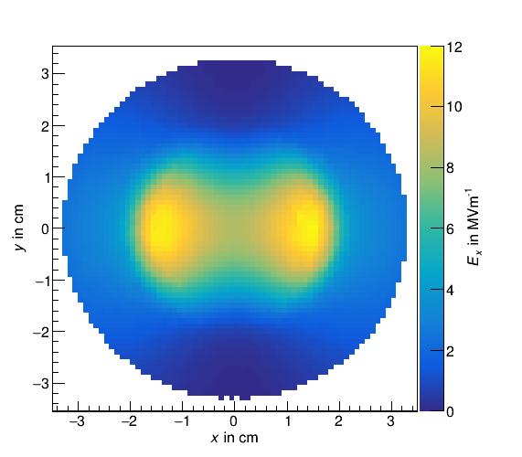
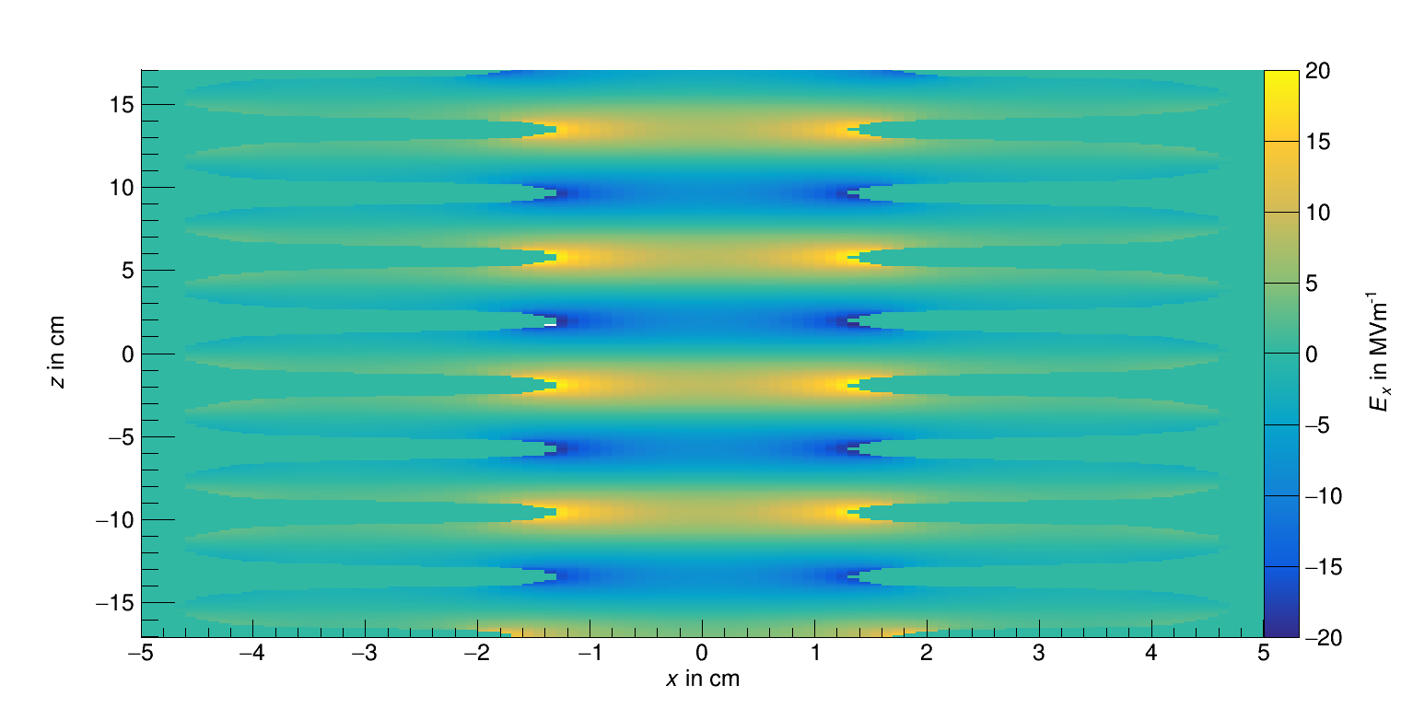


Field of the ILC crab cavities
At $z=4.6cm$
At $y=−0.05cm$
Field maps by G. Burt

Slide 12
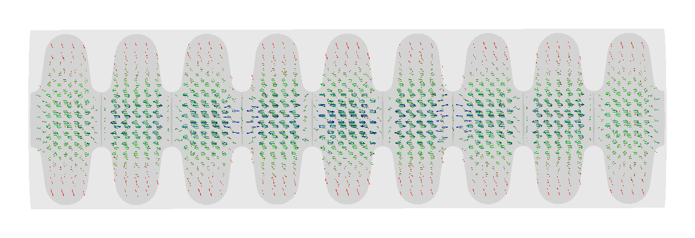
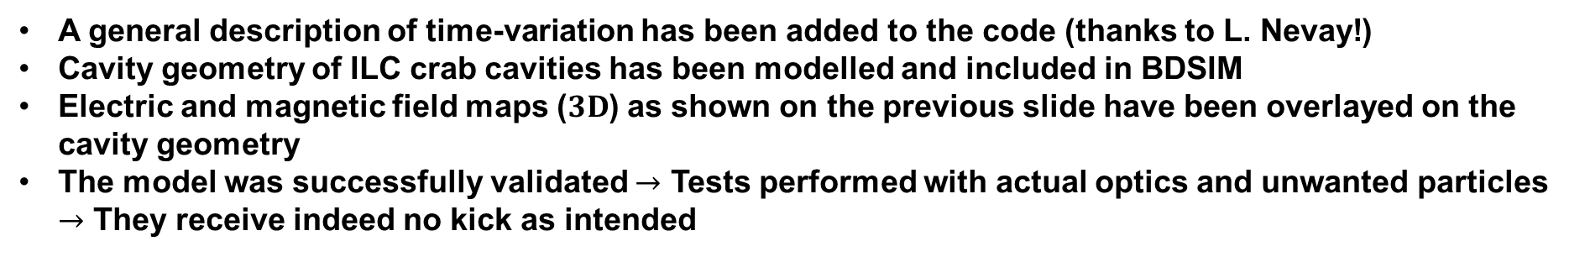
Cavity model in BDSIM
A general description of time-variation has been added to the code (thanks to L. Nevay!)
Cavity geometry of ILC crab cavities has been modelled and included in BDSIM
Electric and magnetic field maps ($3D$) as shown on the previous slide have been overlayed on the cavity geometry
The model was successfully validated $→$ Tests performed with actual optics and unwanted particles $→$ They receive indeed no kick as intended

Slide 13
Outlook
Evaluation of impact of inhomogeneities of the realistic electric field on the separation power
  For particles of interest, transverse field variations are expected to influence angular separation
  For unwanted particles, no change expected
  Reevaluate the separation power plot with both effects considered
Background studies
  Analysis of particles generated in the beam dump and mitigation thereof
Idea of circular polarization (from 2021 workshop)
  Exploitation of deflection in both transverse planes
Investigate possibility to keep muon beam in M2 parallel to the RF separated beam

Slide 14
Thank you for your
attention!

Slide 15
Backup

Slide 16
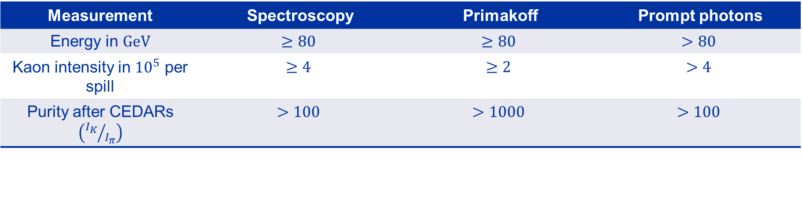
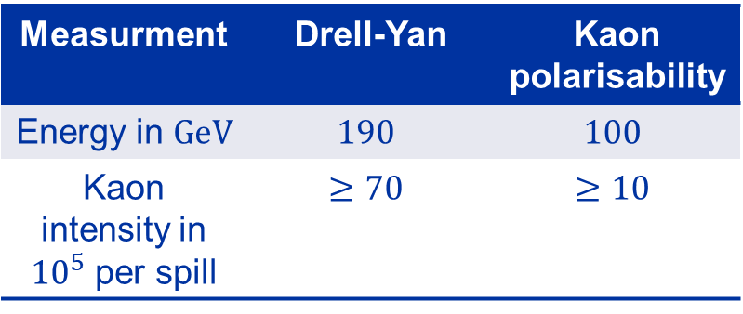
AMBER beam requirements
RF Workshop
Follow-Up Workshop
RF-Separated Beam Project for the M2 Beam Line at CERN
Measurment | Drell-Yan | Kaon polarisability
Energy in $GeV$ | $$190$$ | $$100$$
Kaon intensity in ${10}^{5}$ per spill | $$≥70$$ | $$≥10$$
Measurement | Spectroscopy | Primakoff | Prompt photons
Energy in $GeV$ | $$≥80$$ | $$≥80$$ | $$>80$$
Kaon intensity in ${10}^{5}$ per spill | $$≥4$$ | $$≥2$$ | $$>4$$
Purity after CEDARs $\left({I_{K}}/{I_{π}}\right)$ | $$>100$$ | $$>1000$$ | $$>100$$

Slide 17
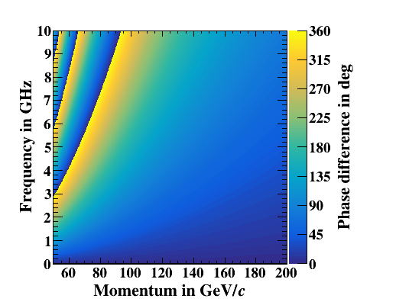
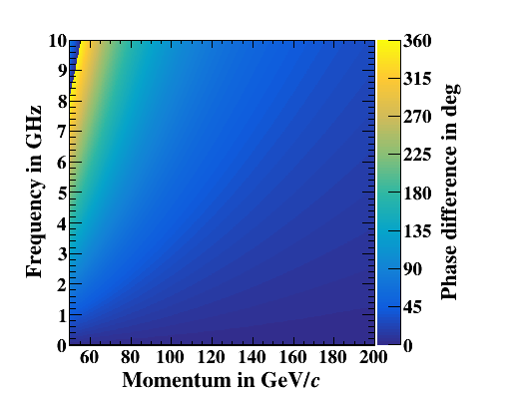


Phase shifts
$${∆φ}_{kaon}^{antiproton}$$
$${∆φ}_{pion}^{kaon}$$

Slide 18
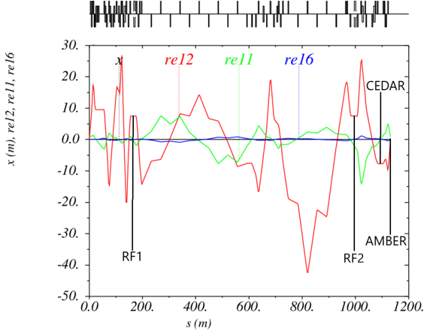
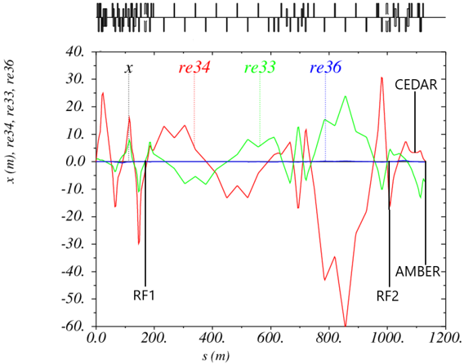

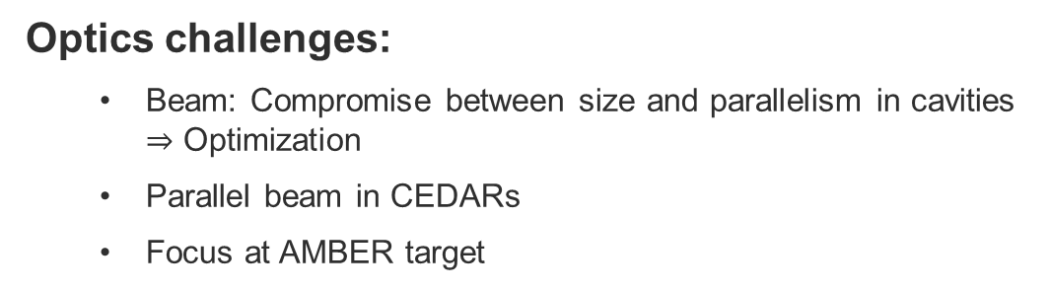

Optics development
Optics challenges:
  Beam: Compromise between size and parallelism in cavities $⇒$ Optimization
  Parallel beam in CEDARs
  Focus at AMBER target
$x$-plane
$y$-plane

Slide 19
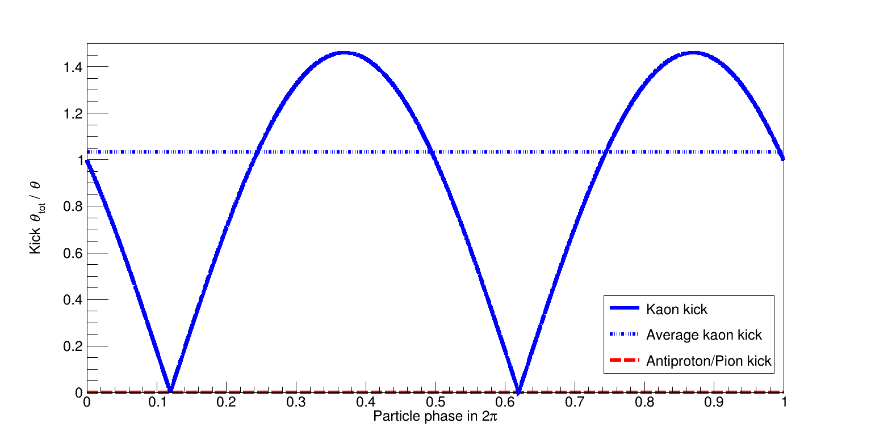
Kick of the cavities

Slide 20
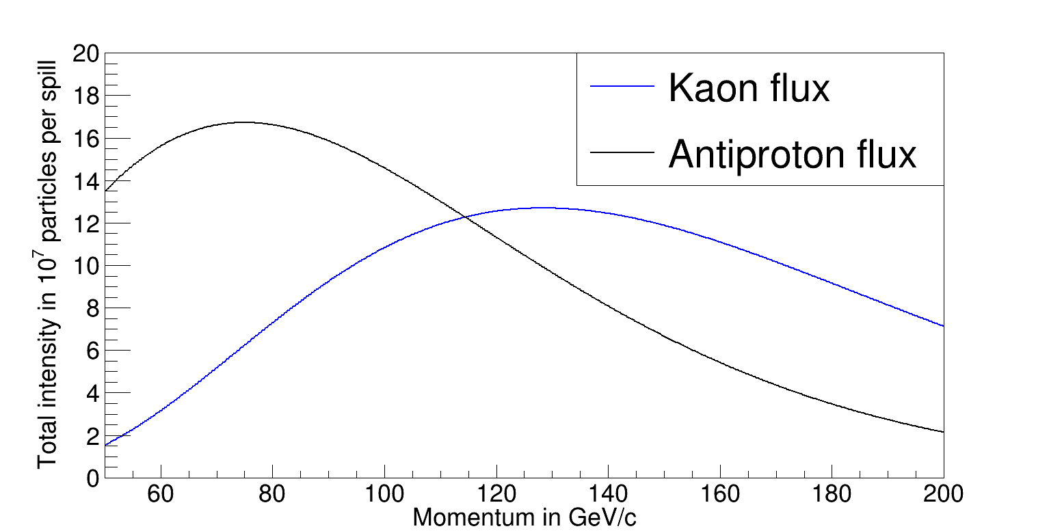
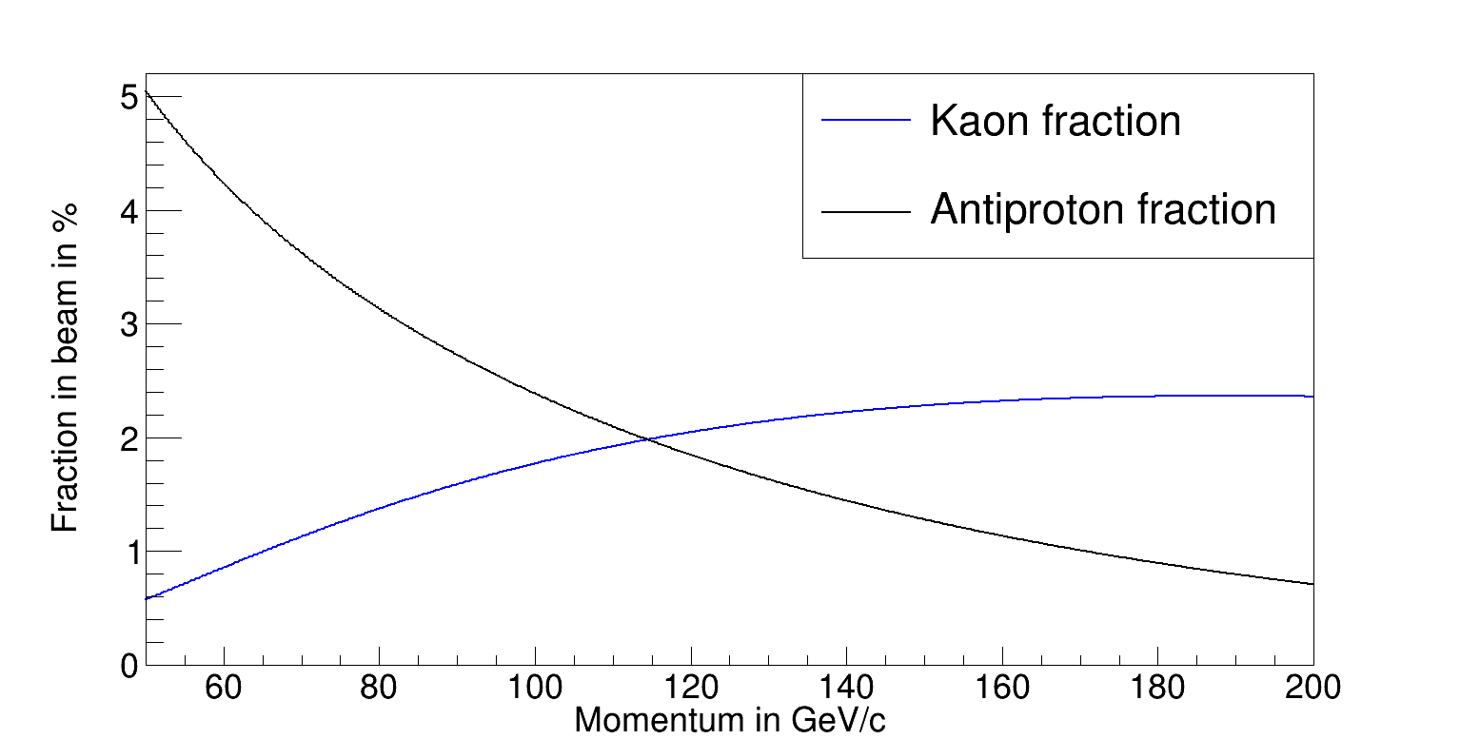
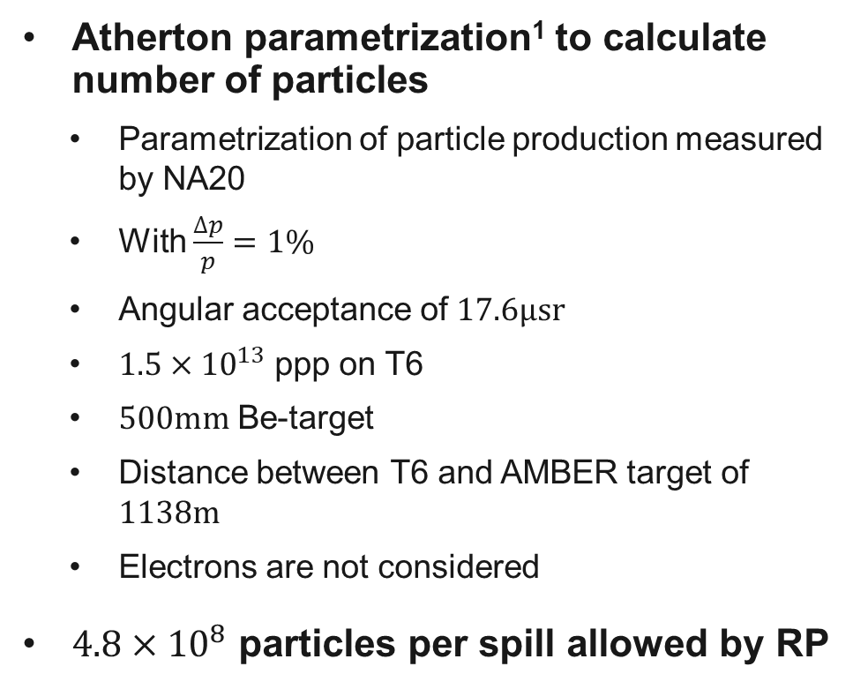
$K^{−}$ and $\overline{p}$: intensities and fractions
¹H.W.Atherton et al., Precise measurements of particle production by 400 GeV/c protons on
beryllium targets, CERN 80-07, 1980
Atherton parametrization¹ to calculate number of particles
  Parametrization of particle production measured by NA20
  With $\frac{∆p}{p}=1\%$
  Angular acceptance of $17.6μsr$
  $1.5×{10}^{13}$ ppp on T6
  $500mm$ Be-target
  Distance between T6 and AMBER target of $1138m$
  Electrons are not considered
$4.8×{10}^{8}$ particles per spill allowed by RP

Slide 21
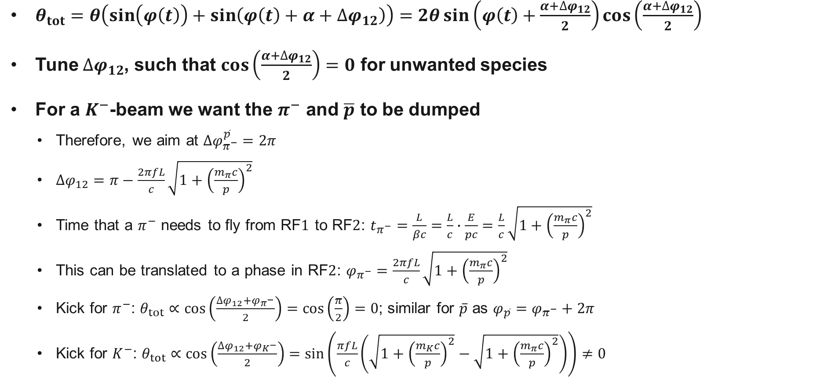
How to tune the phases
$θ_{tot}=θ\left(\sin\left(φ\left(t\right)\right)+\sin\left(φ\left(t\right)+α+∆φ_{12}\right)\right)=2θ\sin\left(φ\left(t\right)+\frac{α+∆φ_{12}}{2}\right)\cos\left(\frac{α+∆φ_{12}}{2}\right)$
Tune $∆φ_{12}$, such that $\cos\left(\frac{α+∆φ_{12}}{2}\right)=0$ for unwanted species
For a $K^{−}$-beam we want the $π^{−}$ and $\overline{p}$ to be dumped
  Therefore, we aim at $∆φ_{π^{−}}^{\overline{p}}=2π$
  $∆φ_{12}=π−\frac{2πfL}{c}\sqrt{1+{\left(\frac{m_{π}c}{p}\right)}^{2}}$
  Time that a $π^{−}$ needs to fly from RF$1$ to RF$2$: $t_{π^{−}}=\frac{L}{βc}=\frac{L}{c}∙\frac{E}{pc}=\frac{L}{c}\sqrt{1+{\left(\frac{m_{π}c}{p}\right)}^{2}}$
  This can be translated to a phase in RF$2$: $φ_{π^{−}}=\frac{2πfL}{c}\sqrt{1+{\left(\frac{m_{π}c}{p}\right)}^{2}}$
  Kick for $π^{−}$: $θ_{tot}∝\cos\left(\frac{∆φ_{12}+φ_{π^{−}}}{2}\right)=\cos\left(\frac{π}{2}\right)=0$; similar for $\overline{p}$ as ${φ_{\overline{p}}=φ}_{π^{−}}+2π$
  Kick for $K^{−}$: $θ_{tot}∝\cos\left(\frac{∆φ_{12}+φ_{K^{−}}}{2}\right)=\sin\left(\frac{πfL}{c}\left(\sqrt{1+{\left(\frac{m_{K}c}{p}\right)}^{2}}−\sqrt{1+{\left(\frac{m_{π}c}{p}\right)}^{2}}\right)\right)≠0$

Slide 22
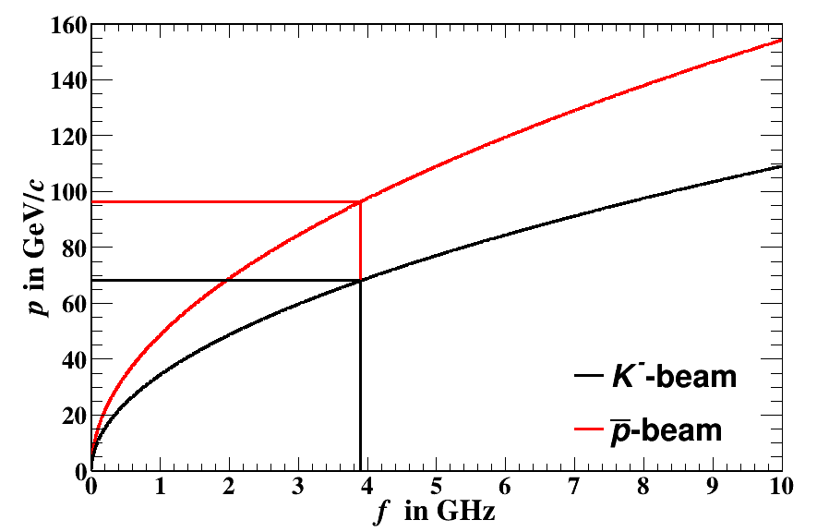
Beam momentum

Slide 23
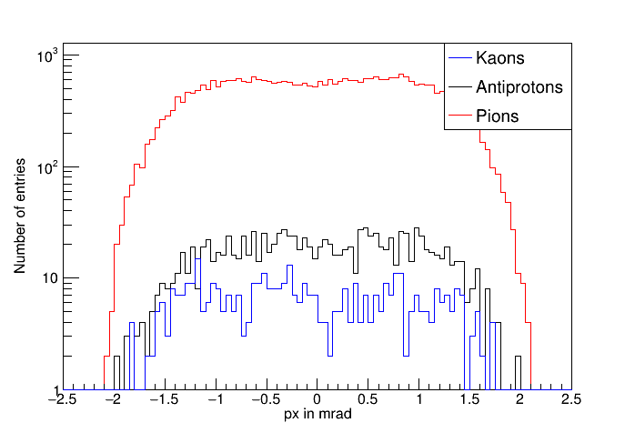
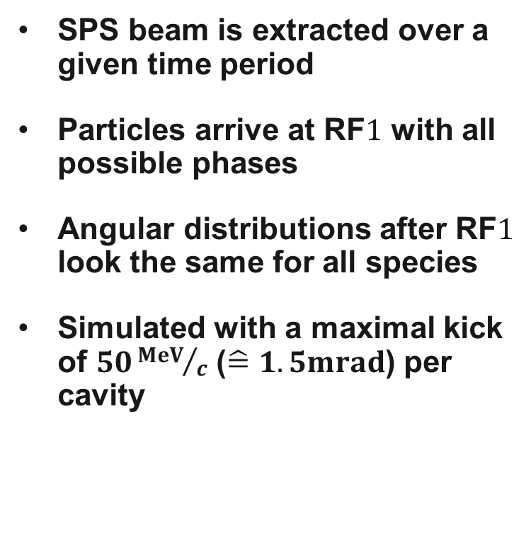
Kick in the first cavity
SPS beam is extracted over a given time period
Particles arrive at RF$1$ with all possible phases
Angular distributions after RF$1$ look the same for all species
Simulated with a maximal kick of $50{MeV}/c$ ($\hat{=}1.5mrad$) per cavity

Slide 24
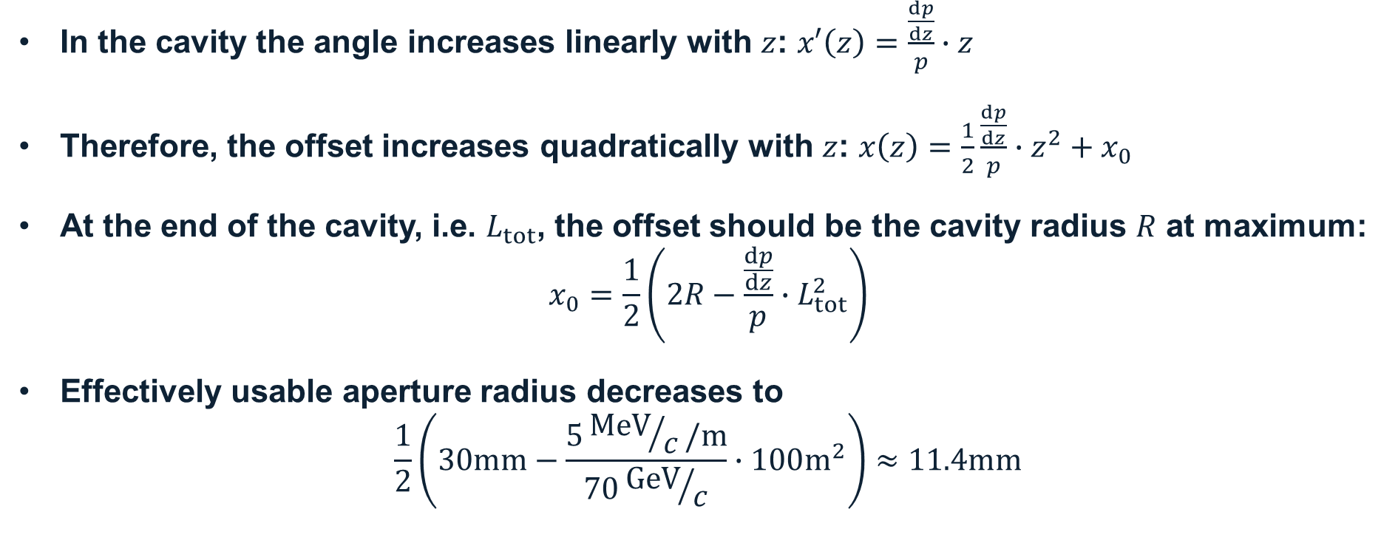
Effect of the cavity kick
In the cavity the angle increases linearly with $z$: $x′\left(z\right)=\frac{\frac{dp}{dz}}{p}∙z$
Therefore, the offset increases quadratically with $z$: $x\left(z\right)=\frac{1}{2}\frac{\frac{dp}{dz}}{p}∙z^{2}+x_{0}$
At the end of the cavity, i.e. $L_{tot}$, the offset should be the cavity radius $R$ at maximum:
$$x_{0}=\frac{1}{2}\left(2R−\frac{\frac{dp}{dz}}{p}∙L_{tot}^{2}\right)$$
Effectively usable aperture radius decreases to
$$\frac{1}{2}\left(30mm−\frac{5{MeV}/c/m}{70{GeV}/c}∙100m^{2}\right)≈11.4mm$$

Slide 25
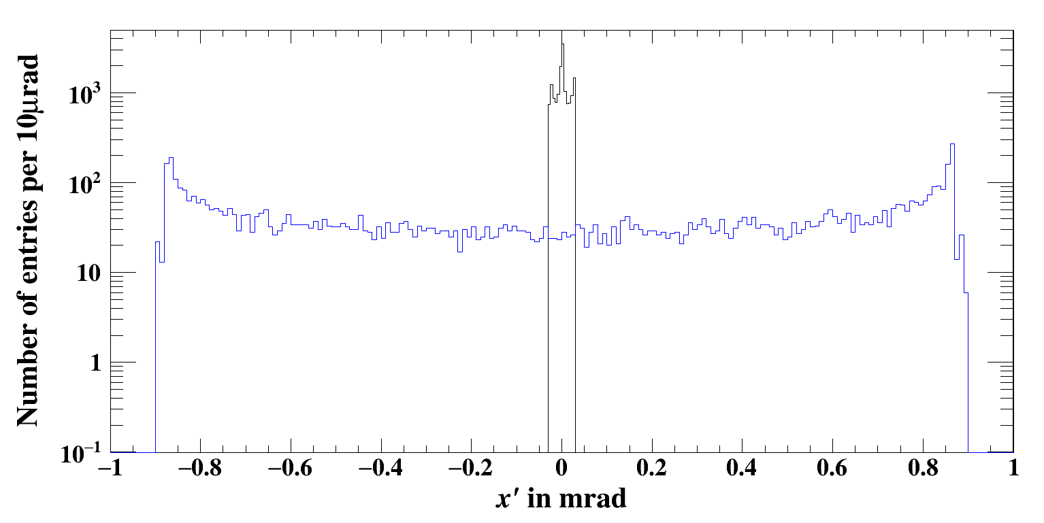
Model test in BDSIM

Slide 26
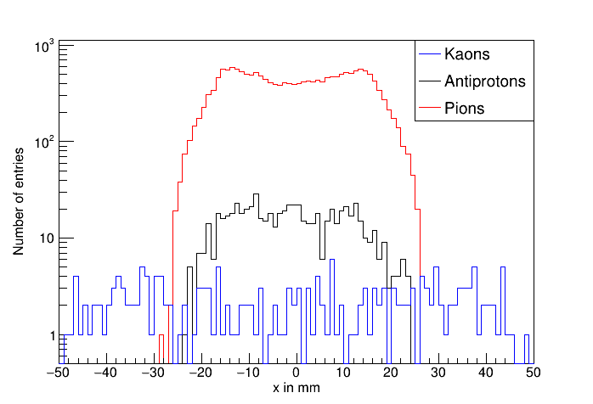
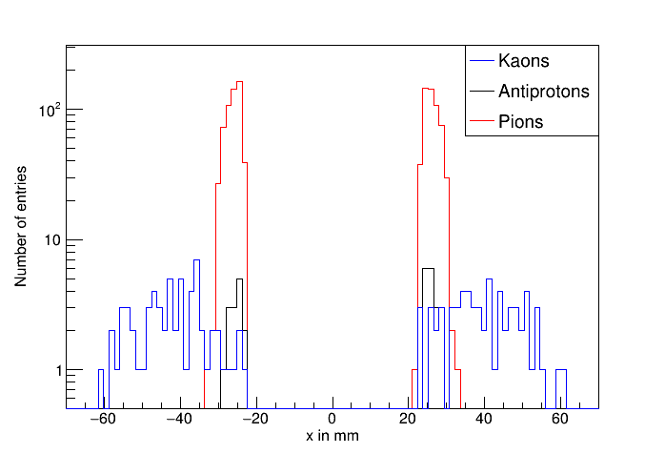
Absorption
Before the dump
After the dump

Slide 27
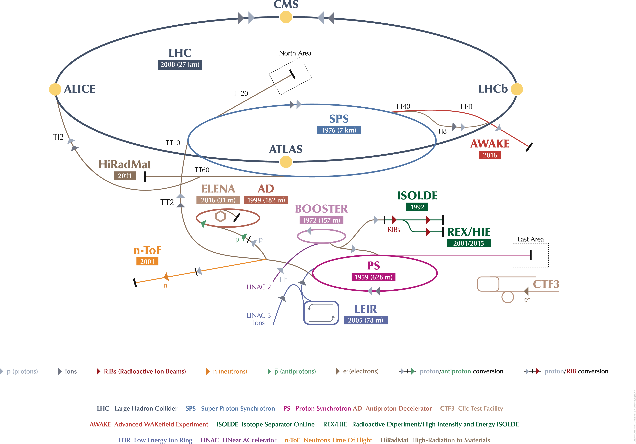
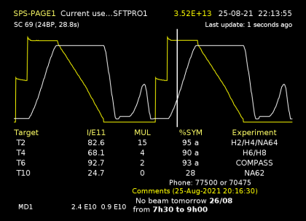
Beams from SPS

