Slide 1

Short range wake estimates for the TESLA cavity
F. Batsch¹ , I. Karpov, H. Damerau
MC RF WG meeting #9
22/03/2022

Slide 2
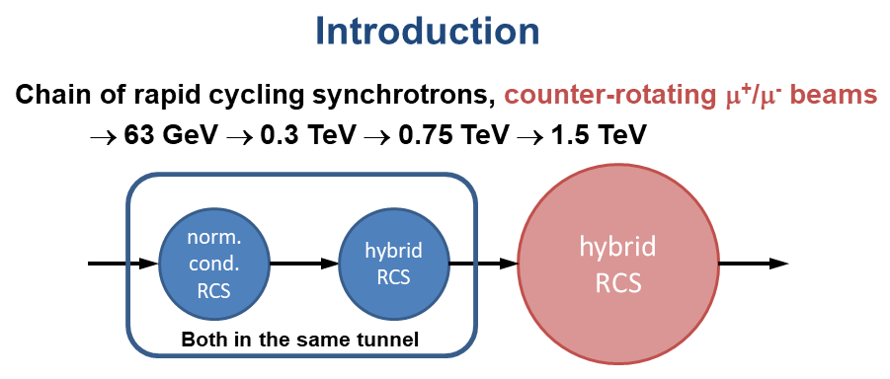

Assumptions for studies:
Studies for the 2nd RCS of the high-energy accelerator chain (300 to 750 GeV)
Multiple RF stations with 1.3 GHz TESLA cavities, providing 20 MV/m
Bunch population of 2.2e12
Using the BLonD code to observe effects of the synchrotron tune and the short-range wakefields
Reminder
2

Slide 3
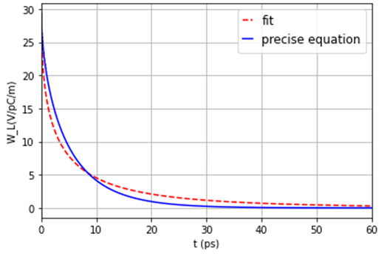
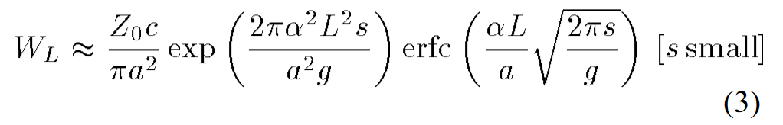
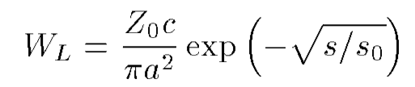
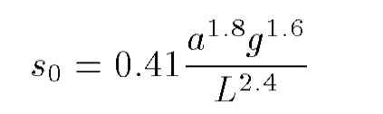
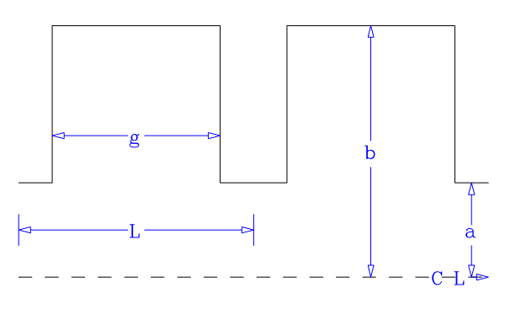
Short-range wakefields:
Based on K. Bane et al., ‘Calculation of the short-range longitudinal wakefields in the NLC linac’, ICAP98, 1998
The longitudinal wake function is given by:
One can approximate this by a semi-analytically expression, valid for small s and s/L<0.15:
The parameters for the Tesla cavity¹ gives long. wake functions on the order of 30 V/pC/m:
The BLonD code convolutes the wake function with the beam profile to obtain the induced voltage
L= 115.4 mm
g= 82 mm
a= 35 mm
b= 103.3 mm
22 March 2022
3
¹Wakefield studies for the Tesla cavity shown in TESLA Report 2003-19

Slide 4
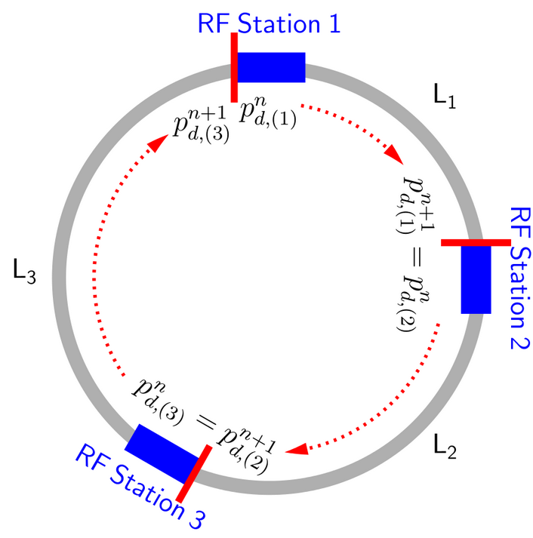
BLonD Simulations
BLonD: macro-particle tracking code, developed at CERN from 2014 on.
As shown by Ivan Karpov in this meeting on 22 June 2021, multiple RF stations are not fully implemented, but a fake ring with circumference C/n_{RF} can be used to study some effect as the synchroton tune and the short-range wakefields
A solution to implement multiple RF stations has been identified and is being implemented at the moment.
First studies show the effect of the number of RF stations and the short range wakefields
From BLonD documentation

Slide 5
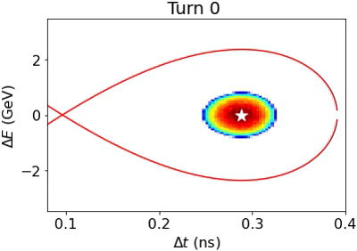

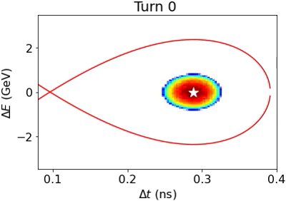


Synchrotron tune vs numbers of RF stations
Acceleration from 300 to 750 GeV for different number of RF stations in the ring:
(the synchrotron tune between two RF stations < or << 1/π)
4 16
32 128
2 RF stations
The high synchrotron tune around 0.5-1 requires a sufficiently large number of RF stations
5

Slide 6
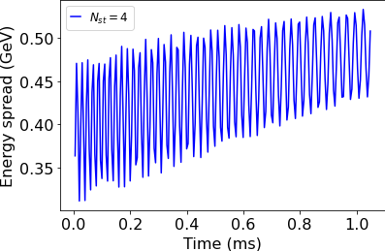
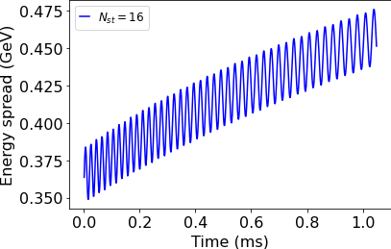
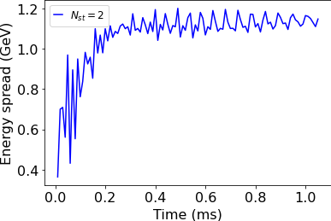
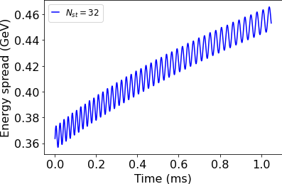
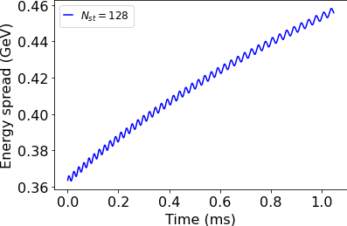
Corresponding energy spread
The high synchrotron tune around 0.5-1 requires a sufficiently large number of RF stations
Acceleration from 300 to 750 GeV for different number of RF stations in the ring:
(the synchrotron tune between two RF stations < or << 1/π)
4 16
32 128
2 RF stations
22 March 2022
6

Slide 7
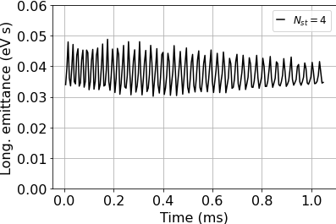
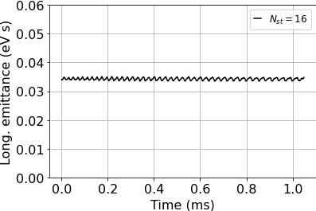
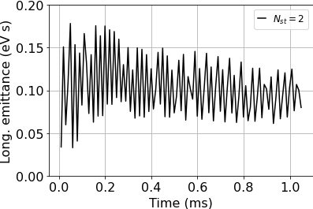
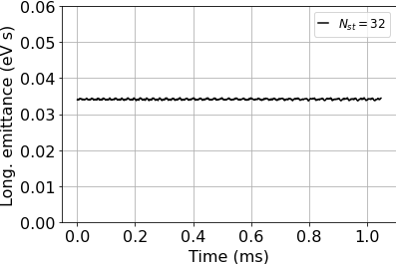
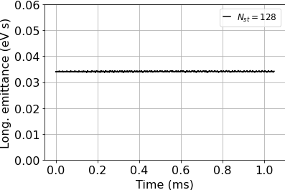
Corresponding emittance
The high synchrotron tune around 0.5-1 requires a sufficiently large number of RF stations
Acceleration from 300 to 750 GeV for different number of RF stations in the ring:
(the synchrotron tune between two RF stations < or << 1/π)
4 16
32 128
2 RF stations
22 March 2022
7

Slide 8
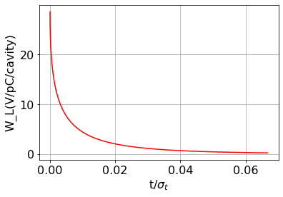
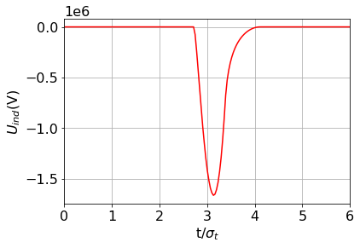
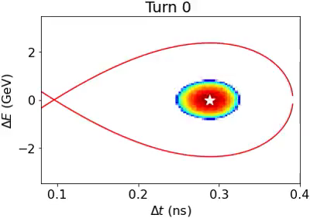
Estimate of short-range wakefields
For the TESLA cavity, the longit. wake function is on the order of 30 V/pC/m.
With 64 RF stations, and 9 cells per cavity, acceleration from 300 to 750 GeV and the parameters from the parameter table, the induced voltage peaks at 1.7 MeV.
The bunch survives the short-range wakefields!
Induced voltage
8

Slide 9
Conclusion
Short-range wakefields described by Karl Bane formulism
Induced voltage from short-range wakefields introduced in BLonD according to that
First studies with muons and the TESLA cavity parameter show the effect of the high synchrotron tune
The induced voltage by the muon bunch does not represent a problem for now, further effects such as beam loading being investigated for final conclusions
14

