Slide 1
ISOLDE – MEDICIS Robots
KUKA discovery day
Jean-Louis GRENARD – SY-STI - CERN
28-03-2022

Slide 2
Content
A few words on ISOLDE facility
How the system has been designed
The implementation of the robots
Recovery methods
Operational feedback
A few word on MEDICIS

Slide 3
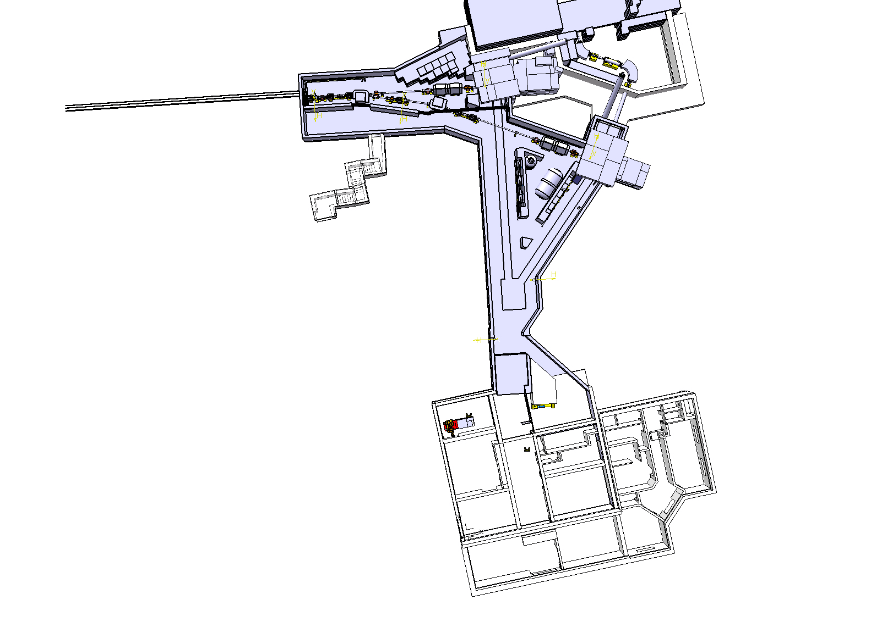
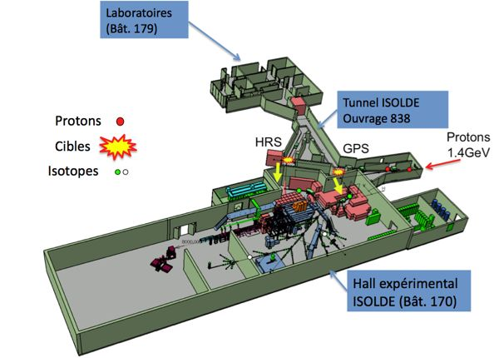
General layout of the ISOLDE facility
Target area

Slide 4
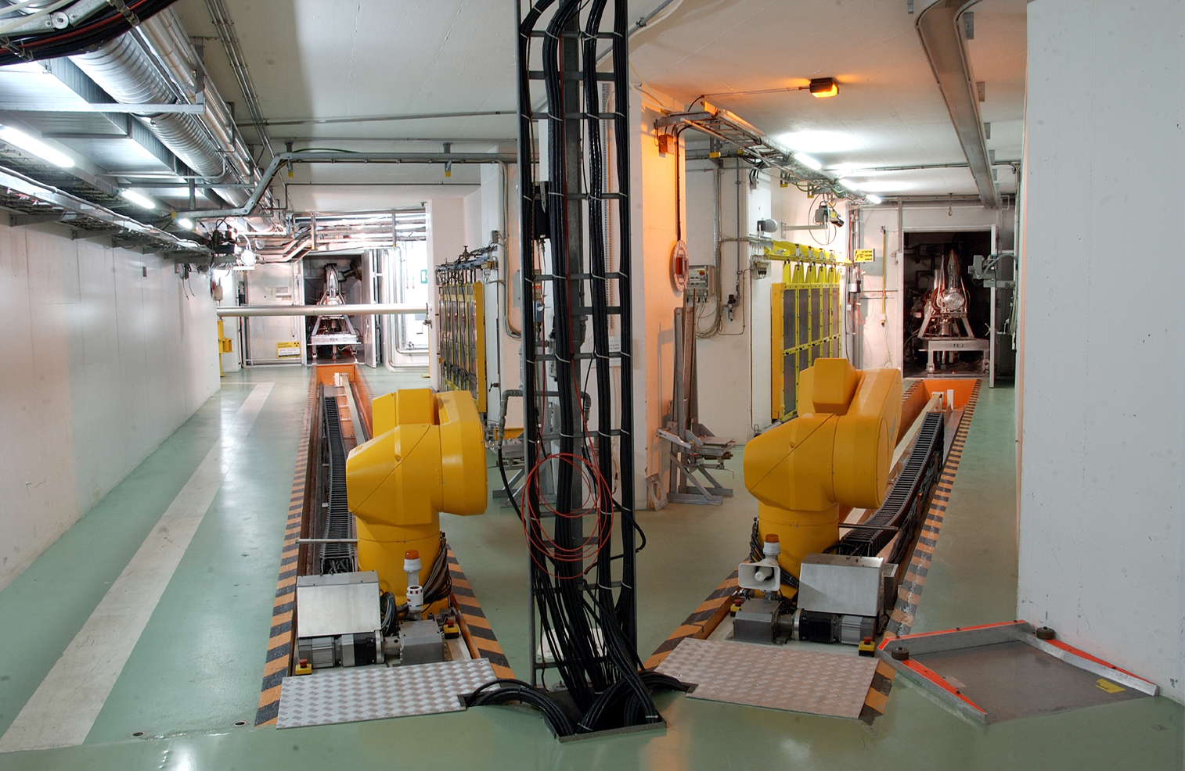
What was the aim of the project
Obsolete controls leading to unacceptable failure rate
No remote recovery options
Needs of evolution regarding the evolution of the facility
In operation since 1992

Slide 5
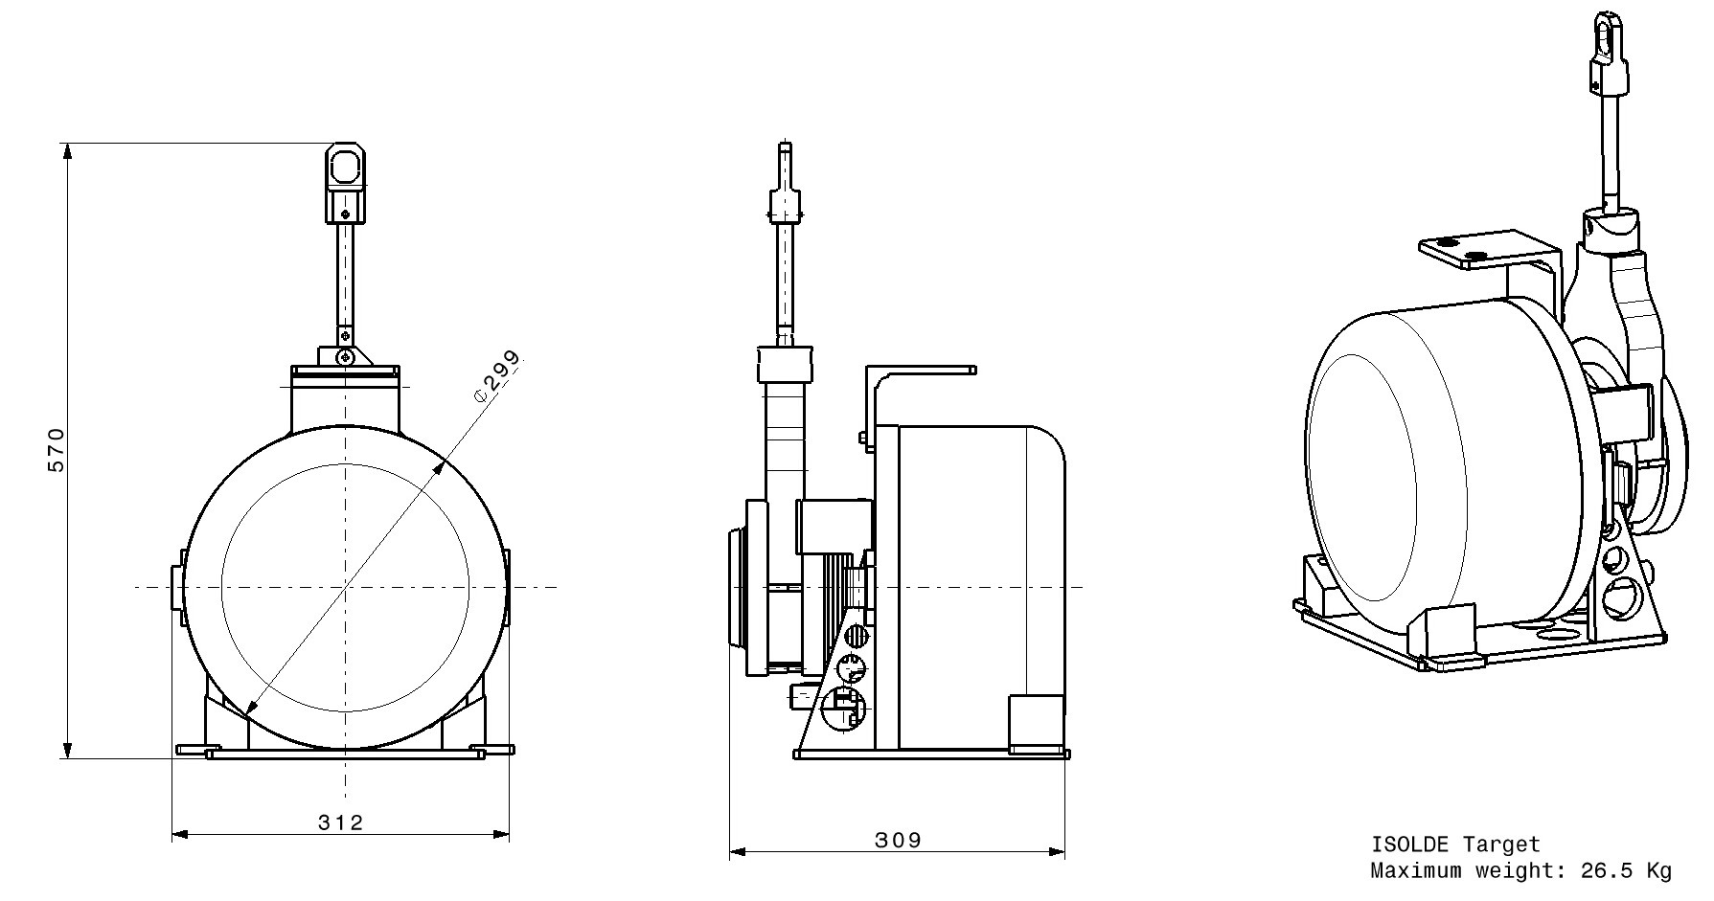
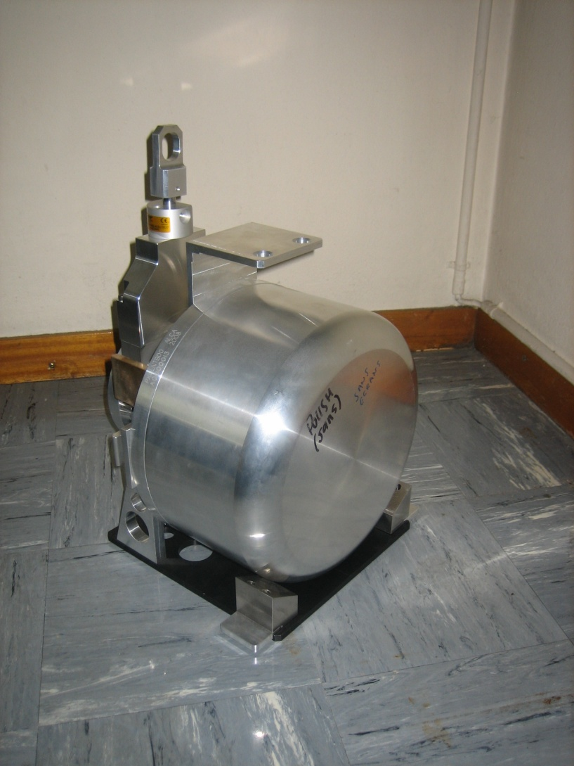
What do the robots do?
Exchange of the targets of the ISOLDE facility
The robots are part of the process of the facility
At ISOLDE ~30 targets exchange/years

Slide 6
How the robot have been selected?
Study of the radioactive environment
  Based on operational records
  Fluka simulation
  Major constrain for the system in term of operation, maintenance and failures scenarios
  Approach on Radiation To Electronics (and Radiation To Material) : see Ruben Garcia Alia talk

Slide 7
Doserate decay - During the target exchange
-On the target 160mSv/h at 10cm after 3 days of cool down
5
2
4
3
6
7
1
1
-On the robot actual storage place ~0.5mSv/h after 8h of cool down
Sort of particles emission : γ

Slide 8
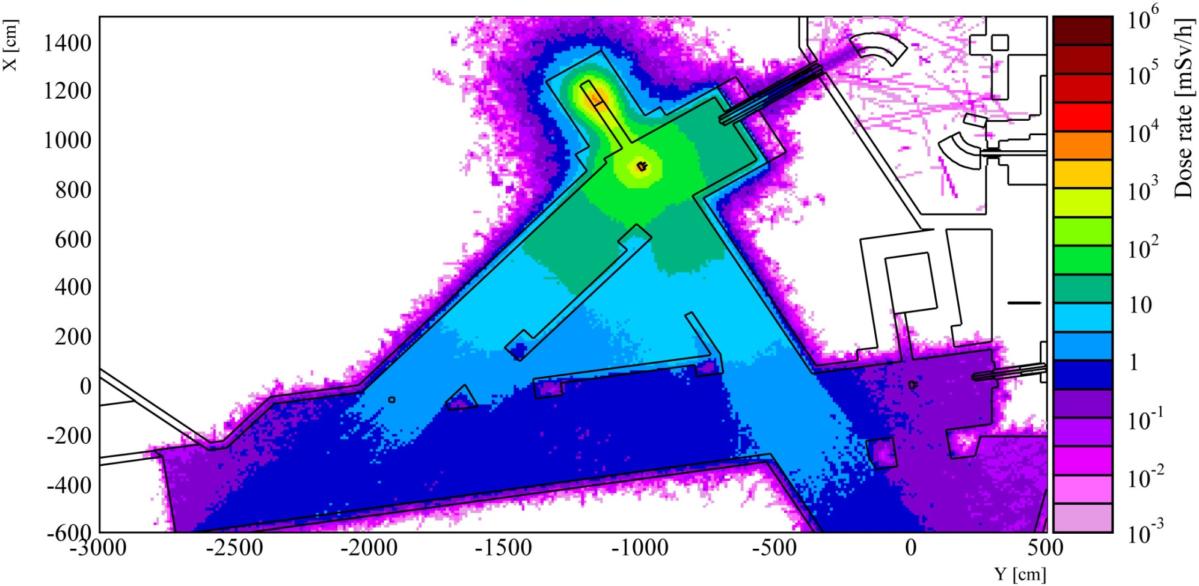
Example of residual dose rate map (72 h CT)
Most of the beam absorbed in the beam dump (shielded)
Several Sv/h on contact of the target (after 72 h of decay)

Slide 9
Actual integrated dose during 1 year of operation
-Integrated dose
15 kGy/year at 2.3m from the target (30⁰ from impact point)
5
2
4
3
6
7
1
1
-Excepted
integrated dose
0.5-1 kGy/year
During the run
Sort of particles emission : n, p, γ…

Slide 10
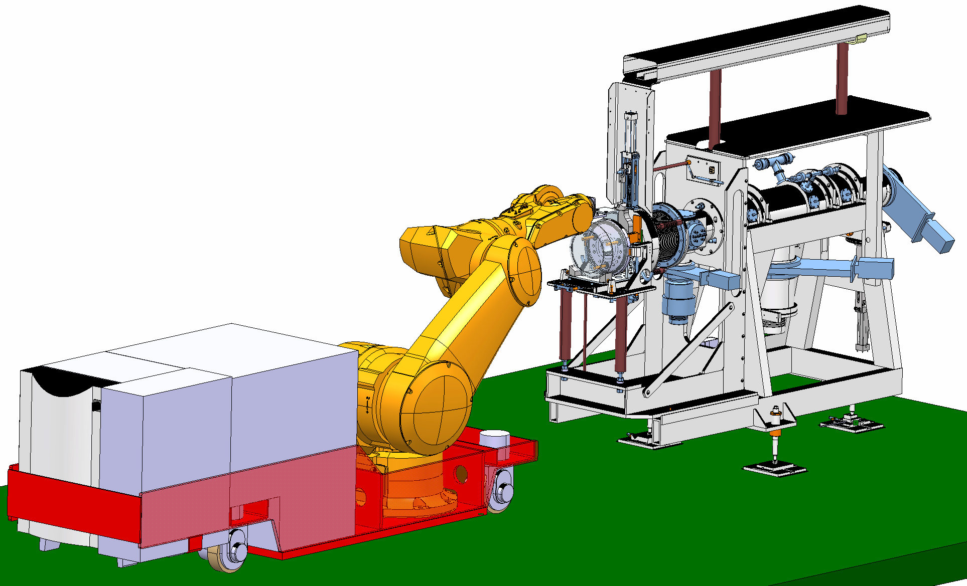
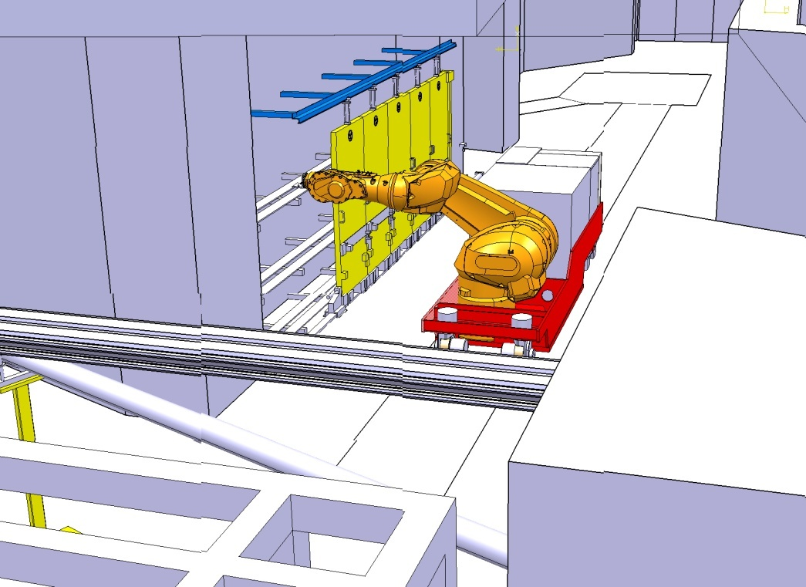
First idea: robot mounted on an AGV
Autonomous vehicle
Battery powered
Onboard controller
Navigation system integrated for positioning
Not retained
In case of failure all the electronics is onboard
No easy remote recovery!

Slide 11
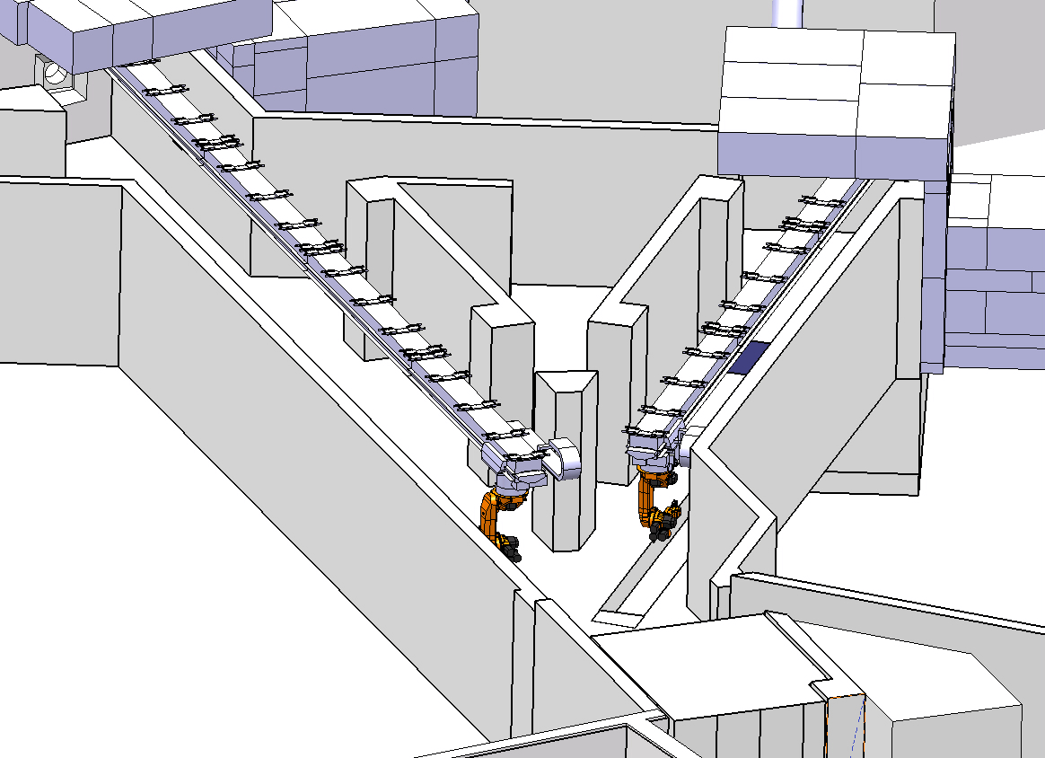
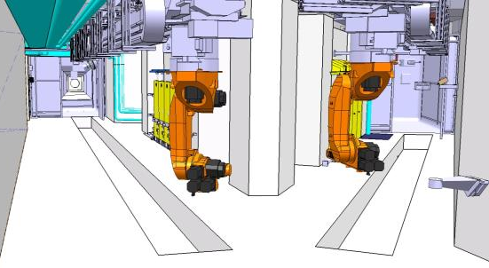
Solution adopted
Two industrial robots mounted on a linear axis

Slide 12

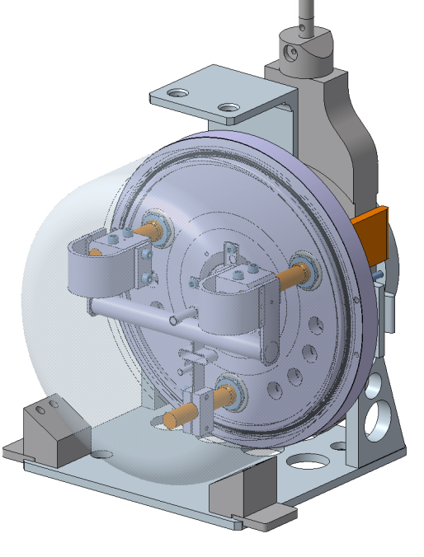

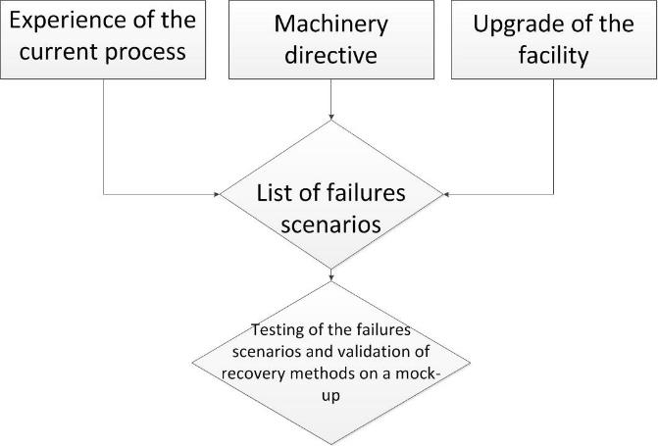
How to decide between those options

Slide 13
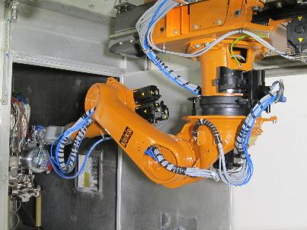

Specificity of the ISODLE robot
Concept base on an industrial robot mounted on a linear axis
KUKA K60L45-3CF (specific options to resist radiation)
Resolver positioning technology
No electronic* on board (see next slide)
Safe robot

Slide 14
No electronic inside the target area
CERN has moved the electronic out of the target area ~60m distance between robot and electronic board
Installation of longer cables tolerant to radiation for robot application (custom built cables from a cable manufacturer)
Capability to bypass the embedded temperature sensor of each motor
Installation of radiation tolerant connectors
Design of a radiation tolerant specific gripper (interface between the target and the robot)
Specific design of the trajectories and the control system
Capability to replace all electronic components without intervening inside the target area

Slide 15
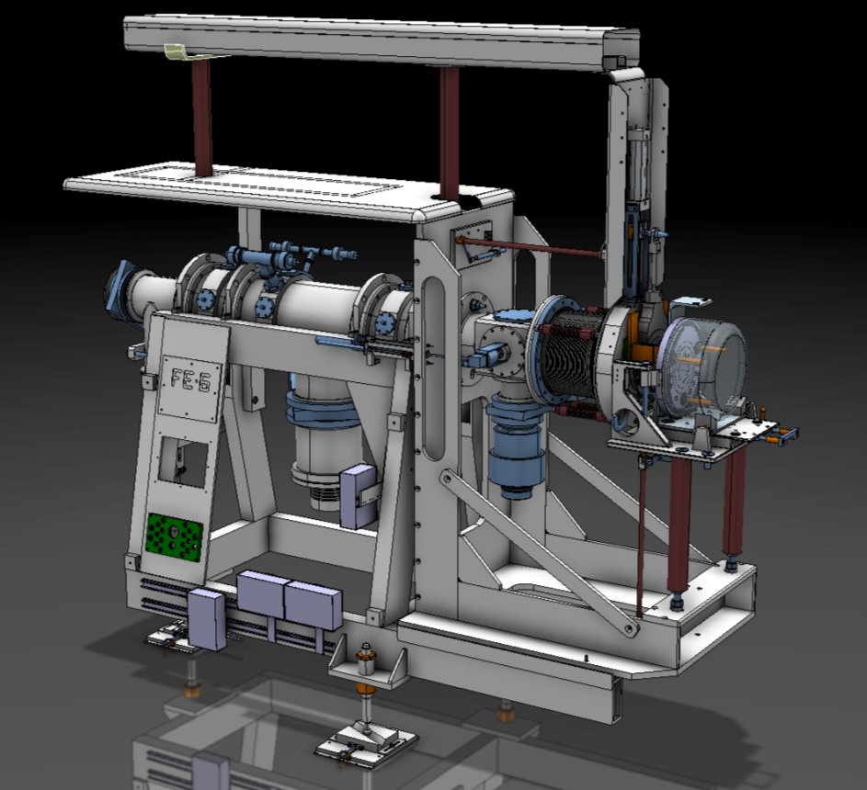
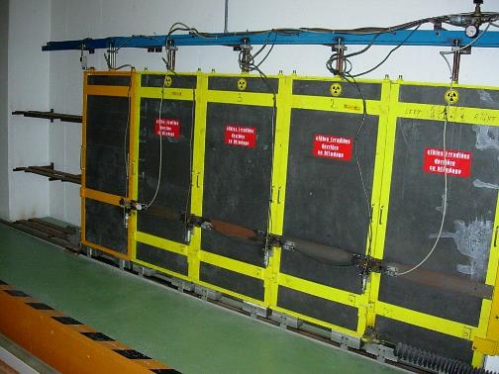
Design and integration of the system
Has to be compatible with the various interface of the facility
Front End
Storage shielded sleves

Slide 16
Risk analysis for the refurbishment of the target exchange system
Experience of the current process
  List of failures during operation with the existing system
Machine directive
  Standards (human aspect)
  Facility aspect (protection of equipment installed in the area)
Upgrade of the facility
  New risks caused by the robots
  New risks caused by the change of the process

Slide 17
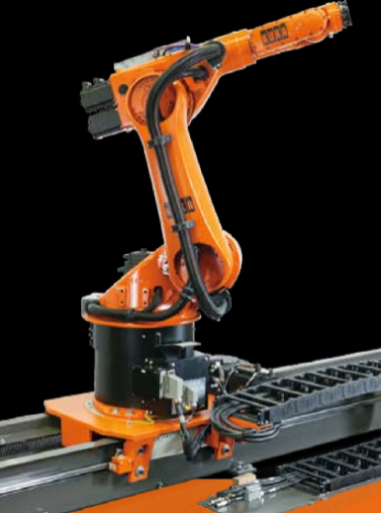
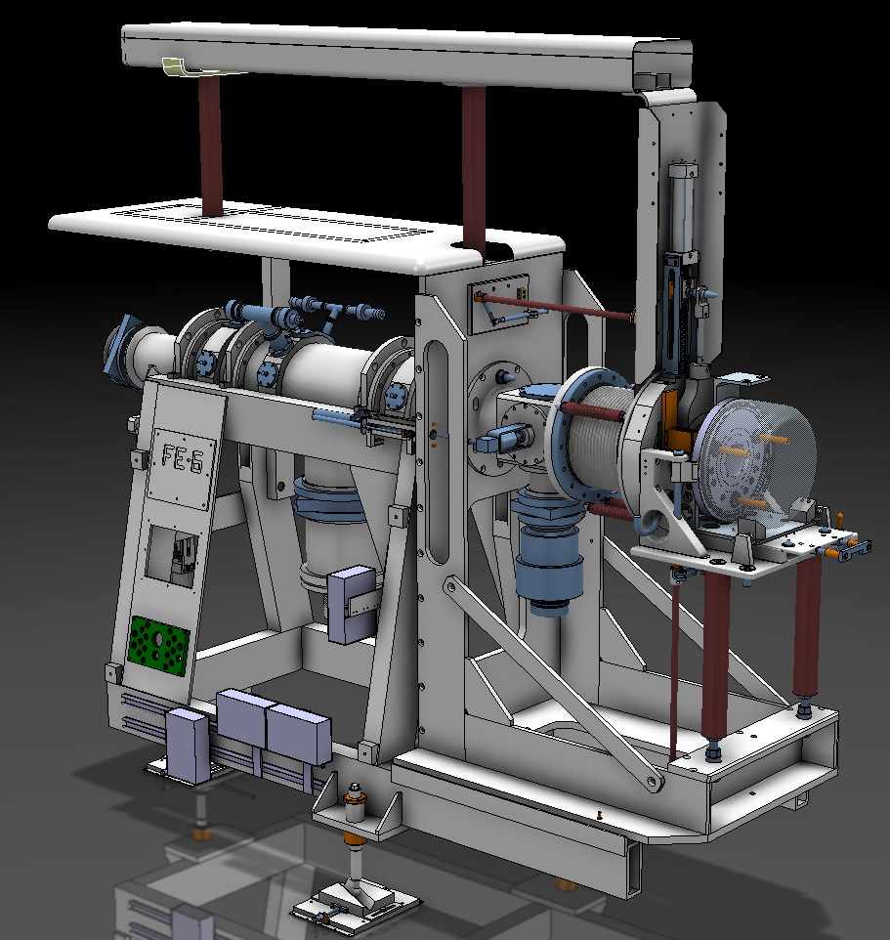
Risk analysis for the refurbishment of the target exchange system
List of 40 failures scenarios
  Include the robots
    Motors
    Cables
    Control
    Gripper
  The interfaces with the robots
    Front ends
    Shielded storage shelves
    Exchange point
    Faraday cage
    Beam Line
    Building
They all include the criticity, and a solution for correcting the failure identified

Slide 18
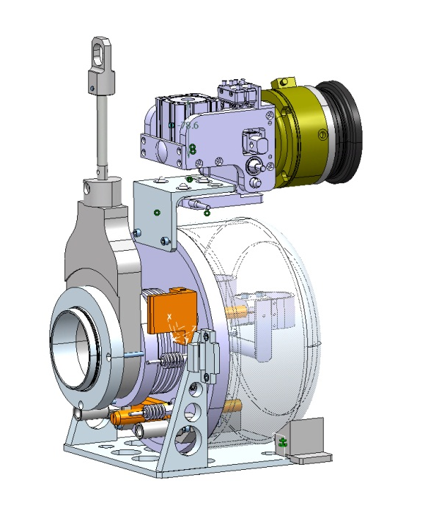
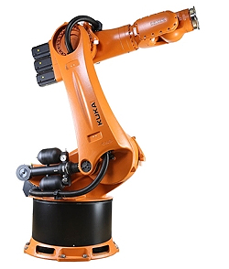
Risk analysis for the refurbishment of the target exchange system
Design change of parts of the process to avoid failures
  New gripper with redundant functions
  Implementation of feedback of each status
  Control system include recovery method
  No electronic on the hot area
  Based on an industrial robot

Slide 19
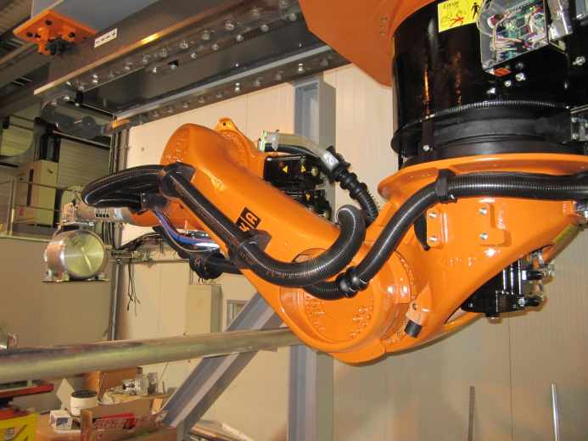
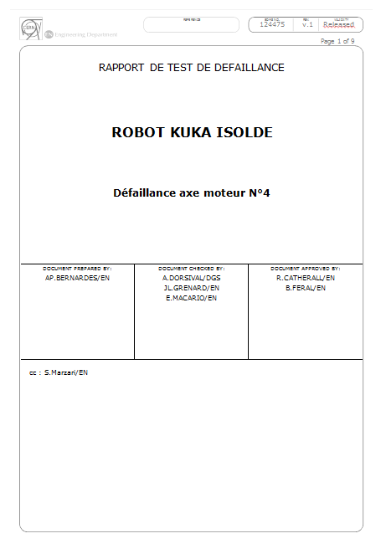
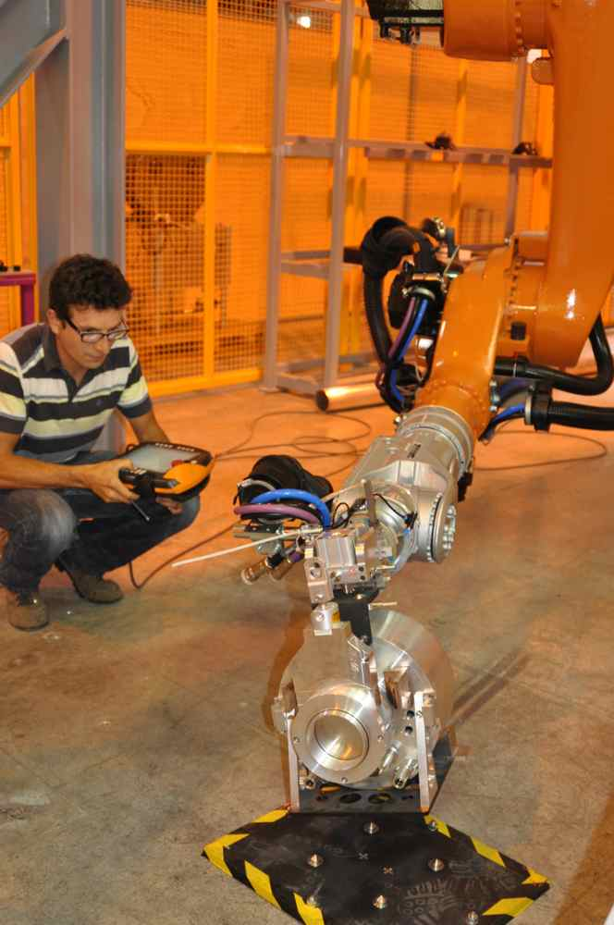
Risk analysis for the refurbishment of the target exchange system
Testing of the failures scenarios
    Simulation of failures on full scale mock up
    Recovery methods
    Test report
All this process are part of the safety file of the target exchange system

Slide 20
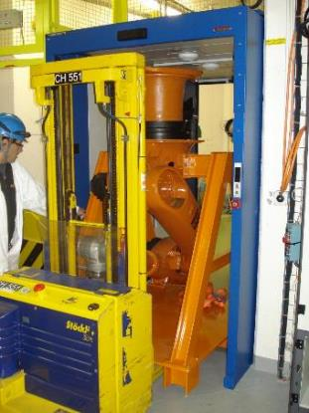
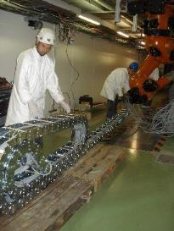
Design and integration of the system
Has to fit (and enter) in the target area
Has to fit with the radiation levels present in the target area
Prevent any damage in case of a clash between any interface

Slide 21
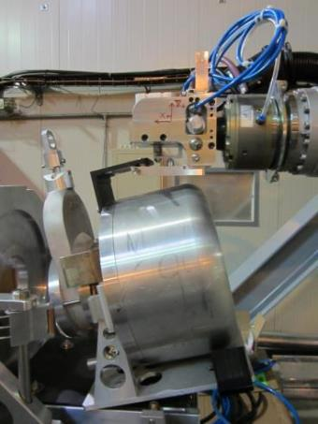
Recovery capabilities
Possibility to bypass all the conditions in order to finish a cycle or get read of the target
Supervision system which guarantee a safe monitoring at any moment of all the actuators during the trajectories
Collision release mechanism at the gripper flange
Check of the conditions at the start of the execution of a cycle
A series of tests has been made in a mock up

Slide 22
Advanced recovery capabilities
In case of major failures other remote recovery technics exist
Visual inspection with a remotely controlled ‘’train’’ or with a mobile robot
Intervention with remotely controlled robot(s)
See Eloise Matheson talk

Slide 23
Feedback of about ~8 years of operation
About 700 operations performed for the ISOLDE target area
Operation of the robot at 15% of maximum operational speed (sufficient for our operational needs)
One failure directly linked to the robot:
    Presence of silicon based temperature sensor embedded on the robot motors (was not identified at the stage of robot selection)

Slide 24
Evolutions of the system
Additional experiment installed in 2017 inside ISOLDE -> MEDICIS
https://medicis.cern/
Production of radioactive isotopes for medical applications
  New handling capability
  Highly activated targets
  Automatic transfer of targets from / to the target area

Slide 25
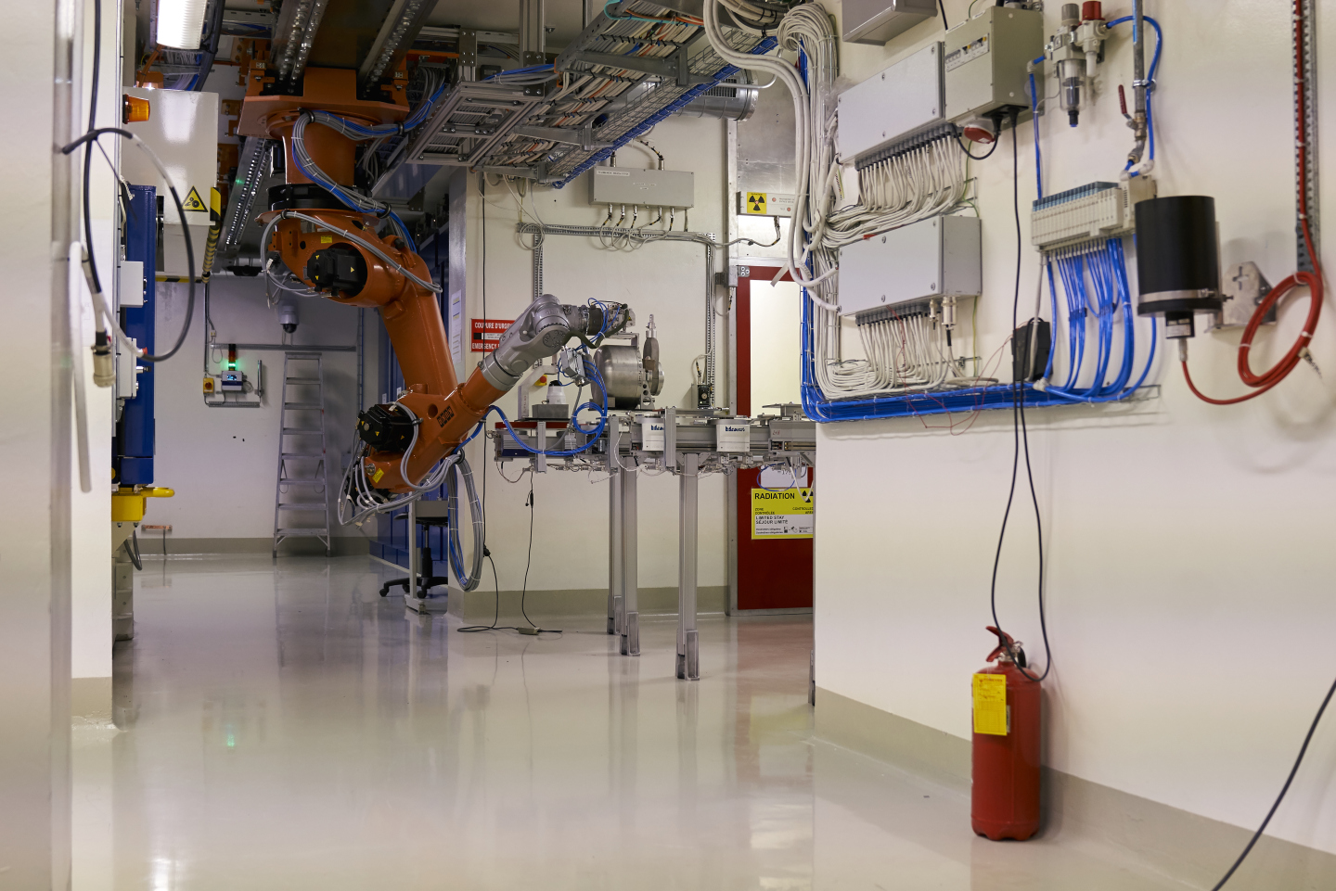
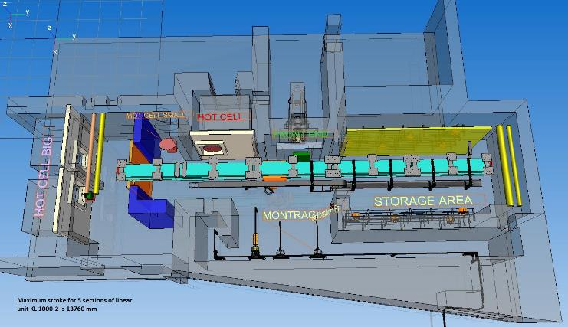
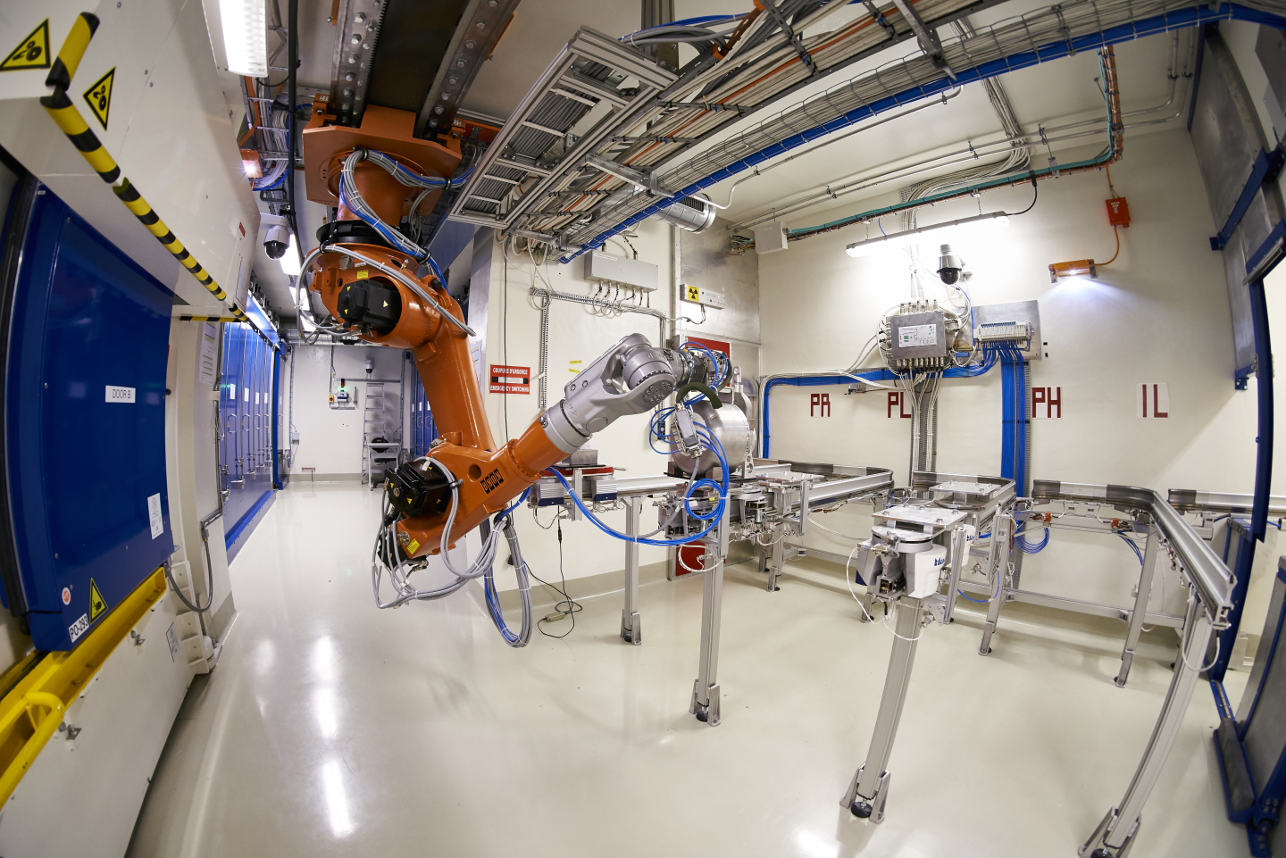
MEDICIS robot
Exactly same concept applied as at ISOLDE
Apart absence of prompt radiation

