Slide 1

Proposal Writing
Sep 3 2022 IDPASC, Olomouc
Ilona Skordis Gottwaldová
Project STIMUL - CZ.02.2.69/0.0/0.0/18_054/0014658

Slide 2
As a scientist you are a professional writer
TRUE
FALSE
Notes:
science articles, grant applications, grant reports, job applications, motivation/cover letters, peer reviews, recommendation letters, posts on your website...
WHO WOULD HAVE THOUGHT SO?
WHO OF YOU WENT TO PHYSICS TO BE A PROFESSIONAL WRITER?
How much time, then, does spent writing? You ref. point being FTE.
WHAT DO YOU HAVE TO DO IF YOU STILL WANT TO DO SOME PHYSICS?
YOU NEED TO WRITE EFFECTIVELY. In 1 hour, I cannot teach you to write effectively. But I can promise you that in one hour I can give you some tools that will help you to get there.
I will start with an example: BASKET

Slide 3
IDEA
So what!
…is it enough?
Notes:
What happened here. How come that these got funded and these did not? 30 people 30 brilliant ideas. Were they new? Original? MOST LIKELY --- Is it enough?
There are many new and original ideas - SO WHAT! When NO ONE CARES. WHY DID noone care? WHY DID THESE ENDED UP HERE? They were not RELEVANT!

Slide 4
Relevance
Why do they care?
…is it enough?
Notes:
Draw a circle. This is your context. SUM OF ideas relevant in your field. INFLOW AND OUTFLOW OF IDEAS. Einstein theory of relativity, ether out. Who DECIDES whether these IDEAS are RELEVANT? --- PEOPLE. Community. Who are they? (Your bibliography? Conference speakers? Peer reviewers --- your evaluators)
HOW do they decide what s relevant? BASED ON WHAT? It is not arbitrary, right? They have to CARE. BUT, why DO they care?

Slide 5
Value
REFOCUS
…is it enough?
Notes:
Because these ideas are valuable. And these three succeeded, because they made their ideas valuable. They have created value. HOW? ---- Le t me ask you:
When do YOU care? When SOMETHING IS LACKING, SOMETHING IS MISSING, SOMETHING IS UNRESOLVED…OR SOMETHING COULD BE BETTER, MAKE YOUR RESEARCH BETTER…YOU are interested, you BECOME interested, you start to CARE.
We have established, that our idea has to be relevant, and it is relevant only if it has a value.
WE have to create value. But is it ENOUGH? REFOCUS.

Slide 6
Problem
Love your problem, not your solution
…is it enough?
Notes:
When we start writing our proposals/craft our arguments, its tempting to start sharing our ideas as soon as possible. We GENERALLY OVERESTIMATE HOW MUCH OTHER PEOPLE ARE INTERESTED IIN WHAT WE FIND FASCINATING. What interests US. And it is a problem. That is why we need to refocus, we have to abandon our idea and instead START with a Problem. Once you love your PROBLEM, not your IDEA, your solution, there are benefits. IF you love your problem you will be writing with you customers/readers in mind.

Slide 7
IDEA PROBLEM
PROBLEM
SOLUTION
Notes:
We have reframed our idea as a problem, and it has brought us closer to our readers.
But there is this thing - in your science you find problems and your nature wants to take you to solution on as a straightforward path as possible. In writing the proposals you should resists this.

Slide 8
STRATEGY
PROBLEM
INSTABILITY
COSTS BENEFITS
SELF - INTERESTED READER
Notes:
SO what should be your strategy. In every problem there is INSTABILITY. SO, if you want to engage your readers you cannot go to the solution directly, you would lose them. Remember, they do not care that much.
IF MADE STABLE….What will be the BENEFITS ----IF LEFT UNSTABLE what will be the LOSSES . ANd only than you have a chance to get the SELF-INTERESTED READER and present your SOLUTION

Slide 9
Readers
Are they funding you?
…is it enough?
Notes:
SO, now know what you need to do to make your readers interested, to care. Why? Well, they will be sending your proposal for funding….or not. These readers are your evaluators. You need to convince them to get you funded.
But they are usually not those who fund you. Funders are.

Slide 10
Readers ≠ Funders
Notes:
Funders are not readers. Readers are their proxies. Readers want to understand what they already understand and understand it better. That is, they want to understand your science. Funders, on the other hand, do not want understand your science, they want to fund you. CHANGE SLIDES.

Slide 11
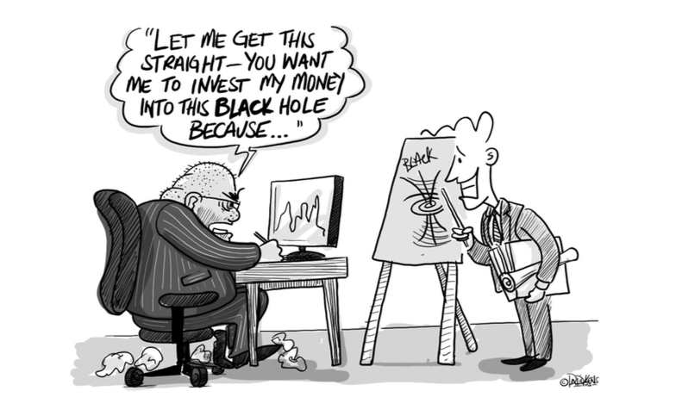
funders
Notes:
And,-- they want to know WHY they should fund YOU and what is in it for them.

Slide 12
Funders
…is it enough?
Notes:
Now you know that funders want fund you but.. Is it enough?
Obviously, you need to know who is the right funder for you, but once you know, you need to know WHAT THEY WANT.

Slide 13
What do they want?
Notes:
First, they want to know whether you are eligible?

Slide 14
Are you eligible?

Slide 15
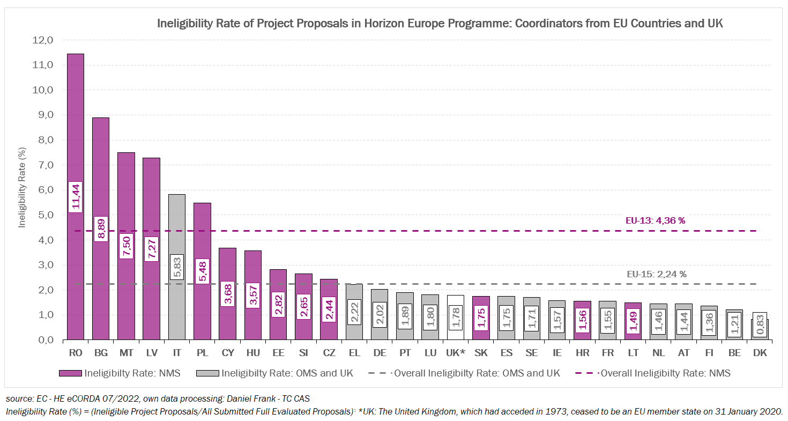
Elibility
Notes:
You would be surprised, but there is some huge space for improvement there….

Slide 16
What else do they want?
  Is your project feasible?
  Is it credible?
  Are there any risks?
  How will you implement it? (what will be done, who will do it and when)
  What impact will your project have? On whom?
Notes:
They a re investors, right, so they want to know what the impact of their investment will be:
societal, economic, technological

Slide 17
Proposal - Typical components:
Case for support—justification of your science idea and work plan
Pathway to impact—the benefits that will come from your work, who the potential stakeholders are and how will you reach them
Dissemination and Communitation Plan—how you will share results with others
Track record—how your experience fits the proposed project
Project management plan—timelines and responsibilities
Risk management plan—identification, minimization and mitigation of project risks
Justification of resources—an itemized budget linked to the work plan
Curriculum vitae—structured
Abstract, key words, title
Notes:
How do these questions translate into the forms? These are typical components and you will be able to find them more or less in all applications.
Some of them are more difficult than others to address. I have chosen…NEXT Slide

Slide 18
Impact
  Think of your research project (current or past) and respond to these requirements.
2.2 Suitability and quality of the measures to maximise expected outcomes and impacts, as set out in the dissemination and exploitation plan, including communication activities
Translation:
Please, describe how you will share your results with others in your research area and beyond and with the general public.
2.3. The magnitude and importance of the project’s contribution to the expected scientific, societal and economic/technology impacts
Translation:
Please, tell us what effect the results of your project will have on your research area; is there an application potential; what will be the effect on the economy; will society in general benefit and how? Indicate how substantial will the impact be and in what time horizon (short term, medium term, long term).
Notes:
Funders present their requirements in the most peculiar manner. But do not get discouraged. There is a way.

Slide 19
Abstract
Read Abstract 1 – both versions. Which one was funded and why?
Read Abstract 2 – both versions. Which one was submitted and why?
Abstract components:
  What is missing?
  What needs to be done?
  Why now?
  How are you going to do it?

Slide 20
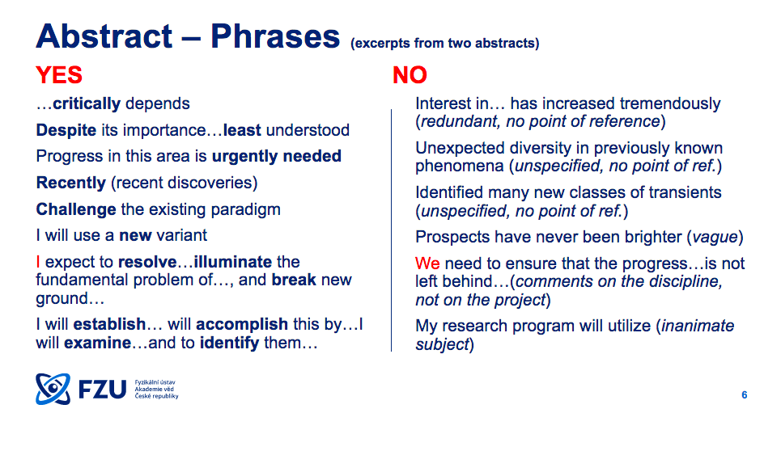
Abstracts

Slide 21
OFTEN UNDERESTIMATED
KEY WORDS and DESCRIPTORS
ACRONYM
TITLE
ABSTRACT
ADMINISTRATIVE FORMS
TIME TO DEADLINE (evergreen)
UNFORESEEN CIRCUMSTANCES
Notes:
YOUR EVALUATORS ARE CHOSEN BASED ON THESE.
SIMPLE, IDEALLY 2 SYLLABLES, EASY TO PRONOUNCE, MEMORABLE.
THE SHORTER THE BETTER
ADMIN. FORMS – LANGUAGE BARRIER, UNCLEAR REQUIREMENTS

Slide 22
IT TAKES ALWAYS LONGER THAN YOU THINK
THINGS DO HAPPEN:
  the supervisor/colleague leaves for holidays/conference
  the grant office has 20 other proposals to attend to
  the Letter of Intent needs to be signed by the Legal representative, who is not available
  Your computer crashes
  The application portal is “on strike”
  inserting a picture keeps shifting you margins
  the admin parts take ages to fill in, you do not know how to answer several questions it is Tuesday, 4.45, deadline is at 5, there is no one to ask.
  Your baby gets born earlier than you expected
Notes:
And there are unforeseen circumstance…

Slide 23
What is out there?
National Funding Agencies
Fellowships
Universities/Research Institutes
Horizon Europe

Slide 24
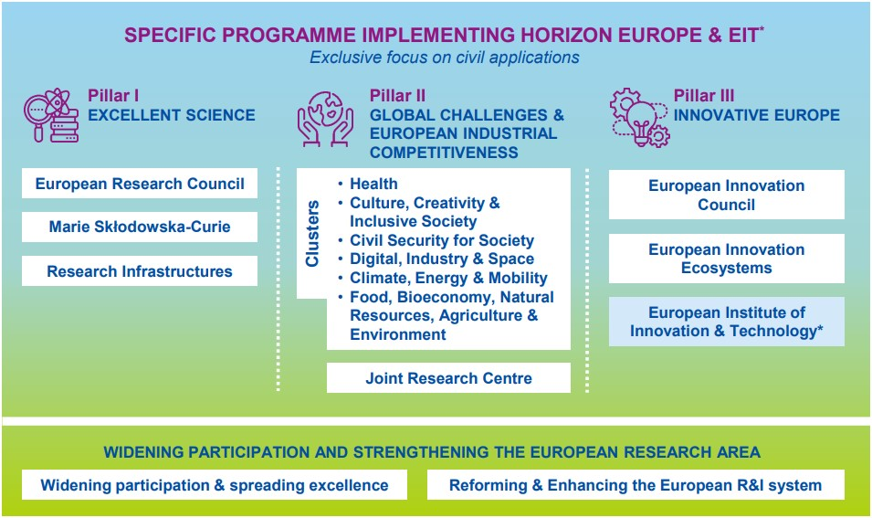
What is out there?
https://ec.europa.eu/info/funding-tenders/opportunities/portal/screen/programmes/horizon

Slide 25
Follow up:
How to Fail in Grant Writing:
https://www.chronicle.com/article/how-to-fail-in-grant-writing/
The Craft of Writing Effectively:
https://www.youtube.com/watch?v=vtIzMaLkCaM
How to Speak:
https://www.youtube.com/watch?v=Unzc731iCUY
Stylish Academic Writing:
https://www.youtube.com/watch?v=IE-TTz13P7w

Slide 26
HAPPY WRITING!

