Slide 1
The Beam Synchrotron Radiation Halo Monitor (BSRH)
Gustavo Sousa, Enrico Bravin, Georges Trad, Daniele Butti
2nd SY- BI Students and R&D Meetings, ZOOM, 11.03.2022

Slide 2
Outline
Synchrotron Radiation
  Beam Halo
Halo Monitor
  Previous Design on the LHC
New Design
  Optics
  Physical Optics Propagation Simulations
  Integration on the LHC BSRT Optical Table
  Components Procurement
Experimental Setup
  ISR
  LHC
Optical Performances
Conclusions

Slide 3
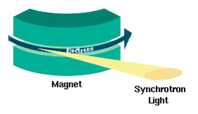
Synchrotron radiation
Electromagnetic radiation emitted when relativistic charged particles are subject to an acceleration perpendicular to their velocity
Allows for a non destructive measurement of the transverse beam distribution
  BSRT
At the LHC, these measurement devices can be found on IP4
Wikipedia, Synchrotron radiation
Enrico Bravin, HL-LHC Meeting 2017, Madrid

Slide 4
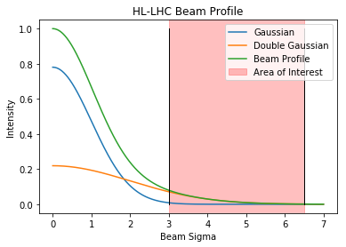
The Beam Halo
Definition
  Mathematical [1]
  Particles in between the beam core (3σ) and the limits set by the primary collimators (6.5σ) [2]
Halo population (above 3σ)
  Lead to loss spikes through orbit jitter
  Damage to collimators or other components
Halo measurements
  Determine effectiveness of equipment that influences the halo
    Hollow Electron Lens
  Failure of crab cavities

Slide 5
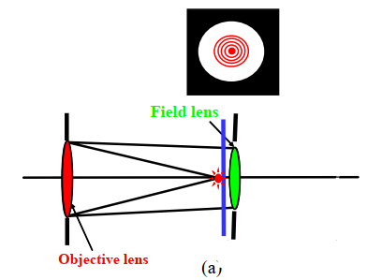
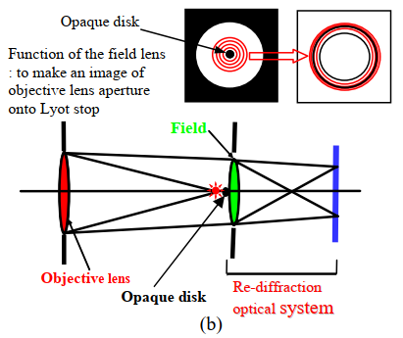
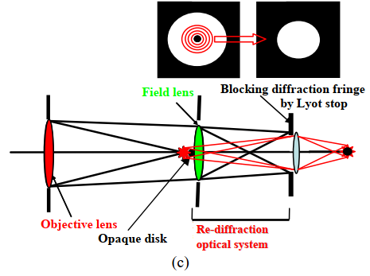
The Halo Monitor
Proposed by Toshiyuki Mitsuhashi [3]
  Objective Group:
    Entrance Aperture limits the light input and creates diffraction
    Objective Lens focus the light source on objective plane where there’s an opaque disk
  Field Group
    Opaque Disk blocks the core of the light source
    Field Lens focus the diffraction created by the Entrance Aperture to another Aperture (Lyot Stop)
      Being close to the opaque disk, this lens does not affect the optical path of the light source already blocked by the opaque disk
  Relay Group
    Lyot Stop blocks the diffraction created by the Entrance Aperture
    Relay Lens focus the resulting light (without core and without diffraction) to the final Image Plane
  Eyepiece (optional, not on picture)
    In case the final image plane needs to be magnified

Slide 6
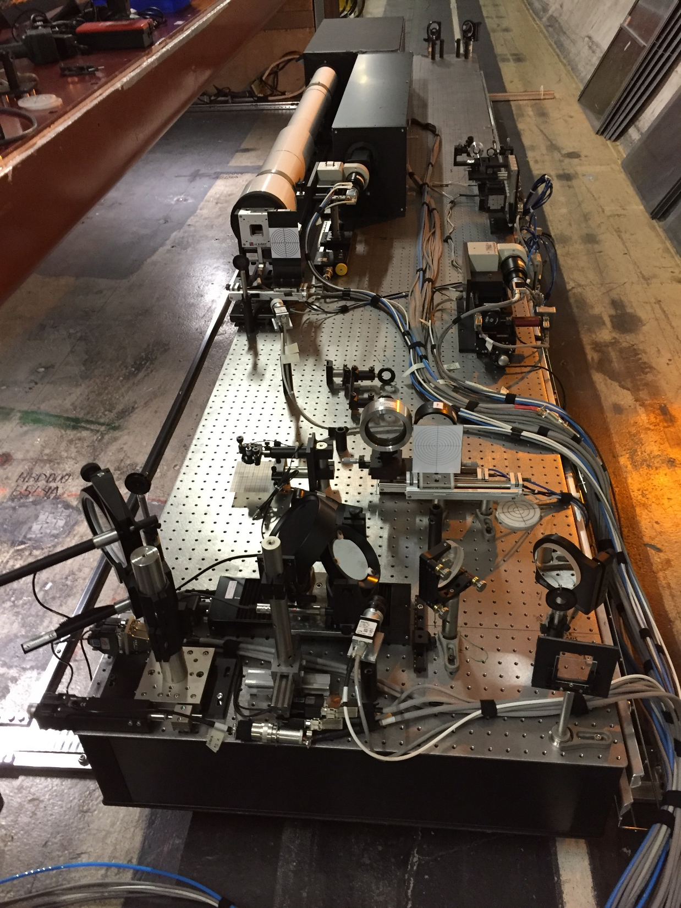
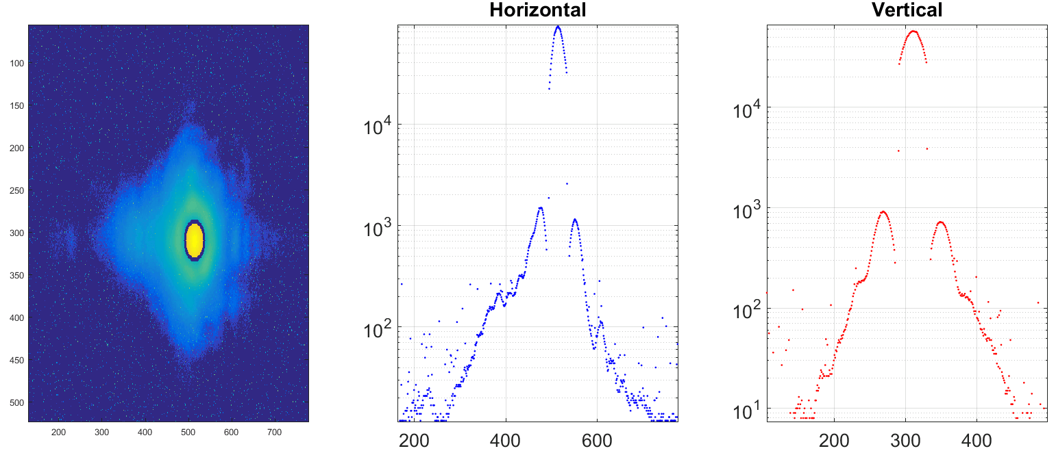
The Halo Monitor on the LHC
Mostly using optics inherited from KEK coronagraph
Demonstrator for proton beams
  Max. achievable contrast:10⁻³-10⁻⁴
    Needed 10⁻⁵ [2]
  Contrast limitation 1st stage MAG
    Higher magnification needed (0.5) [4]
    Mirrors instead of lenses (less noise)

Slide 7
New Optical Design (ZEMAX)
Made in ZEMAX (now OpticStudio)
  Abused the engts02 server (sorry guys)
  Script programing in BASIC
  Boundary Conditions defined in merit functions
    Mirror properties
    Distance between elements limits
  Optimizations with thin lenses
    Easy to match with off the self optics afterwards
  Tolerancing
  Light source from different positions
 | Previous System | New System
Distance from entrance aperture to core mask | 2.3m | 2.4m
Total size | 4.5m | 6.9m
Magnification at Core Mask | -0.077 | -0.5
Magnification at Lyot Stop | -0.556 | -1
Magnification at Image | 0.046 | 0.1
PSF Objective Group | PSF Field Group (source at dipole) | PSF Field Group (source at Entrance Aperture) | Relay Group

Slide 8
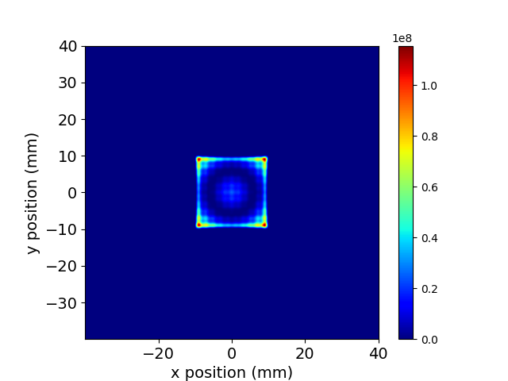
Physical Optics Propagation Simulations (ZEMAX, SRW)
Zemax
  Slow
  Hard (and slow again) to Iterate
    Even with the ZOS API (python)
Better solution found
  Synchrotron Radiation Workshop (SRW)
  Results similar to Zemax
  Expert: Daniele Butti

Slide 9
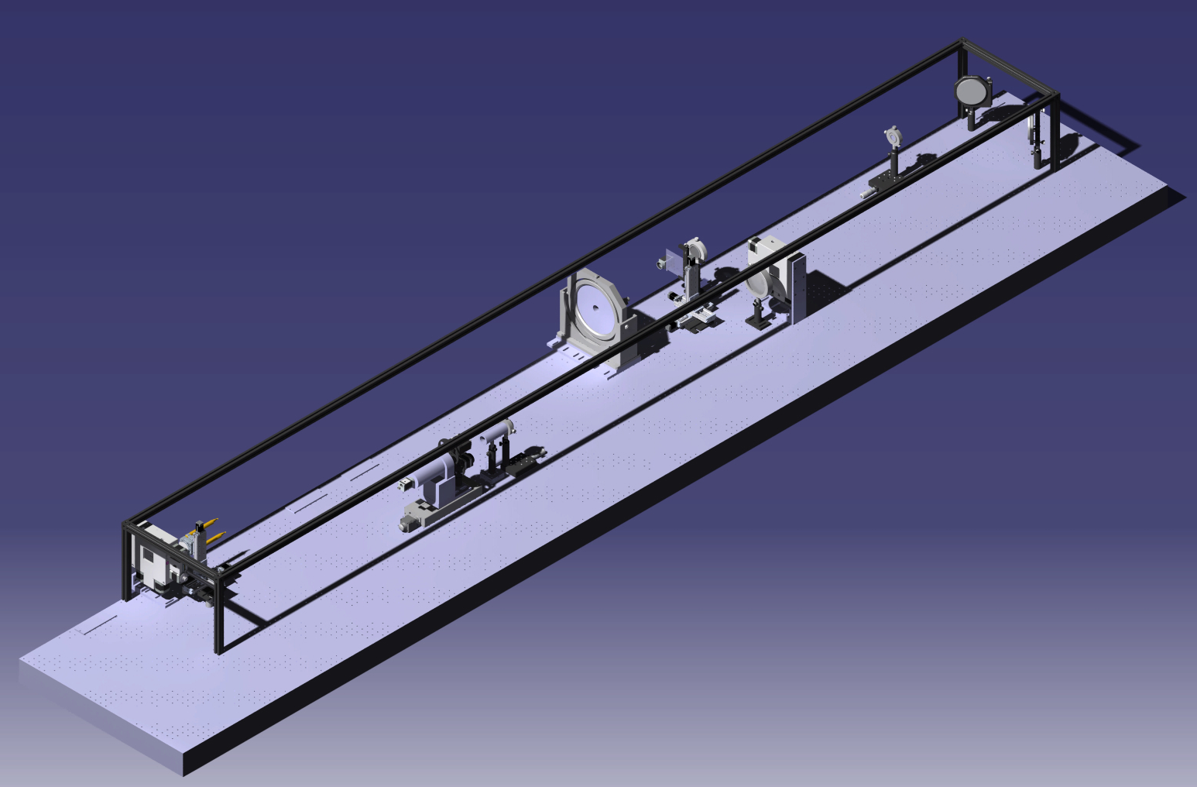
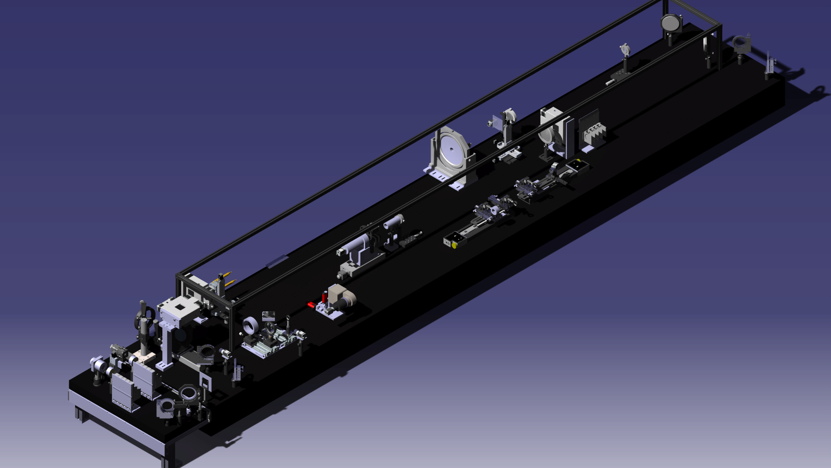
Integration on the BSRT Optical Table (CATIA)
Lots of constrains
  Space below the beam line
  Interference with the BSRT
Several redesigns had to be done
  There was always some incompatibilities
  Everything fits now
Redesigns only on software
  Practically the final version on the LHC
  No time wasted looking for solutions on site

Slide 10
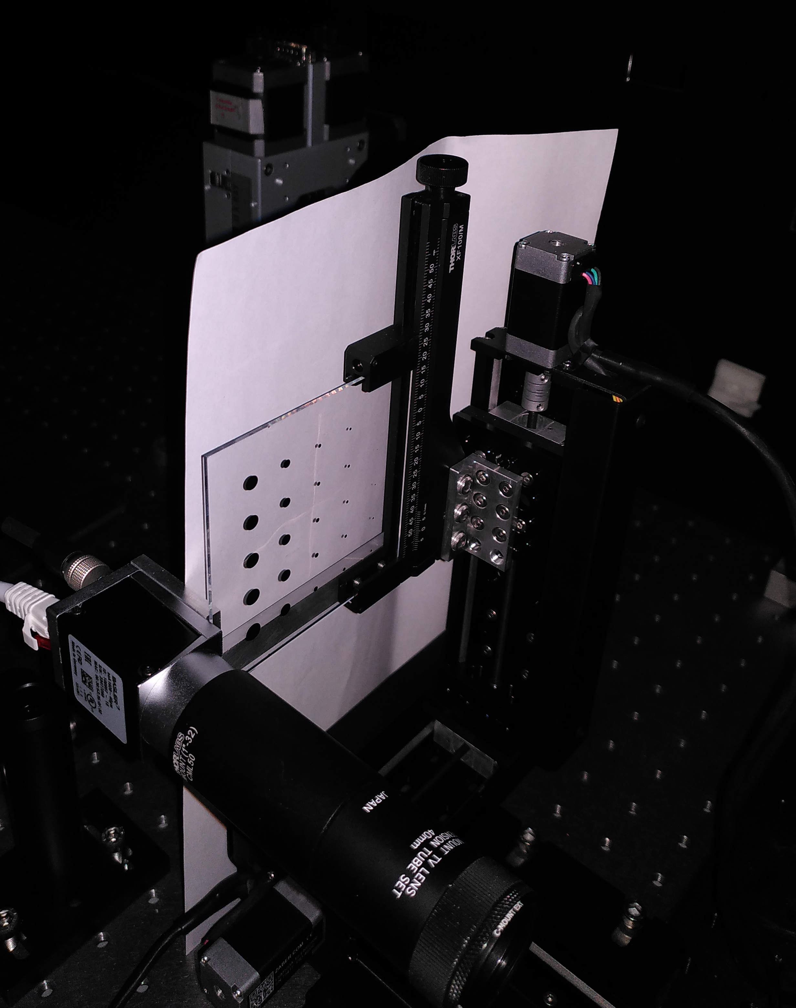
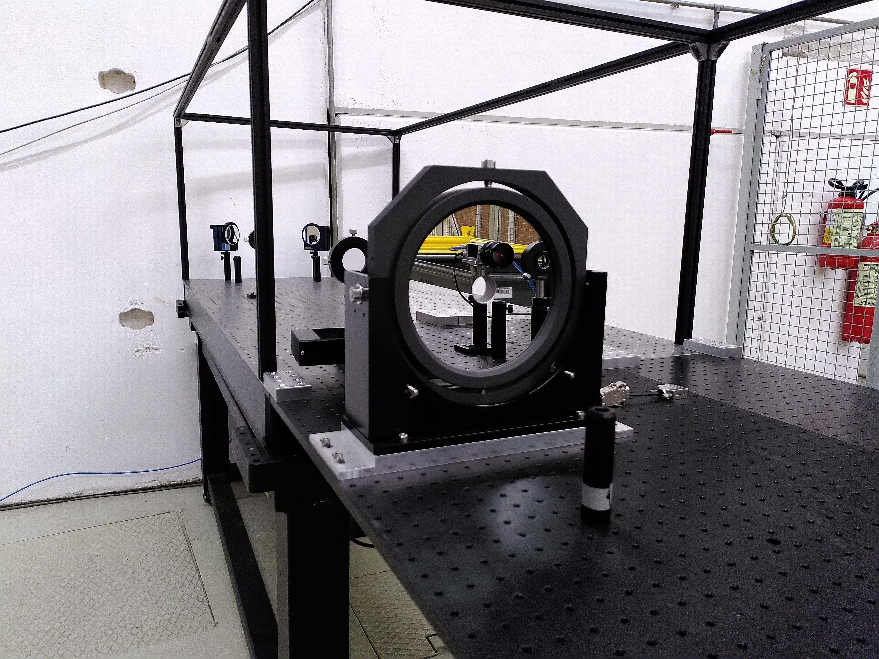
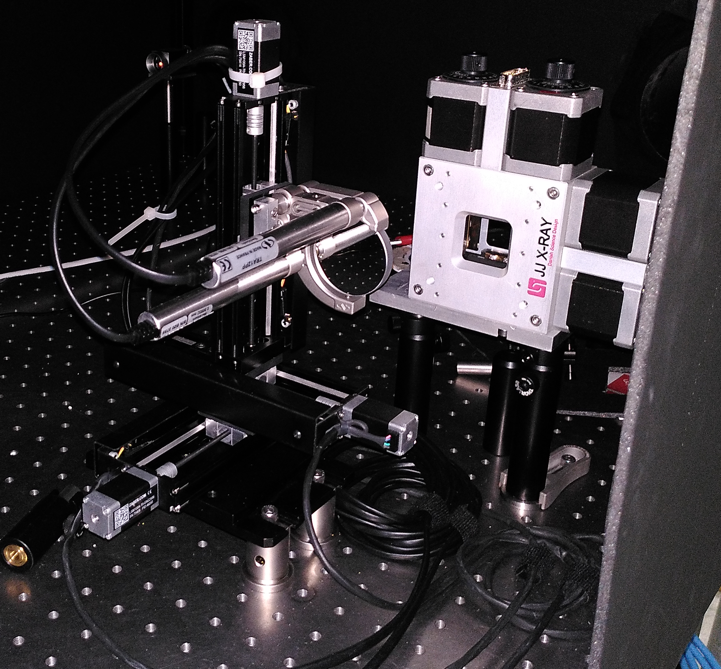
Component Procurement
Almost everything was off the shelf components
  Custom mirrors had to go trough procurement procedures
  Off the shelf translation stages also
  Custom core mask matrix didn’t need these procedures
Do whatever the procurement officers ask you to do

Slide 11
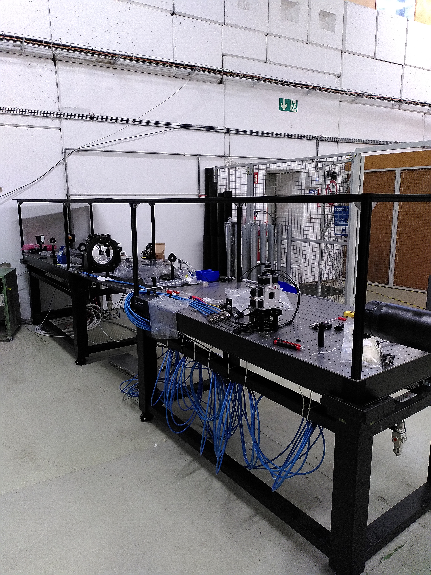
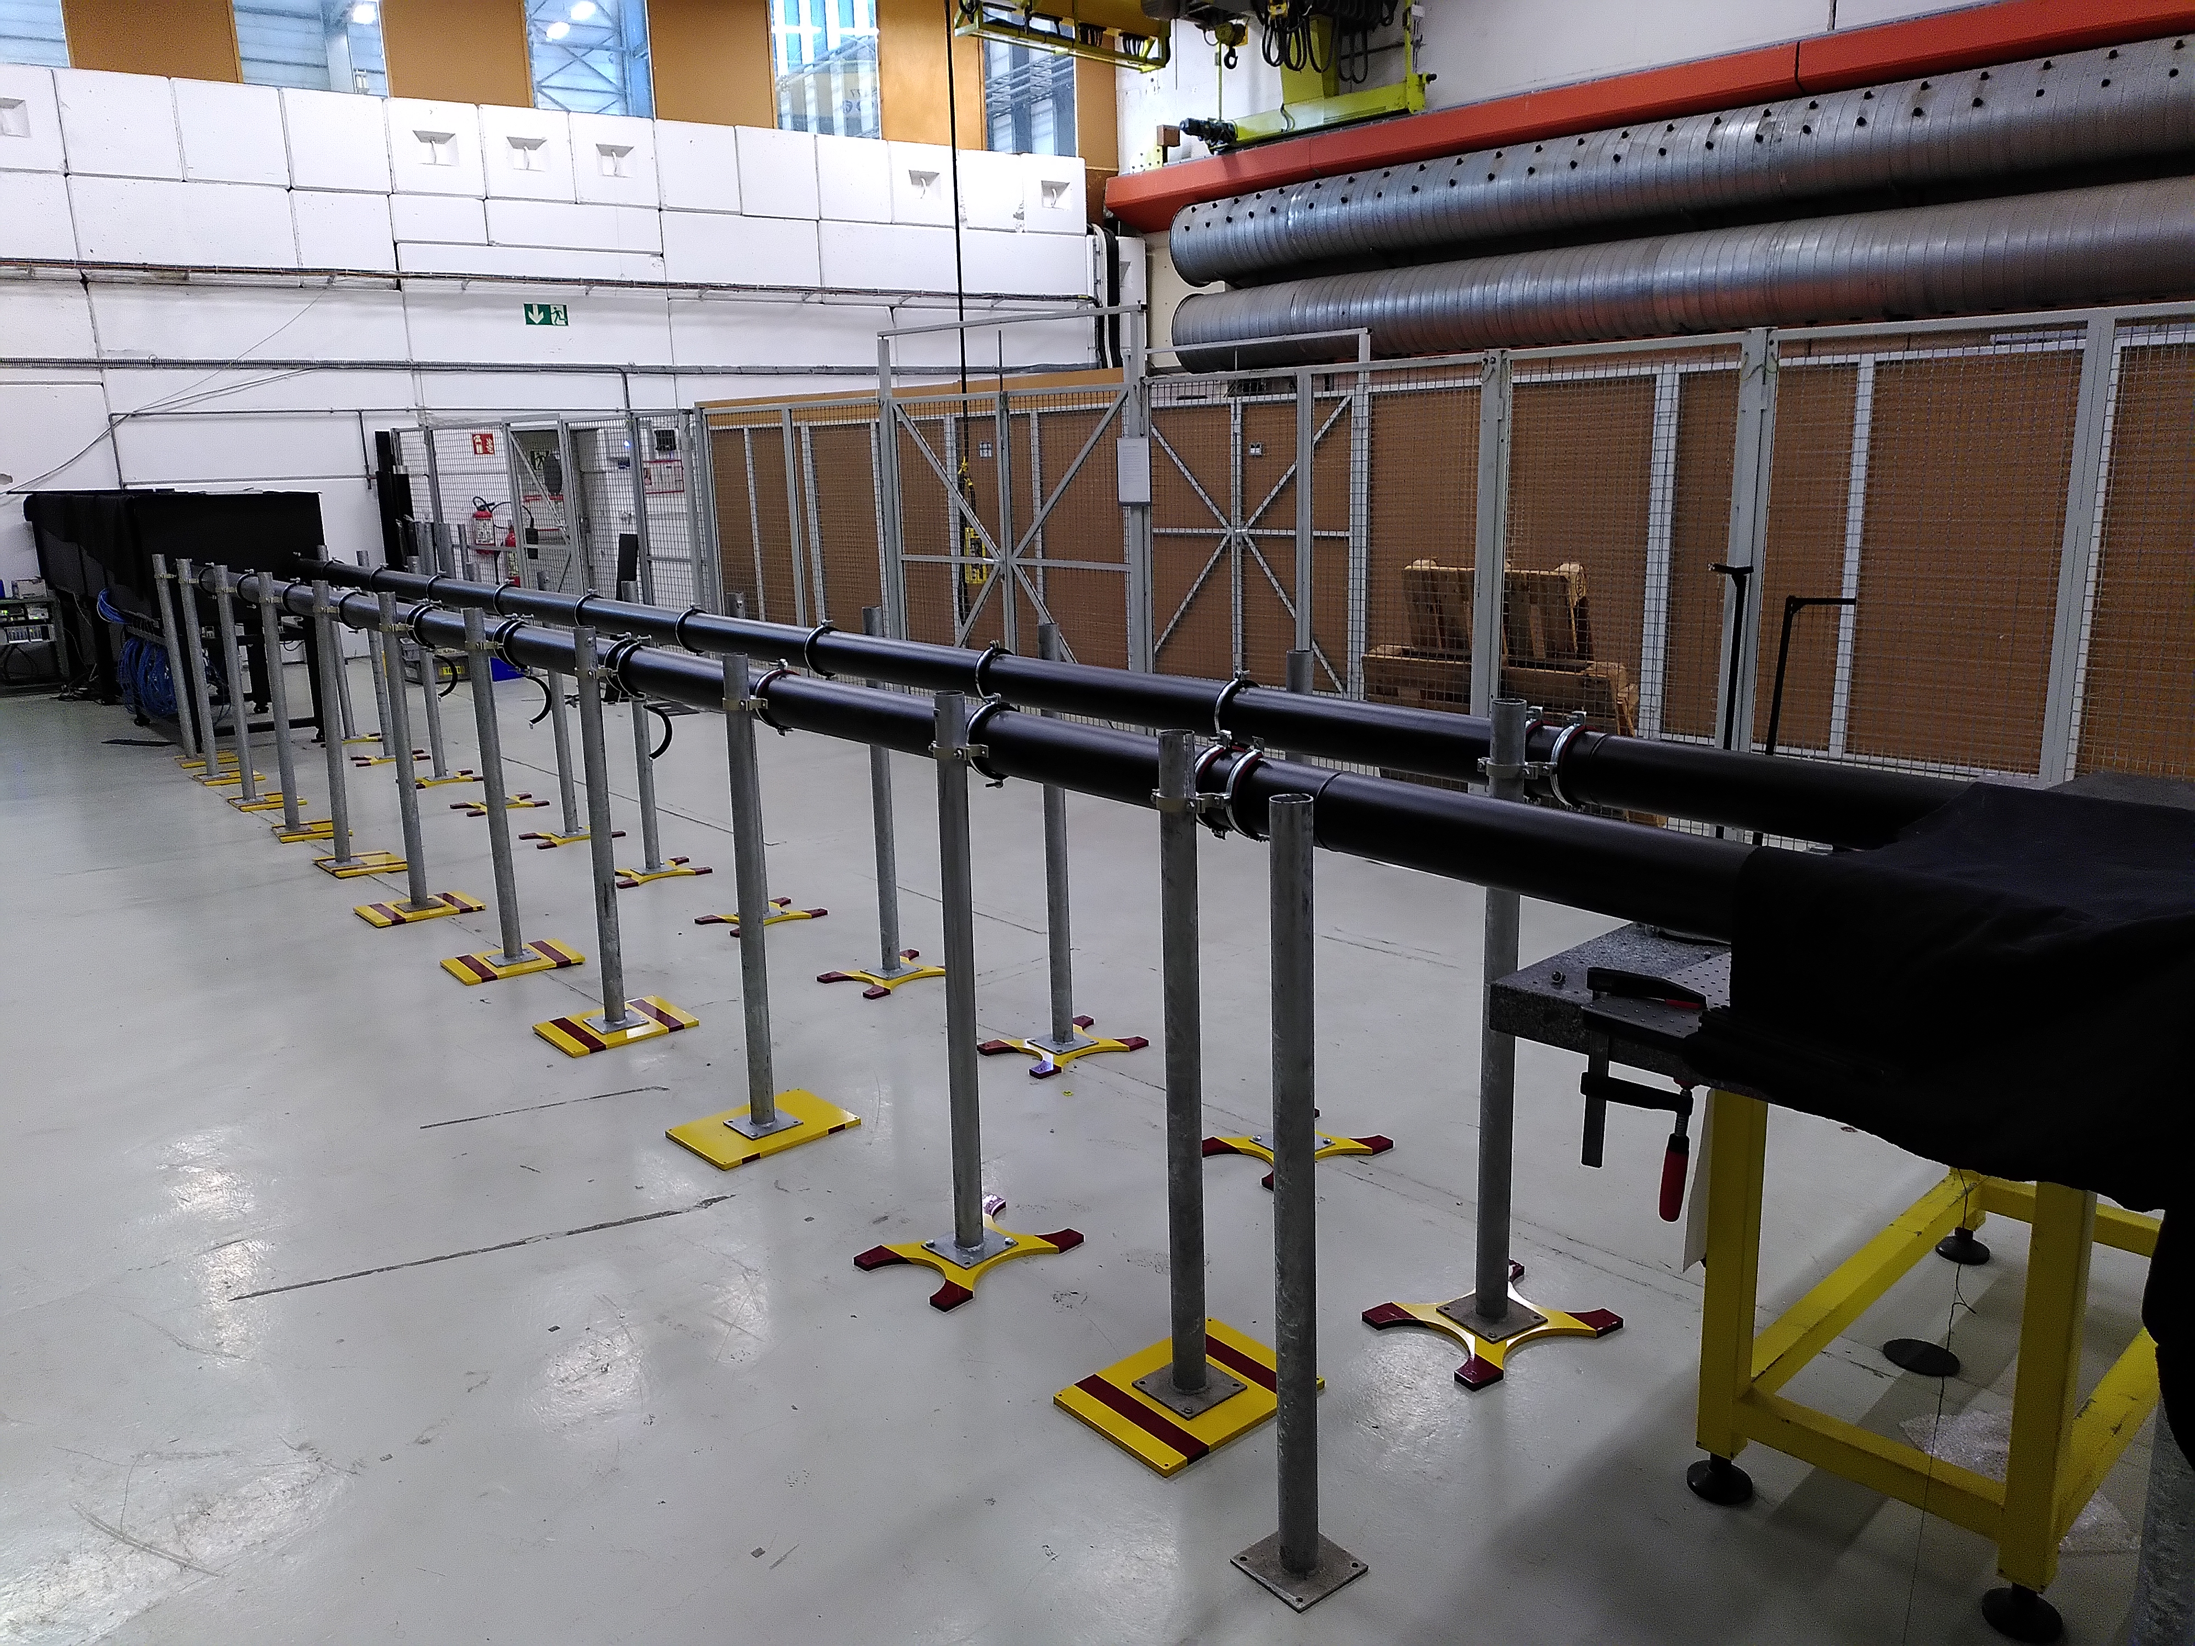
Experimental Setup - ISR

Slide 12

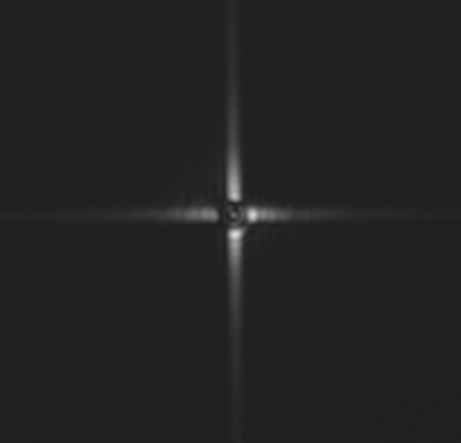
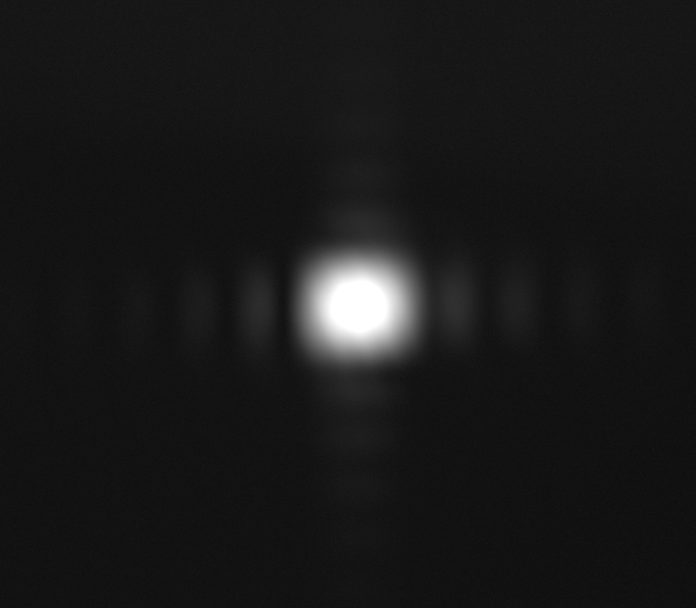
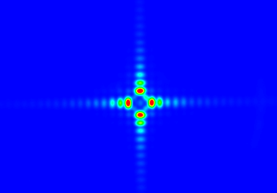
ISR – First Results
Test Bench for the BSRH located in the ISR
First results demonstrated that it worked
Installation important to determine what could happen during the installation on the LHC

Slide 13
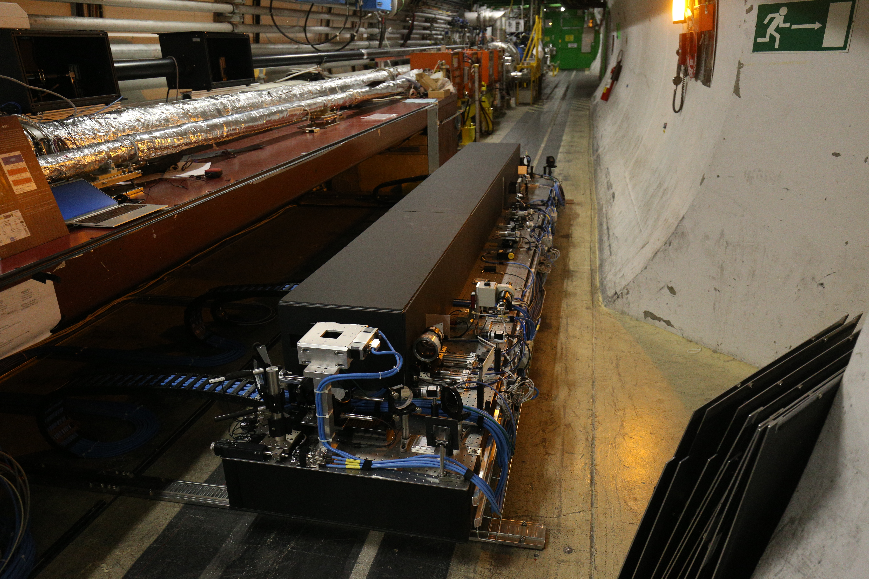
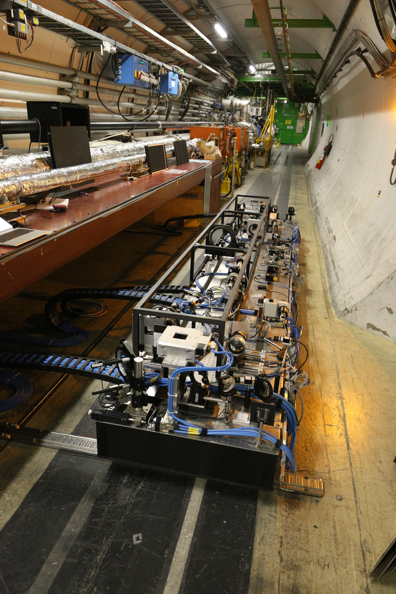
Experimental Setup - LHC

Slide 14
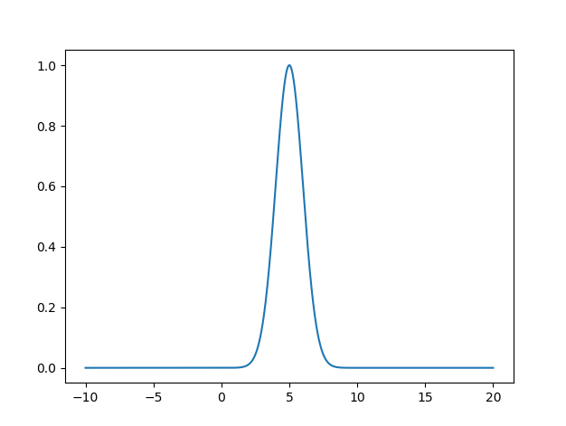
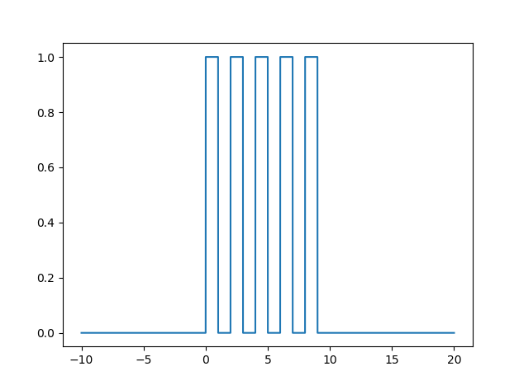
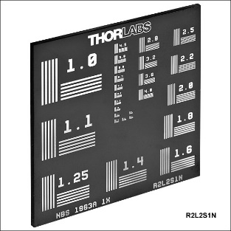
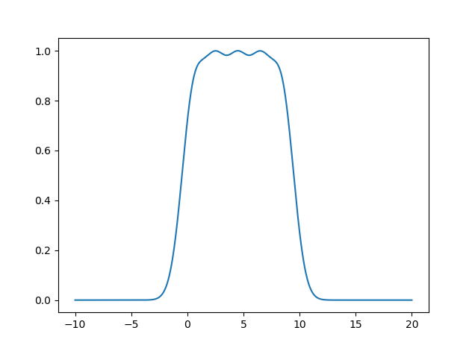
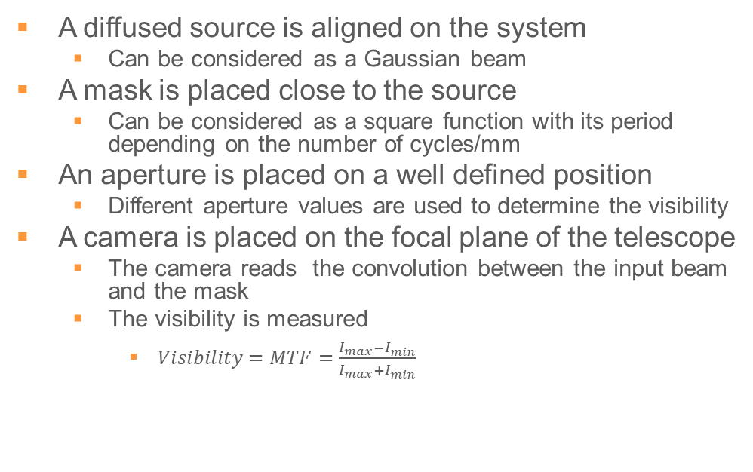
Optical Performance of the BSRH
A diffused source is aligned on the system
  Can be considered as a Gaussian beam
A mask is placed close to the source
  Can be considered as a square function with its period depending on the number of cycles/mm
An aperture is placed on a well defined position
  Different aperture values are used to determine the visibility
A camera is placed on the focal plane of the telescope
  The camera reads the convolution between the input beam and the mask
  The visibility is measured
    $Visibility=MTF=\frac{I_{max}−I_{min}}{I_{max}+I_{min}}$

Slide 15
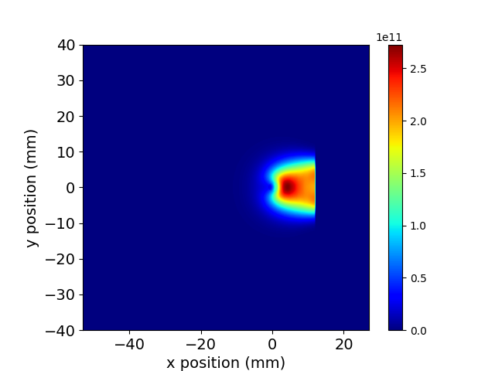
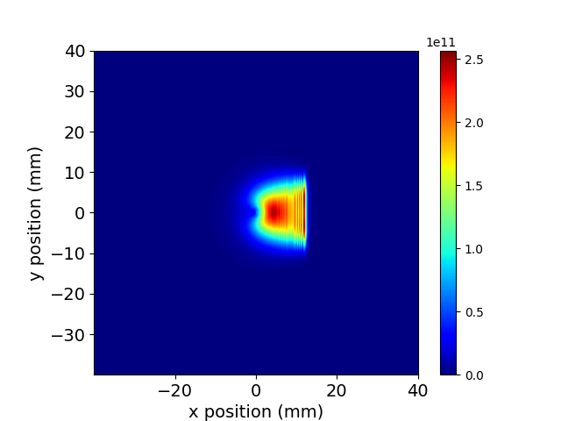
Optical Performance of the BSRH - Results
Results improved
  Removal of reflections from the diffusors close to the light source
  Removal of internal reflections from the entrance aperture slit
The results are still far from the theory
  Especially for smaller entrance apertures
The ISR might be too unstable for precise measurements
  The conditions improve at the end of the day and on weekends, but still not enough
An LHC test was to be performed on the last week of the LSS
  My son got corona…and then I got corona
Access to point 4 will be open on the 16 march
  A visibility test will be done on that day
  To be compared to what we have on the ISR

Slide 16
Conclusions
The Halo Monitor is an important device that, when it works, will be an important non evasive device for beam diagnostics in the Hi-Lumi era
  After talks with experts in the astronomy field, this might be challenging
The performance of the installed Halo Monitor was not yet fully accessed
  New tests need to be made, especially in another place
Designing, Optimizing, Simulating, Building and Testing this device has been an amazing journey
  Thank you very much to everyone that was involved

Slide 17

Afterword
CERN & COVID-19 : Moving to Level 1 – Green from Monday 14 March
  Hopefully definitively
Next meetings in person
  Next week, beer in R1?

Slide 18
References
[1] – Nghiem PA, Chauvin N, Simeoni Jr W, Uriot D. Beam halo definitions and its consequences. Proceedings of HB2012, Beijing China. 2012
[2] – Apollinari G, Béjar Alonso I, Brüning O, Lamont M, Rossi L. High-luminosity large hadron collider (HL-LHC): Preliminary design report. Fermi National Accelerator Lab.(FNAL), Batavia, IL (United States); 2015 Dec 17
[3] – [1] Mitsuhashi T. Beam halo observation by coronagraph. proceedings of DIPAC2005, Lyon, France. 2005 Jun 6
[4] – G. Trad, J. Barros, E. Bravin, T. Mitsuhashi, HL-LHC Meeting, 13-16 November 2017, CIEMAT, Madrid

Slide 19
Thank you

