Slide 1
CI Update
10/03/2022

Slide 2
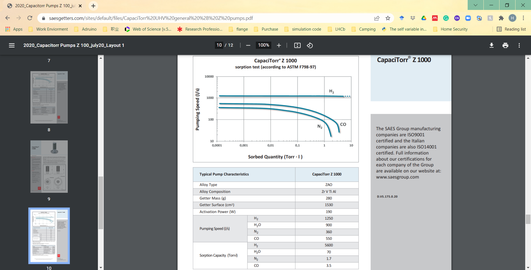
NEG property

Slide 3
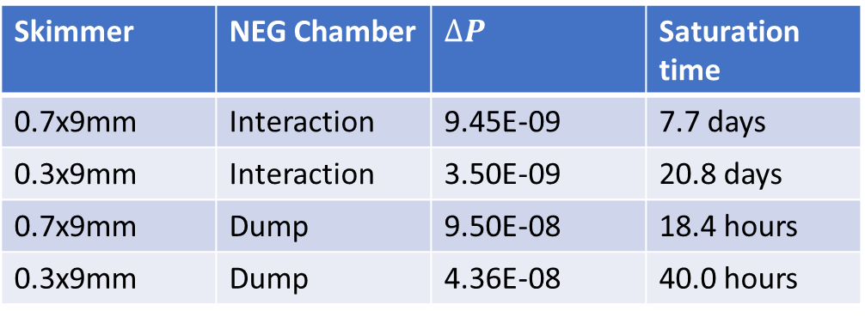

Saturation Estimates
$$t_{saturation}= \frac{Sorption capacity}{Pumping speed × ∆Pressure}$$
Where $∆Pressure= P_{Jet on} − P_{Jet off}$
All data recorded here with a 5bar N2 Jet
Skimmer | NEG Chamber | $$∆P$$ | Saturation time
0.7x9mm | Interaction | 9.45E-09 | 7.7 days
0.3x9mm | Interaction | 3.50E-09 | 20.8 days
0.7x9mm | Dump | 9.50E-08 | 18.4 hours
0.3x9mm | Dump | 4.36E-08 | 40.0 hours
Sorption capacity = 2.26mbar L
Pumping speed
= 360 L/s

Slide 4
NEG Explanation
Sorbed Quantity / mbar.L PV = nRT PV = mbar.L
Pump lifetime is extended due to not always pumping at 360L/s especially at very low pressure, pumping speed is a function of sorbed quantity.
Saturation defined as when entire NEG surface is covered and no longer pumps. We can define as when pressure is too high.

Slide 5
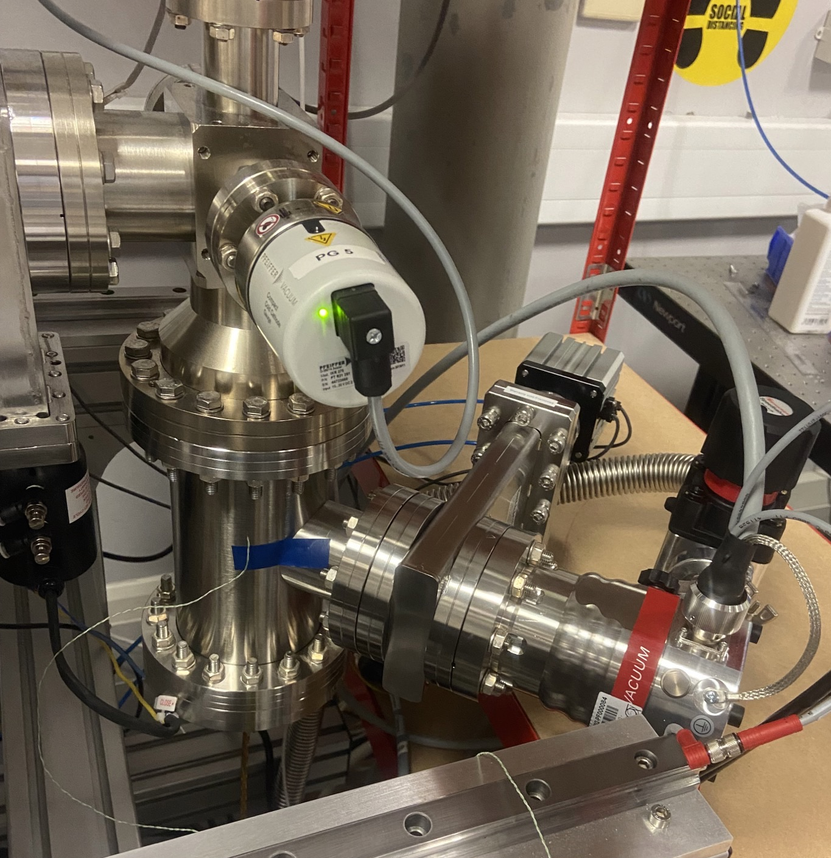
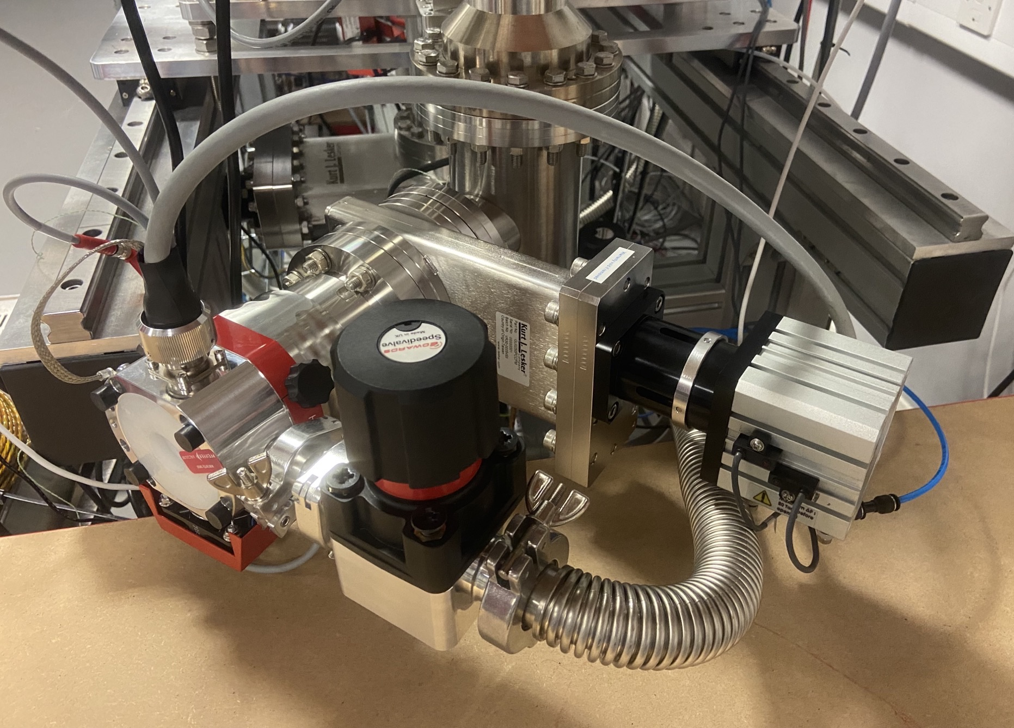
Neg pump installed in the Dump Chamber

Slide 6
Saturation Data (dump chamber)
NEG pumping speed reduced
Reaching equilibrium with diffusion pumping
0.3x9mm Skimmer, NEG at Dump
NEG pumping at 360L/s
0.7x9mm Skimmer, NEG at Dump

Slide 7
Saturation Data (interaction chamber)
0.3x9mm Skimmer, NEG at Dump
0.7x9mm Skimmer, NEG at Dump

Slide 8
Saturation Data (Skimmer 2 chambers)
Skimmer chamber 2 has relatively constant pressures
0.3x9mm Skimmer, NEG at Dump
0.7x9mm Skimmer, NEG at Dump

Slide 9
Saturation Data (Skimmer 1 Chamber)
Skimmer chamber 1 has relatively constant pressures with some increased noise towards the end of testing
0.3x9mm Skimmer, NEG at Dump
0.7x9mm Skimmer, NEG at Dump

Slide 10
Saturation Data (Nozzle chamber)
Pressure in nozzle chamber drops over extended duration (as seen in previous test)
0.3x9mm Skimmer, NEG at Dump
0.7x9mm Skimmer, NEG at Dump

Slide 11
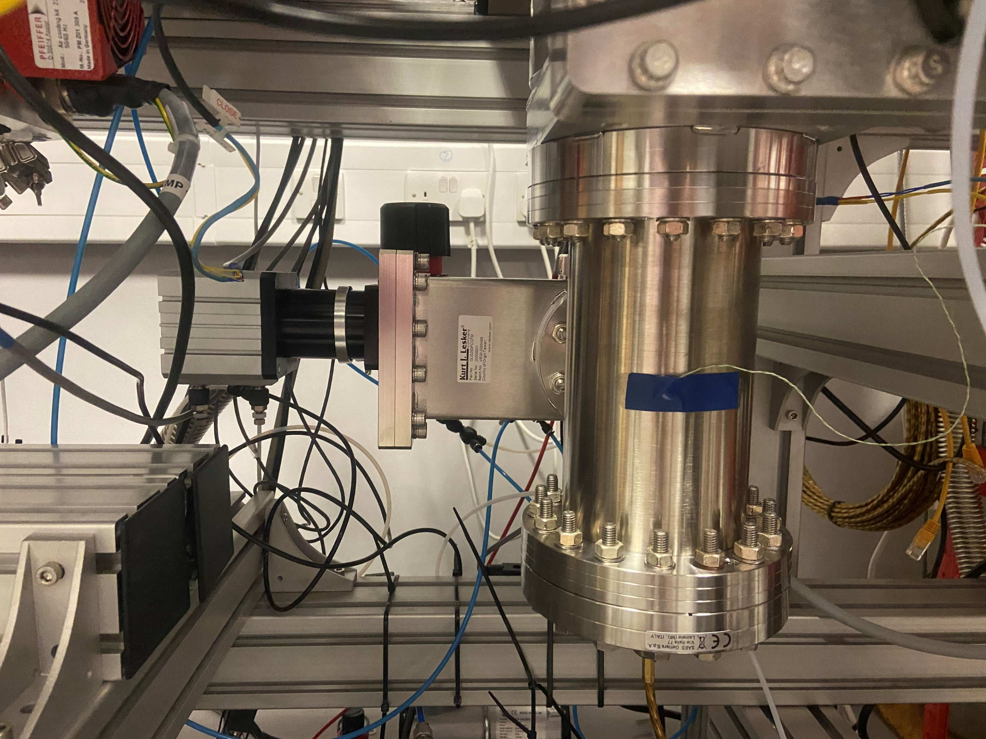
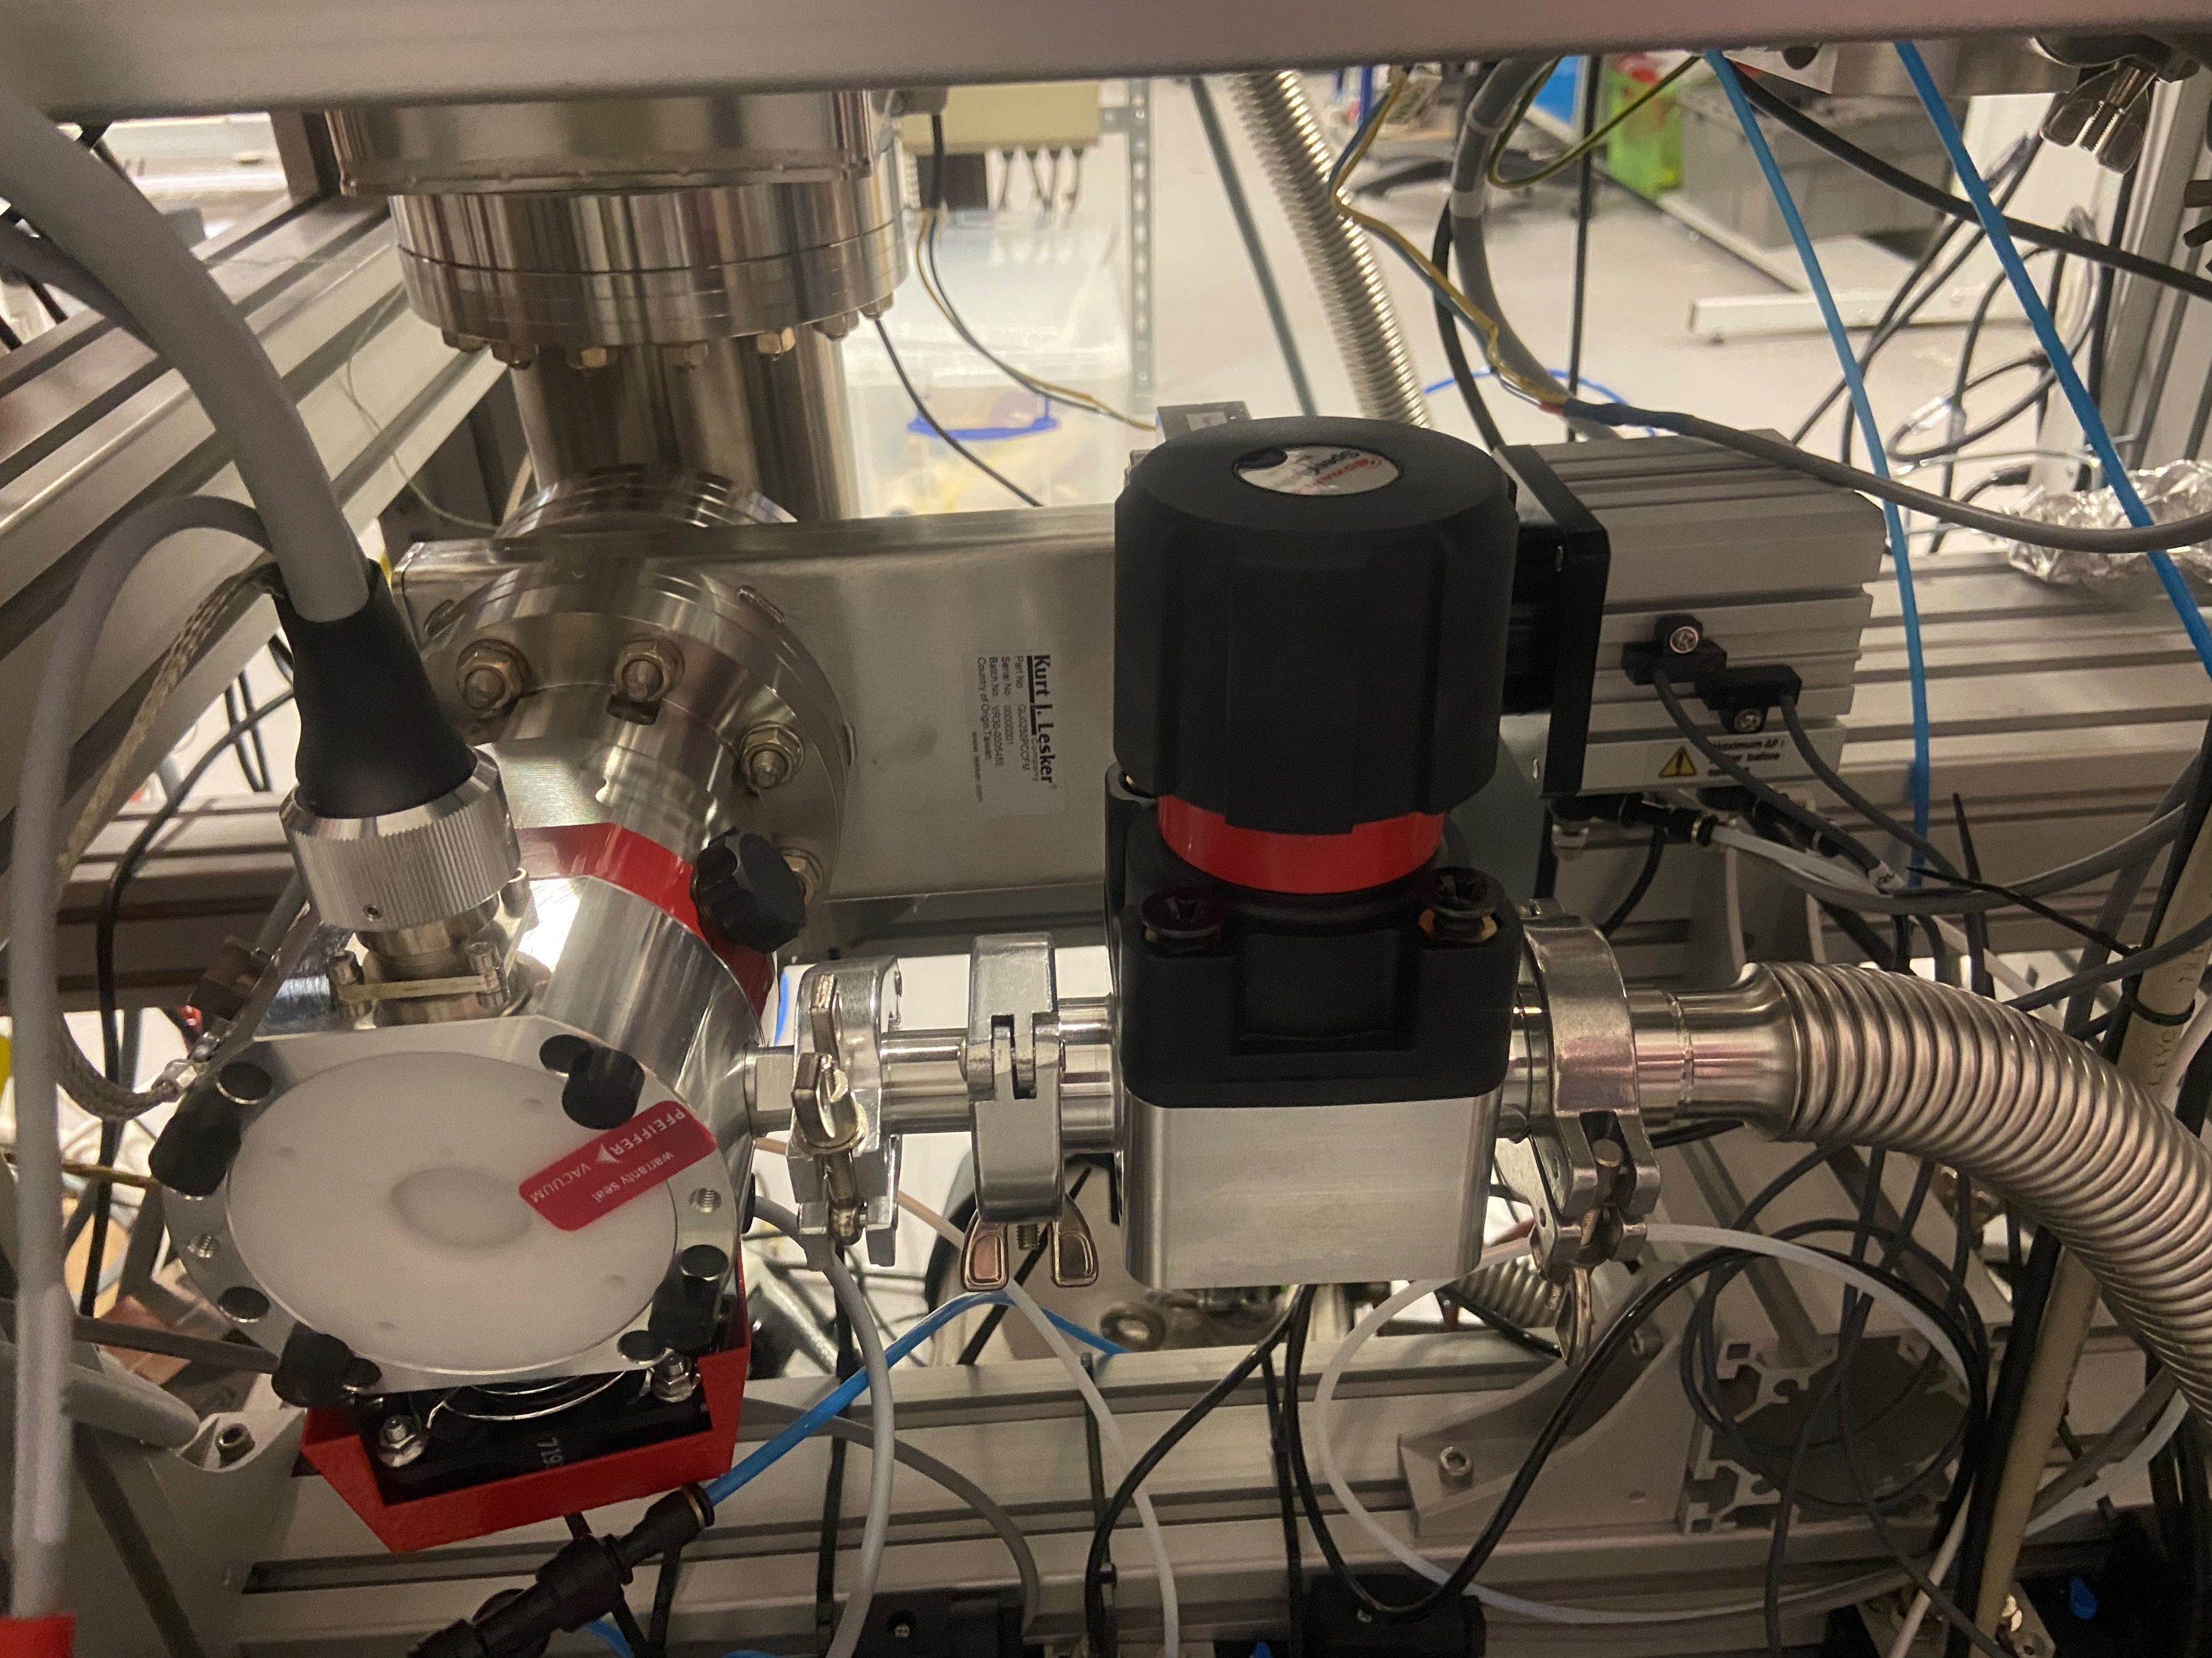
NEG Re-installed in Interaction Chamber
Next results with 0.7x9mm skimmer

Slide 12
Saturation Data (Dump Chamber)
Gate Valve open & degassing
Gas Jet turned on
0.7x9mm Skimmer, NEG at interaction chamber

Slide 13
Saturation Data (Interaction Chamber)
TMP1 controller overheated due to airflow blockage
TMP1 controller overheat (extra peak)
Gate Valve open & degassing
0.7x9mm Skimmer, NEG at interaction chamber

Slide 14
Saturation Data (Skimmer 1&2 Chamber)
TMP controller overheat
0.7x9mm Skimmer, NEG at interaction chamber
*Note: the overheat is due to the controller is covered with the lab book not the pump itself.

Slide 15
Saturation Data (Nozzle Chamber)
TMP1 controller overheat
Non-log scale to show pressure reducing after TMP controller cooled down
0.7x9mm Skimmer, NEG at interaction chamber

Slide 16
0.7*9 mm skimmer comparison (interaction chamber)
NEG at Dump
NEG at Interaction chamber

Slide 17
0.7*9 mm skimmer comparison (dump chamber)
NEG at Dump
NEG at Interaction chamber

Slide 18
Shipping
We will pack on Tuesday (March 15th), ship on March 16th, Hopefully it will arrive at Friday (March 18th).

Slide 19
Summary
Week long data shows the NEG is not saturated for 0.3*9 mm 3rd skimmer (5bar inlet pressure).
Future work:
  Preparation for shipping.

