Slide 2
BGC Regular meeting – CERN Updates
Krystian Sidorowski
March 2022, CERN, Geneva, Switzerland

Slide 3
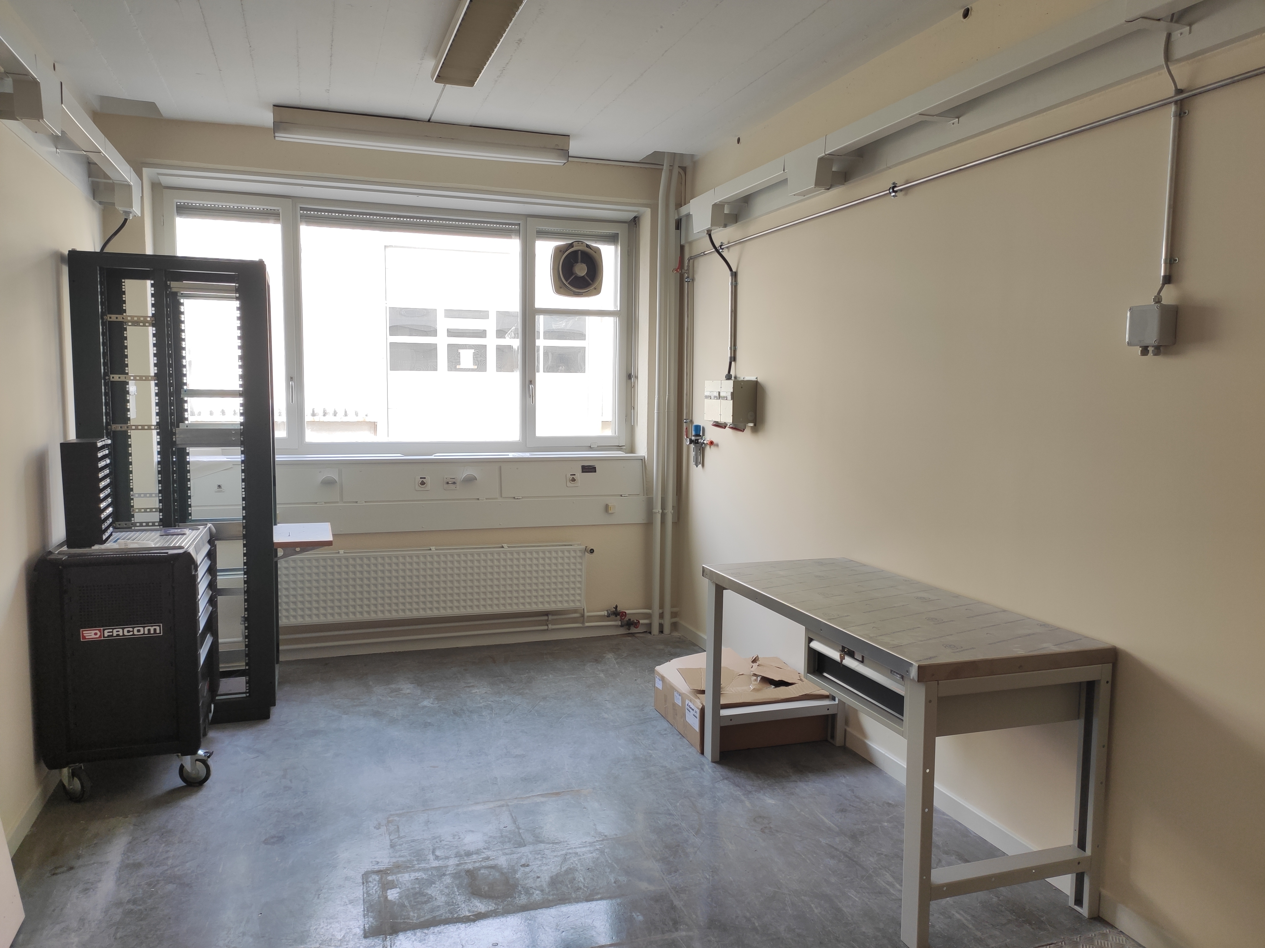
Lab 8-R-014 UpDate
Furniture / equipment is here

Slide 4
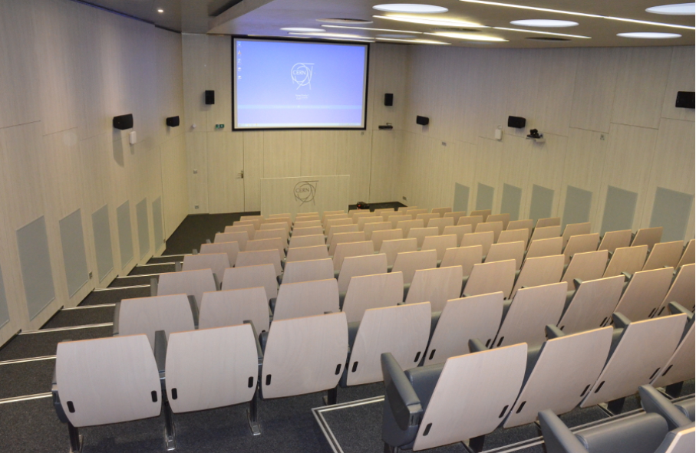
Preparing for the collaboration meeting

Slide 5
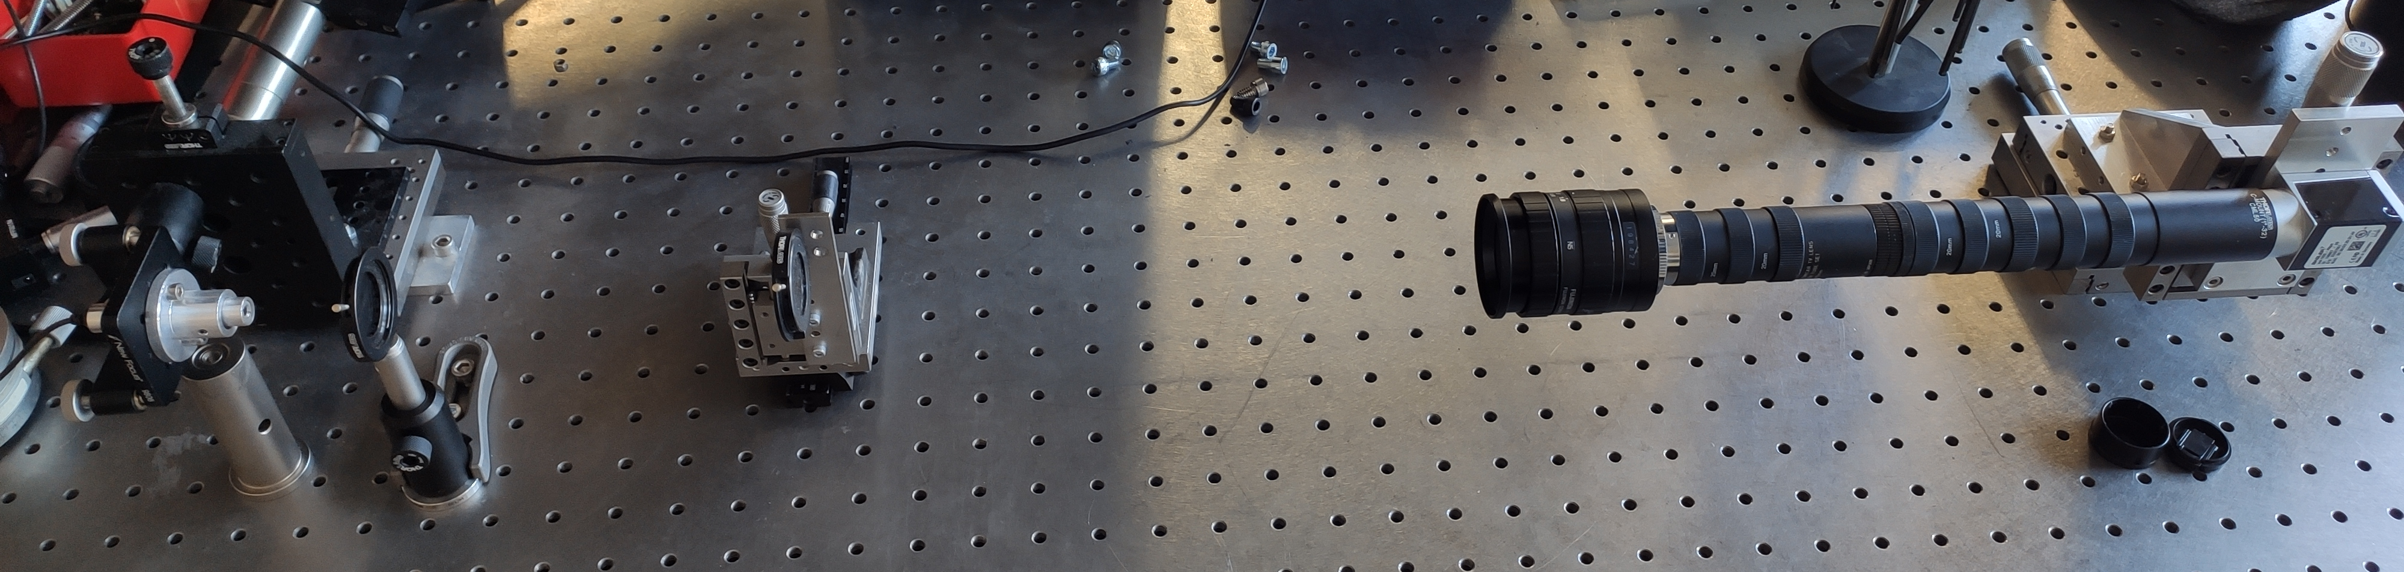
CHROMOX screen will arrive mid April
  45±0.2 x 65±0.2 x 0.3±0.05 mm
Narrow band filter for V3 will be shipped today
Alignment setup for V3 at CERN is build
  Only alignment bed is missing

Slide 6
Thank you!

