Slide 1
Field Quality of the FCC-ee Magnets
J. Bauche, FCC-ee tuning meeting, 17th March 2022.

Slide 2
Outline
Collider magnet designs (CDR)
Field tapering
Mitigation of field errors and orbit correction
Booster magnet specifications
Conclusions
[References]

Slide 3
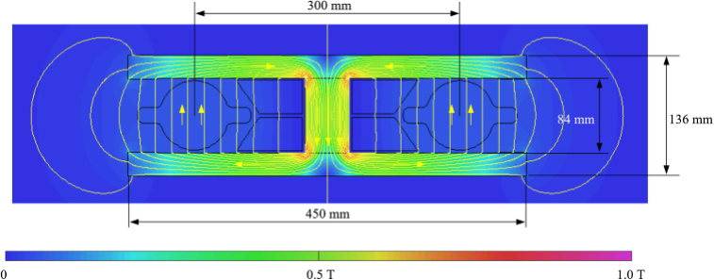
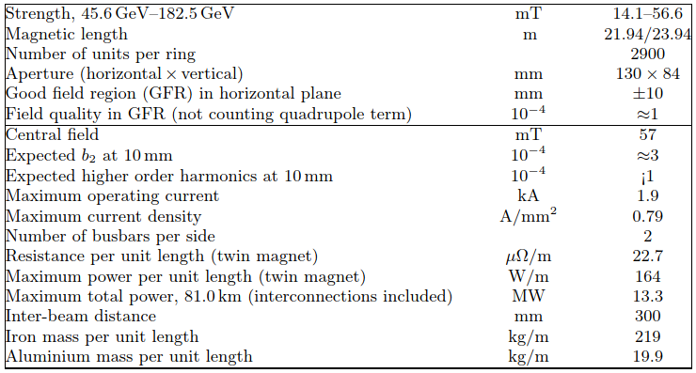
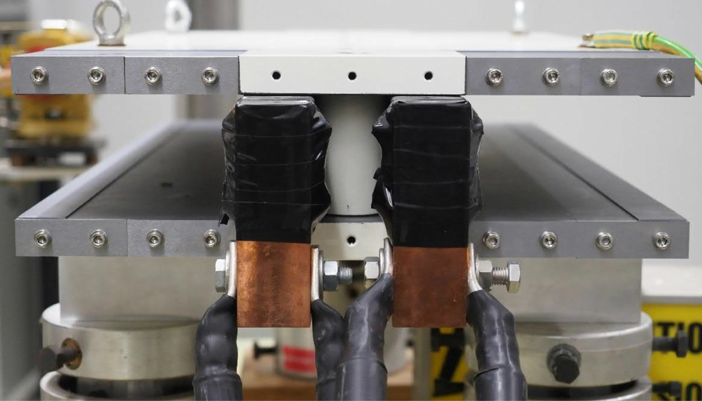
Dipole
  Twin aperture design, magnetically coupled [1], [2], [3]
  Simple, pure, cost effective
  Low power consumption (50% w.r.t. separate magnets)
  300 mm inter-beam distance shared between vacuum chamber size, SR absorbers, busbars and yoke return leg
  DC operation, compatible with solid iron yoke construction, but alternatives are possible
  Twin air-cooled aluminium busbar considered in CDR to be reviewed (SR in mid-plane)
Magnetic model cross-section (CDR), B₀ max = 57 mT
Prototype 1m-long, single busbar “coil”, measurements reported in [4]
Parameters (CDR) [1]

Slide 4
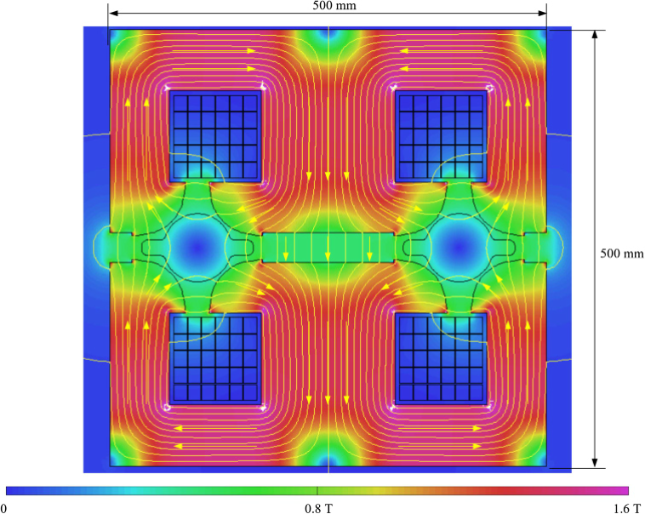
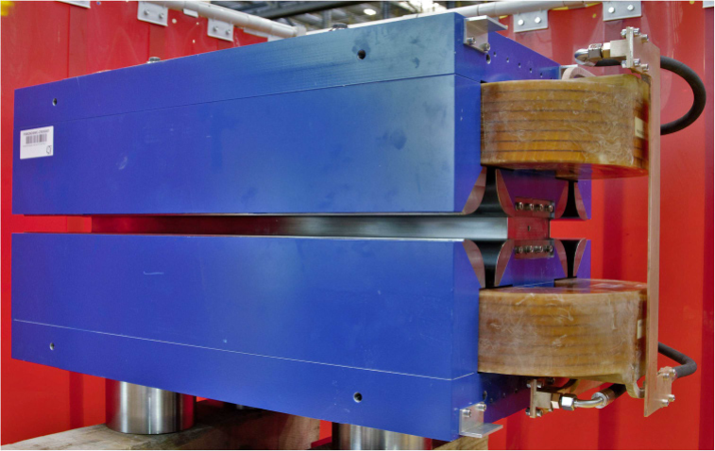
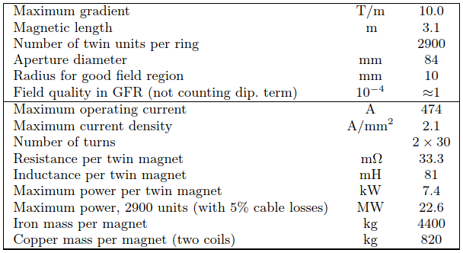
Quadrupole
  Twin aperture design, magnetically coupled [1], [2], [3]
  Only 2 racetrack coils for 8 poles, out of mid-plane (SR)
  Top-bottom assembly via non-magnetic central spacer
  Equilibrium of parallel flux distribution between horizontal and vertical field lines controlled by central gap height (adjustable with end shims on prototype
  ~10x higher flux density than in dipoles; water-cooled coil (optimization of dipole filling factor)
Magnetic model (CDR), G₀ max = 10 T/m, B_{pole tip} 0.42 T
Prototype 1m-long
Parameters (CDR)

Slide 5
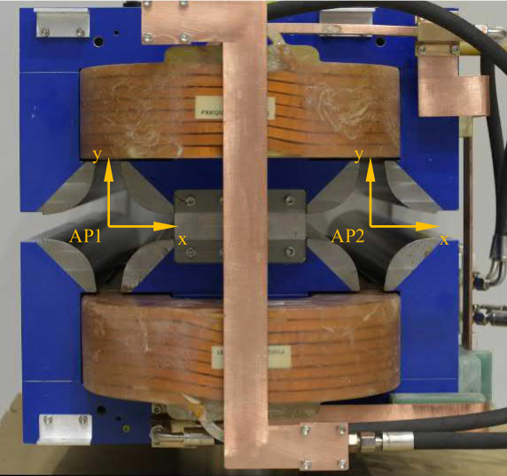
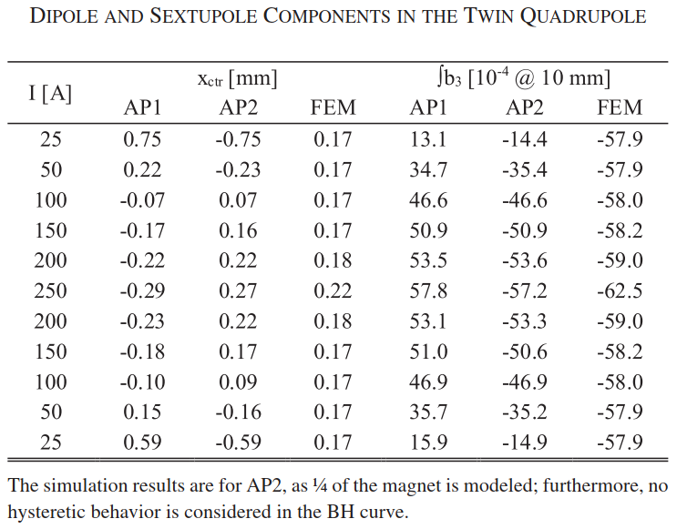
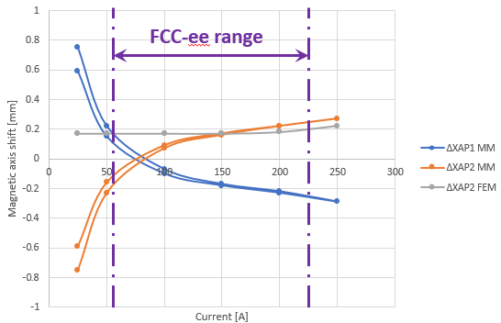
Quadrupole magnetic axis shift
Magnetic measurements performed on 1-m prototype [4]
  ~0.4 mm shift for each aperture between low and high fields
  Mismatch MM vs. FEM (3D) at low fields not completely explained
  ➔ To be further investigated
Measured magnetic axis shift and ∫b3
Magnetic axis shift

Slide 6
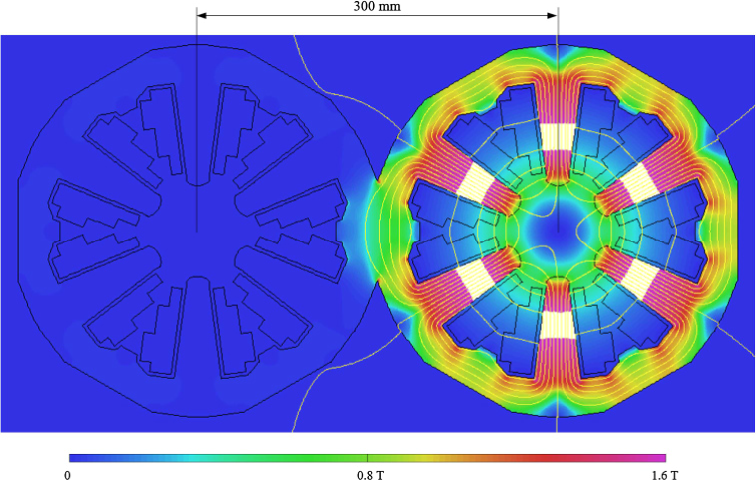
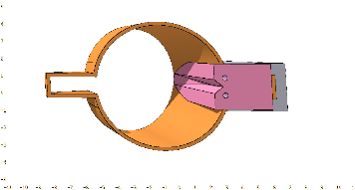
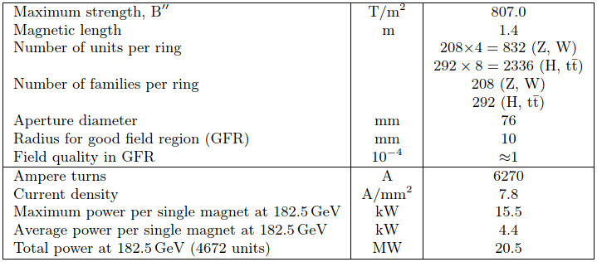
Sextupole
  Classical design as first approach for CDR
  Fits in 300 mm inter-beam distance, compatible with individual magnets for each beam
  Busy cross section, current and flux densities at upper values
  Vacuum chamber winglets and SR absorbers integration issue with coils on mid-plane
  Cross section could be optimized with 120° symmetry of return yoke
  ➔ Design to be reviewed with updated specifications
Magnetic model (CDR), S₀ max = 807 T/m², B_{pole tip} 1.17 T
Parameters (CDR)

Slide 7
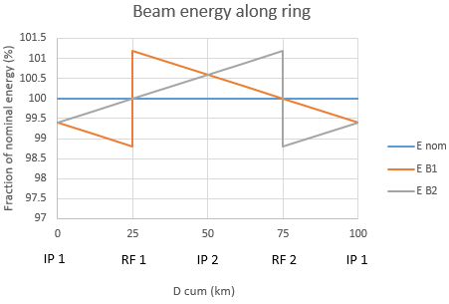
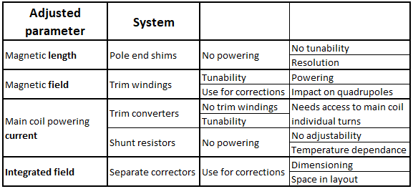


Field tapering
Energy saw-tooth effect needs to be mitigated to limit losses
Field tunability variable with energy, up to ±1.2% at 182.5 GeV [1]
Grouped every 4 FODO in present layout
Options:
Beam energy along ring at 182.5 GeV
Next slides will address effect of tuneable trims on magnet field quality
(More details on other options available in spare slides)

Slide 8
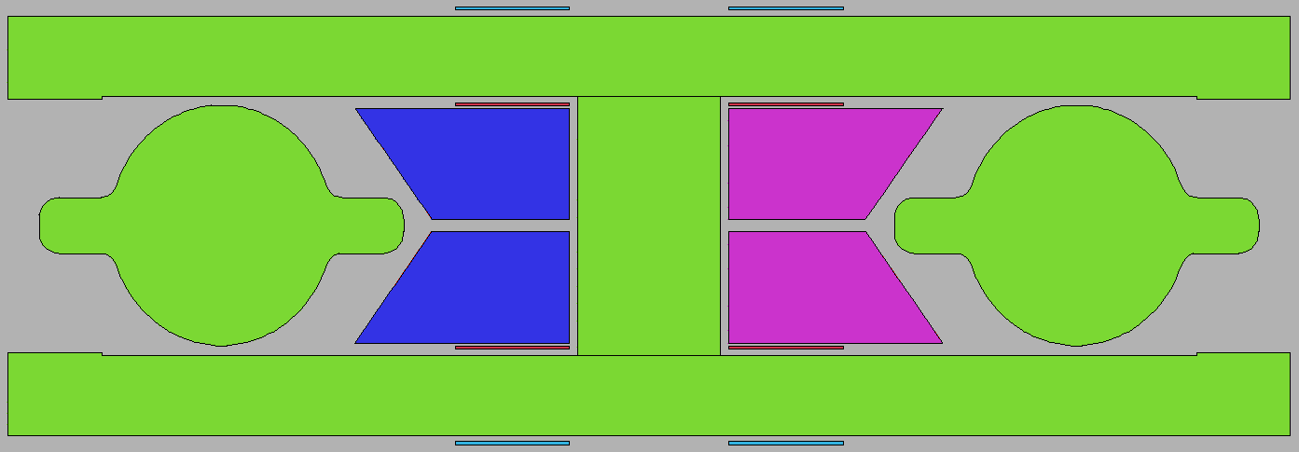
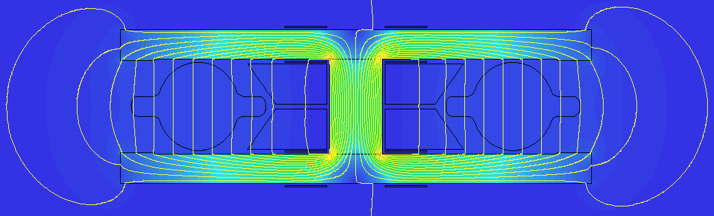
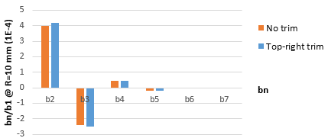
Dipole field tapering
Trim coils / trimmed busbar current
  Needed on each aperture for individual aperture trimming
  Can be made in single turn like the main busbars (Discussed with TE-EPC)
  One single branch per aperture is possible (top or bottom), with marginal impact on field quality
  No cross-talk between apertures (trim effect only on concerned aperture)
  Effect of trim coils or trimmed current on main busbar is identical
Current polarities in main and trim conductors
-dB
B
B
+dB
Normalized harmonics (FEM 2D)
Flux density and field lines with trims activated

Slide 9
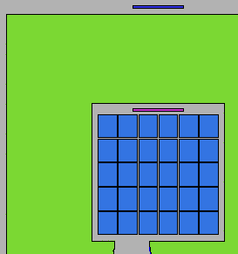
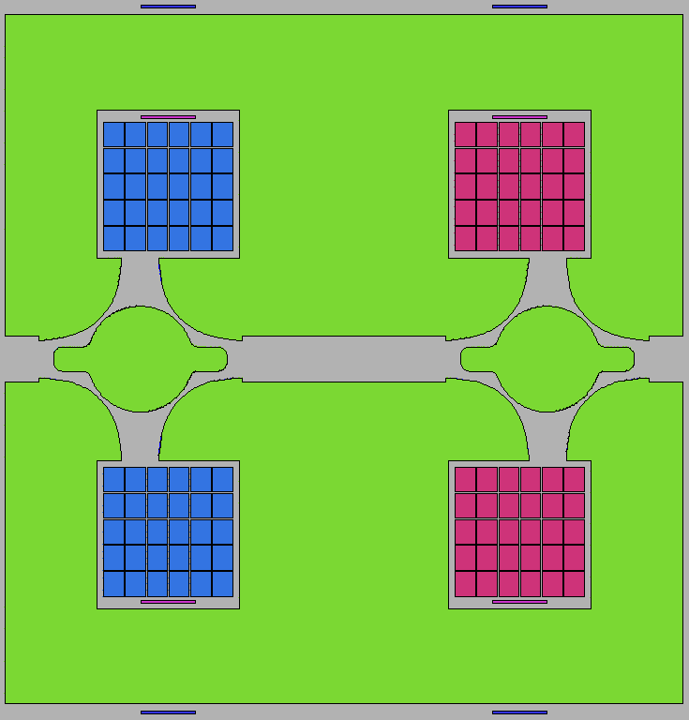
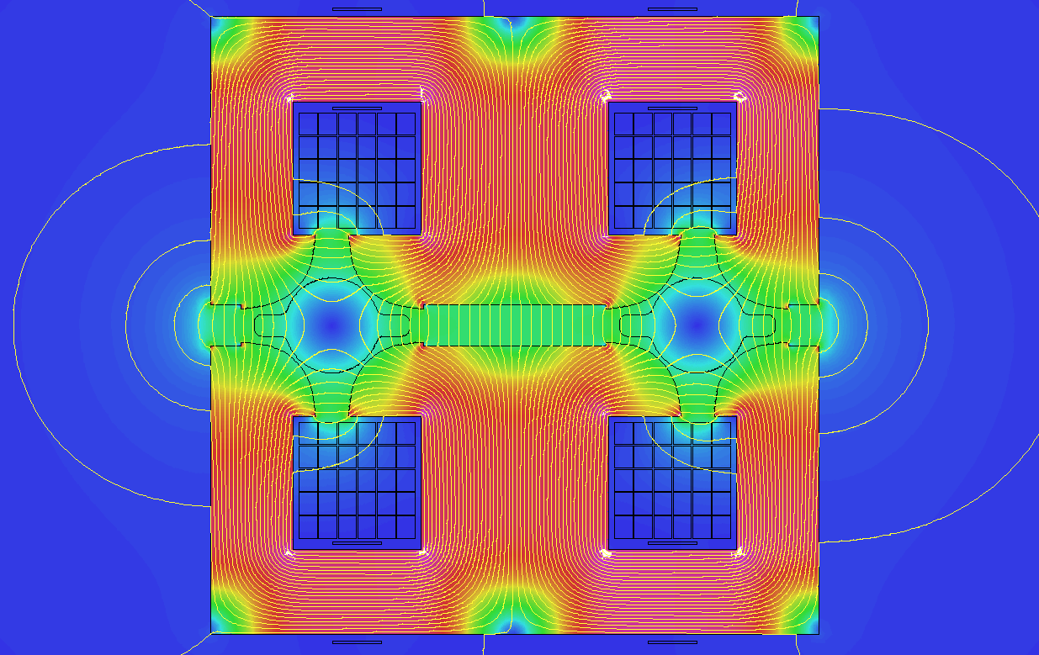
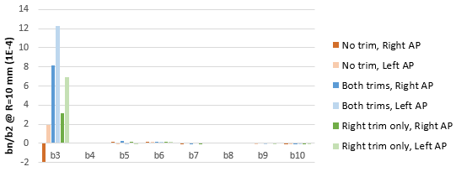
Quadrupole field tapering
Trim coils
  Needed on each aperture for individual aperture trimming
  One single branch (top or bottom) per aperture not possible
  Gradient trim effect only on concerned aperture
  Significant cross-talk : both magnetic axes shift up to 0.2 mm @ 1.2% dB in same direction, even when single aperture trim is activated
  b₃ significantly affected in both apertures with same polarity
Current polarities in main and trim conductors
-dB
+dB
0.2 mm
0.2 mm
Normalized harmonics (FEM 2D)
Flux density and field lines, trims activated

Slide 10
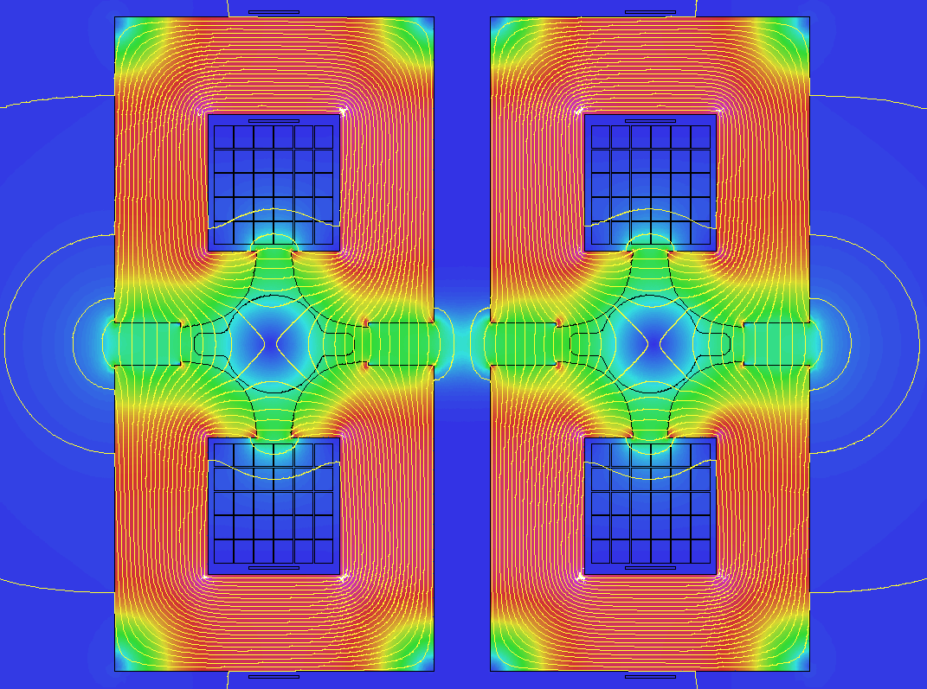
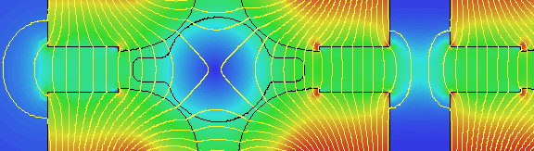
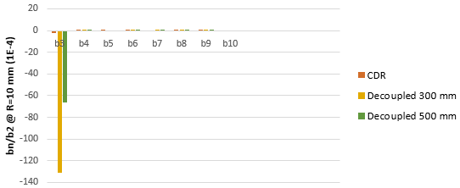
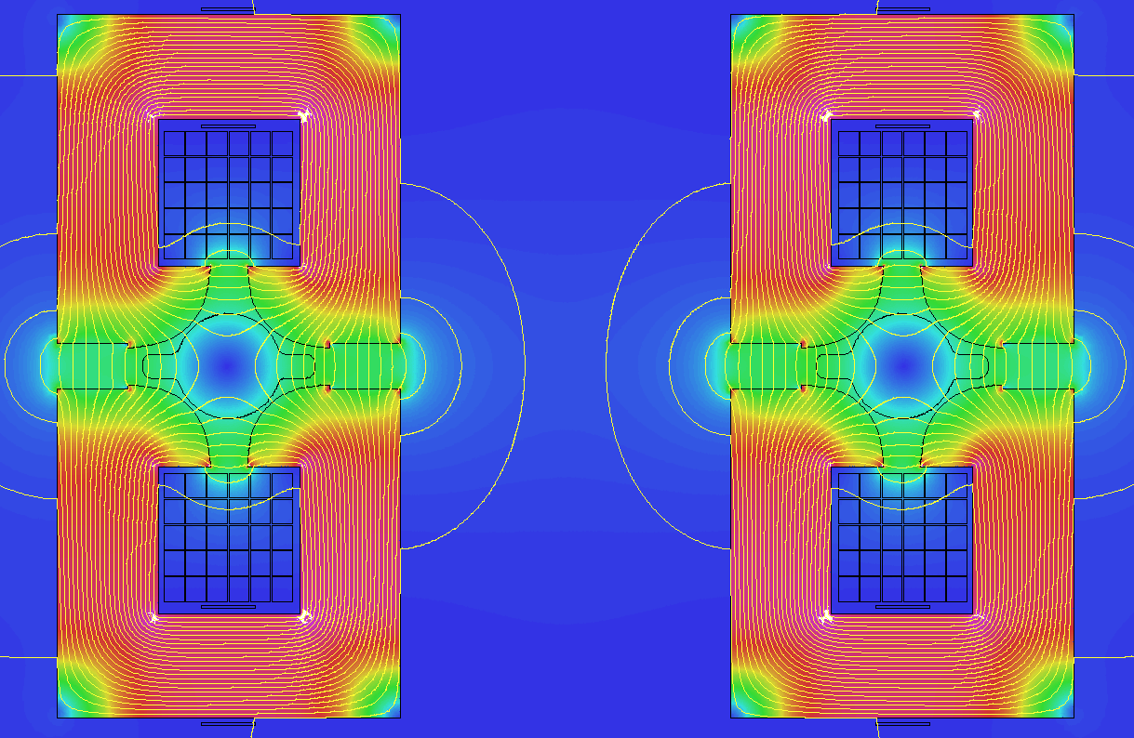
Investigation on coupling
Tentative to decouple yokes
  Attempt to reduce flux crossing between apertures
  Coupling due to proximity of open apertures
  Effect reduces with aperture separation, but doesn’t disappear
  Magnetic axis shift 3 mm for 300 mm vs. 1.5 mm for 500 mm inter-beam
Decoupled yokes, no trims activated, 300 mm inter-beam
Normalized harmonics (FEM 2D)
Decoupled yokes, no trims activated, 500 mm inter-beam

Slide 11
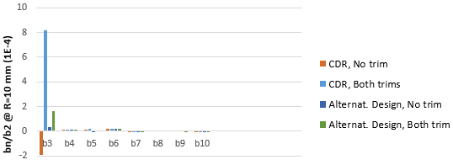
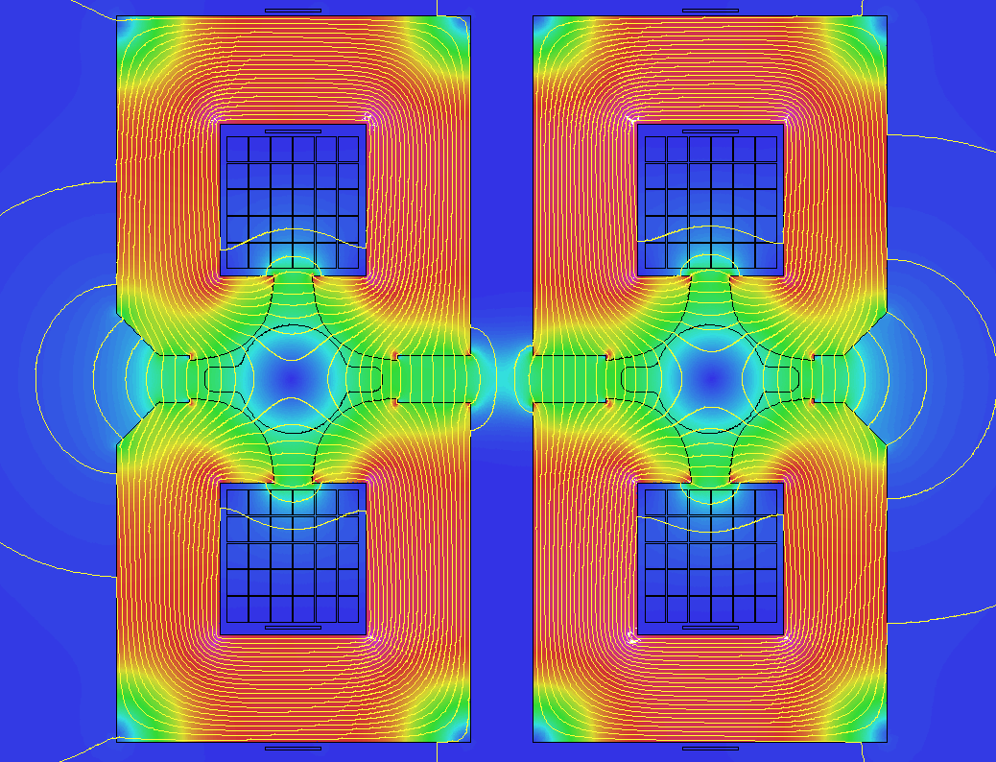
Alternative design
Compensation of inner/outer asymmetry
0.2 mm
0.2 mm
  Chamfer on outer sides to limit flux leakage
  Magnetic axis shift and b₃ mitigated but not suppressed
  To be checked with 3D simulations
CDR design, trims activated
0.03 mm
0.03 mm
Normalized harmonics (FEM 2D)
Alternative design, trims activated

Slide 12
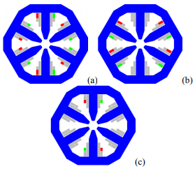
Mitigation of field errors and orbit correction
  Systematic linear b₂ in dipoles
  → could be compensated by arc quadrupoles
  Magnetic axis shift in quadrupoles
  → could be compensated by dipole (active) trims
  b₃ in quadrupoles
  → could be compensated by the sextupoles?
  Dipole active trims
  → could be used for horizontal orbit correction, but limitations for
  connecting to a fast feedback system
  Horizontal and vertical orbit as well as skew quadrupole correctors
    → can be integrated in sextupoles with trim coils [5], [6]
  … but the sextupole strength or length may need to be reviewed
Horiz. Steering; (b) Vert. steering; (c) Skew quad.
Trim coils in ALBA and SESAME sextupoles

Slide 13
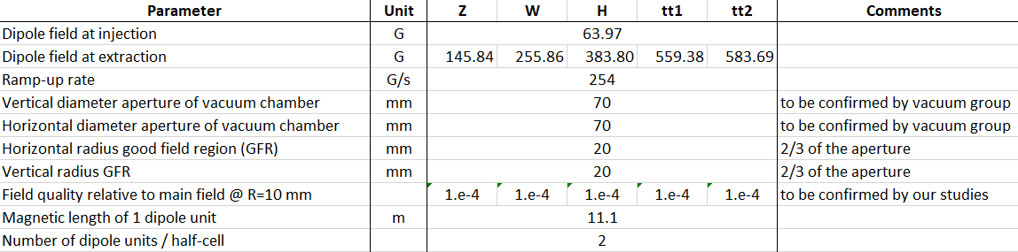
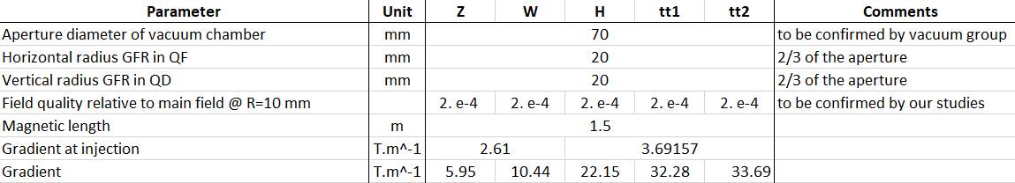
Booster magnet specifications
Dipole
  Very low field at injection is challenging. Window-frame configuration under study, to be compared with coil dominated magnet design
Quadrupole
  Corresponds to 1.93 T on pole tip, not realistic. Gradient will have to be reduced or magnetic length to be increased
Preliminary values given by beam optics team

Slide 14
Conclusions
Twin aperture magnet designs allow low consumption and cost efficient construction
Further optimization of the magnet designs is needed to address some open points on the field quality, in particular regarding the quadrupole magnetic axis shift due to magnetic coupling, accounting also for tuneable field tapering options
The orbit correction strategy needs to be defined to get the magnet specifications

Slide 15
References
M. Benedikt et al., “Future circular collider conceptual design report, vol. 2: The lepton collider (FCC-ee),” Eur. Phys. J. ST., vol. 228, no. 2, 2019. (https://doi.org/10.1140/epjst/e2019-900045-4)
A. Milanese, “Efﬁcient twin aperture magnets for the future circular e+/e- collider,” Phys. Rev. Accel. Beams, vol. 19, 2016, Art. no. 112401.
A. Milanese and M. Bohdanowicz, “Twin aperture bending magnets and quadrupoles for FCC-ee,” IEEE Trans. Appl. Supercond., vol. 28, no. 3, Apr. 2018, Art. no. 4000904.
A. Milanese, C. Petrone, J. Bauche, “Magnetic Measurements of the First Short Models of Twin Aperture Magnets for FCC-ee,” IEEE Trans. Appl. Supercond., vol. 30, 2020, Art. no. 4003905.
M. Pont, E. Boter, M. Lopes, “Magnets for the Storage ring ALBA”, Proceedings of EPAC 2006, Edinburgh, Scotland.
A. Milanese, “Design Report of the SESAME Storage Ring Sextupole and Corrector Magnets”, 2013, CERN EDMS 1257260.

Slide 16
Thank you for your attention!
Questions?
16

Slide 17
Spare slides
17

Slide 18
Field tapering
Energy saw-tooth effect needs to be mitigated to limit losses
Field tunability variable with energy, up to ±1.2% at 182.5 GeV [1]
Grouped every 4 FODO in present layout
Options:
Beam energy along ring at 182.5 GeV
Needs to be modified at each energy phase
Needs calibration for each phase with magnetic measurements at production and strong QA system over machine lifetime
360 length variants for 4 FODO grouping
- For dipoles, lengths range of ~ 30 cm for 24 m
- For quads, lengths range of ~ 37 mm for 3.1 m

Slide 19
Field tapering
Energy saw-tooth effect needs to be mitigated to limit losses
Field tunability variable with energy, up to ±1.2% at 182.5 GeV [1]
Grouped every 4 FODO in present layout
Options:
Beam energy along ring at 182.5 GeV
Tunability can be used for other corrections, e.g. horizontal orbit correction for dipoles on main bendings (limitations for feedback system)
Impact on quadrupole axis shift and b3 (see next slides)
Trim windings can be made simple and cheap to produce

Slide 20
Field tapering
Energy saw-tooth effect needs to be mitigated to limit losses
Field tunability variable with energy, up to ±1.2% at 182.5 GeV [1]
Grouped every 4 FODO in present layout
Options:
Beam energy along ring at 182.5 GeV
Mostly for dipole as access to conductors of each aperture is needed
Can be made efficiently with symmetry thanks to powering by sectors

Slide 21
Field tapering
Energy saw-tooth effect needs to be mitigated to limit losses
Field tunability variable with energy, up to ±1.2% at 182.5 GeV [1]
Grouped every 4 FODO in present layout
Options:
Beam energy along ring at 182.5 GeV
The cheapest! (for dipoles only)
Precision and stability to be assessed
Needs powering by sectors for symmetric correction

Slide 22
Field tapering
Energy saw-tooth effect needs to be mitigated to limit losses
Field tunability variable with energy, up to ±1.2% at 182.5 GeV [1]
Grouped every 4 FODO in present layout
Options:
Beam energy along ring at 182.5 GeV
For dipoles, probably ~10x higher strength needed than classical H orbit correctors

