Slide 1
FCC-ee optics repository
M. Hofer, A. Huschauer, G. Roy

Slide 2
FCC-ee (optics) repository
Motivation and plans presented by Ghislain
in WP2 workshop and 134th FCC-ee optics meeting
  Common place to kept information/data on evolution of FCC-ee design
  for current and future developers/user
Repository was moved to acc-models
  Provides infrastructure for deploying to eos/afs and generating website
  Triggered also a change of file structure
  Please have a look at the new website, repository, and
  the released versions on zenodo

Slide 3
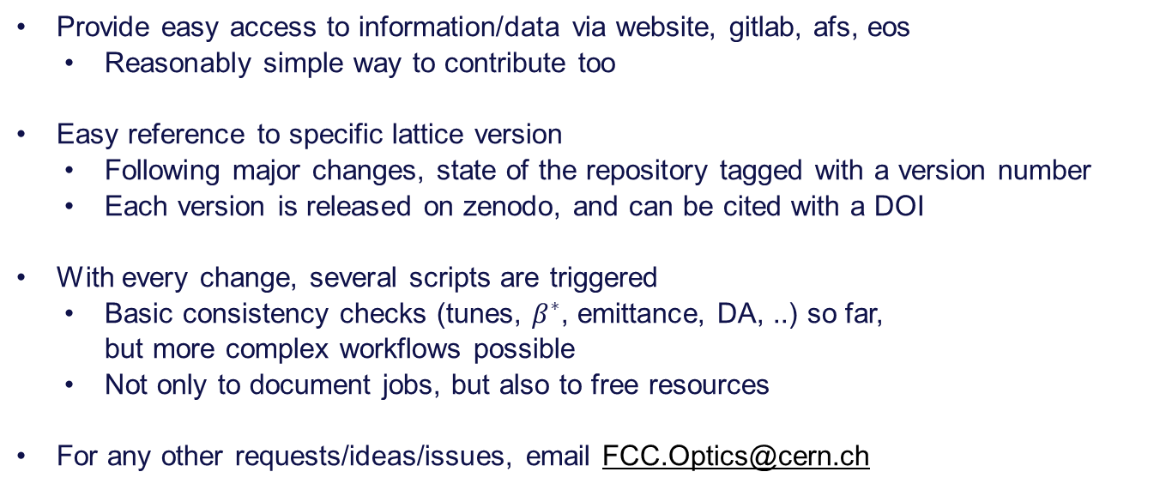
What can repository do for you?
Provide easy access to information/data via website, gitlab, afs, eos
  Reasonably simple way to contribute too
Easy reference to specific lattice version
  Following major changes, state of the repository tagged with a version number
  Each version is released on zenodo, and can be cited with a DOI
With every change, several scripts are triggered
  Basic consistency checks (tunes, $β^{∗}$, emittance, DA, ..) so far,
  but more complex workflows possible
  Not only to document jobs, but also to free resources
For any other requests/ideas/issues, email FCC.Optics@cern.ch

Slide 4
Structure
Few protected branches holding the up-to-date reference version
  V22: released in 2022, based on 91km circumference layout
  V18: released in 2018, previous 217 version
Following major changes, branch will be tagged with a version number
  Convention VYY.idx, with YY the year of the first release, and idx a running index
  Releases include lattices/optics, and parameter set
Three entry points:
  Quick access to parameters, lattices, optics plot, and examples via website
  Development and full data through gitlab, with repository mirrored to afs/eos
  Tagged versions with DOI on Zenodo

Slide 5
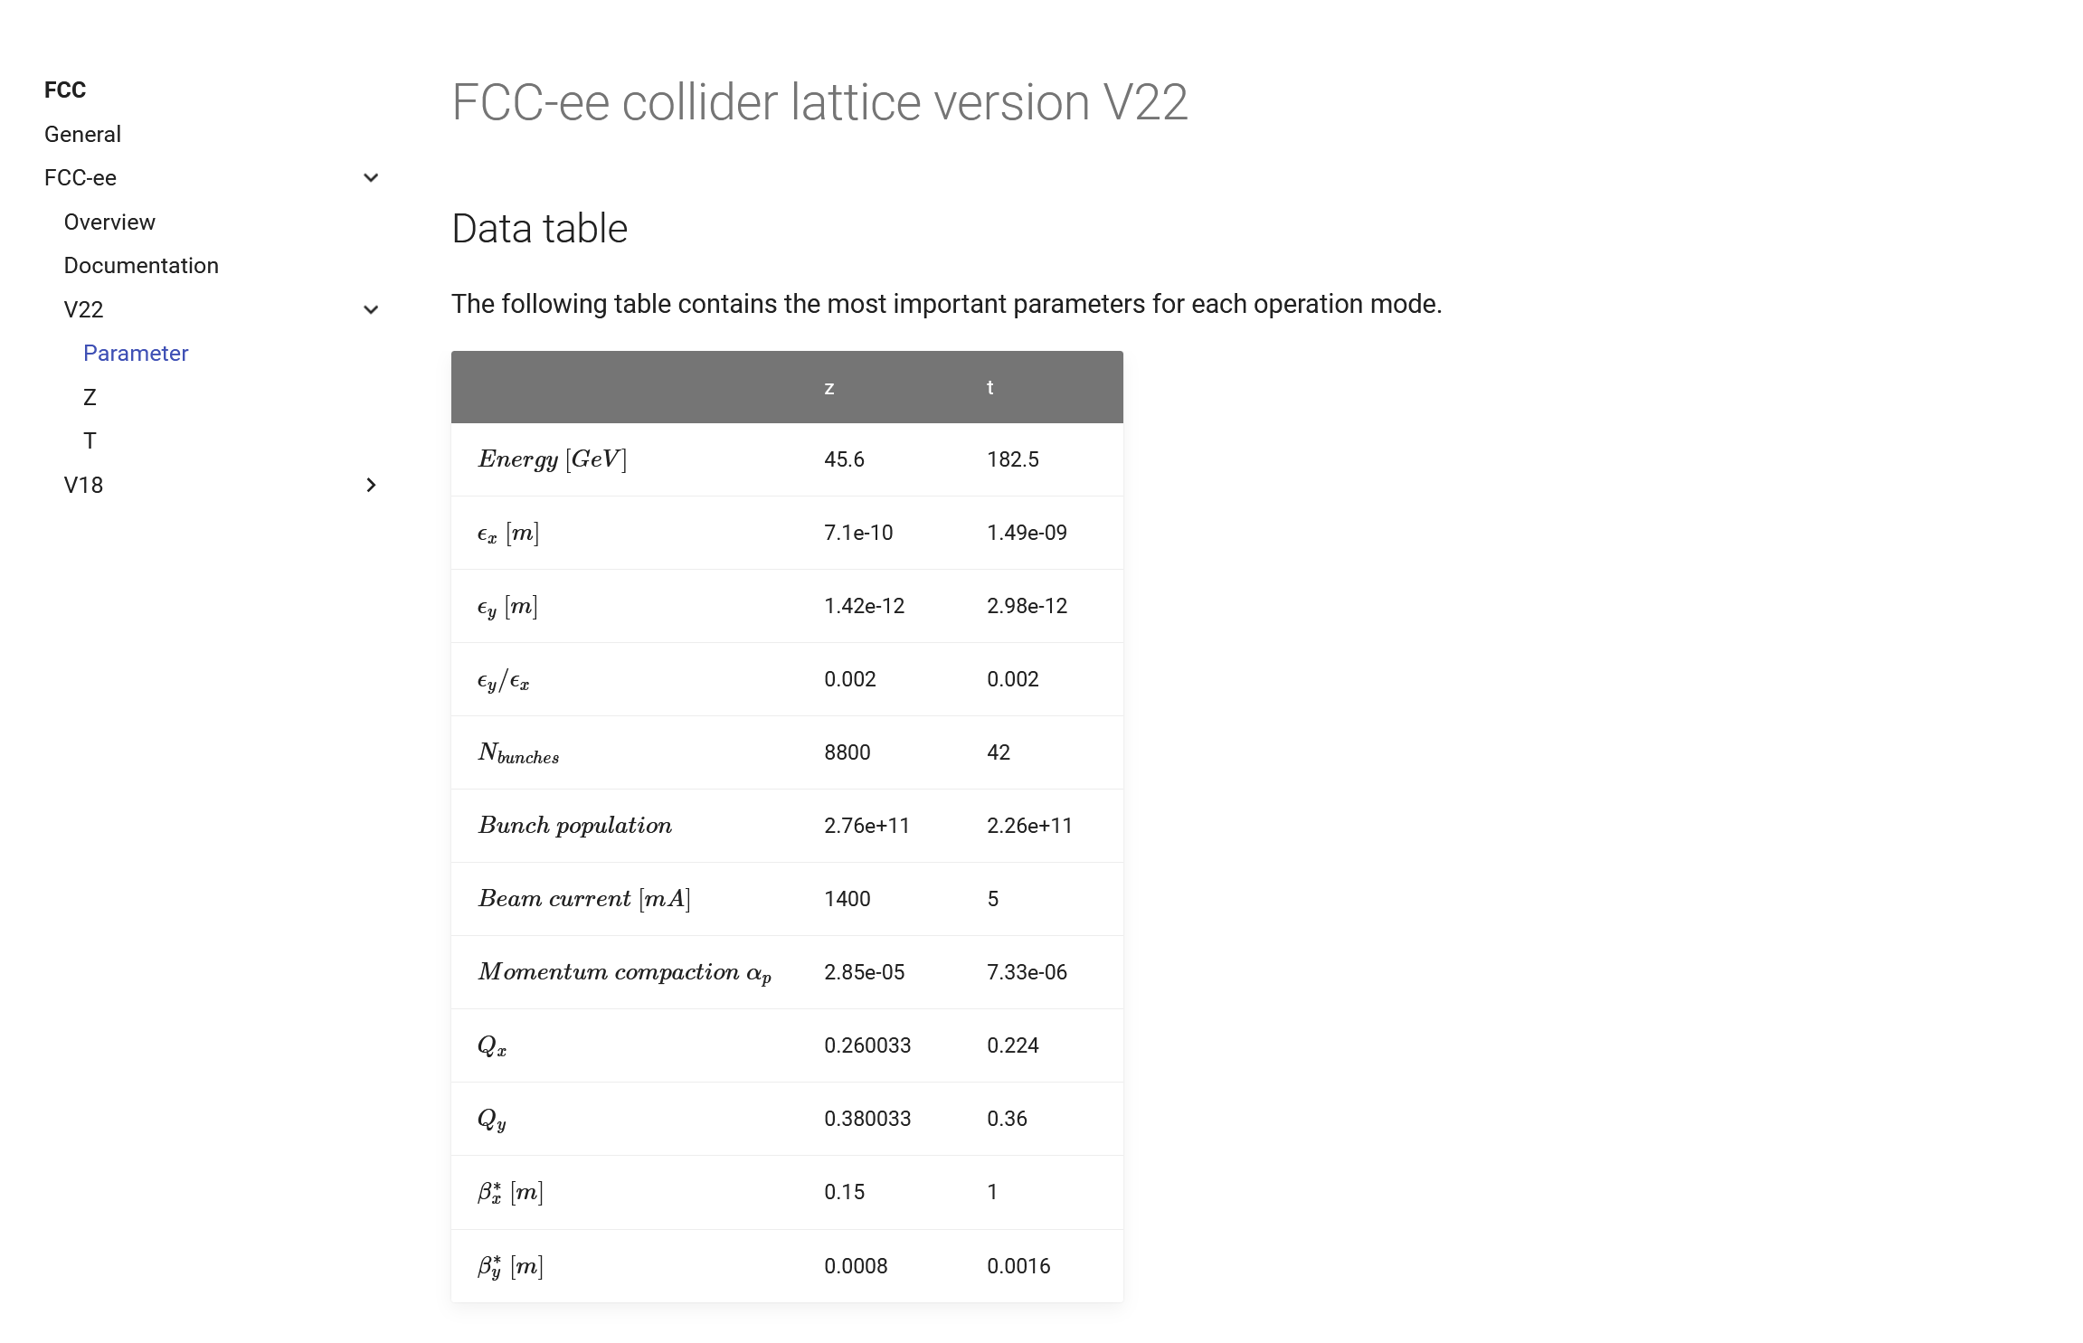
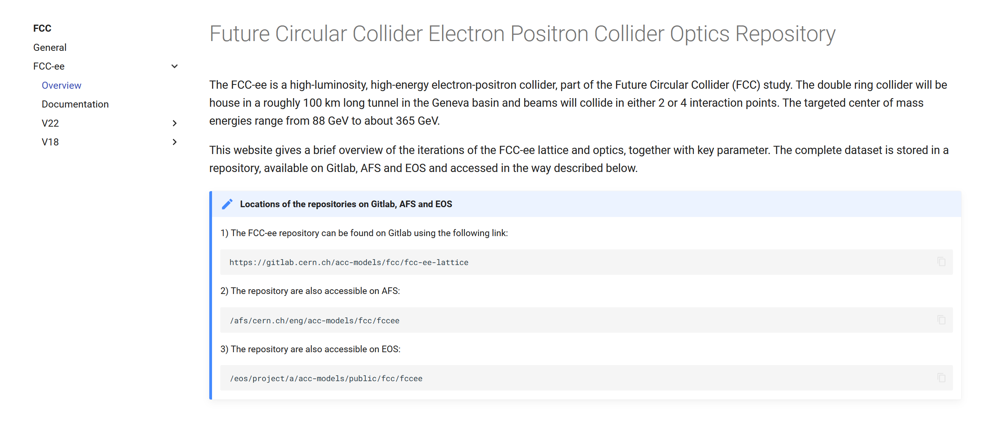
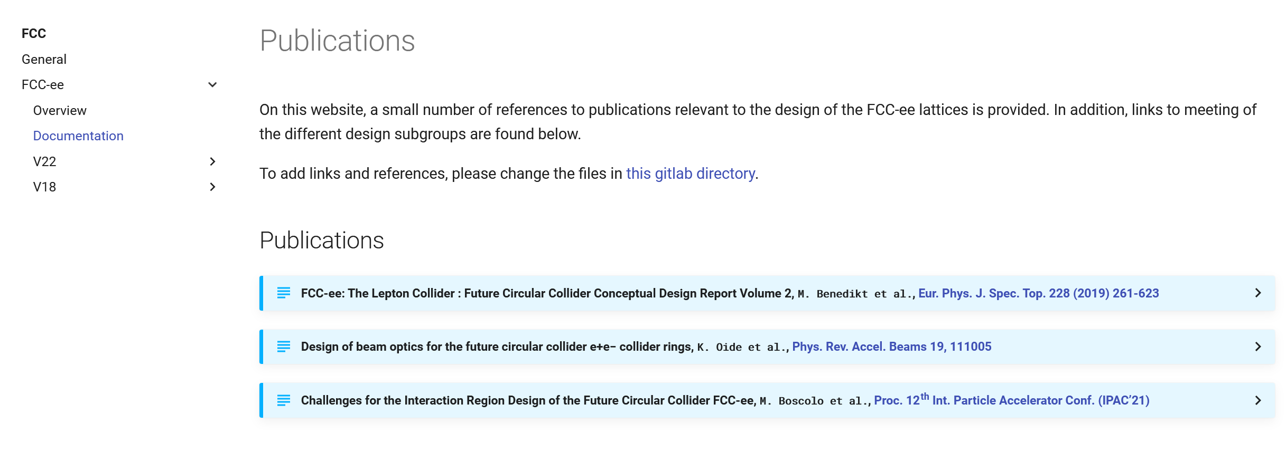
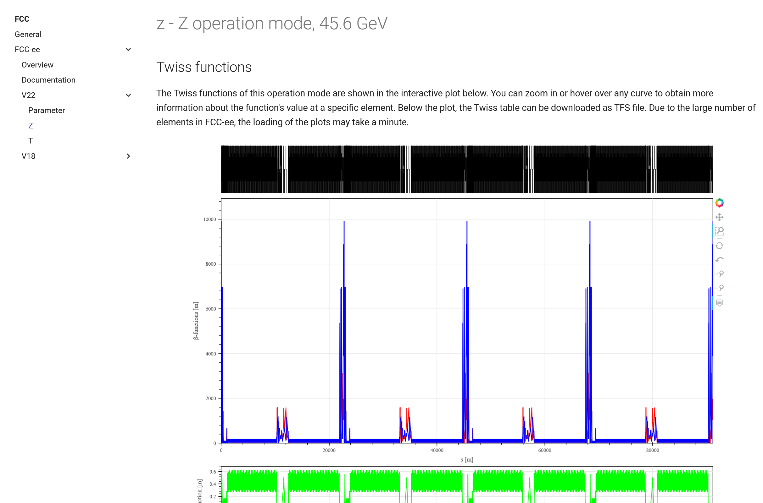
Website

Slide 6
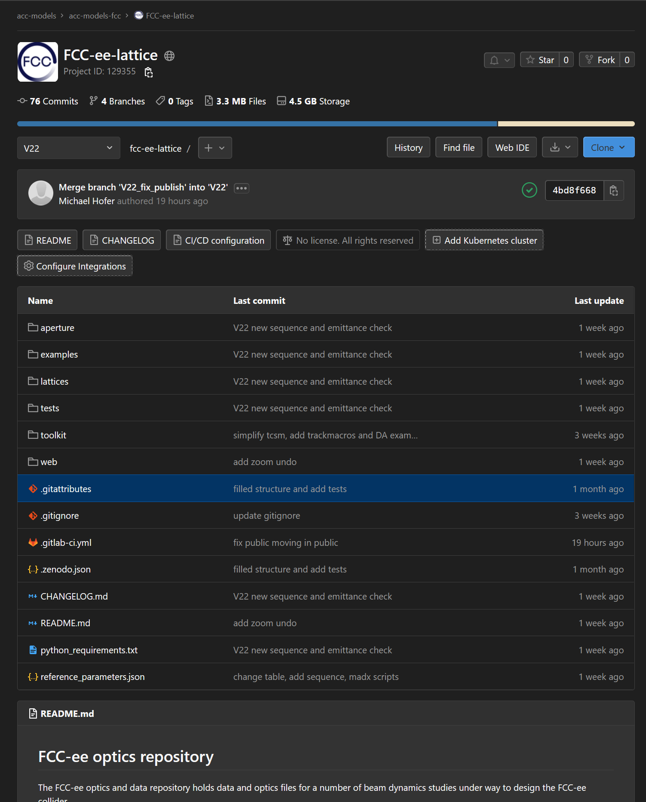
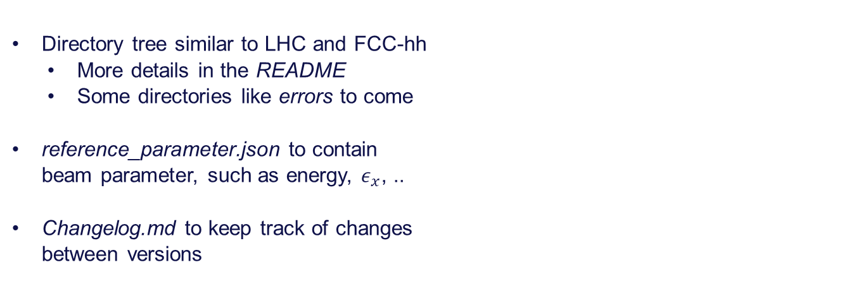
Repository
Directory tree similar to LHC and FCC-hh
  More details in the README
  Some directories like errors to come
reference_parameter.json to contain
beam parameter, such as energy, $ε_{x}$, ..
Changelog.md to keep track of changes
between versions

Slide 7
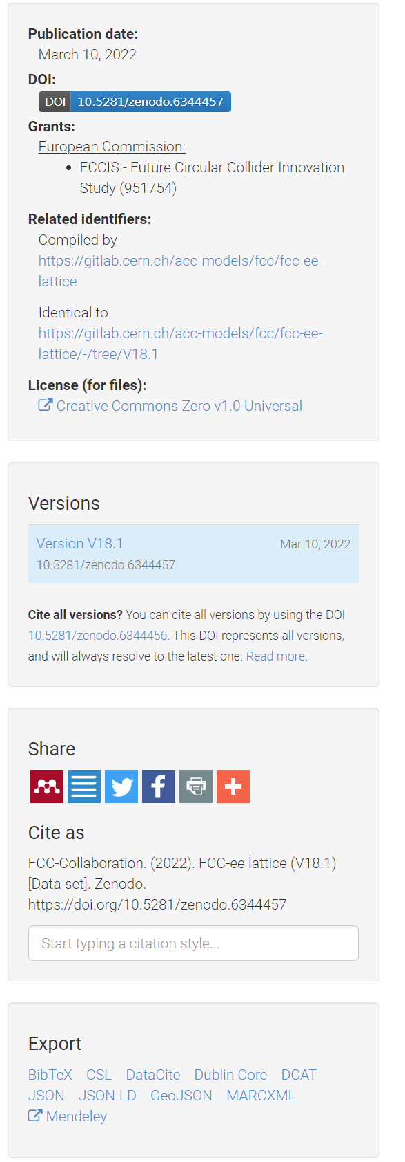
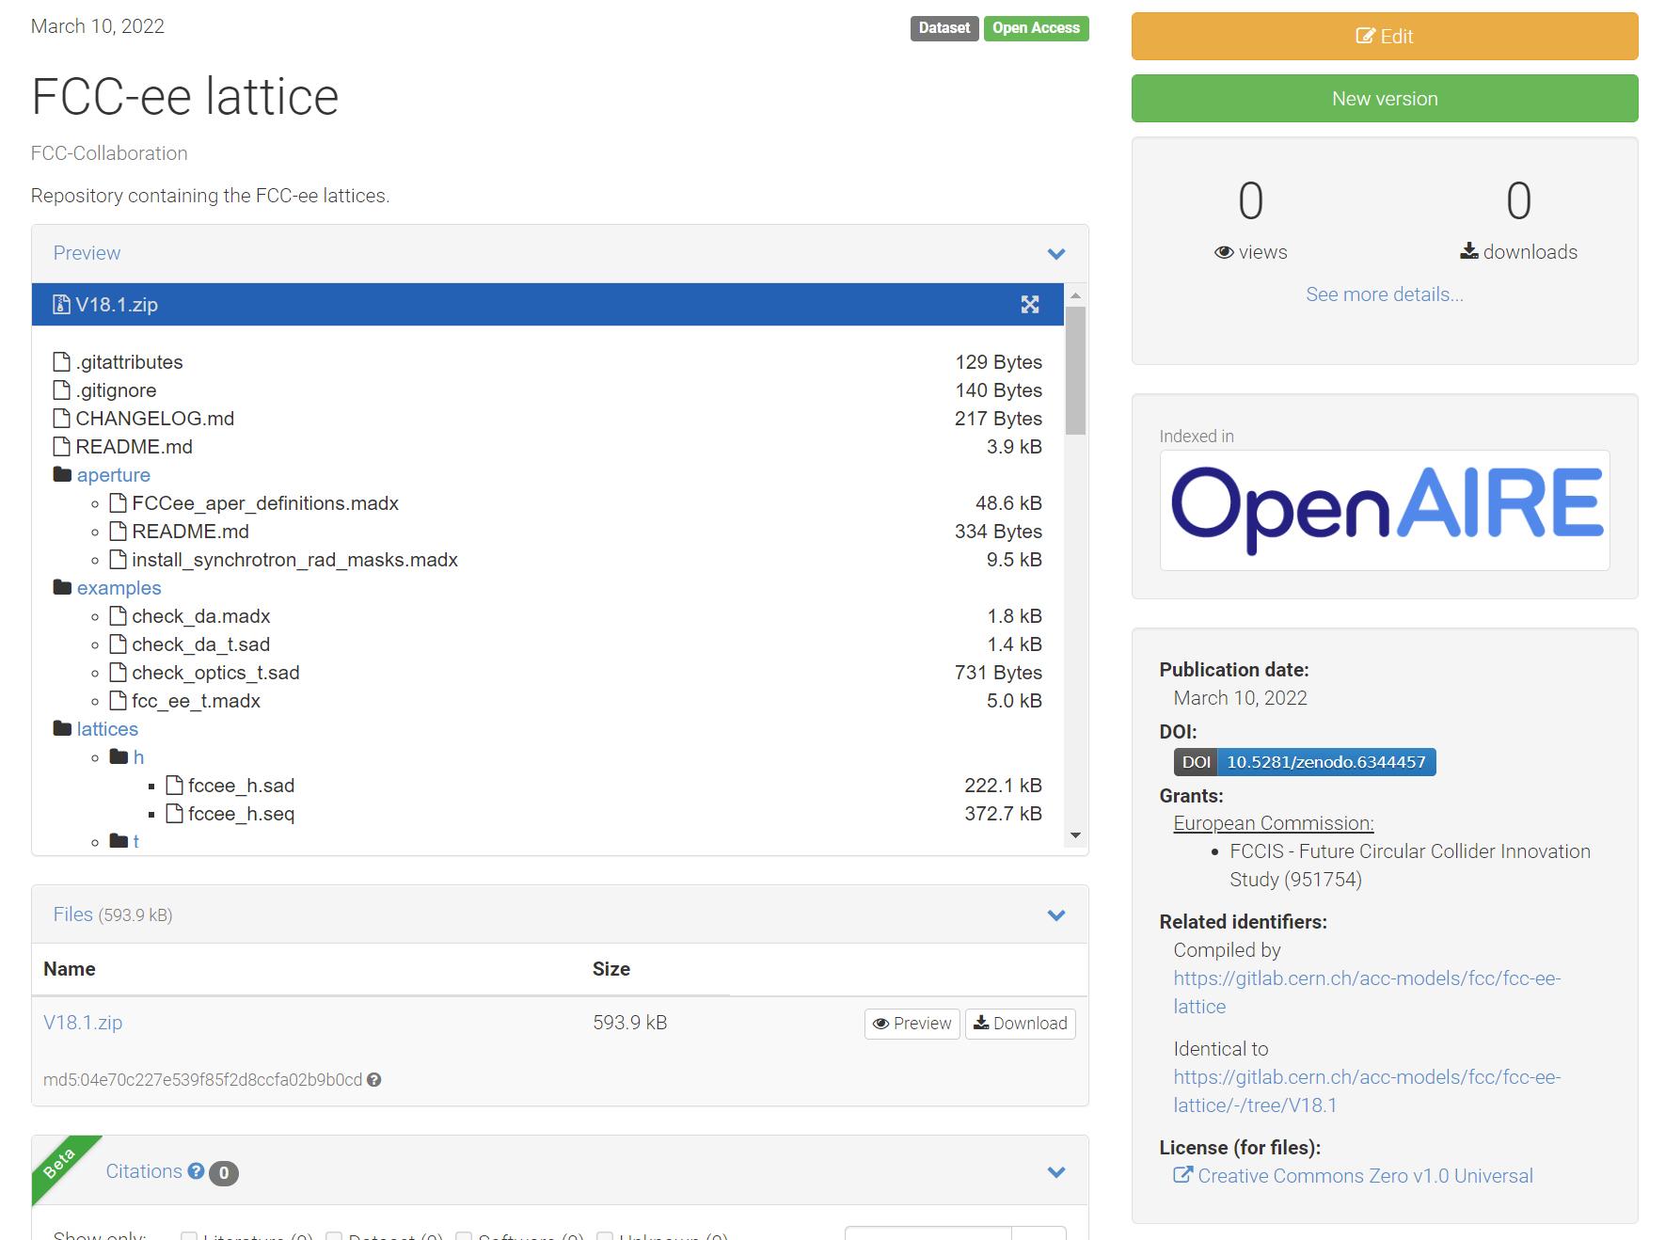
Zenodo

Slide 8
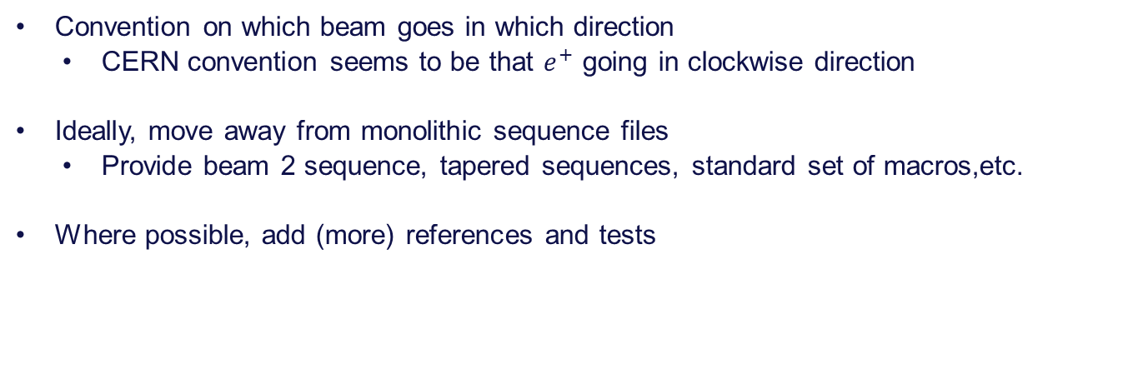
Open points
Convention on which beam goes in which direction
  CERN convention seems to be that $e^{+}$ going in clockwise direction
Ideally, move away from monolithic sequence files
  Provide beam 2 sequence, tapered sequences, standard set of macros,etc.
Where possible, add (more) references and tests
Thank you for your attention (& feedback)!

