Slide 1


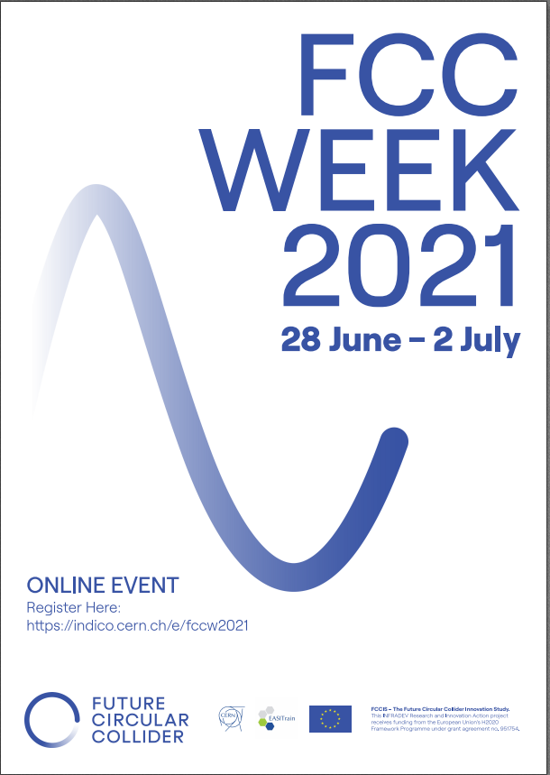
Progress with FCC-ee tuning
Chromaticity correction and effective lattices
Tessa Charles ^{1,2}, Bernhard Holzer ³, Katsunobu Oide ^{3,4}, Dmirty Shatilov, Frank Zimermann ³
Rogelio Garcia ³, Leon Van Riesen-Haupt ³ and the FCC-ee optics team
1. University of Liverpool, 2. Cockcroft Institute, 3. CERN, 4. KEK
FCCIS – The Future Circular Collider Innovation Study. This INFRADEV Research and Innovation Action project receives funding from the European Union’s H2020 Framework Programme under grant agreement no. 951754.

Slide 2
Assigning girder misalignments
Tessa Charles
sextupoles/ quadrupoles
girder
girder
(not to scale)
dipole
dipole
  - 2 independent DX and DY misalignments for each end of the girder, and which can be used to calculate DTHETA and DPHI.
Notes:
And actually we have misalignments on top of misalignments. Within the arcs, we have sextpoles and quadrupoels on a girder.

Slide 3
Misalignments and field errors used in these simulations
Tessa Charles
  Misalignments are randomly distributed via a Gaussian distribution, truncated at 2.5 sigma.
Notes:
This table summarises the current set of misalignments. That’s not to say that this wont’ change. This talk is an update on going work.
\begin{table}[htb!]
\centering
\begin{tabular}{p{3cm}cccccc}
\hline
Type & $\Delta$X & $\Delta$Y & $\Delta$PSI & $\Delta$S & $\Delta$DTHETA & $\Delta$DPHI \\
& ($\mu$m) & ($\mu$m) & ($\mu$rad) & ($\mu$m) & ($\mu$rad) & ($\mu$rad) \\
\vspace{.1cm} \\
\hline
Arc quadrupole* & 50 & 50 & 300 & 150 & 100 & 100 \\
Arc sextupoles* & 50 & 50 & 300 & 150 & 100 & 100 \\
\hline
Dipoles & 1000 & 1000 & 300 & 1000 & 0 & 0 \\
\hline
Girders & 150 & 150 & - & 1000 & 0 & 0 \\
\hline
IR quadrupole & 100 & 100 & 250 & 250 & 100 & 100 \\
IR sextupoles & 100 & 100 & 250 & 250 & 100 & 100 \\
\hline
BPM** & 40 & 40 & 100 & - \\
\hline
\end{tabular}
\end{table}

Slide 4
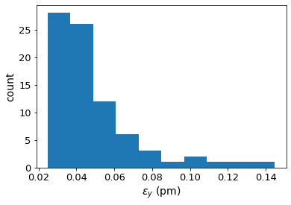
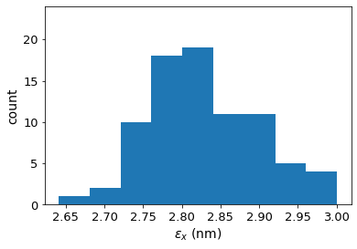
ttbar (182.5 GeV) 4IP lattice,
after correction strategy:
FCC-ee emittance tuning results
– without chromaticity correction
RMS misalignment and field errors tolerances:
Note: BPM errors not included

Slide 5
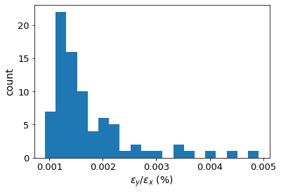
Tessa Charles
ttbar (182.5 GeV) 4IP lattice,
after correction strategy:
FCC-ee emittance tuning results
– without chromaticity correction
RMS misalignment and field errors tolerances:
Note: BPM errors not included
Notes:
Ttbar, 4IP lattice. These are the main results.
run_fccee_girs150_arcs50r400s150pt100_dip1000_IP100r250s250pt100_field_23b_3_gradual2
%$\epsilon_{x, \textrm{median}} = 2.276$ nm rad \\
%$\epsilon_{y, \textrm{median}} = 0.242$ pm rad \\
$\frac{\epsilon_{y}}{\epsilon_{x}} = 0.011$ $\%$ \\

Slide 6
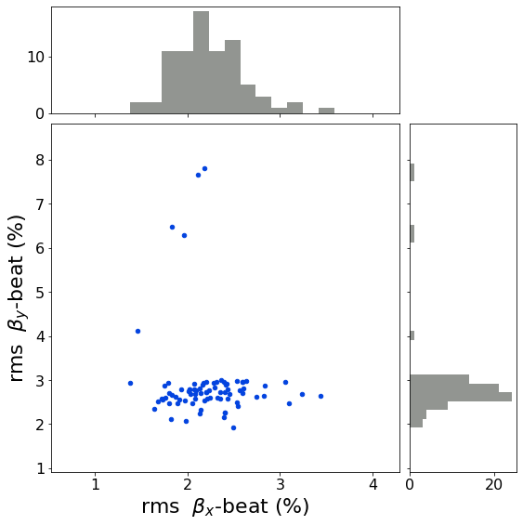
Tessa Charles
FCC-ee emittance tuning results
– without chromaticity correction
ttbar (182.5 GeV) 4IP lattice,
after correction strategy:
RMS misalignment and field errors tolerances:
Note: BPM errors not included

Slide 7
Adding chromaticity correction…

Slide 8
Tessa Charles
Chromaticity correction
Chromaticity corrected with tunable factor applied to arc sextupoles. Same factor applied to all sextupoles of each type.
Applied through MAD-X Match function. Two optimization variables (sextupole strength knobs for SF and SD) and two objectives (chromaticity in x and y).
Notes:
Why does this happen? Chromaticity corr changes sextupole strengths.
Improved orbit correction would help, but it’s already good.

Slide 9
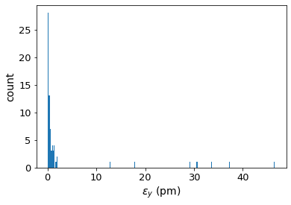
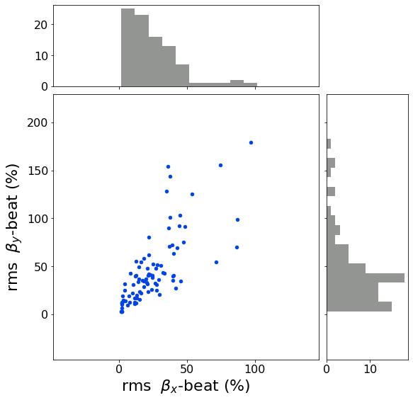
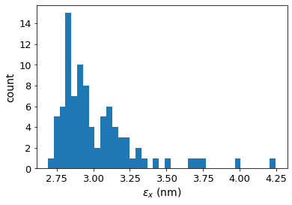
Chromaticity correction added
No chromaticity correction:
Chromaticity correction:
Chromaticity correction clearly increases the emittance in both planes.

Slide 10
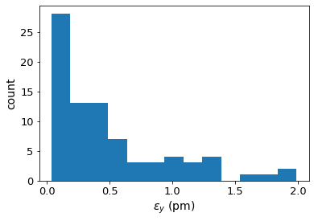
Chromaticity correction added
No chromaticity correction:
Chromaticity correction:
Highest 8 emittances removed, to better view lower end of distribution.
Chromaticity correction clearly increases the emittance in both planes.

Slide 11
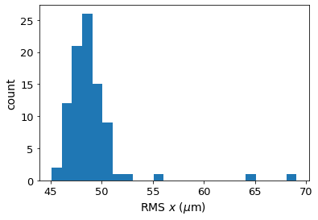
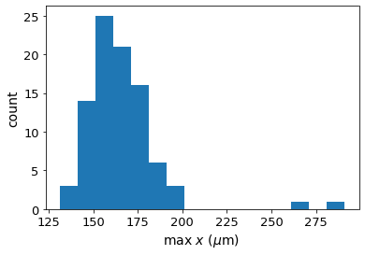
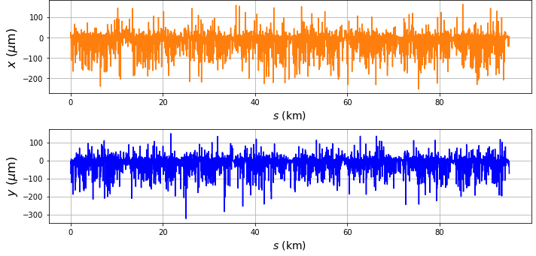
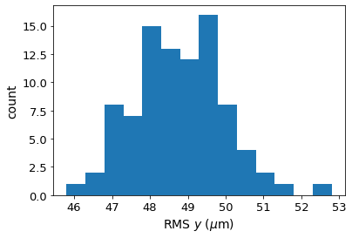
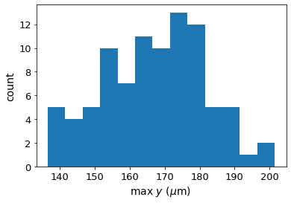
Tessa Charles
Adding chromaticity correction
Multiple variations attempted:
Chroma corr added at the end of original correction algorithm
Chroma corr scattered throughout final stage of correction algorithm (sextupoles at full strength)
Chroma corr performed, followed by a recalculation of the coupling+dy correction resp. mat.
Difficulty: chroma correction corrects chromaticity well, but increases coupling (by a lot).
Applying additional coupling correction changes the chromaticity -> An iterative procedure is necessary.
RMS horizontal orbit and max orbit distortion, after corrections (without BPM errors):
Notes:
Why does this happen? Chromaticity corr changes sextupole strengths.
Improved orbit correction would help, but it’s already good.

Slide 12
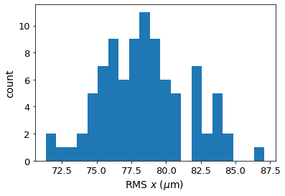
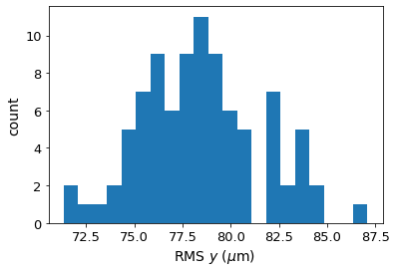
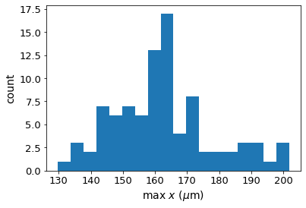
Tessa Charles
Orbit distortion through arc sextupoles after correction
Note: BPM errors not included!
Notes:
Why does this happen? Chromaticity corr changes sextupole strengths.
Improved orbit correction would help, but it’s already good.

Slide 13
Corrected lattice proxy

Slide 14
Tessa Charles
Corrected lattice proxy
Requests for a lattice that resembles a fully corrected lattice to allow other studies to continue.
Relies on making assumptions about the level of correction that will be achievable. However, these corrected lattices are needed for the other studies to progress.
Another approach to generating an ‘effective lattice’:
  Correction algorithm applied to lattice with 10% misalignments. (Results in a median vertical emittance of 0.0002 pm and design horizontal emittance of 1.513 nm).
  Begin rotating quadrupoles to intentionally introduce coupling. Two sets of lattices produced at 0.1% coupling and 0.2% coupling. (Results in a median vertical emittance of 1.49 pm.)

Slide 15
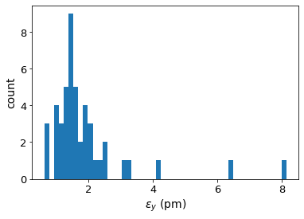
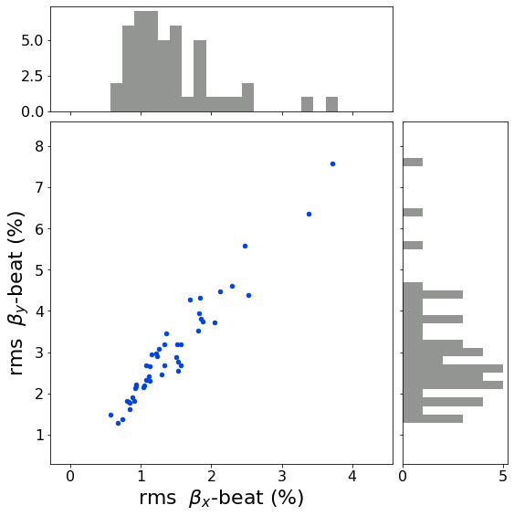
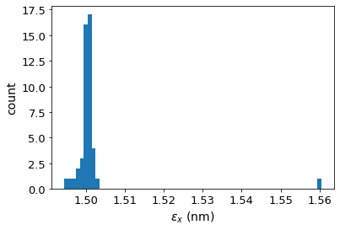
Tessa Charles
Corrected lattice proxy (0.1% coupling)
Notes:
%$\epsilon_{x, \textrm{median}} = 1.50$ nm rad \\
$\epsilon_{y, \textrm{median}} = 1.49$ pm rad \\
%$\frac{\epsilon_{y}}{\epsilon_{x}} = 0.099$ $\%$ \\

Slide 16
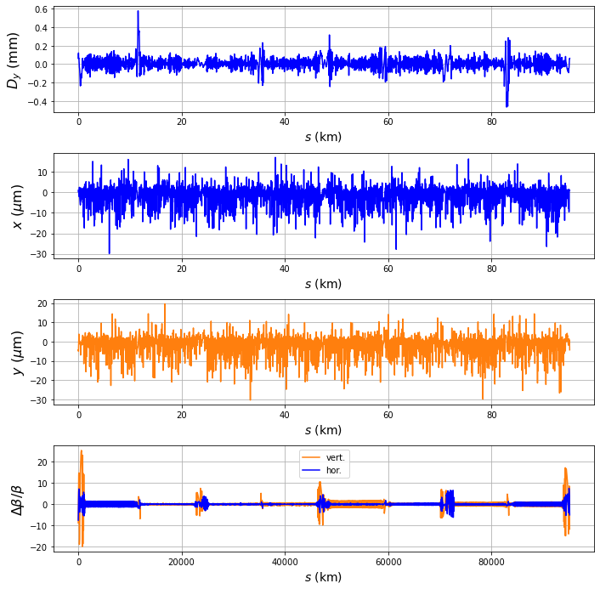
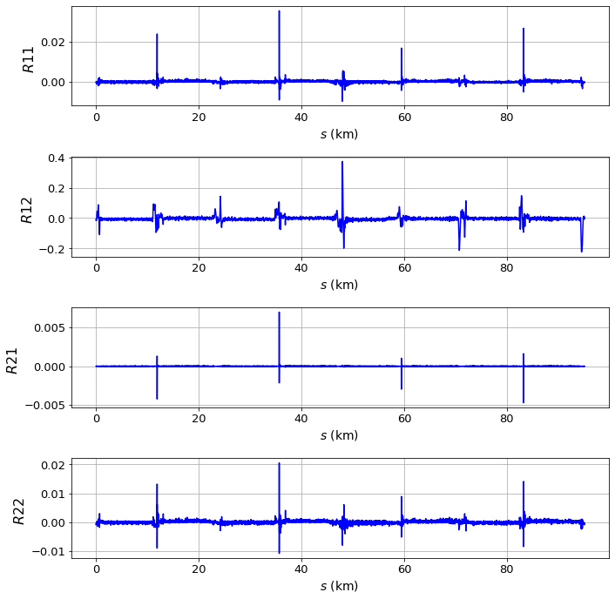
Tessa Charles
Effective lattice (0.1% coupling), ttbar 4 IP lattice:

Slide 17
Conclusions
Tessa Charles
  Progress made in incorporating chromaticity correction. DA calculations to be performed next.
  Orbit correction identified are critical for successful chromaticity correction that maintains reasonable vertical emittance.
  Effective lattices (or proxy lattices) created to achieve specific coupling ratios of 0.1% and 0.2%.
Notes:
For these simulations we assign many misalignments. These figures define the various misalignment types.

