Slide 1
Review of ballistic optics

Slide 2
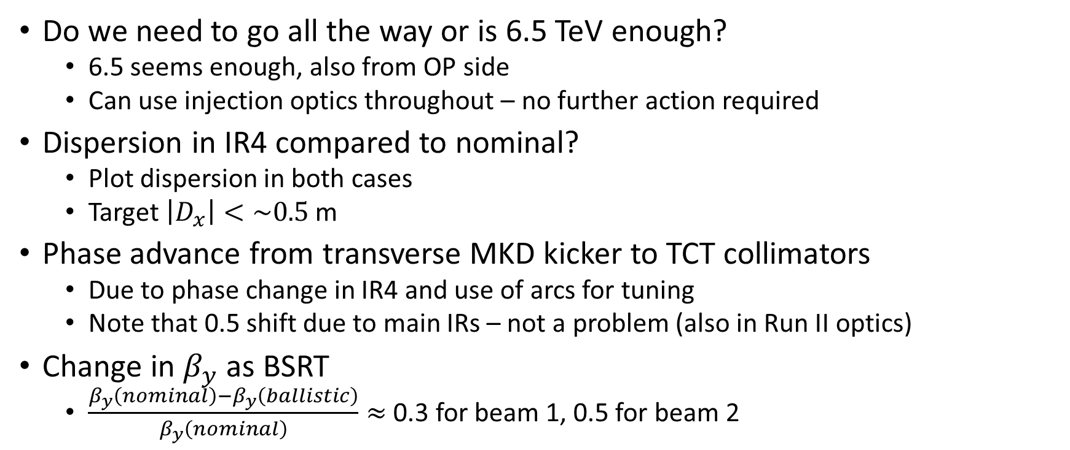
Open Points From Feedback after Talk
Do we need to go all the way or is 6.5 TeV enough?
  6.5 seems enough, also from OP side
  Can use injection optics throughout – no further action required
Dispersion in IR4 compared to nominal?
  Plot dispersion in both cases
  Target $\left|D_{x}\right|<\sim 0.5$ m
Phase advance from transverse MKD kicker to TCT collimators
  Due to phase change in IR4 and use of arcs for tuning
  Note that 0.5 shift due to main IRs – not a problem (also in Run II optics)
Change in $β_{y}$ as BSRT
  $\frac{{β_{y}\left(nominal\right)−β}_{y}\left(ballistic\right)}{β_{y}\left(nominal\right)}≈$ 0.3 for beam 1, 0.5 for beam 2

Slide 3
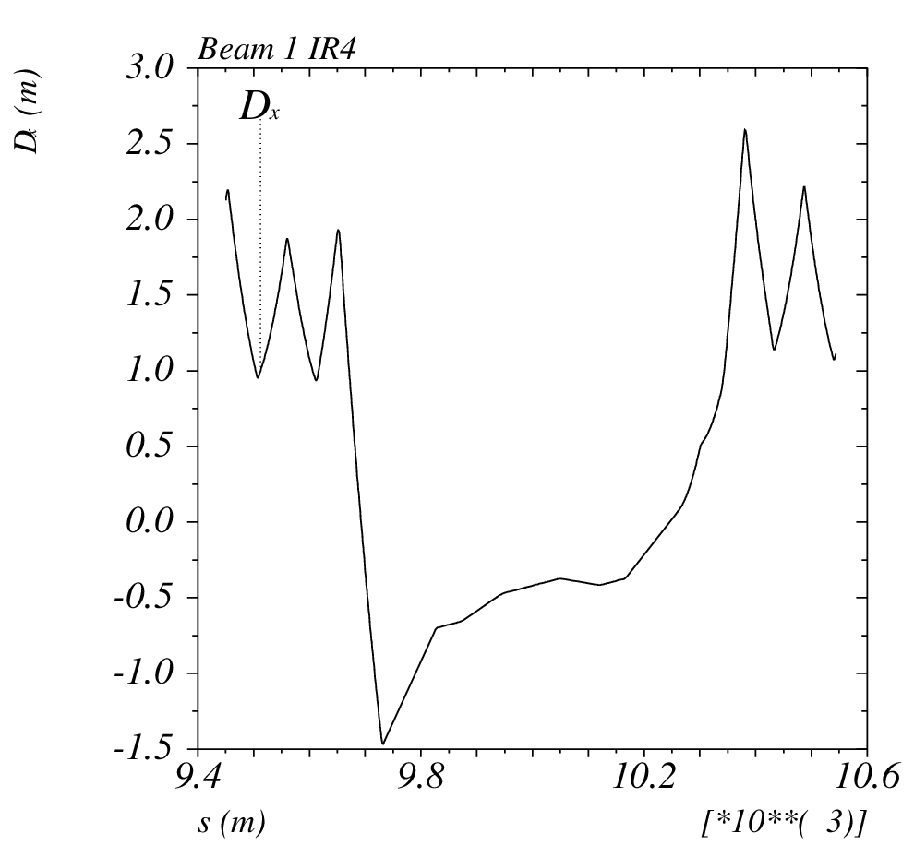
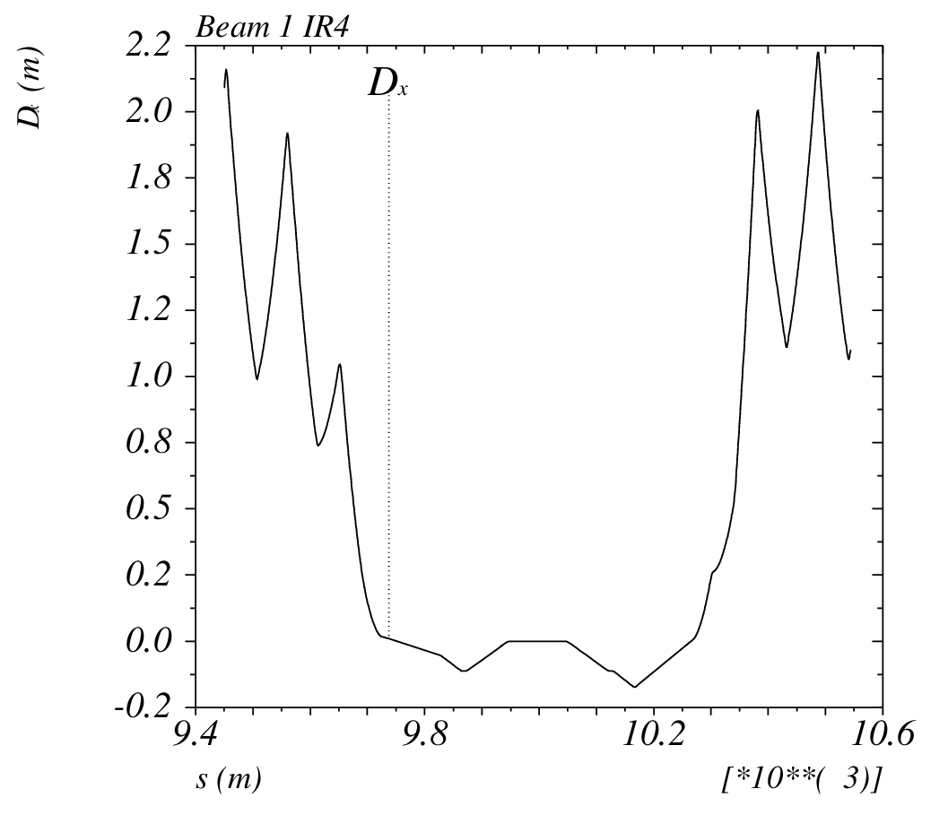
Beam 1
Ballistic
Nominal

Slide 4
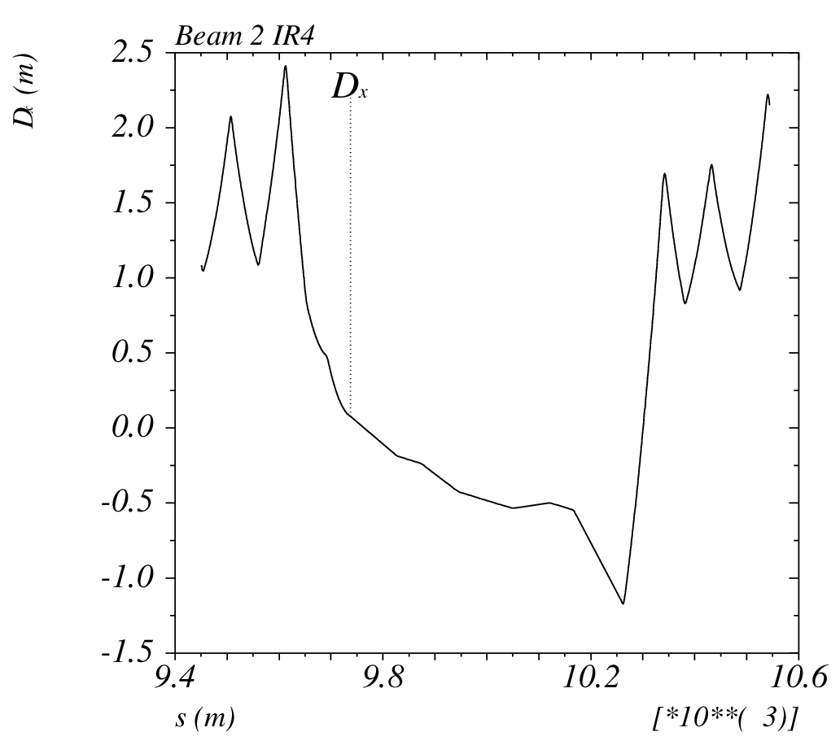
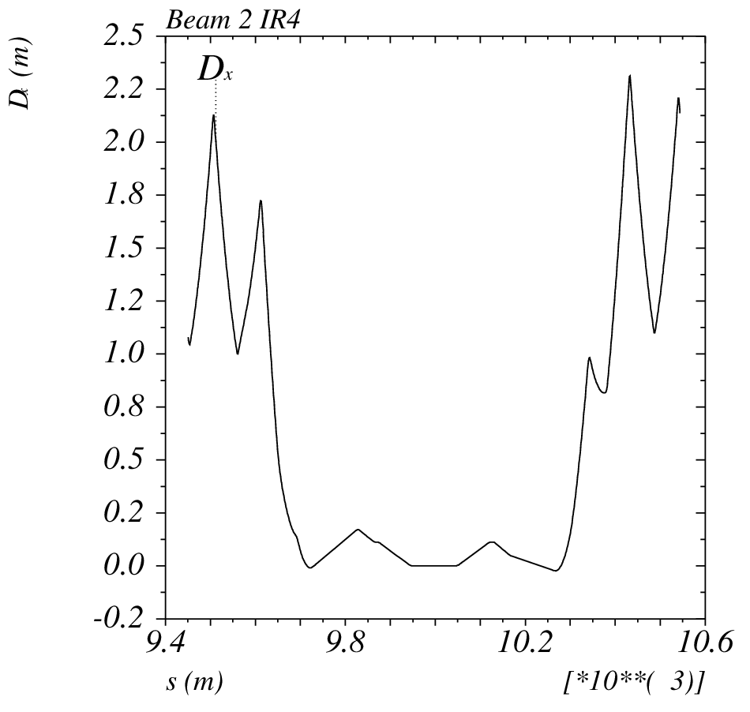
Beam 2
Ballistic
Nominal

Slide 5
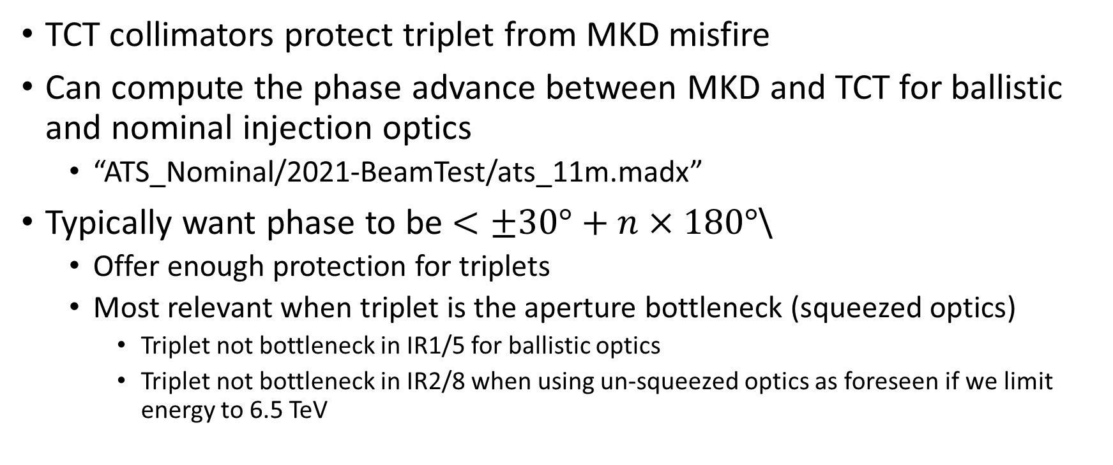
Phase advance between MKD and TCT
TCT collimators protect triplet from MKD misfire
Can compute the phase advance between MKD and TCT for ballistic and nominal injection optics
  “ATS_Nominal/2021-BeamTest/ats_11m.madx”
Typically want phase to be $<±30°+n×180°$\
  Offer enough protection for triplets
  Most relevant when triplet is the aperture bottleneck (squeezed optics)
    Triplet not bottleneck in IR1/5 for ballistic optics
    Triplet not bottleneck in IR2/8 when using un-squeezed optics as foreseen if we limit energy to 6.5 TeV

Slide 6
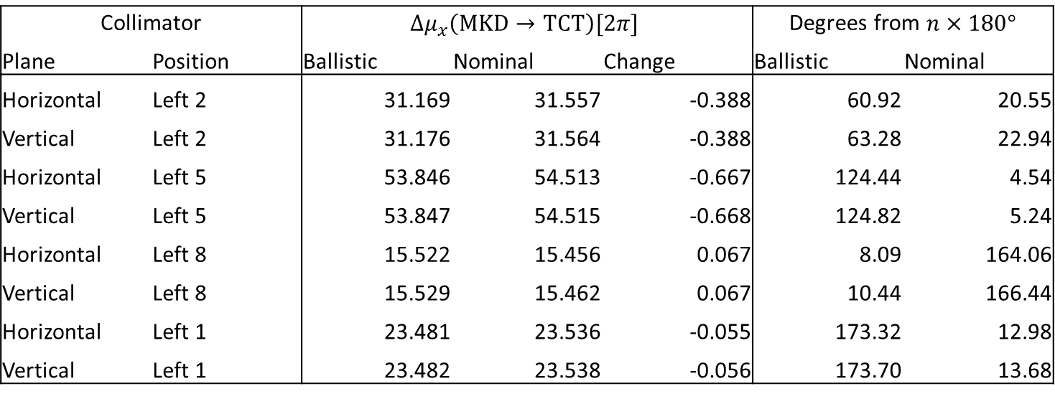
Beam 1
Collimator |  | $$Δμ_{x}\left(MKD→TCT\right)[2π]$$ |  |  | Degrees from $n×180°$
Plane | Position | Ballistic | Nominal | Change | Ballistic | Nominal
Horizontal | Left 2 | 31.169 | 31.557 | -0.388 | 60.92 | 20.55
Vertical | Left 2 | 31.176 | 31.564 | -0.388 | 63.28 | 22.94
Horizontal | Left 5 | 53.846 | 54.513 | -0.667 | 124.44 | 4.54
Vertical | Left 5 | 53.847 | 54.515 | -0.668 | 124.82 | 5.24
Horizontal | Left 8 | 15.522 | 15.456 | 0.067 | 8.09 | 164.06
Vertical | Left 8 | 15.529 | 15.462 | 0.067 | 10.44 | 166.44
Horizontal | Left 1 | 23.481 | 23.536 | -0.055 | 173.32 | 12.98
Vertical | Left 1 | 23.482 | 23.538 | -0.056 | 173.70 | 13.68

Slide 7
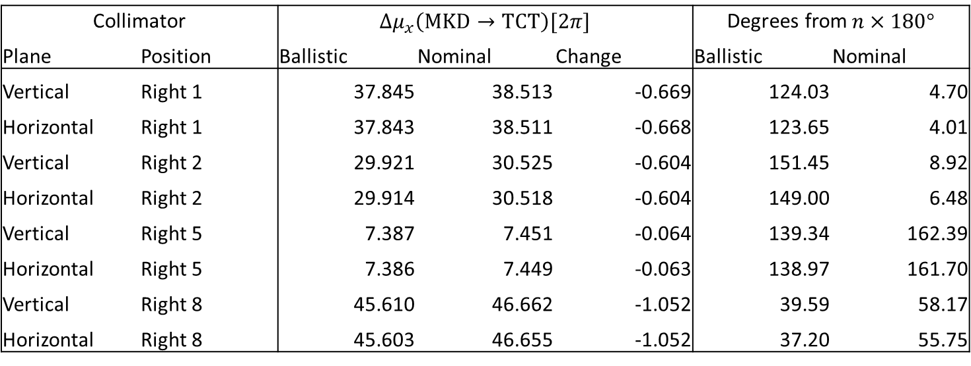
Beam 2
Collimator |  | $Δμ_{x}\left(MKD→TCT\right)[2π]$ |  |  | Degrees from$n×180°$
Plane | Position | Ballistic | Nominal | Change | Ballistic | Nominal
Vertical | Right 1 | 37.845 | 38.513 | -0.669 | 124.03 | 4.70
Horizontal | Right 1 | 37.843 | 38.511 | -0.668 | 123.65 | 4.01
Vertical | Right 2 | 29.921 | 30.525 | -0.604 | 151.45 | 8.92
Horizontal | Right 2 | 29.914 | 30.518 | -0.604 | 149.00 | 6.48
Vertical | Right 5 | 7.387 | 7.451 | -0.064 | 139.34 | 162.39
Horizontal | Right 5 | 7.386 | 7.449 | -0.063 | 138.97 | 161.70
Vertical | Right 8 | 45.610 | 46.662 | -1.052 | 39.59 | 58.17
Horizontal | Right 8 | 45.603 | 46.655 | -1.052 | 37.20 | 55.75

Slide 8
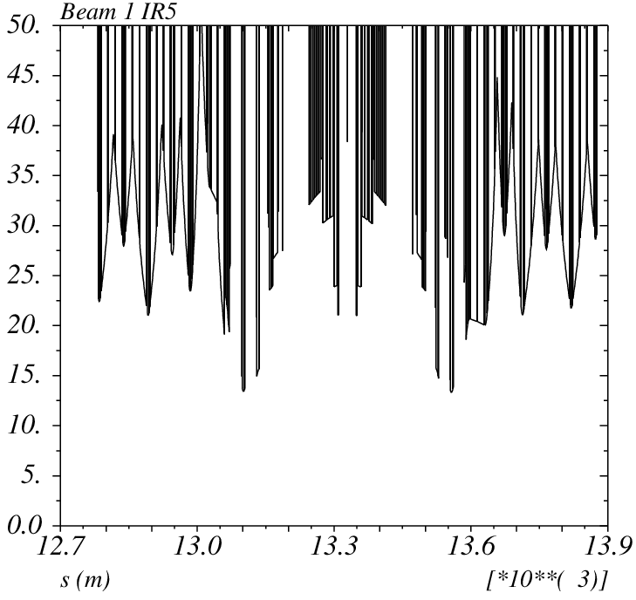
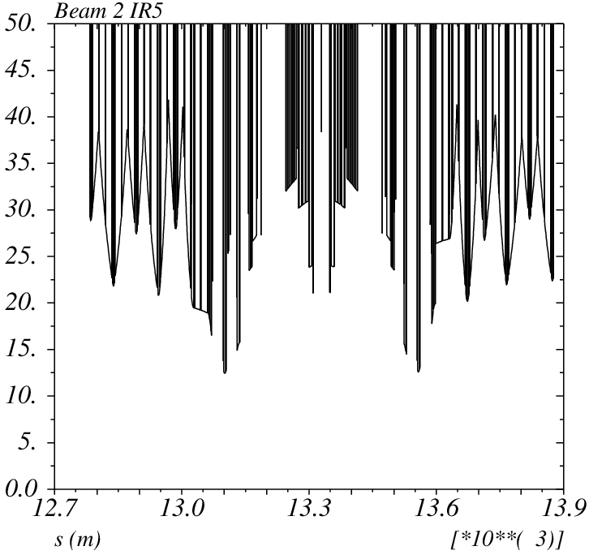
IR1/5 Apperture – Triplet not bottleneck

Slide 9
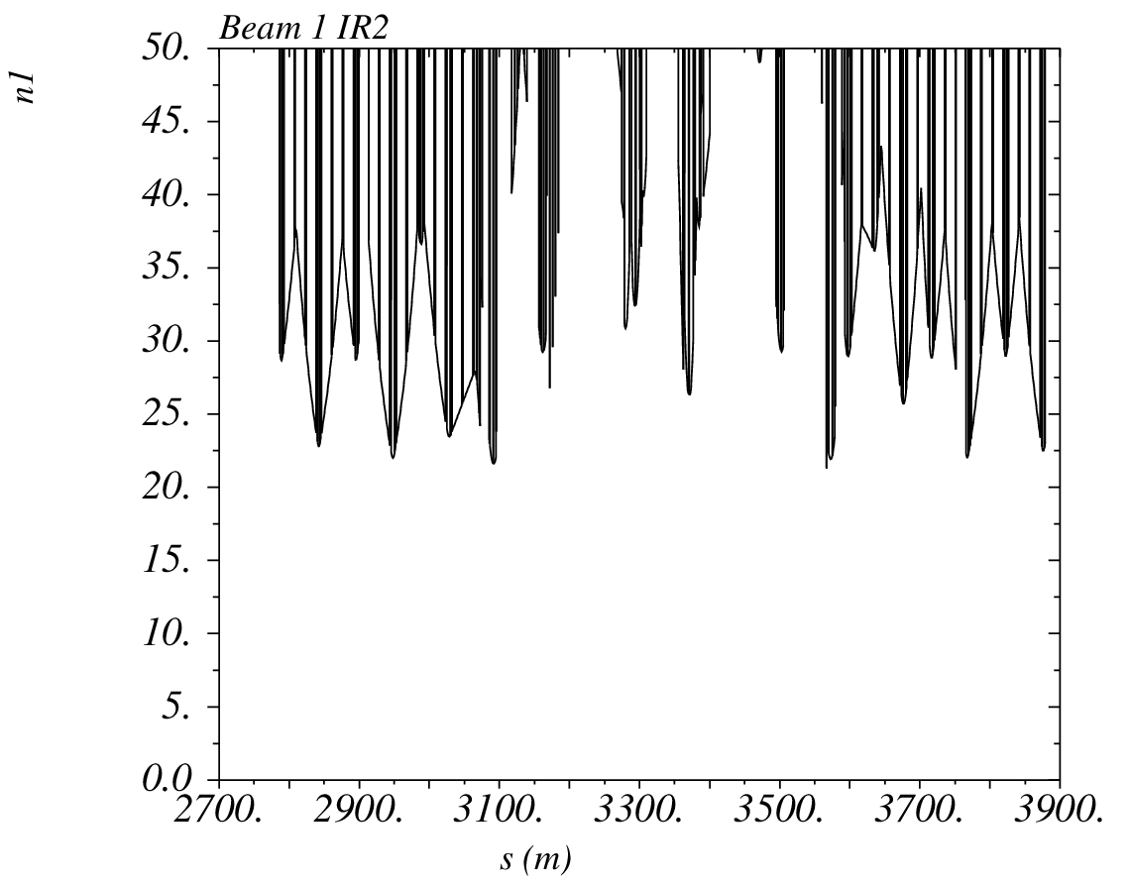
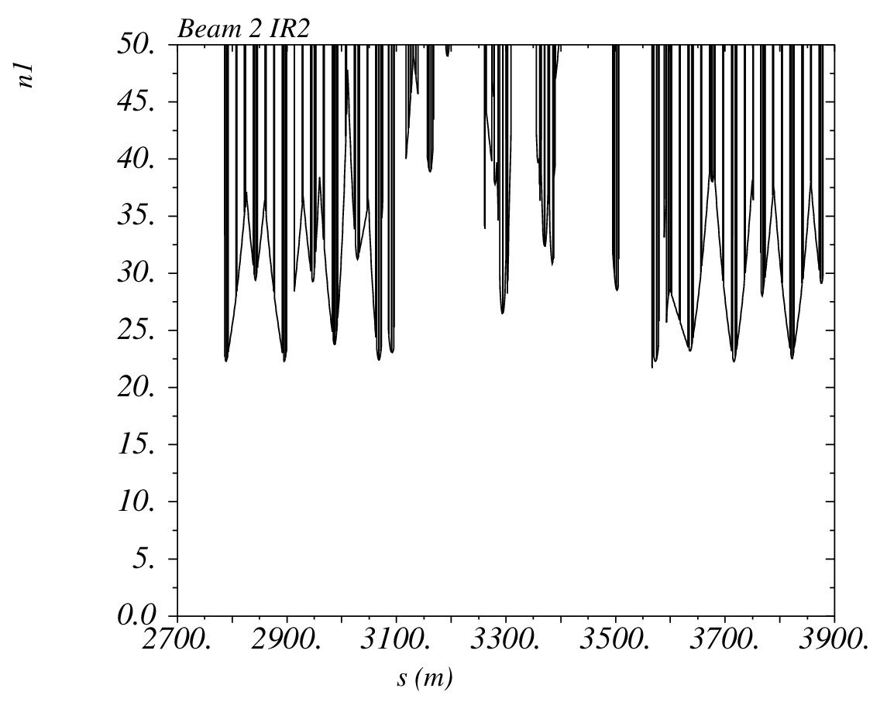
IR2 Apperture – Triplet not bottleneck

Slide 10
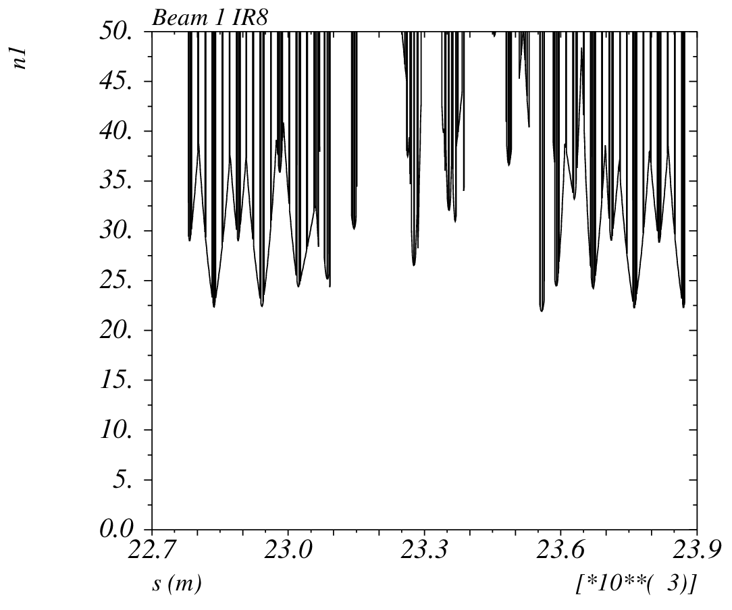
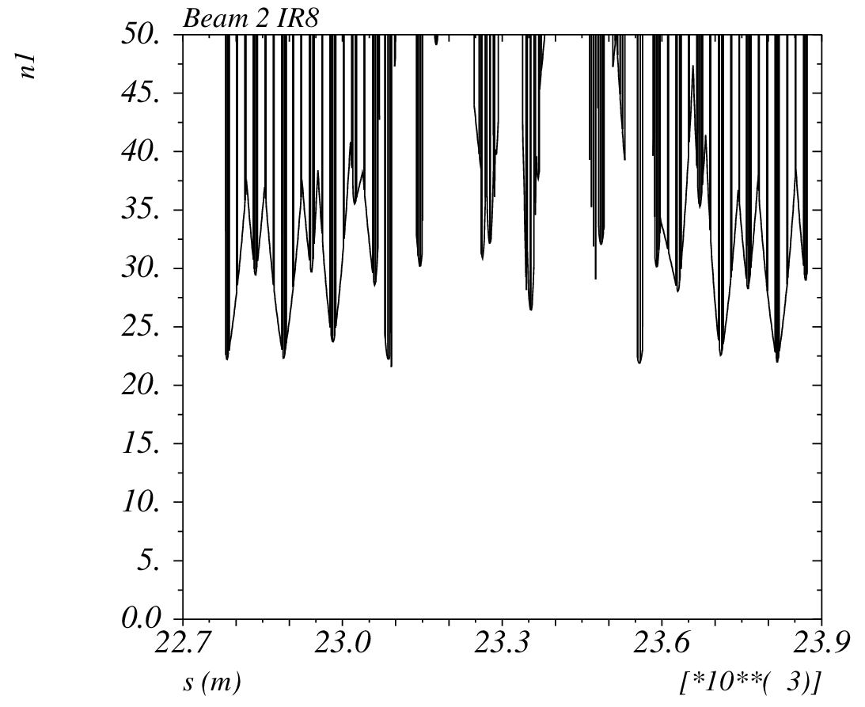
IR8 Apperture – Triplet not bottleneck

Slide 11
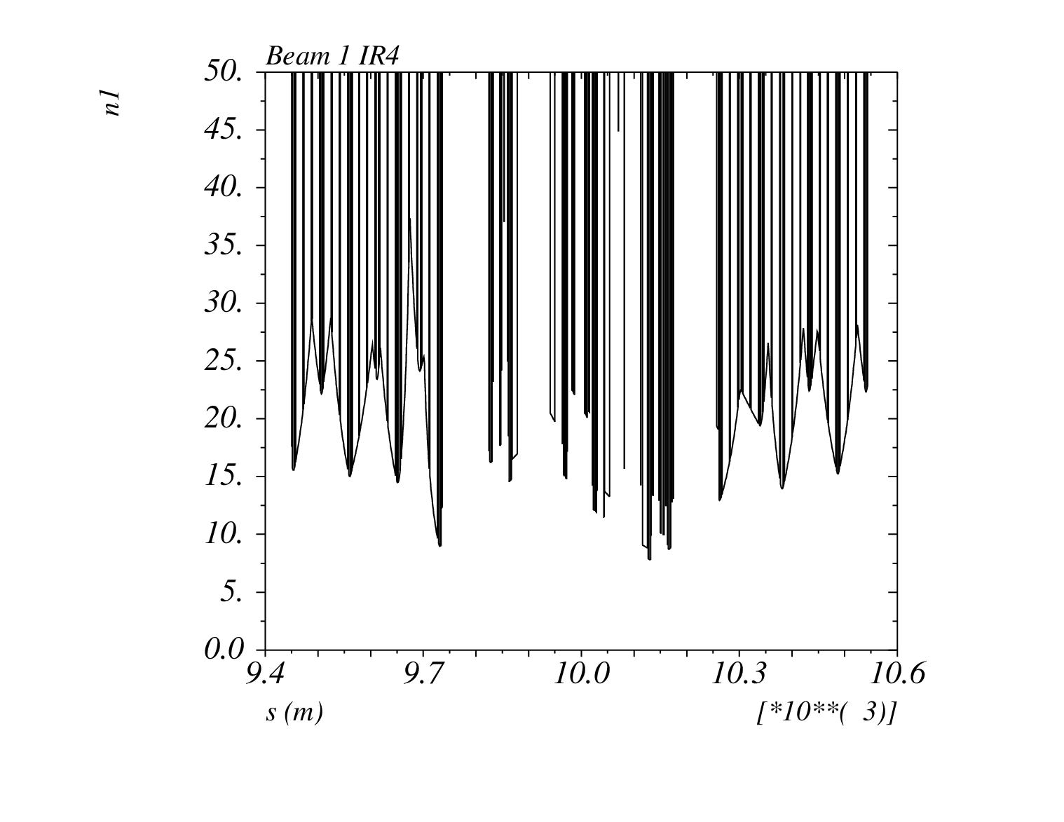
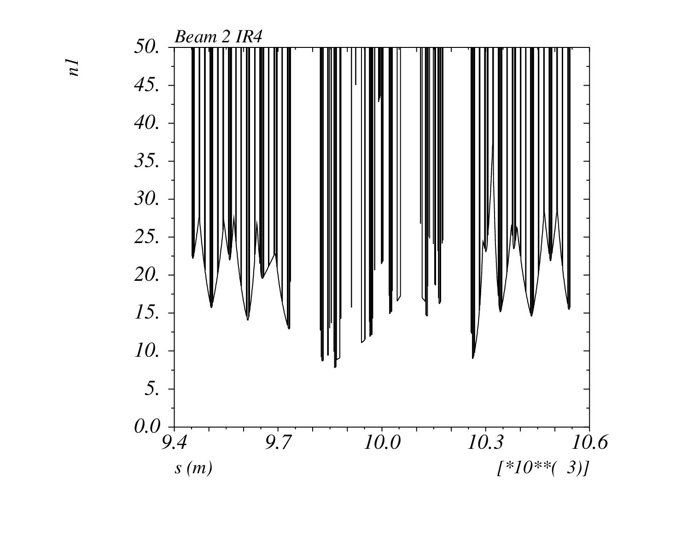

IR4 with $3.5 μm$ beam

Slide 12
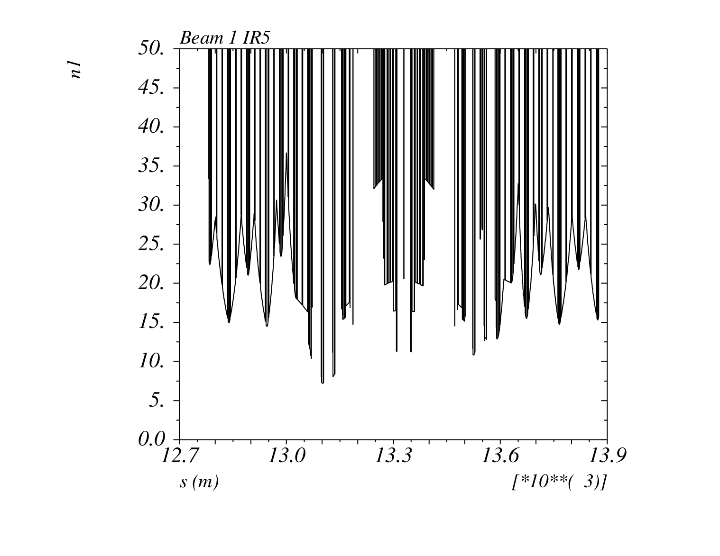
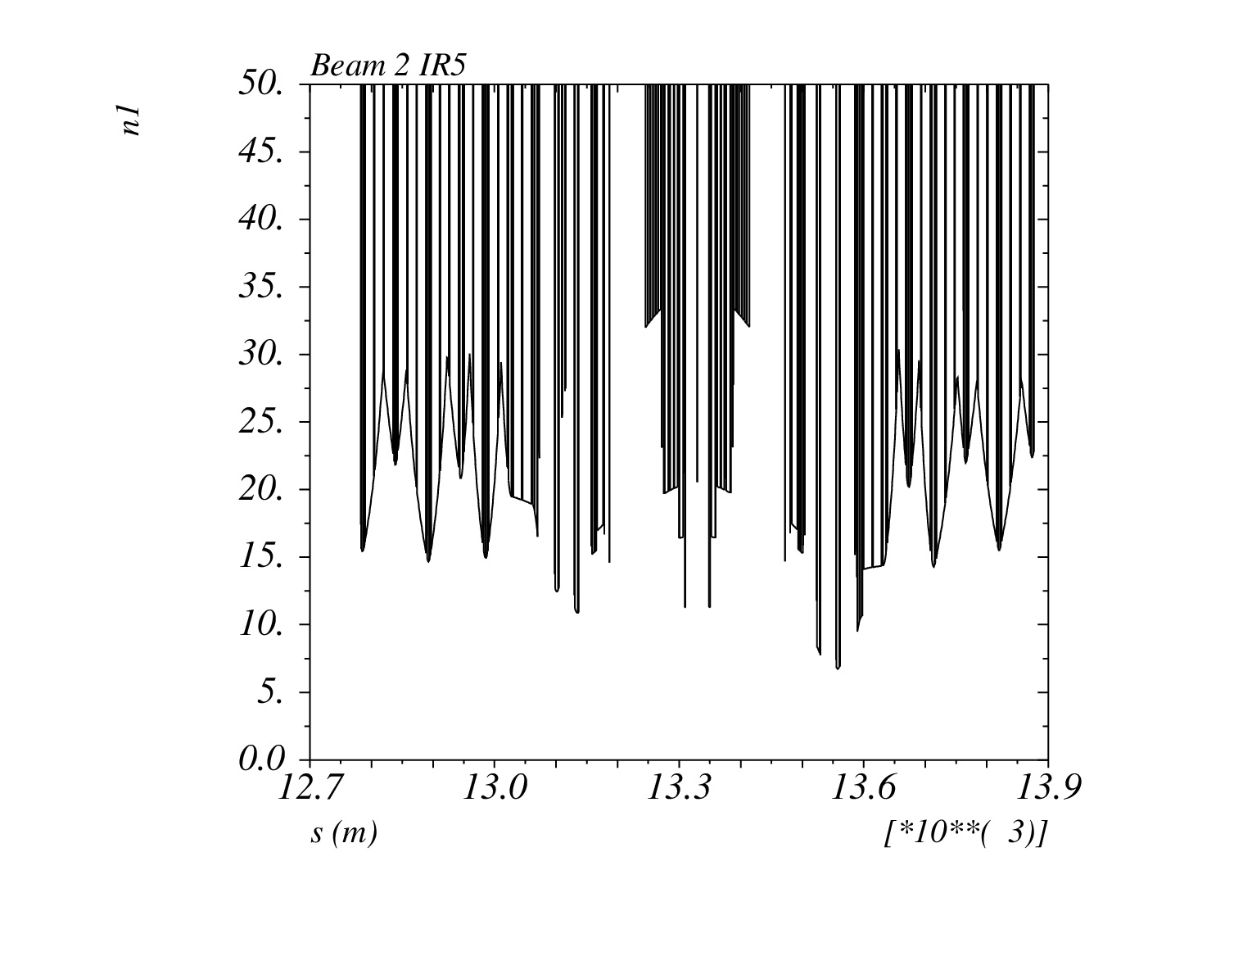

IR1/5 with $3.5 μm$ beam

