Slide 1
Overview PSI RF Systems power consumption
M. Pedrozzi :: In behalf of the PSI RF group :: Paul Scherrer Institute
Workshop on efficient RF sources - July 4-6 2022

Slide 2
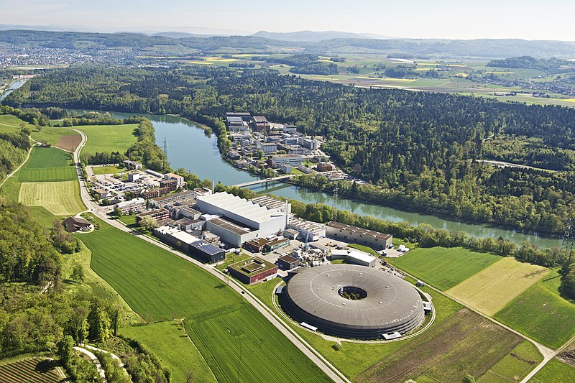
PSI's accelerators in the landscape
HIPA ~52’000 MWh/year
  (High Intensity Proton Accelerator)
SLS ~16’000 MWh/year
  (Swiss Synchrotron Light Source)
SwissFEL ~22’500 MWh/year
  (Swiss X-Ray Free Electron Laser)
PROSCAN ~4’700 MWh/year
  (Proton therapy, not handled here)
3.
1.
4.
2.
Page 2

Slide 3
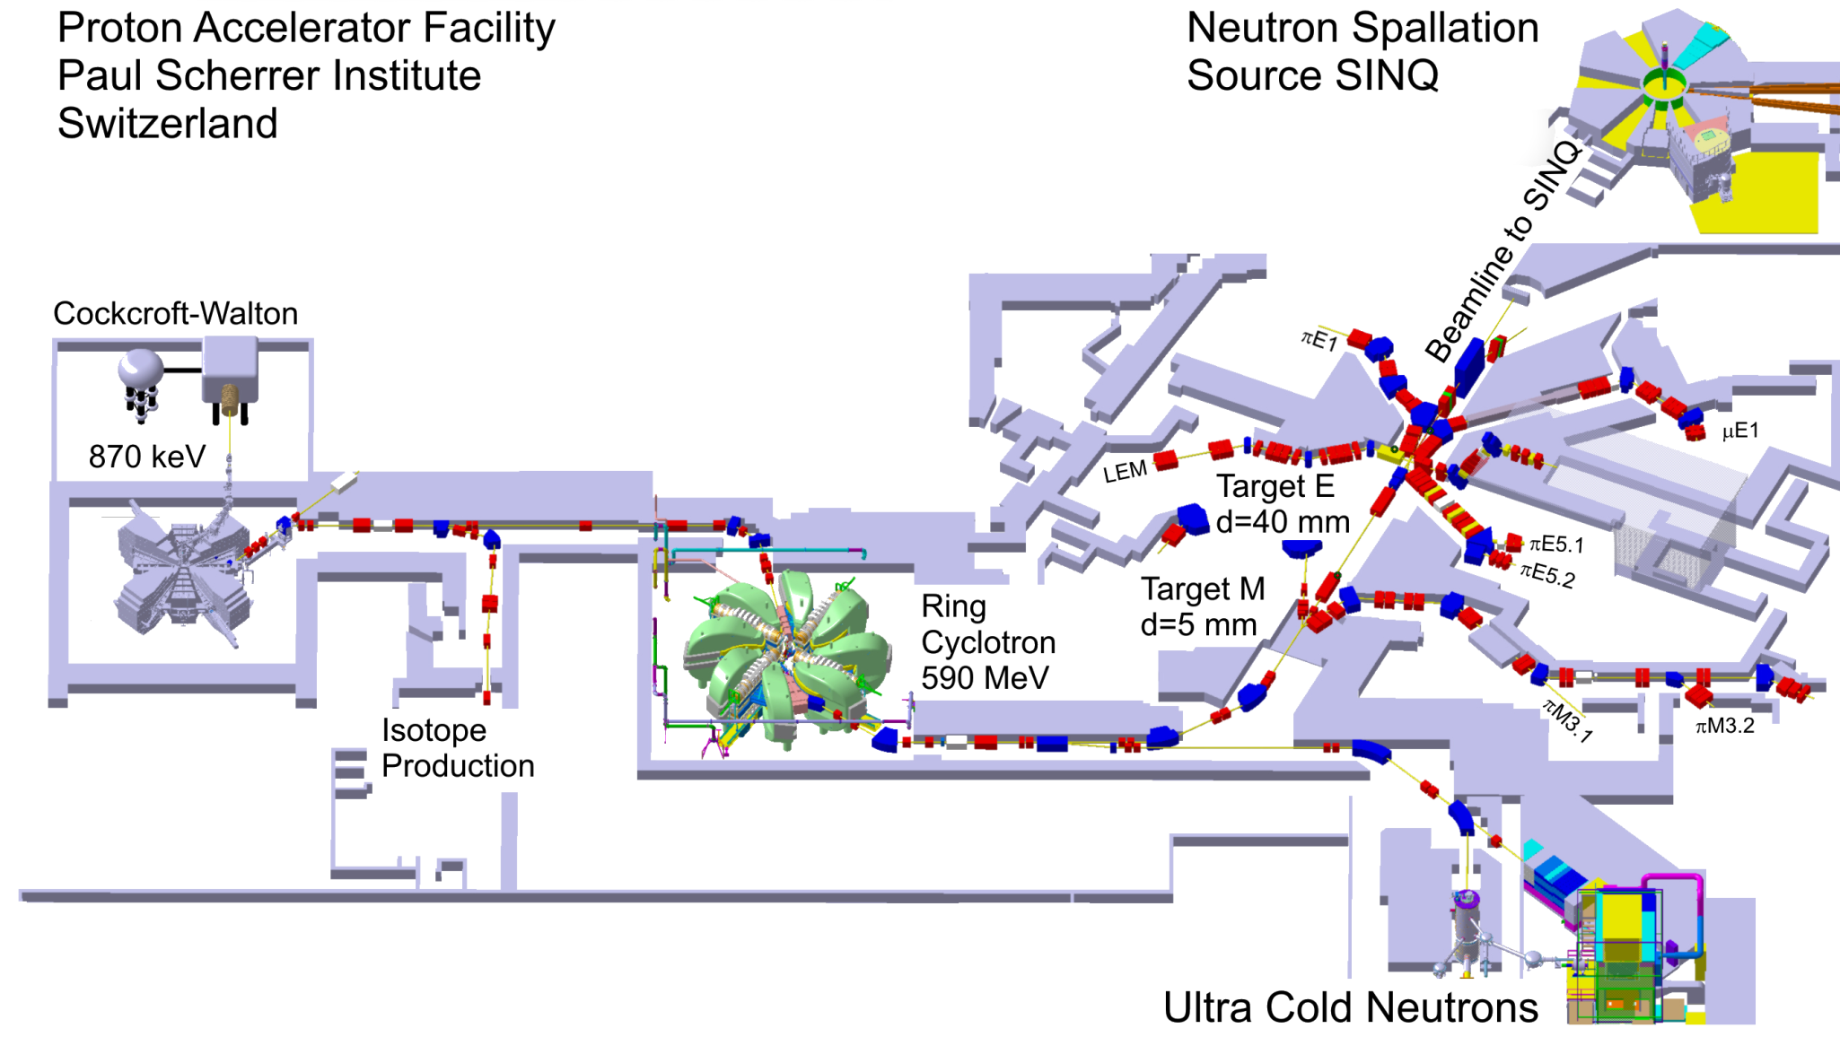
Overview High Intensity Proton Accelerator
1.
Proton source
SμS: Swiss Muon Source
Injector 2
72 MeV
Regular operation at 2.2mA beam current
1.29 MW beam power
Tested up to 2.4 mA beam current
1.4 MW beam power
n2EDM
Global Rf power requirement ~6 MW
(50% of overall requirements)
Notes:
SINQ: neutron spallation source (SpallatIon-NeutronQuelle)
UCN: Ultra Cold neutrons
(n2EDM: neutron electric dipole moment experiment)
Target M & E: Muon sources

Slide 4
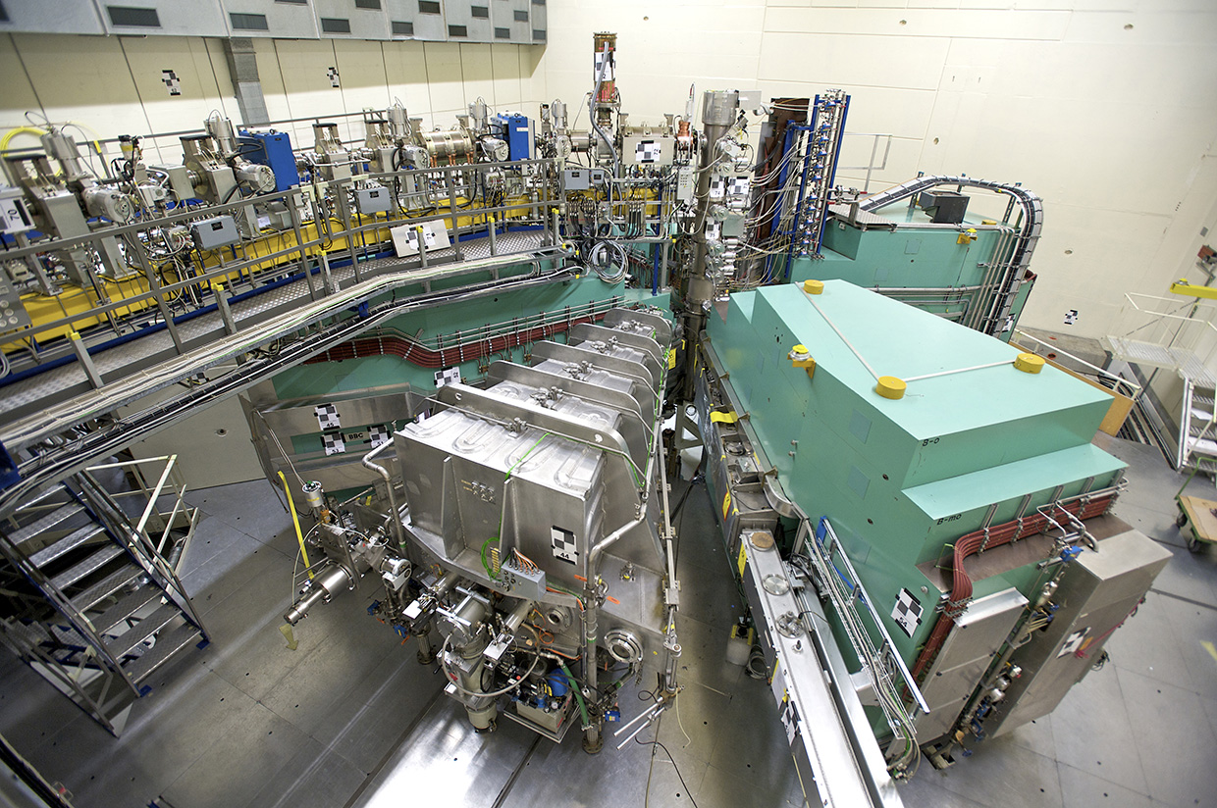
Injector 2 cyclotron
Injection energy: 870 keV
Extraction energy: 72 MeV
Number of turns: 83
1.
Ongoing Upgrade
Replacement resonator 2&4
New Tetrode amplifier chain and LLRF all resonators
Goal: Increase voltage toward 3 mA beam current
No efficiency gain expected
Resonator | type | material | frequency | gap voltage | Wall losses in cavity | incident power @ 2.4 mA Beam
1 & 3 | Double gap cavity | aluminum | 50 MHz | ∼ 420 kVp | ∼ 150 kW | ∼ 225 kW
2 & 4 | Flattop cavity | aluminum | 150 MHz | ∼ 31 kVp | ∼ 5 kW | ∼ 14 kW
2 & 4 new | Single gap cavity | aluminum | 50 MHz | ∼ 400 kVp @ extraction | ∼ 50 kW | ∼ 100 kW

Slide 5
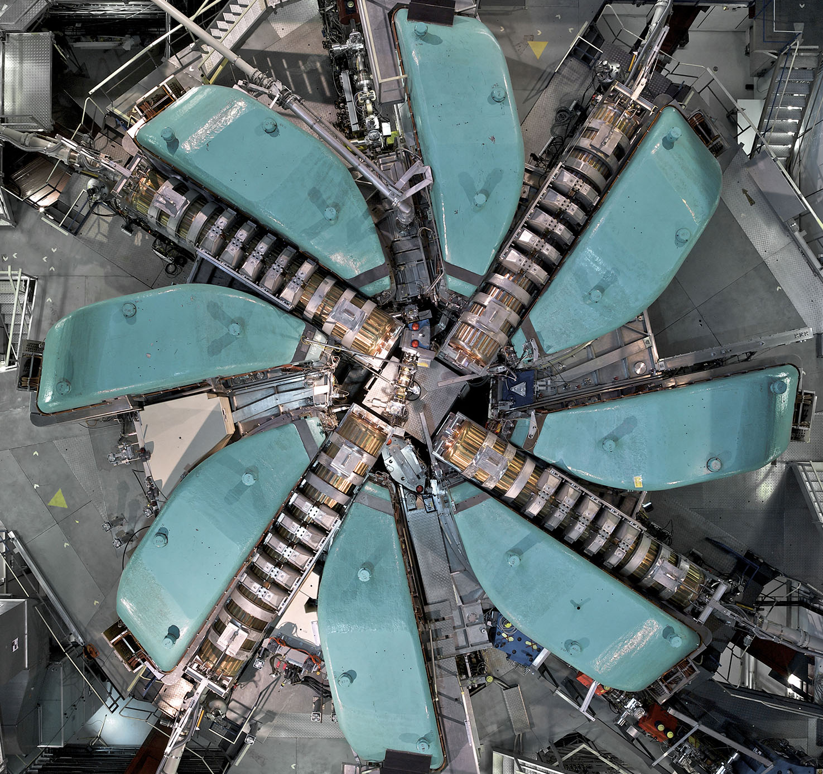
Ring cyclotron
Flattop cavity
1.
Injection energy: 72 MeV
Extraction energy: 590 MeV
Number of turns: 186
Sector magnet
copper cavity
numbers | type | material | frequency | gap voltage | incident power no beam | incident power @ 2.4 mA beam
4 | Main cavity | copper | 50 MHz | ∼ 850 kVp | ∼ 250 kW | ∼ 600 kW
1 | Flattop cavity | aluminum | 150 MHz | 555 kVp | ∼ 110 kW (active) | ∼ - 36 kW (passive)

Slide 6
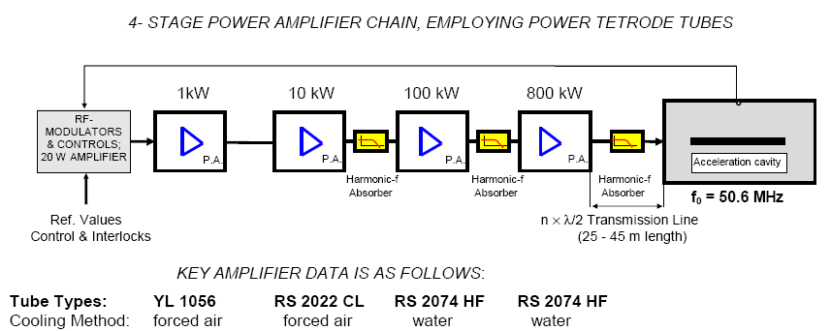
Amplifier chain for one copper cavity in ring cyclotron
1.
1kW 10kW 100kW 1MW
Amplifier chains built in early 90s
Some parts were taken over from older rf-system.

Slide 7
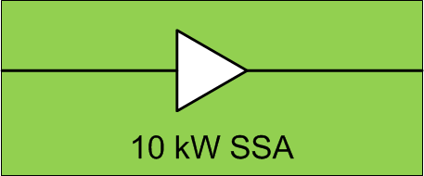
Amplifier chain for one copper cavity in ring cyclotron
1.
100kW 1MW
2022: 1/10kW Tetrode Amplifier replaced by 10kW SSA
(BBL200-A10000 from Rohde & Schwarz)
Of the shelf SSA operated in class A -> no improvement in efficiency, goal is reliability

Slide 8
Power efficiency rf systems for the Ring cyclotron
 | filament on | no Beam | 2.4 mA beam current
forward rf power
cavity 1 |  | 225 kW | 649 kW
cavity 2 |  | 250 kW | 620 kW
cavity 3 |  | 280 kW | 640 kW
cavity 4 |  | 265 kW | 625 kW
Flattop cavity |  | ~110 kW (active) | 14 kW (passive)
Total rf power | 0 kW | 1130 kW | 2548 kW
grid power
Anode PS 1 |  | 413 kW | 1002 kW
Anode PS 2 |  | 413 kW | 995 kW
Anode PS 3 |  | 456 kW | 1052 kW
Anode PS 4 |  | 435 kW | 1016 kW
power distribution WSGA | 181 kW | 526 kW | 533 kW
total grid power | 181 kW | 2244 kW | 4599 kW
efficiency | 0 | 0.50 | 0.55
1.
Total filament power
∼ 100kW
Including all rf systems (llrf, tuning system, control system, forced air cooling,
transmission line cooling, load for flattop).

Slide 9
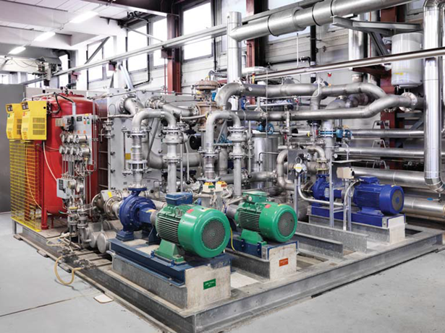
Cooling system for Tetrodes
Demineralized water
Inlet temperature at tube 55°C
Outlet temperature up to 80°C
Heat recovery system
~3’357 MWh/Year
(~6.5% of energy consumption)
Suppling ¼ of heat for PSI buildings
(Shutdown from Christmas to April)
1.
HF0: Cooling circuit for tetrode amplifiers for the ring cyclotron

Slide 10
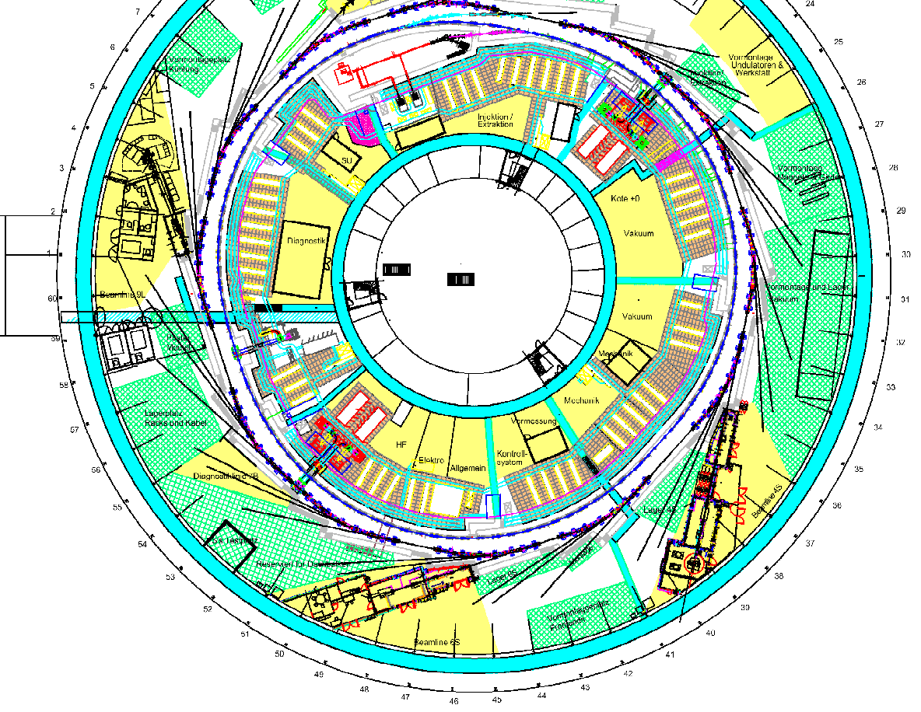
SLS Layout and RF stations
Linac (100MeV):
Two TH2100 (35 MW max) & pfn modulator (3 GHz)
Op. since April 2000
Booster 500 MHz RF
1 Klystron power plant 180 kW (max)
Op. since July 2000
1 in house SSA power plant 65 kW (max)
Op. Since 2016
Both stations can supply the Booster cavity (ramp 2-40 kW) or be used for the RF test facility
Storage ring 500 MHz RF
4 klystron power plants 180 kW (max)
Op. since December 2000
2.
Linac
1
2
T
B
4
3
SC

Slide 11
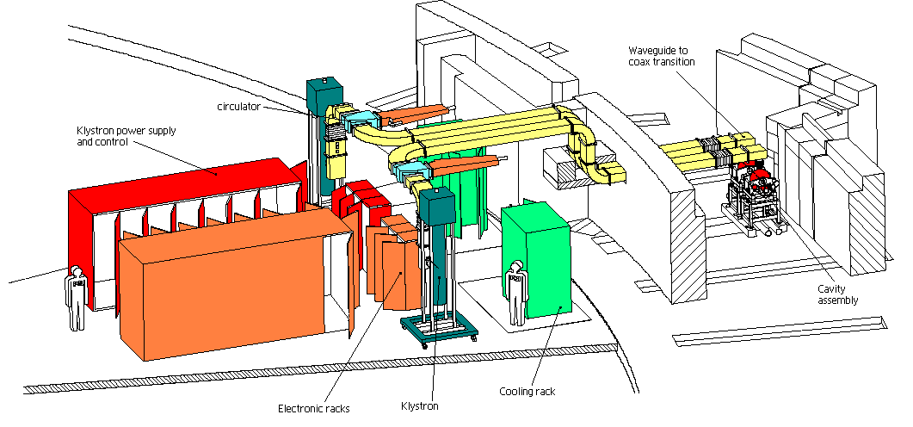
Layout SR 500 MHz accelerating station
(large contribution to power consumption)
2.
Pulse Step Modulator: 46 kV / 7.5 A
Test 180kW CW at 45.5 kV,/ 6.5 A
η≈60% (supplier) => operational 41-51% (not saturated & matching)

Slide 12
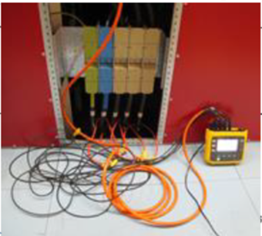
Characterization power consumption SR stations
(measurements on SR2)
2.
Klystron RF power: 115 kW
Grid power measurement: 261 kW
Grid to RF efficiency 44% (good Klystron)
The electronic efficiency of the klystrons fluctuates from tube to tube, and depends on a non optimal matching of the tube exit to the 50 Ohm line (cirulator) and refurbishinh history.
The best case, one klystron reuned for better matching, can reach ~50% efficincy i normal operation
Grid Power measurement at PSM input. Includes all energy consumer of the RF plant included klystron auxiliaries

Slide 13
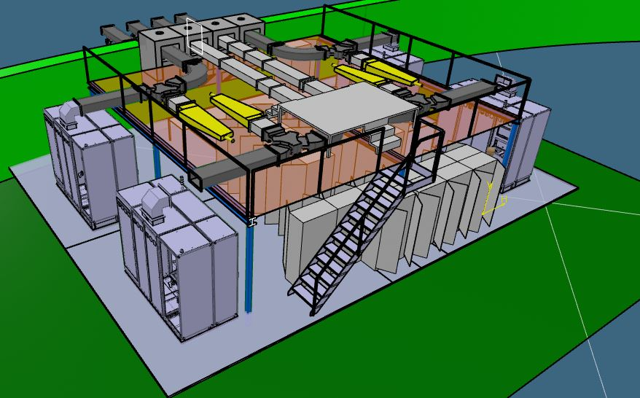
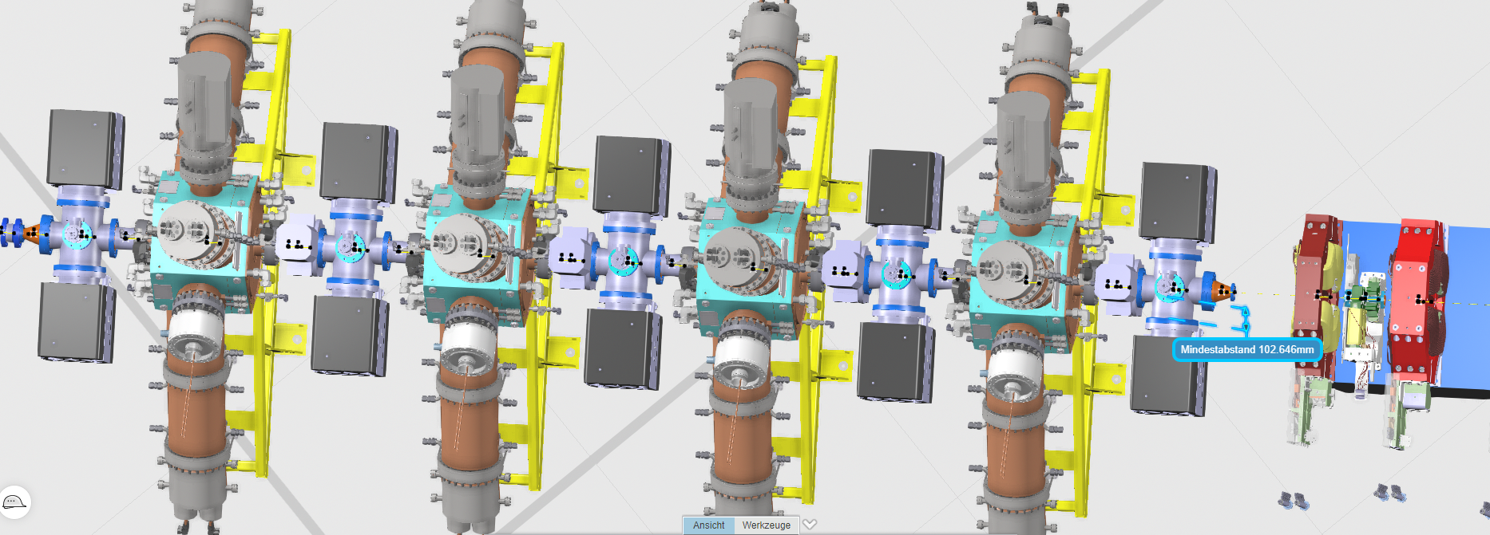
SLS 2 Storage Ring Upgrade & RF
Storage ring 500 MHz RF
4 commercial SSA
150 kW/station maximum
124 kW/station (all ID closed)
Expected global efficiency > 56%
New BLF978P & single ended module
Drain voltage can be optimized for max efficiency at each operation point
4 HOM damped cavities in same straight section
Dark-Period 01.10.2023 - 31.12.2024
Planned commissioning with beam from January 2025
2.
Provisional implementation layout

Slide 14
Comparison SLS1 and SLS2
Main RF-System Storage Ring |  | SLS 1 2.4 GeV – 400 mA | SLS 2.0 2.7 GeV – 400 mA
Total RF voltage | kV | 2080 | 1780
Number of cavities |  | 4 | 4
Voltage per cavity | kV | 520 | 445
Wall loss per cavity | kW | 40 | 30
RF-power/cavity with beam and max. ID Power | kW | 102 | 124
Grid to RF efficiency | % | 0.44 | 0.56
Grid Power/RF amplifier max ID Power | kW | 227.3 (909.1*) | 221.4 (885.7*)
Grid Power /RF amplifier Average ID Power | kW | 227.3 (909.1*) | 196.4 (786*)
2.
Global heat recovery ~200 MWh/year
RF contribute as all other systems, low temperature => low efficiency
(~1.6% of energy consumption)
* For 4 RF amplifier stations

Slide 15
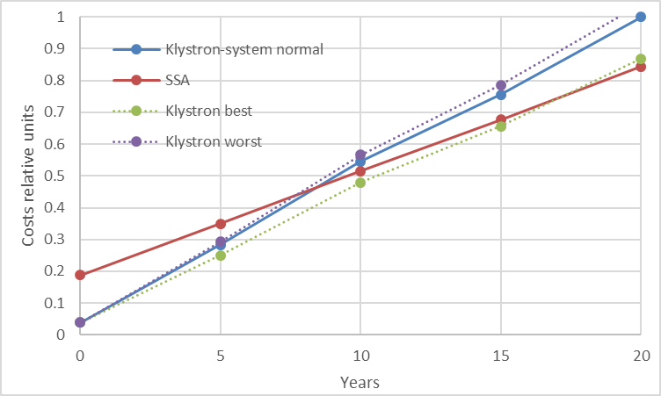
Indication operational RF costs for SLS2
2.
Cost delopments assuming:
1 Kly. refurbising/20years/station
1 Kly. new/20years/station
0.1 CHF/kWh

Slide 16
Rational behind the upgrade to SSA
Motivations
RELIABILITY | Cope with the risk of aging and discontinued components Built-in redundancy
Phase noise | Old Station not fulfilling the SLS2 requirements (keep energy fluctuations below ID BW)
Maintenance | Modular system allows for fast maintenance / In house expertise on SSA (no HV)
Klystron availability | Only few klystron suppliers and growing costs
Grid to RF efficiency | Wasn’t the driving argument, but an improvement is expected
Operational costs | Beside better efficiency, expected low maintenance costs (klystrons)
2.

Slide 17
Overview RF stations in SwissFEL
Regular operation
100 Hz repetition rate
2 Bunches / RF pulse (10 to 200 pC)
Up to 6 GeV beam energy in Aramis
S-Band: 7
C-Band: 27 => dominate power consumption
X-Band: 2
Global RF power requirement ~1.9 MW
3.
2.75- 3.25 GeV
399 m
466 m
Athos Linac
1 Cband station
Deflector
X-Band
Polarix 2 x 1 m
Athos Undulators
Gun: 1 S-Band station
X-Band linearizer: 1 station
Deflectro S-Band: station
Linac 1
13 C-Band stations
Linac 2
13 C-Band stations
Booster 1
2 S-Band stations
Booster 2
2 S-Band stations
0.7- 7 nm
Laser-Heater
BC 1
BC 2
Switch
Yard
Deflector
C-Band
S band
100 MV/m
S band
(2 x4 m)
S band
(4x4 m)
Collimation
Aramis Undulators
1 (0.8) - 7 Å
Linac 3
13 C-Band stations
18 m
150 MeV
80 m
320 MeV
210 m
2.1 GeV
273 m
3.0 GeV
510 m
2.1- 6.1 GeV
568 m

Slide 18
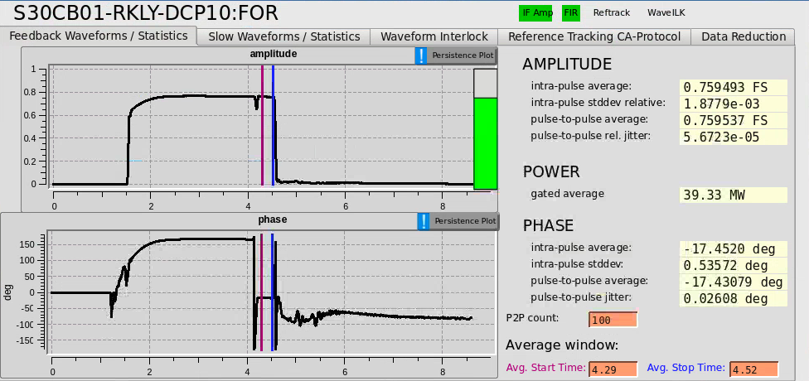
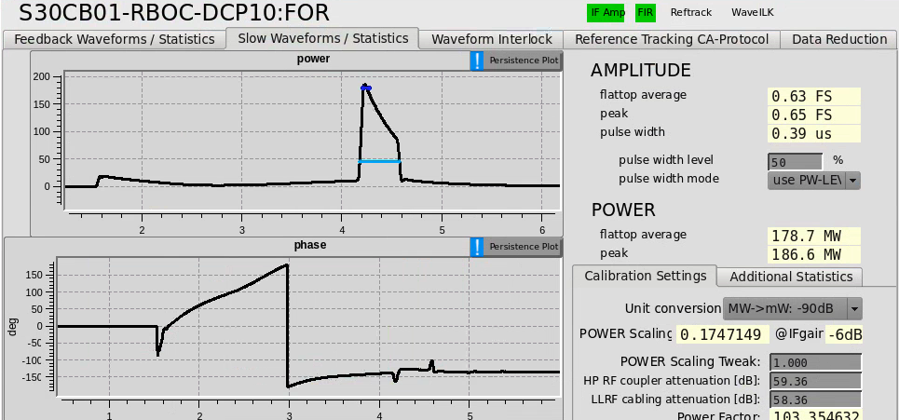
C-band Linac modules
Main LINAC + Athos | #
LINAC module | 27
Modulator | 27
Klystron | 27
Pulse compressor | 27
Accelerating structure | 108
Waveguide splitter | 81
Waveguide load | 108
Klystron modulator
370kV / 344A
3.
C-band-klystron
5.7 GHz, 50 MW, 3 μs, 100 Hz, η≈ 43%
BOC pulse
compressor
four 2 m long C-band structures, 30 MV/m
240 MeV energy gain per module
9 m

Slide 19


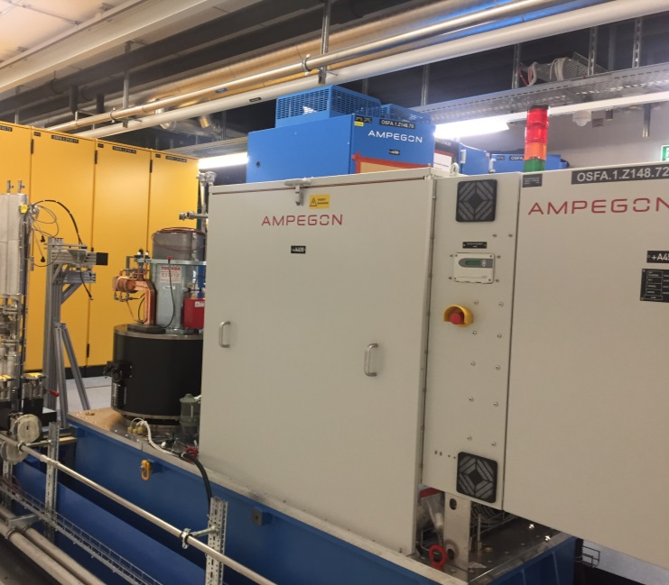
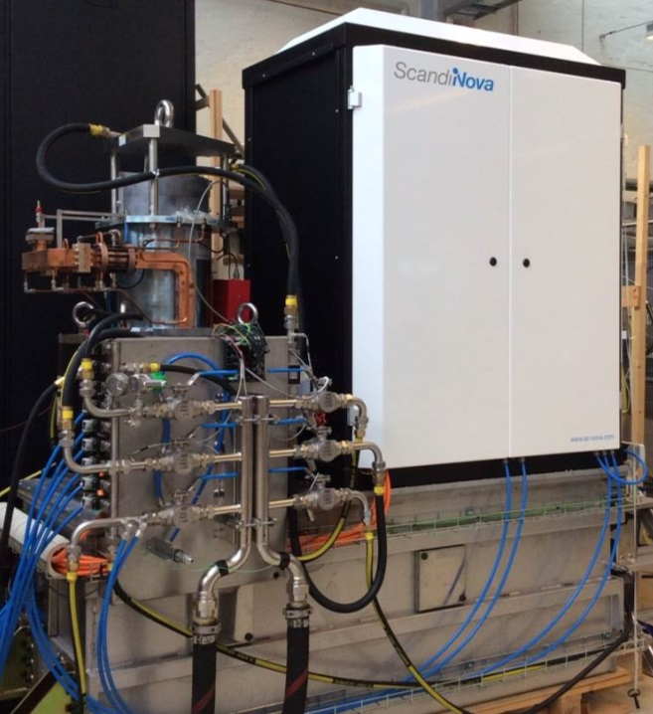
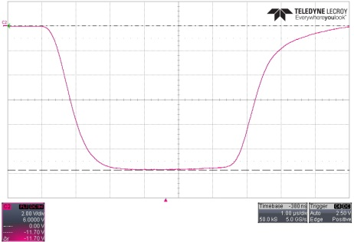
C-Band Linac Klystron modulators
Specified for 50 MW / 3µs RF, 370kV / 344A / < 15 ppm voltage stability pulse to pulse @ 100 Hz
Two technologies (suppliers) were qualified at PSI
3.
12 IGBT Switches
4.5 kV max
3.0 kA max
60 IGBT Switches
1.7 kV max
1.6 kA max
13 units for Linac 1 & 2 + 1 unit for the Athos Linac
Since 2019: Ampegon Power Electronics AG, founded by the group group Aretè & Cocchi Technology (OCEM)
13 K2-3 type (Linac 3)

Slide 20
Grid to RF Global Picture S-, C- and X-Band
Efficiency at the nominal operational conditions at 100 Hz
3.
 | Ampegon | Scandinova
RF FWHM (µs) | 3.0
Peak RF (MW) | 37.65
average RF (kW) | 11.3
Power station av. Power (kW) Measured, includes auxiliaries (solenoid ~6 kW) | 57.2
Grid to RF efficiency (%) Klystron efficiency 43% | ~ 20
Voltage rise time 10-90% (us) | 0.77 | 1.1
Voltage fall time 90-10% (us) | 1.23 | 1.8
Nominal for 240 MeV energy gain

Slide 21
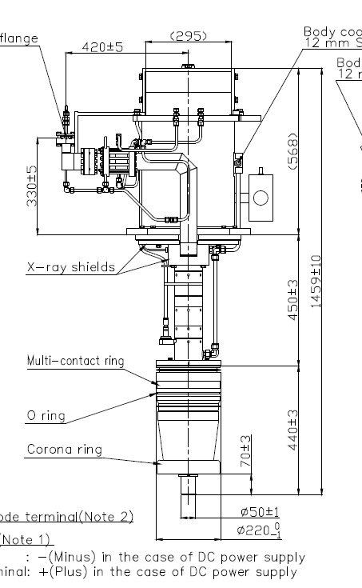
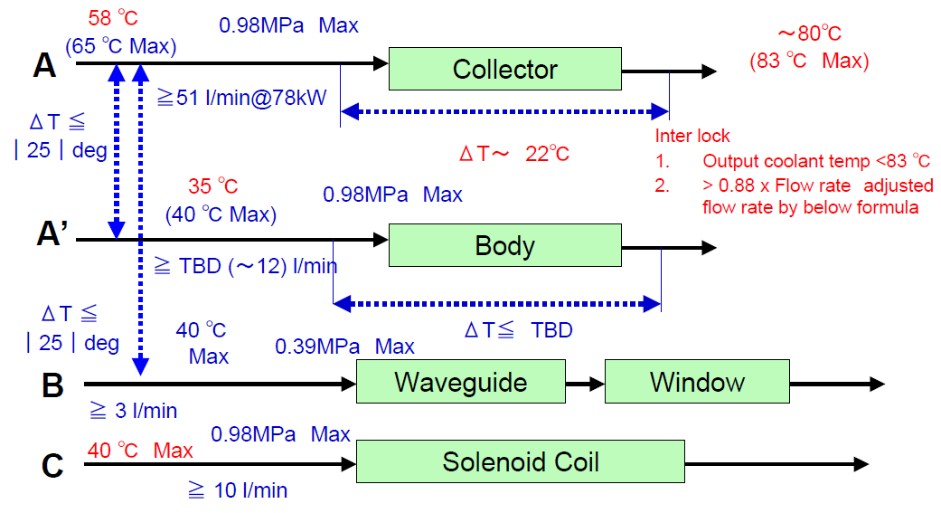
Heat recovery
Modification of klystron agreed with Supplier
3.
~80 °C to
Heat recovery
Collector
Original Design
Bellow for thermal stress reduction
Body
Global heat recovery ~2’600 MWh/year
(~11% of energy consumption)

Slide 22
Rational/priorities behind power source design
Priorities
RELIABILITY | Keep the components between safety margin => large number of sources increases probabilities of failures and shot to shot deviations
Pulse to pulse stability | Essential for pulse to pulse FEL stability (1e-4 energy, fs arrival time, peak current, …) => reached < 10 ppm
Maintenance | Modular system and reasonable HV
Klystron | Allow for hot collector operation (90 °C) & energy recovery
Grid to RF efficiency | Wasn’t a driving argument
3.

Slide 23
Wir schaffen Wissen – heute für morgen
Many thanks to:
M. Schneider (HIPA),
L. Stingelin (SLS)
J. Alex (SwissFEL)
D. Reinhard (Building services)
M. Jörg (Infra. & el. inst.)
For providing material for this presentation

Slide 24
Resereve Material

Slide 25
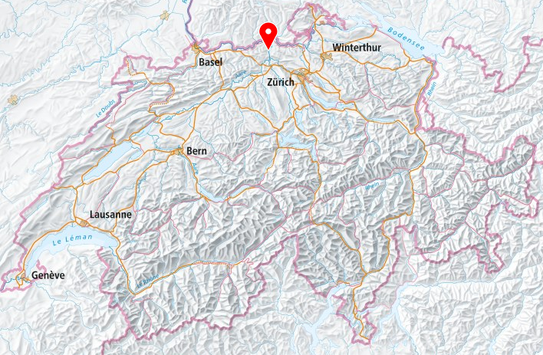
PSI
Zurich
30 km
bird's-eye view
Basel
49 km
bird's-eye view
CERN
220 km bird's-eye view

Slide 26
Operation parameters Ring rf without beam
 |  | cavity 1 | cavity 2 | cavity 3 | cavity 4 | flattop cavity
gap voltage | kVp | 782 | 844 | 848 | 882 | 454
1MW P forward | kW | 225 | 250 | 280 | 265 | 110
1MW P reflected | kW | 17 | 16 | 20 | 17 | 9.9
VSWR |  | 1.76 | 1.68 | 1.73 | 1.68 | 1.86
100kW P forward | kW | 7 | 7.5 | 6 | 6 | 6.5
100kW P reflected | kW | 0.2 | 0 | 0.2 | 0.1 | 0.09
1MW P in driver | kW | 6.8 | 7.5 | 5.8 | 5.9 | 6.41
1MW P produced | kW | 218 | 243 | 274 | 259 | 104
1MW U Anode | kV | 15.9 | 15.9 | 16.5 | 16 | 11.5
1MW I Anode | A | 23.8 | 23.3 | 25.4 | 25.4 | 16.6
1MW P Anode DC | kW | 378 | 370 | 419 | 406 | 191
1MW Anode PS 16kV grid power | kW | 413 | 413 | 456 | 435
tetrode cooling water inlet temperature | °C | 53.6 | 53.5 | 53.7 | 53.4 | 54.8
tetrode cooling water outlet temperature | °C | 66.6 | 63.8 | 65.3 | 63.9 | 66.9
tetrode cooling water delta temperature | °C | 13.0 | 10.3 | 11.6 | 10.5 | 12.1
tetrode cooling water flow rate | l/min | 213 | 227 | 221 | 231 | 112
P calorimetric | kW | 194 | 163 | 179 | 170 | 95
efficiency RF/DC |  | 0.58 | 0.65 | 0.65 | 0.64 | 0.54
efficiency RF/AC 16kV Mains |  | 0.53 | 0.59 | 0.60 | 0.60
1.

Slide 27
Operation parameters Ring rf with beam 2.4mA
 |  | cavity 1 | cavity 2 | cavity 3 | cavity 4 | flattop cavity
gap voltage | kVp | 844 | 842 | 846 | 889 | 553
1MW P forward | kW | 649 | 620 | 640 | 625 | 36
1MW P reflected | kW | 22.5 | 32 | 21 | 30 | 22
VSWR |  | 1.46 | 1.59 | 1.44 | 1.56 | 8.16
100kW P forward | kW | 35 | 35.5 | 34 | 34 | 0.4
100kW P reflected | kW | 1.2 | 0.05 | 1.1 | 1.5 | 0.4
1MW P in driver | kW | 33.8 | 35.45 | 32.9 | 32.5 | 0
1MW P produced | kW | 615 | 585 | 607 | 593 | 36
1MW U Anode | kV | 15.9 | 15.9 | 16.5 | 15.9 | 11.5
1MW I Anode | A | 57.1 | 55.7 | 58.3 | 57.7 | 4.8
1MW P Anode DC | kW | 908 | 886 | 962 | 917 | 55
1MW Anode PS 16kV grid power | kW | 1002 | 995 | 1052 | 1016
tetrode cooling water inlet temperature | °C | 54.2 | 53.6 | 54.2 | 54.1 | 55.3
tetrode cooling water outlet temperature | °C | 79.7 | 77.4 | 79.1 | 76.2 | 60.4
tetrode cooling water delta temperature | °C | 25.5 | 23.8 | 24.9 | 22.1 | 5.1
tetrode cooling water flow rate | l/min | 210 | 220 | 219 | 228 | 107
P calorimetric | kW | 374 | 367 | 382 | 353 | 38
efficiency RF/DC |  | 0.68 | 0.66 | 0.63 | 0.65 | 0.65
efficiency RF/AC 16kV Mains |  | 0.61 | 0.59 | 0.58 | 0.58
1.

Slide 28
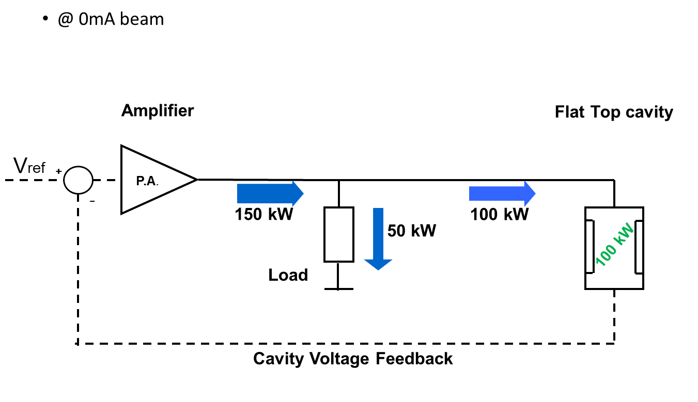
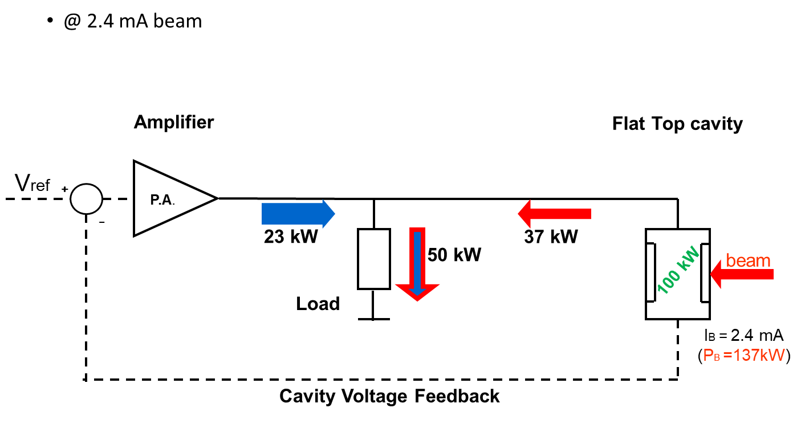
RingCyclotron: Operation Flattop
@ 0 mA (active cavity operation)
@ 2.4 mA (~passive cavity operation)

