Slide 1
Efficiency, Power Quality and Performance of ESS Klystron Modulators
Carlos A. Martins
ESS – Accelerator Division - RF Electrical Power Systems
www.europeanspallationsource.se
Workshop on Efficient RF sources, 4th – 6th July 2022

Slide 2
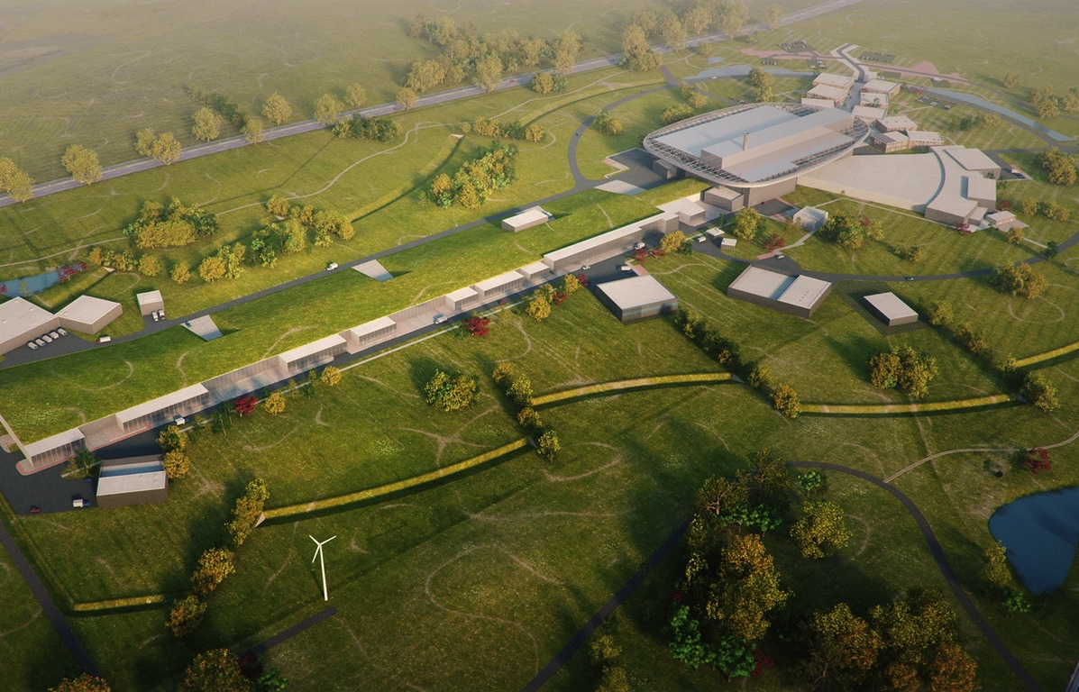
Synopsis – ESS facility
High Power
Linear Accelerator:
Energy: 2 GeV
Rep. Rate: 14 Hz
Current: 62.5 mA
Target Station:
He-gas cooled rotating
W-target (5MW average power)
42 beam ports
16 Instruments in Construction budget
Committed to deliver First Science by 2028
Peak flux ~30-100 brighter than the ILL
Ion Source
Total cost: > 1843 MEuros ₂₀₁₃

Slide 3
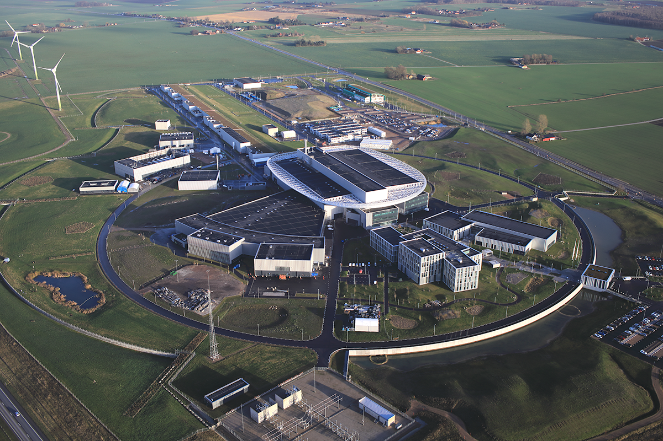
Synopsis – ESS accelerator
Beam power on target: 125MW_{pk}, 5MW_{av} ; Beam pulse length = 2.86ms; PRR = 14Hz
accelerator
Baseline (end 2027):
1 RFQ;
5 DTL tanks;
36 Medium Beta SCRF cavities (1MW_{RF} each);
20 High Beta SCRF cavities
(1MW_{RF} each)
Upgrade:
+ 64 High Beta SCRF cavities (1MW_{RF} each) (upgrade to 5MW average beam power)

Slide 4

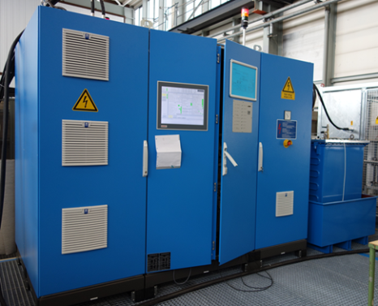
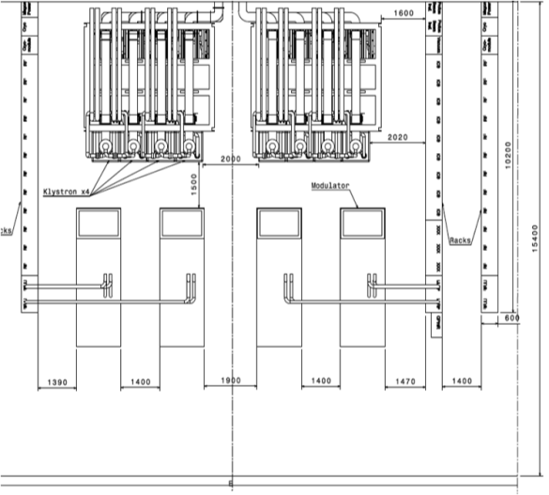
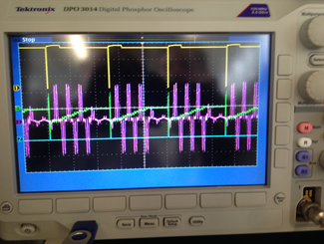
ESS modulator development strategy #1
July
2011
ESS has launched an Invitation To Tender for the design and construction of one 180kVA modulator (turn-key, functional specification):
  Contract awarded in Dec. 2011; Delivery May 2014 (30 months delivery time);
1st ESS modulator (monolithic topology, pulse transformer based):
Rated @ 115kV/25A; 2.8ms/20Hz; 160kVA -> enough to power one 1.4MWpk klystron;
8 modulators per RF cell needed
(Med-Beta, High-Beta)
Limited performance:
Rise time_{(10-99%)} = 350µs;
Flat-top droop = 3%;
Efficiency = 88%;
Power density = 22kVA/m² (no space in RF Gallery)
AC power quality issues (flicker, current harmonic distortion)
High capital cost:
- ~130 modulators needed
One section of the RF Gallery (8x 704 MHz RF sources)
4
Purple: AC line current
Green: Capacitor bank voltage

Slide 5
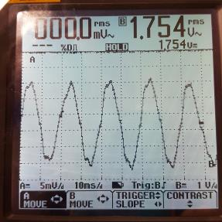
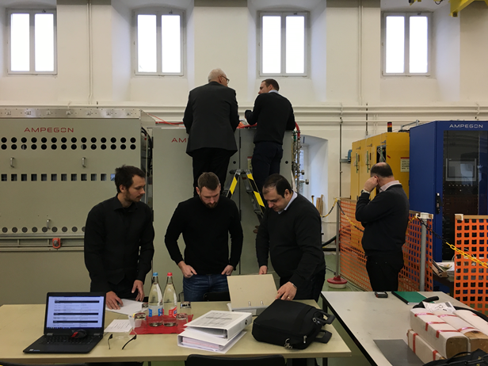
ESS modulator development strategy #2
Jan.
2014
ESS has launched an Invitation To Tender for the design and construction of one 330kVA modulator (turn-key, functional specification):
  Contract awarded in June 2014; Delivery June 2017 (36 months delivery time);
2st ESS modulator (modular topology, HF transformers based):
Rated 115kV/50A; 3.5ms/14Hz; 330kVA -> enough to power two 1.4MWpk klystrons;
Better but still limited performance:
Rise time_{(10-99%)} = ~120µs;
Flat-top droop < 1%;
Efficiency = 87%;
Power density = 66kVA/m²
Better AC power quality: still high current distortion;
Reliability concerns due to huge number of components and limited design margins
Still high capital cost:
- ~65 modulators needed

Slide 6
ESS modulator development strategy #3 – SML modulator
June
2013
ESS has decided to launch a collaboration with LTH / IEA Department, in view of designing and building a modulator prototype for ESS, following a novel topology:
3rd ESS modulator (Stacked Multi-Level topology)
Aimed at final ratings: 115kV/100A; 3.5ms/14Hz; 660kVA -> enough to power four 1.4MWpk klystrons;
Reduced scale prototype (easily scalable) rated at: 115kV/20A; 3.5ms/14Hz; 130kVA
RF cell #1
3-phase, 600V AC, 50Hz
RF source A
SC cavity #A
RF power
Modulator
(Power Supply)
Electrical pulsed power
RF source B
RF power
SC cavity #B
AC Electrical Network
115 kV
4x25 A
3.5 ms
14 Hz
RF source C
RF power
SC cavity #C
Beam
RF source D
RF power
SC cavity #D
RF cell #N
Similar to RF cell #1
15 RF cells in total (Medium Beta and High Beta, 2GeV, 5MW)

Slide 7
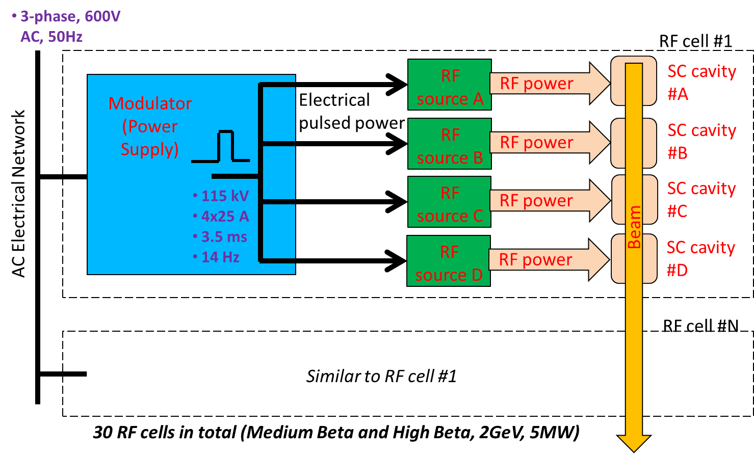
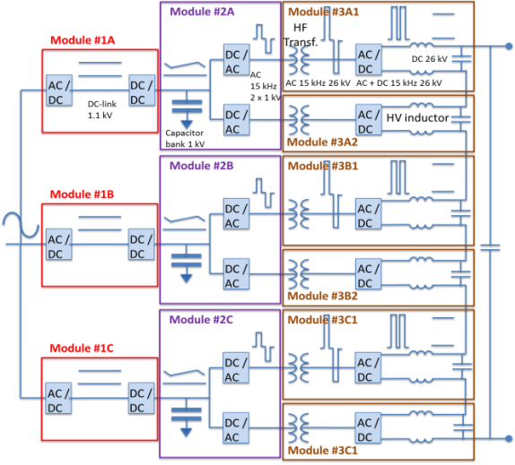
SML Modulator main parameters
Main parameters of SML klystron modulators (as from SoW)
Nominal pulse voltage amplitude | U_{K} | -115 kV
Nominal pulse current amplitude (sum of four outputs) | I_{K} | 4x25 A =100 A
Nominal pulse power amplitude (sum of four outputs) | P_{K} | 11.5 MW
Nominal pulse repetition rate | PRR | 14 Hz
Nominal pulse width (at 50% of magnitude) | T_{P} | 3.5 ms
Maximum pulse rise/fall times (10..99% / 100..10%) | T_{R}, T_{F} | 120 µs
Minimum flat-top duration | T_{T} | 3.35 ms
Maximum droop or slow oscillation at flat-top (frequency range: < 0.3kHz) | ∆U_{K} | 1% of U_{K}
Maximum voltage ripple in the flat-top, rms 0.3kHz > freq. range > 1kHz: 1kHz > freq. range > 100kHz: 100kHz > freq. range > 300kHz: 300kHz > freq. range: | ũ_{k} | 0.3% of U_{K} 0.2% of U_{K} 0.15% of U_{K} 0.3% of U_{K}
Maximum pulse overshoot | U_{K.OVS} | 2% of U_{K}
Pulse to pulse reproducibility (Average voltage over flat-top) | PP_{REP} | 0.15% of U_{K}
Pulse stability (average voltage over flat-top): Over 1 hour, without warm-up: Over 24 hours, after 1 hour warm-up: | ū_{k} | 0.3% of U_{K} 0.3% of U_{K}
- Over 1 year, after 1 hour warm-up: |  | 1% of U_{K}
Maximum energy in case of arc (arc voltage: 50V; with 4 HV output cables <4m length per cable; with R=5Ω in series with output, before arc) | E_{ARC} | 10 J
Minimum efficiency at nominal conditions |  | 90%
Maximum total power losses in air |  | 4% of total power losses
Mains supply, AC power port (R, S, T) |  | 3 x 600V, 50 Hz
Mains supply, AC control port (ext. UPS) |  | 3 x 400V, 50 Hz
Cooling |  | Water cooled
High voltage insulation type, at the oil tank level |  | Mineral oil
Maximum audible noise, at 1m from any point of cabinet | An | 75 dBA
AC line power quality Total Harmonic Distortion (THDi) Flicker of current amplitude | % % | 3 5
exceeded
met
Topology simplified schematic
not met, but non-critical
LV stage (Part I)
HV stage (Part II)

Slide 8
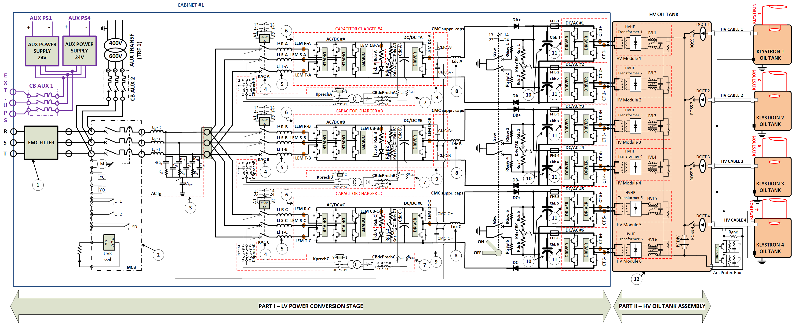
SML modulator schematics
(1)- EMC filter | (5) - AC line filter (L₂ branch) | (9) - Common mode suppression capacitors
(2) - Main Circuit Breaker | (6) - AFE (AC/DC) + DC/DC power stacks | (10) - Main capacitor banks
(3) - AC line filter (L₁C branch) | (7) - DC-link busses pre-charge circuits | (11) – H-bridge (DC/AC) power stacks
(4) - AC contactors | (8) - DC filter inductors | (12) – Oil tank assembly

Slide 9
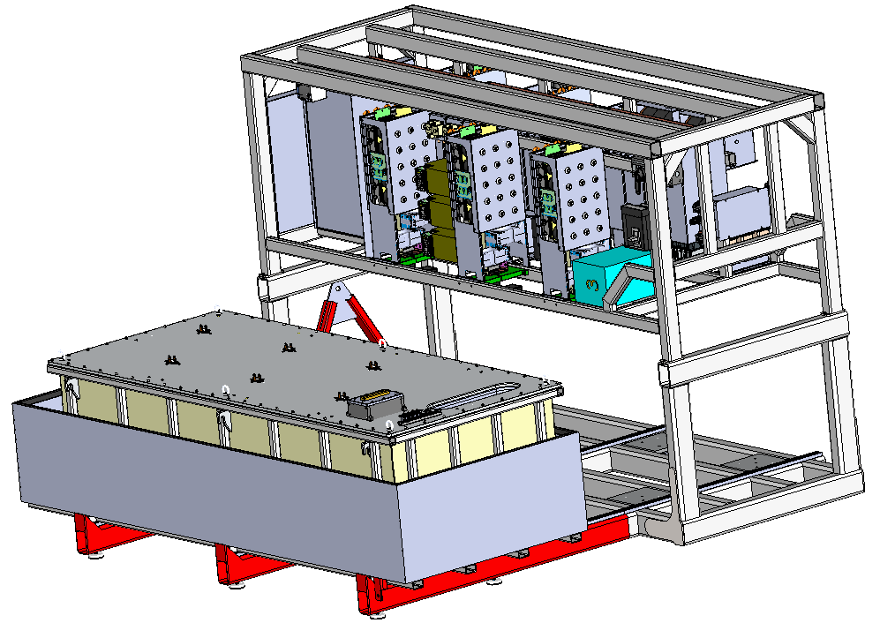
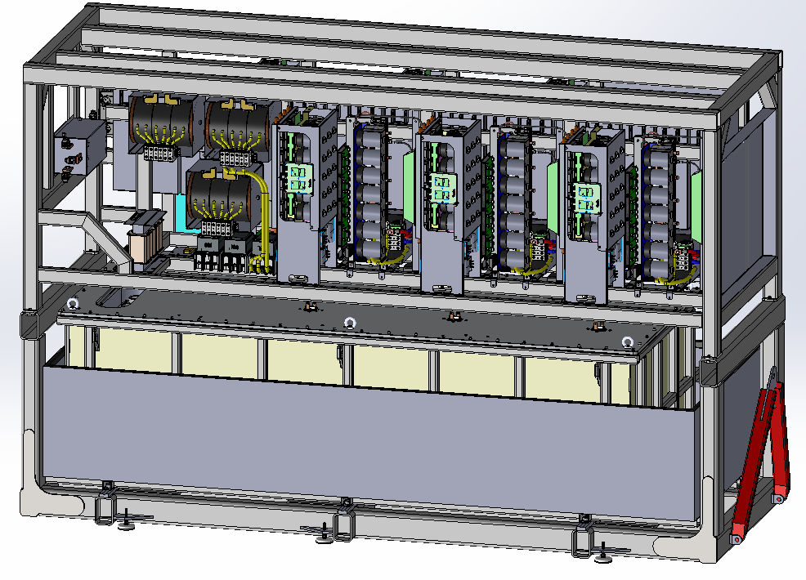
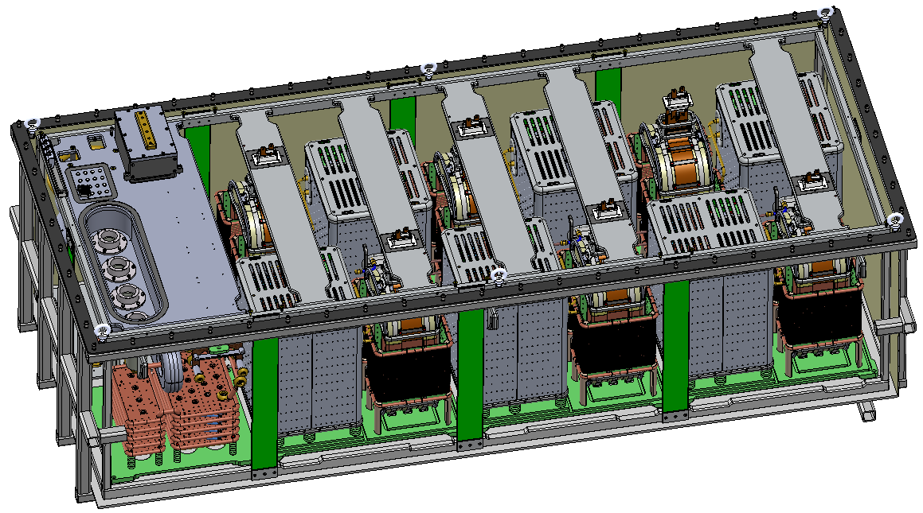
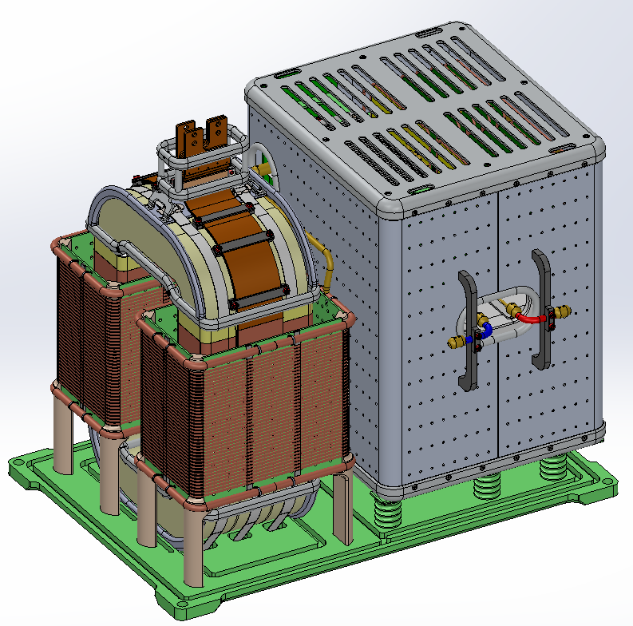
Full Scale Units, rated at 115kV/100A ; 3.5ms/14Hz
Sept.
2016
Design of full scale modulator completed, ready for call for tender
~3.8m
Compact
Retractable HV oil tank for easier access
2.4m
1.4m
Integrated oil spill bin
All in one frame with permanently mounted wheels for easy transportation
Total footprint: 4.2m x 1.4m
Total weight: < 12 tons (with oil);
Total volume of oil: ~ 2000 litters;
HV module

Slide 10
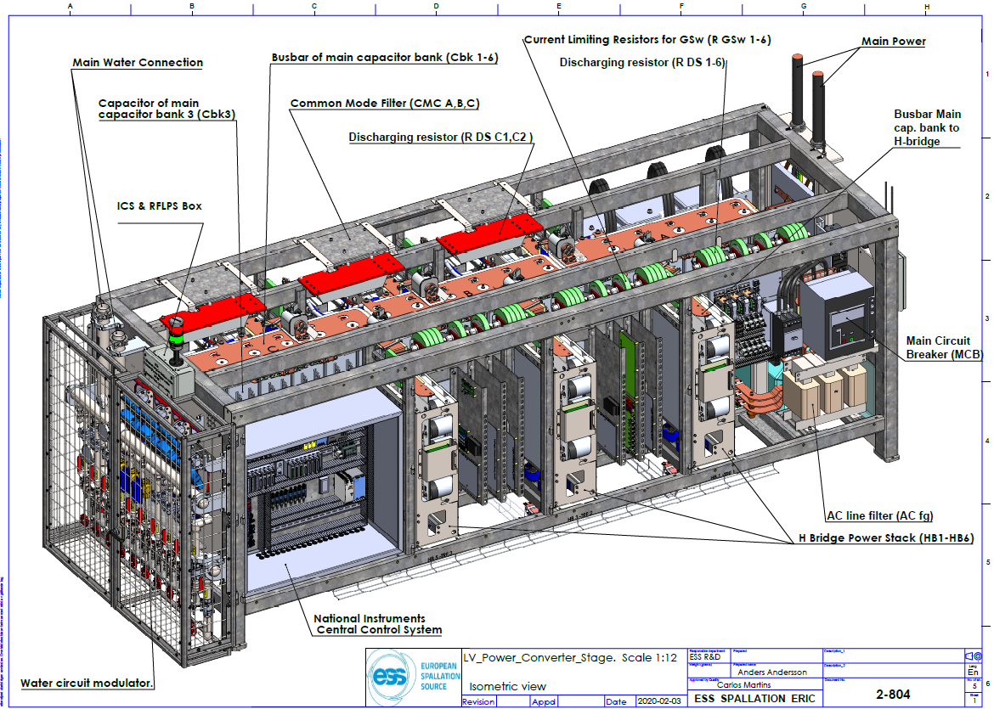
Part I – Low Voltage power conversion cabinet

Slide 11
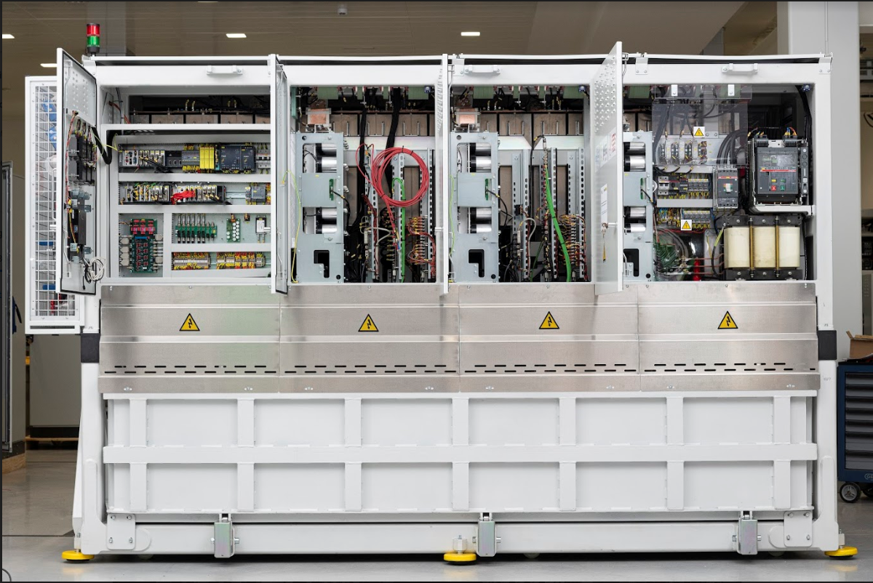
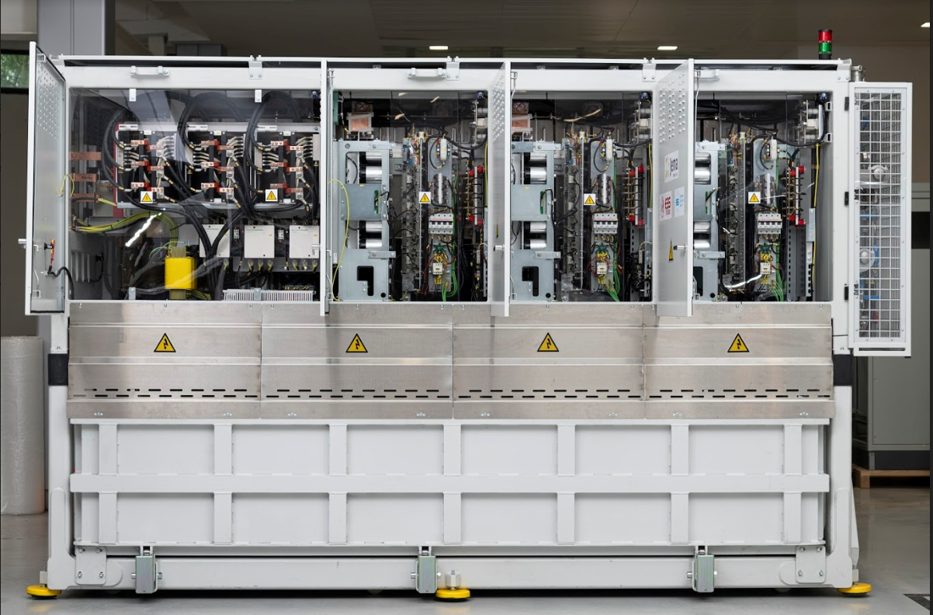
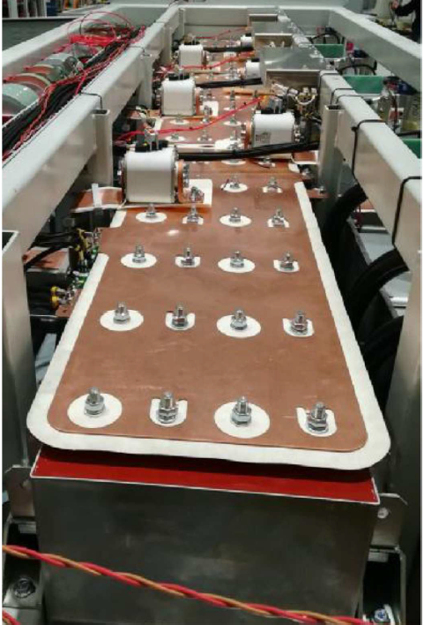
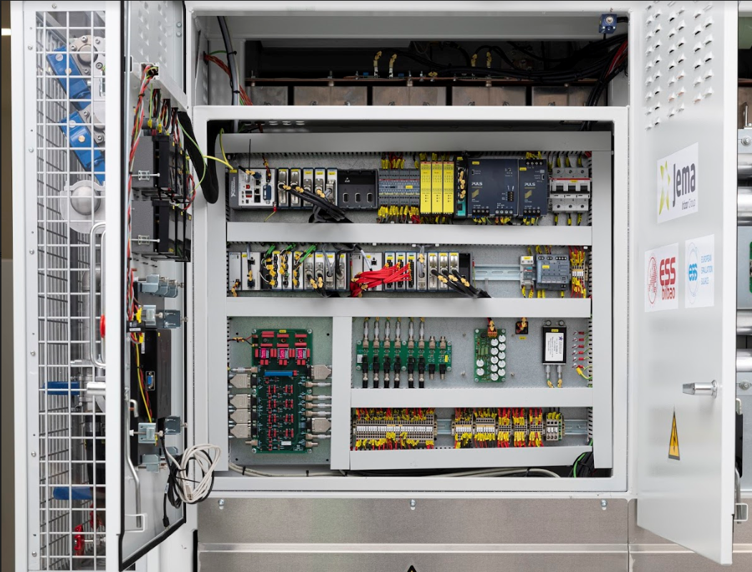
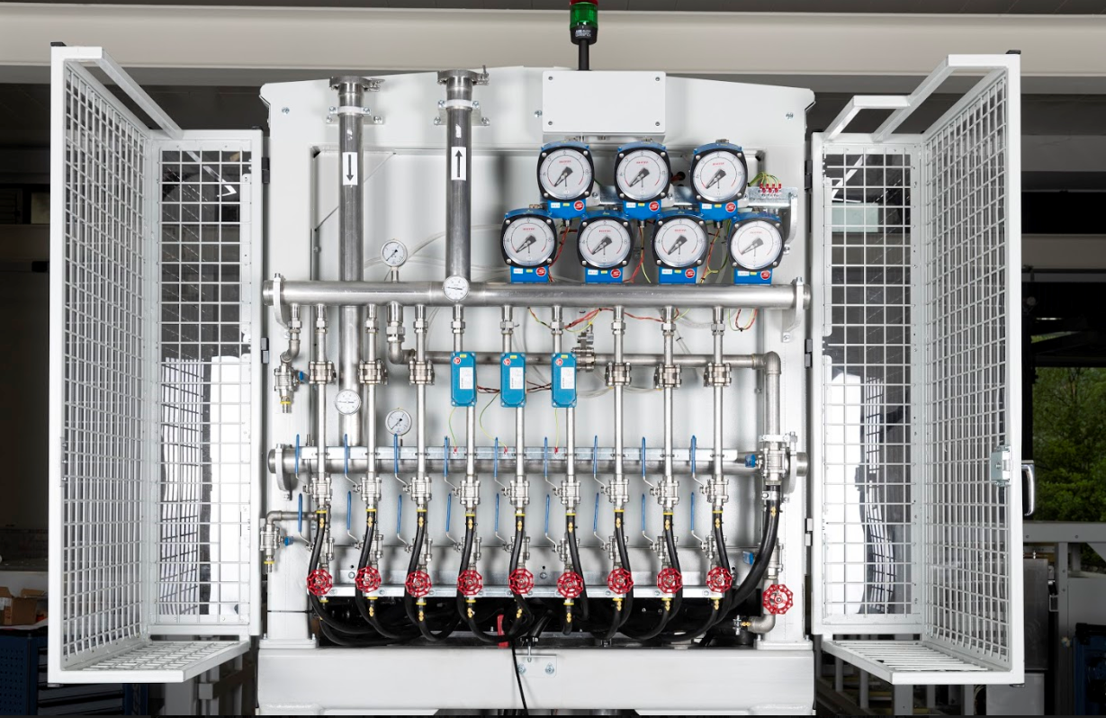
Part I – Low Voltage power conversion cabinet

Slide 12
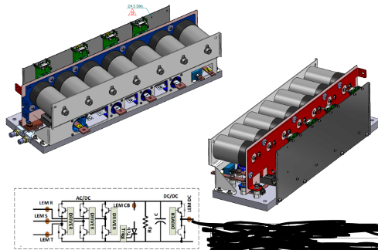
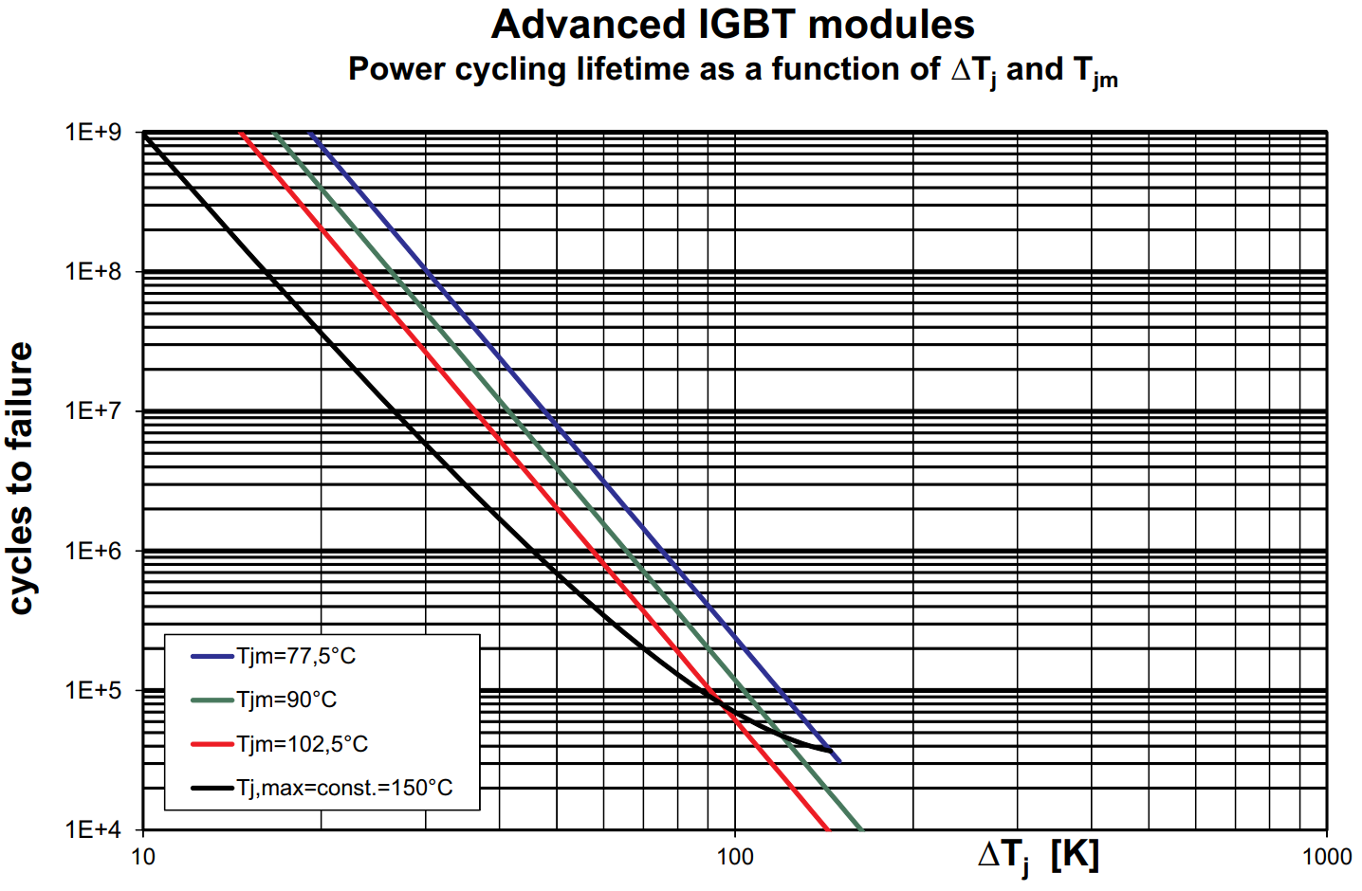
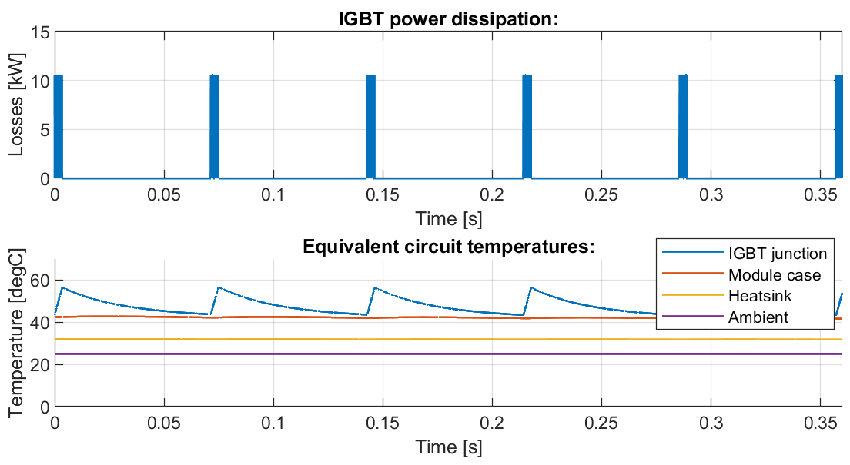
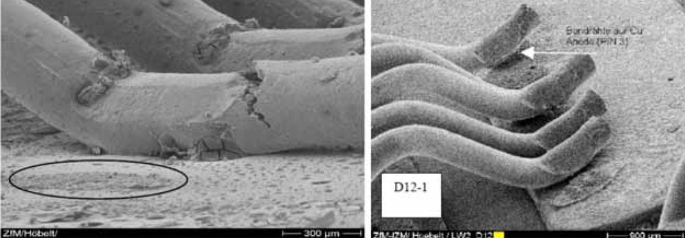
Power Stacks
AFE (AC/DC) + DC/DC (x3)
Designed, manufactured and tested in factory by a specialized sub-contractor
H-BRIDGES (DC/AC) (x6)
ccc
ccc
Power cycling and IGBT lifetime
Water cooled heatsinks;
IGBT modules with Al-Sic baseplates in H-bridges (higher power cycling capabilities);
Standard / well proven IGBT drivers with embedded protections:
  Short circuit, by Vcesat;
  Dead time generation;
  +15V aux. supply undervoltage protection;
  Active Vce clamping at turn-off;

Slide 13
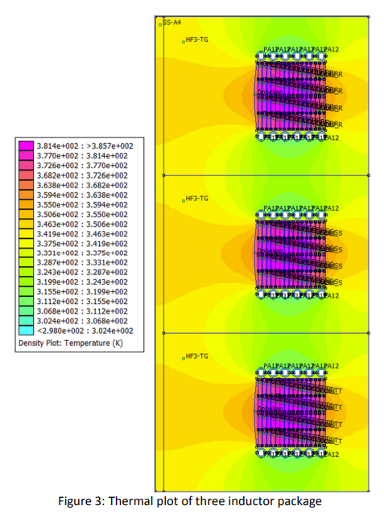
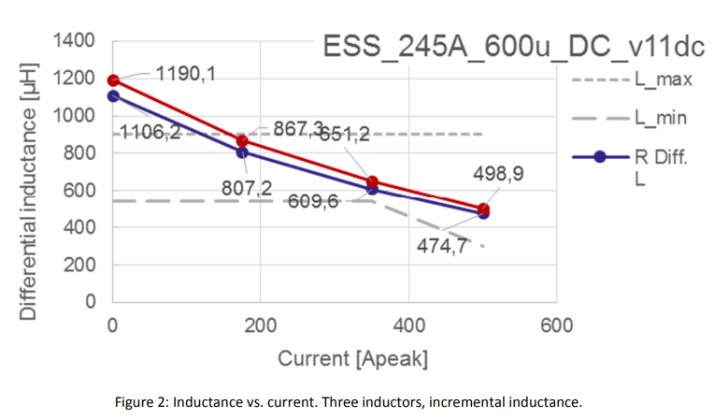
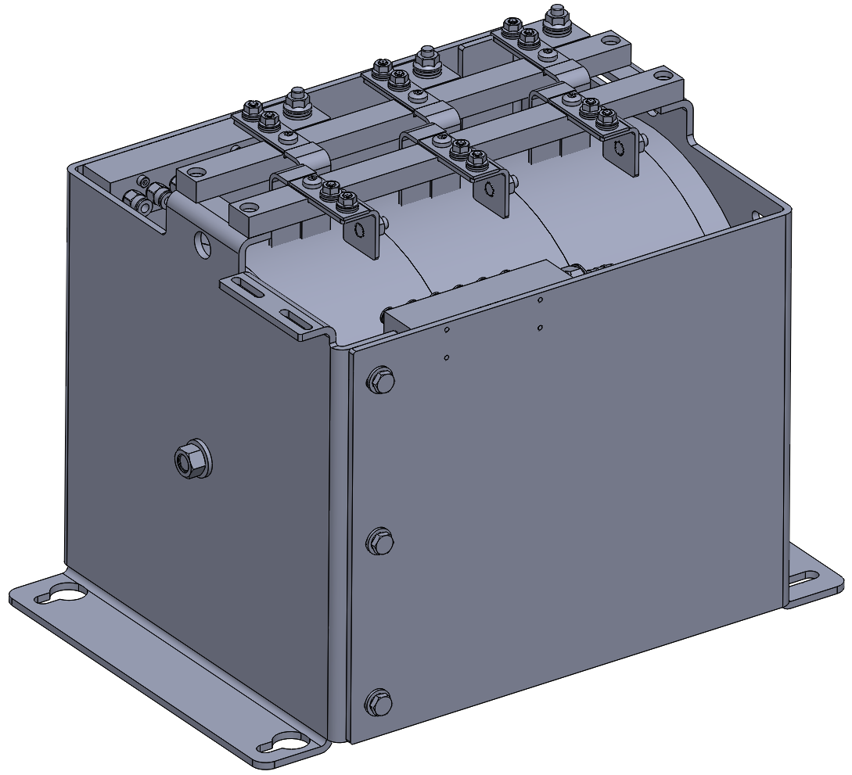
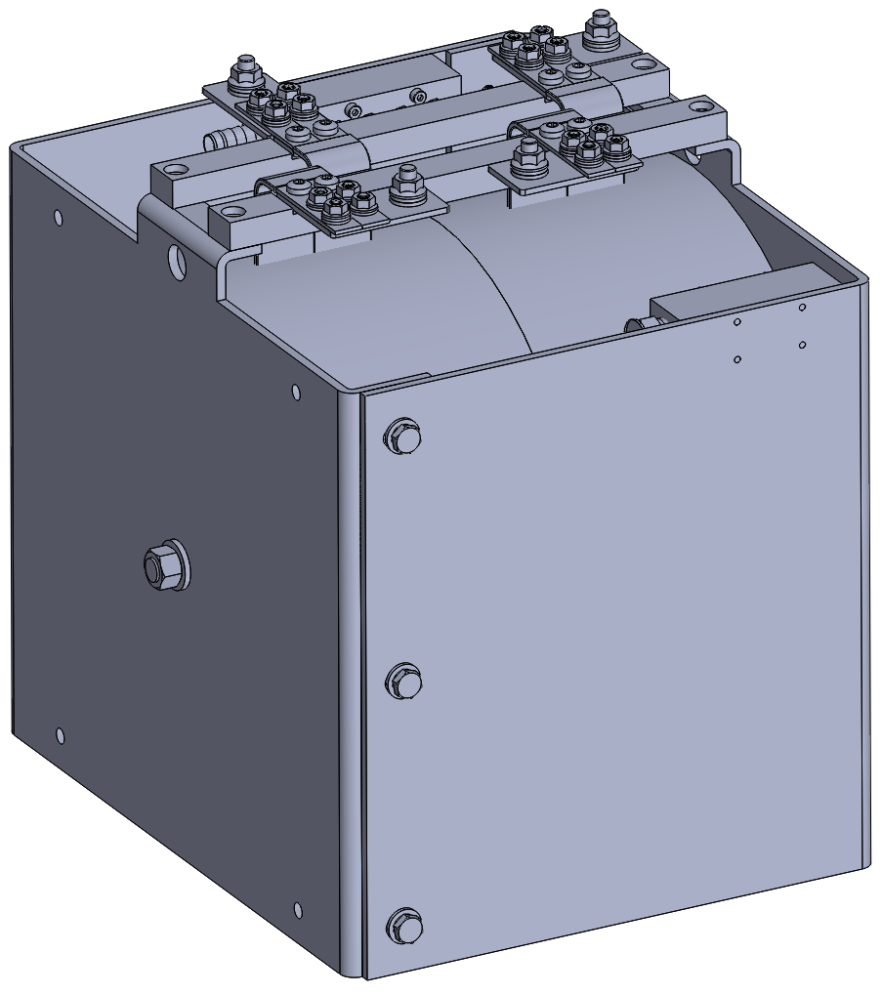
AC line and DC filter inductors
New technology (Casted Iron Powder Inductors)
AC LINE INDUCTOR (x3)
Water cooled;
Casted core (iron powder / epoxy resin mixture);
Compact;
Higher efficiency;
No saturation “knee”;
Higher inductances (for free) at lower currents, where current ripples are higher);
Very low acoustic noise
DC FILTER INDUCTOR (x3)

Slide 14
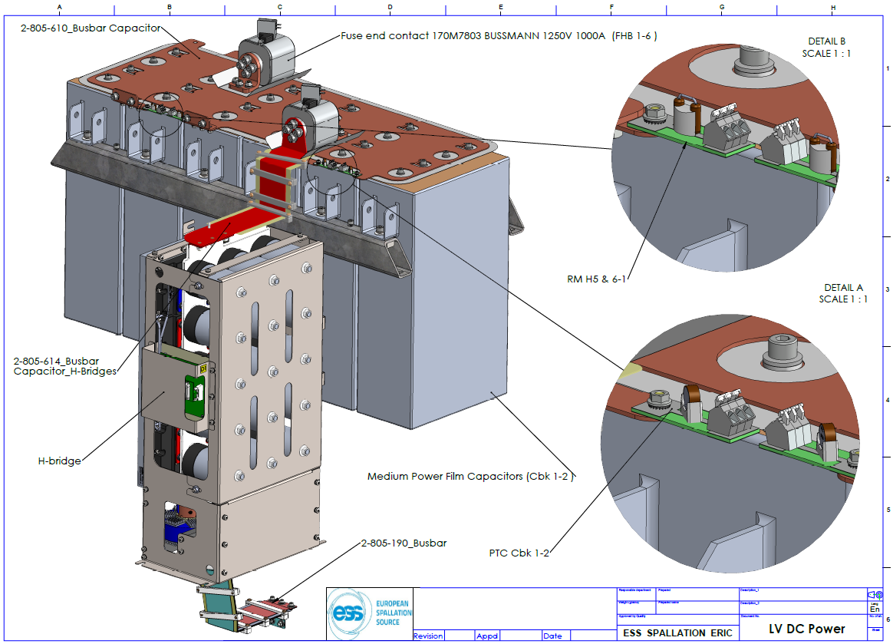
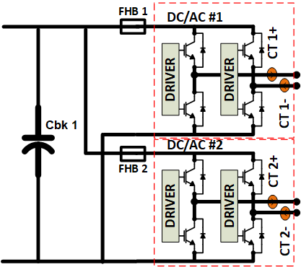
Main Capacitor Banks
Capacitors:
Polypropylene, dry, self-healing type;
- 1.1kV / 3x(6x18mF)

Slide 15
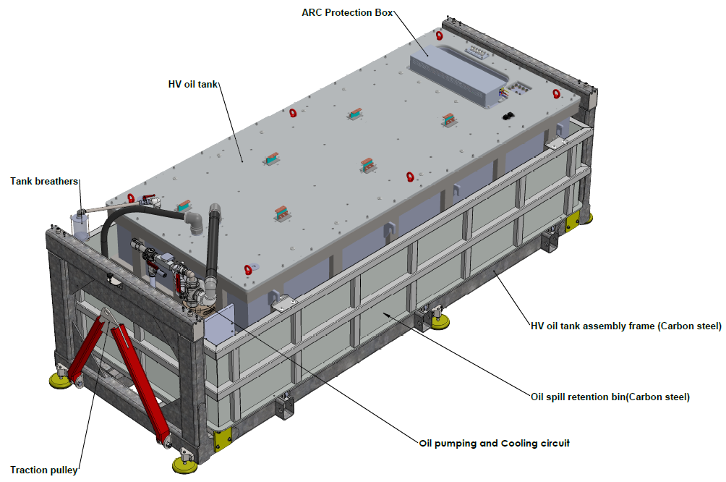
Part II – High Voltage oil tank assembly

Slide 16
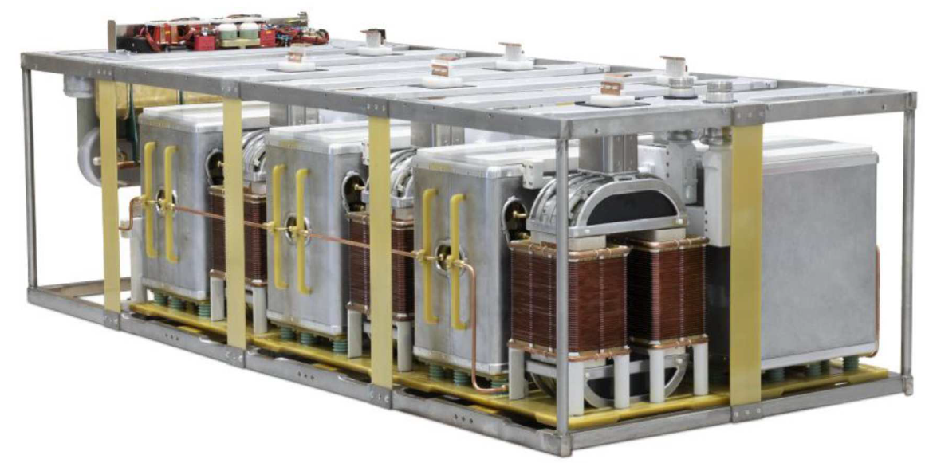
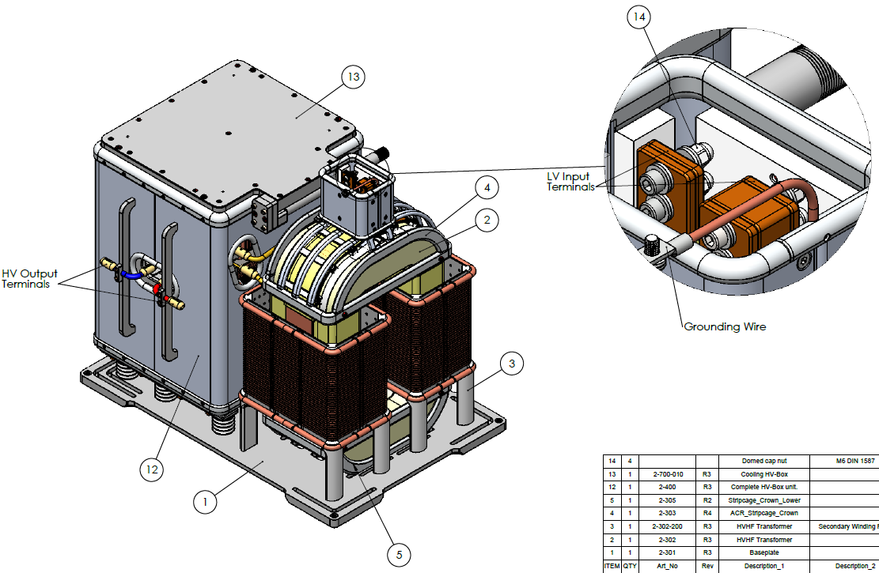
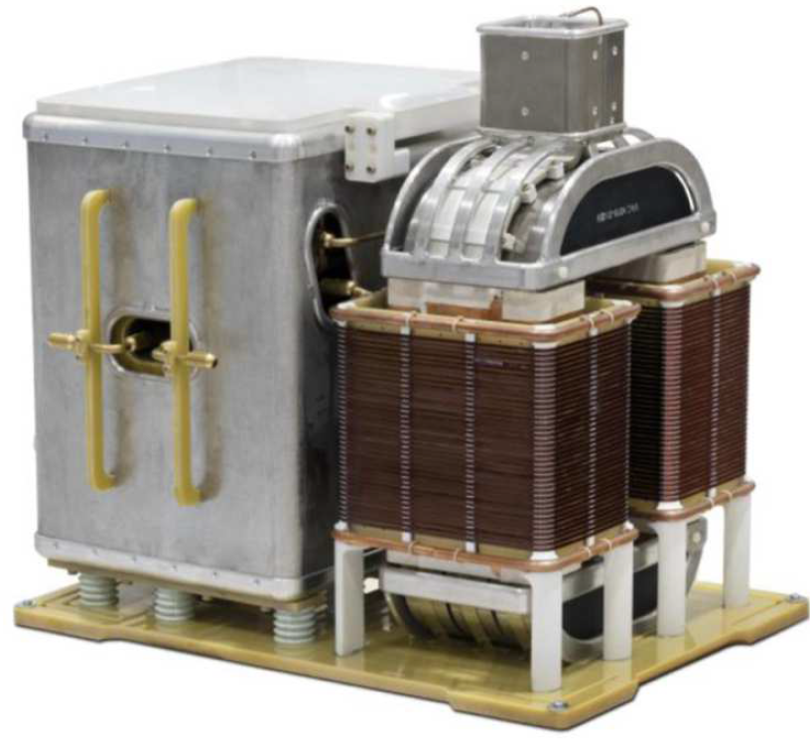
Part II – High Voltage oil tank assembly
HV Rect Box
HVHF Xfrm

Slide 17
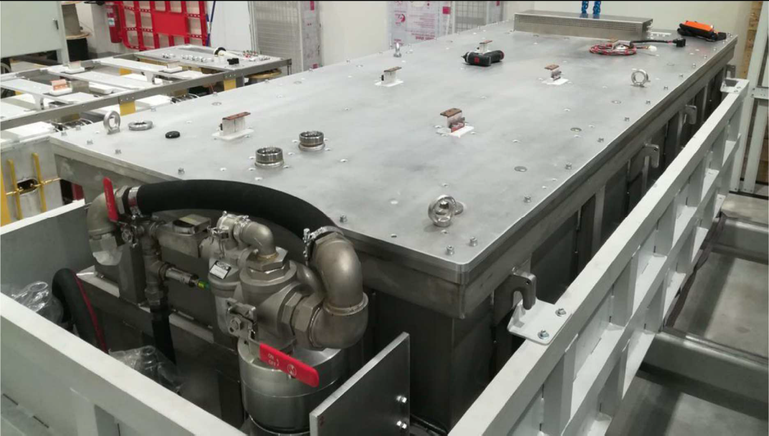
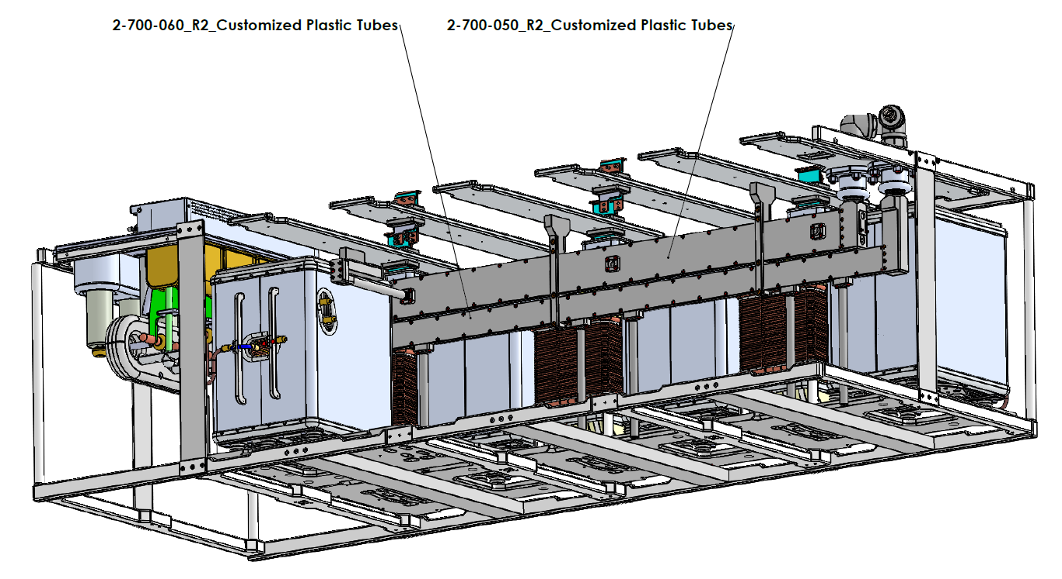
Part II – High Voltage Oil Tank Assembly
Oil outlet
Oil inlet
Oil cooling unit
(oil pump, filter, flow sensor, oil/water heat exchanger

Slide 18
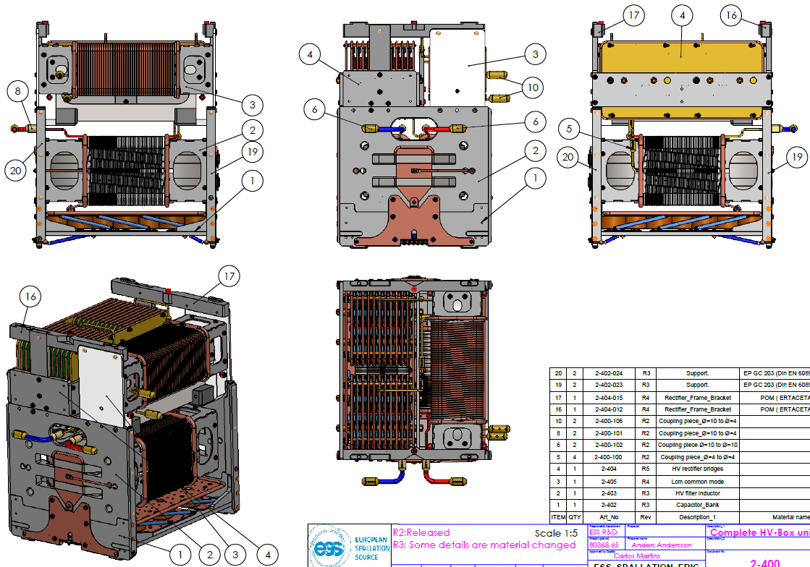
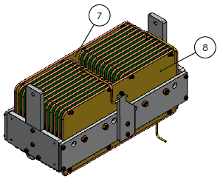
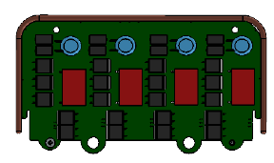
HV rectifier box

Slide 19
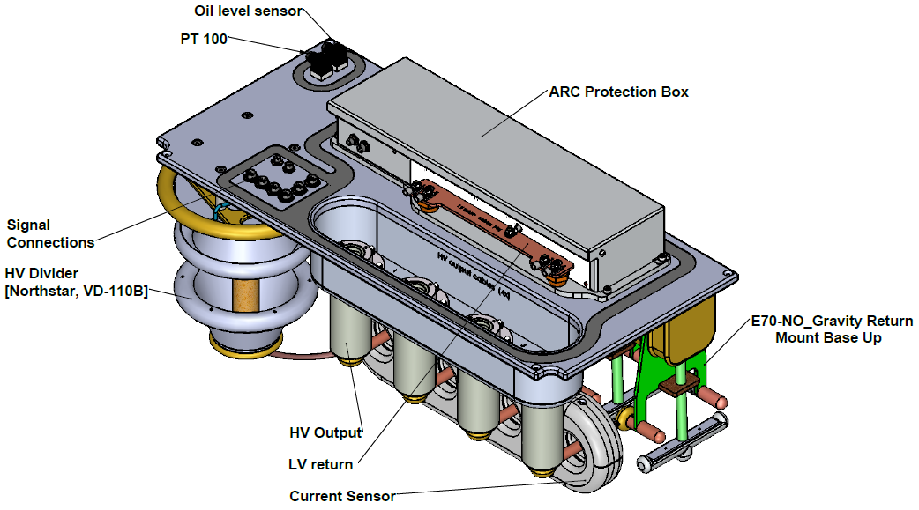
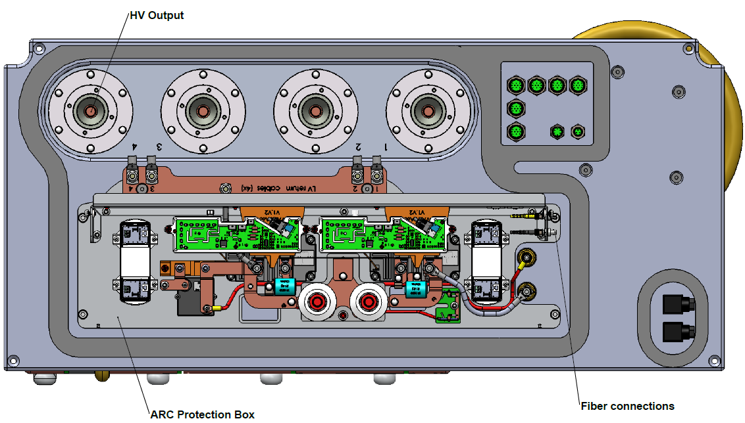
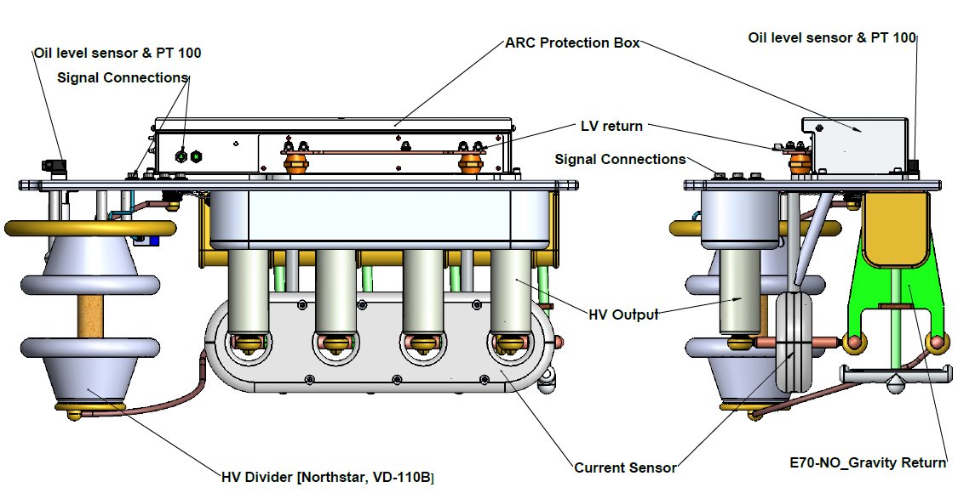
HV output stage
(Connectors, instrumentation, arc protection)

Slide 20
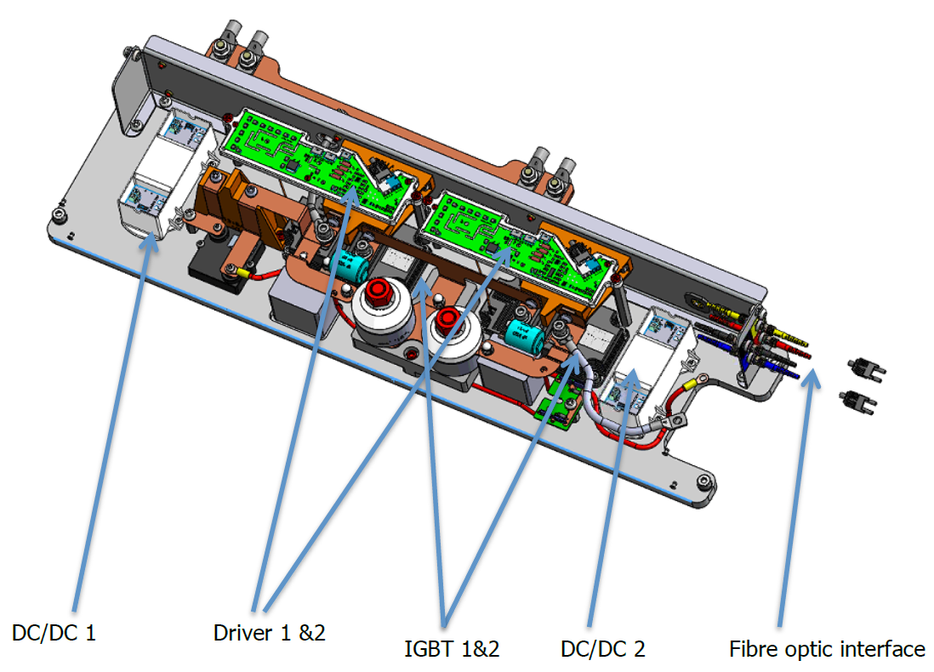
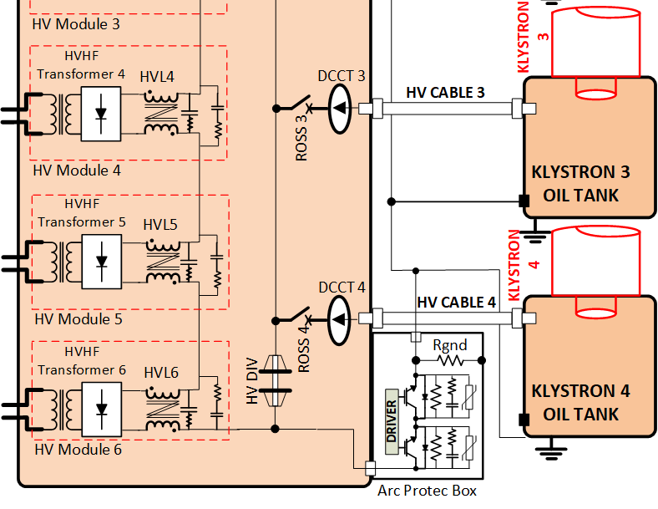
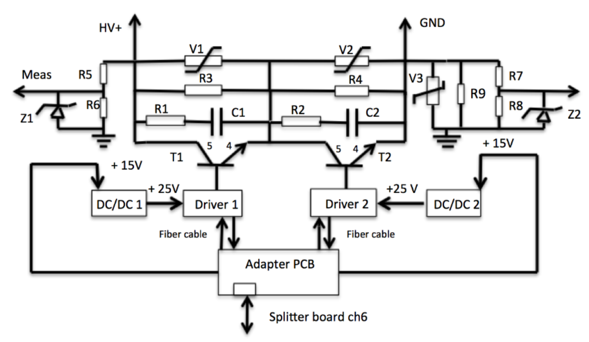
Arc Protection Box
RETURN
RETURN
HV+
HV+
RETURN
HV+
Fiber optic

Slide 21
Extraction and opening of oil tank assembly

Slide 22
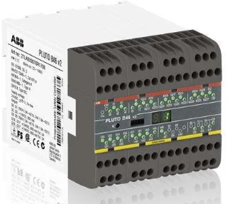
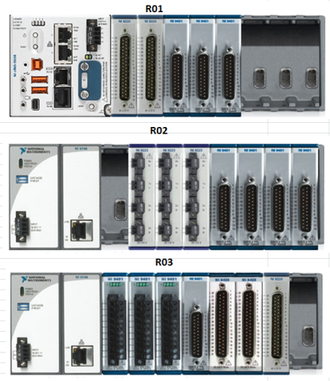
Control system
Safety PLC, PLUTO - ABB®
- Personnel safety:
(Emergency stops, door switches)
CompactRIO, NI®
- General state machine controls (CPU);
- Fast regulation loops & fast interlocks (FPGA);
( voltage/current/power regulations;
overcurrent, overvoltages, dry contact switches, oil / water flows, contactors, etc.)

Slide 23
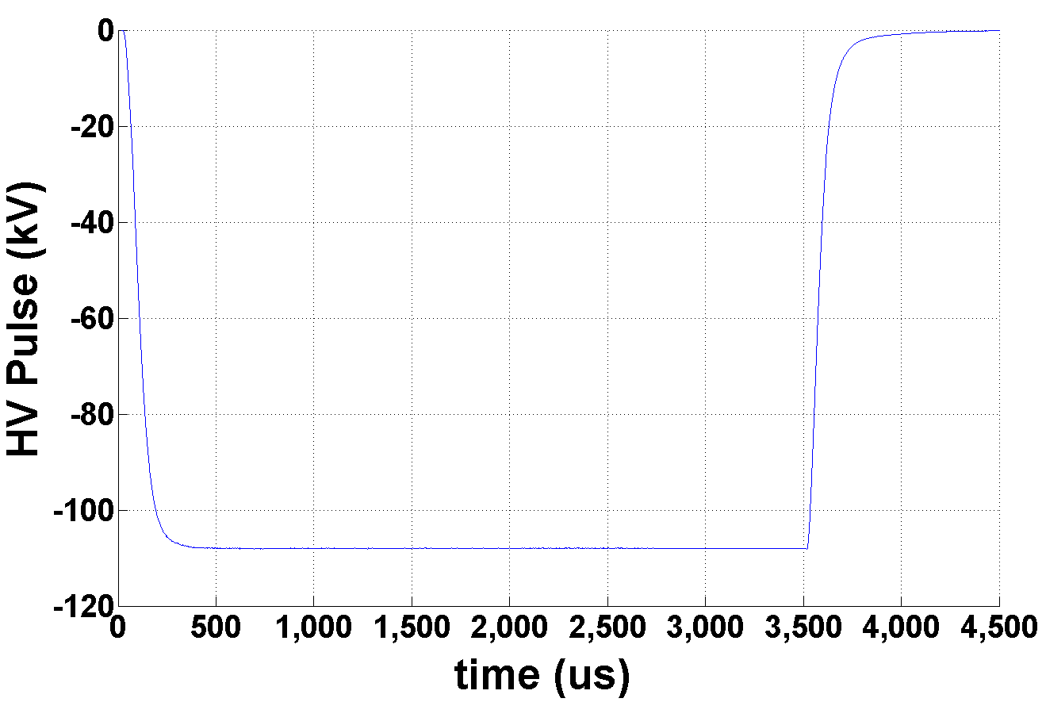
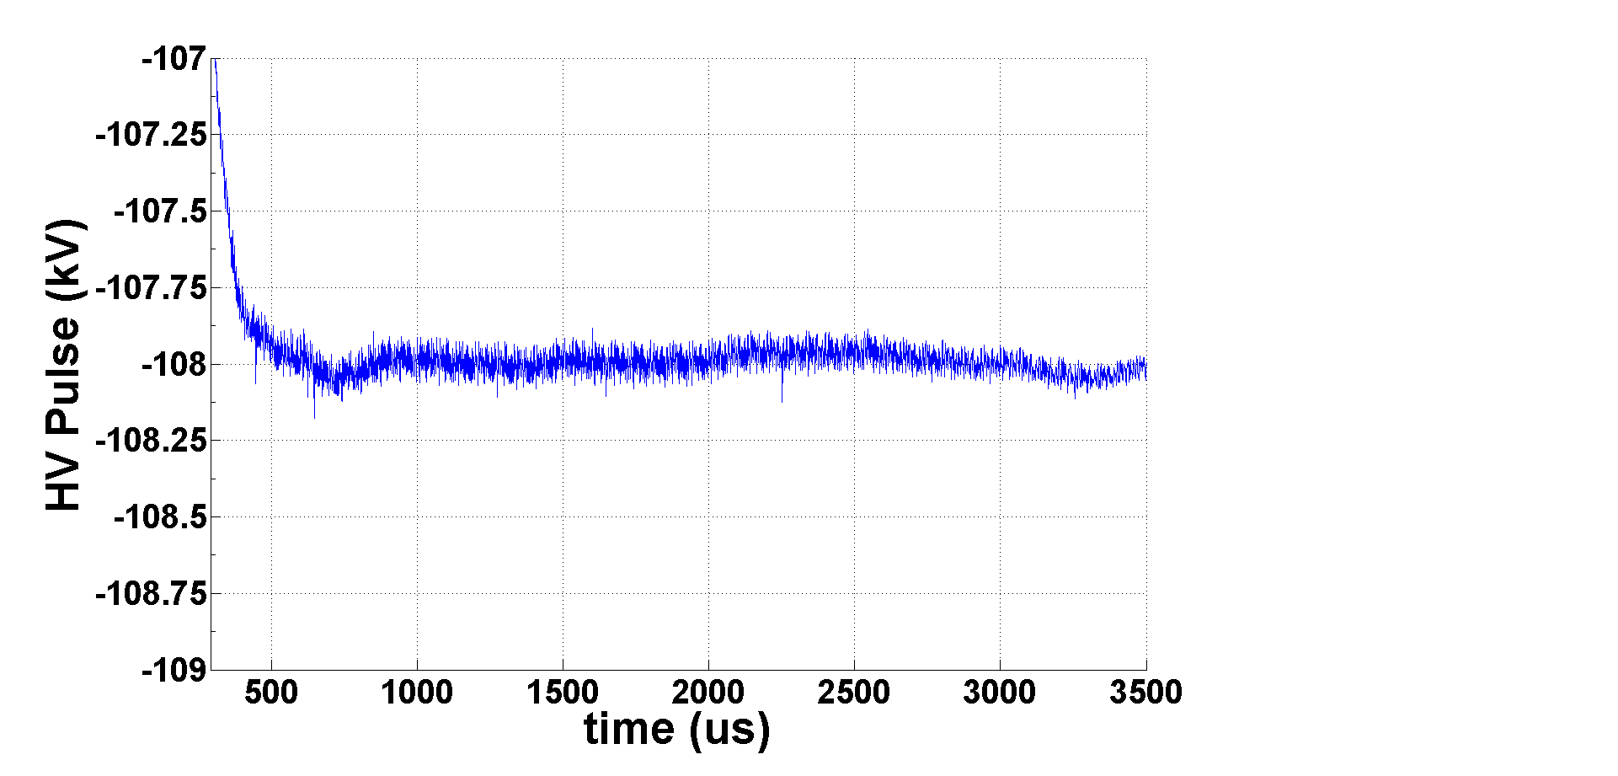
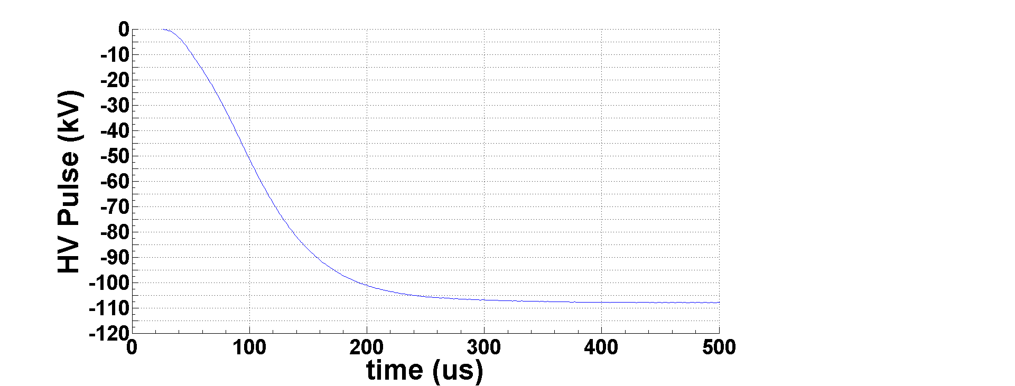

Experimental results on resistive dummy load
– HV Pulse Quality: Rise time, Overshoot, Flat-top Droop, Flat-top Ripple
@ 108kV/96A ; 3.5ms/14Hz
Zoom during flat-top
= 1kV (0.9%)
Full pulse
Droop = 0.25kV (0.22%)
Rise time t_{r(10..99%)} = 180µs
Extra zoom in middle of flat-top
Zoom during rise time
Ripple= 150V (0.13%)
Overshoot = 0%

Slide 24



Experimental results on resistive dummy load
– HV Pulse Quality: Pulse-to-pulse reproducibility
@ 108kV/96A ; 3.5ms/14Hz
(Pav = 508kW ; 90%)
@ 108kV/96A ; 0.5ms/1Hz
(Pav = 5.2kW ; 0.9%)
@ 20kV/17A ; 0.5ms/1Hz
(Pav = 170W ; 0.03%)
Pls-to-Pls reproduc. = 0.03%
Pls-to-Pls reproduc. = 0.11%
Pls-to-Pls reproduc. = 0.06%

Slide 25


Experimental results on resistive dummy load
– HV Pulse Quality: Power ramping up/down
Ramp-up/down 20-108kV; 3.5ms/14Hz
Ramp-up/down 20-108kV; 0.5ms/1Hz
Ramp-up time 20/108kV = 110s
Ramp-up/down time 20/108kV = 10s
Ramp-down time 108/20kV = 150s

Slide 26


Experimental results on resistive dummy load
– AC power quality
voltages
currents
Pulse trigger
currents
Unitary power factor;
Flicker free operation (constant line currents)
Pure sinusoidal current absorption
Minimal line RMS current consumption;
No extra power losses on AC power line (cables, transformers, filters & compensators)
voltages

Slide 27


Arc simulation tests
“cathode” current [A]
@115kV
Arc generator (triggerable spark-gap)
Arc event start
arc charge = 92mC
Arc event stop
time [s]
Arc voltage: 50V
“arc energy” = 4.6J
Note: Energy stored in the HV cables not included

Slide 28

Experimental results on resistive dummy load
– Power Losses and Efficiency
η_{m} > 90%
INPUT CHARGERS
OUTPUT PULSER

Slide 29


SML Modulator main features and performance
Rated 115kV/100A; 3.5ms/14Hz; 660kVA -> enough to power four 1.4MWpk klystron in //;
Demonstrated Performance:
Rise time = ~180µs;
Flat-top droop < 1%;
Flat-top ripple < 0.2%_{pk-pk}
Efficiency = ~90%;
Power density = 124kVA/m²
AC power quality: Active Front End;
(flicker free, sinusoidal current, unitary power factor)
Improved reliability; minimal number of components (most are standard)
Effective capital cost (Mβ+Hβ):
33 modulators
2 modulators per RF cell

Slide 30


I-FAST WU#1 – Powering accelerators from local PV renewable energy
Concept:
Install PV panels near accelerators’ “wasted land”;
Connect them to the main power converters supplying accelerator magnets or RF amplifiers, using high efficiency DC/DC converters;
AFE’s can redirect the PV energy back to the AC grid when accelerator not running;
Up to 15-20% renewable energy utilization possible with no transmission losses and high conversion efficiency;
Lower capital cost & lower payback time;
Objectives:
Feasibility study for ESS case: up-to 2MW installed PV injected into the Linac RF klystron modulators;
MSc thesis with Lund University (starting Feb. 2022);
Conventional scheme:
PV injected into the AC grid (4 stages)
New scheme:
PV injected into power converters (2 stages)
load
(magnets, RF amp’s)
load
(magnets, RF amp’s)
Power Converter
Power Converter
AC grid
AC grid
AC
DC
DC
~
~
DC
DC
DC
AFE: Active Front End
η_{PV}≈0.98x0.97x0.97x0.95 = 87.6%
η_{PV}≈0.98x0.95 = 93.1%
AC
DC
For P=0.5MW ->
savings ≈ 20k€/year
DC
DC
DC
DC

Slide 31


PV energy potential wrt ESS accelerator annual consumption?
10MW installed PV capacity
- Land area: ~18 hectares
@10MW installed PV capacity
Areas in “blue”
(i.e. outer area of ESS site):
~ 18.5 hectares
Yearly electrical PV power yield Lund: 11.2 GWh
( @10MWpk installed PV capacity )
~ 17% of ESS accelerator annual consumption

Slide 32

Acknowledgements
Max
Goran
Marko
Matthew
Yury
Petro

