Slide 1
X-band High Efficiency Klystron Development
Workshop on Efficient RF Sources
5 July 2022
Toshiro Anno

Slide 2
Contents
1. Company Overview
2. Principles of Klystrons
3. High Efficiency 8-MW Klystron Development
in Collaboration with CERN
4. Summary

Slide 3

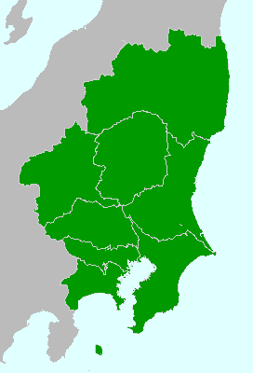
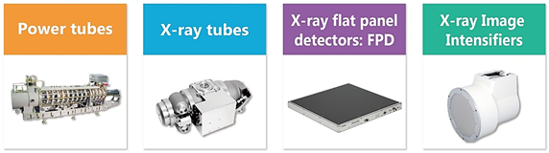
1. Company Overview
Company profile
Company Name | Canon Electron Tubes & Devices Co., Ltd. (CETD)
Founded | 1915 (A part of Toshiba Corp.)
Established | October 1st, 2003 (Renamed: Nov. 1st, 2018)
Headquarters | 1385, Shimoishigami, Otawara-shi, Tochigi 324-8550 , Japan
Business | Development, manufacture and sales of electron tubes and applied products
Main Products | Klystrons, Gyrotrons, Power Grid Tubes, X-ray Tubes, FPDs (Flat Panel Detectors), X-ray Image Intensifiers
Headquarters
Pictures of main products
~150 km
Mt. Fuji
Tokyo office
(Sales Div.)

Slide 4
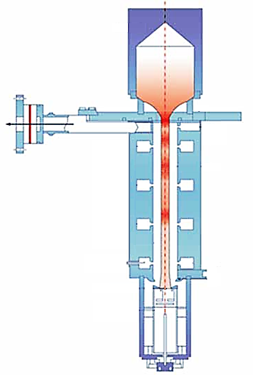
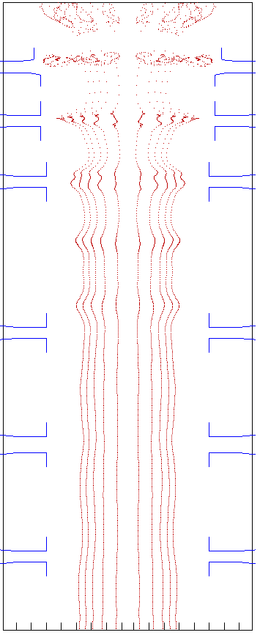
2. Principles of Klystrons
Collector
Bunched beam
(RF current)
Output
window
Last cavity
RF output
Electron bunching
RF circuit
RF input
First
cavity
Cathode
Electron gun
DC beam
(DC current)

Slide 5
2. Principles of Klystrons
Bunching Methods for High Efficiency
Classical Bunching
Core Oscillation Method (COM)
A. Y. Baikov, et al.
Phase
2PI PI 0
Phase
2PI PI 0
Input
cavity
Output
cavity
Core oscillation by long interaction section.
Bunching Alignment Collection (BAC)
I. A. Guzilov
These bunching methods can increase efficiency of klystrons even with high perveance (>1μP).
Phase
2PI PI 0
Core oscillation in reduced length.

Slide 6


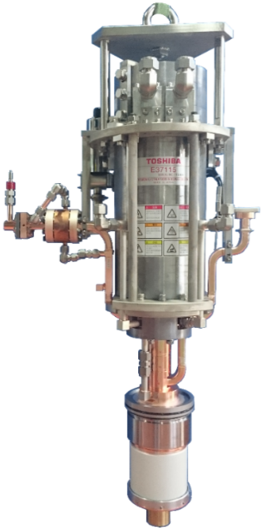
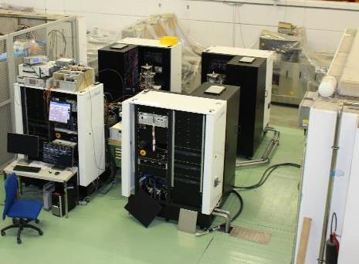
3. High Efficiency 8-MW Klystron
High efficiency klystron development in collaboration with CERN started in 2018 to increase efficiency of existing klystron used in Xbox-3.
Upgrade tube design without modifications of modulators.
Target output power more than 8 MW (~60% efficiency).
Designed by KlyC developed at CERN and confirmed by CST-3D simulations at CERN.
Confirmed by FCI simulation at CETD.
Parameter | E37113
Frequency | 11.994 GHz
Peak output power | 6 MW
Pulse length | 5 μs
Repetition rate | 400 pps
Beam voltage | 154 kV
Perveance | 1.55 μP
Efficiency | 43%
N. Catalan, CLIC 2019
Xbox-3 at CERN

Slide 7

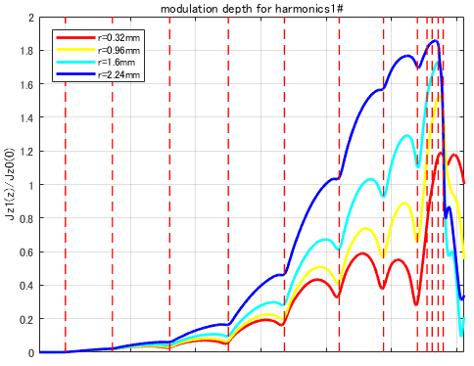
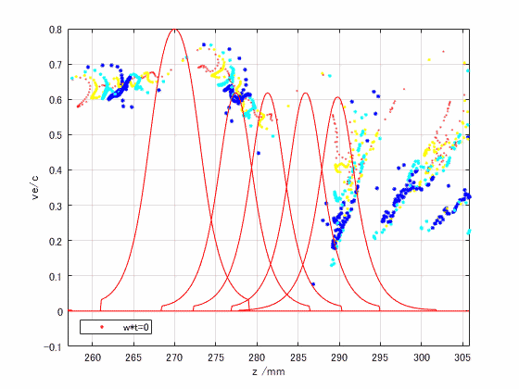
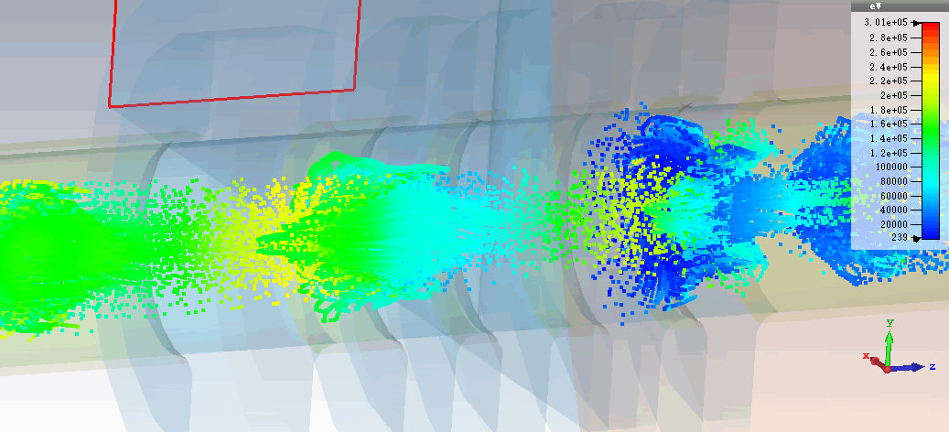
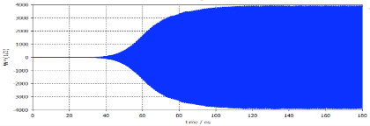
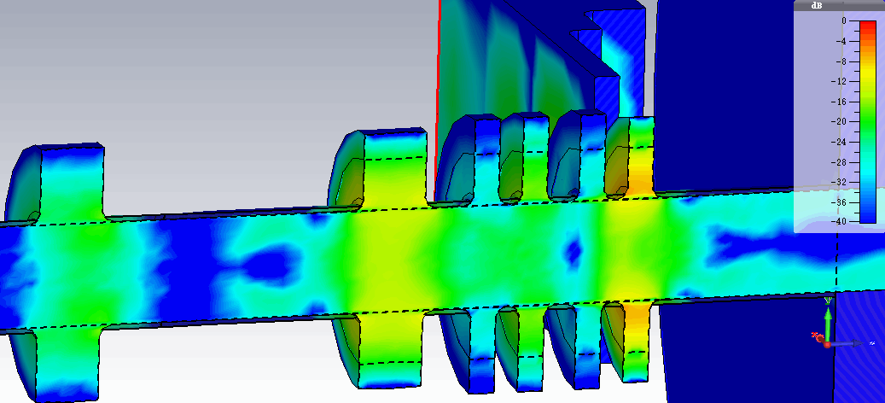
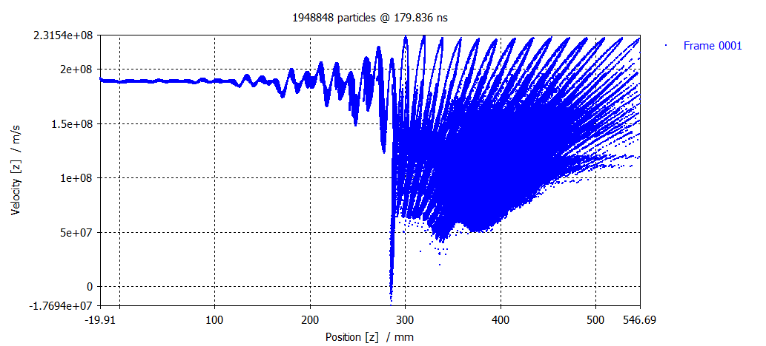
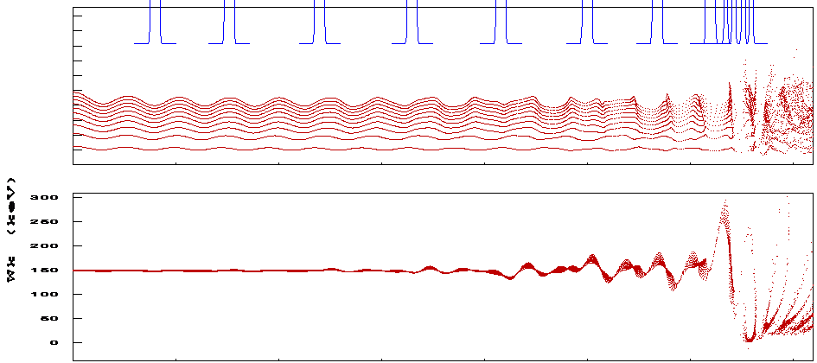
3. High Efficiency 8-MW Klystron
Tube with COM bunching circuit and 4-cells output coupler was designed at CERN by KlyC and confirmed by CST and FCI.
Output coupler
Eff.=58.1%
FCI
No reflected electrons.
84 MV/m max.
KlyC and CST simulation by J. Cai and I. Syratchev
Parameter | KlyC | CST | FCI
Beam voltage [kV] | 154 | 154 | 154
Beam current [A] | 90 | 90 | 90
Drive power [W] | 100 | 100 | 100
Output power [MW] | 8.25 | 8.05 | 8.12
Power efficiency [%] | 59.5 | 58.1 | 58.6
Energy profile

Slide 8
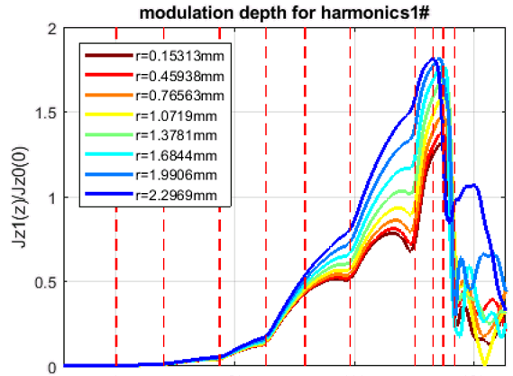
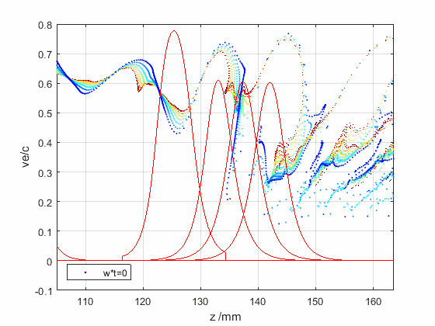
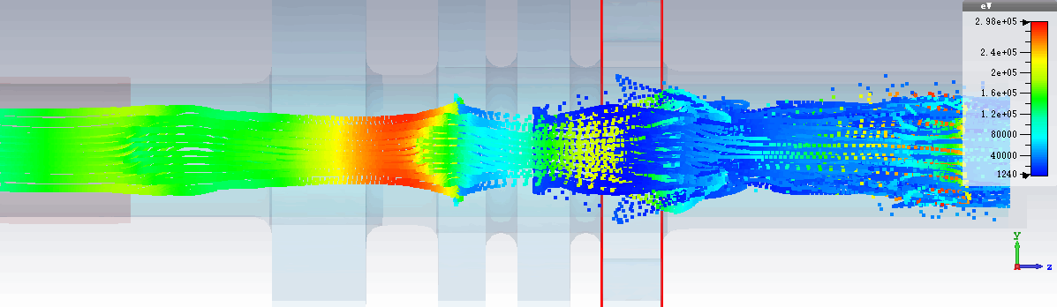
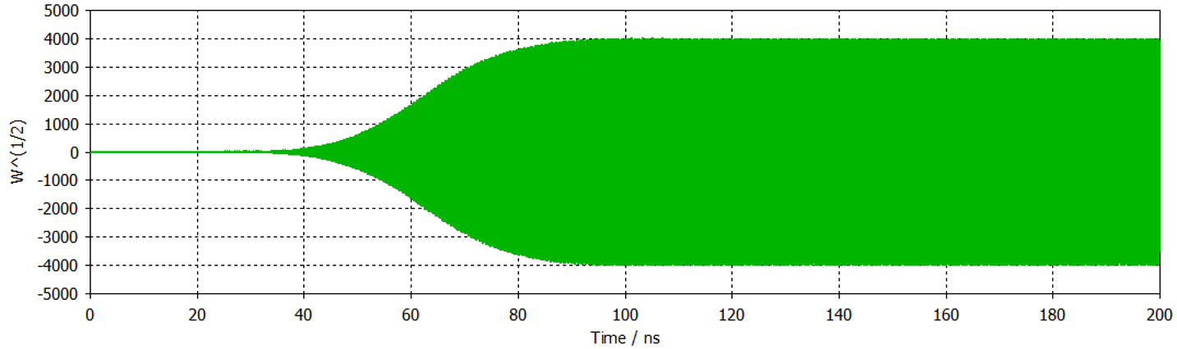
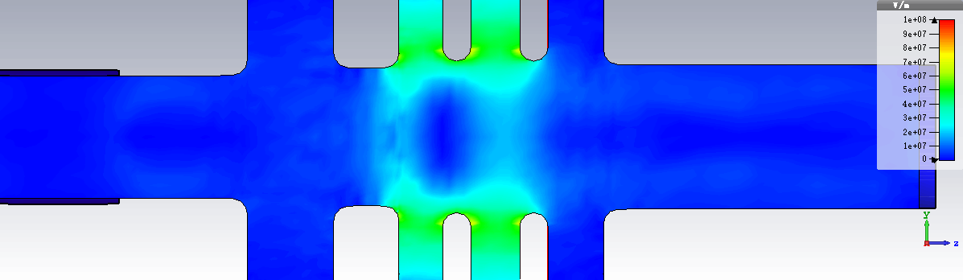
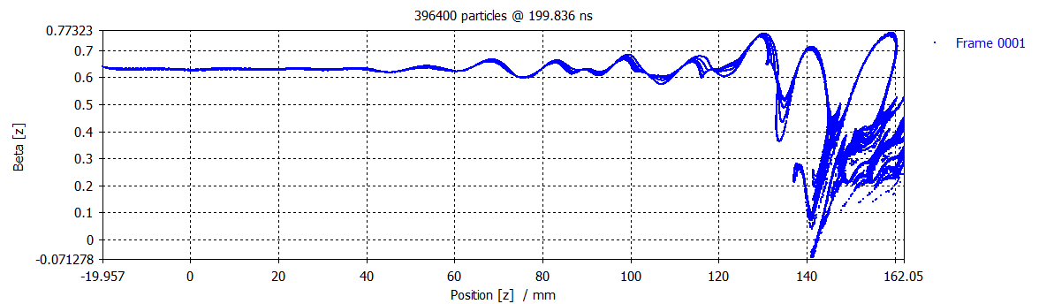
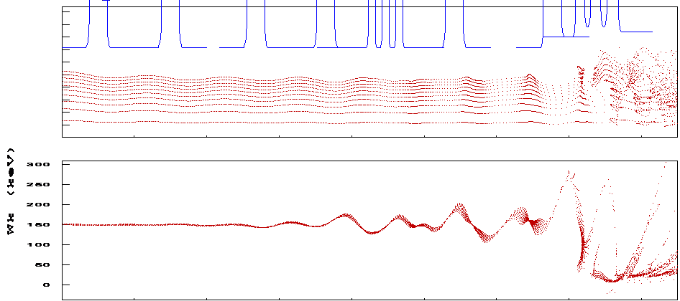
3. High Efficiency 8-MW Klystron
Design of much shorter tube with 2nd harmonic triplet (3-cells cavity) operating in pi mode in bunching cavities and 3-cells output coupler was studied. Length decreased to almost half.
Output coupler
Eff.=56.4%
Eff.=58.1%
FCI
2nd harmonic triplet (pi mode)
No reflected electrons.
87 MV/m max.
KlyC and CST simulation by J. Cai and I. Syratchev
Parameter | KlyC | CST | FCI
Beam voltage [kV] | 154 | 154 | 154
Beam current [A] | 94 | 94 | 94
Drive power [W] | 80 | 80 | 80
Output power [MW] | 8.31 | 8.16 | 8.16
Power efficiency [%] | 57.4 | 56.4 | 56.4
Energy profile

Slide 9
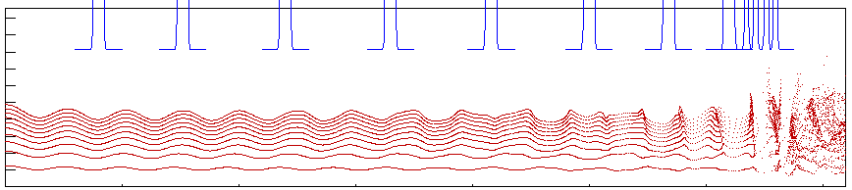
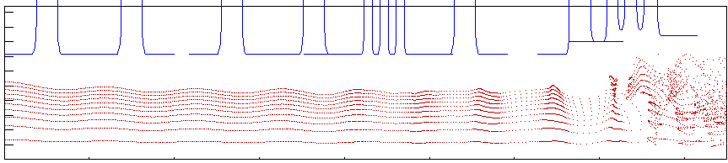
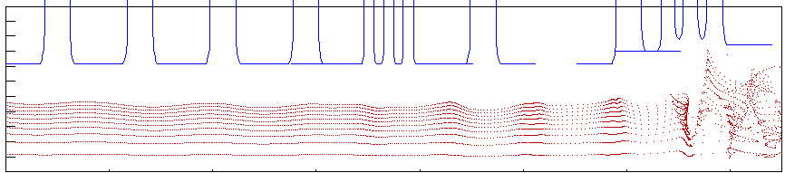
3. High Efficiency 8-MW Klystron
The second design still required new solenoid. We further studied performance of tube that can fit into existing solenoid, and it worked in simulations.
Design 1
Long circuit
New solenoid
Eff. = 58.6%
Design 2
Short circuit
2nd harmonic
New solenoid
Eff. = 56.4%
Design 3
Short circuit (same as 6-MW tube)
2nd harmonic
Existing solenoid
Eff = 56.4%
We decided to fabricate this tube.

Slide 10
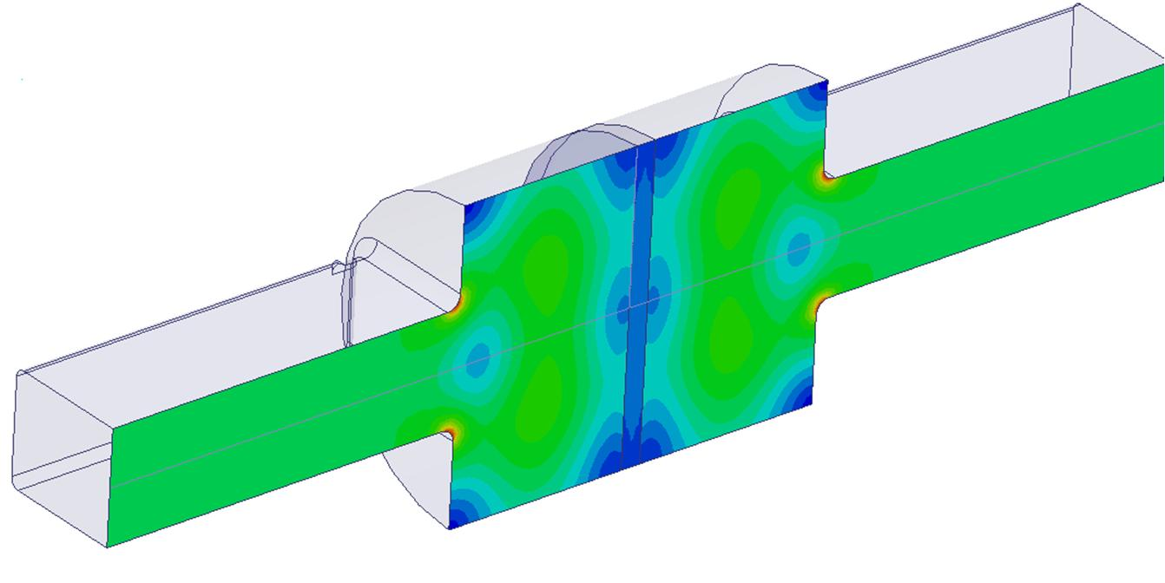
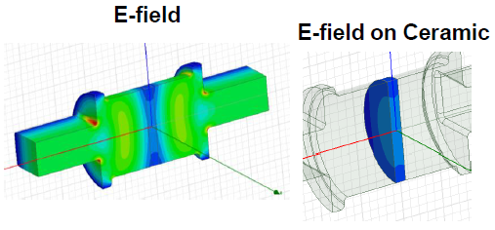
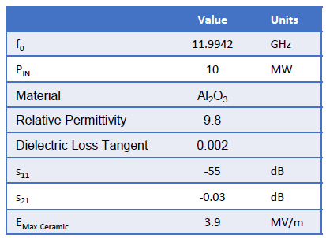
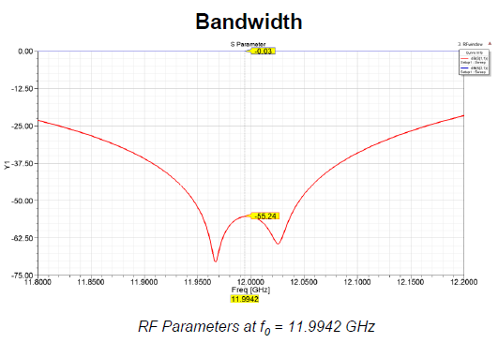
3. High Efficiency 8-MW Klystron
Conventional long pillbox window
4.3 MV/m at 6 MW
4.9 MV/m at 8 MW
Compact RF window with TW in ceramic was designed at CERN to decrease the electric field strength on ceramic.
Designed for
6-MW klystron
E field strength on ceramic decreased by 30%
Compact window with TW in ceramic
3.5 MV/m at 8 MW
3.9 MV/m at 10 MW
C. Serpico and I. Syratchev

Slide 11
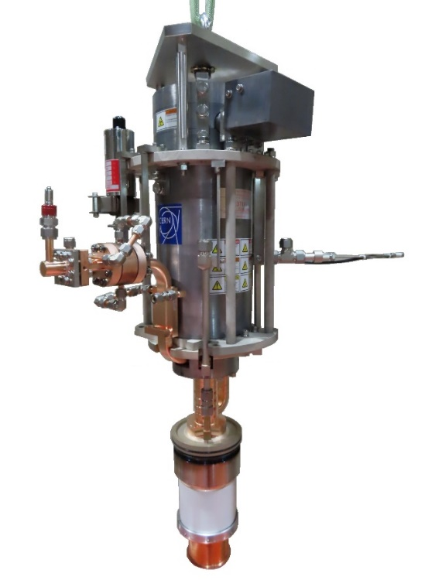
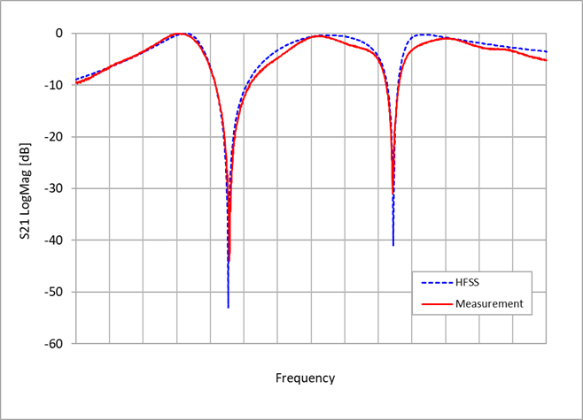
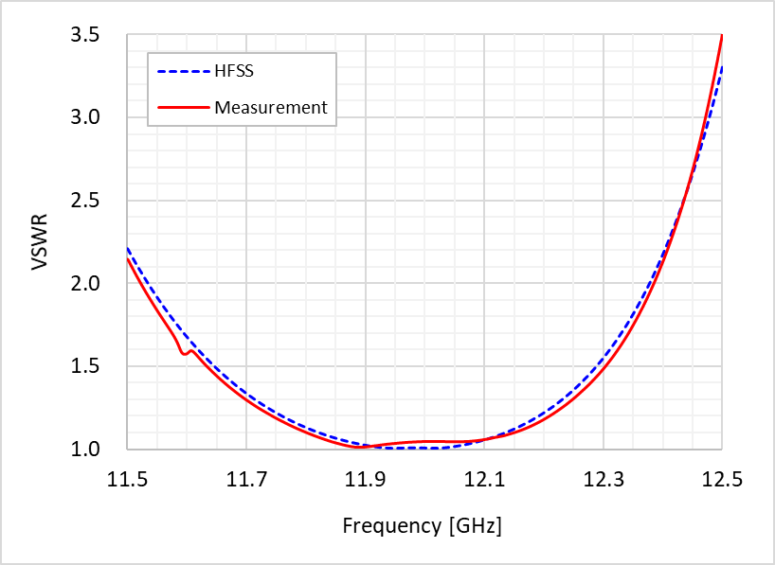
3. High Efficiency 8-MW Klystron
First prototype was fabricated and tested in late 2021 at CETD’s factory. Measurement results of 3-cells output coupler and output window are shown.
Blue: HFSS simulation
Red: Measurement
S21 of 3-cells output coupler
(Max S21 was shifted to 0 dB for comparison)
VSWR of RF output window
First prototype

Slide 12
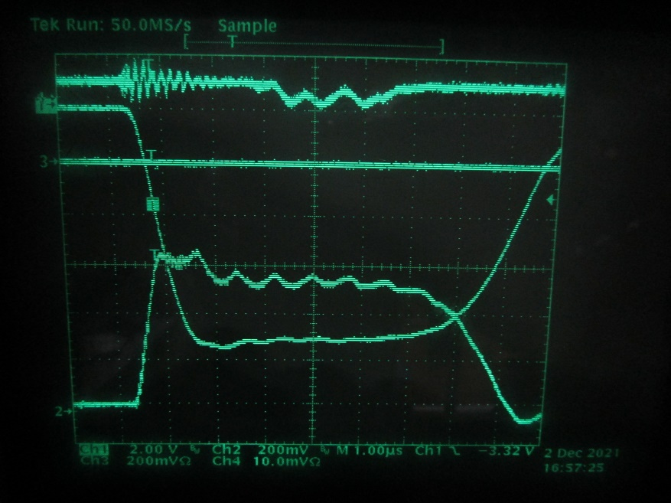
3. High Efficiency 8-MW Klystron
Conditioning of klystron usually starts in diode mode (DC). During diode mode operation, some oscillations were observed unexpectedly at below the design voltage of 154 kV.
Signal from klystron output
Signal from klystron input
Beam current
Beam voltage
Example of diode signal
We started investigation using spectrum analyzer.

Slide 13
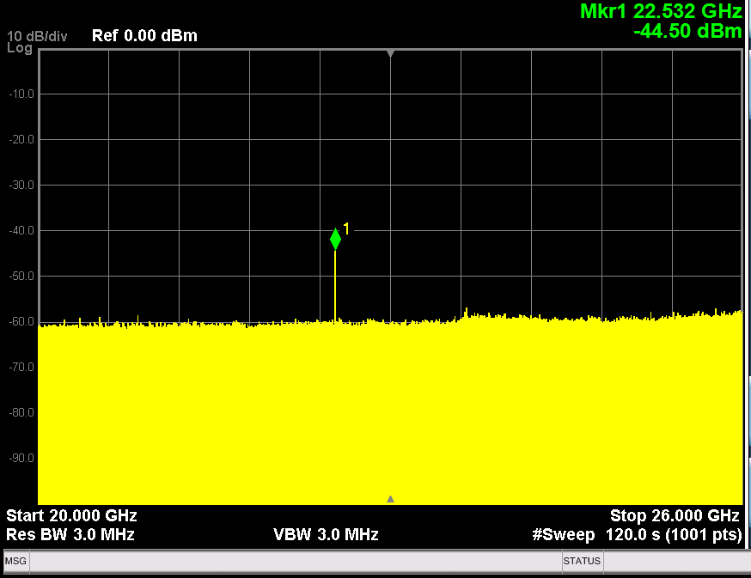
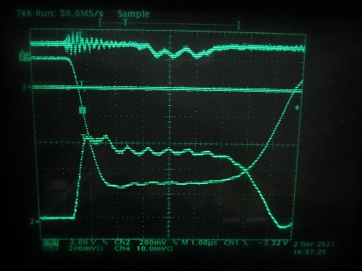
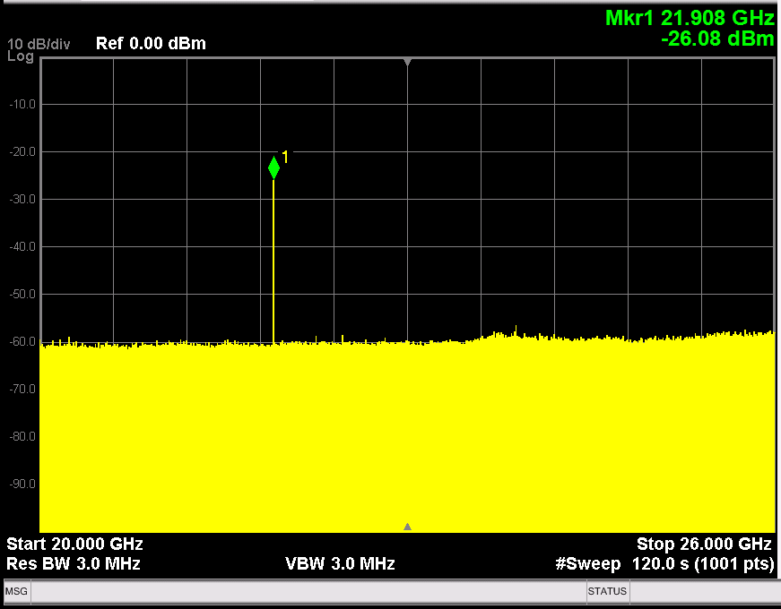
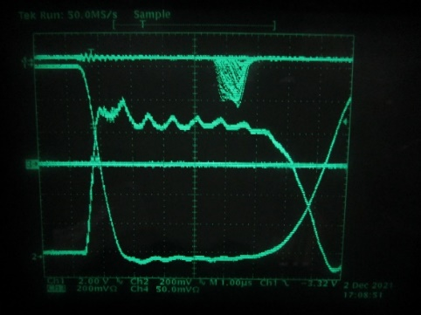
3. High Efficiency 8-MW Klystron
Oscillation investigation results
There seemed to be two types of oscillations. The klystron was tested below 135 kV to avoid the ion pump current burst caused by beam interception.
Voltage [kV] | Frequency [GHz]
85 - 125 | 22.5
Voltage [kV] | Frequency [GHz]
107 - 125 | 21.9 - 22.0
Example of 22.5 GHz oscillation at 92 kV
Example of 21.9 GHz oscillation at 125 kV
TM01 pi/2 mode in 2nd harmonic triplet (22.5 GHz) was suspected.
Through some quick eigen mode analysis, coupled TE modes in bunching cavities were suspected.

Slide 14
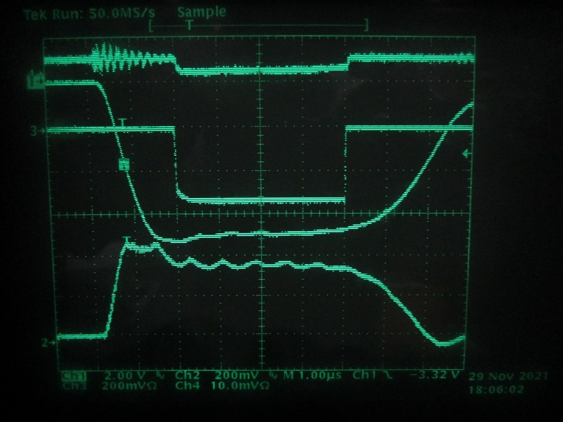
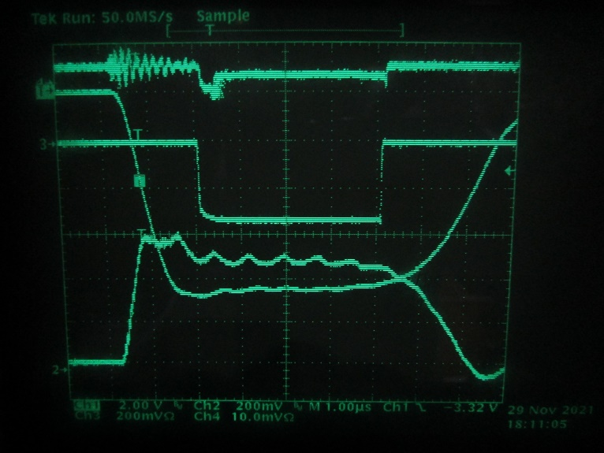
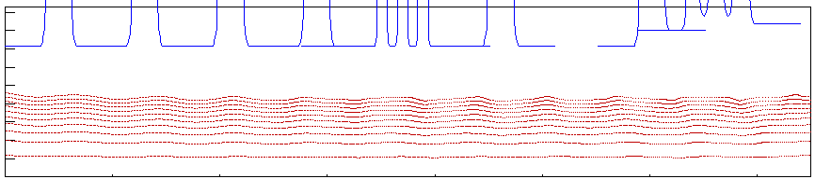
3. High Efficiency 8-MW Klystron
RF test result
Due to oscillations, beam voltage was limited to 70 kV for stable operation whereas design operating point was 154 kV. At such a very low voltage, peak RF output power was only several kW (consistent with simulation).
Output power
Instability
Drive power
(400 W max)
Beam voltage
Beam current
70 kV (Stable)
85 kV (Unstable)
FCI simulation at 70 kV
(Pin = 400 W)

Slide 15
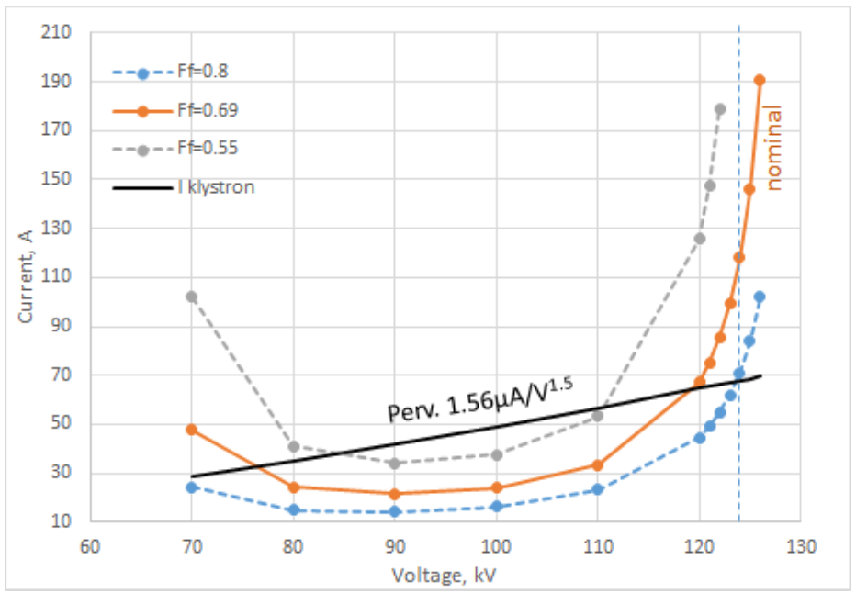
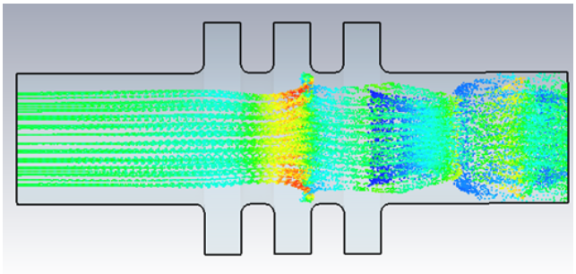
3. High Efficiency 8-MW Klystron
To reach higher voltages, oscillations must be mitigated. Analysis started at CERN. 22.5-GHz oscillation was identified as TM01 pi/2 mode of the 2nd harmonic triplet by KlyC and CST simulations.
Ff=0.8: Larger beam radius
Ff=0.69: Nominal beam radius
Instability zone from 70 to 125 kV (Ff=0.8)
Consistent with test result
Instability zone
Monotron oscillation threshold currents in the 2nd harmonic triplet for different beam tunnel filling factors as functions of the klystron voltage.
Particle trajectories simulated in CST 3D PIC solver at 92 kV beam voltage.

Slide 16
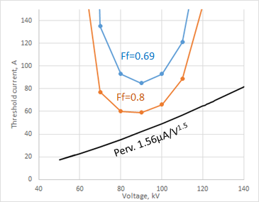
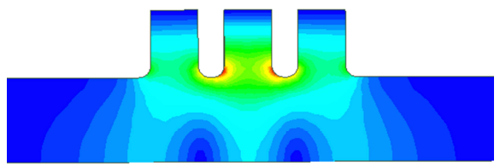
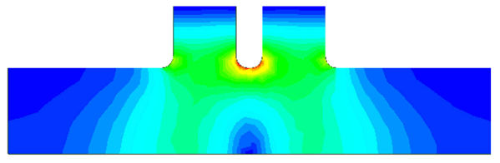
3. High Efficiency 8-MW Klystron
We have tried mitigation and found that by reducing iris thickness of triplet to 60% increased threshold of monotron oscillation to safe level. However, effective impedance of operating π mode decreased by about 30% and triplet lost its benefit. We decided to substitute it by doublet. Threshold current even for the larger beam radius (Ff=0.8) exceeded the klystron current with a good margin.
Triplet
(TM01 pi mode)
Stable zone
Substituted
Doublet
(TM01 pi mode)
Monotron oscillation threshold currents in the 2nd harmonic doublet for different beam tunnel filling factors as functions of the klystron voltage.

Slide 17
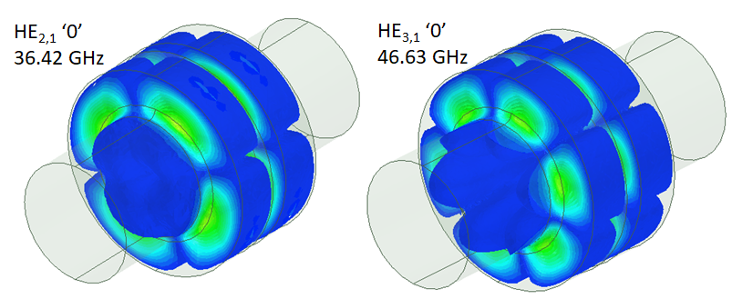
3. High Efficiency 8-MW Klystron
Other potential instabilities in coupled 2nd harmonic cavities were associated with HE_{N,1} hybrid modes (N=2,3). These modes were at high frequencies (36.4GHz and 46.6GHz), but still stayed trapped.
To investigate the mode stability, fast and accurate method to analyze arbitrary instabilities in linear beam devices were used.
Instability onset will be satisfied if Q₀/Q_{beam}< -1
Q₀ : Intrinsic quality factor of known mode
Q_{beam}: Beam loading quality factor
To calculate the Q_{beam}, it is sufficient to measure the beam power at a collision plane for two regimes, the first without the imported mode field-map (DC) and the second with the imported mode field-map (RF).
Beam will be decelerated and extract more RF power than RF power dissipated in cavity walls.
J.C. Cai, I. Syratchev and G. Burt, ‘Numerical Analysis of Resonant Multipolar Instabilities in High Power Klystrons’, IEEE Trans. on Electron Devices, vol.68, issue.7, pp. 3617 - 3621, June 2021.

Slide 18
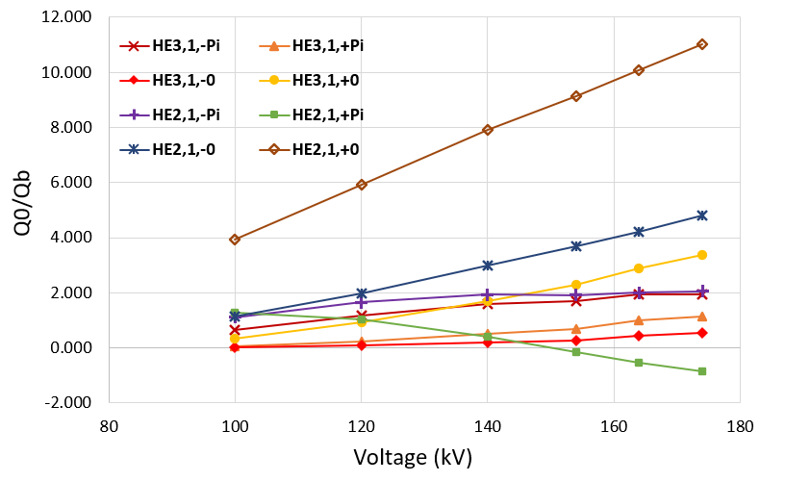
3. High Efficiency 8-MW Klystron
As a result of the Q₀/Q_{beam} calculations, HE modes in doublet were confirmed to be stable up to 174 kV even in larger beam radius condition (Ff=0.8).
-1.000
Instability zone
(Q₀/Q_{beam} < -1)
Q₀/Q_{beam} as a functions of beam voltage for the spatial harmonics (0 and π) of TE21 and TE31 modes. Here, + or – signs indicates the different rotation directions of the modes

Slide 19
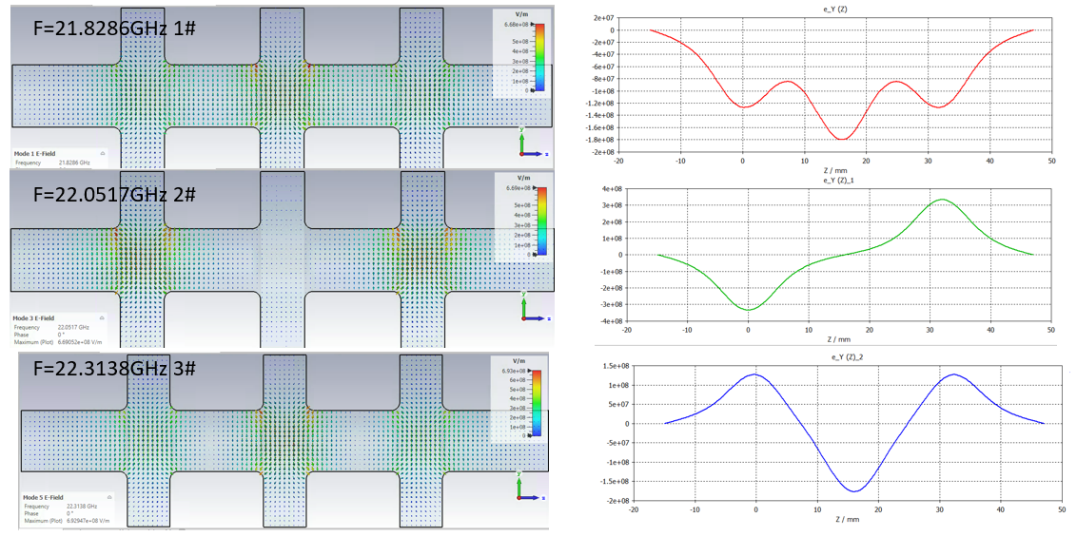
3. High Efficiency 8-MW Klystron
Oscillations at over 107 kV have been also analyzed. Because more than one oscillation was found, this suggest that we must deal with coupled TE11 modes.
Assembly of three bunching cavities (cavity #2 to #4) was simulated in CST eigenmode solver. Two detected modes were identified as TE11 0 and pi/2 coupled modes.
0 mode
pi/2 mode
pi mode
TE11 coupled modes in the three bunching cavities.
Transverse component of electric filed along Z-axis.

Slide 20

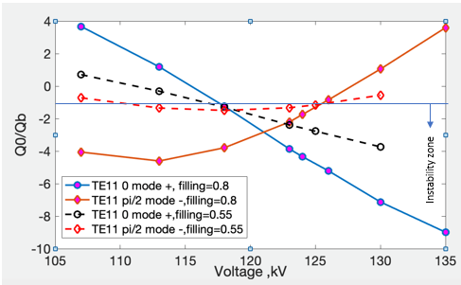

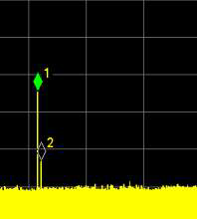
3. High Efficiency 8-MW Klystron
Q₀/Q_{beam} dependency on voltage of TE11 0 and pi/2 coupled modes were analyzed. Cases for two different beam radii (Ff=0.55 and 0.8) were addressed. Simulation results agree well with measured data.
-1
21.908 GHz
(125-130kV, Ff=0.55)
22.016 GHz
(107kV, Ff=0.8)
Q0/Q beam as a functions of beam voltage for the spatial harmonics (0 and π/2) of TE11 mode. Here, ‘+’ and ‘-‘ signs indicate the different rotation directions of the modes.
21.896 & 21.932 GHz
Competing modes
(124kV, Ff=0.8)

Slide 21
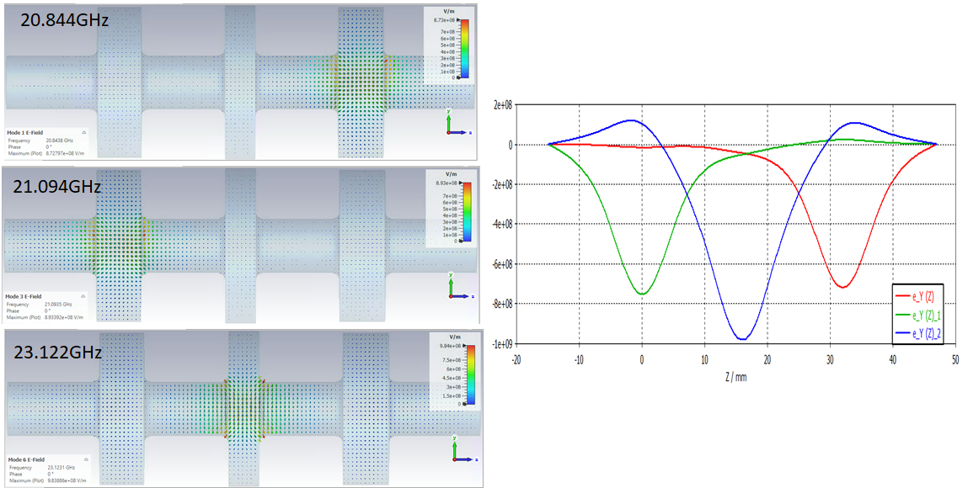
3. High Efficiency 8-MW Klystron
For mitigation of these modes, cavities gaps lengths varied within ± 20% interval with respect to original gap length, and detuning of TE11 modes of 1.8 GHz was obtained.
Modes almost look like modes of individual cavities, however still some residual coupling remains.
TE11 coupled modes in the new set of three bunching cavities.
Transverse component of electric filed along Z-axis.

Slide 22
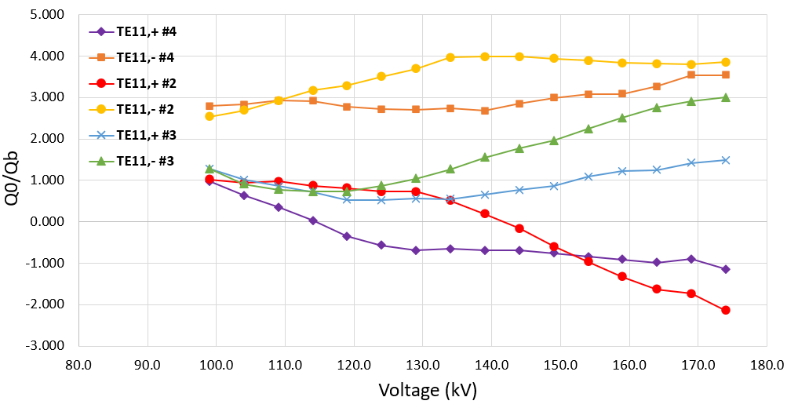

3. High Efficiency 8-MW Klystron
TE instabilities with new cavities were analyzed for voltage range from 100 to 174 kV with filling factor of 0.8 and magnetic field of 0.4T.
Q₀/Q_{beam} as functions of beam voltage for TE11 modes in different cavities. Here, ‘+’ and ‘-‘ signs indicate the different rotation directions of the modes.
Instability zone
(Q₀/Q_{beam} < -1)
Modes located in cavity #2 and cavity #4 are almost at threshold of instability.
We decided to use stainless steel in first four drifts to keep safe margin for TE mode instabilities.
#2
#3
#4
Stainless steel in first 4 drifts

Slide 23


3. High Efficiency 8-MW Klystron
DC beam stability was confirmed in CST-PIC simulation at design operating point of 154 kV and magnetic field of 0.4T, with nominal beam radius.
DC, V=154 kV, Ff=0.69, Bz=0.4 T, Simulation time = 4000 ns
At 174 kV, 0.42 T and nominal beam radius condition, stable DC beam was confirmed in CST-PIC simulation.
DC, V=174 kV, Ff=0.69, Bz=0.42 T, Simulation time = 4000 ns

Slide 24


3. High Efficiency 8-MW Klystron
RF performance was simulated by KlyC and FCI. 8-MW and 10-MW RF power were expected at 154 kV and 174 kV, respectively.
New 3 bunching cavities
2nd harmonic doublet
154kV, 94A, Bz=0.4T, Pin=100W, Pout=8.2MW, Eff.=56.8%
174kV, 113A, Bz=0.42T, Pin=60W, Pout=10.5MW, Eff=53.3%
Power transfer curves at 154 kV and 174 kV by FCI simulations.
Beam trajectories by FCI simulations.

Slide 25
3. High Efficiency 8-MW Klystron
Status of 2nd prototype
Four stainless-steel drifts were successfully incorporated.
Tube with updated RF circuit has been built.
Conditioning has started recently.
DC stability was tested. Results are shown in next slides.

Slide 26






3. High Efficiency 8-MW Klystron
Tube was tested at relatively large beam radius condition (I_{main}=30 A, I_{counter}=7 A). Stability was improved and there were no oscillations below 170 kV. However, at higher voltages, some oscillations were observed (21.3 and 22.2 GHz).
Signal from klystron output
Beam current
Beam voltage
Signal from klystron input
No peaks
165 kV
170 kV
174 kV

Slide 27




3. High Efficiency 8-MW Klystron
Oscillations were successfully eliminated when beam radius was decreased by increasing main coil current or counter coil current of focusing magnet. Results at 174 kV is shown.
No oscillation signal
No oscillation signal
No peaks
No peaks
I_{main}=30→32A, I_{counter}=7A
I_{main}=30A, I_{counter}=7→11A

Slide 28
4. Summary
High efficiency 8-MW X-band klystron was designed in collaboration with CERN to upgrade existing 6-MW klystron in Xbox-3.
Oscillations were observed in the first prototype and mitigation measures were developed.
DC stability of second tube was improved and operation at 174 kV was possible.
RF performance will be tested after RF conditioning.
DC stability issues and mitigation measures are detailed in CLIC-Note-1176.
https://cds.cern.ch/record/2812566
Igor Syratchev, Zaib Un Nisa, Jinchi Cai, Graeme Burt, Toshiro Anno, DC Beam Stability issues in the first commercial prototype of a High Efficiency 8MW X-Band Klystron, CLIC-Note-1176, 2022.

