Slide 1
SSA Developments at SOLEIL
Workshop on Efficient RF sources
Château de Bossey, 4-6 July 2022
Massamba DIOP
On Behalf of the RF & LINAC Group

Slide 2

SSPA Principle
Combining in // a number of elementary amplifier modules (or pallets) of a few 100 W (up to ~ 1 kW)
- MOSFET (V_{d} = 30 - 65 V) → No HV & Low phase ripple
- Circulator & its load to ensure a good isolation (even a small residual VSWR can affect the MOSFET power capability !!)
1:n₁
n₁:1
≈
≈
1:n₂
n₂:1
1:n₃
n₃:1
Pre-
ampli
x 10 kW
n₁ Ampli modules
x kW
≈
≈
≈
≈
≈
≈
Pre-
ampli
Driver
ampli
x n₂
⇔
x 10 kW
x n₃
≈
≈
≈
≈
Few kW unit
x kW
x 10 kW
⇔
The number of pre-ampli depends on the module gain
x kW
Few 10 kW unit
Few 100 kW unit
SOLEIL Booster first SSPA (P_{nom} = 35 kW @ 352 MHz) :
P_{mod} ≈ 300 W ; n₁ = 8 → 2.4 kW ; n₂ = 8 → 19 kW ; n₃ = 2 → 146 RF modules (128 Ampli + 18 Pre-A) → P_{out} ≈ 38 kW
→ Modularity & Redundancy inherent to such a design

Slide 3
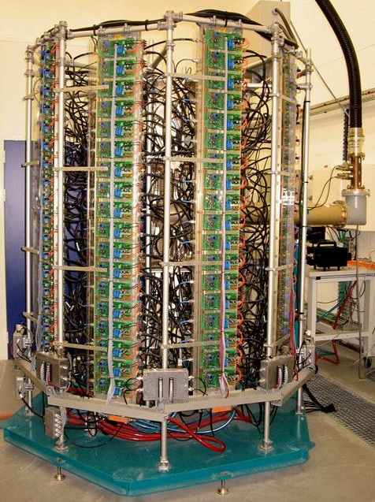
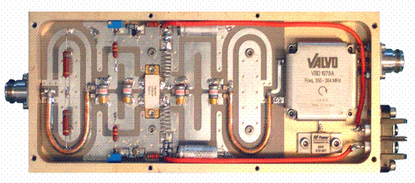

Booster original 35 kW SSPA
330 W CW - 352 MHz amplifier module
VDMOS D1029UK05 from SEMELAB
(G = 11 dB, ƞ = 62 %)
Circulator
600 W - 280 / 28 V dc
power converter
Power combiner
(8 x 8 x 2)
8 dissipaters of
16 + 2* modules
* Pre-amplifiers
35 kW
8 x 300 W
All amplifier components were designed in house and the mass production contracted to industry
In 2005, world record for a SSPA
~ 86 000 running hours over 13 years and only one single trip from the SSPA, in August 2016,
due to a loose connection on a monitoring cable (down time ~ 2.10⁻⁵ and MTBF ~ 48 000 hours)
~ 1 module failure / year, without impact on the operation, thanks to the modularity and redundancy
Notes:
146 modules of 300 W @ 352 MHz & individual power supplies, mounted on 8 water cooled dissipaters

Slide 4
Booster new SSPA’s (2 x 60kW)
Booster RF system was originally designed for standard operation
The 35 kW amplifier drives a 5-cell copper cavity => V_{RF} = 1 MV (P_{diss} = 20 kW ; P_{beam} = 5 kW → P_{tot} = 25 kW)
But low-ɑ operating mode suffered from a low injection efficiency (15-20%) due to the long BO bunches
→ Heavy safety radiation constraints
→ Prevents more beam lines to join this operating mode
2nd RF station installed to increase V_{RF} from 1 MV up to 3 MV in winter 2017-2018
Shorter bunch length → SR injection efficiency improved by a factor of ~ 2 in low-ɑ operation
  Former spare cavity installed in one straight section of the Bo ring and powered with 60 kW (V_{RF} = 1.8 MV)
  New 60 kW - 352 MHz SSPA, identical to a standard tower of our SR amplifiers
  (10 dissipaters of 16 modules, built from 160 RF modules of 400 W with BLF574XR transistors and their dc-dc converters made available by the SR SSPA refurbishment)
  SSPA and its associated LLRF & control (replica of the actual one) inside the Bo RF room
  Increase V_{RF} of the existing plant from 1 MV up to 1.2 MV → P_{RF} ~ 30 kW (P_{beam} ~ 0)
Original 35 kW Booster SSA upgrade up to 60 kW → increase total V_{RF} from 3 MV up to 3.6 MV in October 2019
‘Upgraded’ Low-ɑ operating mode available for users
with V_{RF} = 3.6 MV (SR injection efficiency = 35% instead of 18% before)
+ power savings and redundancy in all other operating modes

Slide 5
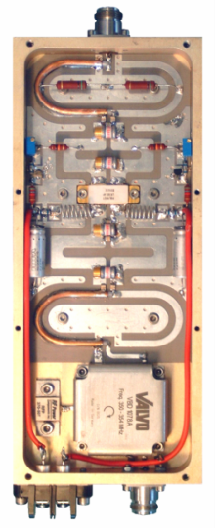
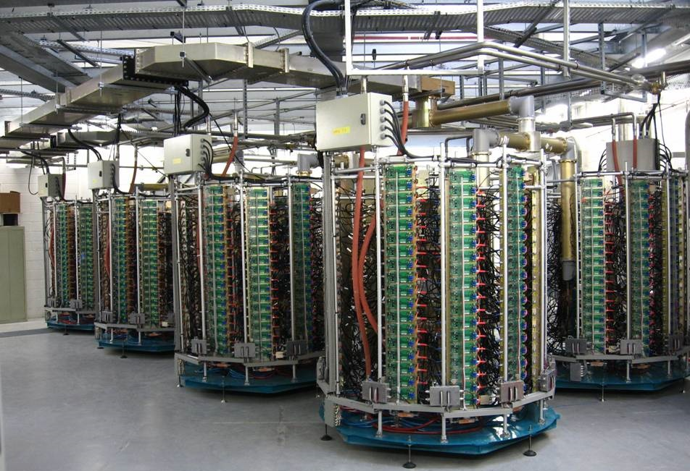
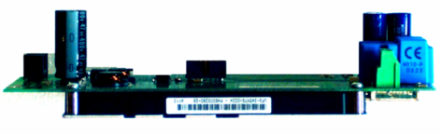
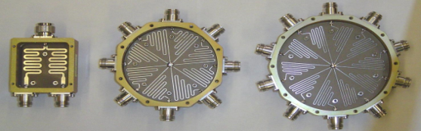
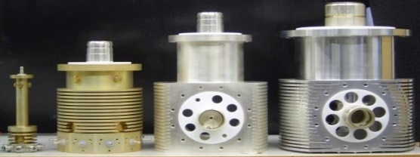
SOLEIL SR 180 kW SSPA’s
Same principle as the BO one but extended to 4 towers of 45 kW:
  10 dissipaters of 18 modules per tower
  726 modules / amplifier x 4 cavities → 16 towers & ~ 3000 modules
LDMOS LR301 from POLYFET
P = 315 W, G = 13 dB, η = 62 %
600 W - 280 Vdc / 28 Vdc
Splitters
A1
Amplifiers 1 & 2 (2 x 4 towers)
powering the 2 cavities of
Cryomodule 1
Combiners
A2

Slide 6
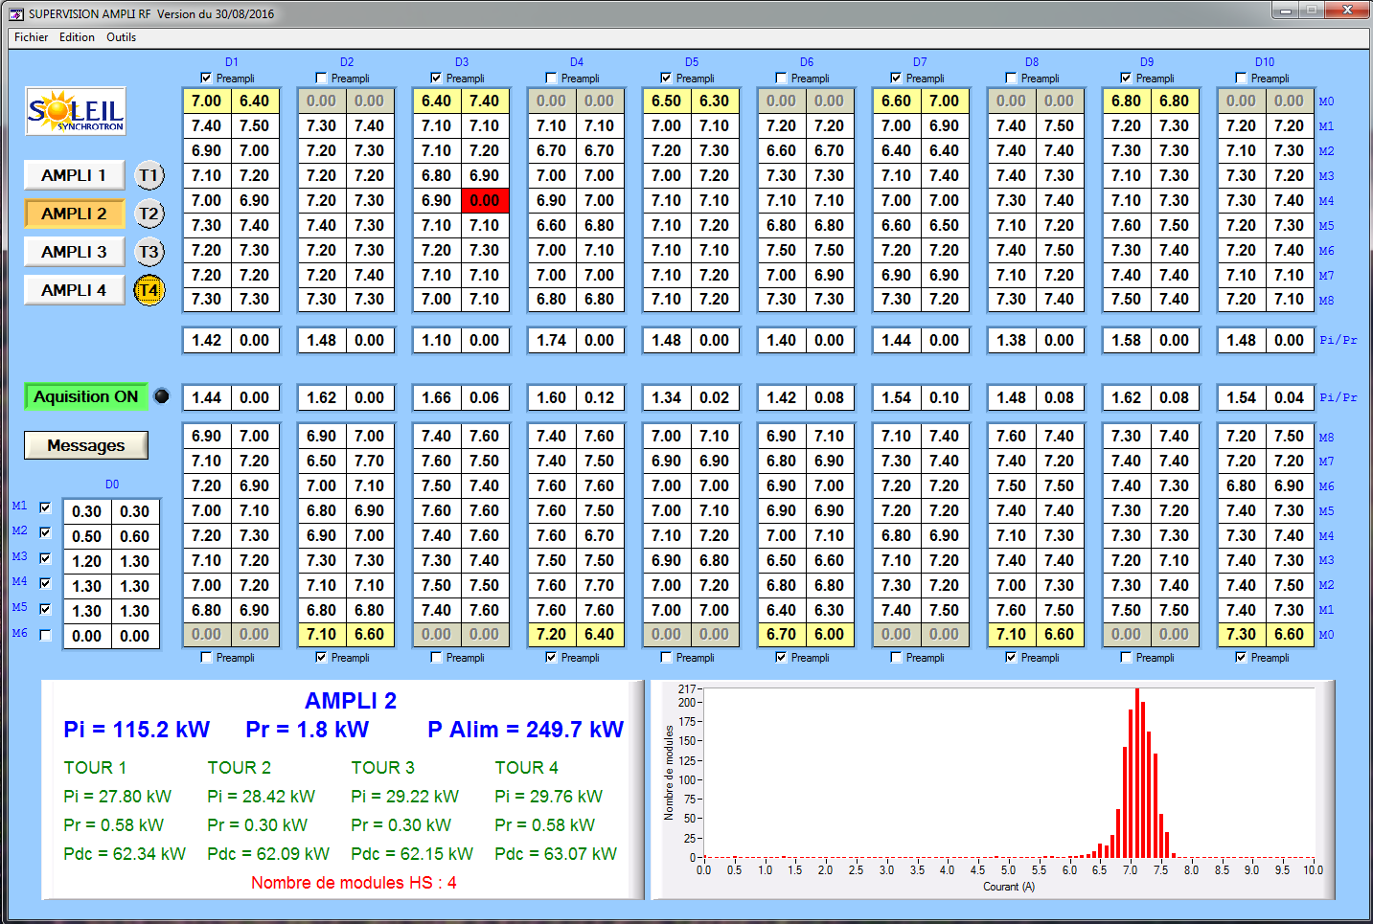
SR SSPA Control
Multiplexing (I x 2 x 680 mod. + P_{i} & P_{r} x 80) → single µcontroller for 1 complete amplifier (4 towers)
Tower T4 of
Amplifier 2
Top transistor currents
Pi & Pr
2.5 kW combiner
Bottom transistor currents

Slide 7
180 kW SSPA’s Refurbishment
The failure rate of our original LR301 transistors remains significant ~ 3% a year.
2 types of failures identified : - Transistor breakdown
- Damaged soldering due to thermal fatigue
→ Module refurbishment from 2013 to 2020 (rate of 5 towers a year with SOLEIL staff + external resources)
LR301 replacement by 6th generation BLF574XR (V_{d} = 50V instead of 30V with better performances)
More robust transistor and lower thermal stress → longer lifetime → less maintenance
→ failure of a single « new » transistor (~ 8 years of operation)
+ 7 dB transistor gain → 160 modules & their dc PS are got back for the new BO SSA
P_{mod} increased : 315 W → 330 W for SR and 330W → 400W for BO
Electrical power savings (efficiency RF/DC: 48 % → 57%) compensated the investment cost in < 3 years
SSPA power increased from 180 to 200 kW
→ More redundancy allowing to store full beam (500 mA) with 3 running SSPA’s out of 4

Slide 8
180 kW SSPA’s Refurbishment
80
Cure the lack of redundancy in the pre-amplification stage → develop a “combiner-divider”
1
1
80
24W
3W
3W
Pre-ampli
300W
300W
24W
190kW
2.4kW
Upgrade
300W
24kW
24kW
Present config : each pre-ampli drives 80 modules; if one of them fails the amplifier is stopped
190kW
Thanks to the combiner-divider, the failure of a pre-ampli does not affect the functioning anymore
Modification of the 2.5 kW combiners (welded → screwed connections) to increase their power capability and robustness

Slide 9
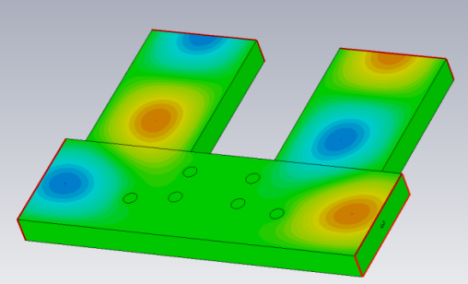
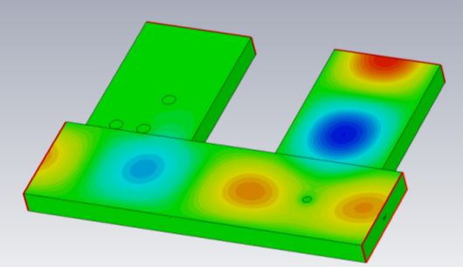
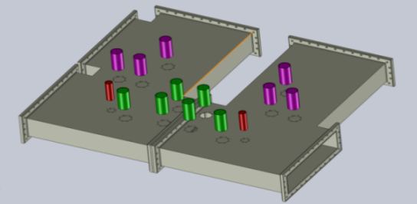
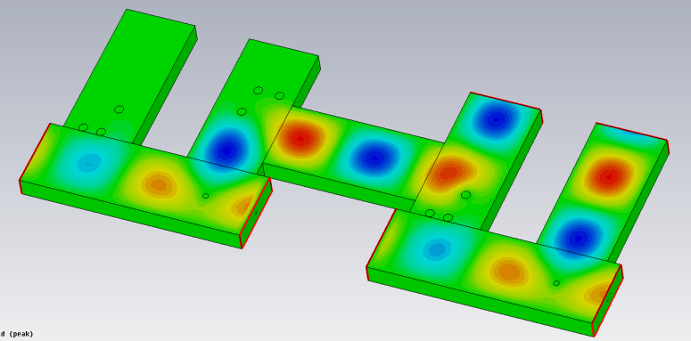
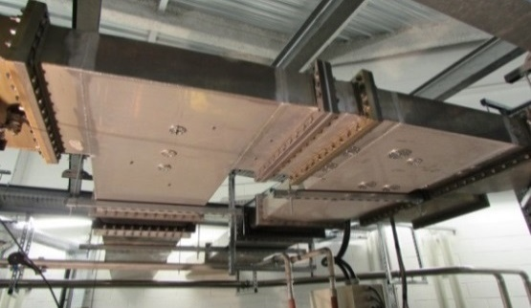
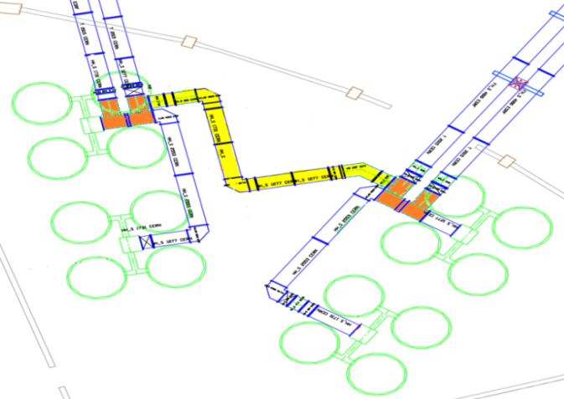
Storing 450 mA using a single CM
Modification of the waveguide network to combine the power from two amplifiers into one cavity → Possibility of storing 450 mA using a single CM
« Magic Switch »
P1
P2
P1+P2
OR
depending on the post configuration
P1
P1
P2
P2
P1+P2
CM2
CM1
P3+P4
P1
P2
P3
P4
Waveguide network layout to power one or the other CM with 300 kW / cav from the 4 SSPA’s, combined by pairs
Connecting 2 Magic Switches
The 2 Magic Switches implemented and waveguide distribution completed in end-2018

Slide 10
SR SSPA’s Operational Results
Investment cost = 3 M€ + 350 k€ for refurbishment
Operational cost = 400 k€ per year → 6 M€ from installation
Maintenance annual cost = 5 k€
4 x 200 kW SSPA’s
MTBF & beam downtime, cumulated by the 4 SR SSPA’s over ~ 95 000 running hours in ~ 15 years
Equipment | MTBF | Downtime | Comments
a) 4 x RF amplifiers | ~ 13 500 h | ~ 8.10⁻⁵ | Failures from preamplifiers and 1st stage combiners (solved) + supervision issues
b) 4 x Power supply 500 kVA thyristor-based with 680 DC/DC converters | ~ 6 300 h | ~ 3.10⁻⁴ | Single rectifier per amplifier + aging DC/DC converters
a) + b) 4 x RF transmitters | ~ 4 300 h | ~ 4.10⁻⁴
Already excellent MTBF and operational avaibility, but still perfectible by :
  Providing some more redundancy in the ac-dc power conversion, which originally consists in a single 500 kW rectifier per SSPA and DC/DC converters
  Upgrading the amplifier supervision system
  → Cures for these “weaknesses” in our new design

Slide 11
Power Supply Upgrade
Rectifier + DC/DC converters replacement by direct AC/DC converters
Redundancy, easy maintenance, reduced time to repair, solved obsolescence issues and cost reduction
Efficiency improvement
Total actual efficiency = 87% (96% rectifier and 90% DC/DC converters)
Increased to 96% with new AC/DC converters
AC/DC converter voltage remote control allows to match for maximum efficiency over whole power range (impossible presently: components set to reach max efficiency only at max power – 1dB compression)
Power supply upgrade plan
From mid-2023, 1 x 50 kW will be installed every 2-3 months in the SR to benefit from four fully upgraded 200 kW SSA’S by the end of 2026 for SOLEIL Upgrade

Slide 12
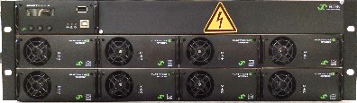
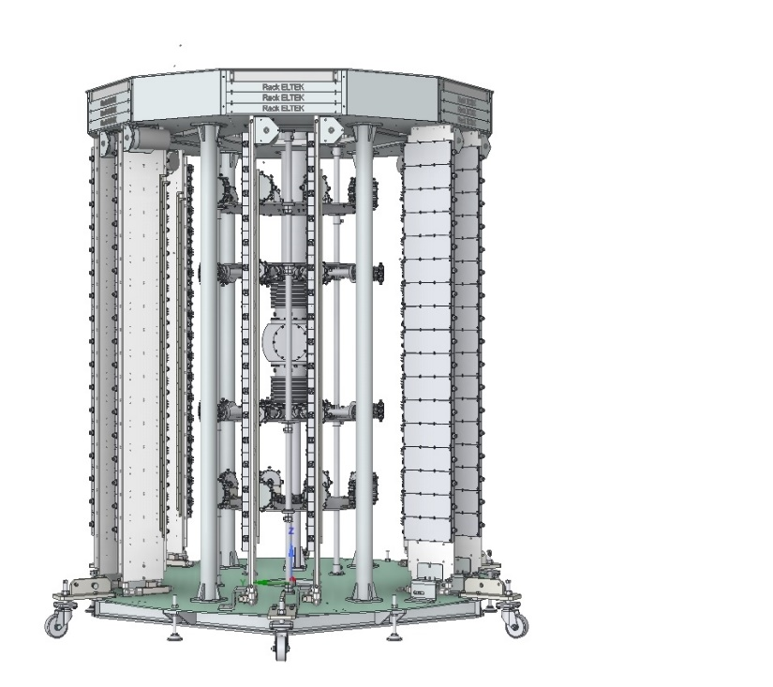
Power Supply Upgrade
8 x 3 kW power converters
Beam current | 450 mA | 500 mA
RF power into the beam | 506 kW | 562 kW
Electrical power (4 SSA’s + rectifiers and converters in present SOLEIL machine) | 1148 kW | 1278 kW
Electrical power (4 upgraded SSA’s @ 50 V) | 1019 kW | 1081 kW
Electrical power (4 upgraded SSA’s @ 44 V) | 894 kW | 952 kW
Maximum consomption reduction (44 V) | 22.1% | 25.5%
5 x 24 kW AC/DC racks (19" 3U)
5 x SSA control rack (19" 1U)
New dissipater orientation to optimize and reduce power cable length
Support pipes with bigger diameter, adapted to the new power supply weight
Power savings of 1.75 GWh max per year
130 k€ savings per year
Compensate the investment cost in ~ 6 years
3D view of a future upgraded SSA RF tower with new AC/DC power converters

Slide 13
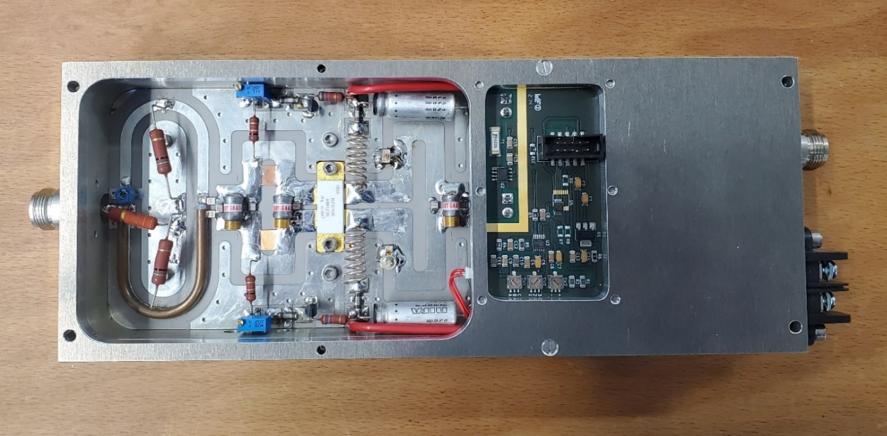
Power Supply Upgrade
Current measurements were initially done in the DC/DC converter.
New architecture → RF module modifications :
  Electronic mezzanine card for supervision (1 x T° sensor on circulator load to evaluate reflected power + 1 current sensor)
+ T° sensor on the dissipater (interlock purpose)
Mezzanine measurement PCB
PCB mechanical support
Module modifications

Slide 14
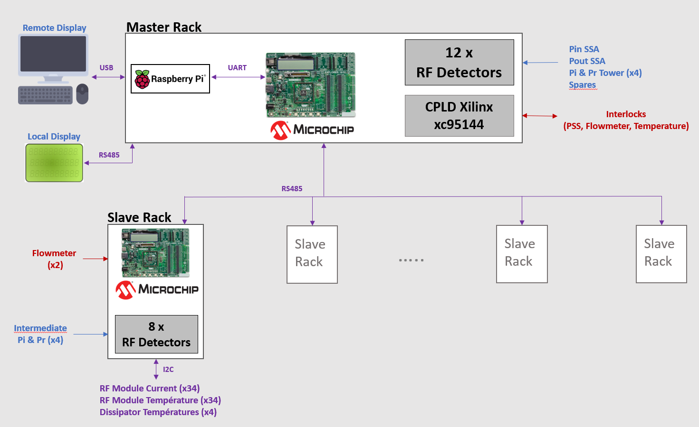
Upgrade of the SSA supervision system
Architecture modification : Single µcontroller for 1 complete amplifier → 1 “slave” ucontroller for 2 dissipaters
+ 1 “master” for the complete amplifier
Timing : Configurable cycle time (min=2ms)
Configurable addressing µcontroller position
Moved from dsPIC33f to PIC32MZ to increase performances
(processing speed, calculation precision, number of communication buses)

Slide 15
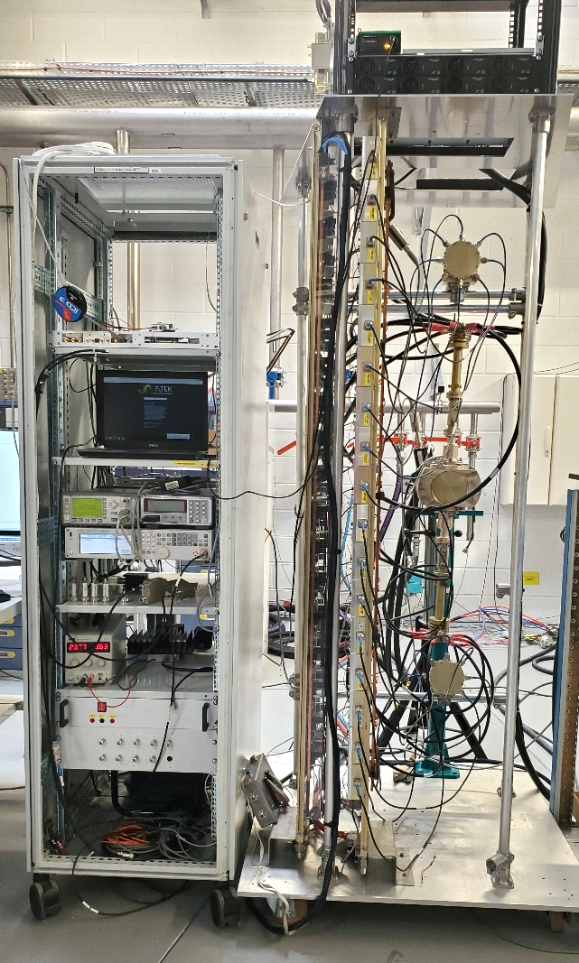
Power Supply and supervision system Upgrade
6 kW prototype test
Variation of DC Voltage
Efficiency comparison results
Next steps
60 kW prototype mounting and tests – September 2022
Implementation in present SOLEIL Booster – October 2022
2nd Booster SSA installation – January 2023
6 kW prototype test stand

Slide 16
SOLEIL SSPA R&D
Scientific Collaborations
and Technology Transfers

Slide 17
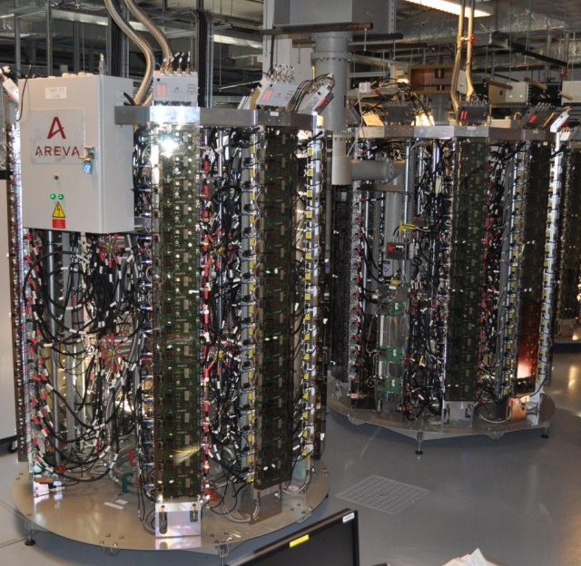
SOLEIL R&D with 352 MHz SSPA’s
Development of new RF modules, based on 6th generation LDMOS (Vd = 50V)
P_{mod} ~ 700 W, G ~ 20 dB, η > 70% at 352 MHz
[ With original LR301 (28V), P_{mod} = 315 W, G = 13 dB, η = 62 % @ 352 MHz ]
→ Huge improvement : P_{mod} x 2.2 , better performance (G , η , linearity) & strong reduction in thermal stress (ΔT : - 60 °C) → longer lifetime
ESRF project of partly replacing its 1 MW klystrons by 150 kW SSPA’s (1 per cavity)
→ 2009, SOLEIL transfer of technology with ELTA-AREVA
→ 7 SSPA’s of 150 kW, built by ELTA under SOLEIL license
ESRF 150 kW 352 MHz SSPA from ELTA/SOLEIL
2 towers of 75 kW ↔ 260 RF modules of 700 W
BO : 4 x 150 kW SSPA’s in use since 2012
SR : 2 x 150 kW SSPA’s in use since 2013
BO + SR : ~ 1 820 transistors
DC-to-RF efficiency of 58%, dc-dc converters included
With new ac-dc converters → η (overall ac to RF) > 60%

Slide 18
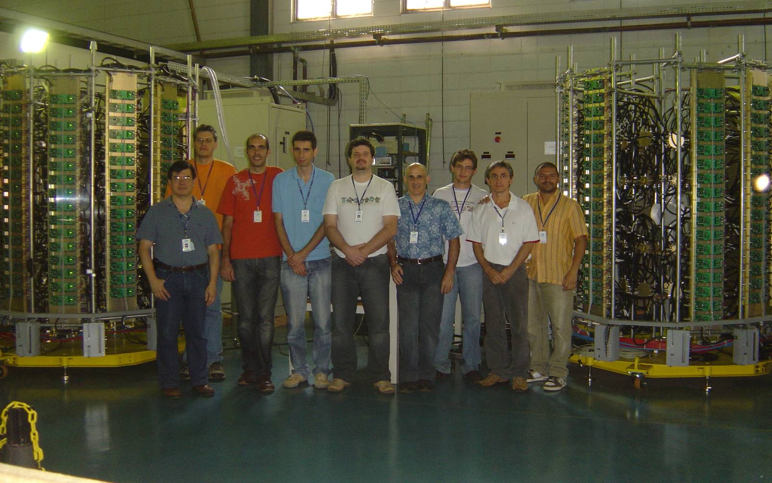
LNLS - SOLEIL Collaboration
Two SSPA’s of 50 kW @ 476 MHz for LNLS (Brazilian LS) SR * with components designed by SOLEIL (400 W modules with BLF574)
April 2010 in Campinas-Brazil : the SOLEIL - LNLS team, after successful tests of the amplifiers
* A 2.5 kW 476 MHz SSA had already been built for the LNLS Booster

Slide 19
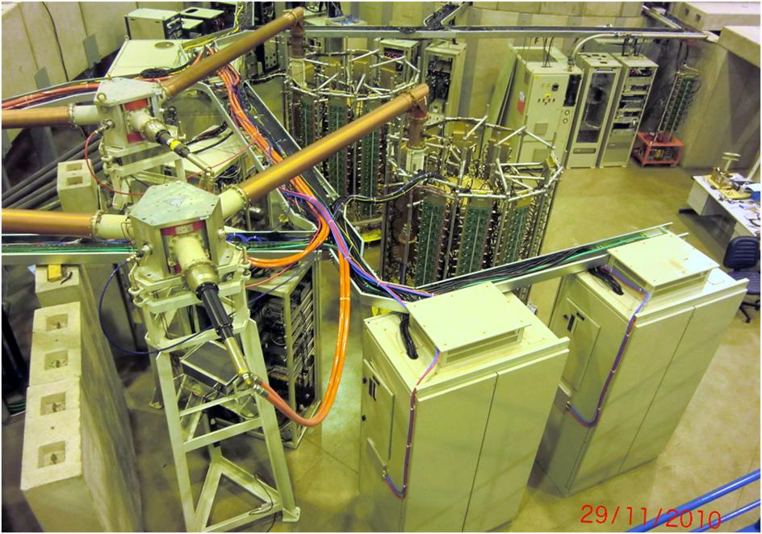
LNLS - SOLEIL Collaboration
The two 50 kW SSPA’s of the LNLS SR have run satisfactorily for > 10 years
→ Use of SSPA’s @ 500 MHz at SIRIUS

Slide 20
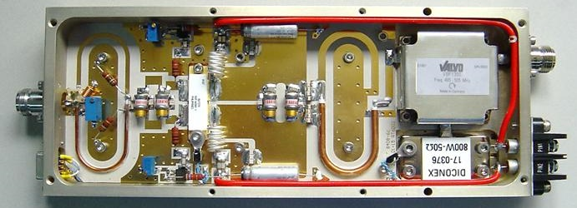
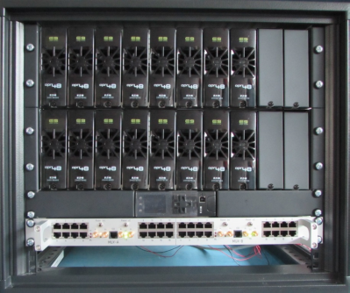
R&D with 500 MHz SSPA at SOLEIL
Experience feedback →
Increase effort on the modularity/redundancy and the efficiency *
Moderate power for long lifetime (thermal stress → soldering degradation)
* + 10 pts in efficiency lead to electrical power savings over 10 years of operation ≈ full amplifier cost
New 650 W - 500 MHz modules using 6th generation (Vd : 50V) LDMOS BLF578 from NXP
RF output power, P_{n} : 650 W CW
Input return loss : - 40 dB at P_{n}
Unconditional stability (K >10 dB)
Gain : 17 dB at P_{n} (1 dB compression)
Efficiency ≈ 62 % at P_{n}
Gain dispersion : +/- 0.2 dB at P_{n}
Phase dispersion : +/- 5° at P_{n}
Mandatory for good combining efficiency → Components for gain and phase adjustments
  Modular dc-dc converters + single power rectifier replaced by modular 230 V_{ac} / 50 V_{dc} converters, in 2 kW units, 96% efficiency, voltage remote control
  → optimized efficiency for any operating power :
  56% (overall) @ P_{max} and 50% @ 0.6 P_{max}
2 kW unit
controller
Modularity brought in the preamplification stage by inserting the « divider-combiner »

Slide 21
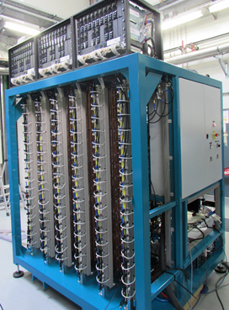
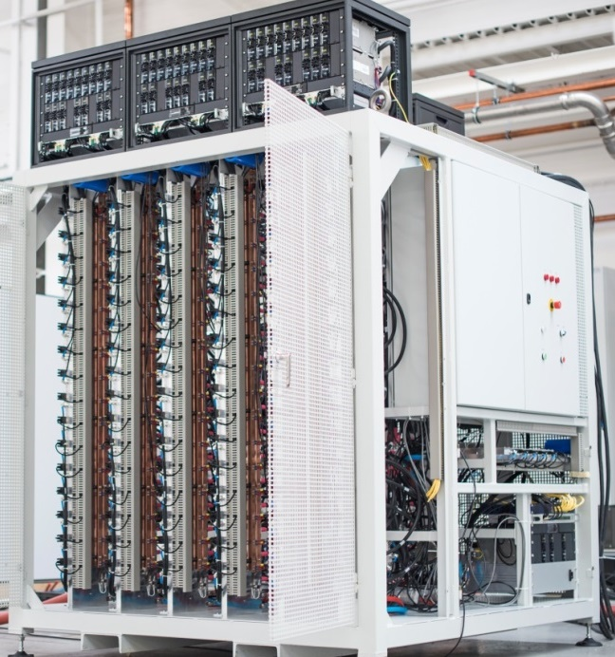
500 MHz SSPA for THOMX⁽¹⁾ and SESAME⁽²⁾
⁽¹⁾ ThomX : Compton X-ray source under construction in Orsay, France
⁽²⁾ SESAME : Jordan Synchrotron light source
  Fully modular 50V power supplies
  230 V_{ac} / 50 V_{dc} converters,
  in 2 kW units, 96% efficiency, with voltage remote control for efficiency optimization
  Change from the tower to cabinet assembly, better suited with the new power supplies
Control upgrade → stand-alone, self-protected and more modular
(1 µcontroler per dissipater)
ThomX 50 kW SSPA
(6 x 16 RF modules + 3 x 15 PS)
SESAME 80 kW SSPA
(10 x 16 RF modules + 5 x 16 PS)
For SESAME SR : 4 x 80 kW SSPA → 1st one built by SOLEIL as a demonstrator
→ 3 others on the same model by SigmaPhi Electronics (former SOLEIL licensee)
Status : all in operation (first pair since end 2016 and 2nd one since May 2017)
The ThomX 50 kW SSPA is also completed and commissioned

Slide 22
1.3-1.4 GHz SSPA R&D
RF Power Source requirements for LUCRECE* : 20 kW CW SSPA @ 1.3 GHz
Comparison between GaN and LDMOS technology
* RF R&D program for the French FEL project LUNEX5
Transistor performance measurements in CW mode
 | Old Gen GaN | Old Gen GaN | New Gen LDMOS | New Gen GaN
V_{d} (V) | 50 | 50 | 50 | 50 (65Vpulse)
P_{out} (W @ 1 dB comp.) | 71.2 | 150.2 | 700 | 400
P_{out} (W @ 3 dB comp.) | 425.9 | 430.9 | X | 1000
Gain (dB) | 14.11 | 18.33 | 18.16 | 17
Efficiency (%) | 55.6 | 65 | 62 | 71
X: not measured
R&D @ 1.4 GHz
On going tests at 40V to limit dissipated power on the dice → 740W at 3dB comp. with 65% efficiency and expected to go up to 900W
Perspective : Possible adaptation of LUCRECE SSPA for SOLEIL Upgrade if the harmonic system is active (1.41 GHz)

Slide 23
Summary and Conclusions
SOLEIL has pioneered the use of SSPA’s in particle accelerators
Original home-made design (35 kW in the BO and 4 x 180 kW in the SR) has operated for about 15 years with outstanding operational MTBF >> 1 year
BO RF upgrade : → 2 RF plants with 60 kW SSPAs → Redundancy + SR injection efficiency improvement in low-ɑ operating mode (~ factor of 2)
SR SSPA refurbishment : in 2013, start of original transistor replacement by 6th generation LDMOS
(V_{d} = 50 V instead of 30 V), much more robust and with higher gain and efficiency → Drastic reduction in module failures, higher power capabilities and efficiency + available components for the new 60 kW BO SSPA
SR SSPA refurbishment + “Magic switches” (+ Upgraded cavity couplers) → Additional redundancy
Possibility to store I_{beam} using either a single CM (450 mA) or 2 CMs (500 mA) with only 3 running
amplifiers/cavities
SOLEIL R&D on SSPA → improvement of the original design in compactness, reliability and efficiency
Overall (plug to RF) efficiency ~ 60% at 352 MHz or lower frequencies, ~ 56% at 500 MHz and ~ 50% at 1.3 – 1.4 GHz
Scientific collaborations & technology transfers to the industry (ESRF, LNLS, ThomX, SESAME, LUCRECE, ...)

Slide 24
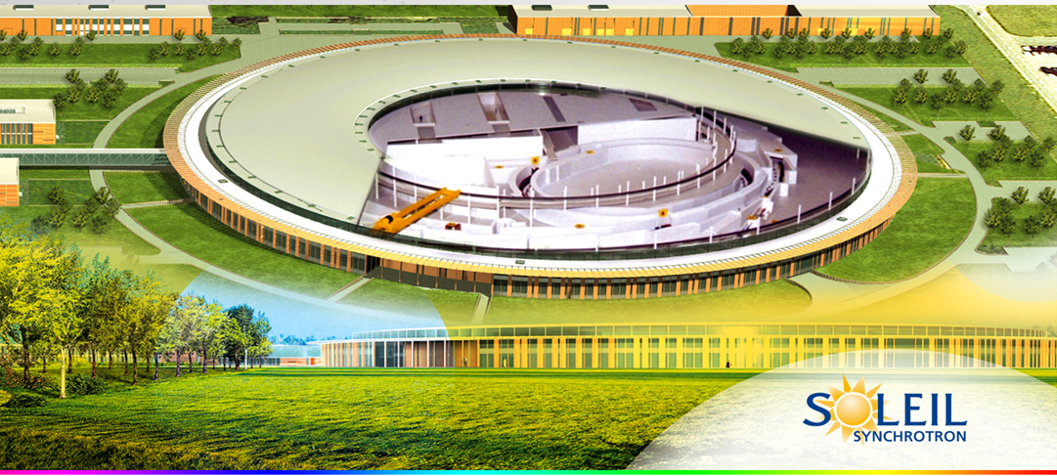
Thank you for your attention

Slide 25
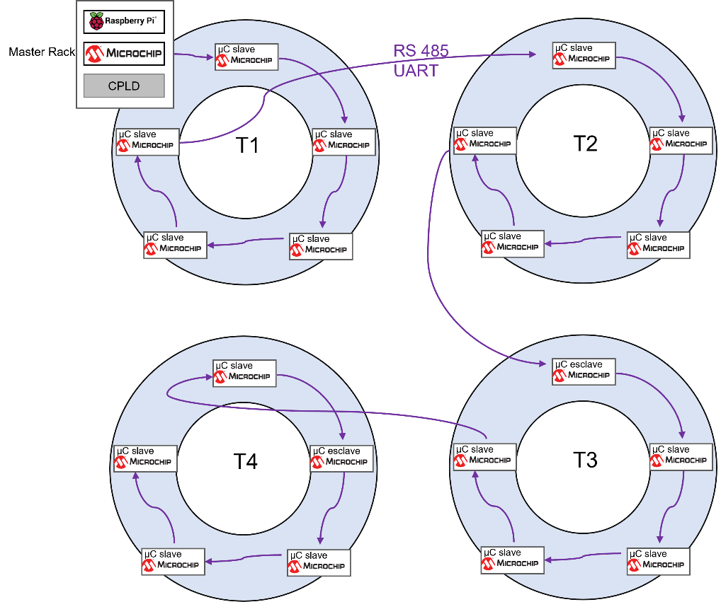
Backup slides
SOLEIL SSA supervision system principle

Slide 26
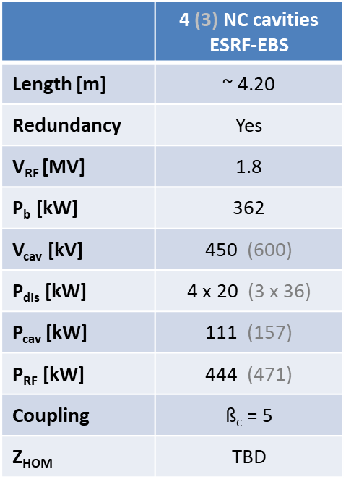
Backup slides
SOLEIL Upgrade Parameters

