Slide 1


CERN SPS SSPA high efficient system at the end
Workshop on efficient RF sources
04-06 July 2022, CERN, Chateau de Bossey, Switzerland
eric.montesinos@cern.ch
On behalf of hundreds of colleagues who made it possible

Slide 2
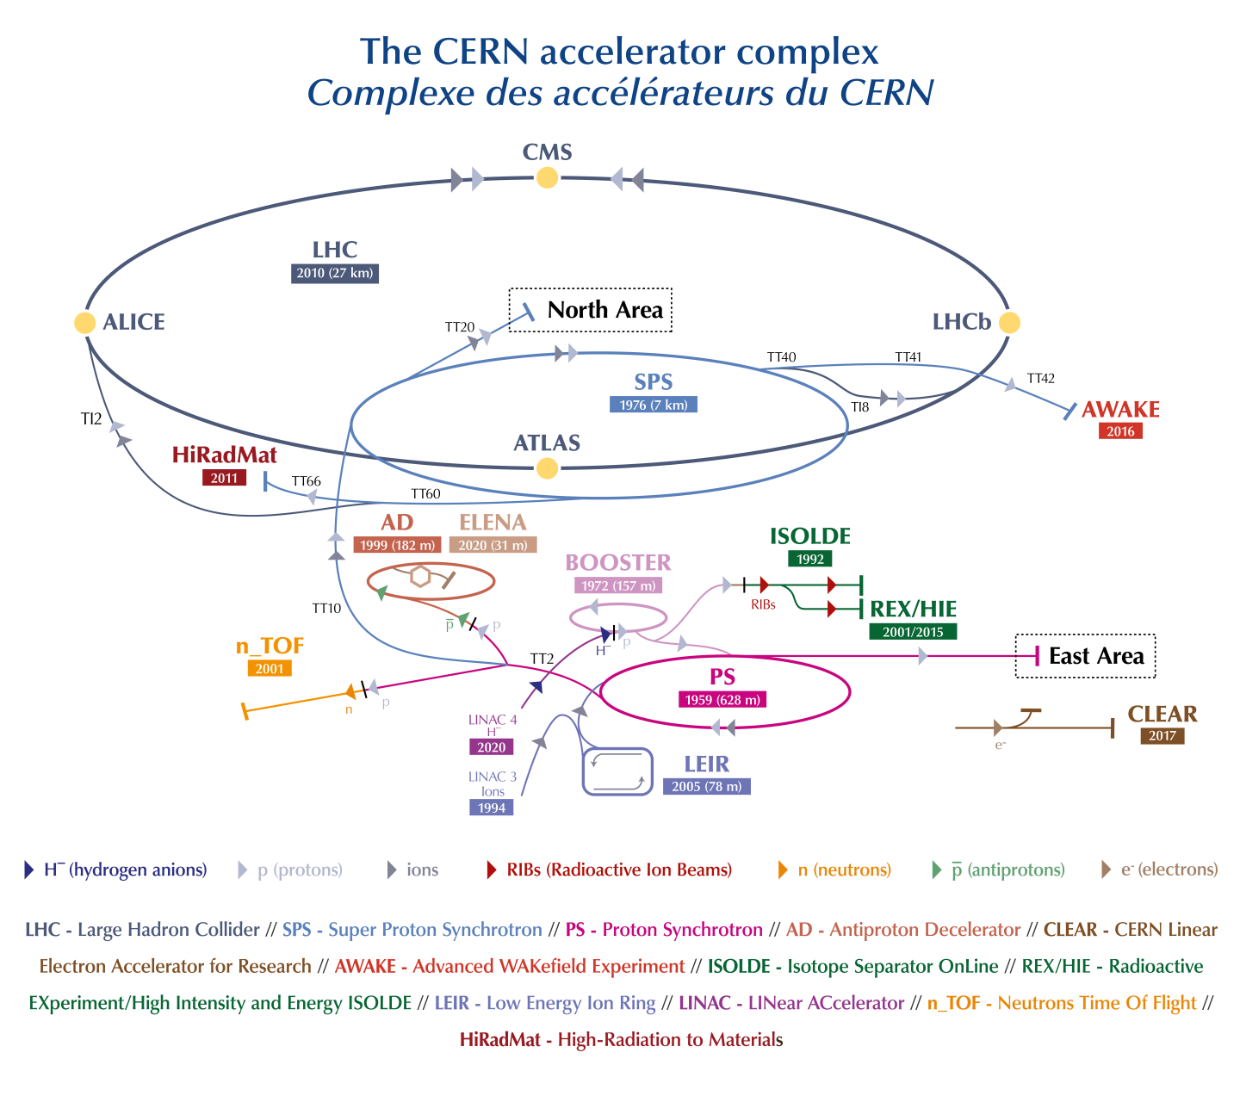
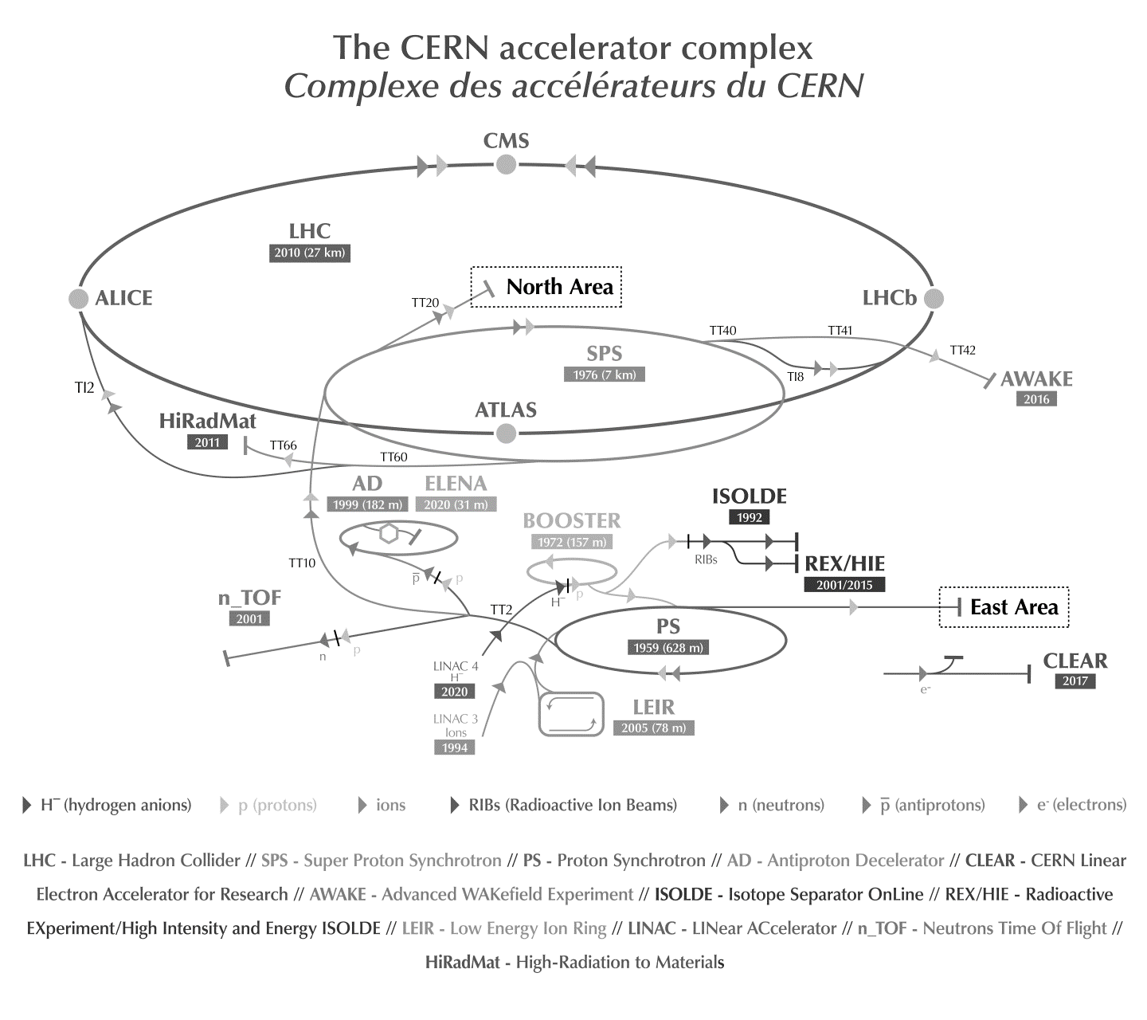


Slide 3
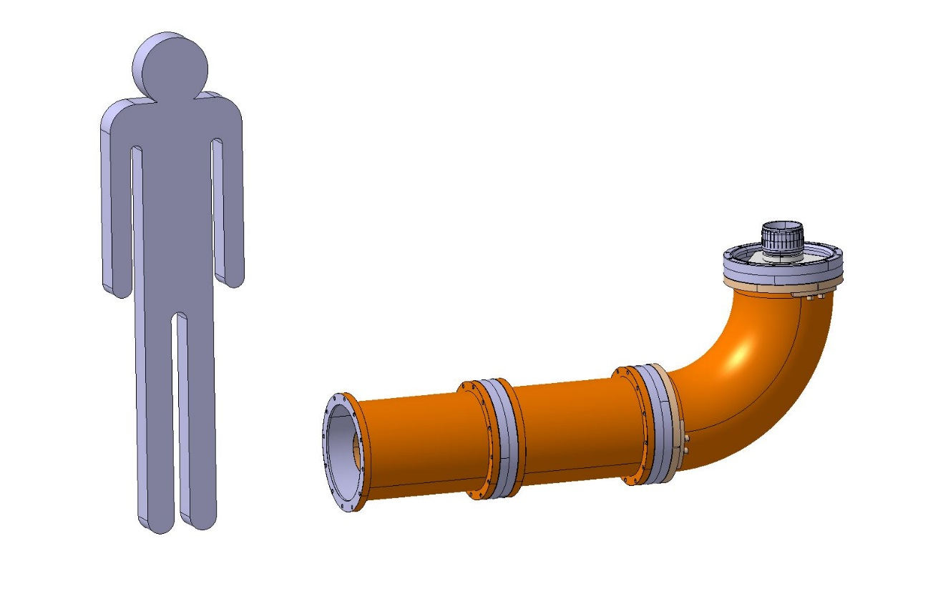
SPS supercycle
Average power limited to 750 kW due to 350 mm coaxial lines
Terrible cycle for all RF power stations!
2000 kW
750 kW
9.8 μs / 23.04 μs (43.4 kHz) or
2.75 μs / 5.76 μs (173.6 kHz)
10 kW
0
5.0
5.0
3.2
10.8
7.6
1.8
1.2
3.0
2.2
3.2
3.4
9.6
10.0 s
21.6 s
8.2 s
16.2 s
MD
Machine Development
LHC
SHIP
Serach Hidden Particle
FT
Fixed Target

Slide 4
History of the rf in the SPS
The SPS RF started in 1976 with 2 x 650 kW RF power stations for main acceleration
Few years later, additional 2 x 650 kW RF power stations were added for main acceleration
Again few years later additional 2 x 250 kW RF power stations were added for Landau damping
Configuration of one of the four
200 MHz power stations
Transmitter
mW
MW
Coaxial line
(150 meters)
Terminating
load
Travelling Wave
Accelerating Cavity

Slide 5
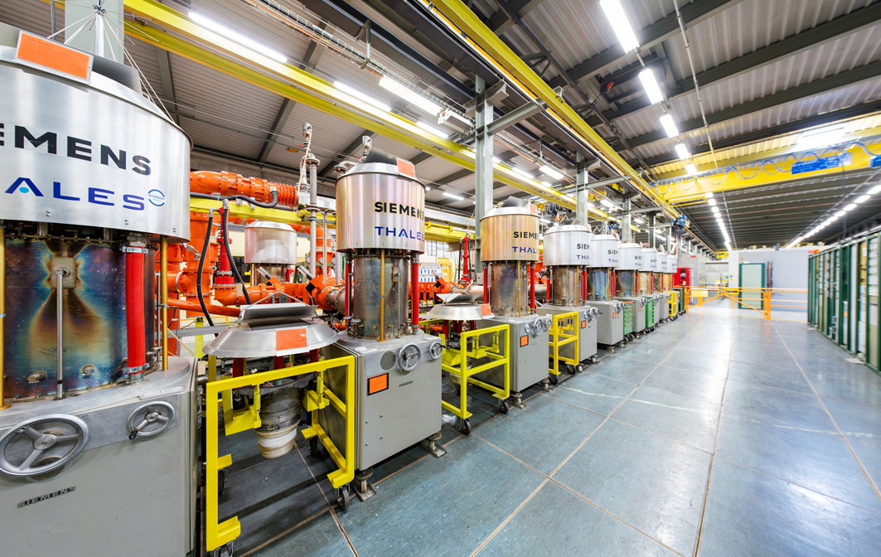
History of the rf in the SPS
Each of the first two RF stations were composed of 8 x 137.5 kWp RS2004 Siemens tetrode, upgraded to RS2004 Thales tetrodes

Slide 6
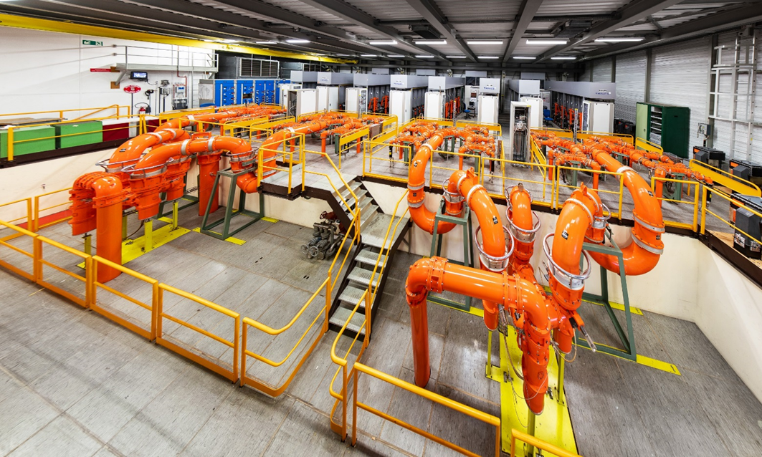
History of the rf in the SPS
Each of the next two RF stations were composed of 32 x 37.5 kWp YL1530 Philips tetrode upgraded to TH335SC Thales

Slide 7
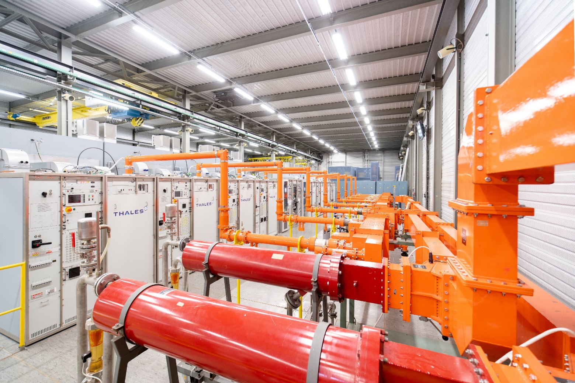
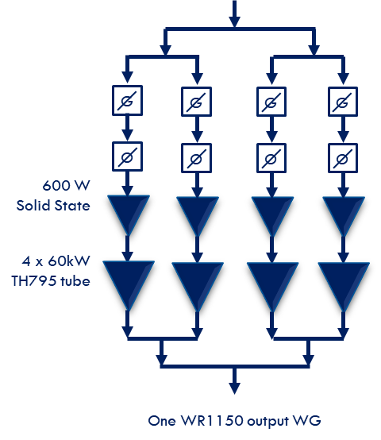
History of the rf in the SPS
Two additional RF stations were added for two Landau cavities, each is composed of 4 x 60 kW YK1198 Valvo klystrons upgraded to TH795 Thales IOT

Slide 8
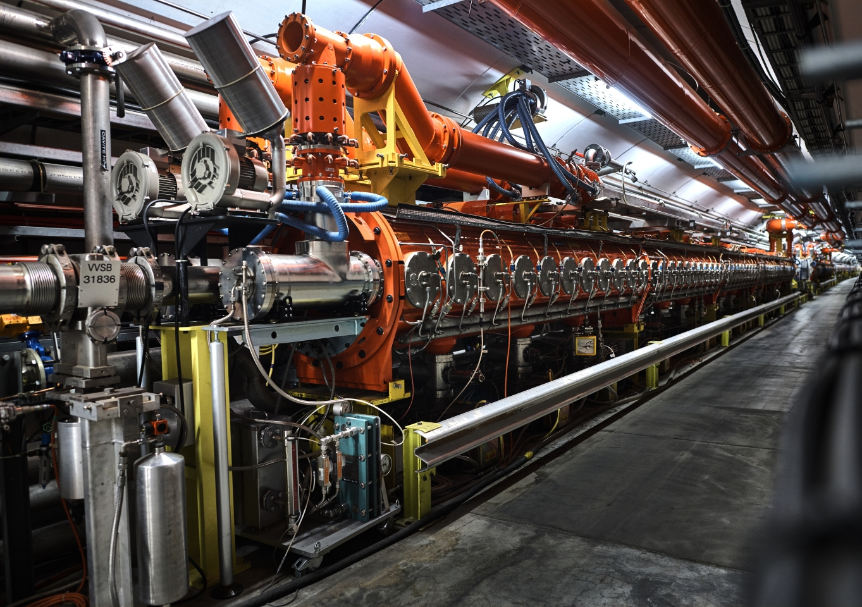
SPS RF Power upgrade
With the 4 cavities configuration we will have difficulties at high intensity LHC beam in the SPS : IPAC11, Upgrade of the 200 MHz RF system in the CERN SPS
Increasing number of shorter cavities with two extra power plants should significantly improve the RF performance for higher LHC intensities
The best new compromise is 6 cavities
  4 x 3 sections cavities with 1.0 MWp
  2 x 4 sections cavities with 1.4 MWp (became 1.6 MWp)

Slide 9
SPS RF Power upgrade
Existing Amplifiers upgrade
New RF Amplifiers
New RF Building
LSS3 Tunnel integration
New RF Building
1 mW
1.7 MWp
RF amplifier
Coaxial transmission line
150 meters
1 mW
1.7 MWp
RF amplifier
Accelerating cavity
Accelerating cavity

Slide 10
Teams involved (more than 350 persons Thanks to all of them)
Dep-Group | Persons
BE-RF | Eric Montesinos, Charles Julie, Frederic Killing, Sébastien Calvo, Gino Cipolla, Antoine Boucherie, Simon Rains, James Bibby, Christophe Renaud, Cedrick Grandbois, Pilar Parrado Caballero, Irene Alonso Romero, Francisco Sauba Esteban, Morgan Wigham, Julien Novello, Sebastien Mutuel, Patrice Girod, Michel Ferrone, Jean-Marie Angonin, Romuald Terry, Sidi Chikhi, David Bastard, Lancelot Brechignac-Denis, Thomas Henry, Elena Shaposhnikova, Thomas Bohl, Christine Vollinger, Nasrin Nasresfahani, Patrick Kramer, Rama Calaga, James Mitchell, Wolfgang Höfle, Philippe Baudrenghien, Gregoire Hagmann, Luca Arnaudon, Carlos Oliveira, Diego Barrientos Turrion, Emile Grospelier, Thomas Kaltenbacher, Ester Sancho Cabrera, Débora Aguilera, Jose Enrique Varela Campelo, Paola Mazzotta, Toon Roggen, Urs Wehrle, Philip Hofer
BE-ABP | Benoit Salvan, Hannes Bartosik, Ghislain Roy, Yannis Papaphilipou
BE-ASR | Marc Tavlet, Christelle Gaignant, Anne Funken, Lisa Kobzeva, Axelle Deleu, Paola Carvalho Correia
BE-BI | Christian Boccard, Patrick Ogier
BE-ICS | Denis Raffourt
BE-OP | James Ridewood
DG-LS | Florence Jacobs
HSE-SEE | Olivier Tison, Cécile Pinto, Jonathan Gulley, Laurent Colly, Guillaume Fontana
IPT-PI | Thierry Lagrange, Anders Unnervik, Ivo Lobmaier, Bjorn Jenssen, Fatima Najeh, Dante Gregorio, Laszlo Abel, Sandrine Magnan, Nordine Azizi, Alexandre Tabary, Sandra Benoit-Godet, Boi-Lan Nguyen-Lemoine
IT-CS | Stephane Casenove
EN-ACE | Katy Foraz, David McFarlane, Emmanuel Paulat, Patrick Bestmann, Julie Coupard, Sonia Bartolome Jimenez, Bertrand Nicquevert, Simon Cherault, Tobias Dobers, Yannick Beraud
EN-CV | Mauro Nonis, Serge Deleval, Michele Battistin, Alexandre Broche, Mathieu Archambau, Bill Bannister, Glen Mason, Aurelio Berjillos Barranco, Michel Obrecht
EN-EL | Nicolas Bellegarde, Guillaume Gros, Nuno Dos Santos, Thierry Bourrel, Jean-Claude Guillaume, Stefano Bertolazi, Georgy Georgiev, Gerardo Velasquez Gutierrez, Joel Lahaye, Denis Ribiollet, Simon Baird, Gérard Cumer, Davide Bozzini, Jérôme Pierlot, Juan Gomez, Thierry Octave, Christophe Crombez, François Duval, Jean-Pierre Sferruzza
EN-HE | Caterina Bertone, Jean-Baptiste Bonnamy, Pascal Brunero, Serge Pelletier, Yann Seraphin, Patrick Vallet, Gilles Roche, Helder Lorenco, Roberto Rinaldesi, Jean-Pierre Grandchelli, Jean-Louis Grenard
EN-MEF | Yvon Muttoni, Frédéric Galleazzi, Scharif Mehanneche, Antoine Kosmicki
EN-MME | Gilles Favre, Stefano Sgoba, Alessandro Dallocchio, Jean-Marc Malzacker, Laurent Deparis, Alession D’Andrea, René Claret, Thierry Tardy, Pierre Moyret, Laurent Prever-Loiri, Jean-Marie Geiser
SMB-SE | Luz-Anastasia Lopez-Hernandez, Christophe Biot, Laurent Faisandel, Mathieu Fontaine
TE-EPC | Jean-Paul Burnet, Gilles LeGodec, Davide Aguglia, Karsten Kahle, Christophe Coupat, Clément Bovet
TE-MSC | Jérémie Bauche
TE-VSC | Paolo Chiggiato, Antonio Mongelluzzo, Sergio Calatroni, Wilhelmus Vollenberg, Ciara Pasquino, Jose Ferreira Somoza, Antonio Mongelluzzo

Slide 11
New 1.7 MWp amplifier, i.e 1.4 MWp cavity
Operating frequency 200 MHz
Pulse mode 1.7 MWp max (10 µs / 43 kHz)
Average 850 kW (thermal limitations in coaxial lines)
A major improvement to existing systems will be to have individual SSA drivers per Final
Combiners and lines will be the same as with existing systems
Four contracts
  Drivers (SSA)
  Finals (Tetrodes, klystrons, IOT, SSPA, …)
  Combiners (3 dB above 100 kW)
  Transmission lines (coaxial, 345 mm outer)
From Beam Control
Drivers
16 SSA
1/16 splitter
Final
16 PAs
1.7 MWp
3 dB
combiners
and power loads
-0.6 dB
1.5 MWp
150 m
Coaxial lines
-0.2 dB
To cavity input 150 m away
1.4 MWp

Slide 12
Final Opened to all technologies
Qualified solution must have demonstrated to be reliable under scientific operation (not only broadcast operation)
Reliability and overall efficiency will be part of the adjudication
Main objective is Availability, and our target is 99,99 % availability for beams, this has driven the architectures of the possible systems
Each power station could have been
  16 x 106 kW tetrodes
  8 x 225 kW tetrodes
  16 x 106 kW IOT
  8 x 225 kW IOT
  4 x 450 kW Diacrodes
  2 x 1.7 MW klystrons
  2’048 x 910 W Solid State Amplifiers
16 x 128 x 910 W SSA, i.e. 4’096 transistors
128 x 910 W
SSA

Slide 13
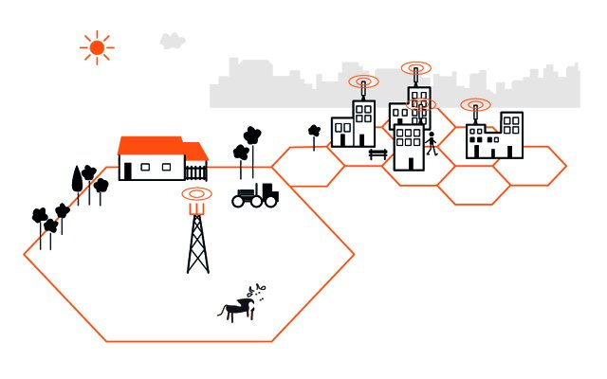
Transistor power ratings – personal view of future perspective (CWRF 2016 + IFAST 2022)
Device | Distance | Power
Phone | 20 km | 2 W
Microcell | 2 km | 10 W
Macrocell | 20 km | 50 W
Voltage limits
 | 2002 | 2006
900 MHz | 41 V/m | 3 V/m
1800 MHz | 58 V/m
2100 MHz | 61 V/m
The tendency is to increase the number of smaller cells in order to keep the phone battery autonomy, increase the data bandwidth, and reduce the exposition of population to too high electromagnetic fields

Slide 14
Transistor power ratings – personal view of future perspective (CWRF 2016+ IFAST 2022)
Transistor supplier main business
will not be higher power per transistor
1482 Million Smartphones in 2015
6.1 Millions Micro cell stations 2009
5.9 Millions Macro cell stations 2009
Freescale + NXP Semiconductors revenue in 2015: $10’000 Millions
Coming soon, power transistors for Microwave ovens, almost doubling the revenue of transistor suppliers
Assumption (with a lot of simplifications)
  Cost of a LDMOS ~ $100
  Revenue for transistors manufacturers $20 Millions
  Over minimum 5 years $4 Millions per year
RF for the biggest RF accelerator could then be 0.04 % of main suppliers revenue per year
Conclusion: below a GHz, 1 kW per transistor (LDMOS) seems to me a very good goal
Machine | # RF stations | Power | # 500 W LDMOS
FCC | 100 | 1 MW | 200’000

Slide 15
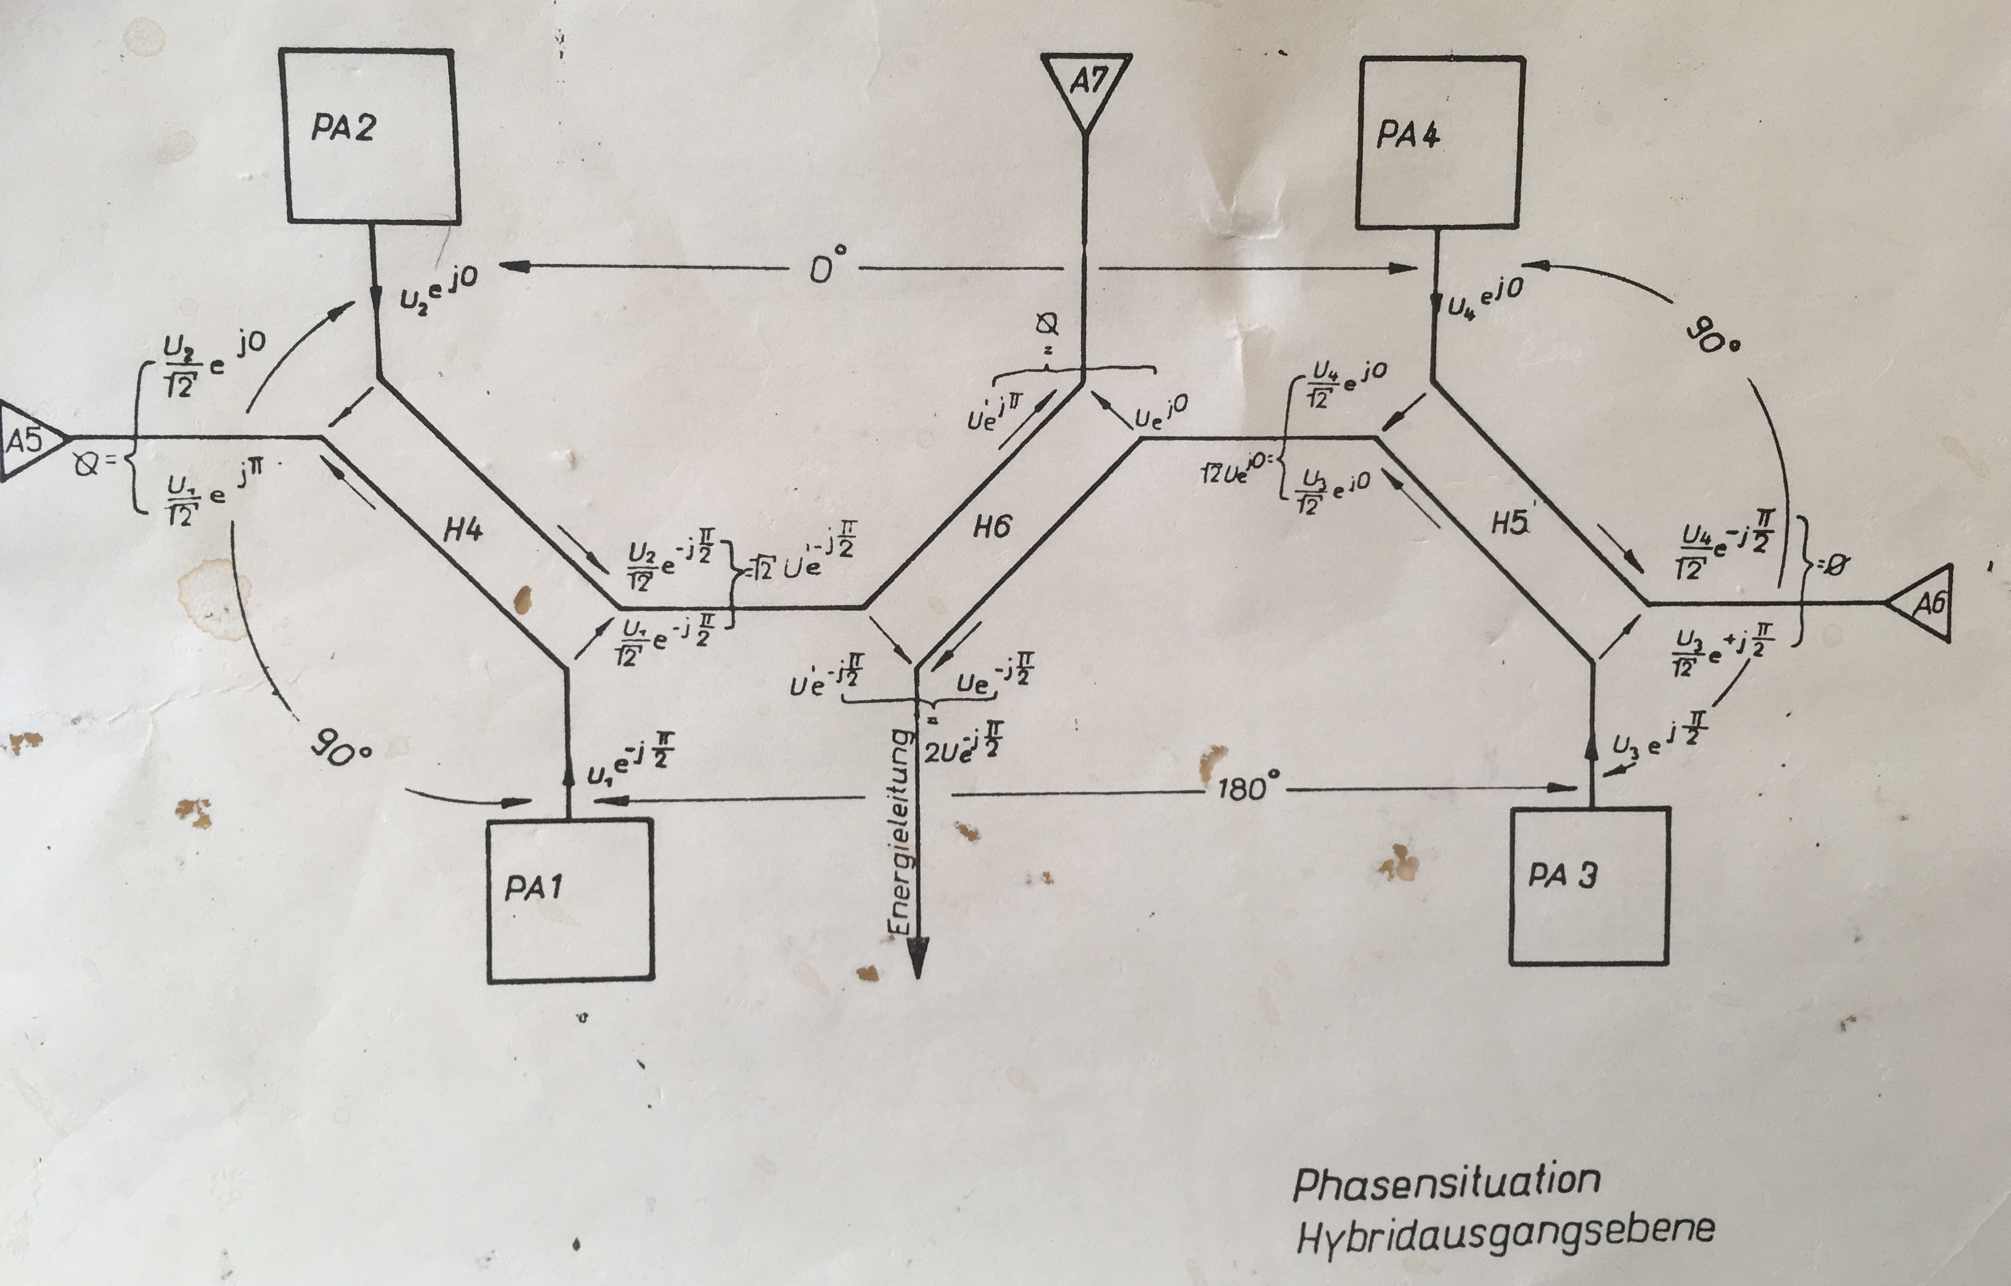


Combination
$$Pout=\frac{PA1+PA2}{2}+ \sqrt{PA1 PA2}$$
3 dB combiner is very common for RF power combination at these frequencies since the 70’s
If one correctly adjusts the phases and the amplitudes, equations show that
With PA1 = PA2 = PA3 = PA4 = P then
Pout = 4 P
Load A5 = A6 = A7 = 0
In case one amplifier is stopped (PA1 for example), then
Pout = (9/16) 4P = 2,25 P
Load A5 = 0,5 P
Load A7 = 0,25 P
$$Pload=\frac{PA1+PA2}{2}− \sqrt{PA1 PA2}$$

Slide 16
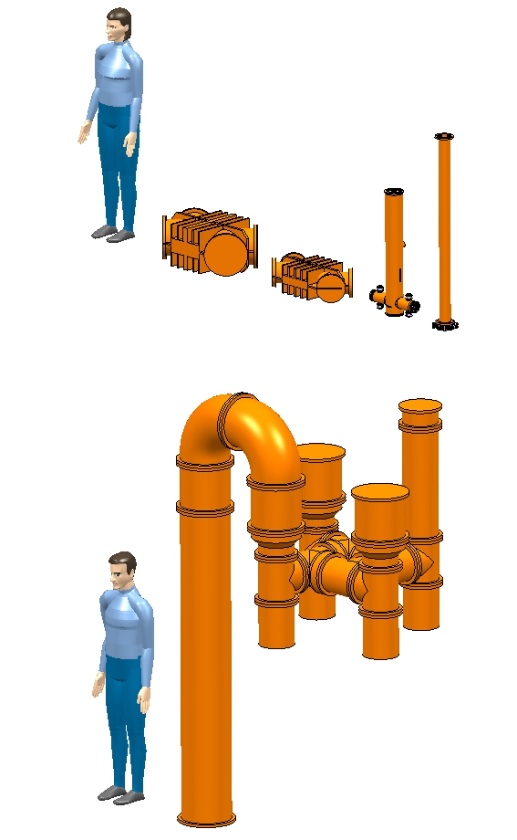
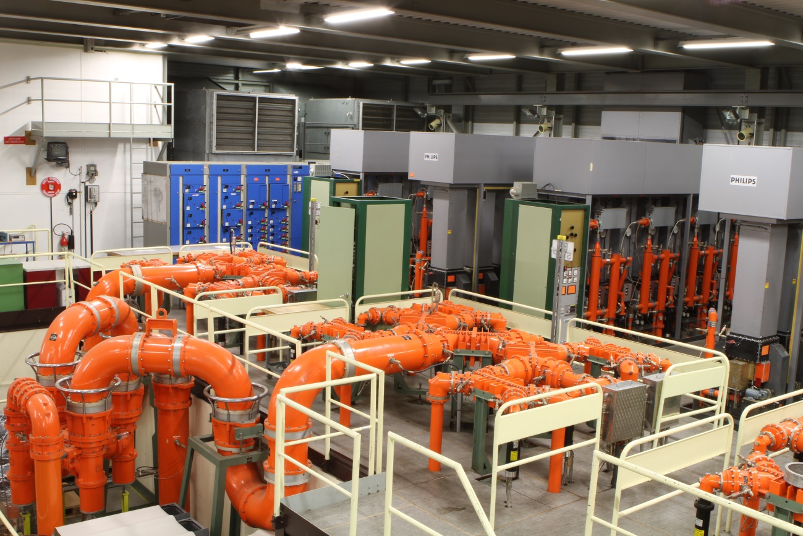
Combination
200 MHz CW combiners
3 dB : 550 kW 3 dB : 160 kW
3 dB : 1.1 MWp
CERN SPS 16:1 combiner @ 200 MHz

Slide 17
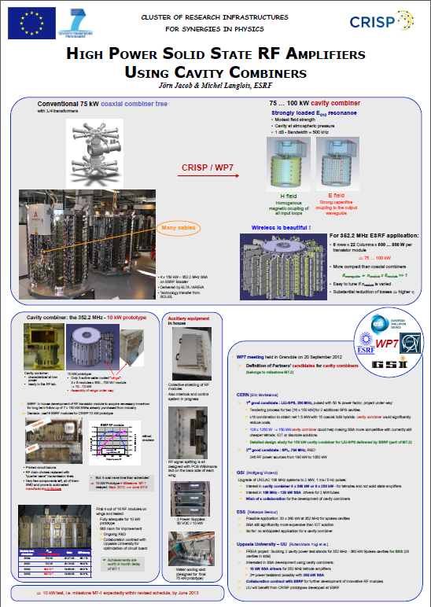
Cavity combiner
CRISP
  Sept 2010
  Jörn Jacob (ESRF) asked for support to the development of cavity combiners receiving funding from the EU as work package WP7 in the framework of the FP7/ESFRI/CRISP program
  CERN immediately supported it
  1st yearly meeting, Grenoble 20 September 2012
  LIU-SPS 200 MHz
  2nd yearly meeting, PSI 18-19 March 2013
  144:1 Cavity combiner for CERN-LIU-SPS
CERN (Eric Montesinos)
  1st good candidate : LIU-SPS 200 MHz

Slide 18
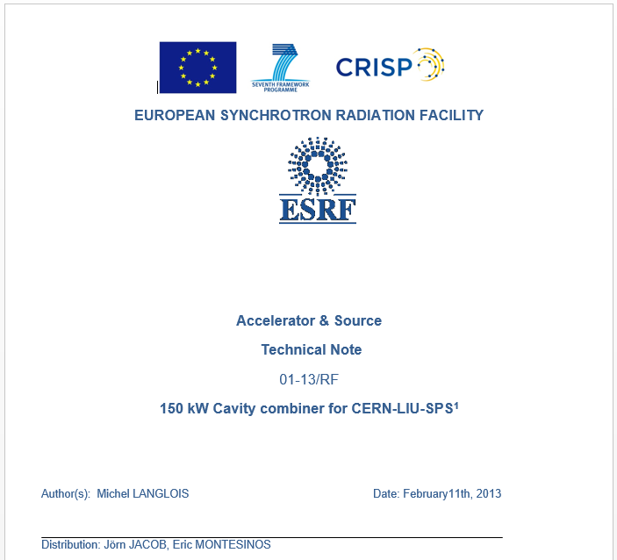
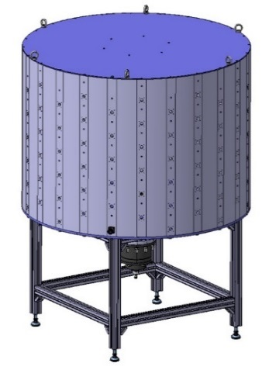
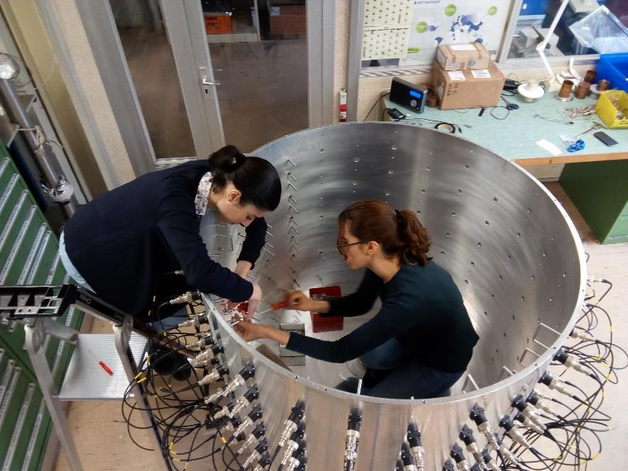
Cavity combiner
Feb 2013, within the CRISP programme, we received a report from ESRF, describing how to build our LIU-SPS 200 MHz 144:1 cavity combiner
We completed the calculations and build a first prototype
We also completed the coupling loop design, the tuning design, and the output coupling element and we finally obtained at fantastic 144:1 cavity combiner with only 0,1 dB insertion loss, as calculated

Slide 19
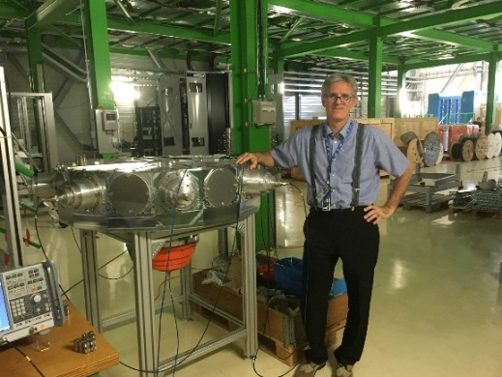
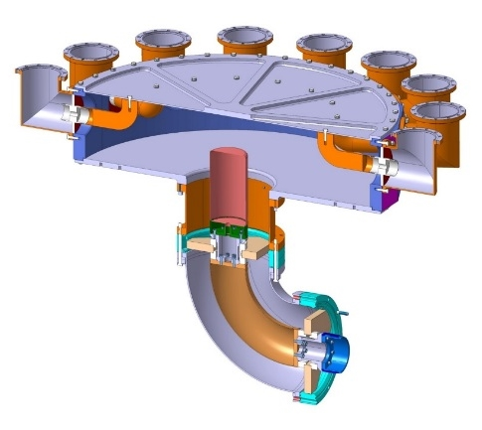
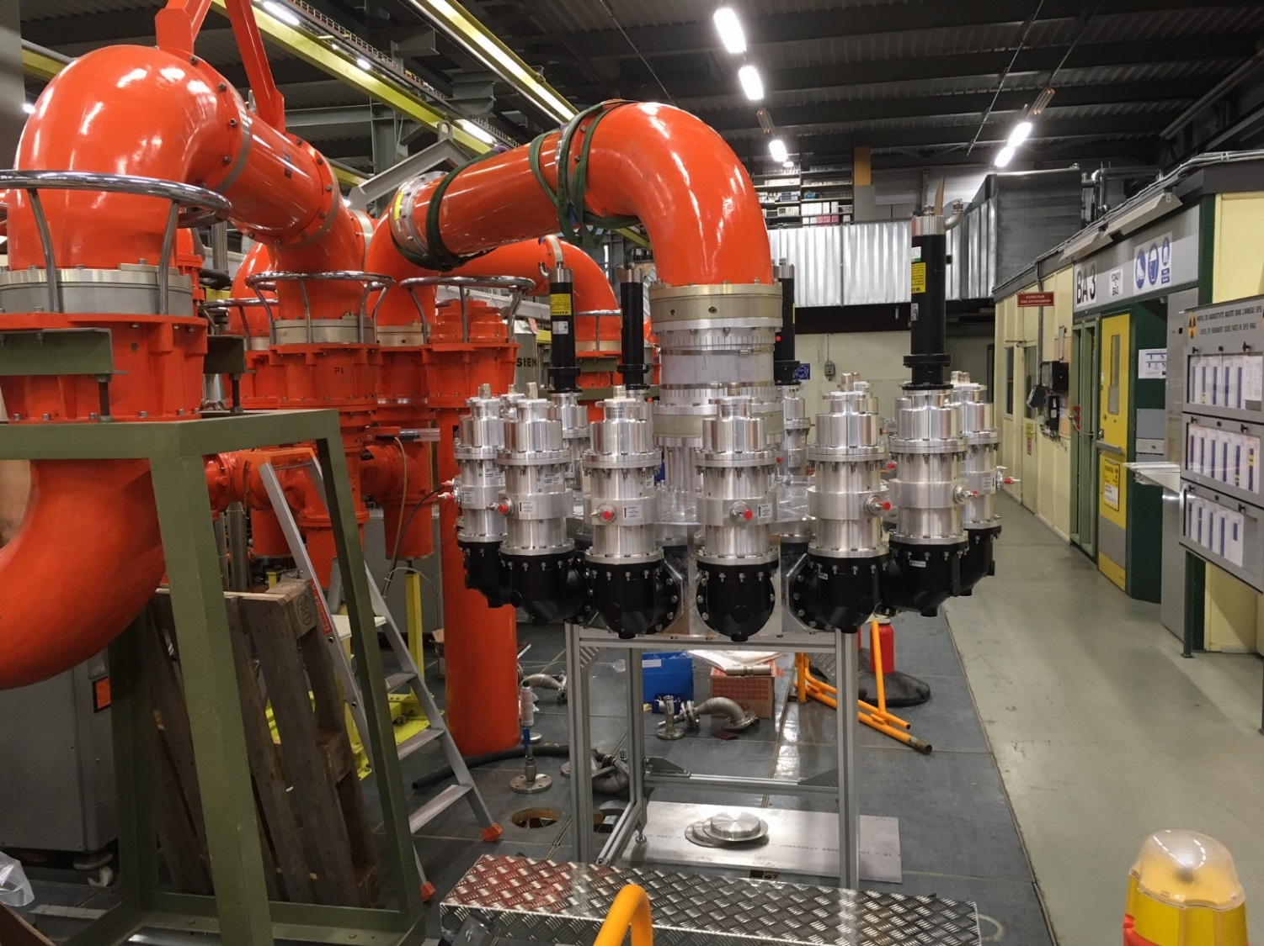
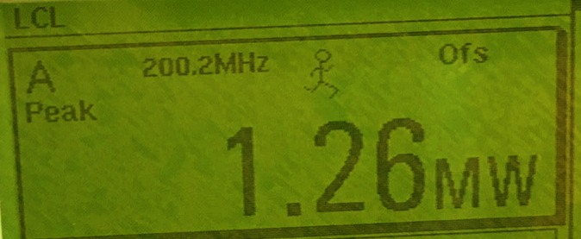
VHPCC (Very High Power Cavity Combiner)
We also designed a VHPCC (Very High Power Cavity Combiner)
The goal was to have 16:1 combiner
with inputs in the hundred of kW range
and an output in the MW range
The ‘cavity’ has been machined from a single piece of metal
We tested it in reverse mode, as we had no hundred kW class amplifiers to test it in forward mode, and we checked that we had a perfect distribution between the test loads
With 1.26 MWp input, we obtained
78 kW +/- 1 kW
and the losses were less than 10 kW

Slide 20
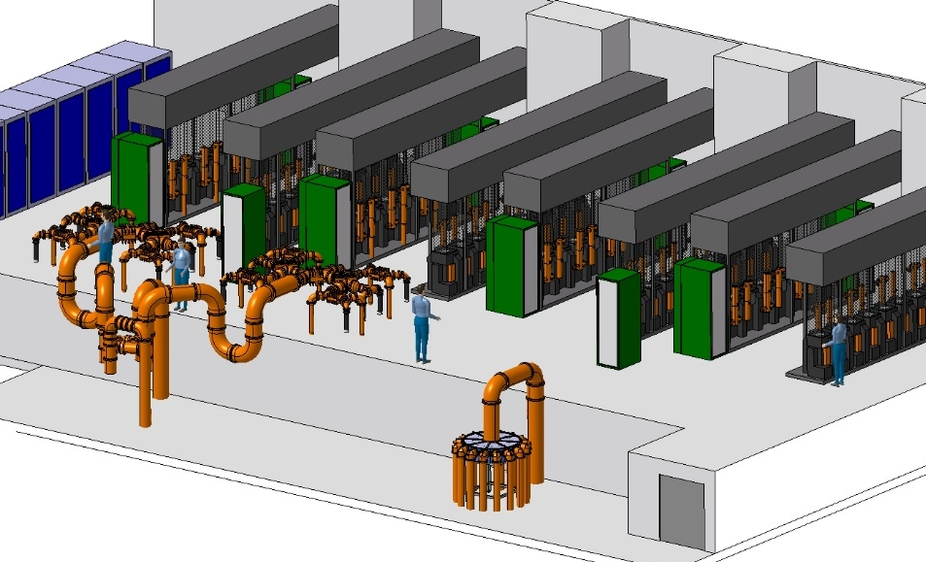
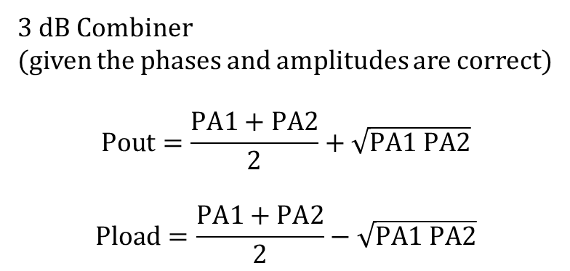
Beauty of cavity combiner
3 dB Combiner
(given the phases and amplitudes are correct)
$$Pout=\frac{PA1+PA2}{2}+\sqrt{PA1 PA2}$$
$$Pload=\frac{PA1+PA2}{2}−\sqrt{PA1 PA2}$$
Cavity combiner is one of the best way to achieve power density with multiple sources
A fantastic intrinsic characteristic of a cavity combiner is that if you present a short circuit at a missing input, the output is the exact sum of all remaining inputs
16:1 combiner with | 3 dB combiner Pout | Cavity combiner Pout
0 missing input | 16 P | 16 P
1 missing input | 14 P | 15 P
4 missing inputs | 9 P | 12 P

Slide 21
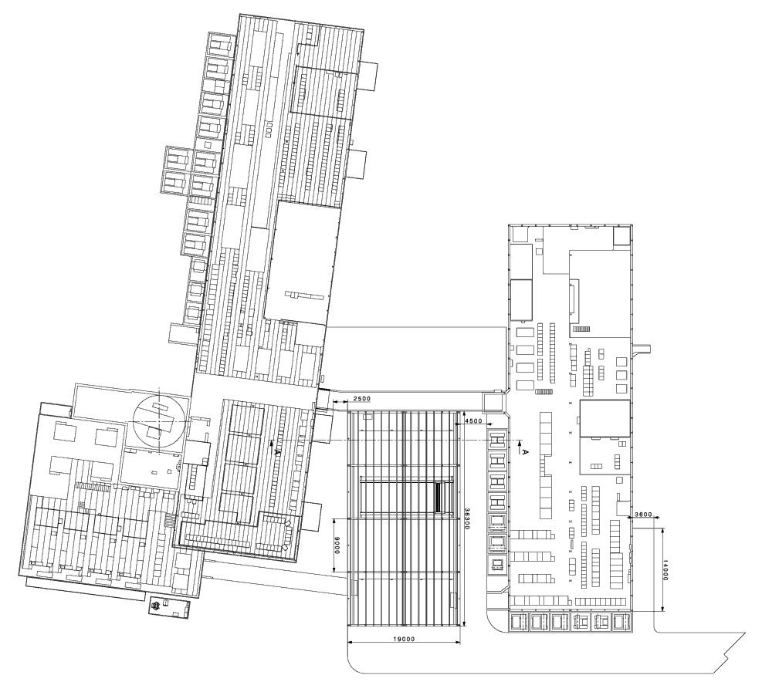
New building
Whatever the solution, Tetrodes, Diacrode, IOT, Klystron, SSPA, the same building is offered
Best possible location allowed a maximum ‘RF’ foot print of 650 m2 + 500 m2
RF
workshop
Siemens
Philips
800 MHz
LLRF Faraday Cage
New RF plants

Slide 22
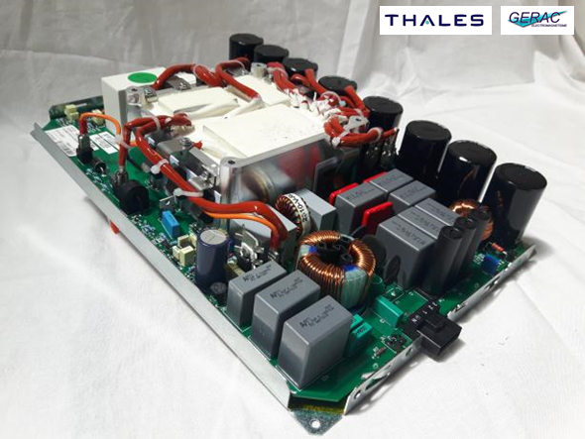

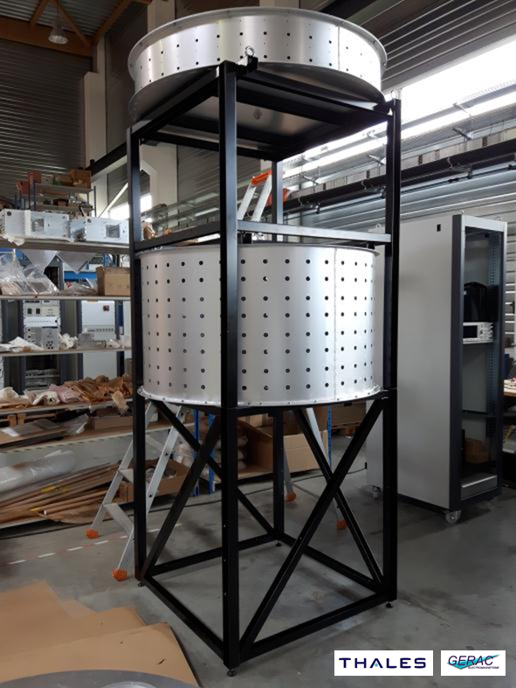

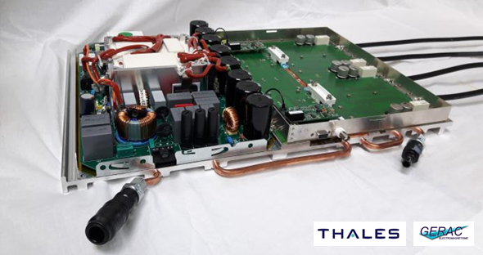

Progress report in June 2016 at CWRF
Specific Power supplies validated
First RF blocs tested up to 2 kW
First Input cavity splitter and first Output cavity combiner constructed
Thales integrated two very clever ideas
The way they make the coupling to the cavity
The way they make possible to decouple one module

Slide 23
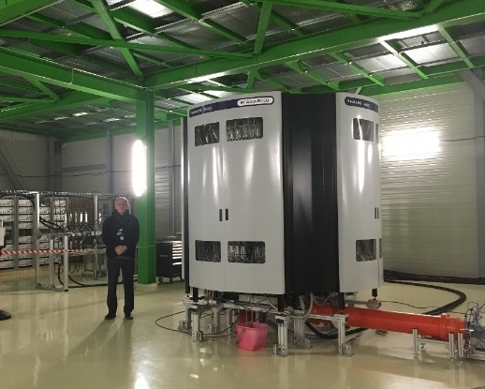
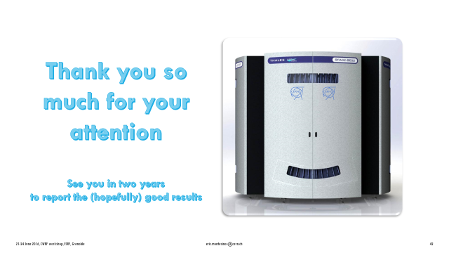
Progress report in june 2016 at CWRF

Slide 24
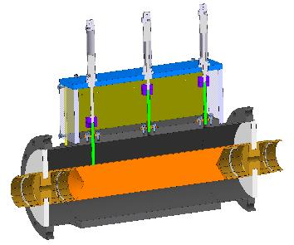
30 long months to find a solution
Technical specification with a lot of requirements
  Integration within the given building
  Repetition rate 0.1 Hz to 500 kHz (require a CW and a pulsed amplifier)
  Full reflection all phases 100 ms (equivalent to 4 time the power level along the lines)
  Non conventional way to measure the BW (required by LLRF and TWC)
  Very good linearity
  Two tone at many power levels
A lot of tests to qualify the amplifiers
  Supercycle test, short circuit test, BW, linearity, …
  Short duration tests to qualify an Amplifier within one week
  Long duration tests to check reliability within one month

Slide 25
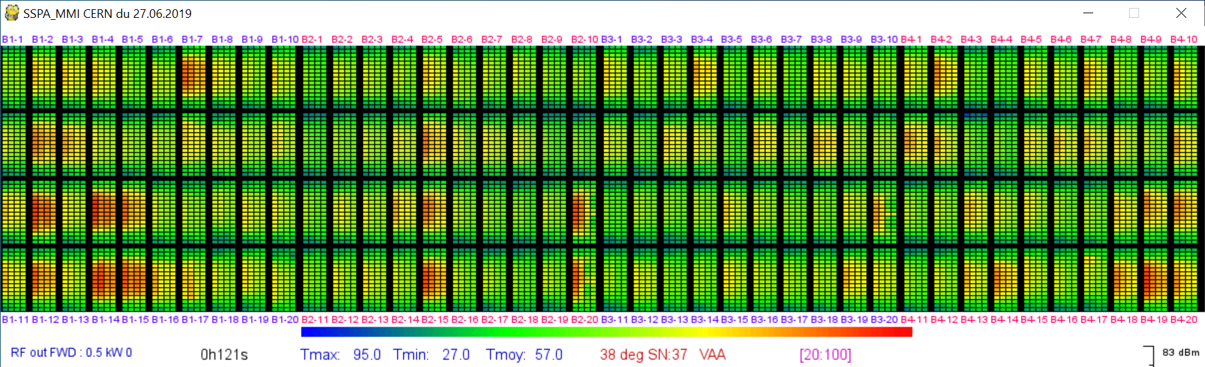
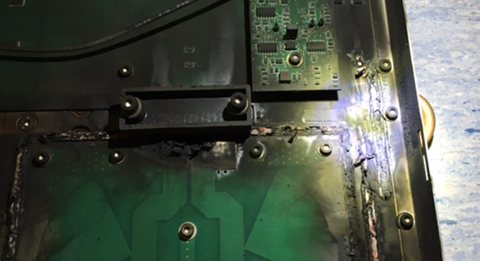
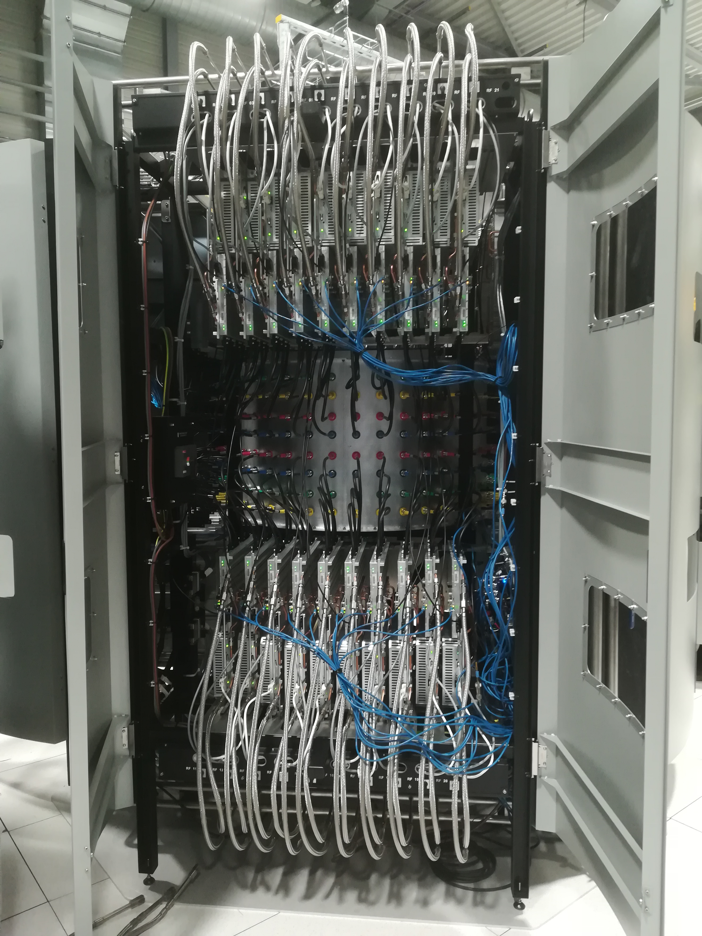
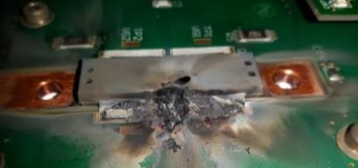
30 long months to find a solution
The first version successfully passed the qualification tests, including short circuit ones
This was impressive as the solution is without circulator
However, when doing the 1’000 hours long duration test, the transistors started to burn
Thales implemented special thermal cameras to help to find out what were the troubles
We noticed that the overheating were randomly distributed amongst the cavity combiner

Slide 26
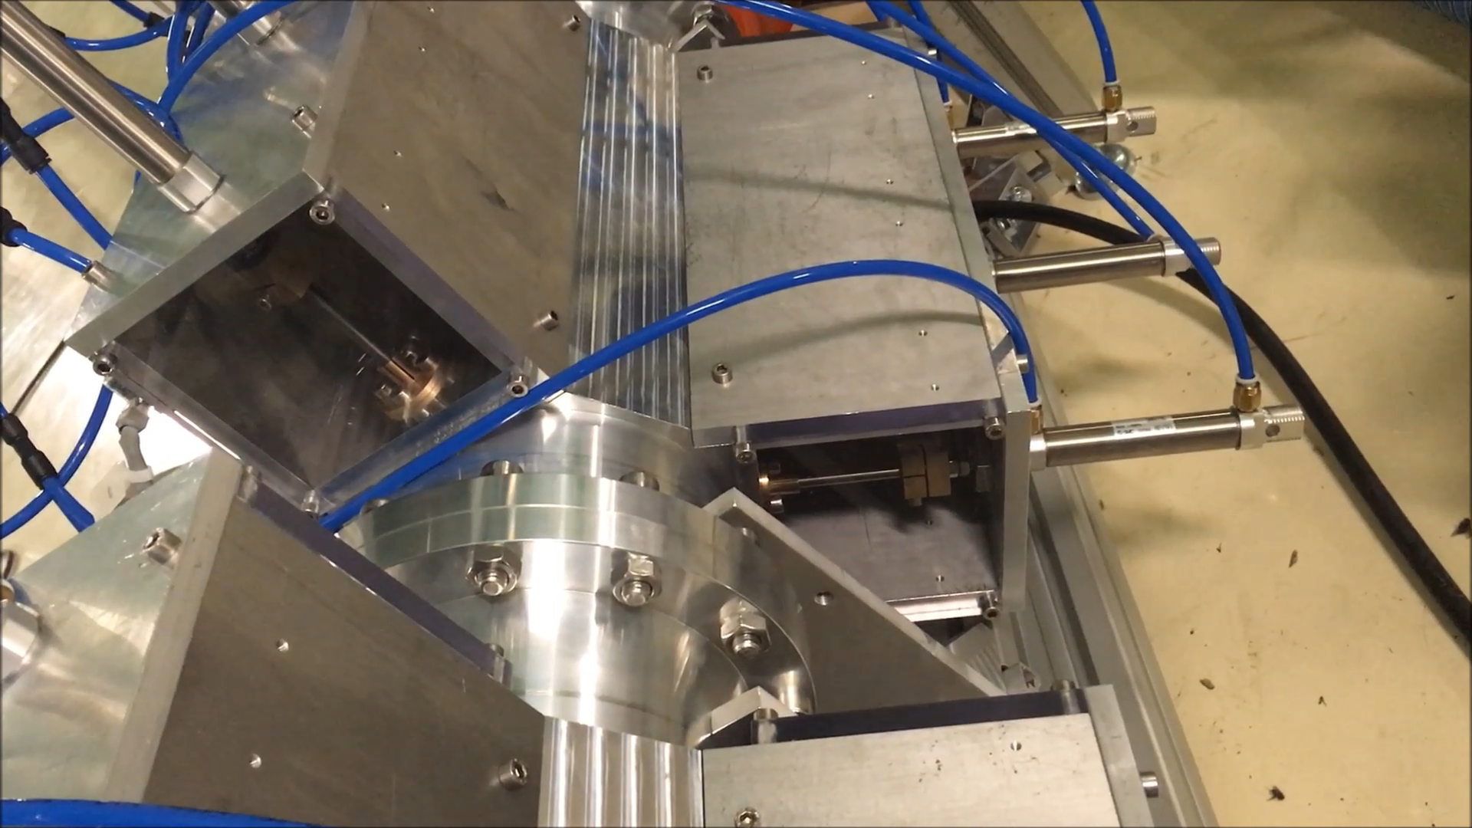

Slide 27
30 long months to find a solution
Thales built a second tower, with improved modules, but we still faced transistor destructions
In order to minimize the number of modules to be built, we built a test bench at CERN in order to do ageing fatigue tests with few modules (good to have modules connected to cavity combiners through cables!)
Thales built a third tower, with better results over the 1’000 hours tests, but then with destruction with short circuit tests

Slide 28
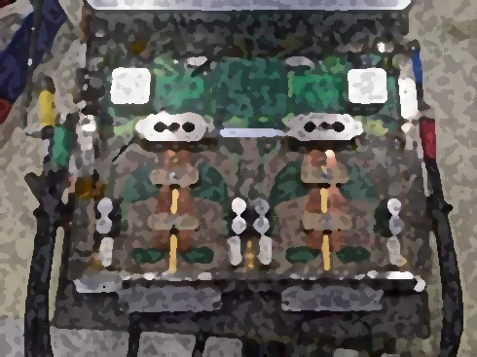
30 long months to find a solution
Oscillations
  9 Special oscillation filtering
  2 Special control electronic
  6 Output DC blockers to allow circulators
  7 Special controls and RF connectors
  8 Special switch off in case of failure
Dispersion
  3 Adjustment of gain and phase dispersion of all modules
  1 New input divider
  12 Reduced RF dispersion of all sub-systems (input cavity + cables + modules + output cavity)
Thermal effects
  10 New water cooling system
  11 Special brazing of transistors
  4 Special output tracks
Mechanical
  5 Special output cables
3
3
7
2
2
1
7
9
9
8
8
9
9
4
4
6
6
5
5

Slide 29
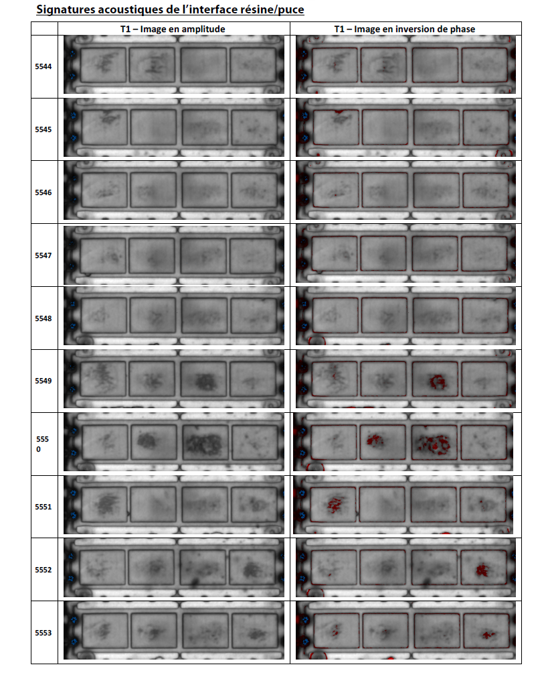
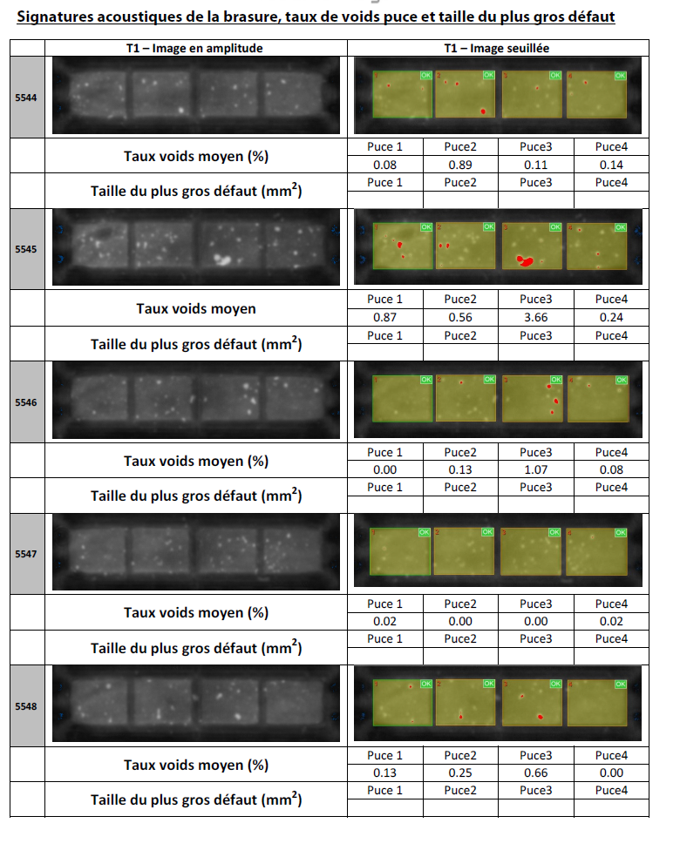
Demonstrator to series
Before Series production, we defined strict Acceptance Test Plans (ATP) and Acceptance Test Reports (ATR)
Tower (x 35)
  Input cavity
  Output cavity
  Bays (x4)
  Hydraulic
  Electrical distribution
  VBF (Vérification de
  bon fonctionnement)
  Temperature
  Bandwidth
  Linearity
  Harmonics
  Supercycle 100 hours
Module (x 3’000)
  Input Card
  Output Card
  Transistor on its heat sink
  (Ultra Sonic tomography sampling 100 % first batches than 2 %)
  Power supply
  Module
  Phase/Gain repeated at CERN
  (all checked by us, no sampling)
In total this has been more than 15’000 test reports that have been produced
As an example of the quality plan, all brazed transistors are inspected (tomography)
no sampling method is applied

Slide 30
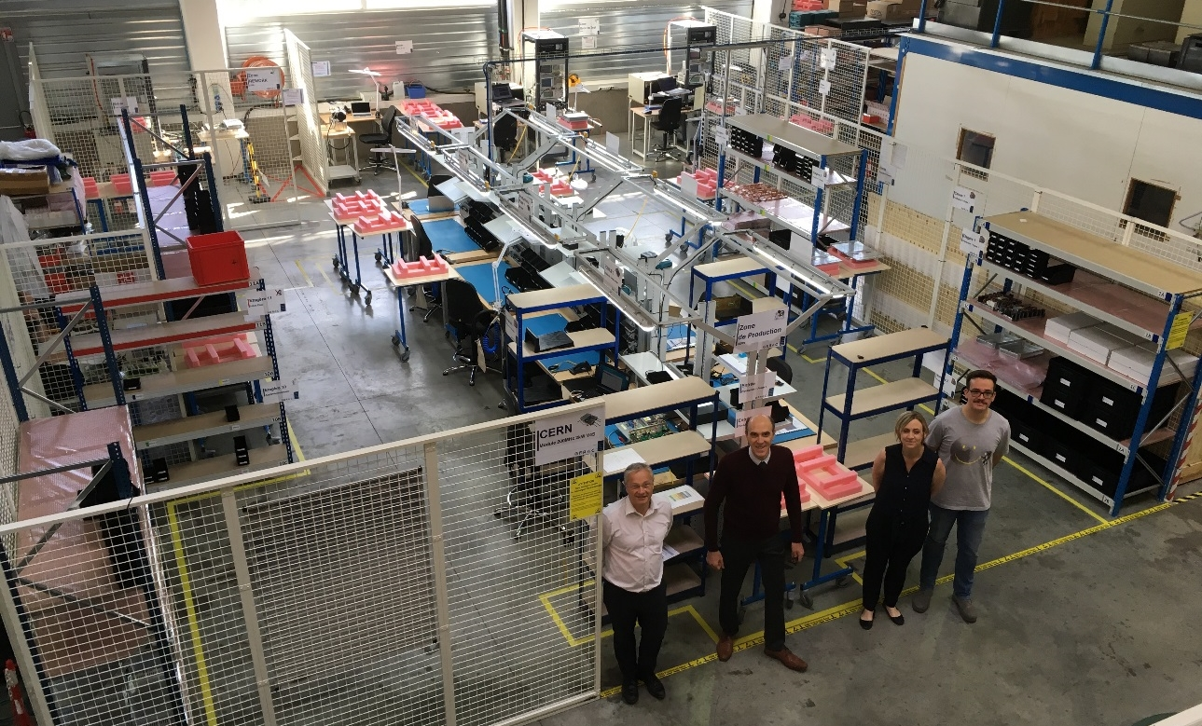
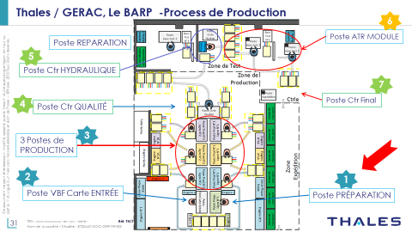
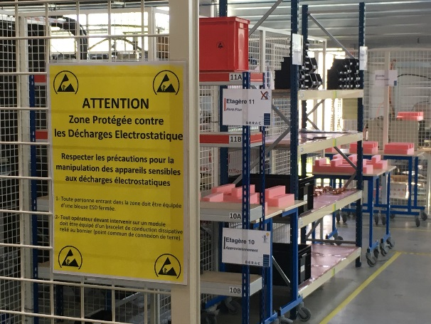
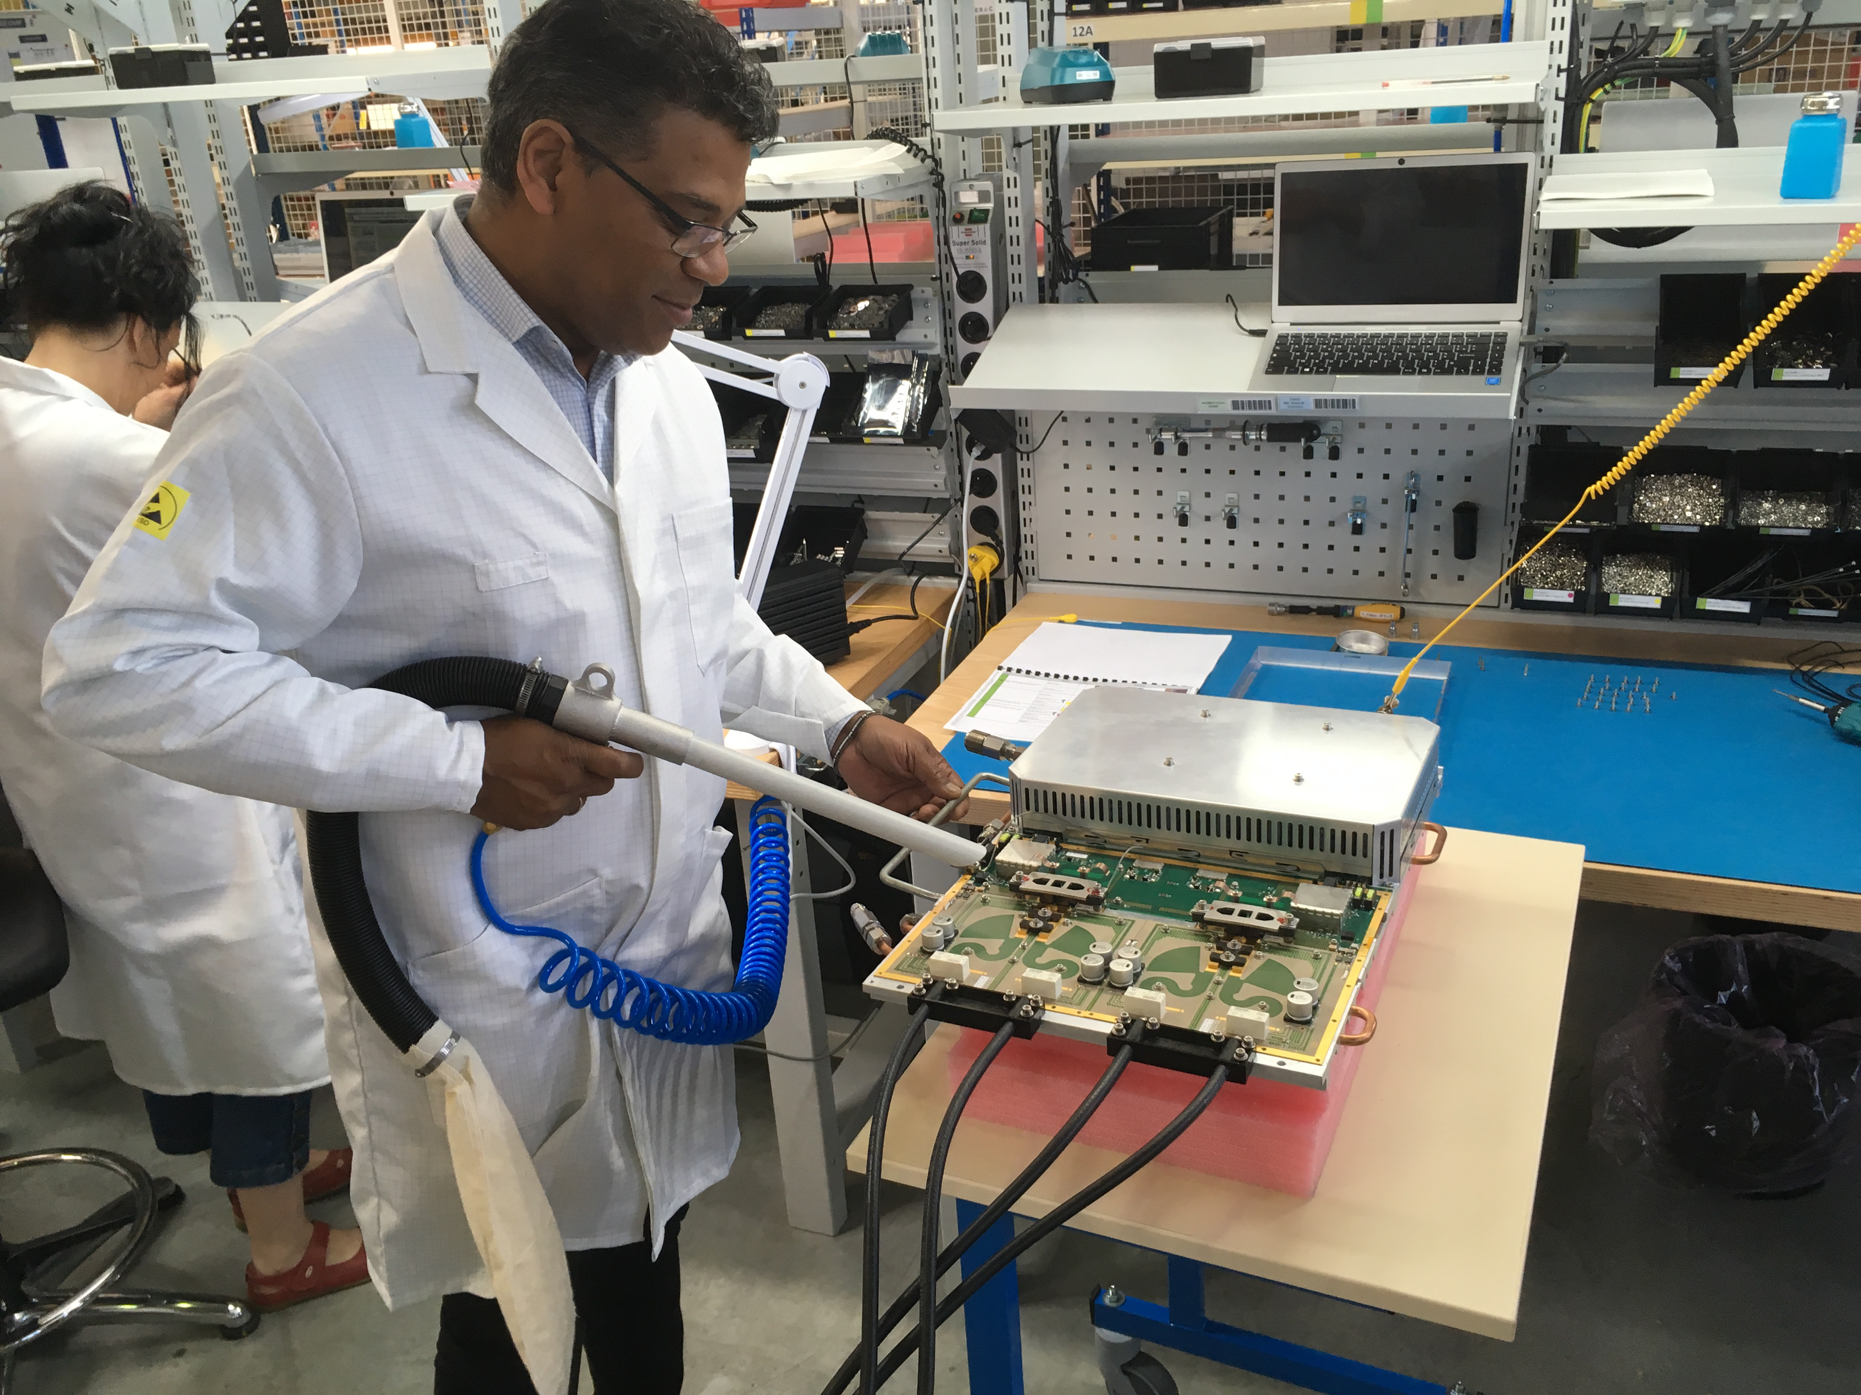
Demonstrator to series
Gérac premises have been upgraded for industrialisation phase
  Two production lines
  Two test benches
  One test place for ‘non conformities’
  Area within highest standards
  One storage area
Production capability is 120+ modules per week
First batch started to be delivered end of June 2019
Thales ‘military’ standards have been applied in order to satisfy the quality plan needed for our project

Slide 31
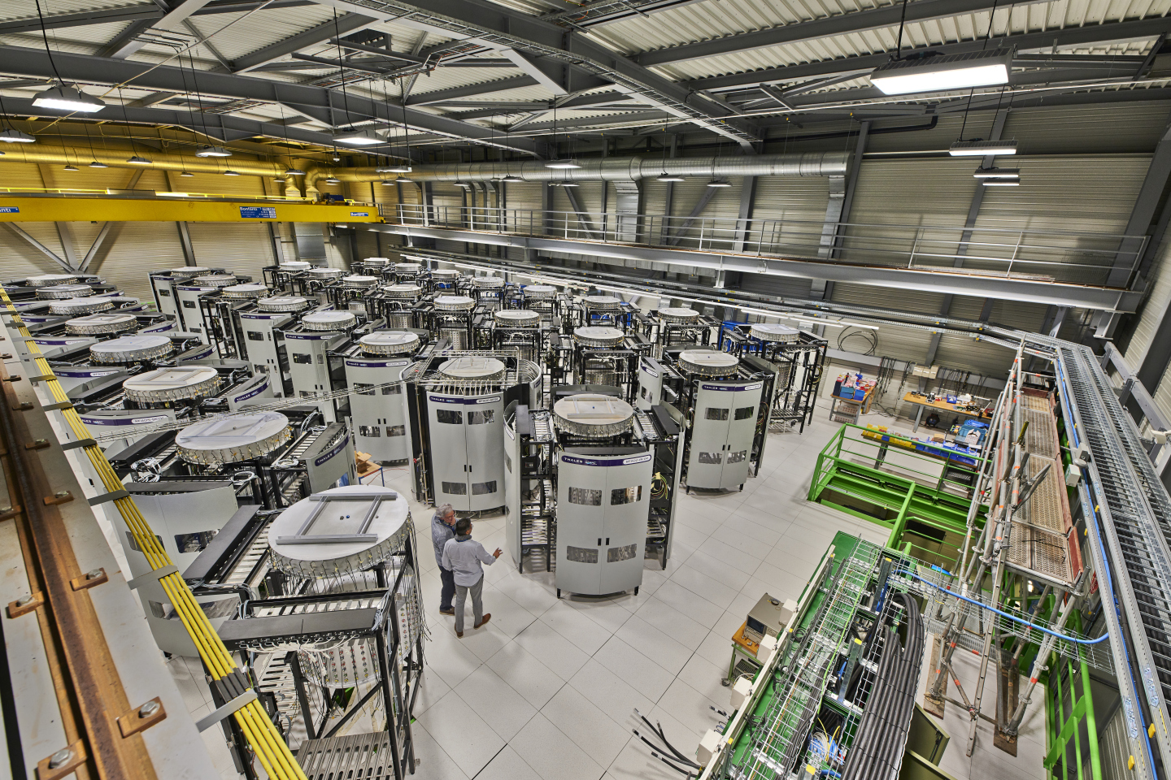
Series production
First Series tower qualified 10th July 2019
Qualification tests performed to qualify a tower, at a glance
  verification of all the 80 modules received by Thales on our CERN's modules test bench, power sweep to verify amplitude and phase of all modules
  integration of the 80 modules in the tower with individual thermal camera per transistor
  parameters checks; interlocks, bandwidth, linearity, harmonics, thermal behaviour with a SPS RF supercycle
  8 x 1 hour test at various predefined RF power levels and duty cycle
  100 hours long duration test with SPS RF supercycle, monitoring RF power and thermal behaviour
  control that the parameters have not changed, repetition of bandwidth, linearity, harmonics and thermal behaviour
Despite the difficulties with the modules, Thales provided all the infrastructure for the 32 towers
(even with no payment from CERN)

Slide 32
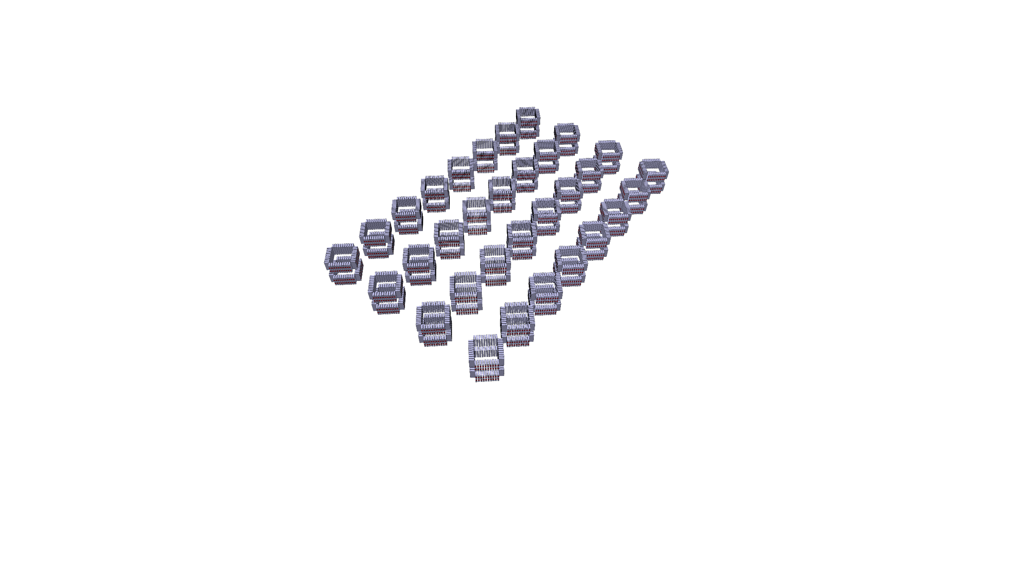
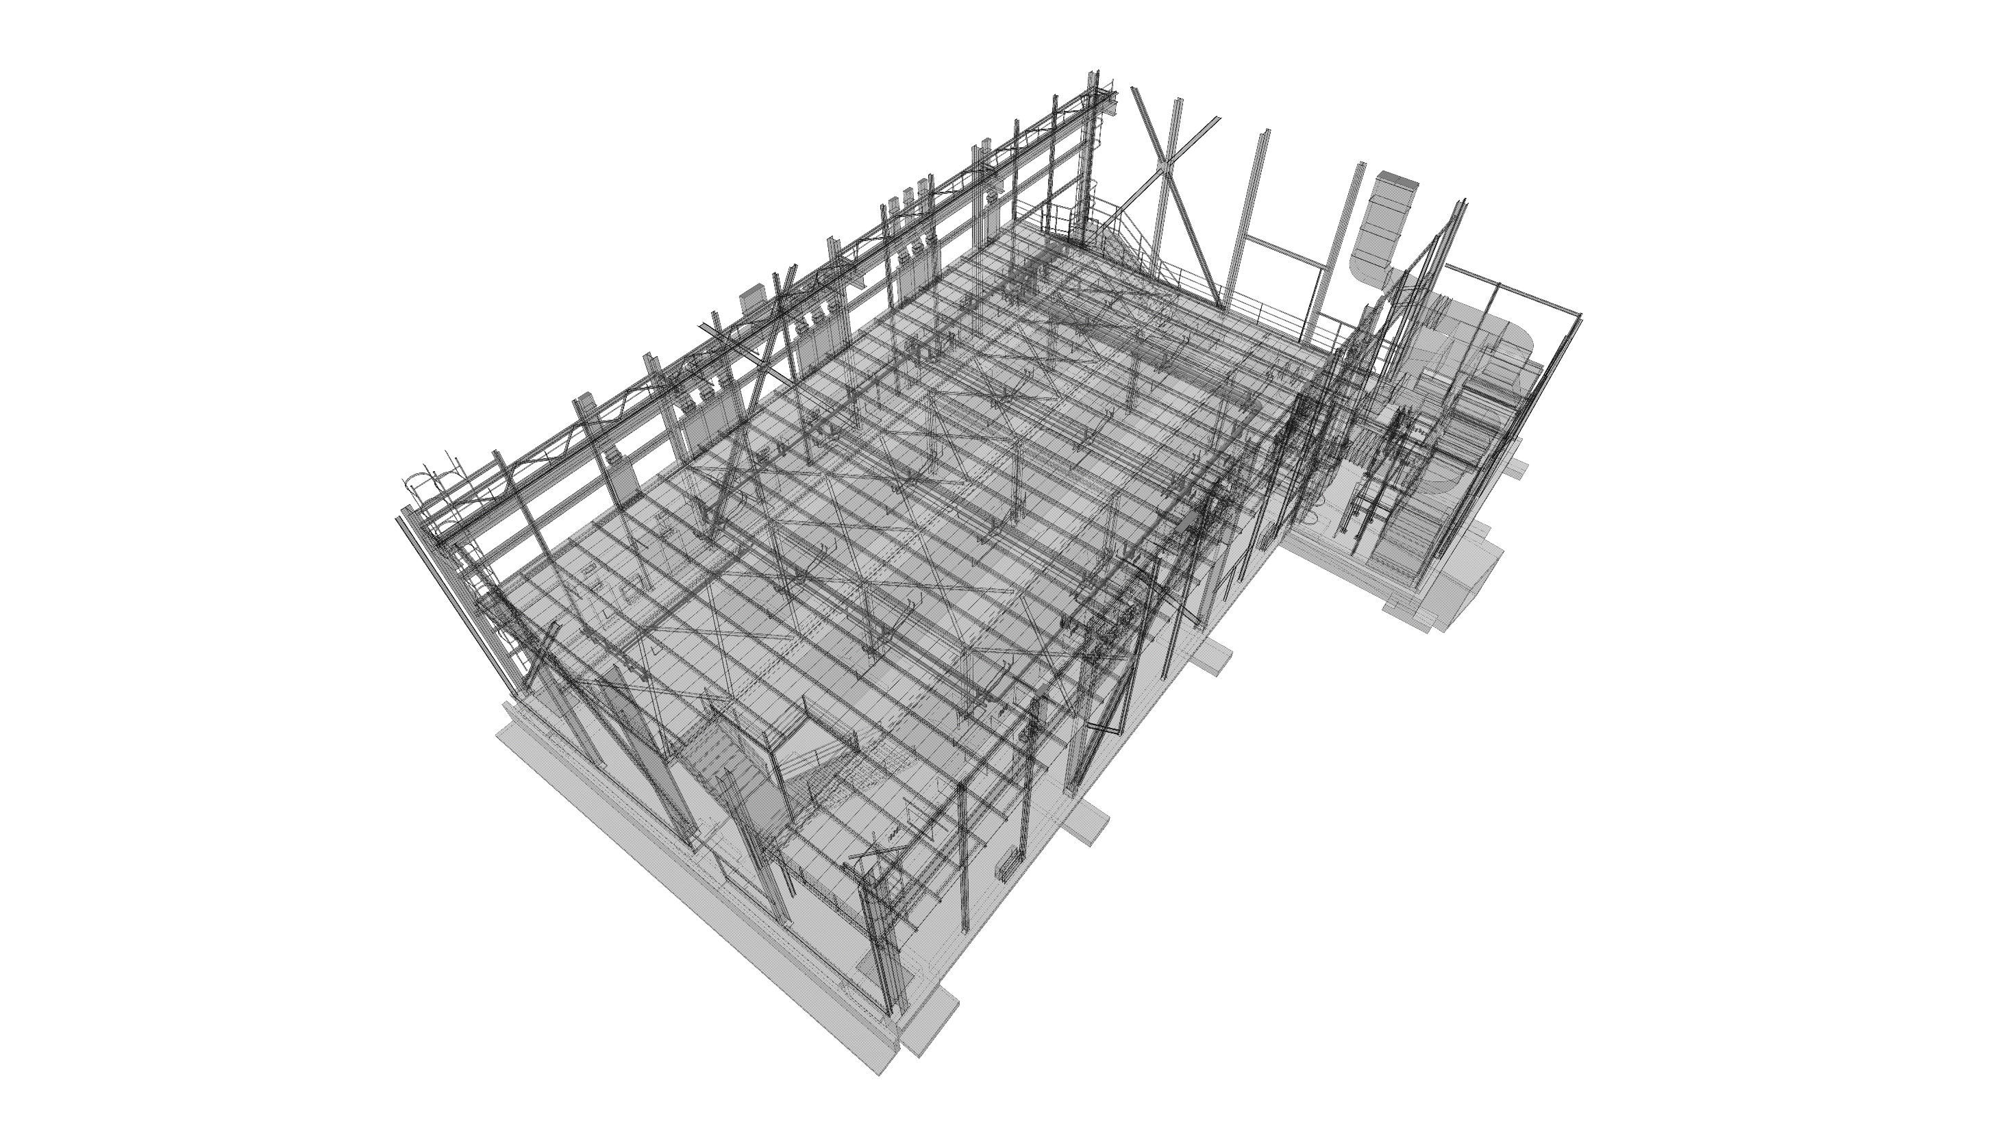
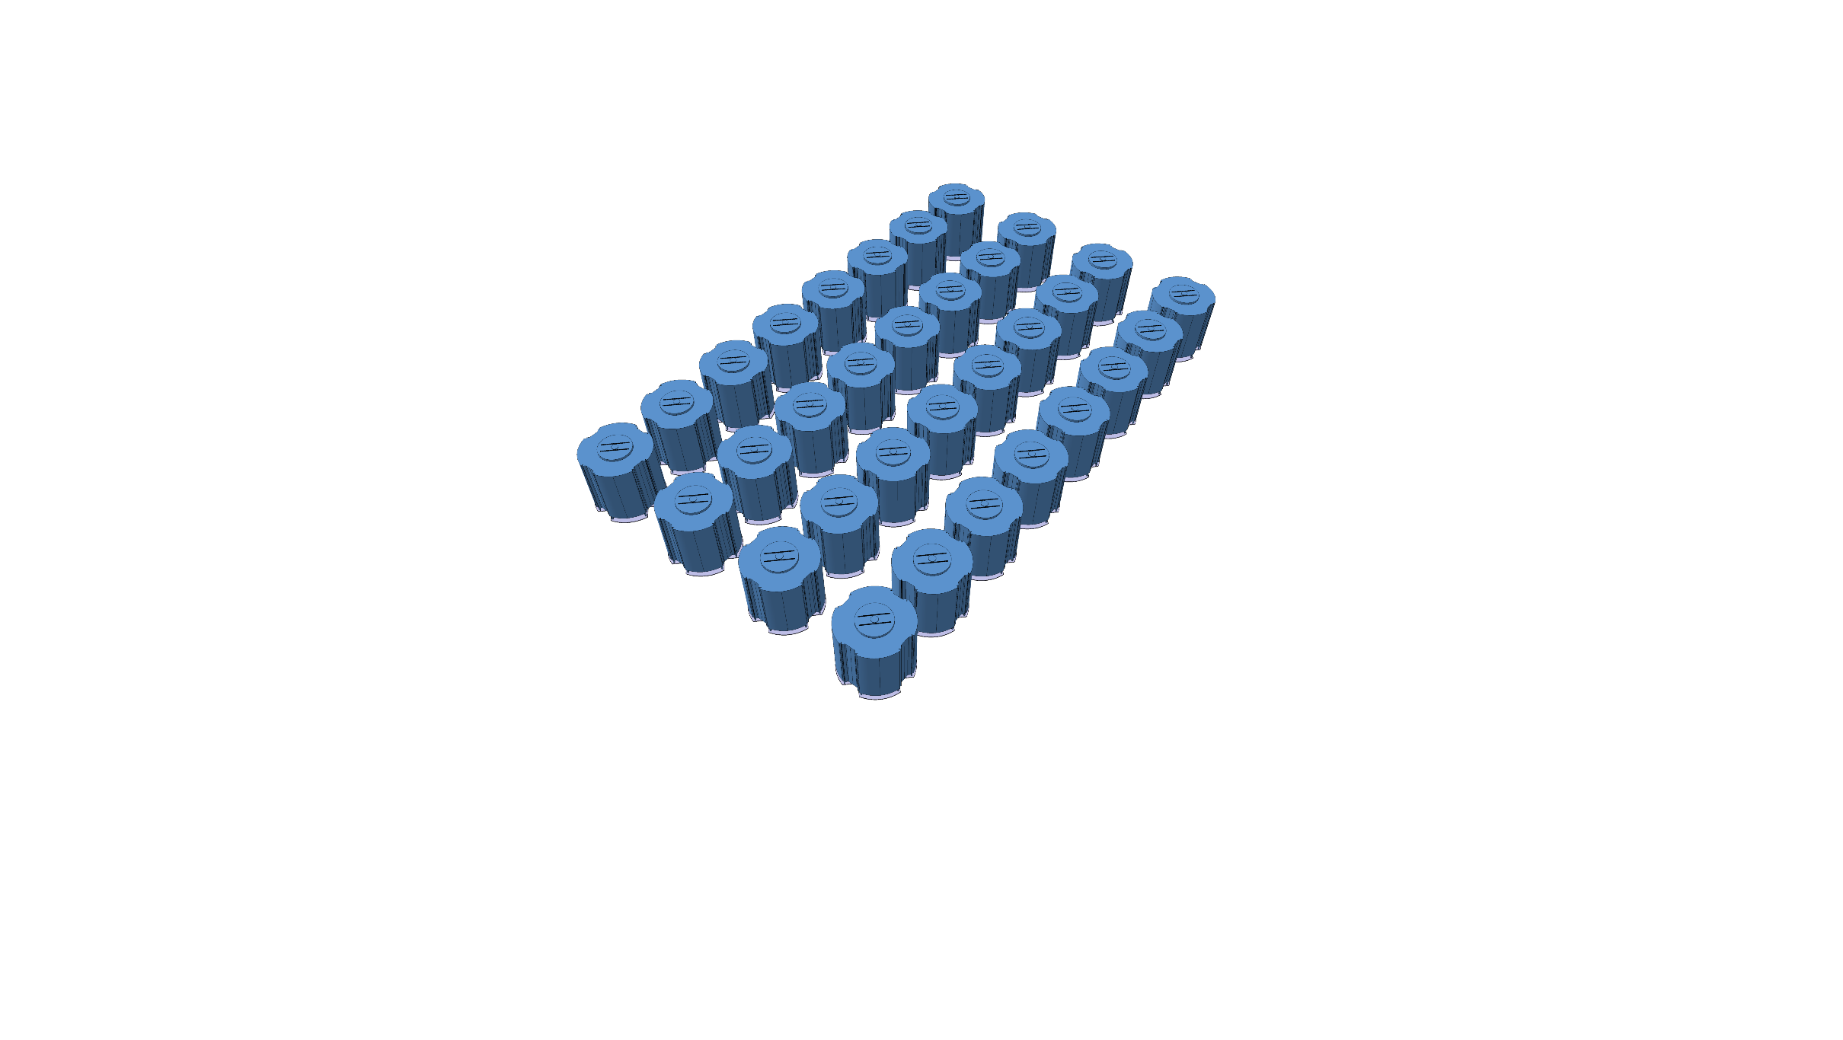
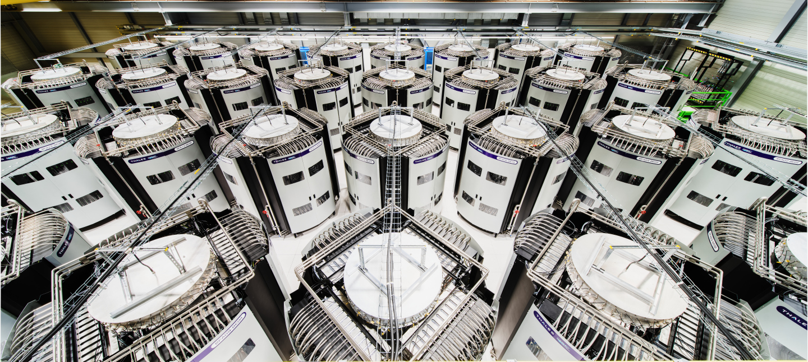
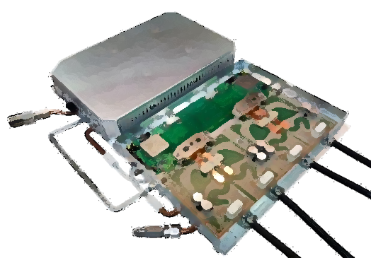
Series production
In total
3’000 modules of 2 kW have been produced
2’560 modules have been arranged in
32 towers of 144 kW each
System is in operation since 2021

Slide 33
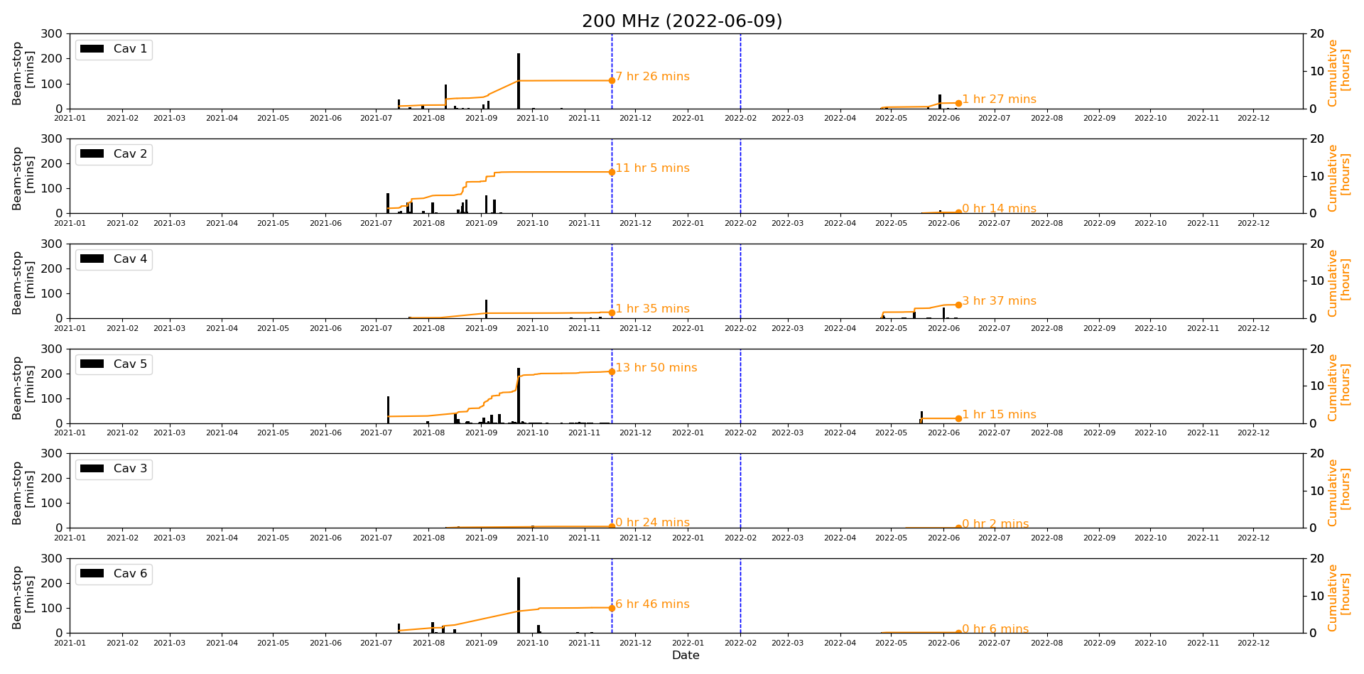
Demonstrated Availability
We operated the system all along 2021
Where tubes were the reason for beam interruption of
  1.5 hours (99.98 % availability)
  7.5 hours (99,9 % availability)
  11 hours (99,84 % availability)
  14 hours (99,8 % availability)
SSPA were stopping the beam for
  0.5 hour (99,99 % availability)
  6.5 hours (99,91 % availability)
This year, after we solved some initial youngness troubles, they seem to be ‘invisible’, and we are reaching our target of 99,99 % availability (8 minutes total / 2’000 hours)
RS2004 tubes
TH335 tubes
SSPA

Slide 34
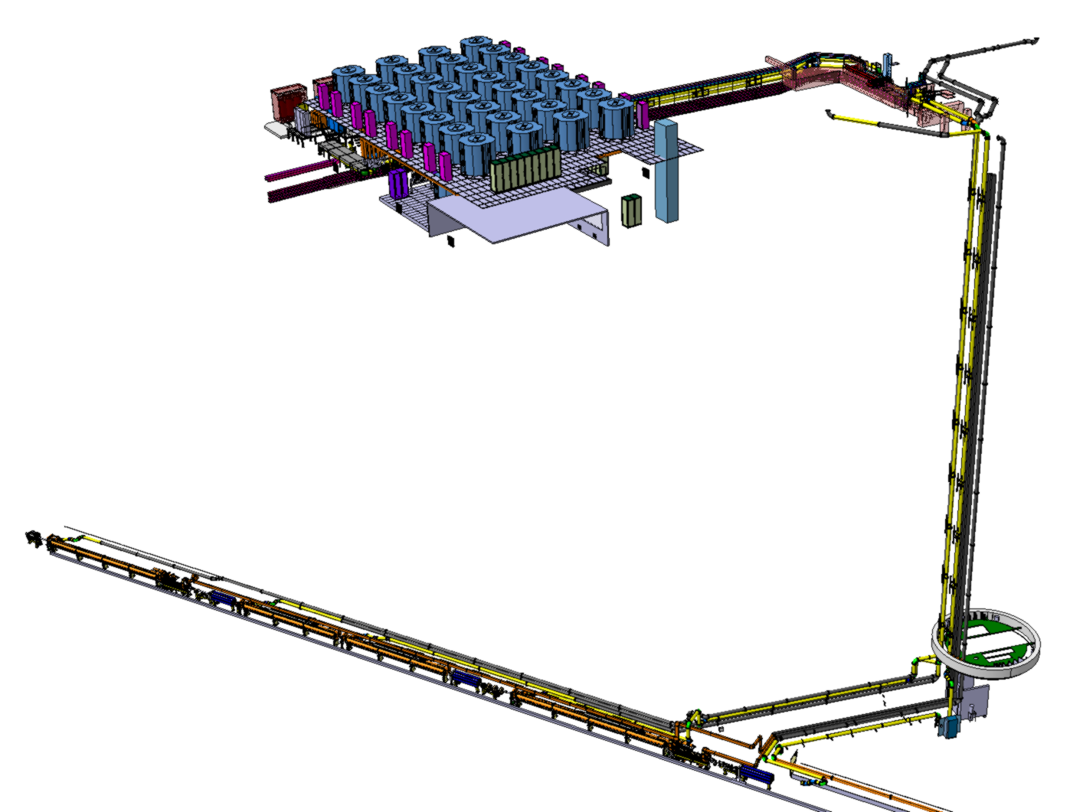
Efficiency
Thales design report: ‘Le rendement des blocs RF avec les MRFE6VP61K25N est de l’ordre de 66 % (valeur conservative)’
This was before linearity and bandwidth adjustments, I reduced it to 60 % for this exercise
Cavity = 1 MW
150 m coaxial line = + 0.2 dB = + 5 % = 1.050 MW
Circulator = + 0.2 dB = + 5 % = 1.103 MW
Hybrid combiner 16:1 = + 0.3 dB = + 7 % = 1.175 MW
DC to RF (efficiency ~ 60 %) = 1.960 MW
AC to DC (efficiency ~ 90 %) = 2.175 MW (1’000 kW to be dissipated)
Air cooling station (10 % of 1’000 kW = 100 kW) ~ + 50 kW = 2.225 MW
Water cooling station (90 % of 1’000 kW = 900 kW) ~ + 45 kW = 2,270 MW
Electrical distribution (5 % of 2.270 MW) ~ + 50 kW = 2,4 MW taken from the grid
Overall efficiency 41,9 %

Slide 35
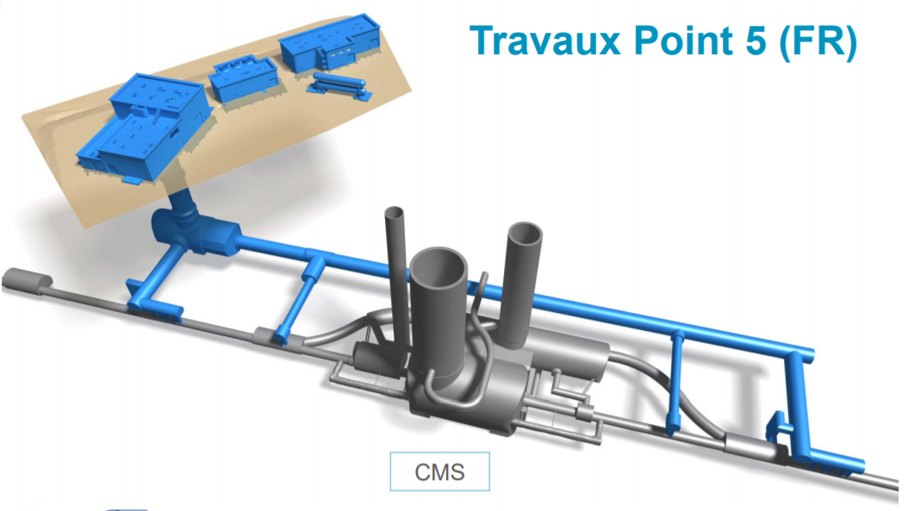
Efficiency
HL-LHC
LIU-SPS
150 m
Cavity = 1 MW
20 m coaxial line = + 5 % + 1 % = 1.010 MW
Circulator = + 0.2 dB = + 5 % = 1.060 MW
20 m
Hybrid combiner 16:1 = + 0.3 dB = + 7 % = 1.130 MW
Having the amplifiers very close to the cavity, will reduce all other losses
A gallery is very expensive, as an acquisition cost, but can help to reduce acquisition cost of transmission lines and to reduce cost of operation
DC to RF (efficiency ~ 60 %) = 1.890 MW
AC to DC (efficiency ~ 90 %) = 2,100 MW (970 kW to be dissipated)
Air cooling station (10 % of 970 kW = 97 kW) ~ + 49 kW = 2,149 MW
Water cooling station (90 % of 970 kW = 873 kW) ~ + 44 kW = 2,190 MW
Electrical distribution (5 % of 2,190 MW) ~ + 99 kW = 2,3 MW taken from the grid
41,9 %
Overall efficiency 43,5 %

Slide 36

Efficiency
Cavity = 1 MW
20 m coaxial line = + 1 % = 1.010 MW
NO Circulator = + 5 % + 0 % = 1.010 MW
Hybrid combiner 16:1 = + 0.3 dB = + 7 % = 1.080 MW
DC to RF (efficiency ~ 60 %) = 1.800 MW
As said, we are now able to build SSPA without circulator (Tetrodes and IOT can also do it)
The ‘cost’ is a (very) good protection system on the LLRF side
AC to DC (efficiency ~ 90 %) = 2,000 MW (920 kW to be dissipated)
Air cooling station (10 % of 920 kW = 92 kW) ~ + 46 kW = 2,046 MW
Water cooling station (90 % of 920 kW = 828 kW) ~ + 42 kW = 2,088 MW
Electrical distribution (5 % of 2,088 MW) ~ + 104 kW = 2,2 MW taken from the grid
Overall efficiency 45,5 %
41,9 %
41,9 %

Slide 37
Efficiency
Cavity = 1 MW
20 m coaxial line = + 1 % = 1.010 MW
NO Circulator = 1.010 MW
VHPCC 16:1 = + 0.1 dB = + 7 % + 2,5 % = 1.035 MW
DC to RF (efficiency ~ 60 %) = 1.725 MW
Using cavity combiners instead of 3 dB combiners will also reduce maintenance cost as no more power loads to maintain
AC to DC (efficiency ~ 90 %) = 1,920 MW (882 kW to be dissipated)
Air cooling station (10 % of 882 kW ~ 88 kW) ~ + 44 kW = 1,964 MW
Water cooling station (90 % of 882 kW ~ 794 kW) ~ + 39 kW = 2,003 MW
Electrical distribution (5 % of 2,003 MW) ~ + 100 kW = 2,1 MW taken from the grid
41,9 %
Overall efficiency 47,6 %

Slide 38
Efficiency
Cavity = 1 MW
20 m coaxial line = + 1 % = 1.010 MW
NO Circulator = 1.010 MW
Granularity of the SSPA solution also allows
to switch ON the exact correct number of modules such that we operate as close as possible to the nominal point
VHPCC 16:1 = + 0.1 dB = + 2,5 % = 1.035 MW
DC to RF (efficiency ~ 60 % ~ 66 %) = 1.570 MW
AC to DC (efficiency ~ 90 % ~ 95 %) = 1,650 MW (615 kW to be dissipated)
Air cooling station (10 % of 615 kW ~ 62 kW) ~ + 31 kW = 1,681 MW
Water cooling station (90 % of 615 kW ~ 553 kW) ~ + 28 kW = 1,709 MW
El. distribution (5 % of 1,709 MW) ~ + 86 kW = 1,8 MW taken from the grid
Overall efficiency 55,5 %
41,9 %

Slide 39


Efficiency
Cavity = 1 MW
20 m coaxial line = + 1 % = 1.010 MW
NO Circulator = 1.010 MW
VHPCC 16:1 = + 0.1 dB = + 2,5 % = 1.035 MW
5 m from HV to LV
DC to RF (efficiency ~ 66 %) = 1.590 MW
AC to DC (efficiency ~ 95 %) = 1,625 MW (590 kW to be dissipated)
Taking advantage of the natural chimney effect of the tower, having a well defined water station (variable speed), and shortening the LV cables will help reducing the remaining losses
Air cooling station (10 % of 615 kW 590 kW ~ 60 kW) ~ + 27 kW = 1,652 MW
Water cooling station (90 % of 615 kW 590 kW ~ 530 kW) ~ + 24 kW = 1,676 MW
El. distribution (5 % of 1,709 MW 3 % 1,676 MW) ~ + 50 kW =
1,7 MW taken from the grid
Overall efficiency 58,8 %
41,9 %

Slide 40
Conclusion (I/II)
A special thank to SOLEIL for being the pioneer in the field
A special thank to ESRF for the cavity combiner development, a real advantage with such an architecture
2 MWp SSPA per station? 750 kW SSPA per station?
We did it and it operates very reliably from Day1
Such projects are always tailored made solutions, and ‘Devil is in many details!’
One must have a very solid industrial partner
Large series are not necessarily less expensive (need of dedicated production line)

Slide 41
Conclusion (II/II)
Efficiency was not the main objective this time, but we already see a lot of possibilities to be (very) efficient with a SSPA solution
  Fantastically efficient cavity combiners
  Granularity allowing to operate very close to the best efficient point
  Granularity allowing for replacement not seen by operation
  Our availability target, being reached, is 99.99 %
FCC could very be with SSPA, we already work on it
  Integrated modules without cables, was too early this time, but clearly an option to be looked at
  Seebeck modules (with Shapal substract) as cooler of the transistors and re-injecting the losses into the power supplies
  Vapour cooling
  Embedded spares with no replacement neither maintenance
  Plenty of other ideas already in mind…

Slide 42
They did not know it was impossible, so they did it
(Mark Twain, 1835-1910)
The ultimate sophistication is simplification
(Leonardo Da Vinci, 1452-1519)

Slide 43

Drivers
Consulted
Selected
72 companies consulted
20 selected
10 offers
Defined a 1.25 kW unit
  Compatible with all Finals technologies
  One to six batches of 50 regarding result of future Finals contracts
TTI Norte, Spain, awarded the contract
(3.7 €/W)

Slide 44
Finals
Consulted
Selected
Offered
74 companies consulted
19 selected
8 declined
7 offers
March 2015 lowest bid was Thales Communication & Security
Very careful verification of the offer
(I am (was) a tube guy !)
I tried during 6 months to convinced Thales that this offer was not at a correct price
Thales ensured they will do it
December 2015, THALES, France, awarded the contract (2.7 €/W)

Slide 45


