Slide 1

Comparison of ESS SML modulators to conventional pulse transformer-based modulators
Max Collins
ESS – Accelerator Division – Electrical Power Systems Group
www.ess.eu
July 4th 2022 – Workshop on Efficient RF Sources

Slide 2
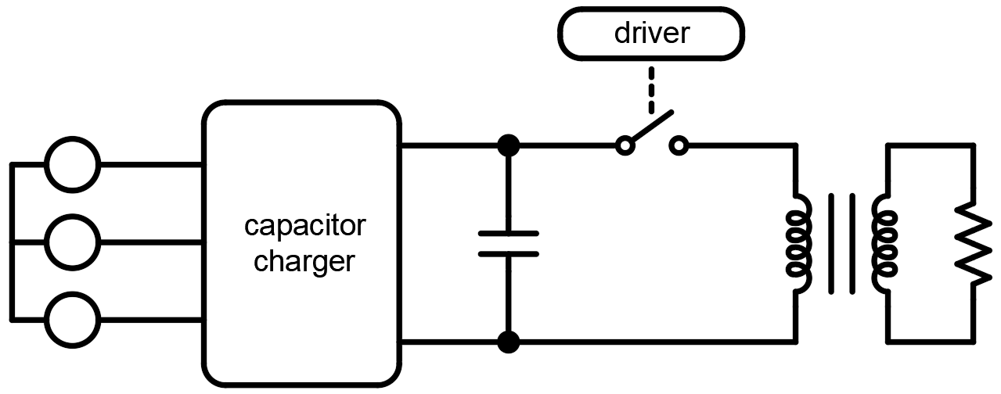
Pulse transformer-based modulators
The pulse transformer-based modulator topology is conceptually simple
Working principle:
  Input charger charges the main capacitor bank energy storage
  To begin pulse generation, the switch is closed- applying the capacitor bank voltage to the matching pulse transformer
  The transformer matches the voltage to the requirements of the klystron load
  To end the pulse, the switch is opened
  The procedure is repeated
Used in many applications, and is typically associated with…
  Straightforward design
  Robustness, reliable operation
  Good performance
switch assembly
capacitor bank
energy storage
pulse transformer
this work:
characterization of pulse transformer modulator subsystems considering long pulse high power applications:
what would the corresponding pulse transformer-based modulator look like for ESS application requirements?
what options and trade-offs exist in optimizing modulator efficiency?
2

Slide 3
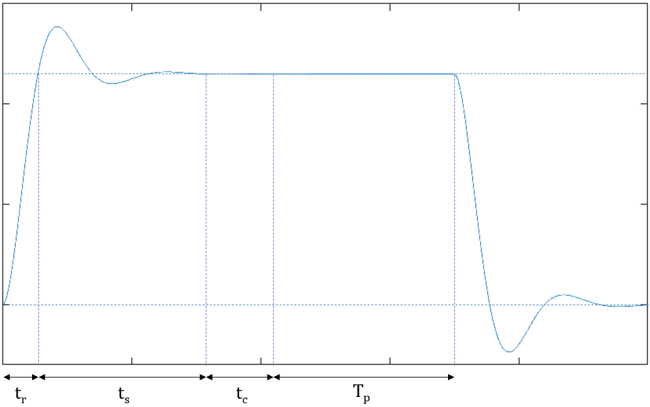
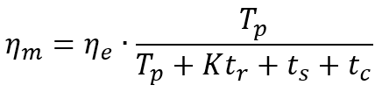
Modulator efficiency
Modulator efficiency η_{m}: “useful output power versus total input power”
  Total input power: active power drawn from the electrical grid
  Useful output power: power which may be used to produce RF
Useful RF power generated only during the pulse beam time T_{p}…
… But energy is also expended in going through the pulse rise time t_{r}, the stabilization time t_{s}, and the RF cavity filling time t_{c}
Modulator efficiency expressed as power used to generate RF over total input power:
(features heavily exaggerated for clarity)
ESS application
t_{s} = 100 µs
t_{c} = 300 µs
T_{p} = 2900 µs
η_{m} = f(η_{e}, K, t_{r}) = f(η_{e}, t_{r})
modulator electrical efficiency
pulse efficiency
… K = 2/3 for long pulse transformers …
3

Slide 4
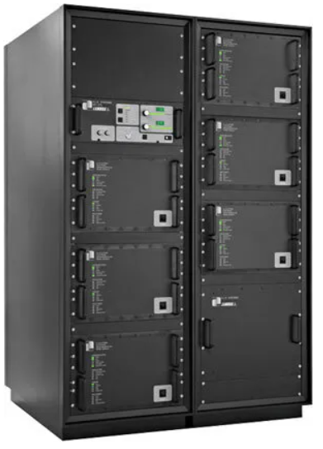
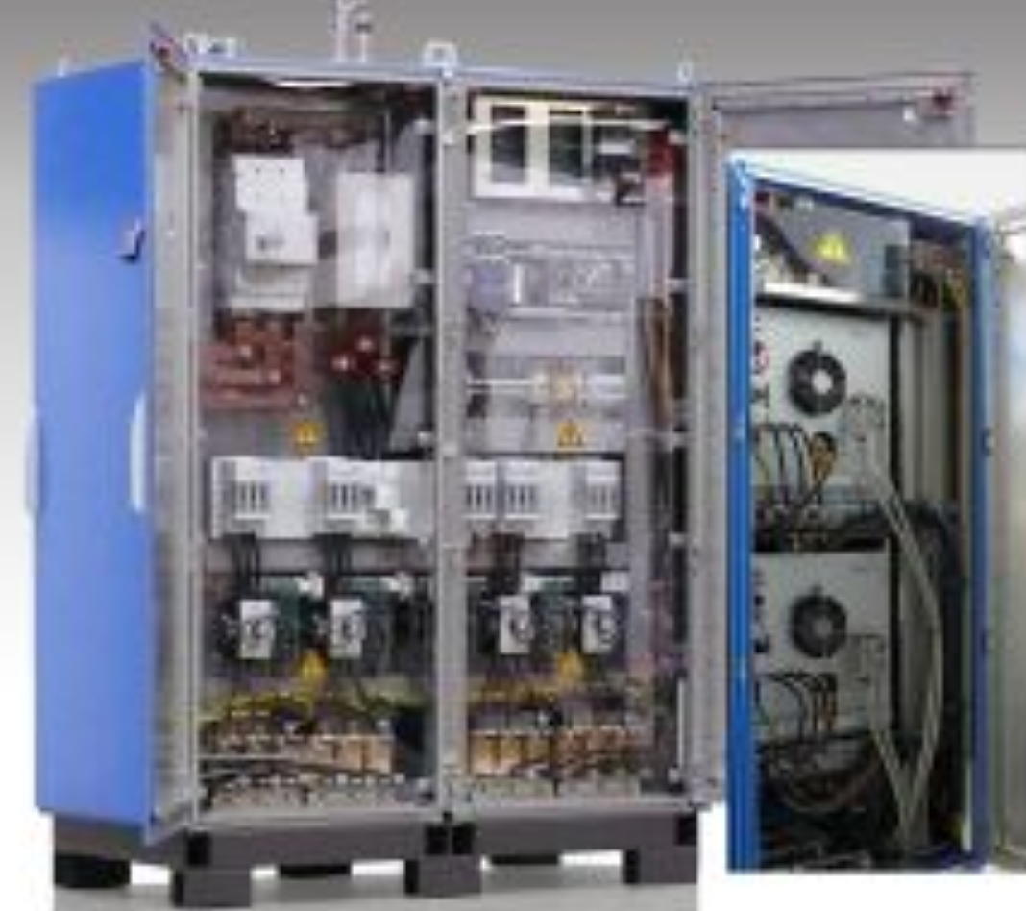


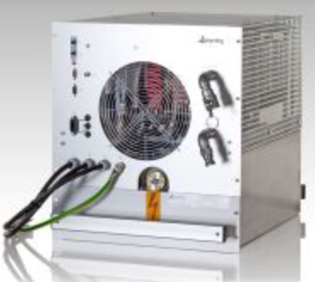
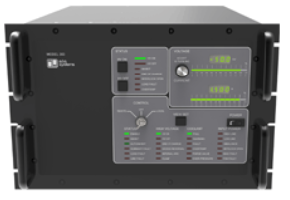
High power capacitor chargers (I)
Input stage chargers re-charge the capacitor bank between pulses
Capacitor charger are sized to deliver the system average power
Commercial high voltage, high power capacitor chargers are based on modular rack-mount units
In principle, any number of charger units can be operated in parallel to increase the maximum power rating
Example: 300 kW Poynting capacitor charger system
Example: 300 kW TDK Lambda charger system
primary control unit
~680 mm
~482 mm
12 RU
4x MOD-75 charger units = 300 kW
Poynting MOD-75
75 kW, 95% efficiency
TDK ALE303
50 kW, 85% efficiency
6x TDK ALE303 = 300 kW
HV junction box
4

Slide 5
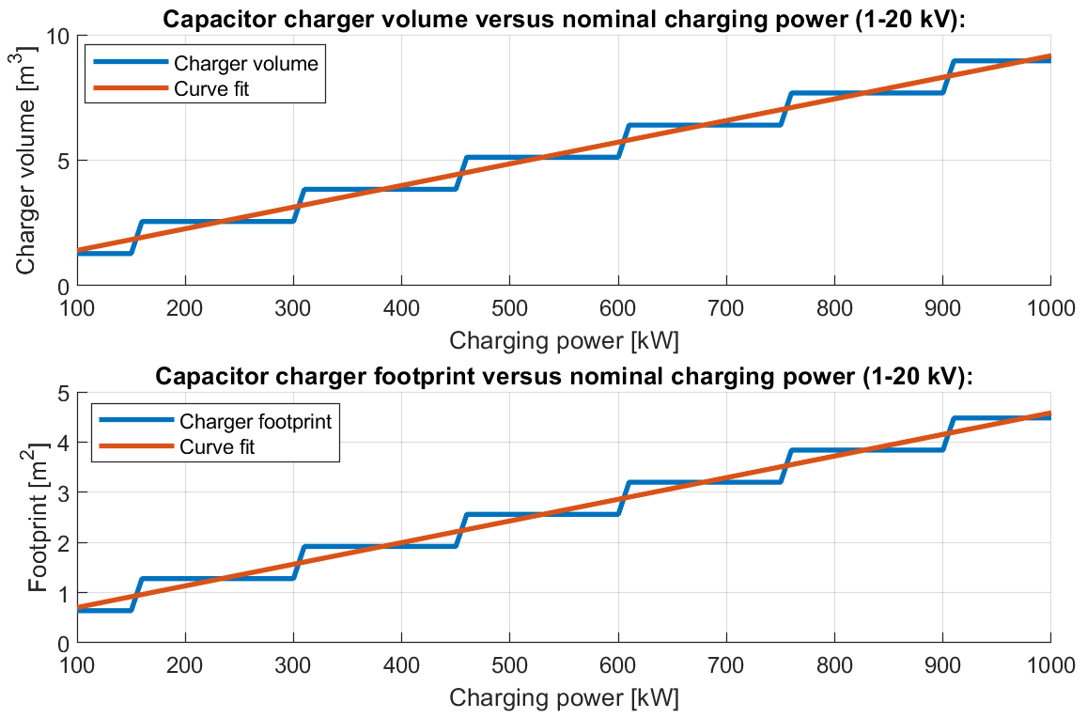
High power capacitor chargers (II)
Study of offerings from TDK, Poynting, Technix, Spellman, …, indicate-
  General utilization of standardized 800x800x2000 cabinets
  Power density of around 150 kW/cabinet
  Efficiency range from 85%-95% at nominal operating condition
Study of high power chargers valid for approximate output voltage range 1 kV-20 kV:
… in practice, the impact on system efficiency is somewhat greater due to generated line-side harmonics, reactive power, the fact that the charger cannot be operated at full load, …
…..
5 cabinets
4 cabinets
2 cabinets
3 cabinets
ESS application
= 5 cabinets (800x800)
= ~3.2 m²
5

Slide 6
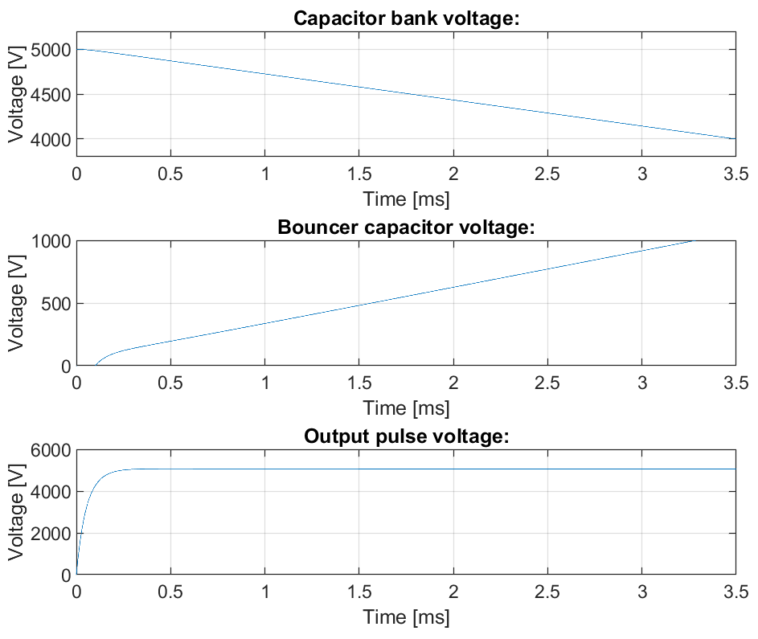
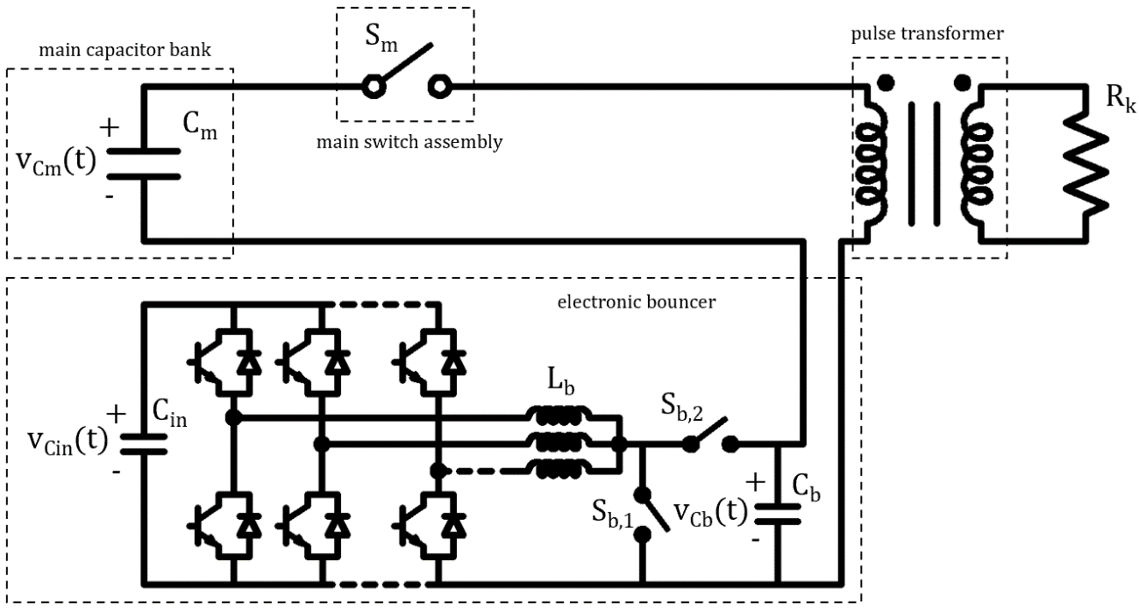
Capacitor bank and droop compensation system (I)
The capacitor bank voltage droops in pulse generation – this is amplified by the pulse transformer and seen in the pulse flat top
Maximum flat top droop is limited by application requirements, typically to ~1%
Oversizing the capacitor bank to meet this requirement for long pulse high power applications is unfeasible
Instead, a droop compensation system or “bouncer” is utilized, significantly reducing overall system size
For long pulse applications, electronic (switch-mode) bouncers are used:
6

Slide 7
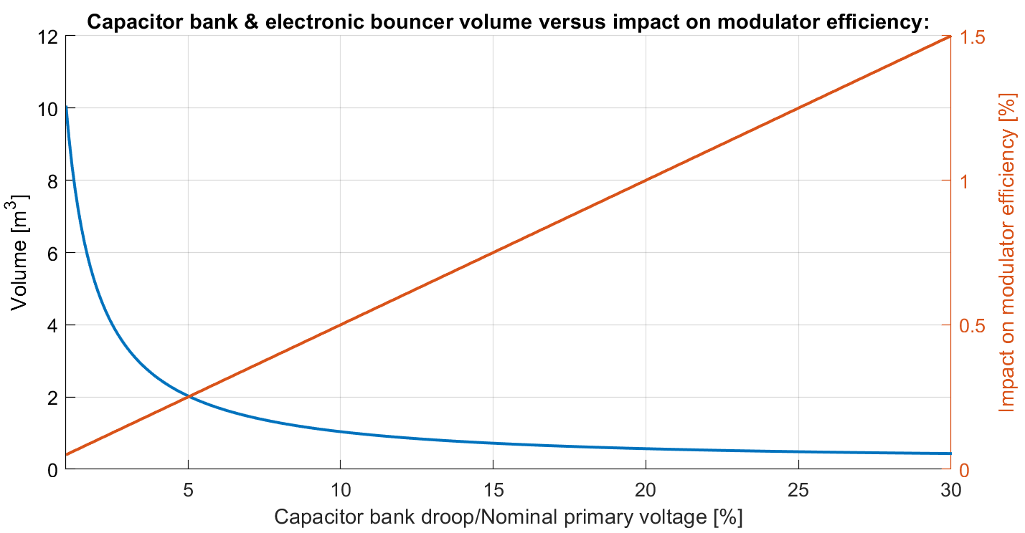
Capacitor bank and droop compensation system (II)
Case study¹ assuming ESS klystron modulator requirements:
PWM switching generates ripple, amplified and seen in the pulse flat top = { flat top ripple limited to 0.15% of amplitude … }
use high switching frequency (10-20 kHz) = requires standard semiconductor switches (< 1.7 kV) = upper limit on droop that can be compensated; ~1 kV, i.e. 20% of 5 kV
Should also practically fit in standard electrical cabinets = lower limit on droop, e.g. ~10%
Compared to simply oversizing the capacitor bank, typical reduction in capacitor bank volume of a factor 10-20(!)
Impact on modulator electrical efficiency between 0.5-1.0% of nominal output power
Trade-off between system volume and system efficiency
too large to practically
fit in standard cabinets..
~0.5%
bouncer voltage too high to
permit use of standard
semiconductors..
~0.5 m³
¹M. Collins and C.A Martins, “Optimal Design of Electronic Bouncers for Long-Pulse High-Power Modulators”, IEEE Trans. Plasma Sci., vol. 49, no. 2, pp. 819-829, Feb. 2021
7

Slide 8
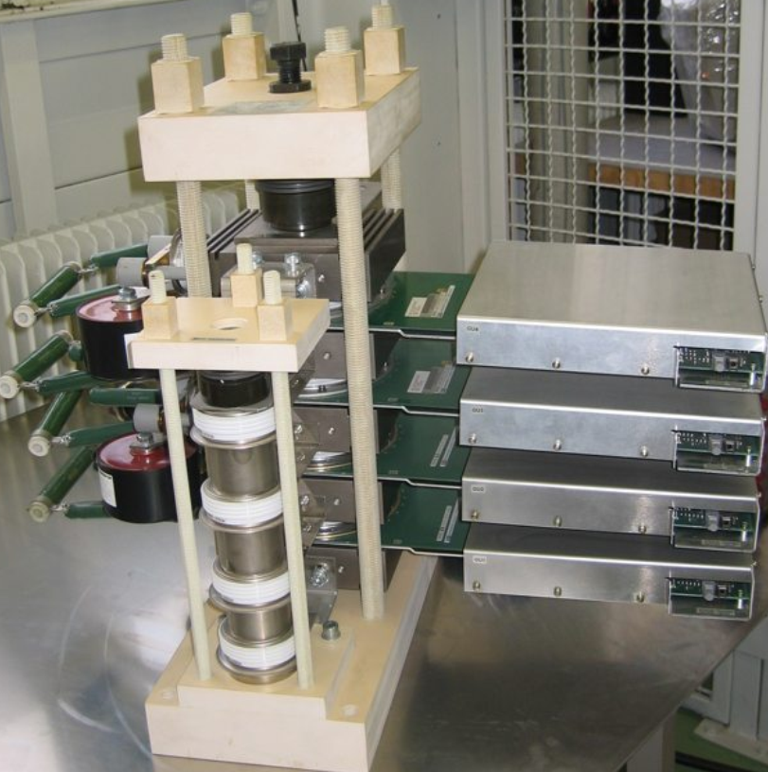
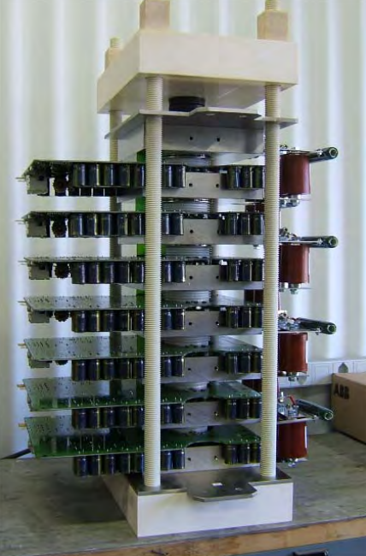
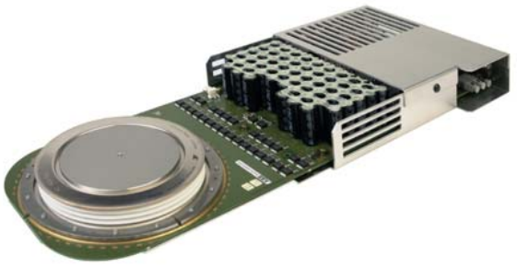
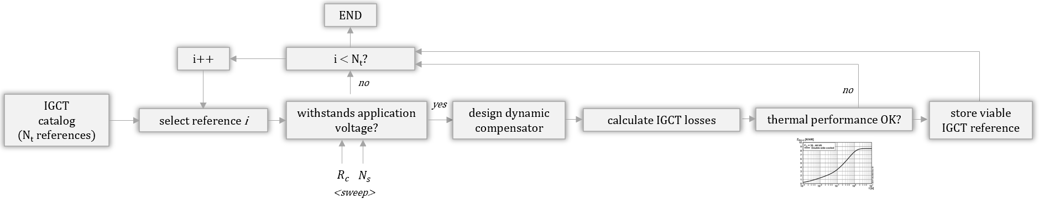
High voltage solid state switch assembly
The HV switch assembly connects the capacitor bank voltage to the primary windings of the transformer for pulse generation
Therefore, the switch must be…
  fully controllable
  able to block the full capacitor bank voltage
  able to conduct the full load current referred to the primary
  able to operate at the desired pulse repetition rate
Typically, solutions based on multiple IGCT switches in series are developed
With series connected switches, the IGCT units must be equipped with compensation circuits
for voltage balancing-
  Generally, a large number of switches is required to handle the full voltage
  Additionally, further switches are often added for redundancy in
  ensuring long term reliability
static&dynamic
compensation circuits
HV isolators
~175 mm
~440 mm
example: ABB switch assembly rated 12 kV/300 A-
7x IGCT switch rated 4.5 kV
8

Slide 9
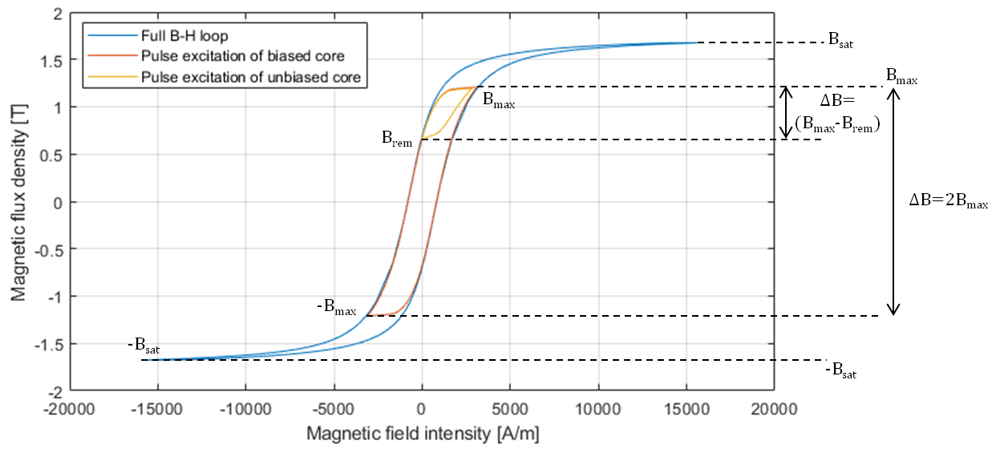
Pulse transformer auxiliary circuit (I)
During pulse generation, the pulse transformer is magnetized over time…
The magnetic flux density is defined by 1) the integral of the applied voltage over the pulse length; and 2) the turns-area product of the transformer
Since the voltage-time integral is defined by the application (long pulse…), the pulse transformer must be sized appropriately to handle the flux
Therefore:
In long pulse high power applications, it is absolutely vital that the transformer is pre-magnetized to minimize pulse transformer size
Following a given pulse event, the transformer must be de-magnetized to avoid saturation during the next pulse event
Typically, these tasks are handled by passive auxiliary circuits – NOT PRACTICAL in long pulse high power applications…
9

Slide 10
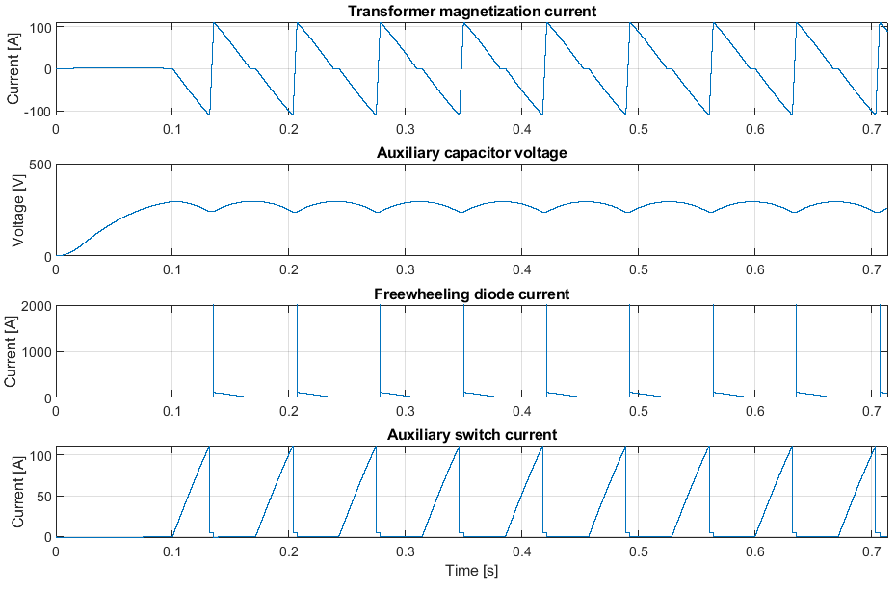
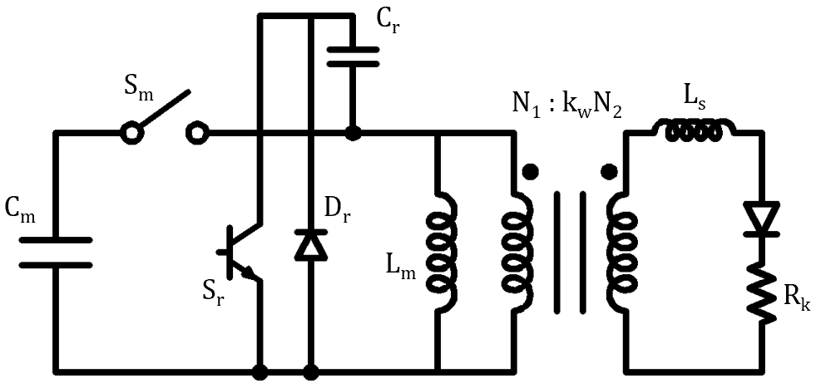
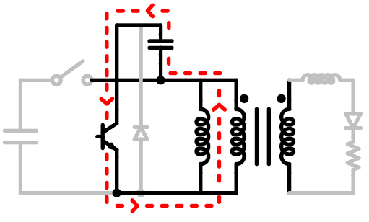
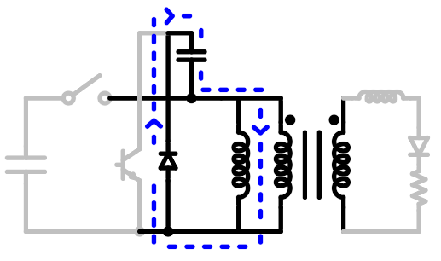
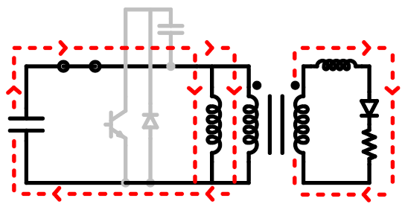
1
2
3
…
i
1
Pulse transformer auxiliary circuit (II)
auxiliary capacitor is pre-charged
Development: active auxiliary circuit
For the purposes of assessing overall volume/losses, this auxiliary circuit may be assumed to be lossless and to be fitted in the switch cabinet
Still- requires additional power supply, active control and timing, … (more complex)
1
2
3
…
i
1
Step 1: pre-magnetization
Step 2: pulse generation
Step 3: de-magnetization
10

Slide 11
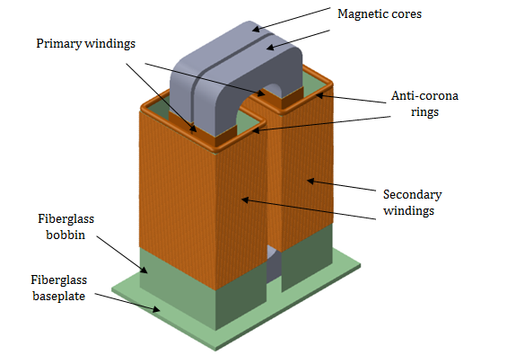
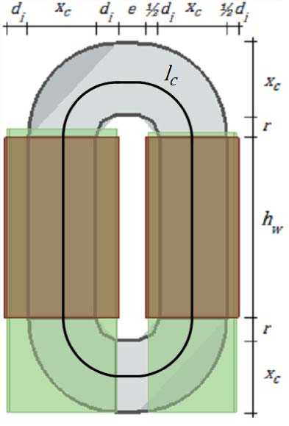
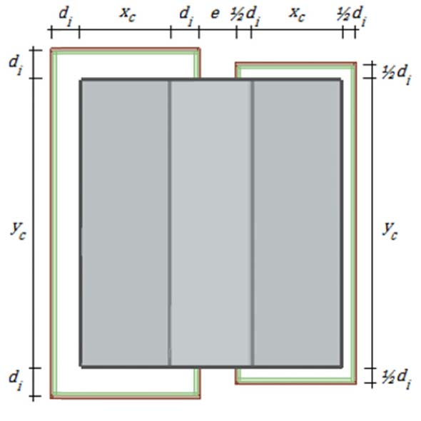
Pulse transformer (I)
Long pulse high power applications…
  Magnetic cores: tapewound double-C cores (size..)
  Primary windings: low voltage, single layer windings
  Secondary windings: high voltage, pancake stack windings
  Fiberglass isolators to provide support and maintain distance
  Integrated in high voltage oil tank assembly
The product of the number of winding turns and the magnetic core cross-section
must be chosen to be able to handle the peak magnetic flux density associated
with the applied voltage-time (long pulse..);
The longer the pulse the greater the required product of turns and magnetic core area;
Minimize transformer & modulator size by increasing number of turns?
Not possible: increasing the number of turns increases the leakage
inductance (~N²) and thereby the pulse rise time (~L_{s}), deteriorating the
pulse efficiency…
generic pulse transformer geometry…
… into mathematical formulation for design optimization
= maintaining decent pulse efficiency implies limiting the number of turns
= very large cross-sectional area required to handle the flux density…
fundamental problem of pulse transformers in long pulse high power applications…
²M. Collins and C.A Martins, “Evaluation of Feasibility of High-Power Long-Pulse Transformer Using Single-Layer and Pancake Winding Techniques,” IEEE Trans. Plasma Sci., vol. 49, no. 7, pp. 2217-2226, Jun. 2021
11

Slide 12
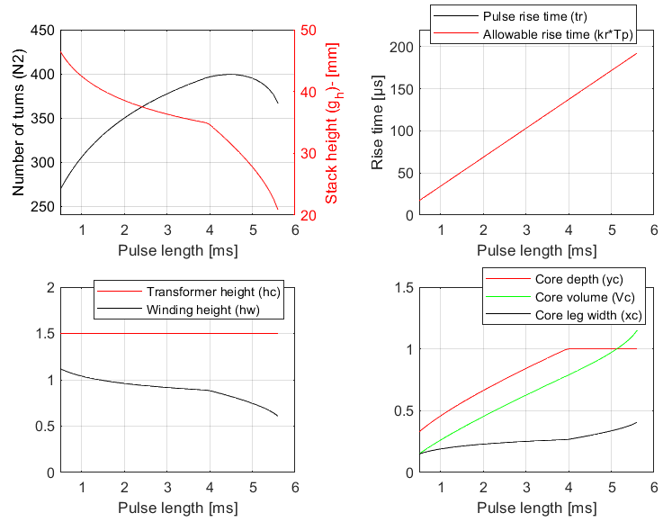

Pulse transformer (II)
Optimization results for ESS pulse power requirements², limiting transformer height to ~1.5 m
Required pulse length is swept to study the impact on pulse transformer design, rise time limited to 3.43% of pulse length (120 µs @ 3.5 ms)
Objective function: minimize volume – implications for pulse transformer losses are dismissed
The resulting pulse transformer and associated oil tank assembly is large and unpractical…
Resulting efficiency of ~99% is good, but cannot readily be improved..
assessment of losses:
magnetic core losses may be neglected
winding copper losses are generally given according to…
material constant…
mean path length is determined by the cross-sectional area and isolation distances
given by the application…
number of turns cannot be increased due to pulse efficiency requirement
number of turns should not be reduced given the transformer size
magnetic core material volume ~0.75 m³
= core material weight ~5.7 ton…
transformer assembly ~2 m…
+ windings..
+ structures…
+ sensors…
+ …
²M. Collins and C.A Martins, “Evaluation of Feasibility of High-Power Long-Pulse Transformer Using Single-Layer and Pancake Winding Techniques,” IEEE Trans. Plasma Sci., vol. 49, no. 7, pp. 2217-2226, Jun. 2021
12

Slide 13
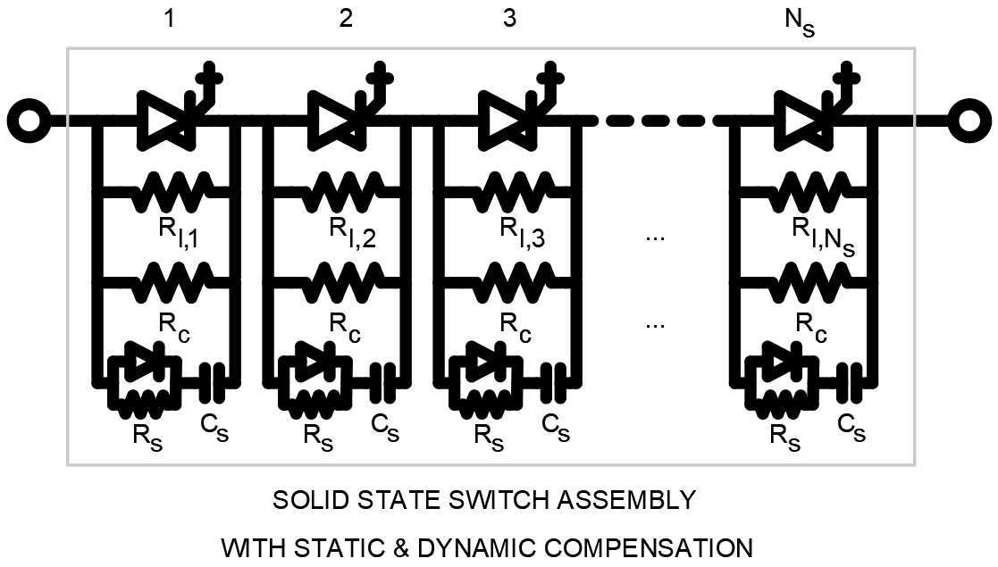
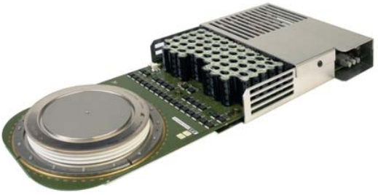

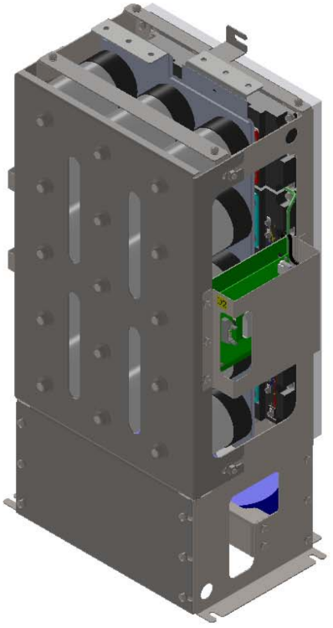
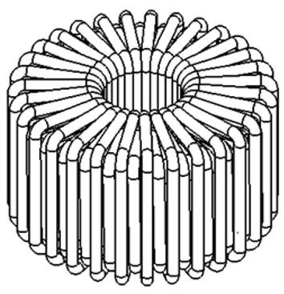
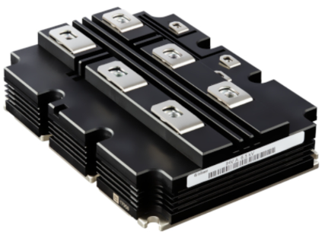
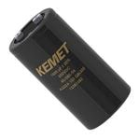
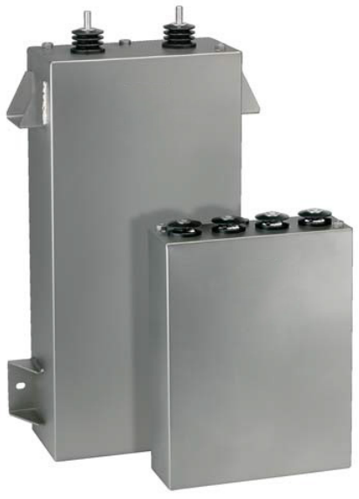
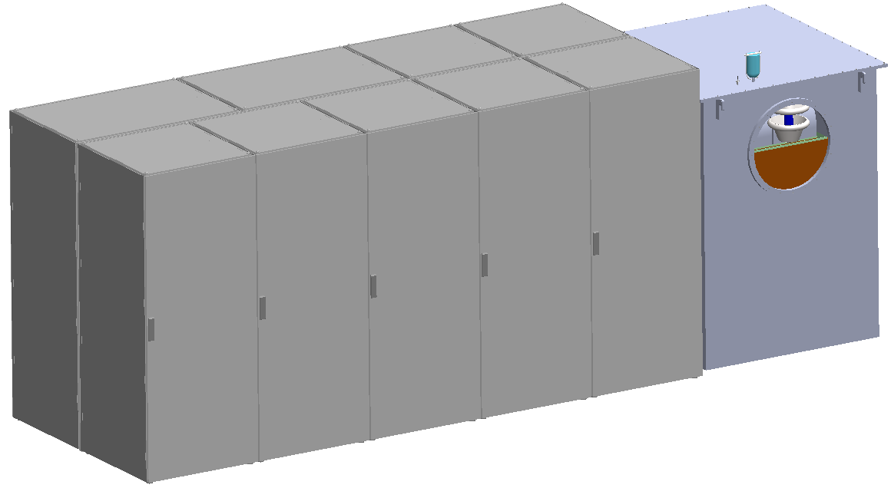
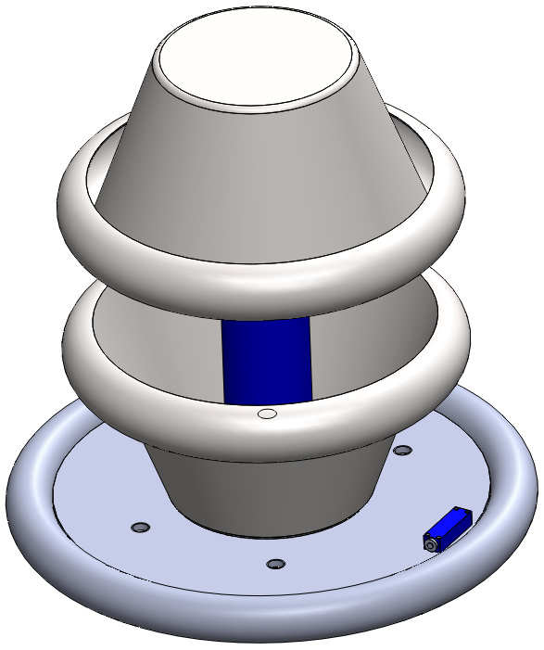
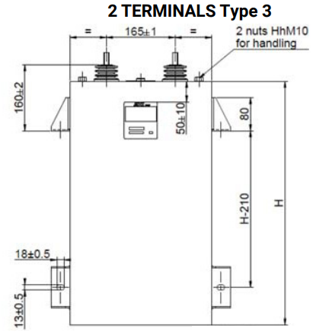
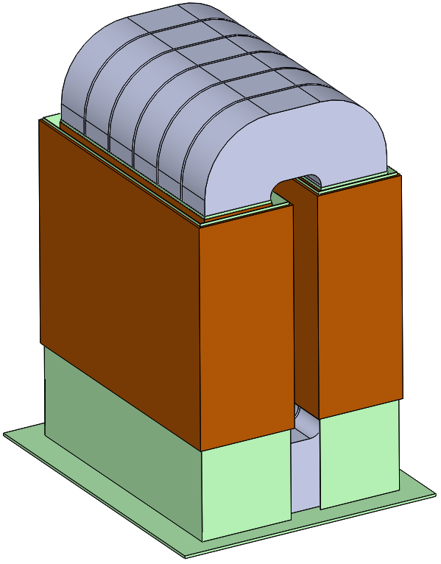
PT-based modulator for ESS application requirements (I)
limit flat top ripple&droop < 0.15%
1x input capacitor
38 mF, 1.1 kV, 2.5 kA_{pk}
3x13.6 mF = ~40.8 mF
(FFLC, AVX-Kyocera)
1x output capacitor
1 mF, 1 kV
1x multi-phase dc/dc converter
3Φ, 1.1 kV, 2.5 kA_{pk}, 20 kHz
3x bouncer filter inductors
40 µH, 2.5 kA_{pk}
5x IGCT switches
5SHY 35L4522
2.8 kV_{DC}, 4 kA_{pk}
switch assembly &
auxiliary circuits
electronic
bouncer
auxiliary
switch
+ low power supply
+ …
capacitor bank
energy storage
15x capacitor
ALS30A222NP500
~20% droop
9x910 µF = 8.2 mF
6 kV capacitors
(TRAFIM, AVX-Kyocera)
HV divider
voltage sensor
+ current transformer
+ …
high voltage
oil tank assembly
HV long pulse
matching transformer
nominal power: 660 kVA
= 5x standard 800x800x2000 electrical cabinets
each cabinet fitted with 2x75 kW or 3x50 kW charger modules
+ controller, junction box, …
capacitor charger cabinets
13

Slide 14
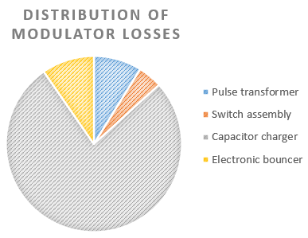
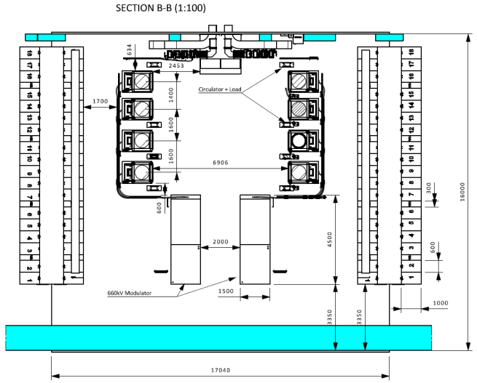
PT-based modulator for ESS application requirements (II)
Modulator electrical efficiency between 83% - 89.5%
Considerable uncertainty regarding the accuracy of capacitor charger efficiency: “85%-95% under nominal load”
  Furthermore: impact of harmonics, reactive power, compensators, not operating at nominal power, …?
Total modulator efficiency is a function of electrical efficiency, waveform factor, and pulse rise time:
η_{e} ≈
83 - 89.5%
η_{m} = f(η_{e}, K, t_{r}) = { t_{r} = 120 µs } = 71.2% - 76.7%
ESS SML modulators: η_{m}=78%
(η_{e} = 90%, η_{p}=86.6%)
… maintainability?
… manufacturability?
.. but fixed K = 2/3 for long pulse transformers ..
.. might not fit in ESS RF gallery ..
2000 mm
1400 mm
1600 mm
4000 mm
5400 mm
ESS SML modulators:
footprint: 1.6 x 4.2 = 6.7 m²
1.6 x 5.4 = 8.64 m²
(30% greater than SML modulators)
14

Slide 15
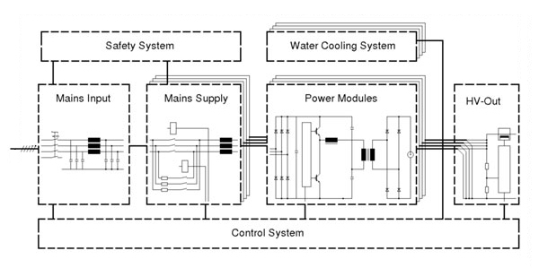
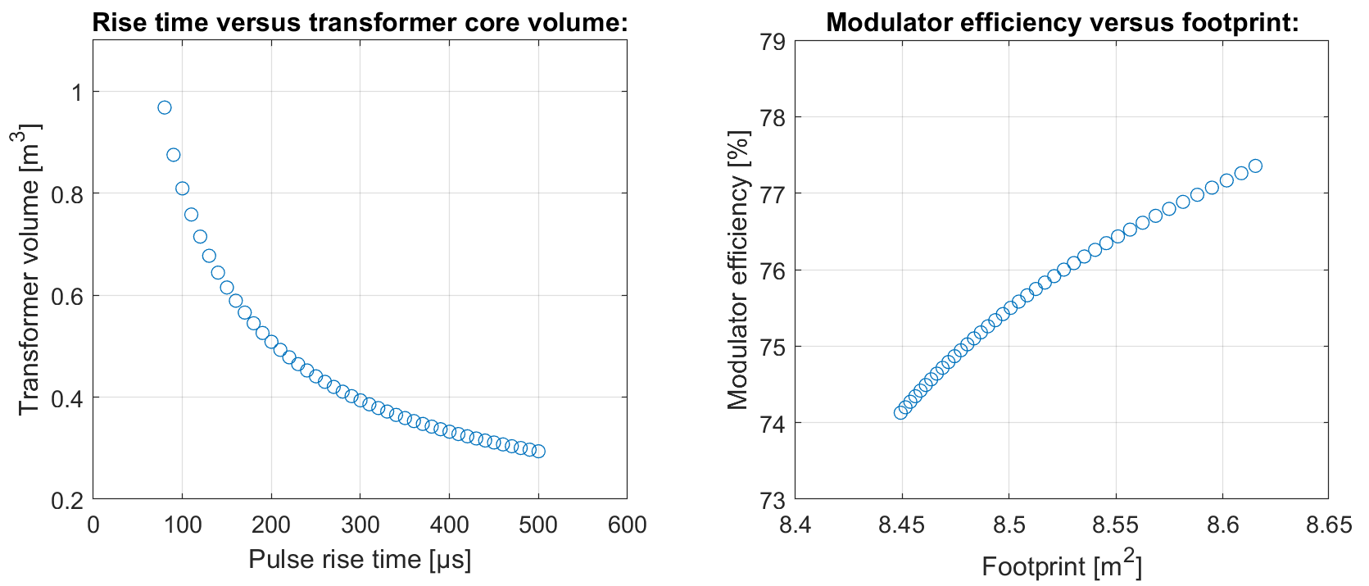
What can we do with respect to modulator efficiency?
Modulator efficiency for pulse transformer-based modulators in long pulse high power applications:
Improve electrical efficiency?
  Chargers- consider customized charger design? Impact on size? Reliability?
  Still- medium voltage capacitor chargers require at least 4 conversion stages…
  Switch?
  Bouncer? … +0.5% at the expense of doubling the size of the capacitor bank
  Pulse transformer?
Improve (shorter) rise time?
  The existing rise time already severely limits the number of turns, requiring a very large transformer magnetic cross-sectional area..
η_{m} = f(η_{e}, t_{r}) = { t_{r} = 120 µs } = 71.2% - 76.7%
capacitor chargers are a strong driver of both modulator size and efficiency
?
t_{r} = 120 µs
η_{m} =71.2% – 76.7%
~0.17 m² (2%...)
allowing a longer rise time simplies transformer design, but represents a modest reduction in footprint and at a severe reduction in modulator efficiency..
~3.5%
t_{r} = 120 µs
t_{r} = 250 µs
t_{r} = 500 µs
15

Slide 16
Conclusions
The simplicity of the conventional pulse transformer-based modulator topology limits performance in long pulse applications:
  The pulse transformer number of turns must be limited to ensure decent pulse efficiency (η_{m} ~ t_{r} ~L_{s} ~N² …)
  Limiting number of turns requires an enormous magnetic cross-sectional area to handle the flux associated with the long pulse
  … = either very bulky and impractical pulse transformer, or poor pulse efficiency …
Fixed electrical efficiency (straightforward system design…)
Capacitor charger is a strong driver of both system volume and system electrical efficiency; opportunity for improvement?
Pulse transformer-based modulator topology cannot easily be scaled for increased pulse repetition rate/pulse length/average power/… in view of long pulse high power applications
SML-type modulators, specifically developed for long pulse applications, are (topologically) more complex, but allow greater freedom in design
  Can vary, e.g., the combination of switching frequency/number of output modules/filter parameters/… in design
SML modulators allow capacitor chargers based on standardized low voltage semiconductors = improved efficiency and volume
The SML topology is based on a pulse modulation/demodulation scheme…
  Decouples modulator size from pulse length
  Significantly simpler to scale up in terms of increased pulse repetition rate/pulse length/average power/…
16

