Slide 1
Ultra low energy ion implantation into transition metal dichalcogenides
B. E. Kardynał
Peter Grünberg Institute 9 (PGI-9),
Forschungszentrum Jülich, Germany
Notes:
Add team members

Slide 2

6/28/2022
2
Acknowledgements
FZJ PGI-9
Minh Bui
Dr Sven Borghardt
Thipwaree Keawphong
Dr Renu Rani
Lanqing Zhou, David Fricker, Zeng Zheng
University of Göttingen
Dr Manuel Auge
Felix Junge
Prof Dr Hans Hofsäss
FZJ PGI-1/IAS-1
Stefan Rost
Dr Christoph Friedrich
Dr Irene Aguilera
Prof Dr Stefan Blügel
University of Limerick
Dr Eoghan O’Connell
Mike Hennessy
Eoin Moynihan
Prof Dr Ursel Bangert
SuperSTEM
Dr Quentin Ramasse
Helmholtz‐Zentrum Dresden‐Rossendorf
Prof Dr Arkady Krasheninnikov
Dr Mahdi Ghorbani
FZJ HNF
Dr Jhih-Sian Tu
Janine Worbs
Stephanie Bunte
FZJ ER-C
Dr Lei Jin
Lidia Kibkalo
Aalto University
Dr Hannu-Pekka Komsa
Arsalan Hashemi
Integration of Molecular Components in Functional Macroscopic Systems initiative

Slide 3
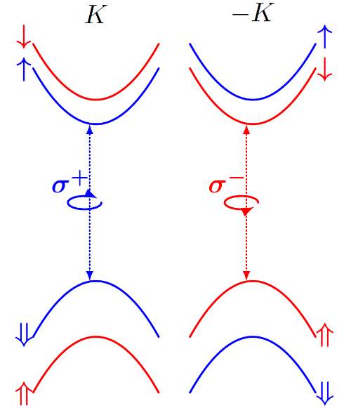
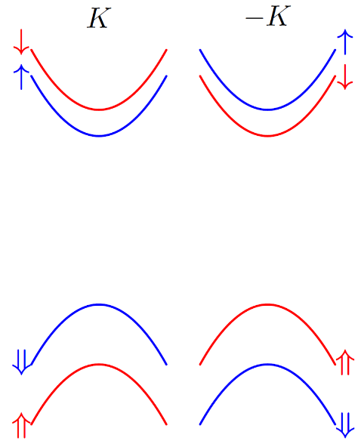
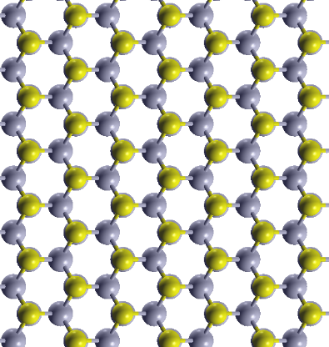

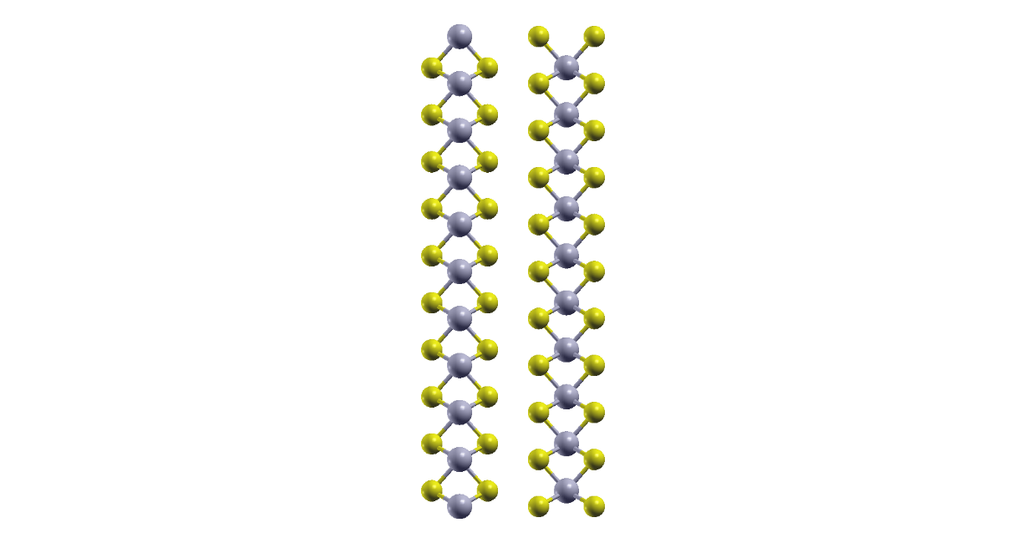

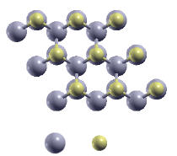
Spin-valley-polarisation locking
MoSe₂
Plan view
1st Brillouin zone
-K
K
K
-K
-K
K
Side view
Mo,W
Symmetry: trigonal, lack of inversion symmetry
Spin-orbit interactions
Spin-valley qubit
Se,S
Direct bandgap
Strong excitonic effects
Optical readout
Notes:
Valence spin splitting: 100s meV
Conduction band splitting: up to 40 meV
Spin-valley-photon polarization locking

Slide 4
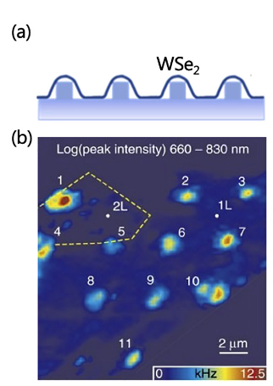
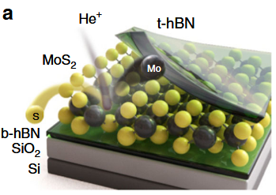
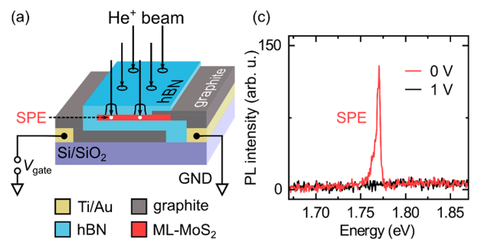
Localisation of excitons
By strain:
On defects:
Klein et al. Nat Commun 10, 2755 (2019)
Brammy et al. Nat. Commun. 8, 15053 (2017)
L. Yu, Nano Lett. 21, 2376 (2021)
Hötger et al., Nano Lett. 21, 1040–1046 (2021)
Notes:
Valley coherence together with other properties: optically addressable spin-valley qubit.
Probed in very simple structures.
Gamma valley, dispersion – 0.01% of excitons in the light cone
Bohr radius 2 nm
Access on single particle level: confinement of an exciton or trion
The way to do it: localize electron / hole in energy minimum: gating , electrostatic, dielectric, doping

Slide 5
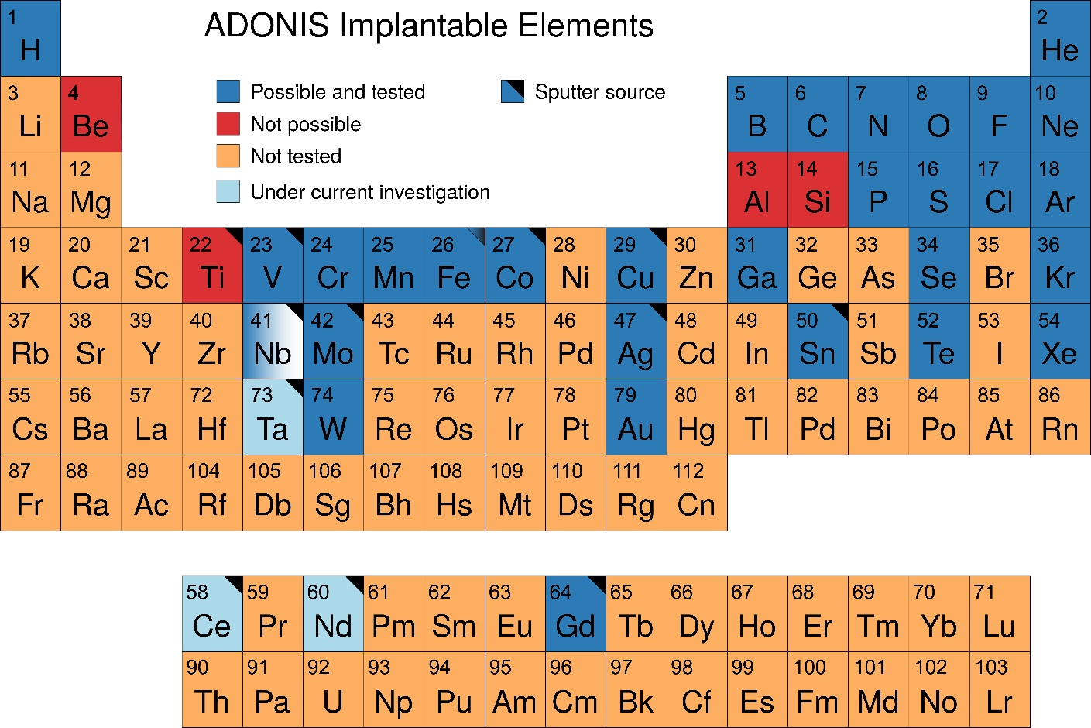
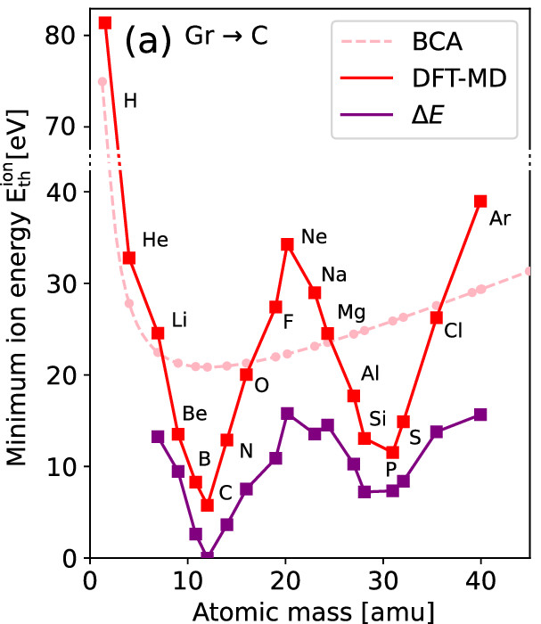
Why ultra low energy ion implantation?
S. Kretschmer et al., J. Phys. Chem. Lett. 13 (2022) 514−519
WHY IMPLANTATION?
Wide range of elements can be used
Clean, performed in vacuum
Post-annealing possible
WHY ULTA LOW ENERGY?
Enough to implant in the ML
Limits number of undesired defects
Enables patterned implantation with free surface
Notes:
Valley coherence together with other properties: optically addressable spin-valley qubit.
Probed in very simple structures.
Gamma valley, dispersion – 0.01% of excitons in the light cone
Bohr radius 2 nm
Access on single particle level: confinement of an exciton or trion
The way to do it: localize electron / hole in energy minimum: gating , electrostatic, dielectric, doping

Slide 6
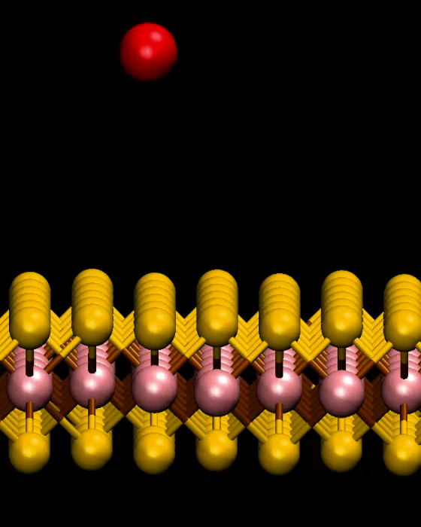
Simulation of Se implantation into MoS₂
Molecular Dynamic simulation: 128 events
Se@S
Se adatoms
S vacancies
A. Krasheninnikov (HZDR, Dresden)
Bui et al., npj 2D Mater Appl 6, 42 (2022)
Notes:
Valley coherence together with other properties: optically addressable spin-valley qubit.
Probed in very simple structures.
Gamma valley, dispersion – 0.01% of excitons in the light cone
Bohr radius 2 nm
Access on single particle level: confinement of an exciton or trion
The way to do it: localize electron / hole in energy minimum: gating , electrostatic, dielectric, doping

Slide 7
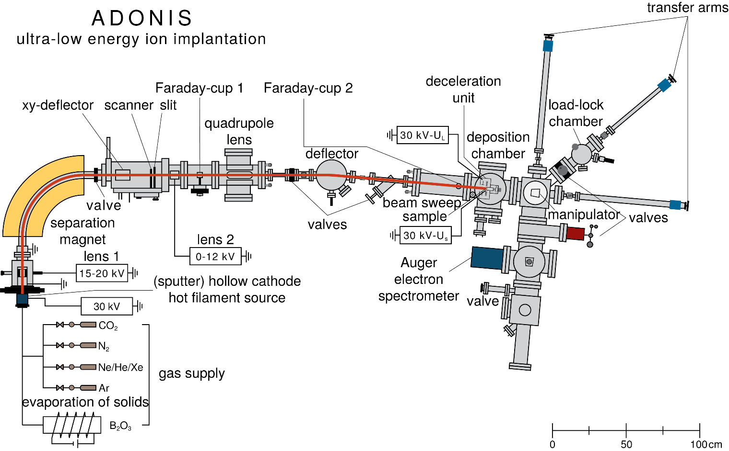
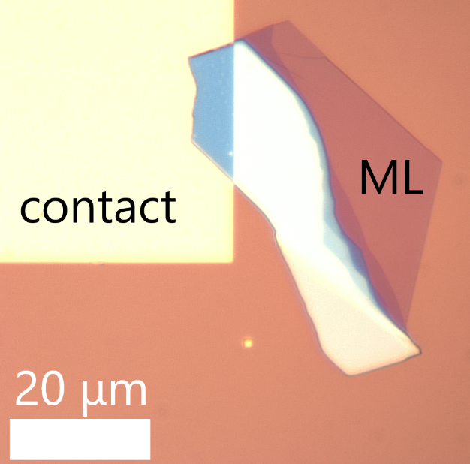
Ultra-low energy ion implantation
MoS₂ on SiO₂
Notes:
Valley coherence together with other properties: optically addressable spin-valley qubit.
Probed in very simple structures.
Gamma valley, dispersion – 0.01% of excitons in the light cone
Bohr radius 2 nm
Access on single particle level: confinement of an exciton or trion
The way to do it: localize electron / hole in energy minimum: gating , electrostatic, dielectric, doping

Slide 8
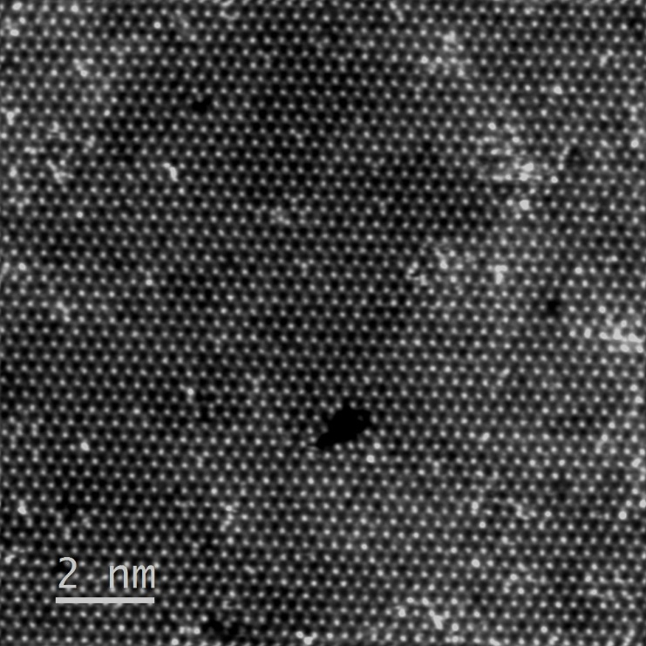
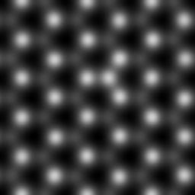
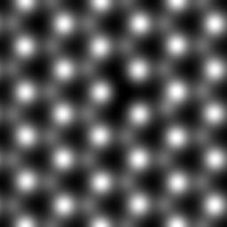
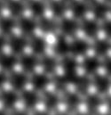
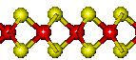
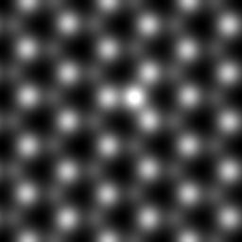

Experimental and simulated HAADF images
MoS₂ implanted with Se at E~10 eV with 10¹⁵ ions/cm²
experimental HAADF STEM image
simulated HAADF STEM images
1
2
3
1
4
2
3
4
Eoghan O’Connell et al – IMC 19
Notes:
Valley coherence together with other properties: optically addressable spin-valley qubit.
Probed in very simple structures.
Gamma valley, dispersion – 0.01% of excitons in the light cone
Bohr radius 2 nm
Access on single particle level: confinement of an exciton or trion
The way to do it: localize electron / hole in energy minimum: gating , electrostatic, dielectric, doping

Slide 9
Optical spectroscopy
~ 0.43 Se/S on top layer
Bui et al. npj 2D Mater Appl 6, 42 (2022)
Notes:
Valley coherence together with other properties: optically addressable spin-valley qubit.
Probed in very simple structures.
Gamma valley, dispersion – 0.01% of excitons in the light cone
Bohr radius 2 nm
Access on single particle level: confinement of an exciton or trion
The way to do it: localize electron / hole in energy minimum: gating , electrostatic, dielectric, doping

Slide 10
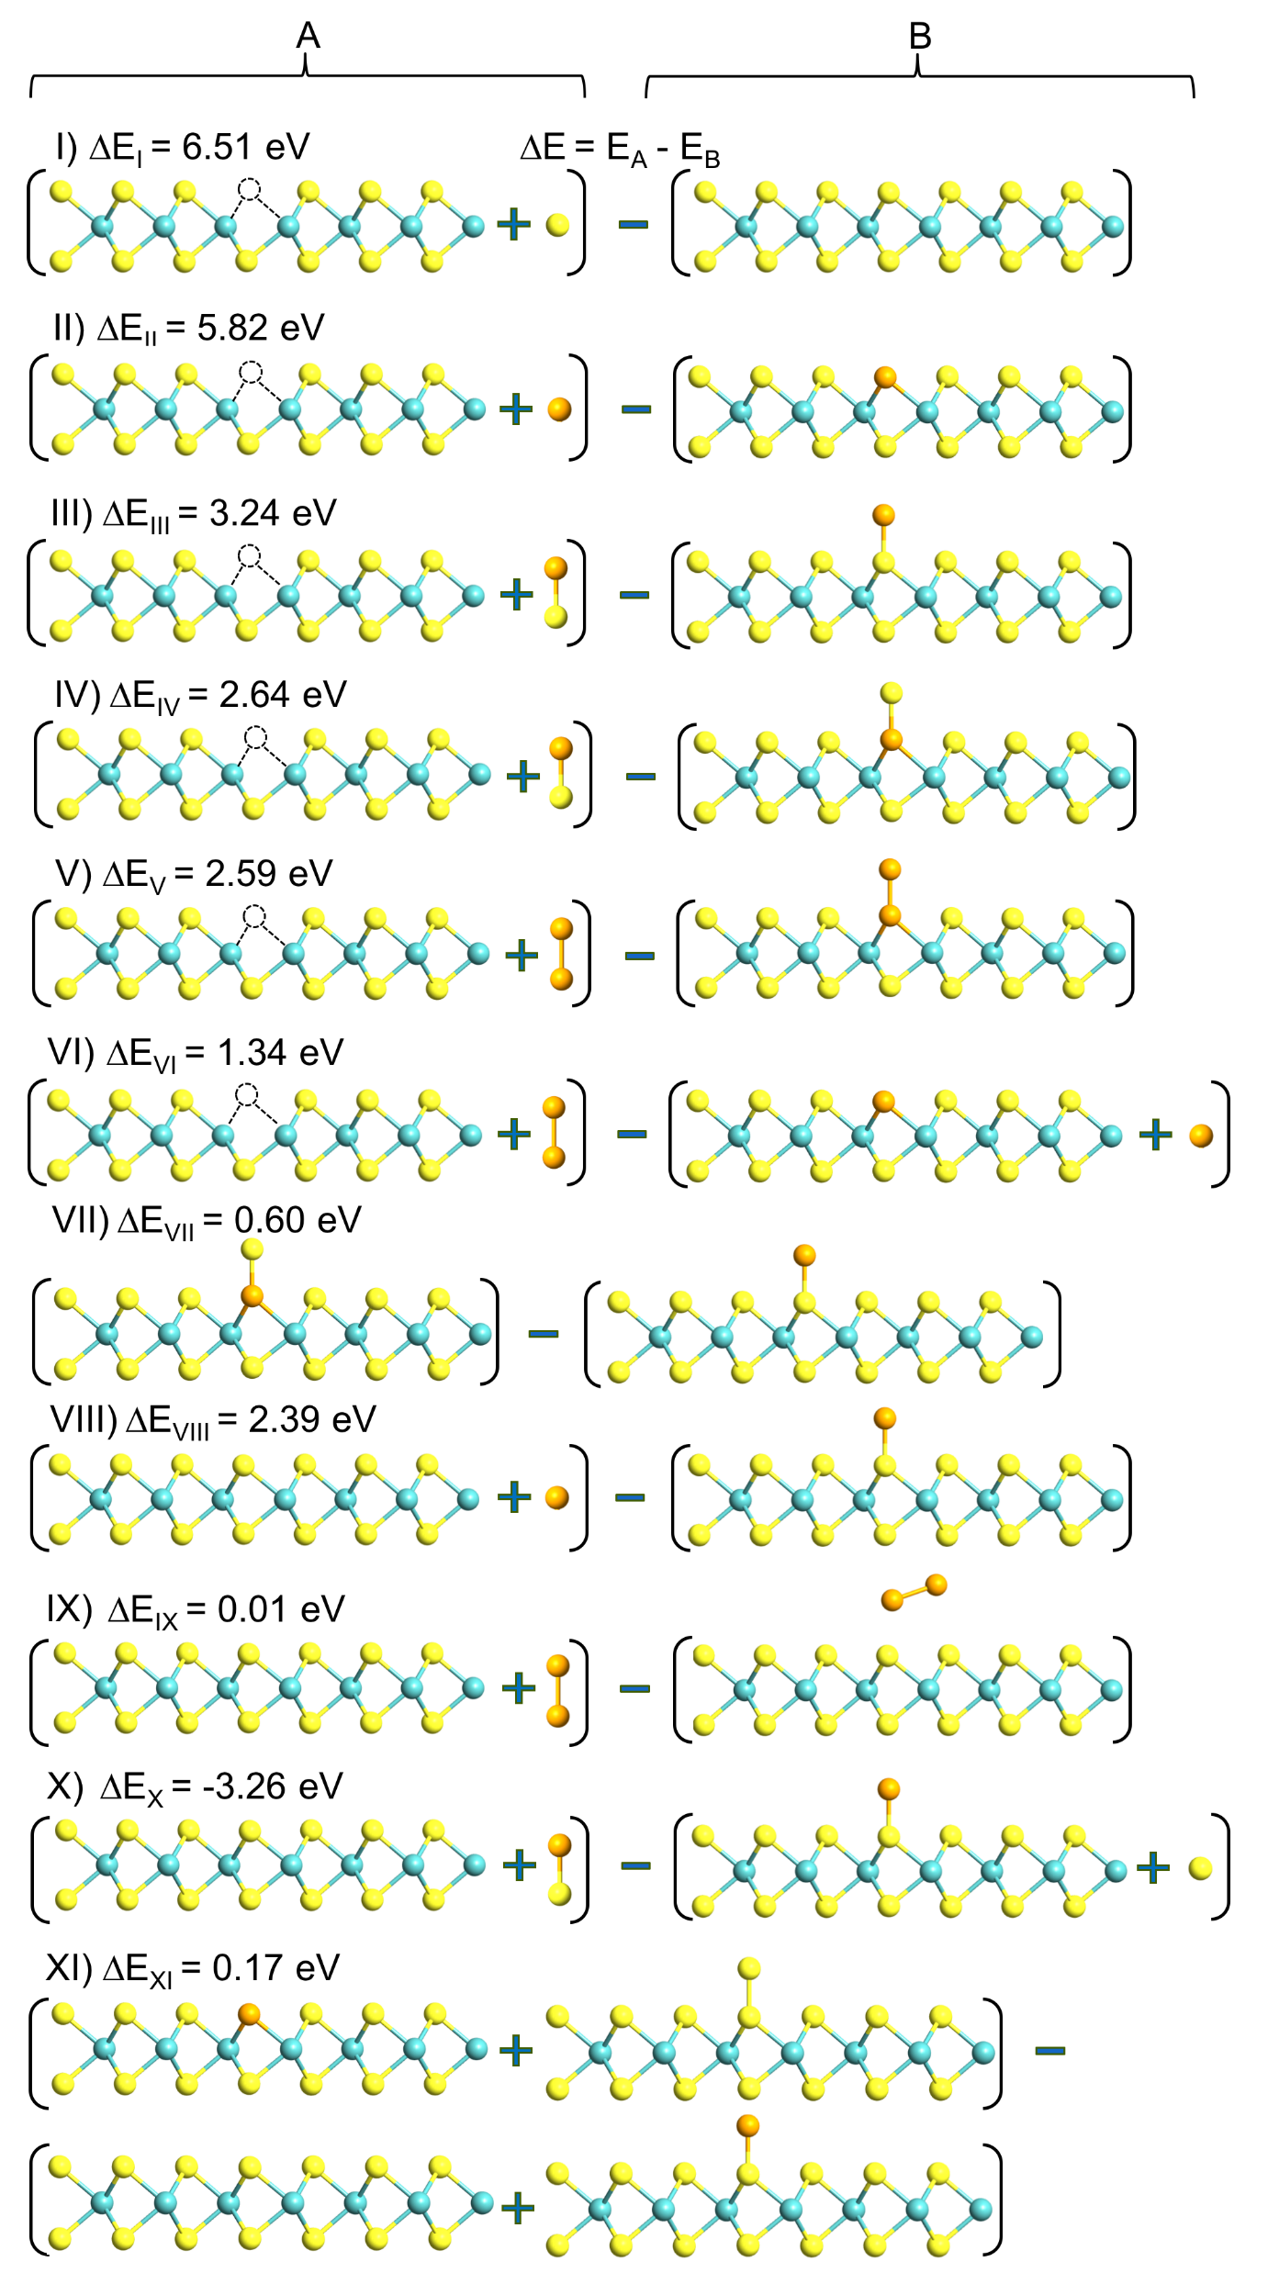
Photoluminescence spectra
Annealing conditions selected considering the binding energy of adatoms:
Annealing: 200ºC, 3 h, 5 x10⁻³ mbar
Under investigation:
MoSe₂ + S
Notes:
Valley coherence together with other properties: optically addressable spin-valley qubit.
Probed in very simple structures.
Gamma valley, dispersion – 0.01% of excitons in the light cone
Bohr radius 2 nm
Access on single particle level: confinement of an exciton or trion
The way to do it: localize electron / hole in energy minimum: gating , electrostatic, dielectric, doping

Slide 11
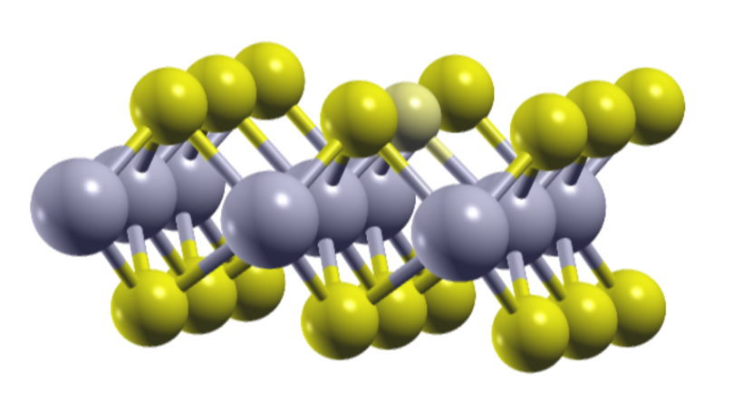

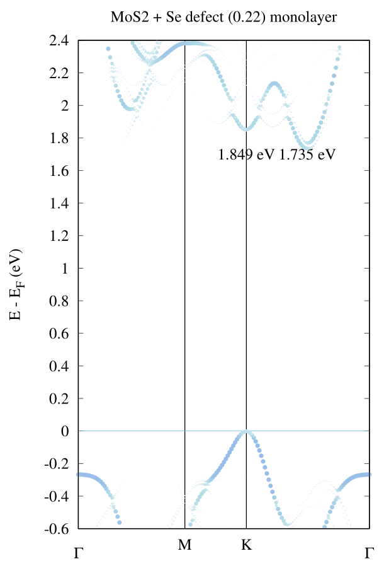
DFT calculations of implanted layers
MoS_{2-0.22}Se_{0.22} ML
2.0
1.0
0.0
1.8
1.7
1.6
1.5
1.4
E-E_{F} (eV)
MoSe₂
MoSe_{2-0.33}S_{0.33}
E-E_{F} (eV)
Γ
M
K
Γ
Bui et al. npj 2D Mater Appl 6, 42 (2022)
Γ
M
K
Γ
Notes:
Correct DFT if time allows

Slide 12
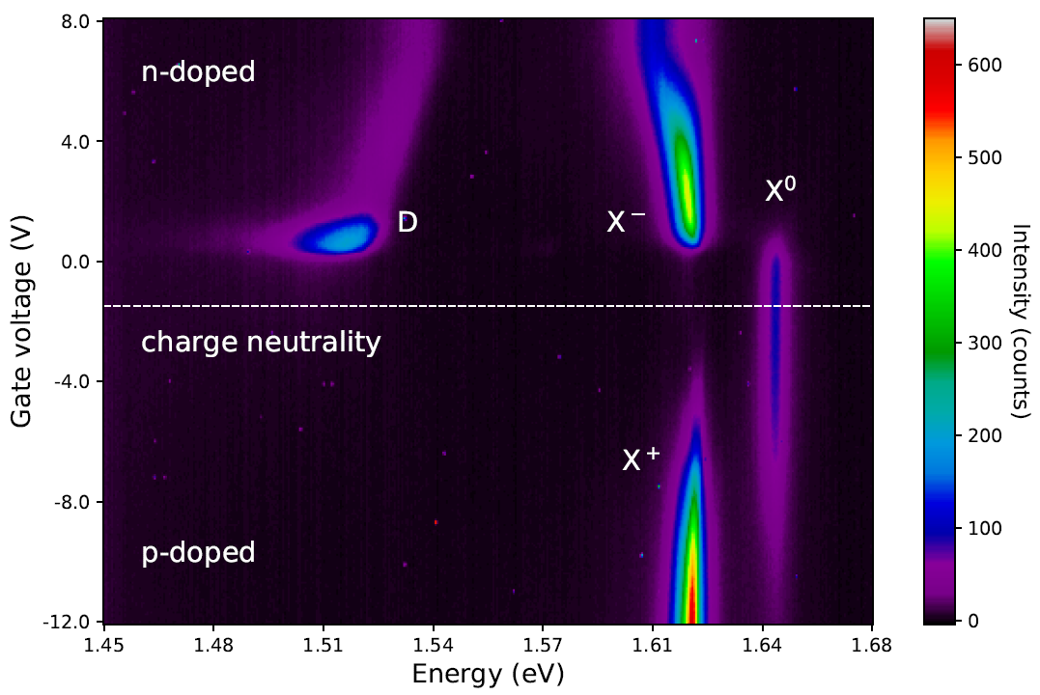
Emission from Cr (E=25eV) implanted MoSe₂
With the possible options:
the origin of D⁰ state is not clear.
interstitial 28%
Cr-Se@Se 41%
T = 10 K
Cr@Mo 28%
top hBN
D⁰
ML
Under investigation:
MoSe₂ + P
hBN +He, Ne, Kr
bottom hBN
D⁰ bound exciton
Gr back
e⁻
h⁺
V
Notes:
Very similar to trion.

Slide 13
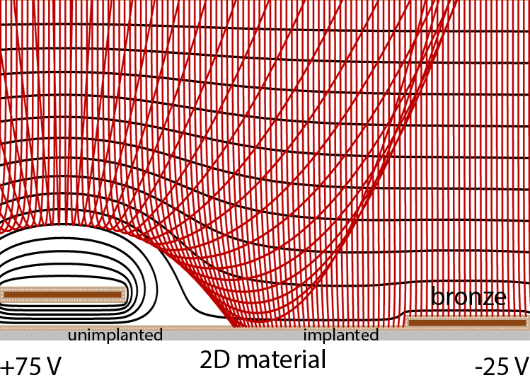
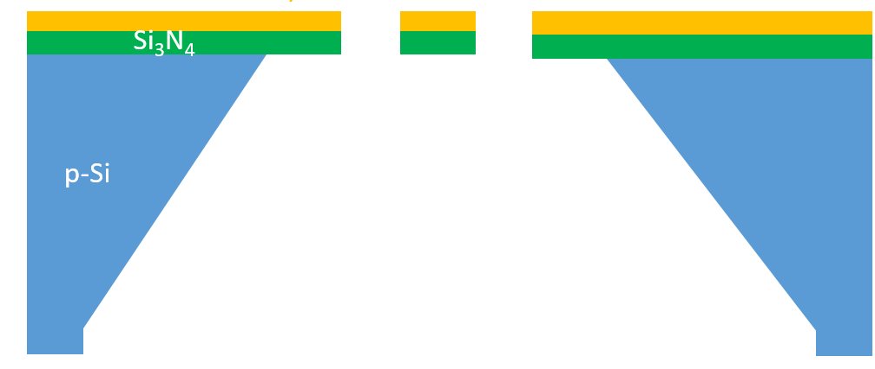
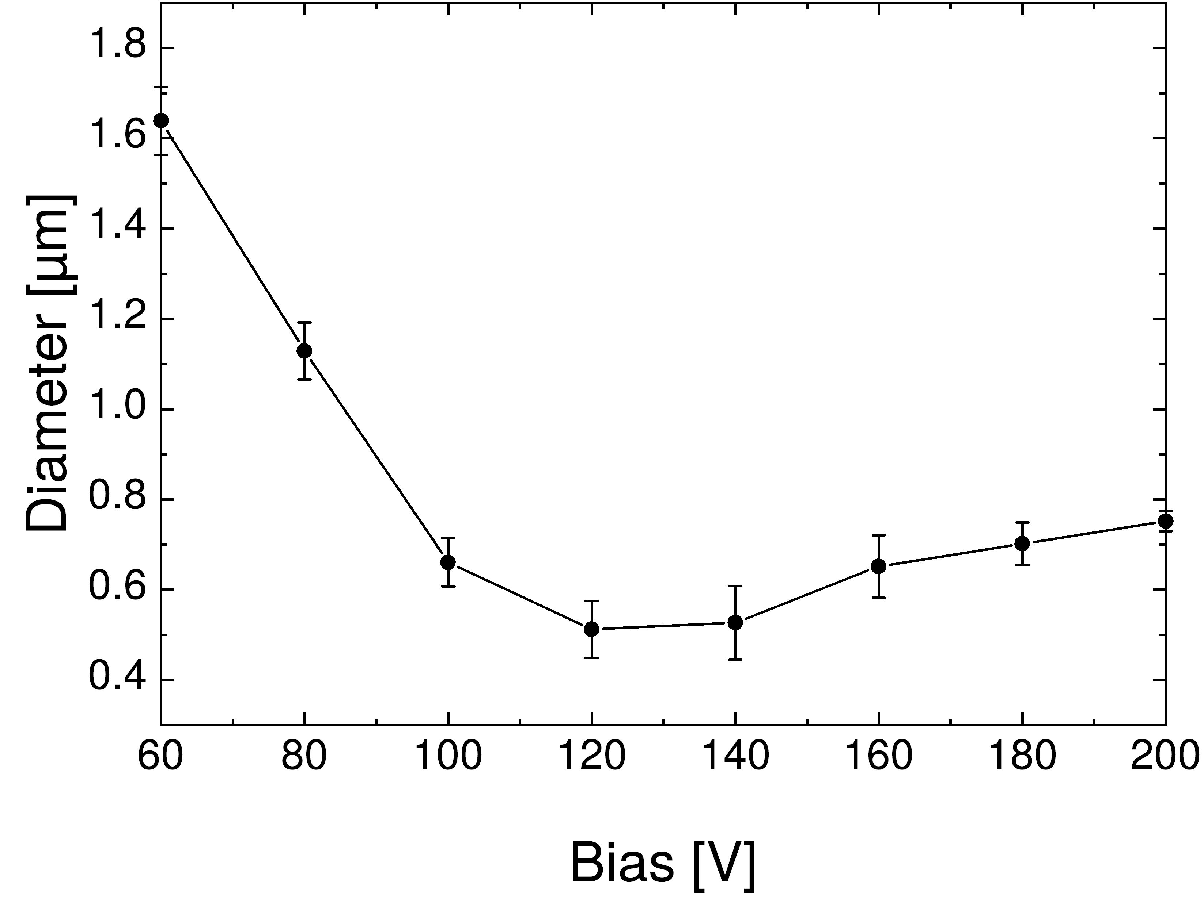
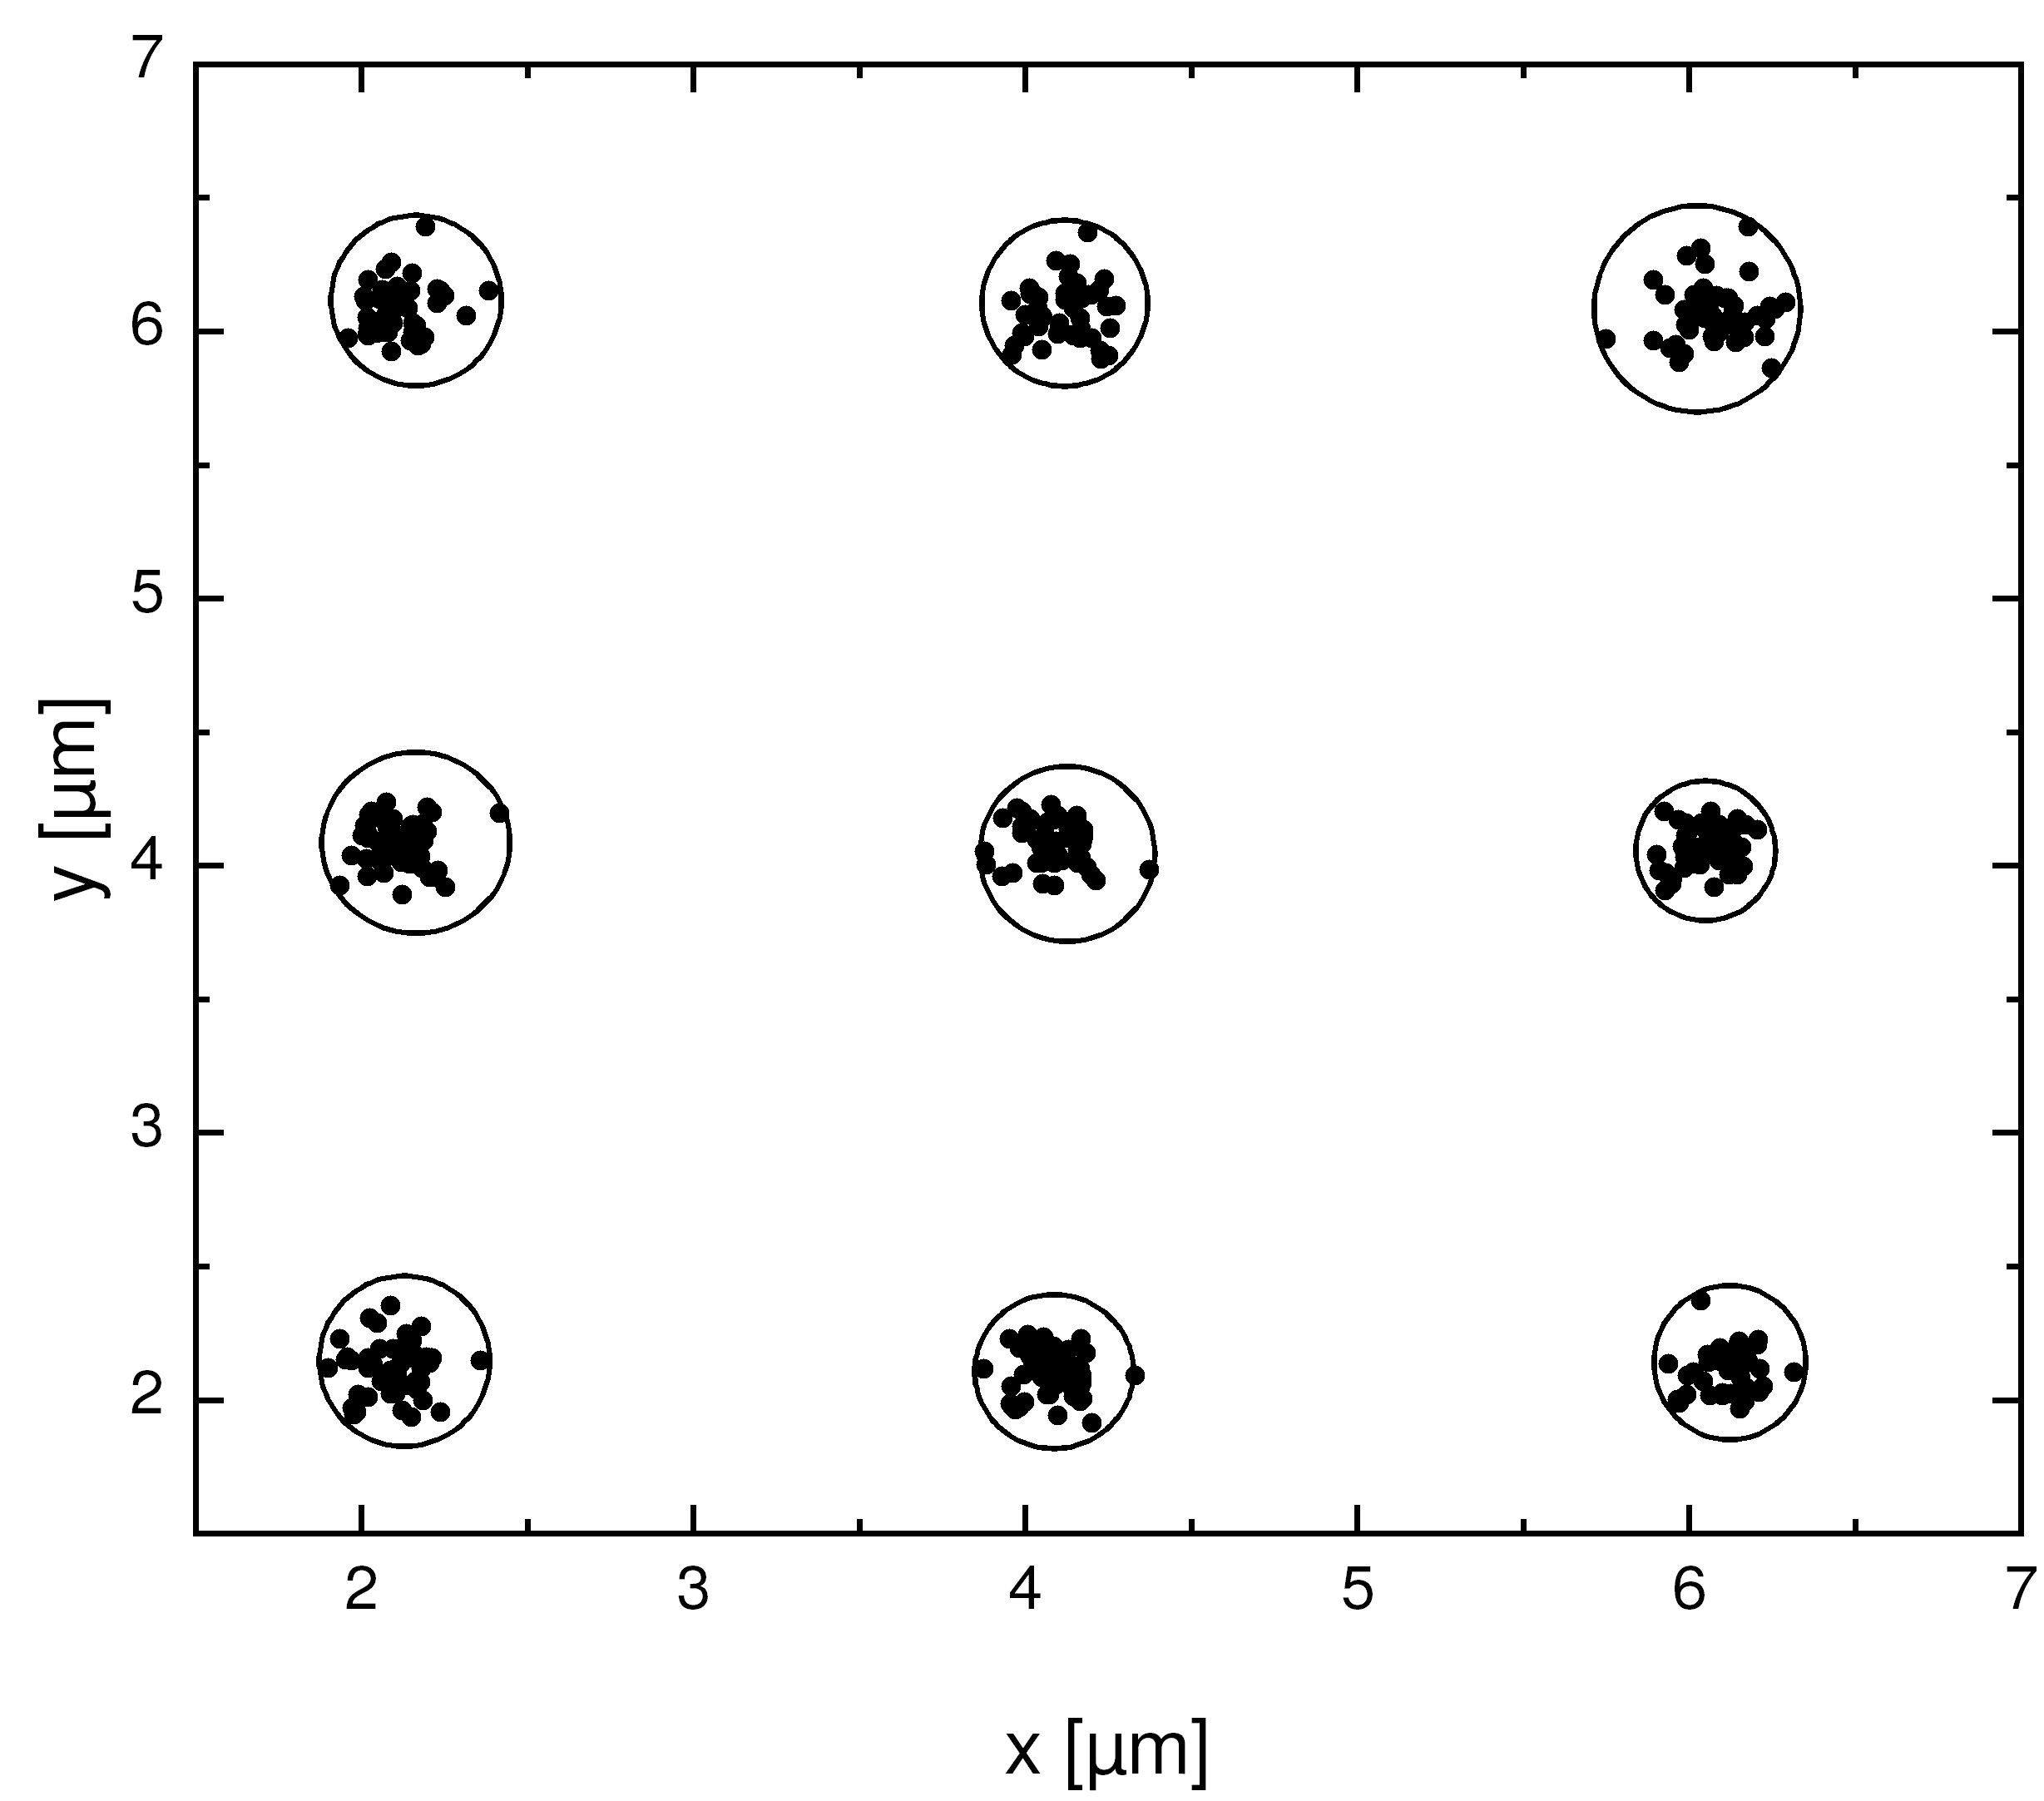
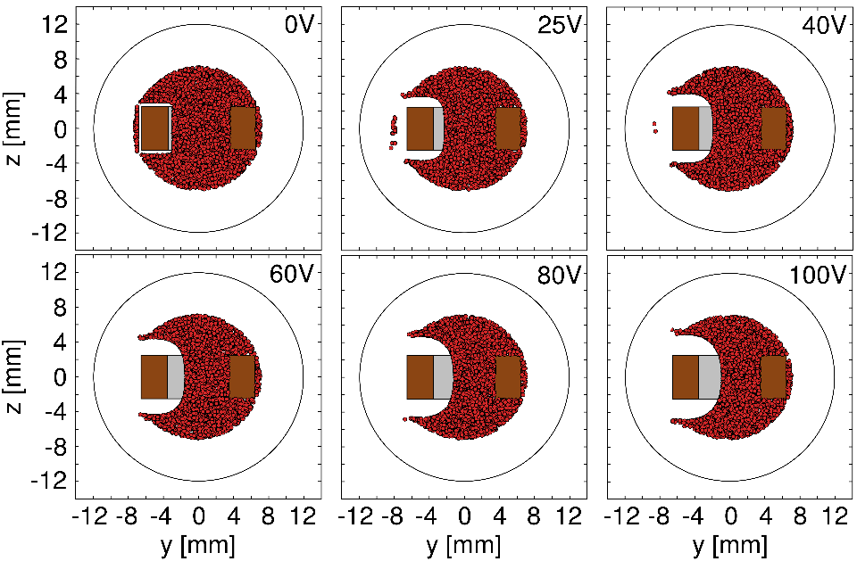
Patterned implantation
V_{ion}
Cr/Au
V_{mask}
Implantation target
Hole
diameter
Notes:
Valley coherence together with other properties: optically addressable spin-valley qubit.
Probed in very simple structures.
Gamma valley, dispersion – 0.01% of excitons in the light cone
Bohr radius 2 nm
Access on single particle level: confinement of an exciton or trion
The way to do it: localize electron / hole in energy minimum: gating , electrostatic, dielectric, doping

Slide 14
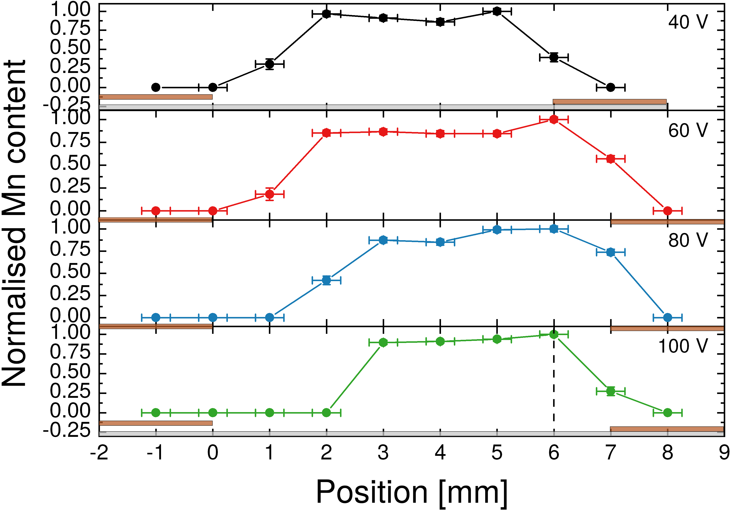
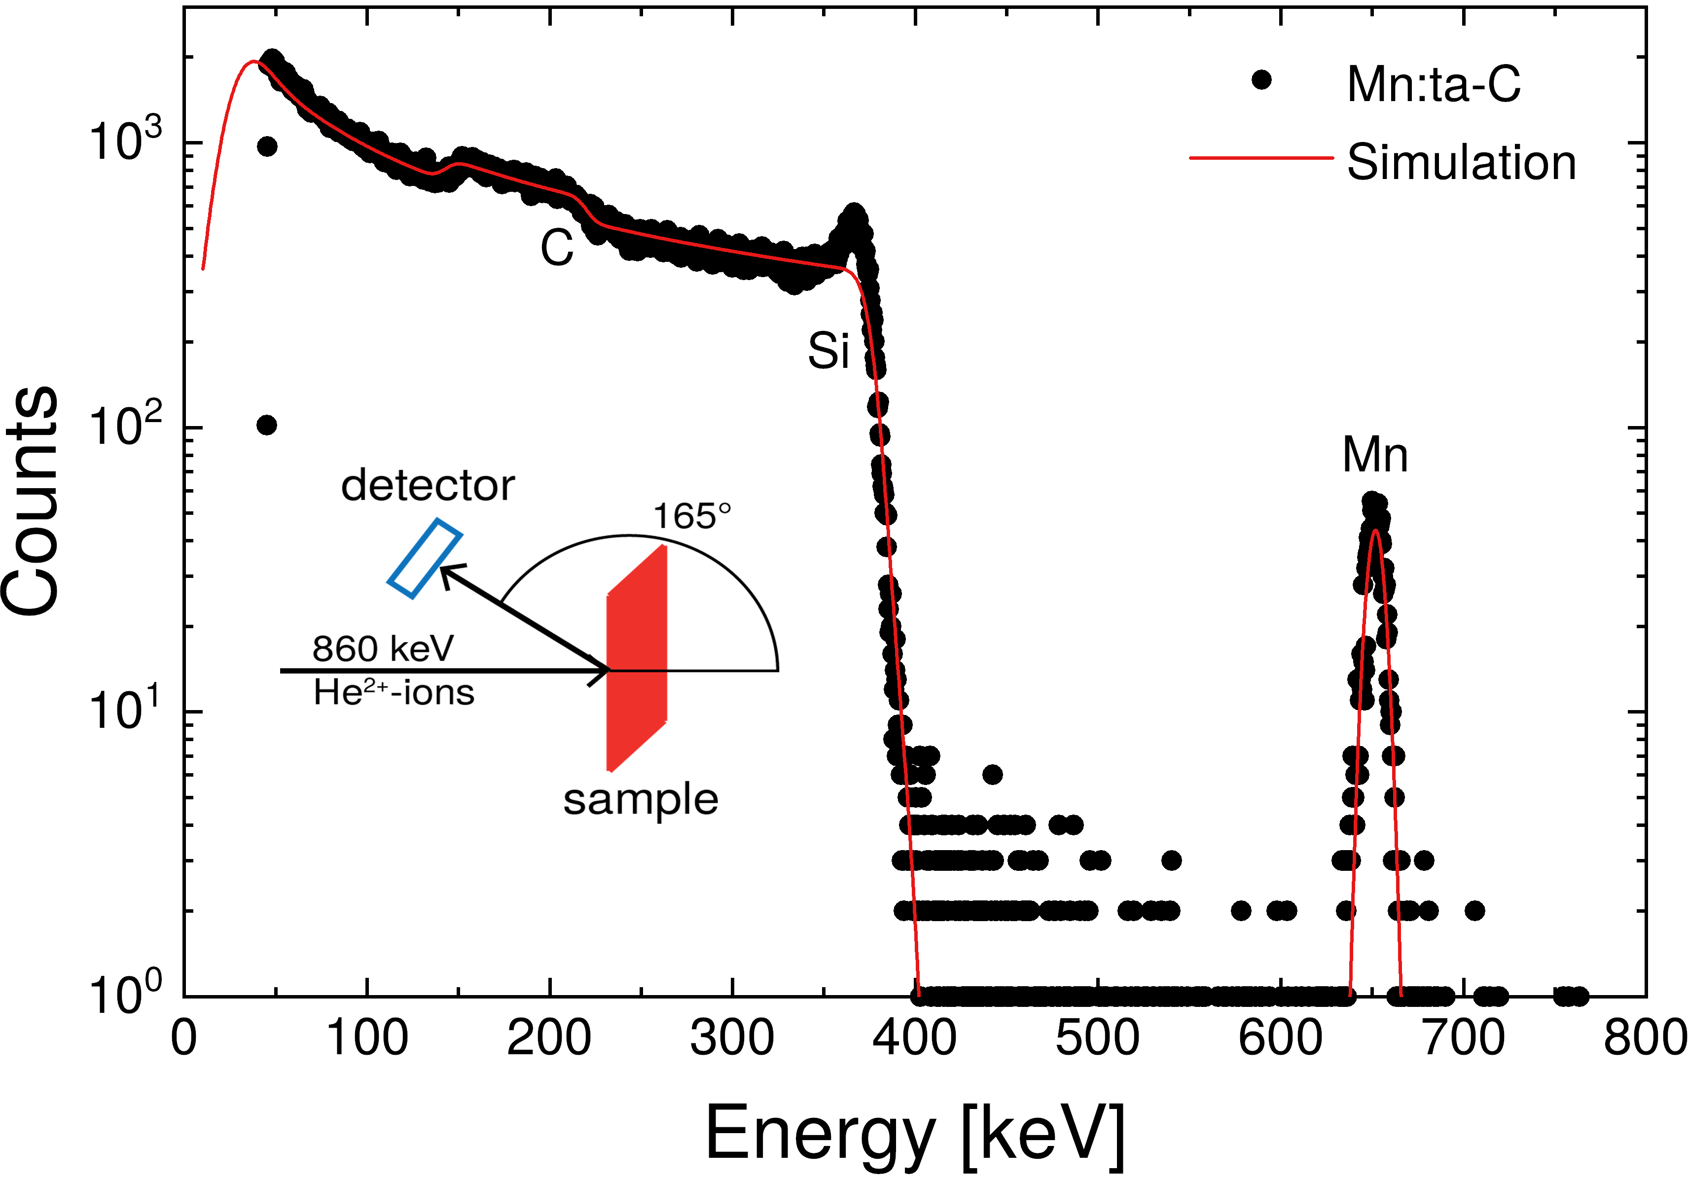
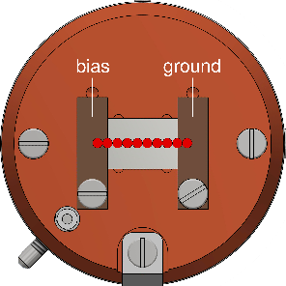
Laterally controlled ULE ion implantation
Implantation of 25 eV Mn ions into ta-C/Si
Adjustment of all spectra by means of SIMNRA
M. Auge et al, NIM-B, 512, 96 (2022)

Slide 15
Summary
Material and process design:
  ion trajectories simulations
  Molecular Dynamics
  DFT calculations
Characterisation:
  TEM
  optical spectroscopies
Ultralow energy implantation into MoS(Se)₂ has allowed us to :
  Generate strain on an atomic scale
  Introduce defects
Ultra low energy implantation very flexible / number of applications
Still much to find out !

Slide 16
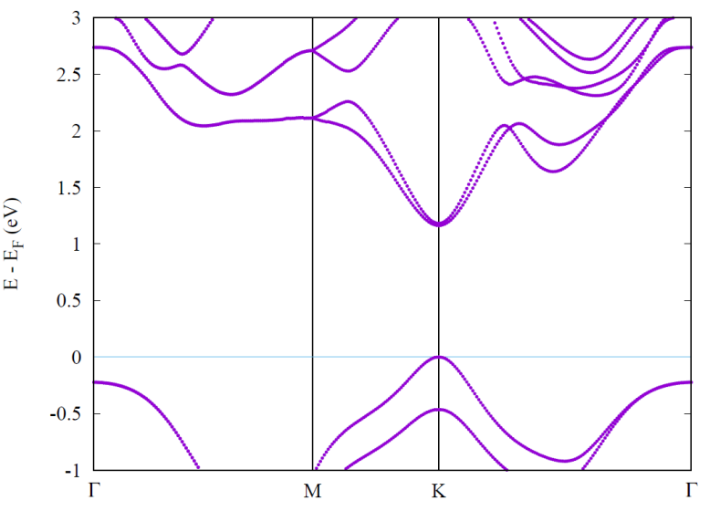
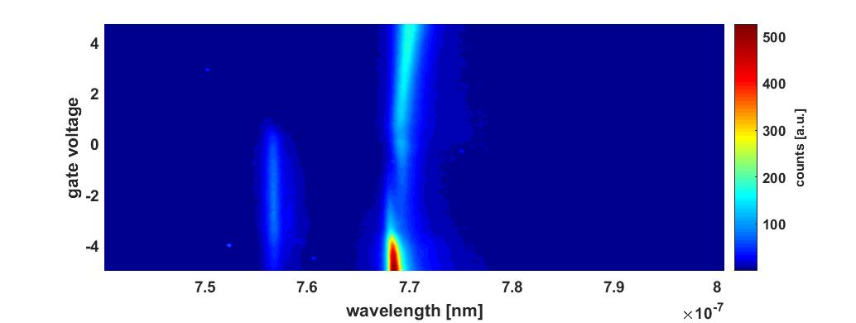
TMDs monolayers
Plan view
3
2
1
0
-1
E (eV)
Γ
-K
M
K
4.0
2.0
0.0
-2.0
-4.0
Max
X⁻
Side view
Gate voltage (V)
Γ
M
K
Γ
Mo,W
X₀
Se,S
Min
X⁺
1.550 1.575 1.660 1.625 1.650 1.675
Energy (eV)
Notes:
Lattice: hexagonal. Minimum at K-point -> direct bandgap. El and holes in the metal layer. 2D confinement means very stong Coulomb interactions. X binding energy depends on the environment and is up to 300meV in vacuum. The result: excitons live even at room temperature. Excitons sensitive to the external fields – dipole field penetrates into barriers.

Slide 17
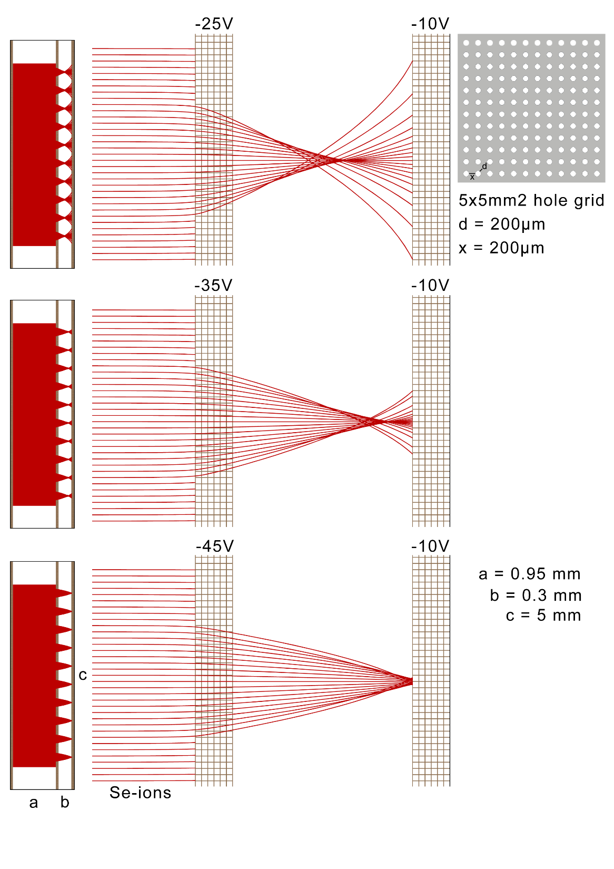
Patterned implantation: simulations
Grid 2
Hole diameter: 1 µm
Spacing: 2 µm

Slide 18
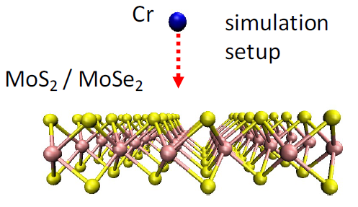
Cr implantation in MoSe₂ - Molecular Dynamics simulation
25 eV
A. Krasheninnikov (HZDR, Dresden)
Cr@Mo 28%
Cr-Se@Se 41%
interstitial 28%
Notes:
Valley coherence together with other properties: optically addressable spin-valley qubit.
Probed in very simple structures.
Gamma valley, dispersion – 0.01% of excitons in the light cone
Bohr radius 2 nm
Access on single particle level: confinement of an exciton or trion
The way to do it: localize electron / hole in energy minimum: gating , electrostatic, dielectric, doping

Slide 19
Emission from Cr implanted MoSe₂
With the possible options:
the origin of D⁰ state is not clear.
top hBN
ML
interstitial 28%
bottom hBN
Gr back
Cr-Se@Se 41%
V
T = 10 K
Cr@Mo 28%
V = 2.0V
x1
D⁰
x3
D⁰ bound exciton
e⁻
h⁺
Notes:
Very similar to trion.

Slide 20
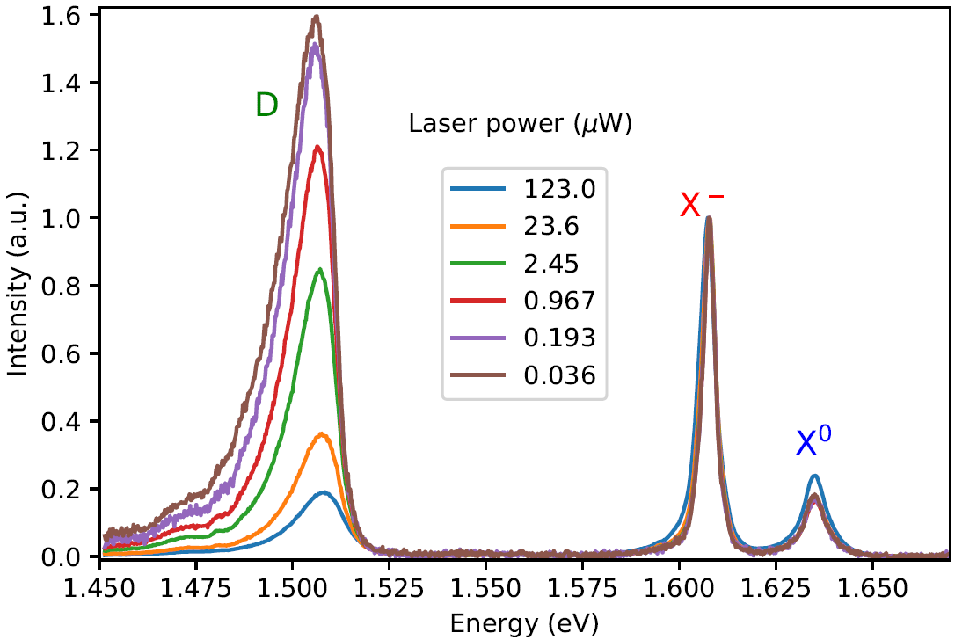
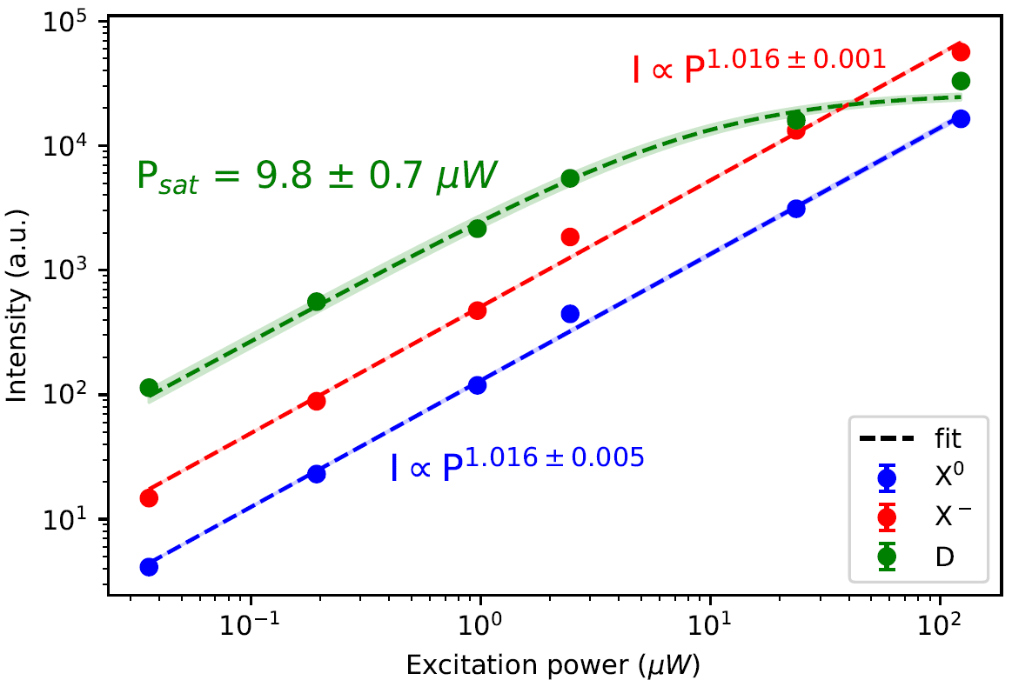
Power dependence
D peak decreases relatively to X⁰ and X⁻
Saturation 10 µW
I = I_{sat} . P/(P+P_{sat})
defect
Bound exciton
Defect-band transition
e⁻
h⁺
Notes:
Valley coherence together with other properties: optically addressable spin-valley qubit.
Probed in very simple structures.
Gamma valley, dispersion – 0.01% of excitons in the light cone
Bohr radius 2 nm
Access on single particle level: confinement of an exciton or trion
The way to do it: localize electron / hole in energy minimum: gating , electrostatic, dielectric, doping

Slide 21
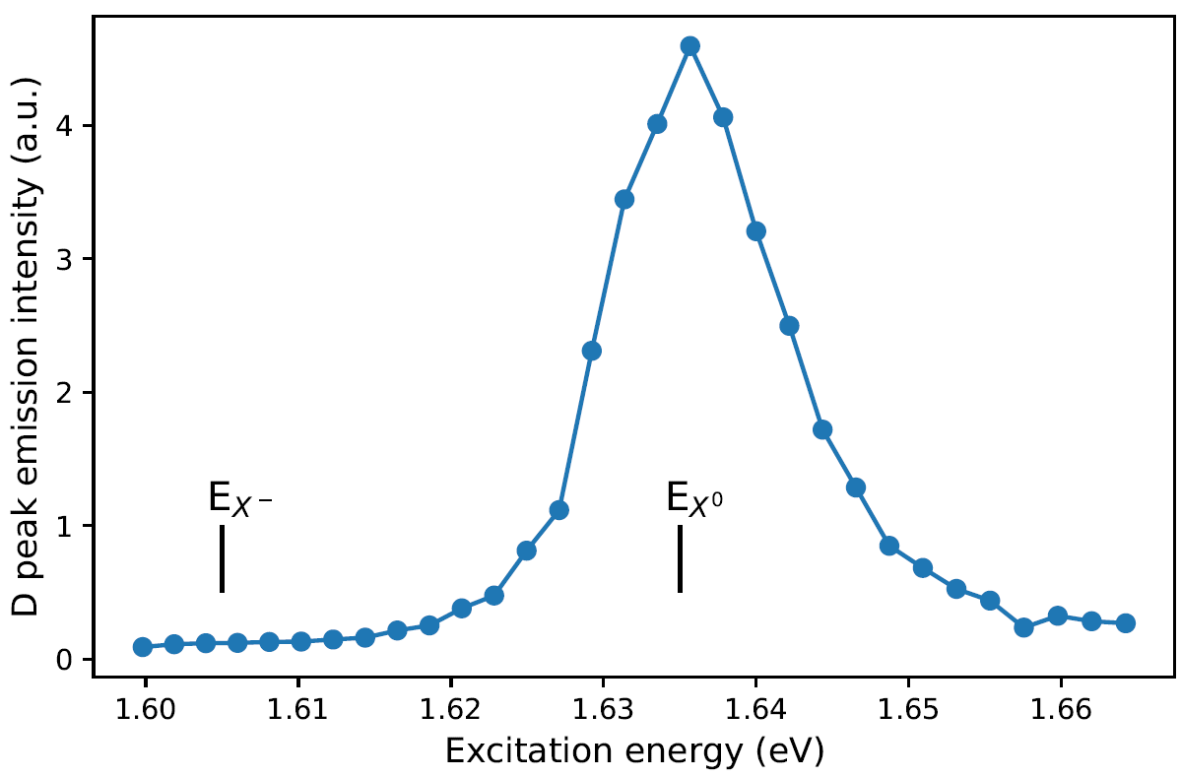

Photoluminescence excitation
D peak formation in resonance with X⁰ generation
Excitation E
Notes:
In previous measurement we excite with fixed laser wavelength. *run e- h+ animation*
More info can be gained when we see at which exc wavelengths the sample’s absorption contributes most to PL.
*run exc E anim at same time* In this measurement of PLE: vary excitation wavelength and record change in D peak intensity *anim*. This can show the absorption property of emission. In this measurement we scan the laser over the range above X0 to below X-
Intensity of D state: highest at X0 emission energy. The absorption on the other hand is not strong around X- → D emission is predominantly formed by trapping excitons, not trions.
This agrees with previous observation that D peak emission competes with X-.
Defect states: fed by X0 generation, not X-: more evidence the transition is donor-acceptor or acceptor-band.? (Competition beween X- and D?)
2 possible origin: from radiative recombination of excitons bound to charged acceptor (?). Alternative: donor-acceptor transition, or acceptor-band.
More to come with doping dependent measurement

Slide 22
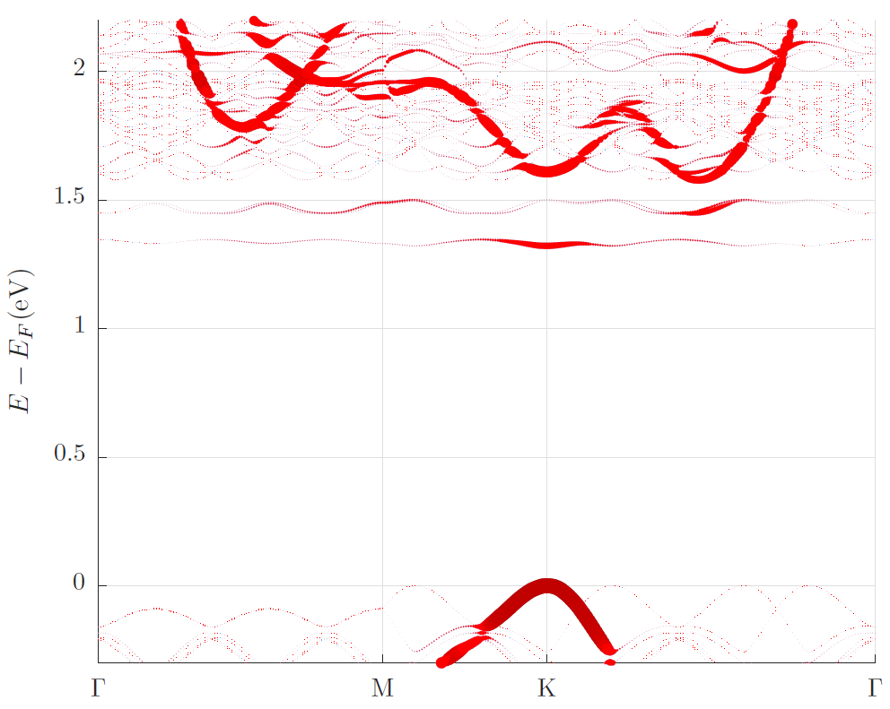
MoSe₂+Cr: DFT
MoSe₂ with Cr@Mo
S.Rost
Notes:
To see how the defects affect our optical property, we did DFT calculations to calculate the band structures of Cr@Mo and Cr@Se-sub. I should update on Stefan’s calculations for interstitial position.
Cr@Mo: acceptor state near conduction band: “Classic” defect: States localised in real space / delocalized in k-space. If the states are not degenerate, we can host single e- and single photon emission can be achieved
Cr@Se-sub: one localised state mid gap, and a dispersive state below CB
Midgap: classic defect states; Others: hybrid with conduction host states.
As a reminder, these DFT: preliminary results, don’t include many body interaction. So may missing E corrections → we don’t rely too seriously on the exact energy levels of the calculations, but the trend should be clear. In any case we should be able to see see defect states.
DFT: 5x5 cell, relaxed to 1e-4 a.u. . SOC included
#Possibility of magnetic coupling / enhancement
Cr@Se: donor state around midgap and acceptor near conduction band

Slide 23
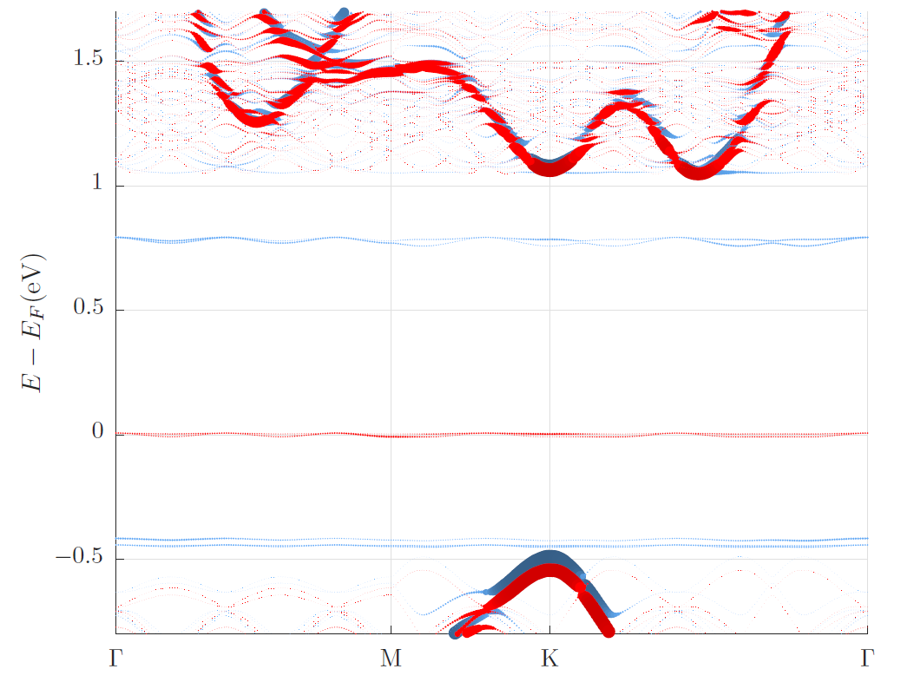
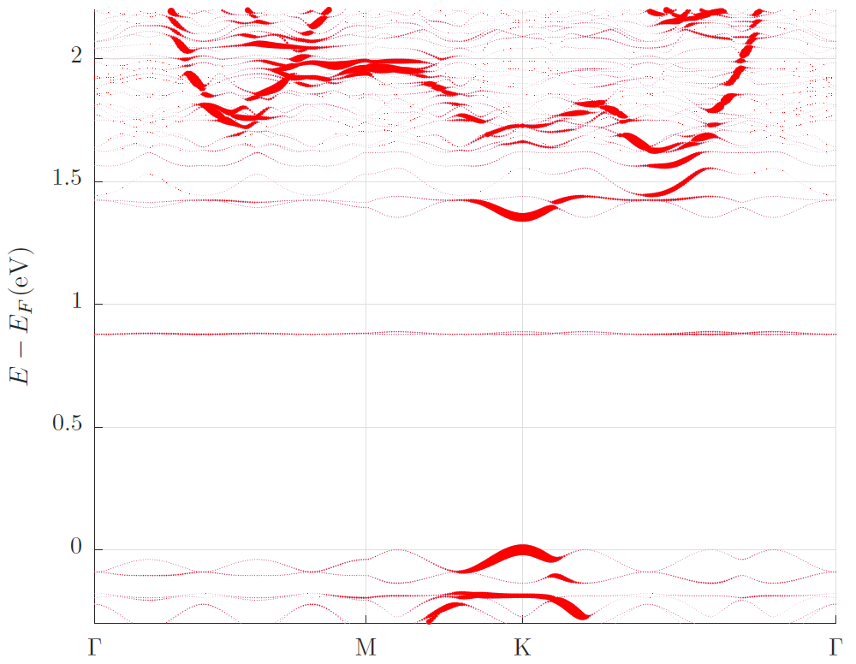
MoSe₂+Cr: DFT
MoSe₂ with Cr_{Se}
MoSe₂ with Cr-Se@Se
S.Rost
Notes:
To see how the defects affect our optical property, we did DFT calculations to calculate the band structures of Cr@Mo and Cr@Se-sub. I should update on Stefan’s calculations for interstitial position.
Cr@Mo: acceptor state near conduction band: “Classic” defect: States localised in real space / delocalized in k-space. If the states are not degenerate, we can host single e- and single photon emission can be achieved
Cr@Se-sub: one localised state mid gap, and a dispersive state below CB
Midgap: classic defect states; Others: hybrid with conduction host states.
As a reminder, these DFT: preliminary results, don’t include many body interaction. So may missing E corrections → we don’t rely too seriously on the exact energy levels of the calculations, but the trend should be clear. In any case we should be able to see see defect states.
DFT: 5x5 cell, relaxed to 1e-4 a.u. . SOC included
#Possibility of magnetic coupling / enhancement
Cr@Se: donor state around midgap and acceptor near conduction band

Slide 24
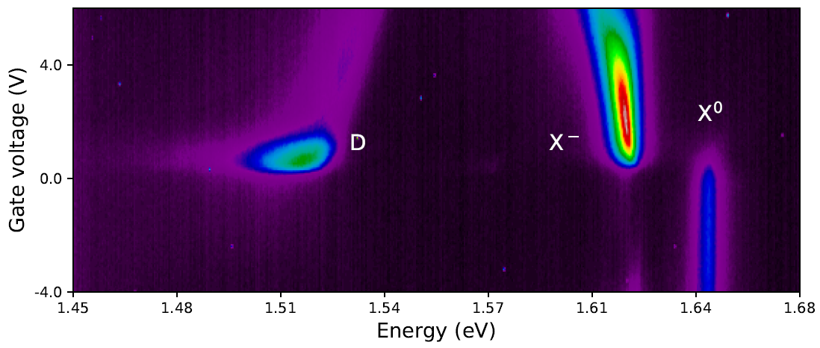
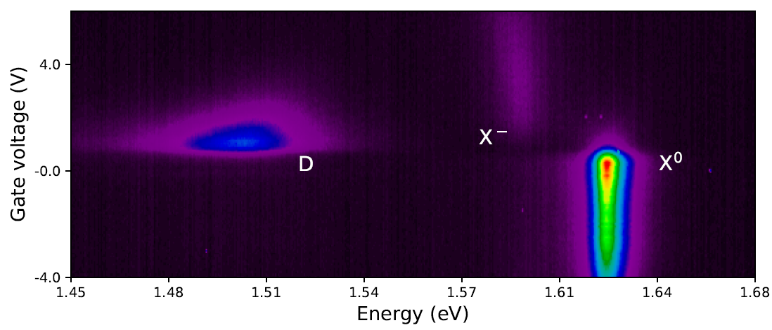
Temperature dependence
-ve charged acceptor
T = 10 K
Bound exciton
e⁻
Normalised intensity (a.u.)
h⁺
A⁻ - band transition
T = 108 K
Notes:
So we have the two possibilies for D emission: exciton bound to A-, or acceptor-band transision.
1st scenario *point on image*: has low binding E, should dissociate as temperature rises
→ we heat the system up to 108 K and measure the PL.
At high temperature: D peak dissociates more slowly than trions → not expected from defect bound excitons.
*animation* This, combining with all observations sofar, implies the D peak transistion is likely from A- band transition.
This D peak, while has electrical controlibilty and remain bright at higher temps, is still a broad emission likely from an ensemble of defect sites. This is because the defect density is still high:
We use ~ 1.5 um2 laser spot, which cover about up to 4e4 defects.
For SPE, we need to dilute ion conc for further insight and possibility of isolating a single defect.
This is what we’re working on and hope to have some new data soon.

Slide 25
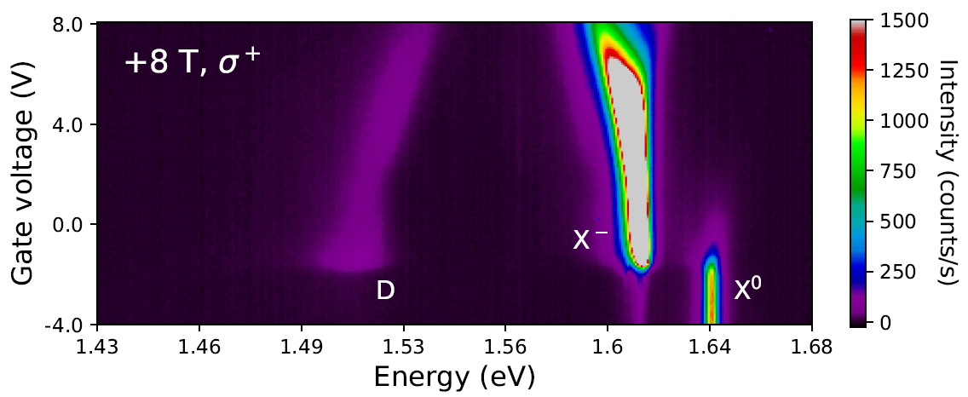
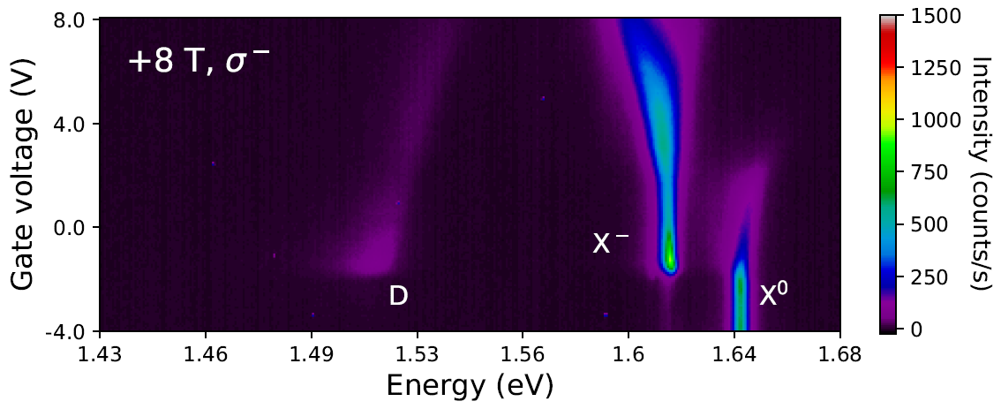
MoSe₂+Cr D peak: spin-valley locking?

Slide 26
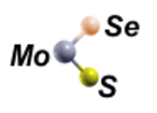


Raman spectroscopy
Bui et al. npj 2D Mater Appl 6, 42 (2022)
Notes:
We then turn to Raman spectroscopy: quick and non destructive measurement technique for Se level in the system, also suitable with samples on SiO2 substrate
In this measurement, laser radiation comes onto the sample and gets scattered inelastically by the lattice vibration of the ML. The measured scattered signal can give information on the lattice structure.
For example, ML MoS2 out of plane vibrational modes A’ show at 404 cm-1 and inplane vibration E’ at 385 cm-1.
*click for animation* Incoporation of Se introduces a mode at at 270 cm-1, caused by the out of plane vibration of S-Mo-Se bond. This can give evaluation of Se presence in the ML. More Se: higher intensity
In addition, Se presence also breaks periodicity of lattice, leading to other development of spectra: e.g. more contribution to phonon lines in LA, or broadening and shifting of peaks. E’ and A’ of MoS2 modes also becomes weaker

Slide 27
MoS₂+Se: discharge
Au contact: necessary to maximize the incorporation rate
Bui et al. npj 2D Mater Appl 6, 42 (2022)
Notes:
2 critical factors for good implantation: metal contact and heating.
1st thing we found: metal contact is essential to define a potential on the sample.
It can also remove charge of implanted ion from ML.
*hover on graph* This graph illustrate the role of contact on implantation results:
Blue curve is the Raman spectrum of an implanted ML with contact, yellow/brown curve is that without a contact.
Blue spectrum shows more Se incorporation rate with higher A’MoSSe.
Without contact: ions implanted on ML build up charge and repel further coming ions. They can have lower energies because of electrostatic repulsion.
At some point, the total number of implanted ions is then limited. → not good for assessing the implant process

Slide 28
MoS₂+Se: heating
Pre-annealing: in-situ before implantation
Post-annealing: in-situ after implantation
Hot implant: implantation during annealing
Bui et al. npj 2D Mater Appl 6, 42 (2022)
Notes:
Next crucial factor for implant is heating/annealing.
Pre-annealing: before implant: aims to clean sample by removing some volatile contamination
After implant, there might be some unwanted defects such as adatoms and vacancies. Annealing may promote diffusion of these adatoms into filling the vacancies and increase Se incorporation.
*anim* While these methods give decent Se substitution level, Biggest change comes from implant at elevated temperature, as seen here in the Raman spectra on the right: For hot-implanted sample: A’MoSSe is most intense and the lines’ sharpness indicate good crystallinity preservation.
While the role of temperature is at the moment not well understood, we believe it’s to ease the discharging process by better mobilizing charge carriers.

Slide 29
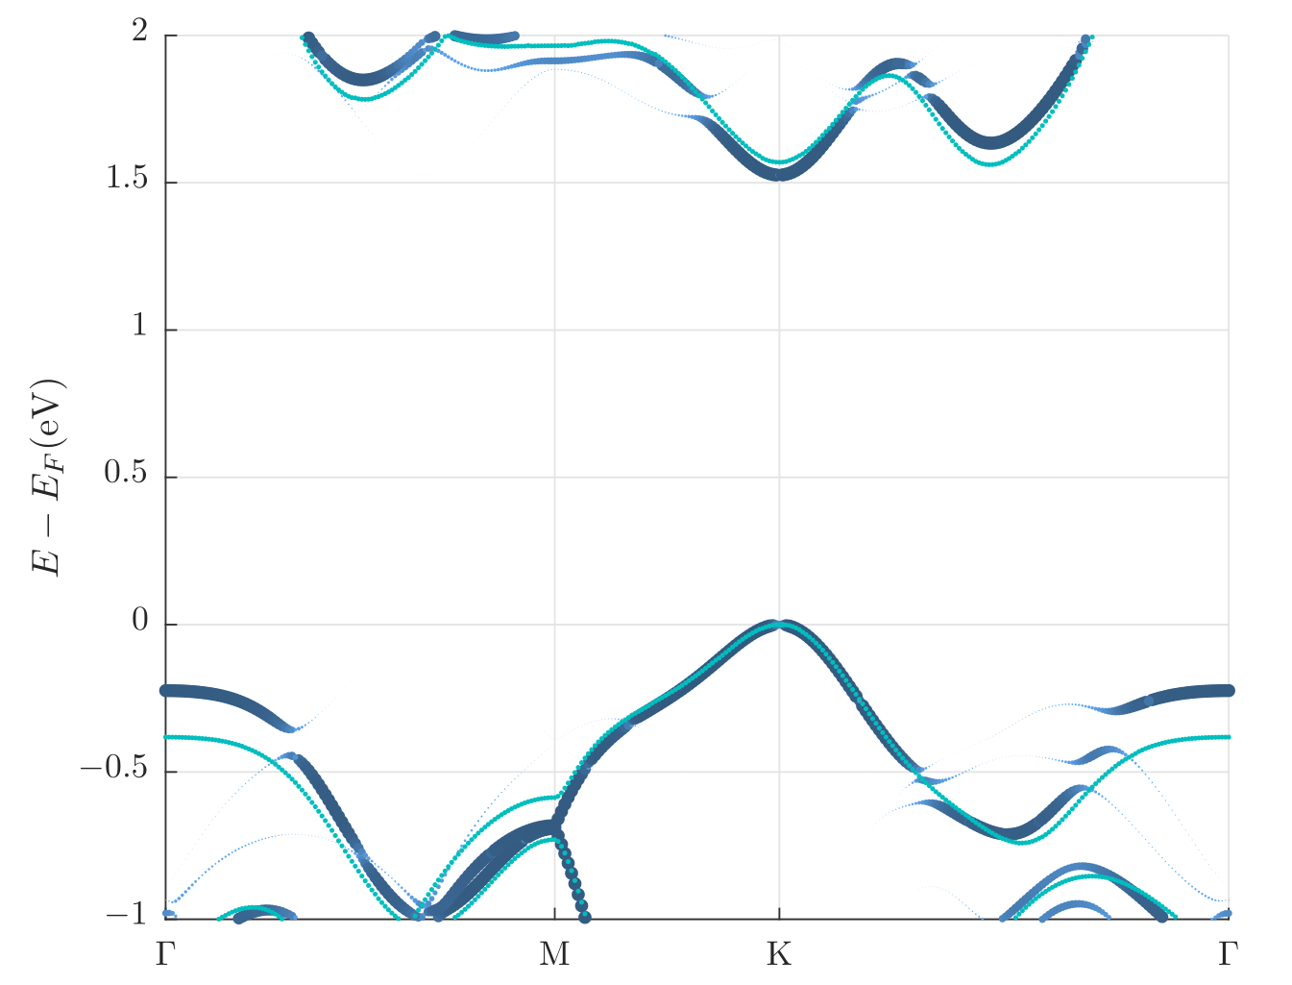
DFT: S implantation in selenides
MoSe₂ +S
1.8
1.7
1.6
1.5
1.4
MoSe_{2-0.33}S_{0.33}
2.0
1.0
0.0
-1.0
MoSe₂
MoSe_{2-0.33}S_{0.33}
E-E_{F} (eV)
E-E_{F} (eV)
Γ
M
K
Γ
Γ
M
K
Γ
Notes:
Correct

Slide 30
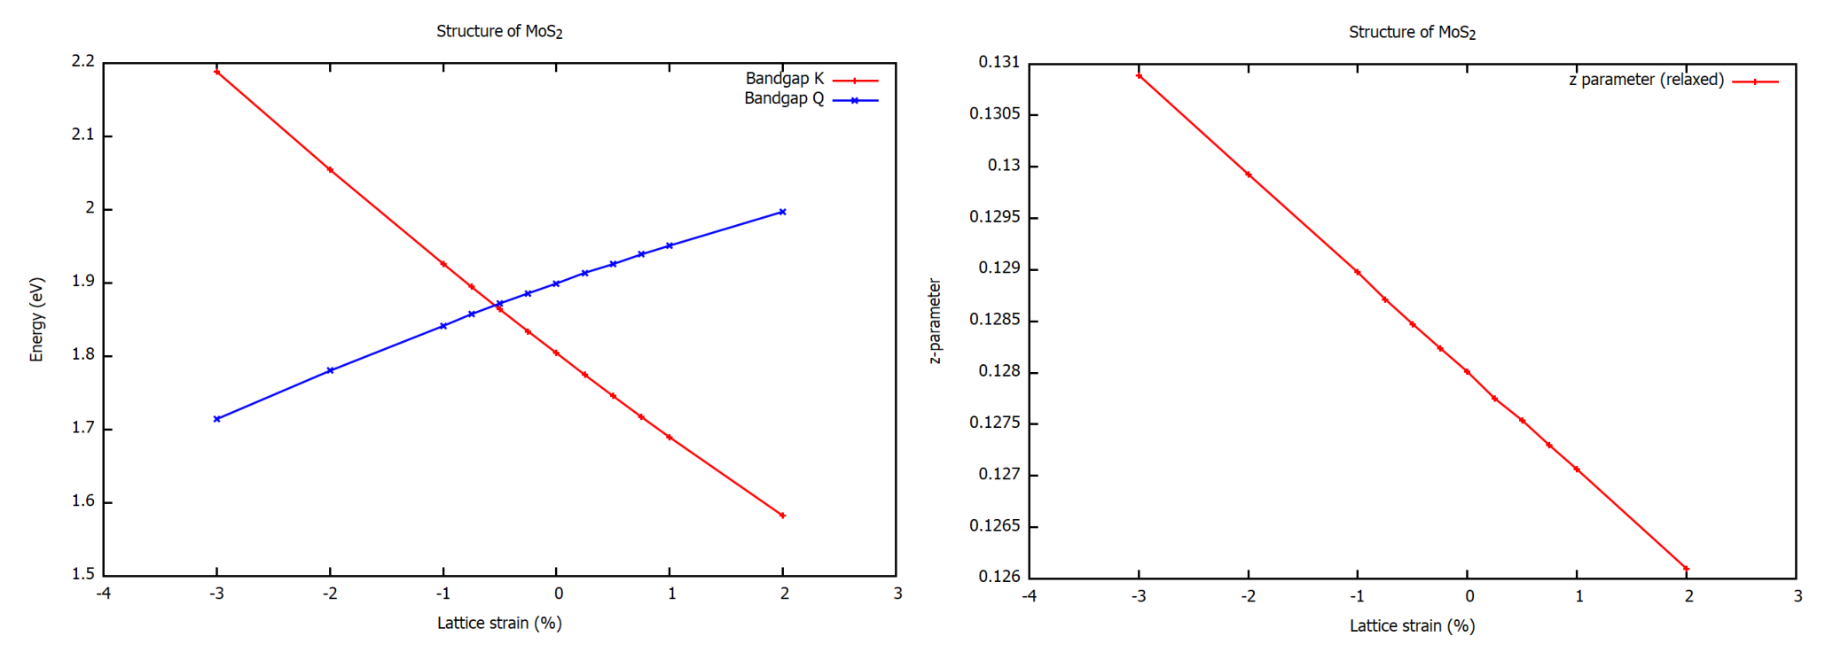
DFT: strain vs implantation
Strained MoS₂ ML
Strained MoS₂ ML
2.2
2.1
2.0
1.9
1.8
1.7
1.6
1.5
0.131
0.130
0.129
0.128
0.127
0.126
Q
c
(0.25-z)c
E_{K/Q} (eV)
z-parameter
Lattice strain (%)
K
Lattice strain (%)
-4 -3 -2 -1 0 1 2 3
-4 -3 -2 -1 0 1 2 3
Notes:
Correct

Slide 31
DFT: S implantation in selenides
MoSe₂ /WSe₂ +S
WSe_{2-0.33}S_{0.33}
1.6
1.5
1.4
1.3
1.2
2.0
1.0
0.0
-1.0
1.8
1.7
1.6
1.5
1.4
MoSe_{2-0.33}S_{0.33}
E-E_{F} (eV)
E-E_{F} (eV)
2.0
1.0
0.0
-1.0
E-E_{F} (eV)
E-E_{F} (eV)
Γ
Γ
K
M
-K
Γ
K
M
-K
Γ
Γ
M
K
Γ
Γ
M
K
Γ
Notes:
Correct

Slide 32
MoSe₂+S
S⁺ @ 20 eV, 2.5 x 10¹⁴ cm⁻²
X⁰
X_{D}
Splitting of A’ mode
Unassigned Raman modes, from presence of disorder (implants)
Notes:
Correct

Slide 33
MoSe₂+S
PL visible at cryogenic T
Defects dominate
Notes:
Valley coherence together with other properties: optically addressable spin-valley qubit.
Probed in very simple structures.
Gamma valley, dispersion – 0.01% of excitons in the light cone
Bohr radius 2 nm
Access on single particle level: confinement of an exciton or trion
The way to do it: localize electron / hole in energy minimum: gating , electrostatic, dielectric, doping

Slide 34
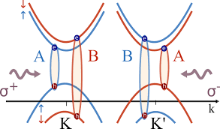
MoSe₂+S
M. Selig et al. PR Res. 1, 022007(R) (2019)
A
B (?)
T = 7.7 K
T = 7.7 K
Notes:
Cryo measurement PL shows clearer changes: redshifted X⁰? Or trion?
*anim* Reflectance: measurement, which reflects the absorption of the compound, A-exciton transition is clear
Additional transition @ 1.83 eV, unclear for now

Slide 35
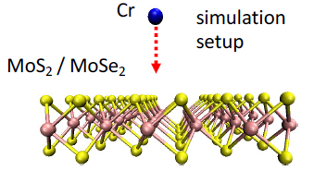

Outcome probability from DFT simulation by A.V. Krasheninnikov
Notes:
Correct

Slide 36

Sample
Gr/hBN/MoSe₂/hBN on SiO₂
MoSe₂
Au
Top hBN
Gr back
ML
Au
Cr⁺: 25 eV
3x10¹² cm⁻² ~0.26% Cr/Mo
220ºC
Bottom hBN
20 μm
top hBN
MoSe₂
MoSe₂
ML
ML
bottom hBN
bottom hBN
Gr back
Gr back
Au
Au
Au
Au
Notes:
Valley coherence together with other properties: optically addressable spin-valley qubit.
Probed in very simple structures.
Gamma valley, dispersion – 0.01% of excitons in the light cone
Bohr radius 2 nm
Access on single particle level: confinement of an exciton or trion
The way to do it: localize electron / hole in energy minimum: gating , electrostatic, dielectric, doping

Slide 37



Sample preparation
Mechanical exfoliation & stamping using PDMS
Au contact: defines potential on flake
Exfoliation
MoS₂ on SiO₂
Notes:
Valley coherence together with other properties: optically addressable spin-valley qubit.
Probed in very simple structures.
Gamma valley, dispersion – 0.01% of excitons in the light cone
Bohr radius 2 nm
Access on single particle level: confinement of an exciton or trion
The way to do it: localize electron / hole in energy minimum: gating , electrostatic, dielectric, doping

Slide 38
A slide to say: while WSe2 shows SPE and coherence, it is not easy to interpret because of the role of defects. Show Sven’s data and Prokhor’s data.

Slide 39




Gating of WSe₂ ML
Measured signal
Excitation
12K
Electron / Hole doping
50
60K
0
V_{g}
WSe₂/ MoSe₂
Gr
-50
1.55
1.65
1.75
SiO₂
p-Si
Excitation at 660 nm
Laser power: 10μW
Spot size: 1.5μm
Notes:
Control of doping needed for example to see T dependence.

Slide 40
Vacancy formation
Tried implanting Kr⁺ (23 eV, 3e12/cm², 220ºC); no samples came back alive (PL quenched), suggesting high level of damage
Tried annealing
RT Raman & PL can detect
M. Mahjouri-Samani et al. Nano Lett. 16, 5213−5220 (2016)

Slide 41
Gated WSe₂ ML
Electron / Hole doping
Notes:
Valley coherence preserved with excitation at energy 132meV above the exciton energy.
Clear asymmetry – sign that band structure is not sufficient.

Slide 42



Excitation Resonant with X₀
EX: 710 nm
EX: 660 nm
100
X^{-’}
12K
X^{-’}
X⁻
X⁻
X⁻
50
X_{g}⁻
X_{g}⁻
V_{gc} (V)
I
I
0
Max
X⁺
-50
X⁺
X⁺ and X⁻ different effective masses, holes are heavier
Phonon resonance between X₀ and X⁻ energies.
X⁺
-100
Min
1.6
1.74
1.6
1.74
hν (eV)
hν (eV)
Notes:
One reason for asymmetry is the trion binding energy

Slide 43



EXTRiNSIC EFFECTS ON TMDs
WSe₂/ MoSe₂
Various substrates
Si
hBN (< 10nm)
hBN (10-30 nm)
WSe₂/ MoSe₂
Si/SiO₂
Dielectrics renormalize energies
Hydrophobic surfaces needed for good contact
S. Borghardt et al., Phys. Rev. Mater. 1, 054001 (2017)
Notes:
Picture of Sven, larger labels, add strain analysis

Slide 44

Device - GatED hBN/MoSe₂/hBN
V_{g}
hBN (< 10nm)
Gr
WSe₂/ MoSe₂
hBN (10-30 nm)
Gr (~10 nm)
Laser
power
Si/SiO₂
4.0
2.0
0.0
-2.0
-4.0
Max
X⁻
hBN
Gr
Gate voltage (V)
ML MoSe2
X₀
Min
20 μm
Gr
X⁺
1.550 1.575 1.660 1.625 1.650 1.675
Energy (eV)
Notes:
Picture of Sven, larger labels, add strain analysis

Slide 45
Device - GatED hBN/MoSe₂/hBN
hBN
Gr
ML MoSe2
Gr
4.0
2.0
0.0
-2.0
-4.0
Max
X⁻
Gate voltage (V)
X₀
Min
X⁺
1.550 1.575 1.660 1.625 1.650 1.675
Energy (eV)
Notes:
Assuming epsilon=3.76 I V=2V, m =0.5 , the potential fluctuations would be 7.6 meV
https://www.nature.com/articles/s41699-018-0050-x

Slide 46

Gated hBN/WSe₂/hBN ML
X⁻
Negative trions
2.0
1.5
1.0
0.5
0.0
-0.5
-1.0
X_{D}⁻
X⁻
Gate voltage (V)
X
XX⁻
Neutral excitons
X
1.60 1.62 1.64 1.66 1.68 1.70 1.72 1.74
Energy (eV)
Phonon assisted trion formation:
E_{x} – E_{x-} = 30 - 36 meV
E_{A’} = 32 meV
X_{D}^{+/-}
X^{+/-}
X_{D}
XX
Notes:
10nm hBN would give 2*10^16 m^-2 carriers, which gives a separation between then of 1.6nm.

Slide 47
Gated hBN/WSe₂/hBN ML
2.0
1.5
1.0
0.5
0.0
-0.5
-1.0
X
X⁻
X^{+/-}
X_{D}^{+/-}
X_{D}
Gate voltage (V)
X
X
X⁺
X_{D}⁺
Positive trions
1.60 1.62 1.64 1.66 1.68 1.70 1.72 1.74
Energy (eV)
Phonon blockade of trion formation:
E_{x} – E_{x-} = 21 meV
E_{A’} = 32 meV
X
Notes:
I need bright positive trion
10nm hBN would give 2*10^16 m^-2 carriers, which gives a separation between them of 1.6nm.

Slide 48

Excitons in p-doped hBN/WSe₂/hBN ML
1.0
0.5
0.0
-0.5
-1.0
X⁻
X⁺
X
X
Gate voltage (V)
X_{d}⁺
X_{d}⁺
X⁺
1.60 1.62 1.64 1.66 1.68 1.70 1.72 1.74
Energy (eV)
S.Borghardt et al. arXiv:1911.01092
Notes:
10nm hBN would give 2*10^16 m^-2 carriers, which gives a separation between them of 1.6nm.

Slide 49




Qualitative rate equation For P-doped WSe₂
X
X⁺
X_{d}⁺
X_{d}
CONSTANT RATES
S.Borghardt et al. arXiv:1911.01092
Notes:
10nm hBN would give 2*10^16 m^-2 carriers, which gives a separation between them of 1.6nm.

Slide 50

Sources of localisation
2.0
1.5
1.0
0.5
0.0
-0.5
-1.0
Sources of localization:
Acceptors
External charge fluctuations
Dielectric constant fluctuations
x30
X⁻
Gate voltage (V)
X
hBN
WSe₂/ MoSe₂
e
e
X⁺
Si/SiO₂
1.52 1.54 1.56
1.60 1.62 1.64 1.66 1.68 1.70 1.72 1.74
Energy (eV)
S.Borghardt et al. arXiv:1911.01092
Notes:
10nm hBN would give 2*10^16 m^-2 carriers, which gives a separation between them of 1.6nm.

Slide 51

Gated WSe₂ ML – linewidth
X⁺
Exciton – boson like – Gaussian broadening
Trion – fermion – Lorenzian line
X
Gate voltage (V)
Notes:
10nm hBN would give 2*10^16 m^-2 carriers, which gives a separation between them of 1.6nm.

Slide 52



STEM-EDX of Se implanted MoS₂
HAADF
Optical properties by EELS
150
100
50
0
EELS counts (a.u.)
θ_{Mo-Se} = 43.1º
HAADF
2.0 2.5 3.0 3.5
S
Se
S/Se
Energy (eV)
10eV, 10¹⁹ m⁻², no annealing
Se incorporation 1~3%.
Extended defects visible – STEM induced?
Vacancies – small contrast
Single S vacancies: 9%
Double S vacancies: 1.4%
5 Å
U. Bangert et al., Ultramicroscopy 176, 31 (2017)
Notes:
We know the contrast difference in STEM HAADF images is not enough to say we have Se implantation. Therefore, here we analyse x-ray signal in the STEM image map. We focus on the area which contains one brighter dot. Then we detect the x ray signal from the image map. The S signal map shows a hole or a vacancy in the map and the map of Se signal reveals a dot like image. As we overlap this two maps together, we observe a perfect match between the two images and also consistent with the HAADF image. Therefore, we are able to estimate the amount incorporation rate is about 1-3 % by accounting those brighter dots in the STEM images. We also try to estimate the S vacancies which leads to be 9% for single S vacancies and 1.4% for double vacancies. The number of double S vacancies much higher then our expectation, since the energy of ion is not enough to create double S vacancies in one impact. The possibility to have double impacts on same site is only about 0.6-0.7%.
On the other hand, the STEM images only show the Se atom is located at the position which suppose to be S atom in MoS2 lattice. I do not understand what you say in the last sentence. The incorporation rate is much lower than our expectoration and calculation. In this case, EM is design to study things within few atoms to thousands of atoms. To give more insight of this alloy structure in bigger picture, we have to use Raman and PL spectroscopy studies. In addition we need to consider ML implantation with MLs supported on substrates.

Slide 53


Gated WSe₂ ML – linewidth
X⁺
X
PRB 67, 241307(R) 2003
Notes:
10nm hBN would give 2*10^16 m^-2 carriers, which gives a separation between them of 1.6nm.

Slide 54




POLARIZATION oF Dark STATES
Measured signal
Excitation
V_{g}
WSe₂/ MoSe₂
Gr
SiO₂
p-Si
3 mm
z-polarized light
S.Borghardt et al. arXiv:2001.08043

Slide 55

monolayer OF WSe₂
Robust valley coherence only in the absence of charge carriers.
Spin-photon polarization entanglement would need to overcome:
  Electron spin – fine structure splitting.
  Exciton scattering into dark state in the presence of disorder.
Polaronic effects need further study.
Better devices needed for quantum correlations
and classical correlations.

Slide 56

Gated WSe₂ ML – linewidth (extended voltage range)
20 μm

Slide 57
Doping of monolayer TMDs
Homojunction devices
Localisation of excitons
Methods:
  Implantation
  Diffusion
  Electrostatic

Slide 58
Low energy ion implantation Se into MoS₂
Se⁺
Se⁺
Se⁺
Se⁺
Monte Carlo simulations predict 70% retention rate.
Isoelectronic with S, forms alloys.
Chemically stable.
Alloys available: good reference point.
Samples: PDMS stamp, CVD.
Potential for electrostatic gating.
Se⁸⁰⁺ implantation:
E_{Se}= 10 - 25 eV
Dose = 1 - 20 x 10¹⁸ m⁻²
0.1 - 1Se atom per S atom in MoS₂ ML
E_{Vs} = 5.9 eV -> min E_{se} = 7.2 eV
E_{VMo} = 13.4 eV -> min E_{Se} = 13.6 eV
Metal contact
TMDs
SiO₂
Si
C.Ataca & S. Ciraci, J. Phys. Chem. C, 115, 13303 (2011)
2/10/2020
Notes:
We start our studies from Se ion implantation on MoS2 ML instead of other interesting dopants such Nb and Br which predicted by theory calculations. Monte Carlo simulations predict 70% of retention rate at 10eV ion energy so we should be able to create an alloy. Since MoSSe alloys can be synthesized directly, we have good reference point to compare the implanted MLs to. Furthermore, the alloy based lateral heterostructure is still highly desirable for study.In addition, Se will not have dangling bonds and thus the mterials is chemically stable.
We chose ion energy low enough to replace S atom with Se ion in a single impact. If we treat all the collision as elastic and assume that Se ion impacts on the surface is at normal to the ML surface, then to create a S vacancy in MoS2 ML one needs 5.9 eV. 13.4 eV is needed to create Mo vacancy. Se ion is able to deliver this energy if it has 7.2 eV and 13.6eV respectively. Since not all ion impact at normal to the surface, we chose ion energy from 10-20 eV and the dose is in the same order magnitude as S density in MoS2 ML.

Slide 59
Low energy ion implantation Se into MoS₂
Se⁺
Se⁺
Se⁺
Se⁺
Monte Carlo simulations predict 70% retention rate.
Isoelectronic with S, forms alloys.
Chemically stable.
Alloys available: good reference point.
Se⁸⁰⁺ implantation:
E_{Se}= 10 - 25 eV
Dose = 1 - 20 x 10¹⁸ m⁻²
0.1 - 1Se atom per S atom in MoS₂ ML
E_{Vs} = 5.9 eV -> min E_{se} = 7.2 eV
E_{VMo} = 13.4 eV -> min E_{Se} = 13.6 eV
Requirements:
Clean surface
Grounding
Metal / graphene
contact
TMDs
SiO₂
Si
C.Ataca & S. Ciraci, J. Phys. Chem. C, 115, 13303 (2011)
10/02/2020
Notes:
We start our studies from Se ion implantation on MoS2 ML instead of other interesting dopants such Nb and Br which predicted by theory calculations. Monte Carlo simulations predict 70% of retention rate at 10eV ion energy so we should be able to create an alloy. Since MoSSe alloys can be synthesized directly, we have good reference point to compare the implanted MLs to. Furthermore, the alloy based lateral heterostructure is still highly desirable for study.In addition, Se will not have dangling bonds and thus the mterials is chemically stable.
We chose ion energy low enough to replace S atom with Se ion in a single impact. If we treat all the collision as elastic and assume that Se ion impacts on the surface is at normal to the ML surface, then to create a S vacancy in MoS2 ML one needs 5.9 eV. 13.4 eV is needed to create Mo vacancy. Se ion is able to deliver this energy if it has 7.2 eV and 13.6eV respectively. Since not all ion impact at normal to the surface, we chose ion energy from 10-20 eV and the dose is in the same order magnitude as S density in MoS2 ML.

Slide 60
Optical spectroscopy of Se implanted MoS₂
E_{ion}= 20eV,
Fluence = 5 x 10¹⁸ m⁻², Annealed at 280ºC
E_{ion}= 20eV,
Fluence = 1 x 10¹⁸ m⁻², Implanted and annealed at 220ºC
Annealing : a key to high quality
PL still broadened
Alloy effect? Disorder?
Notes:
https://onlinelibrary.wiley.com/doi/epdf/10.1002/adma.201304389
We know the contrast difference in STEM HAADF images is not enough to say we have Se implantation. Therefore, here we analyse x-ray signal in the STEM image map. We focus on the area which contains one brighter dot. Then we detect the x ray signal from the image map. The S signal map shows a hole or a vacancy in the map and the map of Se signal reveals a dot like image. As we overlap this two maps together, we observe a perfect match between the two images and also consistent with the HAADF image. Therefore, we are able to estimate the amount incorporation rate is about 1-3 % by accounting those brighter dots in the STEM images. We also try to estimate the S vacancies which leads to be 9% for single S vacancies and 1.4% for double vacancies. The number of double S vacancies much higher then our expectation, since the energy of ion is not enough to create double S vacancies in one impact. The possibility to have double impacts on same site is only about 0.6-0.7%.
On the other hand, the STEM images only show the Se atom is located at the position which suppose to be S atom in MoS2 lattice. I do not understand what you say in the last sentence. The incorporation rate is much lower than our expectoration and calculation. In this case, EM is design to study things within few atoms to thousands of atoms. To give more insight of this alloy structure in bigger picture, we have to use Raman and PL spectroscopy studies. In addition we need to consider ML implantation with MLs supported on substrates.

Slide 61







LocAlISATION BY DOPING
P in MoSe₂ monolayer - relaxed
DOS [a.u.] @ P
2.0
Maintains trigonal symmetry
Shallow dopant (A⁰X, D⁰X)
Could work for WSe₂ and MoSe₂
Energy (eV)
0.0
spin up
3% Se in MoS₂ lattice
spin down
-2.0
2
Γ
M
K
Γ
Cr in MoS₂ monolayer - relaxed
1
0
2.0
θ_{Mo-Se} = 43.1º
Energy (eV)
-1
0.0
-2
-2.0
Γ
M
K
Γ

Slide 62
Power dependence

Slide 63
ADONIS* beam line
  *Anlage zur Deposition
  niederenergetischer Ionen auf Substrate
  (apparatus for the deposition
  of low energy ions on a substrate)

