Slide 1
CLIC vertex R&D at CERN ?
Lucie Linssen
Aim of the meeting
About resources and timeline
Sensor/electronics developments
Interconnect
Thin materials and cooling
Pixel insertion
Power pulsing and power delivery
Summary
http://lcd.web.cern.ch/LCD/

Slide 2
Aim of the meeting
What did we do so far?
Detailed simulation studies => Dominik’s talk
Held a series of CLIC vertex technology meetings (WG4)
  http://indico.cern.ch/categoryDisplay.py?categId=2843
  Review of existing technologies, put in relation to CLIC requirements
    ATLAS, CMS, BTeV, CMOS technology
    Interconnect technologies
    Low-mass mechanics (ALICE, NA62, STAR, Belle II, SiD, Plume)
    Insertion mechanism (CMS)
Can we get started at CERN on some hardware/engineering studies?
CLIC vertex detector is very challenging. Time-line is long. Industrial technology advances will help us.
Let’s start working on some aspects:
  to advance on technical issues
  to build up experience
  to build up a CERN team and collaboration with external groups

Slide 3
About resources
Don’t take this slide to the letter, it just indicates “order of magnitude”.
Names can change….
PH-LCD manpower for vertex R&D:
Dominik Dannheim (staff), Erik van der Kraaij (fellow, part-time), new fellow
PH-ESE:
Xavier Llopart Cudie (50%, ~timepix2), Pierpaolo Valerio (DOCT), Georges Blanchot (part-time tbc), fellow May 2011 (part-time)
Engineering/design support:
Piet Wertelaers (part-time), Eric Richards (design, part-time), DT-technician (part-time in APT), DT-engineer (part-time in APT), Spanish trainee (tbc soon)
+ several interested LHC staff (including possibly synergy with LHCb/ALICE pixel upgrades)
Dedicated materials budget:
~100 kCHF/year (can increase)

Slide 4
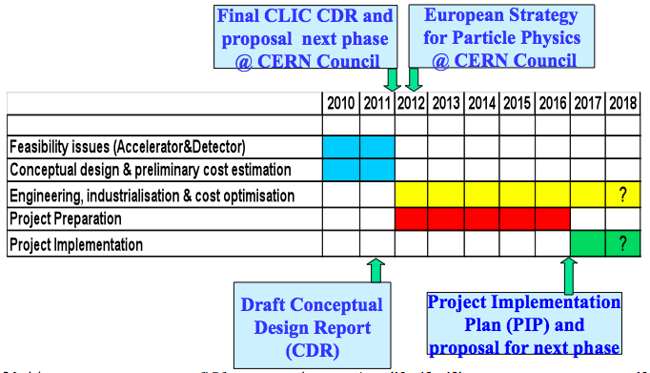
Time-line
CLIC schedule
Aug. 2011
CDR document ready
In the first TDR phase 2011-2016 we need to address critical R&D issues:
The vertex detector is the most challenging element of a CLIC experiment

Slide 5
Sensor/electronics
20*20 micron pixel sizes => requires small feature sizes
Time-stamping ~5-10 ns => requires high-resistivity sensor
0.1%-0.2% material/layer => allows for ~50 μm sensor + ~50 μm electronics
Read out full 156 bunch train, no trigger
Multi-hit capability in 156 ns pulse-train (hopefully not needed, tbc)
Which options?
1: “conservative” and in-house approach => hybrid
2: Participation in existing R&D outside CERN
  e.g. CMOS option with Strasbourg team?
  Other?

Slide 6
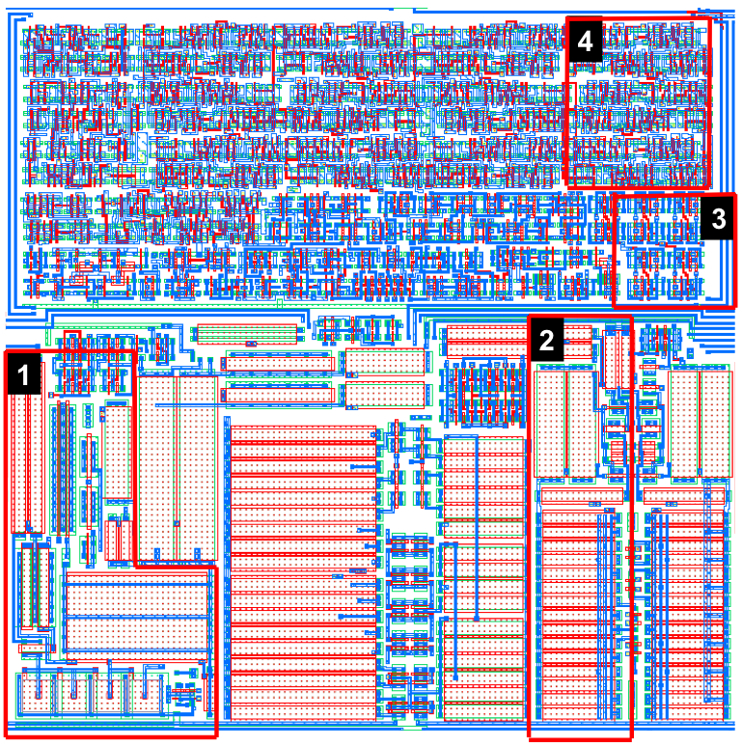
Sensor/electronics => in-house
1: “conservative” and in-house approach => hybrid solution
Start from Medipix/timepix technology line
Medipix3 => Timepix2 => VeloPix => CLICpix
Proposal for work, while previous steps (TimePix2, VeloPix) are being pursued:
Contribute to assessment of smaller feature sizes and development of ancillary circuits within the ASIC (already ongoing: Pierpaolo Valerio)
Work on thinning of sensors and asics
Work on high-density interconnect
Explore suitable sensors options (incl. small edges)
Integrate PH-LCD members in lab tests and beam tests
with Timepix2/VeloPix (with aim of getting experience)
Work for later stages:
Chip design according to CLIC requirements (time scale?)

Slide 7
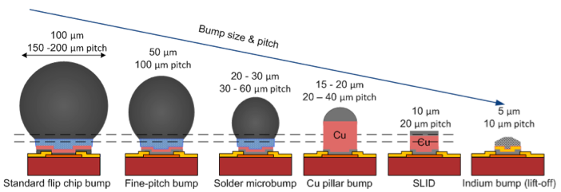
Interconnect
For hybrid solution:
  Fine-pitch bump-bonding will be required
    Review industrial technologies (WP6 of Theme-3)
    Perform sample tests (share between WP6 and LCD?)
    Sample tests with thinned sensors/asics (LCD)
Towards 4-sides buttable integrated approach:
  Participate in AIDA WG3 for “vias last” studies
    Provided AIDA WG3 manages to converge on a suitable work plan

Slide 8
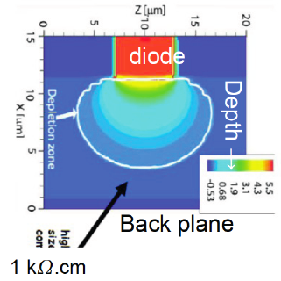
Sensor/electronics => collaboration
Signal speed for time-stamping rules out most ILC technologies
One of the options:
High-resistivity CMOS (Stasbourg)
Marc Winter proposes to work on CLIC vertex as follows:
  High-resistivity ~1 kOhm.cm epi layer, 0.35 mm techno  VDSM
  Going to Deep submicron for readout
  Thinning
  Explore interconnect
    3D interconnect (à la Fermilab)
    High-density low-mass interconnect (e.g. via AIDA)
Conclusion:
M. Winter’s approach has quite some commonalities
with previous slide. Can we work together ?

Slide 9
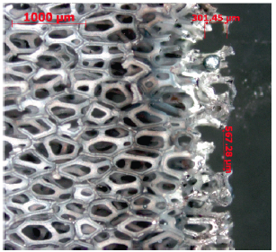
Thin materials and cooling
Many ILC groups are doing such work already
  Plume collab.
    Groups: Bristol, Oxford, DESY, IPHC
    Goal: 0.3%X₀ double-sided ladder and 100 mW/cm2: with Mimosa26 + SiCarbide foam support + power pulsing + air cooling
  Serwiette
    Groups: IK-Frankfurt, GSI, IMEC
    Activities: <0.15% X₀ for unsupported ladder
  Belle II vertex detector (ex-ILC work)
    Groups: DEPFET groups
    Activities: Low-mass structure, thermal studies,
    CO2 cooling at ends for BELLE-II detector
Silicon-Carbide foam
CERN shall not start independent R&D on this
better work together with one of the above groups
(Plume, AIDA?) and look for complementarity.
Note: CERN LCD we will probably get a Spanish trainee for this type of work

Slide 10
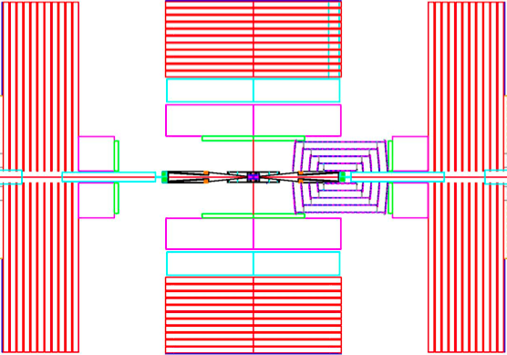
Pixel insertion
LHC experience tells us this is important
Current ILC detectors have not foreseen this
Need for a basic insertion concept at an early stage
  Will undoubtedly influence overall pixel detector layout
    May influence acceptance
    We need to have a view on impact on material
  How will it influence vibration/alignment?
  Will influence vacuum scheme and
  experiment’s opening scenarios
  Can even influence requirements
  on cavern
SiD access to vertex detector

Slide 11
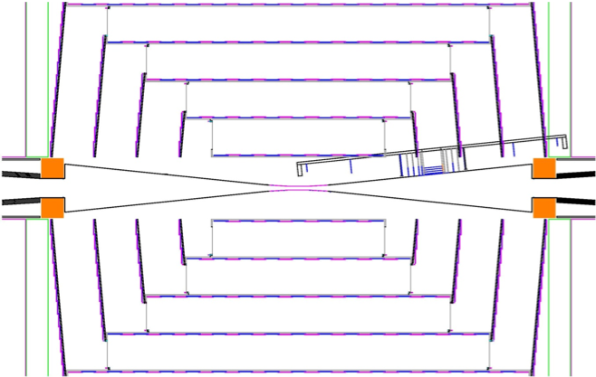
Pixel insertion
Requires involvement of engineer+designer
  In close collaboration with CMS engineers working on CLIC
Propose that CERN makes a conceptual study of insertion.
Goals: maintain acceptance, low-mass, show opening/insertion scenario.

Slide 12
Power pulsing and power delivery
Very much related to “ultra-thin” requirements
Minimise power dissipation => power pulsing
  Reduced mass required for cooling
  Hopefully allows to avoid liquid-based cooling
Minimise power cables => DC-DC conversion
  Synergy with developments for LHC upgrade
Questions to address:
Is it possible to combine DC-DC and power pulsing?
Which circuits to turn on/off?
Influence on signal/noise and time-stamping
Which power reduction factor is feasible?
How does power-pulsing influence requirements on power cables?

Slide 13
Power pulsing and power delivery
Remarks related to power pulsing:
An event on power pulsing will be organised by representatives from SiD, ILD, CLIC detector, ILC technology groups. Will decide tomorrow on venue (Orsay?). Aim of the event: get overview of ongoing work and address future for. CLIC detector will be represented by Georges Blanchot.
CERN has developed 16-channel S-Altro chip. This chip is suited for limited power-pulsing. Possibility to work with Lund + Japanese groups on “system” with multi-chip module, and use it for power-pulsing studies.
Proposal for CERN participation on power pulsing:
Participate on some of the issues raised on previous slide
Possibly use S-Altro system as work-bench for some of the studies
Exploit synergy with powering efforts for LHC

Slide 14
Other questions
Any pre-study on 5 nsec timing feature?
  Required #electrons to achieve this
  Simulate relation to power dissipation
  Study options for distribution of timing reference
Do we need a pre-assessment of data readout ?
  ~2*10⁹ pixels in CLIC vertex detector
  Up to 1.5% occupancy in the inner layer
  Some ~5 Million Pixels hit per 156 ns pulse train overall in the vertex detector

Slide 15
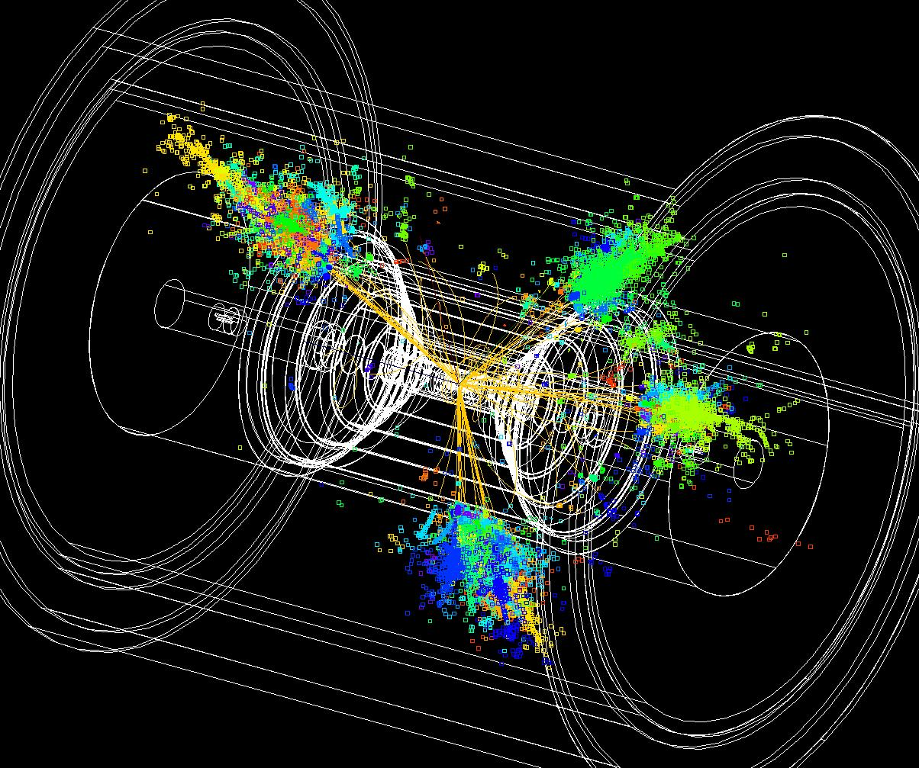
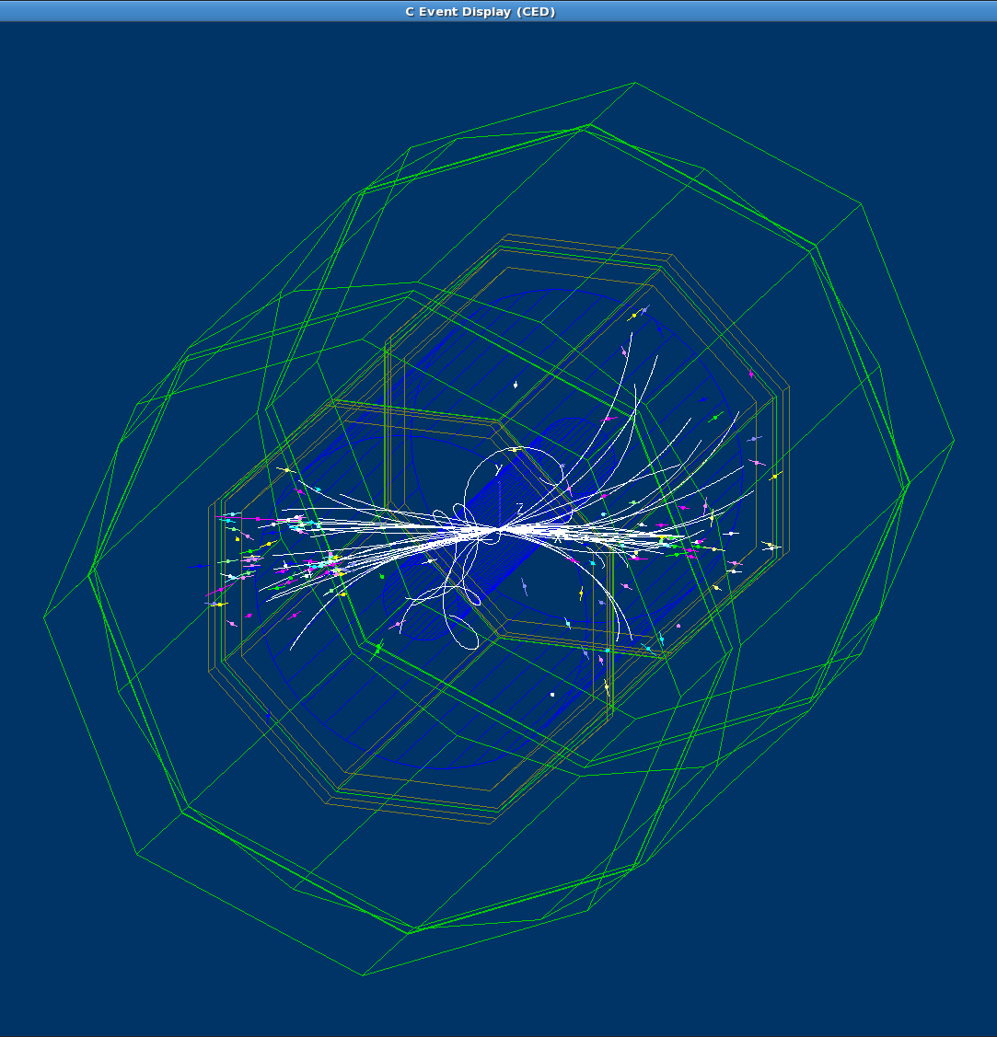
Thank you !
CLIC_SiD
CLIC_ILD

Slide 16
SPARE SLIDES

Slide 17
Linear Collider main parameters
Technology | ILC | CLIC
Centre-of-mass energy (GeV) | 500 | 500 | 3000
Total (Peak 1%) luminosity (10³⁴⁾ | 2.0(1.5) | 2.3(1.4) | 5.9(2.0)
Total site length (km) | 31 | 13.0 | 48.3
Loaded accel. gradient (MV/m) | 31.5 | 80 | 100
Main linac RF frequency (GHz) | 1.3 (Super Cond.) | 12 (Normal Conducting)
Beam power/beam (MW) | 20 | 4.9 | 14
Bunch charge (10⁹ e+/-) | 20 | 6.8 | 3.72
Bunch separation (ns) | 176 | 0.5
Beam pulse duration (ns) | 1000 | 177 | 156
Repetition rate (Hz) | 5 | 50
Hor./vert. norm. emitt (10⁻⁶/10⁻⁹) | 10/40 | 4.8/25 | 0.66/20
Hor./vert. IP beam size (nm) | 640/5.7 | 202 / 2.3 | 40 / 1
Hadronic events/crossing at IP | 0.12 | 0.19 | 2.7
Coherent pairs at IP | 10 | 100 | 3.8 10⁸
Wall plug to beam transfer eff | 9.4% | 7.5% | 6.8%
Total power consumption (MW) | 216 | 129.4 | 415

