Slide 1
Contract Management in/for EN-CV
33rd EAM user meeting – Dany Gain – EN-CV
2022-05-03

Slide 2
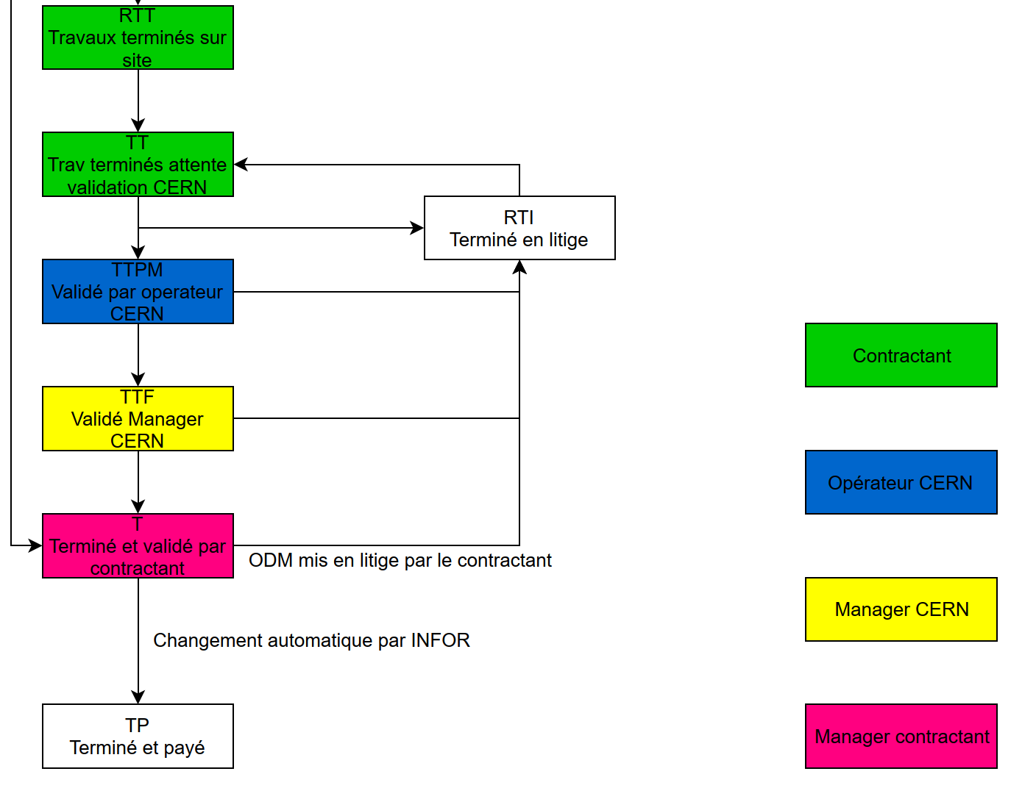
EN-CV goals with Infor CM
The challenges !
The new workflow…
To replace GESMAR
2 contractors using the same database
Confidetiality mandatory
    2 price lists with the same « invoice » codes
    4 (physical and virtual) stores to manage
To demateralize the invoice process (bye bye e-mails and XLSX…)
    New status and worflow
  Accounting transparency for OSVC’s (CH / FR)

Slide 3
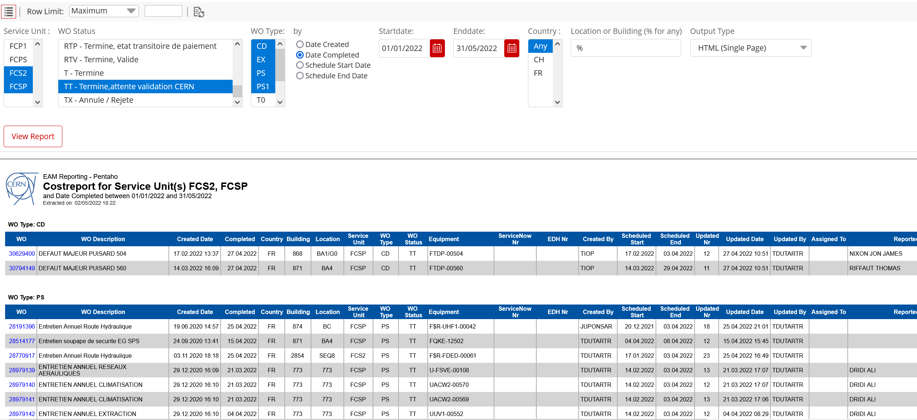
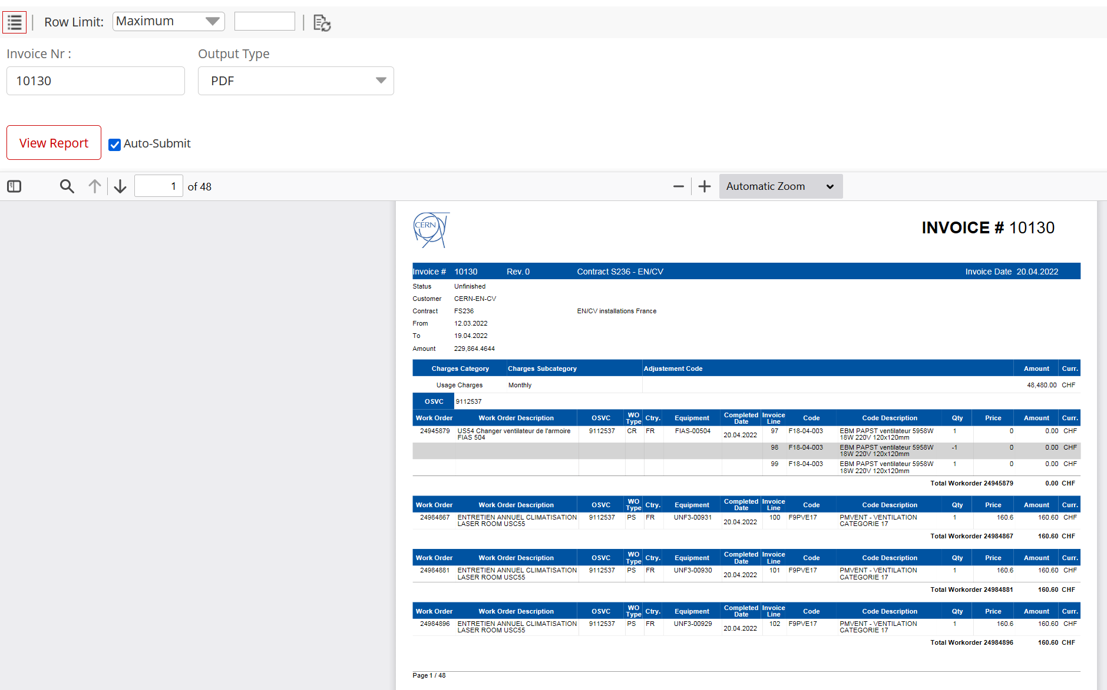
New tools available
Easy approval process with EAM Light
Complete cost report to facilitate the approval
Automatic invoice document generation

Slide 4
Future developments…
Prices to be updated directly by the contractors in there respective customer contracts
Easy CERN approval process to validate the new price codes
Invoice process linked with CERN accounting department
  All Work Order automatically linked with OSVC’s (no manual actions needed)
  Easy / automatic « double » check of the invoice received by CERN
More if affinity…

