Slide 1
Future HEP Global Projects and Accelerator R&D roadmap
Tor Raubenheimer
SLAC National Accelerator Laboratory, US
i-FAST Co-Innovation Workshop, May 3, 2022

Slide 2
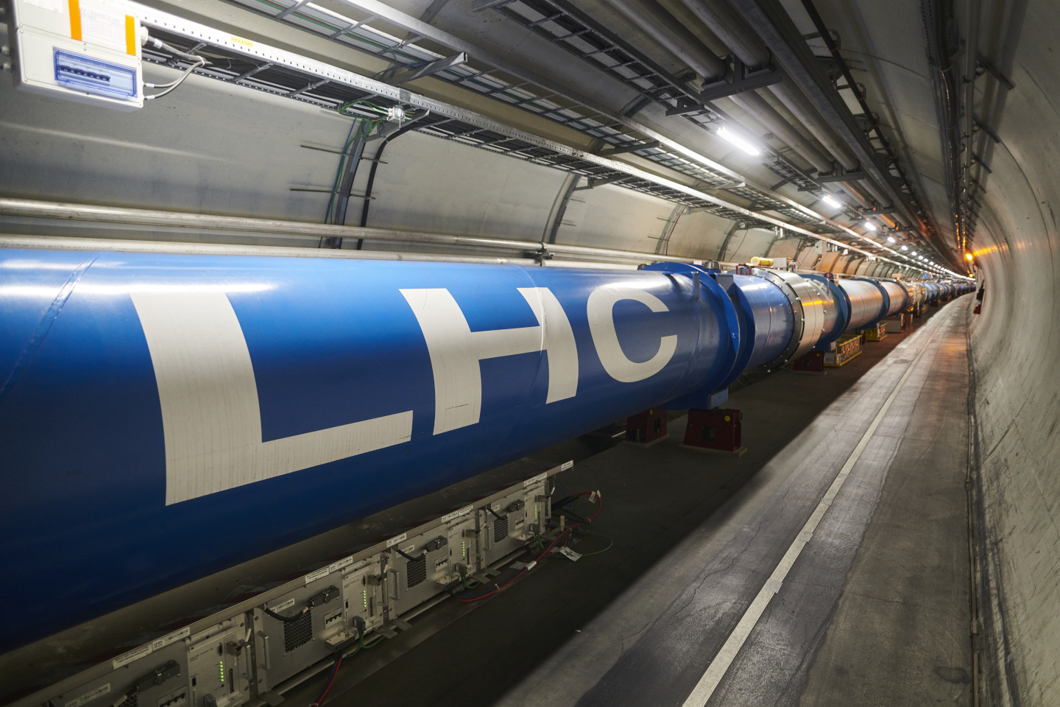
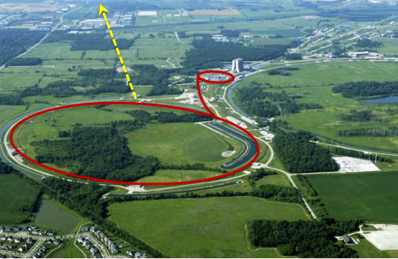
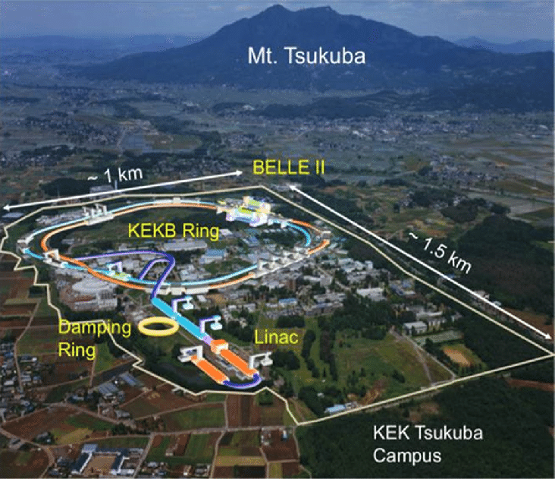
Global Accelerator-based High Energy Particle Physics (HEP)
Particle physics uses accelerators to pursue multiple parallel probes of the Standard Model:
Flavor factories
Higgs and EW Symmetry breaking
Neutrino Sector
as well as Dark Sector and other smaller scale experiments
Primary facilities for HEP:
  LHC / CERN
  MINOS and LBNF/DUNE / Fermilab-US
  Super KEKB / Japan, J-PARC / Japan
  BEPC-II / China
Large-scale facilities → decades to develop and exploit
→ long-range planning needed in global context
FNAL Main Injector

Slide 3


Guidance from last decade
European Strategy for Particle Physics update in 2013:
  Exploit LHC and upgrades
  Consider next generation
  accelerators in Europe
  Consider participation on ILC in Japan
  Consider participation in neutrino programs in US and Asia
US Particle Physics Project Prioritization Panel in 2014
  Engage in HL-LHC upgrade
  Support R&D for ILC in Japan
  Develop LBNF/DUNE neutrino program at Fermilab
Update to the European Strategy
in Particle Physics, 2013
US Particle Physics Project
Prioritization Panel 2014
Report

Slide 4

2020 Update European Strategy for PP
ESPP describes strategy for particle physics in
Europe and their contributions world-wide
ESPP started in 2006, was updated in 2013 and
then again in 2020
The 2020 ESPPU was the culmination of a 2-year
study engaging the community broadly with
a number townhall meetings
Considered particle physics program as well as
synergies with other fields and the societal
and environmental impact of particle physics

Slide 5
Some Priorities from the 2020 ESPP
The full physics potential of the LHC and the HL-LHC, including the study of flavor physics and the quark-gluon plasma, should be exploited
Europe, and CERN through the Neutrino Platform, should continue to support long baseline experiments in Japan and the United States
An electron-positron Higgs factory is the highest-priority next collider
  The particle physics community should ramp up its R&D effort focused on advanced accelerator technologies, in particular that for high-field superconducting magnets, including high-temperature superconductors
  Europe, together with its international partners, should investigate the technical and financial feasibility of a future hadron collider at CERN with a centre-of-mass energy of at least 100 TeV and with an electron-positron Higgs and electroweak factory as a possible first stage.
  The timely realisation of the electron-positron International Linear Collider (ILC) in Japan would be compatible with this strategy and, in that case, the European particle physics community would wish to collaborate
The European particle physics community must intensify accelerator R&D and sustain it with adequate resources → Accelerator R&D Roadmap

Slide 6
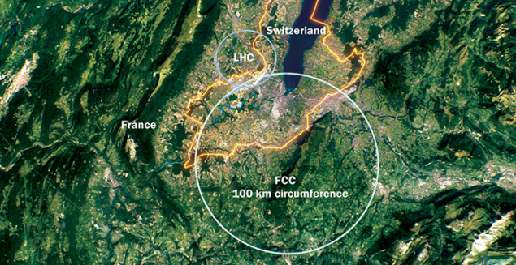
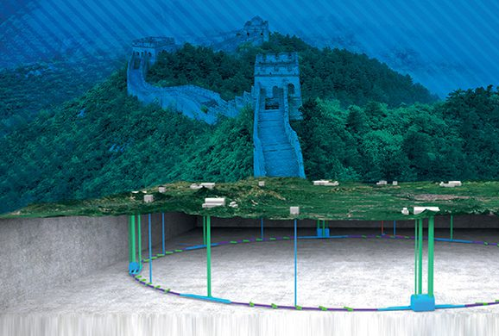
Possible Future Accelerators for HEP
Storage Rings – designs with CDR+
FCC-ee / CEPC would be ~100 km circumference e+/e- storage rings for Higgs and EW
FCC-hh / SPPS would be ~100 km circumference p-p storage rings aimed at 100 TeV (7x LHC)

Slide 7
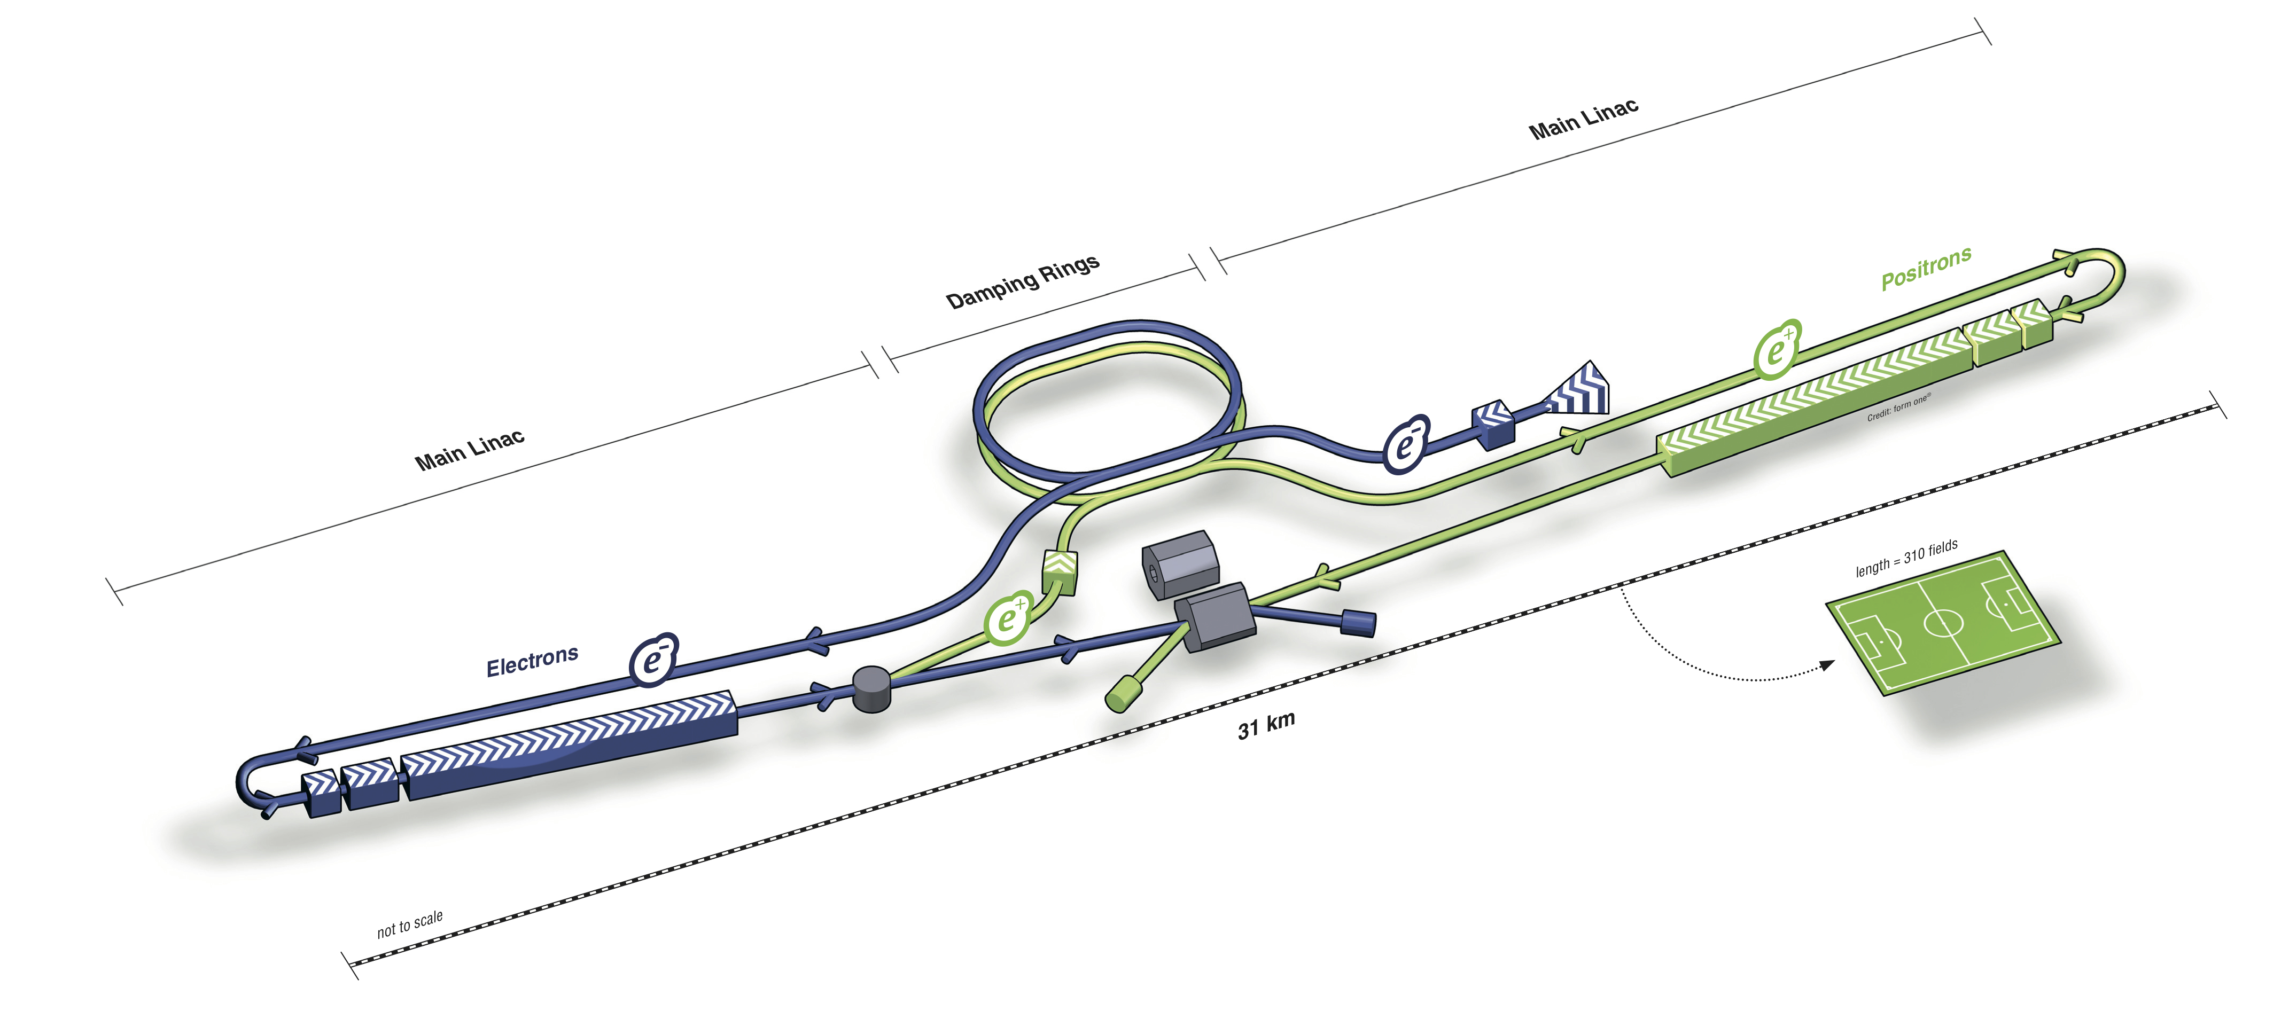
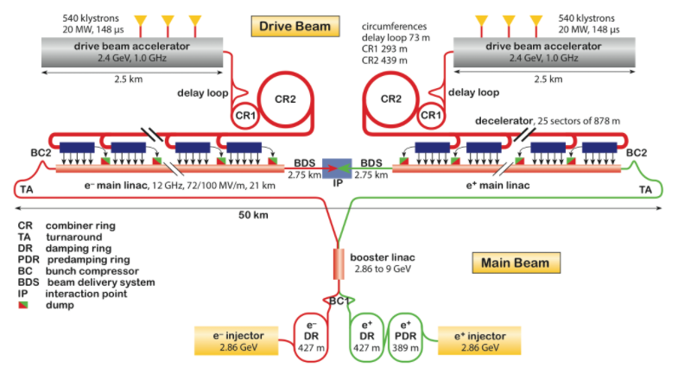
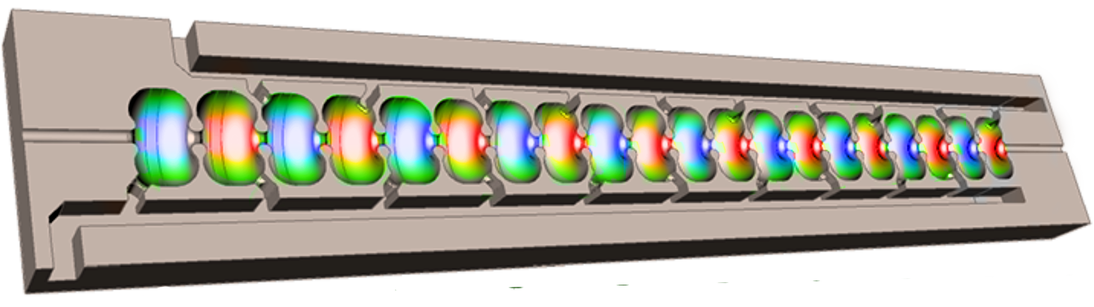
Possible Future Accelerators for HEP
Linear Colliders – designs with CDR++
International Linear Collider – ILC
250 GeV e+/e- initially and upgrade
to 500 GeV in ~30 km in length
ILC, CLIC, C^3
Compact Linear Collider – CLIC
380 GeV e+/e- initially and upgrade to 3 TeV in ~50 km in length
Cool Copper Collider – C³
250 GeV e+/e- initially and upgrade to 550 GeV with ~8 km in length

Slide 8
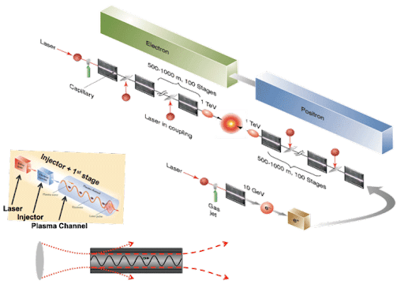
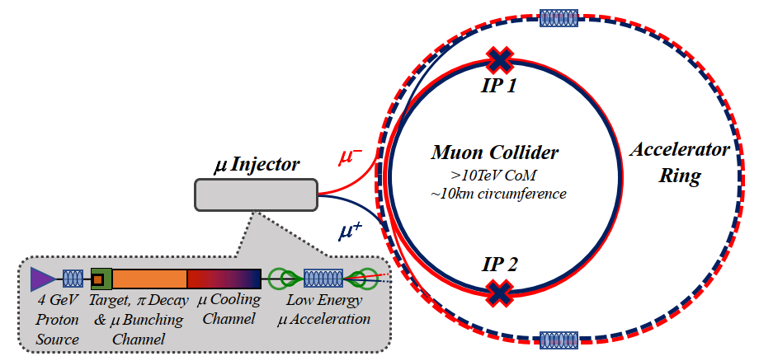
Possible Future Accelerators for HEP
Future Concepts – designs at early stage working toward pre-CDR
Muon Collider – avoids synchrotron radiation challenges of e+/e- but muons are unstable
Plasma Linear Collider – offers very high gradients 10 ~ 100x conventional linear colliders
but challenging beam dynamics and peak powers
ERL Linear Collider – high luminosity but increased
capital costs
Plasma Collider concept
Muon Collider concept

Slide 9
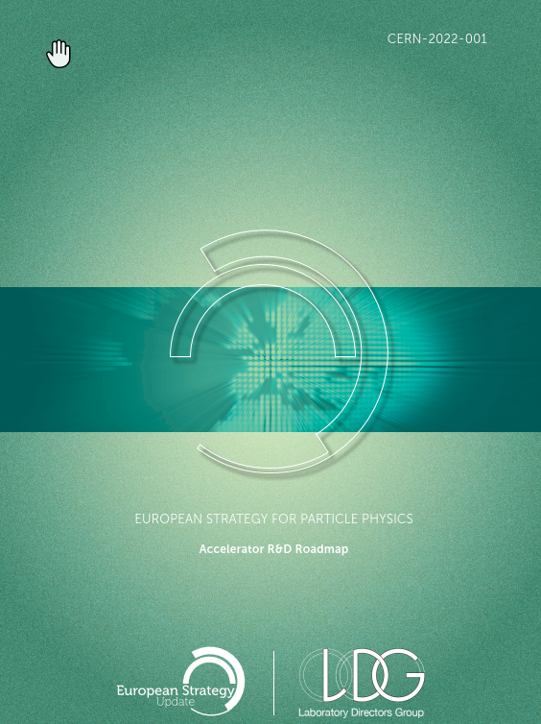
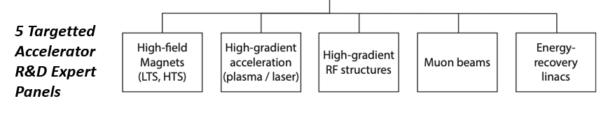
LDG Accelerator R&D 2022 Report
Two immediate outcomes from ESPP
  FCC-ee Feasibility Study → report for next ESPP in 2026
  Lab Directors Group (LDG) Accelerator R&D Panels
  formed to address the question of what are the most
  promising Accelerator R&D activities for HEP
Included discussions of R&D for FCC-ee, ILC and CLIC
Over 170 international contributors to the roadmaps

Slide 10
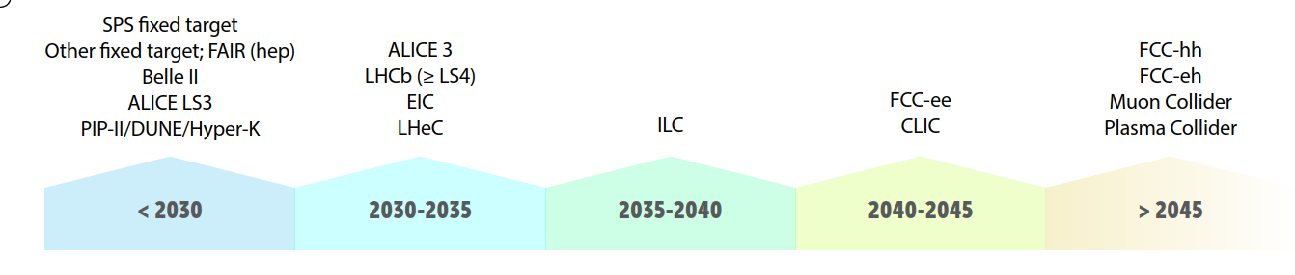
Timeline considered in LDG Accelerator R&D Report
The timeline considered by the LDG is largely dictated by the technical readiness including some consideration of funding and resource availability
Difficult to evaluate concepts with little design work
The timescale for international negotiations can be challenging to anticipate

Slide 11
Snowmass’21 → US planning process
“Snowmass is a particle physics
community study”
https://www.snowmass21.org/
Provides input to P5
(Particle Physics Project
Prioritization Panel) which
develops a strategy for
the US HEP program
July 17-27, Seattle
1.5-2 yrs
Snowmass
~5-7 yrs of
hard work
P5
Strategy
~ 1 yr
DOE/NSF
program

Slide 12
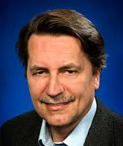
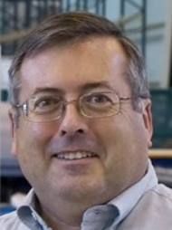


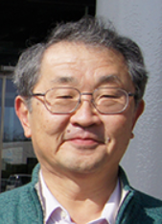
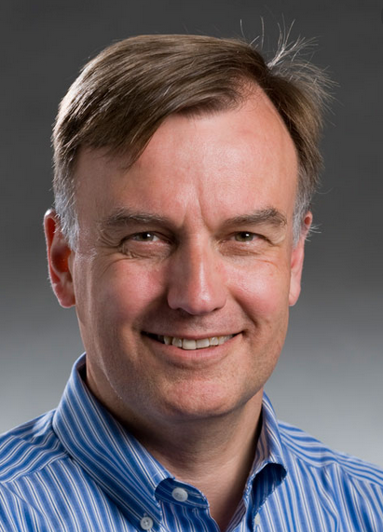


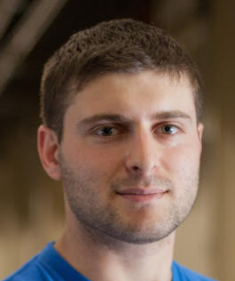
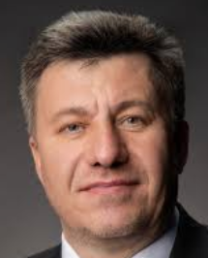

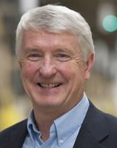
Snowmass Implementation Task Force
Key question for Snowmass’21 Accelerator Frontier to address: “…What are the time and cost scales of the R&D and associated test facilities as well as the time and cost scale of the
facility?”
A large number of possible accelerator projects: ILC, Muon Collider, gamma-
gamma and ERL options, a large circumference electron ring (e.g. FCC-ee),
and a large circumference hadron ring amongst others.
Comparison of the expected costs (using different accounting rules), schedule,
and R&D status for the projects.
The Accelerator Implementation Task Force comprises of 12 world-renowned
accelerator experts from Asia, Europe and US and two representatives of the
Snowmass Young; it is chaired by Thomas
Roser (BNL) and charged with developing
metrics and processes to facilitate a
comparison between projects
Thomas Roser (BNL, Chair)
Philippe Lebrun (CERN)
Steve Gourlay (LBNL)
Tor Raubenheimer (SLAC)
Katsunobu Oide (KEK)
Jim Strait
(FNAL)
Sarah Cousineau
(ORNL)
Marlene Turner (LBNL)
Spencer Gessner (SLAC)
Vladimir Shiltsev (FNAL)
Reinhard Brinkmann
(DESY)
John Seeman
(SLAC)

Slide 13
Technology R&D Needs by HEP Project
  Details in LDG R&D Roadmap and discussed in talks subsequently:
  FCC-ee → SRF, High efficiency klystrons, and efficient tunnel construction
  FCC-hh → High field SC magnets, efficient cryogenics
  ILC → High gradient SRF
  CLIC → High gradient NC RF
  C³ → High gradient NC RF and large scale LN2 cryogenics
  Muon Collider → Acc Physics, High gradient SRF, high field SC magnets, high power targets
  Plasma collider → Fundamental acc Physics, high power lasers
  Recirculating Colliders (FCC-eh, ERLC, …) → ERL

Slide 14
Summary
Major projects are being developed around the world
ESPPU and future P5 reports help prioritize path forward for HEP
    An e+/e- Higgs factory is considered an important next step
    ILC in Japan is one possible route – SRF technology is essentially ready
    Multiple other approaches with varying benefits are being developed:
    FCC-ee / CEPC, CLIC, C³, Muon Collider, …
Path toward next major HEP facility will be clearer in mid-2020’s
Clear acknowledgement in LDG R&D Report of need to engage industry early and provide long-term support

