Slide 1
I.FAST Accelerator-Industry Co-Innovation Workshop, 3-4 May 2022, CERN
Laser technologies for particle acceleration
Leonida A. GIZZI
CNR, Pisa, Italy

Slide 2
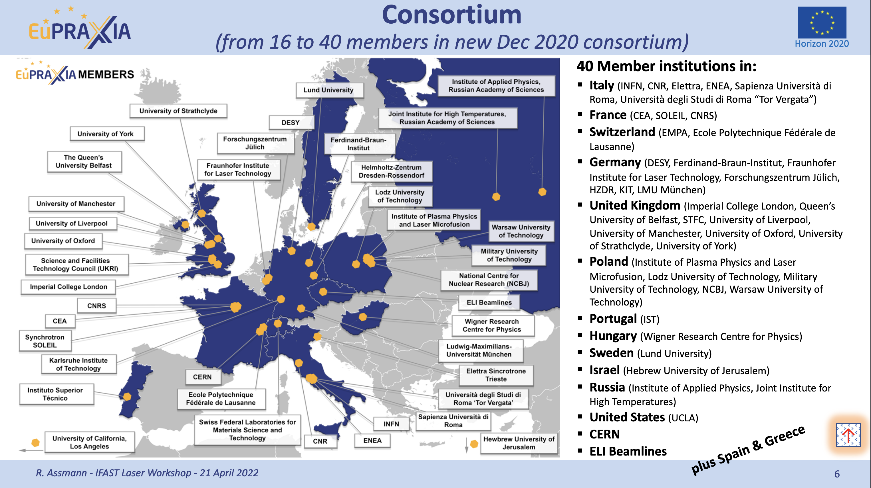

Slide 3
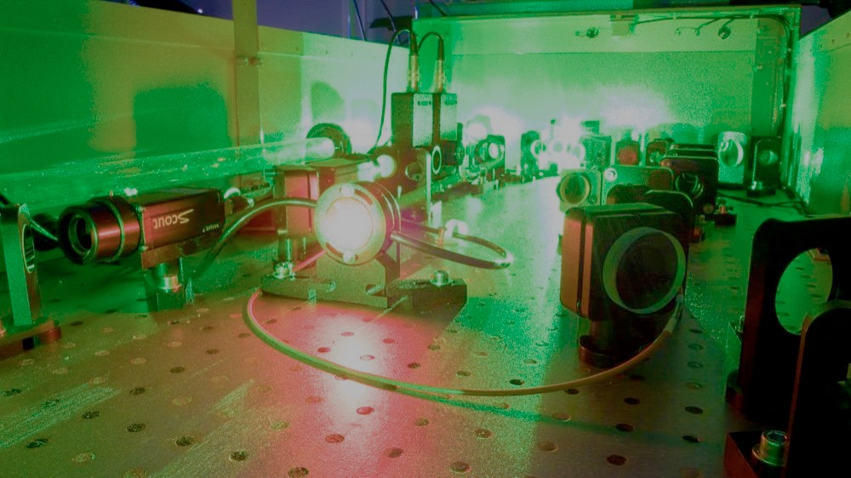
CONTENTS
Ultraintense lasers scenario vs. industry
Motivating societal applications
Strategy for laser drivers for plasma accelerators
Technology challenges and needed R&D
Opportunities for industry
Interactions with industry and knowledge transfer
Trends for R&D scenario in the medium-long term

Slide 4
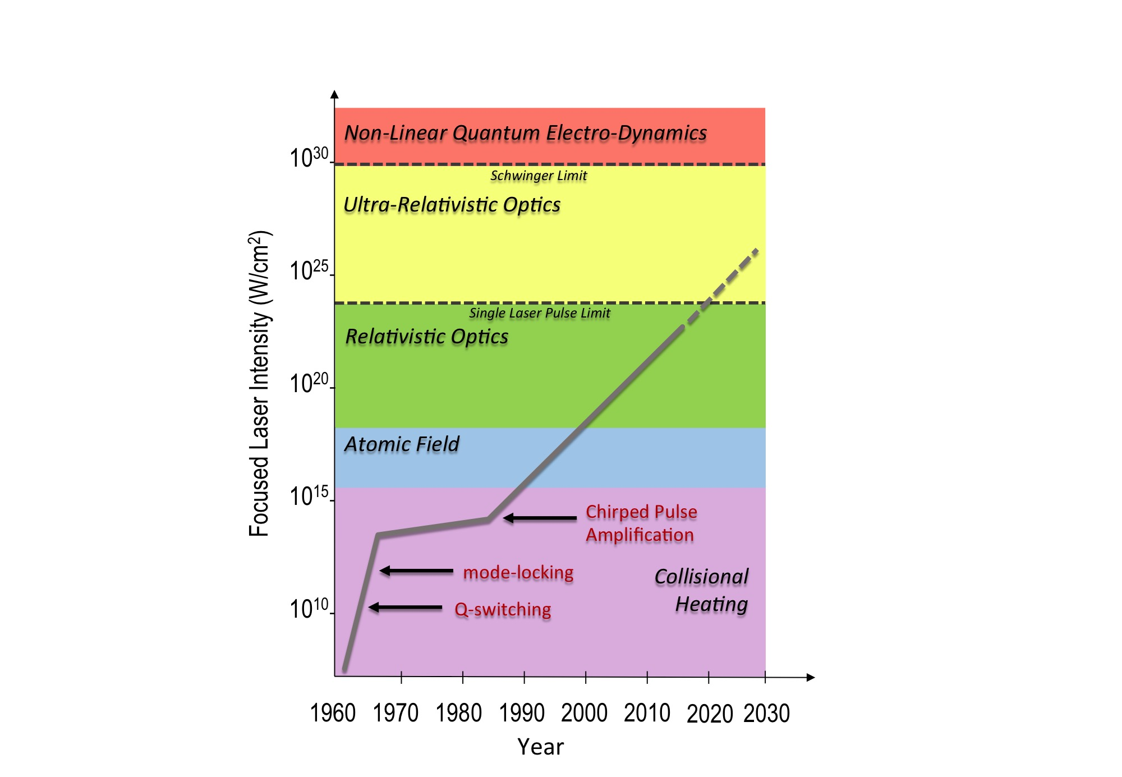

HIGH INTENSITY LASERS: EVOLUTION
Major breakthrough after the invention of Chirped Pulse Amplification
Current laser technology development mainly driven by extreme intensity applications;
Laser-Plasma acceleration (LPA) has developed along with progress in laser performance;
Recent LPA-FEL demonstration [1] highlights the role of laser stability and control;
IFAST/LASPLA will focus on the technology required to achieve high-repetition rate at multi-joule (≈100 TW) scale [2], with high quality and enhanced control and stability;
Key role of industry to establish turn-key, high average/peak power ultrashort pulse technology;
LASER-PLASMA ACCELERATORS
D. Strickland and G. Mourou, "Compression of amplified chirped optical pulses." Optics communications 55, 447 (1985)
*W. Wang, K.Feng et al., Free-electron lasing at 27 nanometres based on a laser wakefield accelerator, Nature 595, 516–520 (2021)
**L.A. Gizzi et al., A viable laser driver for a user plasma accelerator, NIM A 909 , 58 (2018); https://doi.org/10.1063/1.4984906

Slide 5
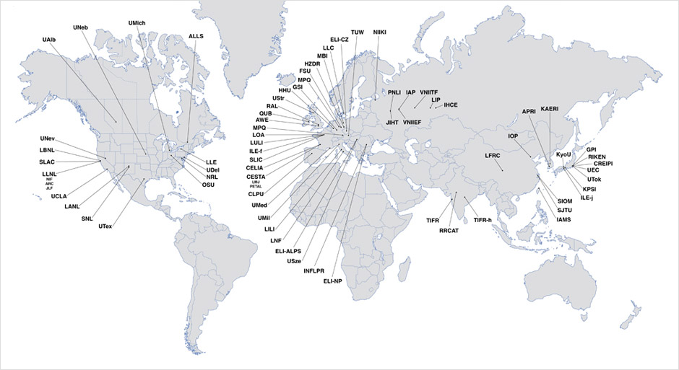




HIGH INTENSITY LASER: WORLD SCENARIO
Laser-Plasma labs spread worldwide exploiting mostly EU industrial CPA lasers and laser technology
ICUIL MAP

Slide 6
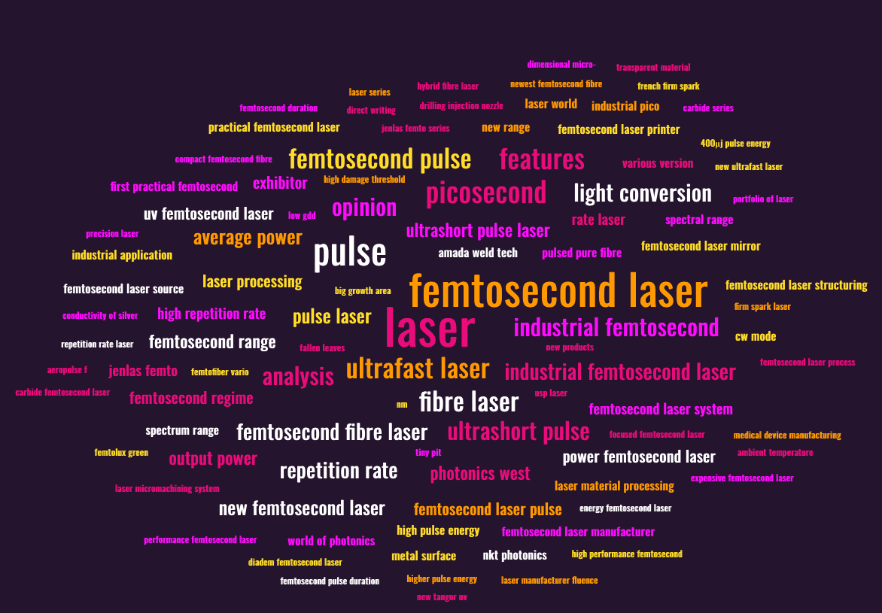

FEMTOSECOND LASERS VS INDUSTRY

Slide 7
FEMTOSECOND LASERS VS INDUSTRY

Slide 8
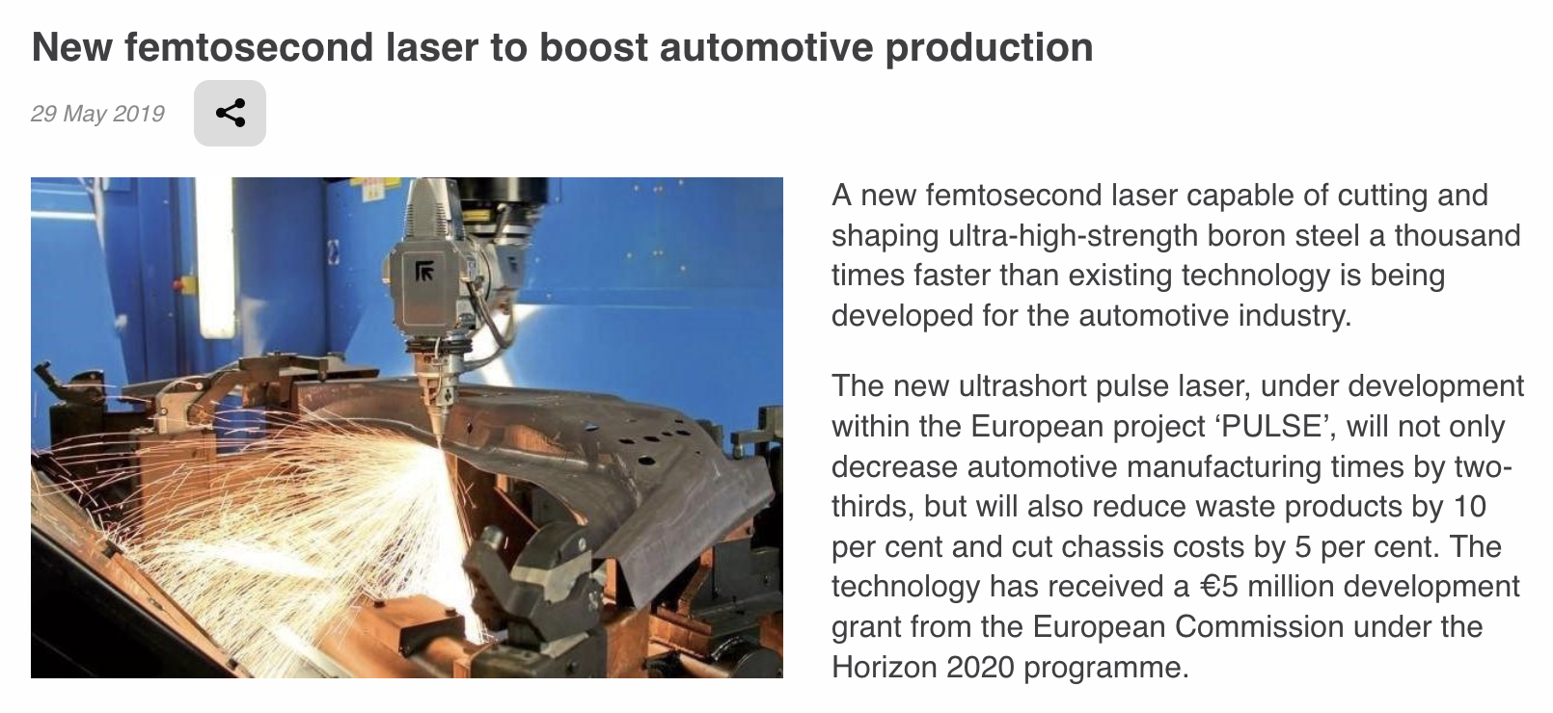
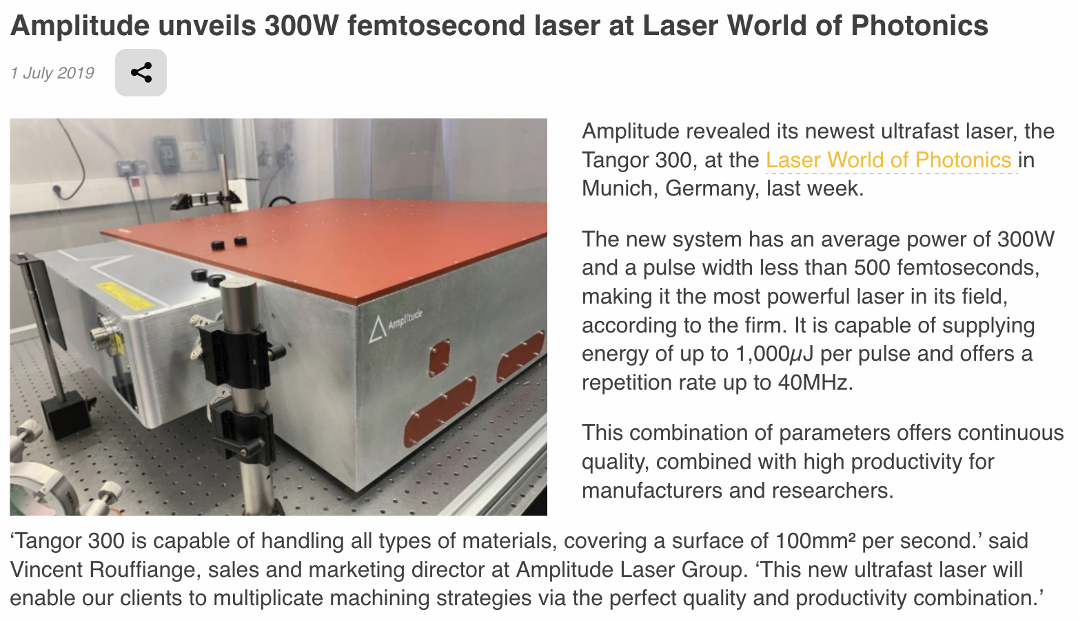

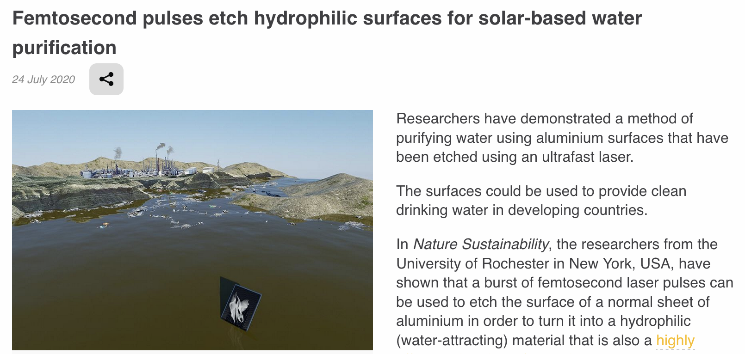
INDUSTRIAL FEMTOSECOND LASERS
Industry focusing on material processing and surface functionalization with up to kW average power, ≈100 fs lasers , repetition rates up to ≈GHz, pulse energy between 2.5-250µJ, for a MW peak power
Needs for laser-based accelerators
> kW average power ≈10 fs lasers, repetition rates up to 10 kHz, pulse energy 1-100 J, for a 100 TW peak power.

Slide 9
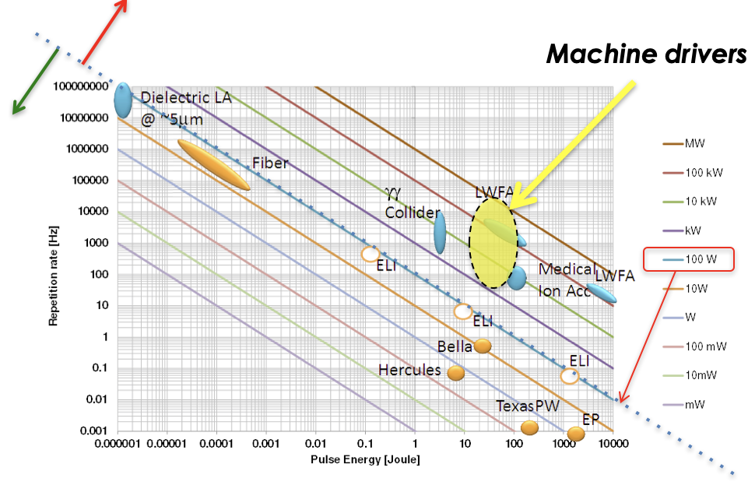



ROADMAP ON LPA LASER DRIVER TECHNOLOGY
Laser-driven plasma acceleration needs ultrashort, high power lasers with high average power
Current technology: ≈ Ti:Sa technology, pumped by flash-lamp pumped lasers
  Robust, reliable industrial technology
Mature technology: ≈ Ti:Sa technology, pumped by diode-pumped lasers
  Strong R&D effort in place (e.g HAPLS@ELI)
  ≈ 3-5 years to go to first industrial LPA demonstrator (e.g. Eupraxia) [1]
Targeting higher wall-plug efficiency and rep. rate, kHz and beyond, stability, control (space, time, spectral);
  5-10 yrs for first efficient, multi-kW-scale demonstrator,
  A strategy is needed to steer effort in the LPA laser driver direction: LASPLA
Current
Systems
[1] R. Assmann et al., EuPRAXIA Conceptual Design Report, The European Physical Journal Special Topics 229, 3675–4284 (2020)
[2] C. Danson et al., Petawatt and exawatt class lasers worldwide High Power Laser Sci. and Eng. 7, e54 (2019)

Slide 10
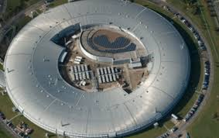
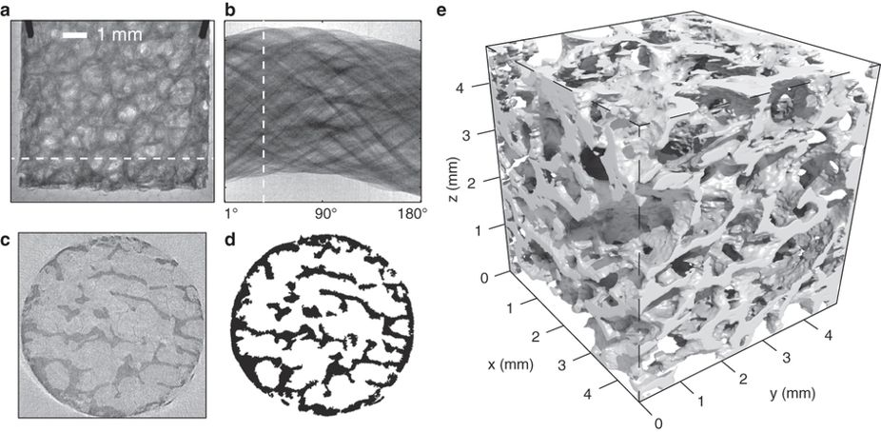
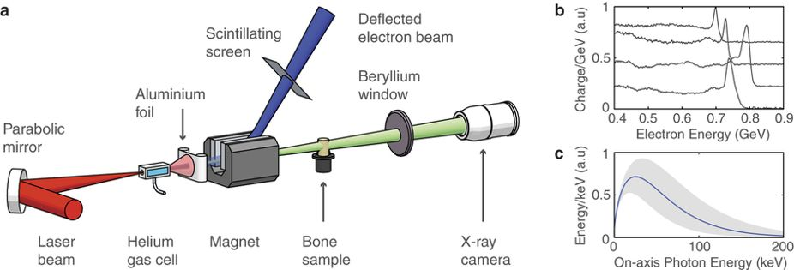
EMERGING APPLICATIONS: X-RAY IMAGING
X-ray imaging for compact, high resolution (phase contrast imaging) bio-medical diagnostics
Address some of the needs of large SR facility users
J.M.Cole et al., Scientific Reports 5, 13244 (2015)
Needs high repetition rate kW laser driver

Slide 11
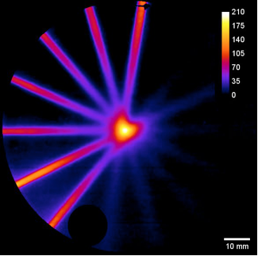
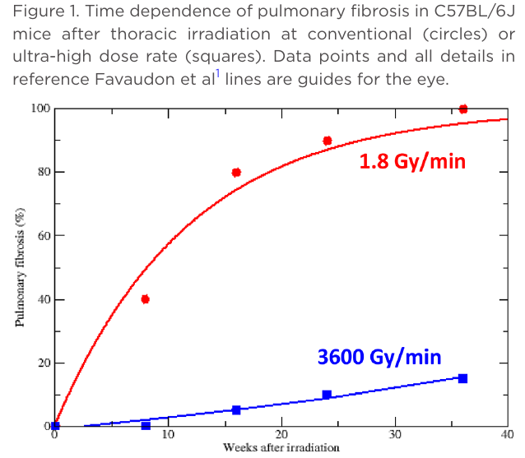
EMERGING APPLICATIONS: RADIOTHERAPY
LPA beams can meet specifications of advanced radiotherapy approaches
Laser-driven electron beams can provide ultra-high dose-rate to meet requirements of future “FLASH” radiotherapy with Very High Energy electrons (VHEE) in a compact size:
VHEE with Laser driven: Dosimetry
High dose-rate preserves healthy tissue
Proof of principle Multi-Field Radiation Therapy Very high energy electrons. (L.Labate et al. Sci Rep, 2020)
Almost none of the 13000 radiotherapy linacs worldwide can deliver FLASH beams: a huge potential still to be addressed, with major R&D in RF accelerators and novel accelerators, including laser-driven LPA.
Needs high repetition rate <kW laser driver
V. Favaudon et al., Sci Transl Med. 2014 Jul 16;6(245):245ra93

Slide 12
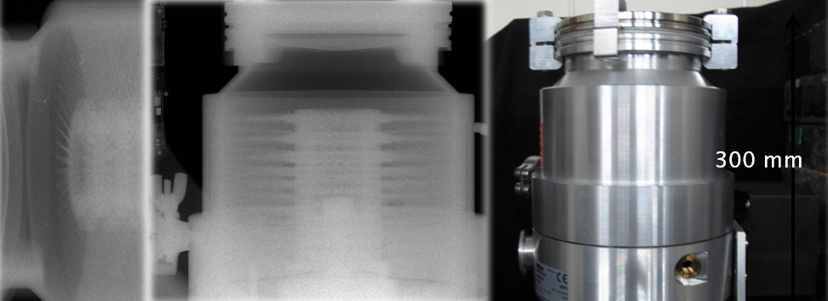
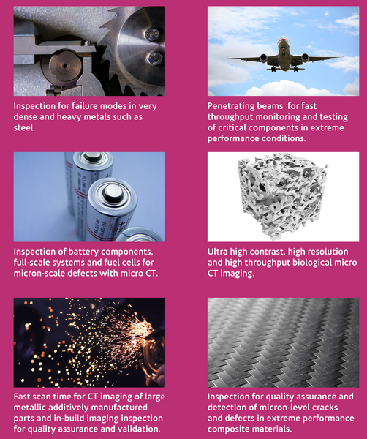
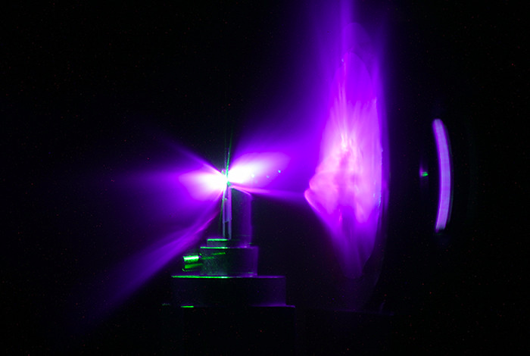
EMERGING APPLICATIONS: INDUSTRY AND SECURITY
High energy X-rays or neutron sources are being developed for industry and security
New high intensity laser based facility (80M GPB investment) to support science, technology, innovation and industry.
Industrial high temporal resolution X-ray imaging - C. M. Brenner et al, PPCF, 58 014039, (2015)
The Extreme Photonics Applications Centre, CLF, UK
Laser driven neutron sources at Los Alamos
Moving to implementation of kW laser technology for users

Slide 13





MATCHING INCREASINGLY HIGH-IMPACT MARKETS WITH LPA STABILITY
Therapy
Oncological beam
Strong
In-vivo
Phase contrast Imaging
Imaging
Ex-vivo
Phase contrast Imaging
Regulatroy constraints
NDT
Micro-tomography (Low Energy NDT)
Average
SHERIL (High Energy NDT)
Courtesy of Francois SYLLA
Beamline (fully-integrated large system)
Research
Weak
KAIO (accelerator head)
Laser-based FEL
Targetry (accelerator components)
Low (TRL 2-3)
Mid (TRL 4-6)
High (TRL 7-9)
LPA stability

Slide 14
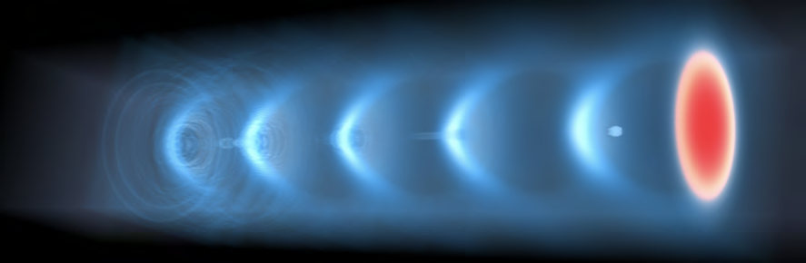
RELEVANT BLOCKS OF A LASER DRIVER
Similar to RF generators (e.g. Klystrons), laser driver power is generated and delivered to cavity (plasma)
Concern is similarly on efficiency, stability, lifetime …
No fundamental limitations, but technology needs major boost;
So far developments driven by science (higher peak power);
Cooling
Pump (Energy)
Optical compressor
Gain medium
Amplifier stages
Transport
Transport
Focusing
Cooling
Need to move to machine-driven developments

Slide 15
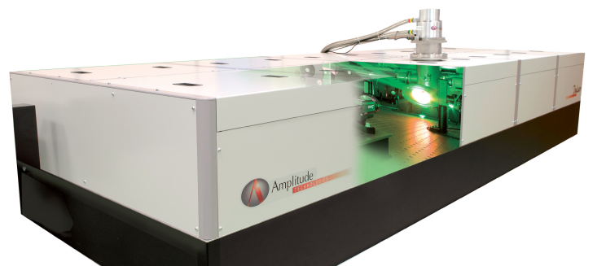
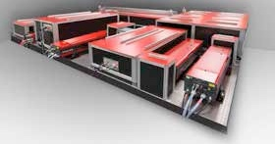
AVAILABLE INDUSTRIAL SYSTEMS
Current EU industrial systems offer robust solutions, incorporating ultrashort pulse capabilities at the PW level, in a compact footprint
Amplitude Technologies
PULSAR: 5 J, <25 fs, 5-10 Hz
Ti:Sapphire
Thales
ALPHA5/XS: 20 J, 25 fs, 5 Hz
Ti:Sapphire
Scientific lasers: still require expert users

Slide 16
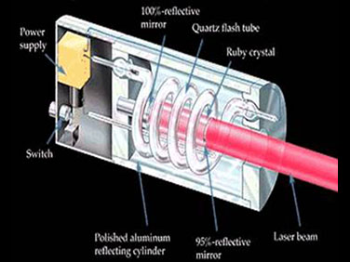
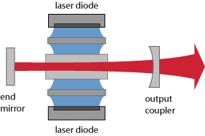
CHANGE OF OPTICAL PUMPING TECHNOLOGY
Analysis of available technologies for PW-class, multi kW average power lasers;
Comparison with the requirements of user beamlines;
Current option: TiSa pumped with diode pumped solid state lasers (DPSSL) – robust;
In progress: Direct CPA for higher rep-rate, higher efficiency.
PUMP SOURCE: Flashlamp
PUMP SOURCE: Diode laser
Major developments in laser technology occurring now!

Slide 17
DIODE LASERS PUMP SOURCES
Underpinning development of novel scientific and industrial lasers

Slide 18
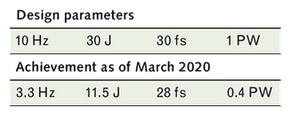
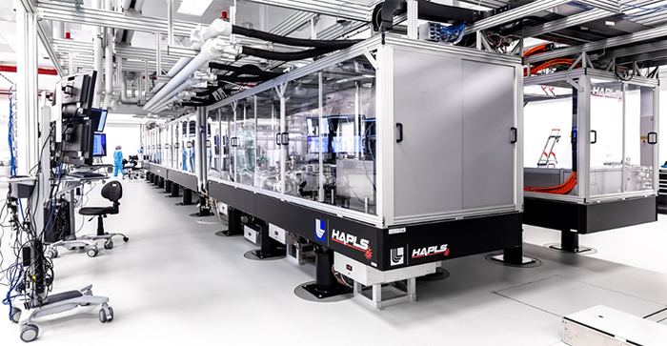
Recent advances for high average power at ELI
Diode-pumping technology for Ti:Sa pump lasers established
Latest (April 2021)
0.5 Petawatt (PW)
13.3 Joules (J)
27.3 Femtoseconds (fs),
3.3 Hertz (Hz) repetition rate
44 Watts average power.
The L3-HAPLS at ELI Beamlines Research Center in the Czech Republic. Credit: ELI Beamlines*
A major change in technology: from old flashlamp pumped lasers to diode pumped lasers;
Cost of DPSSL still prototype and mainly due to diodes - not yet scaled to industrial production;
Cost per W is expected to go down to ≈€/W level (reduction of 2 orders of magnitude)
*L. Koubíková, LaserFocusWorld, 2020

Slide 19


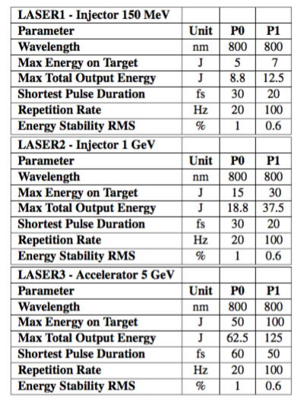
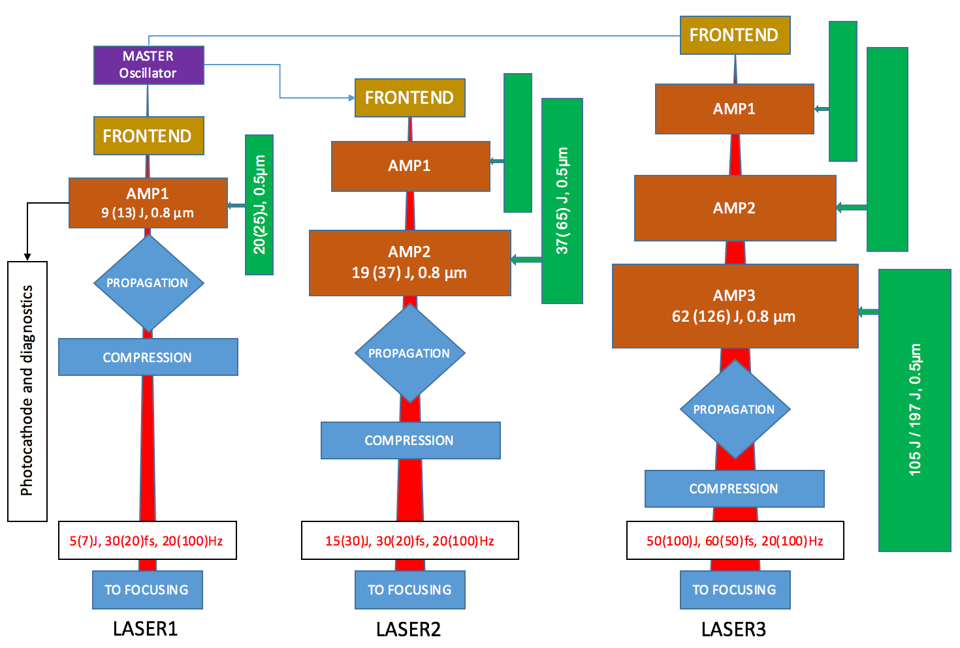








DESIGN STUDY: THE EUPRAXIA LASER
A viable laser driver for a user plasma accelerator with high readiness
L.A. Gizzi et al., Nuclear Inst. and Methods in Physics Research, A 909 (2018) 58–66
L.A. Gizzi et al., NIMA 909, 58 (2018); G.Toci et al., Instruments 3, 40 (2019)
European companies interested

Slide 20


New EU Infrastructures

Slide 21

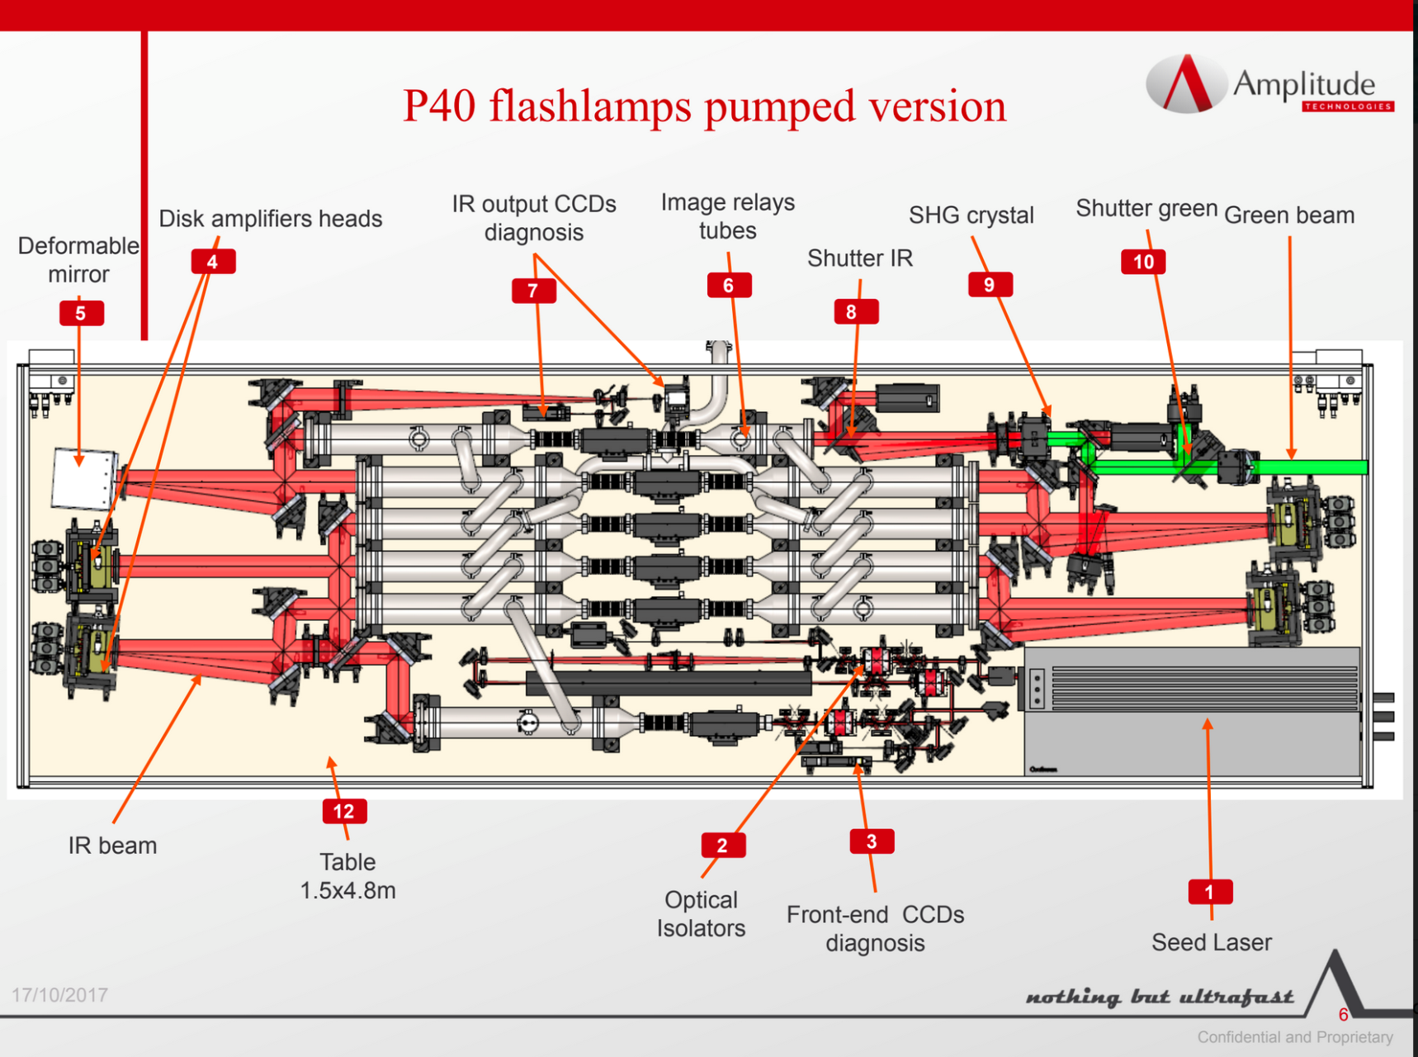
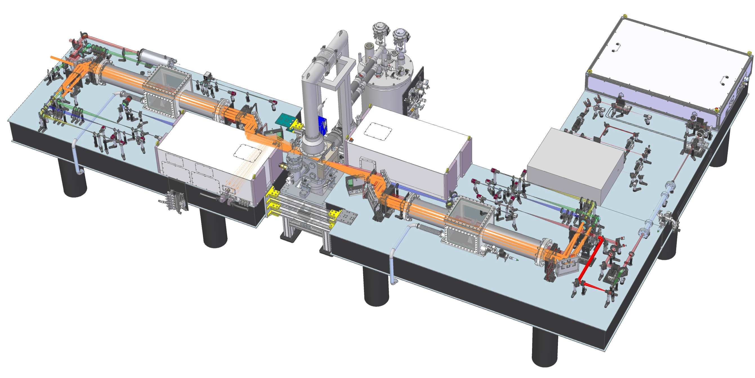
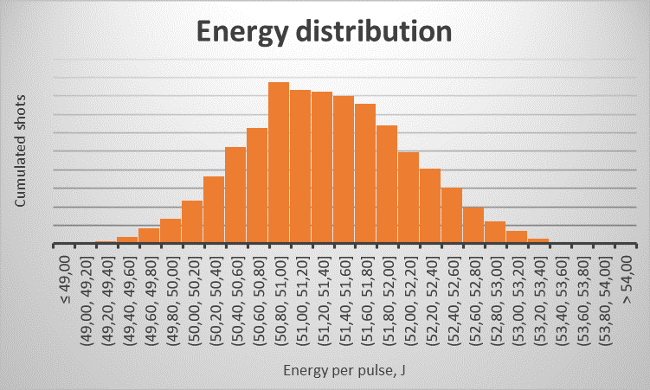
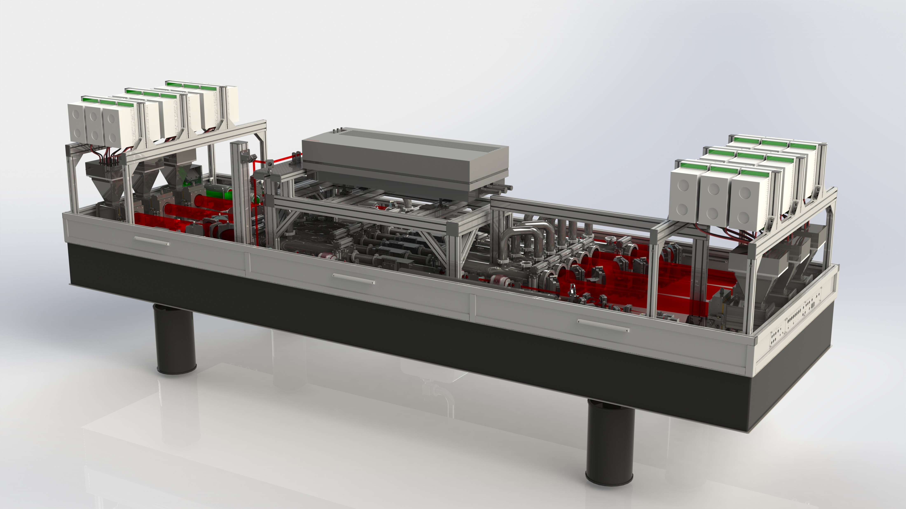



EuPRAXIA Laser Driver: pump lasers
Developments based on diode pumping technology are in progress, progressively matching requirements
Schematic of DiPOLE 100Hz
Cryostat
Pump diodes
100Hz Front end
10J amplifier head
Amplitude P60
Flashlamp pumped Nd:YAG
Design: 60 J @ 10 Hz, 532 nm
VSF
Diode pump technology
  100J @ 10Hz
    Summer 2019 demonstrated 60J @ 10Hz, 515nm in LBO with 66% efficiency (91J @ 1030nm)
    Commissioning of DiPOLE100 @ XFEL commenced Q1 2020 – completion end 2021
    Energy scaling 145J @ 10Hz, 1030nm
    @ HiLASE in January 2021
  10J @ 100Hz
    Build @ CLF near completion –
    commissioning Q4 2021
Conversion to diode pumping fully designed - Premiumlight
Expected specs: 100 Hz – 10 kW (100 J/pulse @ 1µm)
Cost of diode still an issue
currently 5x compared to flash-lamps.
expected to decrease.
Maintenance free operation for 25-30 yrs.
Courtesy of P. Mason
Courtesy of F. Falcoz
More options available and further developing.

Slide 22
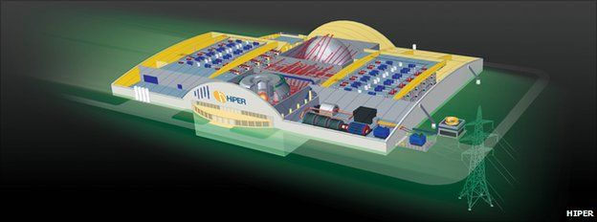
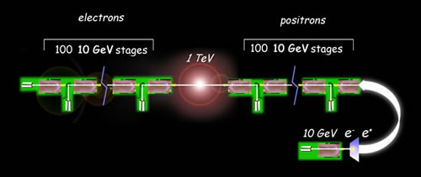
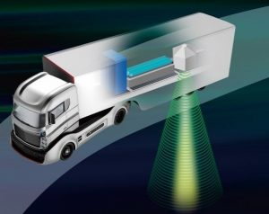
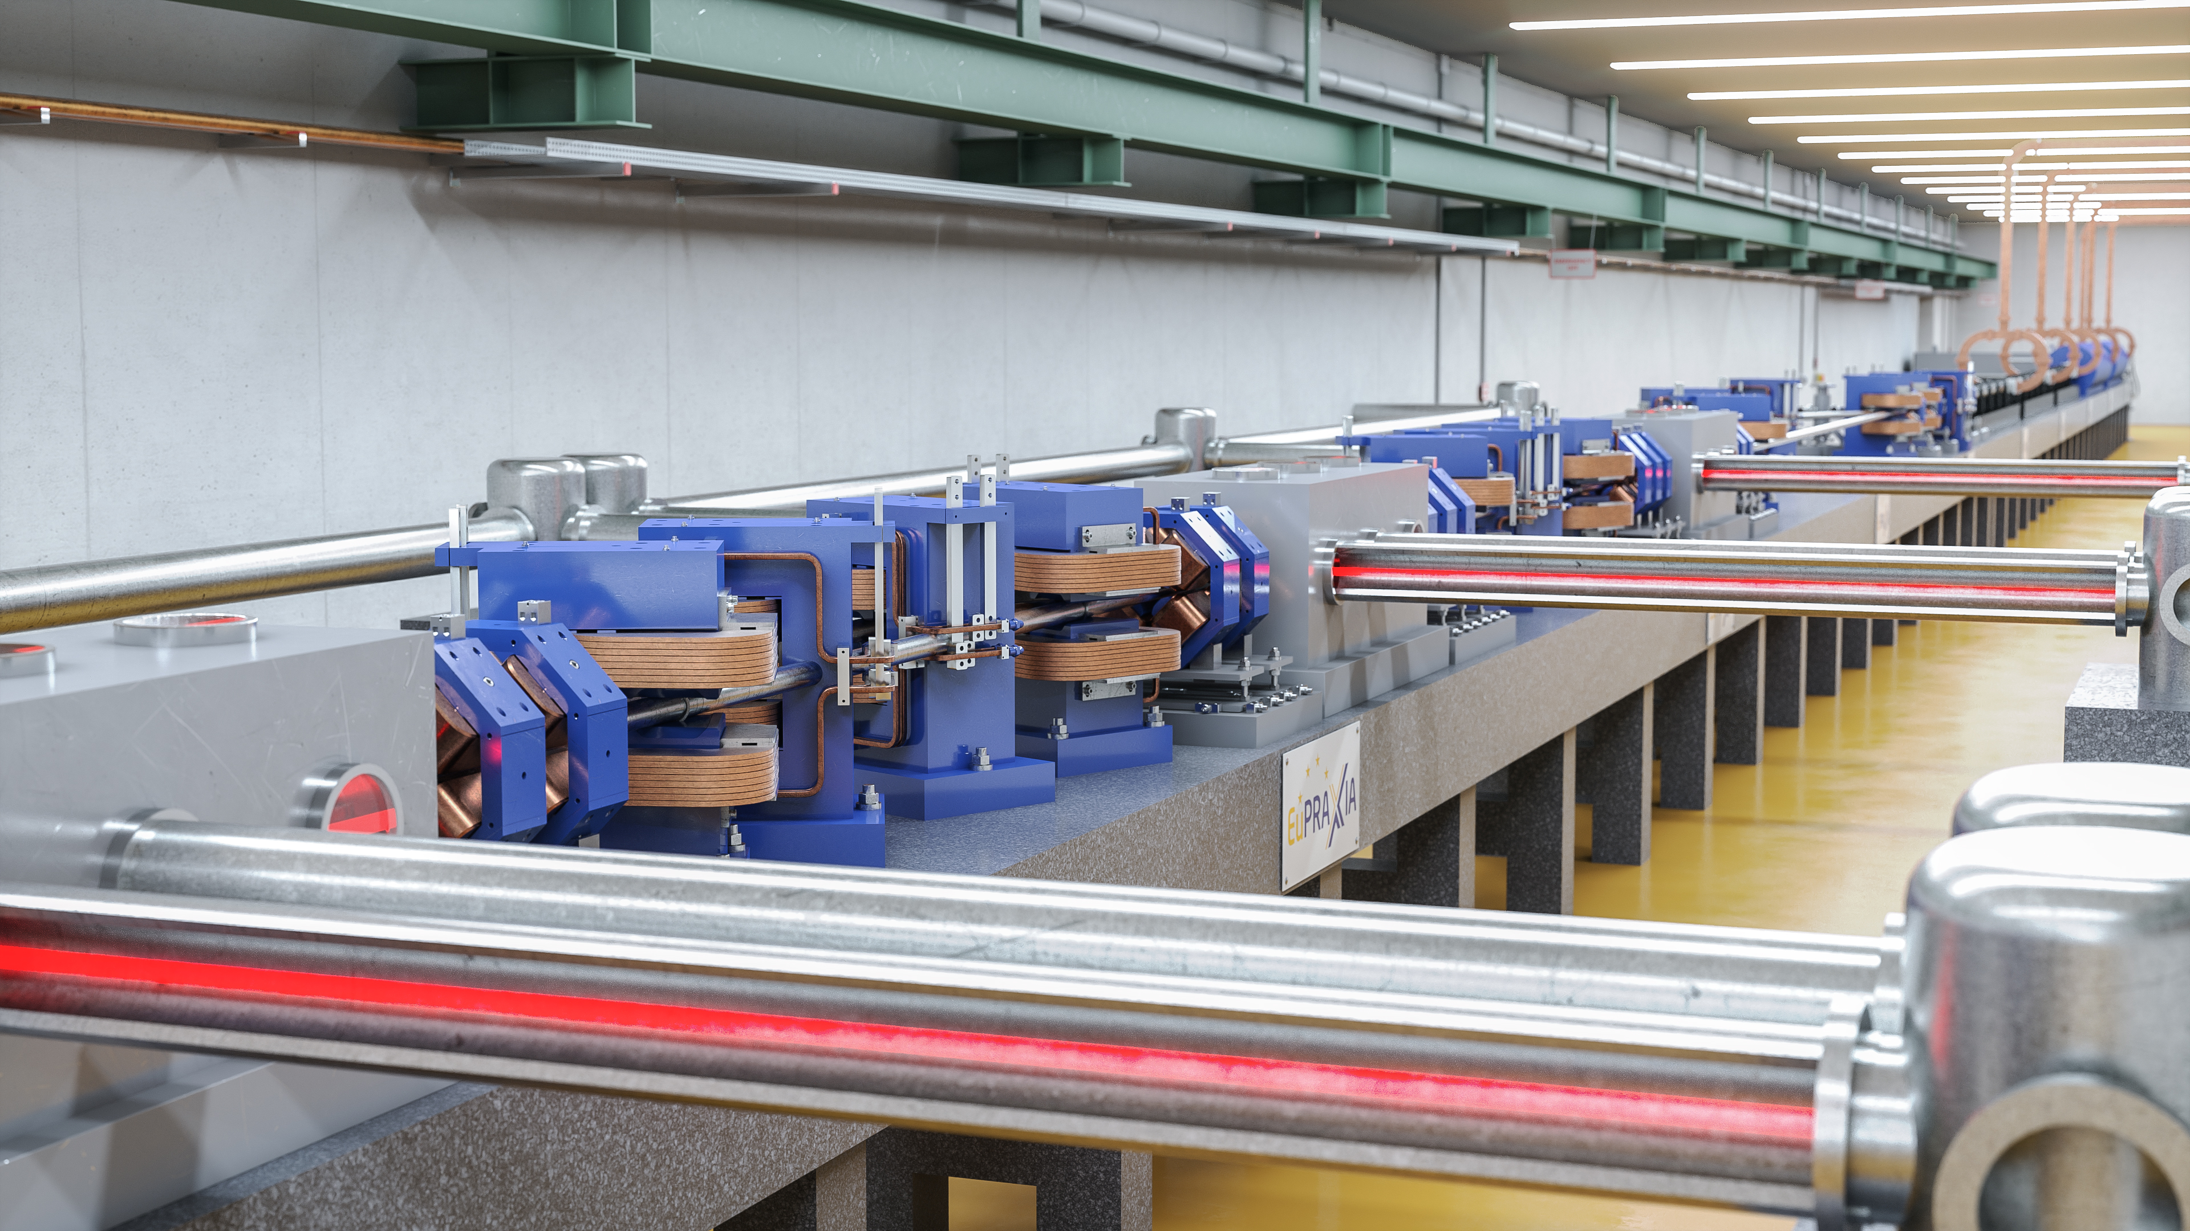

GRAND CHALLENGES OF PLASMA TECHNOLOGY
Aiming at extensive use of multiple (hundreds of) laser units
Towards
CDR
INERTIAL FUSION ENERGY
Limited by laser technology
S. Atzeni et al., https://doi.org/10.1017/hpl.2021.41
CDR
HEP TeV COLLIDER
C. Benedetti et al., https://doi.org/10.48550/arXiv.2203.08366
R&D
Cost, durability, energy efficiency, scalability, mass production of underlying laser components will be
key to unlock these developments.
LASER DRIVEN NEUTRON SOURCES
https://www.ile.osaka-u.ac.jp/eng/research/project/project-lans/index.html
Preparatory phase
COMPACT PLASMA XRAY FEL
R. Assmann et al., https://doi.org/10.1140/epjst/e2020-000127-8

Slide 23
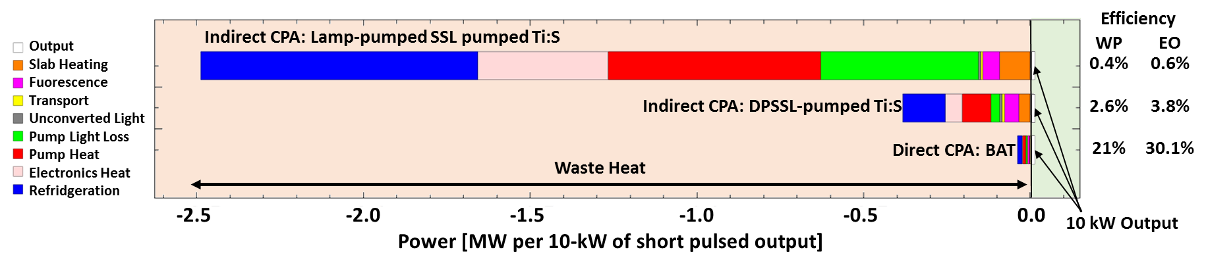
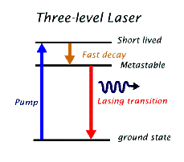
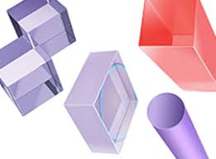
EFFICIENCY PATH
TiSa technology is prompt and will demonstrate repetitive operation 24/7 and stability, but not scalable with poor efficiency (% level) due to the indirect pumping architecture:
Direct CPA is the solution for wall-plug (WP) efficiency and high rep-rate.
From flashlamp to indirect to direct diode pumping
Quantum defect
C. Siders et al., EAAC 2017
WP Efficiency > 50% possible:
e.g. Yb-doped medium
We need a gain medium that can support amplification on a large bandwidth, has a low quantum defect and can be pumped directly with diode lasers: endless quest for the perfect laser medium!!

Slide 24
FUTURE SCENARIO
Other technologies under development aiming at >kW, higher rep. rates, higher average power levels and even more efficient configurations;
Fiber laser technology high WPE >50% in CW mode and coherent combination (pilot projects FSU Jena-Fraunhofer IOF and E. Polyt.-Thales in France). Low energy per pulse >10 kHz or for future upgrades; see also XCAN project;
Direct Chirped Pulse Amplification with lasing media pumped directly by diodes is ideal for higher efficiency and higher rep-rate;
5-10 yrs for first efficient, multi-kW-scale driver demonstrator, provided a strategy is set soon to steer effort.

Slide 25
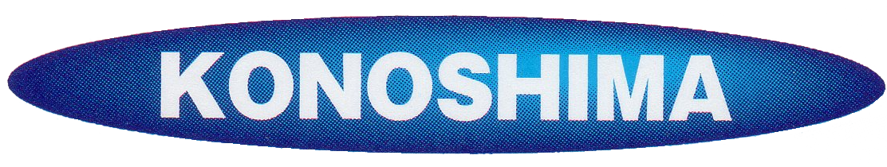
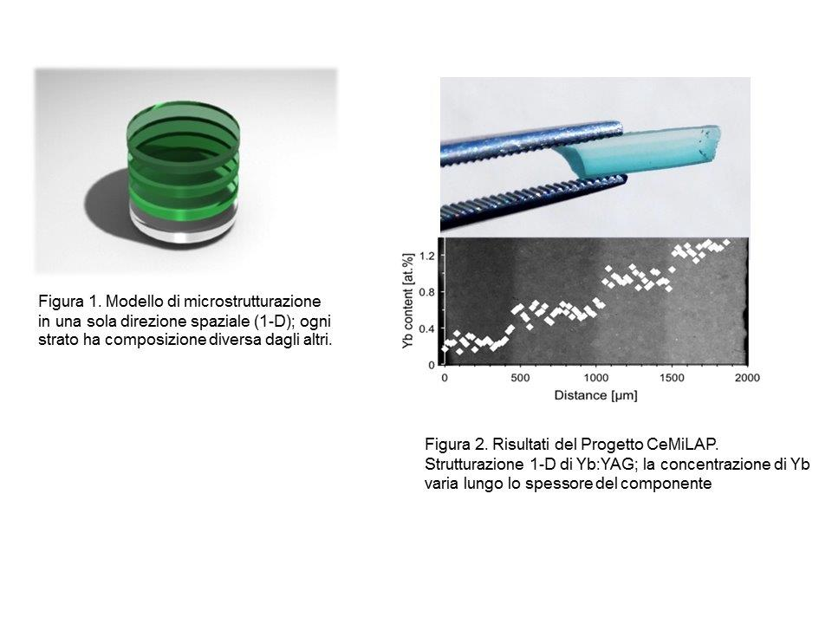

LASER GRADE CERAMICS
Faster and cheaper vs. single crystal growth process.
Large components, -shaping, -graded doping also optimized for thermal management – features not available for single crystals.
Several compositions (e.g. YAG, LuAG , Sc₂O₃, Lu₂O₃) and dopants (Nd, Yb, Er, Tm…) already available
Spectroscopic and thermomechanical properties similar to those of the corresponding single crystals
Better uniformity of dopant distribution on large gain elements
Industrial and R&D effort: (Japan); Research in China, Japan, Russia, USA, France and Italy (ISTEC-CNR) (ZENITH Smart Polycrystals)

Slide 26
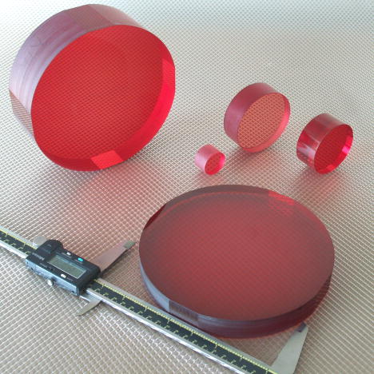
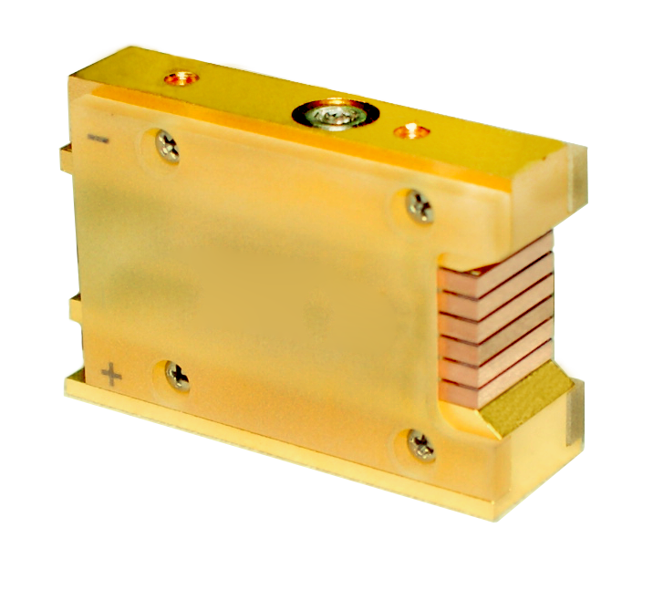
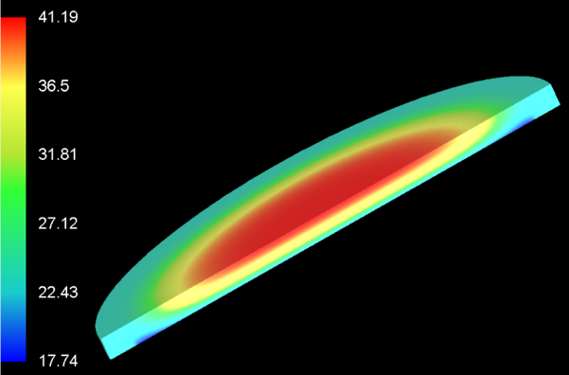
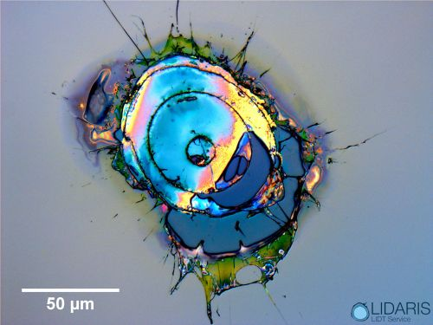
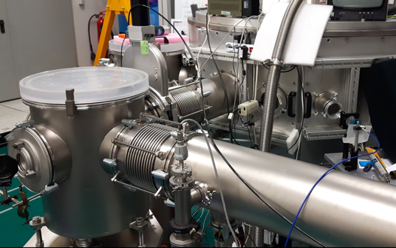

DRIVER DEVELOPMENT vs. INDUSTRIAL R&D
Pumping technology: diode (direct or indirect) pumping, efficient, low cost;
Gain media: industrially available laser quality, scalable in size and supporting large bandwidth and efficient cooling, small quantum defect;
Grating and optics technology with higher damage threshold for smaller beam size;
Thermal load, management, dissipation;
Vacuum technology;
Mechanical stabilization (active and passive);
…
≈10 M€ funding for Infrastructure technical development
Horizon Europe calls to support joint developments to enhance competitiveness of EU Industry (TRL enhancement towards new products)

Slide 27
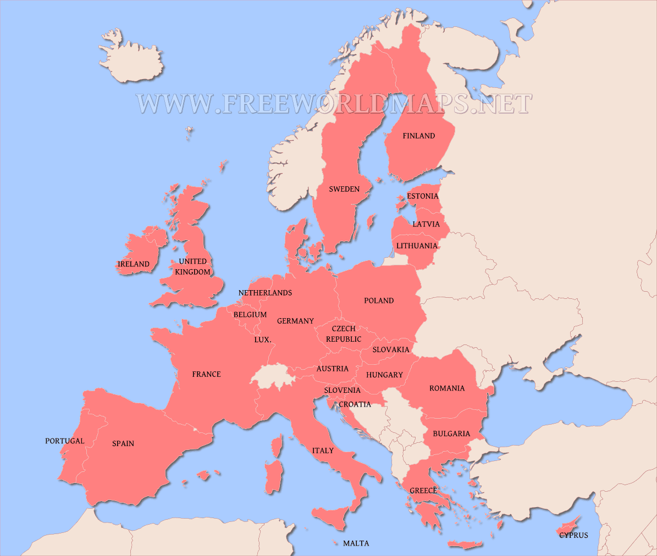







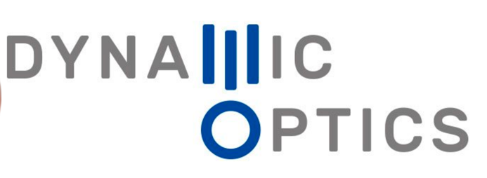
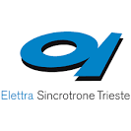

KEY PLAYERS ENGAGED
Increasing population of industrial players for laser and components development, in strong collaboration with Institututional players
Lawrence
Livermore
Natl. Lab
Available expertise covers all areas of intense lasers

Slide 28
SUMMARY
LPA accelerators requiring HAP industrial-strength PW-kW laser system, beyond current state-of-the-art ;
Industry delivering PW systems, now approaching development of HAP with ≈% level WPE using diode pumping;
Short term medical and industrial applications of LPA are now mature and motivate industrial investments in a potentially large market;
Grand challenges of plasma technologies limited by laser technology and cost
Effort now towards scalable laser systems with mass production of key components
Infrastructure development and operation a key thrust for laser R&D and TRL

