Slide 1



BOOSTING
SCIENTIFIC
KNOWLEDGE
MIGUEL ANGEL CARRERA - FOUNDER & CEO
macarrera@a-v-s.es
CO-INNOVATION

Slide 2
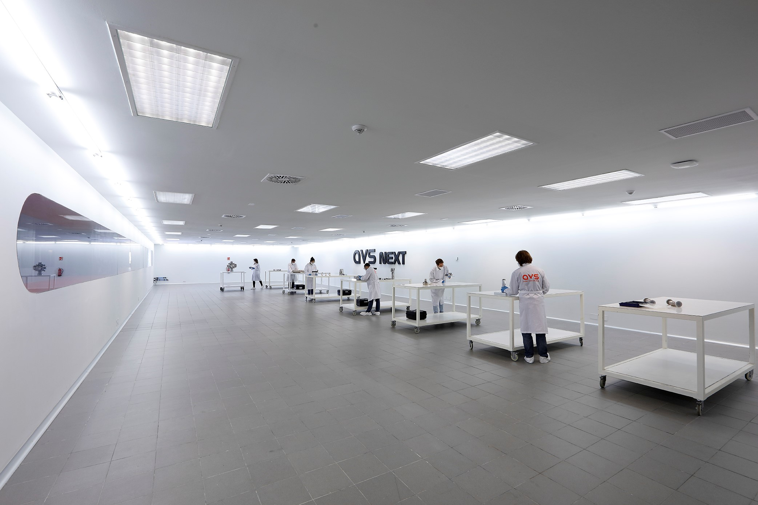
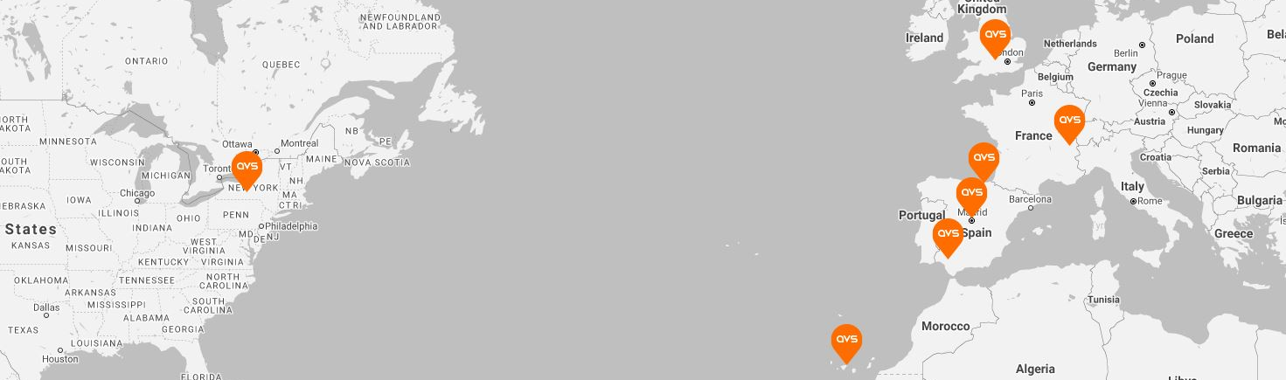

ABOUT AVS
ISO 9001
EN 9100
SET-UP IN 2006
HIGHLY QUALIFIED PERSONNEL
(80% MSc, MEngs and PhDs)
+10.000 m² FACILITIES
MODELLING DETAILED-DESIGN ANALYSIS PROCUREMENT MANUFACTURING ASSEMBLY INTEGRATION TEST

Slide 3
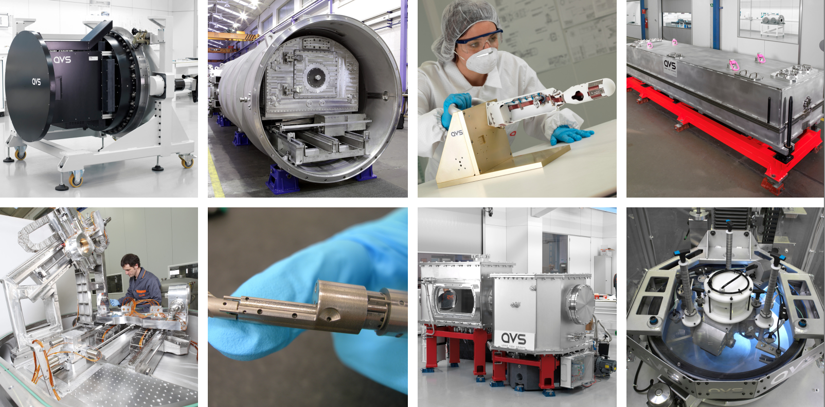
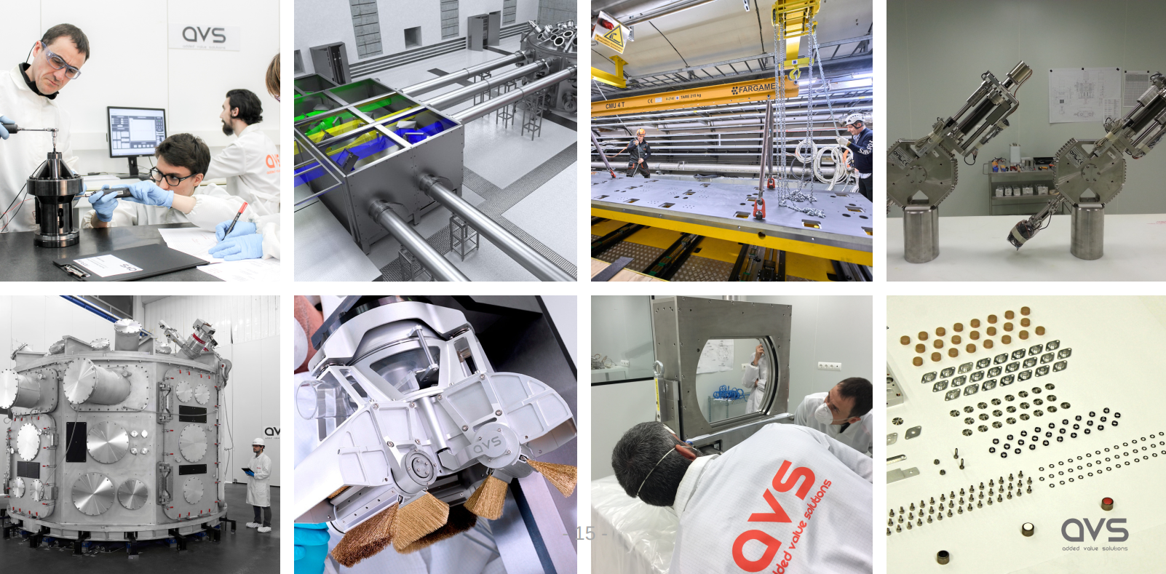
ADVANCED ROBOTICS · ULTRA HIGH VACUUM · MICRO-MECHANISMS · CRYOGENICS · OPTOMECHANICAL SYSTEMS · HIGH MAGNETIC FIELDS · HIGH PRESICION SYSTEMS · RADIATION ENVIRONMENTS · CRITICAL SYSTEMS ·
SPACE
ACCELERATORS
ASTROPHYSICS
SYNCHROTRON
NEUTRON
FUSION
LASER

Slide 4
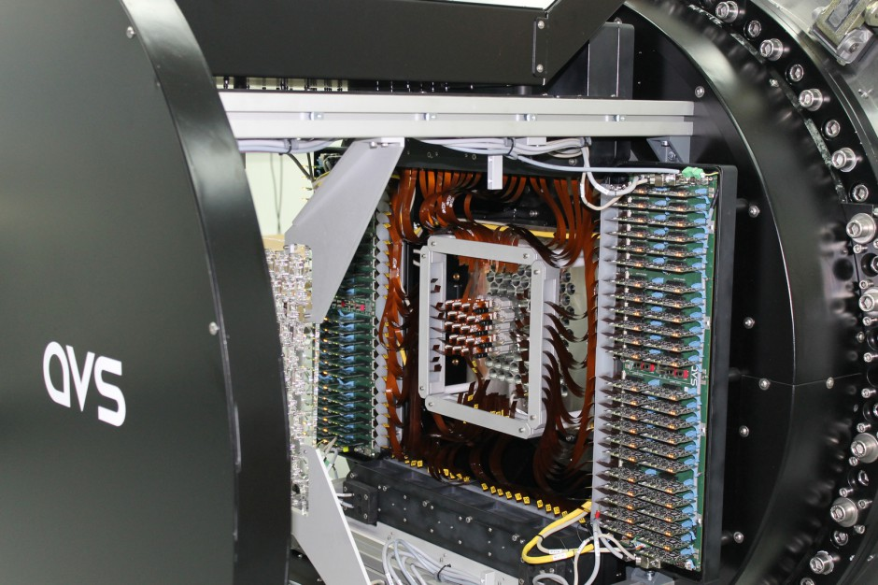
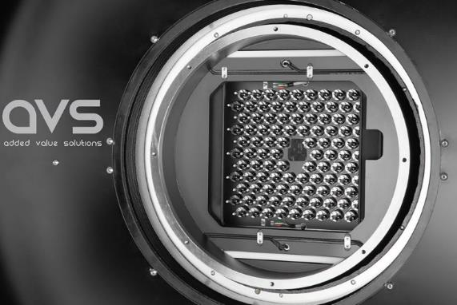
ASTROPHYSICS

Slide 5
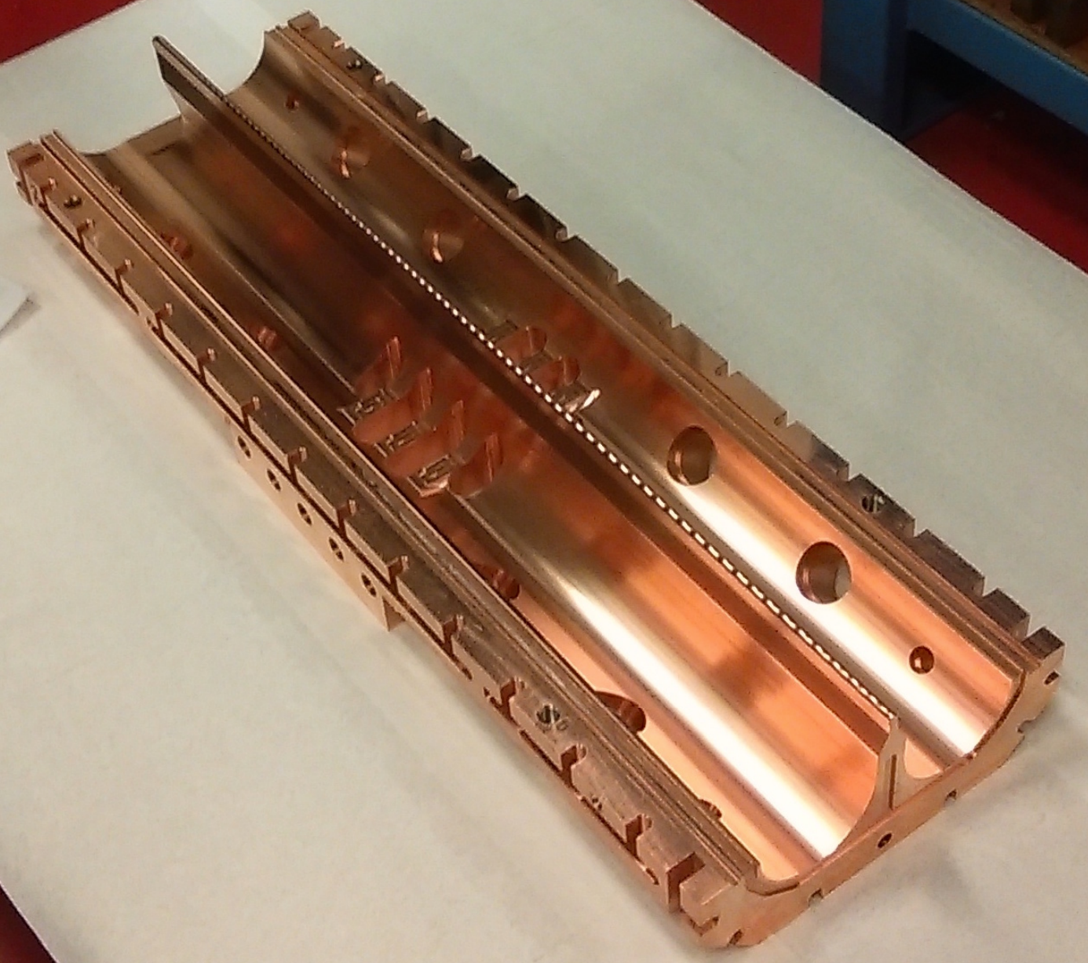

ACCELERATORS

Slide 6

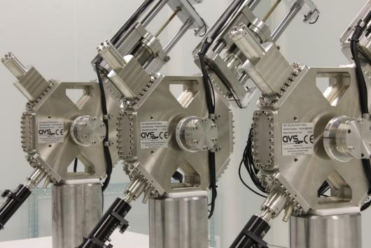
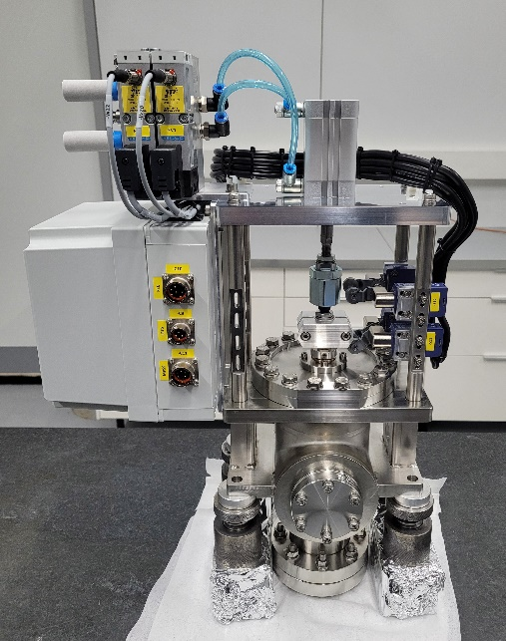
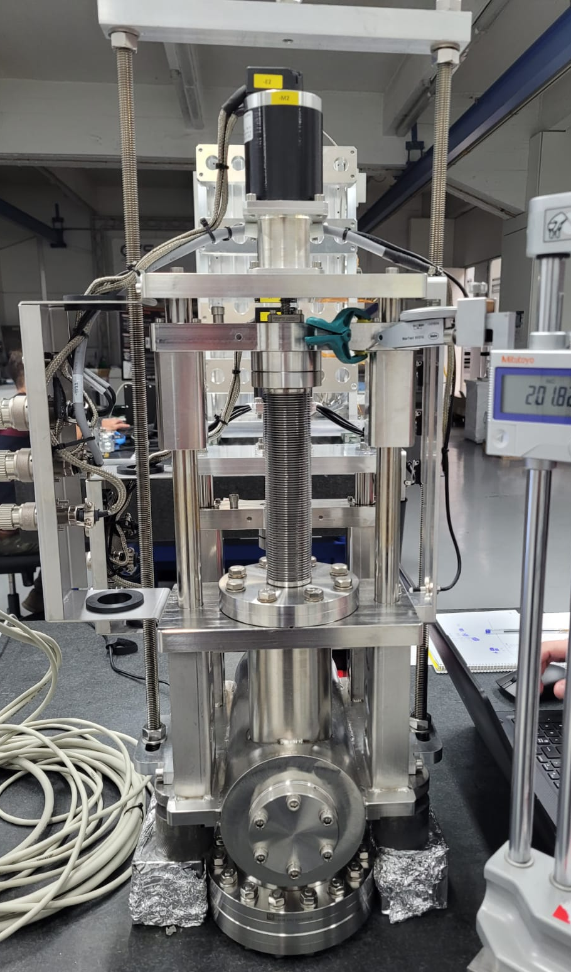

ACCELERATORS

Slide 7
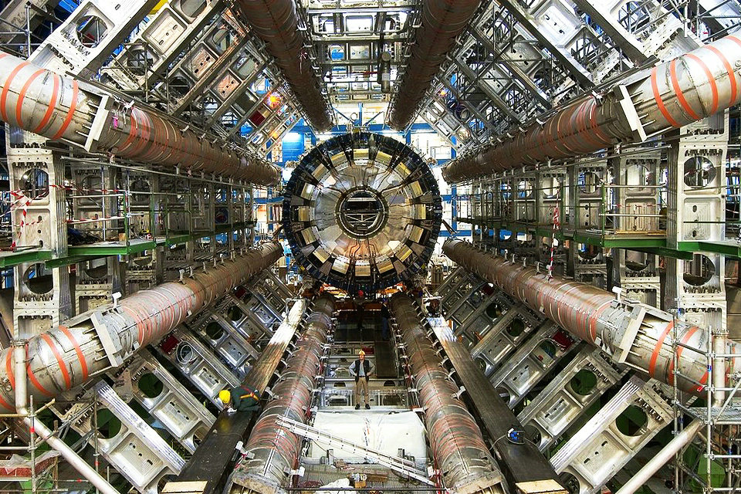
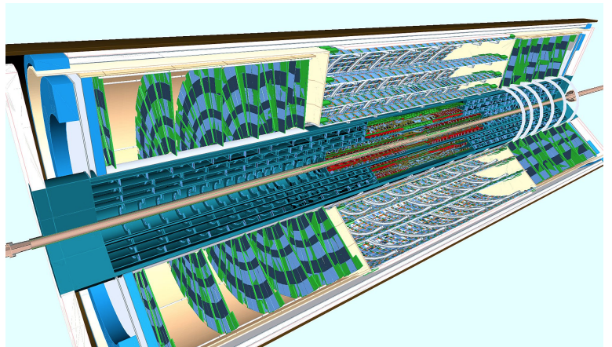
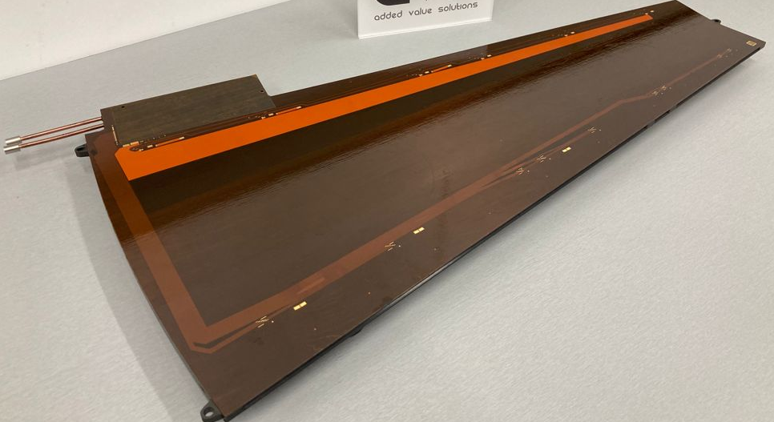
ACCELERATORS

Slide 8

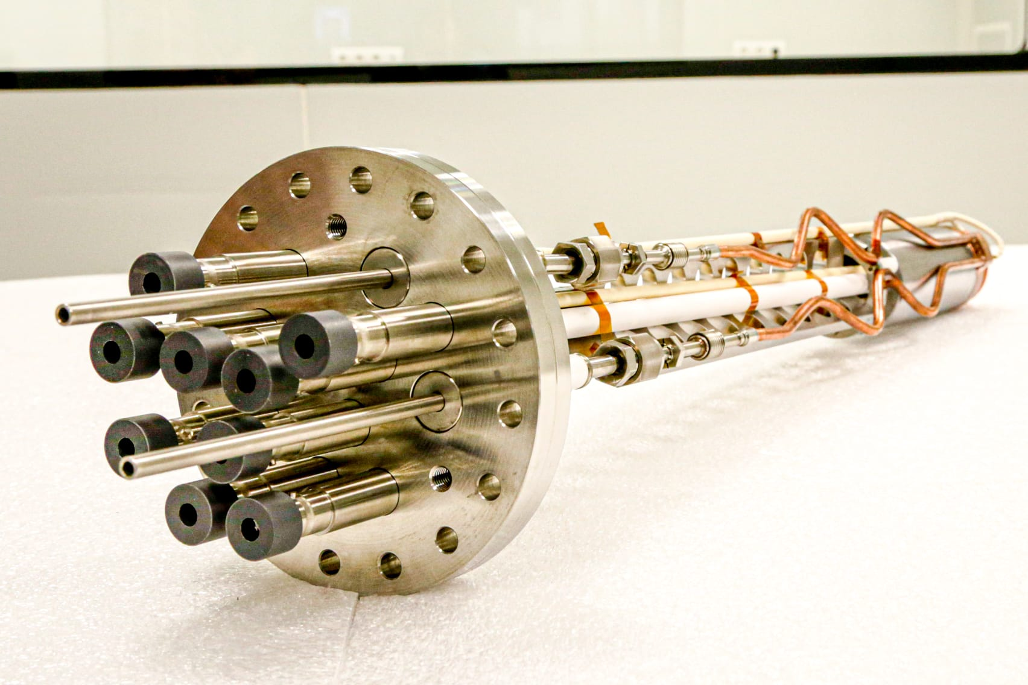
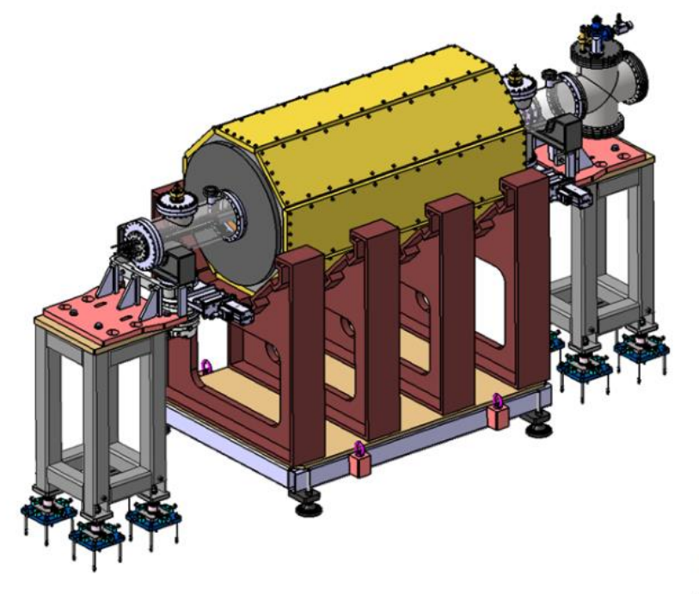
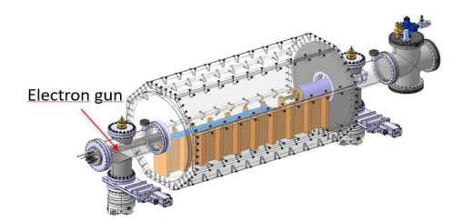
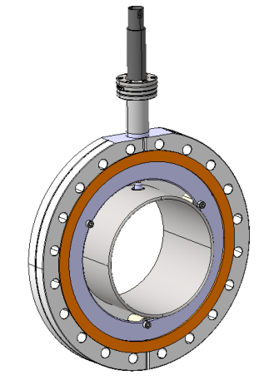
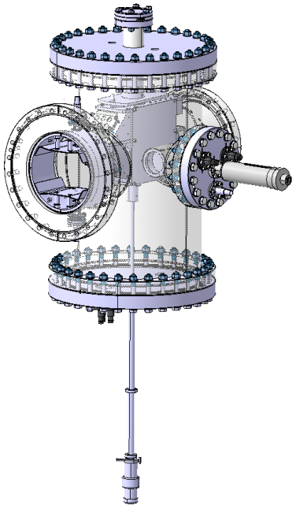
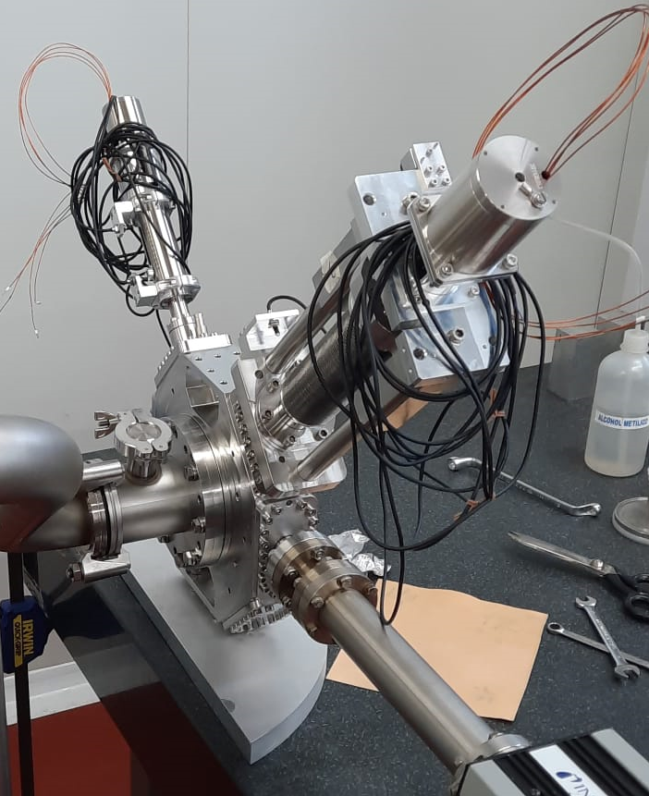
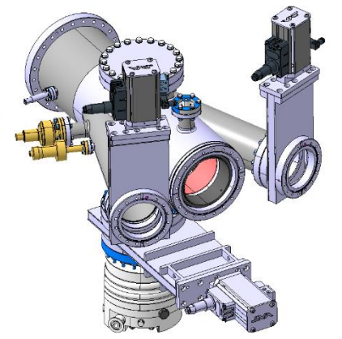
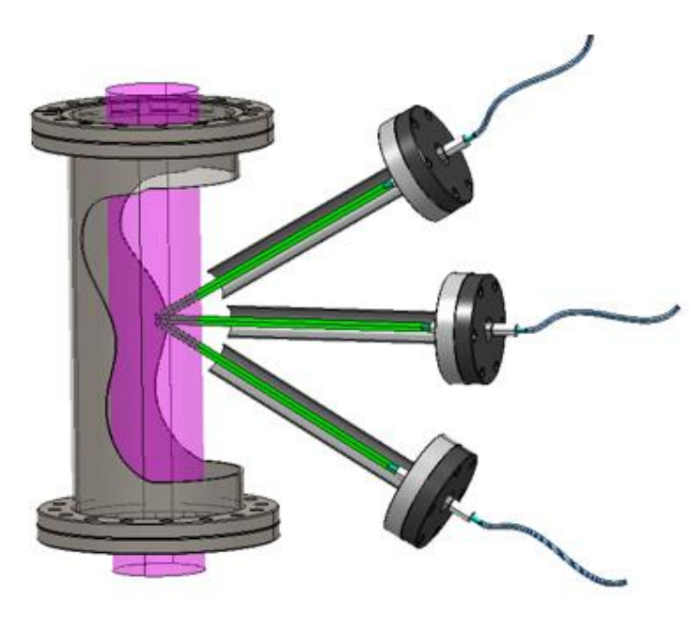
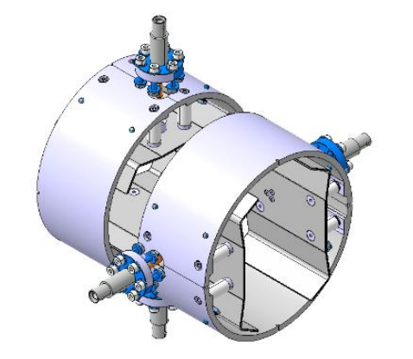
ACCELERATORS R&d
Developments for hadron/carbon therapy compact LINACs
Electron gun for C6+ ion source
- Conceptual design of ion source envelope
- Manufacturing of beam diagnostics
- Ion species diagnostics
- LEBT diagnostics design

Slide 9
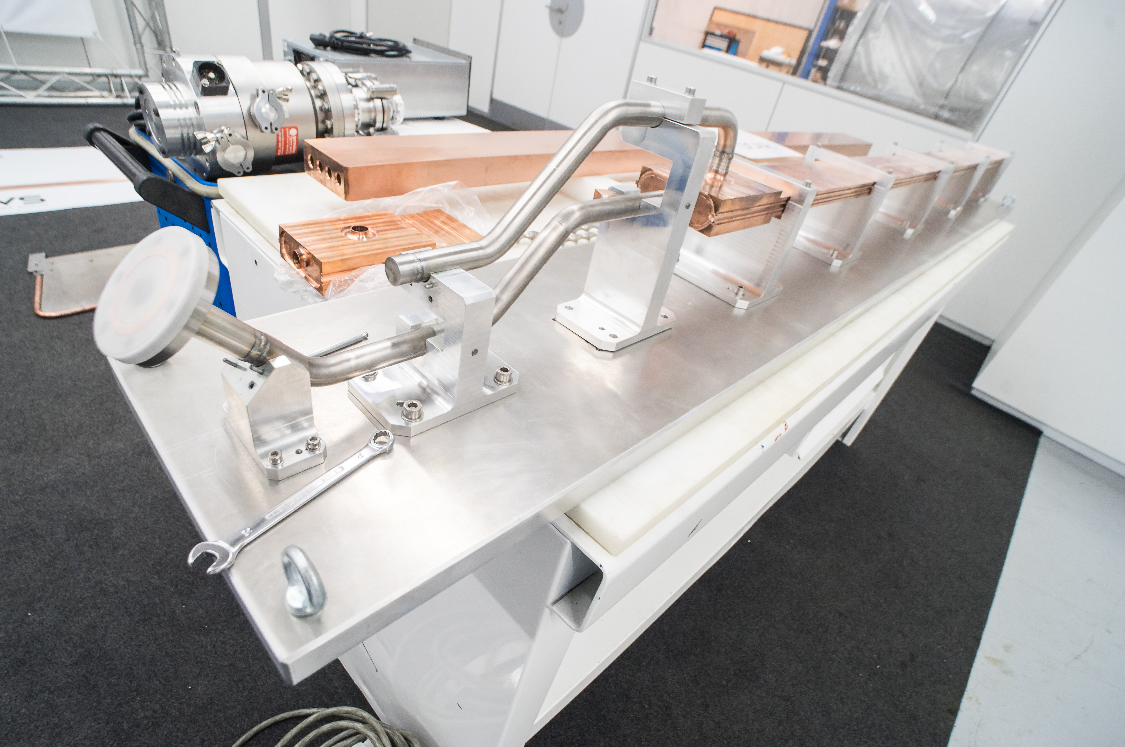
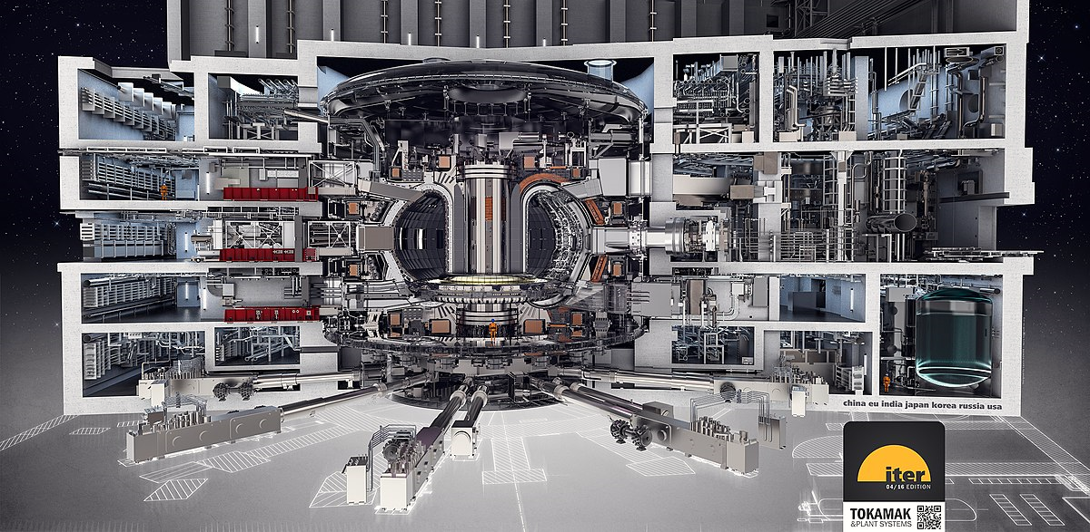
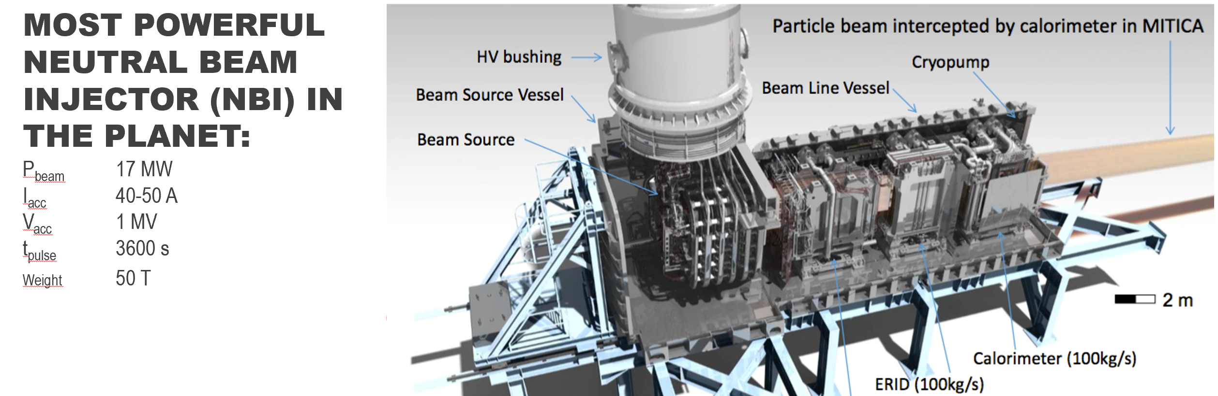
FUSION

Slide 10
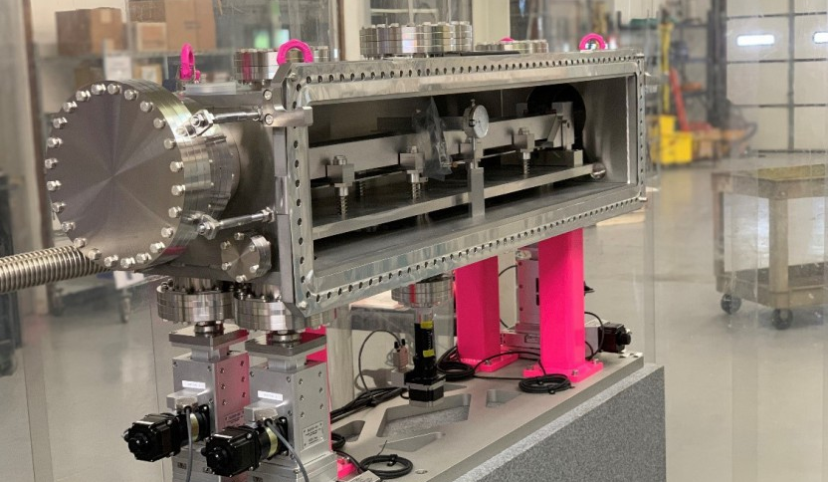
SYNCHROTRONS

Slide 11
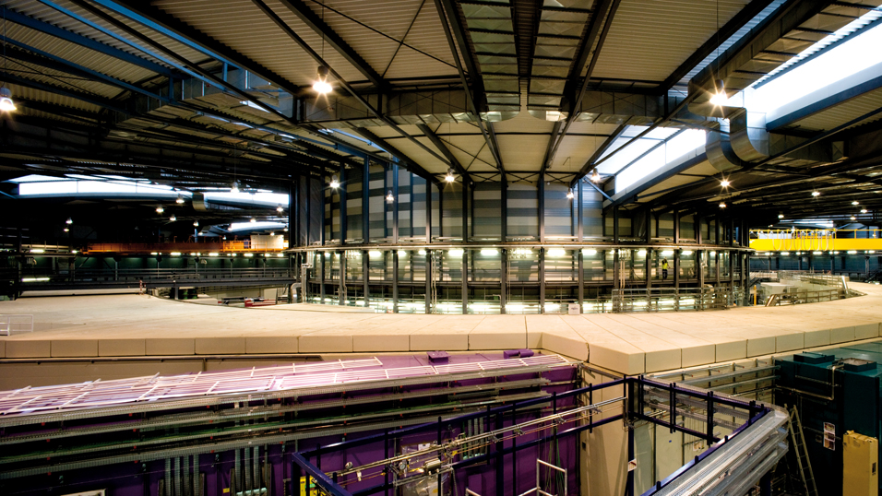

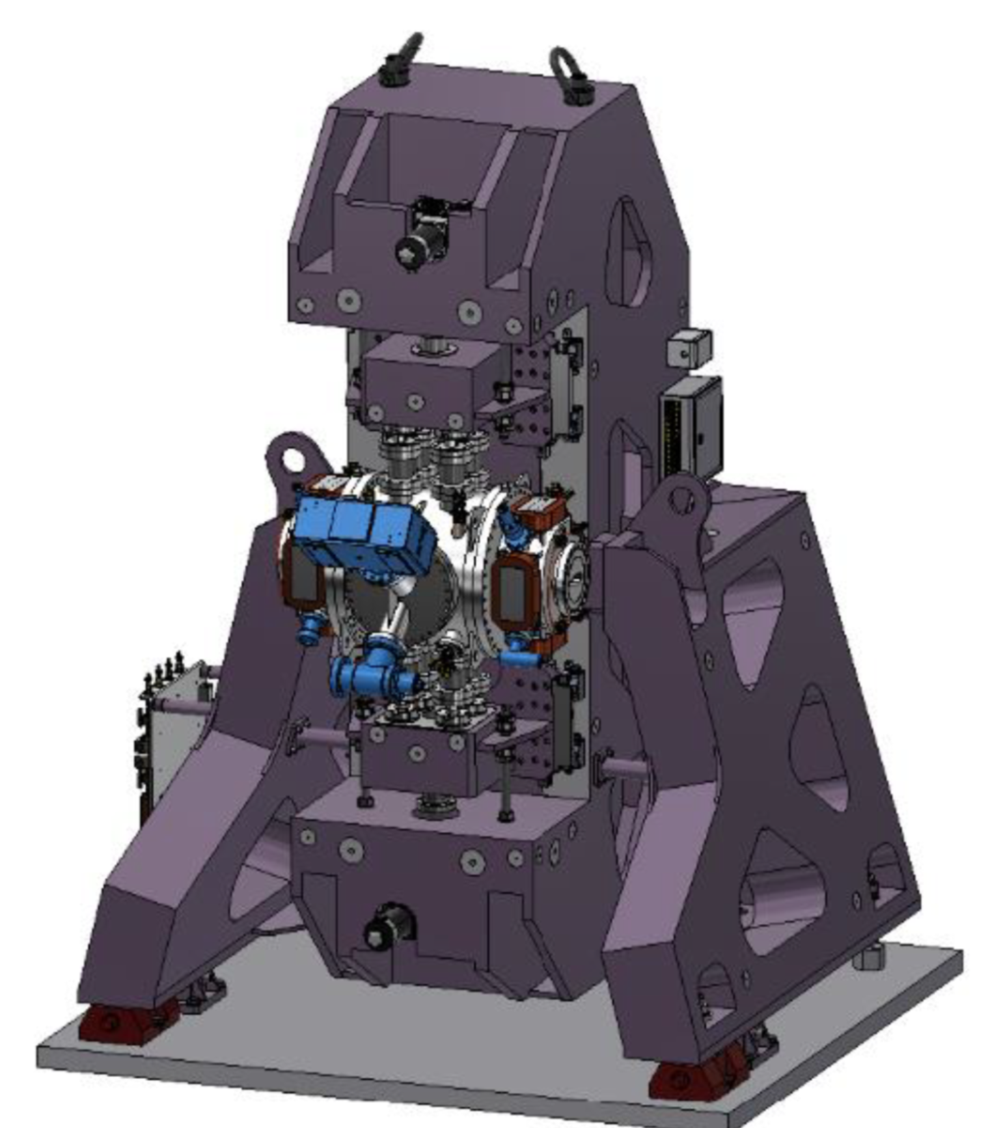
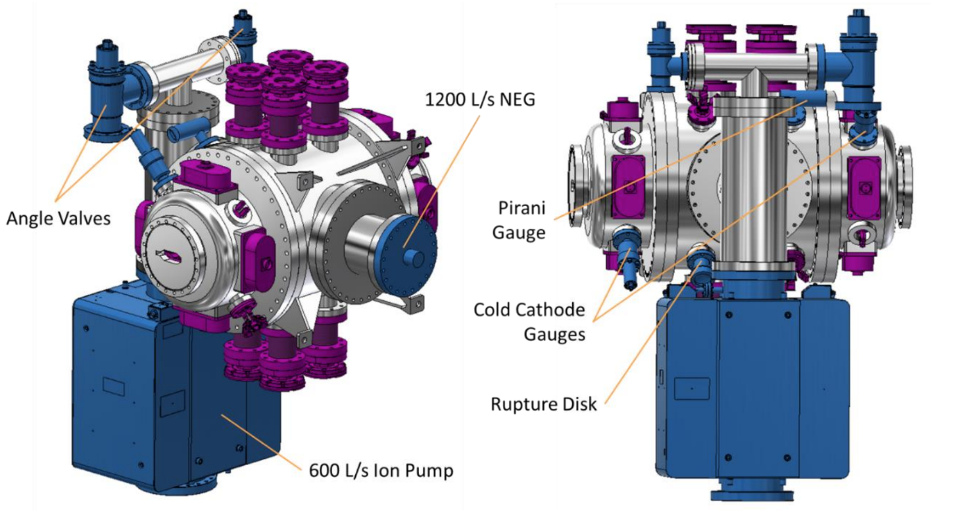
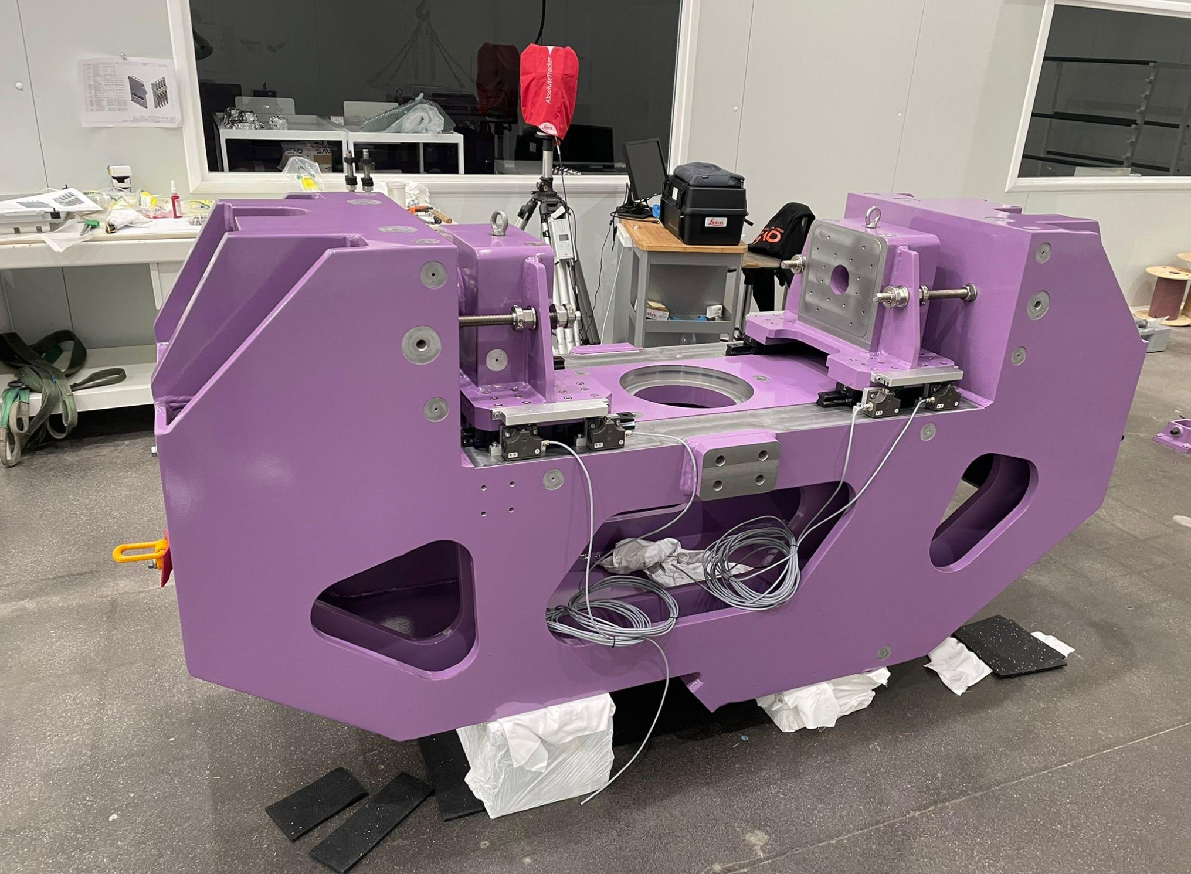
SYNCHROTRONS

Slide 12
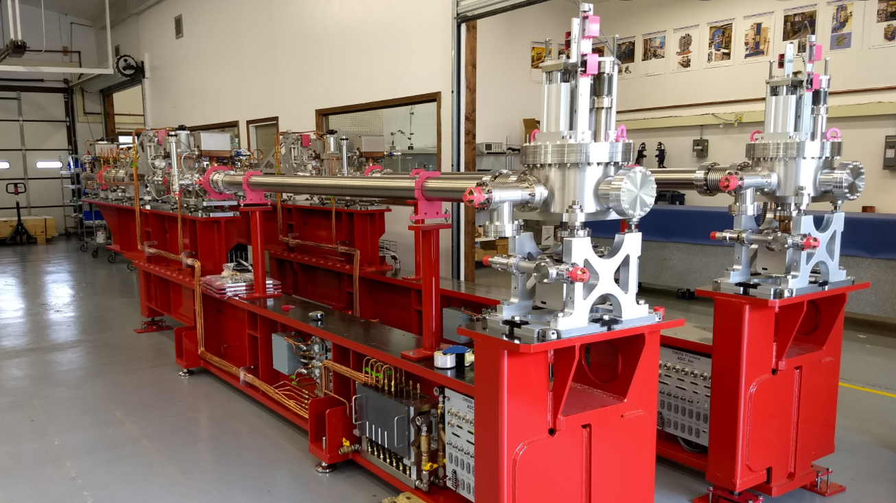

SYNCHROTRONS

Slide 13
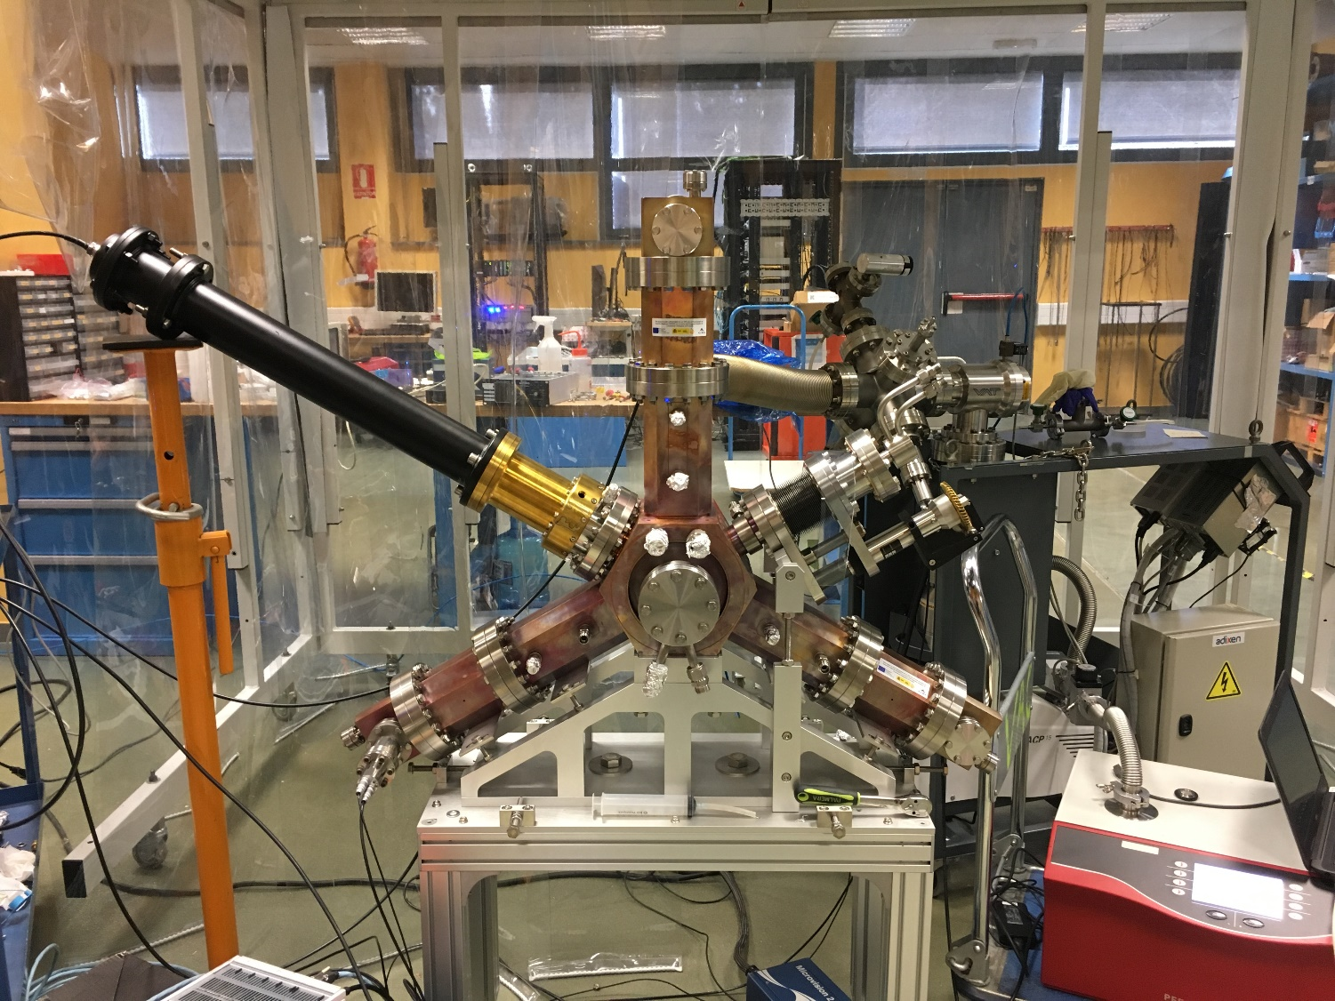
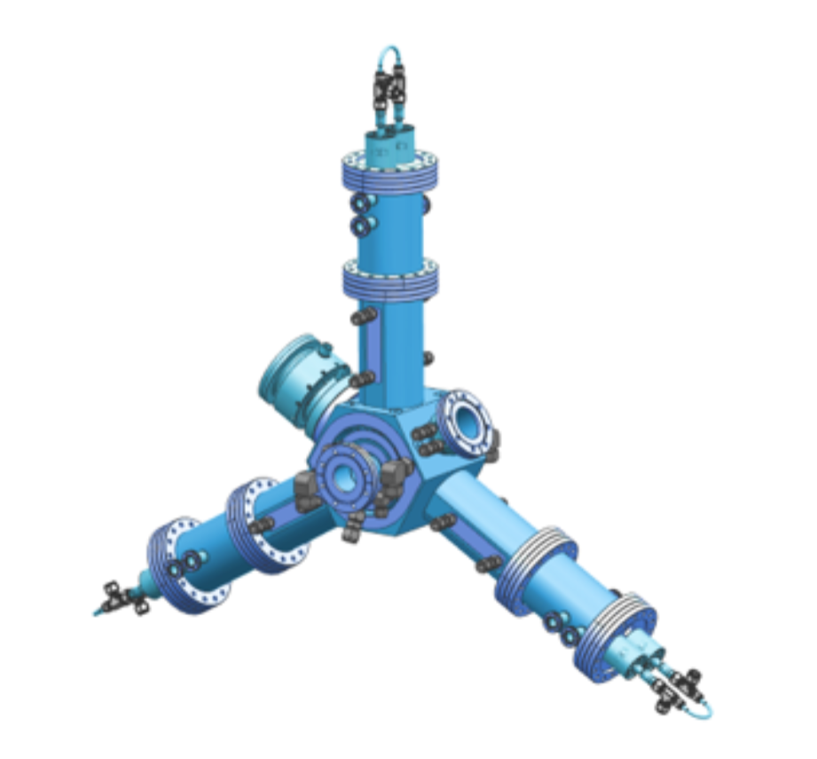
SYNCHROTRONS

Slide 14
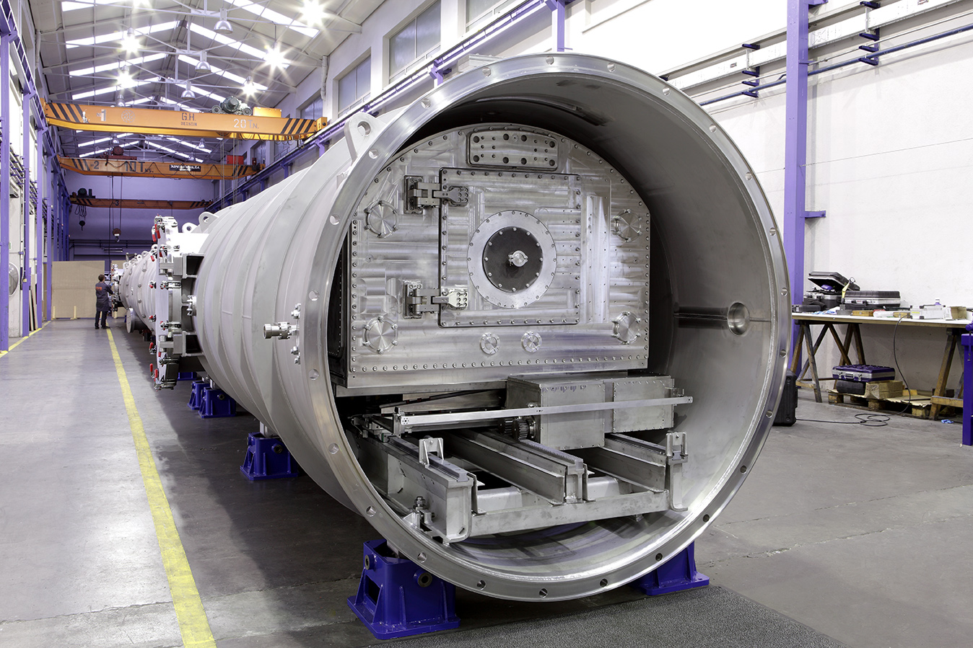

SYNCHROTRONS

Slide 15
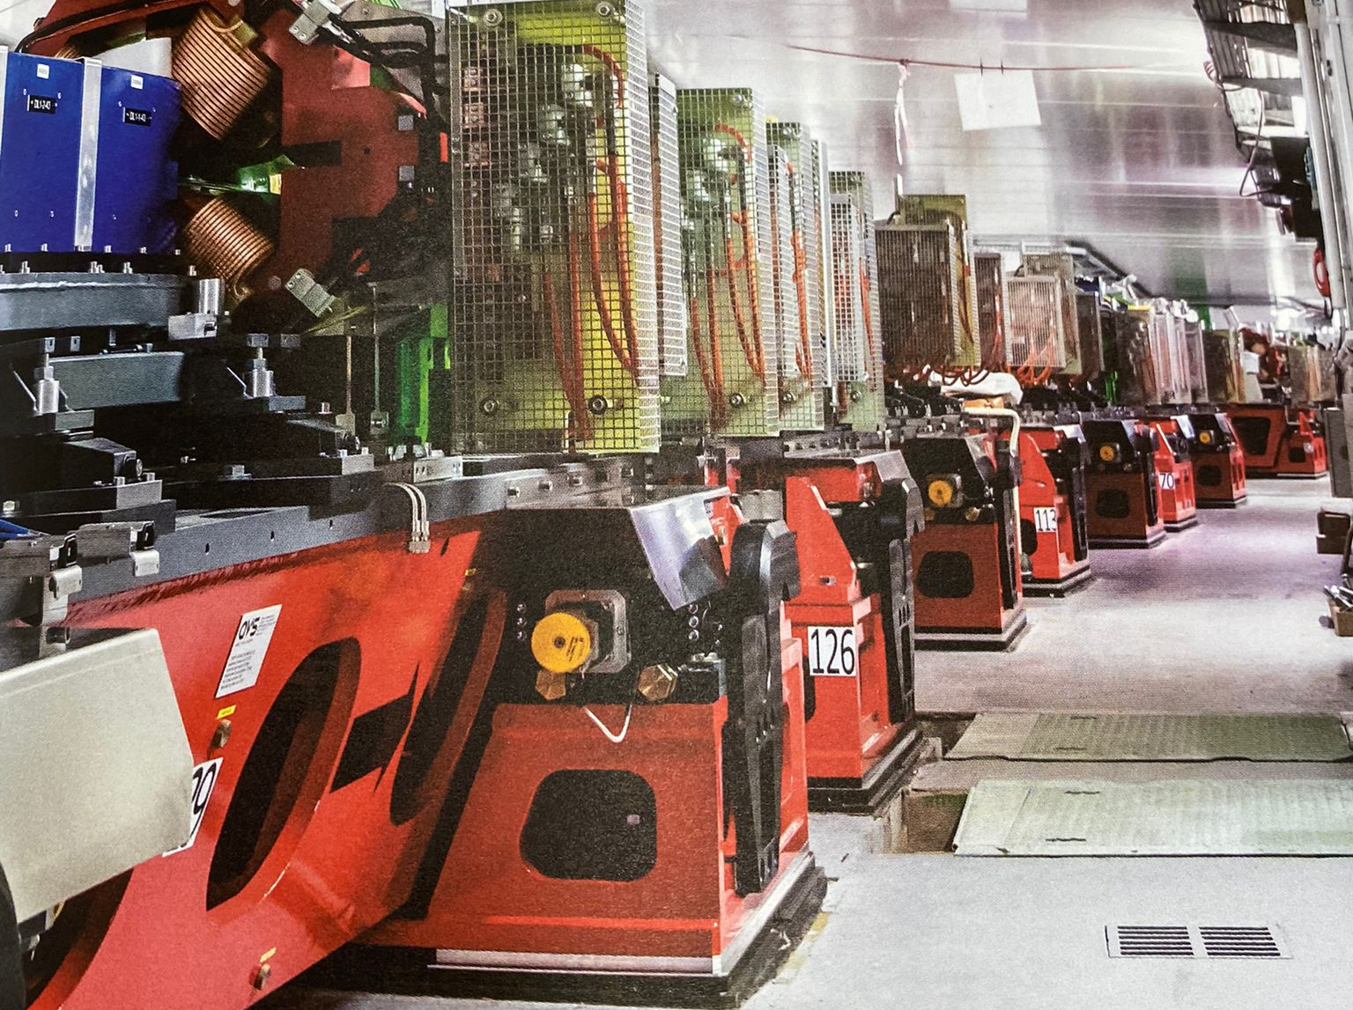
SYNCHROTRONS

Slide 16
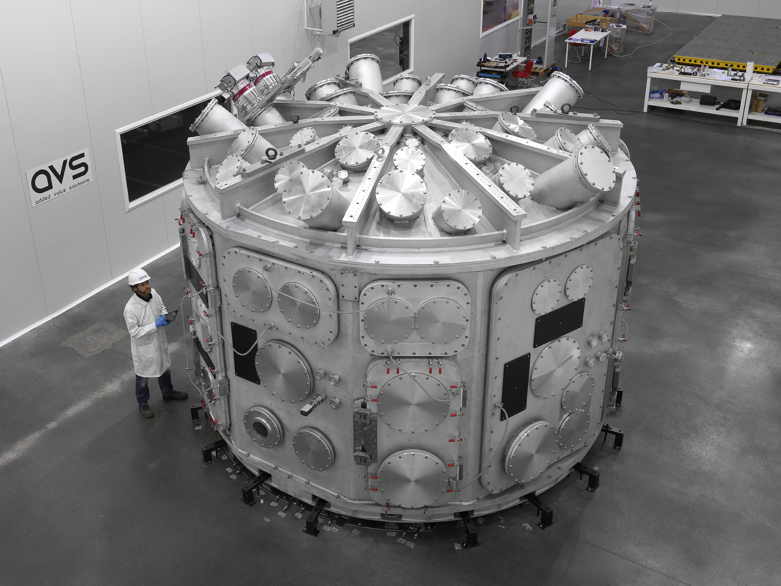

LASERS

Slide 17
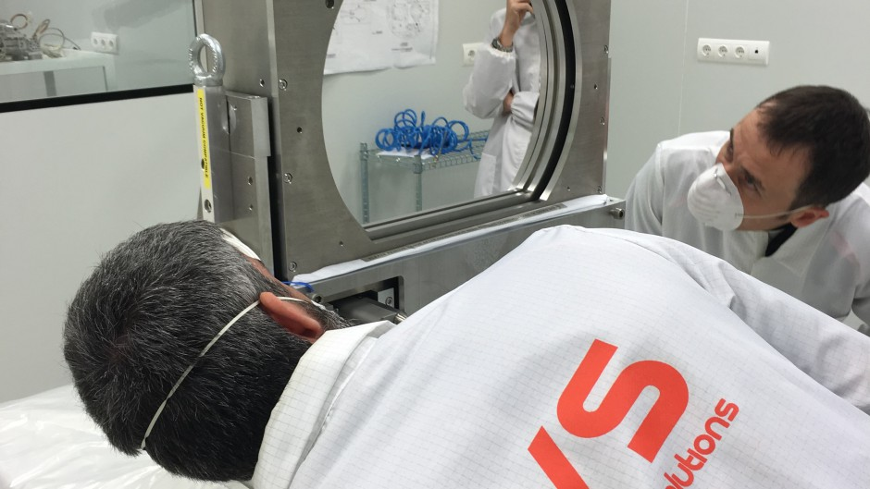
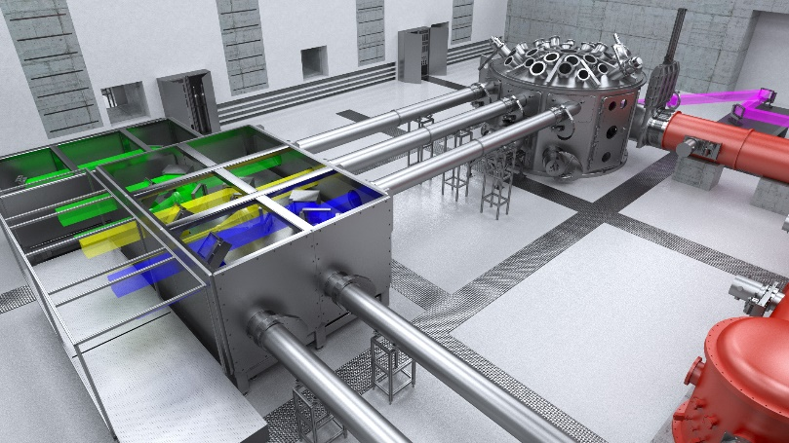
LASERS

Slide 18
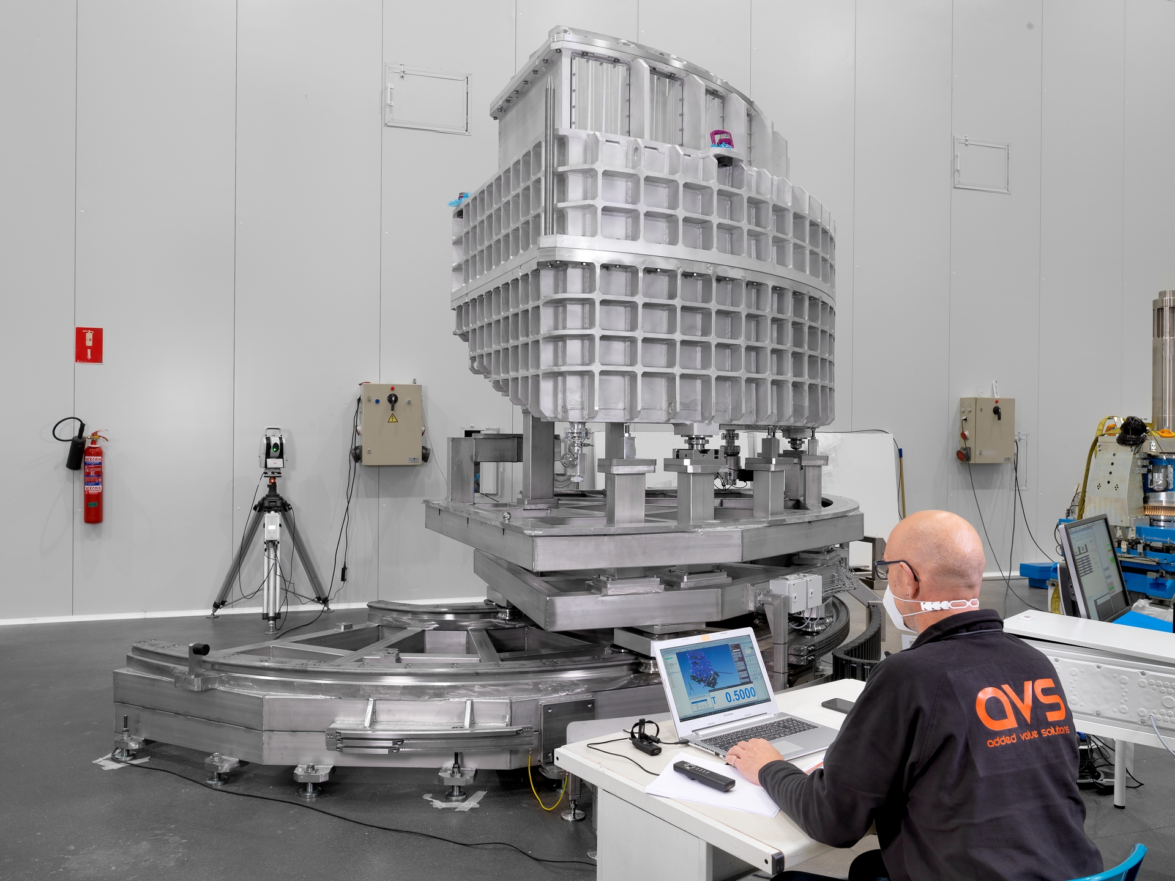
NEUTRONS

Slide 19
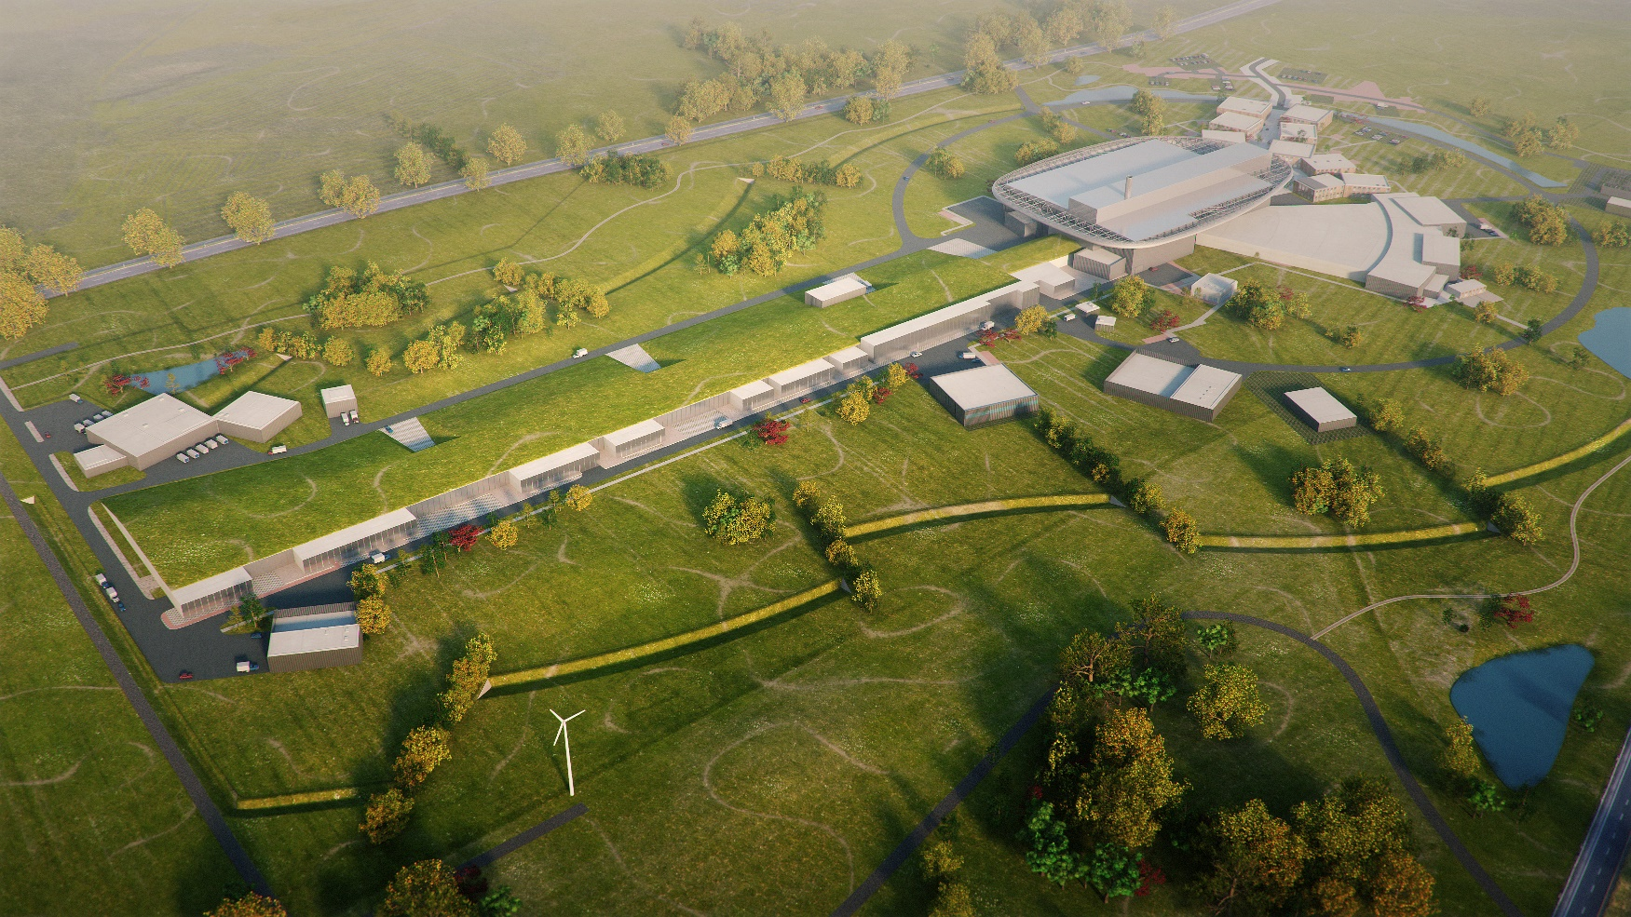

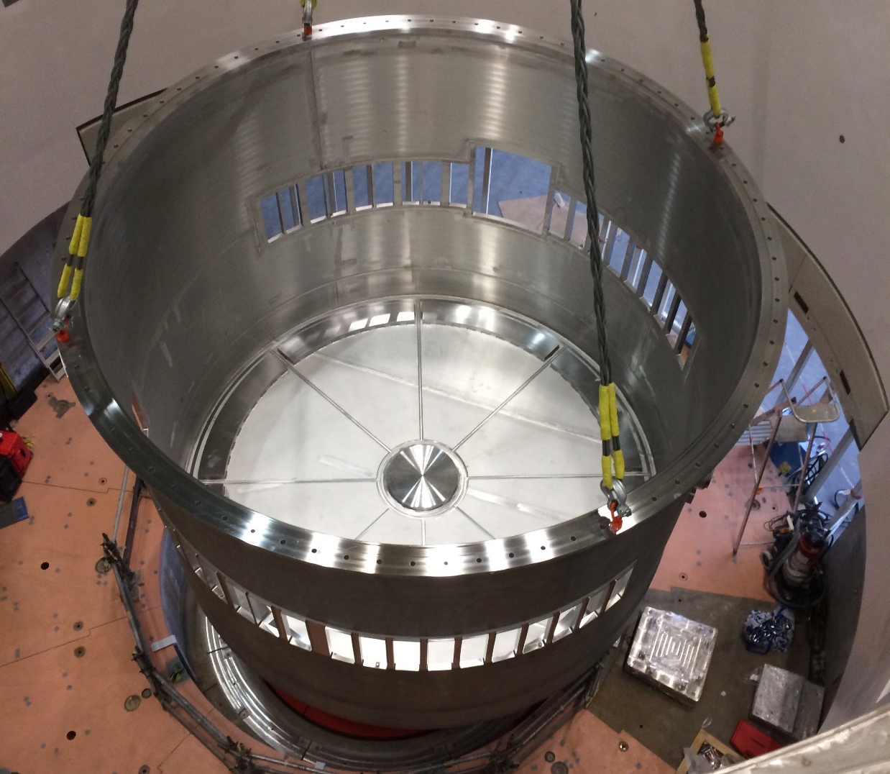
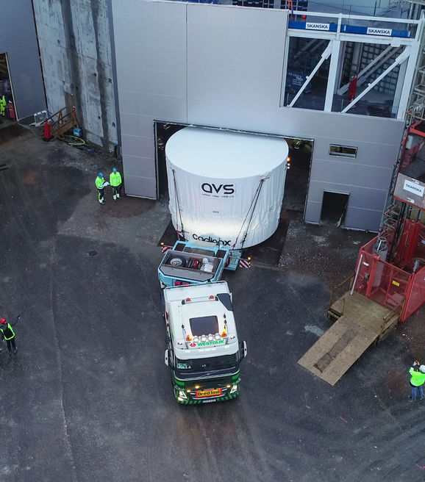
NEUTRONS

Slide 20
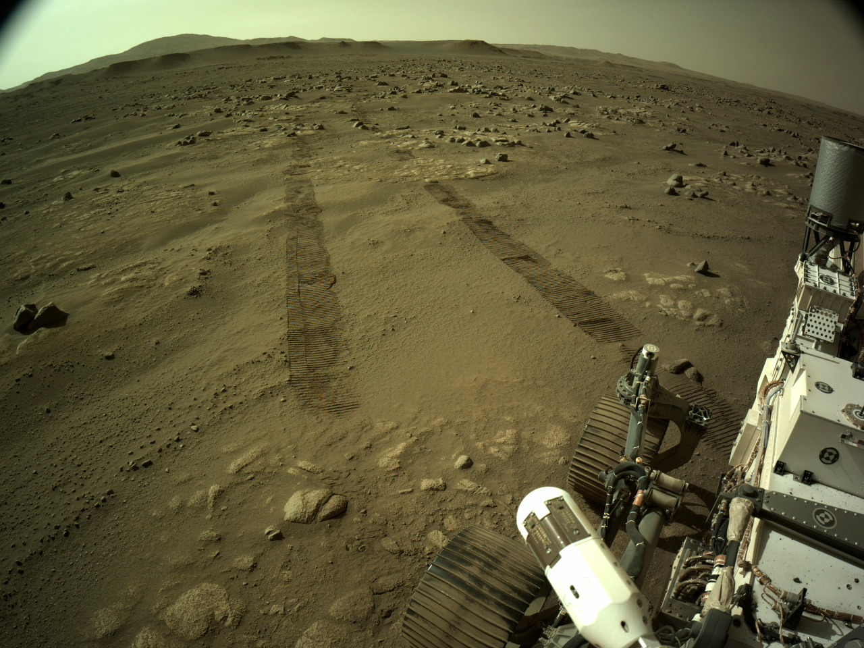
SPACE

Slide 21
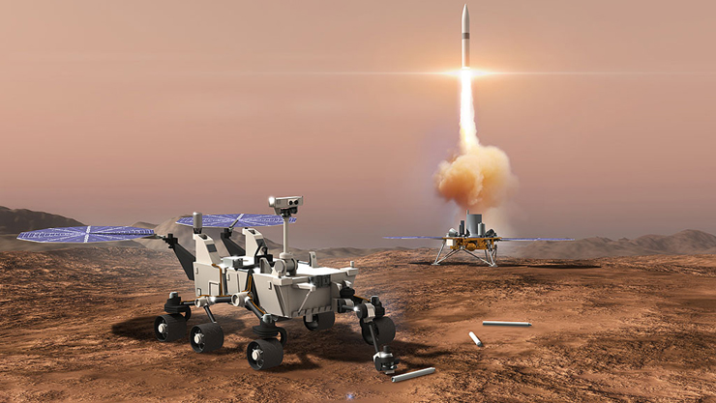

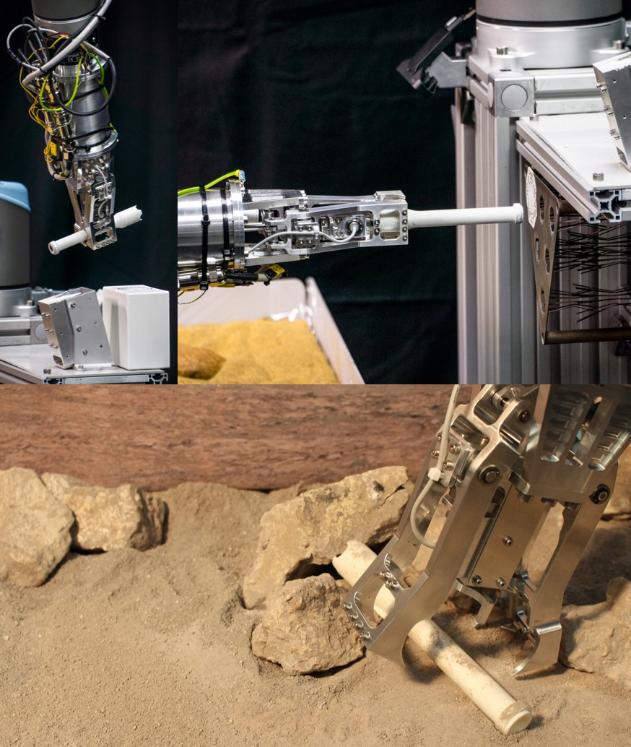

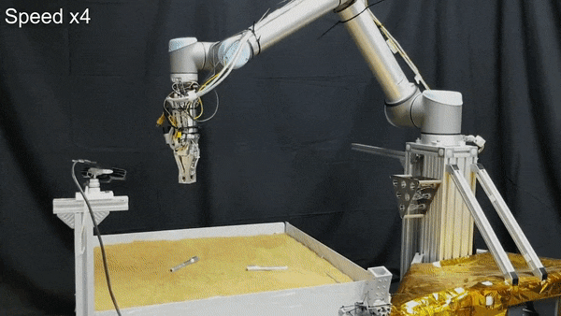
SPACE

Slide 22
CROSS TALKING
(Open co innovation)
CRITICAL SYSTEMS
LOW OR ZERO MANTEINANCE
WORKING IN COMBINATION OF UHV, RADIATION, HIGH MAGNETIC FIELDS, CRYOGENICS…
SPECIAL MATERIALS
SPECIAL PROCESSES
INDUSTRY MINDSET
R&D MANAGEMENT

Slide 23
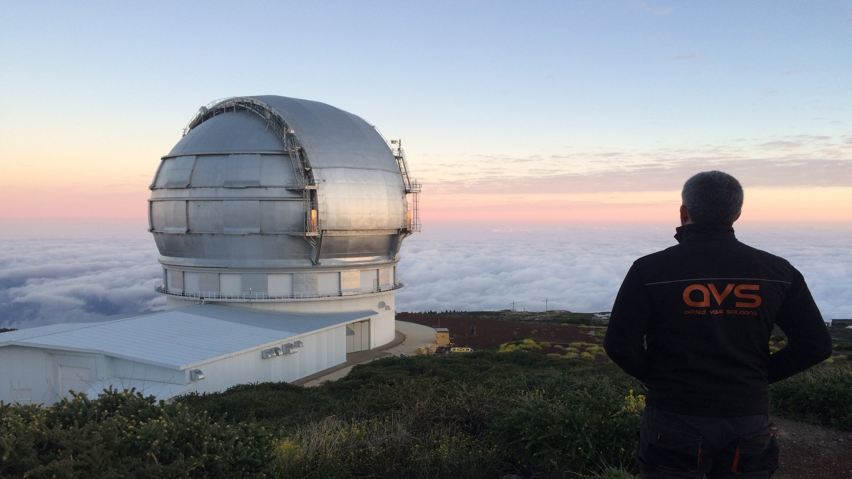
RESEARCH INFRASTRUCTURES
ALL SEGMENTS ARE DIFFERENT
ALL RESEARCH INFRASTRUCTURES ARE DIFFERENT BETWEEN THEM
MULTIPLE DIFFERENT CLIENTS WITHIN EACH R I
MULTIPLE STAKEHOLDERS
DIFFERENT RULES
DIFFERENT TIMING

Slide 24
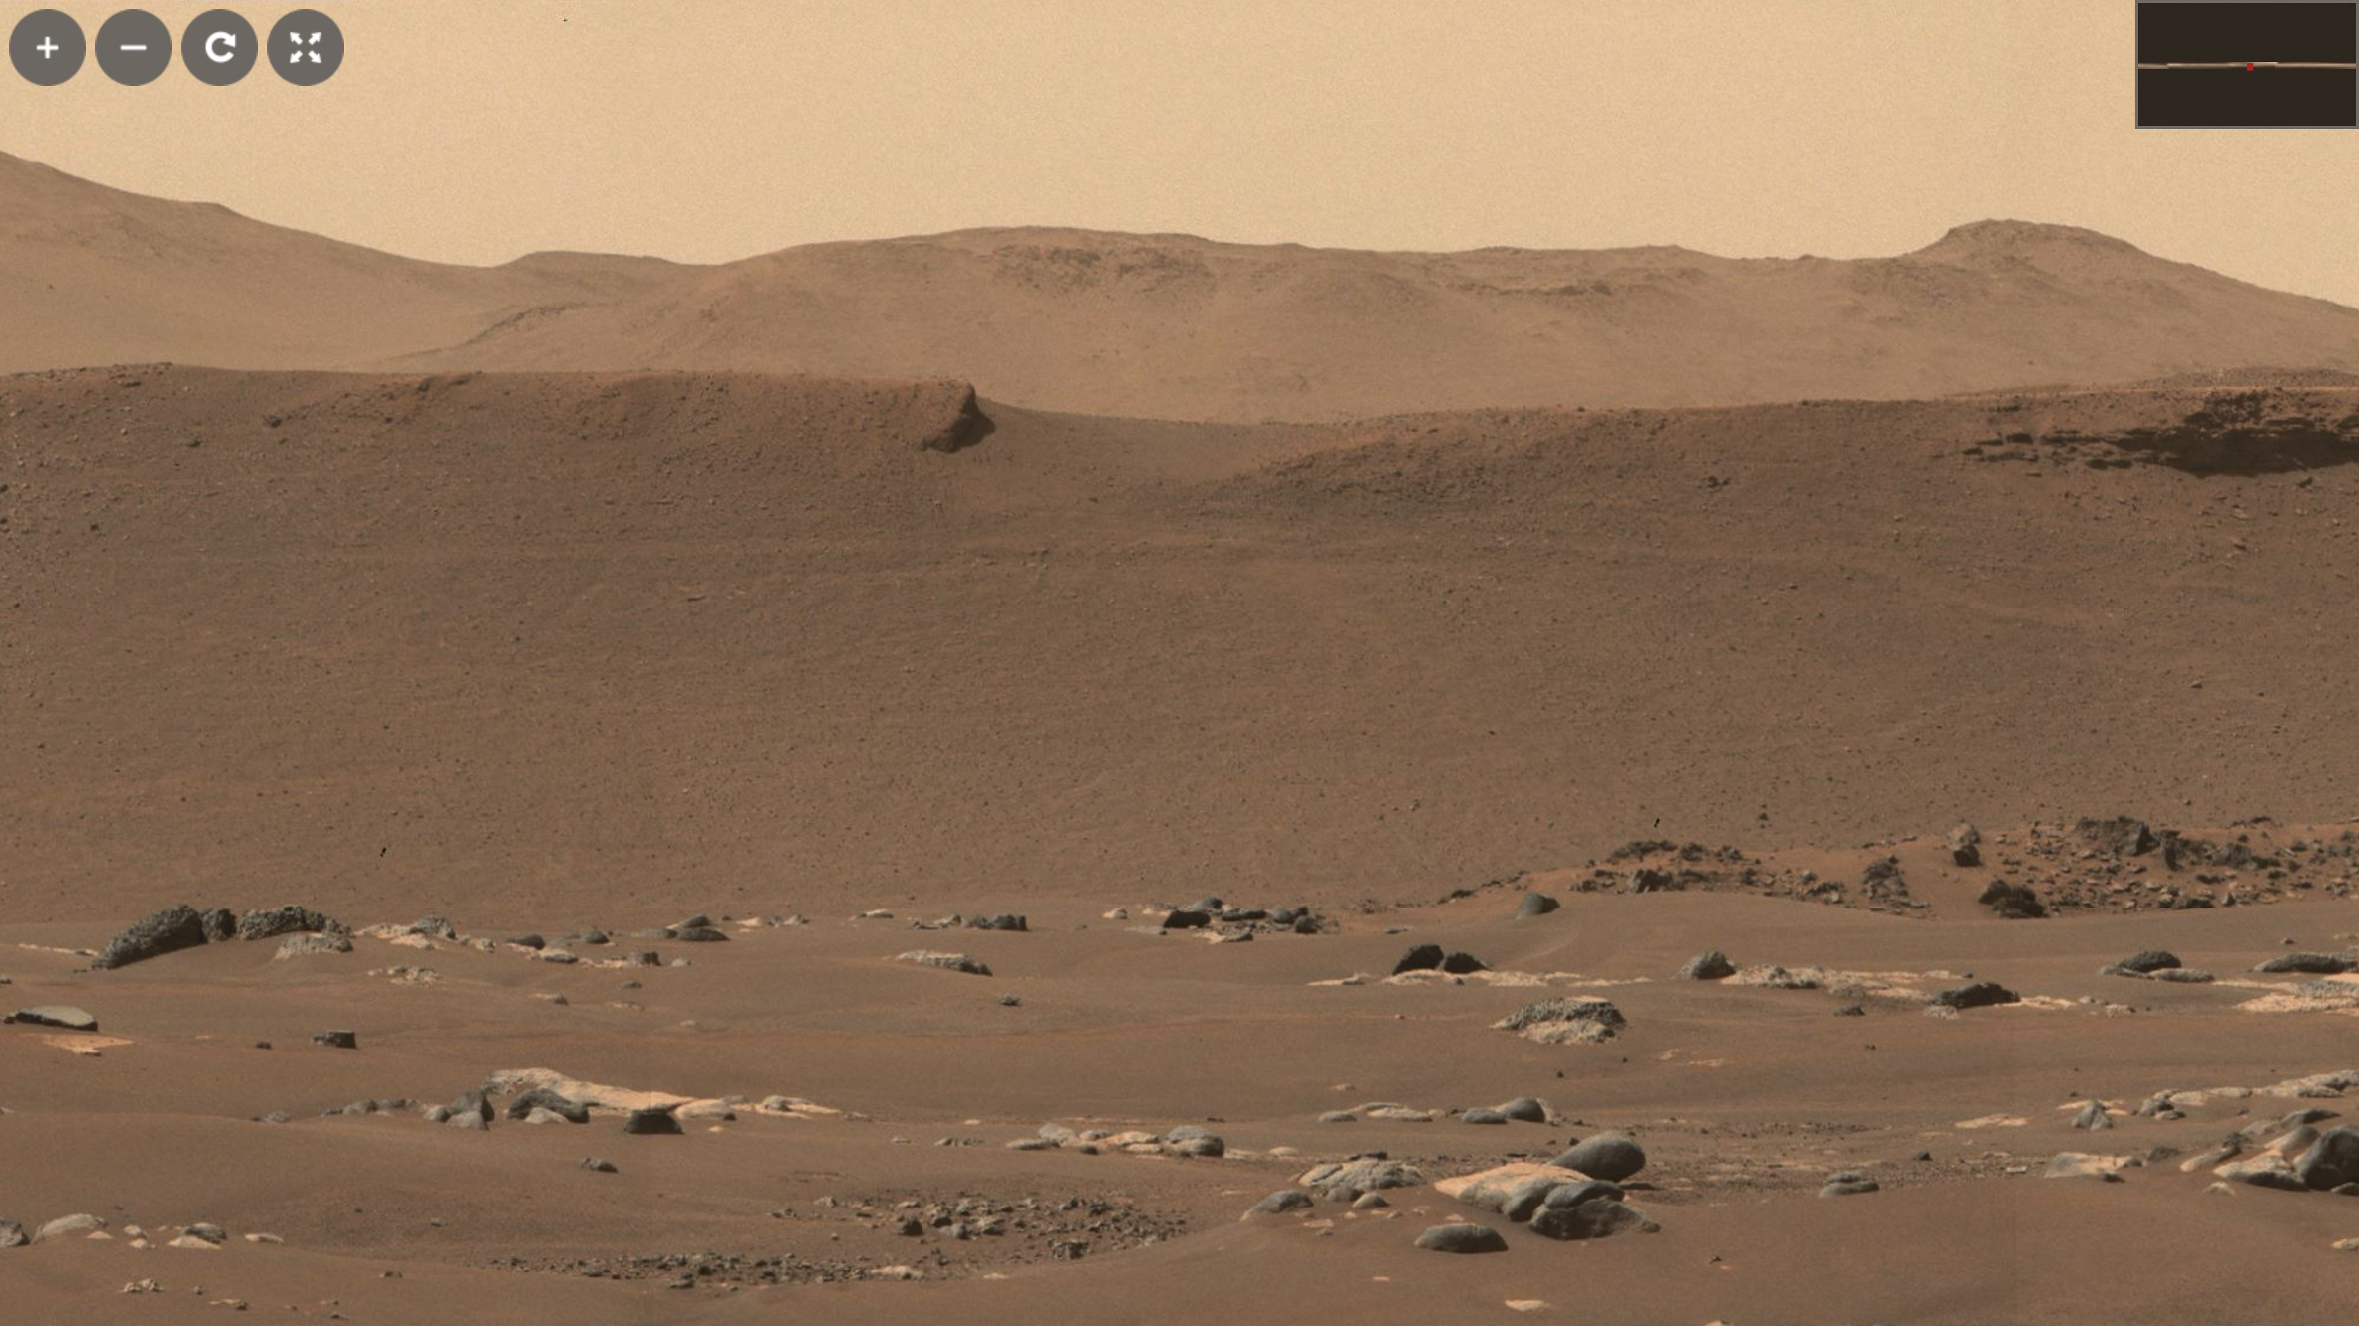
CO INNOVATION
SHARE VISION

Slide 25
PREPARATION (THERE IS TIME)
RESEARCH AND DEVELOPMENT
PEOPLE
FACILITIES
TECHNOLOGIES
SIZE

Slide 26
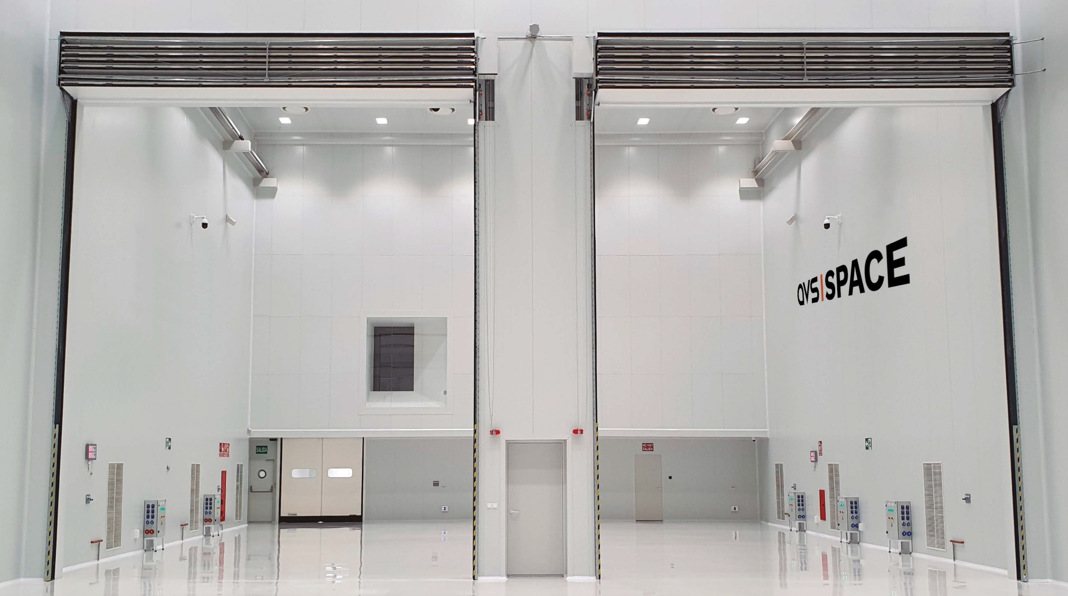
R&D FUNDING
PRIVATE
PUBLIC
PUBLIC PRIVATE PARTNERSHIPS
TENDERS

Slide 27

Thank you!

