Slide 1
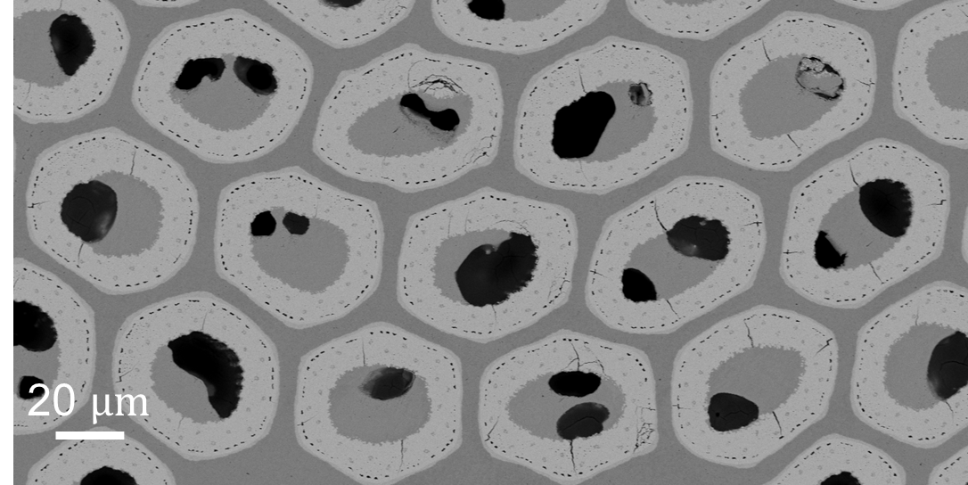
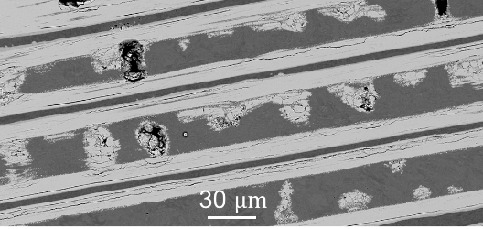
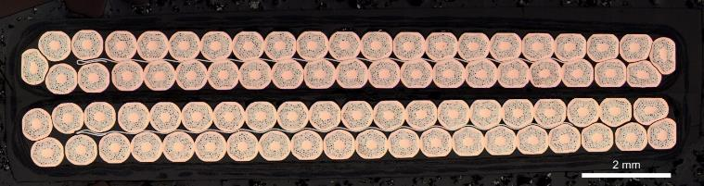
Effect of transverse compressive stress on Nb₃Sn Rutherford cables for accelerator magnets
Gilles Lenoir, Kirtana Puthran, Christian Barth, Felix Wolf, Jérôme Fleiter and Amalia Ballarino
TE-MSC-SCD
MSC seminar - 23/06/2022

Slide 2
Outline
Context, motivation & some literature
Objectives, methodology and specimen
Transverse compressive stress and loadings scenarios
Transport measurements using FRESCA test station
Damage state
Metallographic observation and post-mortem analysis
Discussion and conclusion
Perspectives & on-going work

Slide 3
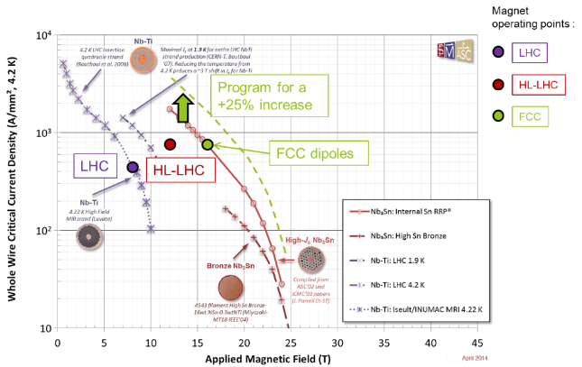
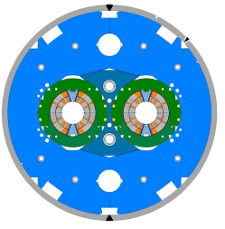
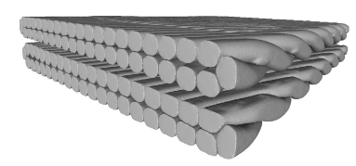
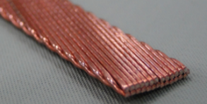
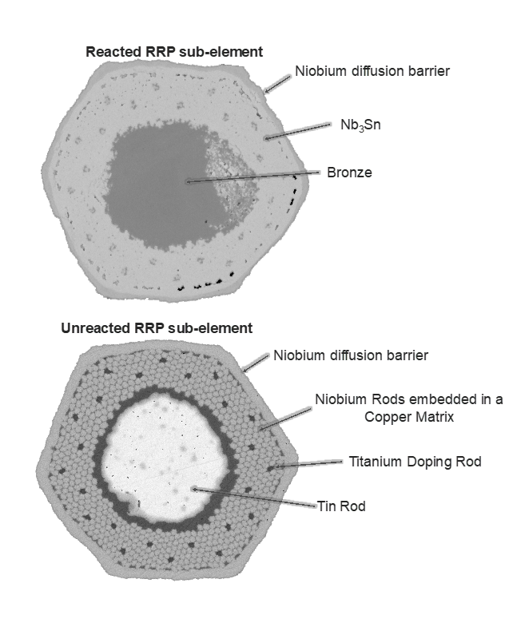
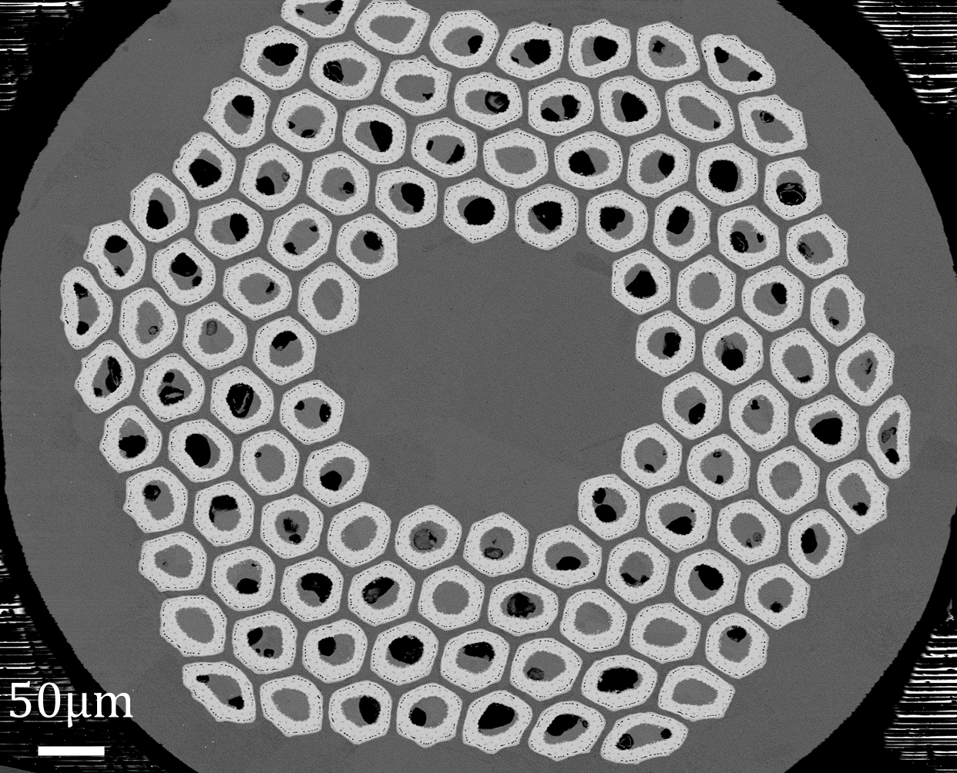
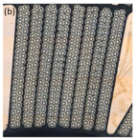
Context and motivation
Need for higher-field accelerator magnets
for HL-LHC and beyond
  Manage mechanical limits as moving to higher fields
  Nb₃Sn conductors to exceed Nb-Ti based technologies
  High Jc LTS RRP 108 /127 ( ~ 2.5 kA/mm2 @ 12 T, 4.2 K)
  HL-LHC 11T (ø0.7 mm) and MQXF (ø0.85 mm)
   Brittle and strain sensitive material
↓ Impact of loading and understanding of mechanical
mechanism in the conductor
Courtesy of E. Rochepault based on the ASC plot.
X-ray tomography of double stack [Wolf 18]
11T schematic cross-section.
© P. Ferracin, IEEE TAS, 2019.
11T conductor block cross-section.
© C. Scheuerlein, IOP SUST, 2019.
RRP 108/127 ø0.7mm from double-stack Rutherford cables.
Courtesy of A. Ballarino

Slide 4
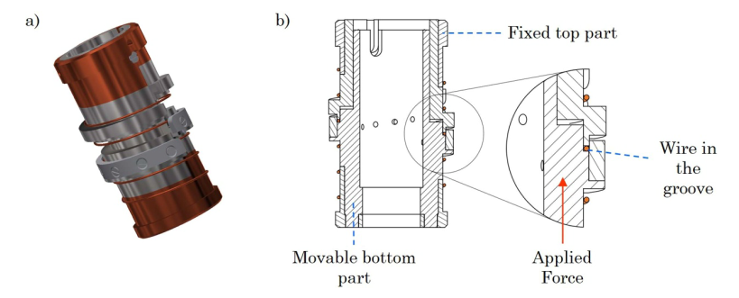
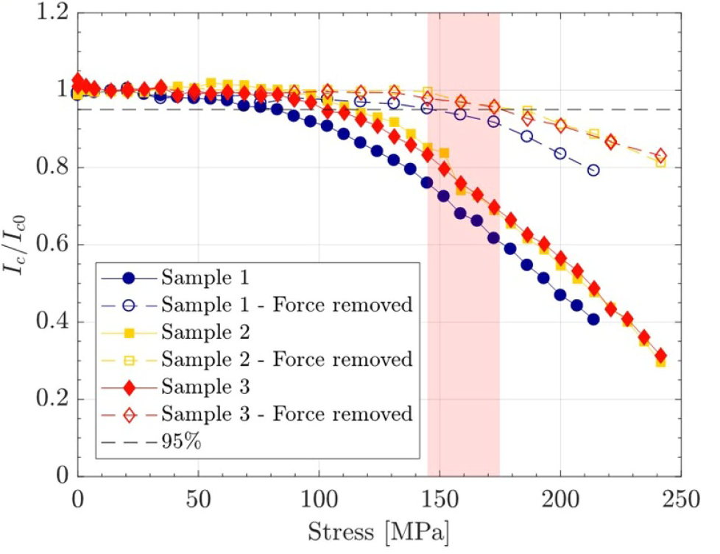
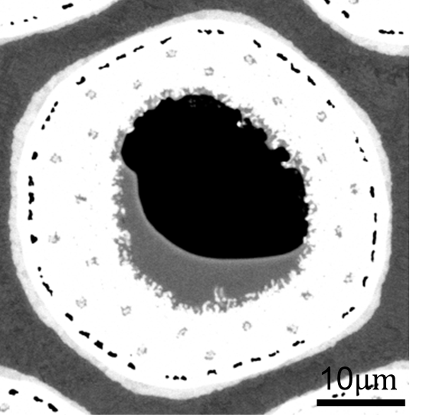
Context and motivation
Mechanical sensitivity of the Nb₃Sn
  Characterization at cold from [Ekin 87] to [Troitino 21]
    axial strain
    transverse pressure
  ↓Reversible and irreversible critical current degradation from
    Deformation of the copper matrix
    Cracks in Nb₃Sn sub-elements
Pre-compressive load applied during manufacturing of
magnet to sustain Lorentz forces and prevent movement
 For 11 T magnets, global limitation of peak stress
during collaring to 150 MPa [Ferracin 19] (not last value)
19 T, 4.2 K
↓ Effect of pressure applied at Room Temperature (RT) on HL-LHC conductors
Relative critical current with applied transverse stress measured using a compressive WASP device [Troitino 2021]

Slide 5
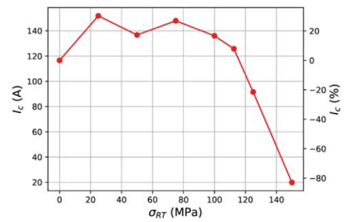
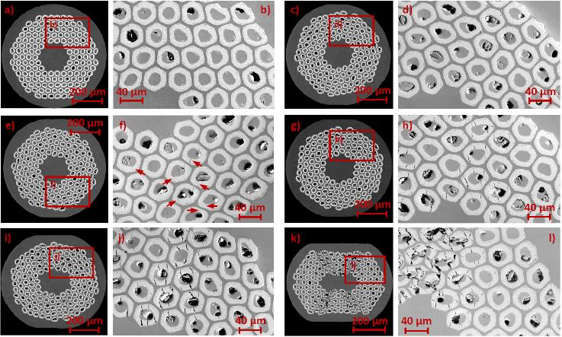
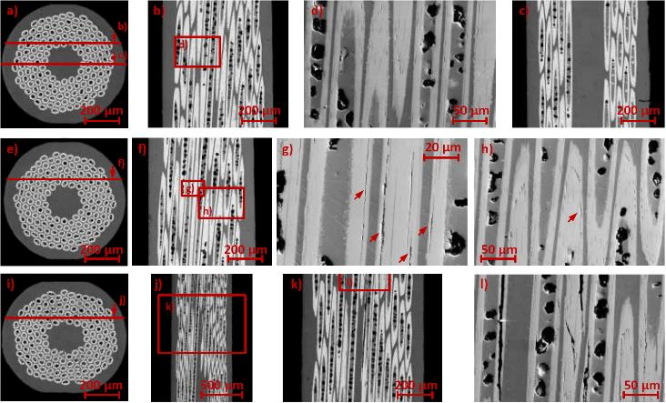
A brief glance in literature – Strand scale
  [Ebermann 2019] - Transverse stress applied on strands
    RRP 144/169 ø0.7mm
    Transverse stress applied at RT (hydraulic press in building180)
    Electrical measurements (@ cryolab),
    metallography (@ EN-MME-MM) and FEM analysis
    Electrical degradation and cracks after 100 MPa
    Cracks in longitudinal CS
    @ 100 MPa: longitudinal direction
    @ 150 MPa: longitudinal cracks propagating to the surface of the sub-elements
Critical current I_{c} at T=16.6 K using E_{c}=100μV/m
SEM micrographs of transverse cross-section of a),b) ref. sample, c),d) 75 MPa, e),f) 100 MPa, g),h) 125 MPa, i),j) 150 MPa and k),l) 200 MPa.
SEM micrographs of longitudinal cross-section of a) to d) 75 MPa, e) to h) 100 MPa, i) to l) 150 MPa.

Slide 6
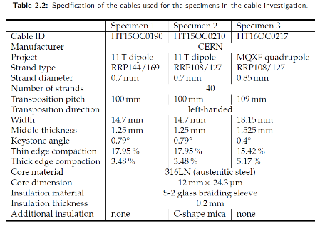
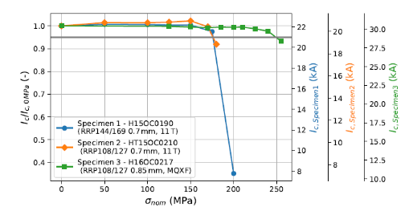
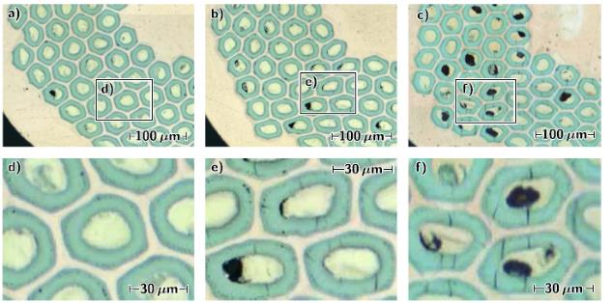



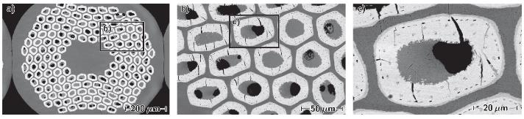
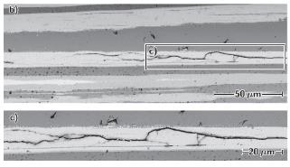
A brief glance in literature – Cable scale
  [Ebermann 2018] + PhD thesis (CERN / TU Vienna)
    Electrical measurements
    in FRESCA after application
    of transverse stress at RT
    Specimen
      Double-stack configuration
      3 different types of cable
    Metallographic analyses
      Specimen 1 – 11T RRP 144/169 (no mica)
Inverted
Inverted
Not inverted
SEM micrographs @200 MPa
150MPa 175MPa 200MPa
Transverse optical micrographs
  No degradation measured or observed at 150MPa
  Degradation after 175 MPa but not enough material to conclude clearly
  Mainly longitudinal cracks observed⇨shrinkage of supercond. area and not interruption
  ⇨ Cable H15OC0190 with RRP 144/169 ø0.7 mm
  ⇨ Limited data in interesting interval 150-175-200 MPa

Slide 7
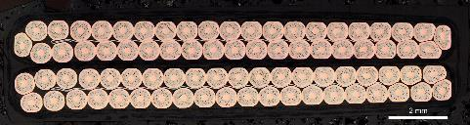
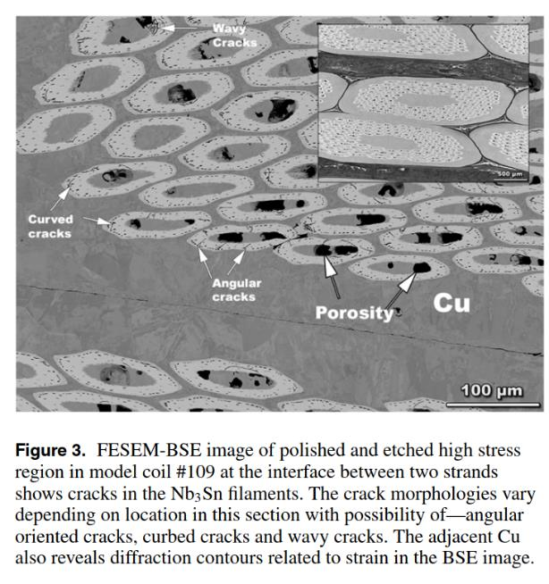
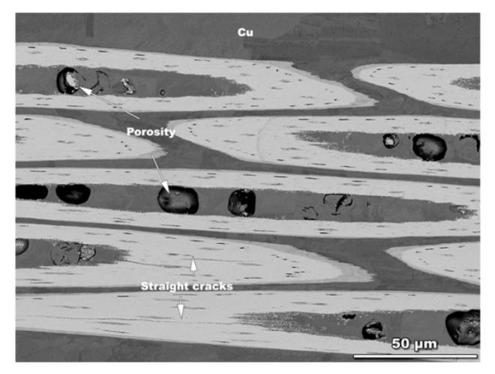
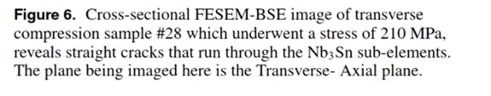
A brief glance in literature – Coil scale
Top longi. cross-section
Side longi. cross-section
  [Balachandran 2021] – Metallographic analyses
  of 11T dipole coils
    SMC #109 (cable 220B “small gap” RRP 108/127 ø0.7mm)
      Critical current limitation
      Cracks
    10-stack (SMC #105 cable 196A RRP 144/169 & 150/169)
      Loaded
      transversally
      at 210 MPa
      Cracks
Transverse cross-section
  ⇨ For the coil, crack distribution and varying orientation indicate multi-axial stress state
  For the 10-stack, cracks oriented along principal planes and principal direction
  Difficult to understand and compare
  Limited conclusions given cost and time

Slide 8
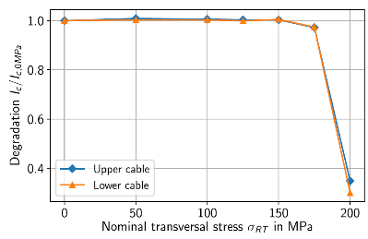

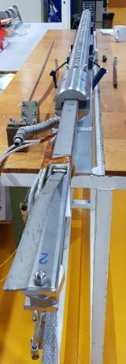
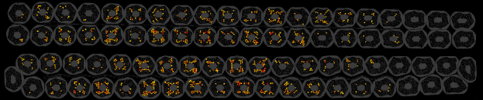
Objectives and methodology
Data for a few and different architectures
Investigate the correlation between I_{c} degradation
and damage phenomena
  Stress levels for which damage can be observed
  Correlation between I_{c} degradation and cracks
↓Evaluate possible extrapolation between scales
Objective
  Data of recent cable configuration
  Investigate the impact of monotonic / cumulated loading
  Develop and propose procedure to study elementary loadings
  w/ statistical & systematic study of damage
    I_{c} measurements
    Damage phenomena
      Crack initiation / damage in epoxy / etc.
      Spatial cracks distribution & pattern
Main steps
  Transport measurements under magnetic field of a double-stack
  specimen after application of pressure at RT
  Metallographic analysis of samples transversally
  loaded and comparison of damage state and
  transport measurements
I_{c}-σ_{trans} for Cable H15OC0190 with RRP 144/169 [Ebermann 19]
Architecture
Ic degradation
Mech. behavior
Design & operating limits

Slide 9
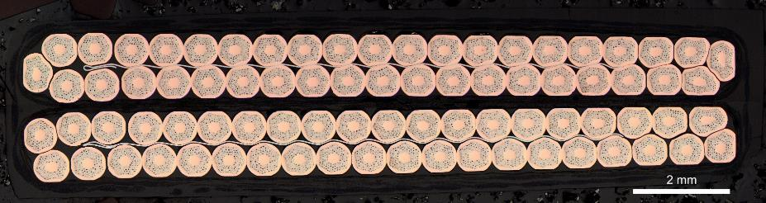
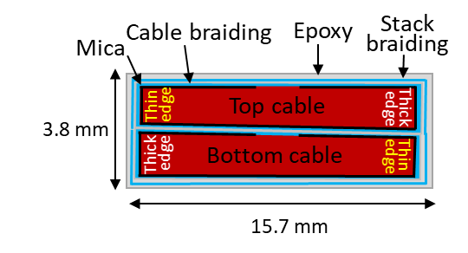
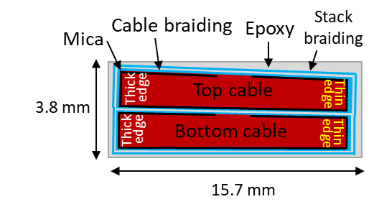
11T cable specimen
Strand and cable configuration
  RRP 108/127 ø0.7 mm
  “Small mica gap”
  Keystoned cable
Double-stack configuration
  Preparation
    S2-glass fiber and mica insulation of the bare cable
    Heat treatment
    Vacuum impregnation in epoxy CTD-101K
  Possible configurations
    Inverted – Compensate the keystone
    Non-inverted – Doesn’t compensate the keystone

Slide 10

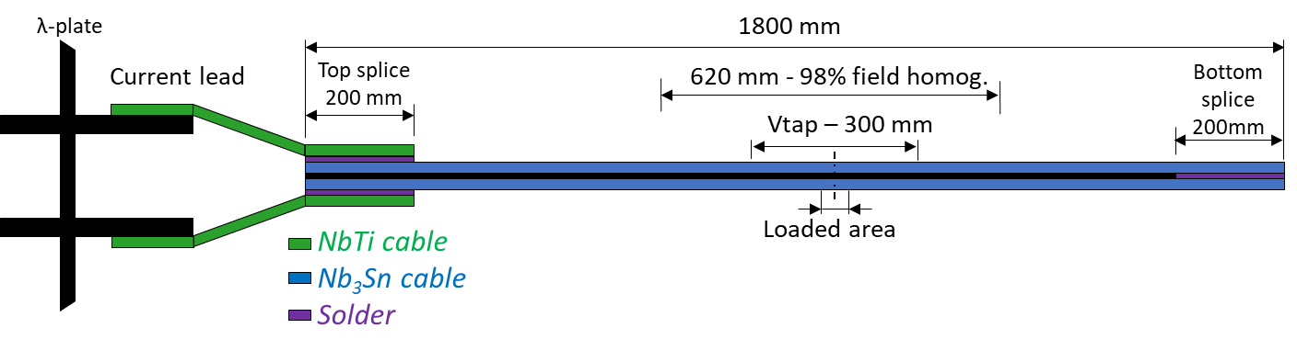

Investigated specimens
Schematic layout of the long FRESCA specimen
3
2
1
2
3
2
1
2
Ref. samples
Loaded area
Ref. samples
Specimen for transport measurement – “FRESCA specimen”
  1.8 m long double-stack cable with Vtaps and splices
  Area transversally compressed in high field region always the same
Metallographic samples cut from FRESCA specimen after
transport measurements
  Cut with a diamond wire saw
  Samples
    Loaded area of the FRESCA specimen
    Reference samples checked for absence of damage
    60 mm long samples for microscopy to which transverse compressive stress was applied separately
    after the transport measurements
1
1
2
3

Slide 11
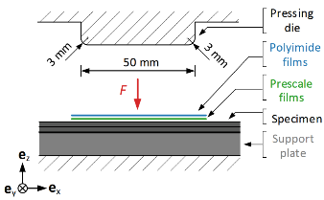
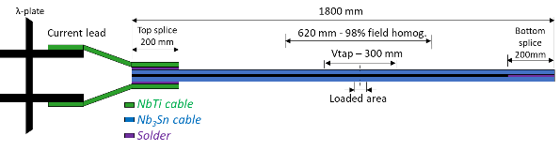
Transverse stress and loading cases
Increase homogeneity
Transverse pressure
  Applied using hydraulic press at building 180 at CERN developed by F. Wolf and P. Ebermann [Wolf 18] [Ebermann 18]
  Boundary conditions: no constraints on the sides of the specimen
  Evaluation of stress distribution
    Stress from Prescale ﬁlm measurements was within 12.5%
    from the stress from calibrated load cells [Wolf 18]
    From Prescale film, pressure is lower at the side of the cable
     recent analyses showed this depend on the specimen
  Stress case name come from the
  averaged pressure applied
Loading scenarios
  Transport measurments
    1/ Measurement at virgin state
    2/ Warm up & application of pressure @ RT
    3/ Cool down & measurement in FRESCA
    4/ After the 190 MPa step, specimen loaded to
    20 cycles at 190 MPa and measured in FRESCA
  Metallographic analyses
    Selected stress levels applied for transport measurements
    140 MPa / 160 MPa / 170 MPA / 180 MPa
    Monotonic and cumulated loadings
Evaluate stress distrib.
Schematic side view of the setup to
apply transverse load [Ebermann 18]
σ [MPa]
20 cycles
190
Transport measurement in FRESCA
180
170
160
150
140
130
130 to 190 MPa w/ 10 MPa step
0
t
⇨ cumulated loading
virgin
130
140
150
160
170
180
190 MPa
190 cycled
σ [MPa]
160
150
160 cumulated
140
160 monotonic
130
0
t

Slide 12
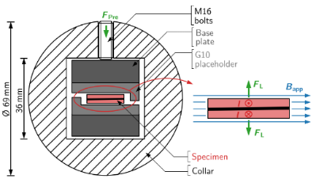
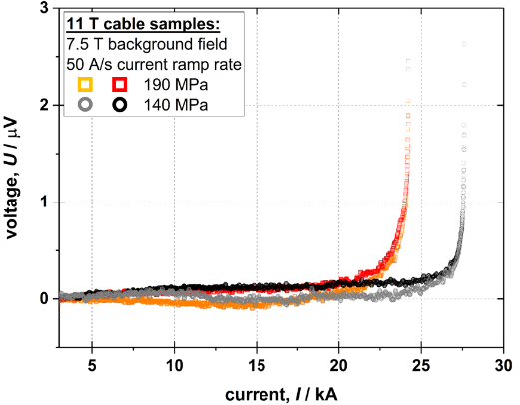
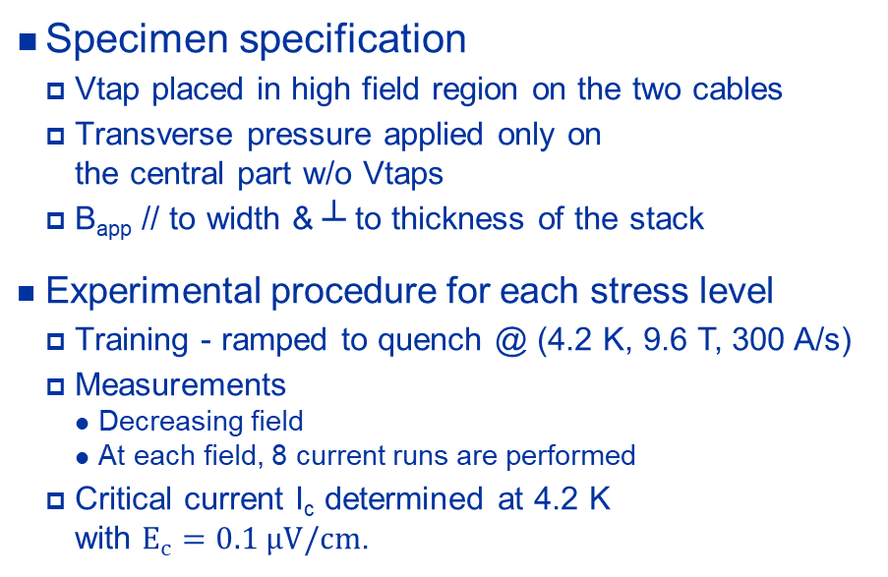
Transport measurements in FRESCA [Verweij 99]
Schematic layout of the long FRESCA specimen
Specimen specification
  Vtap placed in high field region on the two cables
  Transverse pressure applied only on
  the central part w/o Vtaps
  B_{app} // to width & ┴ to thickness of the stack
Experimental procedure for each stress level
  Training - ramped to quench @ (4.2 K, 9.6 T, 300 A/s)
  Measurements
    Decreasing field
    At each field, 8 current runs are performed
  Critical current I_{c} determined at 4.2 K
  with $E_{c}=0.1 μV/cm$.
Schematic cross-section of the FRESCA sample holder [Ebermann 18].
U-I curve of two stress cases measured on each cable

Slide 13
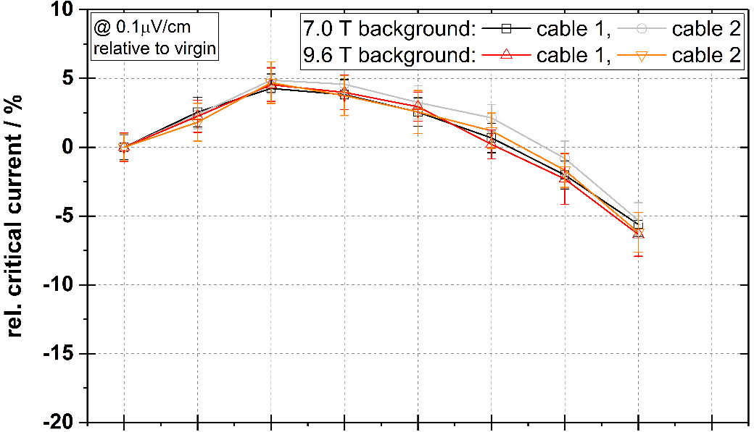
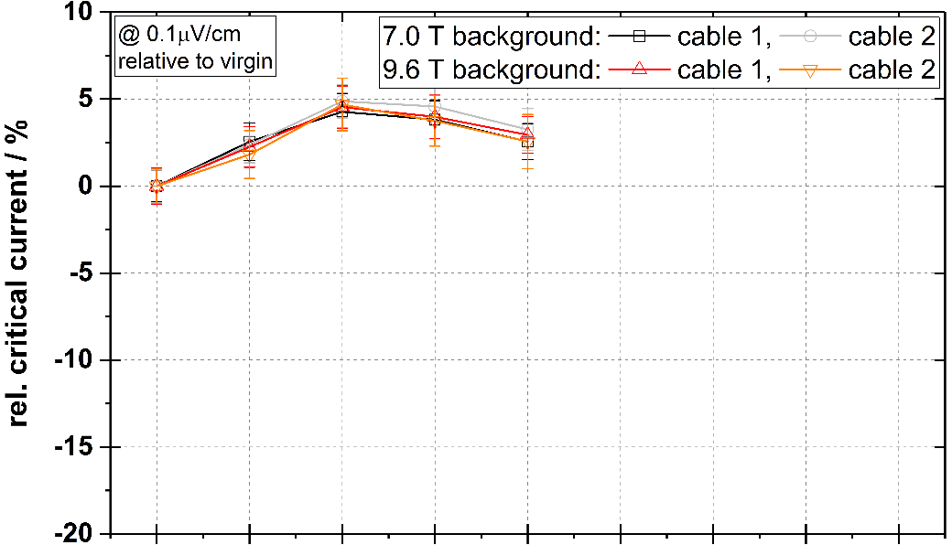
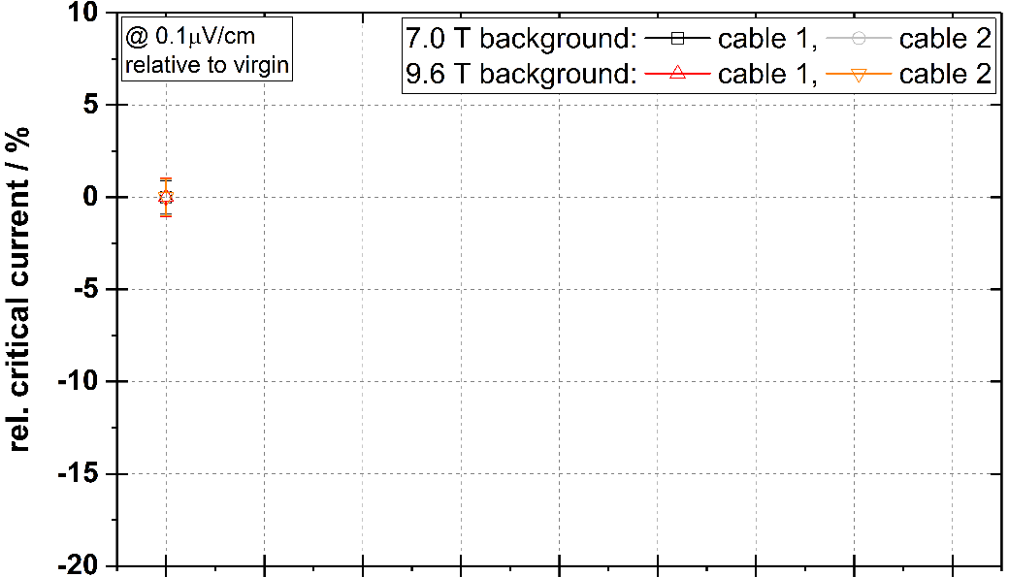
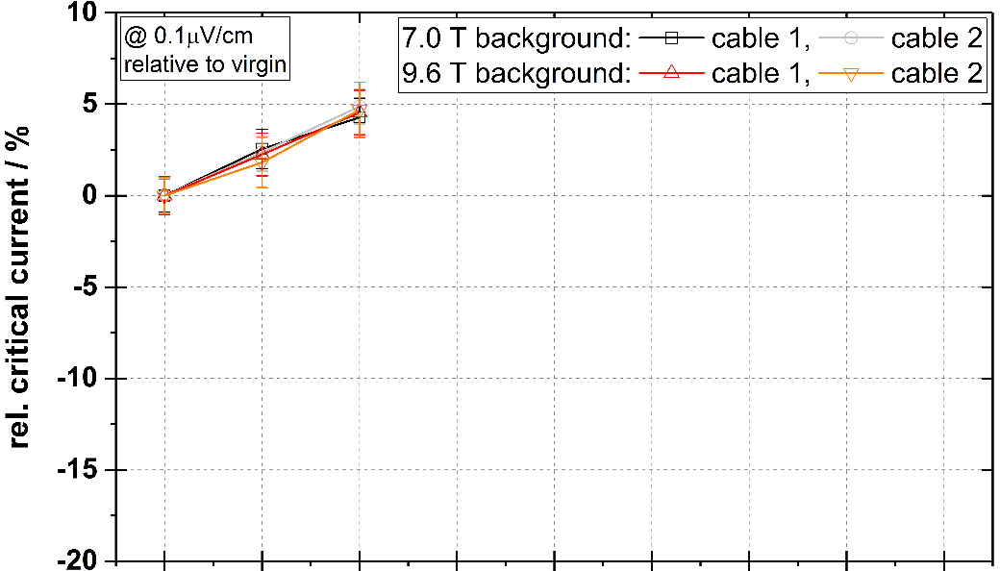
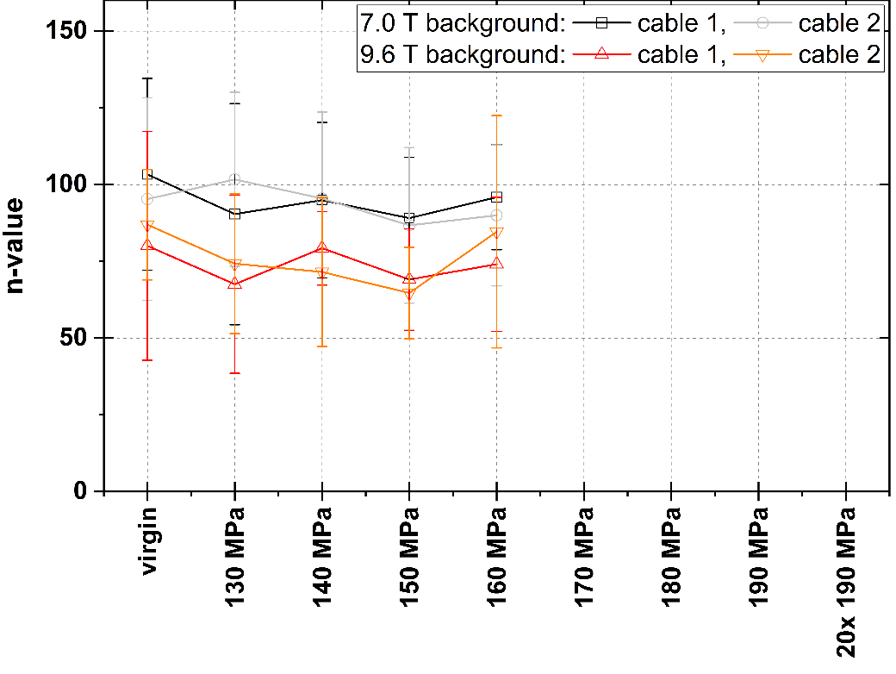
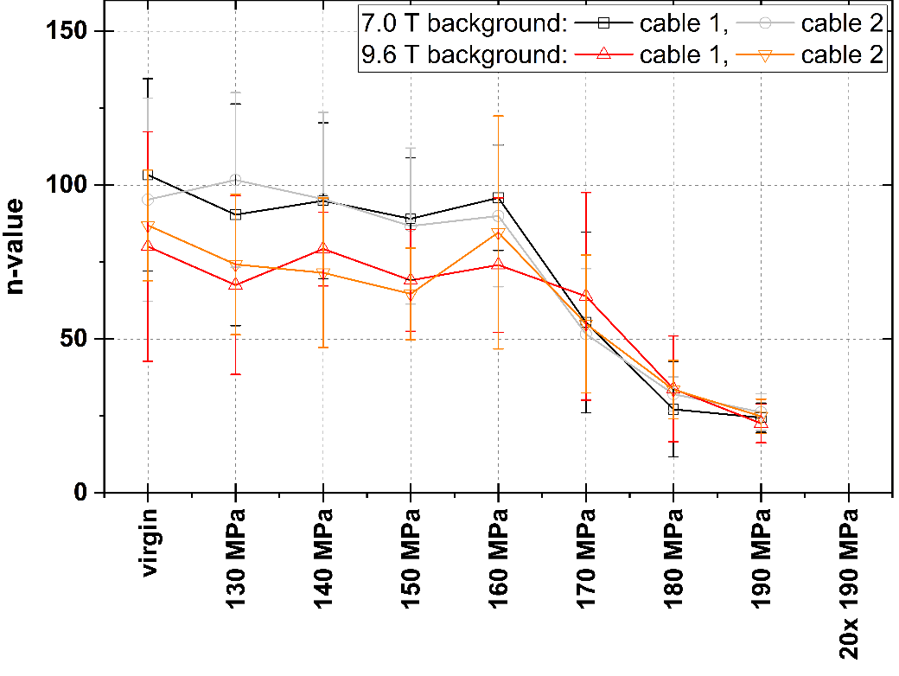
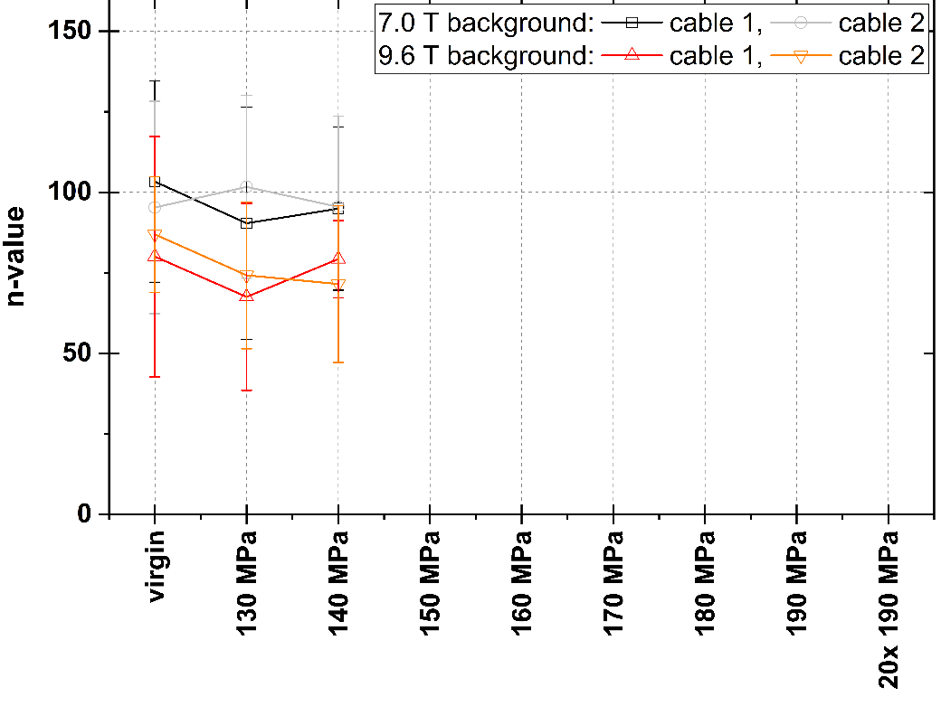
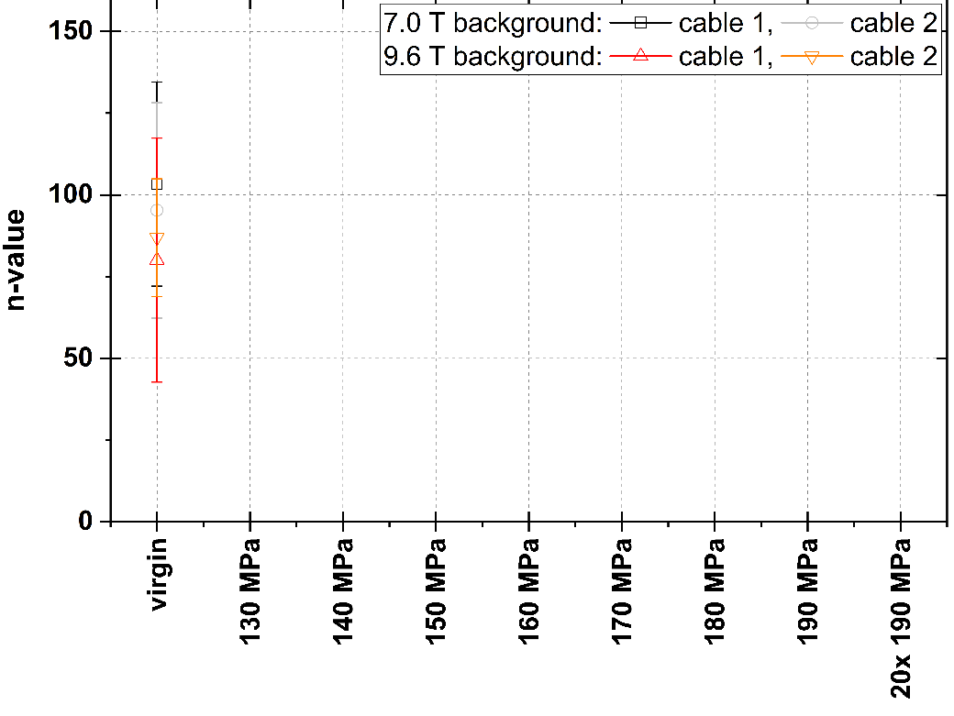

Transport measurements
$\left(\frac{I_{c}}{I_{c virgin}}−1\right)with σ_{transverse}$ for min and max B_{app}
Evolution of the relative critical current and
n-value for the 2 cables at minimum and
maximum applied field with applied stress at RT
  Until 140 MPa
    I_{c} is increasing due to initial strain state of Nb₃Sn
    n is stable
  140 MPa to 160 MPa
    I_{c} is decreasing from max but still above virgin case
    n is stable
  170 MPa
    Small Ic decreases above/near virgin case
    n is decreasing
  180 MPa & 190 MPa: significant Ic decreases
    180 MPA: ̴2 % below virgin state, ̴6 % below max
    190 MPA: ̴6 % below virgin state, ̴8 % below max
    Reduction of n-value from 90 to < 50
n-value $with σ_{transverse}$ for min and max B_{app}

Slide 14
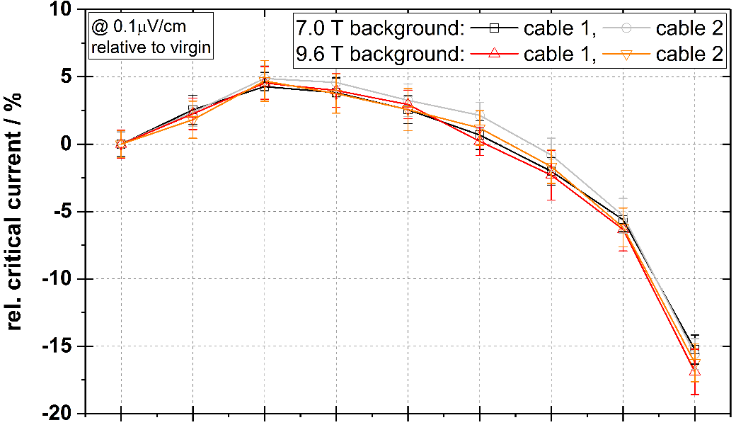
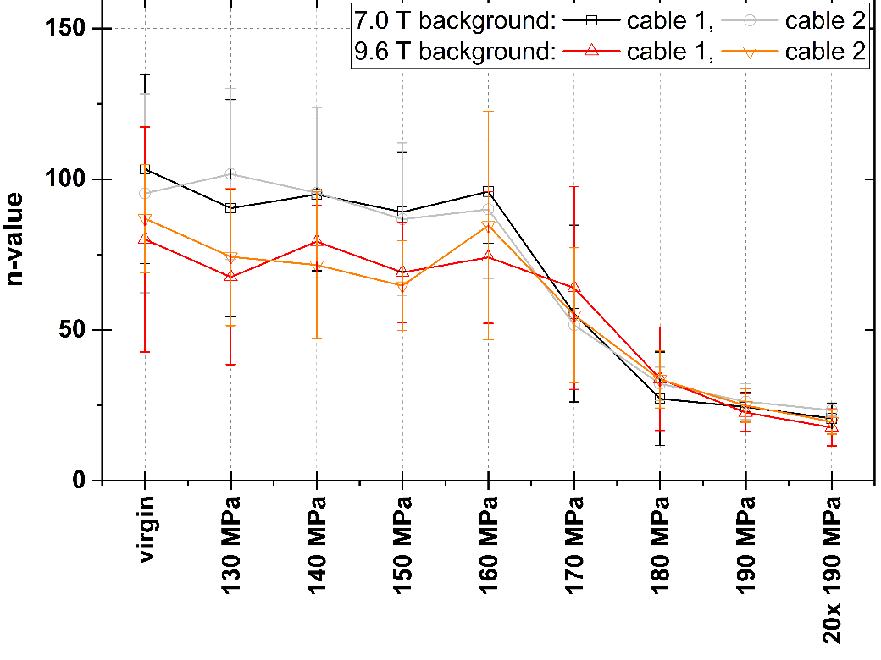
Transport measurements
$\left(\frac{I_{c}}{I_{c virgin}}−1\right)with σ_{transverse}$ for min and max B_{app}
Evolution of the relative critical current and
n-value for the 2 cables at minimum and
maximum applied field with applied stress at RT
  Until 140 MPa
    I_{c} is increasing due to initial strain state of Nb₃Sn
    n is stable
  140 MPa to 160 MPa
    I_{c} is decreasing from max but still above virgin case
    n is stable
  170 MPa
    Small Ic decreases above/near virgin case
    n is decreasing
  180 MPa & 190 MPa: significant Ic decreases
    180 MPA: ̴2 % below virgin state, ̴6 % below max
    190 MPA: ̴6 % below virgin state, ̴8 % below max
    Reduction of n-value from 90 to < 50
  20 cycles from 0 MPa to 190 MPa
    Strong Ic degradation: ̴16% from virgin case
    No clear evolution of n
n-value $with σ_{transverse}$ for min and max B_{app}

Slide 15
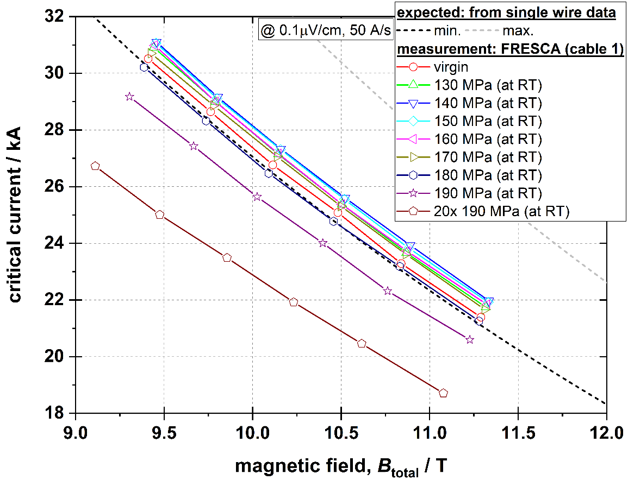
Transport measurements
Field dependence of the critical current for different applied stress with min and max plots of the expected performances derived from single wire data
  Virgin: I_{c} just within expected range
  ≤170 MPa: within expectations
  180 MPa: min expected performance
  190 MPa: below expectations
  20 cycles at 190 MPa: severely degraded

Slide 16
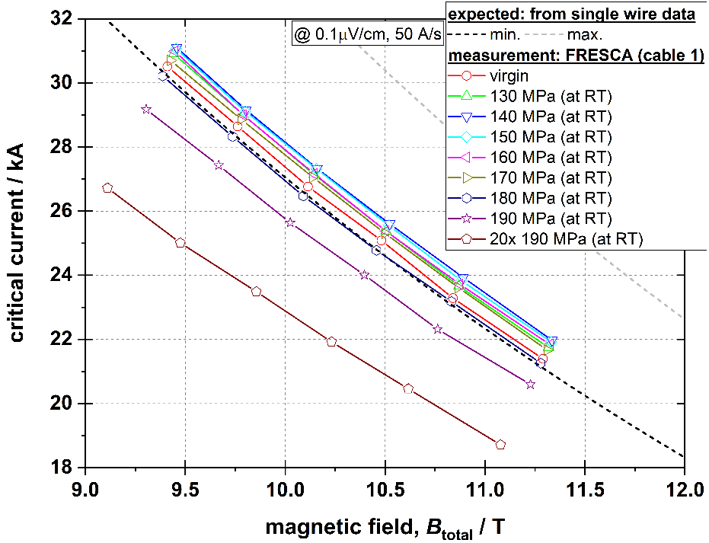
Transport measurements
$\left(\frac{I_{c}}{I_{c virgin}}−1\right)with σ_{transverse}$ for min and max B_{app}
Until 160 MPa
Ic is increasing or stable
170 MPa
Withing expectation with
slight evolution of n
180 MPa & 190 MPa
significant Ic decreases
20 cycles from 0 MPa to 190 MPa
n-value $with σ_{transverse}$ for min and max B_{app}

Slide 17
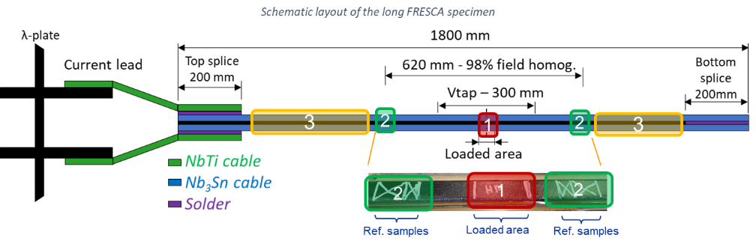


Metallographic analysis - Investigated specimens
  Cut from FRESCA specimen after transport measurements
  Description of samples
    190 cycled - Loaded area of the transport
    measurement sample
    0 or Reference samples
      Used to validate the absence of damage from
        previous steps (handling, tests)
        Preparation (cutting, grinding, polishing)
      Ref. samples prepared together with analyzed
      samples to guarantee the preparation
    xxxC or xxxM - 60 mm long samples used to apply transverse stress
    and compared with transport measurements
       140C / 160M / 160C / 170M / 170C / 180M / 180C
1
2
Loading of the 190 Cycled
3
Presented here
Exemple of loadings of the metallographic samples

Slide 18






Metallographic analysis – Preparation and analysis
Top longi. cross-section
Cutting of samples with diamond wire saw
 impact of cutting evaluated on ref. samples < 20 μm
from cutting plane
Preparation of the sample
  Embedded in epoxy resin at cold
  Grinding and polishing with
  decreasing particle size
  (SiC papers and water-based
  diamond pastes)
  Vibro-polishing final step
Observation & Analysis
  Optical microscope for global analysis and small cracks using SEM
  Quantification of cracks on grey scaled stack pictures
  with color scheme assigned to cracked filaments
    yellow-1crack, orange-2, red-3 and dark red-4 & more
    Doesn’t represent the size of the crack!
    One yellow coded sub-element may have a
    3 μm long crack or a 10 μm long one
Side longi. cross-section
Transverse cross-section
Grinding with P1200 paper
Polishing with 1 μm diamond solution
Vibro-polishing with 0.02 μm SiO₂ susp.
3 μm
10 μm
Transverse cross-section w/ SEM
190 Cycled
Radial cracks in sub-elements

Slide 19

Metallographic analysis – 190 Cycled
    yellow-1crack orange-2 red-3 dark red-4&more
190 cycled heavily damaged
No cracks observed in strands
located at the kink
Damaged concentrated in middle
& thick side
 From Prescale film, pressure is
lower on the side of the cable
 Thick side more impacted
↓Non-inverted configuration
X-shape damage pattern in strands

Slide 20




Metallographic analysis – 190 Cycled
wavy crack
[Balachandran 21]
Radial crack

Slide 21



Metallo. analysis – 190 Cycled Transverse CS
Radial crack
Large opened cracks
Apparent lower cracks density than [Ebermann 18]
SEM micrographies of the 200 MPa sample [Ebermann 18]
  Cable H15OC0190 with RRP 144/169

Slide 22



Metallo. analysis – 190 Cycled Longitudinal CS
Side longitudinal – Strands located on the transition layer
Transverse
crack
Longi/straight crack
wavy crack

Slide 23

Metallo. analysis – 190 Cycled Longitudinal CS
Top longitudinal – First layer of top cable

Slide 24



Metallo. analysis – 190 Cycled Longitudinal CS
Top longitudinal – First layer of top cable

Slide 25

Metallo. analysis – 190 Cycled Longitudinal CS
Top longitudinal – First layer of top cable
  [Eberman 18] –longi. cracks because transv. load
   degradation due to shrinkage of supercond.
  area and not interruption
  [Jewell 08] – Ic degradative
  cracks are transverse
Longitudinal cracks on top longi. CS RRP strand [Ebermann 18]
Transverse cracks on longi. CS RRP strand [Jewell 08]
Longitudinal CS requires time and effort (& luck?) to obtain relevant information
Not adapted for first cracks / damage initiation studies

Slide 26




Metallographic analysis – 160 Monotonic & Cumulated
    yellow-1crack orange-2 red-3 dark red-4&more
160 MPa Cumulated
160 MPa monotonic

Slide 27
Metallographic analysis – 160 Monotonic & Cumulated
160 MPa Monotonic
160 MPa Cumulated
Example of cracks in a sub-element of the 160 monotonic sample

Slide 28
Metallographic analysis – 160 Monotonic & Cumulated
160 MPa Monotonic
    yellow-1crack orange-2 red-3 dark red-4&more
160 MPa Cumulated
Crack density is more important in the cumulated sample
Center of stack is mainly damaged
Damaged concentrated in middle & thick side
 From Prescale film, pressure lower at the side
 Non-inverted configuration

Slide 29


Metallographic analysis – 140 Cumulated
10μm
140 MPa Cumulated
Presence of cracks at 140 MPa with a cumulated loading
Transport measurement at 140 MPa cumulated
  I_{c} max
  no evolution of n-value from virgin

Slide 30


Metallographic analysis - Outcomes
All samples show cracks, even the lowest one: 140 MPa Cumulated.
Density of cracks more important in cumulated loaded samples than monotonic one.
Damage in cables localized mainly in center, thin side less damaged than thick side.
 Non-inverted configuration (can be confirmed with inverted configuration comparison)
 From Prescale film, pressure lower at the side (sample dependent)
Cracks
  Initiated from
    Porosities (core & restack)
    Interfaces (Nb/Nb₃Sn & core/Nb₃Sn)
  Nb barrier & core never cracked
  Pattern of cracks in sub-element
    Cracks are localized in the 45° planes from loading direction.
    Damaged sub-elements orientation does not vary wrt. the rotation
    of the hexagon structure for high stress levels
    For low stress levels, hexagon structure and deformed shapes of
    sub-elements seems to play a role in the degradation
    Majority of the cracks oriented // to loading direction
     Cracks ┴ to loading direction appear in severely damage sub-elements localized in zone C
    In strands with less damage (1 to 10 sub-elements affected) cracks localized in A,B & C.
    As cracks density , localized in C.
    Heavily damage strands, zone D is reached and multiple cracks

Slide 31







Other investigation method
Etching of copper matrix
X-ray tomography – CT scan
  Non-destructive method
  Require high resolution to observe cracks
Ion beam abrasion
So called Cross-section polisher
  Minimize damage surface
  Allow to look for small cracks
Etching of an IT strand [Jewell 08]
Bundle of sub-element of RRP 144/169 longitudinal view [Ebermann 19]
Tensile test in-situ SEM on PIT strand
Spatial resolution 4μm [Lenoir 17]
200 MPa step – Spatial resolution 10μm
No cracks visible [Ebermann 18]
80nm
Cross-polishing of longitudinal CS of IT strand after interrupted tensile test [Lenoir 17]

Slide 32
Conclusion
Transport measurements & damage state
  Damage in sub-element observed before transport measurements degradation
  No impact of small cracks observed at low stress levels on the transport measurements performed at the stack scale
Cumulated / cyclic loading
  Clear differences in damage occurring in monotonic and cumulated / cyclic loadings
Question
  Effect of cyclic loadings (mech. & thermal) at lower pressure?
  ⇨ “Sultan” type tests
  Correlation between I_{c} degradation and damage phenomena
   At which pressure / stress level the first cracks appear?
   Physical phenomena and damage process involved?
  Extrapolation between strand, stacks (double & 10-stack) and coils scales?
  Can we build magnets with below stress level for which appears first cracks?
  Can we live with some of the cracks?

Slide 33
Perspectives & on-going work
Numerical twin using the CoCaSCOPE approach [Manil 21]
11 T samples
  Lower stress levels
  Longitudinal cross-section
  Statistics (crack density, size, pattern)
MQXF specimens – K. Puthran
  Inverted stack configuration
  First cracks and stress levels
  Impact of impregnation resin
Statistical & systematic study of damage
  Transport measurements
  Damage phenomena
    Crack initiation / damage in epoxy / etc.
    Spatial cracks distribution & pattern
Stack sample
  Inverted or non-inverted configurations
    ↓ both should be done
  Simplified structure allowing to study mechanical
  and electrical responses under known conditions
  Easier, quicker, cheaper.
  Experimental procedure
  Metallographic analysis (procedure, tools, etc.)
Architecture
Ic degradation
Mech. behavior
Design & operating limits
Elementary loadings
  Transverse
  Bending
  Tensile
Damage analysis
Transport measurement
Numerical simulation

Slide 34

Effect of transverse compressive stress on Nb₃Sn Rutherford cables for accelerator magnets
Thank you for your attention
Gilles Lenoir, Kirtana Puthran, Christian Barth, Felix Wolf, Jérôme Fleiter
and Amalia Ballarino
TE-MSC-SCD
[Balachandran 21] S. Balachandran et al., SUST, 2021, 10.1088/1361-6668/abc56a.
[Ebermann 18] P. Ebermann et al., SUST, 2018, 10.1088/1361-6668/aab5fa.
[Ebermann 19] P. Ebermann et al., SUST, 2019, 10.1088/1361-6668/ab2e51.
[Ekin 87] JW. Ekin, Journal of Applied Physics, 1987, 10.1063/1.338986.
[Ferracin 19] P. Ferracion, IEEE TAS, 2019, 10.1109/TASC.2019.2899284.
[Jewell 08] M. Jewell, PhD thesis, University of Wisconsin–Madison, 2008, link.
[Lenoir 17] G. Lenoir, PhD thesis, CentraleSupélec, Université Paris-Saclay, 2017, link.
[Manil 21] P. Manil et al., CERN TE-MSC seminar, 2021, https://indico.cern.ch/event/1085648/.
[Troitino 21] J. Ferradas Troitino et al., SUST, 2021, 10.1088/1361-6668/abd388.
[Verweij 99] A. P. Verweij et al., IEEE TAS, 1999, 10.1109/77.783259.
[Wolf 18] F. Wolf et al., IEEE TAS, 2018, 10.1109/TASC.2017.2780850.

