Slide 1
IT-4738 Specifications Committee
Ll. Miralles

Slide 2
Outlook
Introduction
Design
Project contract breakdown
MS-4738 results

Slide 3
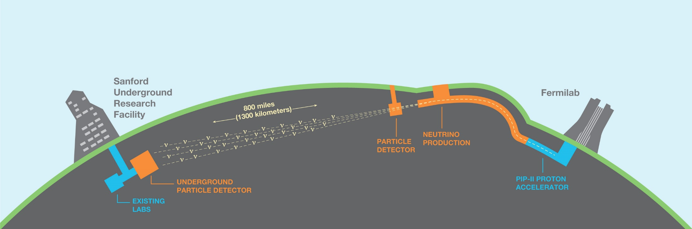
Introduction
The Long-Baseline Neutrino Facility (LBNF)
supporting the international
Deep Underground Neutrino Experiment (DUNE)
“The LBNF/DUNE project will be the first internationally conceived, constructed, and operated mega-science project hosted by the Department of Energy in the United States” - DOE

Slide 4
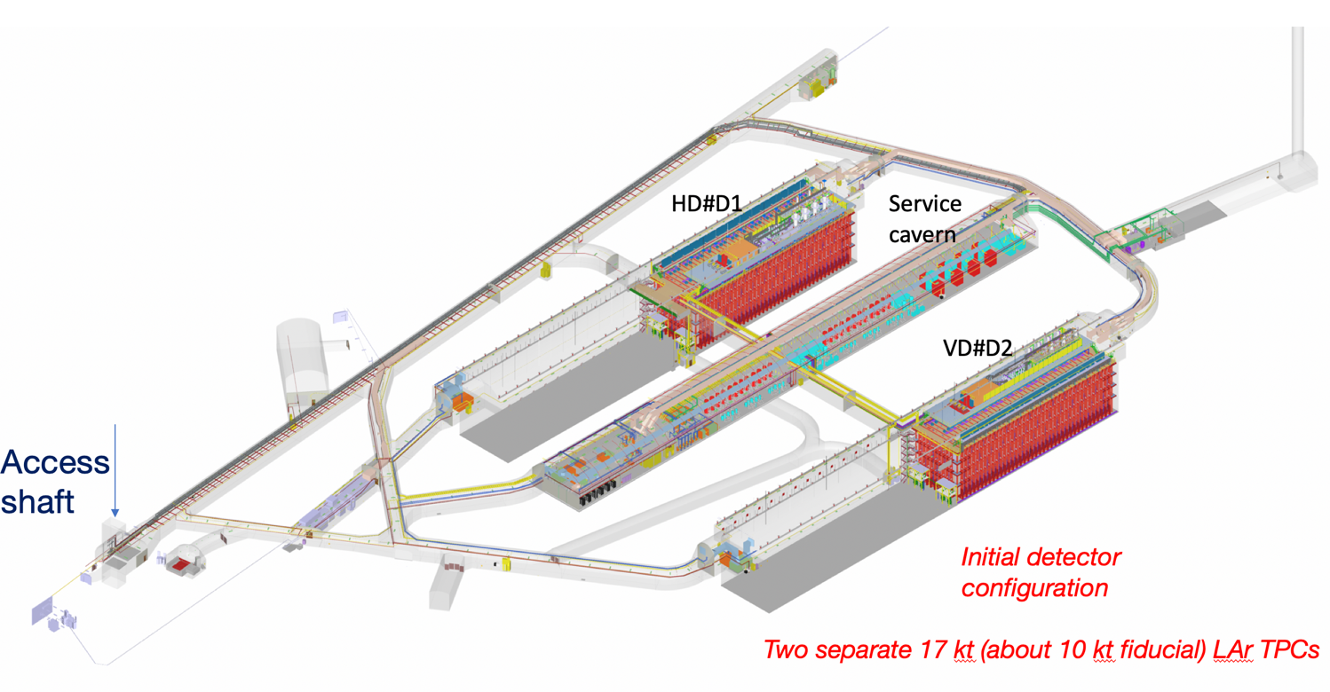
Introduction
DUNE Far detectors initial configuration
Single Phase horizontal drift
Single Phase vertical drift
1.5 Km

Slide 5
Design
LAr TPC : large cryostat vessels
Cold cryostat volume ~ 13’000 m³, an industrial type of building
Liquid argon ~18 ktons / cryostat
Passive insulation to minimize long-term operation risks (no vacuum insulation)
Location : deep underground with limited elevator access : very modular assembly, minimal welding, …
LNG technology adopted

Slide 6
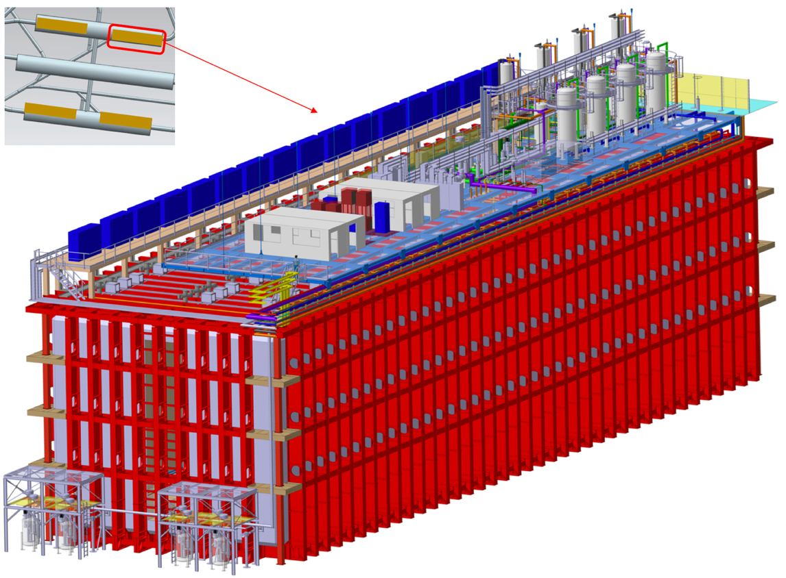
Design
LAr TPC : LBNF membrane cryostats
Far Detectors
FS det # 1
FS det # 2
High precision tracking (TPC charge collection)
High precision calorimetry
(charge and scintillation light)
17.5 ktons of LAr/det
>10 ktons active/det
3700 tons cryostat weight
65’840 mm x 18’940 mm x 17’840 mm
(L x W x H)
6

Slide 7
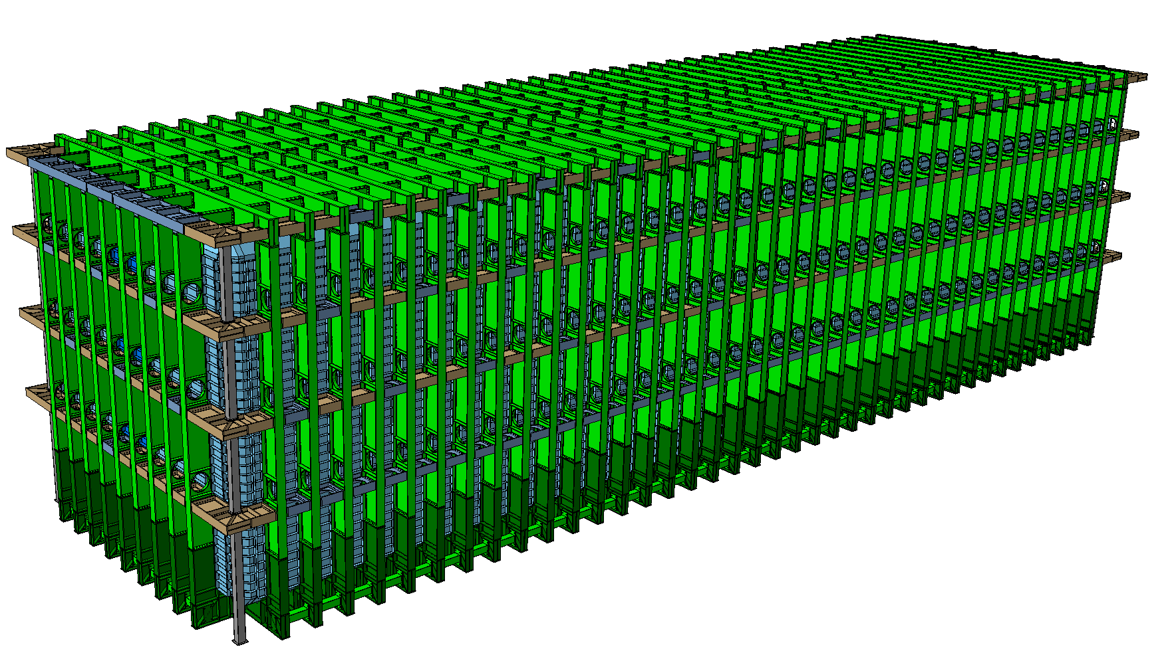
Warm structure

Slide 8
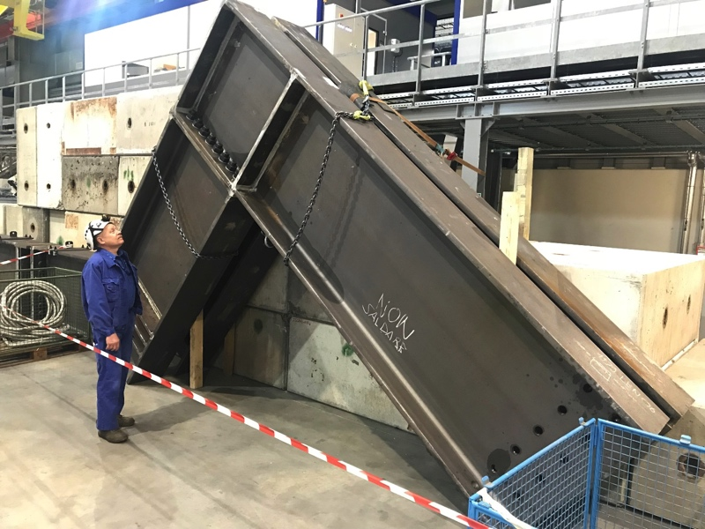
Warm structure

Slide 9
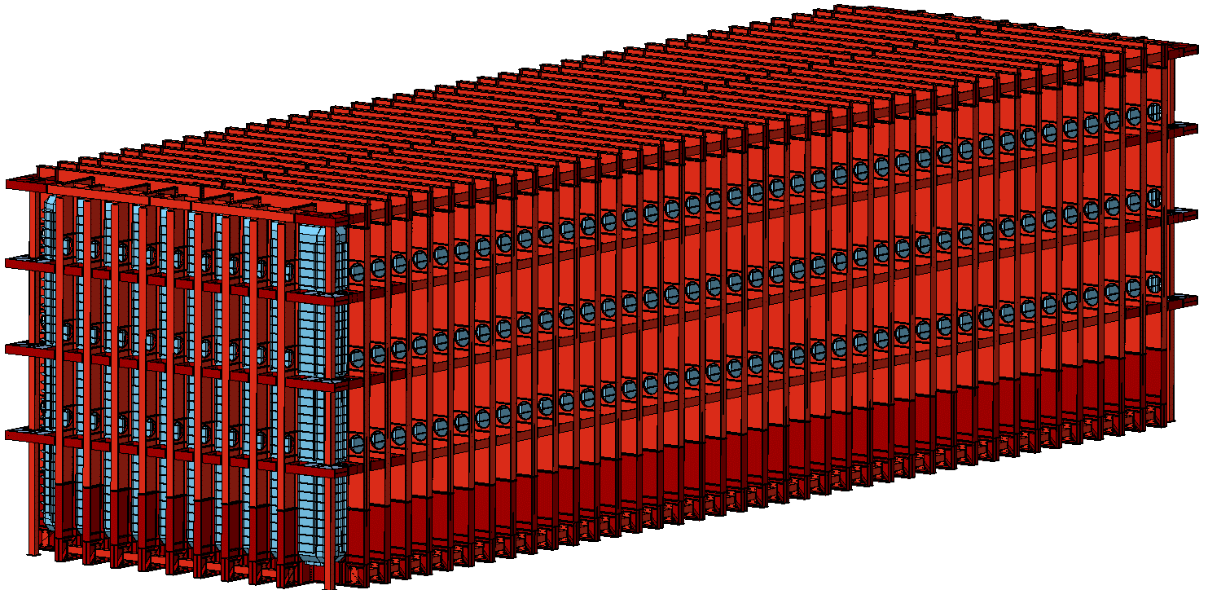
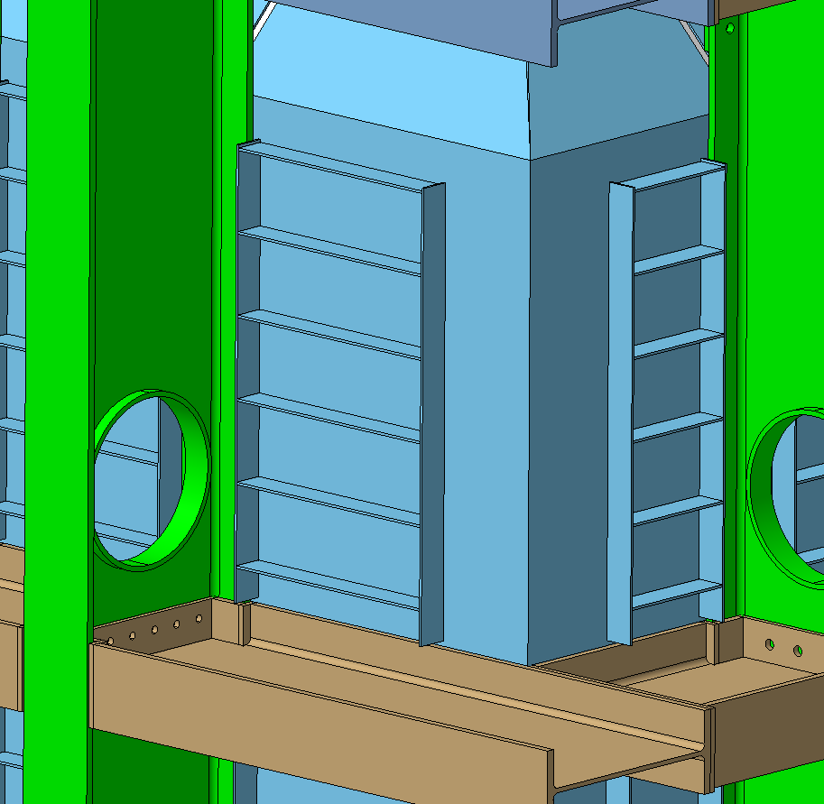
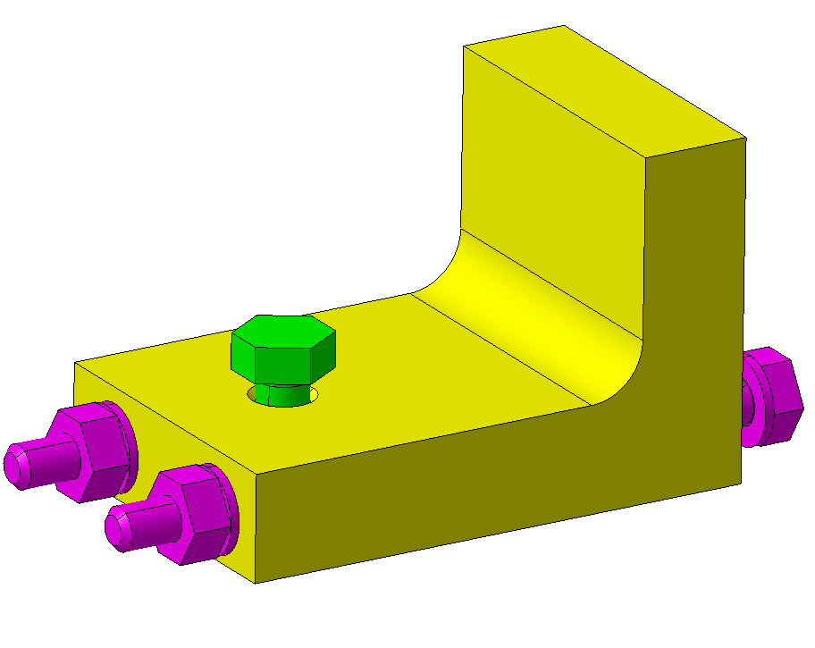
Tertiary membrane
The membrane of the LBNF have some ribs oriented vertically and horizontally;
Some clamps are used in order to fix and support the weight of the plate during installation and provide stability during the vacuum load case;
Analytical computations and simulations to verify the ribs pitch and the clamp capacity where performed.
Clamp
Ribs
M16
M14
Note: M14 bolts simulated with As – for more conservative results.
In addition, frictionless contacts were used for the clamp.
M14 and M16 bolts of class 8.8.

Slide 10
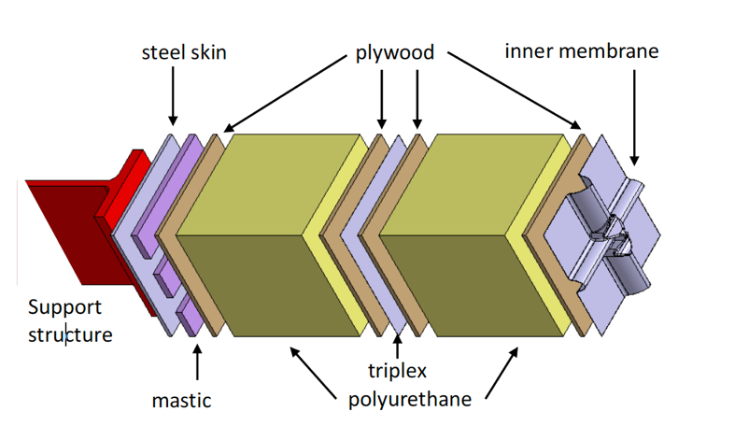
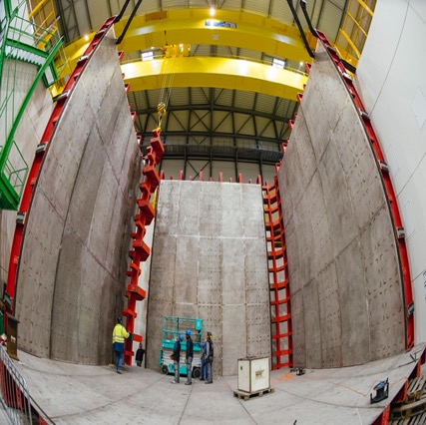
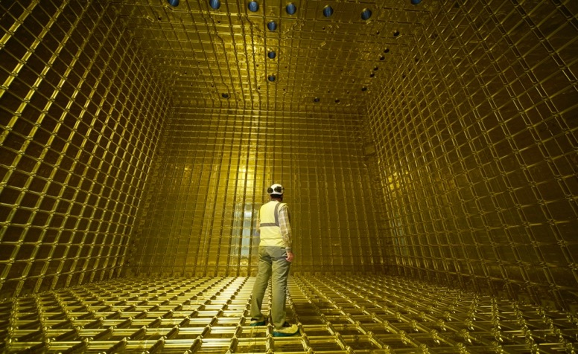
Cold structure
LAr TPC : large membrane cryostats
Warm steel structure (equivalent to the LNG ship)
Cold structure (protected by industrial IP)
80 cm PU reinforces foam
corrugated primary membrane
additional secondary membrane
+ many details

Slide 11
Project contract breakdown
Warm structure material
Warm structure components manufacturing
Warm structure membrane manufacturing
Warm structure underground assembly
Cold structure material procurement
Cold structure underground assembly

Slide 12
Budget breakdown
CONCEPT | ESTIMATION (MCHF)^{(*)} | DR
Warm structure material | 2.4 | YES
Warm structure components manufacturing | 6.3 | YES
Warm structure membrane manufacturing | 1.0 | YES
Small components procurement | 1.3 | NO
Warm structure underground assembly | 4.0 | YES
Cold structure material procurement | 11.1 | YES
Cold structure underground assembly | 8.2 | YES
Transport | 1.2 | NO
TOTAL | 35.5
^{(*)} 1 Cryostat

Slide 13
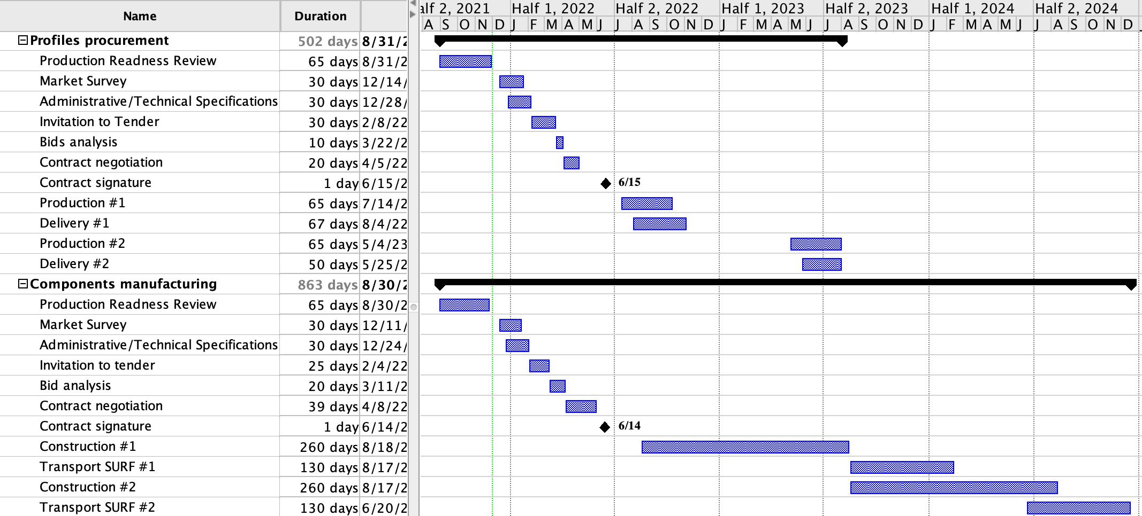
Schedule

Slide 14
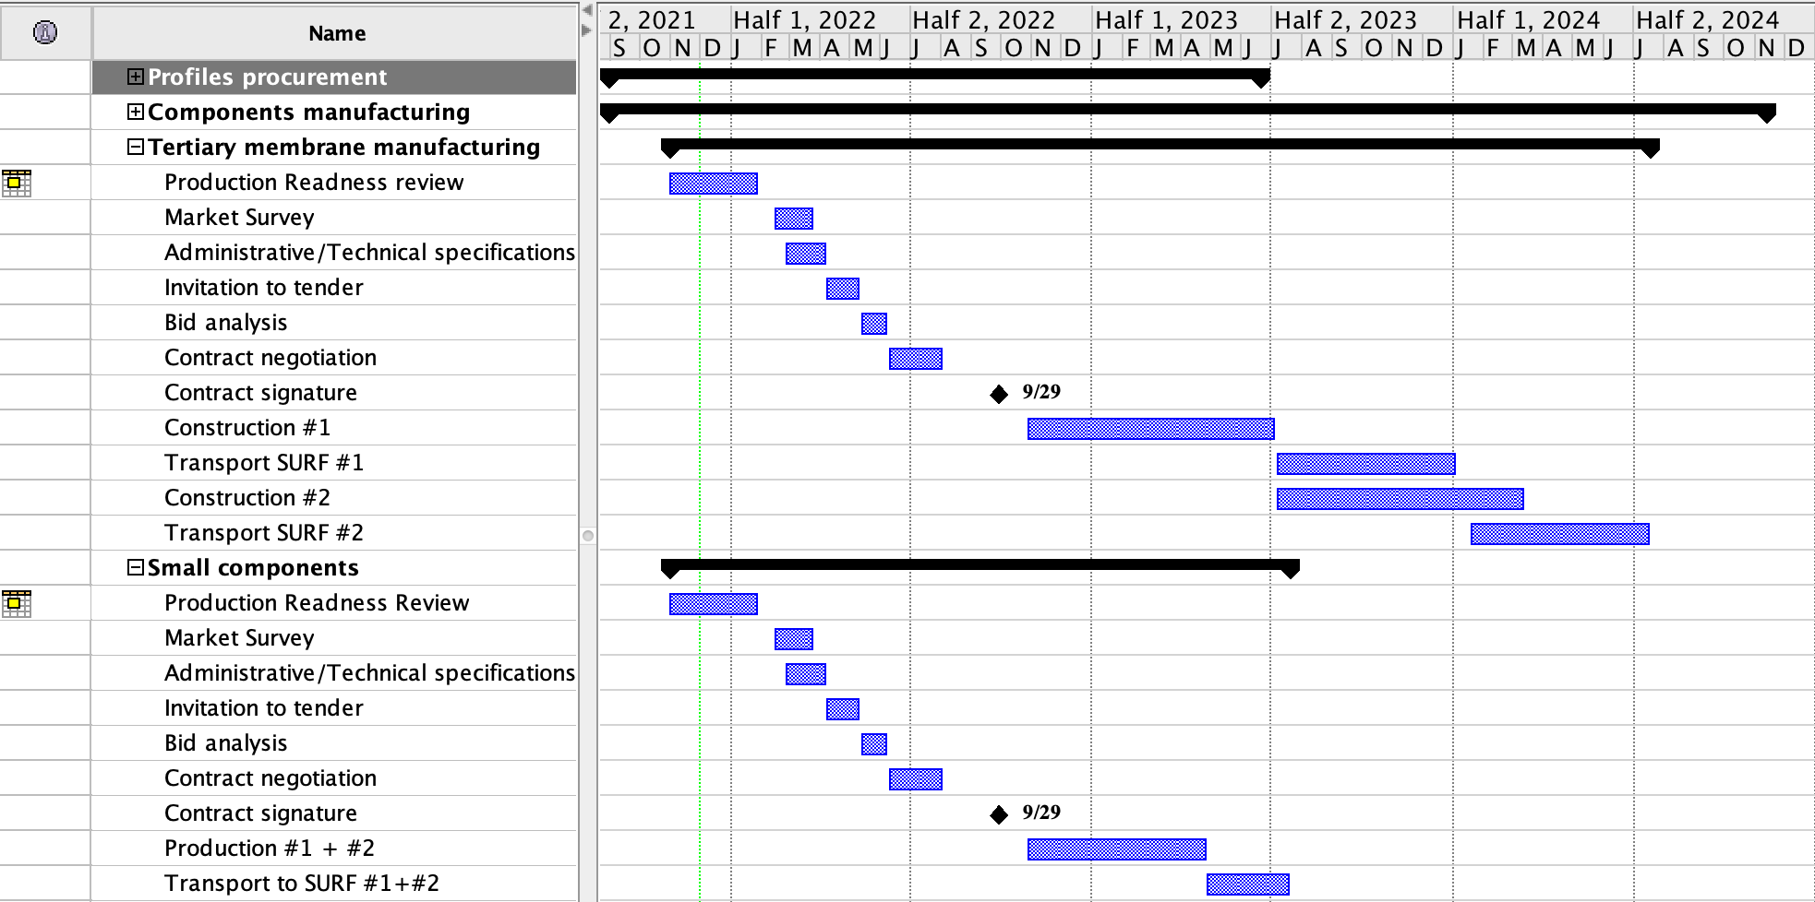
Schedule

Slide 15
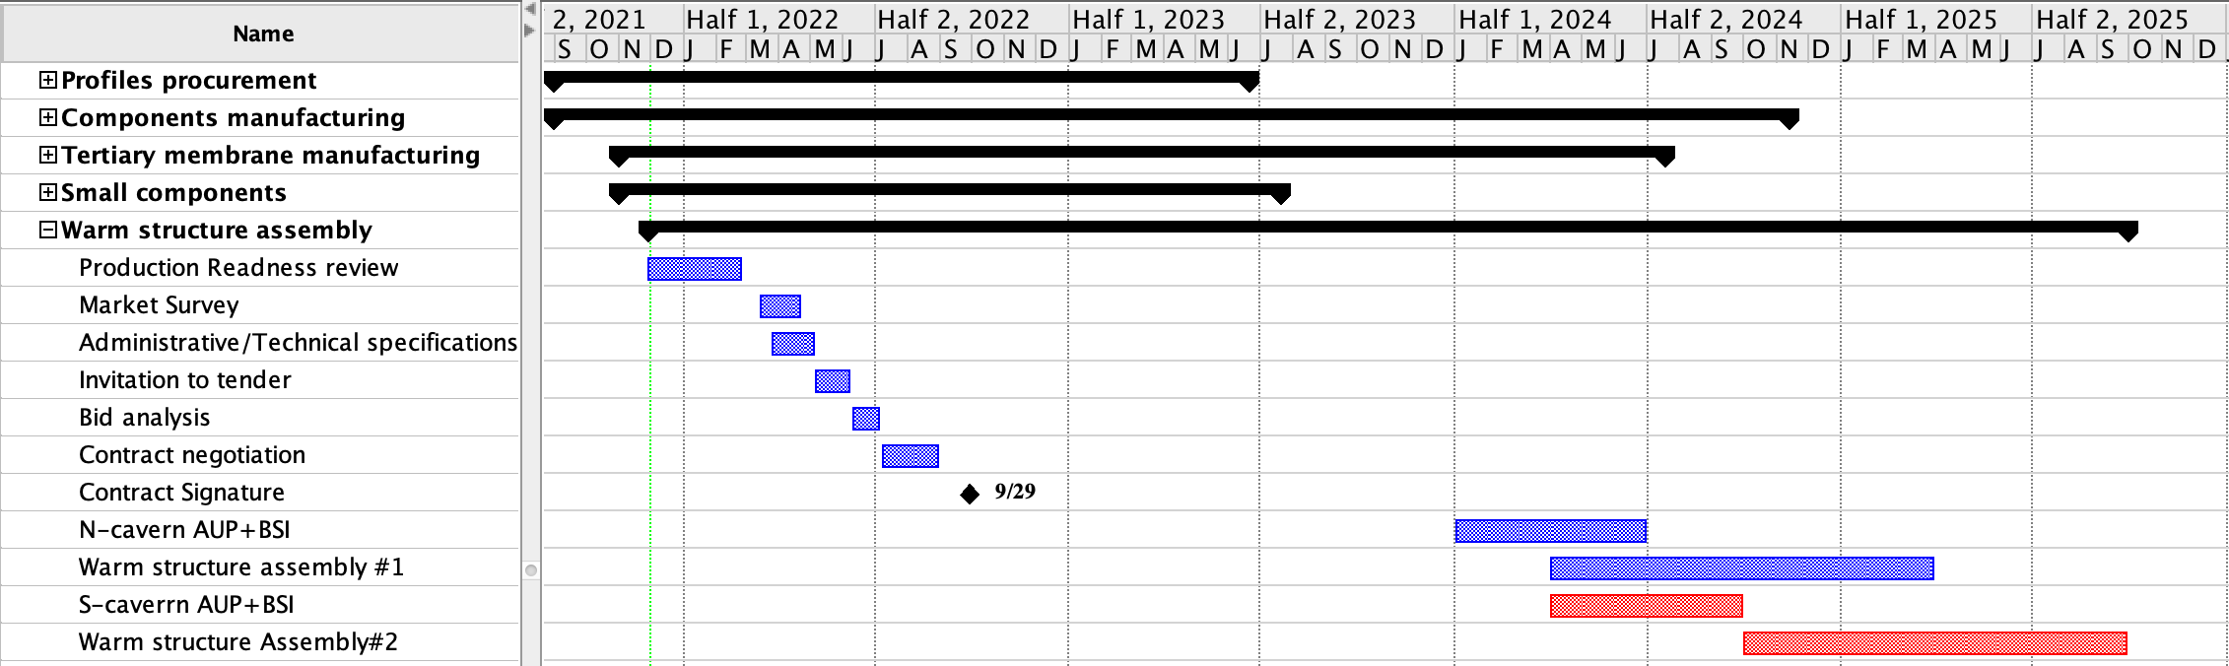
Schedule

Slide 16
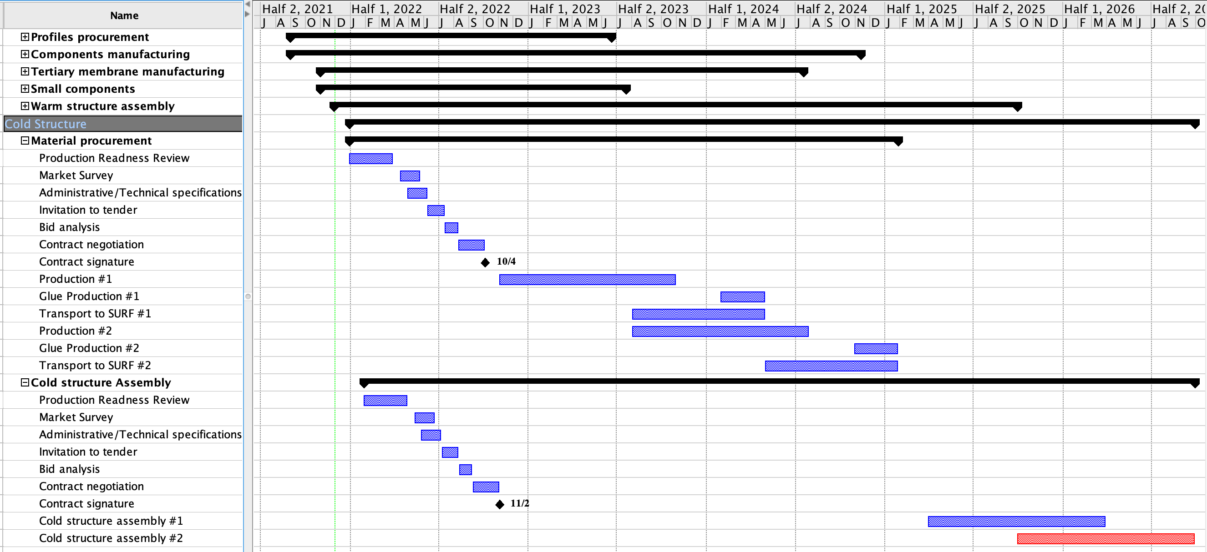
Schedule

Slide 17
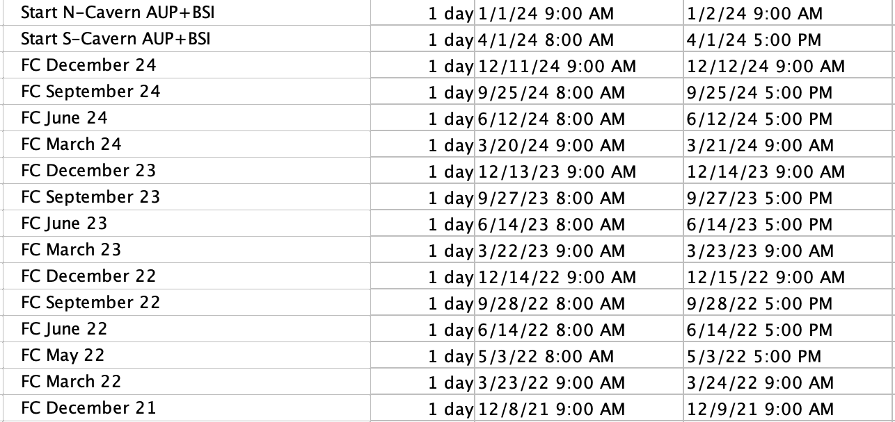
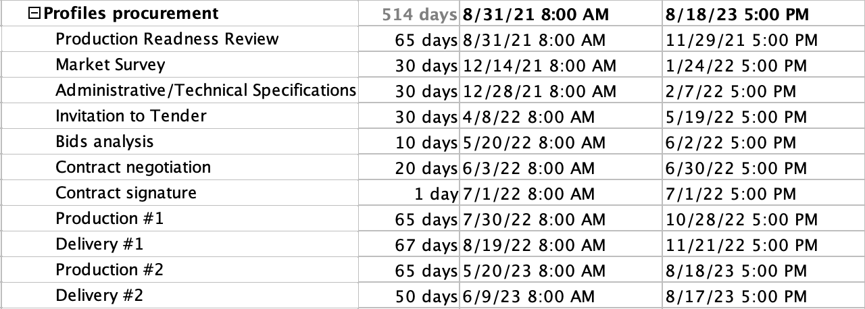
Schedule

Slide 18
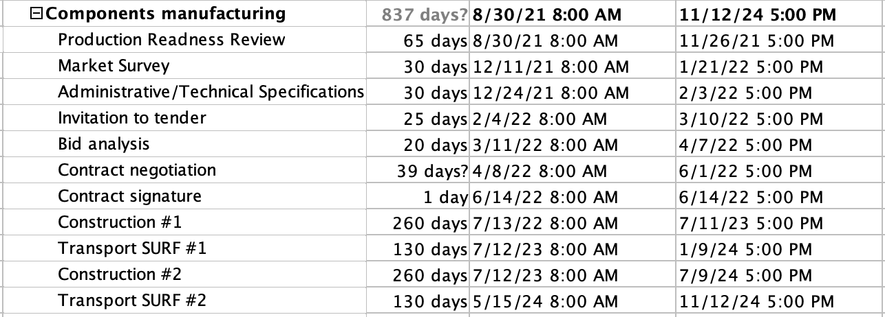
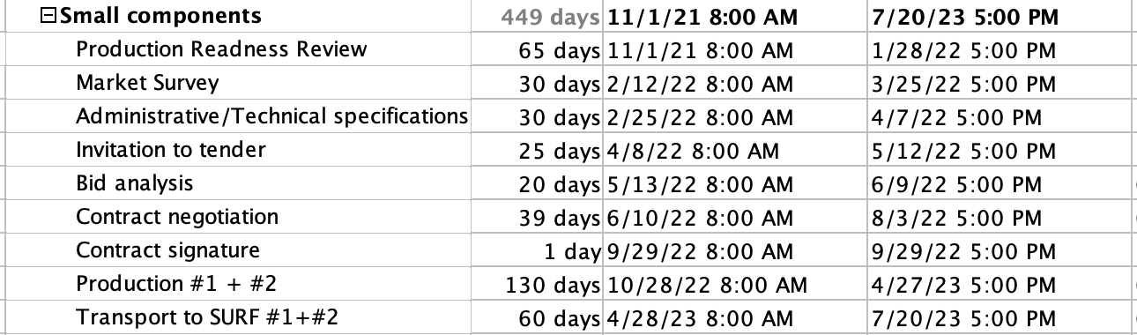
Schedule

Slide 19
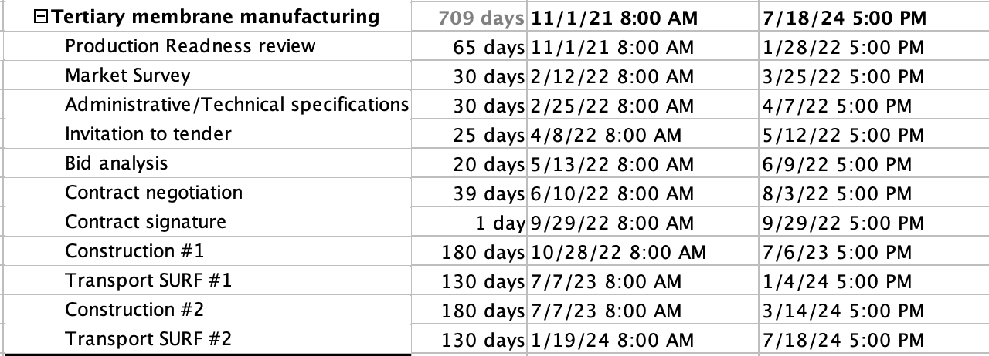
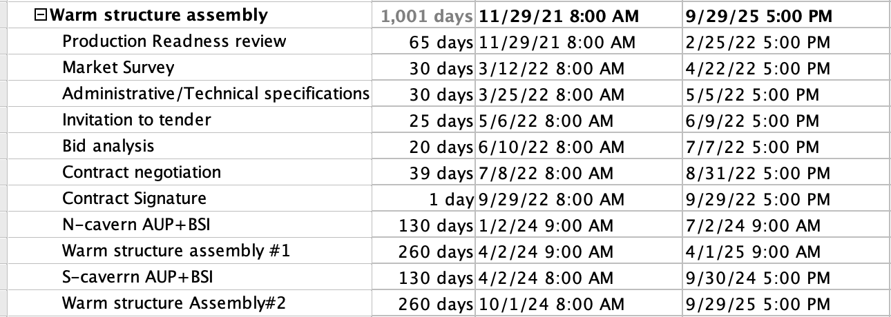
Schedule

Slide 20
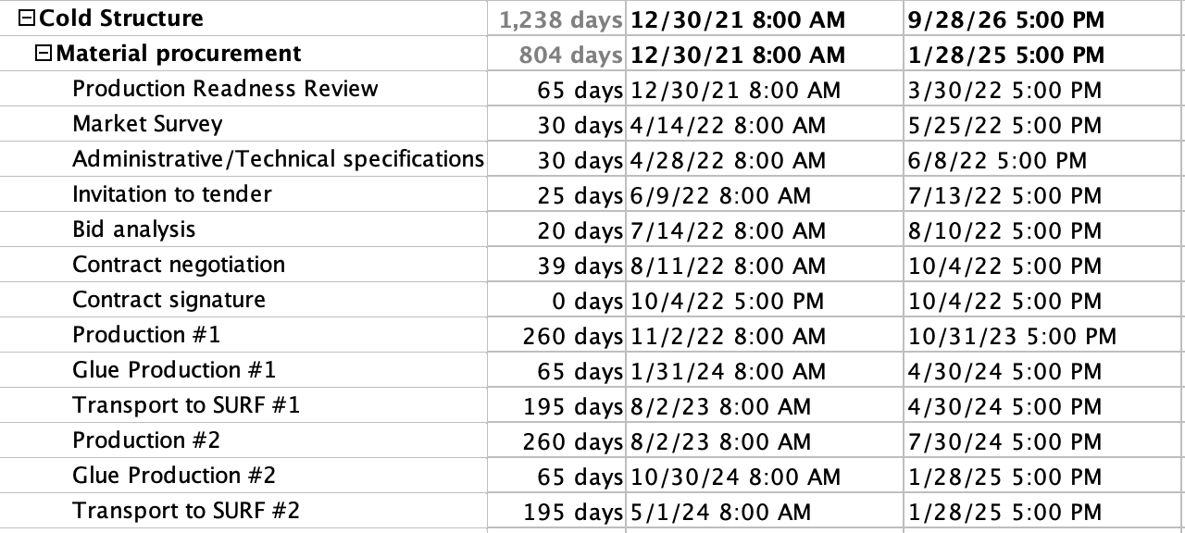
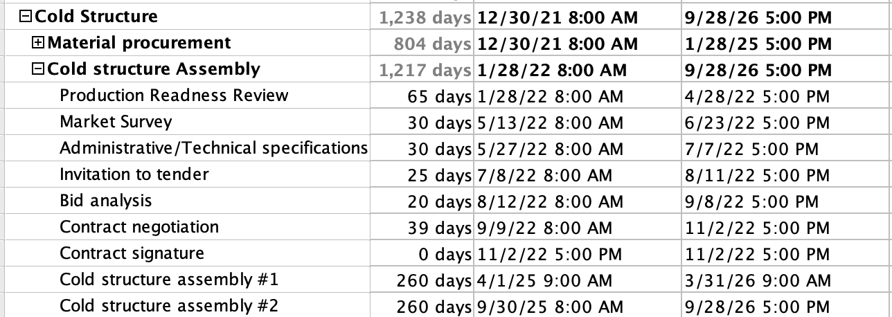
Schedule

Slide 21
MS-4738 results

Slide 22
MS-4738 Results

Slide 23
MS-4738 Results

Slide 24
MS-4738 Results
1 firm qualified from an European non member state

Slide 25


