Slide 1
SNOWMASS PERSPECTIVE WITH
RESPECT TO THE
INSTRUMENTATION FRONTIER
Snowmass IF wiki: https://snowmass21.org/instrumentation/start
Maxim Titov
RD51 Collaboration Meeting, June 16, 2022

Slide 2
The Charge of the Snowmass Process (2020-2022)
“define the most important questions in the field of particle physics and identify
promising opportunities to address them.”
Long-term planning exercise for the particle-physics community
→ Develop community long-term physics aspirations
→ Communicate opportunities for discovery in particle-physics to broader
community and to the (US) government
Physics-driven effort
→ Covers all areas of particle physics and facilitates cross-cutting
→ Develop overarching physics studies
Global context
→ Input from non-US community is essential
→ Input from recent international studies, for example HL-LHC, European
Strategy Particle Physics Update (ESPPU), future colliders, ECFA Detector
R&D Roadmap Panel, etc …
Timescale:
→ Planning for 2025-2035 with a view toward 2050
→ Sponsored by Division of Particles and Fields of the American Physical Society

Slide 3
Past Snowmass (2013) and P5 (2014) Efforts
Snowmass (2013): new successful model
Energy Frontier
Intensity Frontier
Cosmic Frontier
Cross-cutting groups: Facilities, Instrumentation, Computing, Theory, Communication.
Report: https://www.slac.stanford.edu/econf/C1307292/
P5 (2014): identified five science drivers
Use the Higgs boson as a new tool for discovery.
Pursue the physics associated with neutrino masses.
Identify the new physics of dark matter.
Understand cosmic acceleration: dark energy and inflation.
Explore the unknown: new particles, interaction, and physical principles.
Report: https://www.usparticlephysics.org
Using Snowmass’s scientific input and budget scenarios provided by US DOE, P5 developed and presented to DOE, via HEPAP, a 10-year execution plan, with priorities & recommendations, for the field in the US, with an eye also towards the 10 years after
P5 has a broad mandate but tends to focus on large projects and facilities

Slide 4
The Range of Snowmass Discussions (2020-2022)
There are ten Snowmass Frontiers spanning (with Liaisons in-between)
Five scientific areas of particle physics addressing fundamental questions about the universe
→ Accelerator Frontier
→ Cosmic Frontier
→ Energy Frontier
→ Neutrino Frontier
→ Rare Processes and Precision
Four complementary areas which enable scientific work
→ Computational Frontier
→ Instrumentation Frontier (in this talk)
→ Theory Frontier
→ Undergrounds Facilities
And Community Engagement Frontier addressing the community development needed to maintain a vibrant profession and to engage with society

Slide 5
Instrumentation Frontier and Liaisons Among Frontiers
Instrumentation Frontier – Topical Groups & Conveners:
Liaisons provide high-level and bi-directional communication b/w Frontiers:
(between Instrumentation and Other Frontiers)

Slide 6
IF1 Quantum Sensors
IF3 Silicon Tracking &
Vertexing
Snowmass 2021: Quantum Sensors for HEP Science - Interferometers, Mechanics, Traps, and Clocks: https://arxiv.org/abs/2203.07250
Quantum Sensors for high precision measurements of spin-dependent interactions: https://arxiv.org/abs/2203.09488
Simulations of Silicon Radiation Detectors for High Energy Physics Experiments: https://arxiv.org/abs/2203.06216
Novel Sensors for Particle Tracking: a Contribution to the Snowmass Community Planning Exercise of 2021: https://arxiv.org/abs/2202.11828
4-Dimensional Trackers:
https://arxiv.org/abs/2202.13900
Integration and Packaging: https://arxiv.org/abs/2203.06093
Mechanics, lightweight materials, cooling: authors expect to submit soon
Monolithic Active Pixel Sensors on CMOS technologies: https://arxiv.org/abs/2203.07626
IF2 Photon Detectors
Future Advances in Photon-Based Neutrino Detectors: https://arxiv.org/abs/2203.07479
Photon counting from the vacuum ultraviolet to the short wavelength infrared using semiconductor and superconducting technologies: https://arxiv.org/abs/2203.12542

Slide 7
IF4 TDAQ
IF5 MPGDs
Innovations in trigger and data acquisition systems for next-generation physics facilities:
https://arxiv.org/abs/2203.07620
Readout Technologies for Future Detectors:
https://arxiv.org/abs/2203.14894
Physics Community Needs, Tools, and Resources for Machine Learning:
https://arxiv.org/abs/2203.16255
Applications and Techniques for Fast Machine Learning in Science:
https://arxiv.org/abs/2110.13041
MPGDs: Recent advances and current R&D: https://arxiv.org/abs/2203.06562
Micro Pattern Gaseous Detectors for Nuclear Physics: https://arxiv.org/abs/2203.06309
Recoil imaging for dark matter, neutrinos, and physics beyond the Standard Model: https://arxiv.org/abs/2203.05914
MPGDs for TPCs at future lepton colliders: https://arxiv.org/abs/2203.06267
MPGDs for tracking and Muon detection at future high energy physics colliders: https://arxiv.org/abs/2203.06525

Slide 8
IF5 (MPGDs) White Papers & Letter of Interests
IF05 WP1: MPGDs: Recent Advances and Current R&D
IF05 WP4: MPGDs for
TPCs at Future
Lepton Colliders
IF05 WP2: MPGDs for Nuclear Physics Experiments
IF05 WP5: MPGDs for
Tracking and Muon Detection
at Future High Energy Colliders
IF05 WP3: Recoil Imaging for DM, neutrino and BSM physics

Slide 9
Dedicated MPGD development facilities: Currently, the majority of MPGD developers and users in the U.S. rely on production facilities and expertise, diagnostic facilities, and standardized readout electronics associated with the RD51 collaboration and CERN. This significantly slows down the R&D cycle and limits the speed of innovation in the US. It also means all production for US-led experiments has to be outsourced.
A U.S.-based MPGD Center of Excellence is needed and would address this issue. We envision a facility similar in nature to the Gaseous Detector Development (GDD) lab at CERN or the SiDet facility at FNAL. Such a facility would benefit both the nuclear physics and particle physics communities in the US. There are also ample opportunities for commercialization and collaboration with industry.
We envision such a facility hosted by one of DOE’s National Laboratories, such as Jefferson Lab or Brookhaven National Laboratory.

Slide 10
IF6 Calorimetry
IF7 Electronics & ASICs
Precision timing for collider-experiment-based
calorimetry:
https://arxiv.org/abs/2203.07286
Materials for Future Calorimeters:
https://arxiv.org/abs/2203.07154
Particle Flow Calorimetry:
https://arxiv.org/abs/2203.15138
Dual-Readout Calorimetry for Future Experiments
Probing Fundamental Physics:
https://arxiv.org/abs/2203.04312
Enabling Capabilities for Infrastructure and Workforce in Electronics and ASICs:
https://arxiv.org/abs/2204.07285
Readout for Calorimetry at Future Colliders:
https://arxiv.org/abs/2204.00098
Electronics for Fast Timing:
https://arxiv.org/abs/2204.00149
Fast (optical) Links:
https://arxiv.org/abs/2203.15062
Smart sensors using artificial intelligence for on-detector electronics and ASICs:
https://arxiv.org/abs/2204.13223
RF Electronics: https://arxiv.org/abs/2204.01809

Slide 11
IF8 Noble Element Detectors
IF08 organized Executive Summary pages instead of white papers. They will be located at: https://snowmass21.org/instrumentation/noble_elements
Pixel readout for noble element time projection chambers
Charge gain for noble element time projection chambers
Light Collection for noble element time projection chambers
Low-threshold TPCs
Enabling directionality and micron precision in noble element time projection chambers
Metastable Fluids detectors
Enhancing physics reach at existing noble element infrastructure
Barium Tagging in Xenon TPCs
Scaling challenges for noble element detectors
Noble element detector characterization and calibration

Slide 12
IF9 Cross-Cutting
& Systems Integration
IF10 Radio Detection
Cryogenic User Facilities for R&D on Noble Liquid Detectors and Low Temperature Devices:
https://arxiv.org/abs/2203.06146
A Facility for Low-Radioactivity Underground Argon:
https://arxiv.org/abs/2203.09734
Test Beam and Irradiation Facilities:
http://arxiv.org/abs/2203.09944
Instrumentation Development for Radio Detection of High-Energy Neutrinos
Large-Format, Transmission-Line-Coupled Kinetic Inductance Detector Arrays for HEP at Millimeter Wavelengths:
https://arxiv.org/abs/2203.15902
More papers of general interest has been submitted to the Snowmass 2021 Proceedings - Instrumentation Frontier: https://snowmass21.org/submissions/if
Several IF Topical Groups need to coordinate sections in their summary reports with Topical Groups in other Frontiers (incl. Energy Frontier)
Plan to organize either TG-level working meetings or IF-wide workshop with other Frontiers’ TGs between now and Seattle

Slide 13
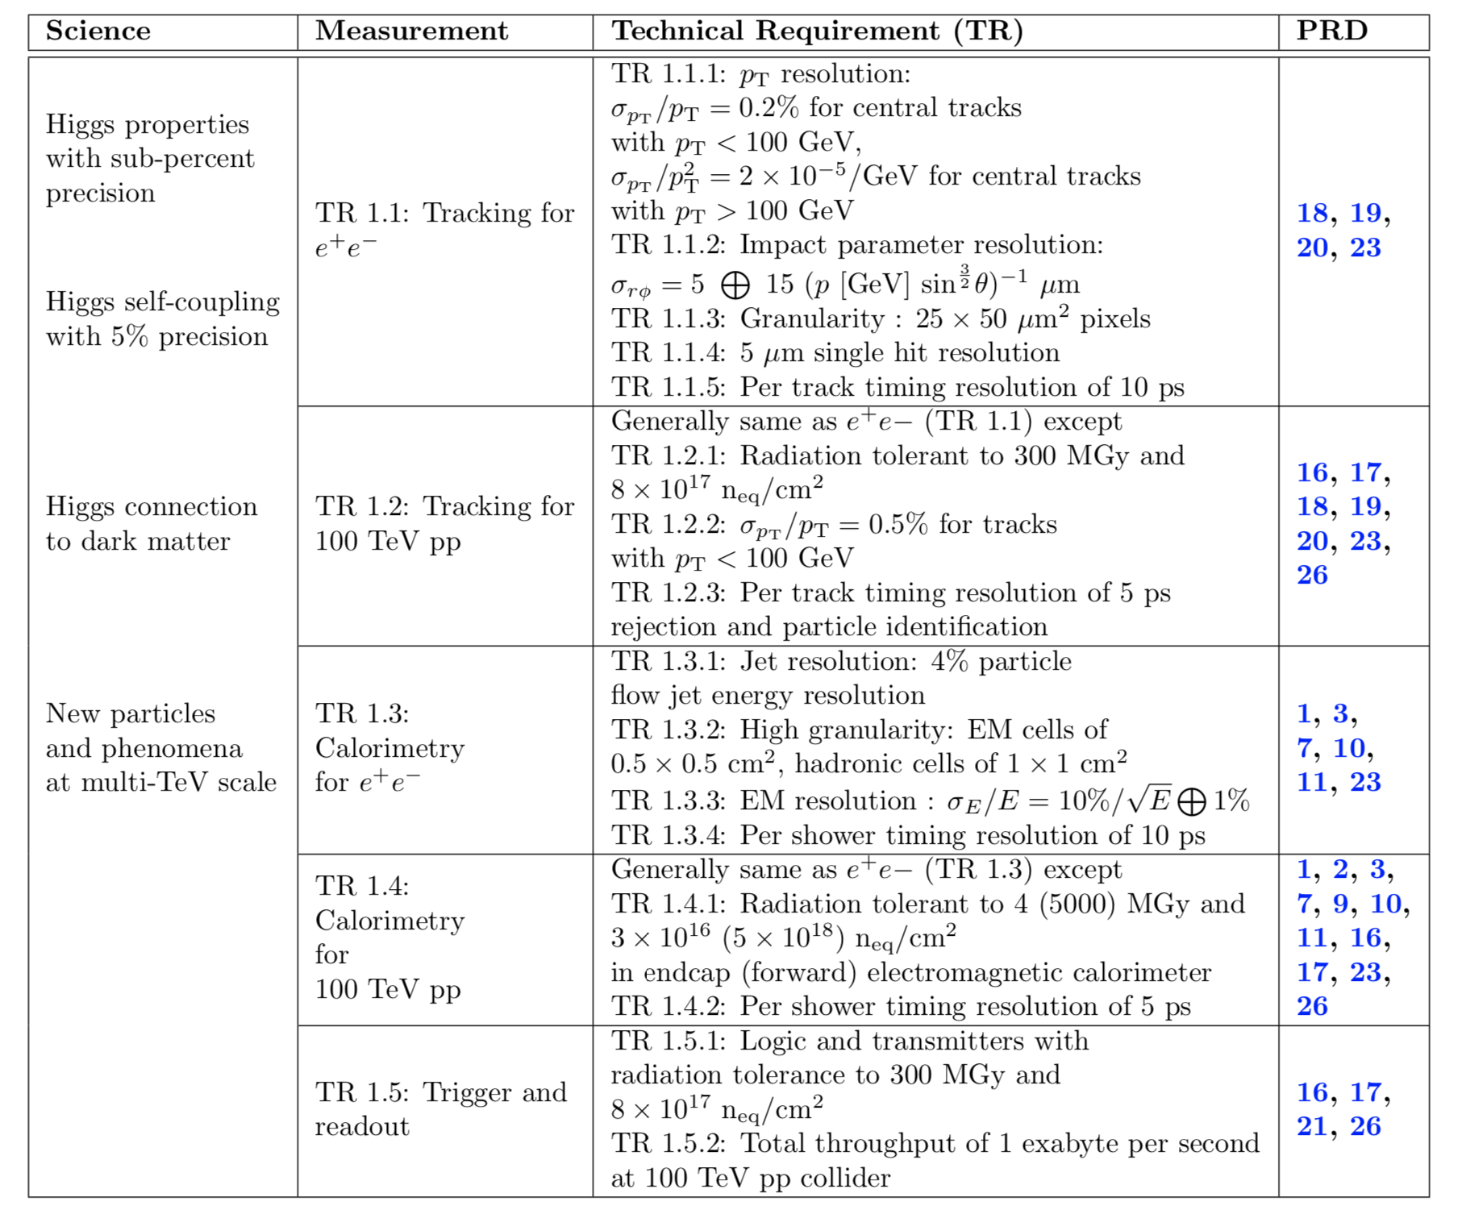
DOE Basic Research Needs Study on HEP
Detector Research & Development in 2019
Guidance and structure of BRN is excellent resource to start and structure future plans →
The BRN has both a physics section to motivate goals and a very detailed technology section
outlining where we are and what is needed: https://science.osti.gov/hep/Community-Resources/Reports
The transformative physics goals include 4 inspiring & distinct directions:
Higgs properties @ sub-%
Higgs self-coupling @ 5%
Higgs connection to DM
New multi-TeV particles
Priority Research Directions for Tracking Detectors:
Create building blocks for Systems-on-Chip for extreme
environments
Adapt new materials and fabrication/integration techniques for particle tracking
Realize scalable, irreducible mass trackers
Achieve on-detector, real-time, continuous data processing and transmission to reach the exascale
Primary Research needs related to Timing Detectors:
Advance calorimetry with spatial and timing resolution and radiation hardness to master high-rate environments
Design new devices and architectures to enable picosecond timing and event separation (for photo-detectors).
Develop high spatial resolution pixel detectors with precise high per-pixel
Time resolution to resolve individual interactions in high-collision-density environments (for solid state detectors).

Slide 14
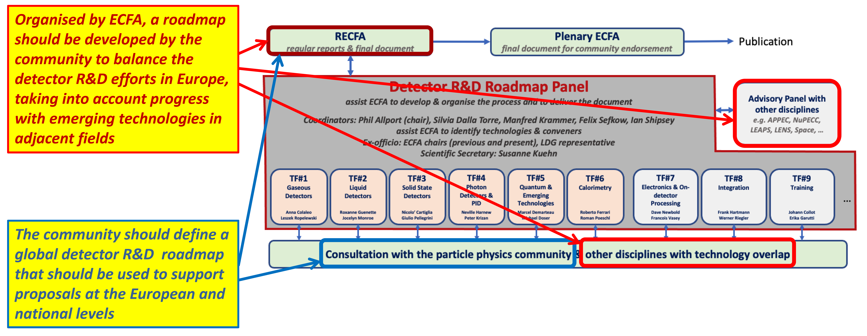
ECFA Detector R&D Roadmap
Focus on the technical aspects of detector R&D requirements given the 2020 EPPSU deliberation document listed “High-priority future initiatives” and “Other essential scientific activities for particle physics” as input and organise material by Task Force.
Task Forces start from the future science programmes to identify main detector technology challenges to be met (both mandatory and highly desirable to optimise physics returns) to estimate the period over which the required detector R&D programmes may be expected to extend.
Within each Task Force create a time-ordered technology requirements driven R&D roadmap in terms of capabilities not currently achievable.
The roadmap
identify and describe
diversified detector
R&D portfolio that
has the largest
potential to enhance
the performance of
the particle physics
programme in the
near and long term.”
Final report released in Dec. 2021: https://cds.cern.ch/record/2784893

Slide 15
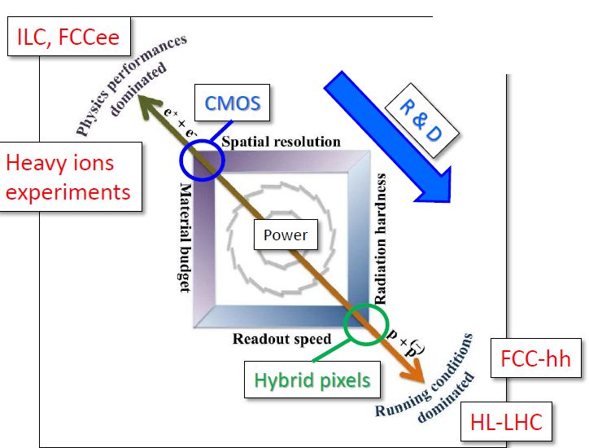
Enabling Technologies for Low-Mass Tracking Detectors
Basic applications are optimized for two different realms of interest : electron and hadron colliders → different optimizations/requirements
(pp: radiation hardness, speed; e+e-: granularity, material budget)
Design problems include: granularity vs the power (particularly for precision timing) and the inactive material to service power and data readout etc. for both accelerator types. Radiation hardness and a strong emphasis on data reduction / feature extraction for the on-detector electronics are particular issues for hadron colliders.
Hadron Colliders:
Hybrid pixel detectors (planar & 3D)
HV/HR-CMOS for outer pixel layers
for HL-LHC upgrades;
LGADs for ps-timing
Lepton Colliders:
CMOS (STAR HFT, ALICE ITS)
DEPFET (Belle II)
Chronopix
SoI
FPCCD
3D-IC (Global Foundries, LAPIX,
TJas,…industries)
Needs: collect requirements for different collider types / experiments
→ IF topically group summary, and more importantly to make sure the
developments in the community meets the experimental need

Slide 16
Enabling Technologies for Picosecond-Timing Detectors
Picosecond-level timing was not the part
of initial HL-LHC detector requirements:
Became available through pioneering R&D
on LGAD / crystals / precise timing with Si:
Fast development of precise timing sensors:
4D pattern recognition for HL-LHC
pile-up rejection: tracking ~O(10’s) μm
& timing detectors ~O(10’s) ps
ps-timing reconstruction in calorimetry
(resolve develop. of hadron showers,
triangulate H → γγ prim. vertices)
TOF and TOP (RICH DIRC) PID →
new DIRC applications (~ 10’s of ps
& 10’s of μm per MIP/pixel)
→ both at hadron / lepton colliders
General push for higher luminosity at
LHC, Belle-II, Panda, Electron-Ion Collid.
→ Fast timing is needed at colliders, fixed
target, and neutrino experiments
Regular PMTs → large area, … but slow
MCP-PMT → fast, but small, and not available in quantities
to over large areas:
→ ultimate time resolution ~ 3.8 ps (single-pixel devices)
→ radiation hardness up to ~ 20 C/cm (HPK, ALD-coated MCP-PMT°
arXiv:
2203.13900
Challenges:
Radiation hardness: LGAD-sensors, 3D-trench Si sensors, …
Large scale applications : system aspects of timing detectors
“5D reconstruction”: space-points / ps-timing are available at
each point along the track → LHCb EoI for LS4 is of general interest across experiments;
LAPPD → large-area ps- PID/TOF for hadron/lepton colliders
Incom Inc. company started to produce LAPPDs → cost still
has to be controlled

Slide 17

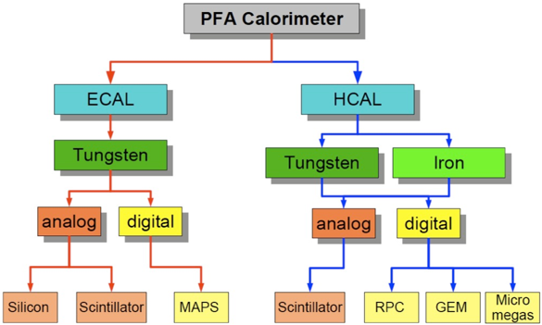
Particle Flow Calorimeters: CALICE Collaboration
Development and study of finely segmented / imaging calorimeters: initially focused on the ILC, now widening to include developments of all imaging calorimeters, e.g. CMS HGCAL for Phase II):
Imaging Calorimetry → high granularity
(in 4D), efficient software (PFA).
Mixture of matured concepts
and advanced ideas:
MATURED (CALICE):
SiW-ECAL
SciW-ECAL
AHCAL
DHCAL (sDHCAL)
→ (Almost) ready for
large-scale prototype
→ Prepare for quick realization
of 4-5 years to real detector
ADVANCED (beyond CALICE):
MAPS ECAL
Dual-readout ECAL
LGAD ECAL (CALICE)
→ Evaluate additional physics
impact to ILC experiment
→ Needs intensive R&D effort
to realize as real detector
Issues: overlap between showers,
complicated topology, sep. “physics
event” from beam-induced bkg.
Example: ILD detector for ILC, proposing CALICE collaboration tech.

Slide 18
Imaging Calorimeters: The 5th Dimension ?
Impact of 5D calorimetry (x,y,z, energy, time) needs to be evaluated more deeply to undertand optimal time acc.
What are the real goals (physics wise)?
Mitigation of pile-up (basically all high rates)
Support for full 5D PFA → unchartered territory
Calorimeters with ToF functionality in first layers?
Longitudinally unsegmented fibre calorimeters
Replace (part of) ECAL with LGAD for
O(10 ps) timing measurement
20 ps TOF per hit can separate
π/k/p up to 5-10 GeV
Timing resolution
Is affected by noise
The added value of timing information is recognized
→ Gain in scientific return of complete analysis still to be quantified
(Tracking PID ? Calorimetry PID ? Shower development ? )
Trade-off between power consumption
and timing capabilities (maybe higher noise level)
Timing in calorimeters / energetic showers?
→ intelligent reconstruction using O(100) hits &
NN can improve “poor” single cell timing
→ can help to distinguish particle types:
usable for flavour tagging (b/c/s),
long-lived searches (decaying to neutrals) ,
enhance σ(E) / E
sDHCAL R&D: improved timing with
replacement of RPC with MRPC → O(20-100) ps

Slide 19
Advanced Concepts in TRIGGER and DAQ (TDAQ)
Massive amounts of data coming of upgraded and next generation experiments
Optical data transmission is key in
readout modern HEP detectors:
Current links at 10 Gb/s, and limited to 5 x 10¹⁵ n_{eq}/cm², 100 Mrad in radiation tolerance;
→ current state-of-the art – VCSEL;
Silicon photonics for optical conversion and multiple amplitude modulation can provide high bandwidth;
Wireless transmission (60 GHz), could allow on-detector data reduction (e. g. for trigger readout of trackers) → promising upcoming alternative
Trigger Architecture:
multi-layered (event building, event processing);
triggerless, multi-level trigger;
Trigger Tools:
→ ASICs, ATCA, FPGA, CPU, GPU
General trend: progressive replacement of the
complex multi-stage trigger system with a single
level trigger system and a large farm of Linux
computers for the final online selection:
ATLAS TDAQ → single-level hardware trigger
(max. rate 1 MHz and 1 um latency);
ALICE and LHCb will be triggerless (no hardware
trigger) after LHC Phase I upgrade

Slide 20
Snowmass 2021: Timeline for Snowmass Book
March 15: Contributed papers (a.k.a. White Papers)
May 31: Preliminary Topical Group Reports
June 30: Preliminary Frontier Reports
July 17 – 26: Converge on reports for all the frontiers and produce executive summaries representing the views of their communities and providing the basic input needed for P5
September: draft Executive Summary and Report Summary
October- November: Snowmass Book finalized and ready for submission

Slide 21
Snowmass Community Summer Study Workshop
July 17-26, 2022 at the University of Washington, Seattle
→ http://seattlesnowmass2021.net/
→ The frontiers were asked to propose topics that they particularly wanted
to communicate to the whole community
I : Long plenary for Primary presentation of the Frontiers (10)
S : Shared session (two topics in parallel. Secondary presentations by Frontier (5x2)
G : General topic (not specific to any frontier) (10)

