Slide 1
Diamond-like carbon coatings for cryogenic operation of particle detectors
S. Leardini, Y. Zhou, A. Tesi, M. Morales, D. González-Díaz, A. Breskin, S. Bressler, L. Moleri, V. Peskov
13/06/2022

Slide 2
Background
spark-quenching
Needs in detectors with HV
Solution –> resistive materials
adjusting the charge-induction profile from moving charges to improve space
resolution in tracking detectors
reducing local charging-up
Too conductive -> problem not solved
Too resistive -> charging-up + field deformation

Slide 3
Objective
Find a suitable material for spark-quenching operating at LAr temperature -> candidate: DLC
Right range of surface resistivity: 10-100 Mohm / sq
Characterize such material and model its behavior with temperature

Slide 4
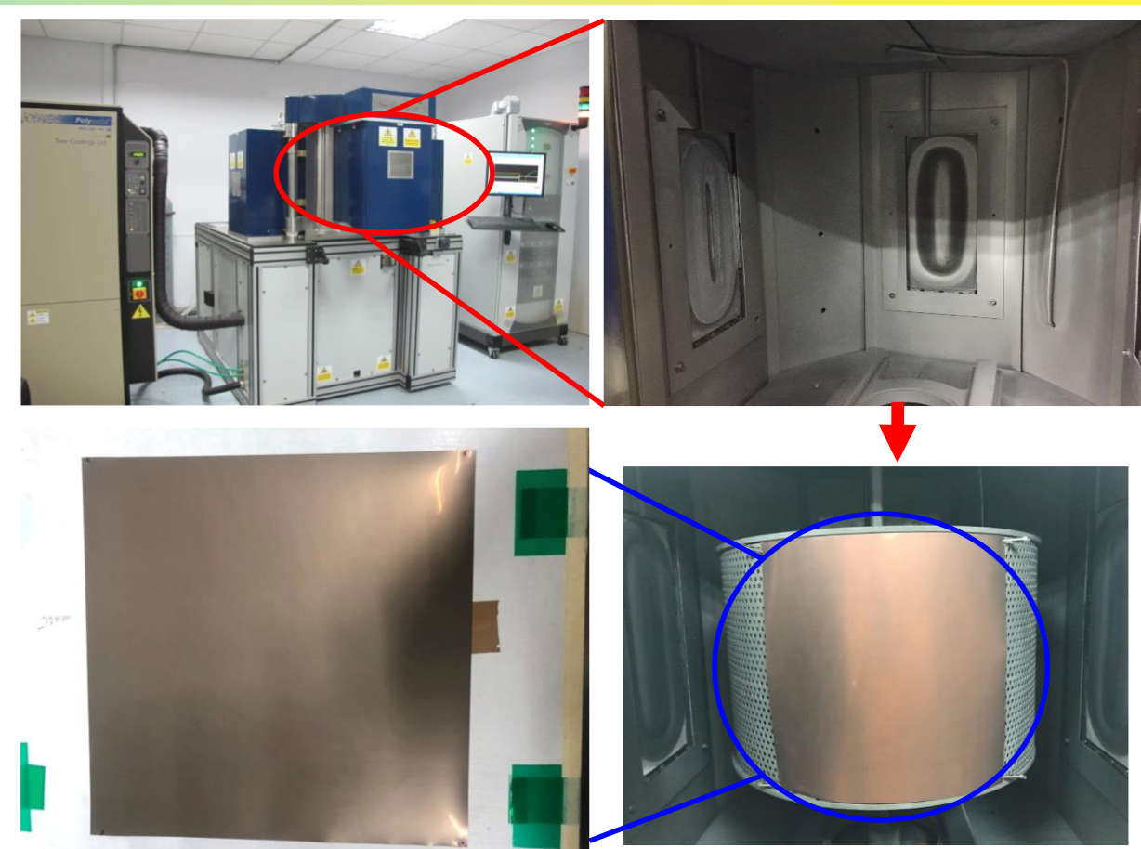
Material - 1
- DLC produced at the University of Science and Technology of China
deposition through magnetron sputtering
Procedure: - substrate kept in oven @ 70ºC
- surface cleaned with ethanol
- vacuum @ 10^-5 mbar
- deposition (20-60 min)
From talk by Yi Zhou: https://indico.cern.ch/event/852331/contributions/4611238/attachments/2367150/4042458/Resistive%20Detectors%20with%20DLC.pdf

Slide 5
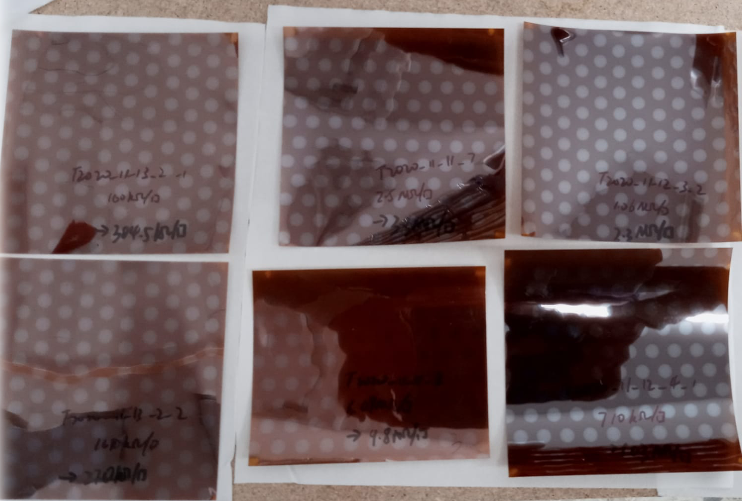
Material - 2
- 6 different samples with kapton substrate (named A-F), 2 with FR4 substrate (named “a” and “f”)
~ 10 x 10 cm

Slide 6
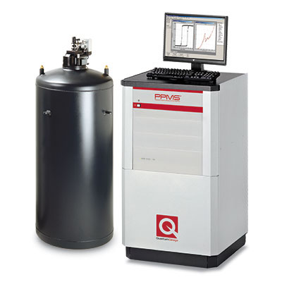
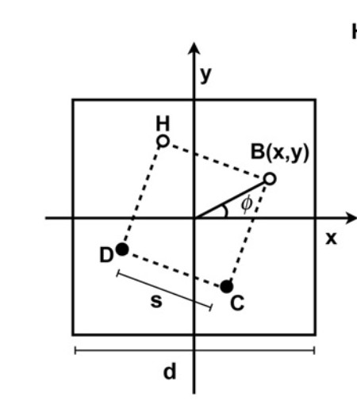
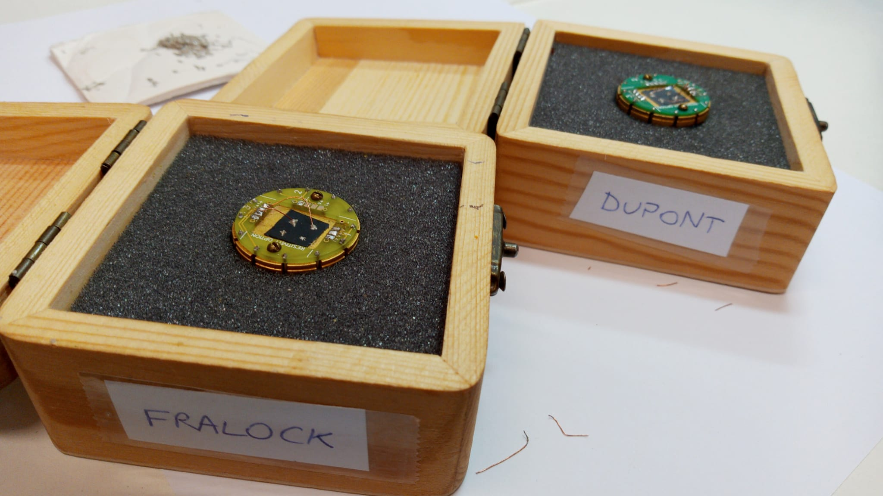
Cryogenic setup - 1
- First measurements done with “Physical property
measuring system” (PPMS)
- Able to ensure thermal equilibrium for all the
temperatures
- Measured sample ”A” (4 different ~ 1 x 1 cm regions)
with 4-point probe
- Able to cover only up
to 30 Mohm/sq
I Miccoli et al 2015 J. Phys.: Condens. Matter 27 223201

Slide 7
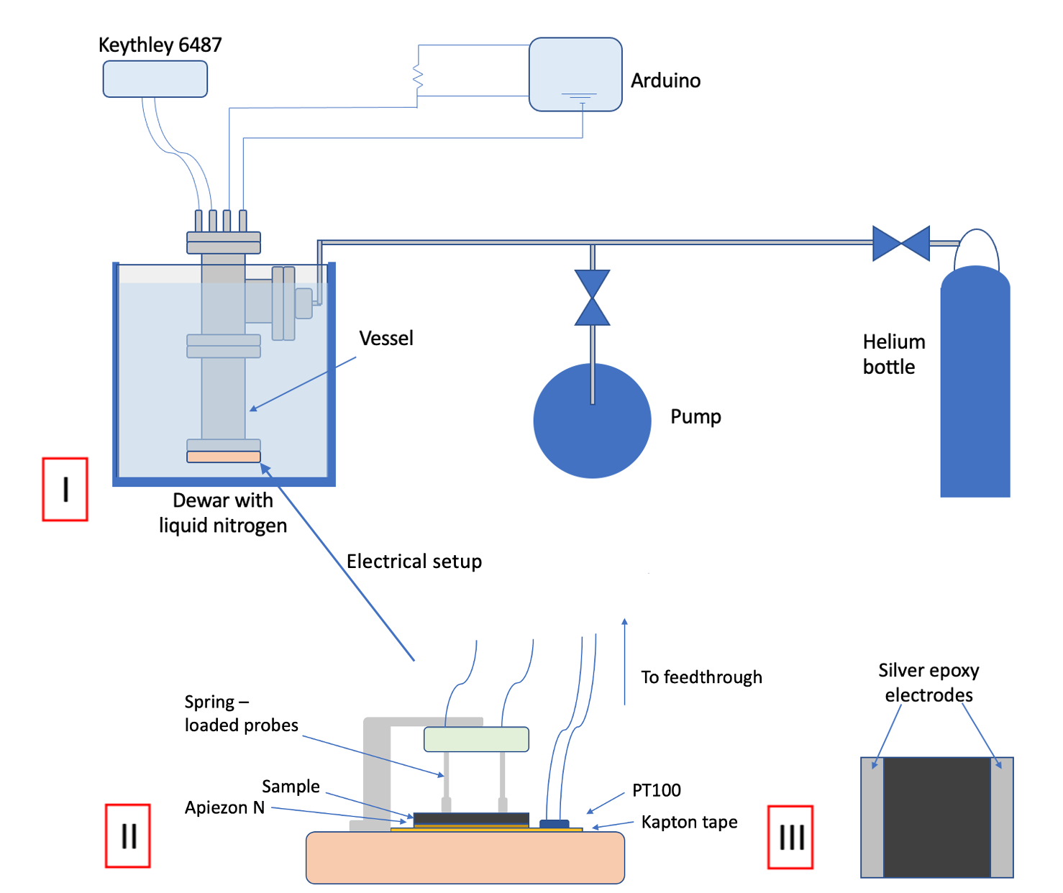
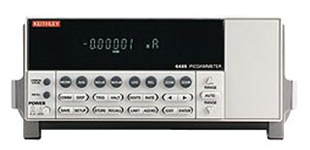
Cryogenic setup - 2
Home- made cryostat
Able to measure all the range
of resistivities

Slide 8
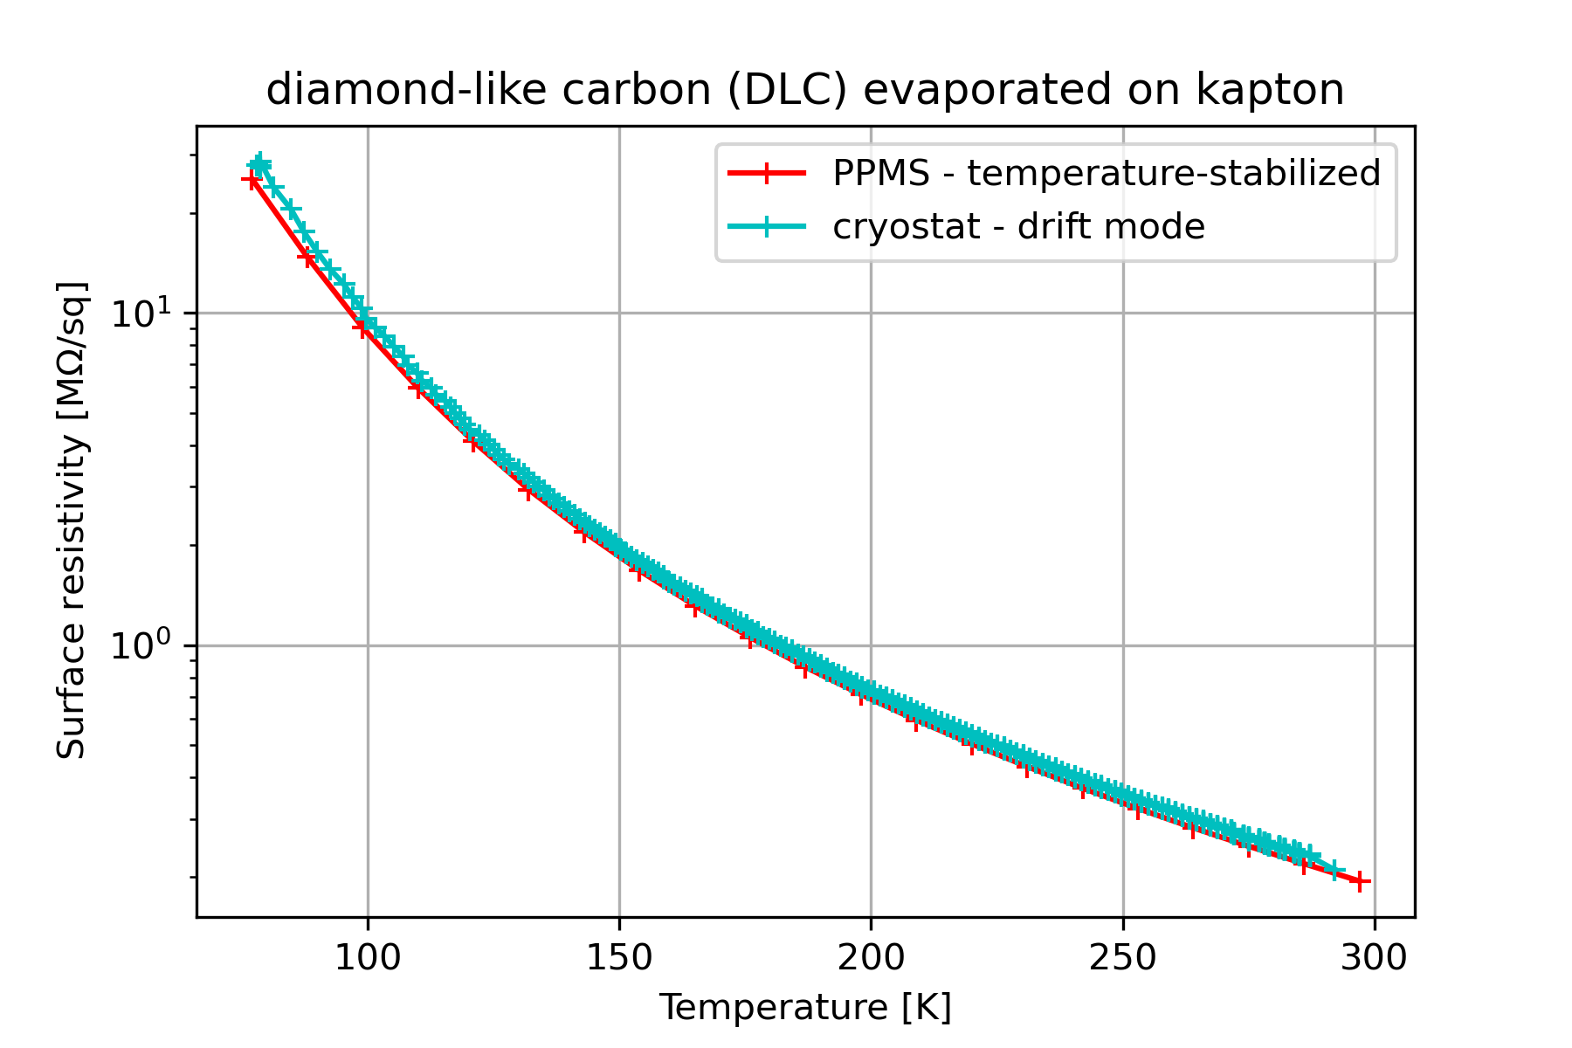
Commissioning
10% agreement

Slide 9
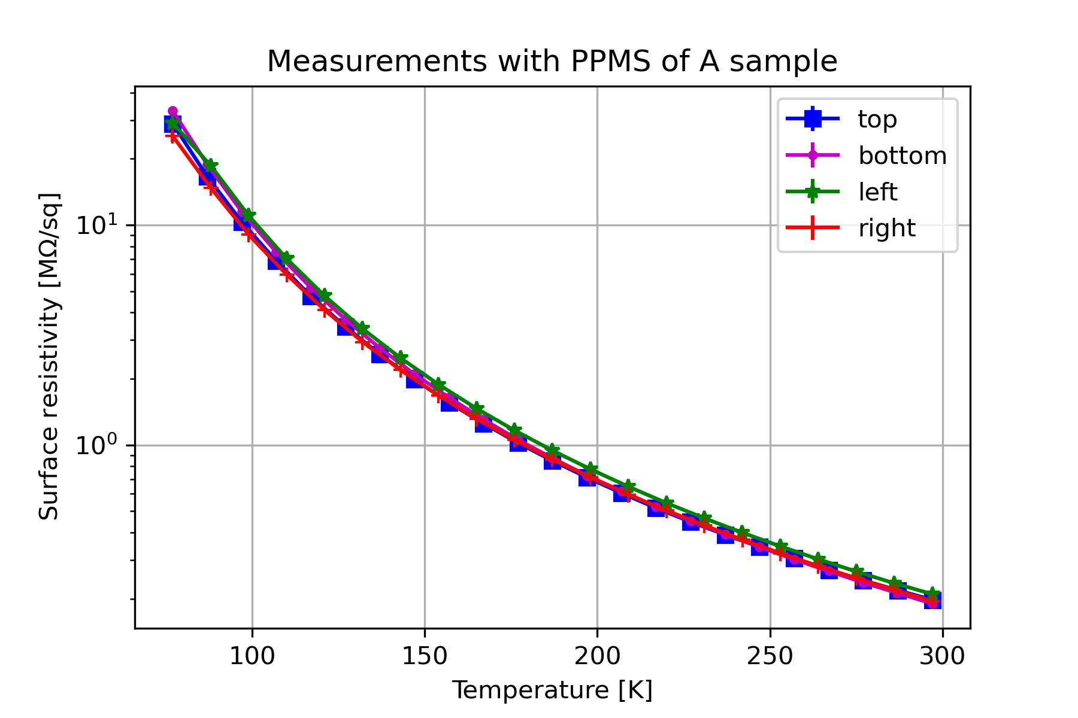
Uniformity (with PPMS)
20% variation

Slide 10
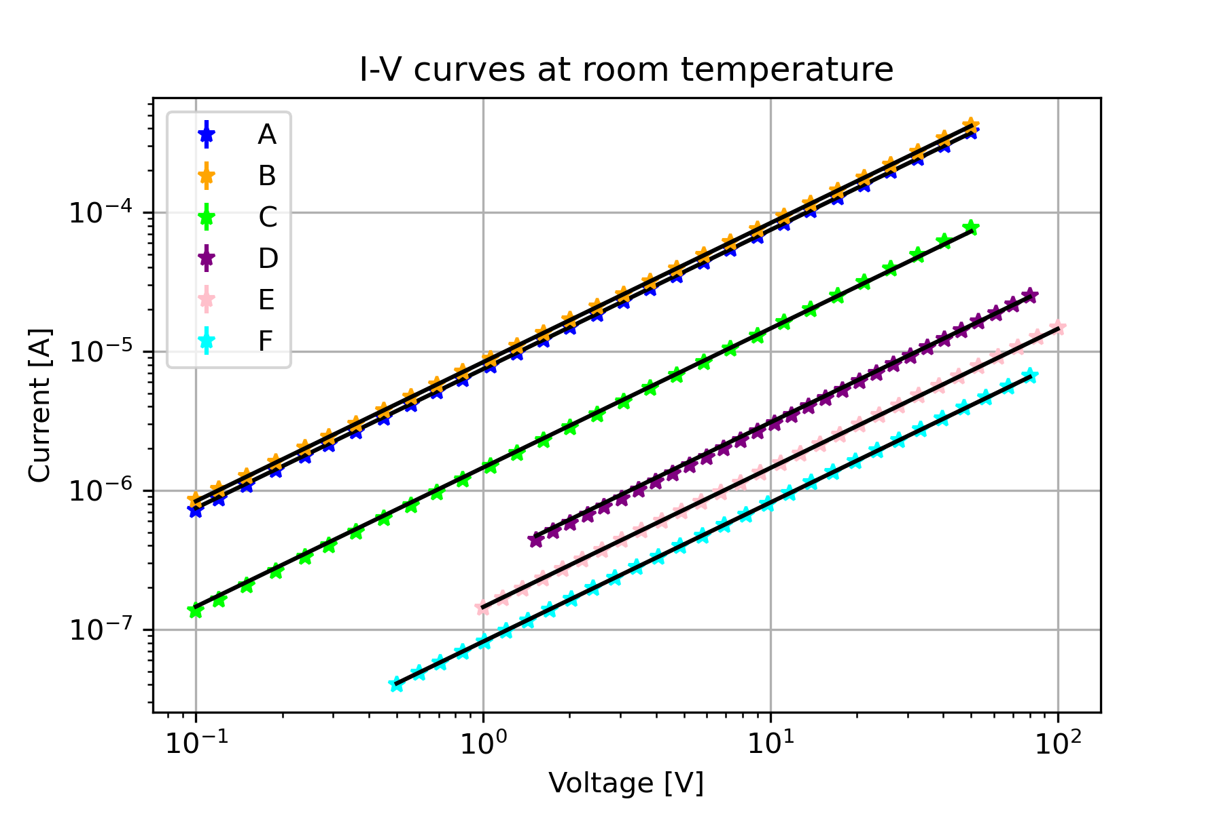
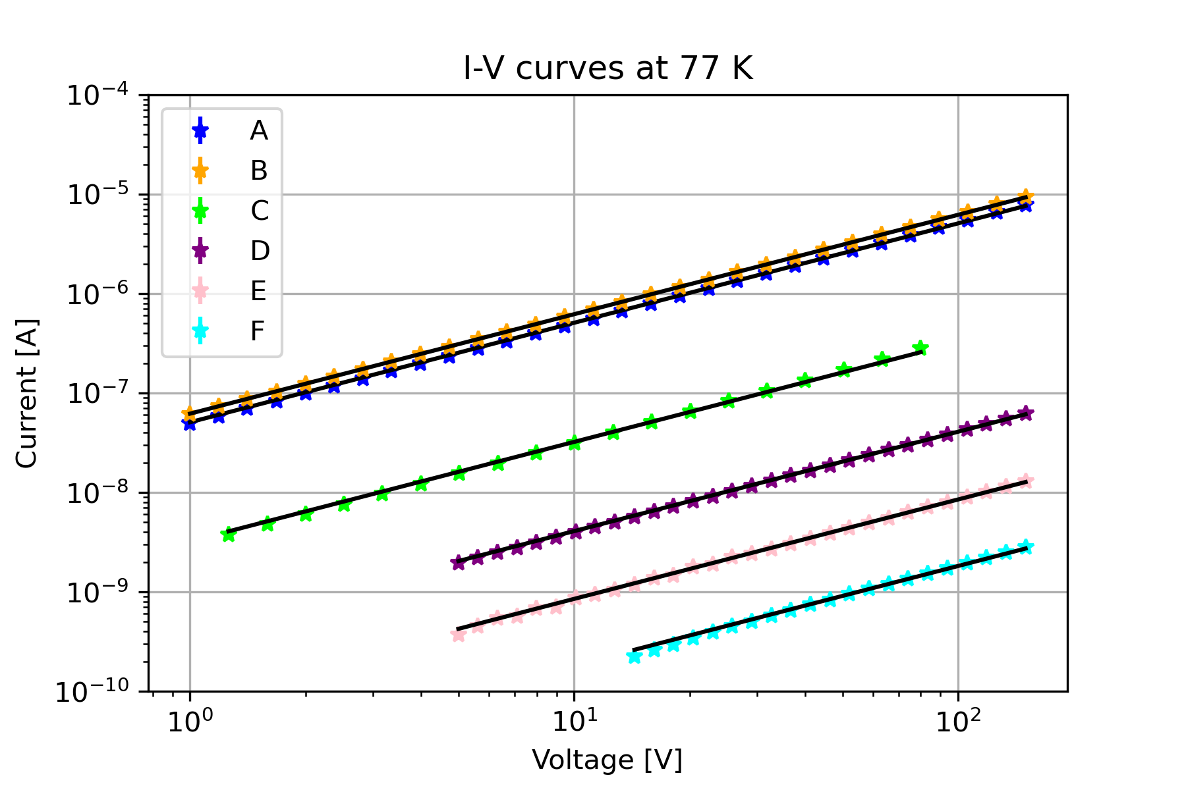
Linearity

Slide 11
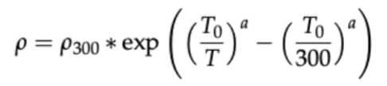
R-T curves (modeling) - 1
2 R-T curves taken for each sample
Global fit to all the samples with the function
with parameter T common for all the samples
0

Slide 12
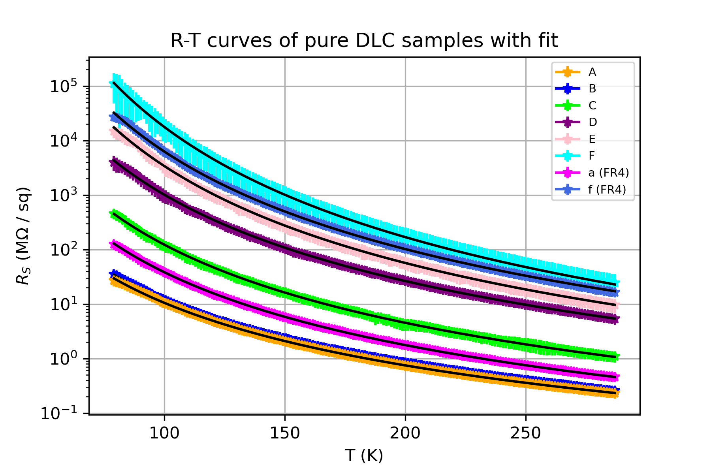
R-T curves (modeling) - 2

Slide 13
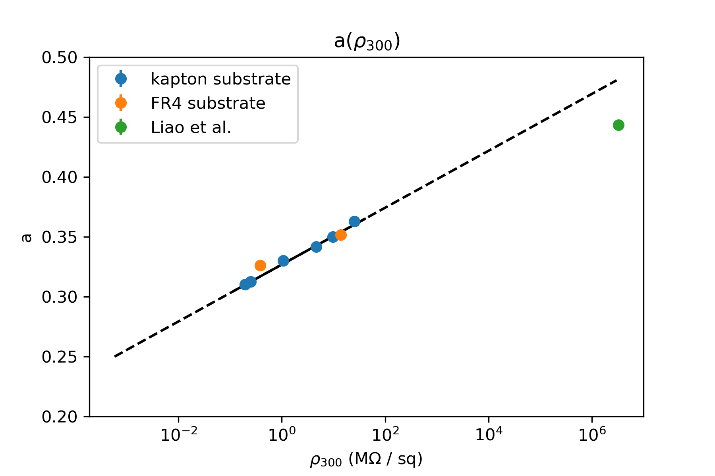
R-T curves (modeling) - 3
Expressed “a” as a function of rho_300, logarithmic relation
- Expected value for “a” according to variable- range hopping model: 1/4

Slide 14
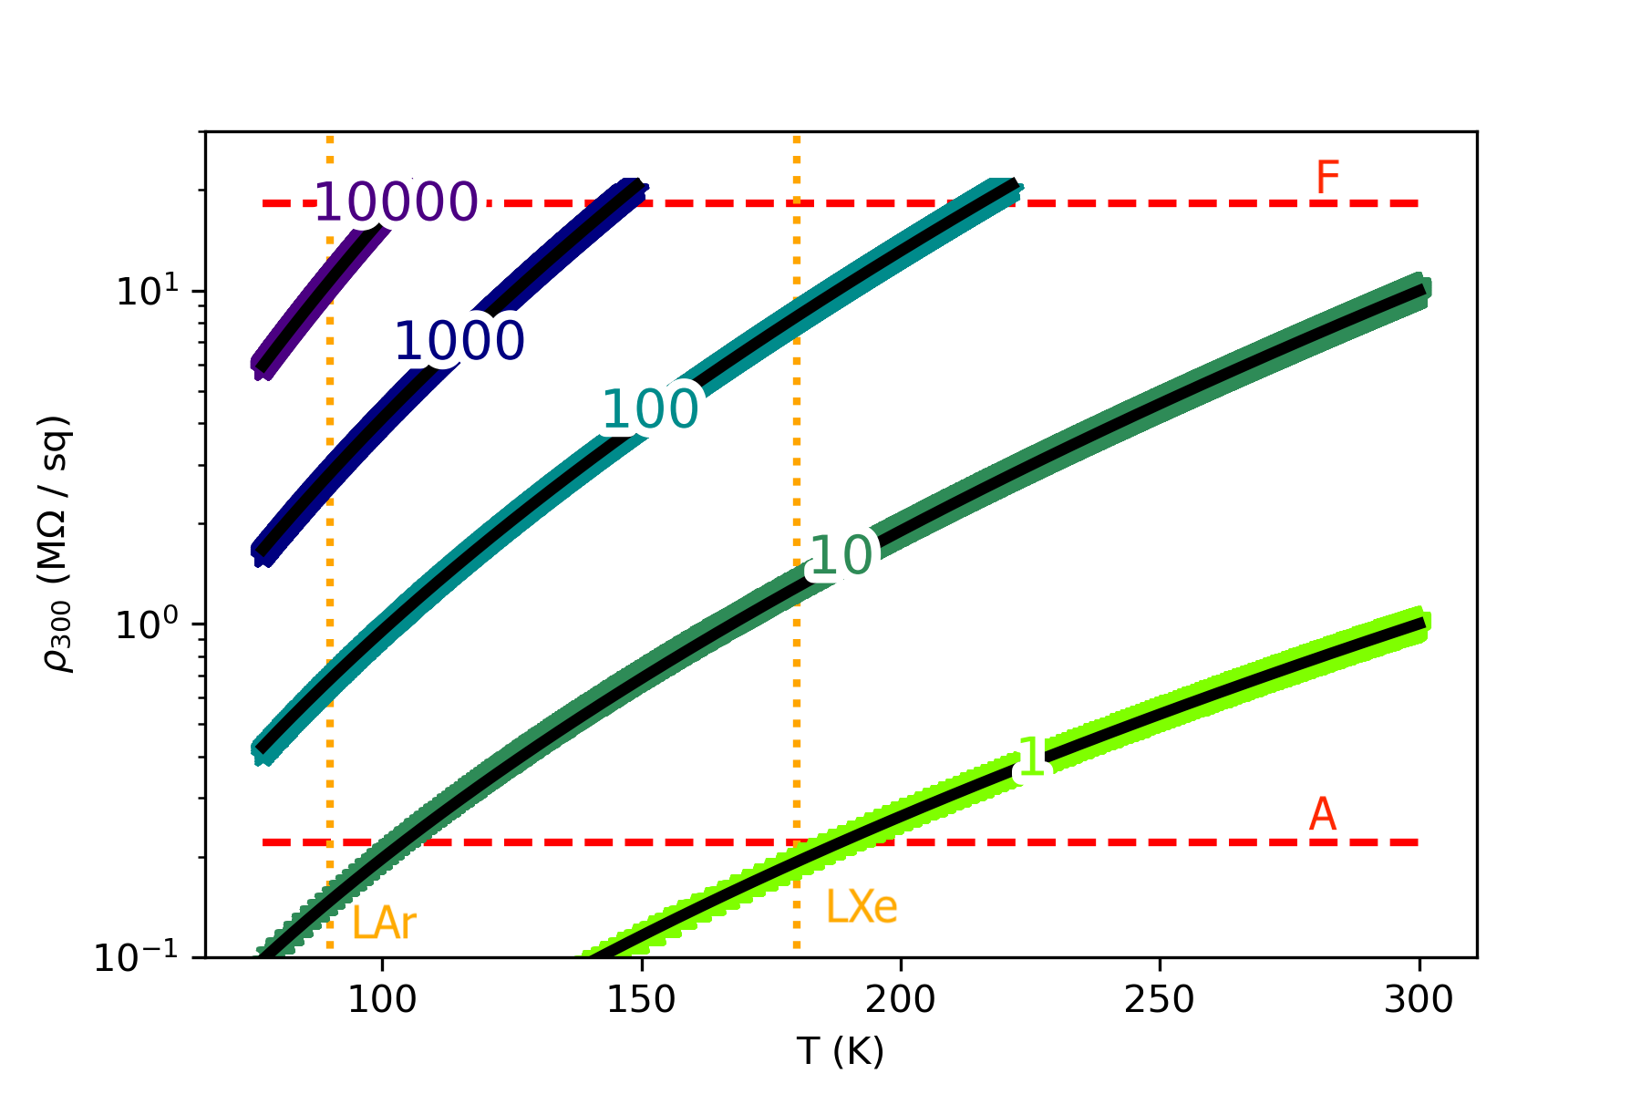
R-T curves (modeling) - 4
produced many curves and inverted the fitting function numerically
Got iso-resistivity curves to select the initial rho_300 if we wish some resistivity at a certain temperaure

Slide 15
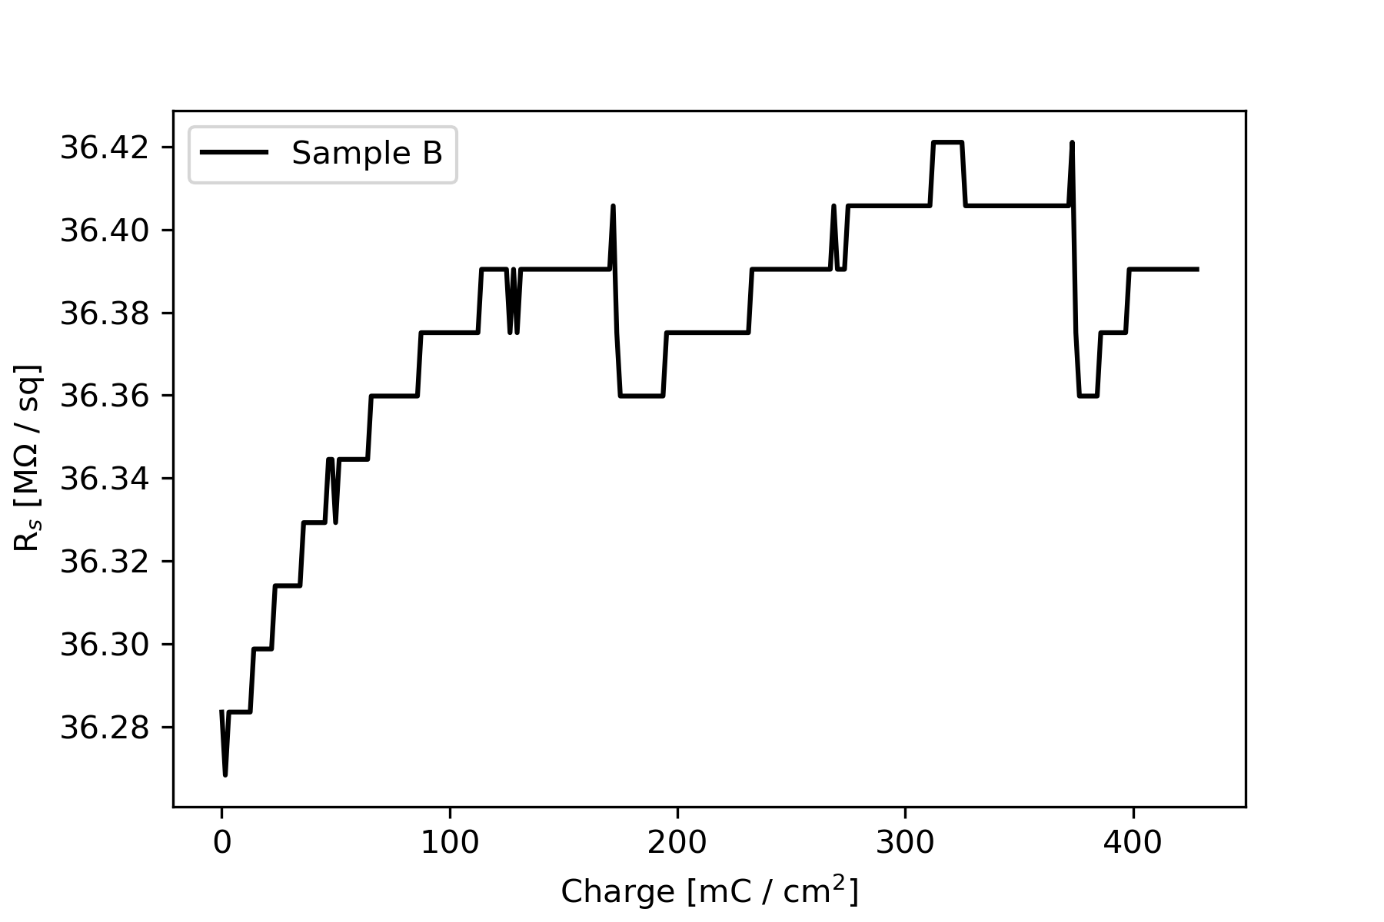
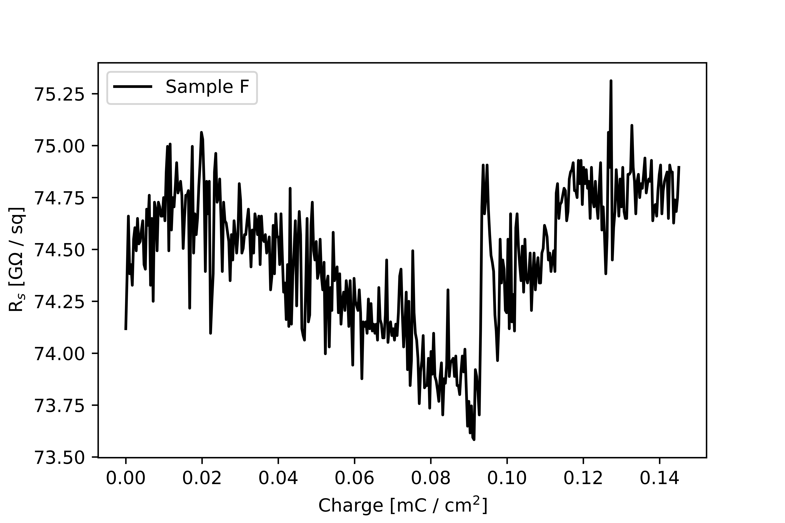
Aging
RT : no aging effect after transporting > 2 C / cm^2
LN : < 2% variations
DUNE Far Detector (assuming Ar background, gain =100):
60.5 μC/cm2 in 10 years
-variations < factor of 2 in > 1 year
-no effect of humidity

Slide 16
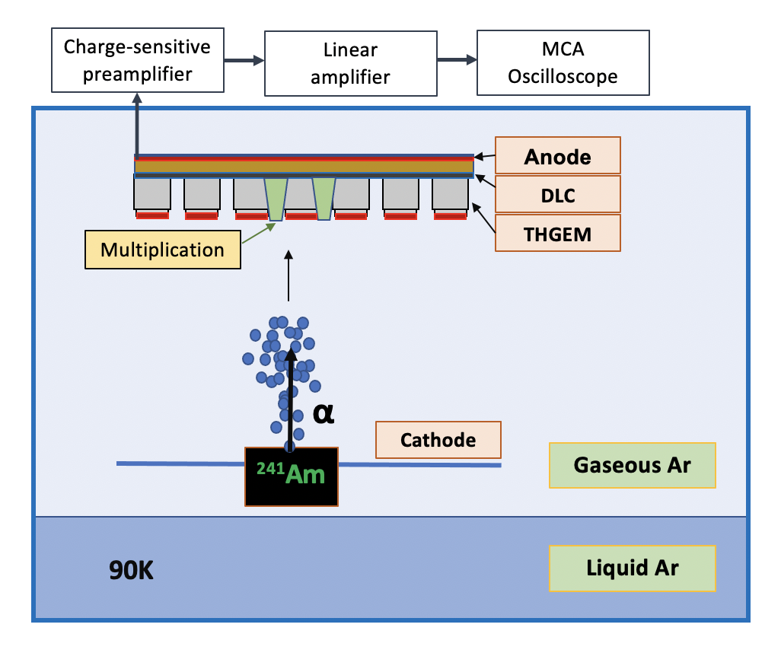
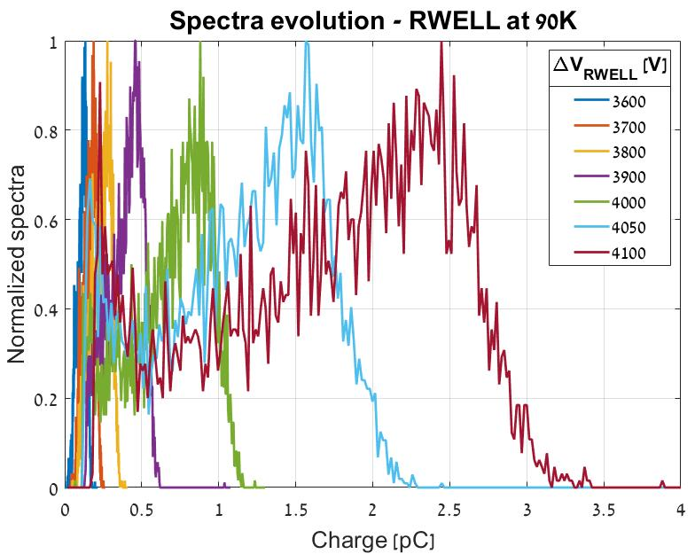
Test in detector (RWELL) – 90 K
Charge multiplication occurring inside the detector in a stable manner!

Slide 17
Conclusions
- We characterized the DLC material produced at the University of Science and Technology of China focusing on uniformity, linearity, behavior with temperature and aging
The material is well – behaved in all these aspects, looking a very promising material to operate in a detector at LAr temperature (and in all the range up to RT in fact)
We made a predictive parametrization that may facilitate the production of new DLC samples with a desired resistivity at any temperature
We managed to operate a detector at 90 K with a DLC layer obtaining charge multiplication in a stable manner

Slide 18
Thanks for your attention!

