Slide 1
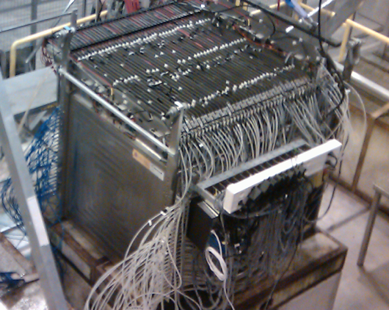
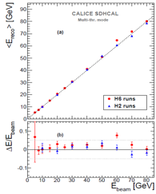
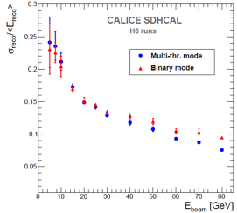
SDHCAL
I. Laktineh
On behalf of
the CALICE SDHCAL groups
48 layers
1 cm X 1 cm granularity
≅ 3-threshold, 500000 channels
Power-Pulsed
Triggerless DAQ system
Self-supporting mechanical structure
JINST 10 (2015) P10039
JINST 11 (2016) P04001
JINST 15 (2020) P10009

Slide 2
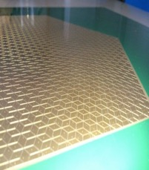
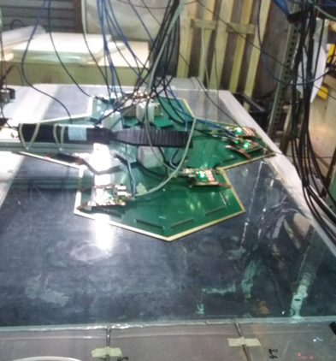
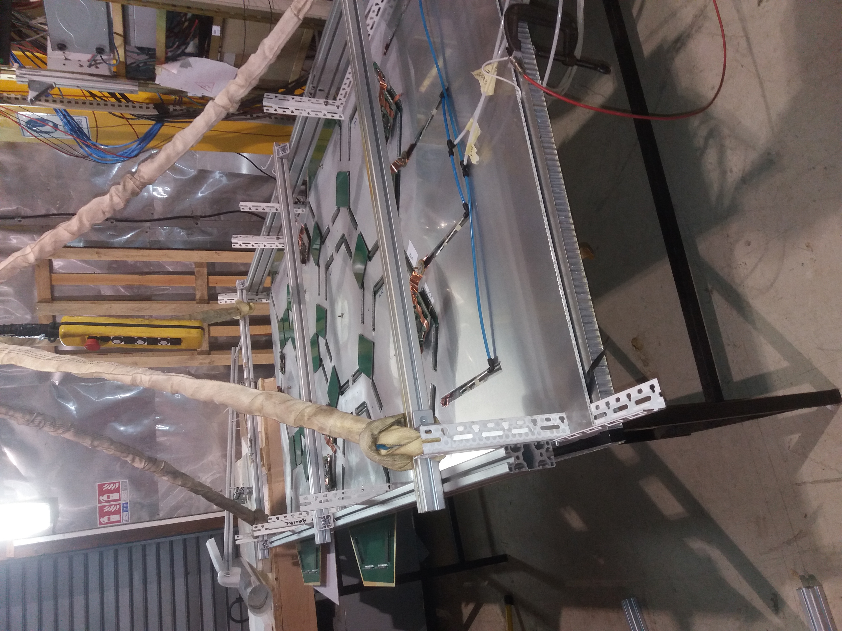
Beam Test goals
Main goals:
Apply a new calibration scheme (based on equalizing the response by applying different threshold value/ASIC) in order to improve on the SDHCAL response homogeneity.
Study the difference of hadronic showers produced by protons, pions and kaons
in order to exploit their differences in developing new PID techniques.
Other goals:
Test SDHCAL with SiW ECAL
Test the woven strips scheme
Test first timing-SDHCAL layers (AiDAInnova)
Test µWell chambers as active layers by replacing
a few GRPC
Beam requirements:
- Muons
Pions, kaons, protons, from 10 to 90 GeV
(pure hadrons)
Low intensity beam ( < 1000 particle/cm2/spill)
Polarity: positive

Slide 3
Additional requests:
Mandatory:
- 2 Cerenkov detectors for particle identification
Necessary:
Moveable table (Nikhef one)
Help from gas group (TFE, CO2, SF6)

