Slide 1



Baryon number, strangeness, and electric charge fluctuations in hydrodynamics at LHC high energy collisions
Christopher Plumberg, Dekrayat Almaalol , Travis Dore , Debora Mroczek , Patrick Carzon , Jordi Salinas San Martin, Lydia Spychalla , Matthew Sievert, Jacquelyn Noronha-Hostler
(Theory: Arxiv.2209-11210- Phenomenology: Arxiv.2311-xxxx)
University of Illinois at Urbana-Champaign
The 30th International Conference on Ultra-relativistic Nucleus-Nucleus Collisions
UH (Sep 03-09), HOUSTON, TEXAS

Slide 2

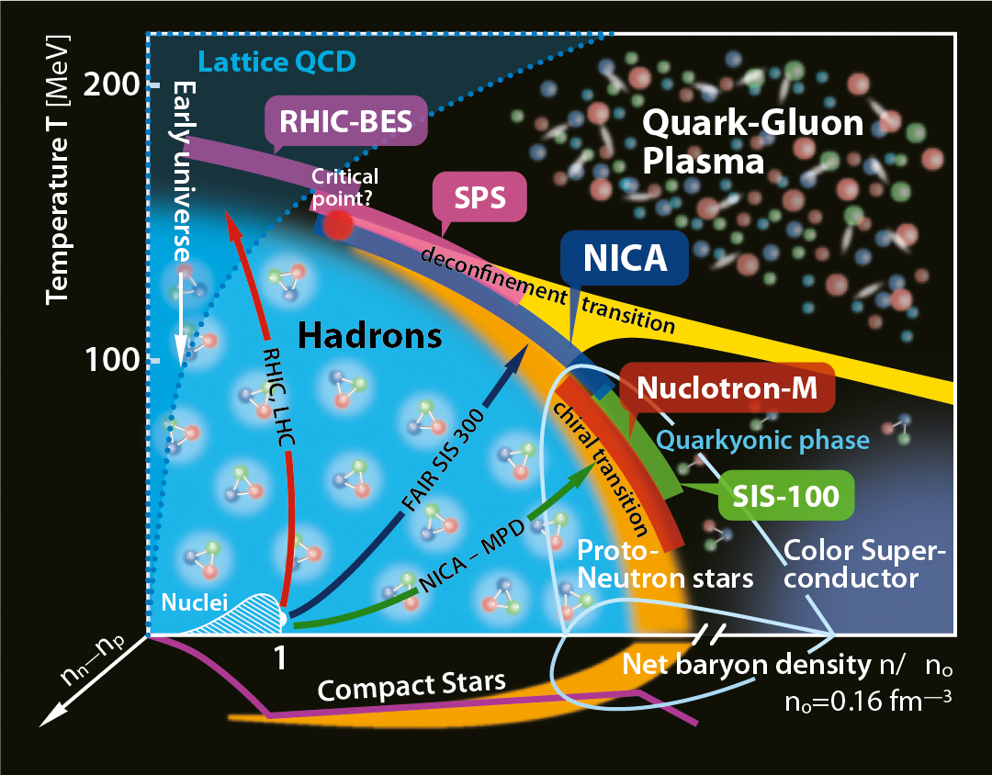
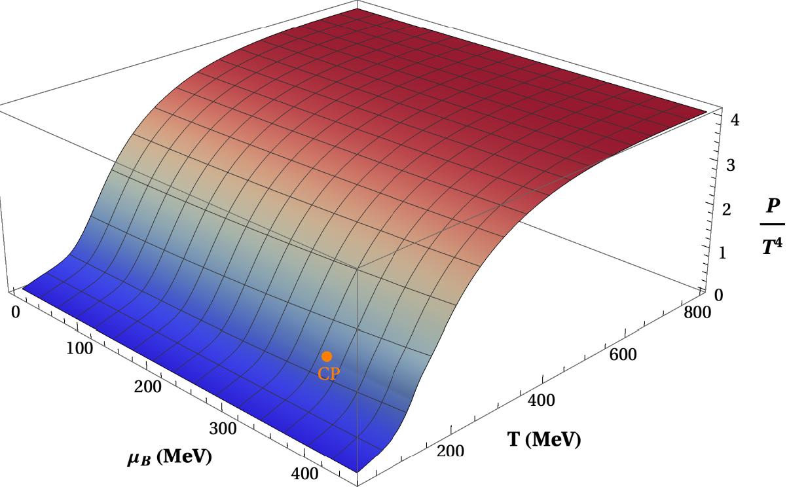
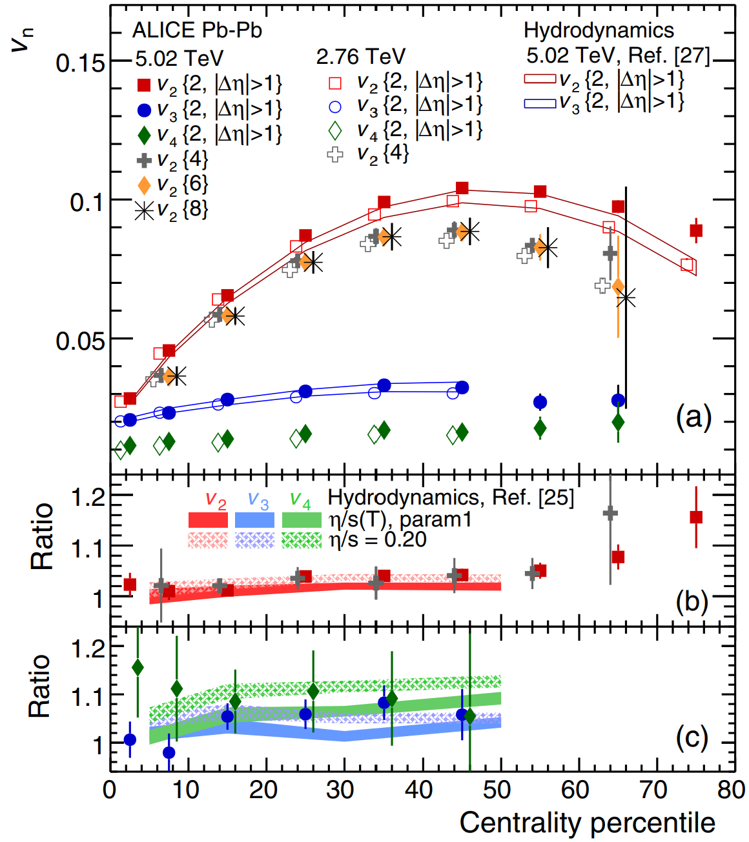
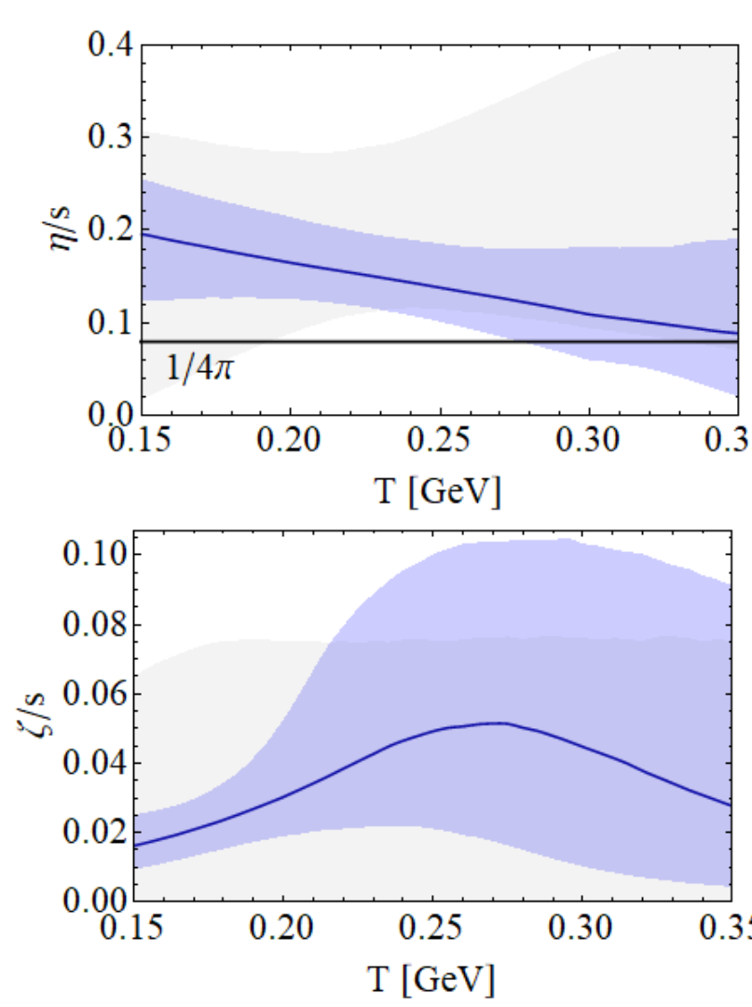
Big picture| Heavy ion simulations and the QCD matter properties
Notes:
Correct reference for hydro?

Slide 3
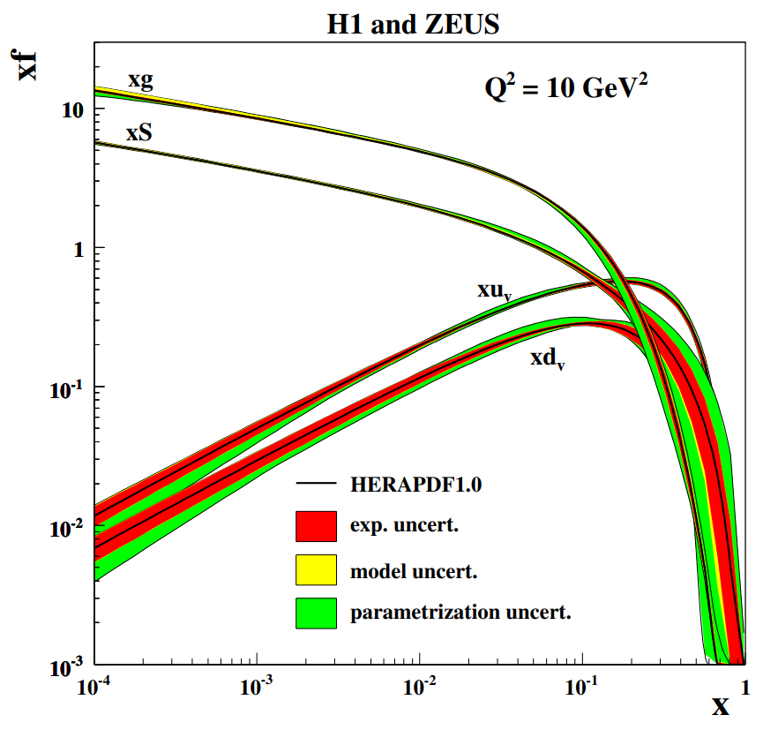

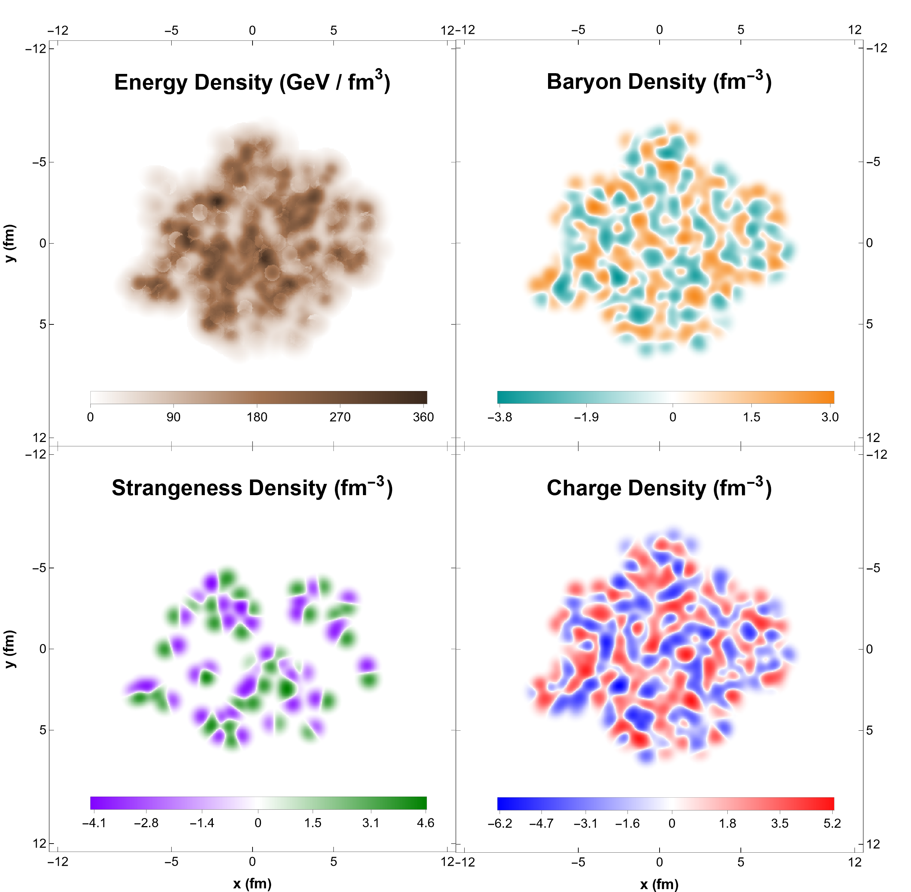

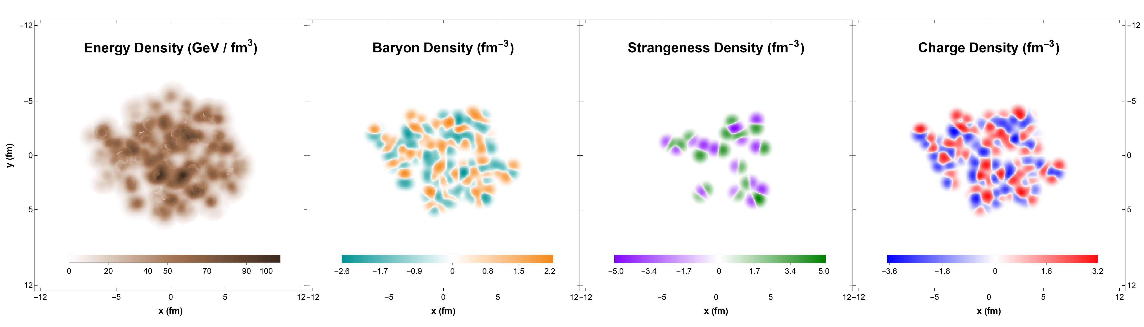

An opportunity | local charge fluctuations at LHC energy
Notes:
Initial
Conserved Charges in Nuclear Geometry

Slide 4
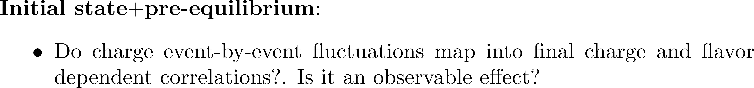
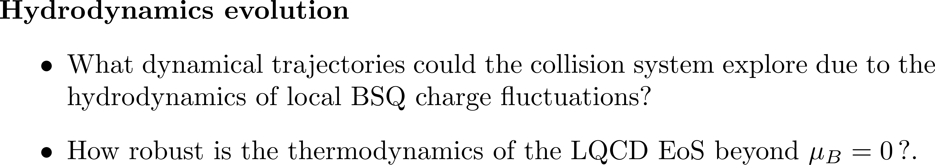
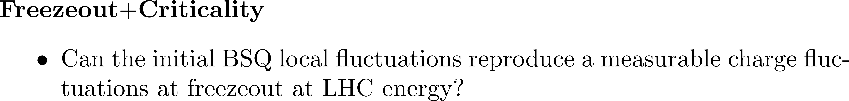

Open questions | QCD at finite charge density

Slide 5

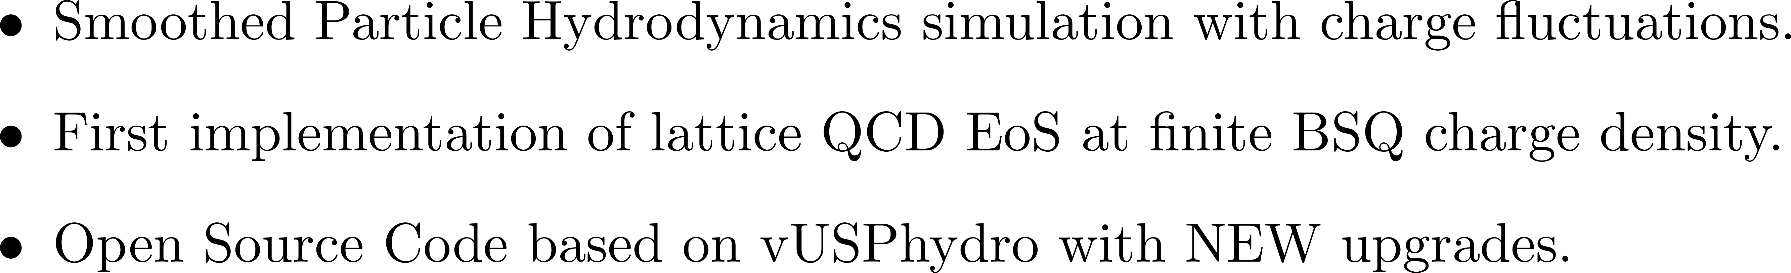
FrameworK |
CCAKE
Notes:
The transport coefficients η, ζ, and κ should be thought of as input parameters for hydrodynamics: like in any effective theory, they can not be evaluated in hydrodynamics itself, but rather need to be computed from the underlying short-distance physics, for example using the Boltzmann equation

Slide 6

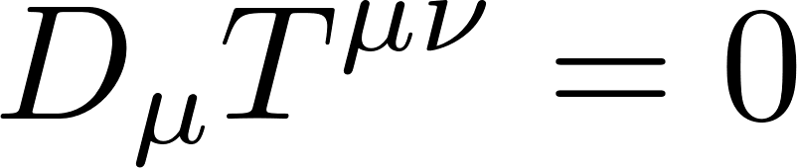
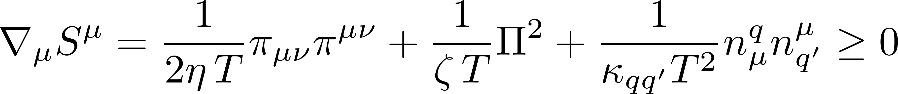
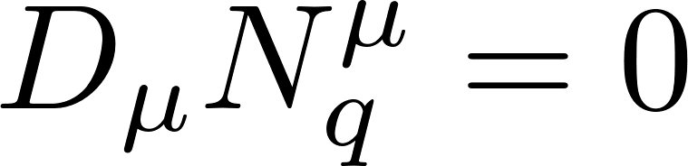


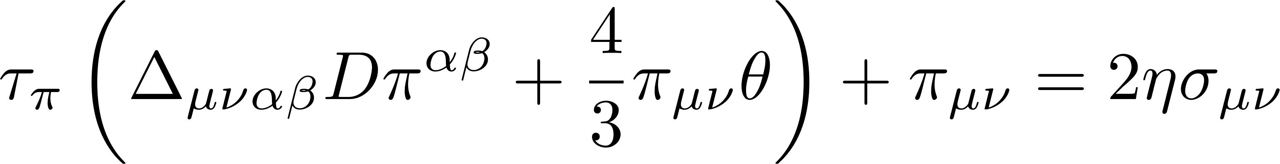
Theory | transient multiple component fluid dynamics
Notes:
Add: theory of macroscopic, we still have a lot to learn about how these dynamics affect each other? Studies looked at one or the other but not quiet the interplay between them
Also add arrows

Slide 7

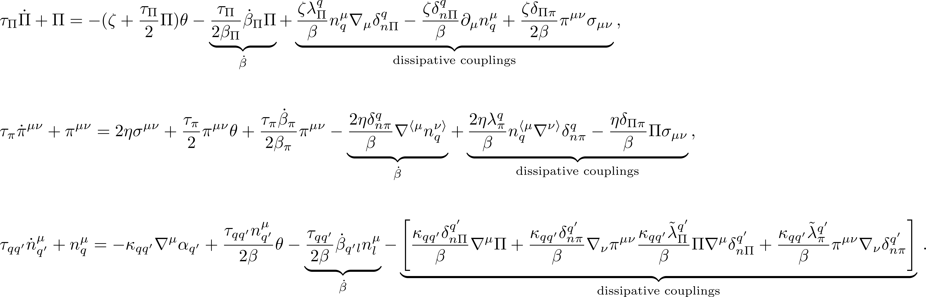
Theory | transient multiple component fluid dynamics
Notes:
Add: theory of macroscopic, we still have a lot to learn about how these dynamics affect each other? Studies looked at one or the other but not quiet the interplay between them
Also add arrows

Slide 8


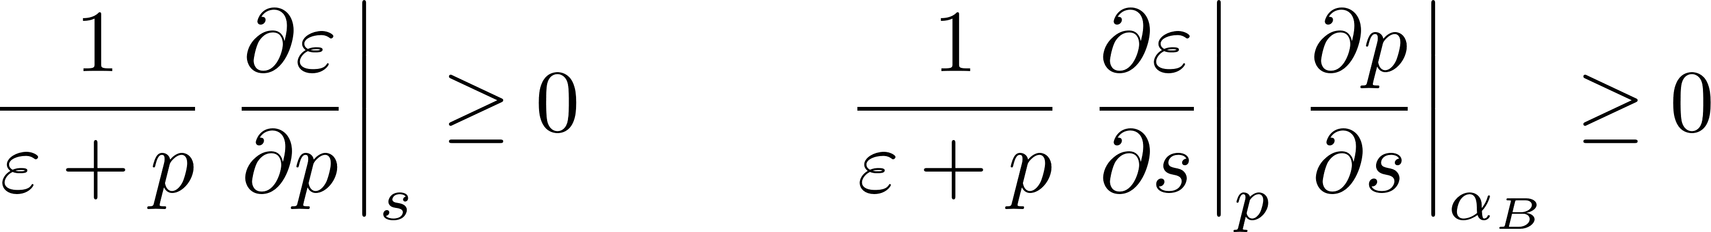

Stability & causality analysis| multi component fluid dynamics

Slide 9
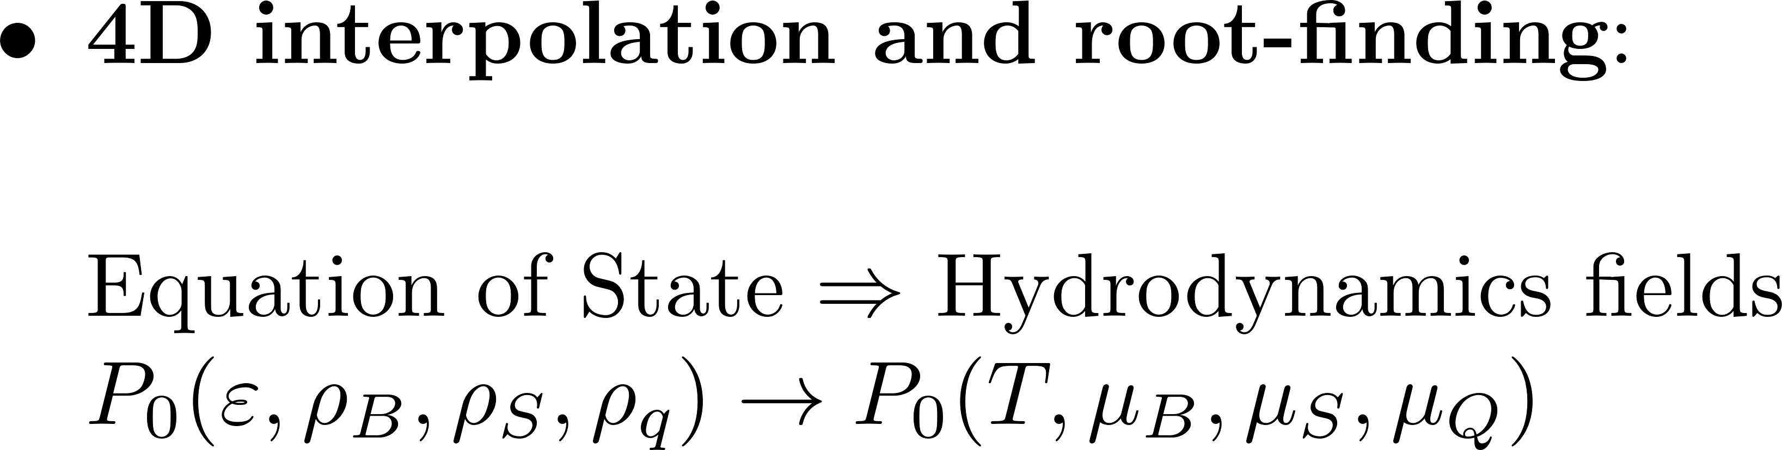

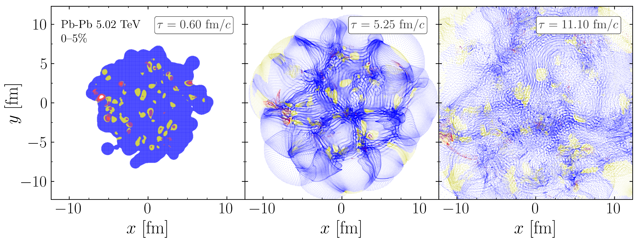
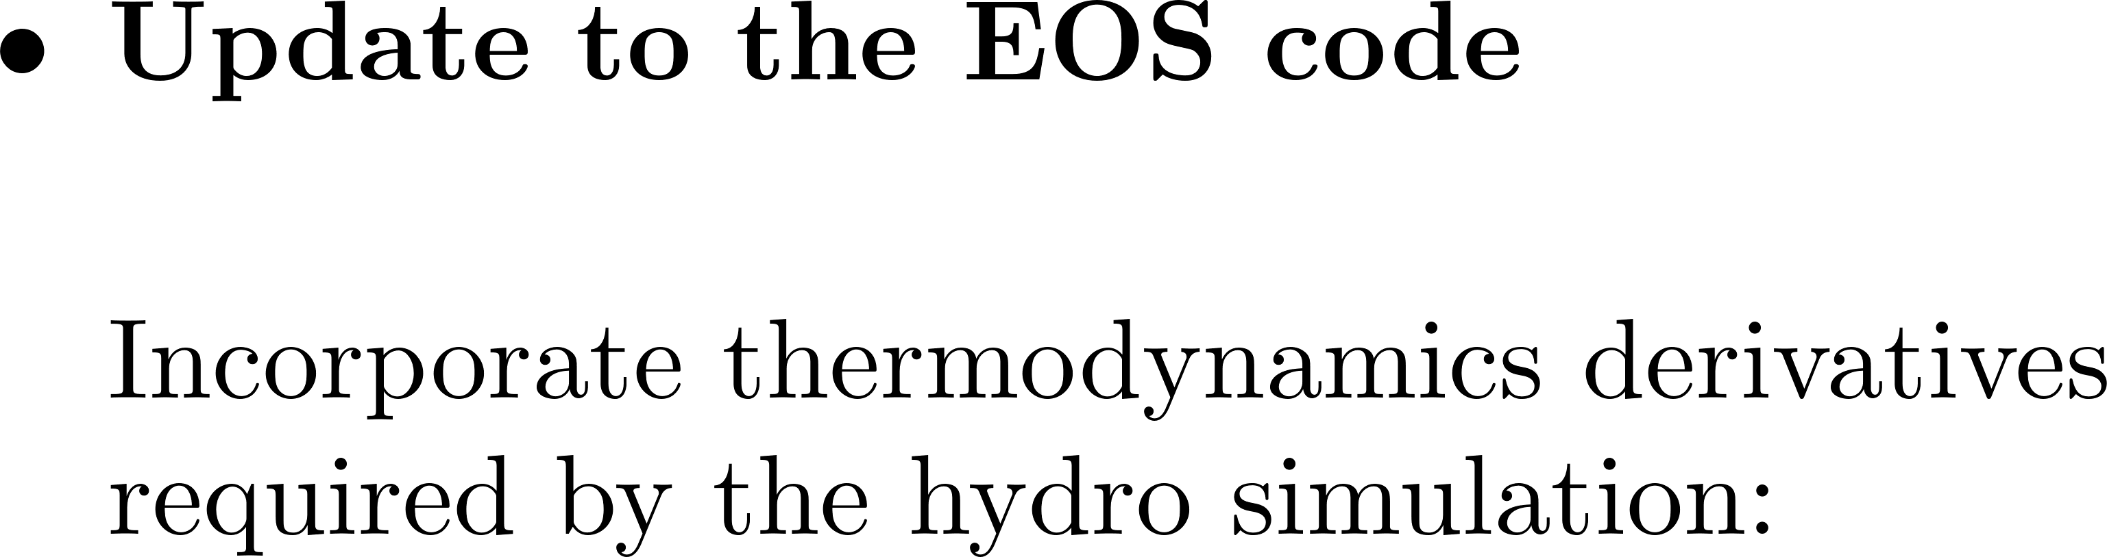
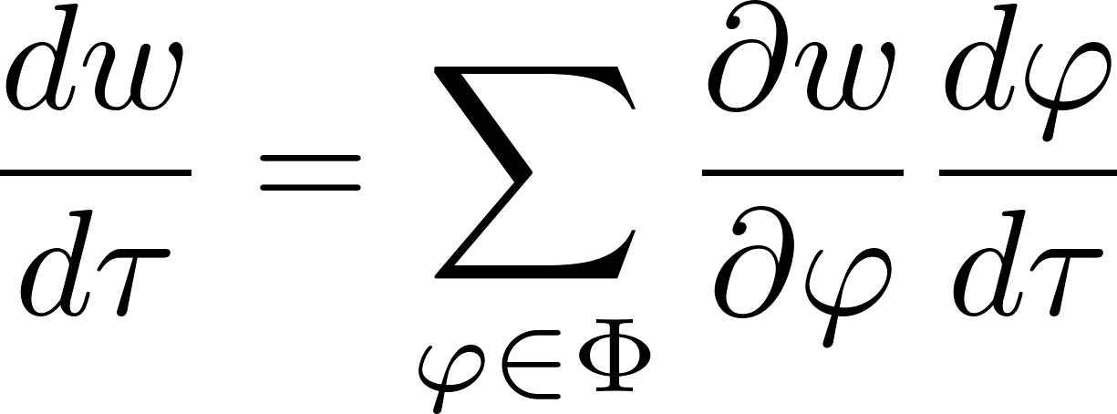

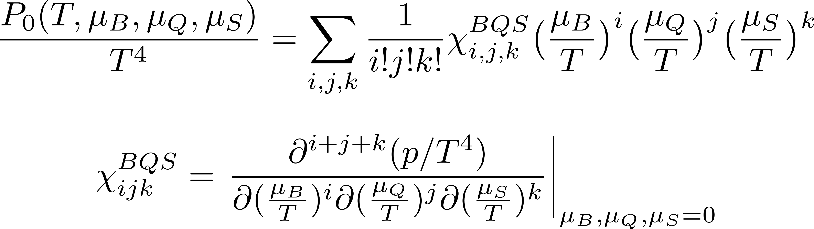
Testing lattice eos at finite density
Notes:
Out-of-bound fluid cells that are beyond the each of the Taylor Series, 4D interpolation and root-finding, Accuracy and speed, Thermodynamic derivatives.

Slide 10
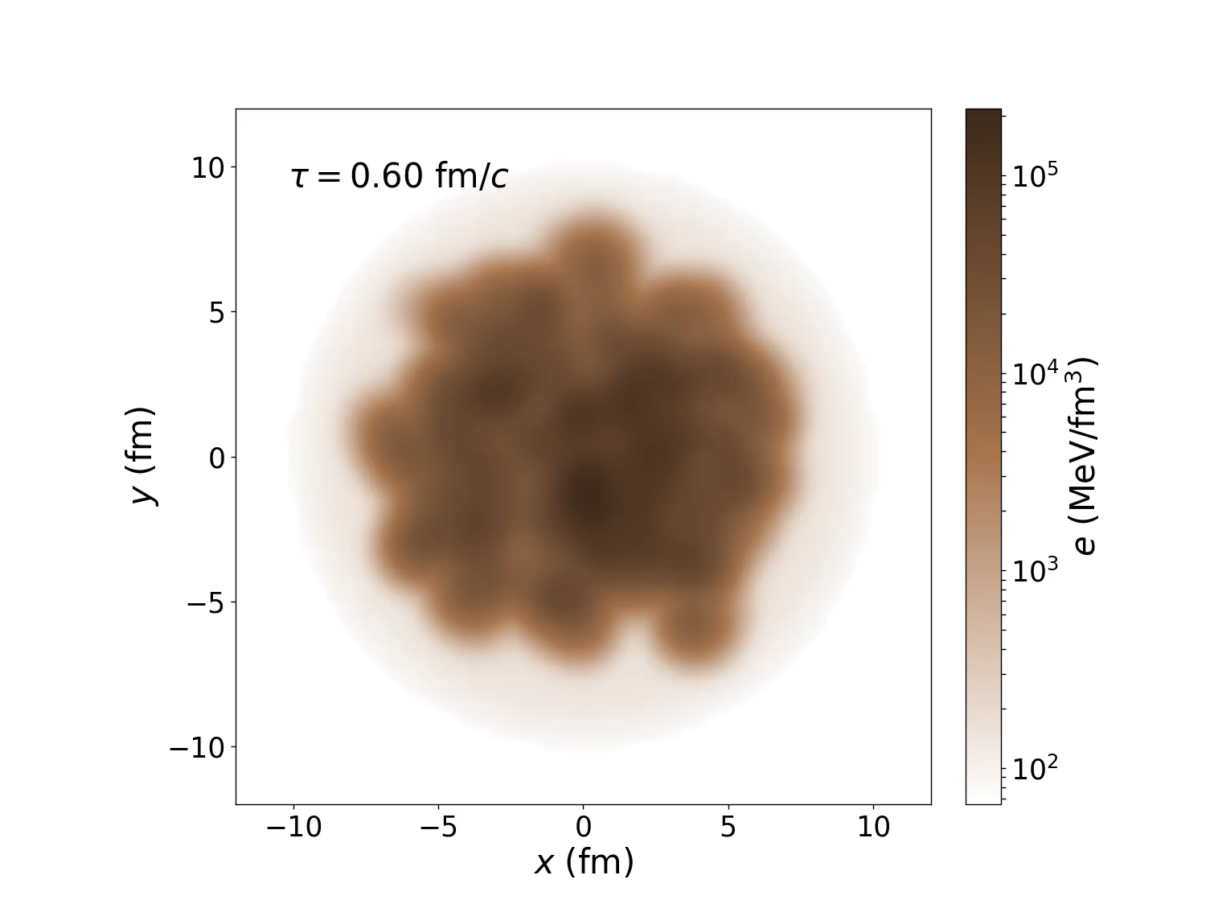
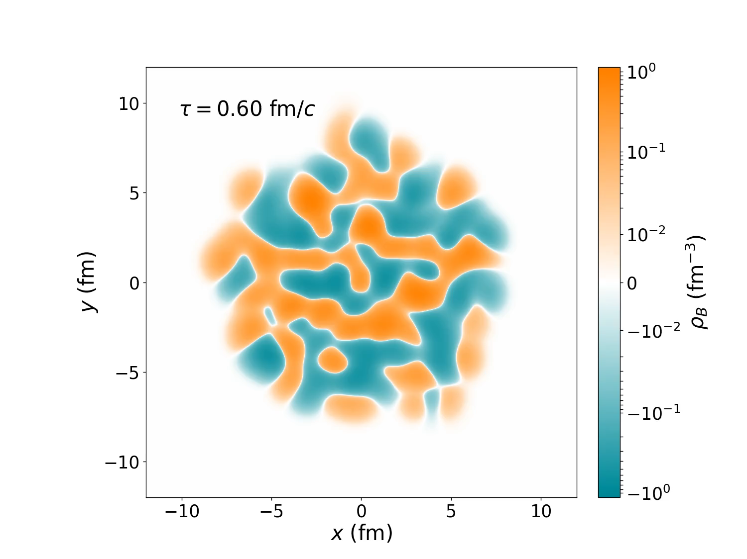
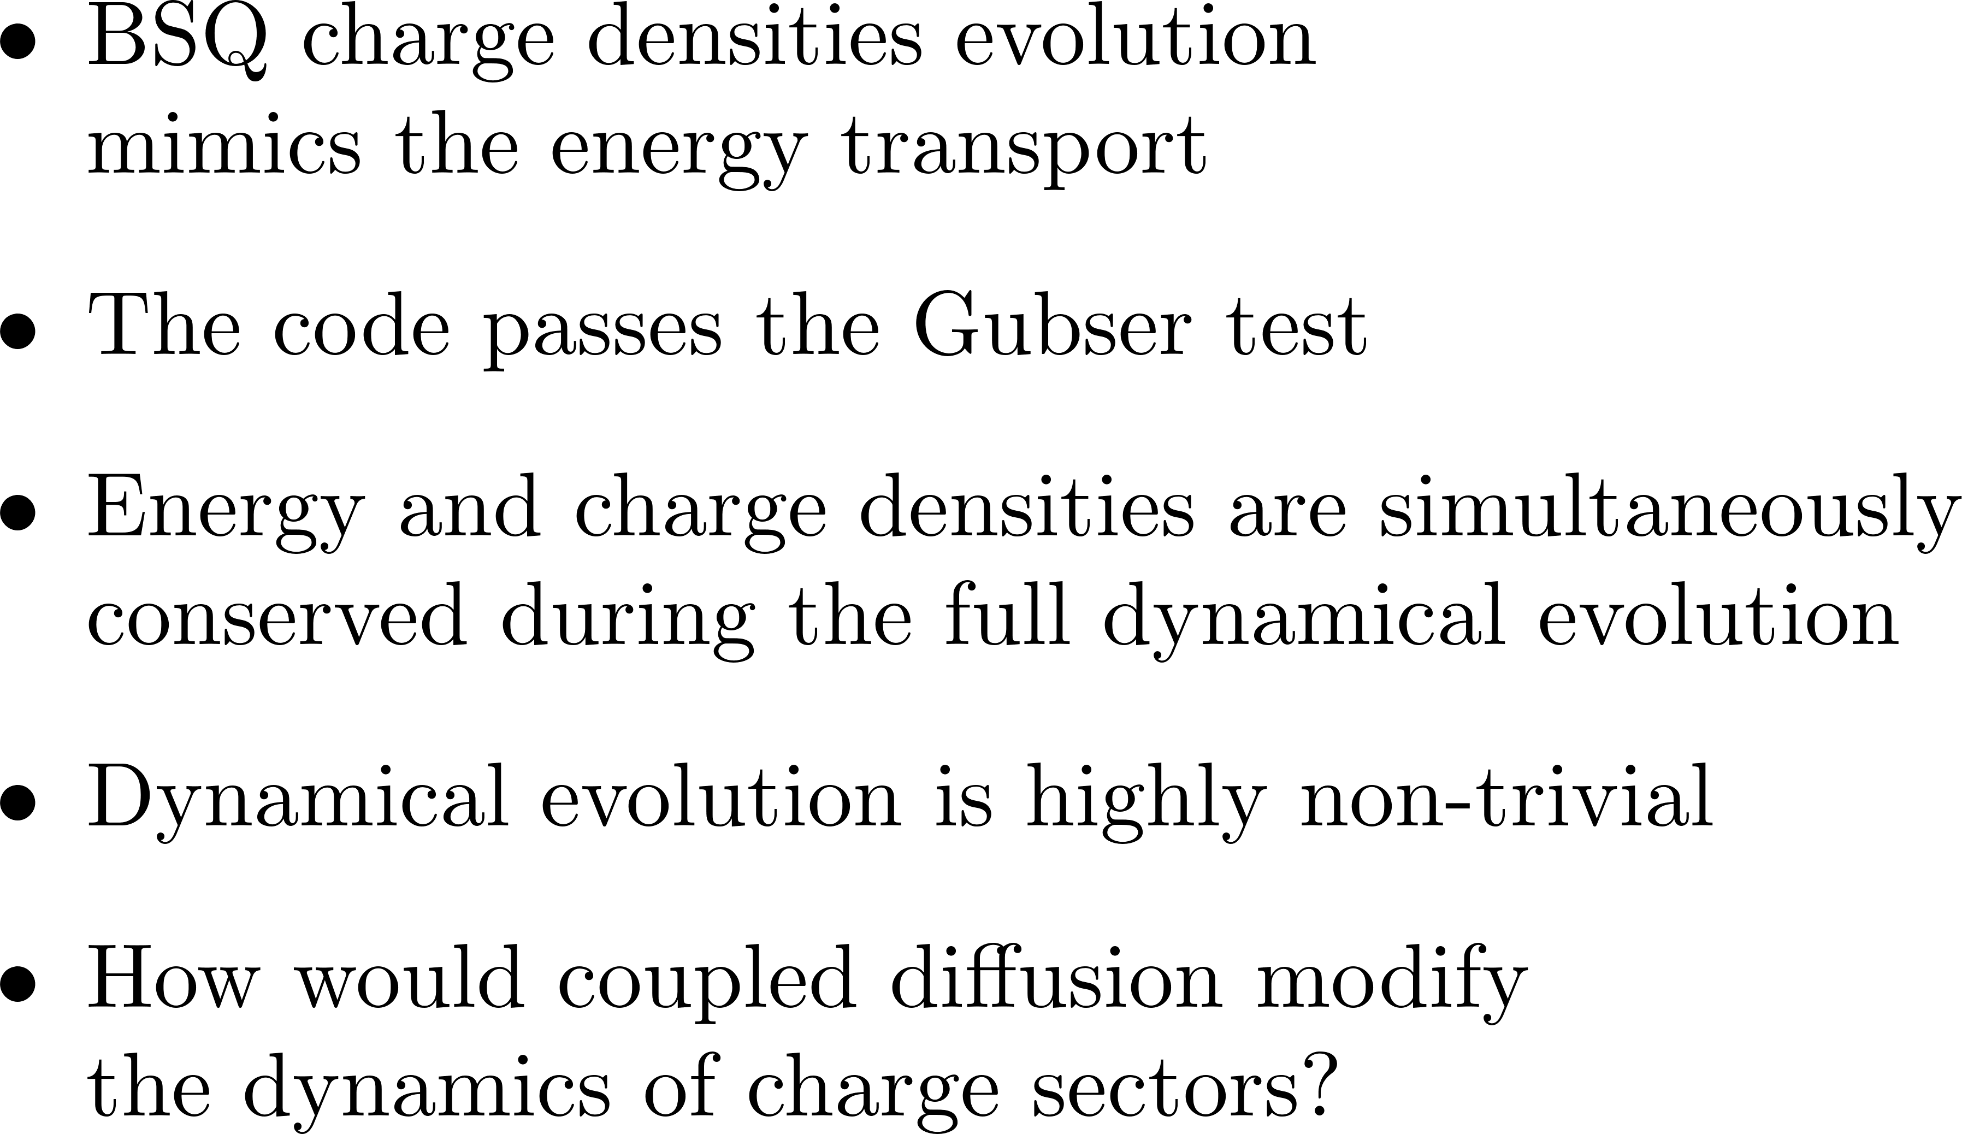
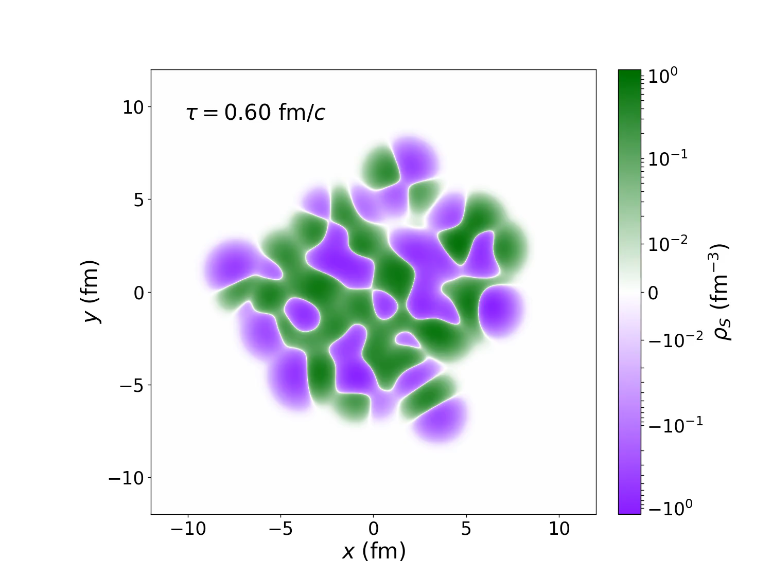
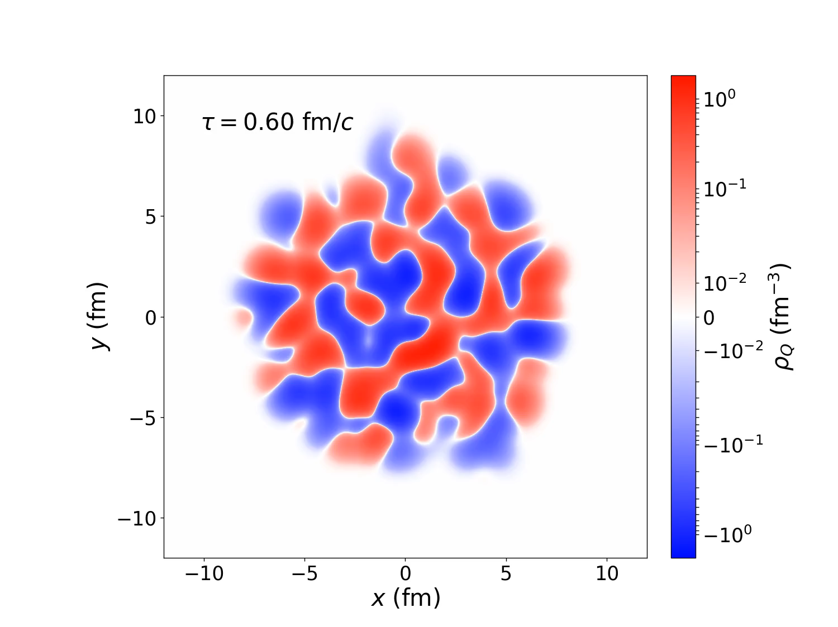
2+1D Dissipative fluid dynamics with ideal BSQ evolution
CCAKE

Slide 11
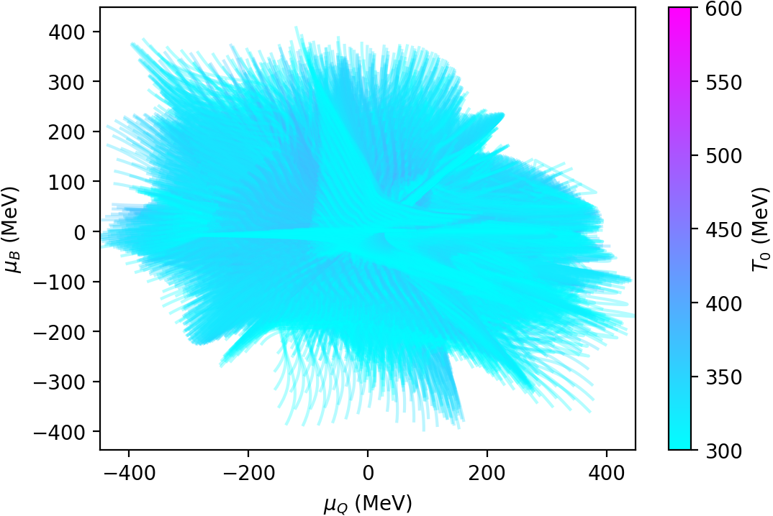

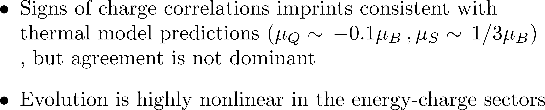
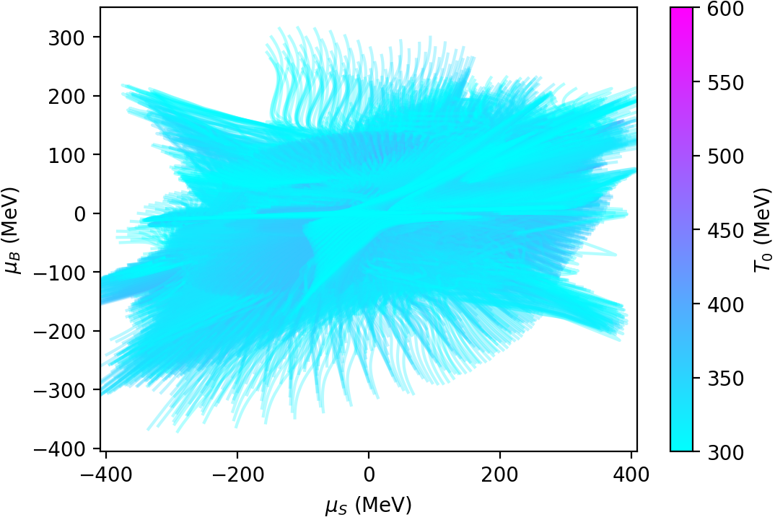
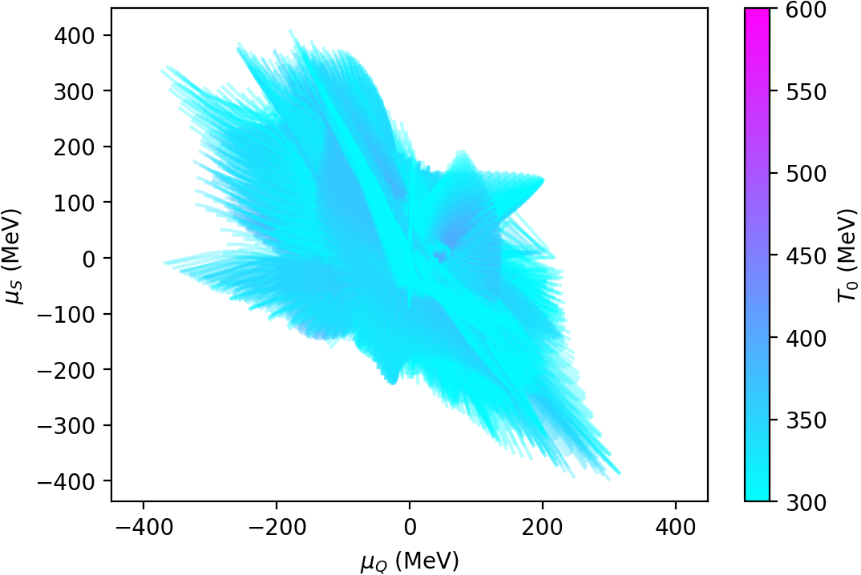
BSQ charge correlations | Dynamical trajectories 0-5%
Notes:
Bottom: event0_cent20-30_JP1_center,

Slide 12
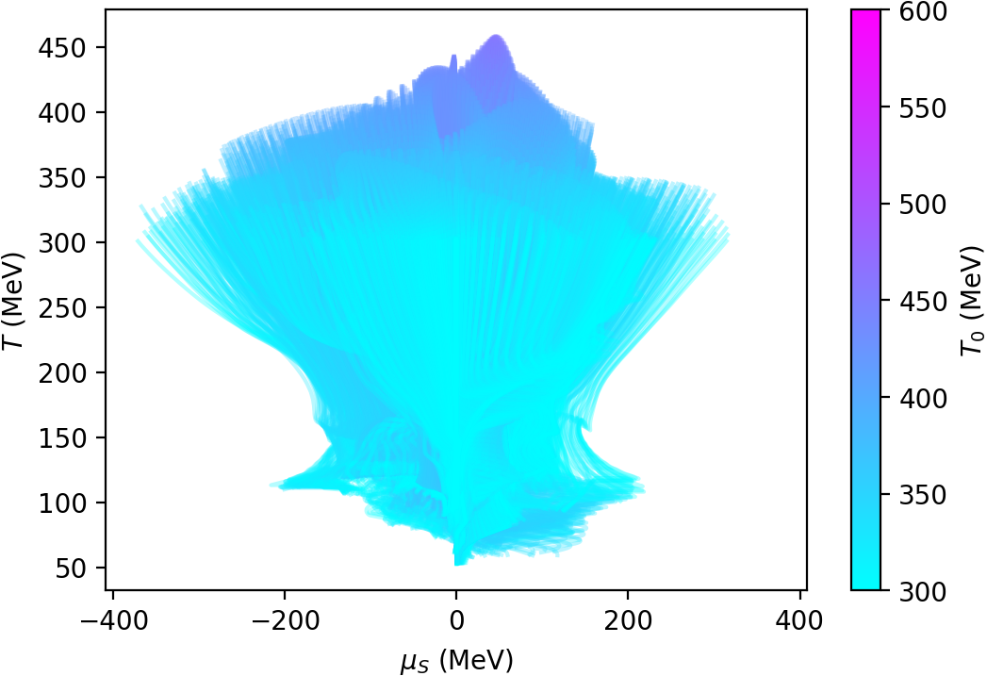
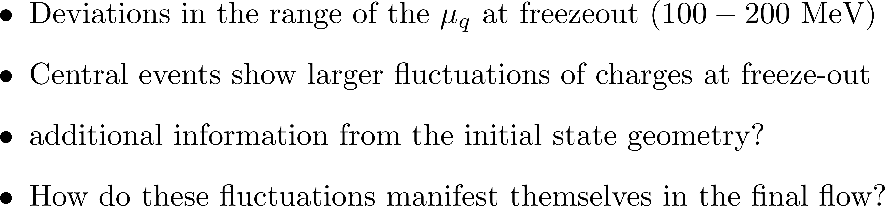
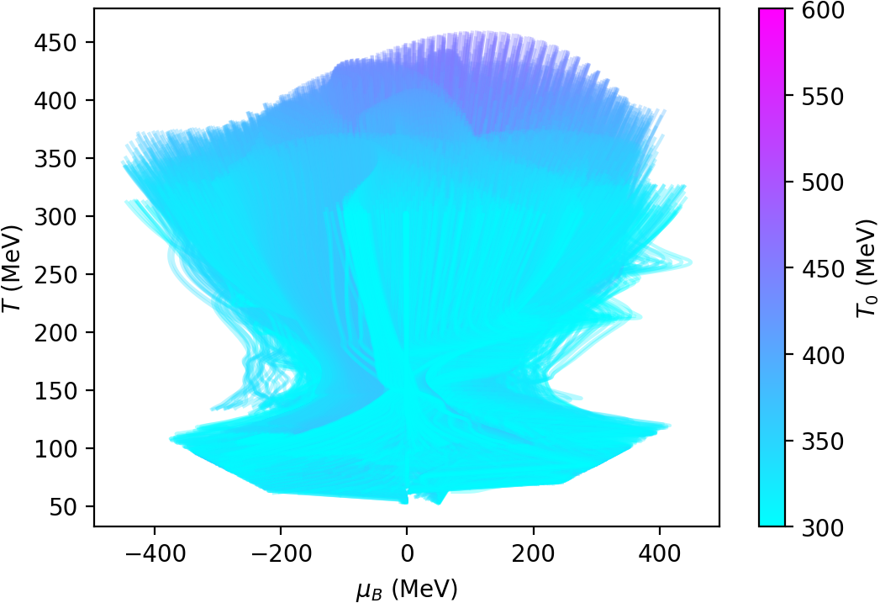
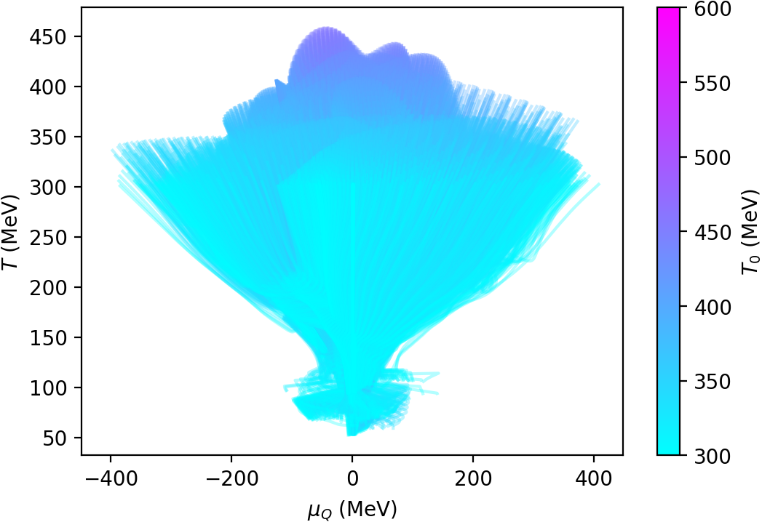
BSQ chemical potentials | freeze-out

Slide 13
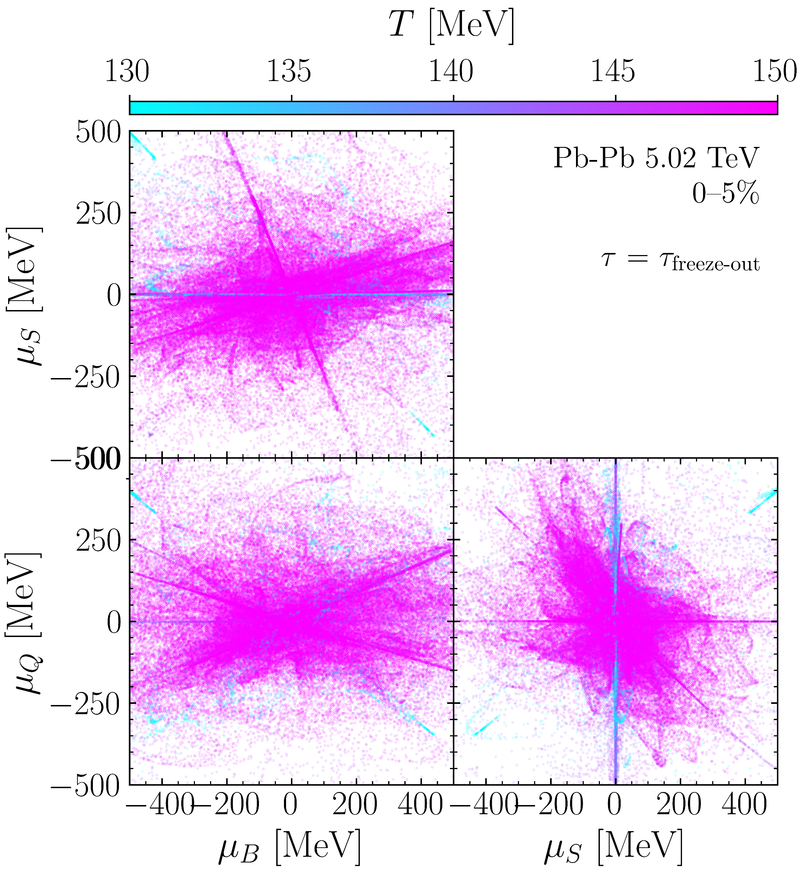
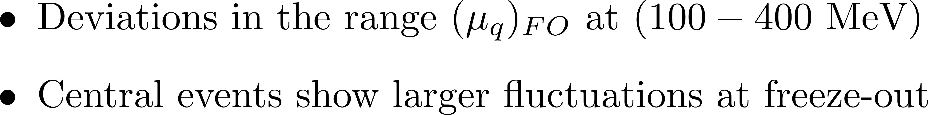
BSQ chemical potentials | freeze-out

Slide 14
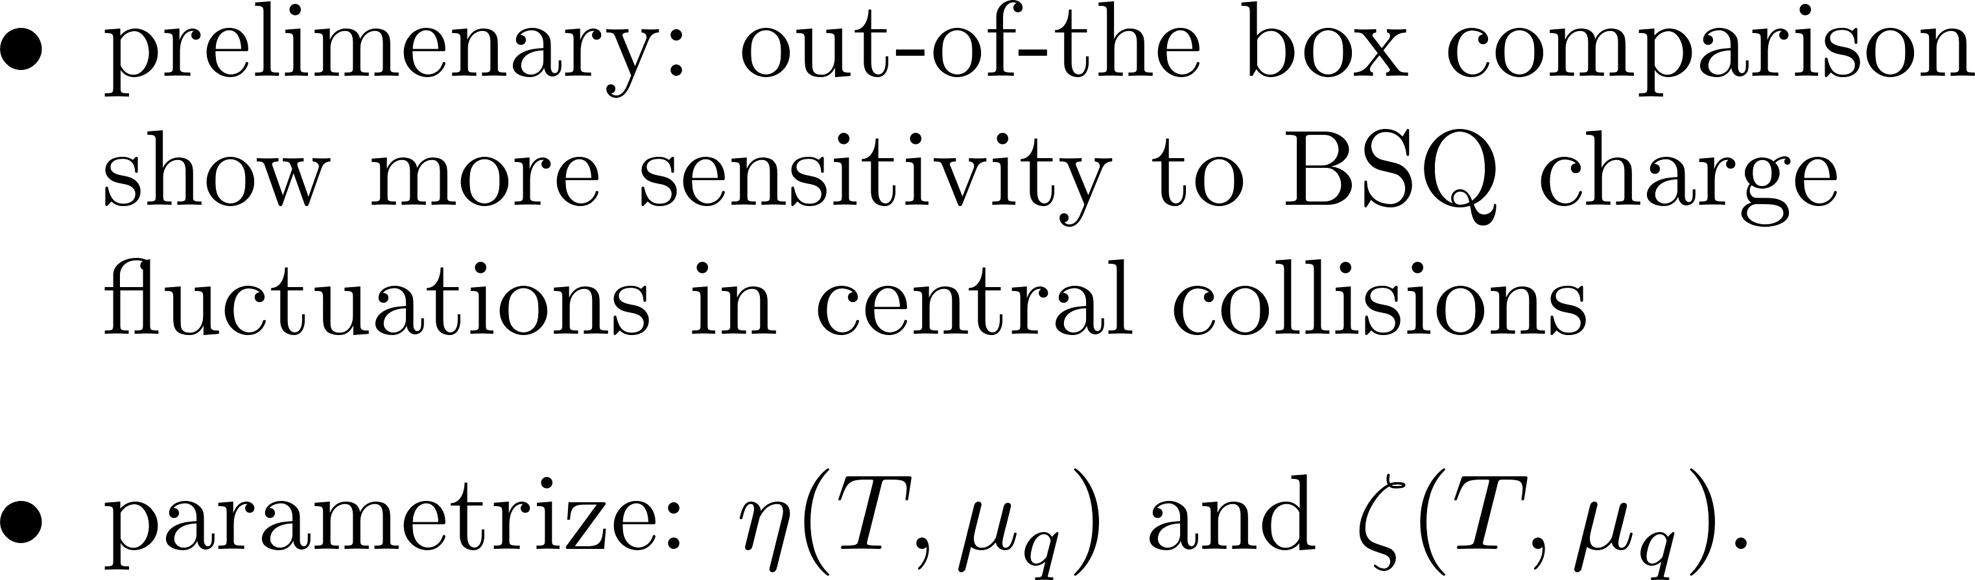
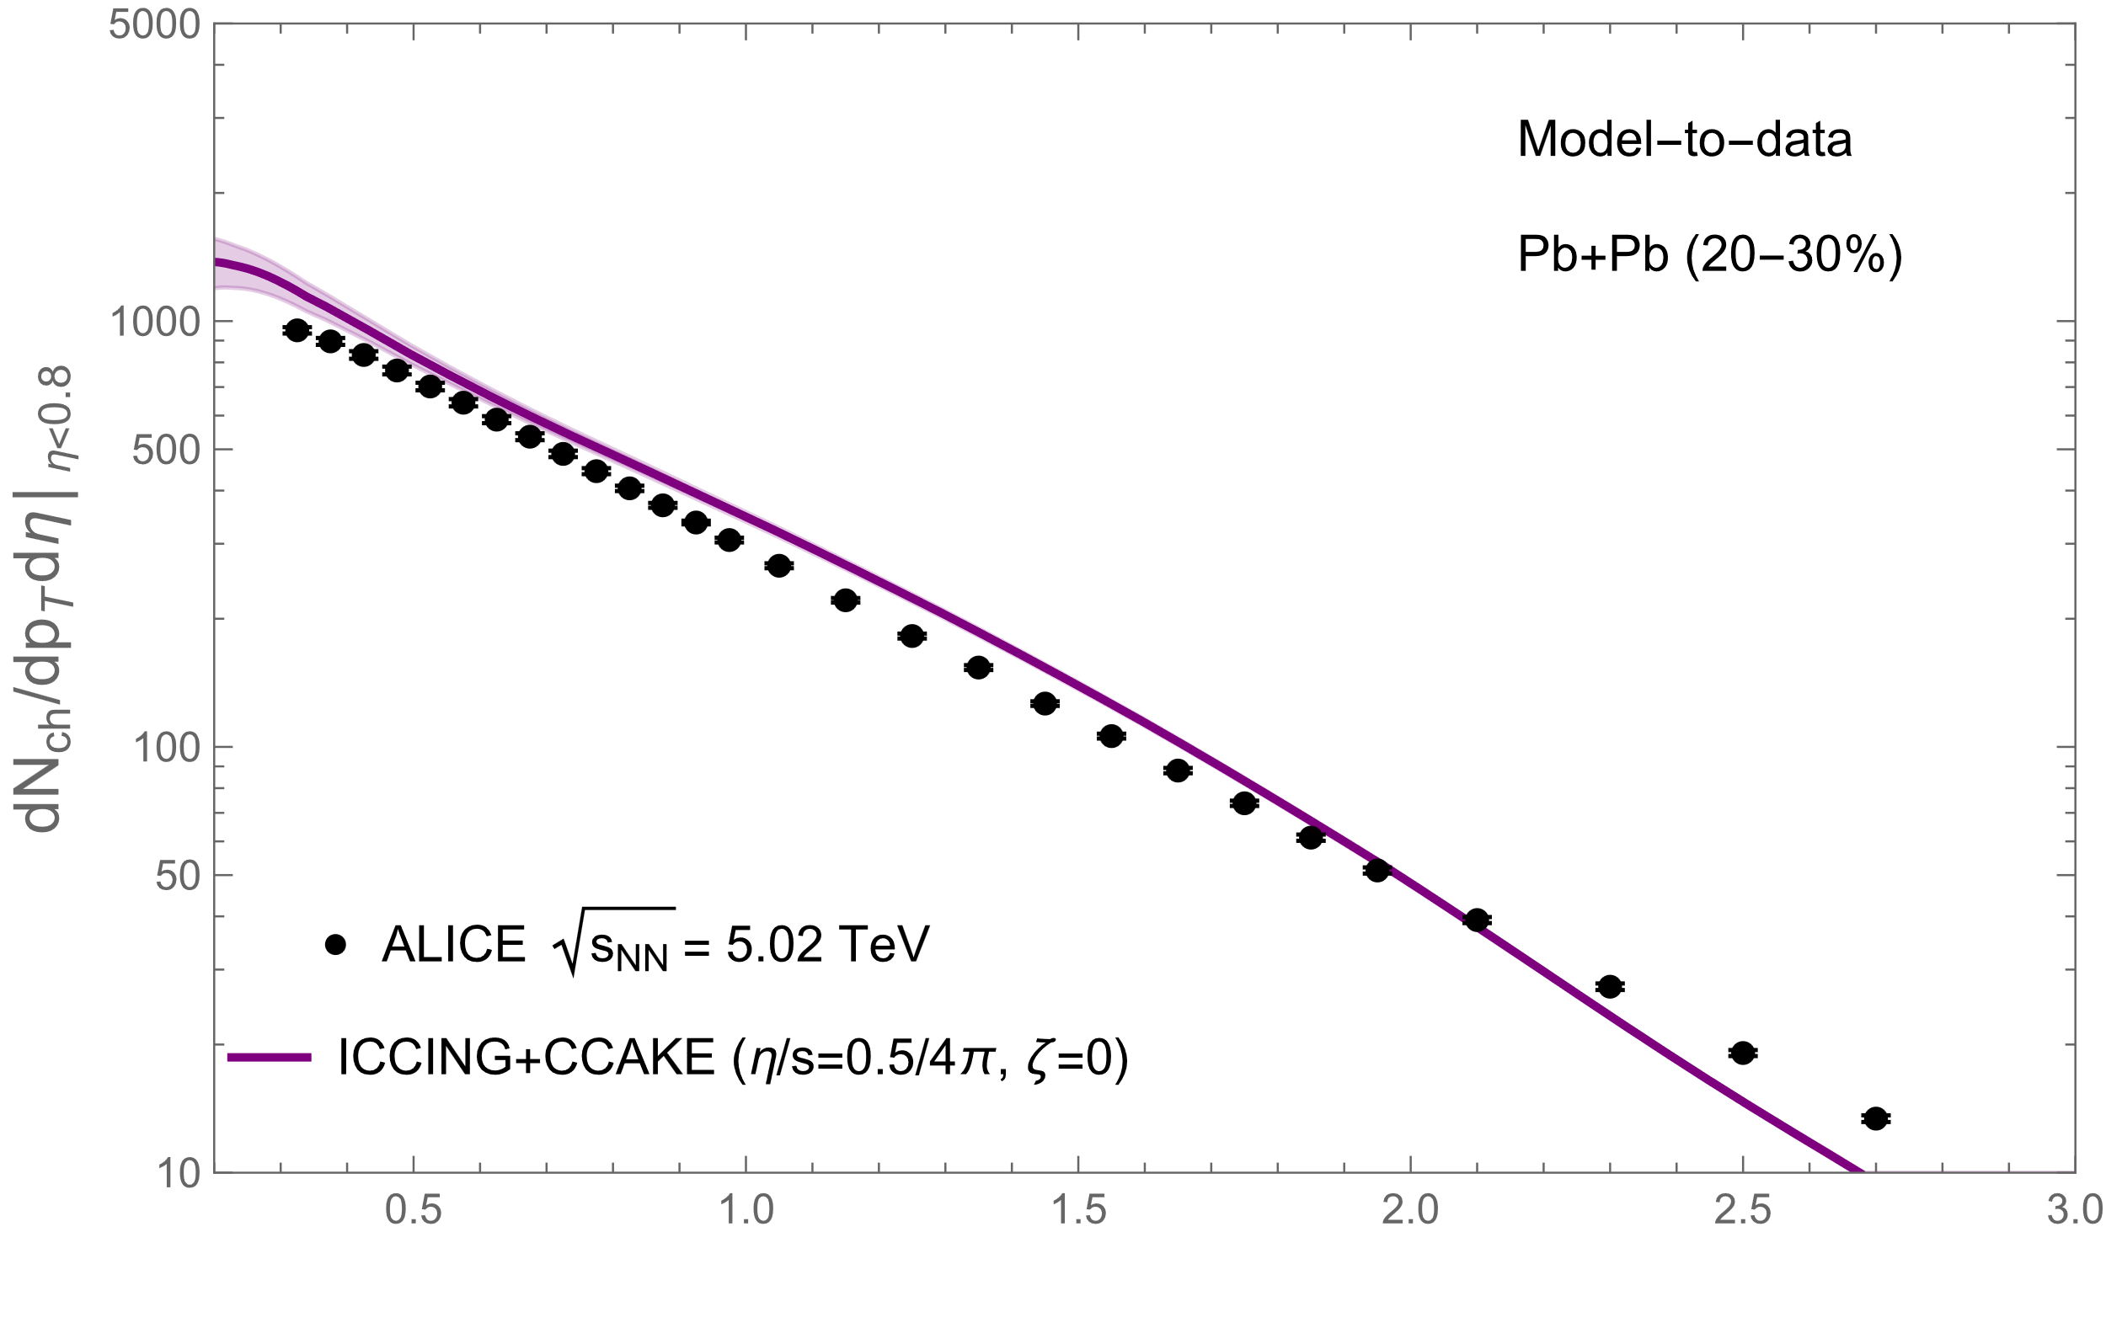
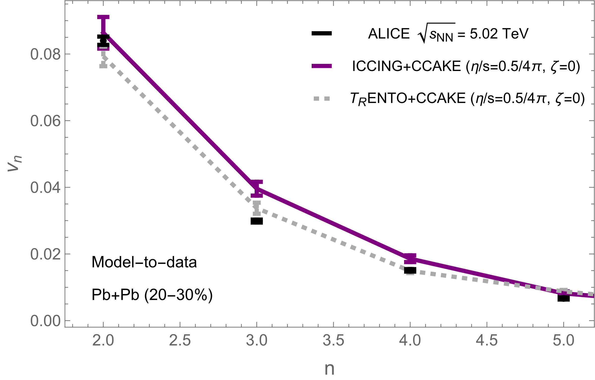

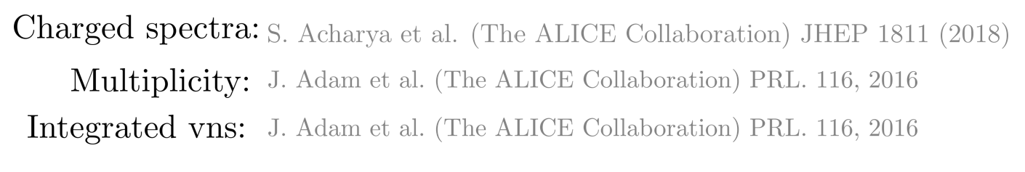
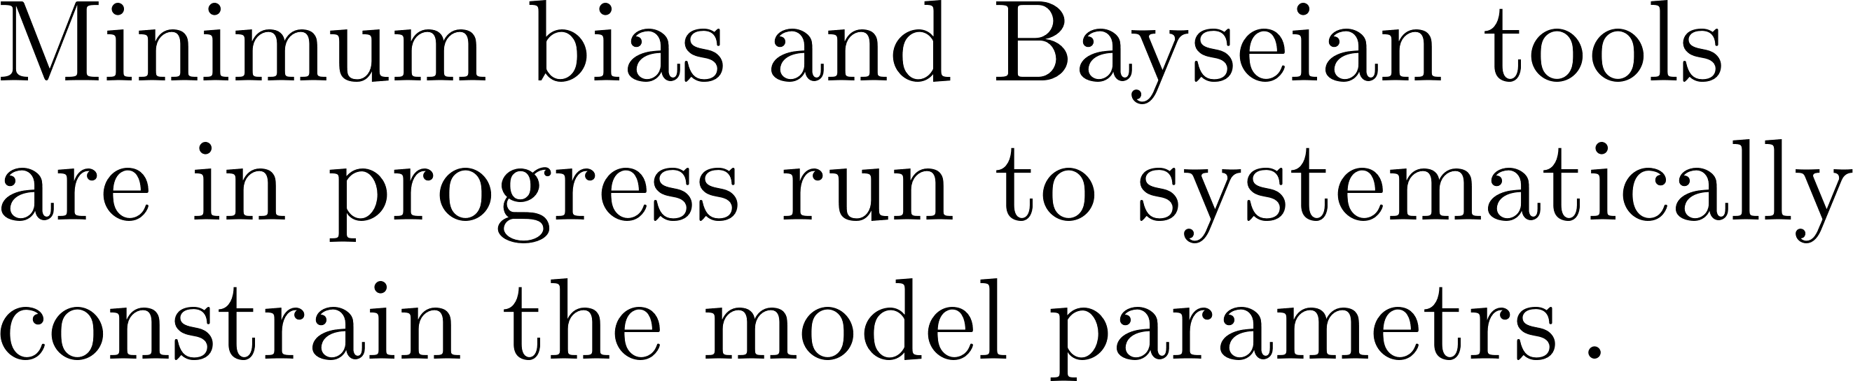
Flow | Observables at LHC with charge fluctuations

Slide 15
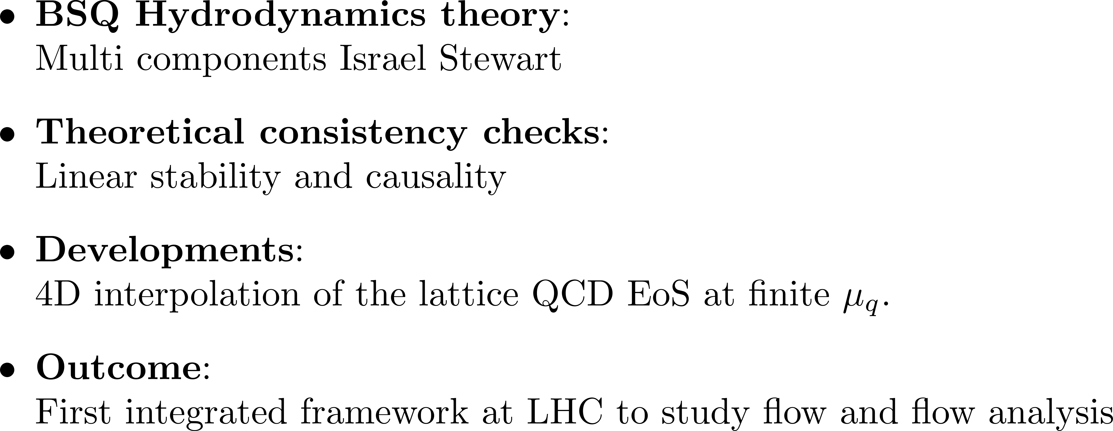



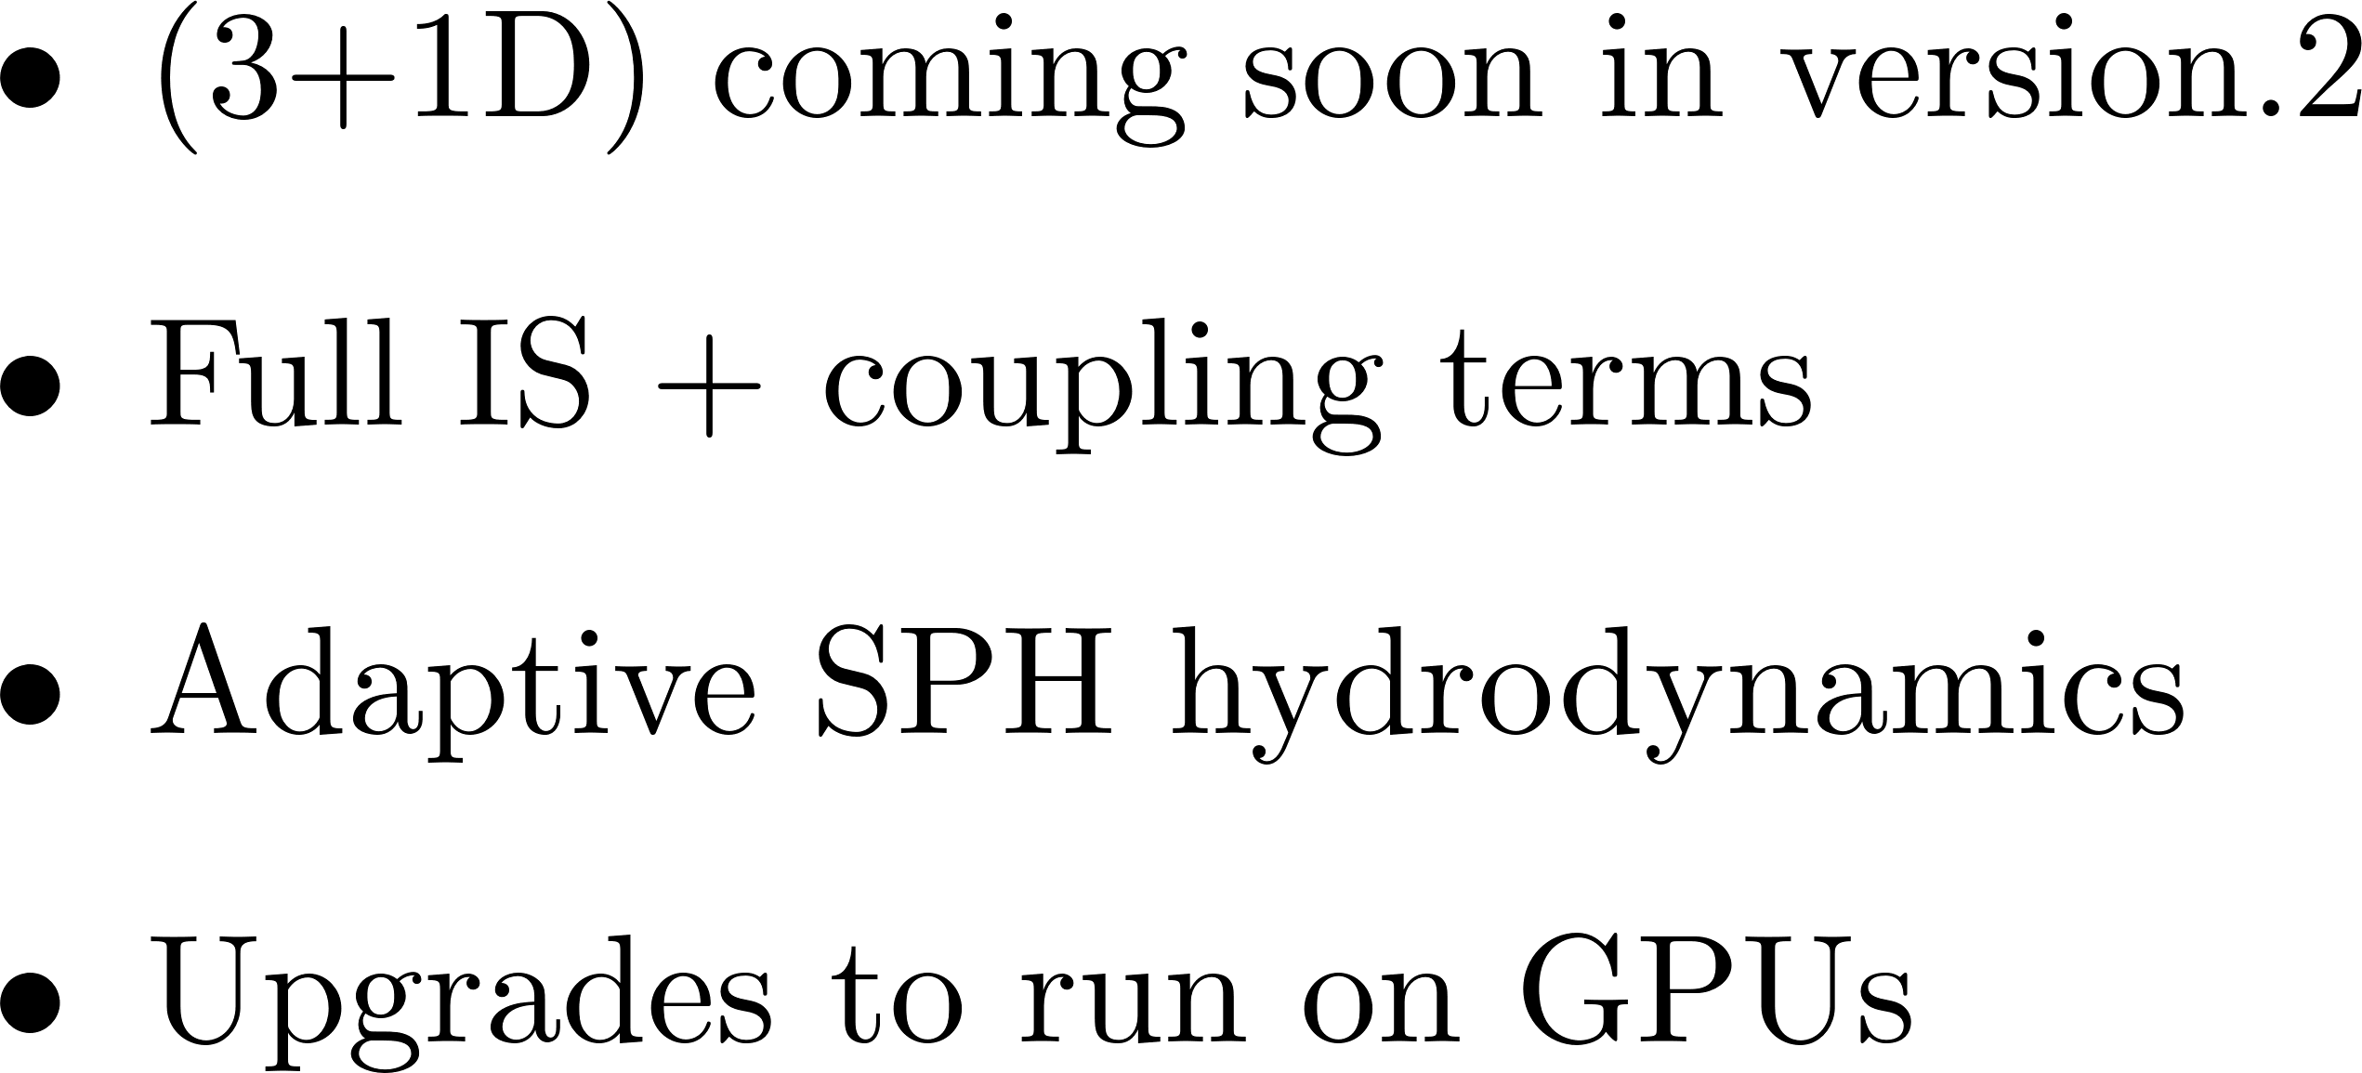

Conclusions and OUTLOOK

Slide 16
Thank you for your attention

Slide 17
Back-up

Slide 18

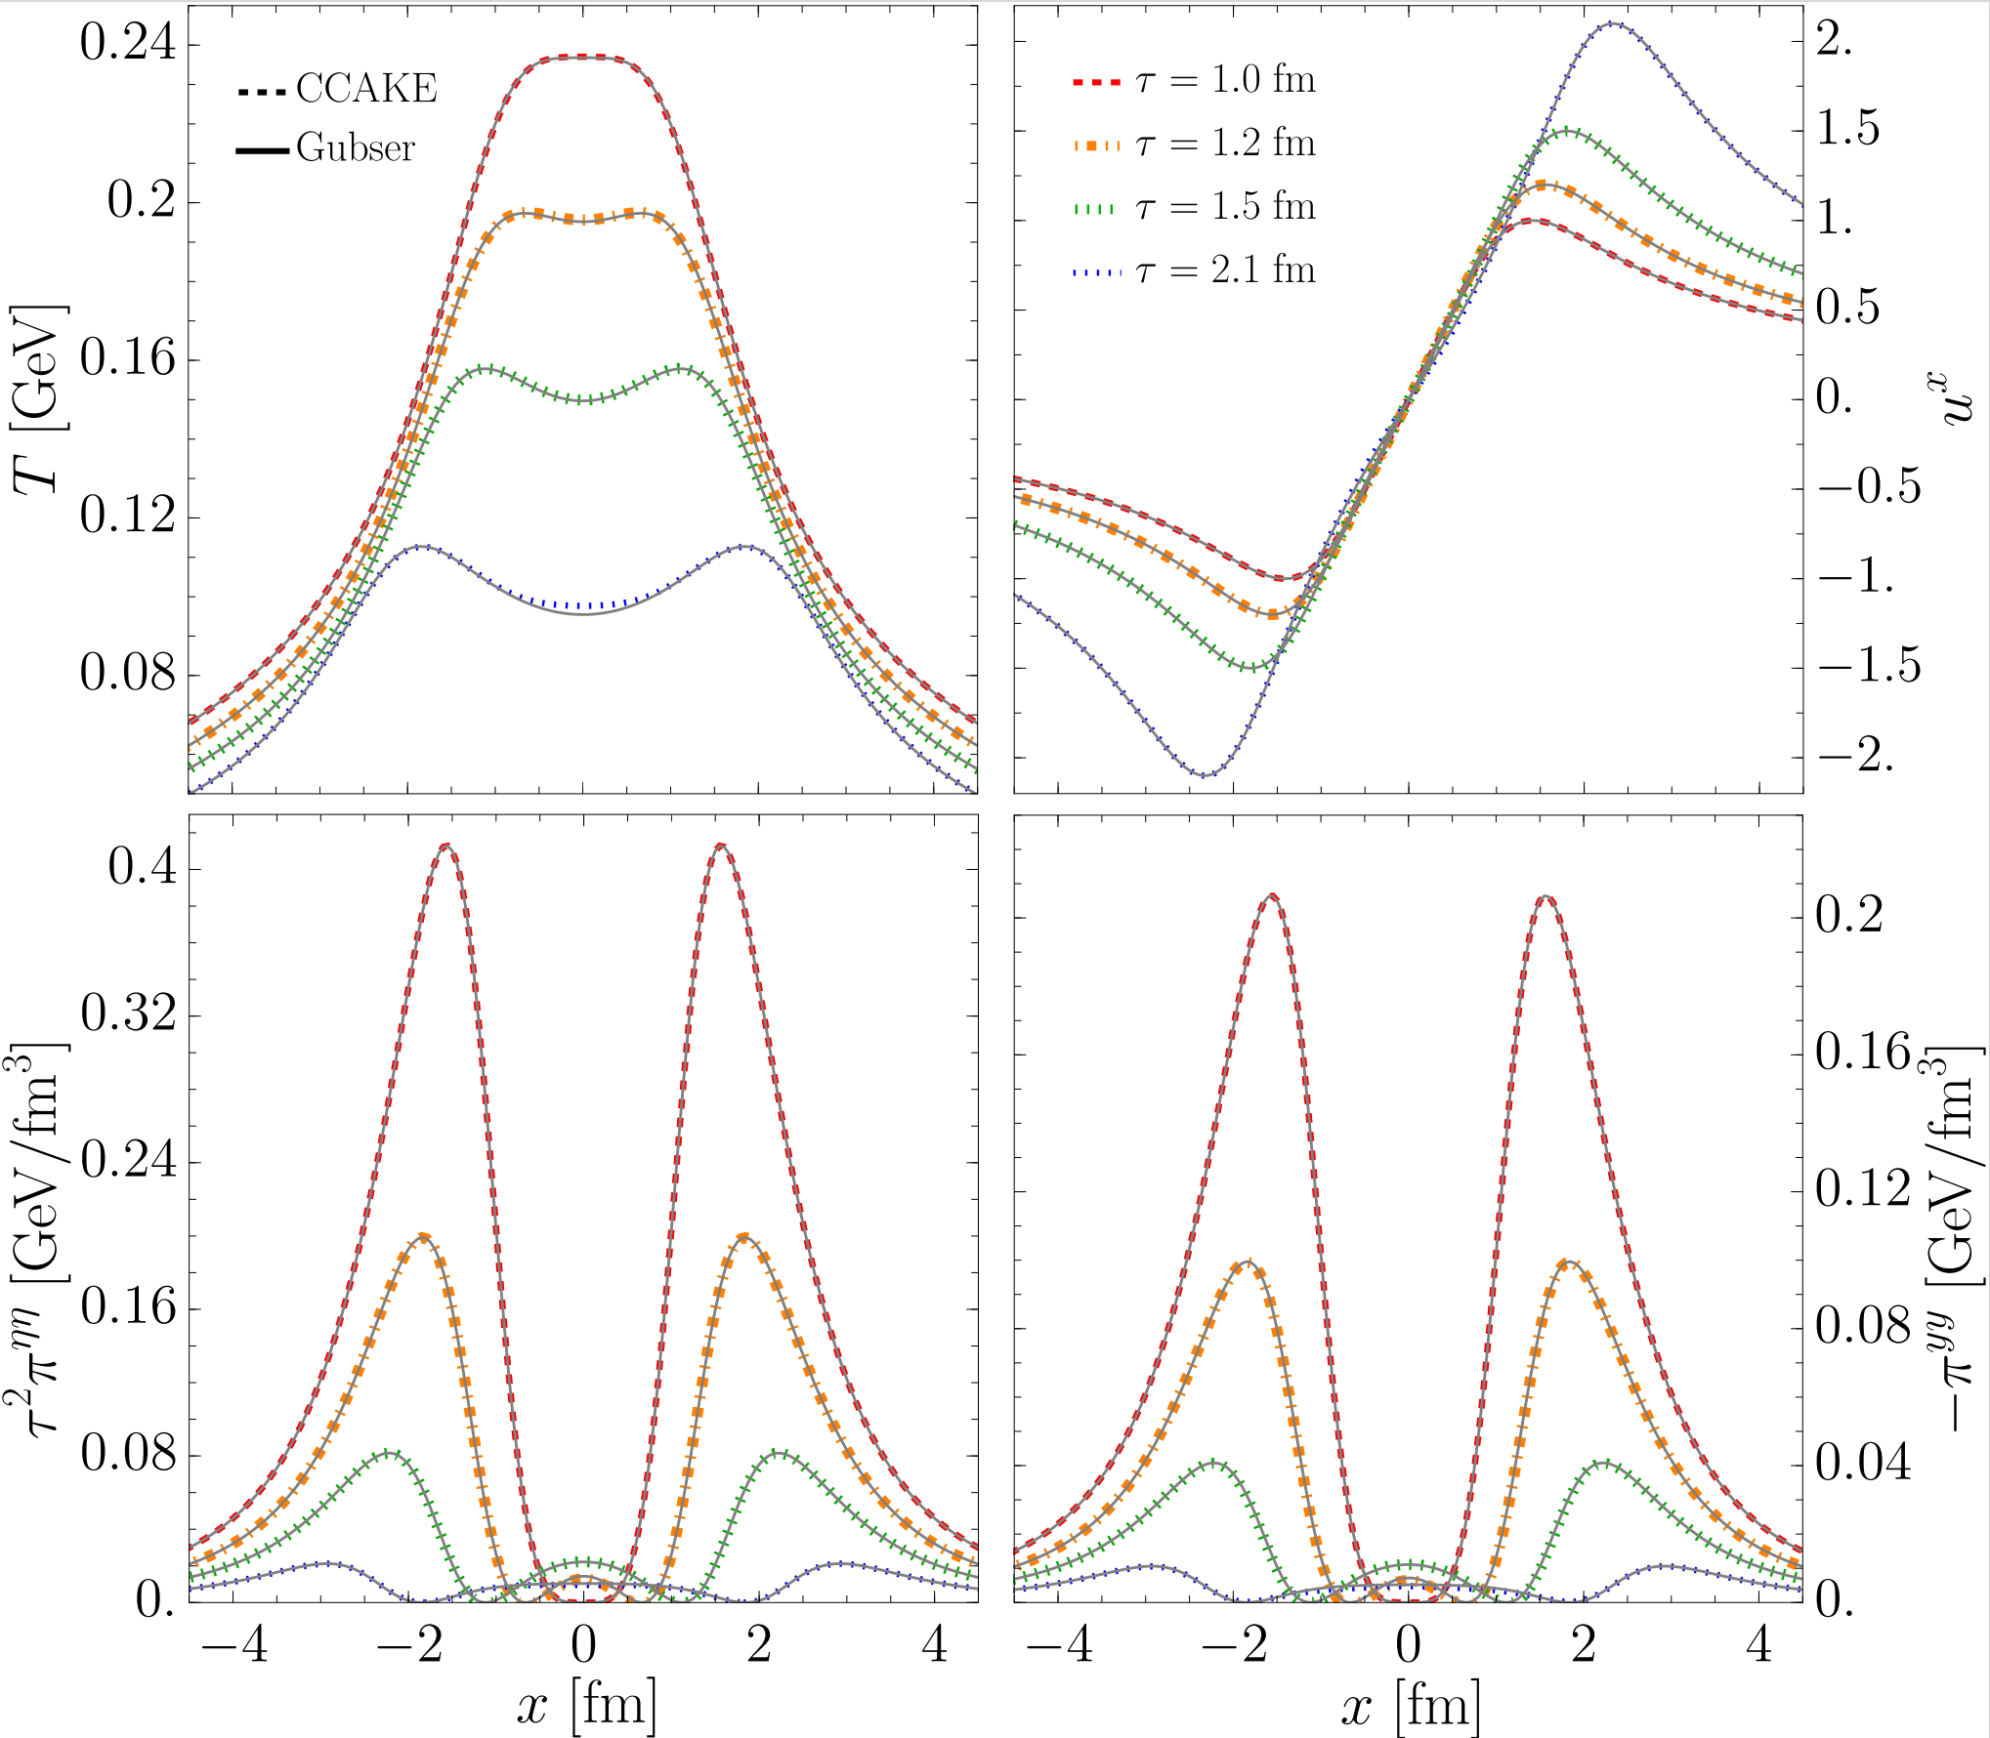

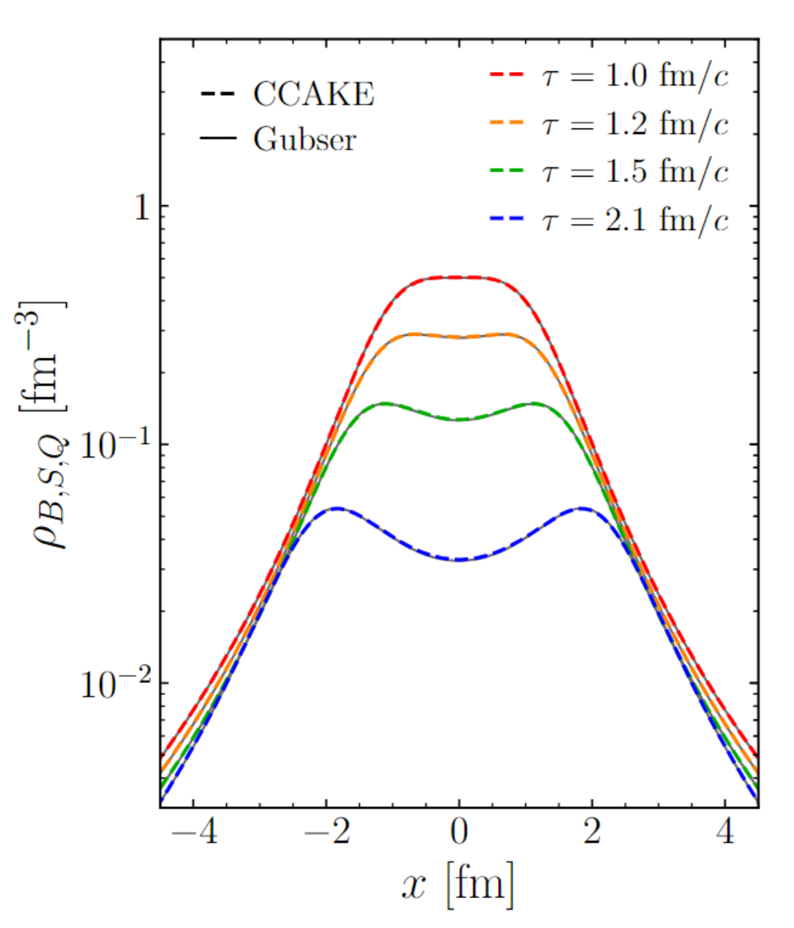

Numerical Benchmark|| Gubser Flow

Slide 19
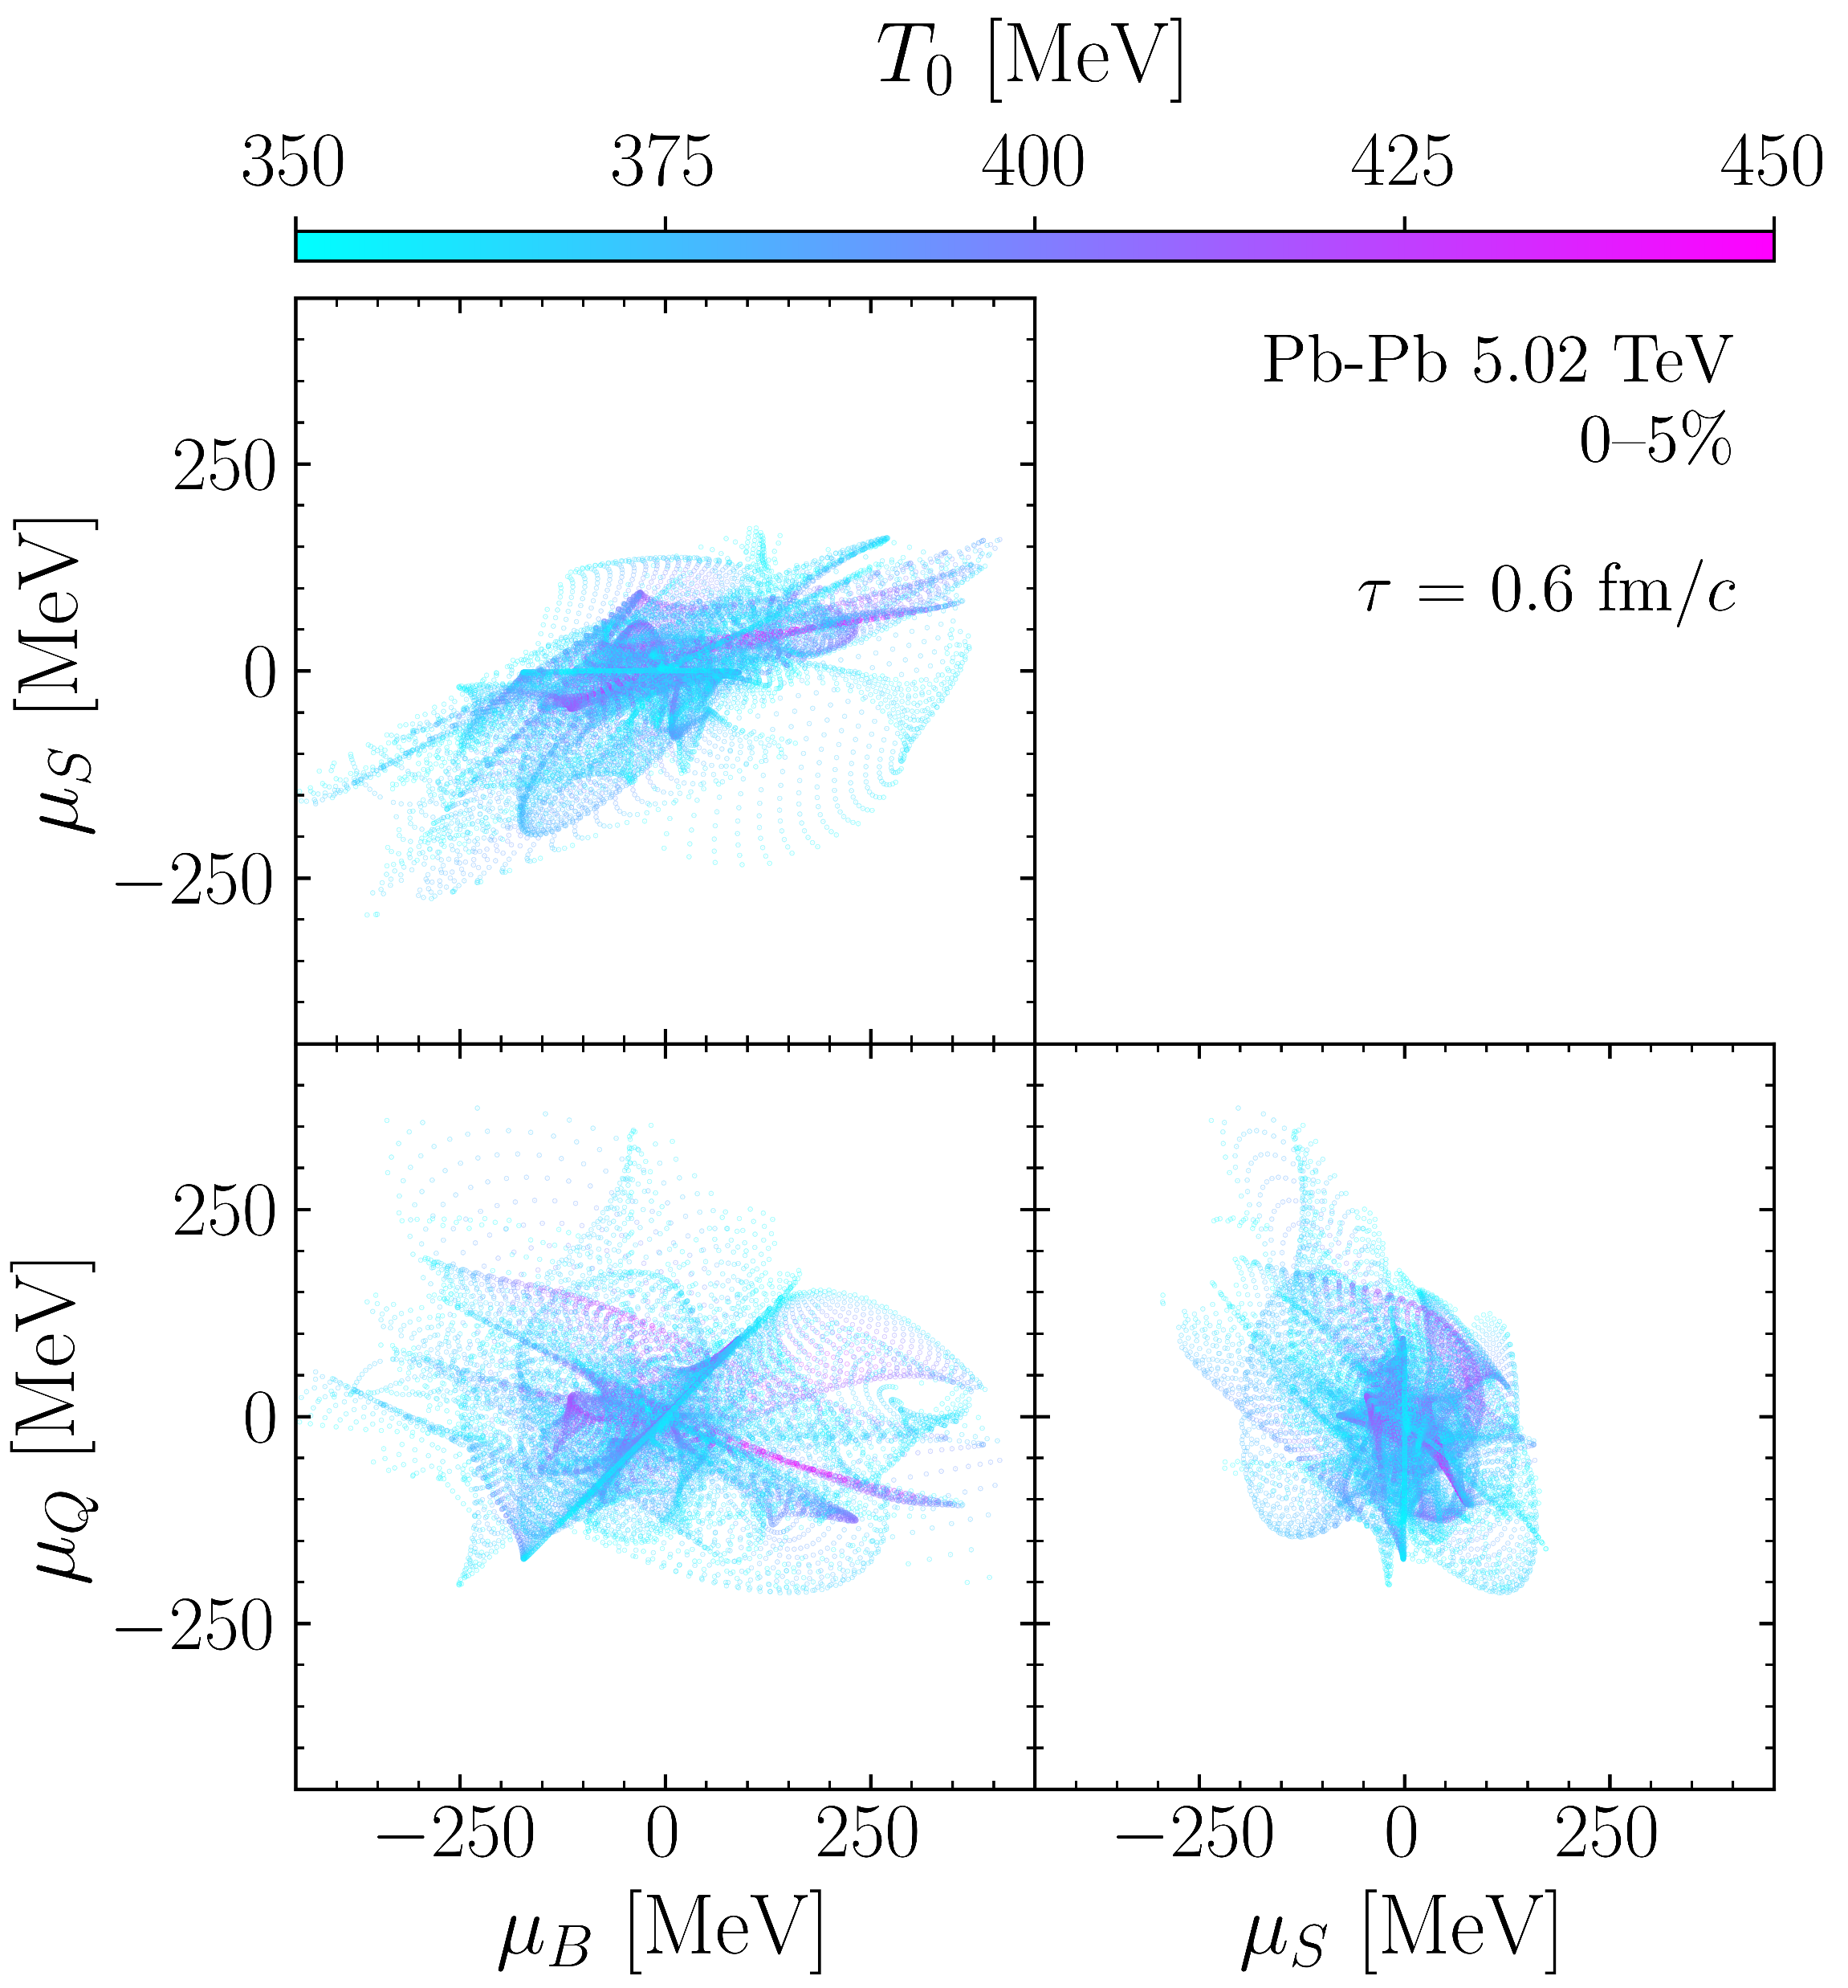
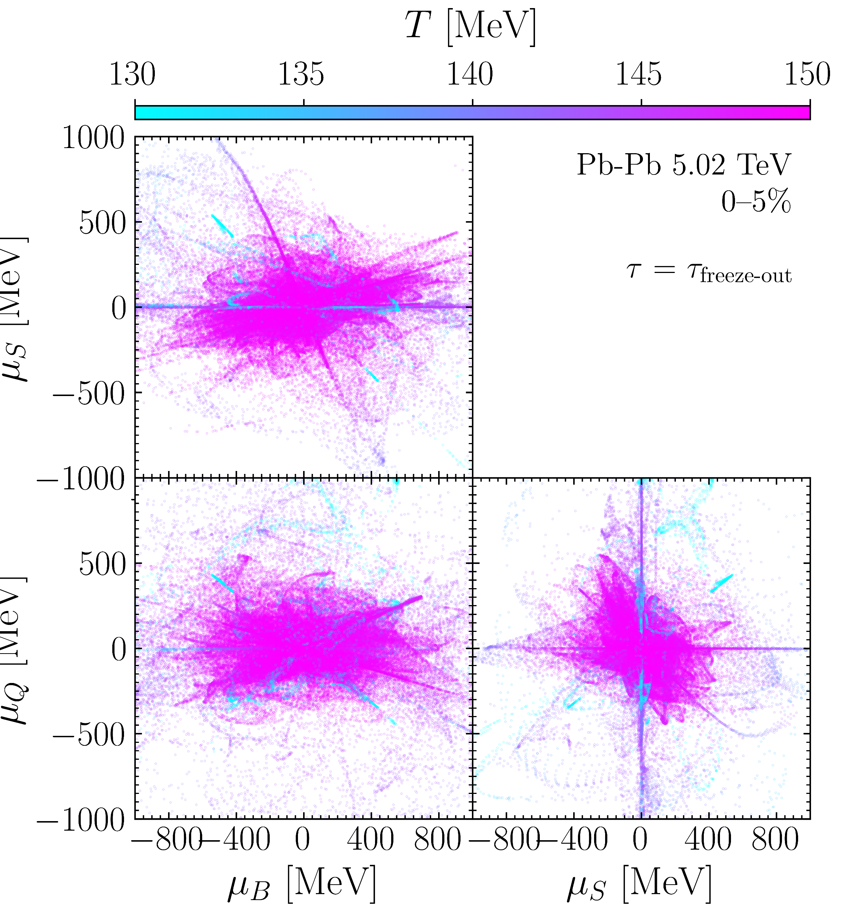

Slide 20
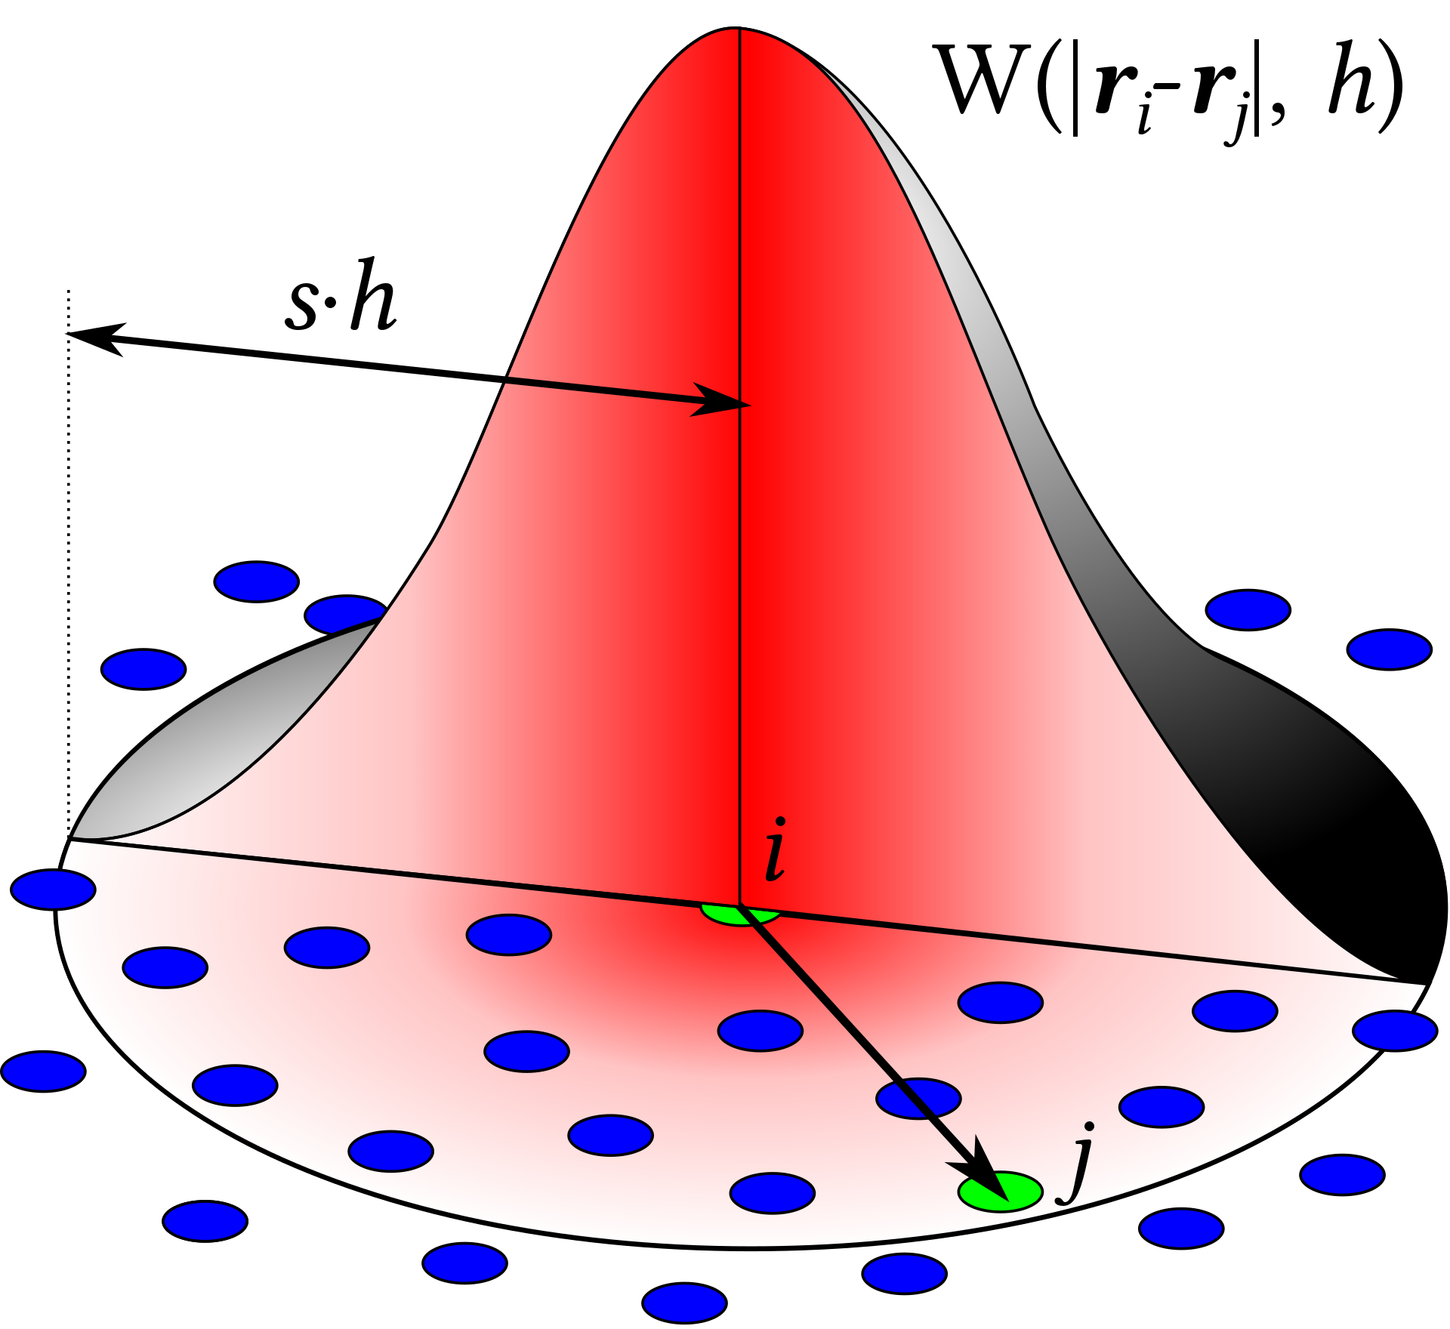
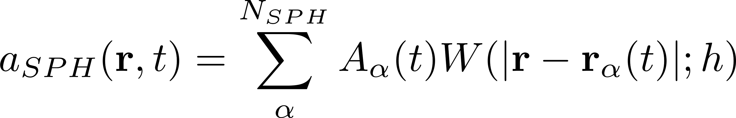




smoothed particle hydrodynamics

Slide 21


INITIAL STATE|| Local BSQ FLUCTUATIONS at LHC
Carzon et al, soon to appear

Slide 22




Charge fluctuations at freeze-out

Slide 23




Charge fluctuations at freeze-out

Slide 24
Multi-component Hydrodynamics as an effective field theory
Notes:
The transport coefficients η, ζ, and κ should be thought of as input parameters for hydrodynamics: like in any effective theory, they can not be evaluated in hydrodynamics itself, but rather need to be computed from the underlying short-distance physics, for example using the Boltzmann equation
Romatschke: If the relaxation time τΠ is not too small, Eq. (2) are the most general shear viscous hydrodynamic equations that are causal and guarantee that entropy can never locally decrease [12]. Formally, Eq. (2) correspond to the relativistic Navier-Stokes equations in the limit τΠ → 0, but contain corrections of higher order in gradients for τΠ > 0.

Slide 25



linear Stability analysis
DA, Dore, Noronha-Hostler (Arxiv.2209-11210)
See Gavassino Class.Quant.Grav. 38 (2021)

Slide 26



Backup|| CCAKE
Initial State
+ Pre-equilibrium
Hydrodynamics
SPH lagrangian method
Freezeout
Ideal Distribution
Or
One component fluid
X
X
X
X
Transport:
X
Equation of state
4D Interpolator of EoS
Notes:
Add a box tag

Slide 27





Next|| BSQ Diffusion: what to expect
Greif, Fotakis et al., PRL 120, (2018) , Fotakis, Greif et al., PRD 101, (2020)
L. Du and U. Heinz, Comput. Phys. Commun. 251, (2020)
See : Denicol, Gale, Sangyong, Monnai, Schenke, Shen PRC 98 (2018)

Slide 28







Open questions: QCD dynamics at finite charge density

Slide 29



An opportunity ||local charge fluctuations in LHC collisions

