Slide 1





Bayesian calibration of viscous anisotropic hydrodynamic simulations of heavy-ion collisions
Ulrich Heinz, Dananjaya Liyanage, Cullen Gantenberg
DE-SC0004286
OAC-2004601
Dan Liyanage et al., arXiv:2302.14184 (Phys. Rev. C, in press)
Cullen Gantenberg, research honors thesis, The Ohio State University, April 2023

Slide 2
The many stages of a heavy-ion collision

Slide 3
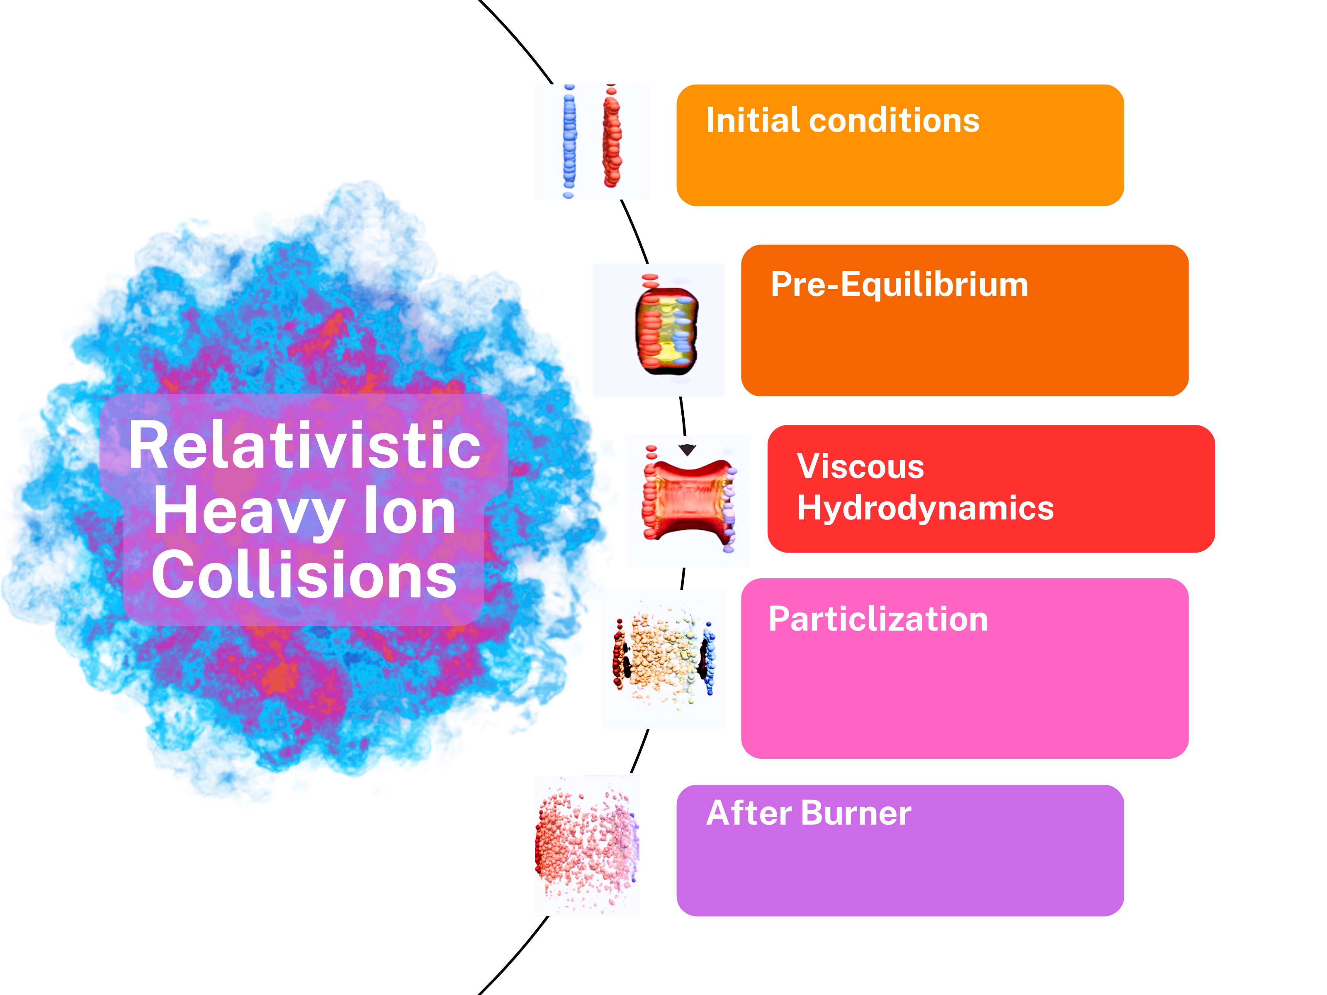
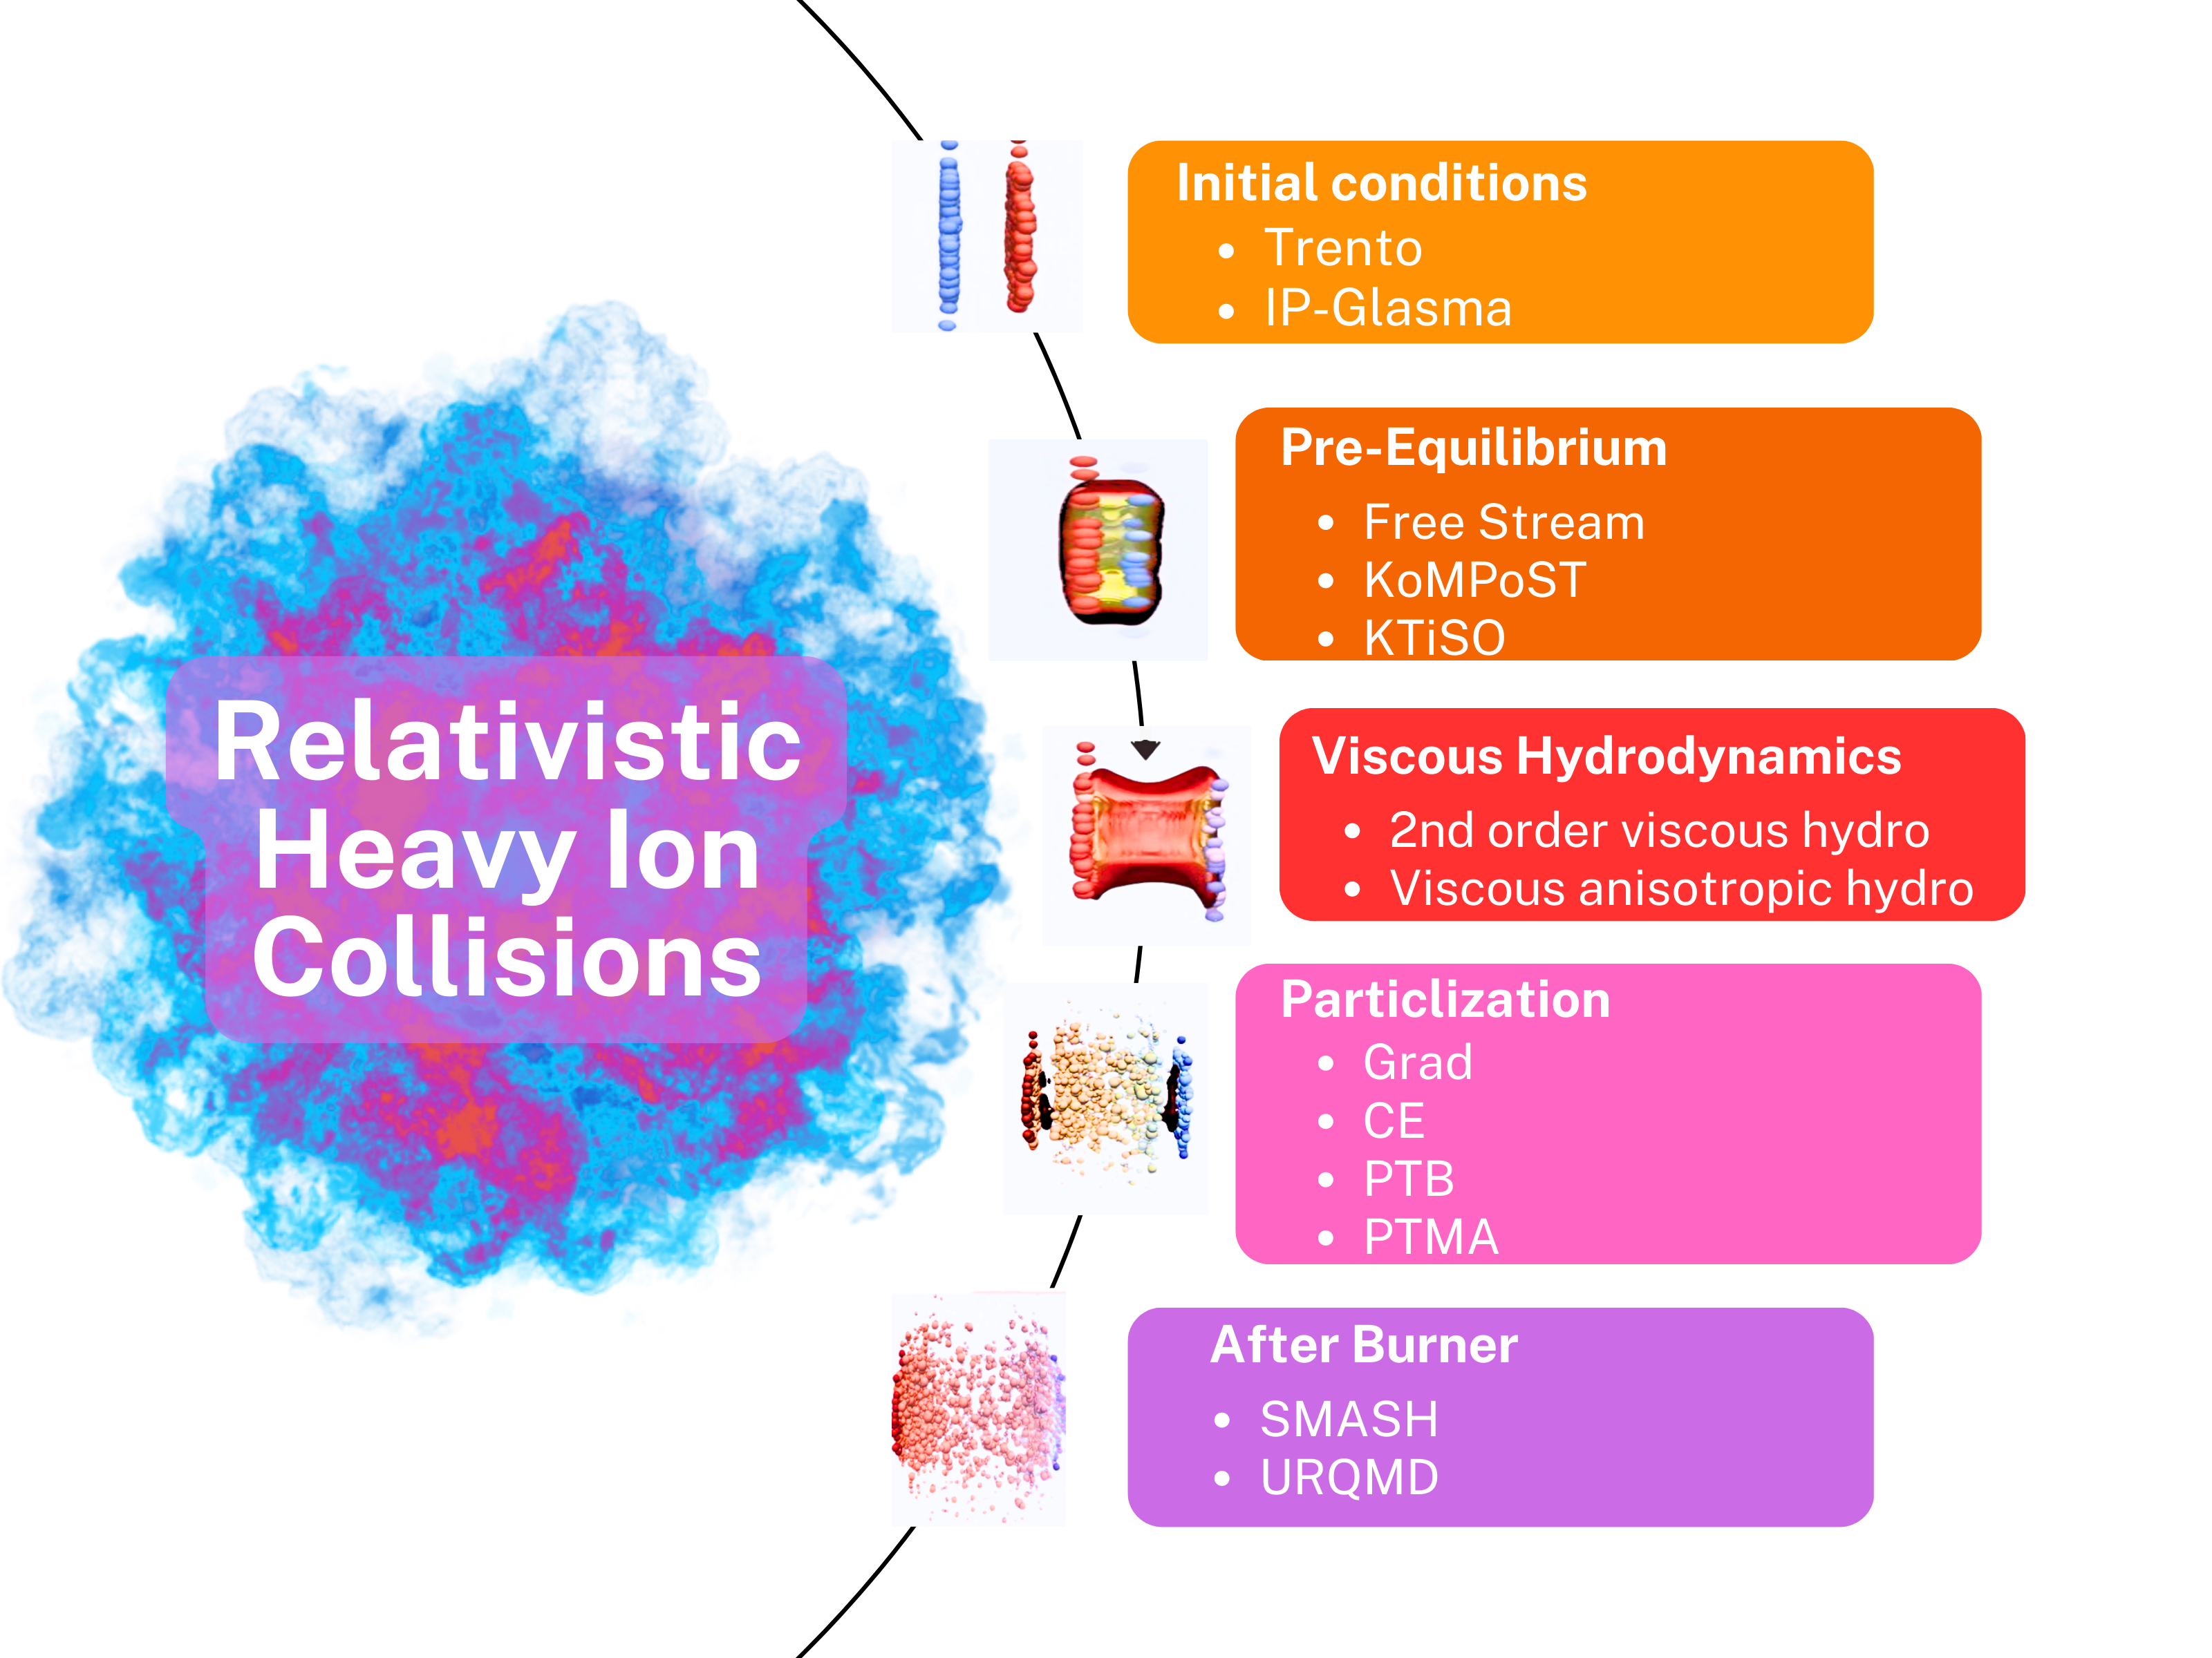
Simulation Modules
JETSCAPE SIMS calibration
D. Everett et al. 2010.03928, 2011.01430
T_{R}ENTo
MUSIC
SMASH
N : normalization
($η/s)(T)$ : shear viscosity
(𝜂/𝑠)(𝑇) : shear viscosity
$(ζ/s)\left(T\right)$ : bulk viscosity
(𝜁/𝑠)(𝑇) : bulk viscosity
d_{min} : min. dist. betw. nucleons
p : generalized mean power
w : nucleon width
$σ_{k}$ : multiplicity fluct. variance
𝜎_𝑘 : multiplicity fluct. variance
Free-
stream
CE
T_{sw} : switching temperature
$τ_{r}$ : free-stream time scale
𝜏_𝑟 : free-stream time scale
$α_{s}$ : energy density scaling of $τ_{r}$
𝛼_𝑠 : energy density scaling of 𝜏_𝑟
GRAD
CE
PTB
SMASH
Pb+Pb @ 2.76 A TeV

Slide 4
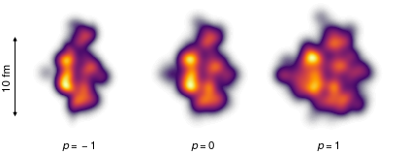
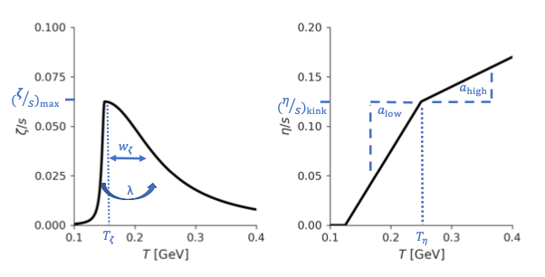
Simulation Modules
Viscous Anisotropic Hydrodynamics (VAH)
M. McNelis, D. Bazow, and U. Heinz, Computer Physics Communications 267, 108077 (2021)
VAH calibration
D. Liyanage et al. 2302.14184
T_{R}ENTo
VAH
PTMA
SMASH
p : Reduced thickness
w : Nucleon width
$σ_{k}$ : fluctuation
𝜎_𝑘 : fluctuation
N : Normalization
d_{min} : nucleon min-dist.
T_{sw} : switching temp.
$η/s(T)$ : shear viscosity
𝜂/𝑠(𝑇) : shear viscosity
$ζ/s\left(T\right)$ : bulk viscosity
𝜁/𝑠(𝑇) : bulk viscosity
R : Initial pressure ratio
p=-1
p=0
p=+1
Pb - Pb at 2.76 TeV
98 Observables
15 model parameters

Slide 5
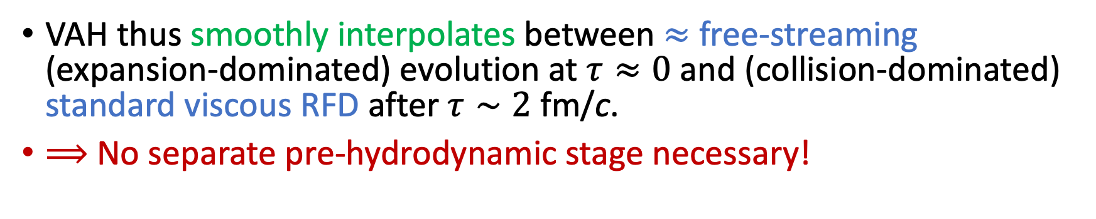
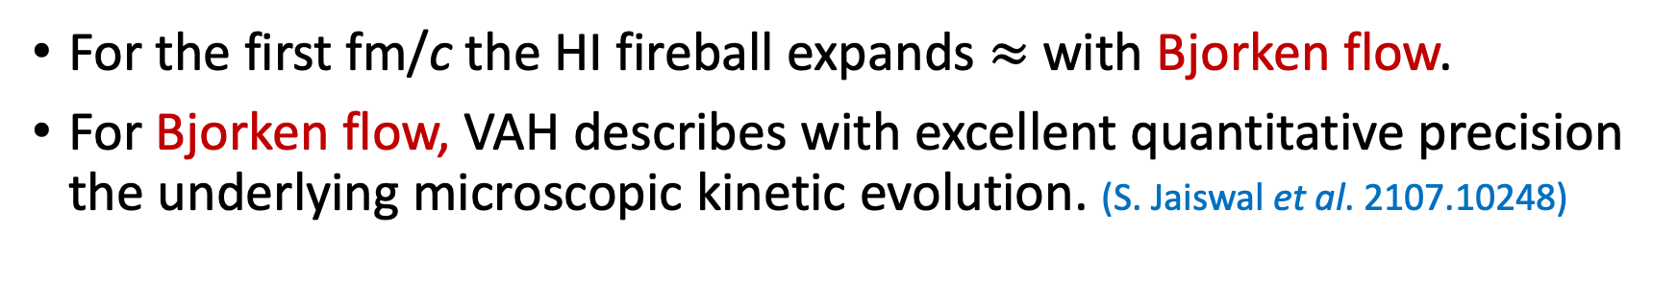
The VAH advantage
S. Jaiswal et al. 2107.10248
For the first fm/c the HI fireball expands $≈$ with Bjorken flow.
For Bjorken flow, VAH describes with excellent quantitative precision the underlying microscopic kinetic evolution. (S. Jaiswal et al. 2107.10248)
VAH thus smoothly interpolates between $≈$ free-streaming (expansion-dominated) evolution at $τ≈0$ and (collision-dominated) standard viscous RFD after $τ∼2$ fm/c.
$⟹$ No separate pre-hydrodynamic stage necessary!
solid: kinetic theory
dashed: VAH

Slide 6
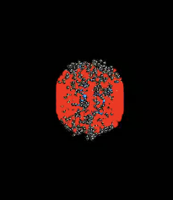
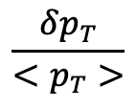
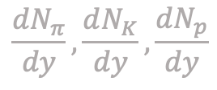




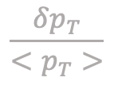





Measurements
(in transverse plane at midrapidity)
Centrality
Particle yields for kaons, pions and protons:
Charged particle yield:
0-5 %
5-10 %
20-30 %
40-50 %
$$dN_{ch}/dη$$
Observables
type
$$\frac{dN_{π}}{dy}, \frac{dN_{K}}{dy}, \frac{dN_{p}}{dy}$$
$$dE_{T}/dη$$
Observables
(≈ 100)
$$dN_{ch}/dη$$
Mean transverse
energy:
$$\frac{dN_{i}}{dy}$$
$$dE_{T}/dη$$
Elliptic, triangular and quadrangular flows:
$$v_{2}^{ch}\{2\}$$
.
.
.
$$v_{2}^{ch}\left\{2\right\}, v_{3}^{ch}\left\{2\right\}, v_{4}^{ch}\left\{2\right\}$$
$$\frac{δp_{T}}{<p_{T}>}$$
Mean transverse
momentum fluctuations:
$$<p_{T}>_{k}$$
$$\frac{δp_{T}}{<p_{T}>}$$
Mean transverse momenta of kaons, pions, protons:
${⟨p}_{T}⟩π$, ${⟨p}_{T}⟩K$, ${⟨p}_{T}⟩p$

Slide 7
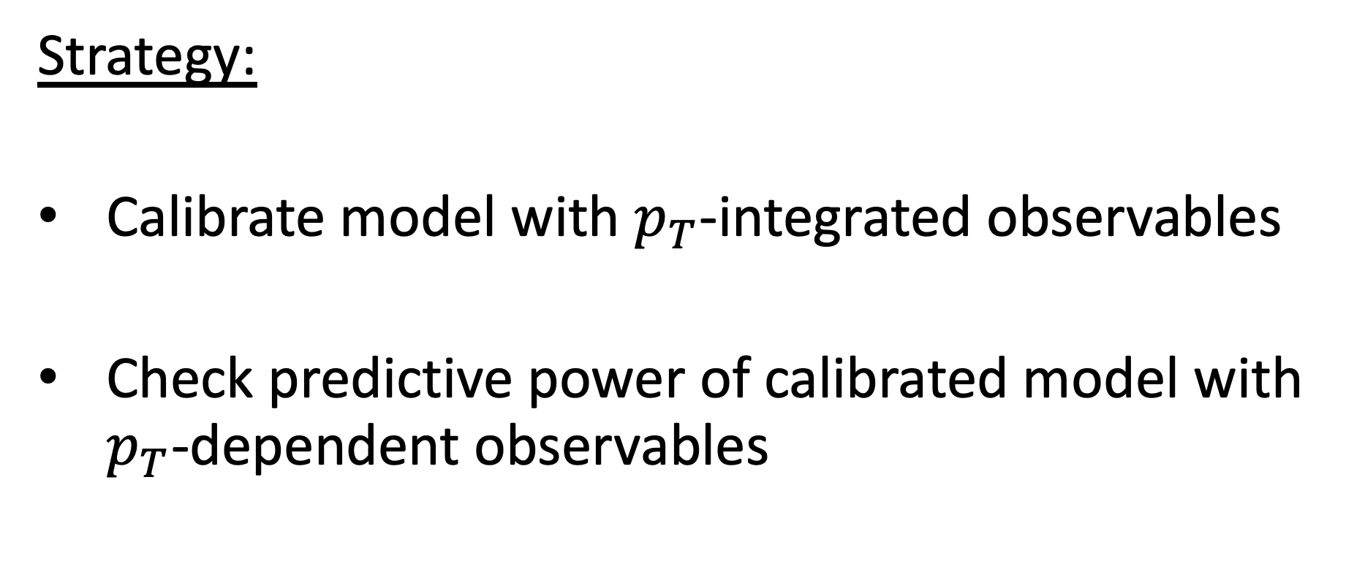
Strategy:
Calibrate model with $p_{T}$-integrated observables
Check predictive power of calibrated model with $p_{T}$-dependent observables

Slide 8
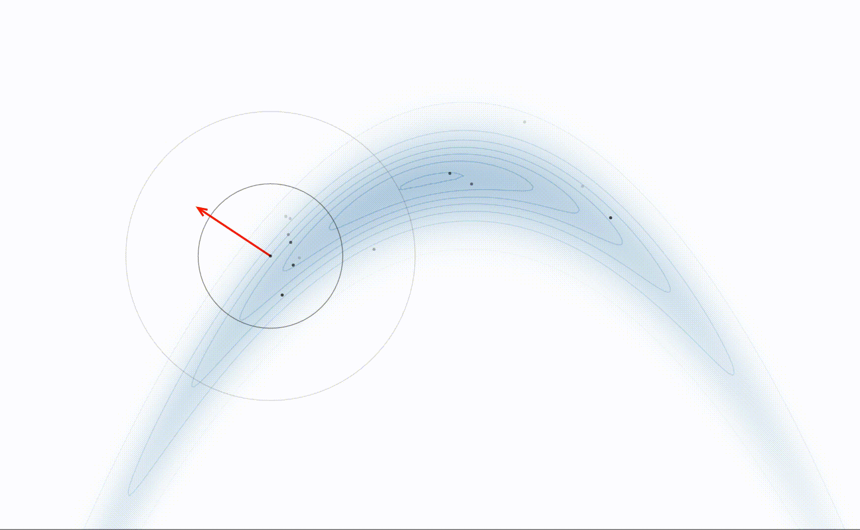



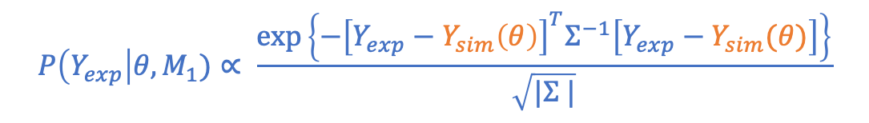

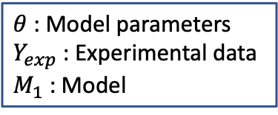
Bayesian Model Parameter Inference
$θ_{2}$
Markov Chain Monte Carlo
Bayes theorem
$\left\langle O_{sim}\right|Y_{exp} , {M_{1}⟩=∫dθ O_{sim}\left(θ\right) P\left(θ | Y_{exp} , M_{1}\right)}_{ }$
Likelihood
Prior
$$P\left(θ | Y_{exp} , M_{1}\right)=\frac{P\left(Y_{exp}\right|θ, M_{1}) P(θ|M_{1})}{P\left(Y_{exp}\right|M_{1})}$$
$θ$ : Model parameters
$Y_{exp}$ : Experimental data
$M_{1}$ : Model
Posterior
Marginal Likelihood
$$P\left(Y_{exp}\right|θ, M_{1})∝ \frac{exp⁡\left\{{−\left[Y_{exp}−Y_{sim}\left(θ\right)\right]}^{T}Σ^{−1}\left[Y_{exp}−Y_{sim}(θ)\right]\right\}}{\sqrt{|Σ |}}$$
$$Σ=Σ_{experimental}+Σ_{simulation}$$
$θ_{1}$
MCMC animation from Chi Feng’s Github

Slide 9
Innovations introduced in Liyanage’s thesis:
Efficient emulator training through Transfer Learning
Liyanage et al. (together with JETSCAPE) 2201.07302
Efficient emulator training using Adaptive Sampling (an Active Learning strategy)
Liyanage et al. (together with BAND) 2302.14184; Sürer, Plumlee, Wild, 2305.16506
More precise Advanced PCSK emulators that use both mean and variance information of the training data
Liyanage, Sürer et al. 2302.14184
Please read the papers and visit TAWERET if interested.

Slide 10
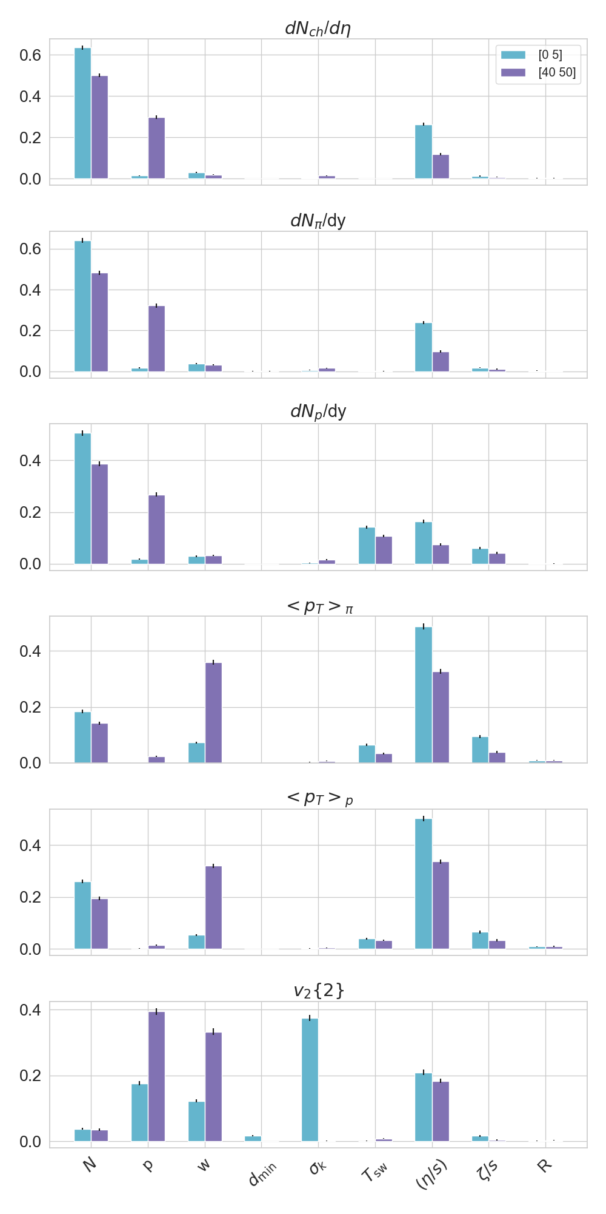
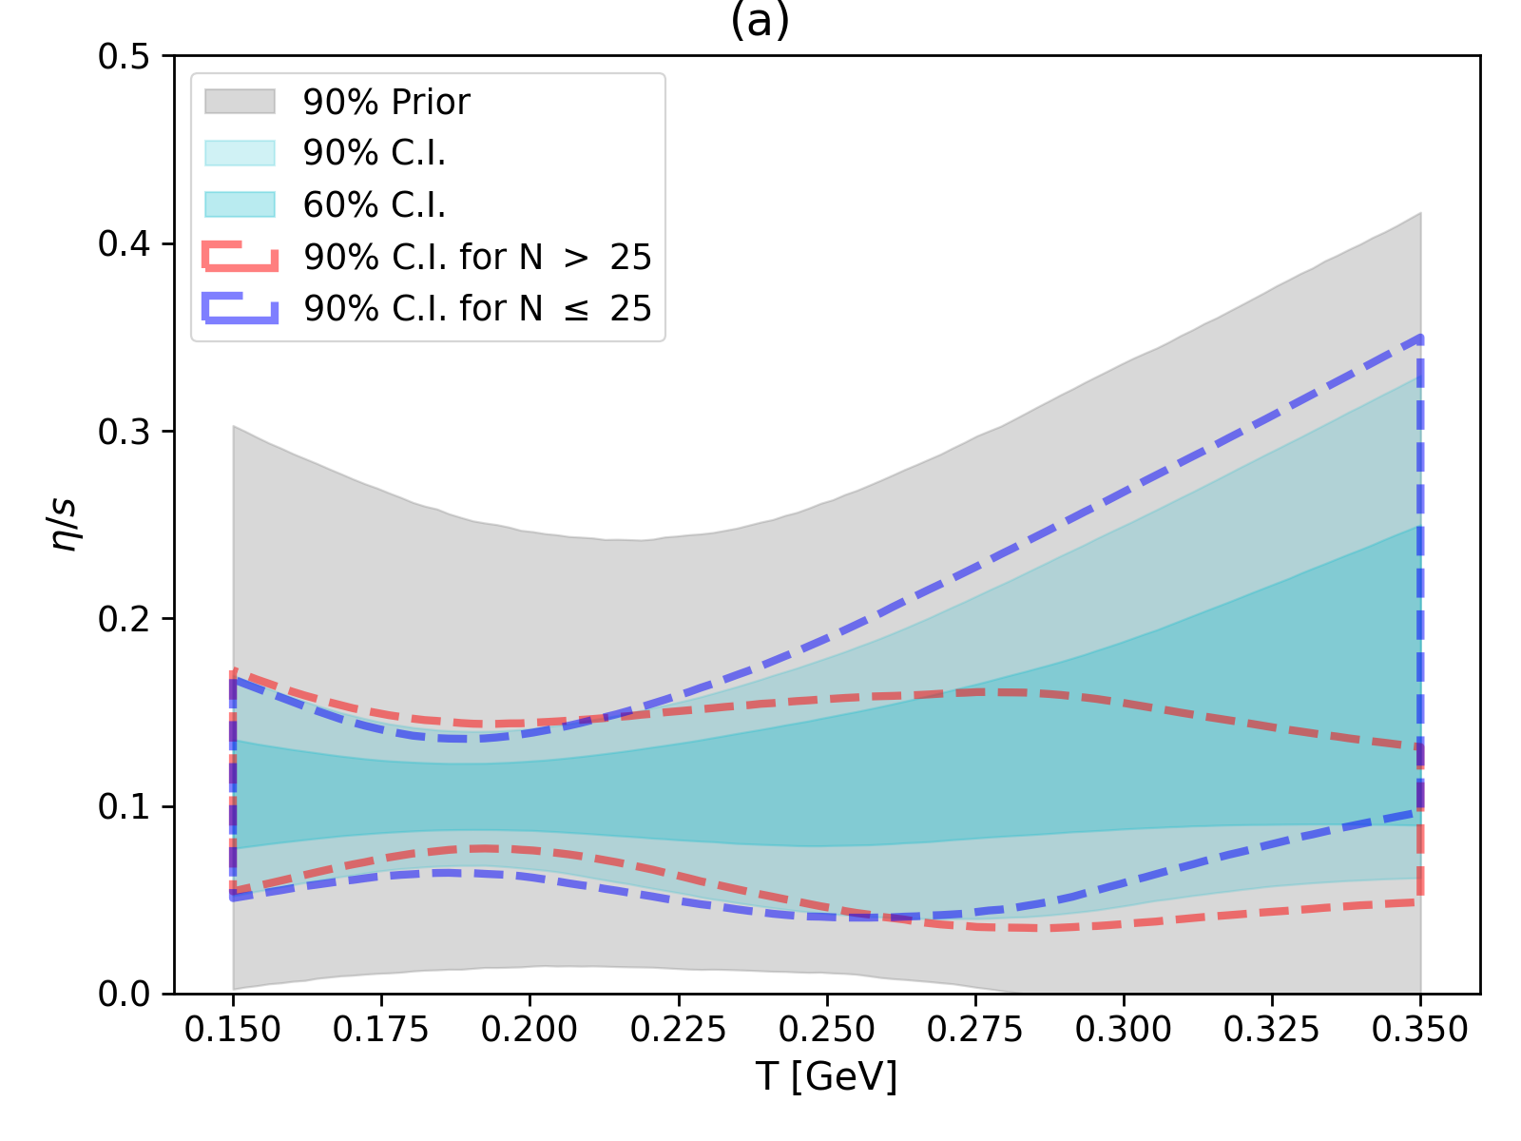
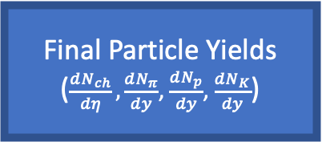

VAH model parameters
Sensitivity Analysis
D. Liyanage et al., 2302.14184
Initial entropy
Generated entropy
N
$$\frac{η}{s}$$
Final Particle Yields
($\frac{dN_{ch}}{dη},\frac{dN_{π}}{dy}$, $\frac{dN_{p}}{dy}$, $\frac{dN_{K}}{dy}$)
Joint marginal distribution of posterior
Temperature dependent specific shear viscosity
Notes:
Point to cullens work on predicting pT dependent observables with calibrated VAH. We have added a serious competitor to the available list of models.

Slide 11
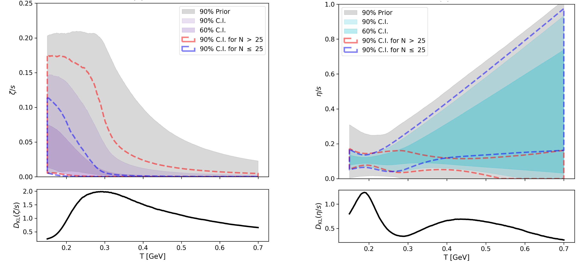

Temperature-dependent specific QGP viscosities
specific bulk viscosity specific shear viscosity
JETSCAPE SIMS model
VAH model
(Note doubled T-range!)
Significant tightening of the $(η/s)\left(T\right)$ constraints!

Slide 12
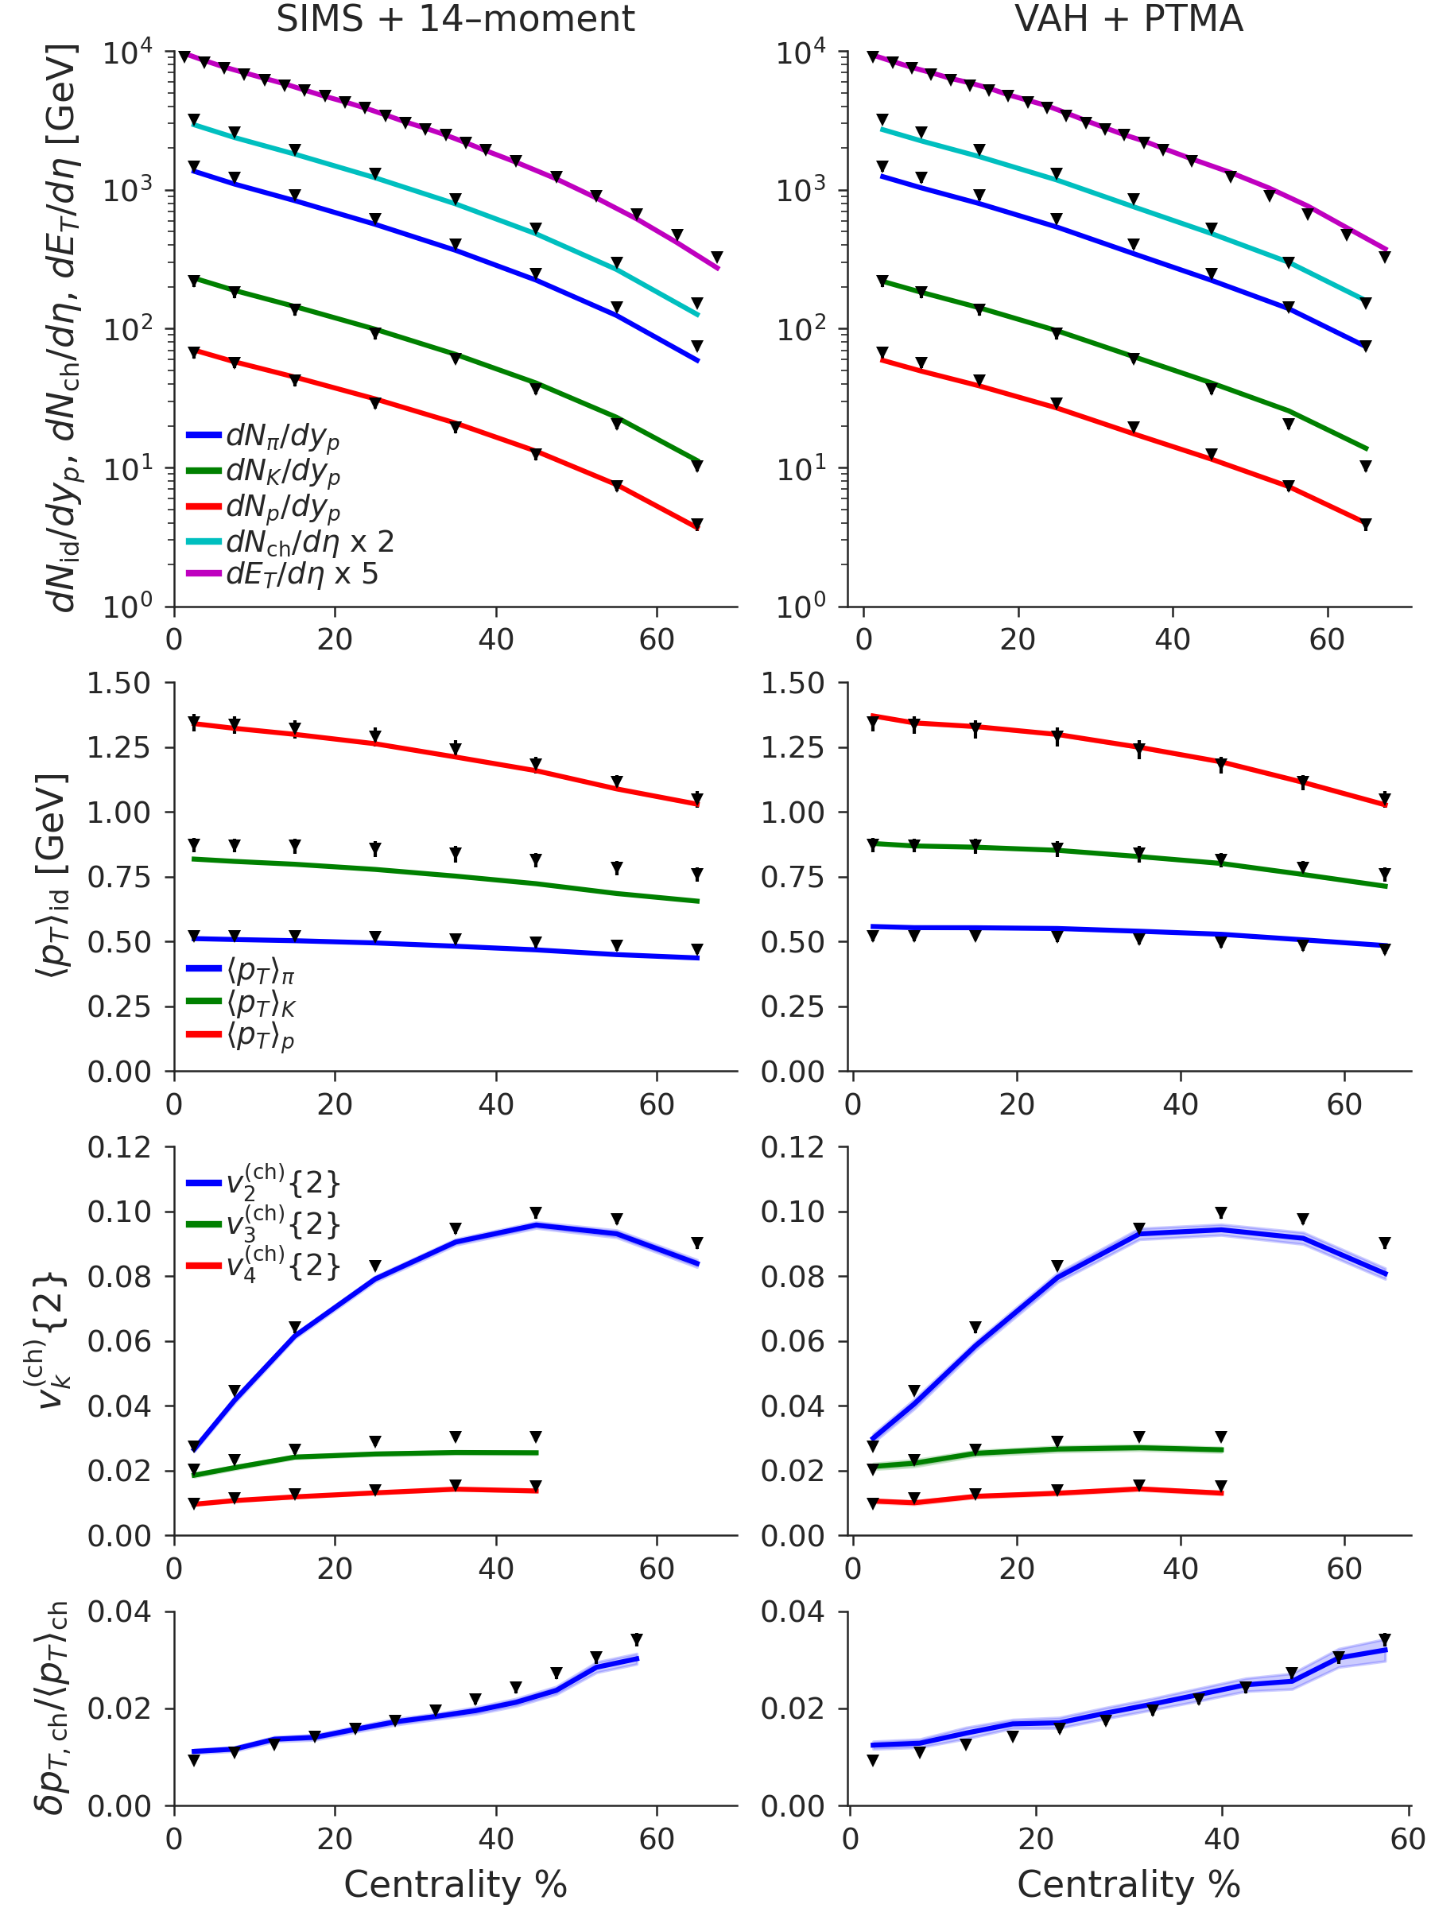
Best fit (MAP) output from the calibrated Model:
prediction
prediction
D. Everett et al. (JETSCAPE Collaboration), Phys. Rev. C 103, 054904 (2021)
D. Liyanage et al., 2302.14184

Slide 13
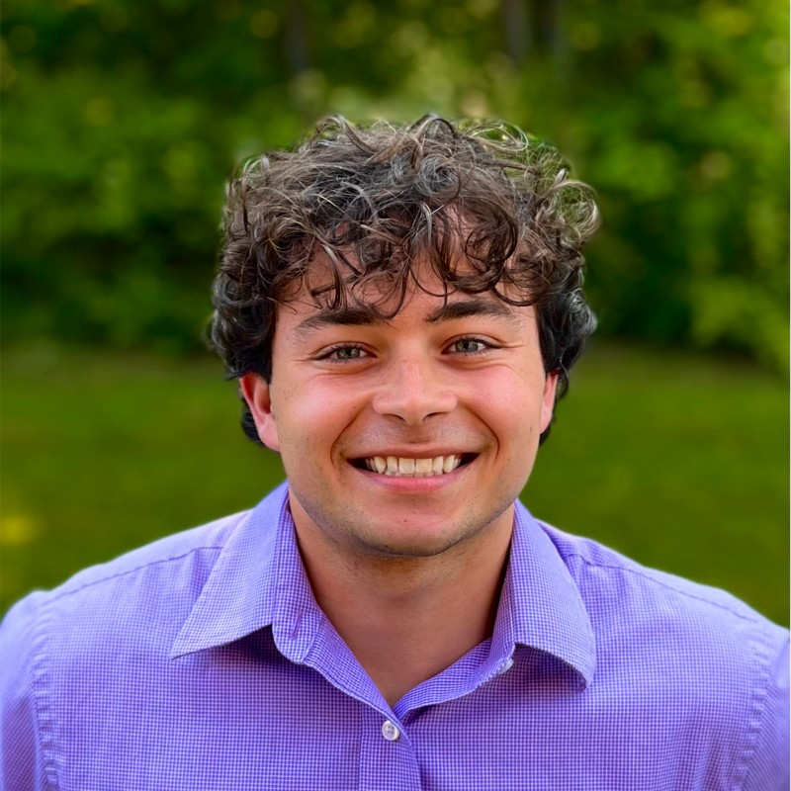
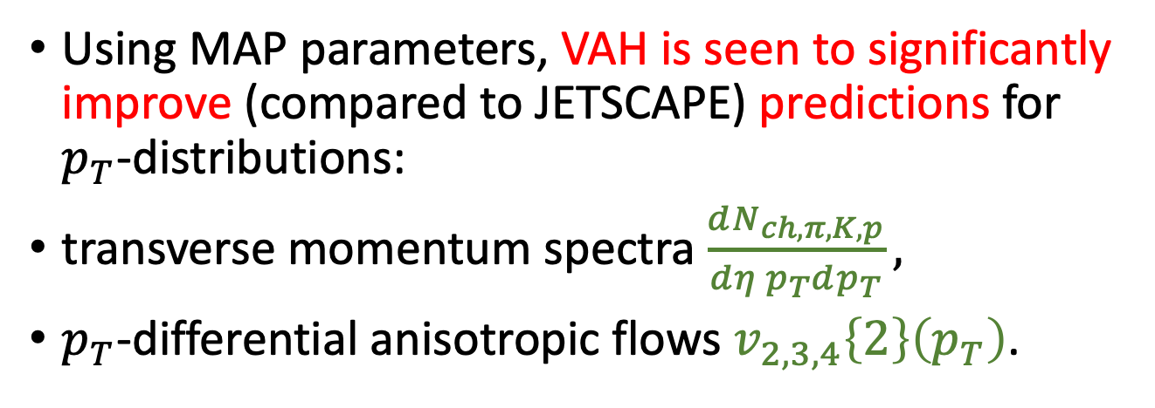
More predictions: Cullen Gantenberg, OSU Honors Thesis; C. Gantenberg, D. Liyanage, UH, in prep.
Cullen Gantenberg
(UW-bound)
Using MAP parameters, VAH is seen to significantly improve (compared to JETSCAPE) predictions for $p_{T}$-distributions:
transverse momentum spectra $\frac{dN_{ch,π,K,p}}{dη p_{T}dp_{T}},$
$p_{T}$-differential anisotropic flows $v_{2,3,4}\left\{2\right\}\left(p_{T}\right)$.
Analysis of Anisotropic Flow in Ultrarelativistic Heavy Ion Collisions
OSU Honors Thesis
Showing only a few selected examples for illustration:

Slide 14
Simulation Modules
M. McNelis, D. Bazow, and U. Heinz, Computer Physics Communications 267, 108077 (2021)
Viscous Anisotropic Hydrodynamics Model
p=-1
p=0
p=+1
T_{R}ENTo
VAH
PTMA
SMASH
p : Reduced thickness
w : Nucleon width
$σ_{k}$ : fluctuation
𝜎_𝑘 : fluctuation
N : Normalization
d_{min} : nucleon min-dist.
T_{sw} : switching temp.
$η/s(T)$ : shear viscosity
𝜂/𝑠(𝑇) : shear viscosity
$ζ/s\left(T\right)$ : bulk viscosity
𝜁/𝑠(𝑇) : bulk viscosity
R : Initial pressure ratio
Pb+Pb @ 2.76 A TeV
98 Observables
15 model parameters

Slide 15
Simulation Modules
JETSCAPE models (Not VAH)
T_{R}ENTo
MUSIC
SMASH
N : normalization
($η/s)(T)$ : shear viscosity
(𝜂/𝑠)(𝑇) : shear viscosity
$(ζ/s)\left(T\right)$ : bulk viscosity
(𝜁/𝑠)(𝑇) : bulk viscosity
d_{min} : min. dist. betw. nucleons
p : generalized mean power
w : nucleon width
$σ_{k}$ : multiplicity fluct. variance
𝜎_𝑘 : multiplicity fluct. variance
Free-
stream
CE
T_{sw} : switching temperature
$τ_{r}$ : free-stream time scale
𝜏_𝑟 : free-stream time scale
$α_{s}$ : energy density scaling of $τ_{r}$
𝛼_𝑠 : energy density scaling of 𝜏_𝑟
GRAD
CE
PTB
SMASH
Pb+Pb @ 2.76 A TeV

Slide 16
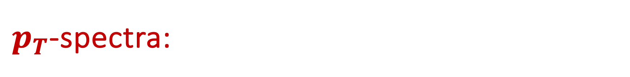
$p_{T}$-spectra:
JETSCAPE CE
VAH

Slide 17
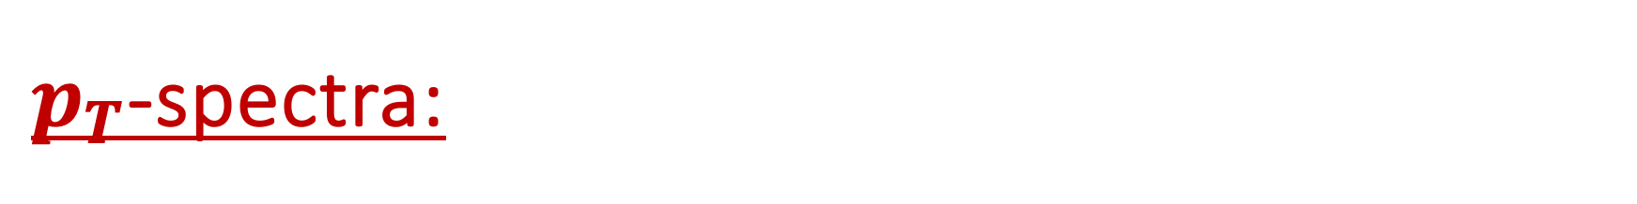
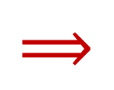
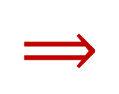
$p_{T}$-spectra:
JETSCAPE CE:
$$⟹$$
VAH:
$$⟹$$

Slide 18


Anisotropic flows: Cullen Gantenberg, OSU Honors Thesis; C. Gantenberg, D. Liyanage, UH, in prep.
Elliptic flow $v_{2}\left\{2\right\}\left(p_{T}\right)$ for pions, kaons, protons
Triangular flow $v_{3}\left\{2\right\}\left(p_{T}\right)$ for pions, kaons, protons

Slide 19

Anisotropic flows: Cullen Gantenberg, OSU Honors Thesis; C. Gantenberg, D. Liyanage, UH, in prep.
Elliptic flow $v_{2}\left\{2\right\}\left(p_{T}\right)$ for pions, kaons, protons
Triangular flow $v_{3}\left\{2\right\}\left(p_{T}\right)$ for pions, kaons, protons
Quadrangular flow $v_{4}\left\{2\right\}\left(p_{T}\right)$ for pions, kaons, protons
Among Chapman-Enskog (CE), Grad 14-moment (Grad), and Pratt-Torrieri-Bernhard (PTB) particlizations, CE yields the best results in the JETSCAPE SIMS calibration. VAH with PTMA particlization beats them all!

Slide 20
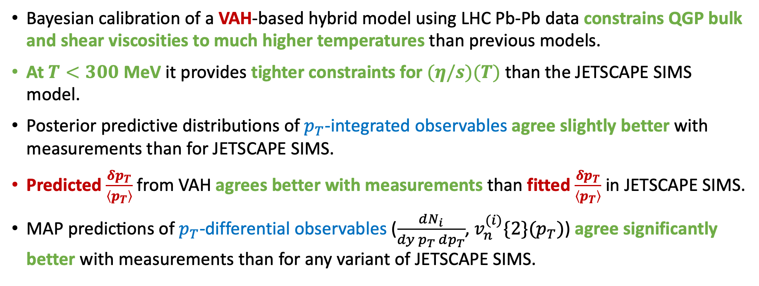
Summary:
Bayesian calibration of a VAH-based hybrid model using LHC Pb-Pb data constrains QGP bulk and shear viscosities to much higher temperatures than previous models.
At $T<300$ MeV it provides tighter constraints for $(η/s)(T)$ than the JETSCAPE SIMS model.
Posterior predictive distributions of $p_{T}$-integrated observables agree slightly better with measurements than for JETSCAPE SIMS.
Predicted $\frac{δp_{T}}{\left\langle p_{T}\right\rangle }$ from VAH agrees better with measurements than fitted $\frac{δp_{T}}{\left\langle p_{T}\right\rangle }$ in JETSCAPE SIMS.
$\text{MAP} \text{predicti}\text{ons} \text{of} p_{T}$-differential observables ($\frac{dN_{i}}{dy{ p}_{T} dp_{T}}$, $v_{n}^{(i)}\{2\}(p_{T})$) agree significantly better with measurements than for any variant of JETSCAPE SIMS.

Slide 21
THANK YOU!

