Slide 1





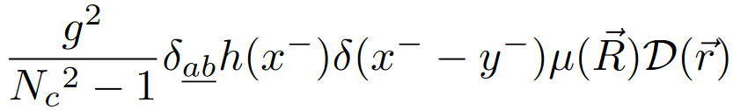
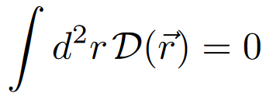





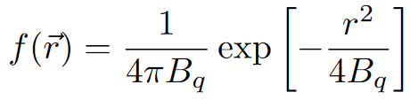
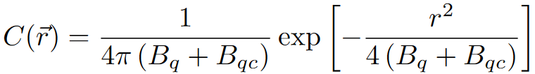
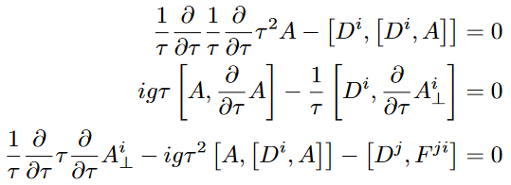
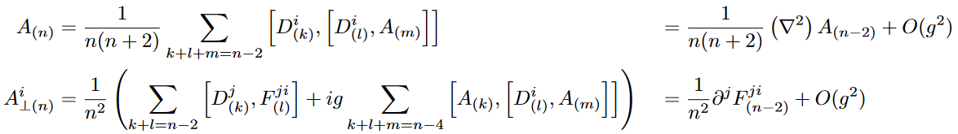
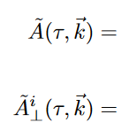
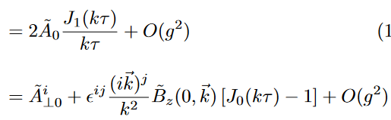

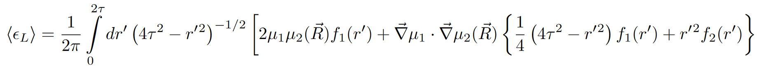
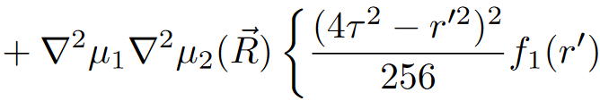
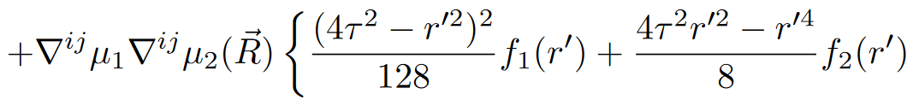
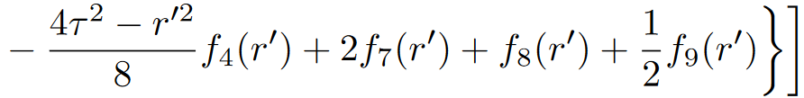
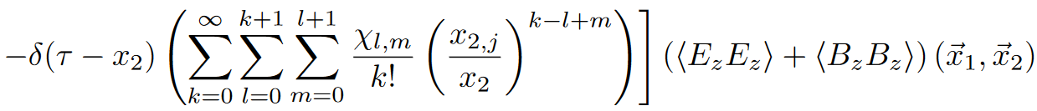
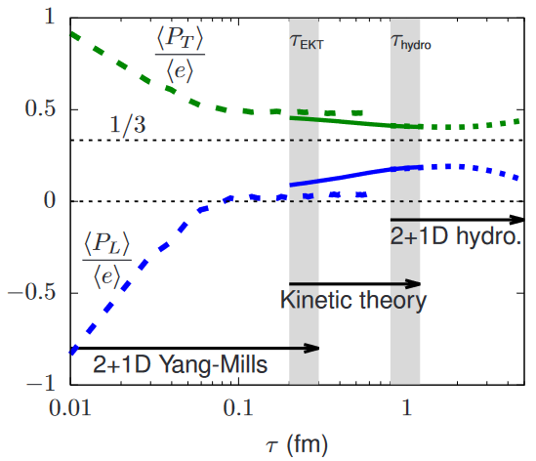
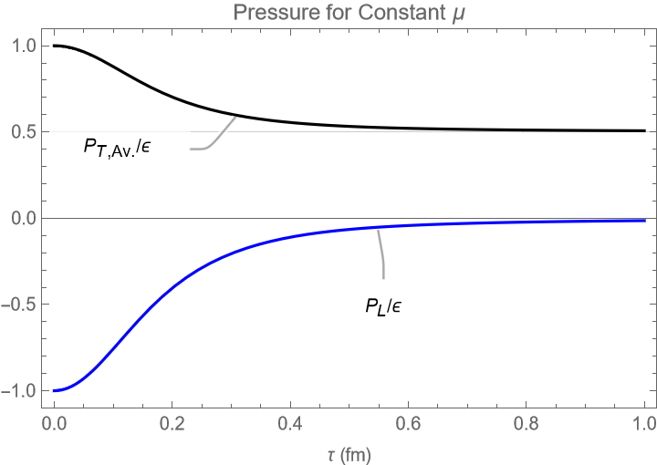
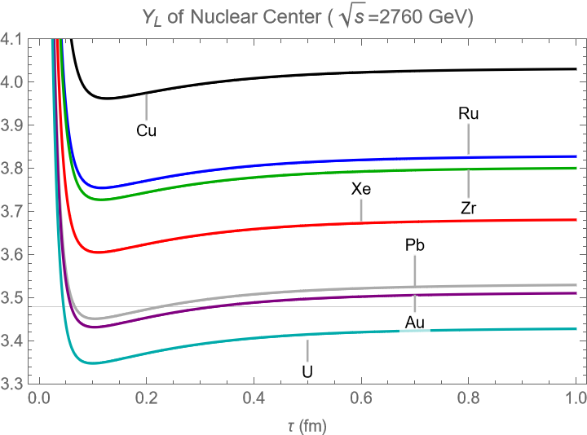
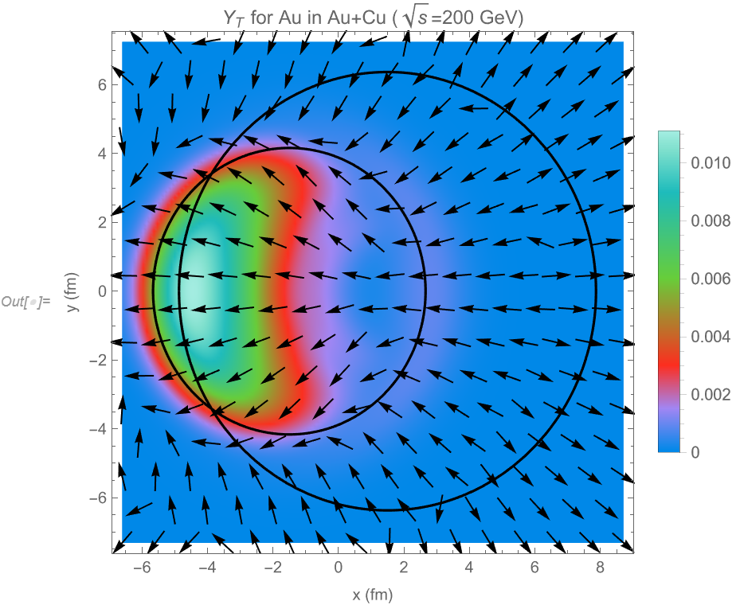
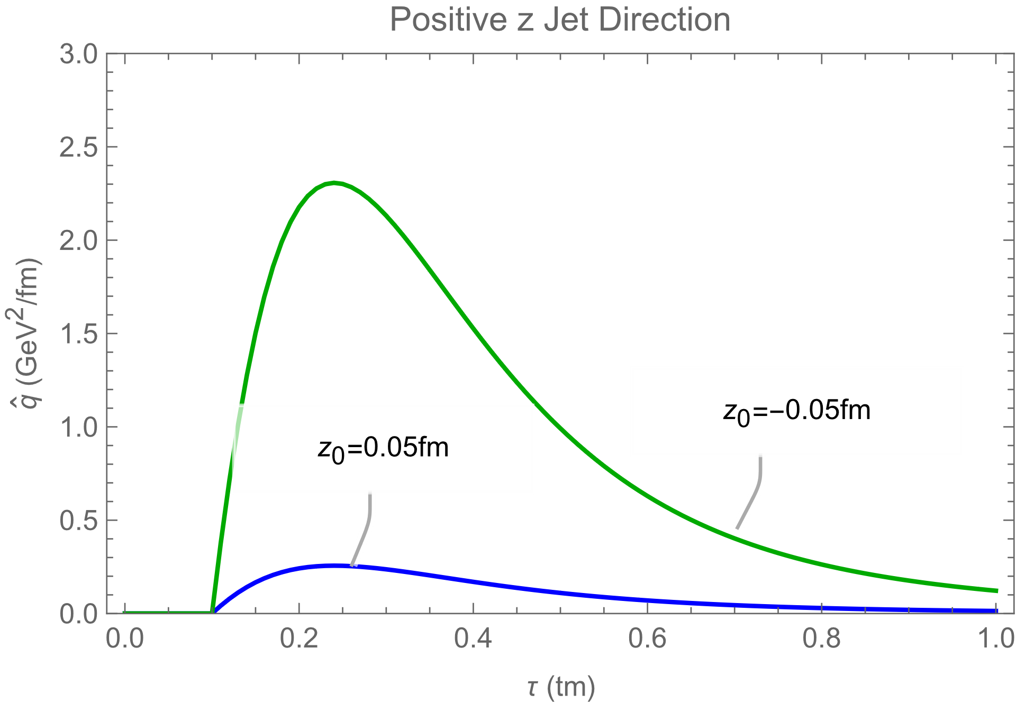
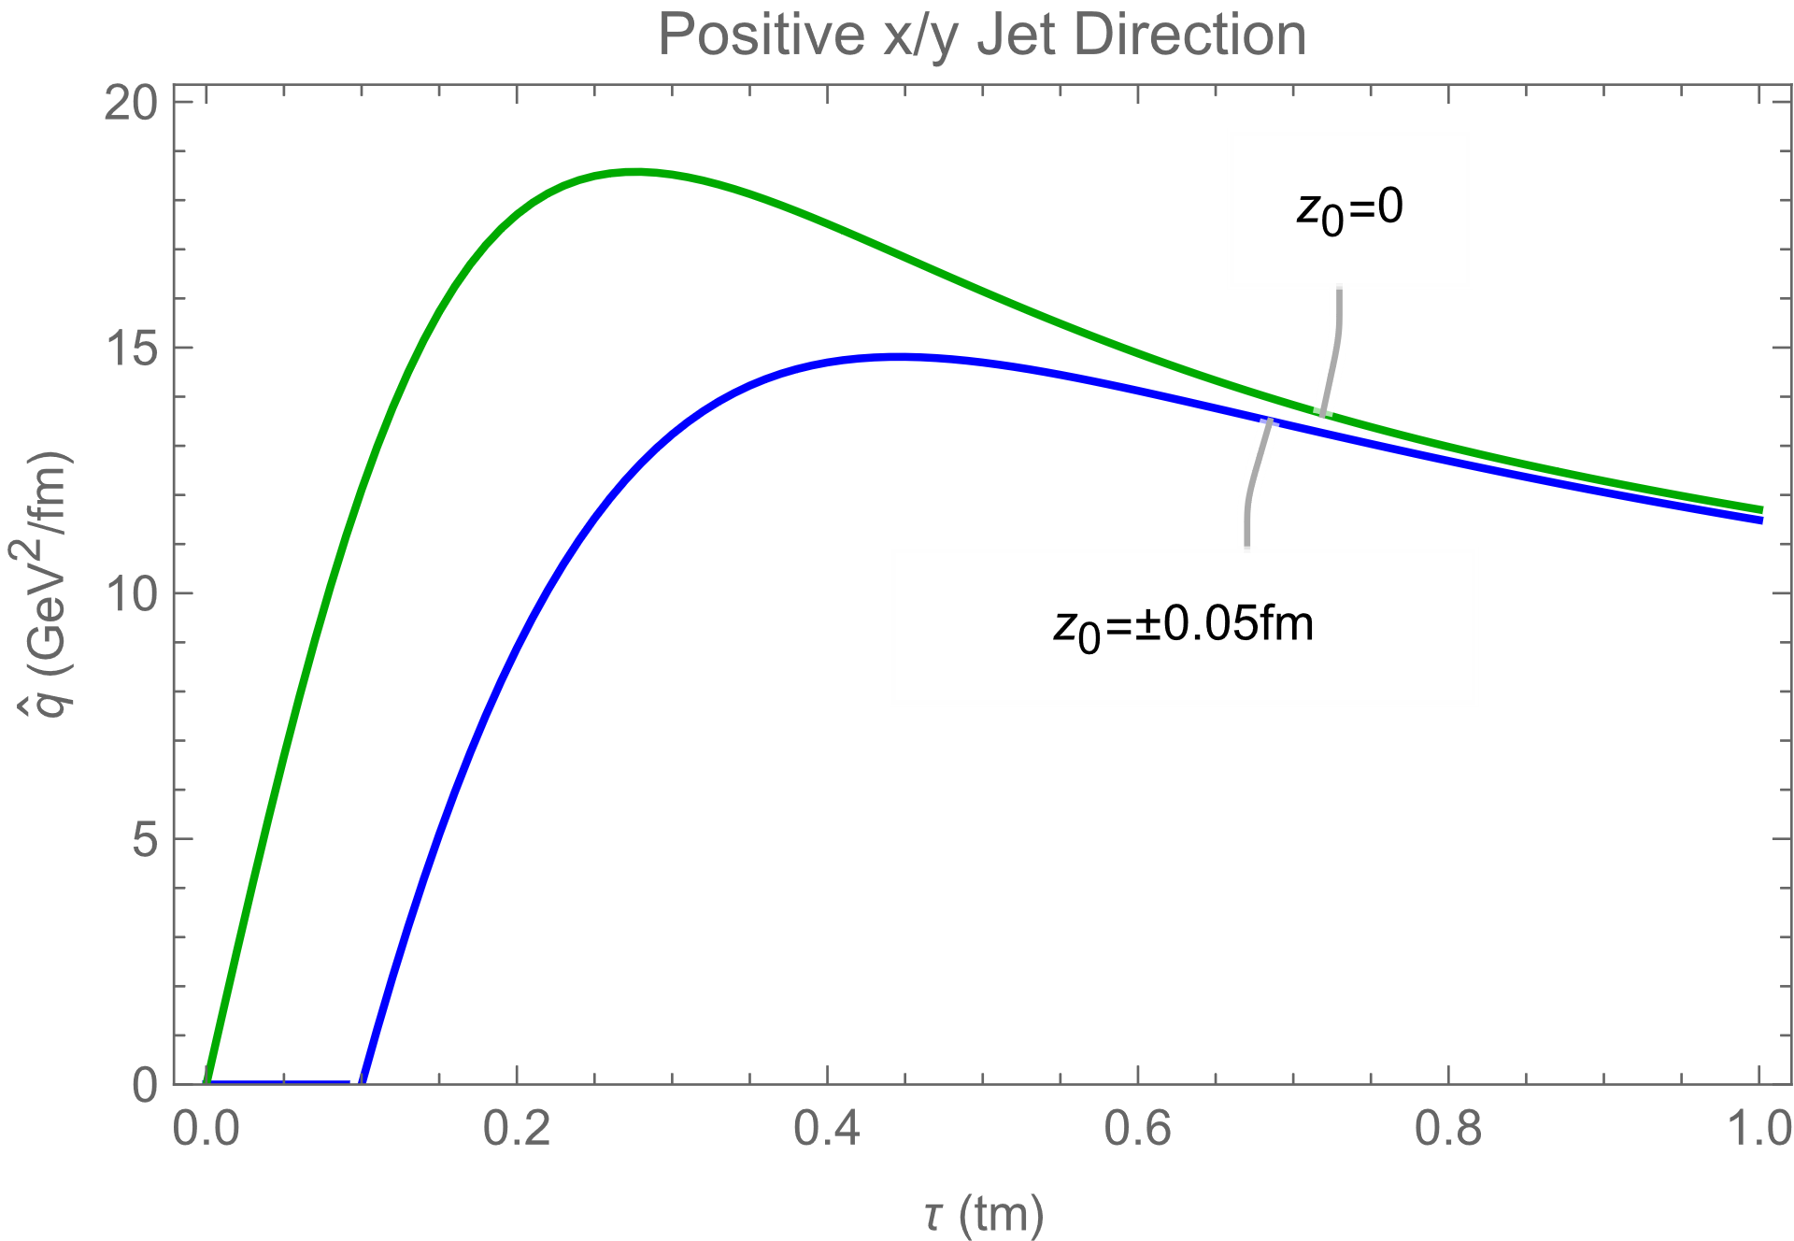
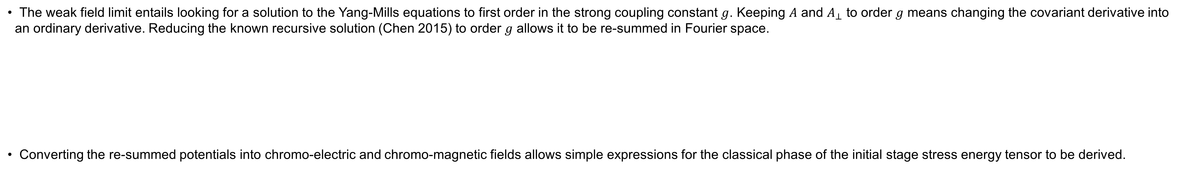
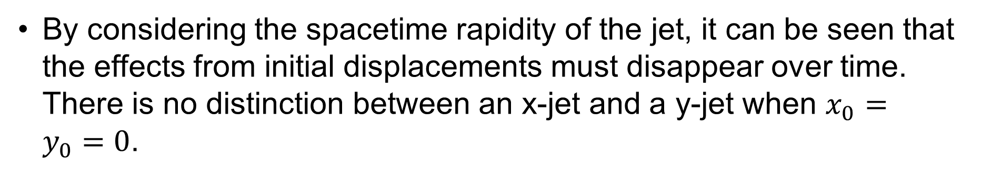
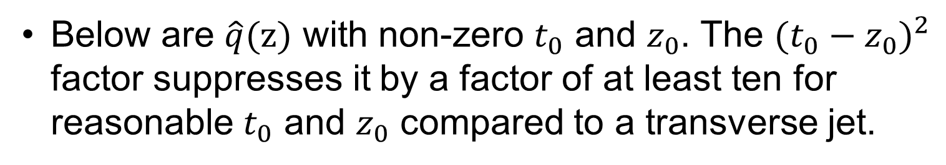
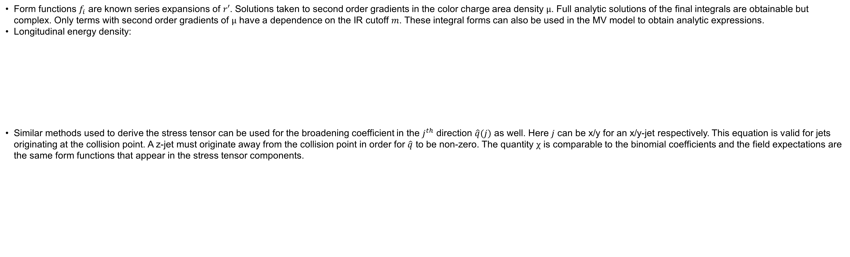
Analytic and Semi-Analytic Calculations for Color Glass in the Weak Field Limit
S. Robicheaux
Color Glass and a Gaussian Model
The nucleus of an atom moves at a significant fraction of the speed of light in a heavy ion collision. As a result the nucleus experiences a large amount of Lorentz contraction and its longitudinal extent can no longer be resolved by a gluon.
  The nucleus is said to be in an effective state of matter called color glass.
Color glass fields behave classically because of the large occupation numbers of the field. This is most applicable at the center of a large nucleus.
  The classical description is enforced through the use of event averages. The weight functional of the volume charge density is taken to be Gaussian.
One common model of color glass is the McLerran Venugopalan model which takes to be a 2D delta function. It is easily seen that this choice fails the integral on the right.
  This integral test is important because it was shown that a hadron must pass it in order to be color neutral (Lam 1999).
The form of can be derived from the same picture as IP-Glasma. The result forms a Gaussian model. It is found that this Gaussian model is free from UV singularities and is less susceptible to IR divergences.
Yang-Mills Equations in the Weak Field Limit
The weak field limit entails looking for a solution to the Yang-Mills equations to first order in the strong coupling constant $g$. Keeping $A$ and $A_{⊥}$ to order $g$ means changing the covariant derivative into an ordinary derivative. Reducing the known recursive solution (Chen 2015) to order $g$ allows it to be re-summed in Fourier space.
Converting the re-summed potentials into chromo-electric and chromo-magnetic fields allows simple expressions for the classical phase of the initial stage stress energy tensor to be derived.
Analytic Expressions for the Stress Tensor Components and the Broadening Coefficient
Form functions $f_{i}$ are known series expansions of $r′$. Solutions taken to second order gradients in the color charge area density $μ$. Full analytic solutions of the final integrals are obtainable but complex. Only terms with second order gradients of $μ$ have a dependence on the IR cutoff $m$. These integral forms can also be used in the MV model to obtain analytic expressions.
Longitudinal energy density:
Similar methods used to derive the stress tensor can be used for the broadening coefficient in the $j^{th}$ direction $\hat{q}(j)$ as well. Here $j$ can be x/y for an x/y-jet respectively. This equation is valid for jets originating at the collision point. A z-jet must originate away from the collision point in order for $\hat{q}$ to be non-zero. The quantity $χ$ is comparable to the binomial coefficients and the field expectations are the same form functions that appear in the stress tensor components.
Applications
The time evolution of the stress tensor plays a central role in the deceleration of the colliding nuclei after the collision. If the nuclei decelerate too much, then they are not sufficiently close to the light cone for the color glass approximation to be accurate. A longitudinal rapidity ~3.5 for Pb or Au must be maintained for self consistency.
One direct application of this work is to calculate the initial conditions for later phases of a heavy ion collision. Some authors, including (Kurkela 2019), use a second phase to the initial stage to smooth the transition to thermodynamic equilibrium. A rough sketch on when to start their effective kinetic theory showed it may start ~.2fm/c after the collision.
This work provides a more detailed picture of the first phase. In the weak field limit, ~0.7fm/c after the collision seems a more appropriate time to begin the second phase. The reason for the change is the Abelianization of the Yang-Mills equations.
Transverse motion can be computed at the same time as the longitudinal deceleration. Nuclei exhibit a preference to move outward through the opposite nucleus at around 1% the speed of light.
Below are $\hat{q}(z)$ with non-zero $t_{0}$ and $z_{0}$. The ${(t_{0}−z_{0})}^{2}$ factor suppresses it by a factor of at least ten for reasonable $t_{0}$ and $z_{0}$ compared to a transverse jet.
By considering the spacetime rapidity of the jet, it can be seen that the effects from initial displacements must disappear over time. There is no distinction between an x-jet and a y-jet when $x_{0}=y_{0}=0$.
References: G. Chen, R. Fries, J. Kapusta, and Y. Li, Phys. Rev. C 92, 064912 (2015).
A. Kurkela, A. Mazeliauskas, J.-F. Paquet, S. Schlichting, and D. Teaney. Phys. Rev. C 99, 034910 (2019)
C. S. Lam and G. Mahlon, Phys. Rev. D 61, 014005 (1999).
Acknowledgments: This work was funded in part by the National Science Foundation under grant numbers 1812431 and 2111568. Transverse
rapidity plot computed with TAMU HPRC computing resources.

