Slide 1


New LHCb results on quarkonia production (and exotic hadron) in pp and pPb collisions.
Cesar Luiz da Silva for the LHCb Collaboration
Los Alamos National Lab
LA-UR-23-30003

Slide 2
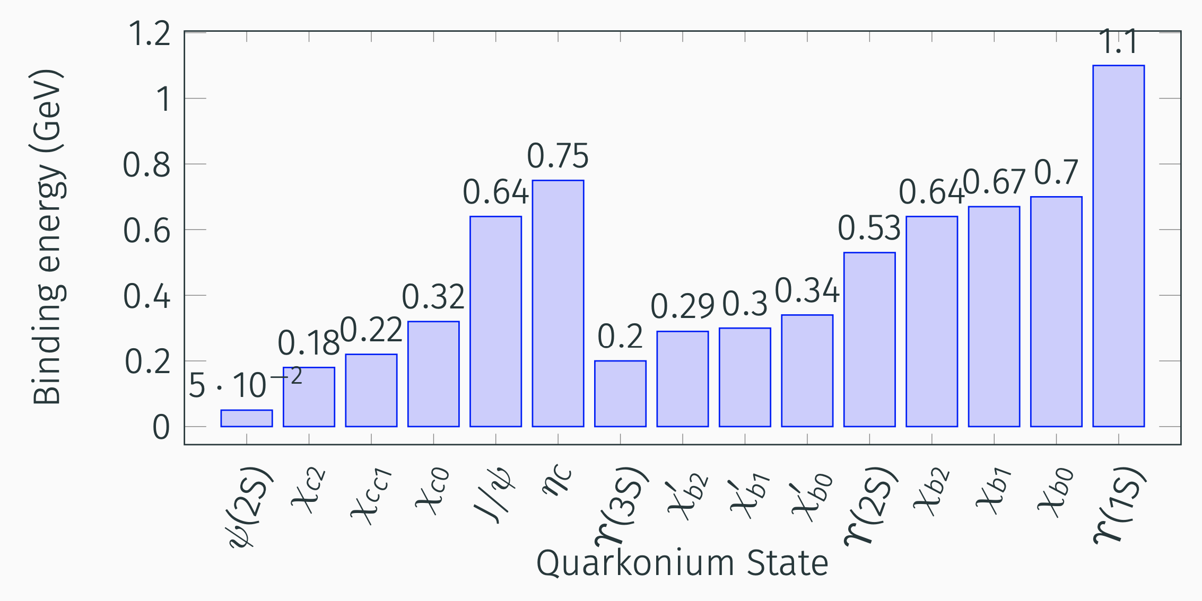
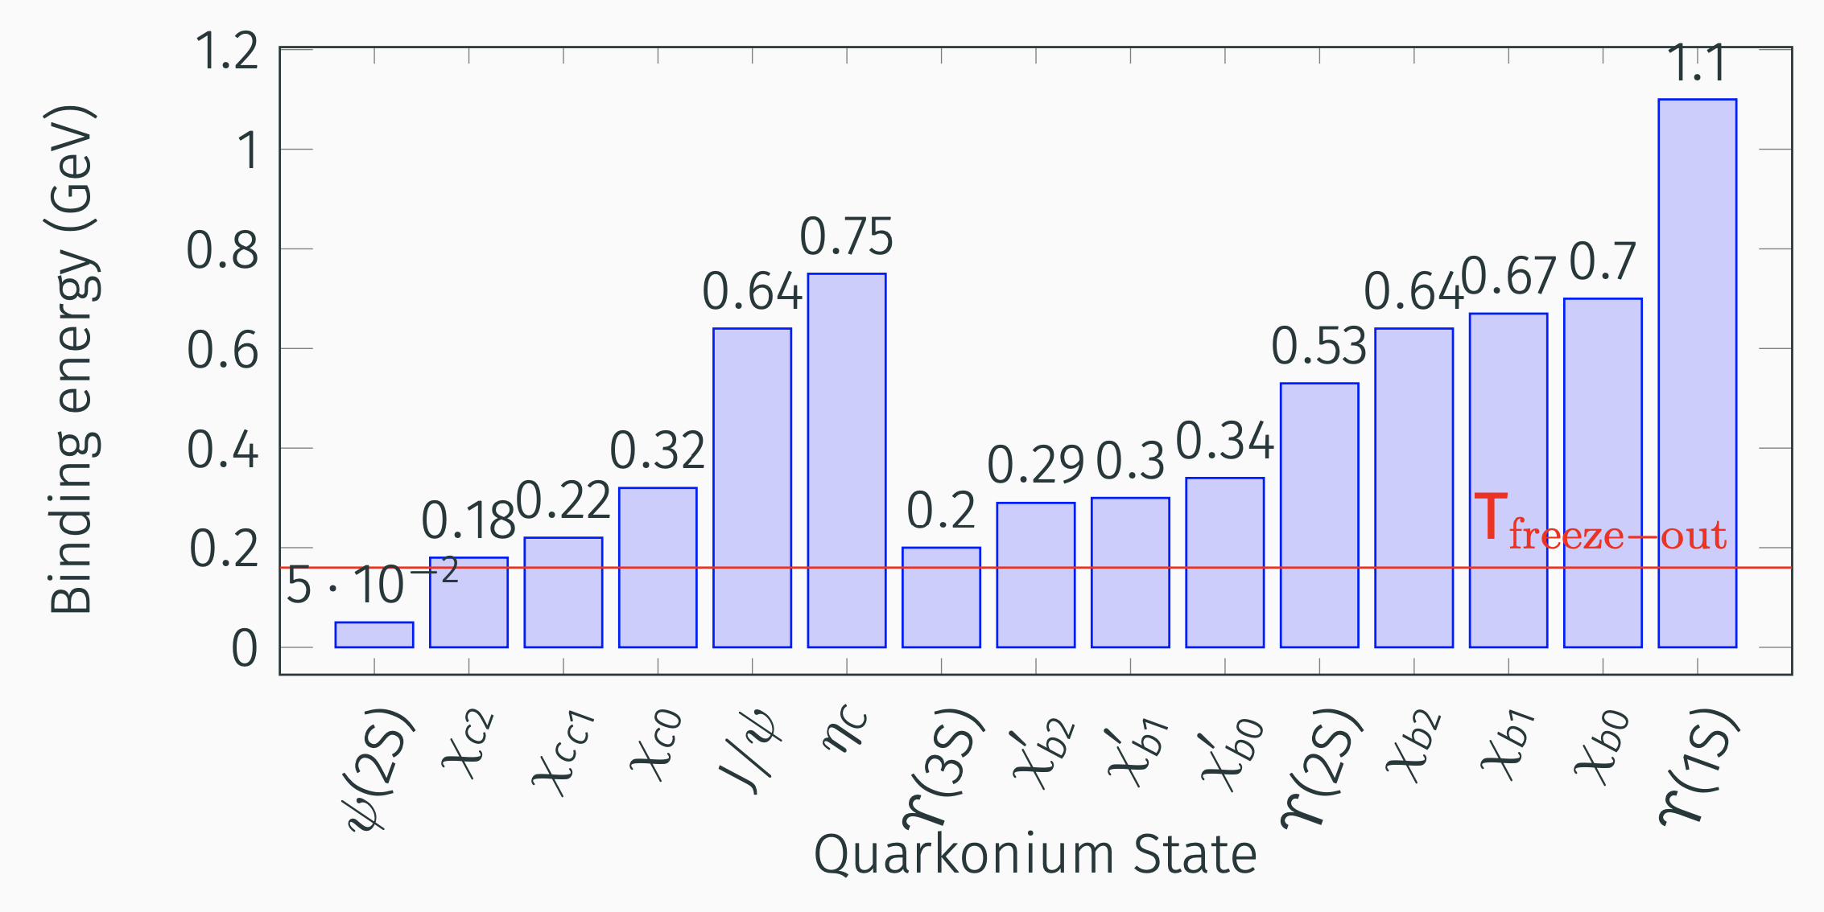
Quarkonium States
If medium is formed and temperature is above its binding energy, the quarkonium state is inhibit to be produce.
T_{freeze-out} ~ 155-160 MeV
Lattice QCD A. Bazavov et al., PLB795 (2019) 15
Thermal Model N. Sharma et al. PRC 99 (2019) 044914
Thermal fits to ALICE data F. A. Flor, PLB 834 (2022) 137473

Slide 3
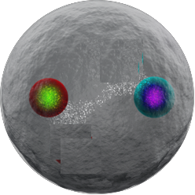
Alternative way to break quarkonium states:
Large quarkonium states can break in high-multiplicity environment when interacting with co-moving particles [Ferrero, PLB749, 98 (2015)].

Slide 4
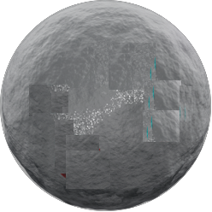






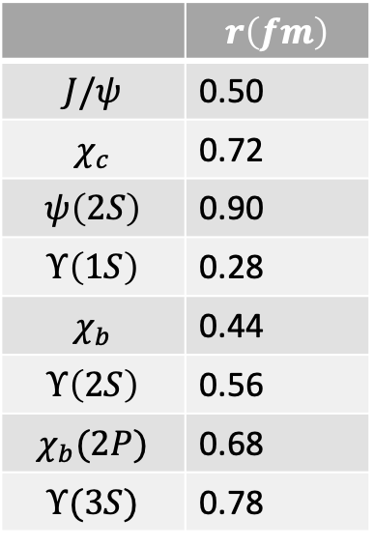
 | $$r\left(fm\right)$$
$$J/ψ$$ | 0.50
$$χ_{c}$$ | 0.72
$$ψ\left(2S\right)$$ | 0.90
$$Υ\left(1S\right)$$ | 0.28
$$χ_{b}$$ | 0.44
$$Υ\left(2S\right)$$ | 0.56
$$χ_{b}(2P)$$ | 0.68
$$Υ(3S)$$ | 0.78
$$ψ(2S)$$
$$χ_{c},Υ(3S)$$
Non-Relativistic Potential Theory: Satz, J.Phys.G32:R25 (2006)
J/ψ$,Υ(2S)$
$$Υ(1S)$$

Slide 5
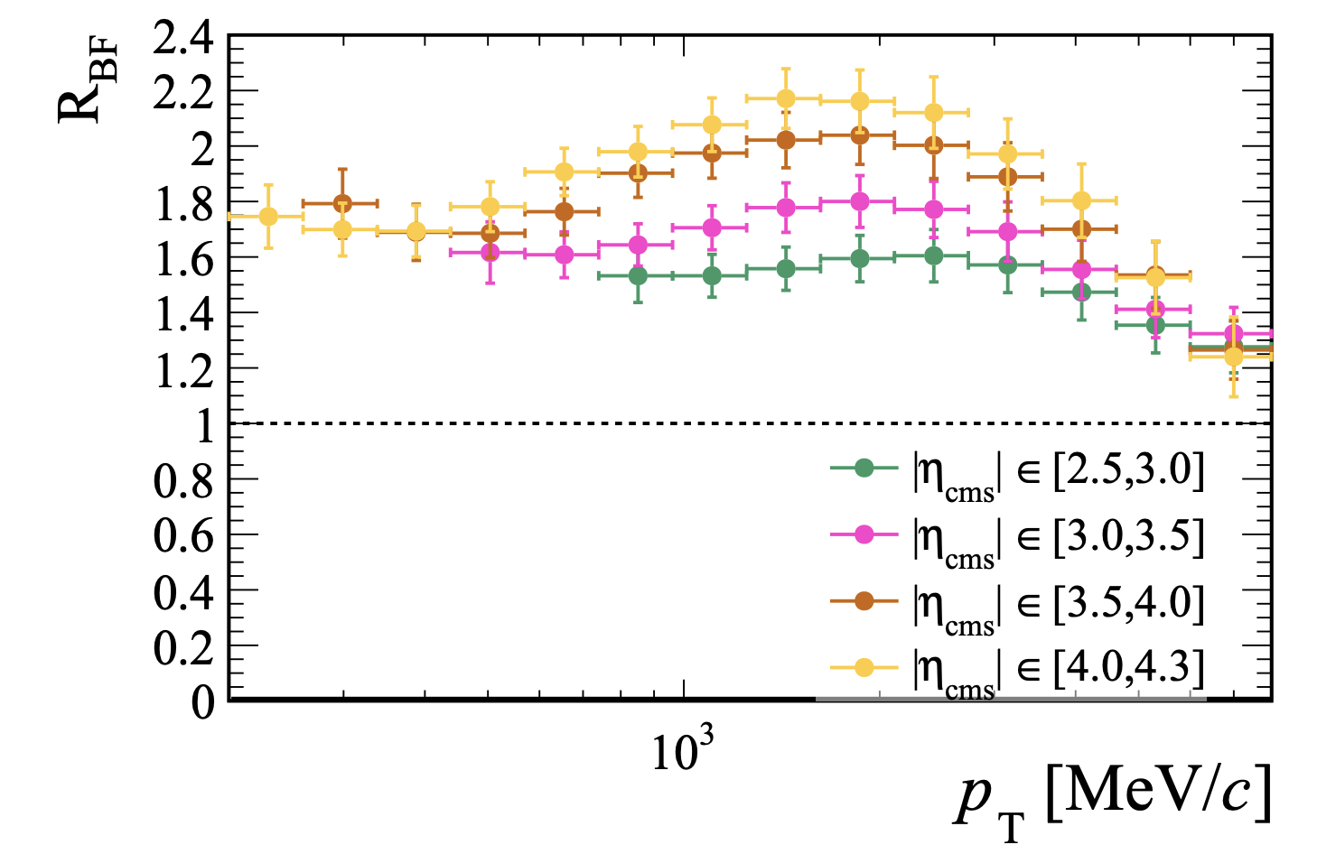

Extracted from PRL 128, 142004 (2022)
LHCb
$$dN_{backward}/dN_{forward}$$
Particle multiplicities are higher at the backward rapidity (A-going direction).

Slide 6
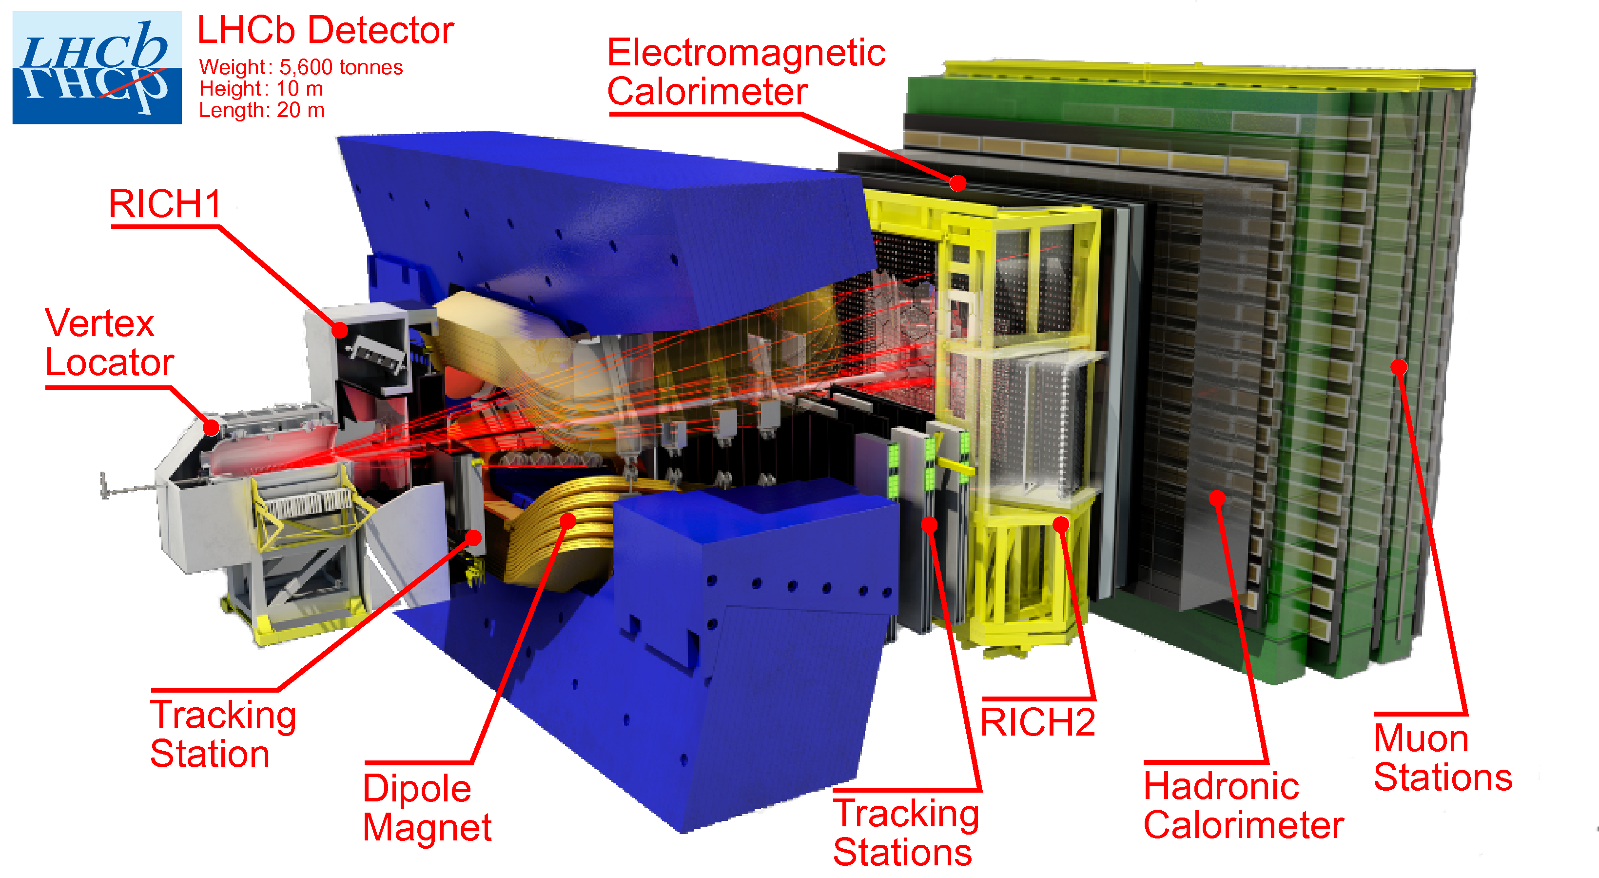


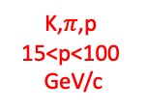


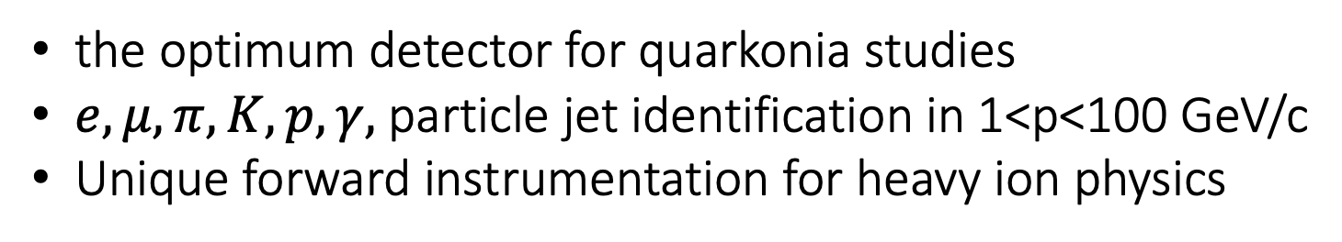
The LHC beauty detector
Converts stopping e,$γ$ energy in scintillating signal.
J. of Instr.,3(08):S08005, 2008
Kaon,$π$,proton
1<p<60 GeV/c
$$\left\langle δx\right\rangle \sim 40μm$$
K,$π$,p
15<p<100
GeV/c
$$\frac{δp}{p}<0.35\%$$
Converts stopping hadron energy in scintillating signal.
the optimum detector for quarkonia studies
$e,μ,π,K,p,γ,$ particle jet identification in 1<p<100 GeV/c
Unique forward instrumentation for heavy ion physics

Slide 7
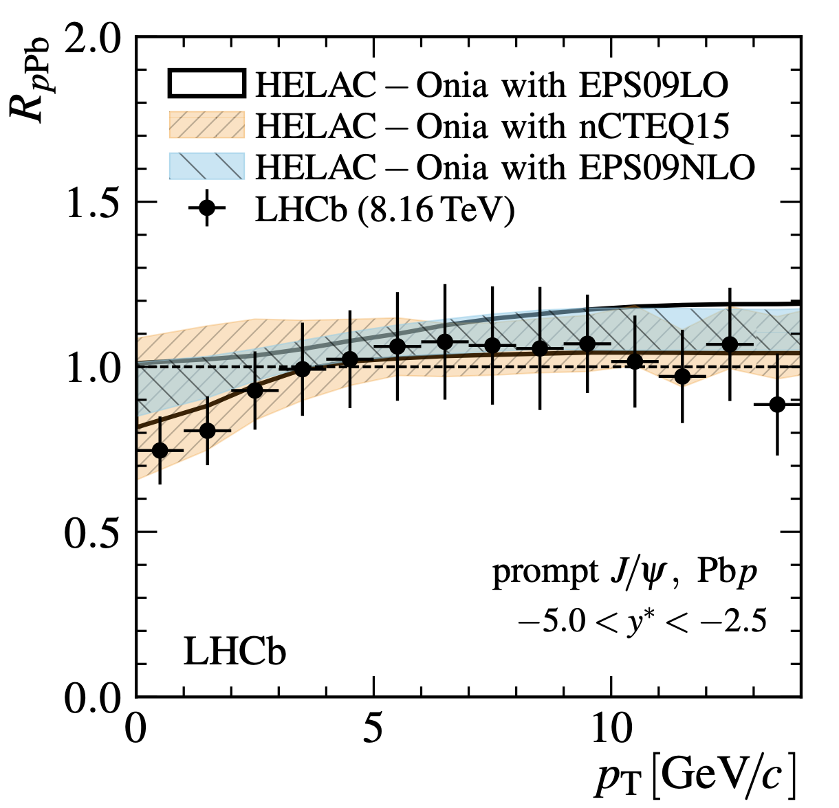
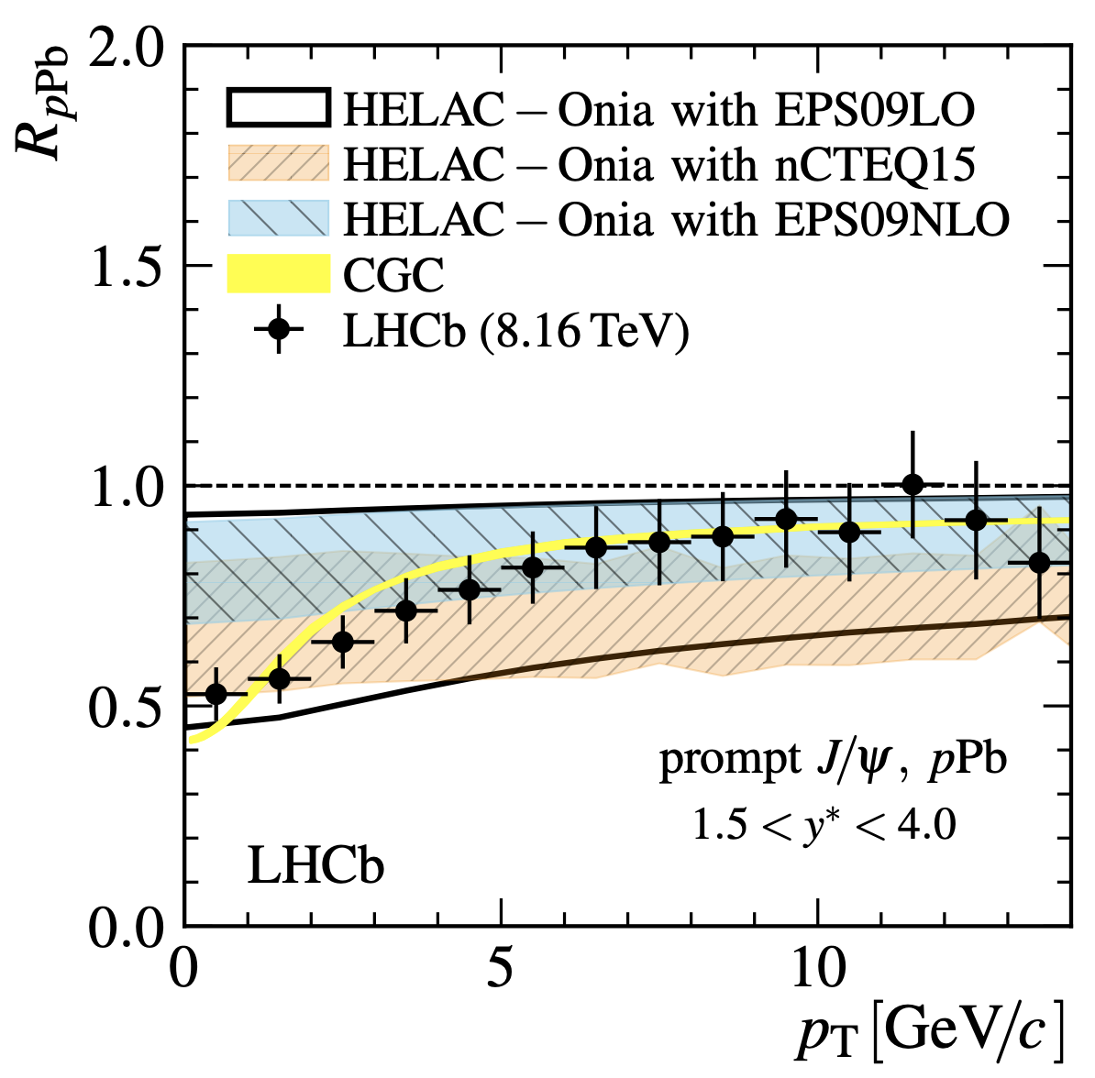
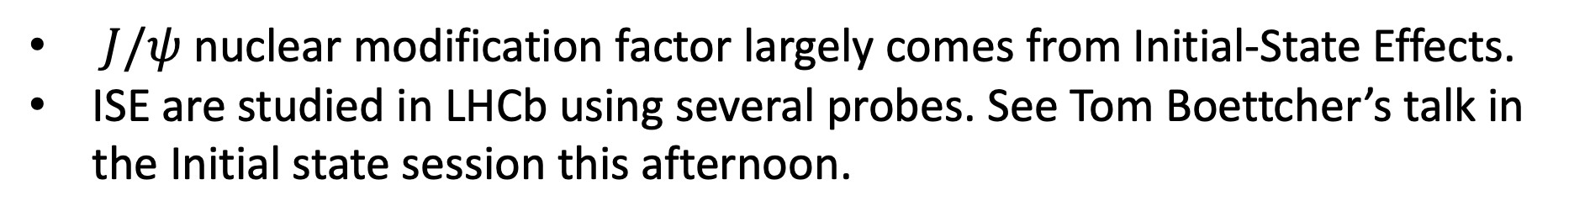
PLB774, 159 (2017)
$J/ψ$ nuclear modification factor largely comes from Initial-State Effects.
ISE are studied in LHCb using several probes. See Tom Boettcher’s talk in the Initial state session this afternoon.

Slide 8
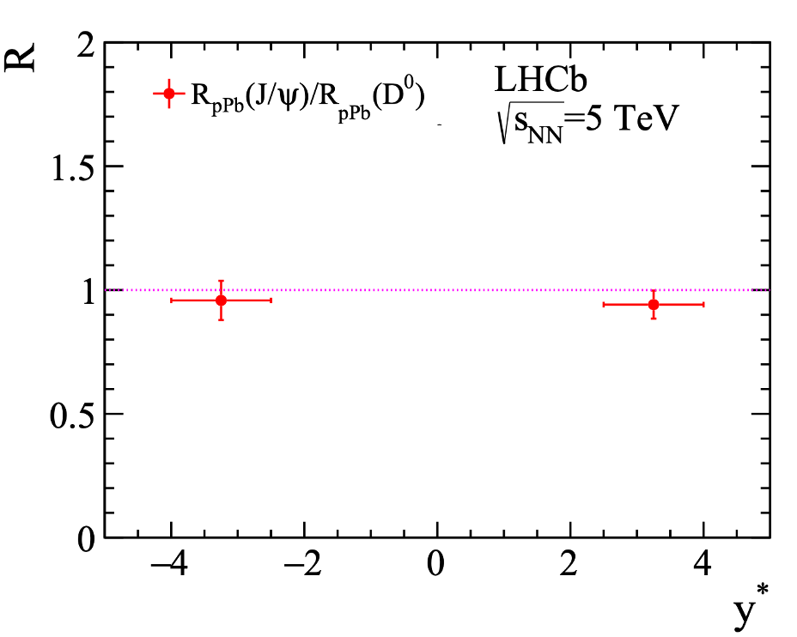
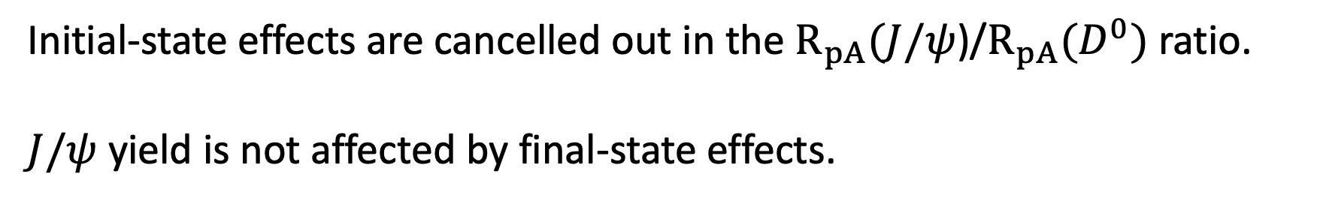

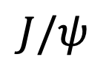


Cancelling out Initial-State Effects
JHEP 1710 (2017) 090
$$J/ψ$$
Q²
$p_{T}<15$GeV/c
$$D^{0}$$
$${\overline{D}}^{0}$$
Q²
Initial-state effects are cancelled out in the $R_{pA}(J/ψ$)/$R_{pA}(D^{0})$ ratio.
$J/ψ$ yield is not affected by final-state effects.

Slide 9







JHEP 1710 (2017) 090
Agnes Mocsy’s thermometer
$Υ\left(1S\right)$ 1100 MeV
$J/ψ$ 640 MeV
$Υ(2S)$ 530 MeV
$χ_{b}(2P)$ 300 MeV
$χ_{c},Υ(3S)$180-220 MeV
$ψ(2S)$ 50 MeV
Initial-state effects are cancelled out in the $R_{pA}(J/ψ$)/$R_{pA}(D^{0})$ ratio.
$J/ψ$ yield is not affected by final-state effects.

Slide 10
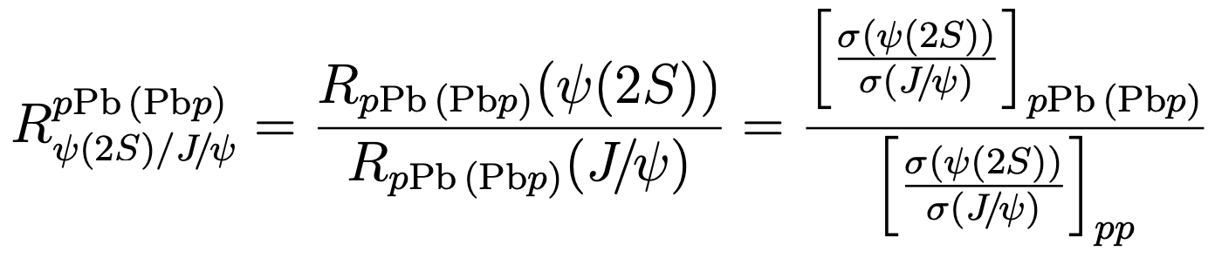
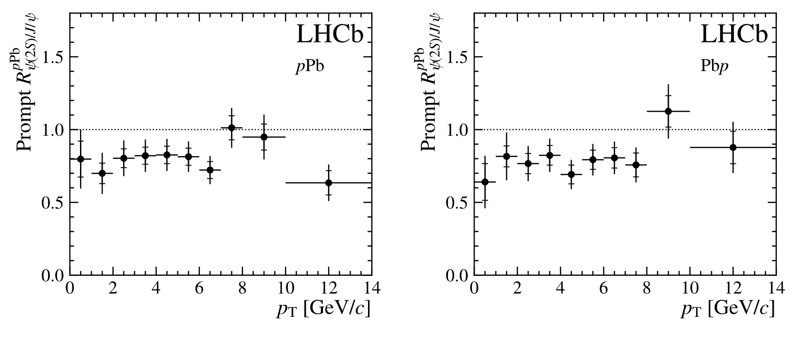
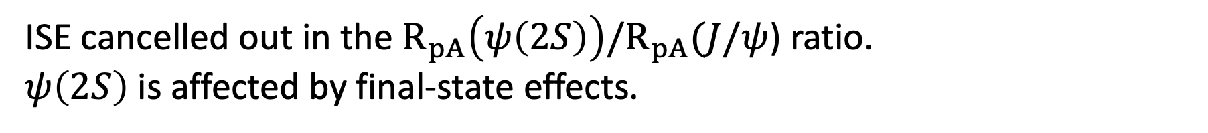

New $ψ$(2S) Result at $\sqrt{s_{NN}}$=8.16 TeV
LHCb-PAPER-2023-024 in preparation
Preliminary
Preliminary
ISE cancelled out in the ${R_{pA}\left(ψ\left(2S\right)\right)/R}_{pA}(J/ψ$) ratio.
$ψ\left(2S\right)$ is affected by final-state effects.

Slide 11
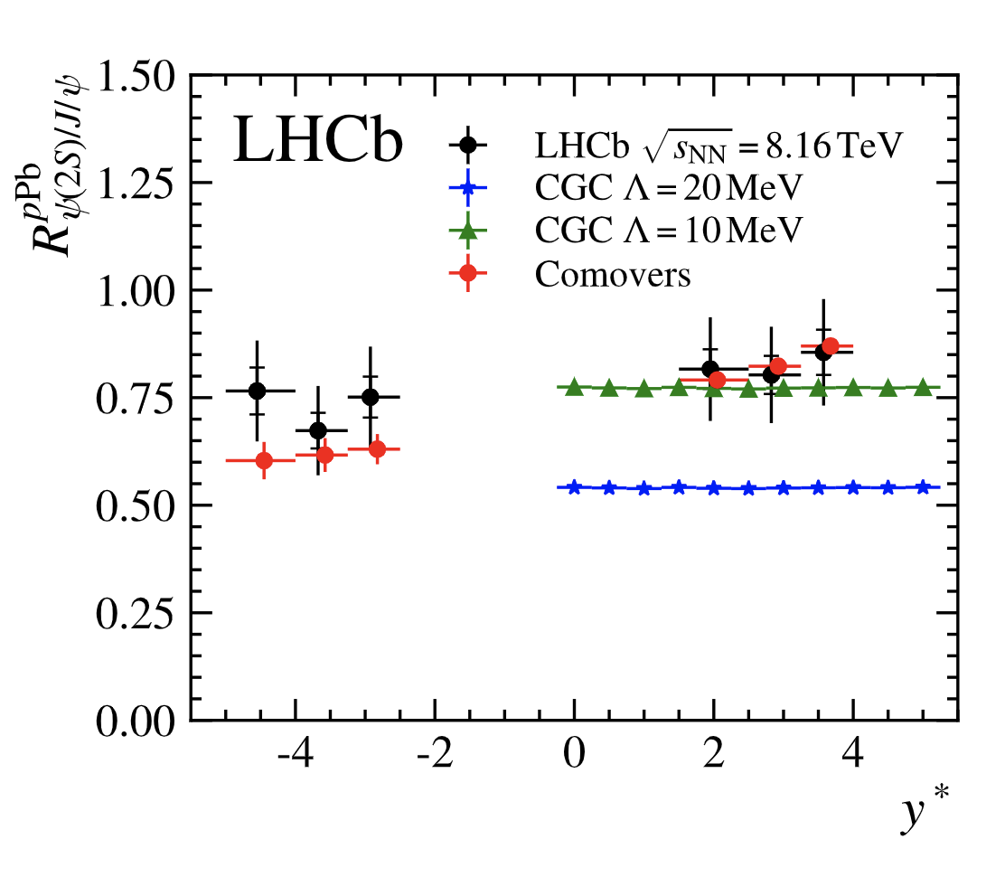
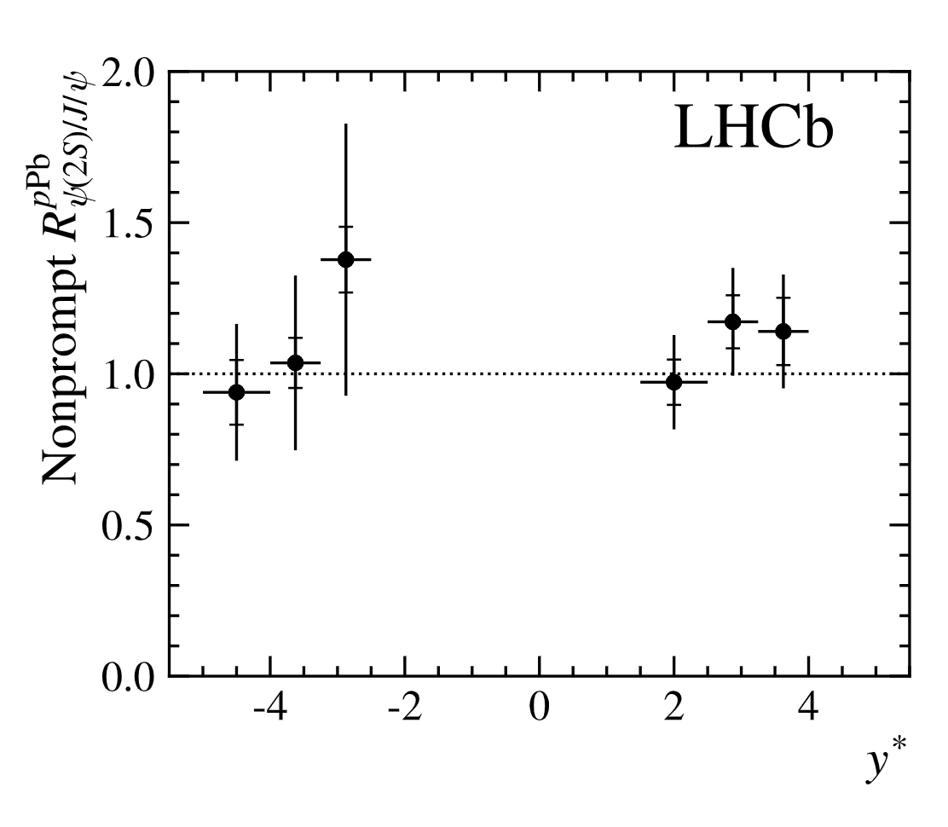
New $ψ$(2S) Result at $\sqrt{s_{NN}}$=8.16 TeV
LHCb-PAPER-2023-024 in preparation
Preliminary
Preliminary
prompt
from B-meson decays
Additional $ψ\left(2S\right)$ suppression only present in the prompt component, consistent with co-mover particle interactions [PLB749, 98 (2015)]
CGC : Factorization violating soft gluon exchanges PRC97, 014909 (2018)

Slide 12
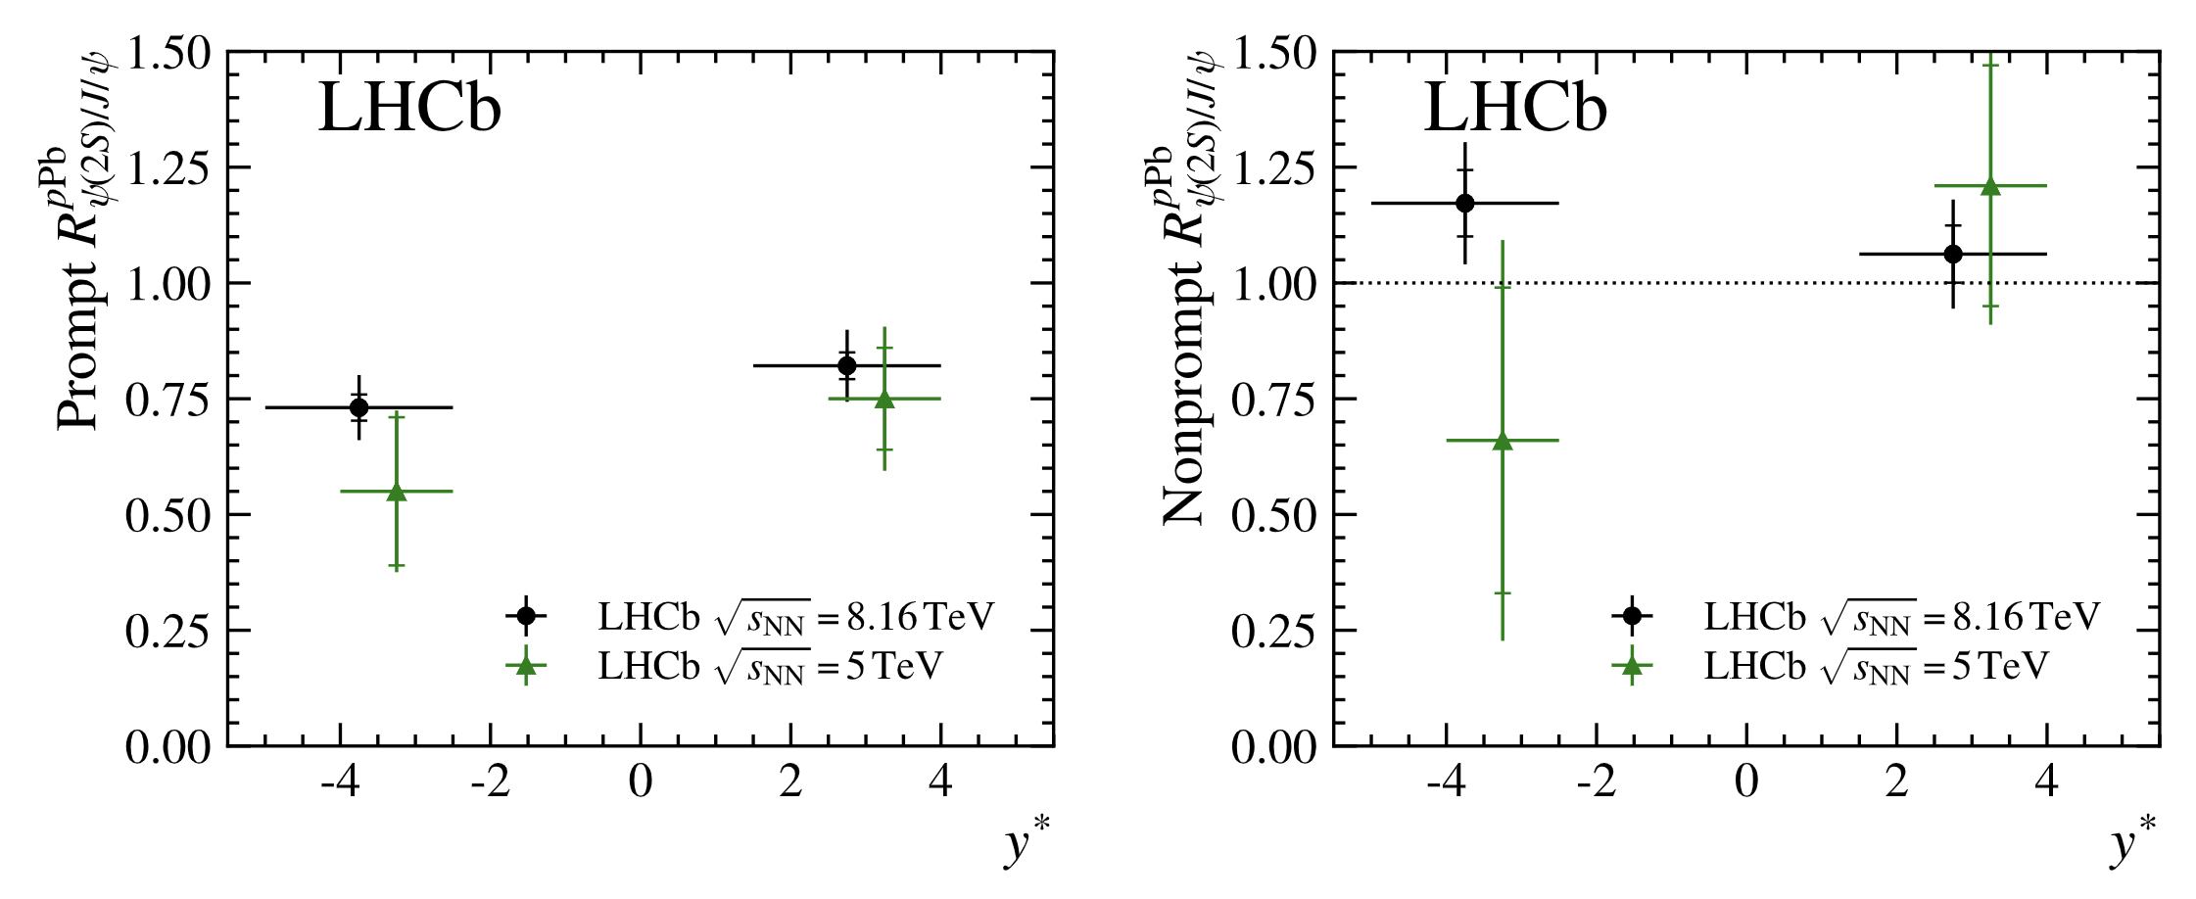

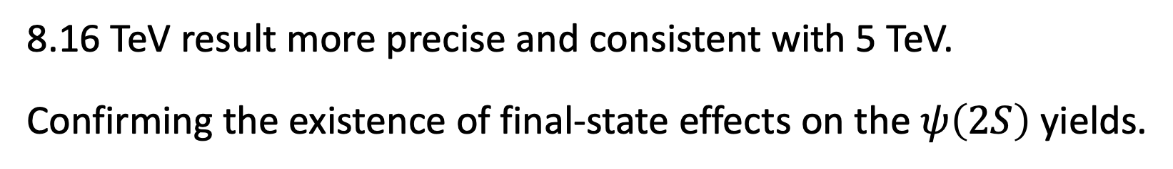





New $ψ$(2S) Result at $\sqrt{s_{NN}}$=8.16 TeV
LHCb-PAPER-2023-024 in preparation
$Υ\left(1S\right)$ 1100 MeV
Preliminary
$J/ψ$ 640 MeV
$Υ(2S)$ 530 MeV
$χ_{b}(2P)$ 300 MeV
$χ_{c},Υ(3S)$180-220 MeV
$ψ(2S)$ 50 MeV
8.16 TeV result more precise and consistent with 5 TeV.
Confirming the existence of final-state effects on the $ψ\left(2S\right)$ yields.

Slide 13
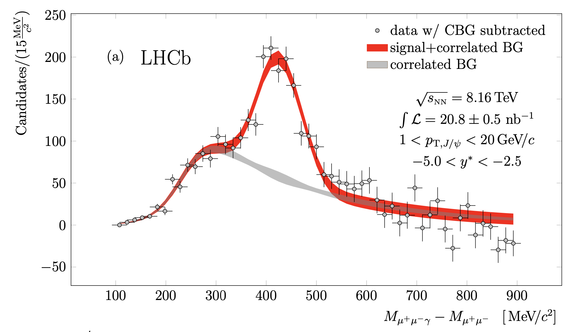
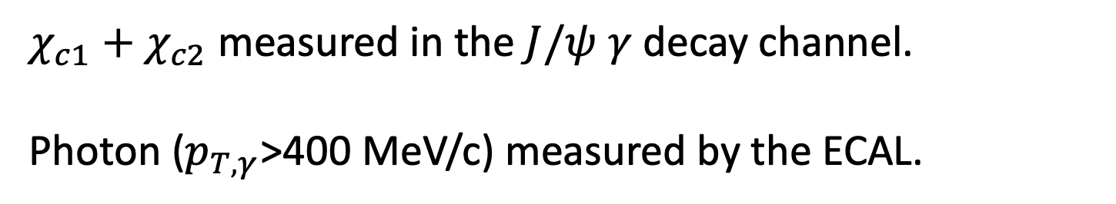

New $χ_{c}$ Result
LHCb-PAPER-2023-028 in preparation
Preliminary
$χ_{c1}+χ_{c2}$ measured in the $J/ψ$ $γ$ decay channel.
Photon ($p_{T,γ}$>400 MeV/c) measured by the ECAL.

Slide 14
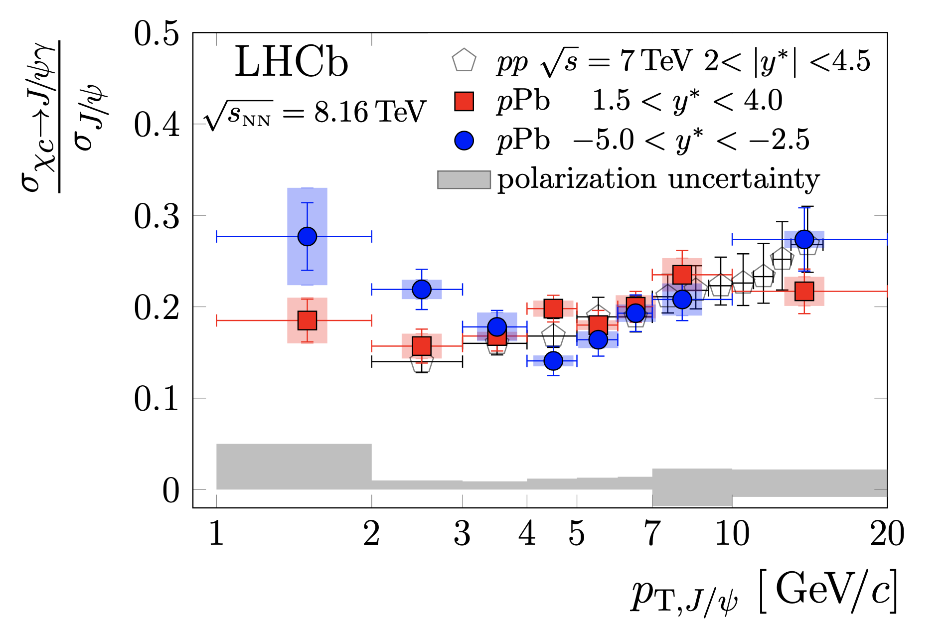

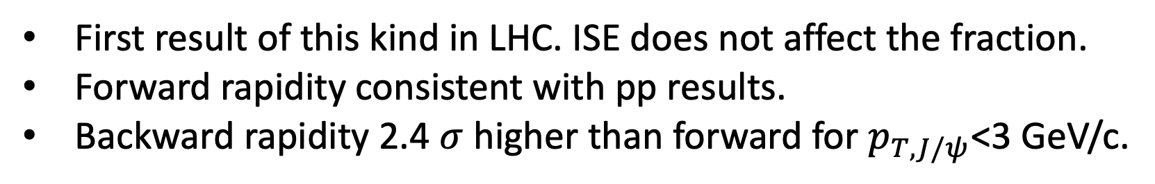
Fraction of $χ_{c}$ decays in prompt $J/ψ$.
LHCb-PAPER-2023-028 in preparation
Preliminary
First result of this kind in LHC. ISE does not affect the fraction.
Forward rapidity consistent with pp results.
Backward rapidity 2.4 $σ$ higher than forward for $p_{T,J/ψ}$<3 GeV/c.

Slide 15
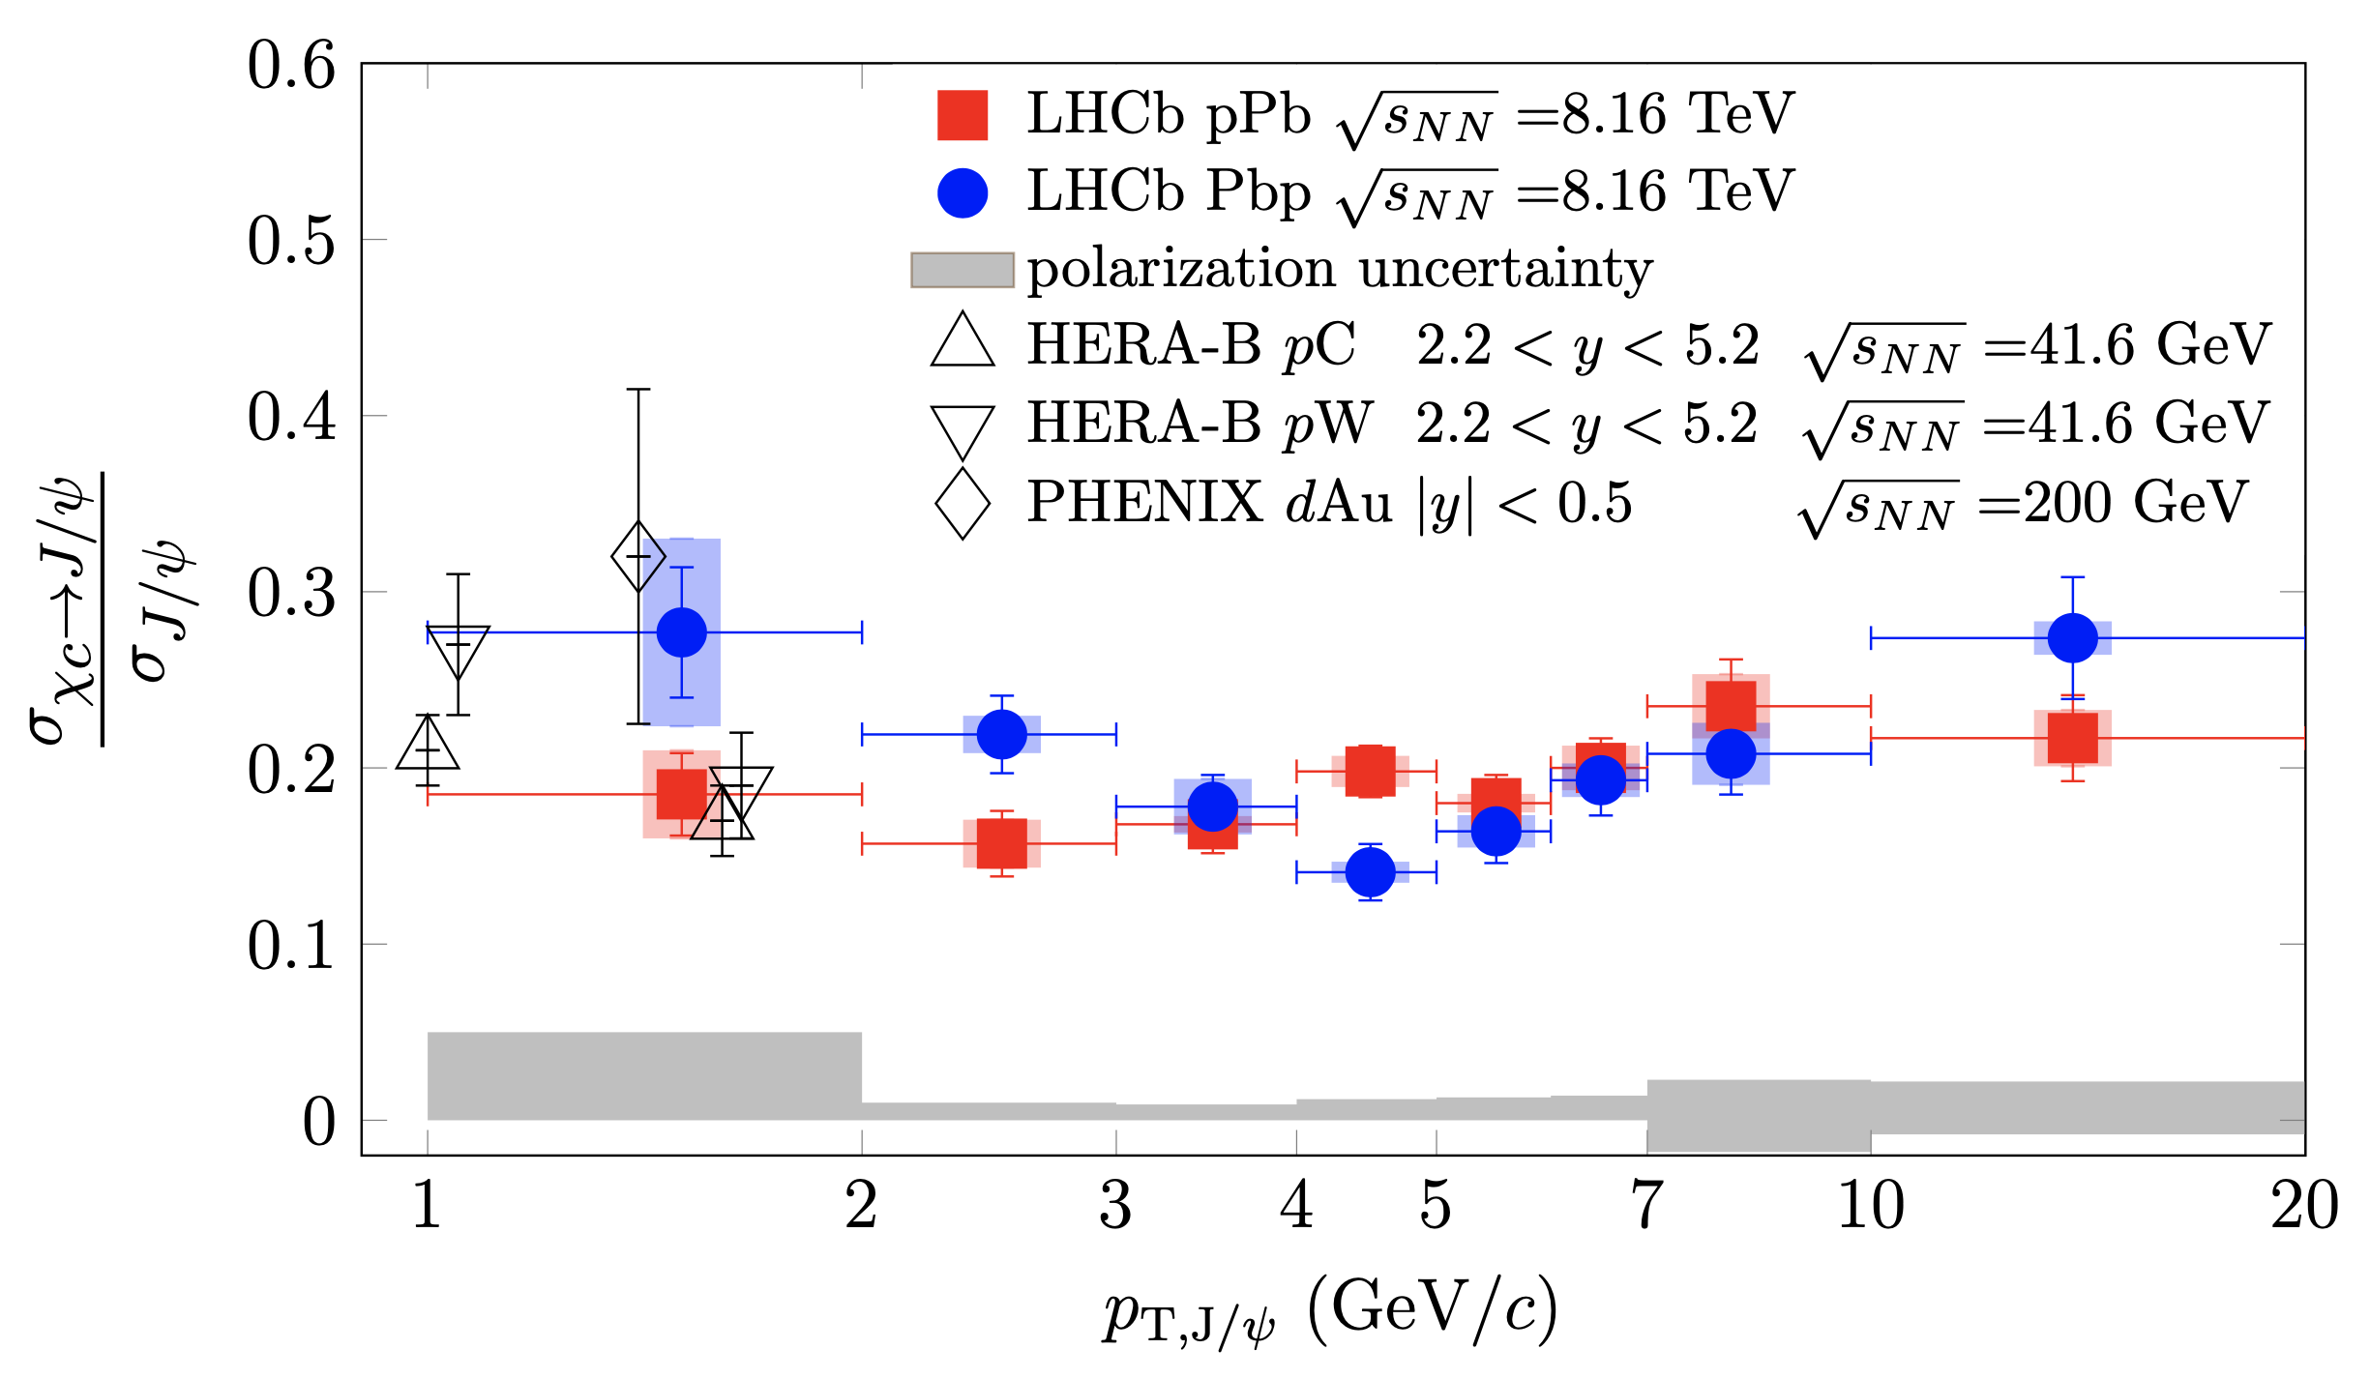
Fraction of $χ_{c}$ decays in prompt $J/ψ$.
LHCb-PAPER-2023-028 in preparation
Preliminary
Result consistent with lower energy measurements from HERA-B and PHENIX.

Slide 16
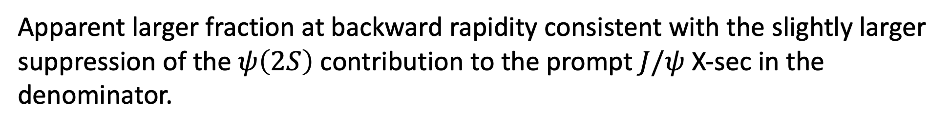
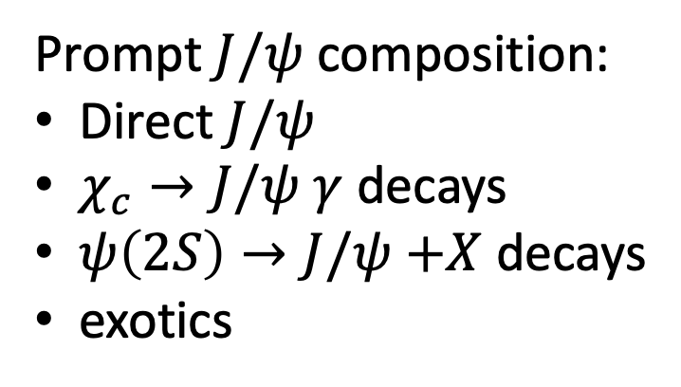
Fraction of $χ_{c}$ decays in prompt $J/ψ$.
LHCb-PAPER-2023-028 in preparation
Preliminary
Prompt $J/ψ$ composition:
Direct $J/ψ$
$χ_{c}→J/ψ$ $γ$ decays
$ψ\left(2S\right)→J/ψ$ $+X$ decays
exotics
Apparent larger fraction at backward rapidity consistent with the slightly larger suppression of the $ψ\left(2S\right)$ contribution to the prompt $J/ψ$ X-sec in the denominator.

Slide 17
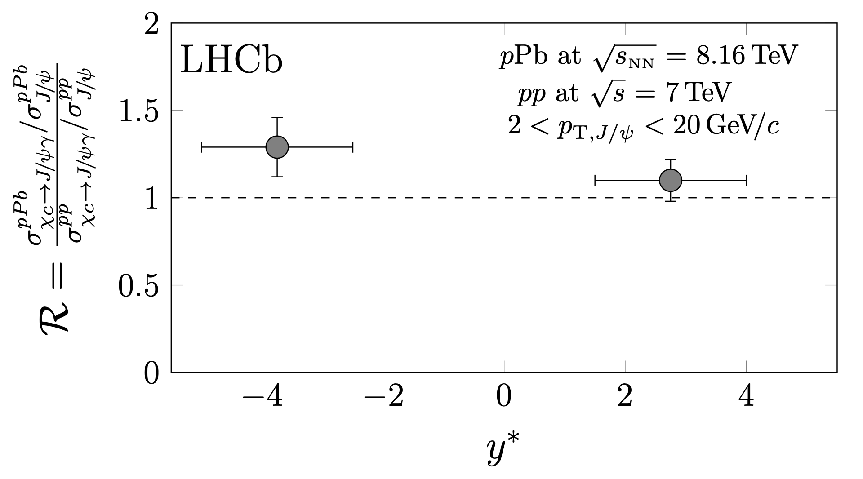

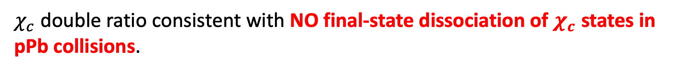





LHCb-PAPER-2023-028 in preparation
Preliminary
$Υ\left(1S\right)$ 1100 MeV
$J/ψ$ 640 MeV
$Υ(2S)$ 530 MeV
$χ_{b}(2P)$ 300 MeV
$χ_{c},Υ(3S)$180-220 MeV
$ψ(2S)$ 50 MeV
$χ_{c}$ double ratio consistent with NO final-state dissociation of $χ_{c}$ states in pPb collisions.

Slide 18
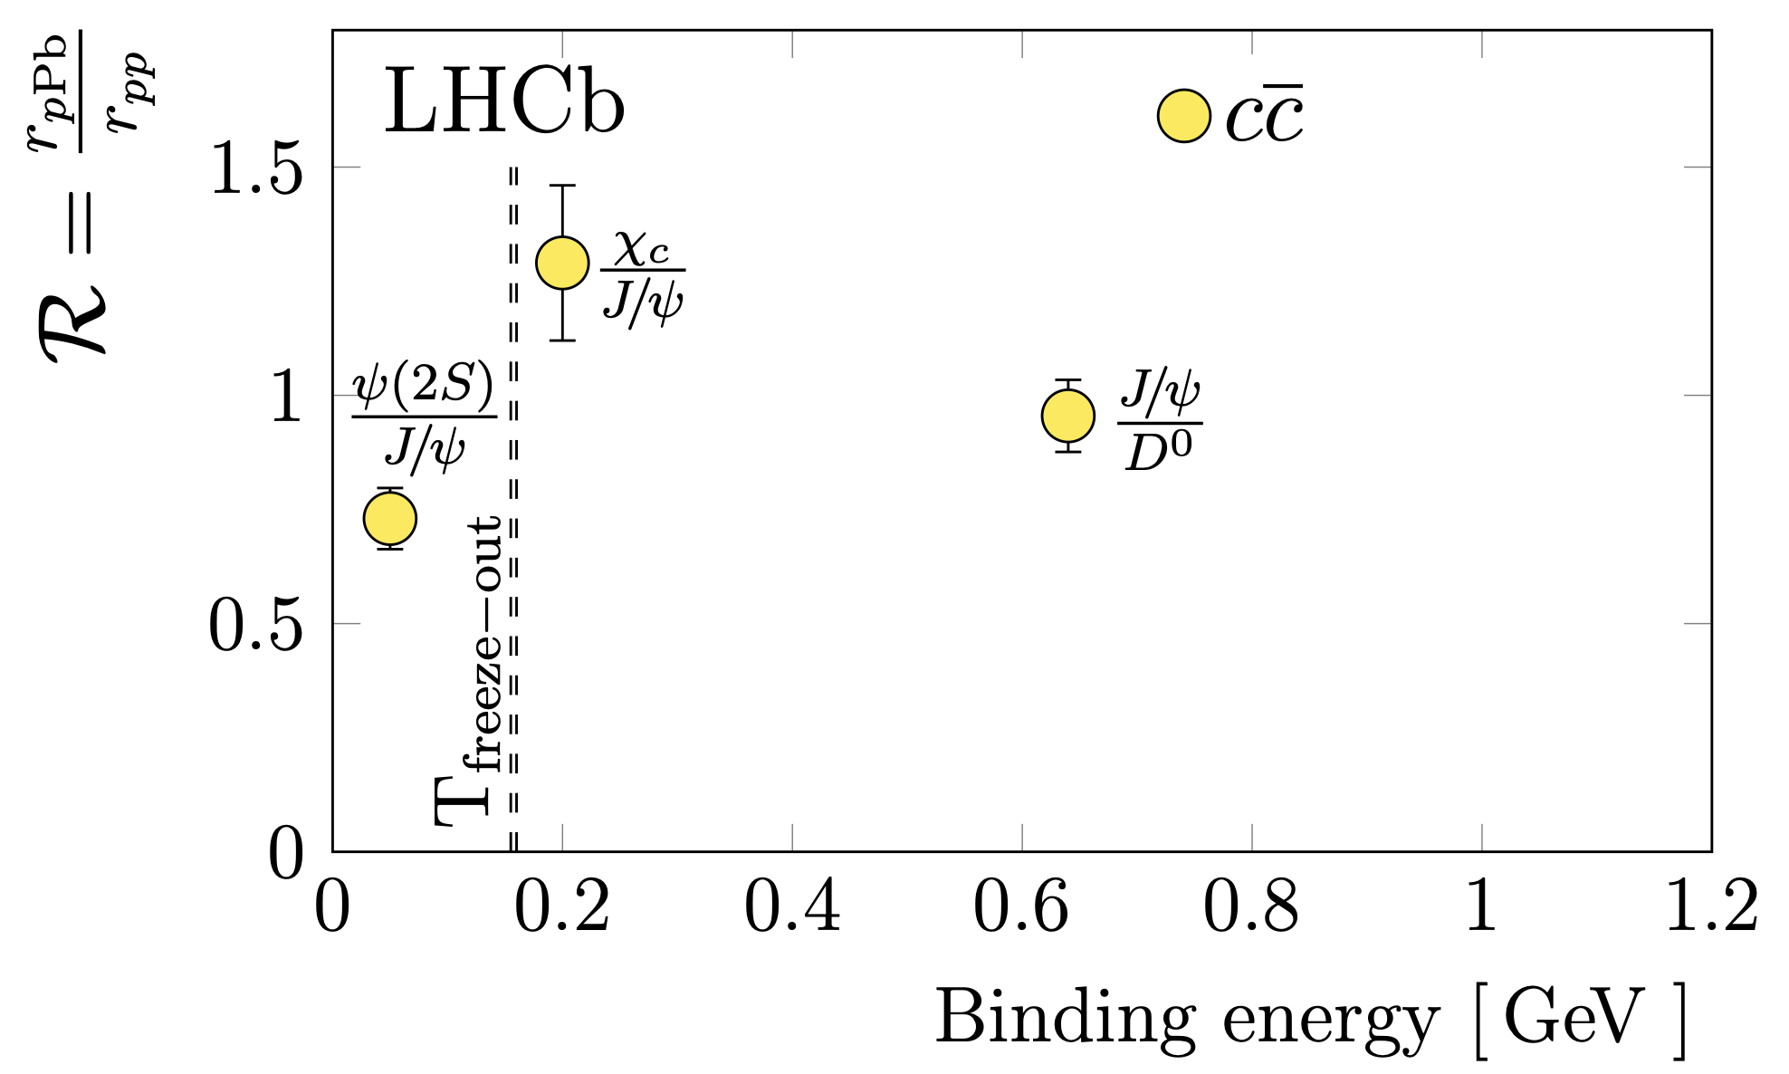







Constraints to maximum medium temperature in pPb collisions.
LHCb-PAPER-2023-028 in preparation
backward rapidity
$Υ\left(1S\right)$ 1100 MeV
$J/ψ$ 640 MeV
$Υ(2S)$ 530 MeV
$χ_{b}(2P)$ 300 MeV
$χ_{c},Υ(3S)$180-220 MeV
Preliminary
freeze-out
$ψ(2S)$ 50 MeV
The medium temperature hypothetically formed in pPb collisions cannot inhibit the formation of charmonium states with binding energy larger than 180 MeV, just 20 MeV above the estimated freeze-out temperature.

Slide 19
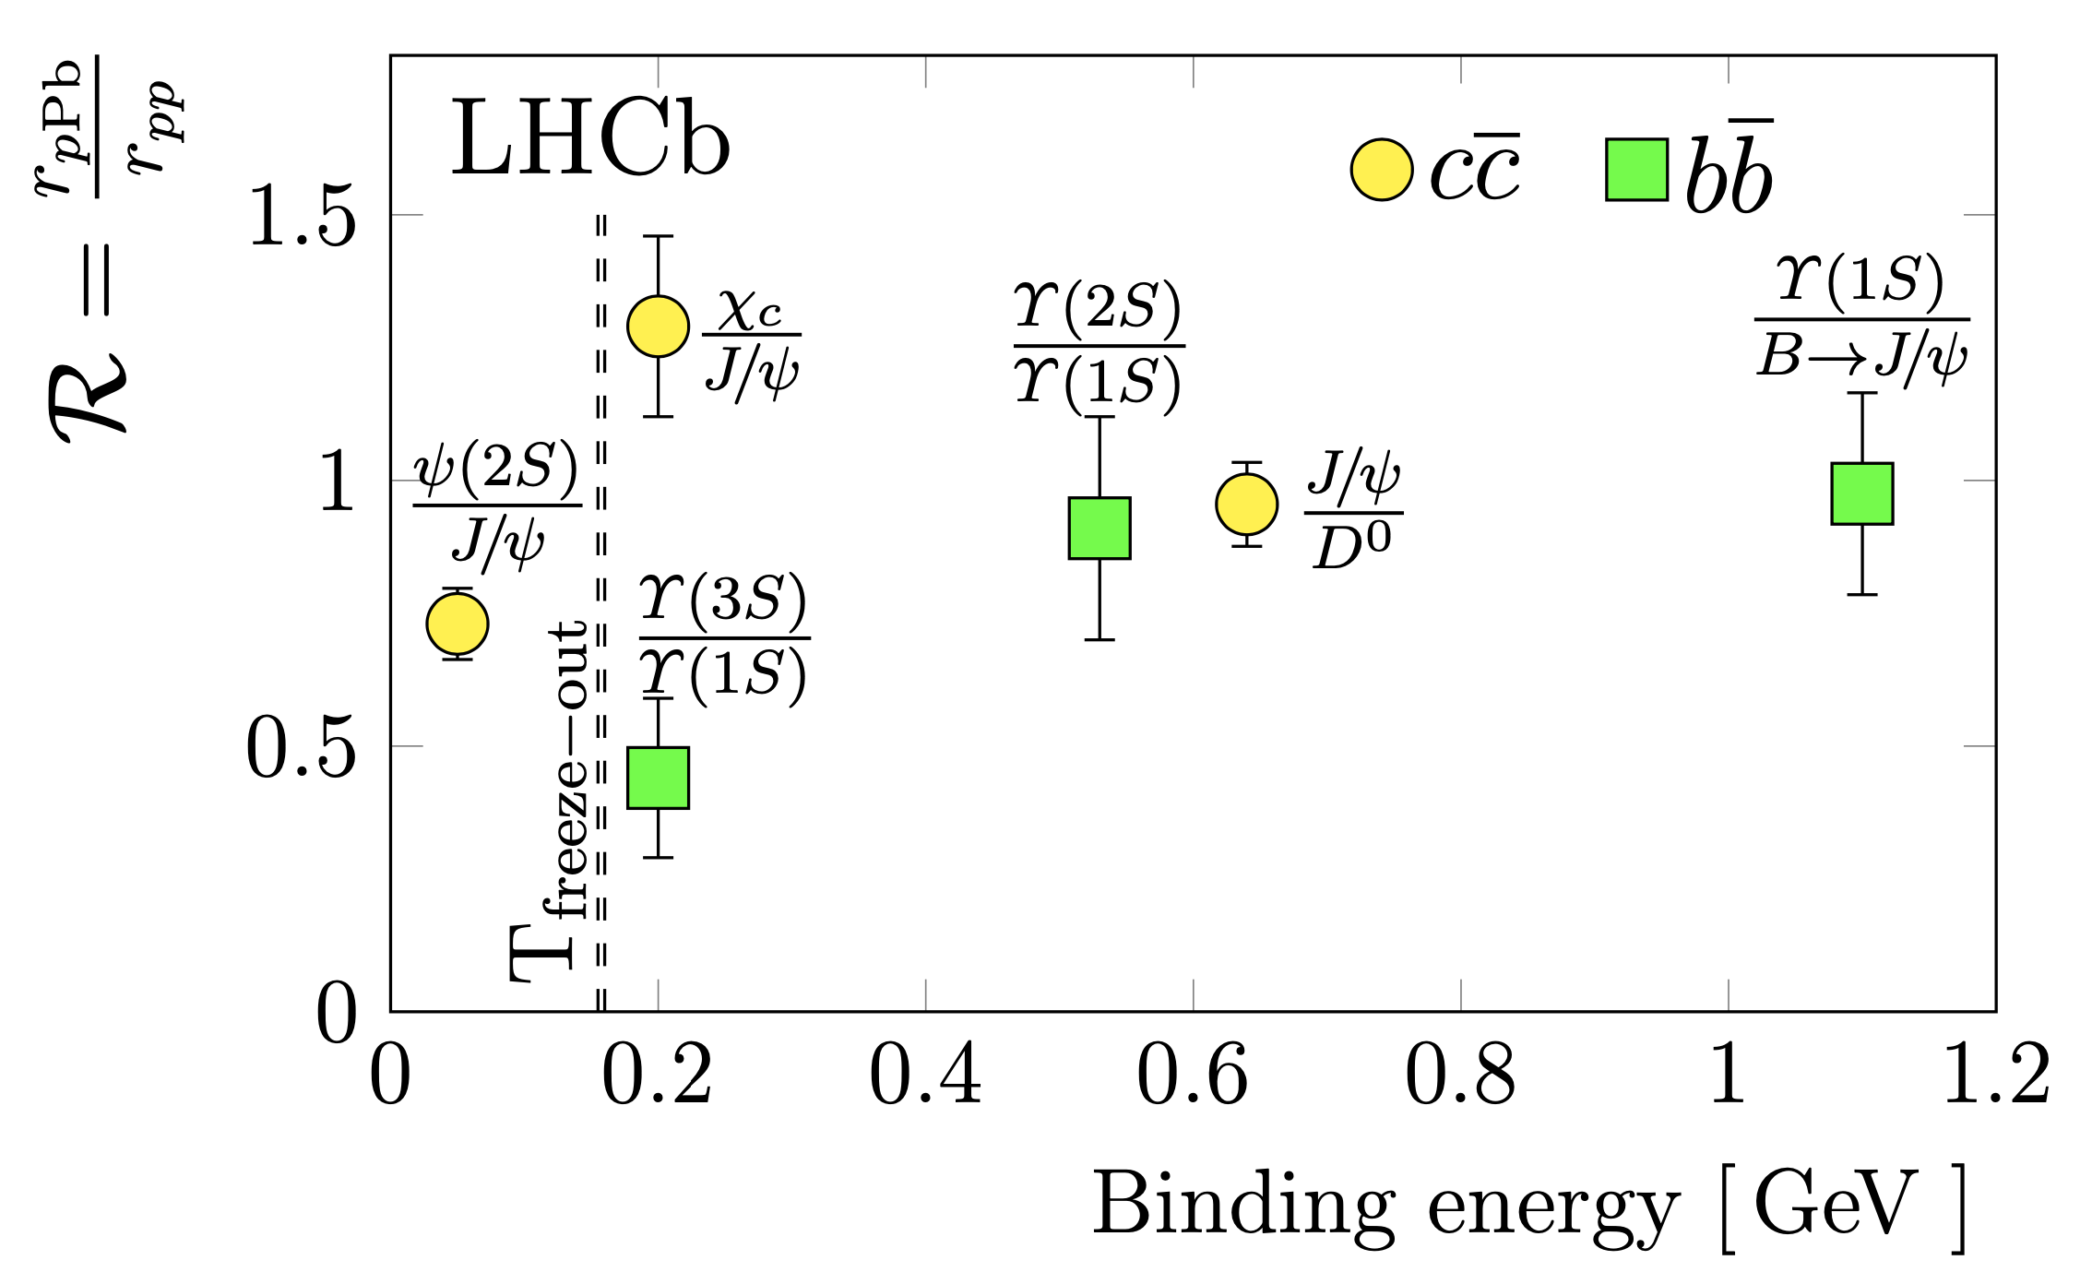
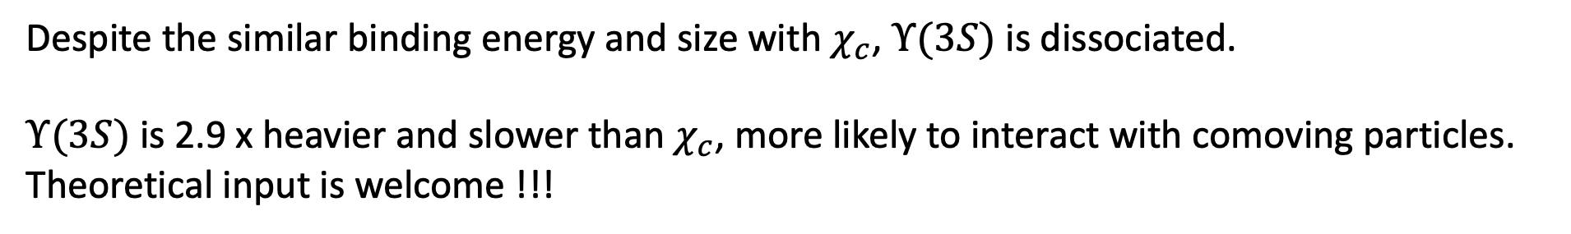
Constraints to maximum medium temperature in pPb collisions.
LHCb-PAPER-2023-028 in preparation
backward rapidity
$Υ\left(1S\right)$ 1100 MeV
$J/ψ$ 640 MeV
$Υ(2S)$ 530 MeV
$χ_{b}(2P)$ 300 MeV
JHEP11(2018)194
$χ_{c},Υ(3S)$180-220 MeV
Preliminary
freeze-out
$ψ(2S)$ 50 MeV
Despite the similar binding energy and size with $χ_{c}$, $Υ(3S)$ is dissociated.
$Υ(3S)$ is 2.9 x heavier and slower than $χ_{c}$, more likely to interact with comoving particles. Theoretical input is welcome !!!

Slide 20
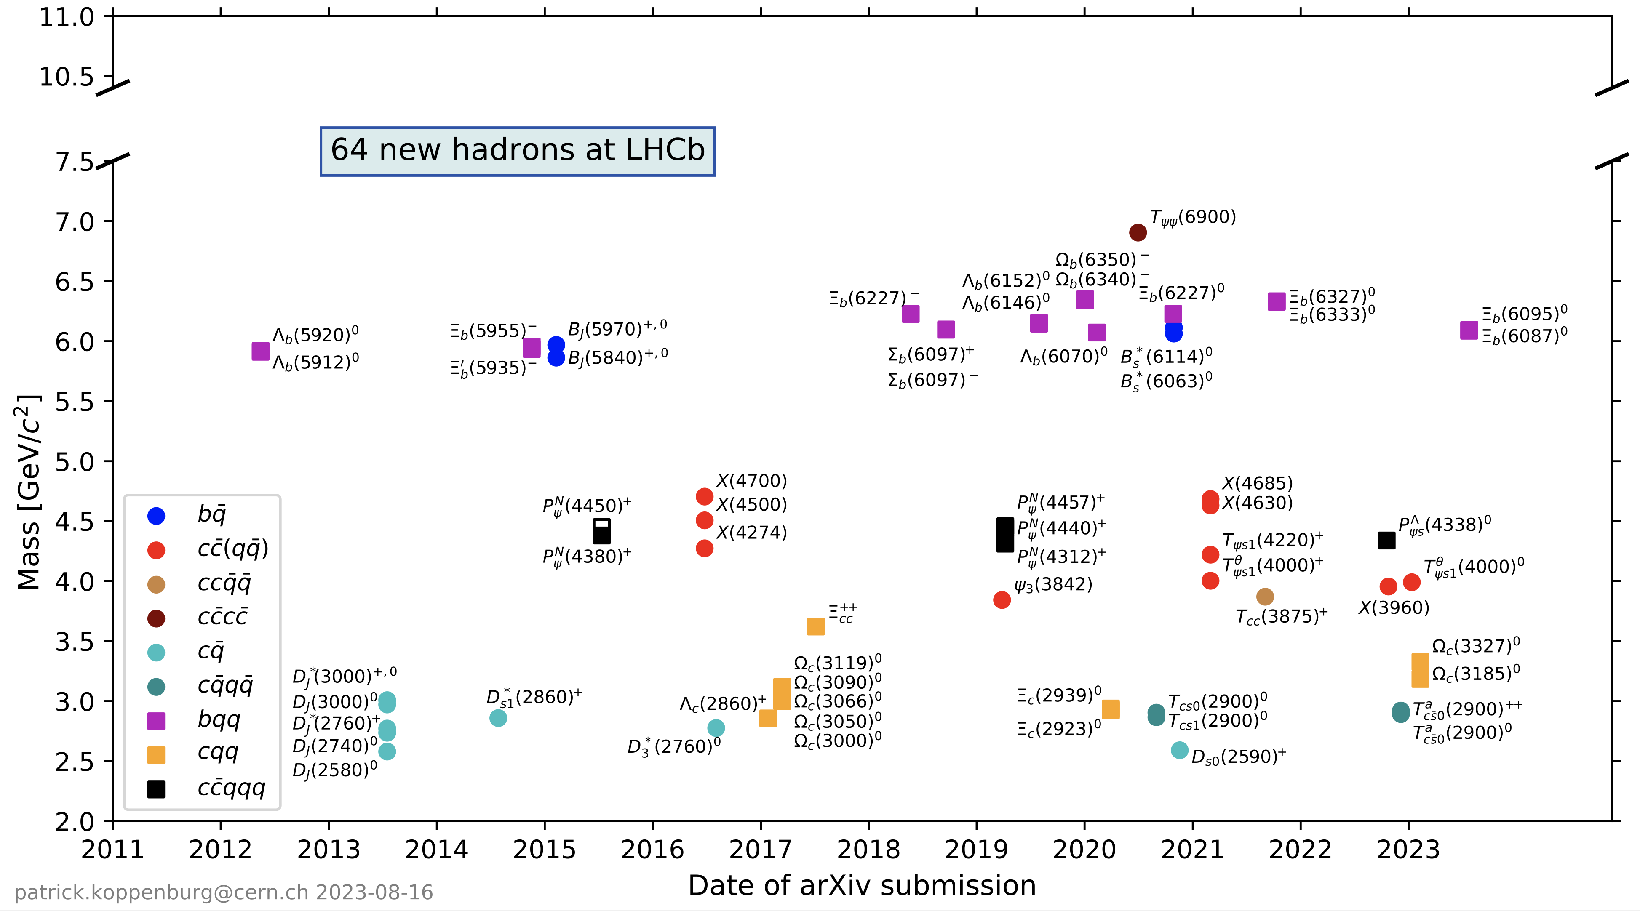
Exotic Particles
https://www.nikhef.nl/~pkoppenb/particles.html

Slide 21
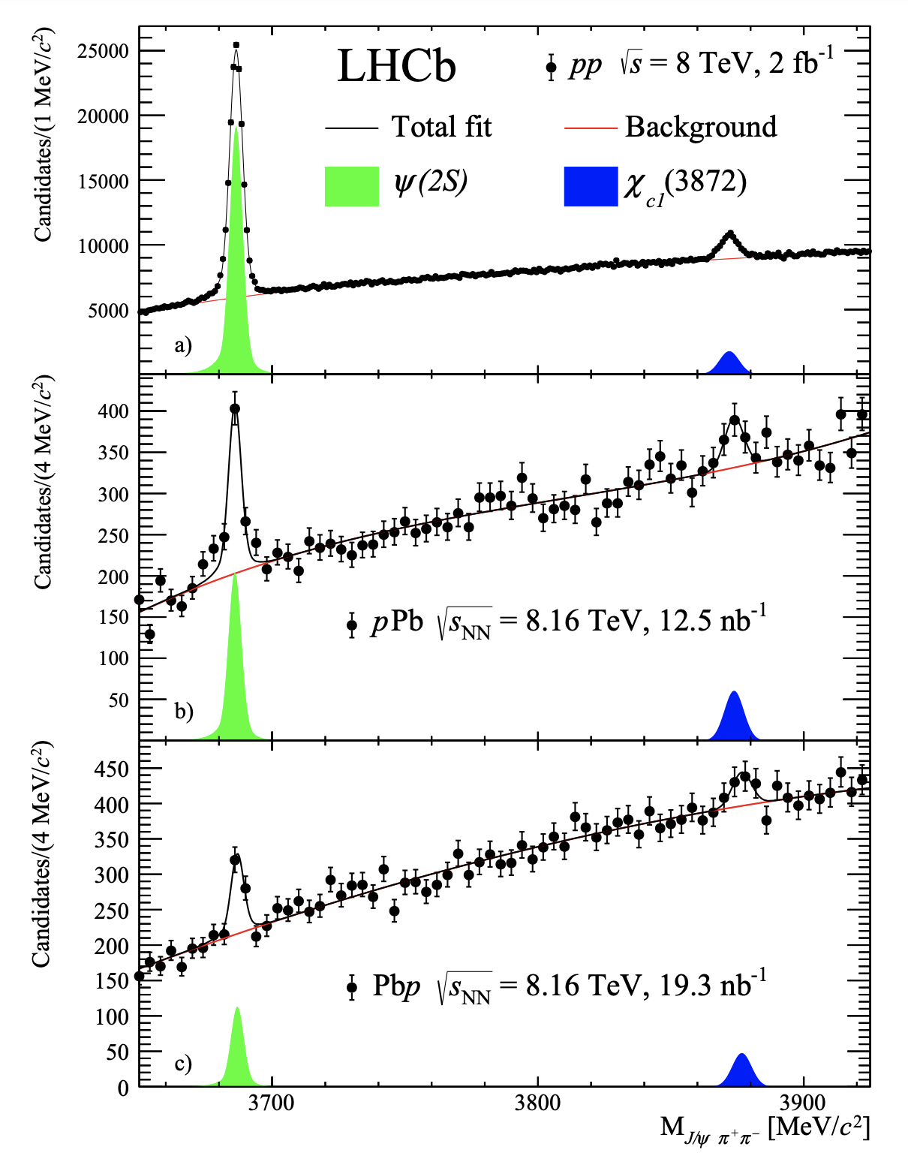
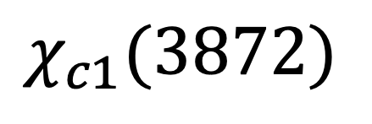
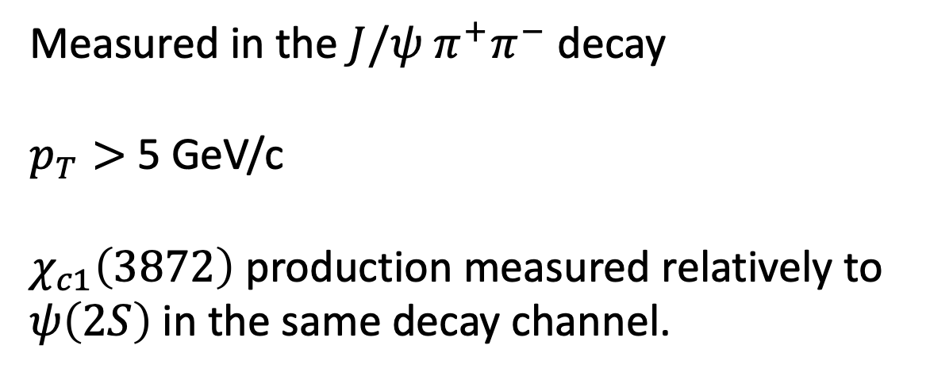
$$χ_{c1}(3872)$$
Preliminary
Measured in the $J/ψ{ π}^{+}π^{−}$ decay
$p_{T}>$ 5 GeV/c
$χ_{c1}\left(3872\right)$ production measured relatively to $ψ\left(2S\right)$in the same decay channel.
LHCB-PAPER-2023-026 in preparation

Slide 22
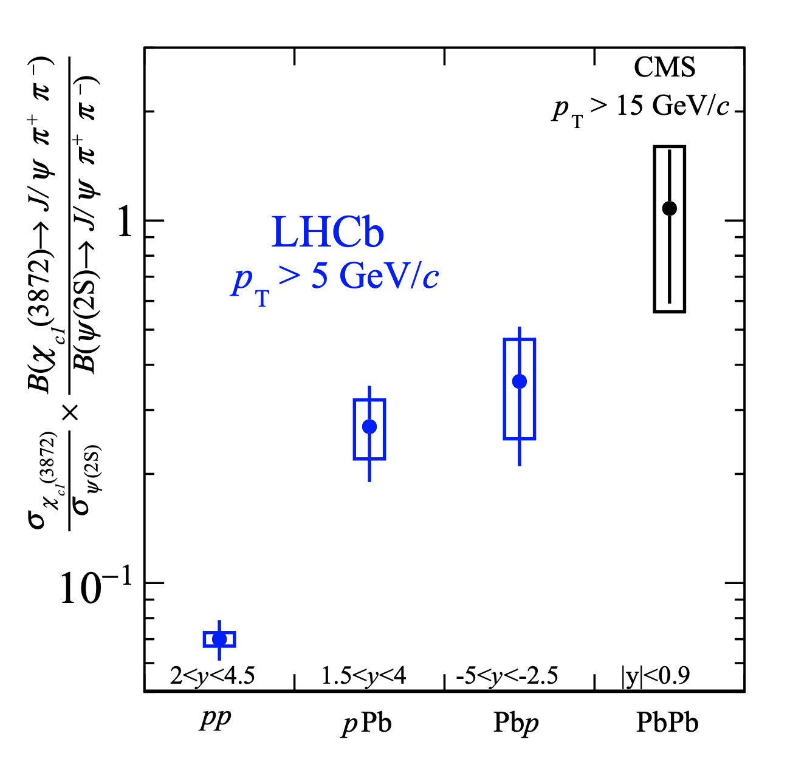
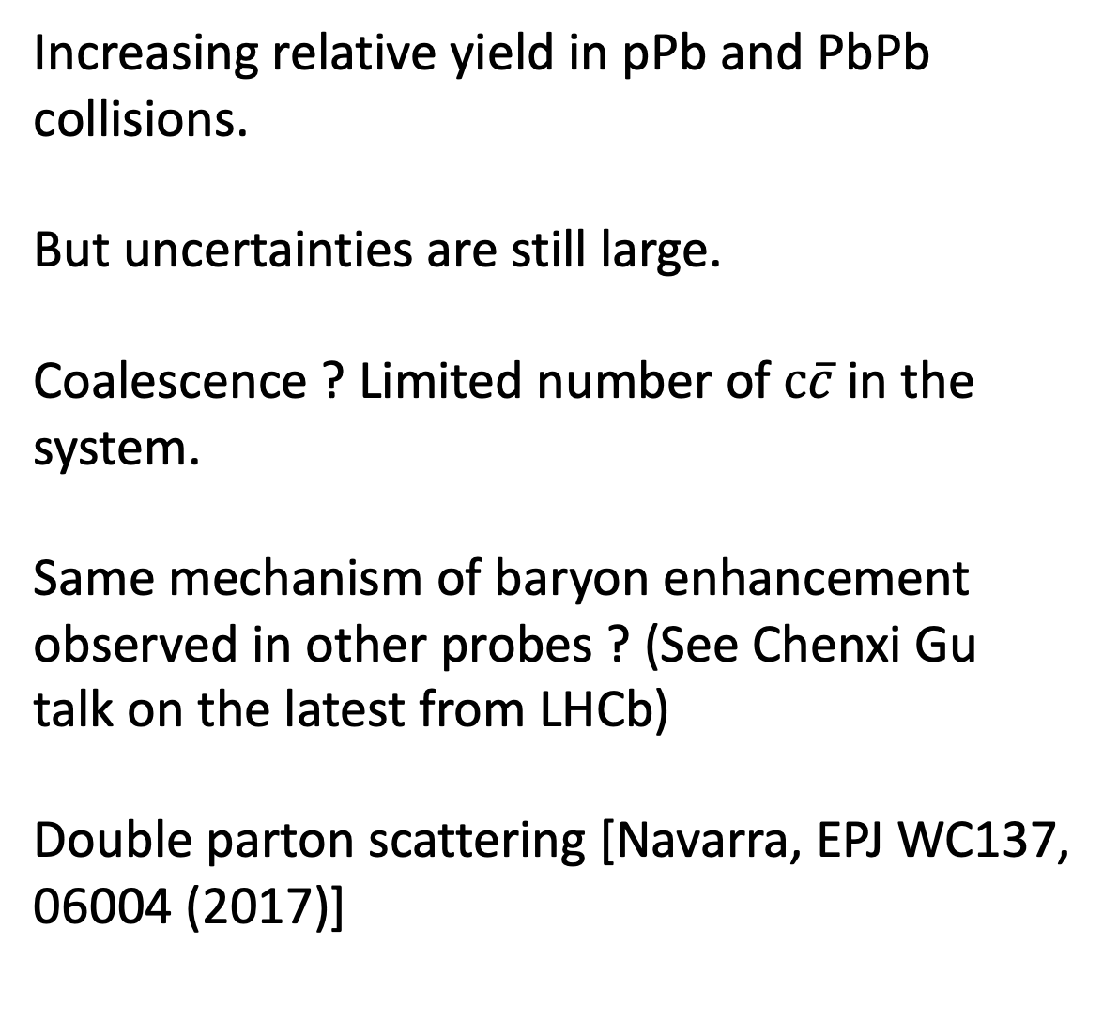
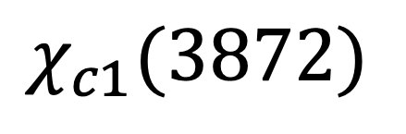
$$χ_{c1}(3872)$$
LHCB-PAPER-2023-026 in preparation
Increasing relative yield in pPb and PbPb collisions.
But uncertainties are still large.
Coalescence ? Limited number of $c\overline{c}$ in the system.
Same mechanism of baryon enhancement observed in other probes ? (See Chenxi Gu talk on the latest from LHCb)
Double parton scattering [Navarra, EPJ WC137, 06004 (2017)]
Preliminary

Slide 23
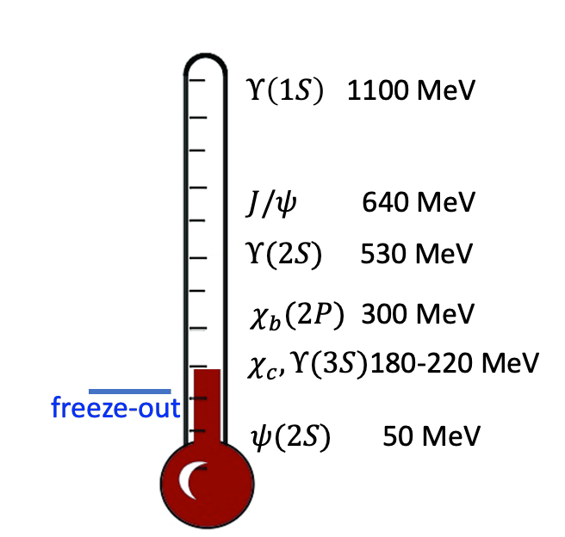
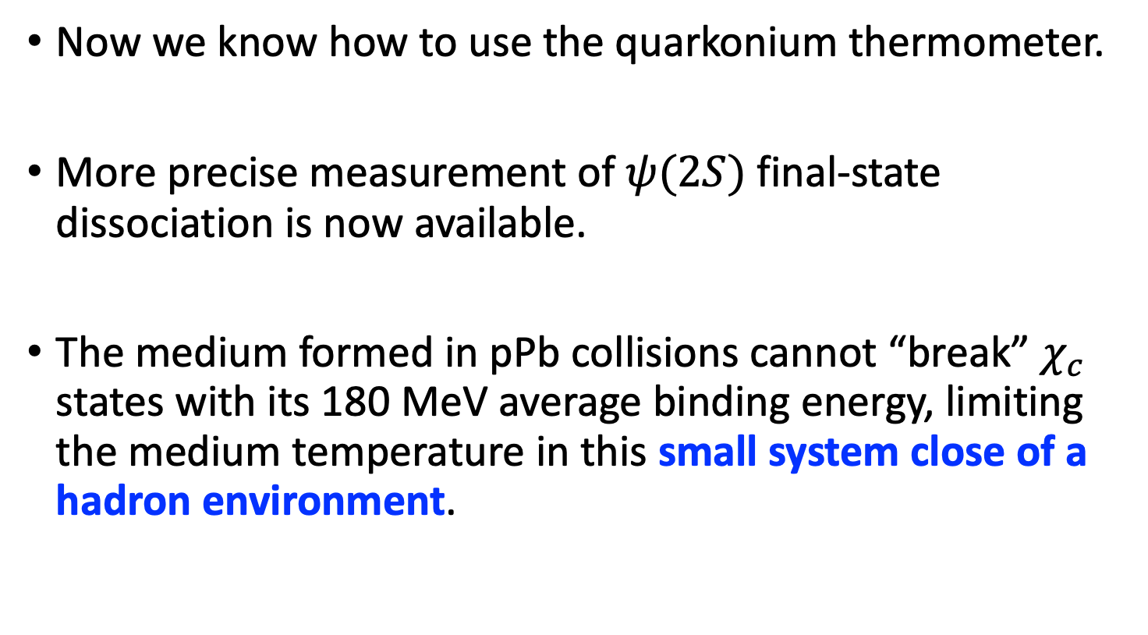
Take away
Now we know how to use the quarkonium thermometer.
More precise measurement of $ψ(2S)$ final-state dissociation is now available.
The medium formed in pPb collisions cannot “break” $χ_{c}$ states with its 180 MeV average binding energy, limiting the medium temperature in this small system close of a hadron environment.
pPb collisions
Observed apparent $χ_{c1}\left(3872\right)$ enhancement in pPb collisions, suggesting an additional production mechanism of tetraquark states in nuclear collisions.

Slide 24
EXTRAS

Slide 25
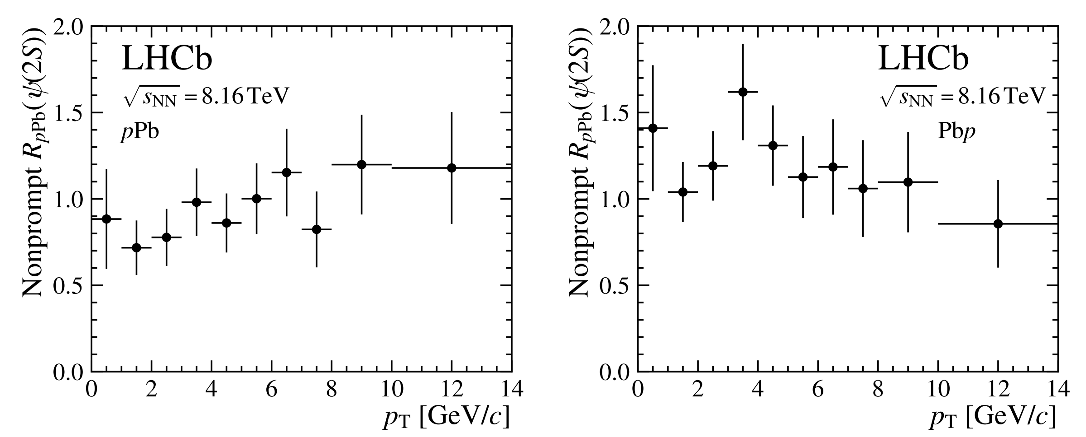
LHCb-PAPER-2023-024
13.6 ± 0.3 nb⁻¹
20.8 ± 0.5 nb⁻¹
Small to no-suppression of the non-prompt component from B-meson decays.

Slide 26
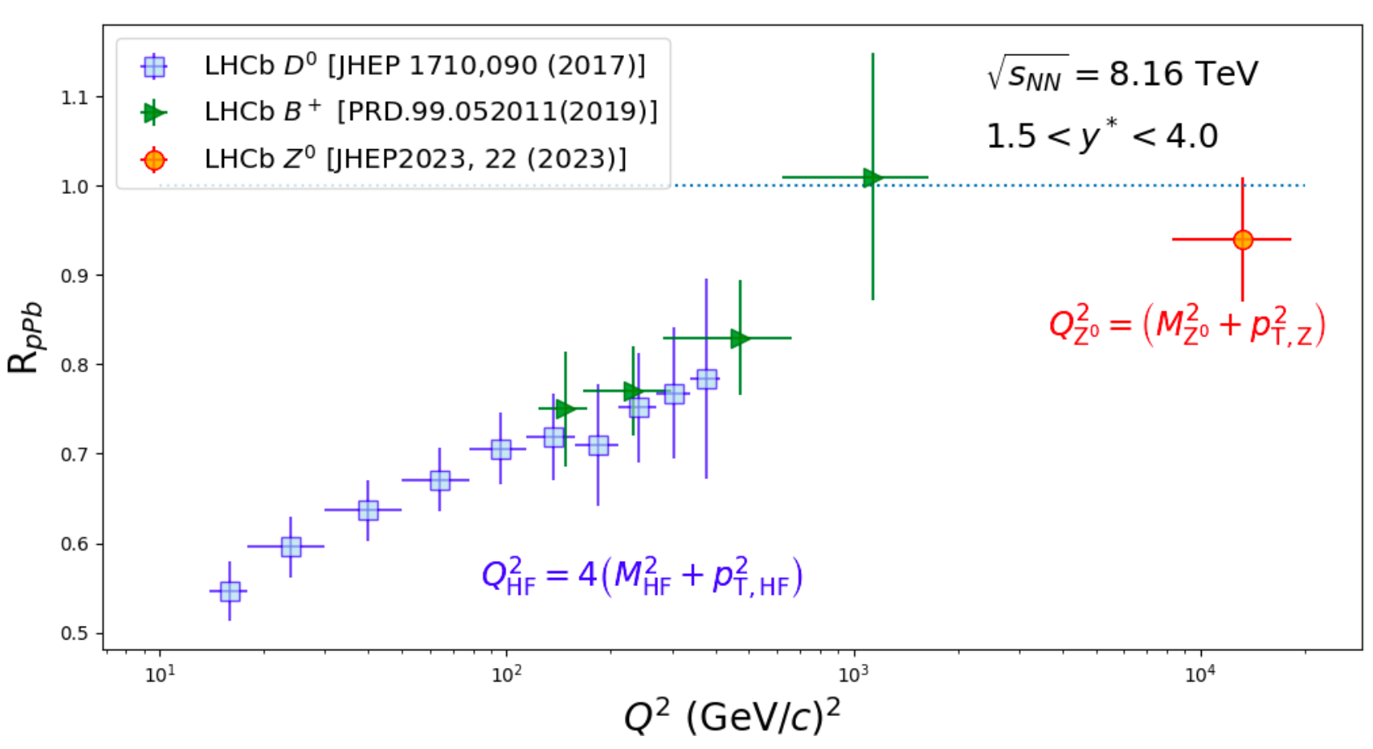

Slide 27
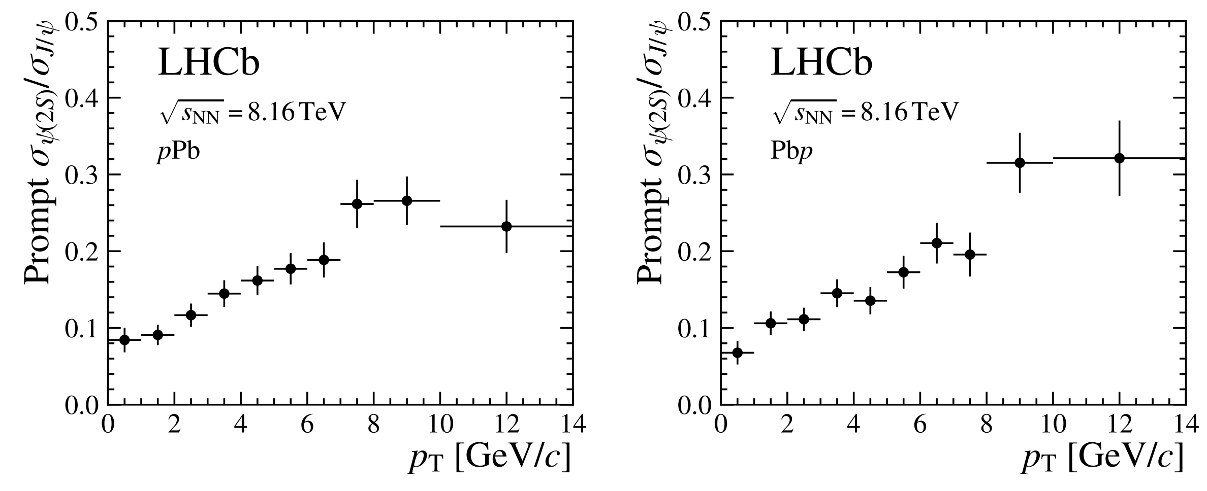
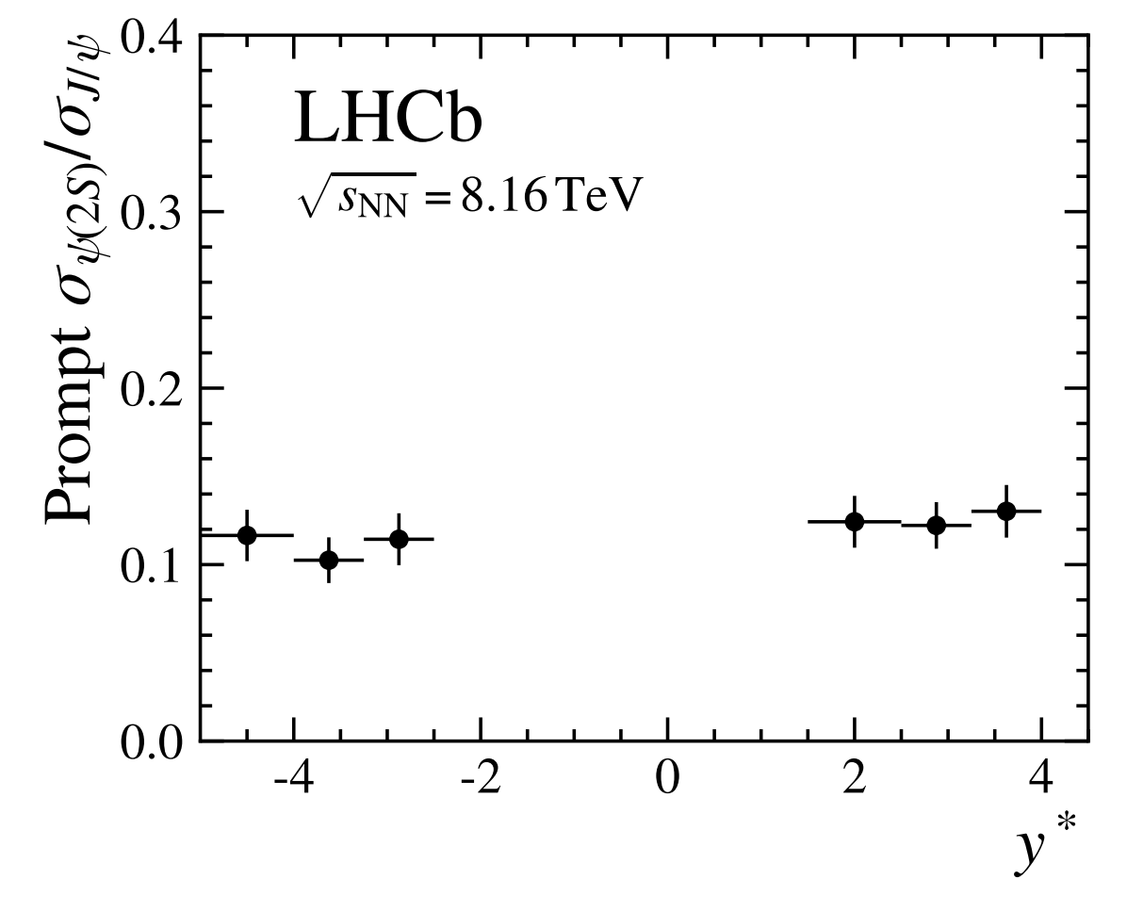
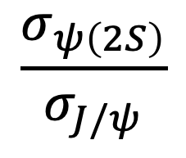

LHCb-PAPER-2023-024
$$\frac{σ_{ψ\left(2S\right)}}{σ_{J/ψ}}$$
increases with $p_{T}$
flat in rapidity

Slide 28
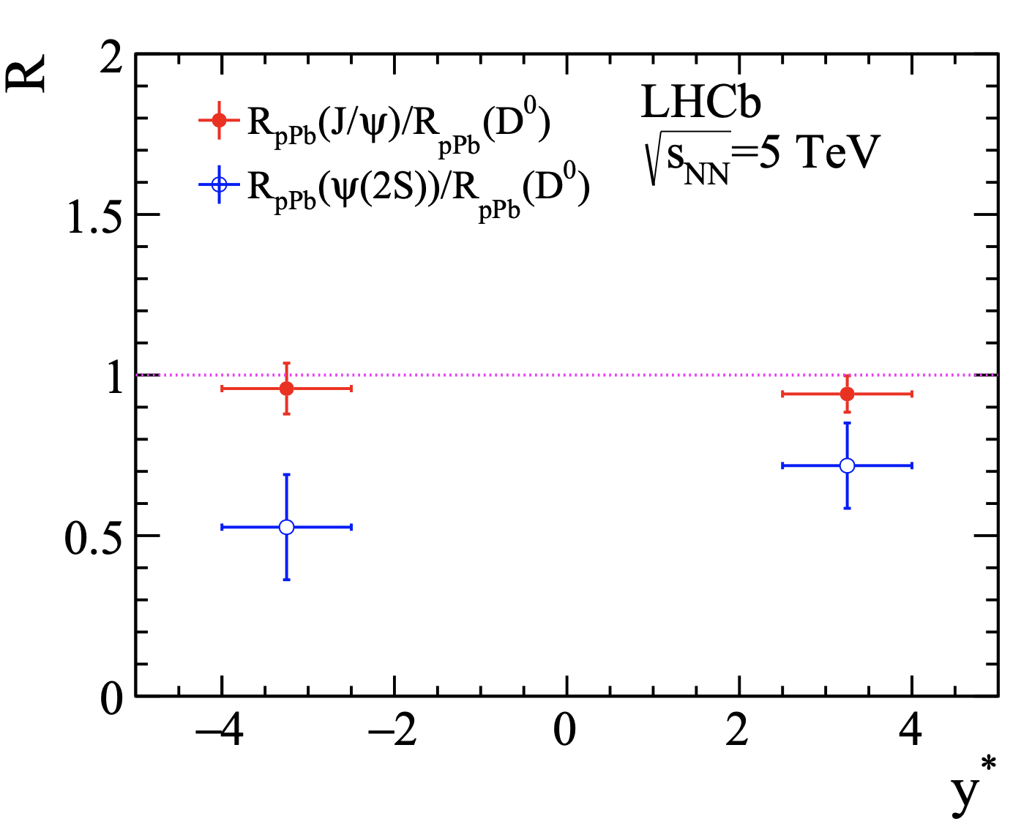
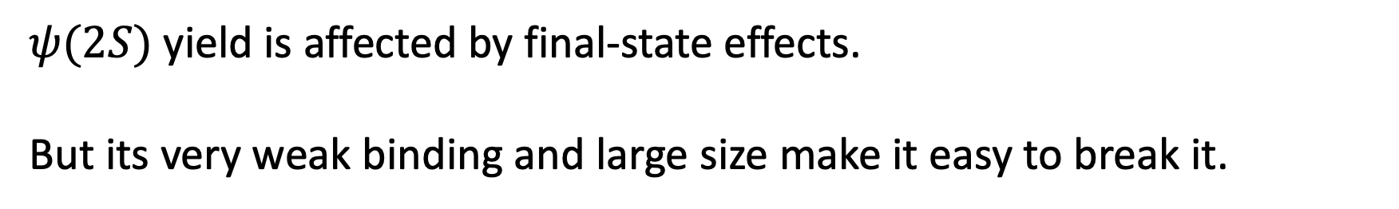
JHEP 1710 (2017) 090
Agnes Mocsy’s thermometer
$Υ\left(1S\right)$ 1100 MeV
$J/ψ$ 640 MeV
$Υ(2S)$ 530 MeV
$χ_{b}(2P)$ 300 MeV
$χ_{c},Υ(3S)$180-220 MeV
$ψ(2S)$ 50 MeV
$ψ(2S)$ yield is affected by final-state effects.
But its very weak binding and large size make it easy to break it.

Slide 29





$$χ_{c1}(3872)$$
PRL126 (2021) 092001
Suppression of $χ_{c1}\left(3872\right)$ relative to $ψ\left(2S\right)$ at high multiplicity pp events.
Consistent with dissociation of a compact tetraquark in comoving particles.
Molecular explanation from Bratten

Slide 30


New $ψ$(2S) Result
LHCb-PAPER-2023-024
13.6 ± 0.3 nb⁻¹
20.8 ± 0.5 nb⁻¹
Preliminary
Preliminary
A larger suppression seen in $ψ\left(2S\right)$ yield. Better quantify it with a double ratio with $J/ψ$.

Slide 31


PRL 118, 192001 (2017)
APS/Alan Stonebraker

