Slide 1
Development of particle accelerator technologies for societal applications
WP4
Andris Ratkus
11.04.2022

Slide 2
Project work package 4 objective
The main objective of WP4 is to grow the research capacity in Latvia in the field of accelerator technology

Slide 3

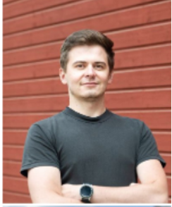

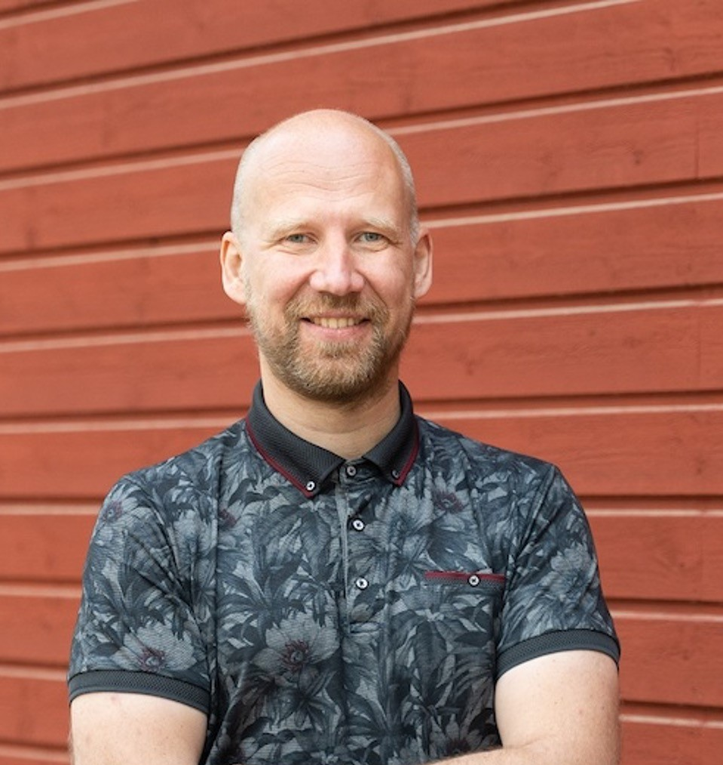
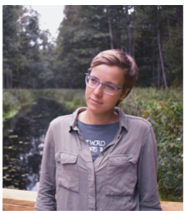
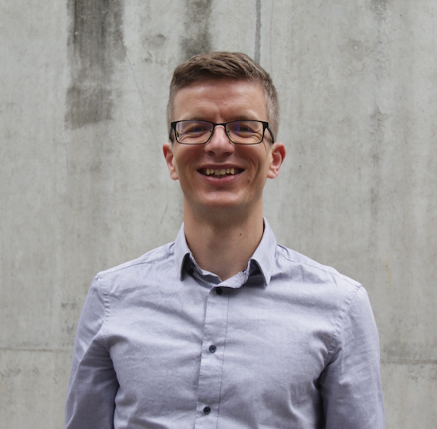
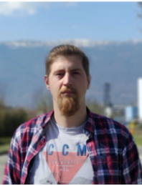
Deliverables
1. Doubling of the accelerator technology (AT) research community in Latvia
AT Researchers not in SRP:
Kristaps Paļskis
Jānis Vilcāns
Luca Piacentini
Lazar Nikitovics
Progress – Accomplished
Researchers in SRP:
Guntis Pikurs
Dagnija Kroģere
Andris Ratkus

Slide 4

Deliverables
2. Participation in CERN-based AT projects with 2 registrated researchers in at least 1 group at CERN, e.g. MSC, MME
Progress:
Contributing in two CERN-based AT projects – Accomplished
Heavy Ion Therapy Research Integration plus (HITRIplus) project task 7.5;
General Mechanical gantry design development and integration
Innovation Fostering in Accelerator Science and Technology (I.FAST) project tasks 10.1, 10.2 and 10.3;
To promote, demonstrate additive manufacturing technology as a production and repair tool to the accelerator community

Slide 5
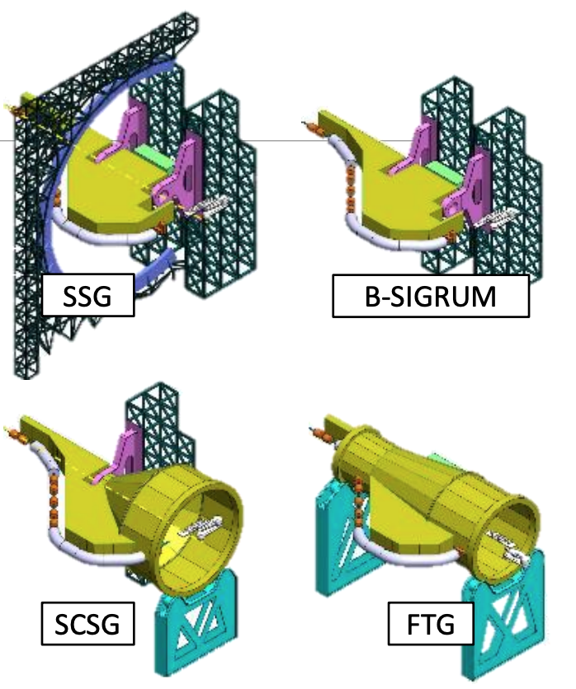
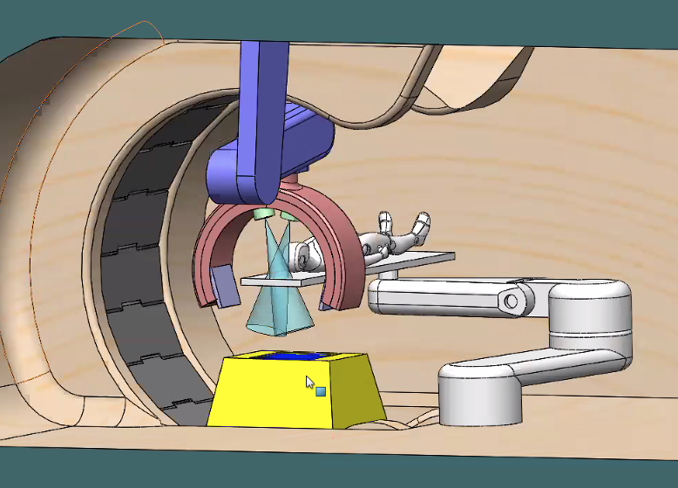
HITRIplus
Several potential Mechanical gantry designs have been developed and in the initial phase treatment room and imaging systems are considered; As well as work on curved cryogenic magnet fixing and adjustment devices design for the mobile cryostat
AT Researchers: Jānis Vilcāns, Luca Piacentini and Andris Ratkus

Slide 6
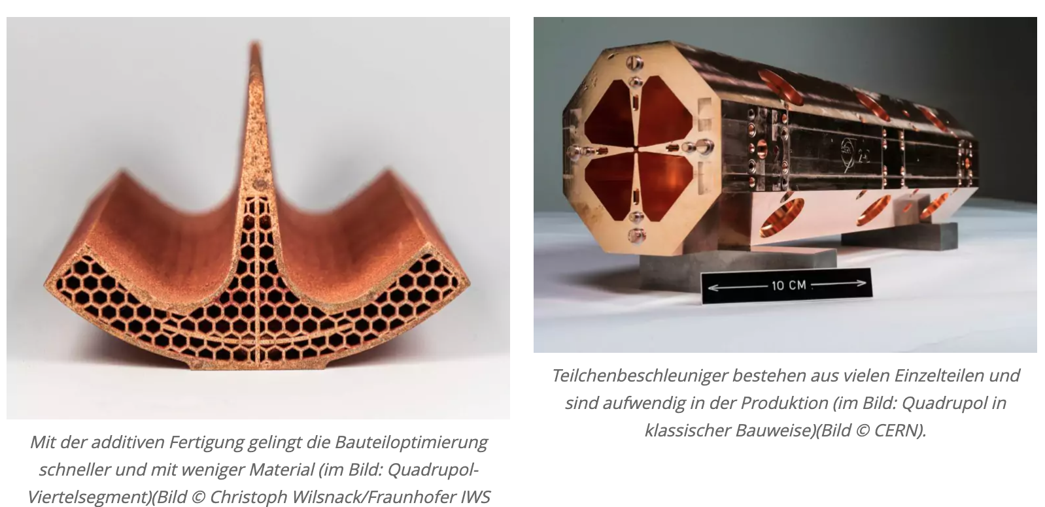

I.FAST
The worlds first pure copper ¼ Radio Frequency Quadrupole (RFQ) has been manufactured by AM within the I.FAST project
A few AM media that republished Fraunhofer IWS press release about ¼ RFQ:
3D printing Meadia
chemeurope.com
metal-am.com
analytica-world.com
idw-online.de
innovations-report.com
3D-Drucker - Oiger
3d-grenzenlos.de
AT Researchers: Guntis Pikurs, Dagnija Kroģere and Andris Ratkus

Slide 7
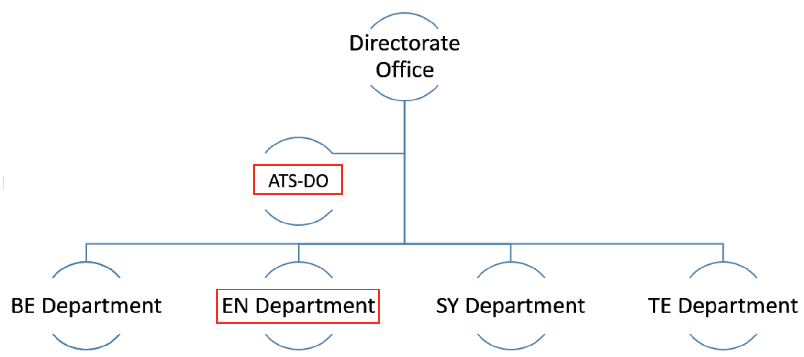
Deliverables
2. Participation in CERN-based AT projects with 2 registrated researchers in at least 1 group at CERN, e.g. MSC, MME
Progress
Two registrated researchers in CERN – Accomplished
The team is registered and we are working at the CERN Accelerator and Technology Sector Directorate Office (ATS-DO; link)
Our team has been involved at CERN Engineering – Mechanical and Materials Engineering (EN-MME) group activities.

Slide 8

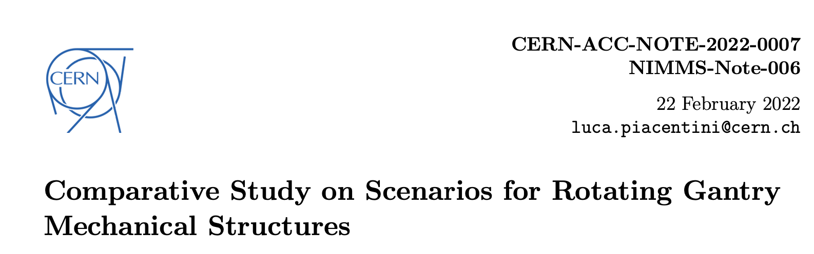
Deliverables
3. Two scientific publications resulting from the on-going research, published in journals listed in databases like Web of Science and SCOPUS and made publicly available
Progress
Two publications are published – Accomplished
Potentially third publication can be developed;

Slide 9

Deliverables for all SRP
Defended Master’s thesis by Ekaterina Tskhay
“Qualitative and quantitative analysis of the hybrid electron accelerator exhaust gas abatement technology impact to the selected maritime logistics aspects”
The master thesis is in the development stage by Dagnija Kroģere
“Research of additive manufacturing applications and strategies for repairing particle accelerator components”

Slide 10


Another AT Project
Next Ion Medical Machine Study:
towards a new generation of accelerators for cancer therapy
Two PhD thesis are in the development stage:
“Studies of different ion types and their use for radiation therapy, FLASH therapy aspects. Optimization of ion beam parameters for very high dose rate (FLASH) radiotherapy”
“Design study of a high-frequency linear accelerator for the purposes of injection into a therapy synchrotron and parallel production radioisotopes”
AT Researchers: Kristaps Paļskis, Lazar Nikitovics

Slide 11
Thanks

