Slide 1
2022 Report WP3 WP3: Development of the sub-detectors of the CMS experiment for the operation at the HL-LHC and research in crystal scintillator detectors Anatoli POPOV (LU CFI)
4th Strategic Committee Meeting
for the State Research Programme in High Energy Physics and Accelerator Technologies - Apr 11, 2022

Slide 2
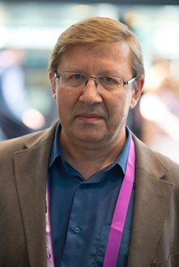
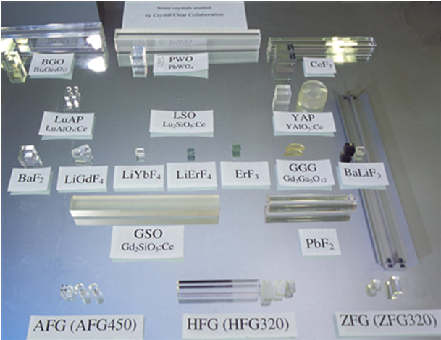
State research programme «High Energy Physics and Accelerator Technologies»
WP3: Development of the sub-detectors of the CMS experiment for the operation at the HL-LHC and research in crystal scintillator detectors
Institute of Solid State Physics University of Latvia (UL ISSP). Team:
Dr. Phys. Anatoli Popov (LU ISSP) – team leader
Dr. Phys. Vladimir Pankratov (LU ISSP)
PhD student Anna Ivanova (LU ISSP)
Master student Viktorija Pankratova (LU ISSP) → PhD student
Team leader - Dr. Phys. Anatoli Popov – member of Crystal Clear Collaboration CERN (since 1995), board member (since 2017)
The Crystal Clear Collaboration, also known as "Crystal Clear" or "CCC" was created in 1990 and approved by the CERN Detector Research and Development Committee as RD18 in April 1991, with the objective of developing new inorganic scintillators suitable for crystal electromagnetic calorimeters of LHC experiments.
https://crystalclearcollaboration.web.cern.ch/

Slide 3
State research programme «High Energy Physics and Accelerator Technologies»
WP3: Development of the sub-detectors of the CMS experiment for the operation at the HL-LHC and research in crystal scintillator detectors
The main tasks of WP3 can be summarised as follows:
T.3.1 - to develop, in close cooperation with WP2, the particle detector technologies for the CMS upgrade projects;
T.3.2 - to investigate the radiation tolerance of various present and future particle detection technologies via the involvement in the CMS experiment;
T.3.3 - to gather and analyse new data of crystal scintillator detectors in collaboration with the CERN-based CCC;
T.3.4 - to assist in the grow and develop the HEP research community via linking the physics research with the development of particle detection technologies.

Slide 4
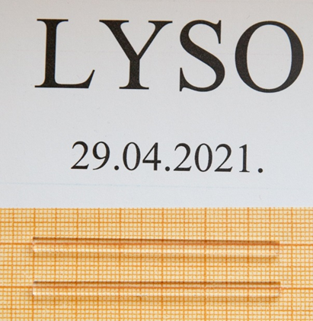
WP3: Development of the sub-detectors of the CMS experiment for the operation at the HL-LHC and research in crystal scintillator detectors
T.3.1 - to develop, in close cooperation with WP2, the particle detector technologies for the CMS upgrade projects.
Two research directions within T.3.1
1. Experimental study of radiation stability, structural and luminescence properties of Ce³⁺-doped Lu_{x}Y_{(2-x)}SiO₅ crystals obtained from CERN ( A. Popov, V. Pankratov, V. Pankratova).
2. Electronic and Atomic structure of pure and Ce³⁺-doped Lu_{x}Y_{(2-x)}SiO₅ crystals from DFT/TD-DFT calculations (A. Popov, A.Ivanova)
Two different samples of Y_{(2-x)}Lu_{(x)}SiO₅ : Ce³⁺ were received from CERN
We have performed the following comparative measurements, including along the samples :
Luminescence spectra (in house / DESY, MAXIV synchrotron facilities)
Excitation spectra (in house / DESY, MAXIV synchrotron facilities)
Raman spectra (in house)
Time-resolved luminescence spectra (in house / DESY synchrotron)
Ab initio modeling

Slide 5

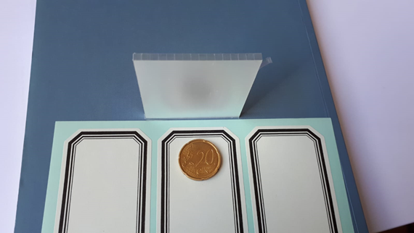

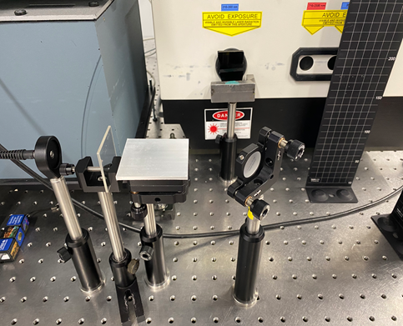
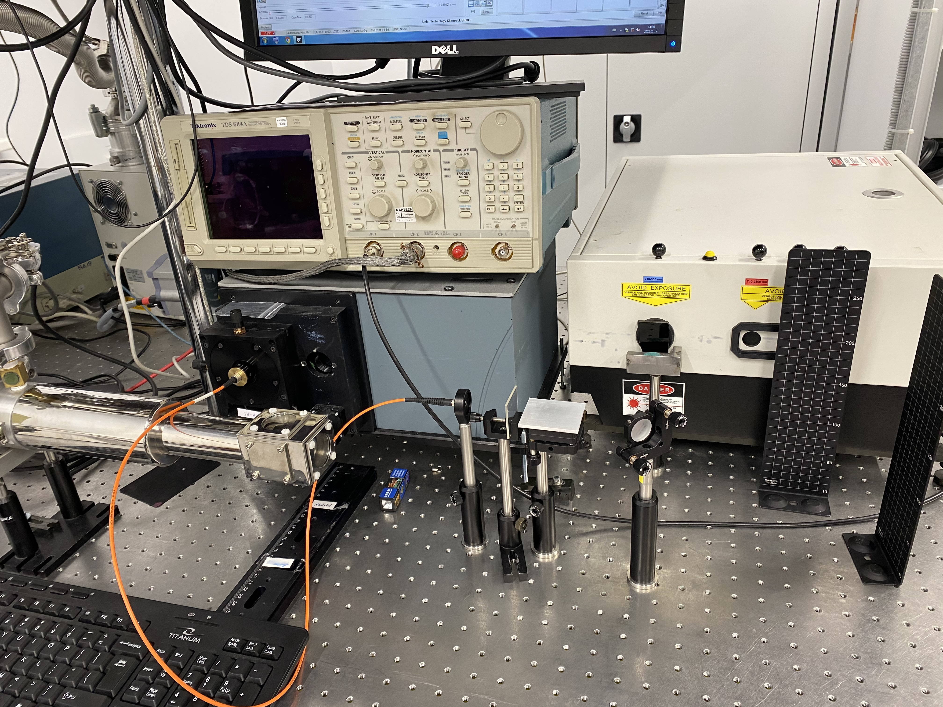
T.3.1 - to develop, in close cooperation with WP2, the particle detector technologies for the CMS upgrade projects. Luminescence /Raman measurements at ISSP LU
LYSO Single crystals (from CERN) and LYSO Detector unit – 16 crystals from
CALTEH (USA)

Slide 6
T.3.1 - to develop, in close cooperation with WP2, the particle detector technologies for the CMS upgrade projects.
Luminescence /Raman measurements at ISSP LU
Some examples – luminescence spectra
Comparison: Laser excitation at 264 nm (Ce1) or 325 nm (Ce2)
Ce1 (seven oxygen ligands) and Ce2 (six oxygen ligands)
Model | Gauss
Equation | y=y0 + (A/(w*sqrt(pi/2)))*exp(-2*((x-xc)/w)^2)
Plot | Peak1(Normalized1) | Peak2(Normalized1) | Peak3(Normalized1) | Peak4(Normalized1)
y0 | 0.00745 ± 0.0011 | 0.00745 ± 0.0011 | 0.00745 ± 0.0011 | 0.00745 ± 0.0011
xc | 3.07558 ± 0.00182 | 2.92912 ± 0.01372 | 2.79606 ± 0.0987 | 2.56714 ± 0.04871
w | 0.12053 ± 0.00447 | 0.21091 ± 0.03482 | 0.27405 ± 0.07409 | 0.46028 ± 0.03416
A | 0.03988 ± 0.00644 | 0.14105 ± 0.15135 | 0.16633 ± 0.17307 | 0.13866 ± 0.03242
Reduced Chi-Sqr | 6.63E-05
R-Square (COD) | 0.999317
Adj. R-Square | 0.999308
Model | Gauss
Equation | y=y0 + (A/(w*sqrt(pi/2)))*exp(-2*((x-xc)/w)^2)
Plot | Peak1(E) | Peak2(E)
y0 | -0.00691 ± 0.00156 | -0.00691 ± 0.00156
xc | 2.85902 ± 0.00253 | 2.58008 ± 0.00916
w | 0.32137 ± 0.00592 | 0.49109 ± 0.00832
A | 0.19668 ± 0.01707 | 0.47247 ± 0.0188
Reduced Chi-Sqr | 1.69E-04
R-Square (COD) | 0.998617
Adj. R-Square | 0.998608

Slide 7
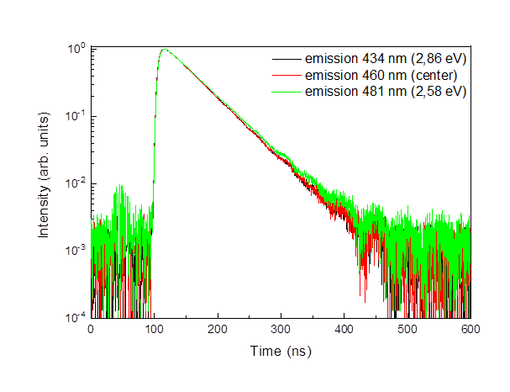
T.3.1 - to develop, in close cooperation with WP2, the particle detector technologies for the CMS upgrade projects.
Luminescence /Raman measurements at ISSP LU
Some examples Luminescence decay kinetics (emission at the center of the peak and of its Gaussian components)
Laser excitation at 264 nm (Ce1)
emission | decay time (ns)
 | excitation 264 nm
403 nm (Gaussian peak 1) | 37 ns
423 nm (Gaussian peak 2) | 39 ns
428 nm (center) | 39 ns
443 nm (Gaussian peak 3) | 40 ns
482 nm (Gaussian peak 4) | 47 ns
Laser excitation at 325 nm (Ce2)
emission | decay time (ns)
 | excitation 325 nm
434 nm (Gaussian peak 1) | 47 ns
460 nm (center) | 47 ns
481 nm (Gaussian peak 2) | 49 ns
Ce1: 35-38 ns Ce2: 59 ns (Martins et all, 2017)

Slide 8
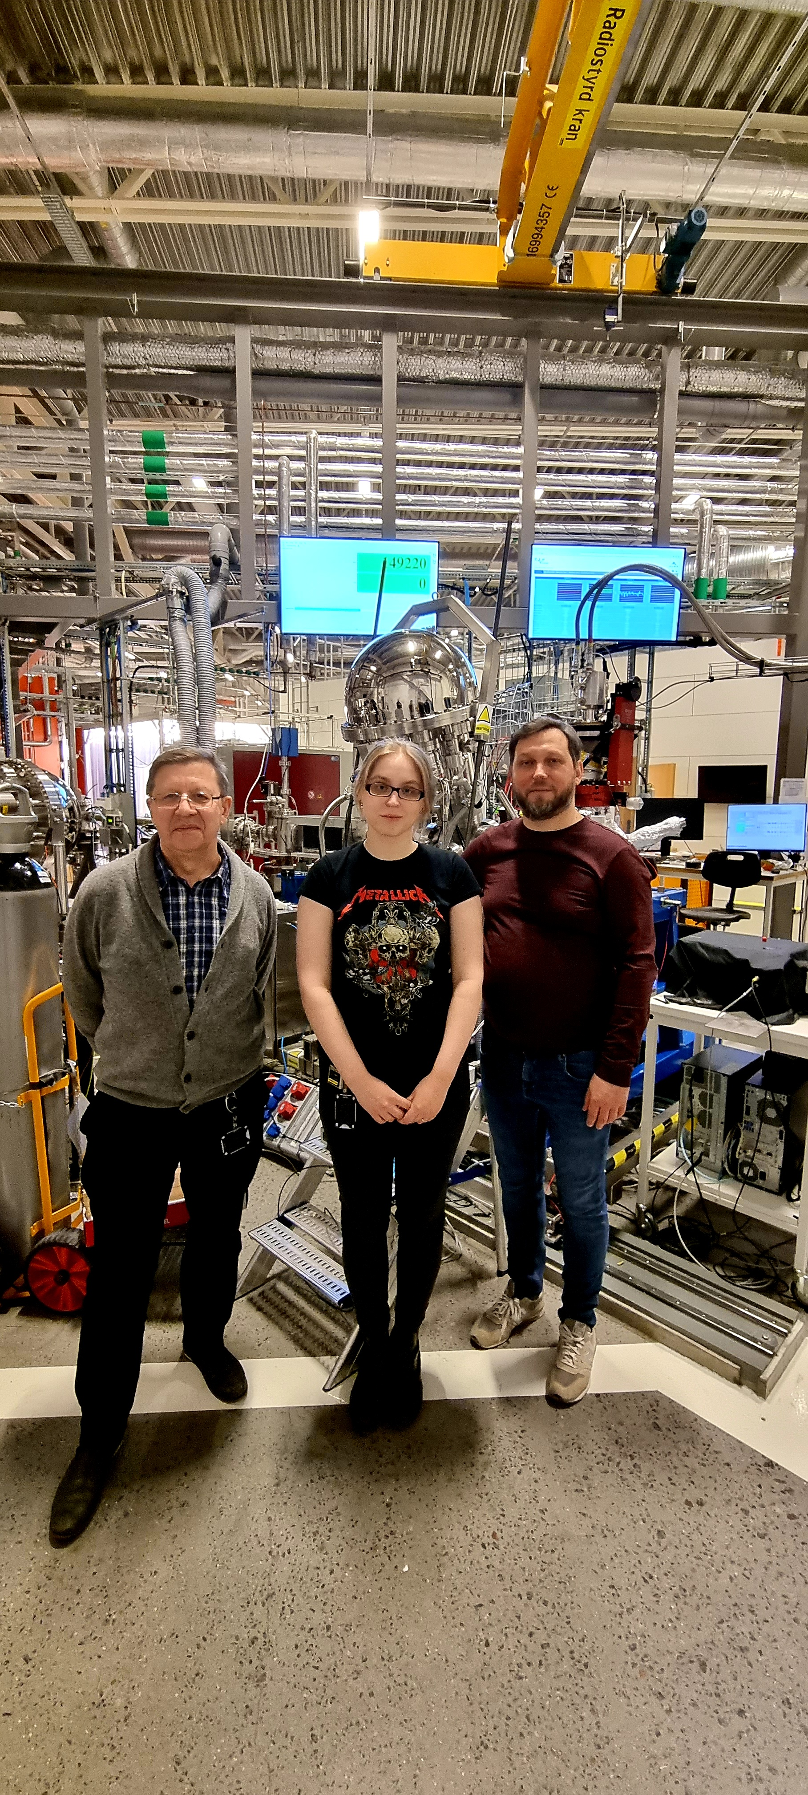
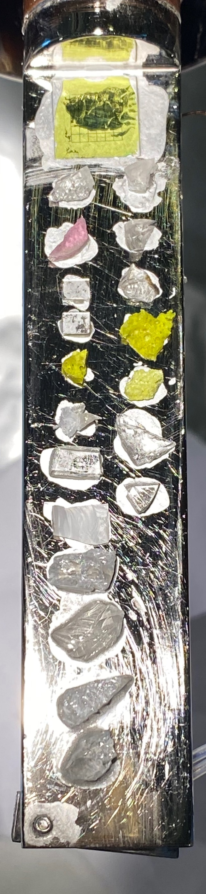
T 3.1 VUV measurements at MAXIV synchrotron radiation facility, LUND, SWEDEN
LYSO = Lu_{x}Y_{(2-x)}SiO₅
Contour map of the excitation and emission spectra of Ce³⁺ centers at 295 K. The profiles of the emission spectra (top) and excitation spectra (right) in the maximum intensity are shown.
Temperature dependency of the excitation spectra monitored in Ce³⁺ emission band

Slide 9
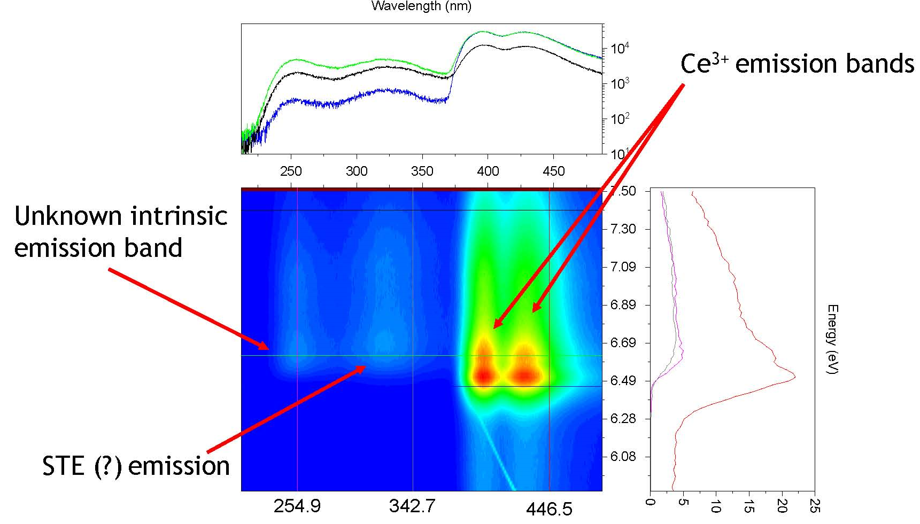
T 3.1 VUV measurements at MAXIV synchrotron radiation facility, LUND, SWEDEN
Low temperature measurements Ce-doped LYSO from CERN
Recent experiment 20210408 FinEstBeAMS 2022-02-09 to 2022-02-14
Contour map of the excitation and emission spectra of Ce³⁺ centers at 7 K. The profiles of the emission spectra (top) and excitation spectra (right) in the maximum intensity are shown.

Slide 10
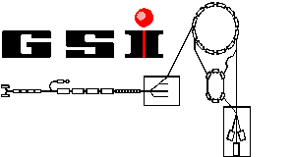
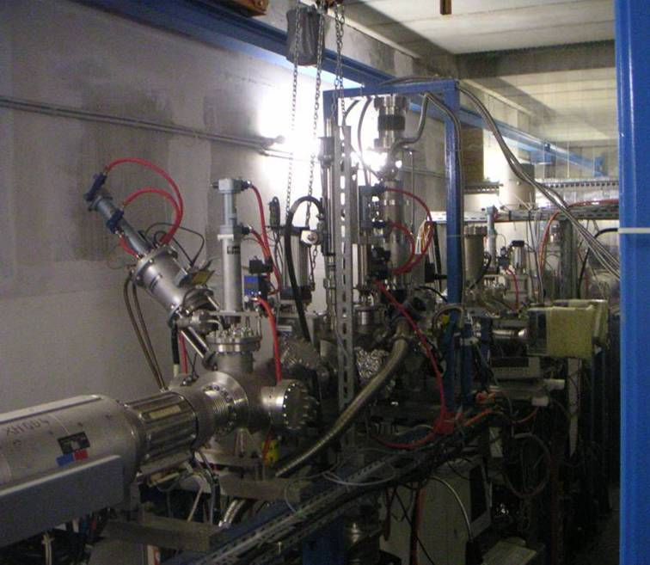
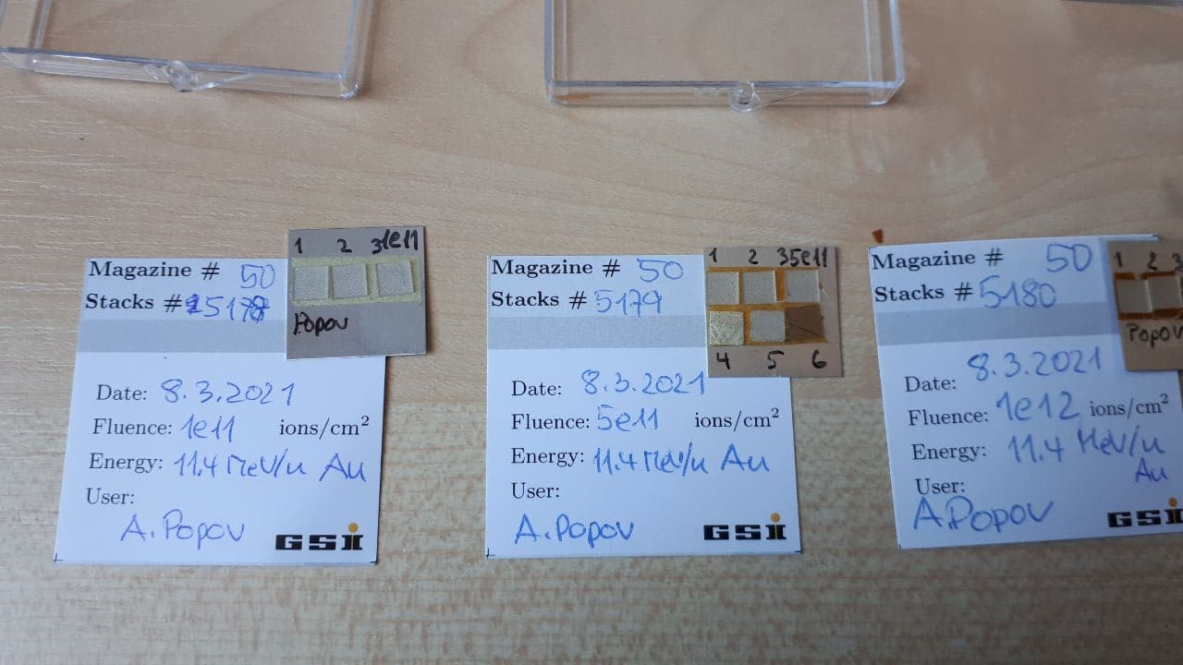
WP3: Development of the sub-detectors of the CMS experiment for the operation at the HL-LHC and research in crystal scintillator detectors
T.3.2 - to investigate the radiation tolerance of various present and future particle detection technologies via the involvement in the CMS experiment;
Irradiation campaigns:
a) GSI Helmholtzzentrum für Schwerionenforschung,
Darmstadt, Germany
Prof.Christina Trautmann
Au ions 8.6 MeV/u
1e11, 5e11 and 1e12
b) Gumilev Eurasian University Eurasian Natinaonal University
the DC-60 heavy ion cyclotron of Interdisciplinary Scientific Research Center (Xe, Kr)
c) IC-100 cyclotron at FLNR JINR (Dubna) - Xe, Bi ions - fluences 10¹⁰ - 10¹² cm⁻² ions/cm²
ion species C...Xe,…,U
Energy 1 … 10 MeV/u
range 10 … 100 µm
fluence 1 … ~10¹⁴ ions/cm²
PbF₂
PbWO₄

Slide 11
WP3: Development of the sub-detectors of the CMS experiment for the operation at the HL-LHC and research in crystal scintillator detectors
T.3.2 - to investigate the radiation tolerance of various present and future particle detection technologies via the involvement in the CMS experiment
(few more examples)
F-type color center formation (oxygen vacancies with trapped electrons)
Optical density of virgin and irradiated YAG and GGAG:Ce,Be,Mg single crystals
Xe ions (E=156 MeV)

Slide 12
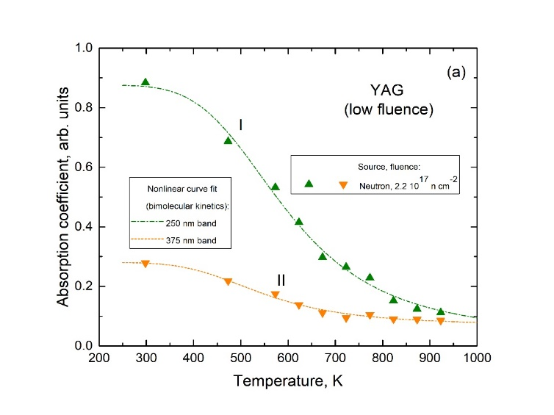
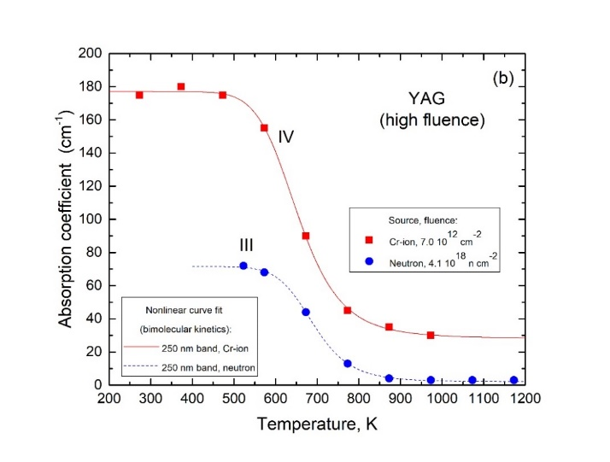
T.3.3 – to gather and analyse new data of crystal scintillator detectors in collaboration with the CERN-based Crystal Clear Collaboration
Experimental study and theoretical analysis of radiation defect annealing in particle irradiated scintillator materials.
Example: Y₃Al₅O₁₂ crystals irradiated by neutrons or Cr swift ions. More data are in progress, after analysis of new samples irradiated with Au (GSI, Darmstadt) and Bi (Dubna).
Nr. | Type | E_{a} (eV) | X (K⁻¹) | Legend
1 | F⁺(375 nm) | 1.09 | 1.9x10⁵ | Fast neutrons (>1.2 MeV), fluence 4.1 x 10¹⁸ n cm⁻²
2 (I) | F (250 nm) | 0.17 | 1.6x10⁻² | Fast neutrons (>1.2 MeV), fluence 2.2 x 10¹⁷ n cm⁻²
3 (II) | F⁺(375 nm) | 0.15 | 1.2x10⁻² | Fast neutrons (>1.2 MeV), fluence 2.2 x 10¹⁷ n cm⁻²
4 (III) | F (250 nm) | 0.81 | 1.6x10³ | Fast neutrons (>1.2 MeV), fluence 4.1 x 10¹⁸ n cm⁻²
5 (IV) | F (250 nm) | 0.61 | 7.5x10¹ | Cr ions, fluence 7.0 x 10¹² cm⁻²
Manucript in preparation: “Peculiarities of defect recombination kinetics in irradiated yttrium aluminium garnet” by
A.I. Popov , E.A. Kotomin, M. Izerrouken, V.N. Kuzovkov, R. Villa
ISSP, Latvia; CERN, Nuclear Research Center of Draria, Algiers and CIEMAT, Spain

Slide 13
WP3: Development of the sub-detectors of the CMS experiment for the operation at the HL-LHC and research in crystal scintillator detectors
T.3.3 - to gather and analyse new data of crystal scintillator detectors in collaboration with the CERN-based CCC (in-house and/or synchrotron)
Materials studied:
LYSO:Ce³⁺
Gd₃(Ga,Al)₅O₁₂:Ce³⁺ (GAGG)
Y₃Al₅O₁₂ (YAG)
PbWO₄
PbF₂
Pure and doped MgAl₂O₄
AlON
Ga₂O₃
BaGa₂O₄:Eu³⁺
DESY beamtimes 2021-2022:
Beamtime Proposal Beamline Dates of visit
I-20211648 EC P66 21-Apr-2022 - 27-Apr-2022
I-20211006 EC P66 02-Dec-2021 - 08-Dec-2021
I-20210976 EC P66 18-Oct-2021 - 25-Oct-2021
MAX IV beamtimes 2021-2022
Beamtime Proposal Beamline Dates of visit
20211074 FinEstBeAMS 2022-05-11 to 2022-05-16
20210408 FinEstBeAMS 2022-02-09 to 2022-02-14
20200308 FinEstBeAMS 2021-11-17 to 2021-11-22
Reflectivity, excitation luminescence spectra, and time-resolved luminescence
Temperature range: 10 – 300 K
Excitation energy: 40 eV- visible

Slide 14
WP3: Development of the sub-detectors of the CMS experiment for the operation at the HL-LHC and research in crystal scintillator detectors
T.3.4 - to assist in the grow and develop the HEP research community via linking the physics research with the development of particle detection technologies
1. Sample exchange and joint sample characterization
with team UL Institute of Chemical Physics Elīna Pajuste and Toms Elvijs Šusts.
2. Collaboration with CCC CERN, GSI Darmstadt, Research & Irradiation facilities in ESS MAX IV, DESY, ENU, Tartu University.
3. Involvement of the student
Two students involved –
Doctoral student – Anna Ivanova;
Master student - Viktorija Pankratova.
!!! New PhD student from Kharkov (Ukraine)
Anastasiia Chekhovska just joined my group last Friday (details on the next slide)
4. Publicity:
a) papers are already published and few are in preparation (details on the next slide)
b) conferences, including invited talks and conference organization (EMRS)
Promocijas darba tēma (latviešu, kā arī angļu, vācu vai franču valodā) Ar Ce³⁺ dopēto Y_{(2-x)}Lu_{(x)}SiO₅ kristālu radiācijas noturības un luminiscences īpašību modelēšana ar DFT/TD-DFT metodēm. Radiation stability and luminescence properties of Ce³⁺-doped Y_{(2-x)}Lu_{(x)}SiO₅ crystals from DFT/TD-DFT calculations.

Slide 15
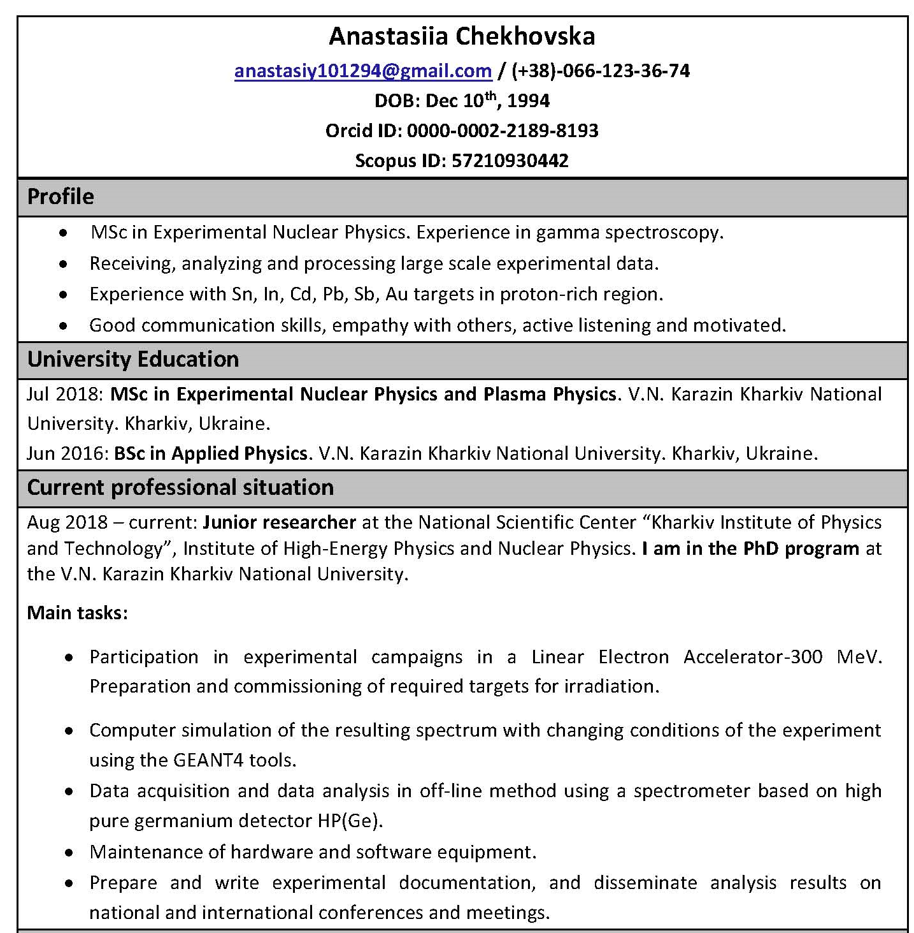
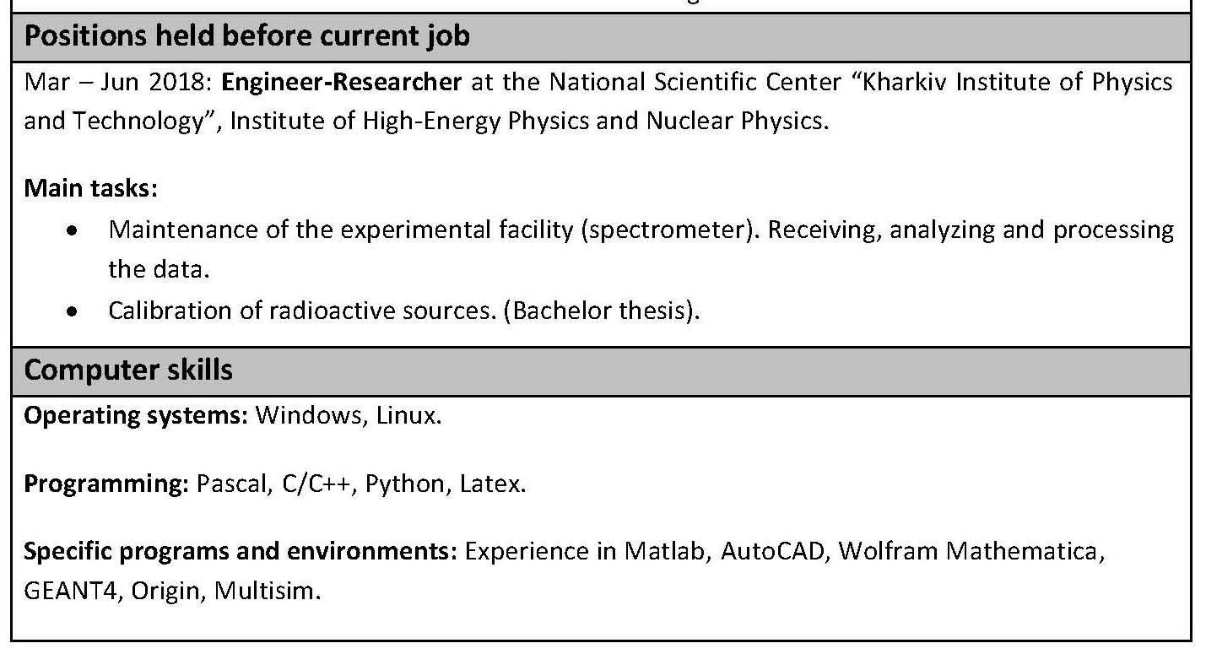
Short Info about New PhD student
“Stellar Nucleosynthesis: Experimental Yields of the ¹¹²Sn(γ,n)¹¹¹Sn and ¹¹²Sn(γ,p)^{111m,g}In Reactions for p-Nuclei Production Simulation”
Chekhovska, A.V., Semisalov, I.L., Kasilov, V.I., Skakun, Y.O.
Springer Proceedings in Physics, 2019, 219, р. 301–305
“Nuclear Data Sheets for A=218” Singh B., Basunia M.S., Martin M., McCutchan E.A., Bala I., Caballero-Folch R., Canavan R., Chakrabarti R., Chekhovska A., Grinder M.M., Kaim S.l, Kanjilal D., Kasperovych D., Kobra M.J., Koura H., Nandi S., Olacel A., Singh A., Tee B.P.E. Nuclear Data Sheets, 2019, 160, р. 405–471
“Intensities of the strongest γ-ray transitions originating from the 112gIn decay determined via photoactivation yield measurements” Semisalov, I., Chekhovska, A., Skakun, Y., Karpus, S., Kasilov, V. Applied Radiation and Isotopes, 2021, 176, 109843
“Intensities of the strongest γ-ray transitions originating from the ¹¹¹Sn decay determined via photoactivation yield measurements”
Chekhovska A., Skakun Y., Semisalov I., Kasilov V. Nuclear Instruments and Methods in Physics Research Section B: Beam Interactions with Materials and Atoms 2022, 517, pp.1-5

Slide 16
LIST OF Our Publications
Kozlova, A. P., Buzanov, O. A., Pankratova, V., Pankratov, V. Low-temperature luminescence of catangasite single crystals under excitation by vacuum ultraviolet synchrotron radiation. Low Temperature Physics, 2020, 46(12), 1178-1184. https://doi.org/10.1063/10.0002471
(Q3, CiteScore=1.5; Impact Factor=0.923, SNIP = 0,658)
Klym, H.; Karbovnyk, I.; Luchechko, A.; Kostiv, Y.; Pankratova, V.; Popov, A.I. Evolution of Free Volumes in Polycrystalline BaGa₂O₄ Ceramics Doped with Eu³⁺ Ions. Crystals 2021, 11, 1515. https://doi.org/10.3390/cryst11121515
(Q2, CiteScore=3.2; Impact Factor =2.589, SNIP = 0.886) OPEN ACCESS
Usseinov, A.; Koishybayeva, Z.; Platonenko, A.; Pankratov, V.; Suchikova, Y.; Akilbekov, A.; Zdorovets, M.; Purans, J.; Popov, A.I. Vacancy Defects in Ga₂O₃: First-Principles Calculations of Electronic Structure.
Materials 2021, 14, 7384. https://doi.org/10.3390/ma14237384 (Q2, CiteScore=4.2, Impact Factor =3.623, SNIP= 1.261) OPEN ACCESS
Klym, H.; Karbovnyk, I.; Piskunov, S.; Popov, A.I. Positron Annihilation Lifetime Spectroscopy Insight on Free Volume Conversion of Nanostructured MgAl₂O₄ Ceramics. Nanomaterials 2021, 11, 3373. https://doi.org/10.3390/nano11123373
(Q1, CiteScore=5.4, Impact Factor =5.076, SNIP = 1.129) OPEN ACCESS
Mastrikov, Y. A., Chuklina, N. G., Sokolov, M. N., Popov, A. I., Gryaznov, D. V., Kotomin, E. A., Maier, J. (2021). Small radius electron and hole polarons in PbX₂ (X= F, Cl, Br) crystals: a computational study. J. Mater. Chem. C, 2021,9, 16536-16544 https://doi.org/10.1039/D1TC01731D
(Q1, CiteScore=11.1; Impact Factor = 7.393, SNIP = 1.314)
Akopdzhanyan, T. G., Kondakov, A. A., Rupasov, S. I., Kozlova, A. P., & Pankratov, V. (2021). Optical properties of powder and ceramics of aluminium oxynitride obtained by self-propagating high-temperature synthesis. Lithuanian Journal of Physics, 2021, 61(3), pp.169-176. https://doi.org/10.3952/physics.v61i3.4516
( Q3, CiteScore=1.6, Impact Factor=0.633, SNIP=0.492)
Pankratov, V., Pankratova, V., & Popov, A. I. Luminescence and Vacuum Ultraviolet Excitation Spectroscopy of Nanophosphors under Synchrotron Irradiation. physica status solidi (b), 2022, 2100475.
https://doi.org/10.1002/pssb.202100475
(Q3, CiteScore=2.9, Impact Factor=1.710, SNIP=0.632)
***************************************************
Just accepted:
V. Pankratova, V.A. Skuratov, O.A. Buzanov, A.A. Mololkin, A.P. Kozlova, A. Kotlov, A.I. Popov, V. Pankratov, Radiation effects in Gd₃(Al,Ga)₅:O₁₂:Ce³⁺ single crystals induced by swift heavy ions,
Optical Materials (accepted)
Few more papers are under review (two) and in preparation

Slide 17
Main results and achievements
Main scientific results and achievements
We have performed several irradiation experiment on, YAG, PWO, GAGG, PbF₂ etc with different swift heavy ions in Dubna, GSI (Darmstadt, Germany) and INP/ENU Nursultan (Kazakhstan).
Most of these samples were successfully characterized using luminescence excitation and reflectivity methods at DESY and MAX-IV (Lund) synchrotron radiation facilities
Thermal annealing of radiation damage and corresponding Raman spectra analysis are in progress.
In addition, complementary ab initio calculation were performed in the case of LYSO, PbF₂ and Ga₂O₃

