Slide 1
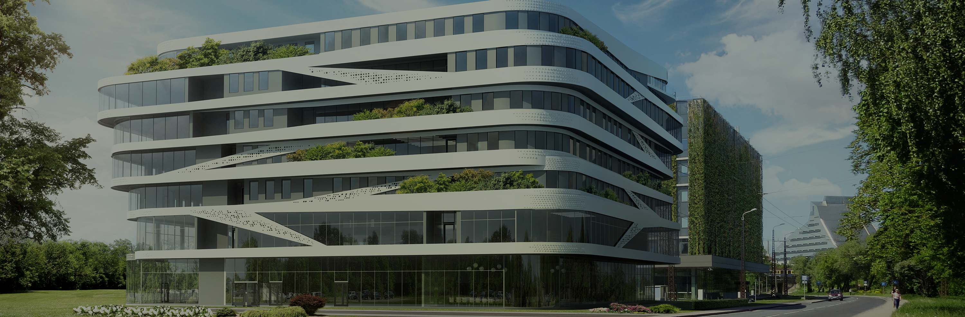
State research programme «High Energy Physics and Accelerator Technologies» Project
«Top quark and Higgs physics at the CMS experiment, development of crystal scintillator detectors and sub-detectors of the CMS detector, and the development of particle accelerator technology for societal applications in collaboration with CERN»
UL Institute of Chemical Physics - activities SRP
E. Pajuste
April 11, 2022

Slide 2





Capacity building
Joint RTU and LU PhD program Particle Physics and Accelerator Technologies
01.11.2021 – up to now
(Normunds Ralfs Strautnieks)
Fermi National Accelerator Laboratory CMS Data Analysis School (CMSDAS) 2022
04.01.2022 - 14.01.2022
(Normunds Ralfs Strautnieks, Elina Pajuste)
Introduction to Accelerator Physics CERN Accelerator School 25.09.2021 – 8.10.2021 (Elina Pajuste)
Training on Nuclear instrumentation (detectors), IAEA Seubersdorf laboratories
7.03.2022 – 18.03.2022
(Elina Pajuste)

Slide 3
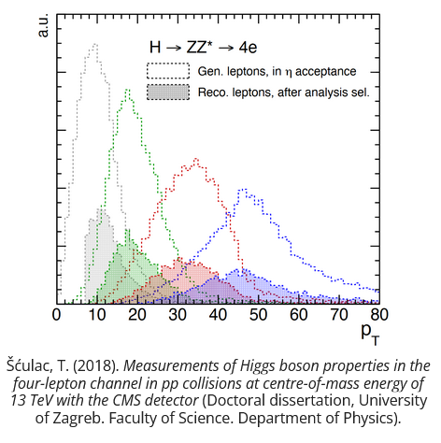
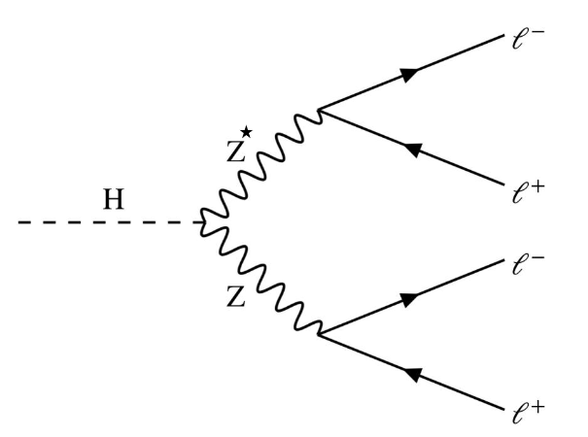
Research activities WP2 «CMS Physics»
N.R. Strautnieks works in close collaboration with MsC phys A.Gaile and Dr. phys J.Proskurins
Main task - improving low-pT electron efficiency measurements to decrease systematic uncertainties in Higgs ZZ group analysis
One of Higgs boson decay channels is H -> ZZ* -> 4l, called the ‘‘golden channel’’ (all decay products are observable and reconstructable)
2 of the decay electrons that come from Z* are in low-pT region, which is problematic because of high particle and jet background resulting in high systematic uncertainties for experimental results
Feynman diagram for Higgs boson decay to 4 leptons
Improvement in precision of low-pT electron selection and reconstruction efficiency measurements is needed in low-pT region
Around 60% of total experimental uncertainty is coming from these low-pT electrons)

Slide 4
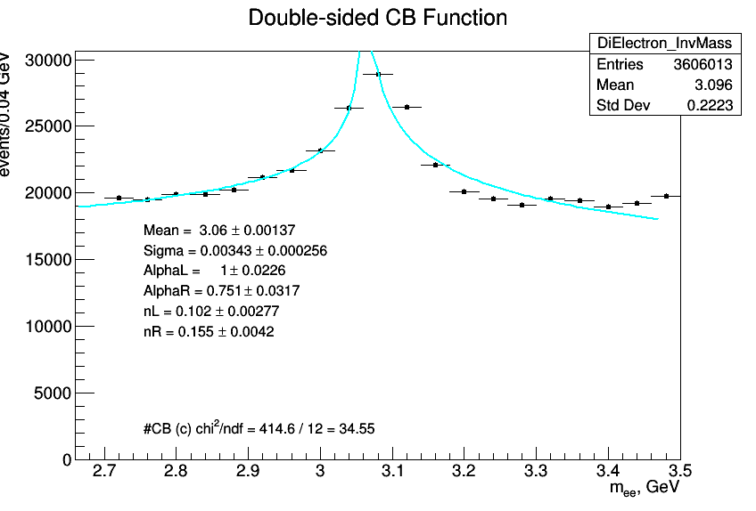
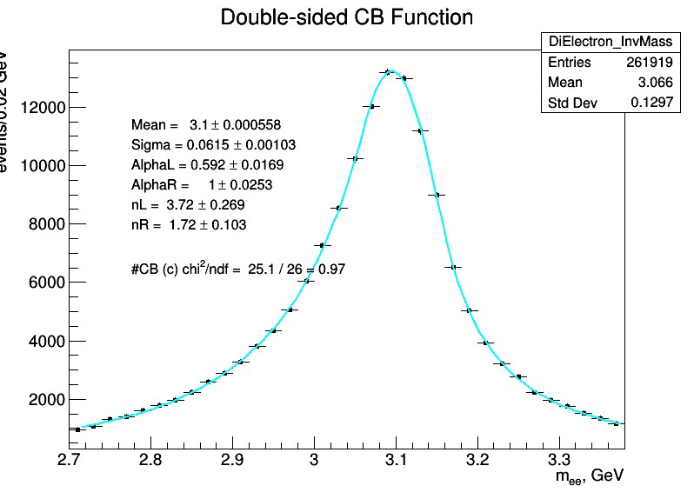
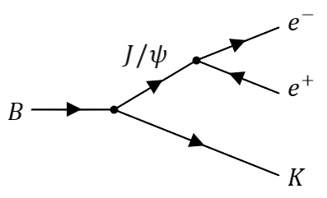
Research activities WP2 «CMS Physics»
Progress milestones in low-pT electron studies:
Identified the low-mass resonance needed for this analysis – J/ψ meson (3.1 GeV), which decays into 2 low-pT electrons
Identified LHC collision data in which we can find J/Psi mesons – (B meson decays)
B -> K + J/Psi and afterwards J/Psi -> e⁺ e⁻
Identified MC simulations for the same J/Psi decays
Analysis code for processing few TB of collision data and MC has been made (including electron identification and isolation parameters)
The methodology of performing efficiency studies has been learnt (Tag and Probe method)
Invariant mass of J/Psi decays (Data)
Next steps:
Getting the best signal to background ration using the available electron ID’s and isolation parameters (Data and MC)
Performing efficiency studies on acquired low-pT electrons from J/Psi decays (Data and MC)
Invariant mass of J/Psi decays (MC)

Slide 5
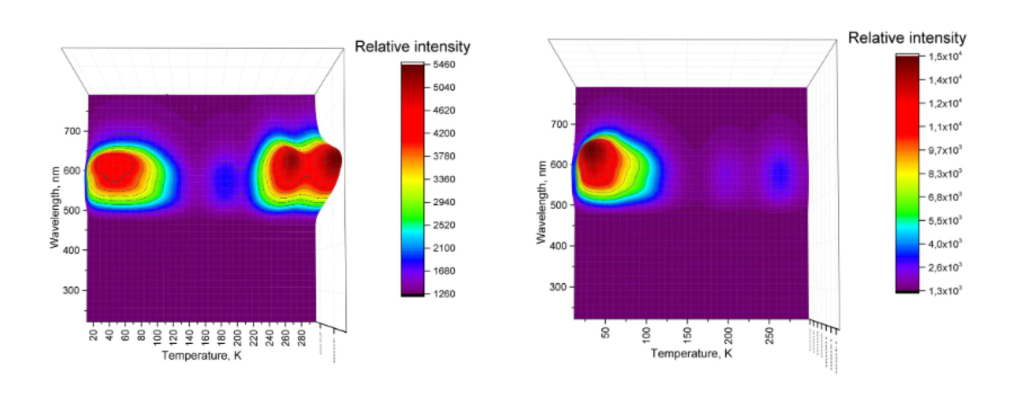
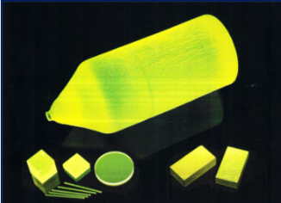
Research activities WP3 «CMS Detector and LYSO crystals»
Toms Elvijs Šusts in very close collaboration with CFI researchers Dr. phys. A. Popovs and Dr. phys V. Pankratovs has continued activities related to scintilation crystal studies
Studies of cerium doped gadolinium aluminium gallium garnets (GAGG:Ce) radiation stability, properties of radiation defects has been performed with the focus on low temperature behavior.
Different mathematical models had been applied for thermoluminescence measurement data analysis, such as Randall-Wilkins and May-Patridge models
GAGG:Ce crystals
TSL 3D curve for GAGG:Ce
TSL 3D curve for GAGG:Ce (vacuum preannealed)

Slide 6
Thank you for your attention!

