Slide 1

BPM Processing for the HiLumi LHC Interaction Region BPMs
Douglas BETT, SY-BI-BP
Michal Krupa
Manfred Wendt
Andrea Boccardi
Manuel Barros Marin
Irene Degl’Innocenti
Selim Ozdogan
Phil Burrows
Joël Daricou
BI Student and R&D Meeting #3, 18 March 2022

Slide 2
Contents
Introduction to the HL-LHC IR BPM upgrade
Simulation framework for BPM processing
Power compensation

Slide 3
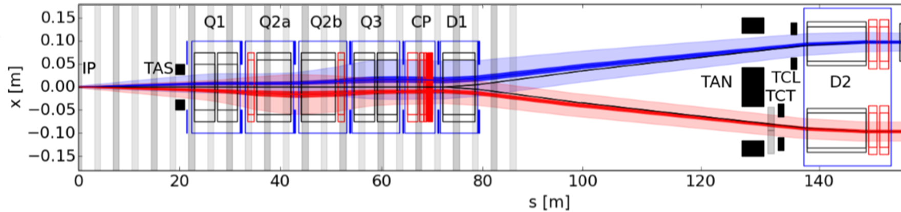
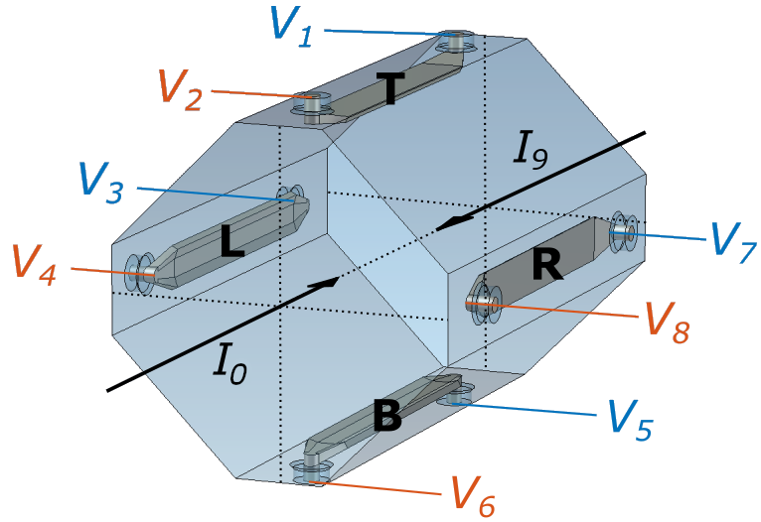
BPM upgrade
BPM | Type | s [m] | bxt [ns]
Q1 | A | 21.853 | 3.92
Q2A | B | 33.073 | 3.92
Q2B | B | 43.858 | 6.82
Q3 | B | 54.643 | 9.72
CP | B | 65.743 | 10.52
D1 | B | 73.697 | 7.36
type-A
type-B
bxt = bunch crossing time i.e. beam-beam delay
New stripline BPMs in the immediate vicinity of interaction regions 1 (ATLAS) and 5 (CMS), where the two beams coexist within a single pipe
Signals from all eight ports required to calculate the horizontal and vertical position of both beams
The distortion of the beam signals due to the presence of the other beam must be compensated for
A

Slide 4
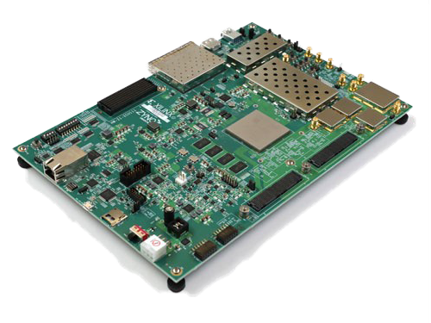
Zynq RFSoC: Candidate digital processor
Xilinx Zynq RFSoC (= radio frequency system on a chip)
Model ZU28DR (Zynq UltraScale architecture)
Processing System
Quad Arm Cortex-A53
Dual Arm Cortex-R5
RF-ADC
DDC
RF in
RF-ADC
GTY Transceiver
RF-DAC
DUC
RF Out
RF-DAC
Programmable Logic
Zynq RFSoC
ZCU111 Evaluation Board

Slide 5
Zynq RFSoC: Candidate digital processor
Processing System Features
Application Processing Unit | Quad-core Arm Cortex-A53 up to 1.33 GHz
Real-Time Processing Unit | Dual-core Arm Cortex R5 up to 533 MHz
Xilinx Zynq RFSoC (= radio frequency system on a chip)
Model ZU28DR (Zynq UltraScale architecture)
Processing System
Quad Arm Cortex-A53
Dual Arm Cortex-R5
Direct-RF Signal Chain Features
Max. RF input Frequency (GHz) |  | 4
Decimation / Interpolation |  | 1x, 2x, 4x, 8x
12-bit RF-ADC | # of ADCs | 8
 | Max Rate (GSPS) | 4.096
14-bit RF DAC | # of DACs | 8
 | Max Rate (GSPS) | 6.554
RF-ADC
DDC
RF in
RF-ADC
GTY Transceiver
RF-DAC
DUC
RF Out
Programmable Logic
System Logic Cells (K) | 930
DSP Slices | 4,272
Memory (Mb) | 60.5
33G Transceivers | 16
Maximum I/O Pins | 347
RF-DAC
Programmable Logic
Zynq RFSoC
Asynchronous clocking
~1.5 counts of noise
ZCU111 Evaluation Board

Slide 6
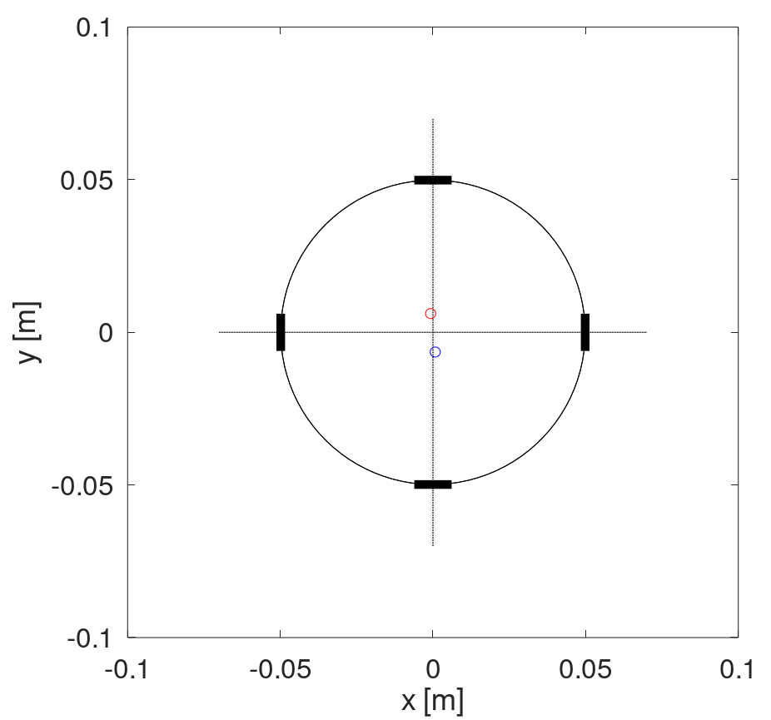
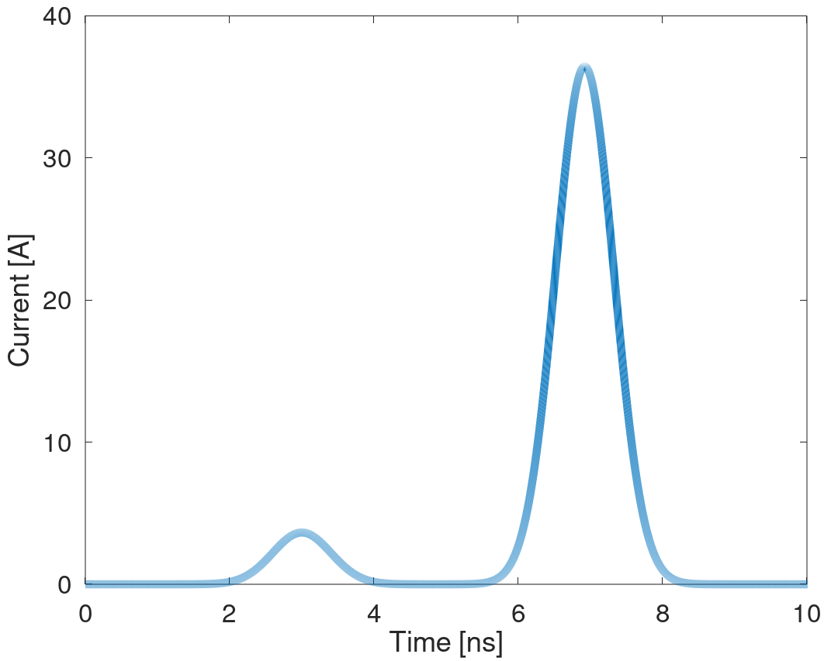
BPM signals
IR1 Q1 presqueeze orbit
Gaussian (RMS 0.95 ns)
Bunch crossing timing 3.92 ns
Both beams close to center in horizontal
~6 mm off in vertical
Second beam
(2.3e11)
First beam
(2.3e10)

Slide 7
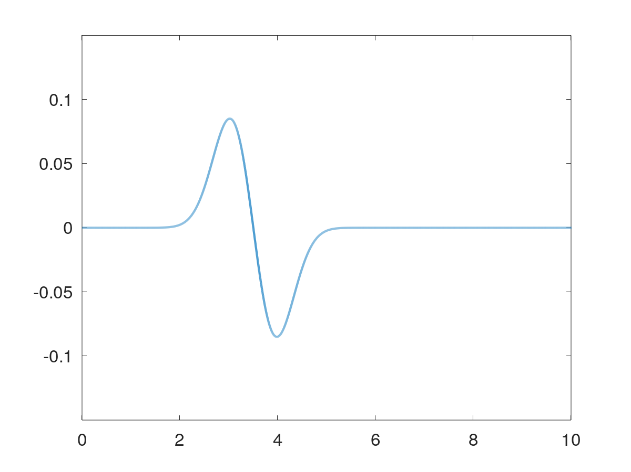

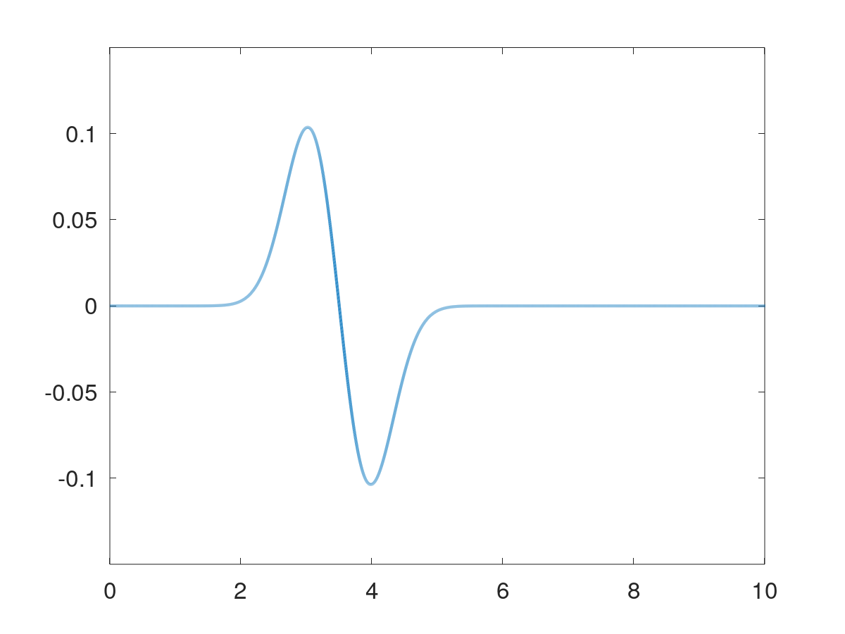

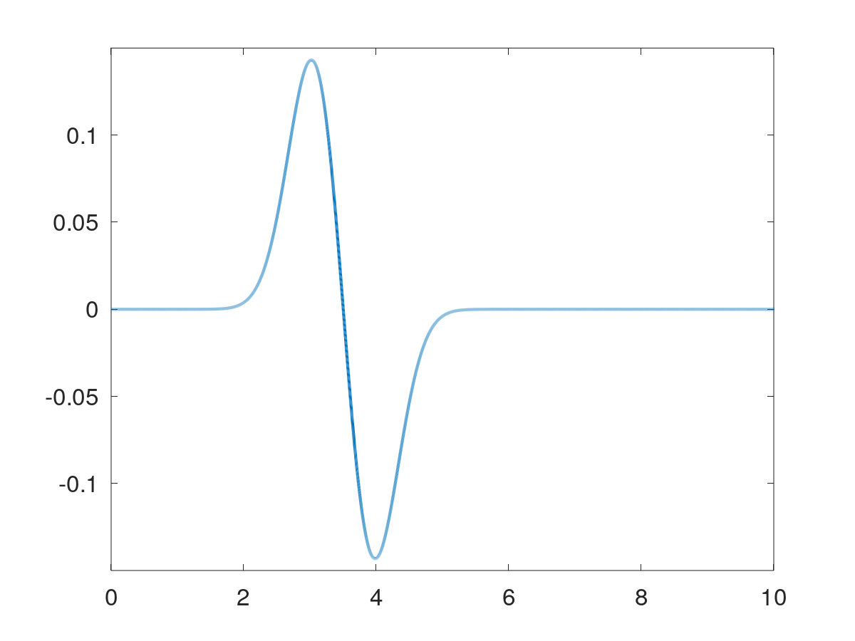
Signals from first beam
Port 1 (T)
First beam
“coupled”
signals
Port 3 (L)
Port 7 (R)
Port 5 (B)

Slide 8
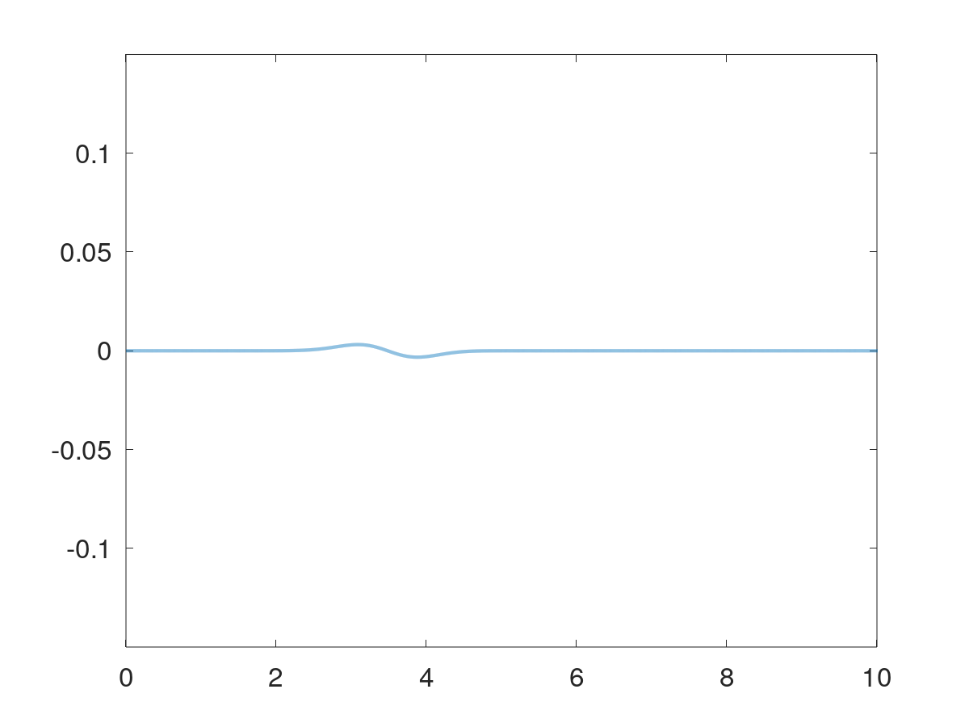
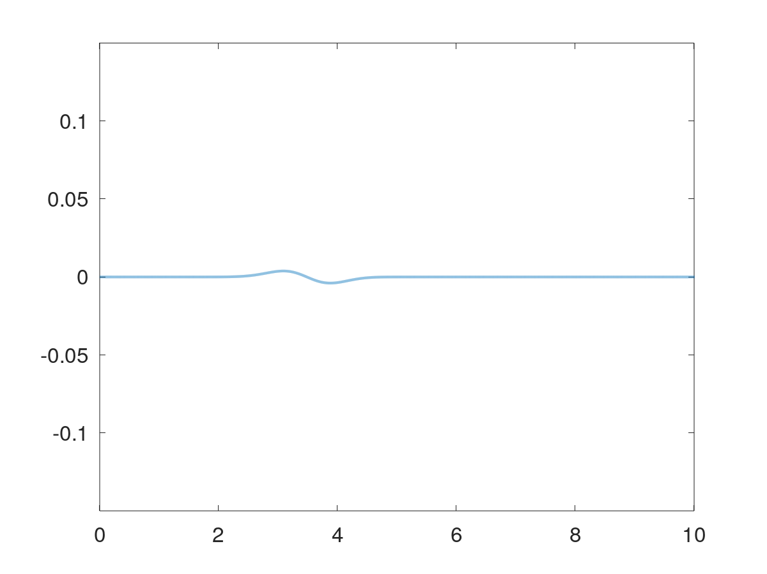


Signals from first beam
First beam
“isolated”
signals
Port 2 (T)
Port 4 (L)
Port 8 (R)
Port 6 (B)
Signals small at downstream end due to stripline directivity

Slide 9
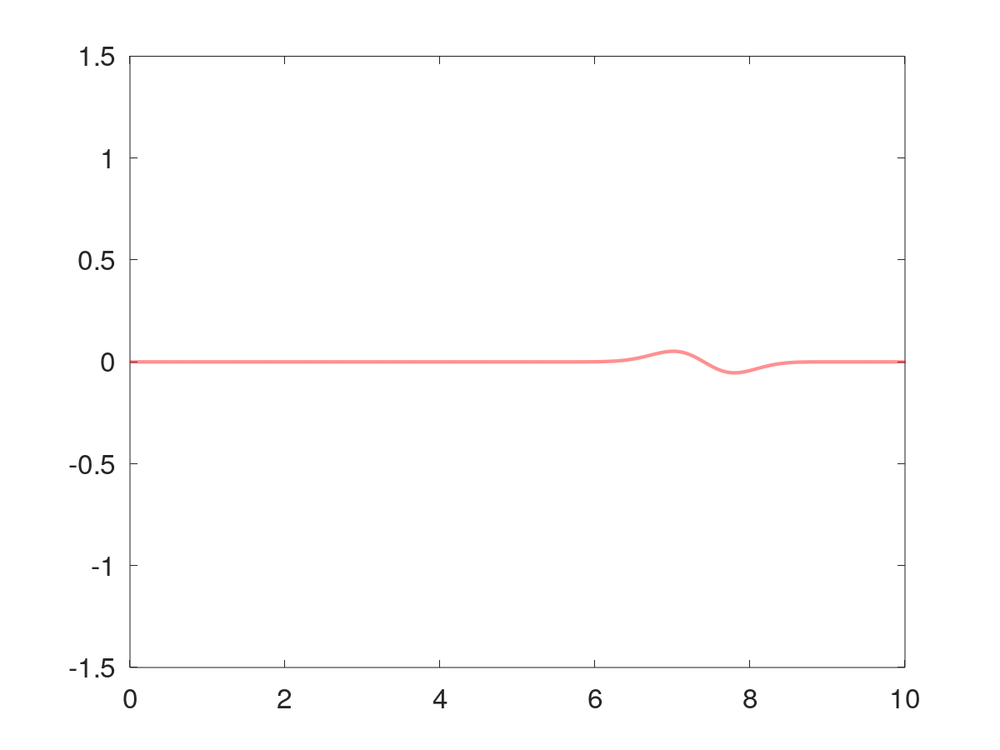
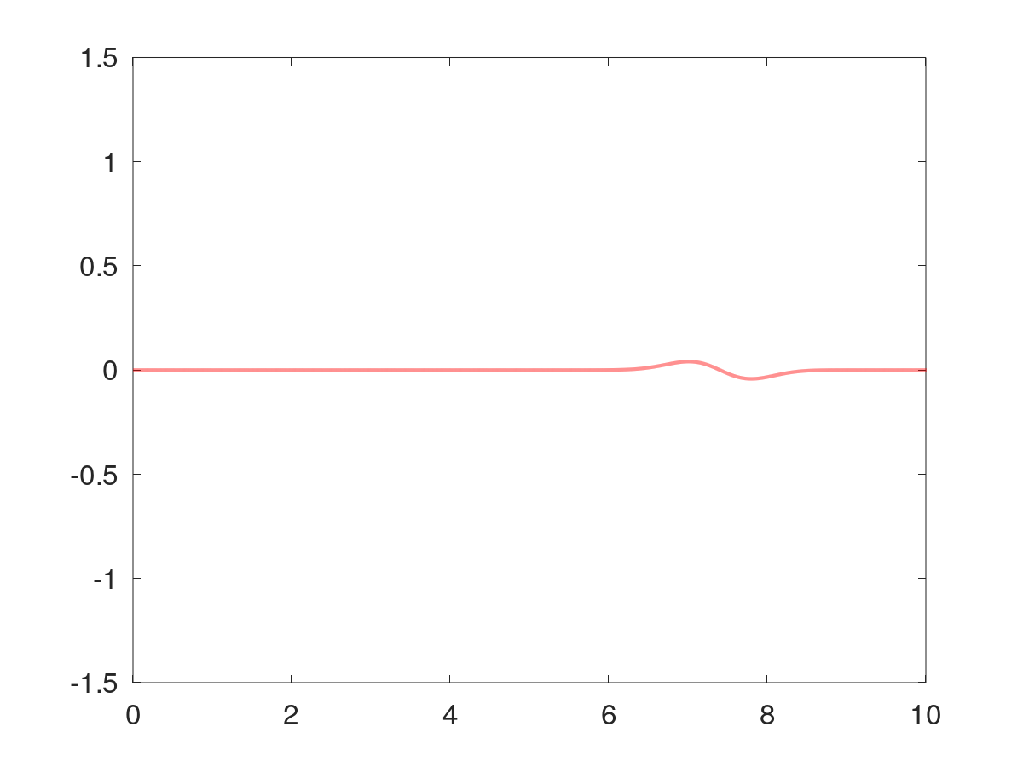

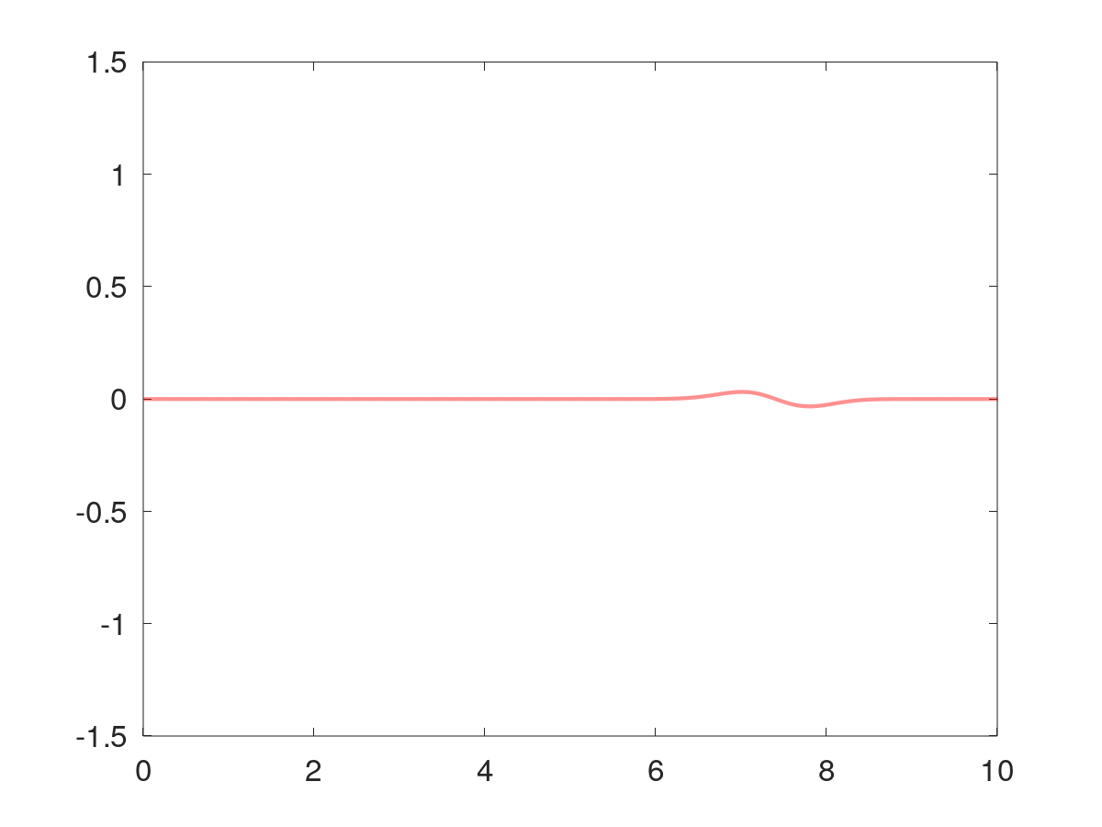
Signals from second beam
Port 1 (T)
Second beam
“isolated”
signals
Port 3 (L)
Port 7 (R)
Port 5 (B)

Slide 10
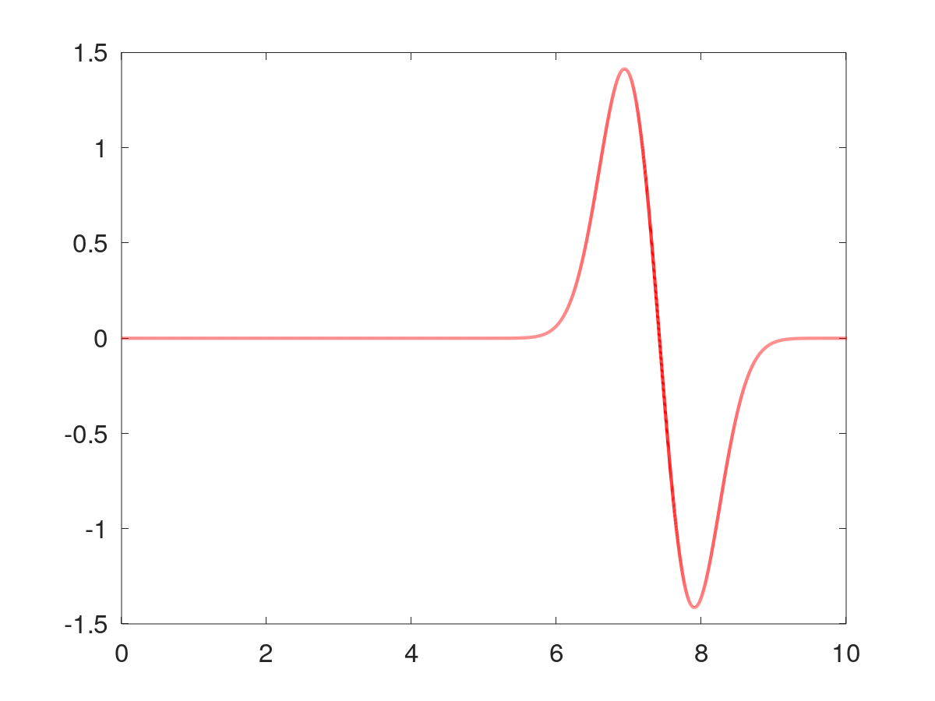
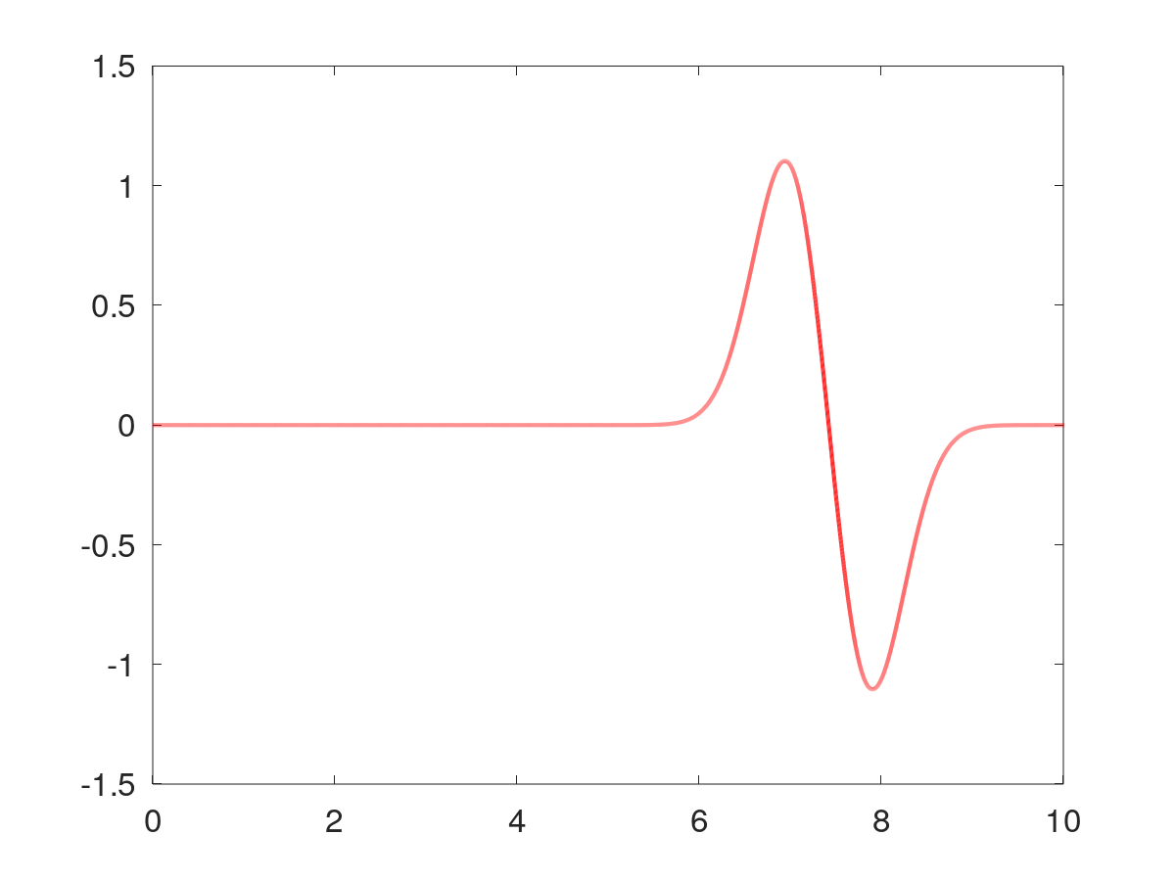
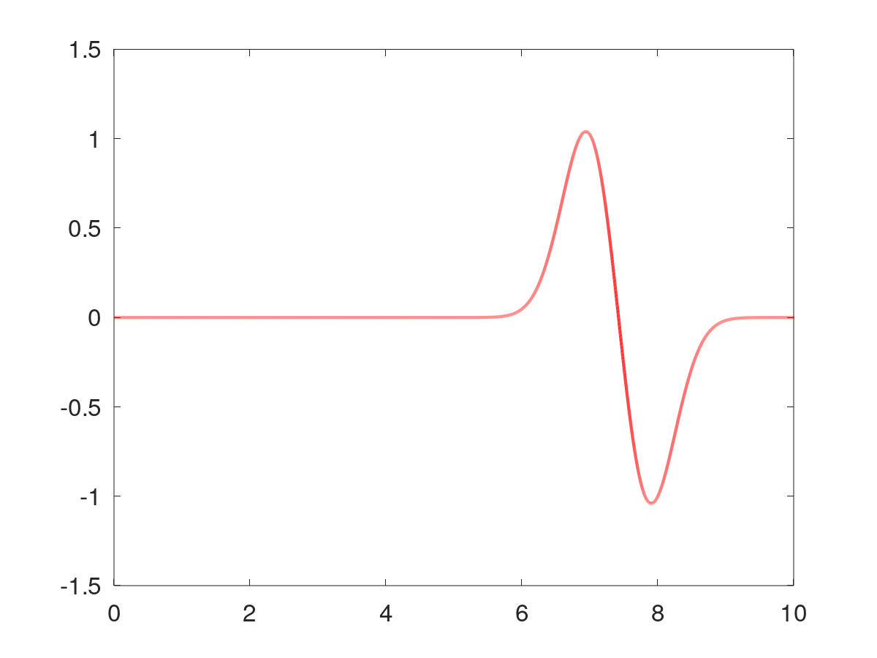
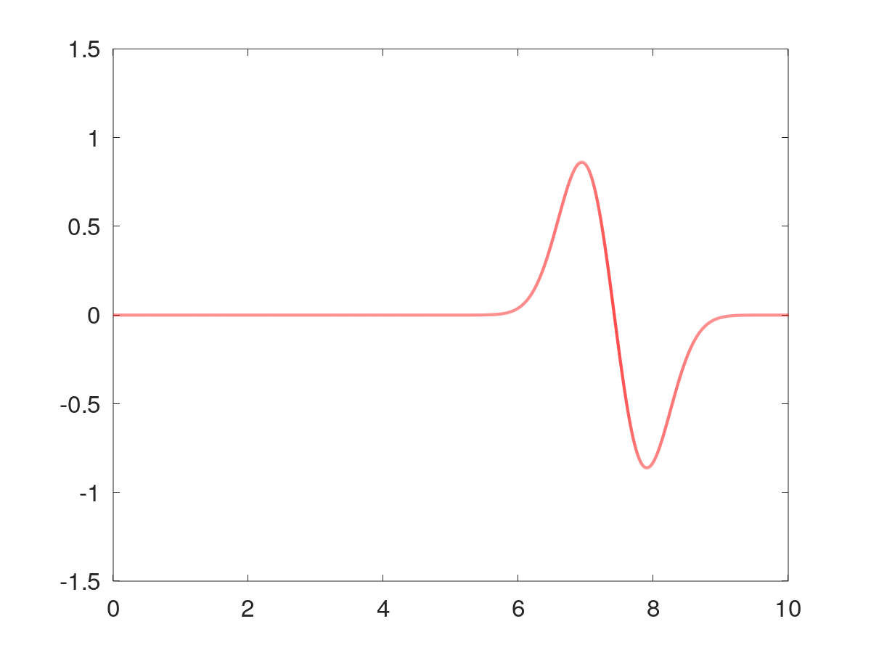
Signals from second beam
Second beam
“coupled”
signals
Port 2 (T)
Port 4 (L)
Port 8 (R)
Port 6 (B)
Signals arrive later and are larger due to higher intensity

Slide 11
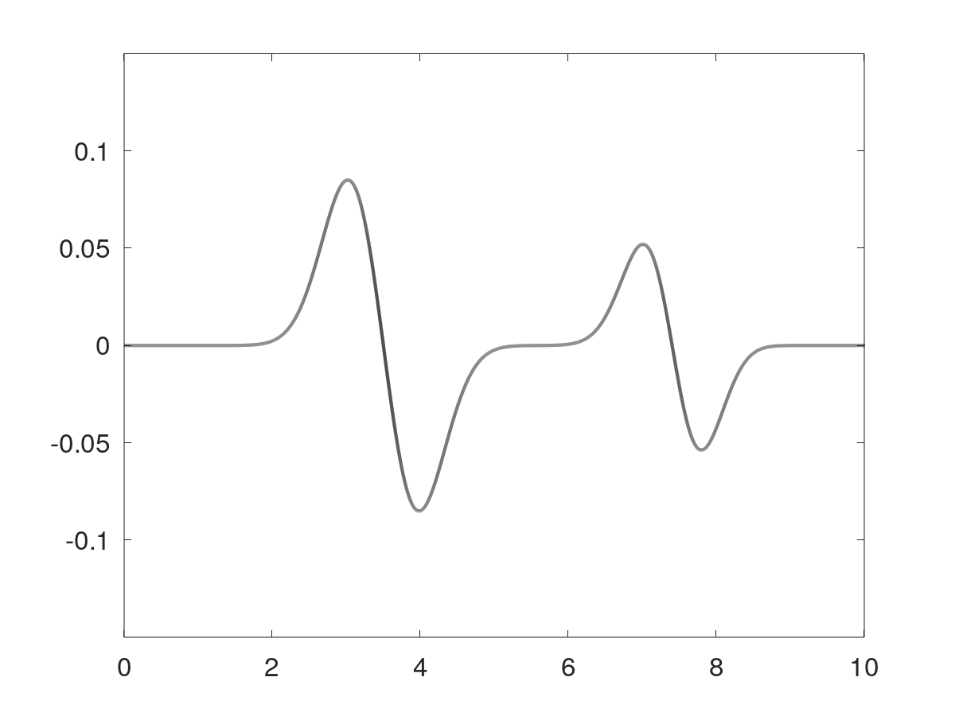
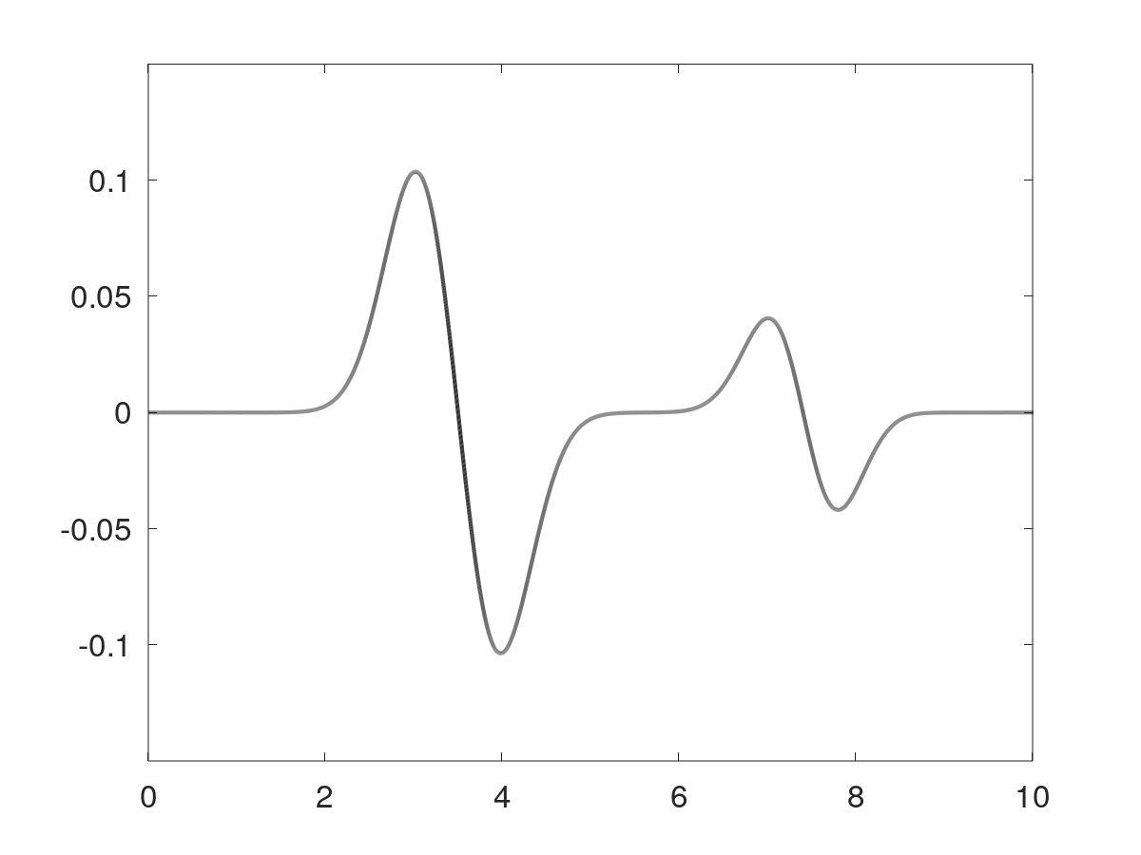

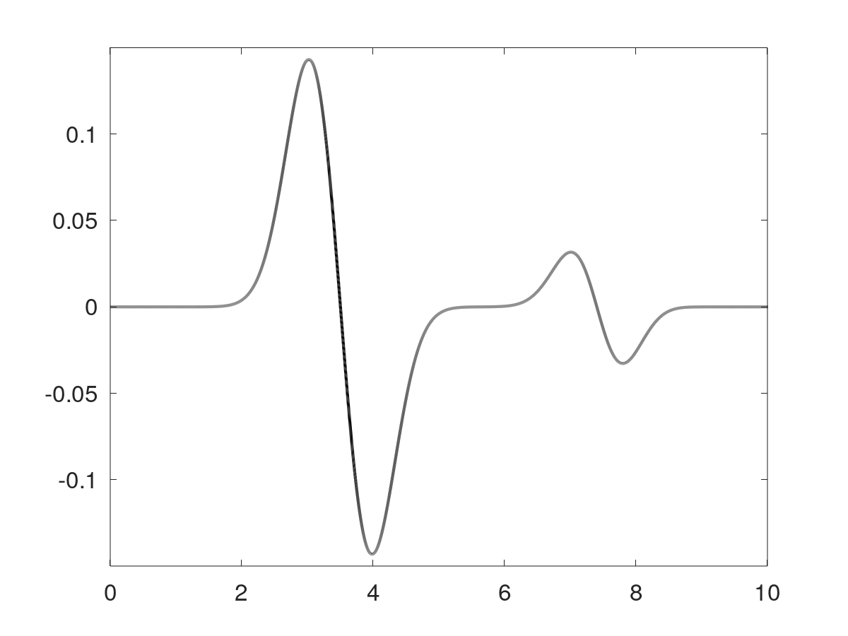
Two beam signals
Port 1 (T)
Port 3 (L)
Port 7 (R)
Port 5 (B)
Signals from second beam visibly distort signals used to calculate position of first beam

Slide 12
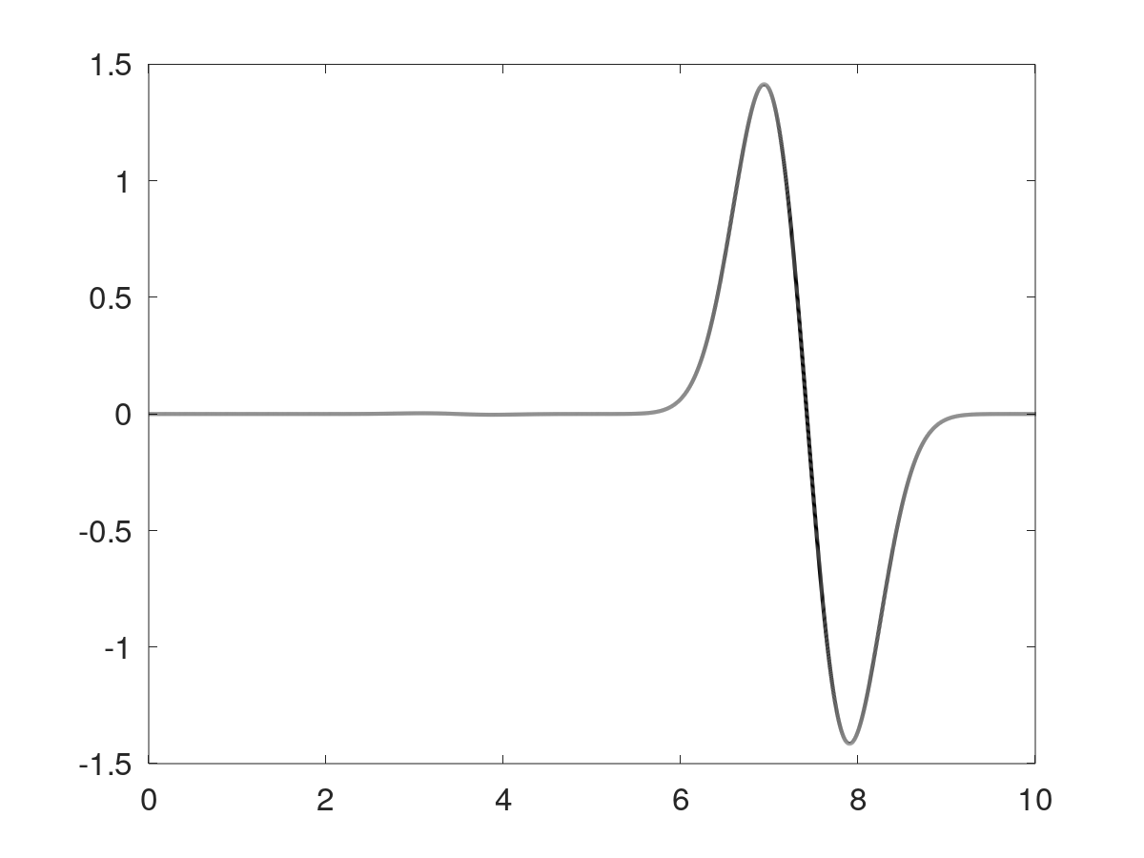
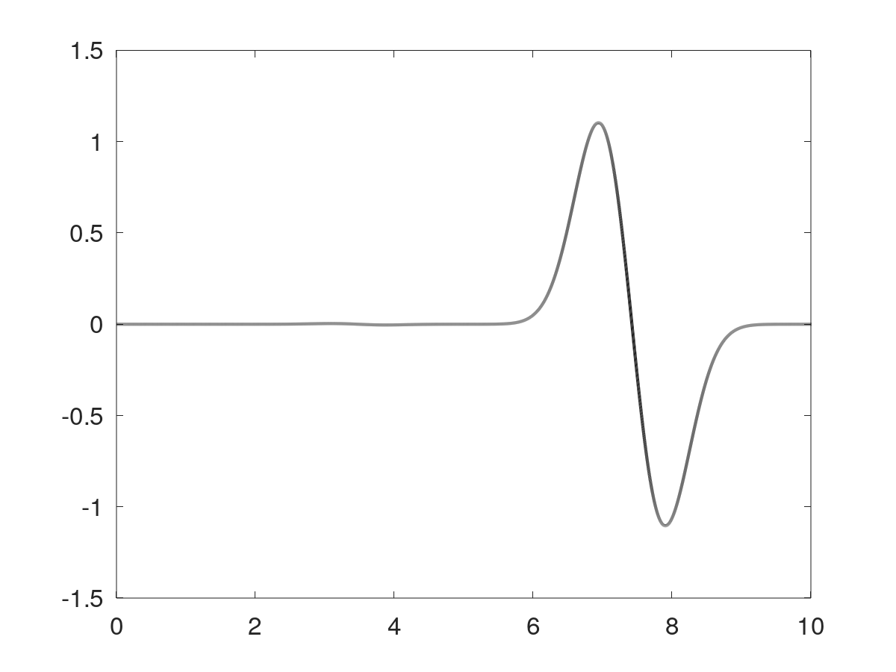
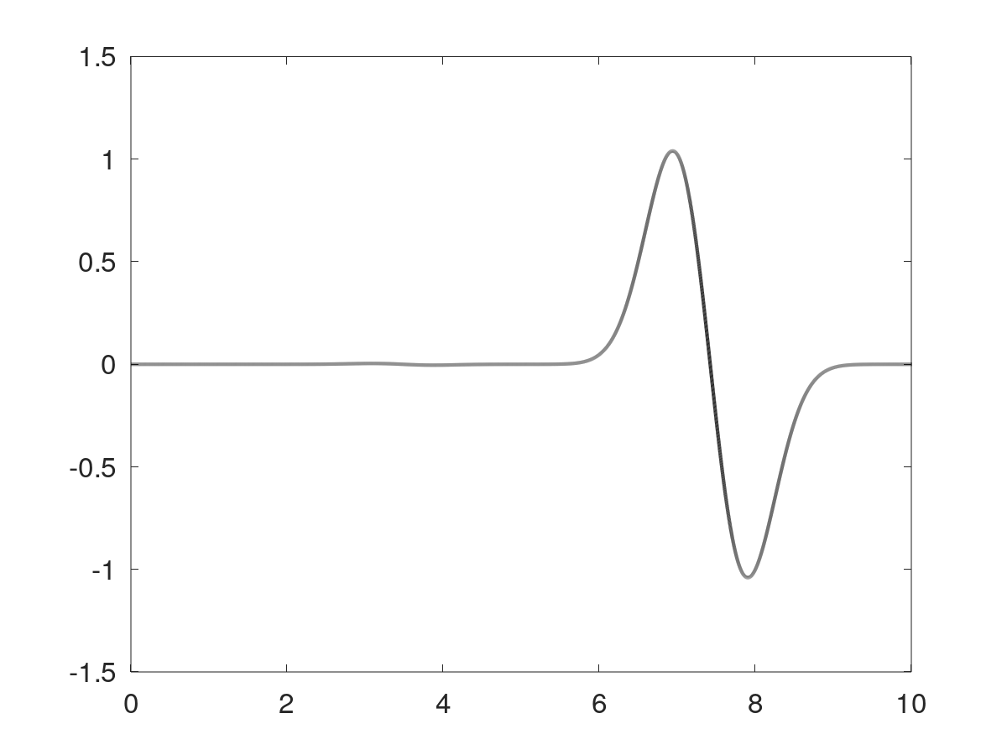

Two beam signals
Port 2 (T)
Port 4 (L)
Port 8 (R)
Port 6 (B)
Signals from first beam difficult to discern due to much lower intensity

Slide 13
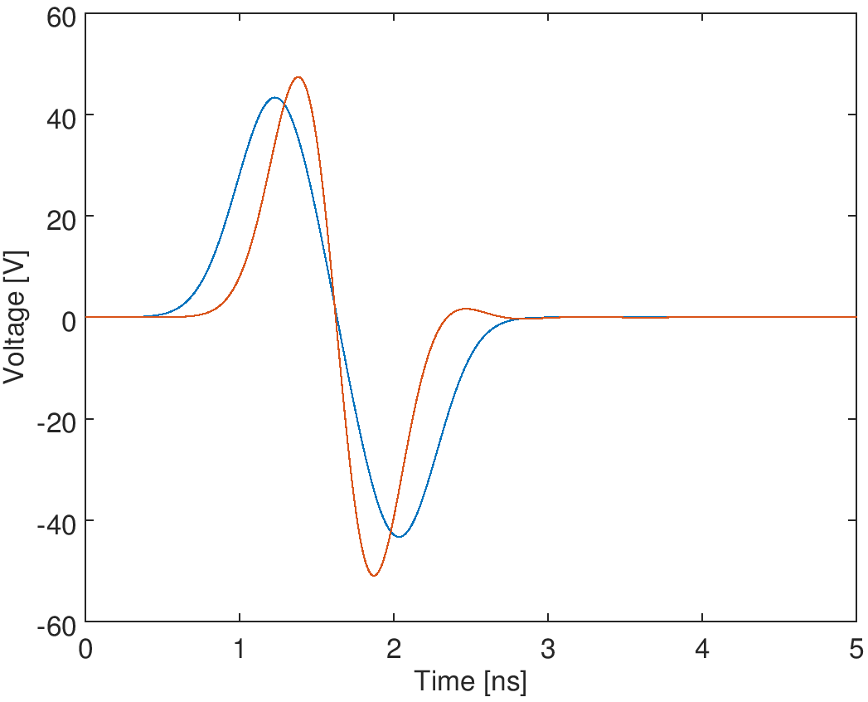
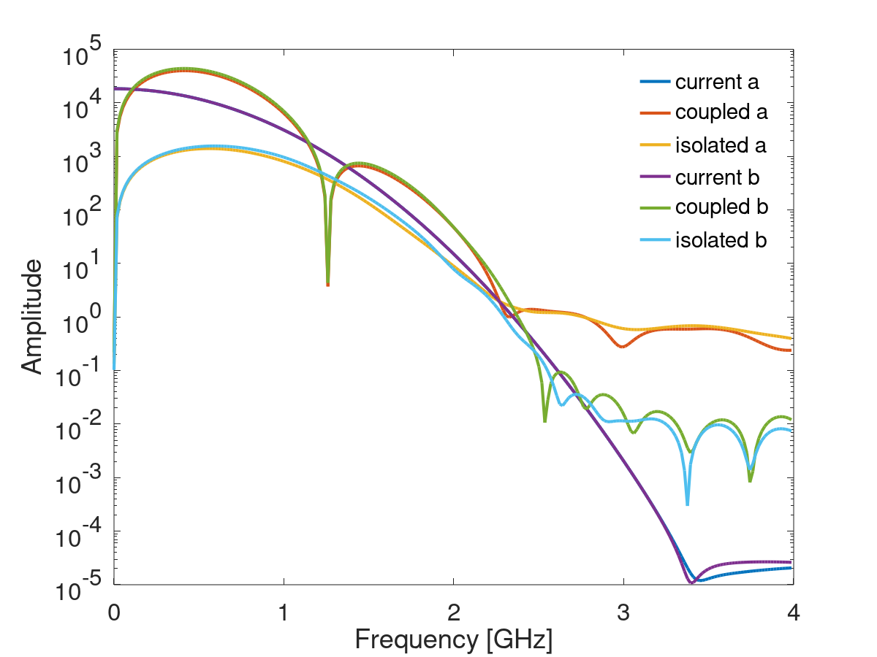
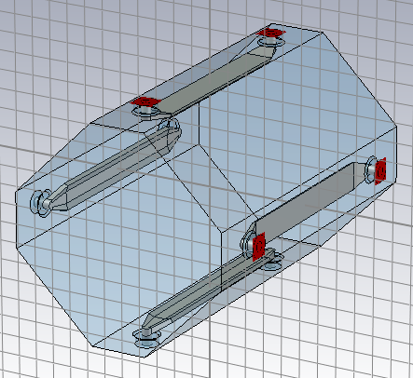
Simulation framework: analogue front-end
Ideal induced signal from CST
beam on axis, intensity 1e11
coupled
isolated
x20
beam

Slide 14
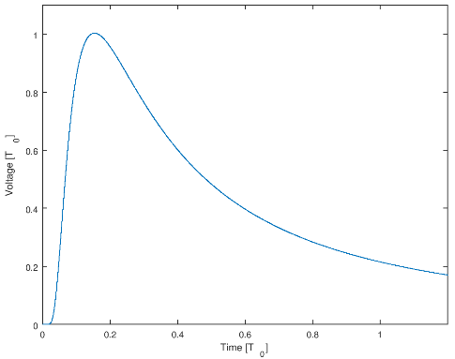
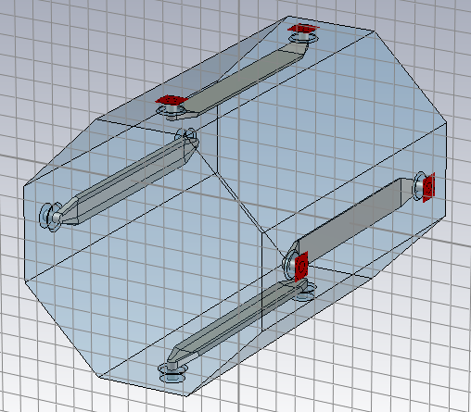
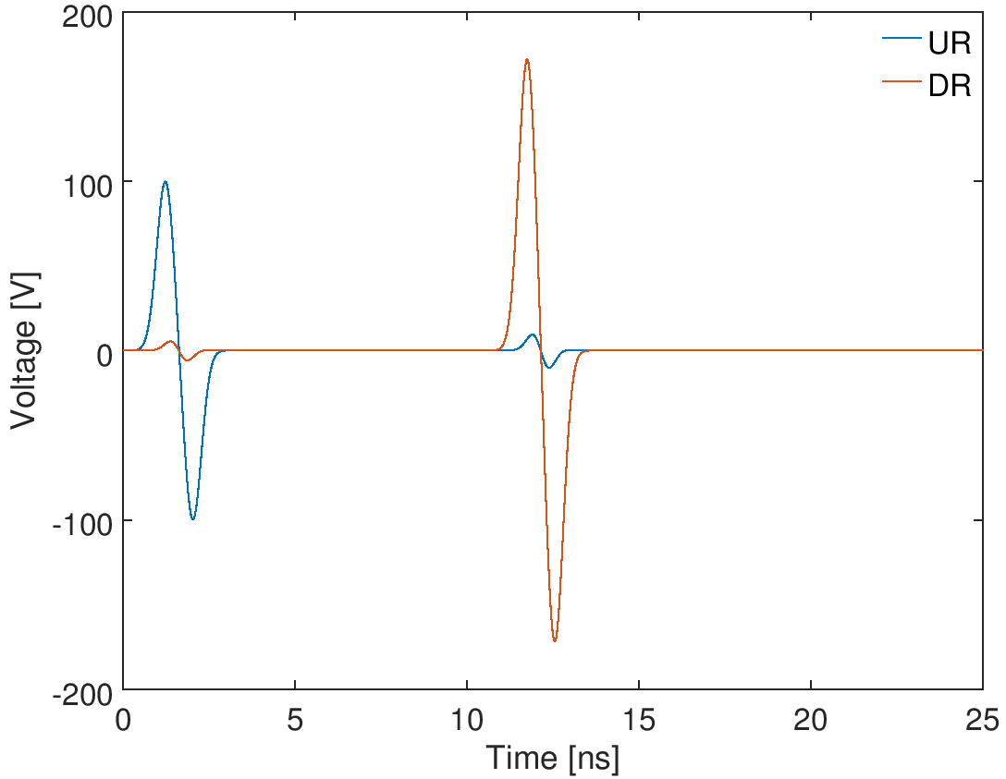
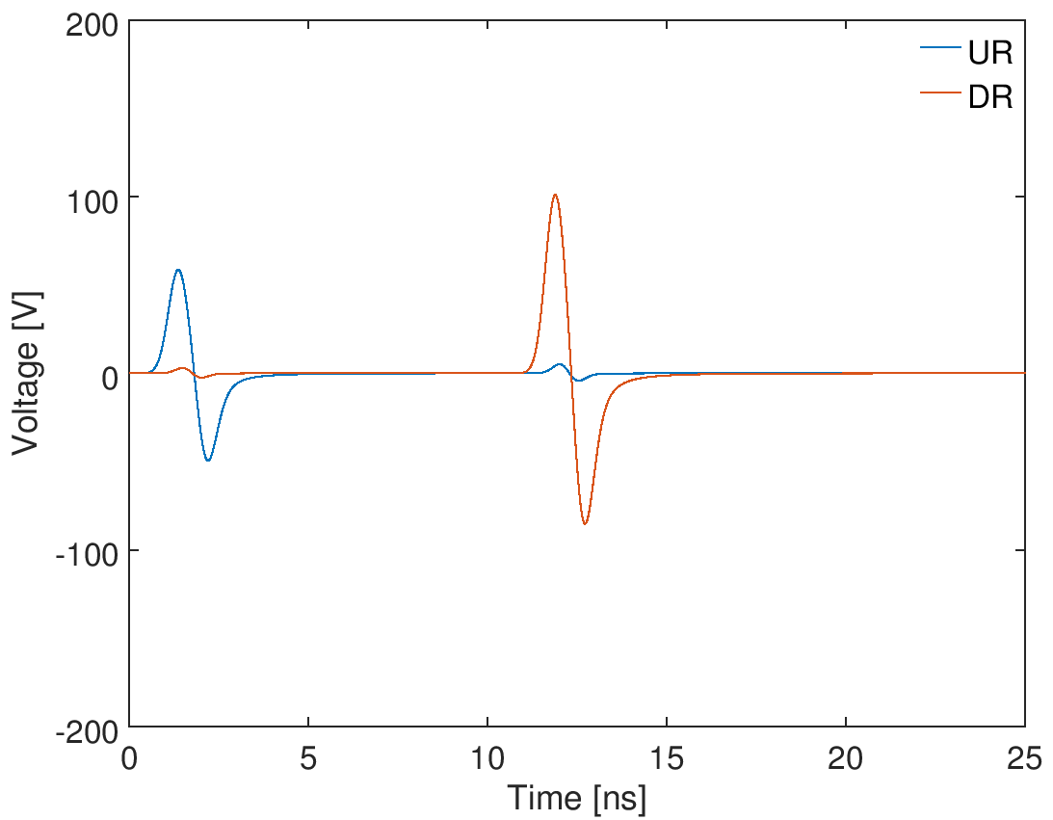
Simulation framework: analogue front-end
Stripline BPM
Impulse response
of coaxial cable
LCF12-50JFN
Length = 100 m
Velocity = 0.88c
Attenuation = 7.19 dB/100 m @ 1 GHz
long cable
Cable in
Cable out
Constructed signals

Slide 15
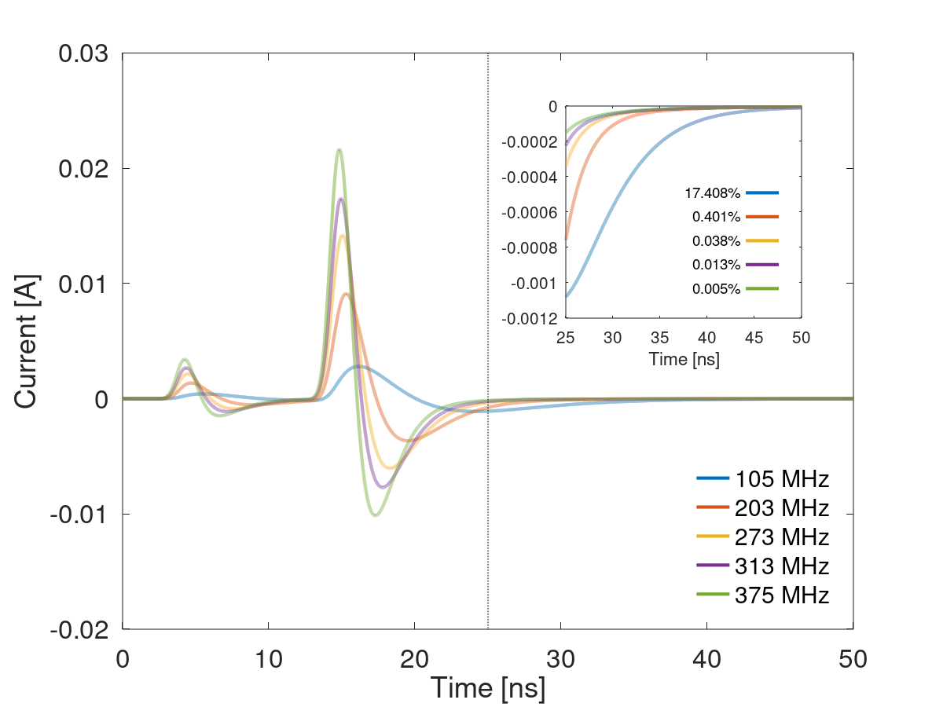
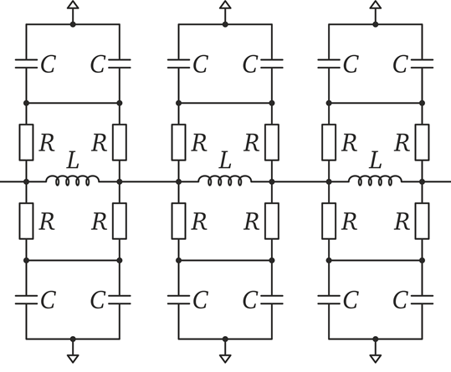
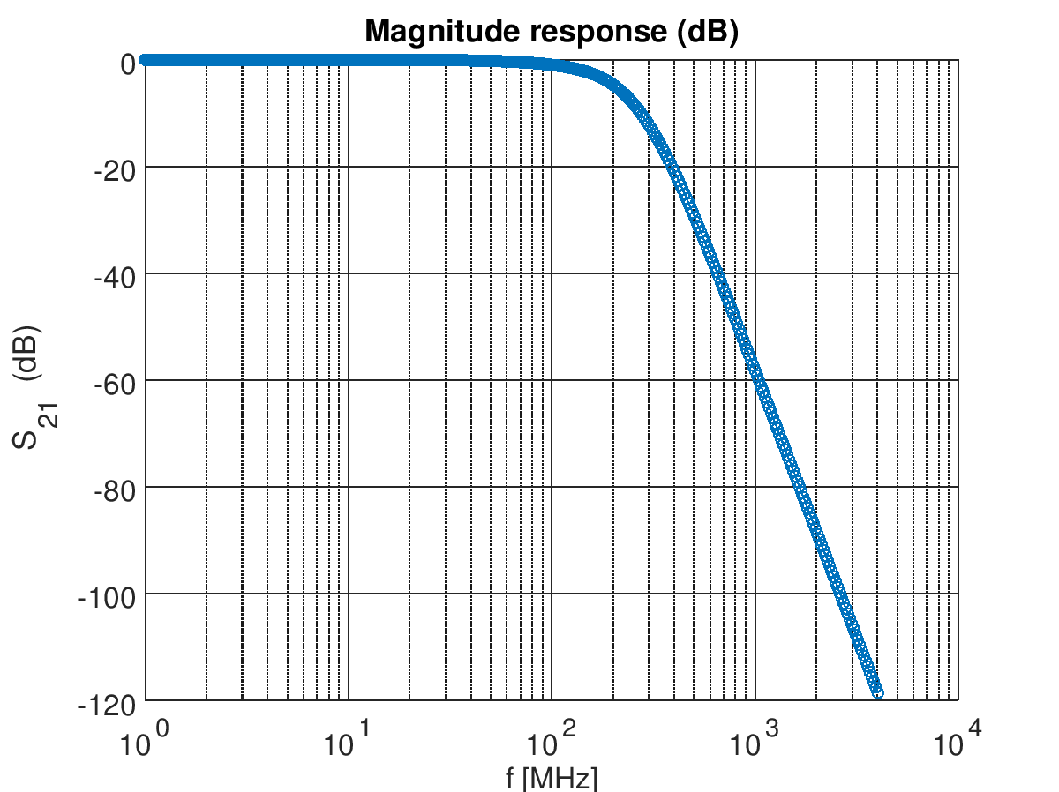
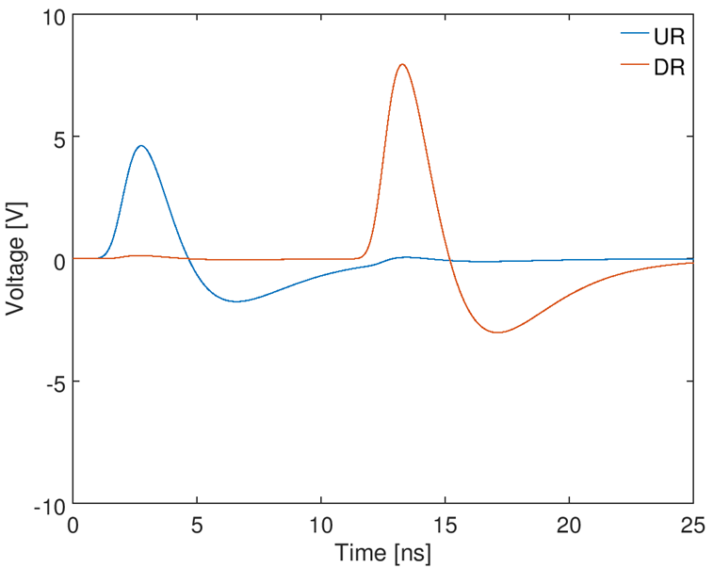
Simulation framework: analogue front-end
Stripline BPM
long cable
Low-pass filter
“absorptive” filter (low reflections)
Constructed signals post-filter

Slide 16
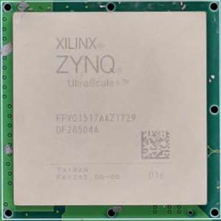
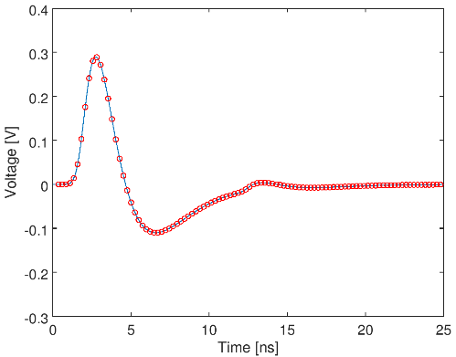
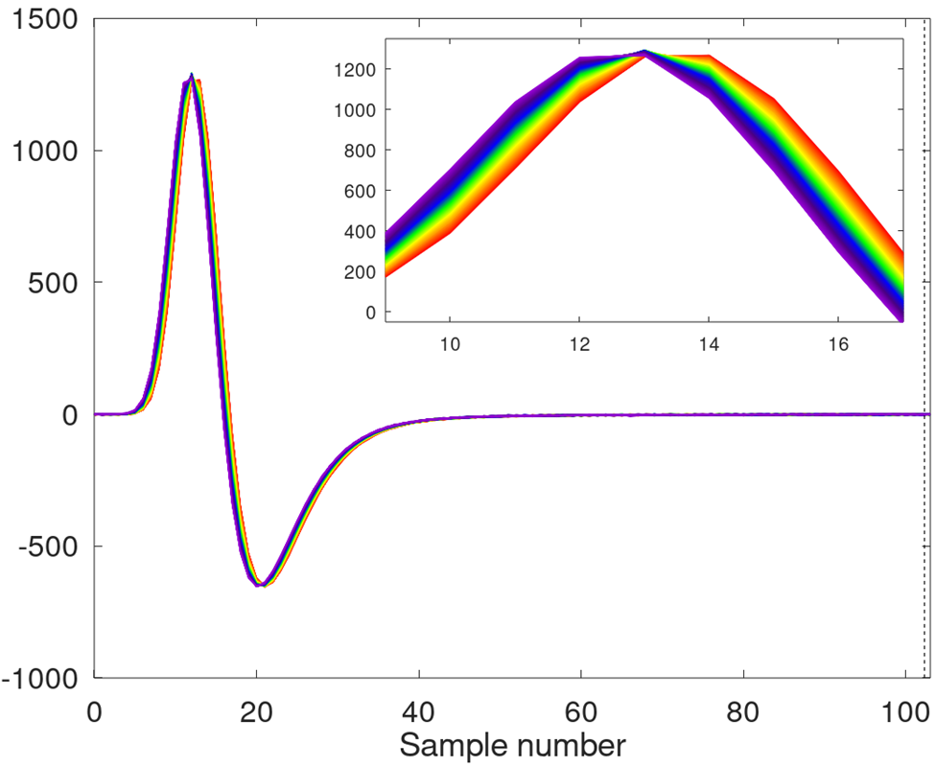
Simulation framework: analogue front-end
Stripline BPM
2 dB step size
Digitizer
long cables
Low-pass filter
variable attenuator
12-bits @ 4.096 GSPS
Asynchronous clock

Slide 17

Simulation framework: digital processing
Standard BPM processing operations
e.g. root of sum of squares (rss)
Polynomial adjustment (2D)
Digitize waveforms
Compensate for other beam
Integrate channels
Calculate position
Correct non-linearity
Calibrate, account for BPM roll
$Δ/Σ$ algorithm

Slide 18
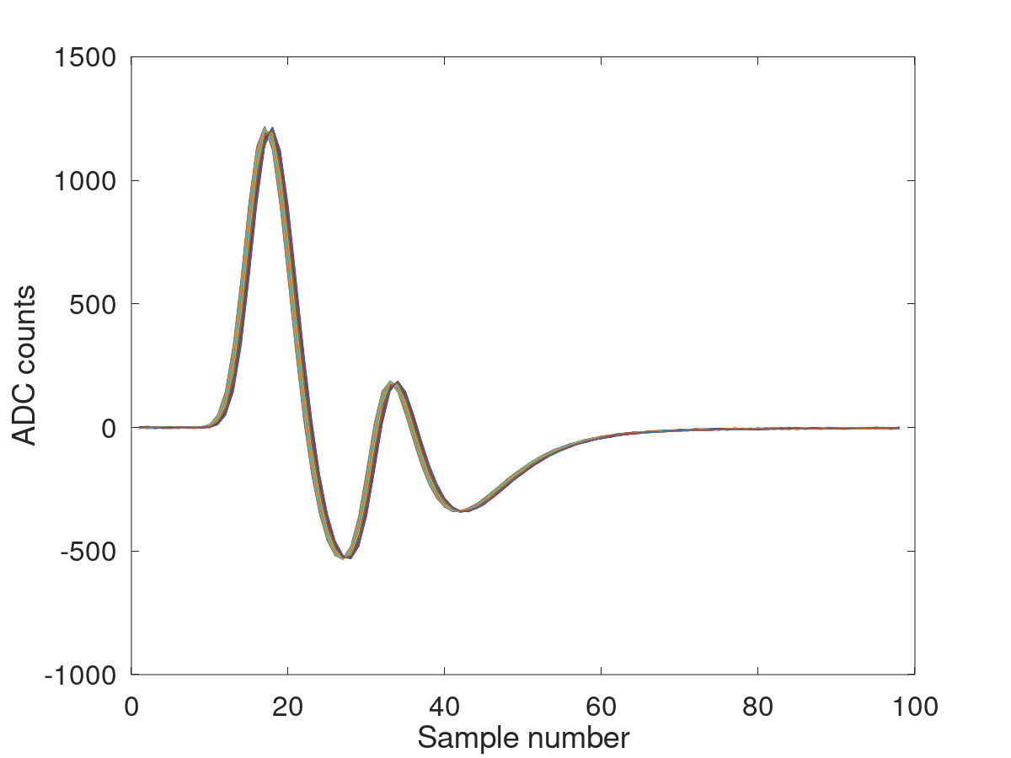
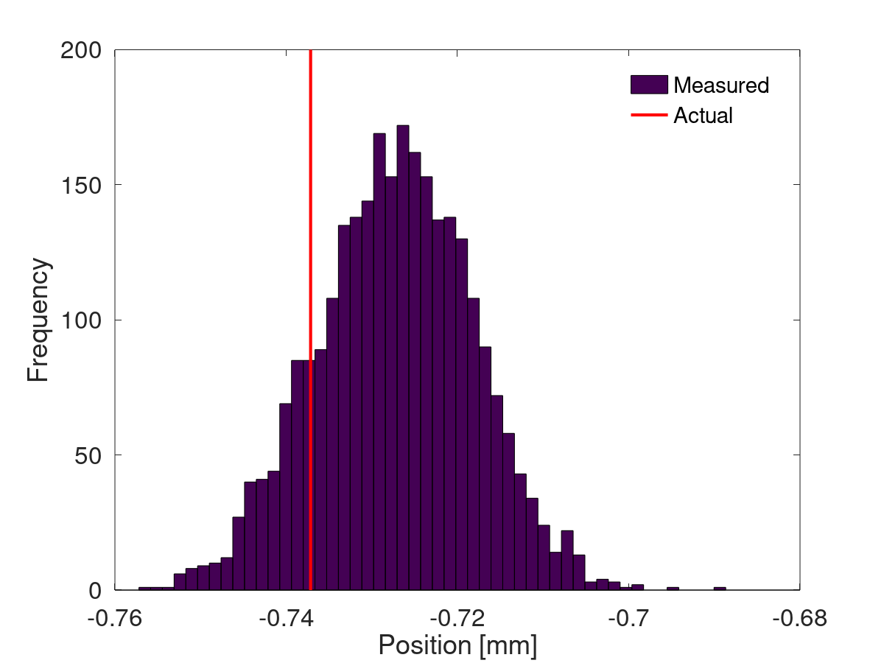

Digitized waveforms
Channel 1 @ 4 GHz
12-bit, ±0.5 V
Stable orbit assumed
Position calculated from $Δ/Σ$ of waveform power
Shot-by-shot resolution ~10 µm
Unwanted signal from counter beam
2,760 acq.
Systematic error on mean position:
~10 µm horizontal [1.5%]
~200 µm vertical [3%]

Slide 19
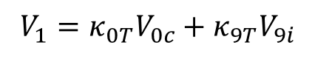



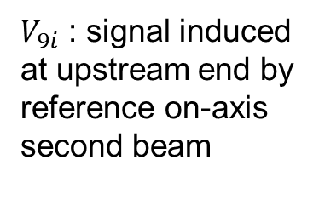
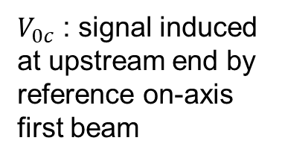
Power compensation I
Each waveform can be expressed in the form:
$$V_{1}=κ_{0T}V_{0c}+κ_{9T}V_{9i}$$
$$V_{1}$$
$$κ_{0T}V_{0c}$$
$$κ_{9T}V_{9i}$$
=
+
$V_{0c}$ : signal induced at upstream end by reference on-axis first beam
$V_{9i}$ : signal induced at upstream end by reference on-axis second beam
$κ$ scale factor sets amplitude of each term according to intensity, position of beam. Higher intensity or closer to stripline → larger $κ$

Slide 20



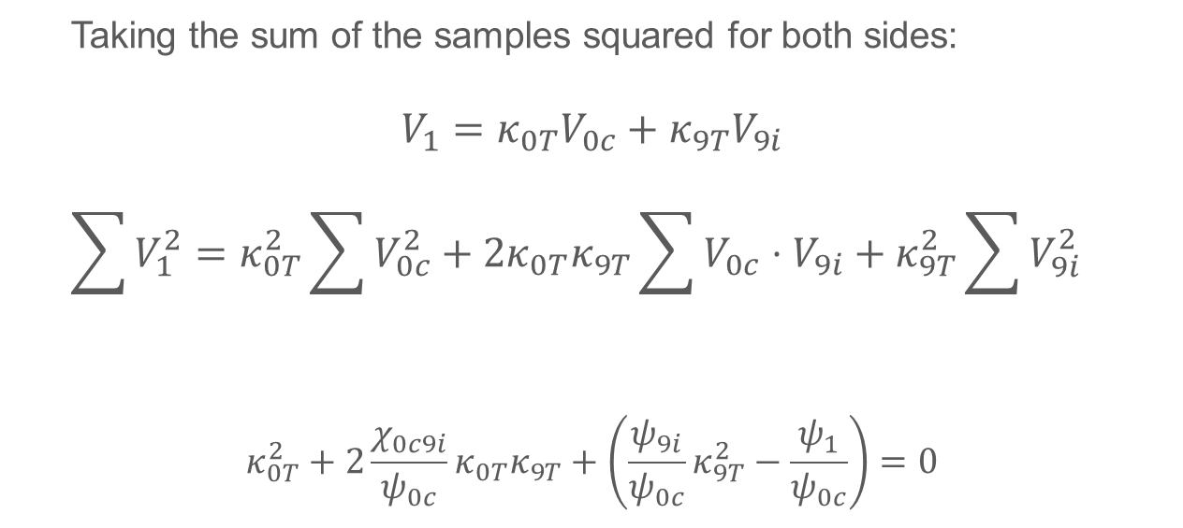

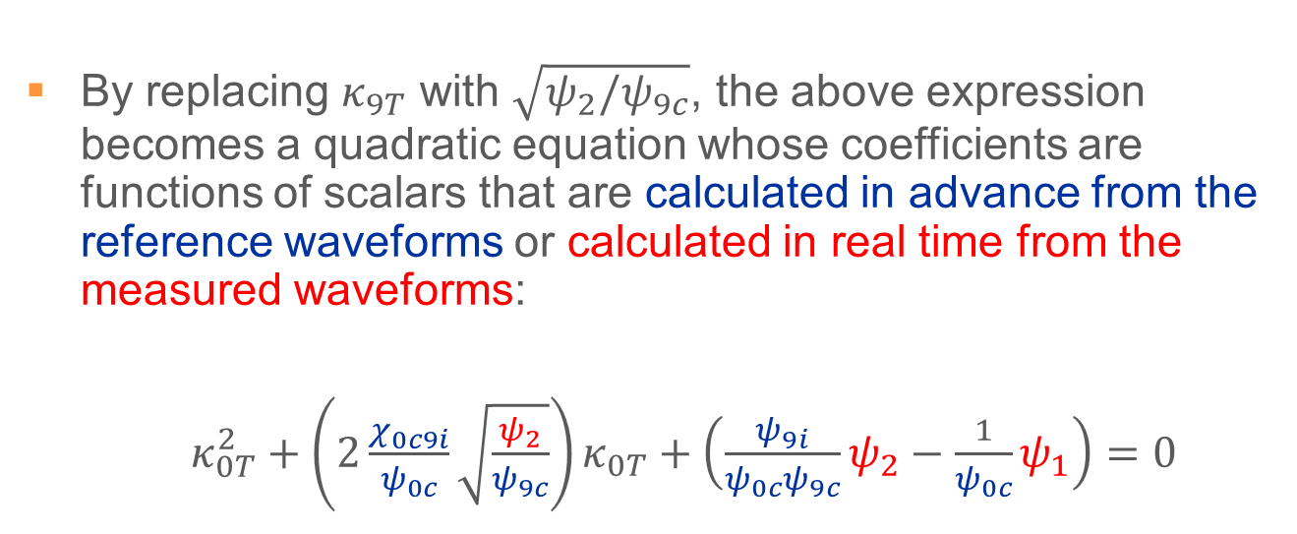

Power compensation II
Taking the sum of the samples squared for both sides:
$$V_{1}=κ_{0T}V_{0c}+κ_{9T}V_{9i}$$
  $$\sum{V_{1}^{2}}=κ_{0T}^{2}\sum{V_{0c}^{2}}+2κ_{0T}κ_{9T}\sum{V_{0c}⋅V_{9i}}+κ_{9T}^{2}\sum{V_{9i}^{2}}$$
$$κ_{0T}^{2}+2\frac{χ_{0c9i}}{ψ_{0c}}κ_{0T}κ_{9T}+\left(\frac{ψ_{9i}}{ψ_{0c}}κ_{9T}^{2}−\frac{ψ_{1}}{ψ_{0c}}\right)=0$$
$$ψ_{1}$$
$$ψ_{0c}$$
$$χ_{0c9i}$$
$$ψ_{9i}$$
By replacing $κ_{9T}$ with $\sqrt{ψ_{2}/ψ_{9c}}$, the above expression becomes a quadratic equation whose coefficients are functions of scalars that are calculated in advance from the reference waveforms or calculated in real time from the measured waveforms:
$κ_{0T}^{2}+\left(2\frac{χ_{0c9i}}{ψ_{0c}}\sqrt{\frac{ψ_{2}}{ψ_{9c}}}\right)κ_{0T}+\left(\frac{ψ_{9i}}{ψ_{0c}ψ_{9c}}ψ_{2}−\frac{1}{ψ_{0c}}ψ_{1}\right)=0$
Can be solved for $κ_{0T}$

Slide 21
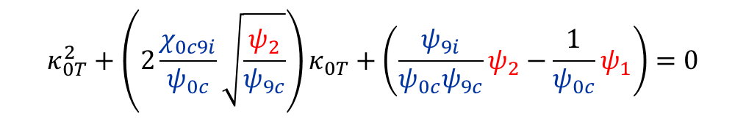
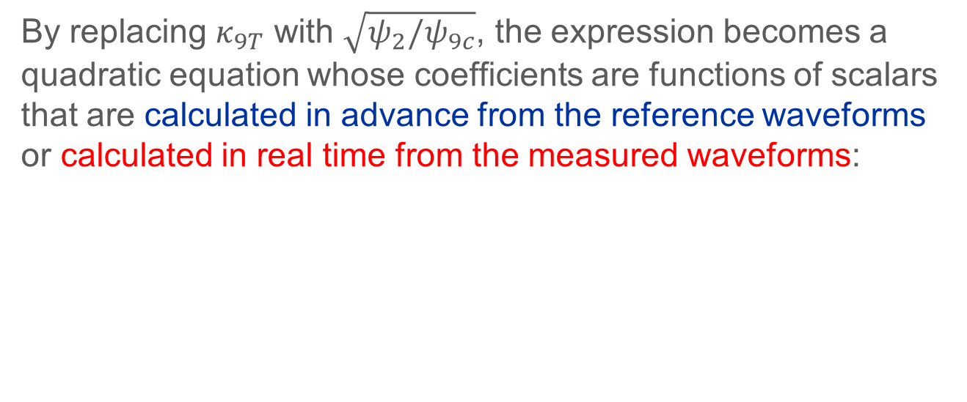
Power compensation III
By replacing $κ_{9T}$ with $\sqrt{ψ_{2}/ψ_{9c}}$, the expression becomes a quadratic equation whose coefficients are functions of scalars that are calculated in advance from the reference waveforms or calculated in real time from the measured waveforms:
$$κ_{0T}^{2}+\left(2\frac{χ_{0c9i}}{ψ_{0c}}\sqrt{\frac{ψ_{2}}{ψ_{9c}}}\right)κ_{0T}+\left(\frac{ψ_{9i}}{ψ_{0c}ψ_{9c}}ψ_{2}−\frac{1}{ψ_{0c}}ψ_{1}\right)=0$$

Slide 22
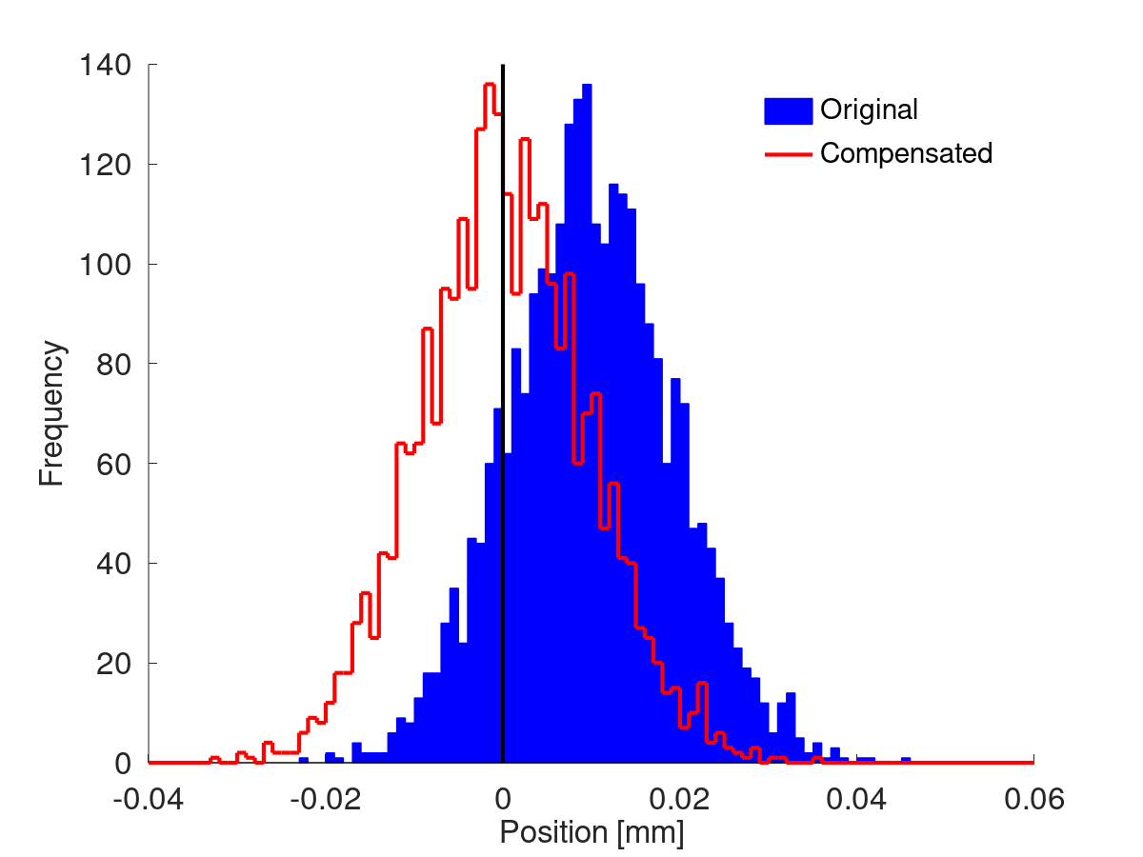
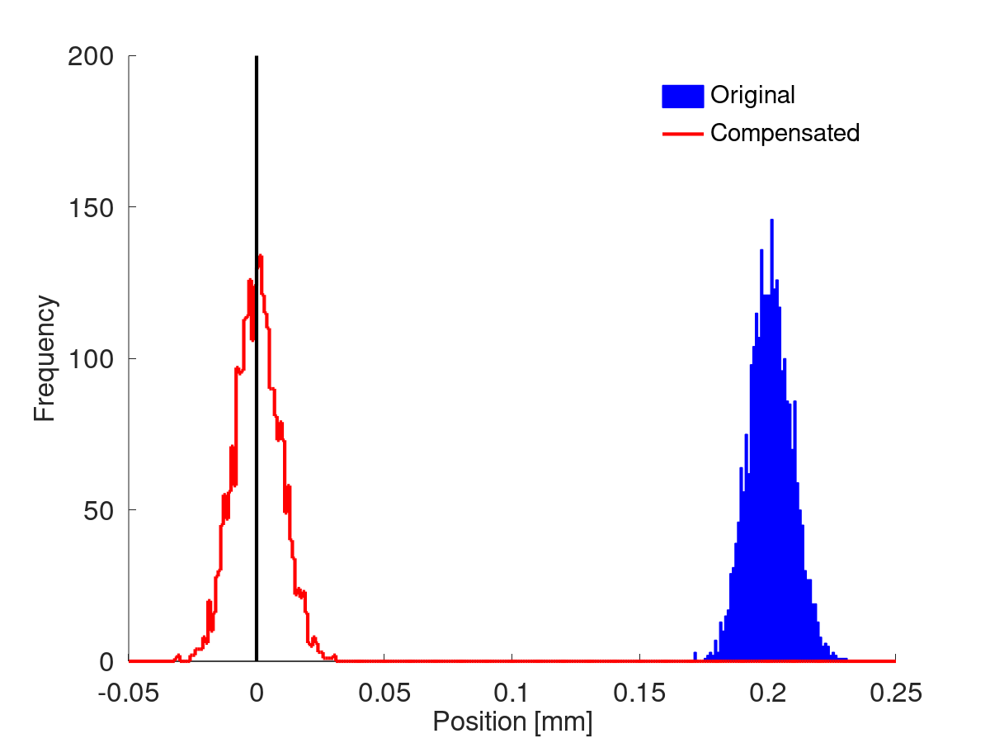
Power compensation
First beam, horizontal
First beam, vertical
Mean offset
10.0 µm → 0.22 µm
Mean offset
201 µm → 0.36 µm

Slide 23
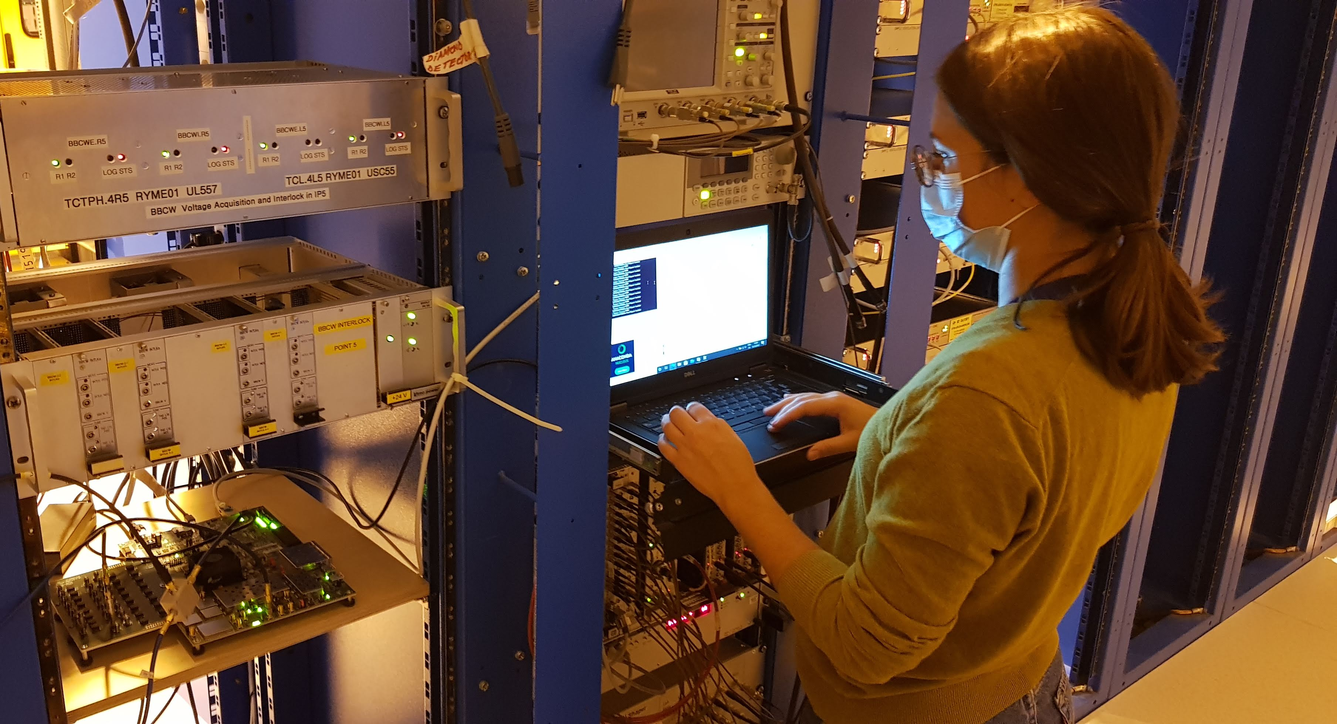


Measurement campaign
Gateware and firmware designed by Irene Degl’Innocenti to digitize 4 of 8 ADCs
Companion board produced by Selim Ozdogan
Actual two-beam waveforms
~200 ns
BPM 2L5

Slide 24
CONCLUSION
New stripline BPMs for HiLumi interaction regions require new processors; direct digitization with RFSoC is ideal
Primary challenge for is accurately recovering position of each beam in presence of unwanted signal from the other
Power compensation scheme proposed and found to deliver best results for simulated beam waveforms
Future studies involving beam time and position scans will test performance of the power compensation method with realistic beam signals

