Slide 1





Nb bulk QPR (A5) and RF disk processing
Oleksandr Hryhorenko / IJCLab – CNRS

Slide 2
QPR-A5 (HZB)

Slide 3
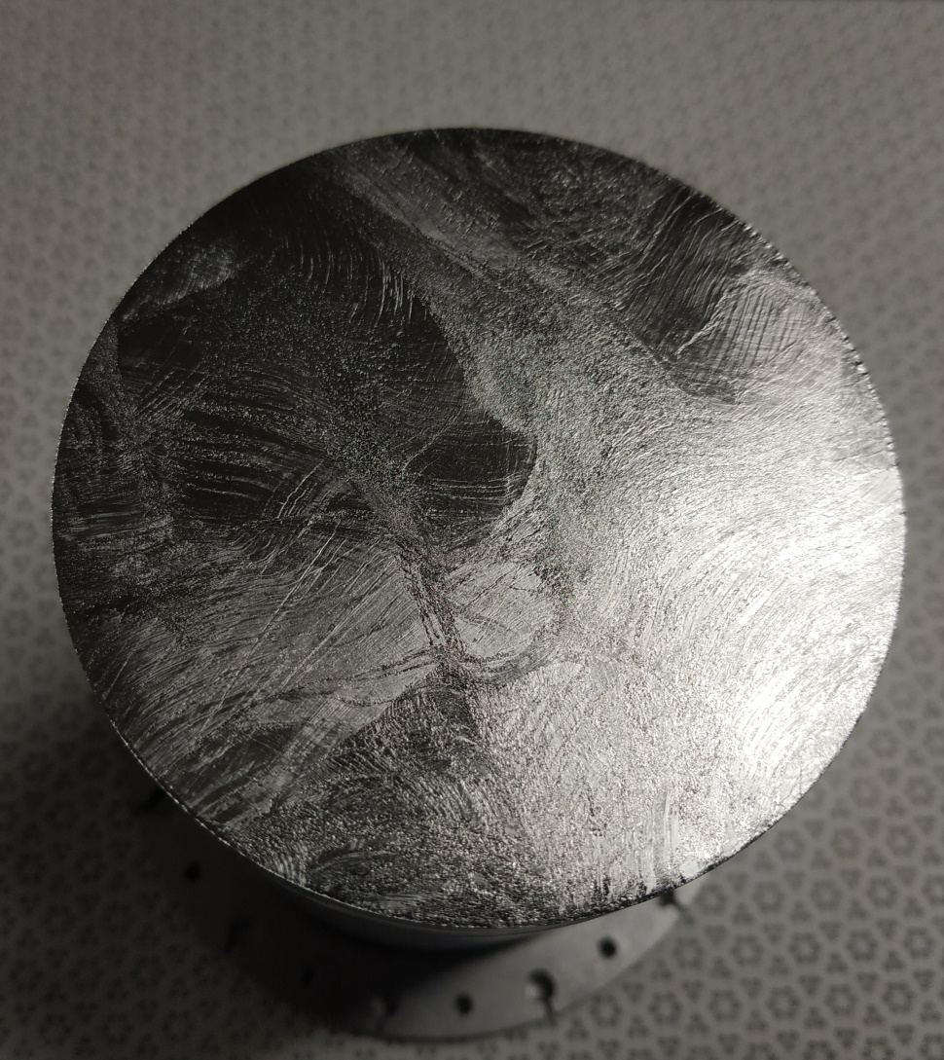
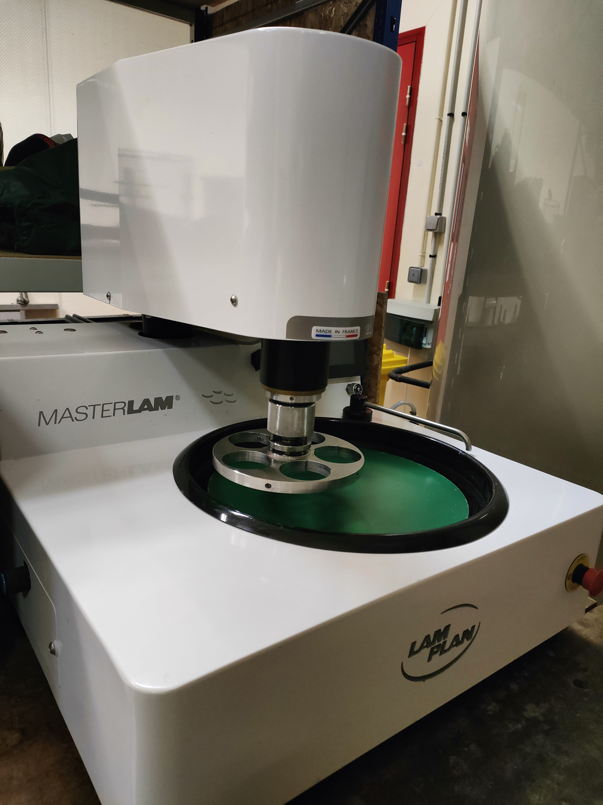
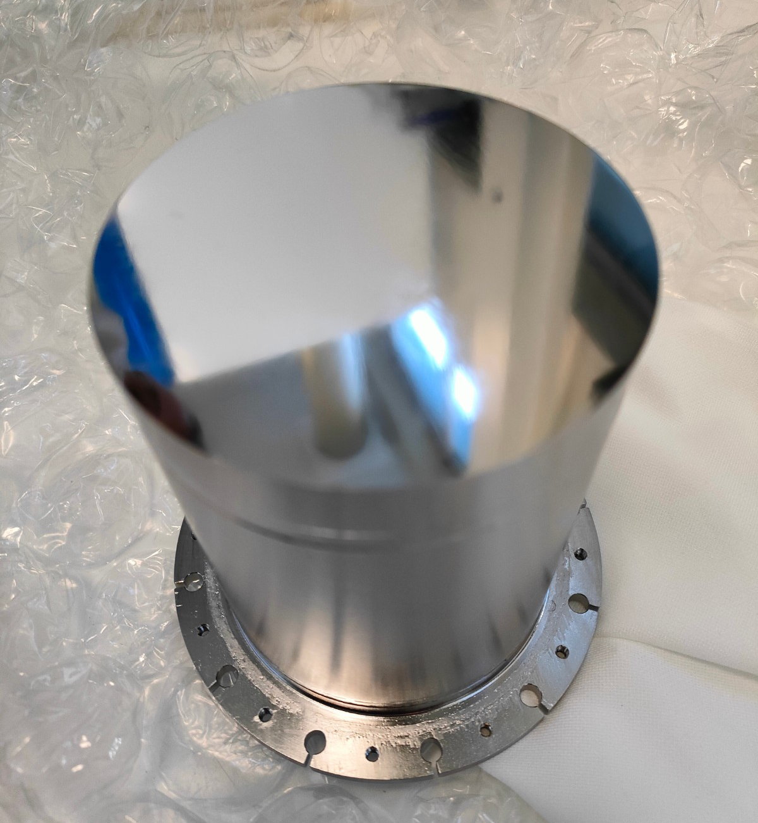
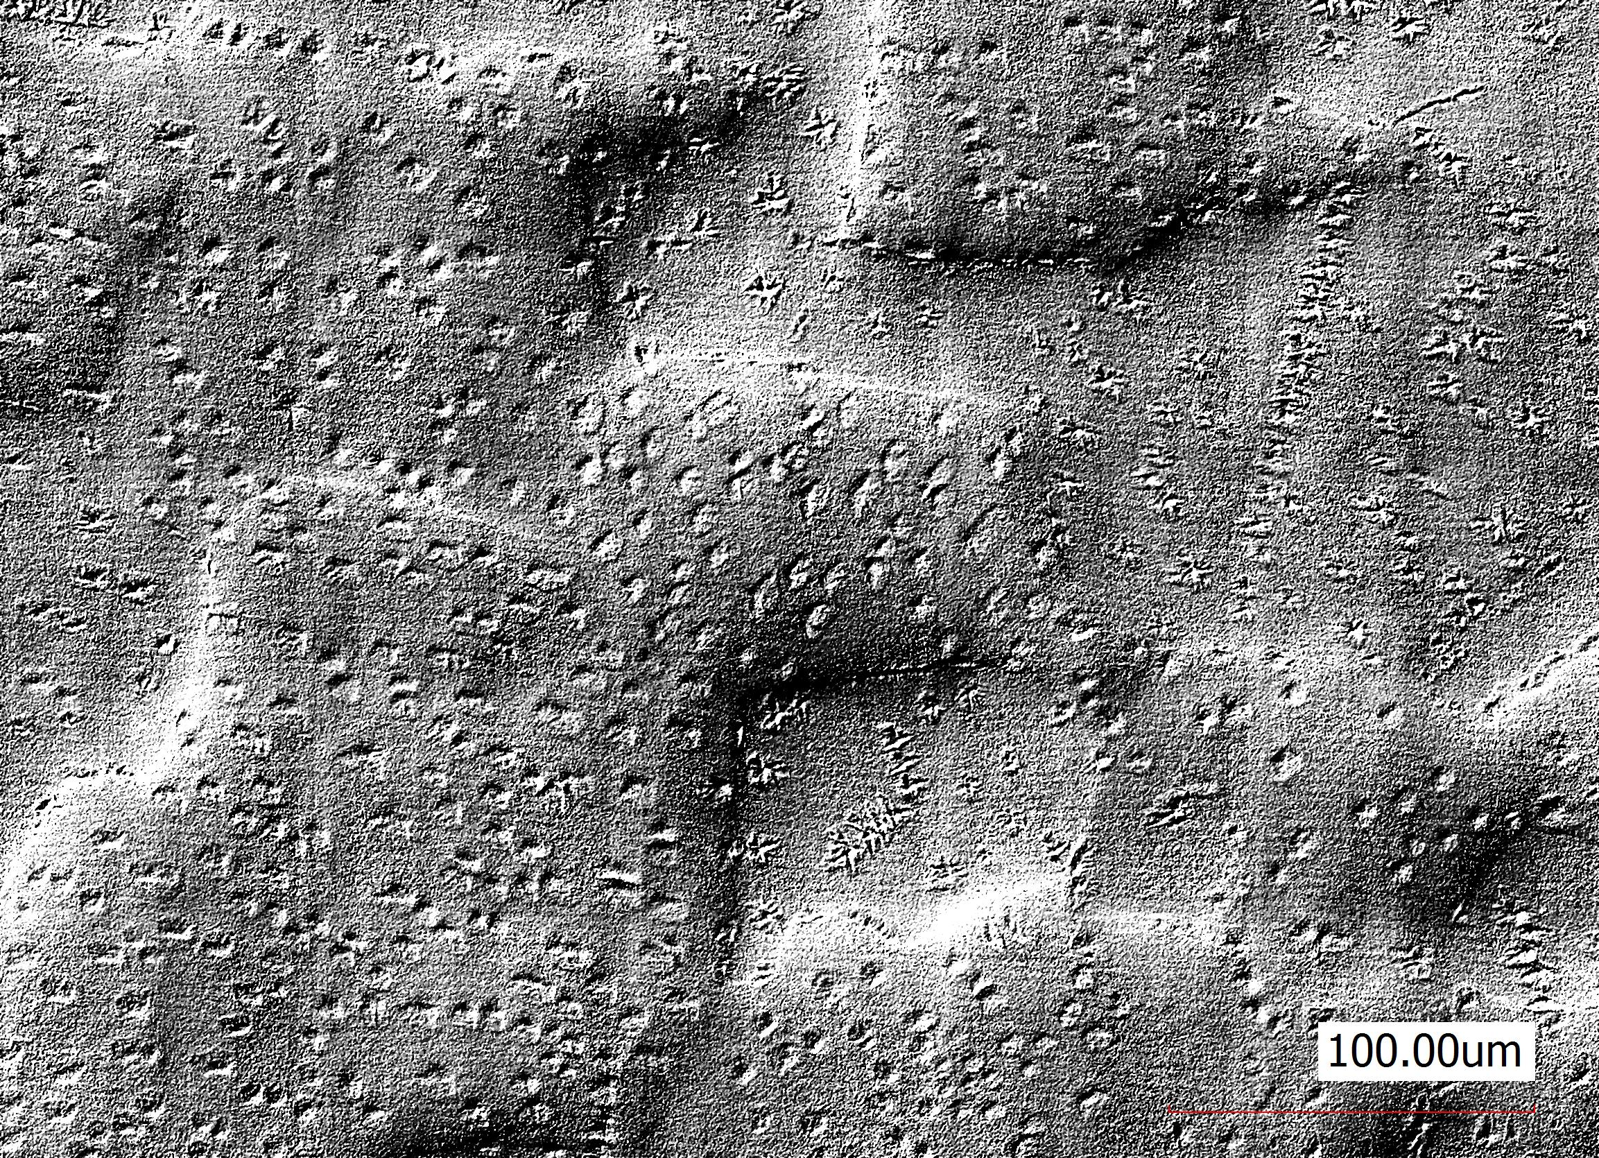
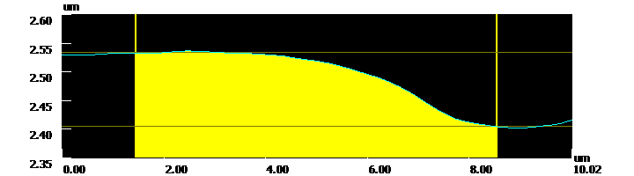
QPR-A5 Summary
History of QPR-A5
Surface preparation
BCP removal of 150 µm at RI
800 °C annealing, 4 hours
BCP removal of 10 µm at RI
MP removal of 250 µm (2 steps) at IJCLab
RF evaluation
RF test at HZB = > “Bad” RF performance => Q-disease => Precipitation of hydrides => Surface dislocations “Skeletons”
Q-disease mitigation treatment
2 phases of precipitations:
Peaks
Valleys
Improved roughness
Bad RF performance
Standard path (applied on QPR sample)
Trace of NbHx
segregations
along the scratch
EP removal of 50 µm at CEA (remove skeletons)
800 °C annealing, 3 hours (hydrogen degassing)
EP removal of 25 µm at CEA (due to C contamination caused by furnace)
NbHx Pits
~ 150 nm peak to valley difference
What step brings Hydrogen during MP and how to mitigate it without chemistry?
~ 10-15 um in-plane size

Slide 4
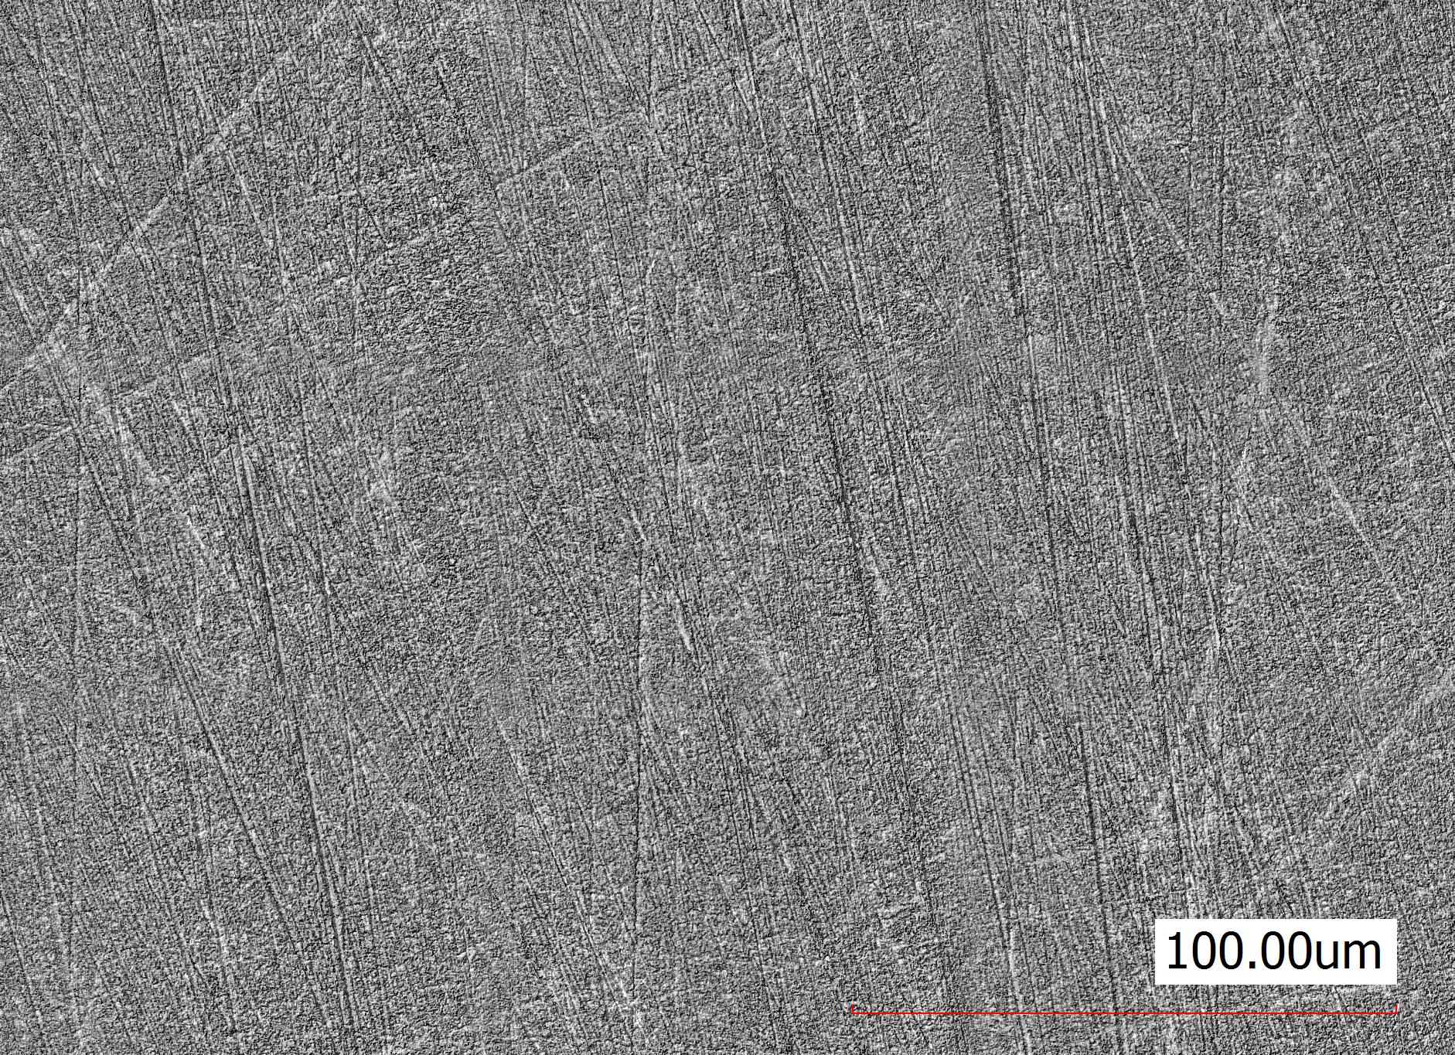
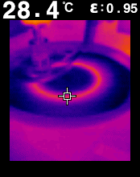
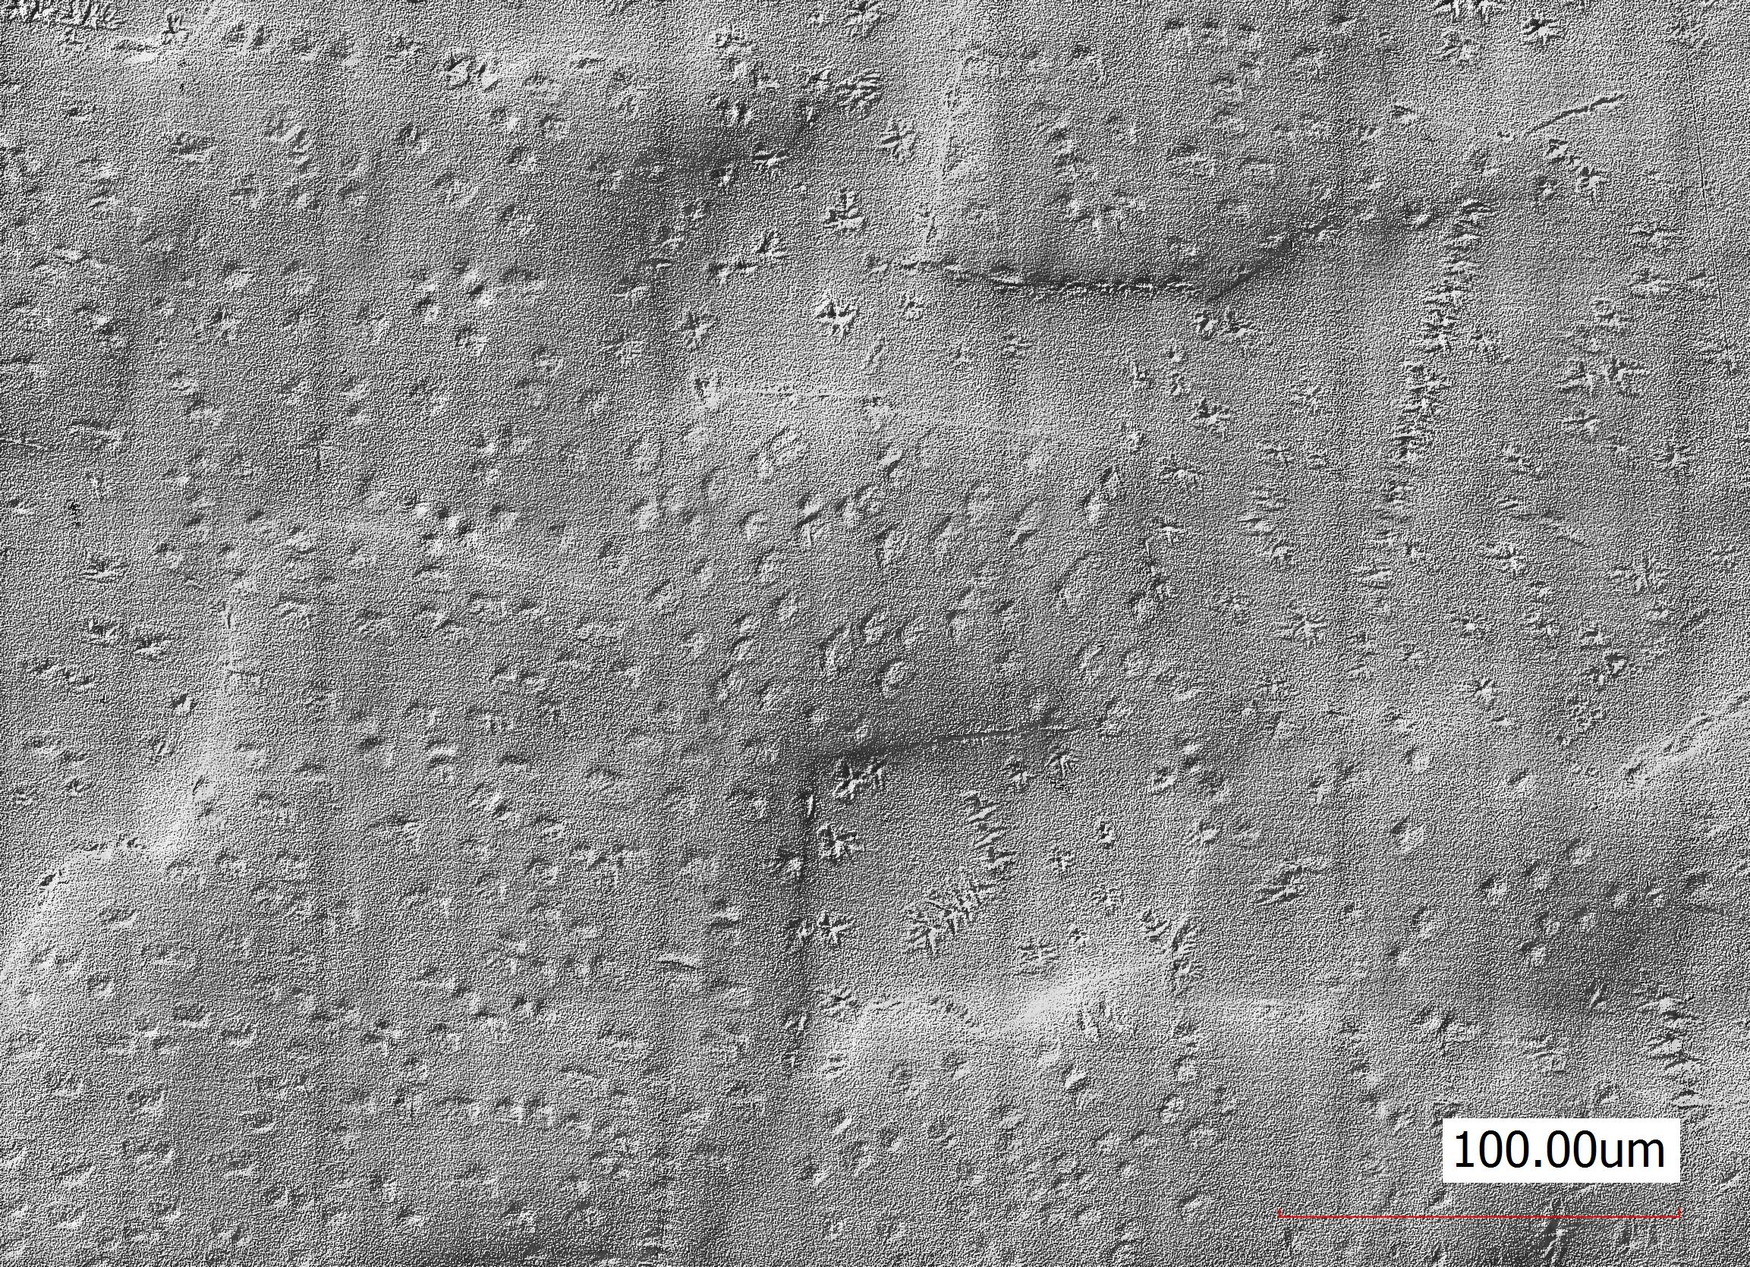
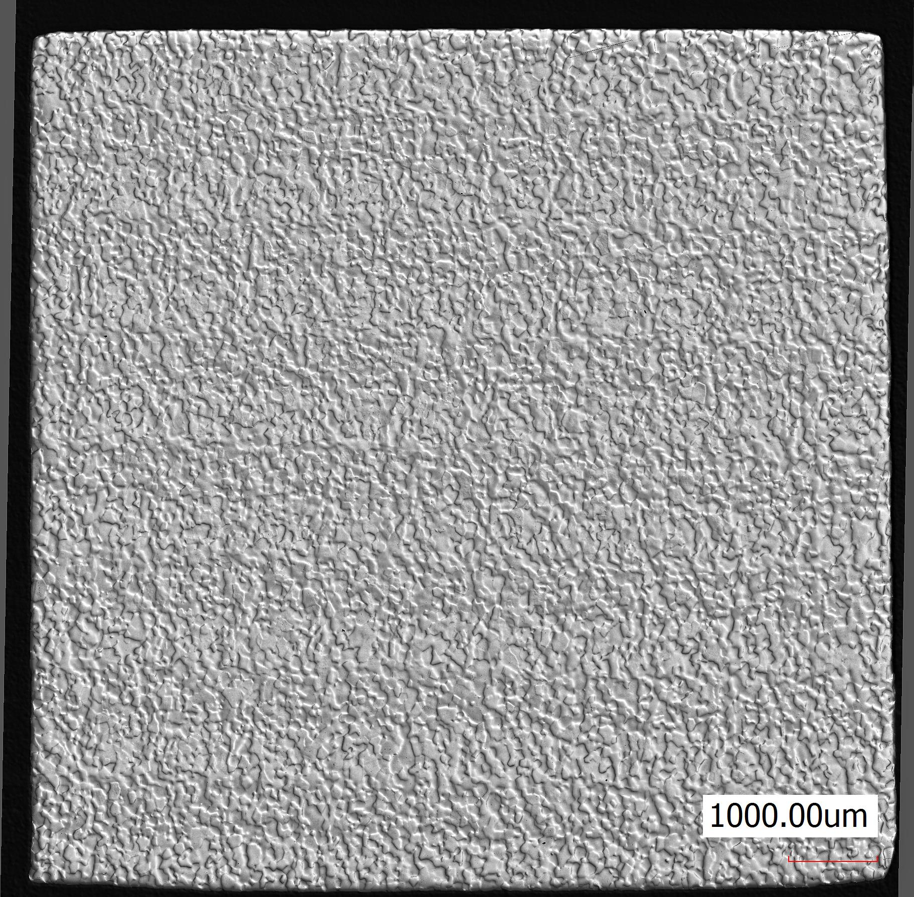
Q-disease analysis (studies on samples)
Q-disease analysis
Step 1: removal of 250 µm
39.5°C
Hydrides are not observed
Too damaged or no Q-disease
Precipitation of Hydrides
Step 2: polishing 2 hours
Q-disease test
Hydrides are observed
Q-disease
~10-12h
LN2

Slide 5

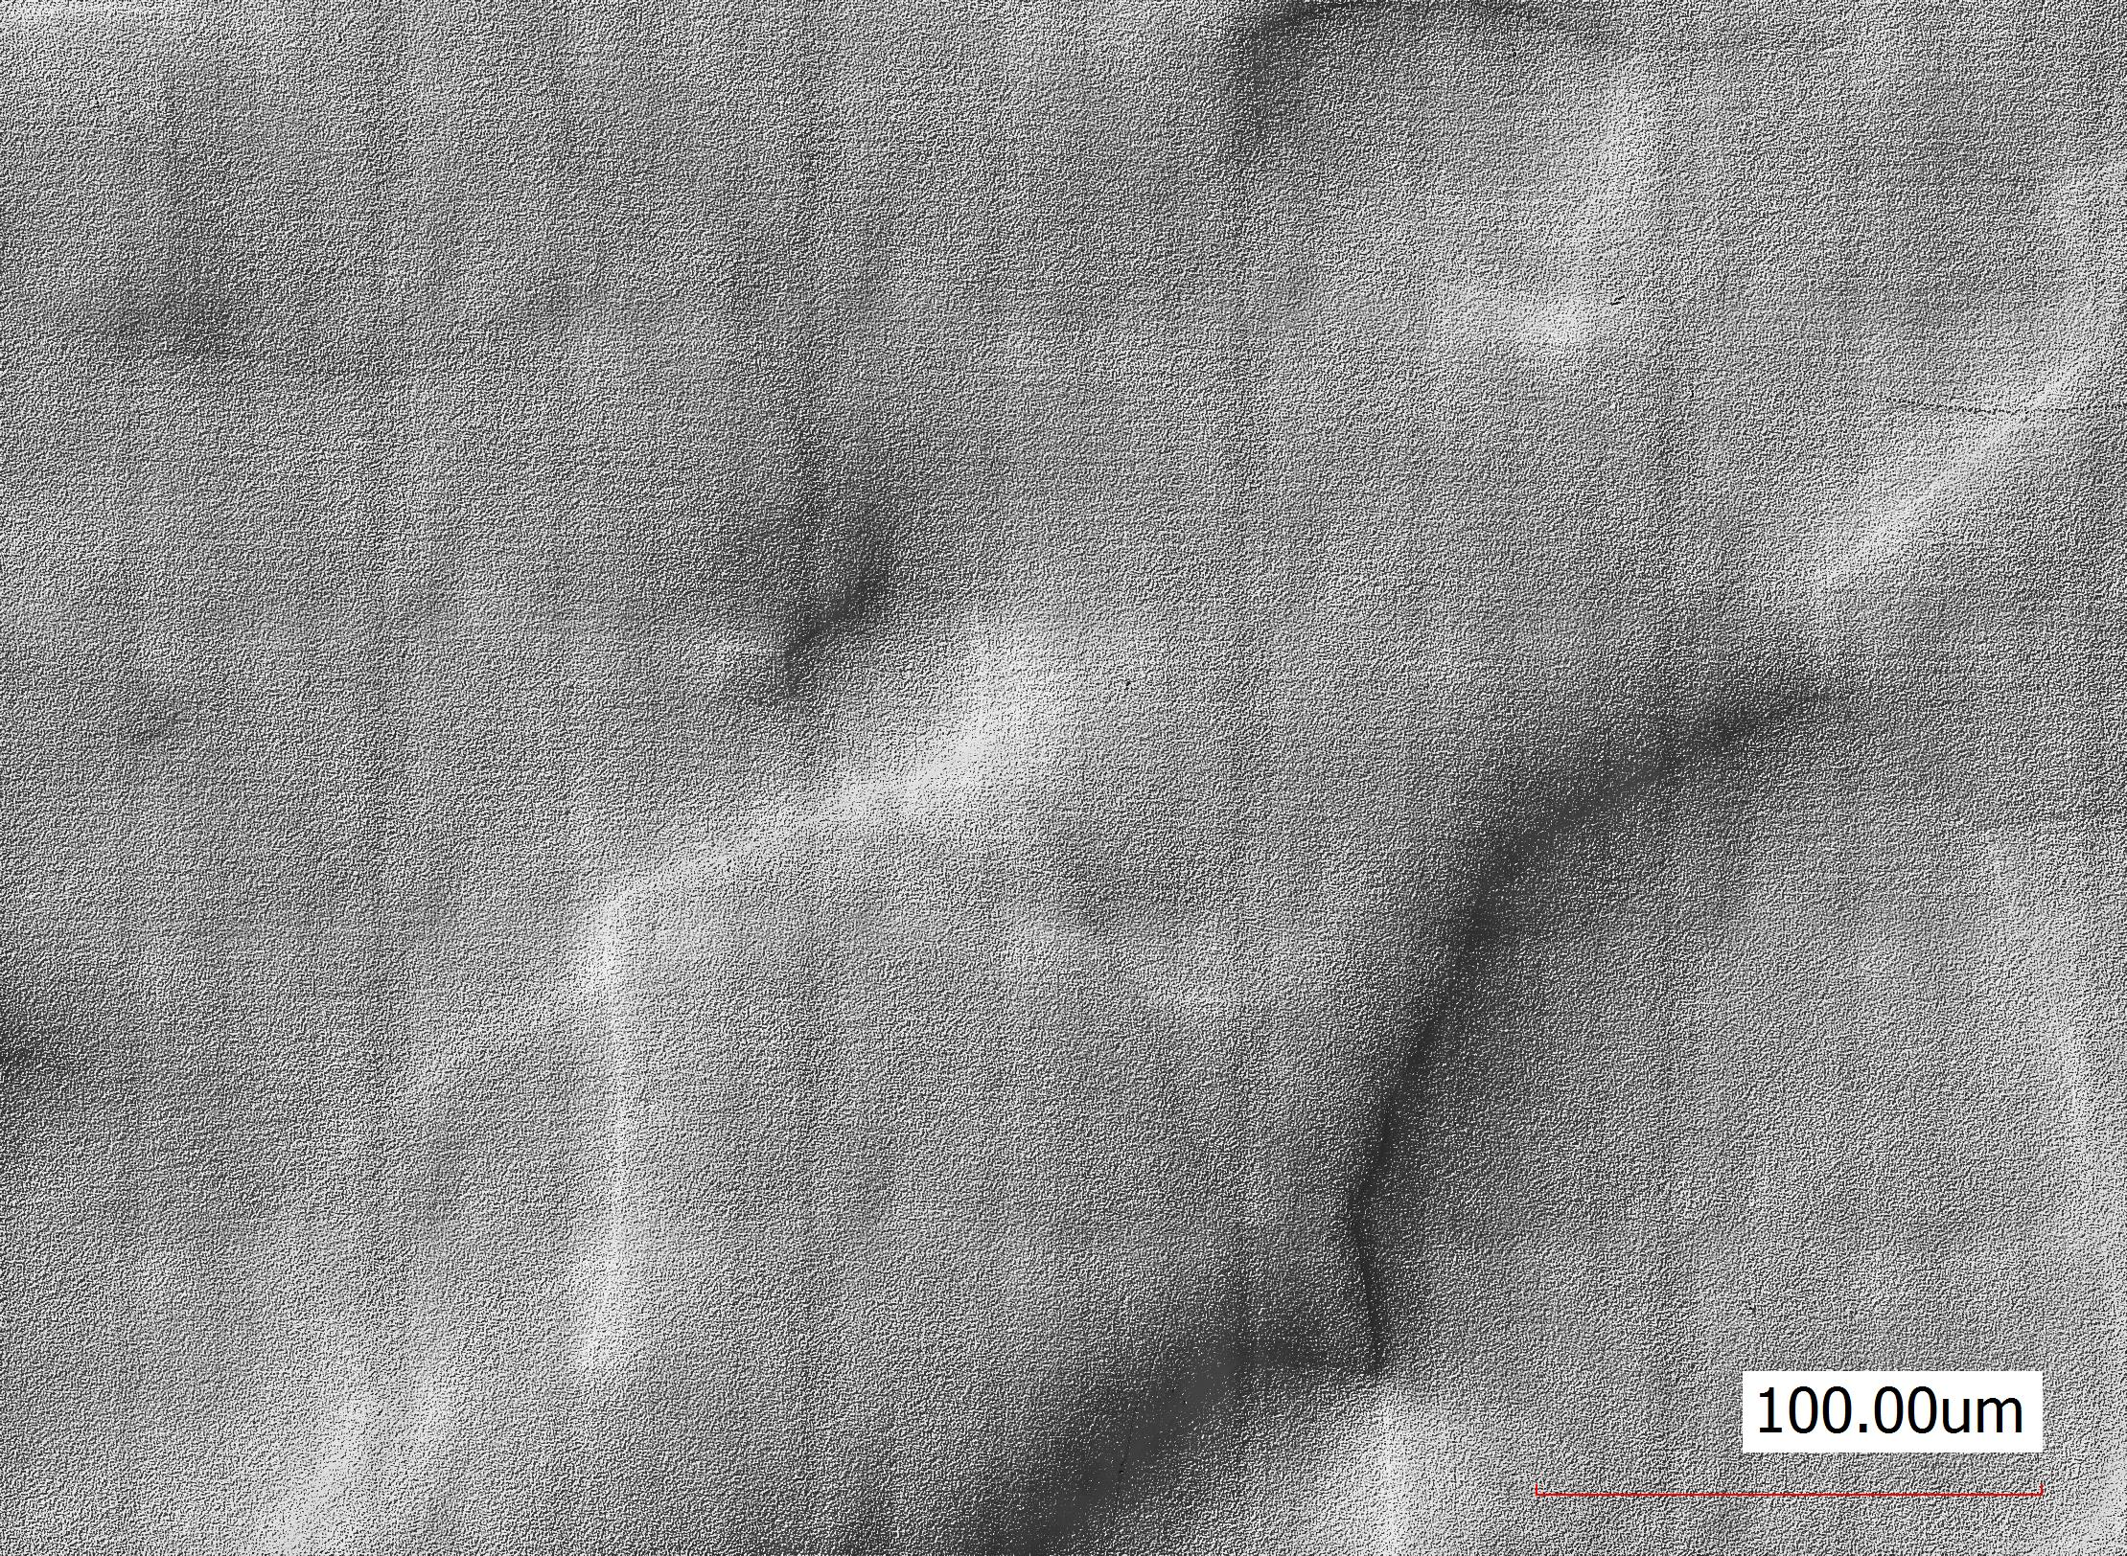

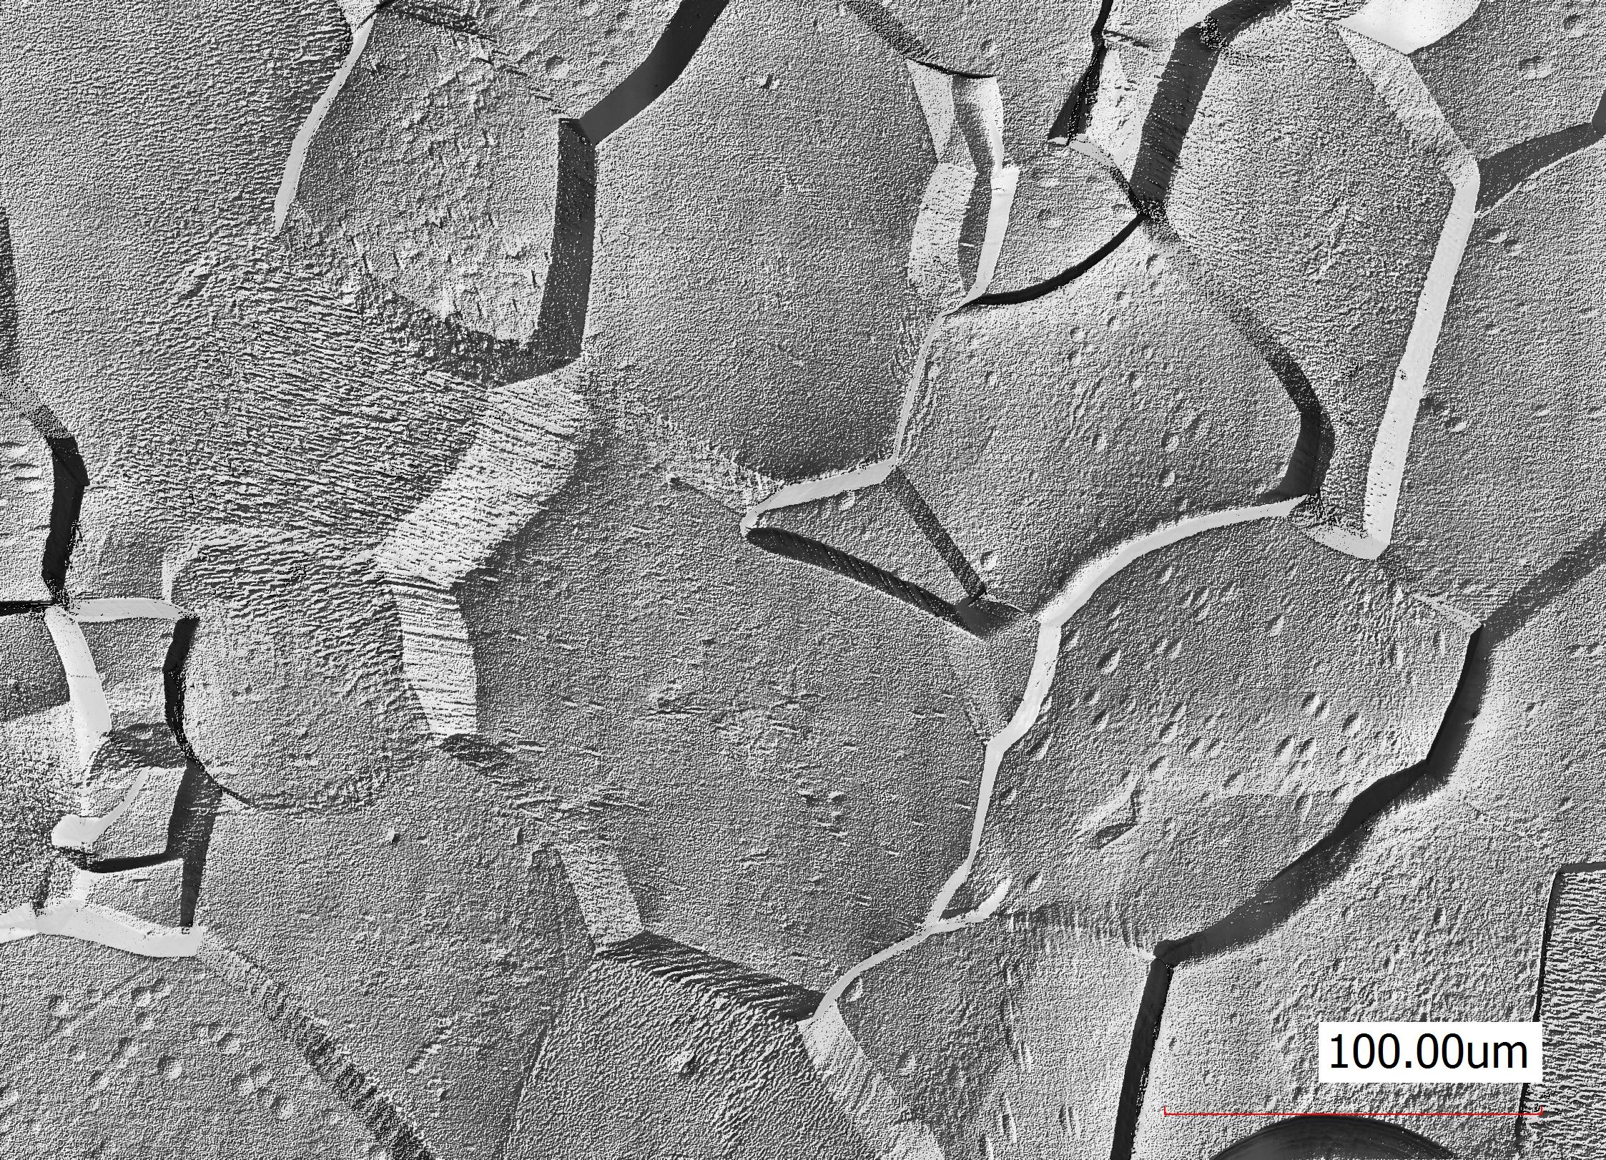
Q-disease analysis (studies on samples)
Q-disease analysis
Mitigation treatment
Step 1: removal of 250 µm
Annealing + test: 800C for 3 h
Hydrides are not observed
Too damaged or no Q-disease
Hydrides are not observed
Now no Q-disease
Precipitation of Hydrides
Step 2: polishing 2 hours
BCP + test: removal of 5 µm
Q-disease test
Hydrides are observed
Q-disease
Hydrides are not observed, but revealed strain is presented
Now no Q-disease
~10-12h
LN2

Slide 6
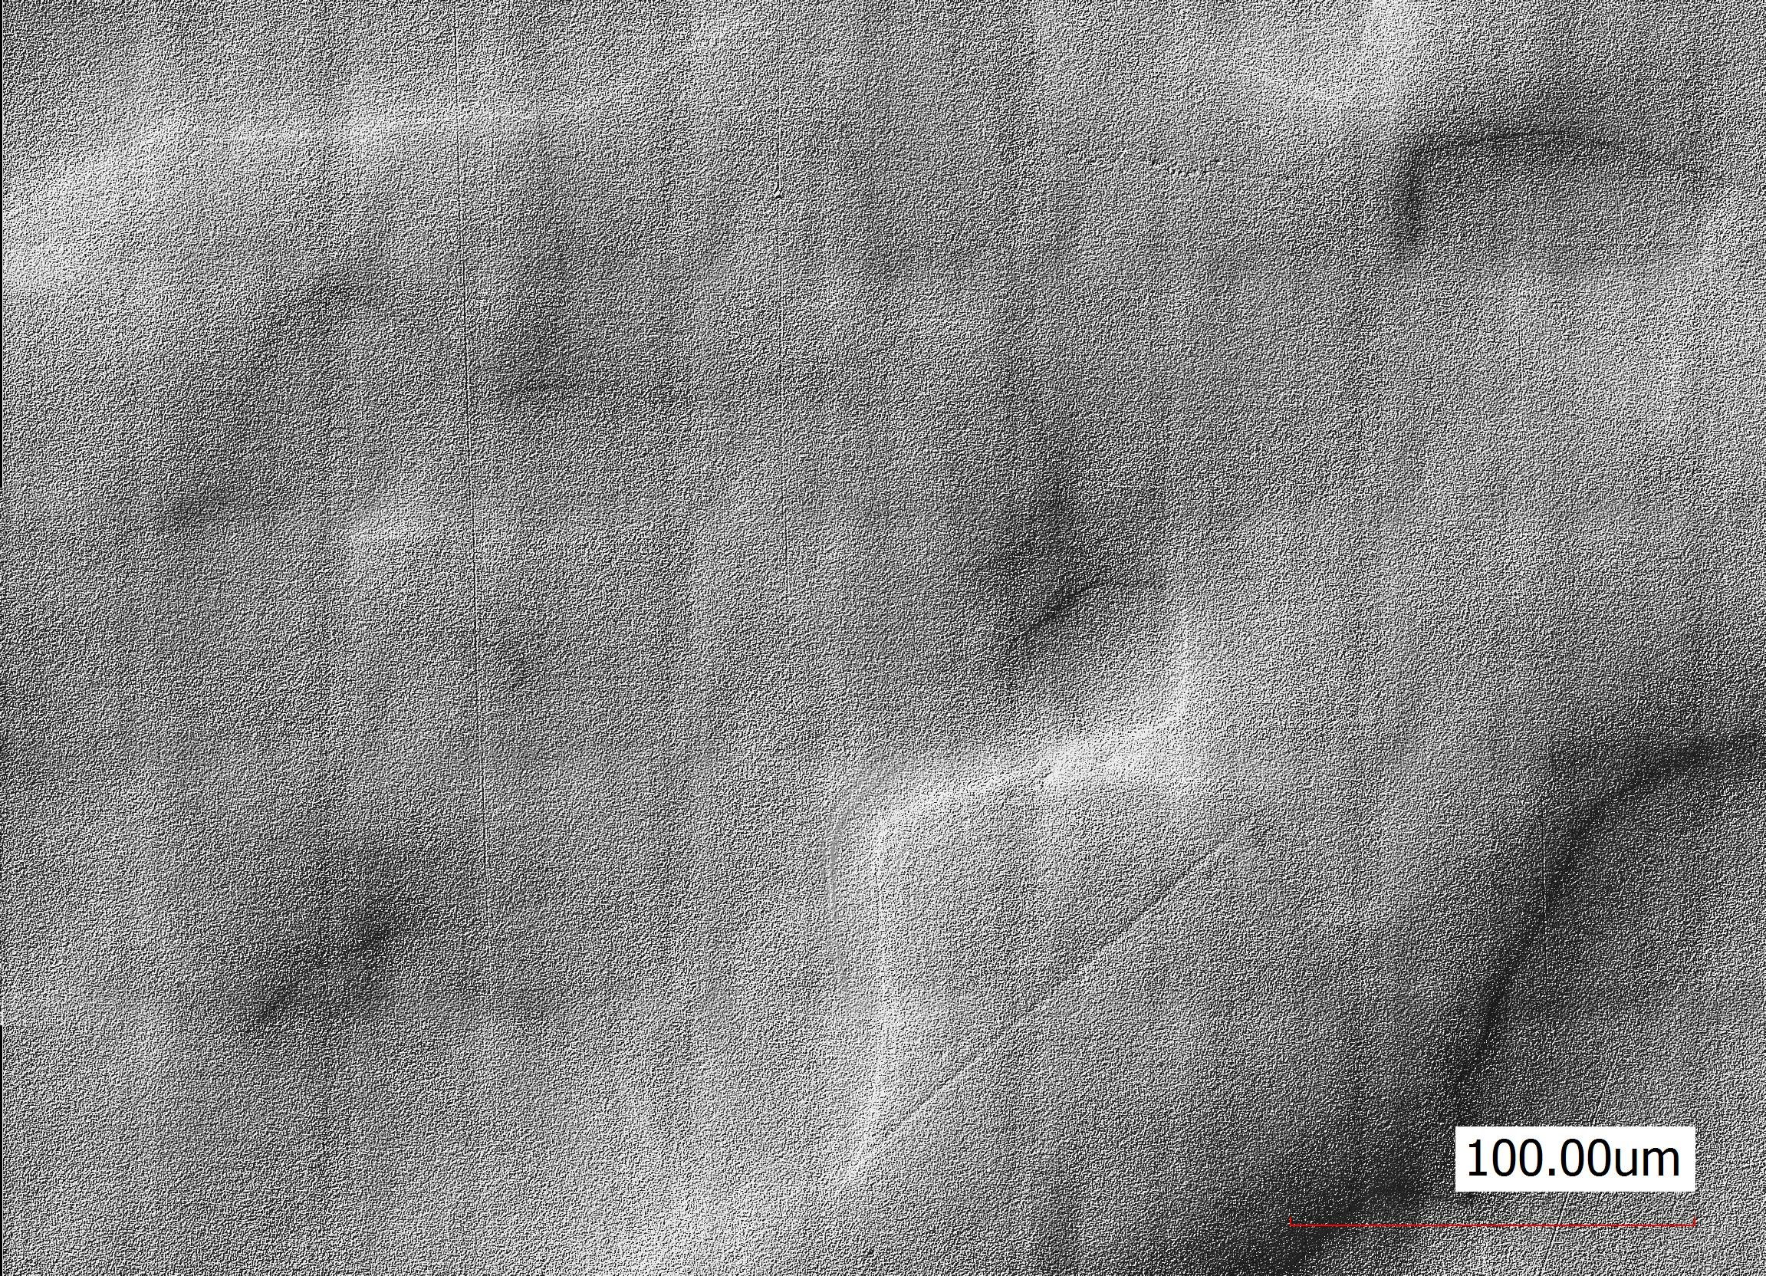
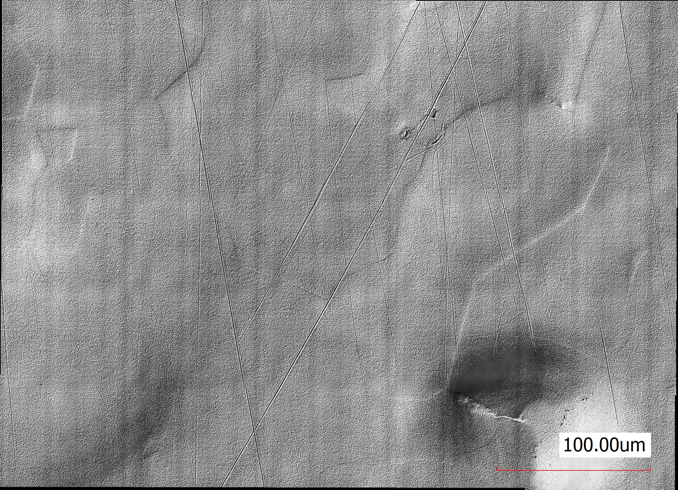
Q-disease analysis (studies on samples)
Q-disease analysis
Mitigation treatment
Q-disease analysis: prolongation
Step 1: removal of 250 µm
Annealing + test : 800C for 3 h
Step 2+15 min+test
Hydrides are not observed
Too damaged or no Q-disease
Hydrides are not observed
Now no Q-disease
Step 2: polishing 2 hours
BCP + test : removal of 5 µm
Step 2+15 min+test
Hydrides are observed
Q-disease
Hydrides are not observed, but revealed strain is presented
Now no Q-disease

Slide 7
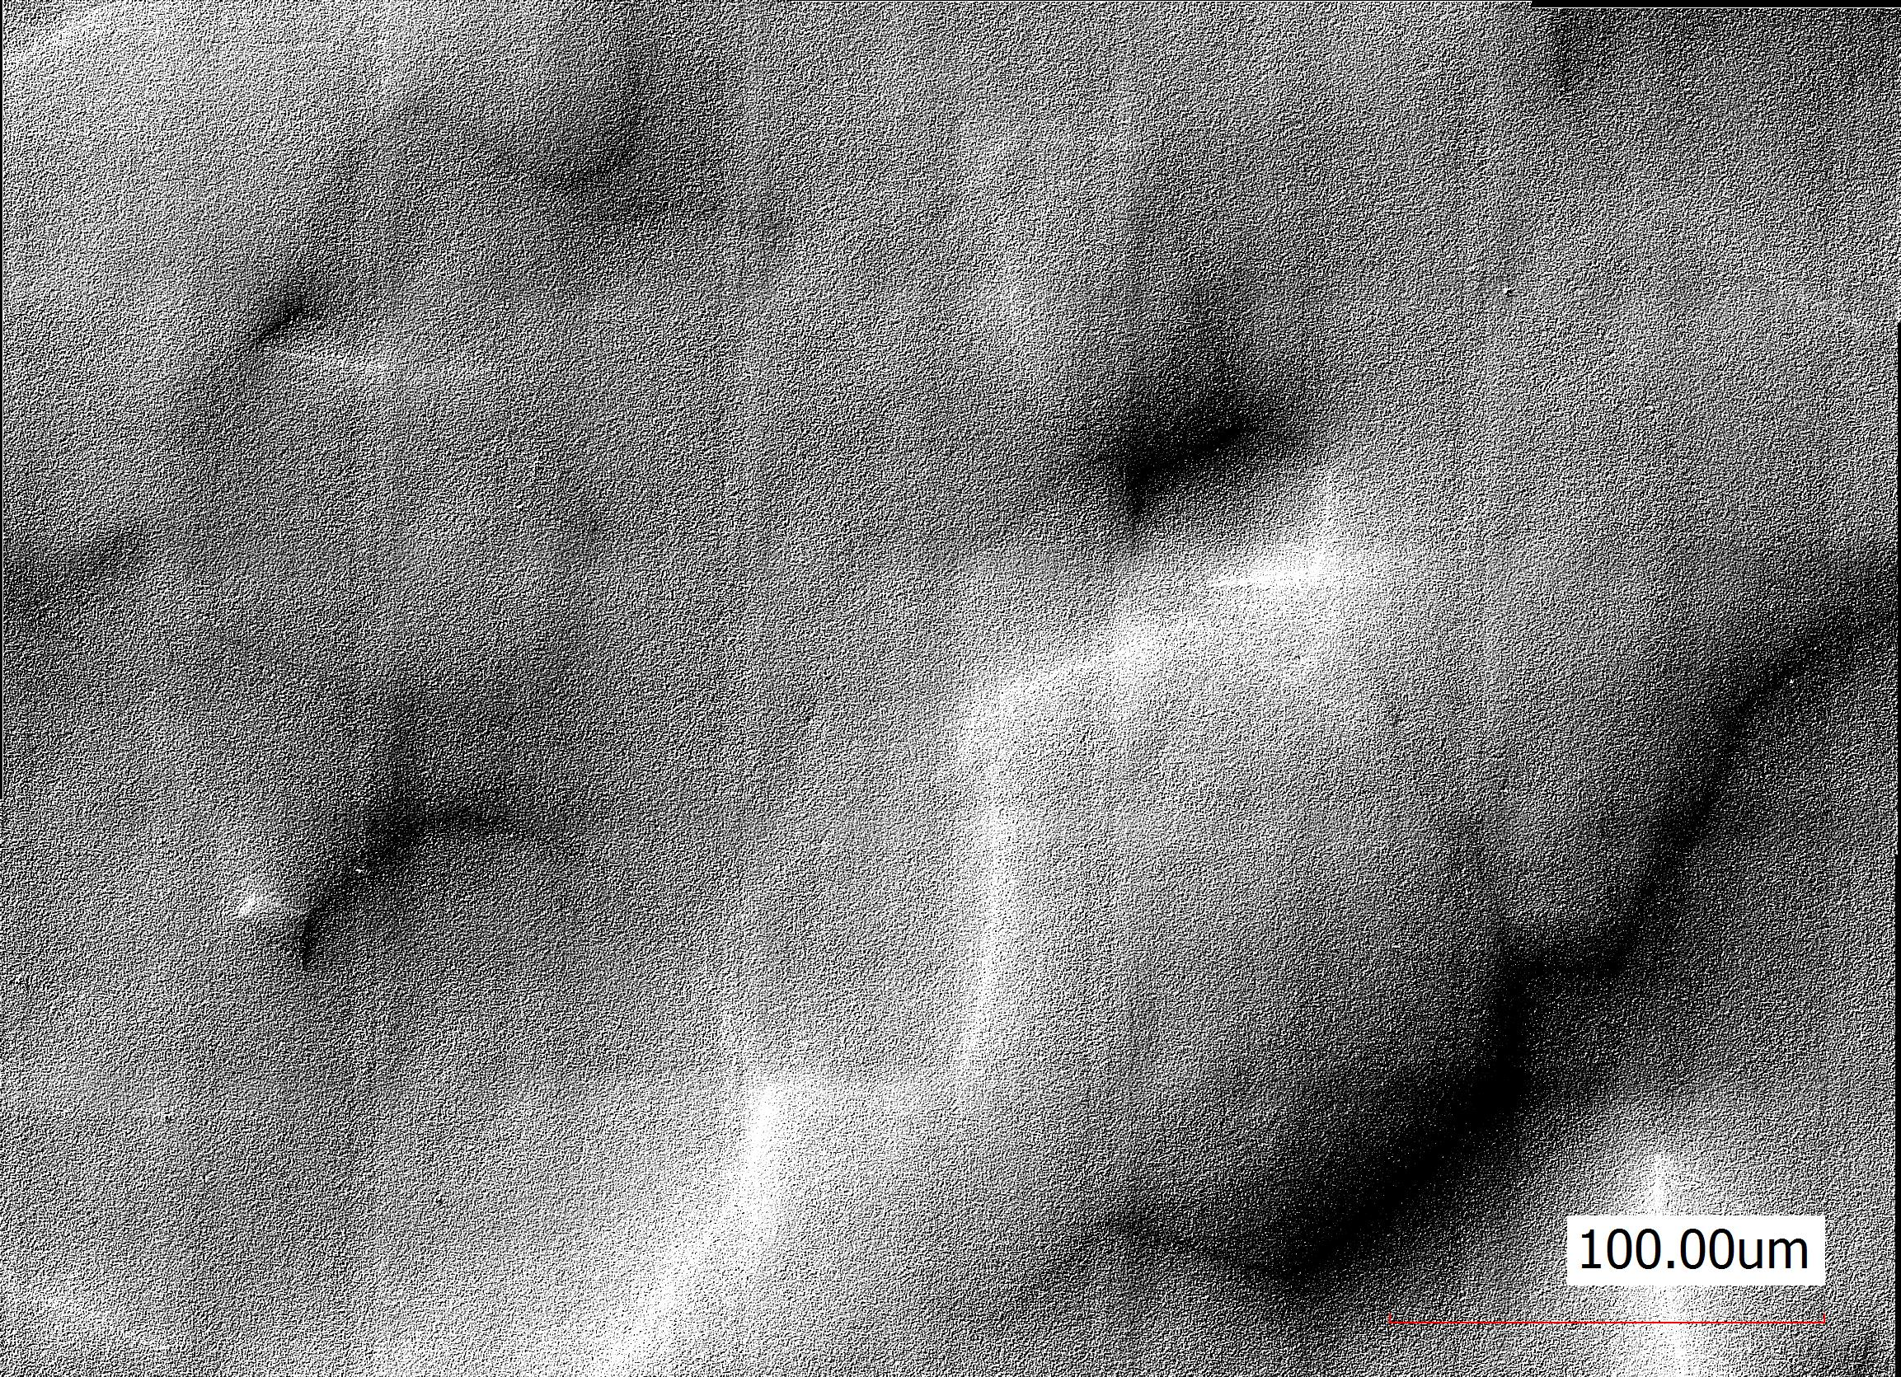
Q-disease analysis (studies on samples)
Q-disease analysis
Mitigation treatment
Q-disease analysis: prolongation
Step 1: removal of 250 µm
Annealing + test : 800C for 3 h
Step 2+15 min+test
Step 2+120 min+test
Hydrides are not observed
Too damaged or no Q-disease
Hydrides are not observed
Now no Q-disease
Step 2 is not a source of hydrides as passivation process prevents hydrogen penentration + reduced temperature processing
Step 2: polishing 2 hours
BCP + test: removal of 5 µm
Step 2+15 min+test
Hydrides are observed
Q-disease
Hydrides are not observed, but revealed strain is presented
Now no Q-disease
Any comments?

Slide 8
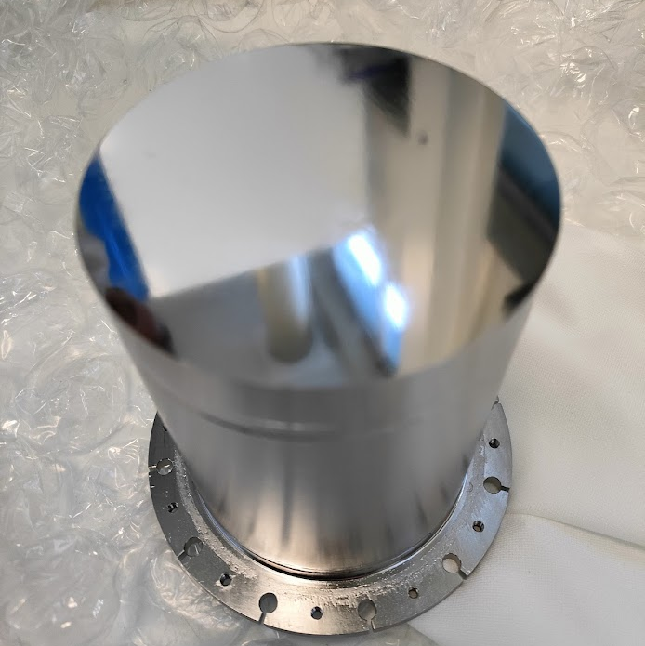
Perspectives
History of QPR-A5
Surface preparation
BCP removal of 150 µm at RI
800 °C annealing, 4 hours
BCP removal of 10 µm at RI
MP removal of 250 µm (2 steps) at IJCLab
EP removal of 50 µm at CEA (remove skeletons)
800 °C annealing, 3 hours (hydrogen degassing)
EP removal of 25 µm at CEA (due to C contamination caused by furnace)
RF evaluation in perspective at HZB

Slide 9
RF disk (STFC)

Slide 10
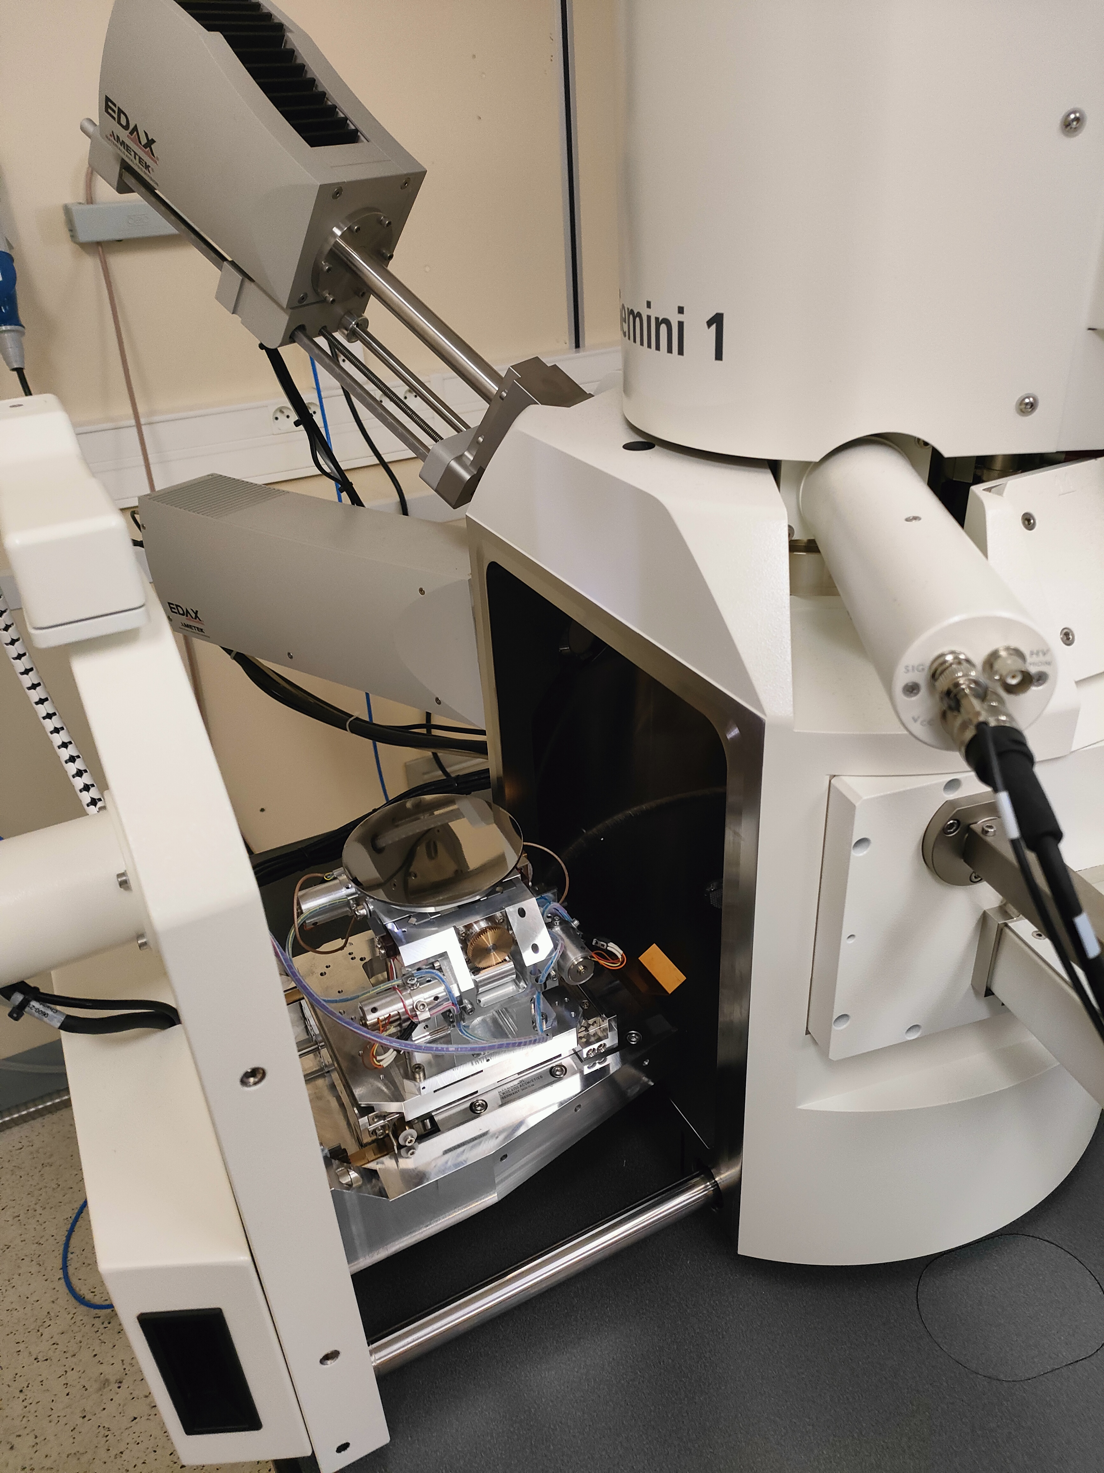
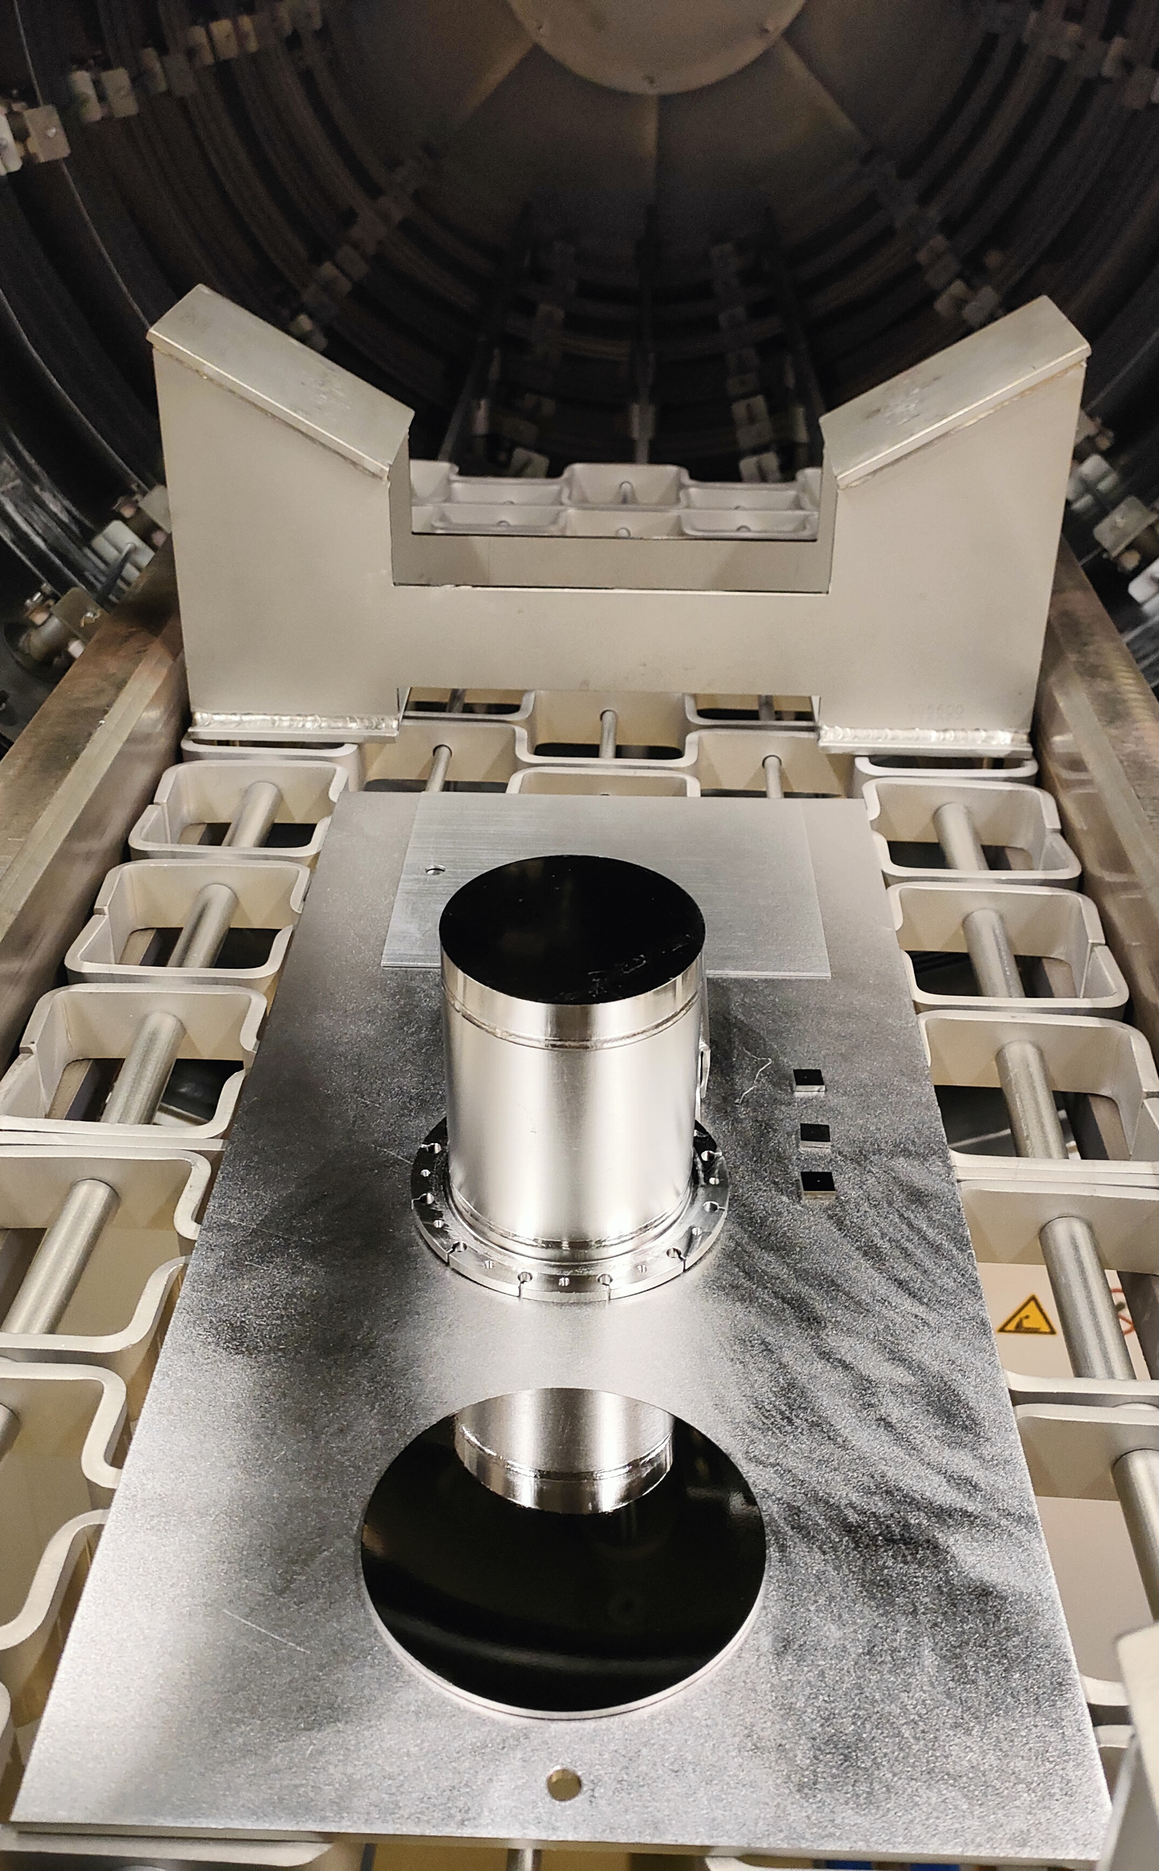
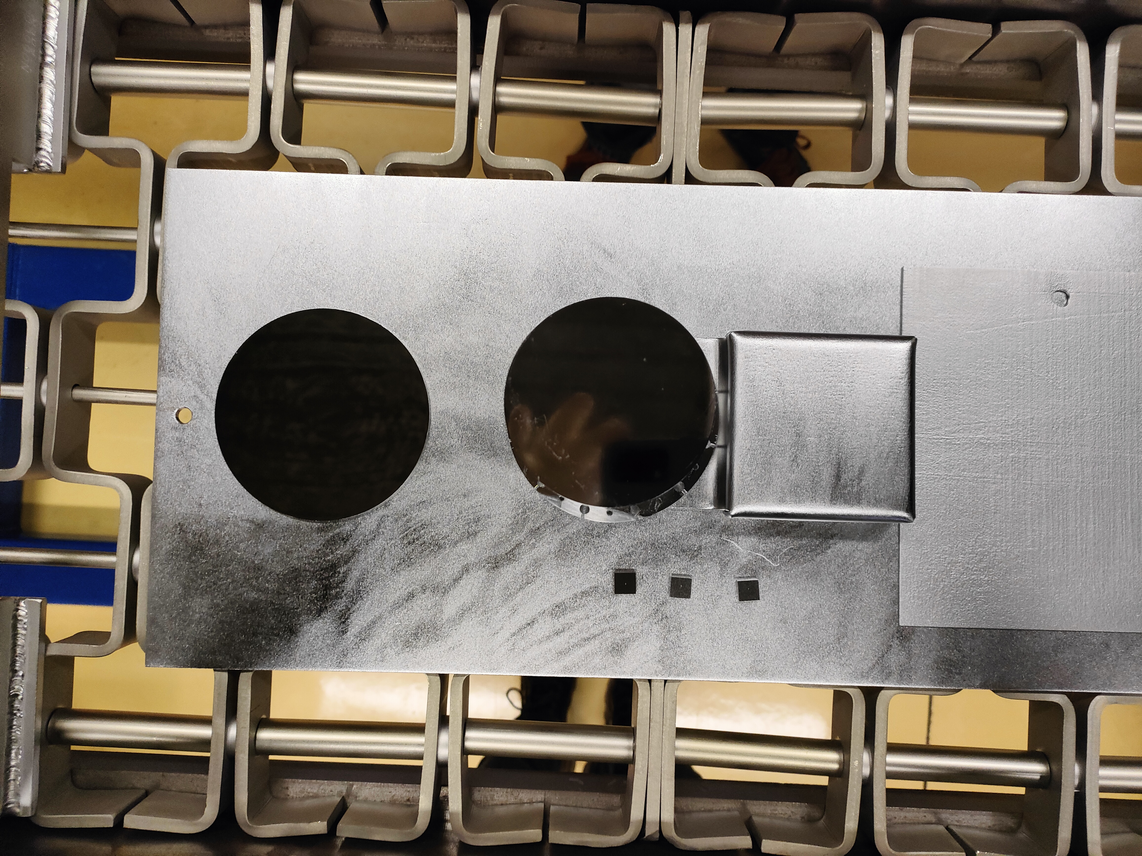
RF disk (STFC) Summary
Samples
QPR
Summary:
Performed a heat treatment (800°C for 3h) to reduce the H phase
No need to use light chemical removal (SiO2 particles were removed by recleaning), no C contamination
NEXT STEP:
RF disk test at STFC (Daniel Seal)
RF disk

Slide 11
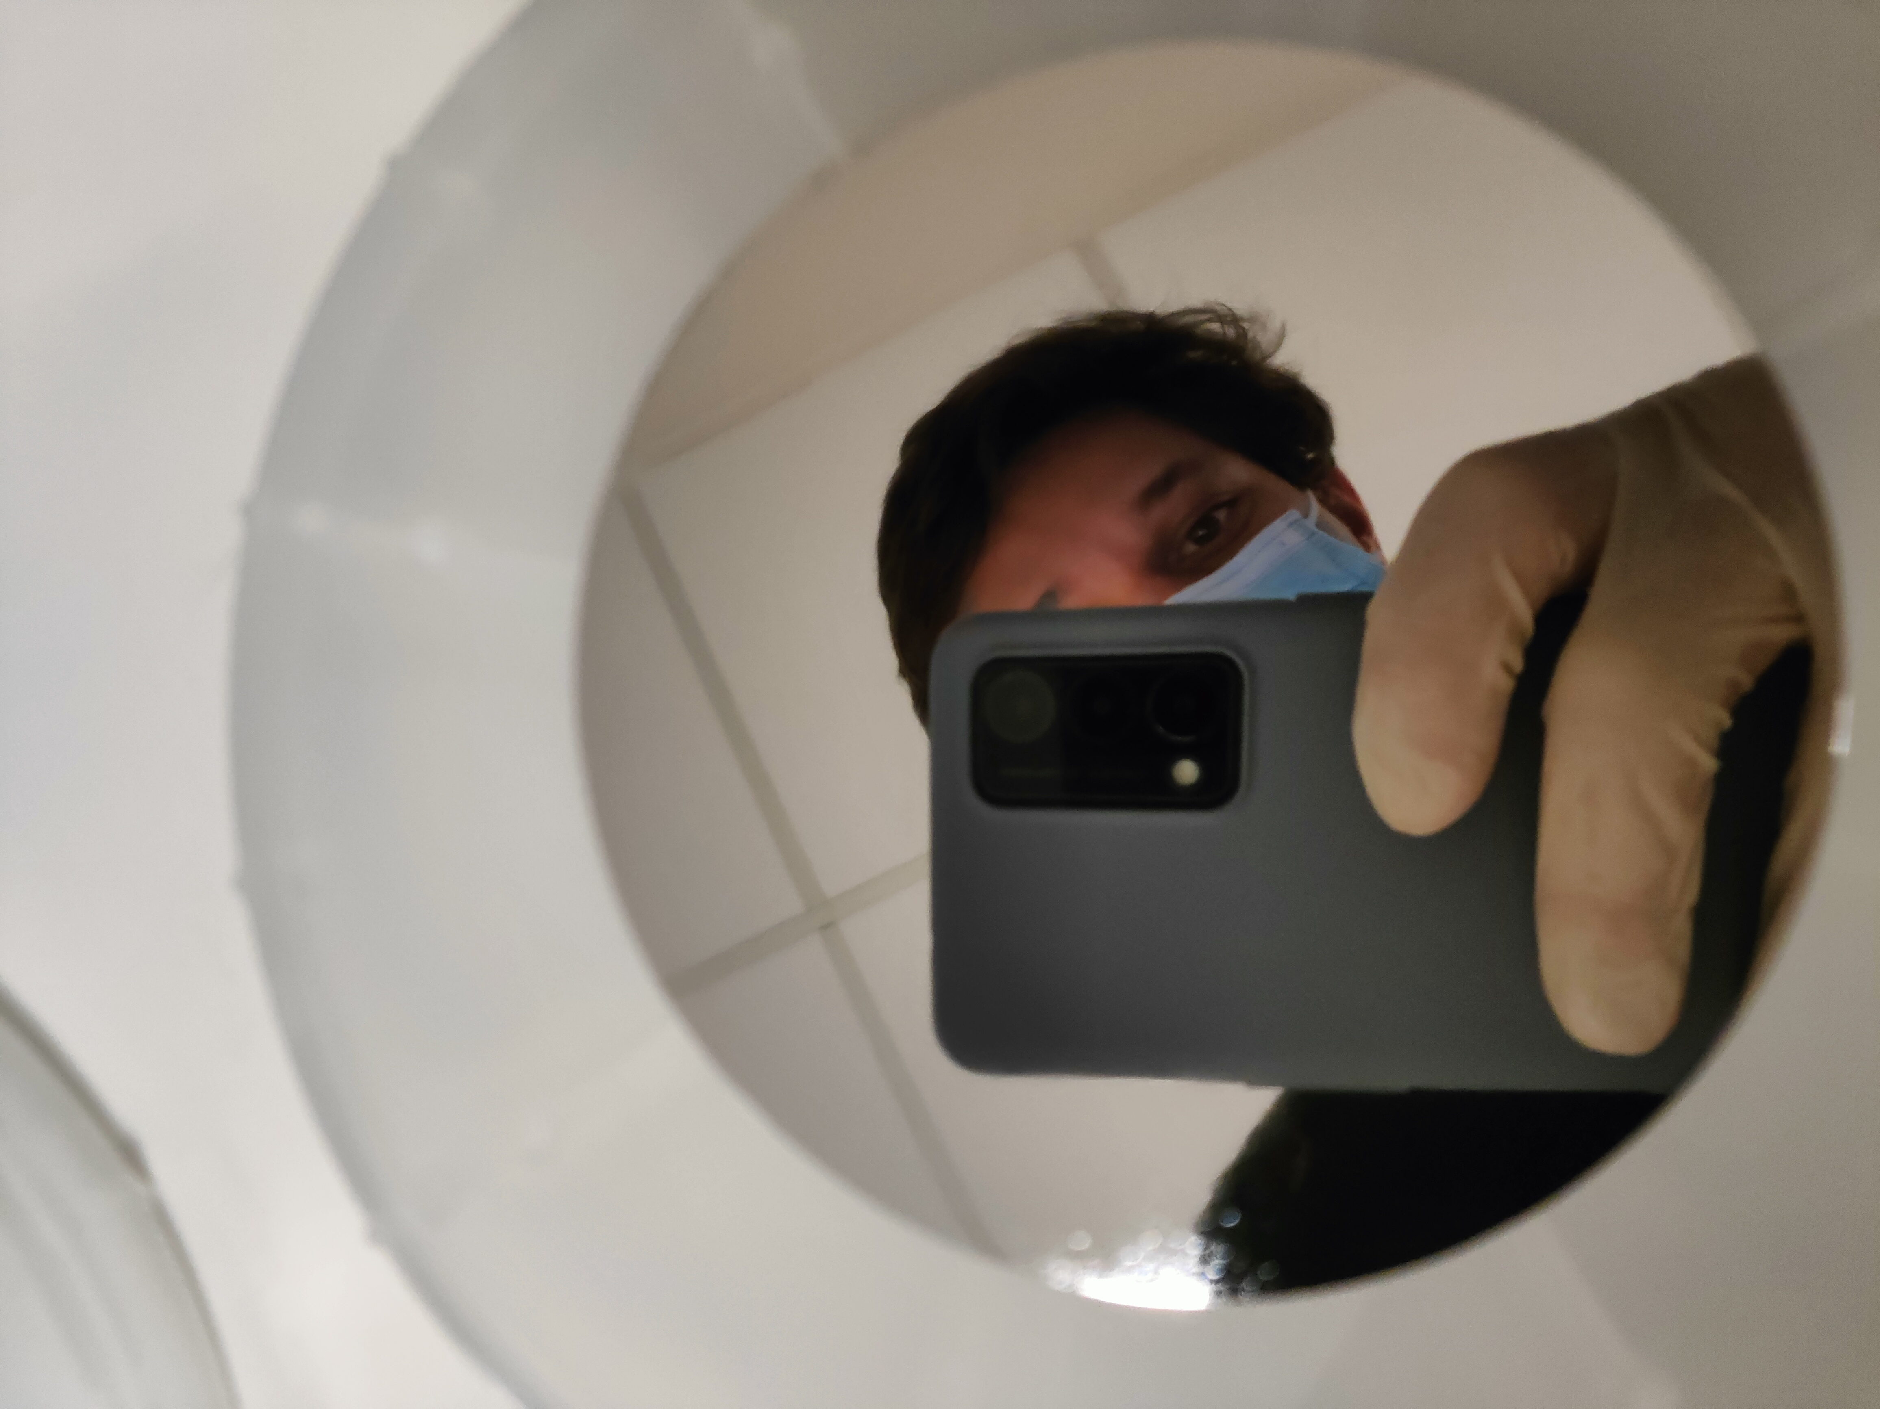
Thank you for your attention

