Slide 1

IFAST 1st Annual Meeting, 03/05/2022
Analysis of Nb and Pb foils.
Liam Smith, Daresbury Laboratory.

Slide 2
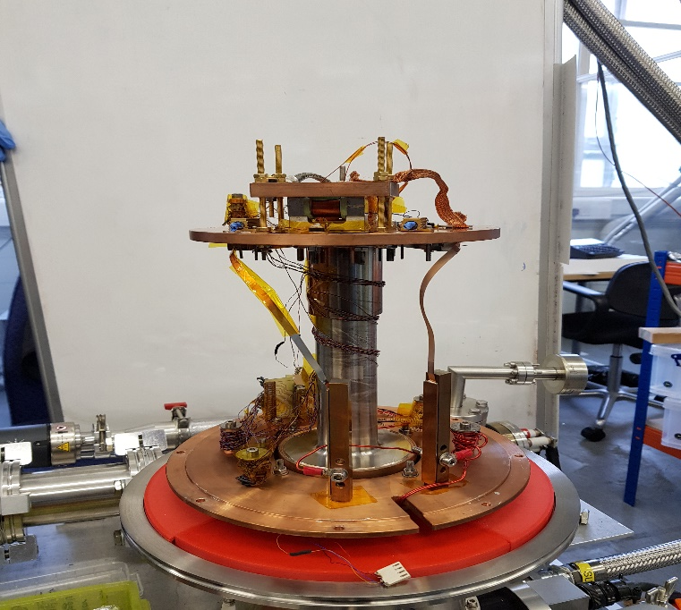
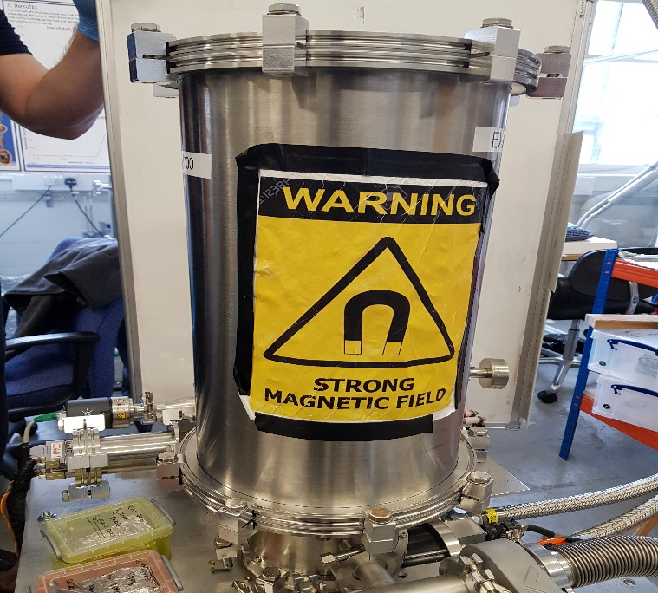
Penetration Facility, Method and Function.
The penetration facility, determines the critical field (Hfp) of superconducting materials.
The facility can reach cryogenic temperature of 2.6 K and applies a maximum magnetic field of 600mT.
A magnetic field is applied parallel to the sample surface and is applied from one side of the sample to the other.
There are two Hall probe detectors located each side of the sample (Hp1 & Hp2) that determine the field of full flux penetration (Bfp).

Slide 3
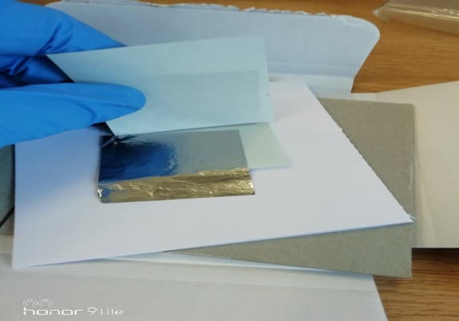
Background of the study
A paper by Dan Turner is being published after conducting an experiment to investigate how the size of a sample effects results due to leakage. In the study, a sample was reduced in size from 50x50 mm to 10x10 mm and the results were analysed.
Following on from that study, I have began to carry out the same investigation using Nb foil for comparison.
I have two samples that can also be cut down, starting from 50x50 mm. Sample thickness is 10 µm and 1 µm.
Early results have been demonstrated in this presentation.
Samples sourced from Goodfellow Ltd
99.99% purity

Slide 4

Nb Foil Samples, 50x50. 4.20 K (1$µm$)

Slide 5

Further Analysis, Nb. Type two Superconductor.

Slide 6

Points taken from the Critical field compared to points taken from possible Flux jump.

Slide 7

Pb Foil Samples, 50x50. 4.20 K, (1$µm$).

Slide 8

Further Analysis, Pb. Type one Superconductor.

Slide 9

Hfp as a function of Time. Pb, 50x50.

Slide 10

Bfp for all temperature points of Pb (10 $µm$)
B₁K₁

Slide 11
Bfp for all temperature points of Nb foil (1µm).

Slide 12
Conclusion
Sample size is an issue.
Add a further plate to the top of the sample.
Should have better results at the next meeting from the 10 µm sample.

Slide 13

Thank you for your attention

