Slide 1
Superconducting Nb
Flash lamp processing
Slawomir Prucnal, Shengqiang Zhou
s.prucnal@hzdr.de, s.zhou@hzdr.de
Helmholtz-Zentrum Dresden-Rossendorf (HZDR)

Slide 2
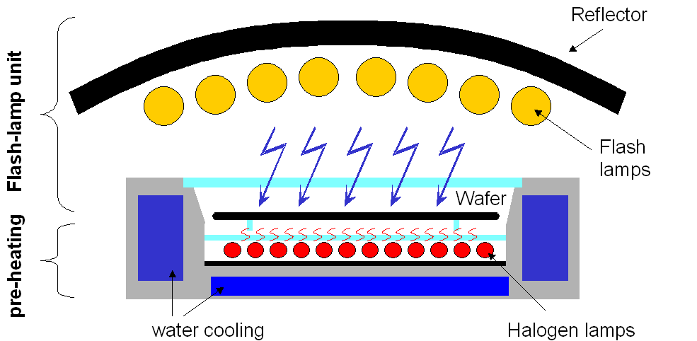
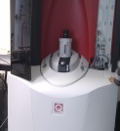
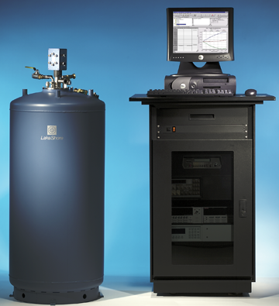
Resources: Semiconductor materials
Material processing: flash lamp annealing
Material characterization: Raman, RBS, Positron
Material characterization: magnetic and electrical
SQUID-VSM
SQUID-MPMS
Lakeshore Hall Measurement system
1.8-400 K
up to 7 T

Slide 3
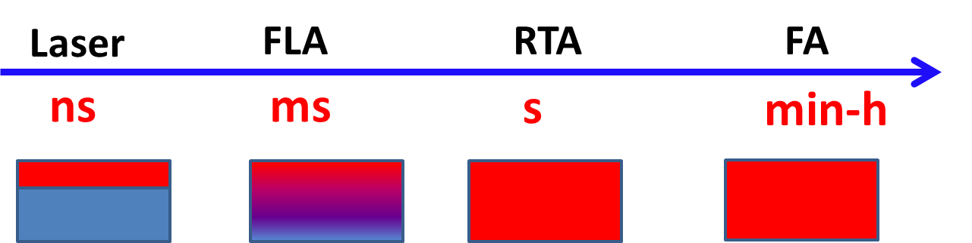
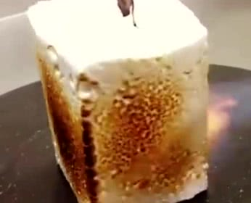

Thermal processing of semiconductors
ultra-short annealing
Kun Gao PhD Thesis (2014).
Zhou, Shengqiang, et al. Sci. Rep. 5 (2015).
Notes:
The two most commonly used annealing techniques are furnace annealing (FA) and rapid thermal annealing (RTA). FA process can last between minutes to hours and RTA can last several seconds. (The time range for both FA and RTA allows samples to reach nearly thermal equilibrium condition under which the self-organization is in progress to modify the material. However, under thermal equilibrium condition,) Under this annealing time range, the dopant beyond solubility tends to segregate from the host material to form clusters / grains or even evaporate, this makes FA and RTA not suitable for the case of hyperdoped with deep level impurities.
The two ultra-short annealing techniques applied in this experiment are pulsed laser melting and flash lamp annealing, both of which use ultra-short light pulse to achieve ultra-fast heating and consequent ultra-fast cooling. This makes it is possible to get single crystallization, epitaxy growth. (In this energy range, during the implantation process will form a large number of defects, the as-implanted region can be partially or even completely amorphized. To reform or restore the lattice from the amorphized structure and to activate the dopants, post-implantation annealing is required. Combine with ultra-short annealing, during which the materials cannot reach thermal equilibrium condition.)

Slide 4
As-received materials
Nb13052021LCM, Nb on Cu
After ZFC
At 2 K

Slide 5
Nb13052021LCM, Nb on Cu

Slide 6
As-received materials
Nb13052021LCM, Nb on Cu

Slide 7
As-received materials
Nb13052021LCM, Nb on Cu

Slide 8
Next step
RBS measurements
Positron annihilation lifetime
Need proposal to apply for beamtime
But I can do RBS for a few samples by using my beamtime

