Slide 1


5th IFAST WP9 Meeting

Slide 2
Deposition of 6 GHz cavity

Slide 3
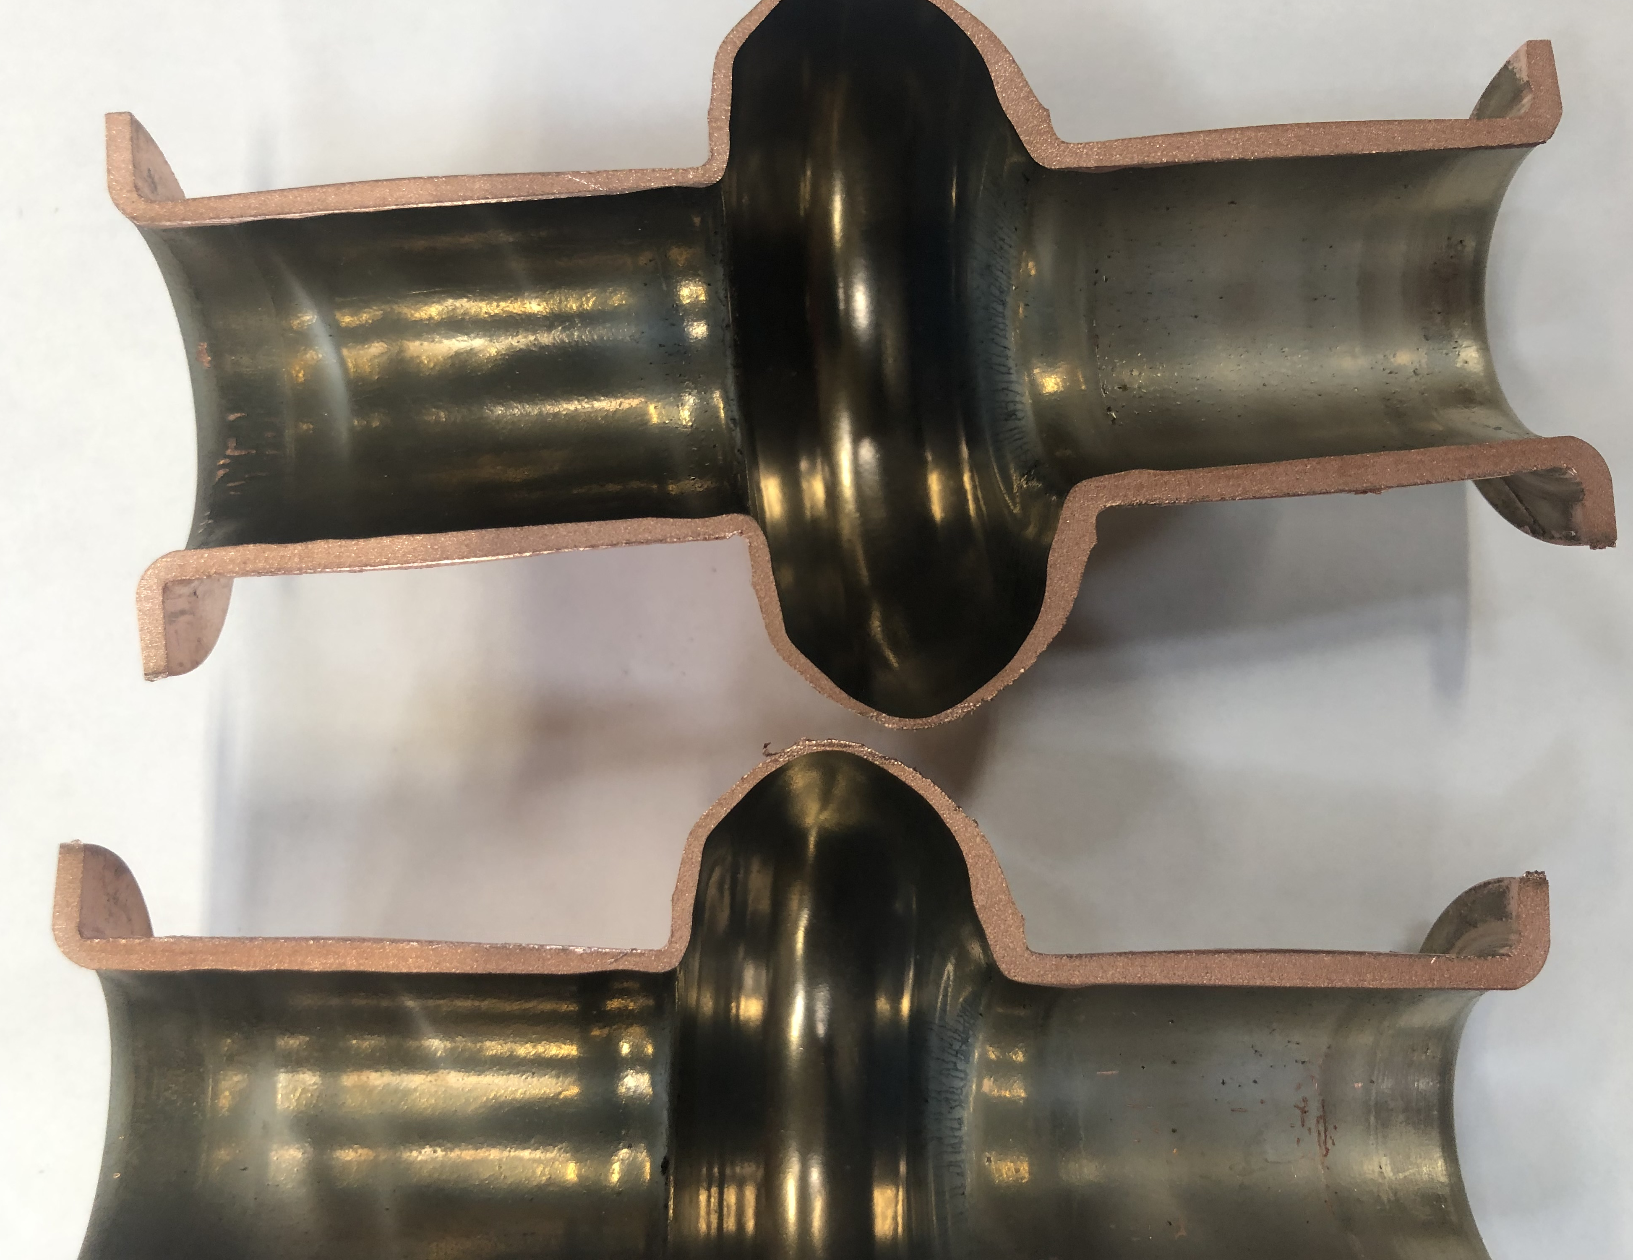
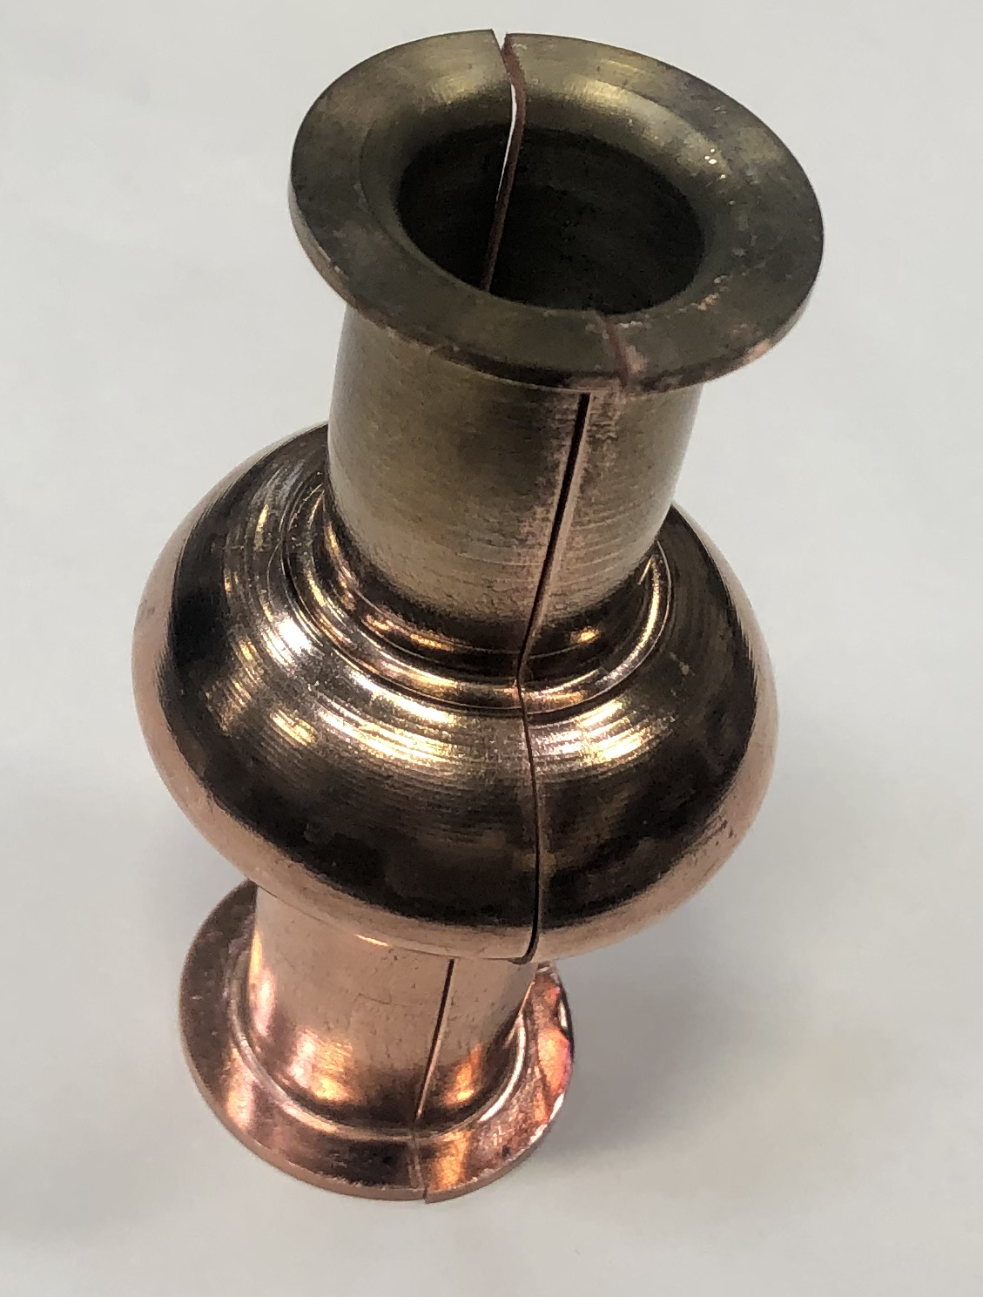
Deposition of NbTiN inside the 6 GHz
Deposition parameters:
Power 150 W
Current 0.23 A
Voltage 658 V
Dep Temp 650 C
Pulsed DC
Frequency 350 KHz
Dual Time 1.1us
Deposition time 1 h 30 min
Dep pressure 2.6 x10⁻² mbar mag current 7.54 A

Slide 4
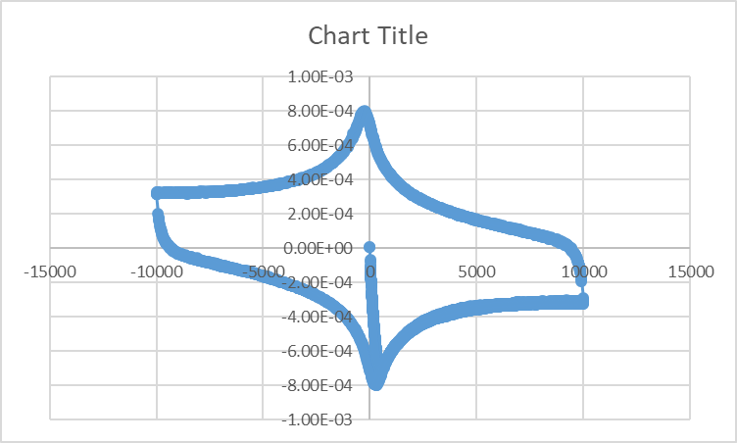
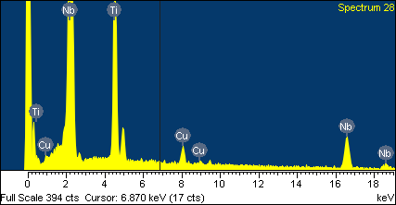
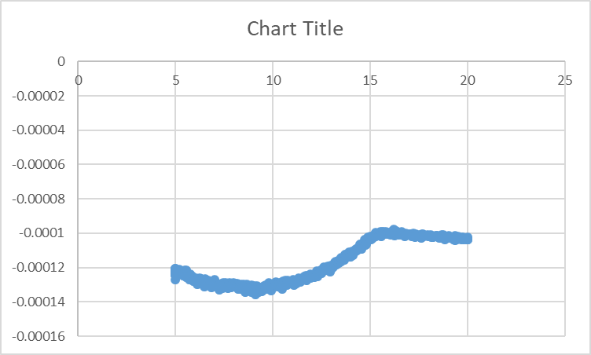
SEM of NbTiN film at cavity equator
Element | Weight% | Atomic%
Ti K | 25.77 | 39.49
Cu K | 5.13 | 5.93
Nb L | 69.09 | 54.58
Totals | 100.00
Element | Weight% | Atomic%
Ti K | 25.40 | 38.99
Cu K | 5.39 | 6.24
Nb L | 69.21 | 54.77
Totals | 100.00

Slide 5
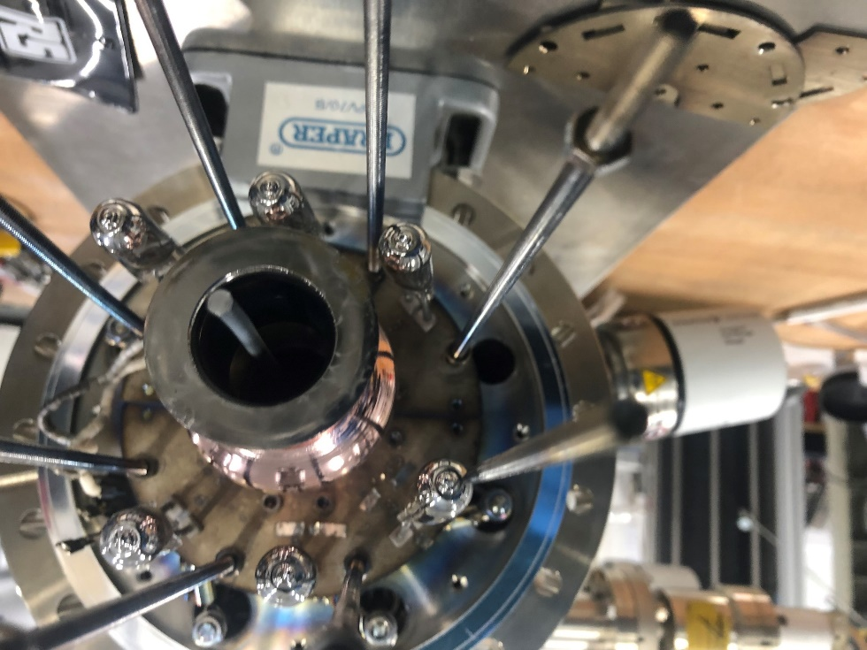
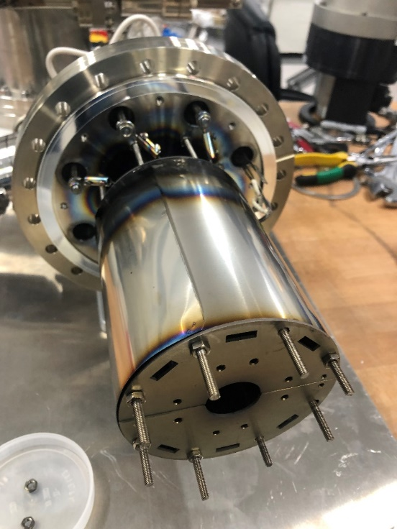
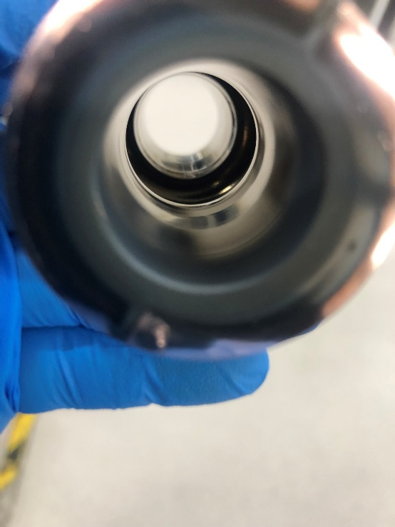
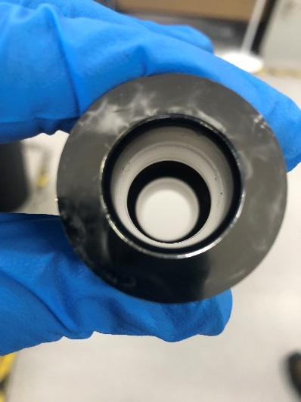
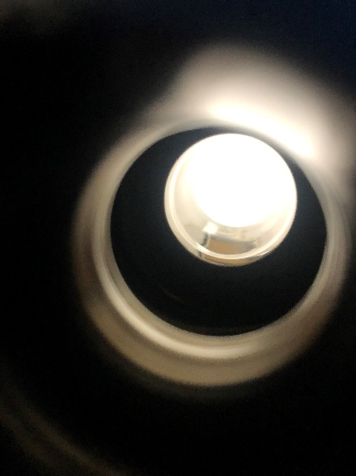
Deposition of Nb thin film inside 6 GHz cavity
Deposition parameters:
Power 150 W
Current 0.23 A
Voltage 658 V
Dep Temp 650 C
Pulsed DC
Frequency 350 KHz
Dual Time 1.1us
Deposition time 1 h 30 min
Dep pressure 2.6 x10⁻² mbar
mag current 7.54 A

Slide 6
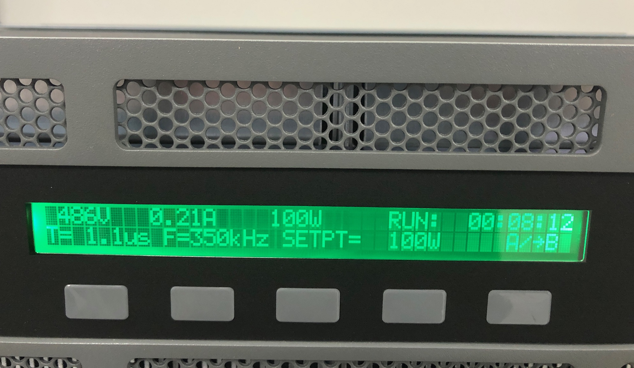
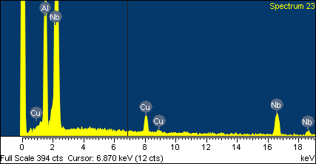
Deposition of Nb3Al on copper disk
Element | Weight% | Atomic%
Al K | 22.83 | 49.22
Cu K | 8.53 | 7.81
Nb L | 68.63 | 42.97
Totals | 100.00

