Slide 1
COSINUS Collaboration Meeting LNGS/GSSI Introduction
April 2022
Florian Reindl

Slide 2
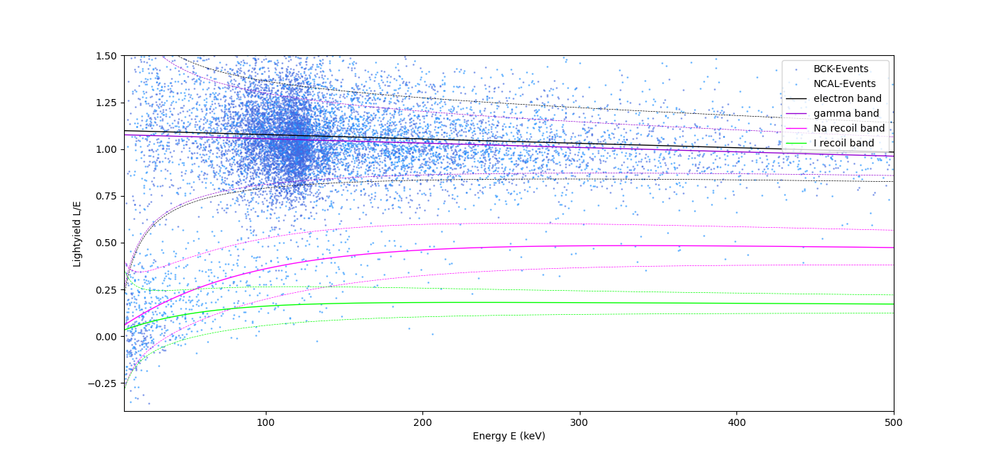
Fantastic News - remoTES
Very rough
first values
QF NaI: 0.25
QF I: 0.1
preliminary
σ=2keV →
Ethr ~10keV

Slide 3
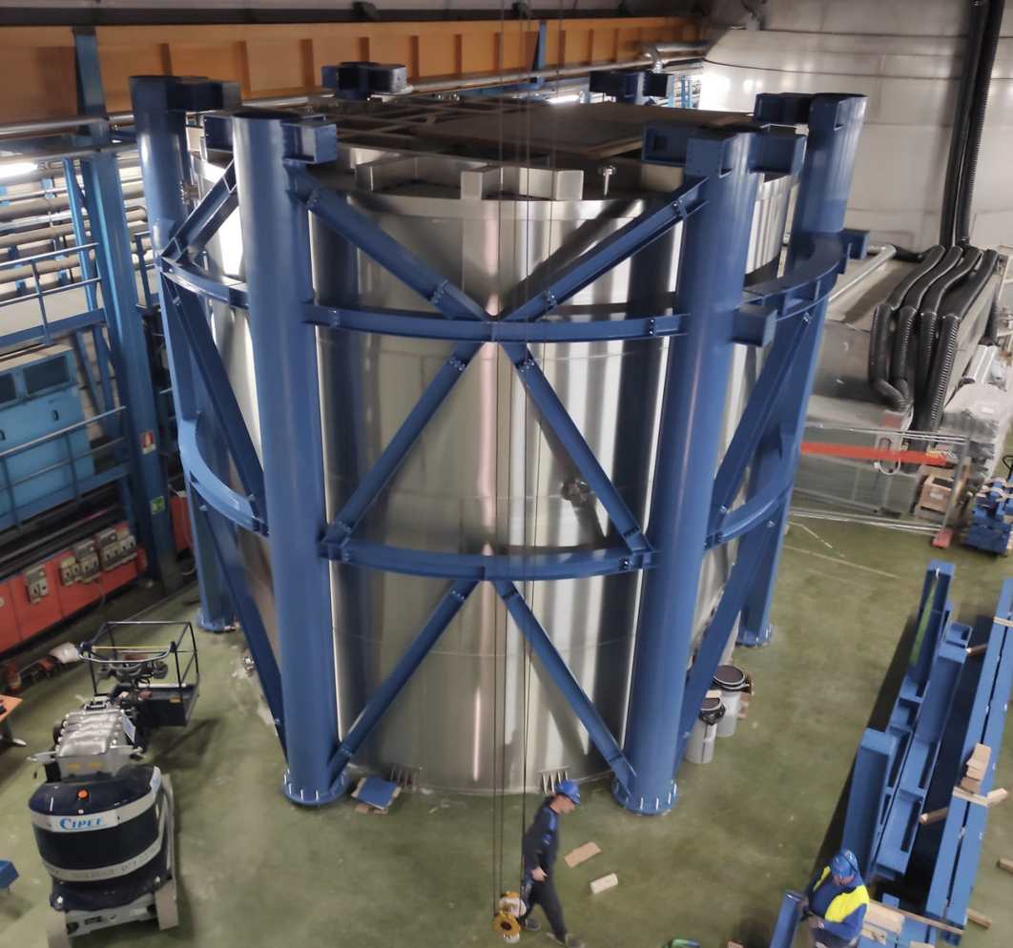
Fantastic News – Setup proceeds
Status: Monday, 14.04.2022

Slide 4
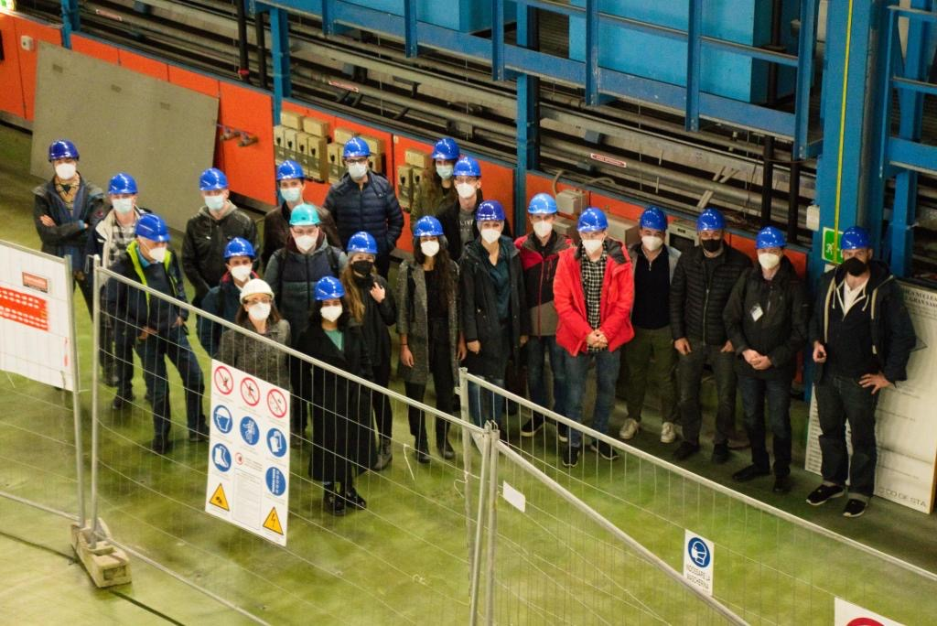
Summary
We (almost) have a detector
Collaboration meeting 11/2021

Slide 5
Summary
We (almost) have a detector
We (almost 🤣) have a setup
Collaboration meeting 11/2021

Slide 6
Summary
We (almost) have a detector
We (almost 🤣) have a setup
We (almost) have all money
Collaboration meeting 11/2021

Slide 7
Summary
We (almost) have a detector
We (almost 🤣) have a setup
We (almost) have all money
We have a team
Collaboration meeting 11/2021

Slide 8
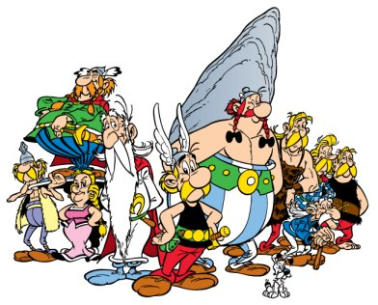
Who is Who

Slide 9
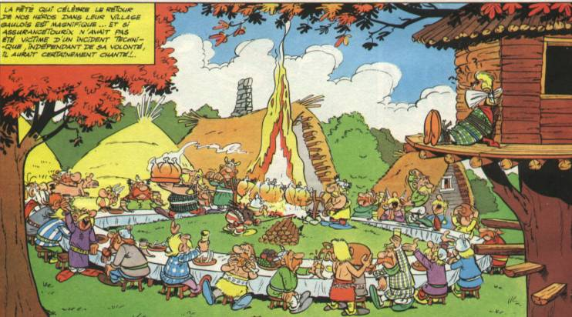
Round Tables
Please let us know if more round tables are needed.

Slide 10
Let’s Go!

