Slide 2
COSMOS
BE-CSS Alarm Tools Portfolio
Frank Locci
CTTB Industrial Controls Forum - #4
April 2022

Slide 3
Agenda
COSMOS service: a quick overview
COSMOS alarms
  Principle
  Concerns
Conclusion

Slide 4
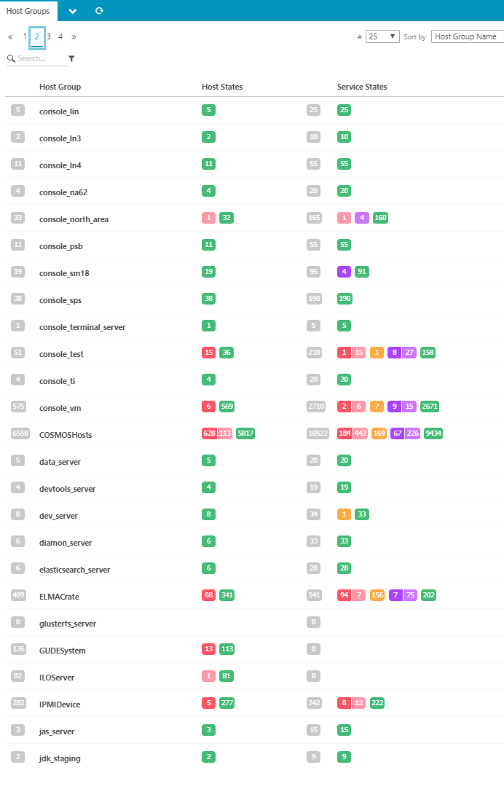
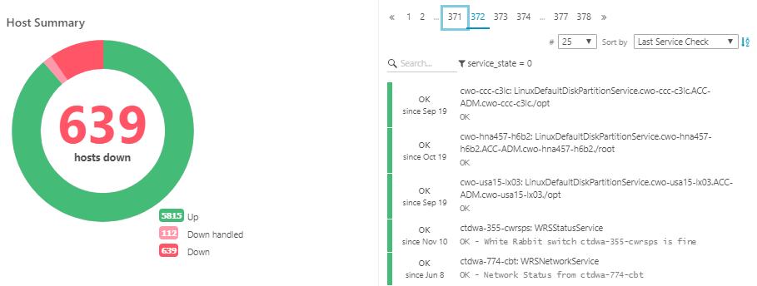




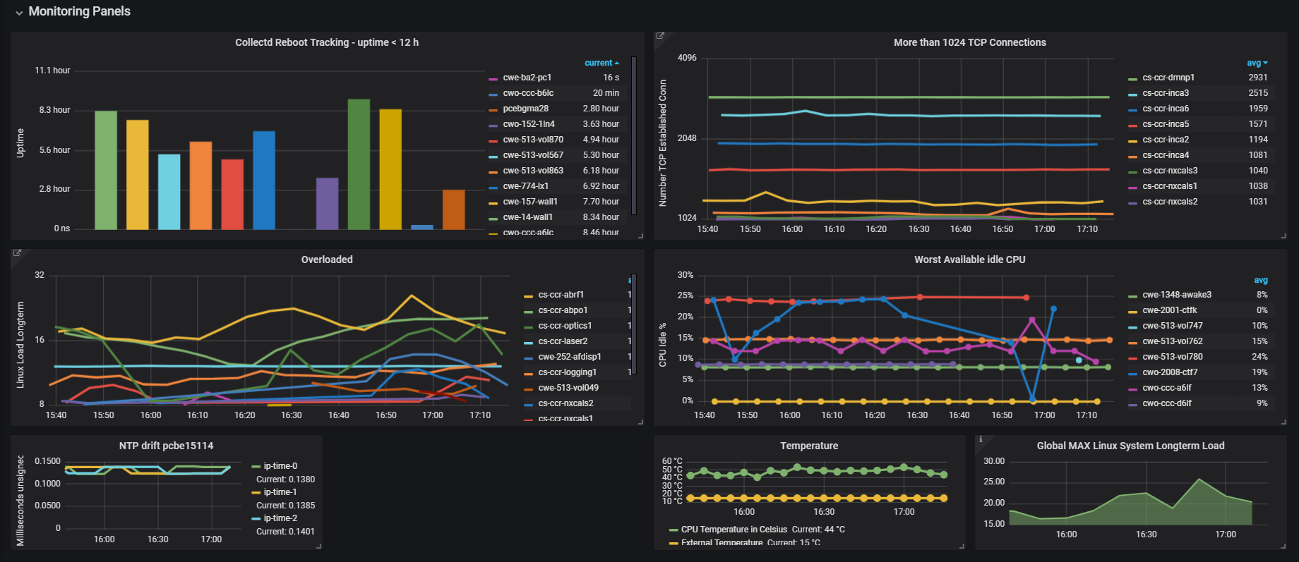
COSMOS: Controls Open-Source Monitoring System
Main principles
Monitoring of whole ACC control infras. (excluding business data)
Cooperative model (custom checks, dashboards)
Rely on standard and OSS technologies:
3 different levels of GUIs:
  Acc-oriented for operation: “Diamon” console
  Dashboards for metrics
  Web expert tool for fine diagnostics
monitored hosts: ~7300
monitored services: ~36000
custom checks: >60
custom dashboards: >100

Slide 5

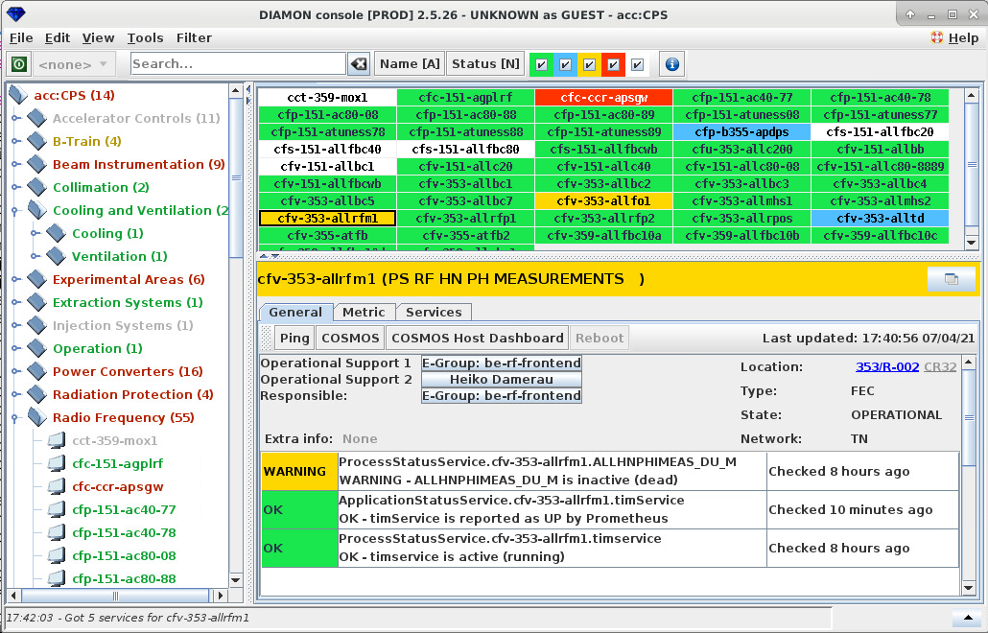



COSMOS alarms principle
notification
Alarms service
  Centralized source (icinga)
  Default checks:
      Hosts (ping), services and application up/down
      Base components status: Disk, mem, CPU-load, http, ssh, …
  Custom checks:
      Any specific Hardware and Software components of the control infrastructure
Alarms configuration
  Automatic setup (75%): common setting (static) + CCDB setting (update twice/day)
  Manual setup (25%): on-demand to sys-admin
  (notification medium/type/attributes, thresholds, source-categories, multi-conditions, etc.)
Alarms interface
  On-event: Email (by default), SMS
  Visual: GUIs (Diamon console, Grafana, Icingaweb, Carousel)
  [possible] Webhooks (e.g. Mattermost)
visualization
WEB
monitoring
Hosts and Services

Slide 6
COSMOS alarms concerns
Regarding infrastructure alarms, it’s difficult (if not impossible) to satisfy all users expectation with common tools
  sys-admin → off-the-shelf monitoring specialized tools (icinga, Zabbix, Prometheus, etc.) + OS tools
  expert → generic, configurable and expandable diagnostic platform (Grafana, logging, time-series database, etc.)
  operation → dedicated application accelerators-control oriented, including specific features and basic commands (ping, reboot, restart, …)
Like for any other monitoring system, COSMOS is not spared from Alarms management pitfalls
  In particular: Nuisance alarms, continuous and/or useless, incorrect prioritization
Also concern about the specific notifications setup (25% of cases) → maintenance!
  Same event from the same source does not mean same setting. It depends on the user/team!
  Tens of criteria and runtime conditions increase a lot the configuration complexity
  Even using modern technologies to share and delegate more, we cannot escape to manual setup!
expert
sys-admin
event-based
operation
cx
cx
visual-based

Slide 7
Conclusion
Main priority regarding COSMOS Alarms today is:
  To renovate the operational console GUI (Diamon):
      using CSS modern and standard technology (comRAD, WRAP, ?)
      full integration to the COSMOS infrastructure
      providing better interconnection with other controls tools when needed (e.g. CCDB, LASER, AFT, etc.)
  To improve the alarms definition and configuration:
      by defining a model of the infrastructure monitoring alerts
      by proposing a solution to share and to deploy the configuration (DB, GitLAB, CI/CD, ?)
      COSMOS is fully in favour of adhering to a standard.
      With a central and common definition/configuration platform.

